Slide 1
TWLHA Projects
Core Team Meeting 1
Thomas Geoffrey Luca
8 July 2025

Slide 2
WLHA Core-Team Personnel
WLHA Head of Facility: Marco Pedrozzi
RF (Project Leader): Thomas Lucas and Paolo Craievich
Mechanical Engineering: Mariia Zykova and Reto Fortunati
High Power RF: Roger Kalt and Carl Beard
Instrumentation: Rasmus Ischebeck and Nir Bluvstein
LLRF: Mark Dällenbach and Zheqiao Geng
Technical Support: Michael D’Amico

Slide 3
WLHA: Current and Future Plans
WLHA is key to the success of SwissFEL. Here we test concepts for the current machine as well as understanding future concepts.
For the foreseeable future we will conduct a few key projects within WLHA that aim to continue/improve the performance of SwissFEL.
Current
Klystron/modulator component testing (also LLRF Concepts): This is the key task for WLHA. It ensures that (particularly) klystrons are available for high power operation within SwissFEL.
C-band High Power Test Facility: Testing RF components for future upgrades to SwissFEL.
Future
S-band Klystron/Modulator Test: Test of inhouse built modulators before installation into SwissFEL.
S-band High Power Test Facility: Testing RF components for future upgrades to SwissFEL.

Slide 4
Projects and Meeting relating to WLHA
Projects
IFAST 1: Testing of high gradient rf photoguns for a potential upgrade to SwissFEL
CHART 3: Testing of the Spare SwissFEL gun at high charge
IFAST 2: Testing of concepts for beam brightness increase and beam diagnostics for low energies.
Meetings
Core Team Meeting: Monthly. Discuss WLHA tasks/resources and update list.
Technical Groups: Every two months. Update technical groups on requirements for coming months.

Slide 5
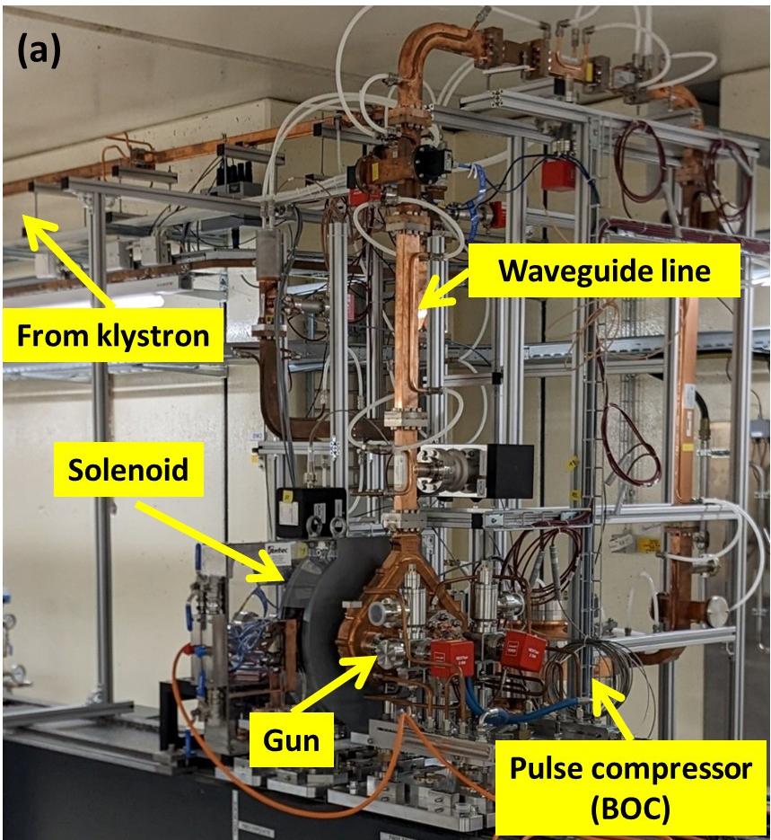
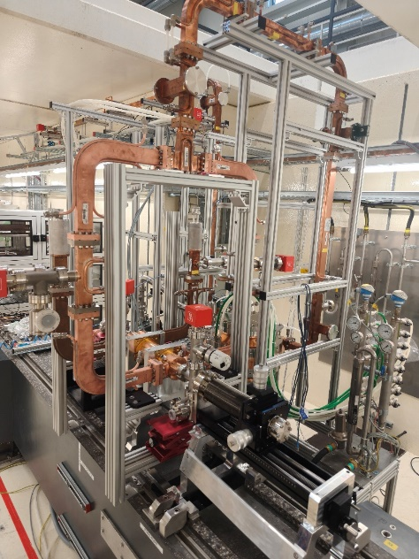
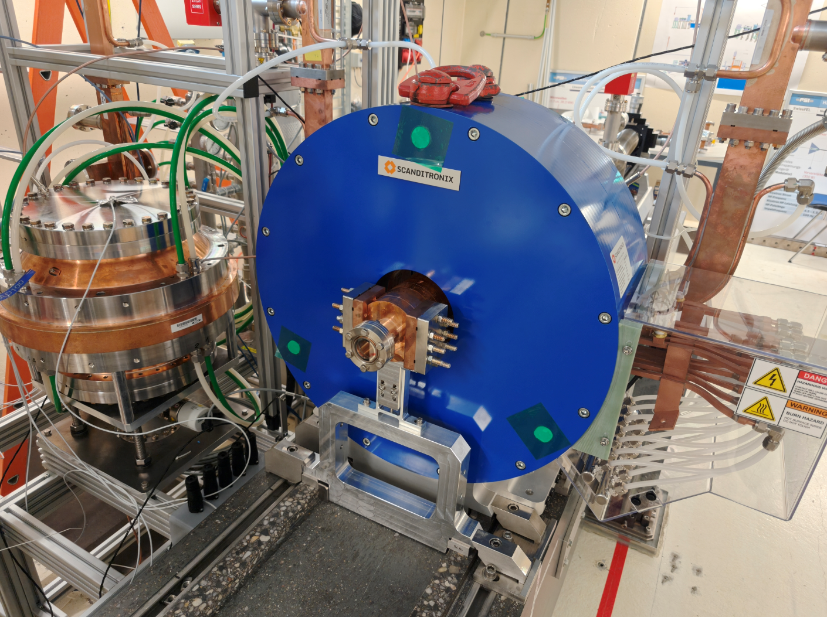
Achievements and large activities over past 12 Months
Completion of high power conditioning of standing-wave gun.
  Achieved 160 MV/m on cathode.
Conditioning of travelling-wave rf photogun
  Achieved 160-180 MV/m on cathode.
Installation of High Field Solenoid and Installation of diagnostic beamline
  Recent installation preparing

Slide 6
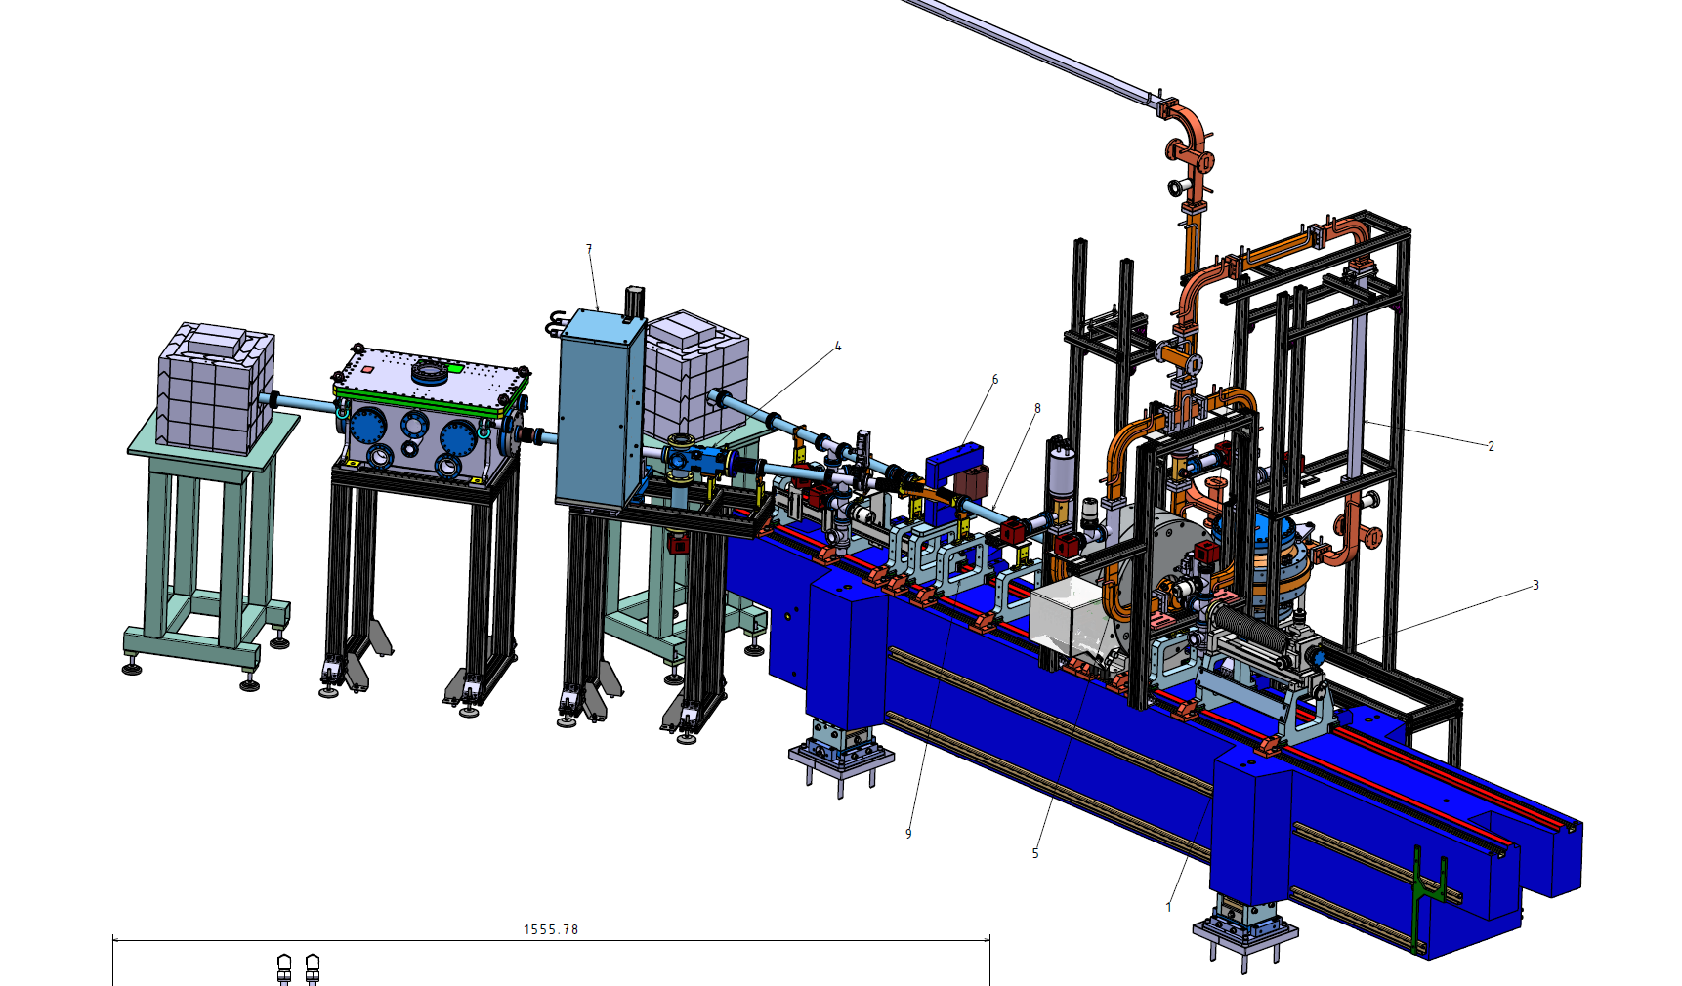
Current Situation: Beamline Buildup

Slide 7
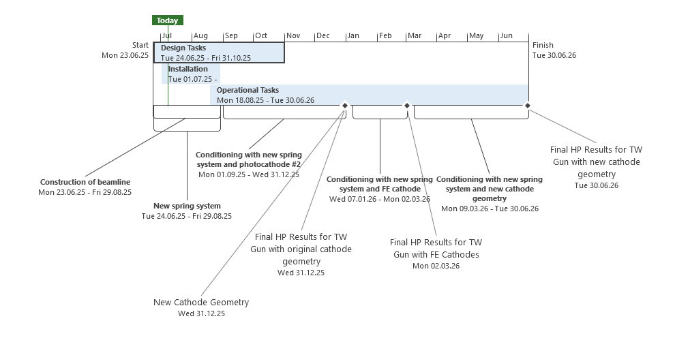
Timeline WLHA (C-band)

Slide 8
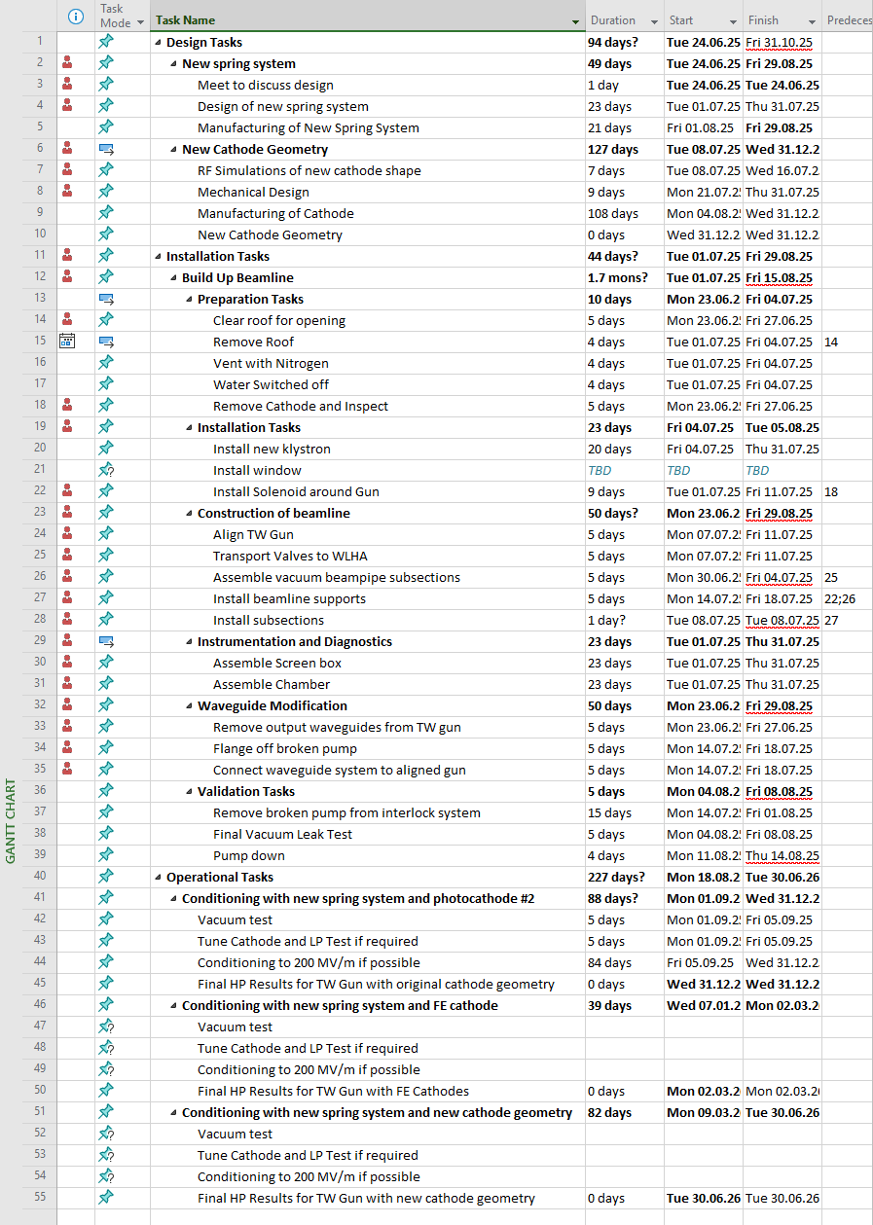
List of tasks for C-band

Slide 9
Please suggest tasks to be added

Slide 10
Please inform me of required activities for HPRF and LLRF

