Slide 1
4D Phase Space Reconstruction based on Neural Networks
and Differentiable Simulations
Harsh Der
29 July, 2025

Slide 2

Outline
Motivation and Background
Methodology
Implementation and Results
Analysis and Limitations
Further development
Other work:
  Sequencer
  Chatbot
References
HARSH DER
‹#›

Slide 3
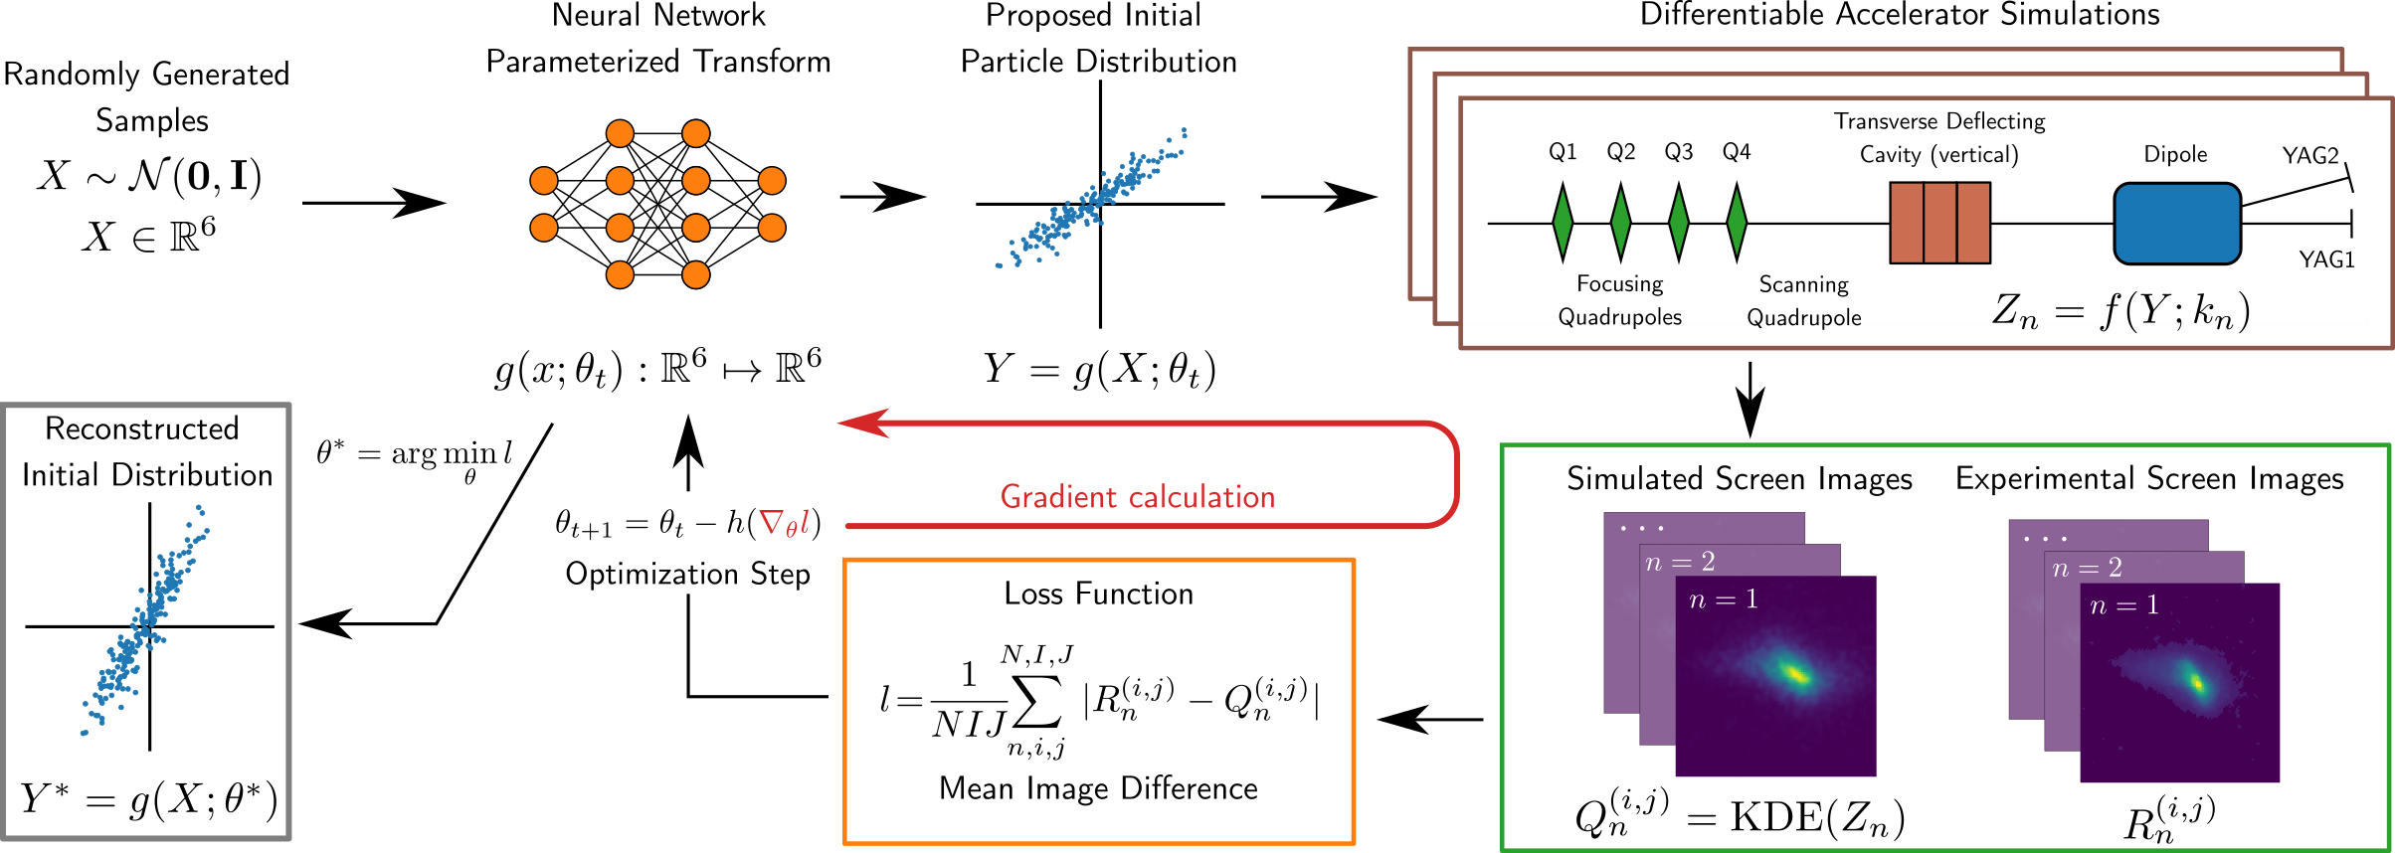
Phase Space Reconstruction from Accelerator Beam Measurements Using Neural Networks and Differentiable Simulations [2]
A neural network is initialized by a latent initial particle distribution.
This distribution is propagated through a differentiable accelerator simulation to produce predicted screen images.
Simulated images are compared to experimental data, and a custom loss function with image similarity and physical constraints is minimized using gradient descent to refine model weights and accurately reconstruct the beam.
Why use this method?
Already successfully implemented for 4D and 6D phase space reconstruction at other facilities.[2][10]
Good candidate for Wakefield diagnostics. We apply it first on a simpler problem: 4D phase space reconstruction based on existing Emittance measurement at SwissFEL.
Fig 2. Phase Space Reconstruction implementation [2]
The full particle beam phase space is 6-dimensional, comprising x (position), px (momentum), y (position), py (momentum), t (arrival time), and E (energy).
HARSH DER
‹#›

Slide 4
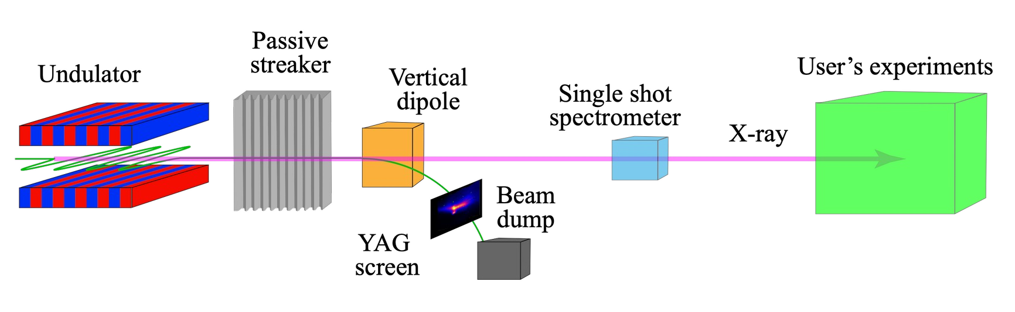
Motivation: Passive Wakefield Streaker Diagnostics with Neural Networks
Cost-efficient and self-synchronized alternative to RF deflector (TDS) diagnostics.
Available implementation at SwissFEL [5] is based on simple iterative algorithms that has certain shortcomings.
Diagnostics could probabily be improved by Neural Network techniques.
The current iterative method for passive streaker diagnostics does not take into account all wakefield forces such as the Quadrupole Wakefield effect and thus has a limited accuracy.
Fig 1. SwissFEL: after Aramis [5]
HARSH DER
‹#›

Slide 5
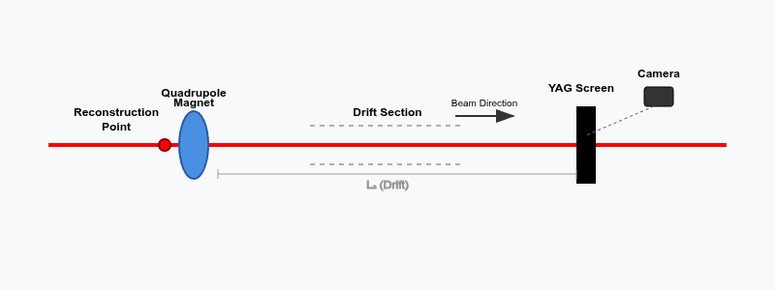
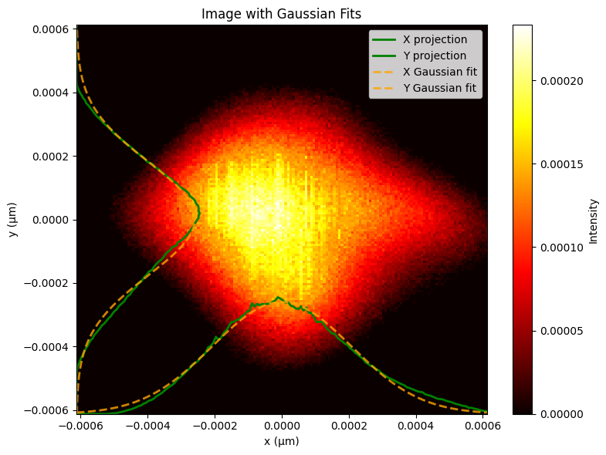
Data acquisition method used at SwissFEL
A reconstructed electron beam (with known initial properties at the reconstruction point) passes through a quadrupole magnet with variable strength.
The quadrupole focuses/defocuses the beam differently in x and y directions based on its strength setting.
The drift section converts angular changes from the quadrupole into position changes, allowing the YAG screen to capture the beam's transverse profile via camera
Multiple images are taken with different quadrupole strengths.
Fig 3. Measurement setup for Emittance measurement
HARSH DER
‹#›

Slide 6
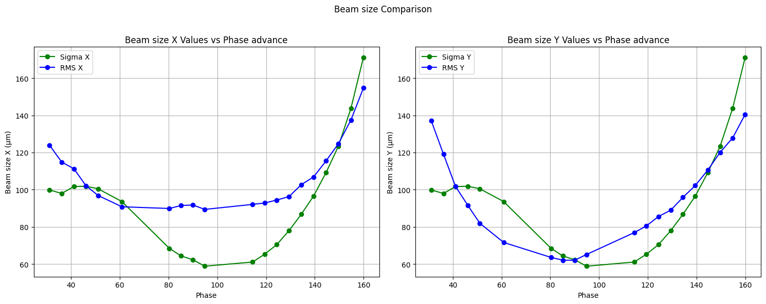
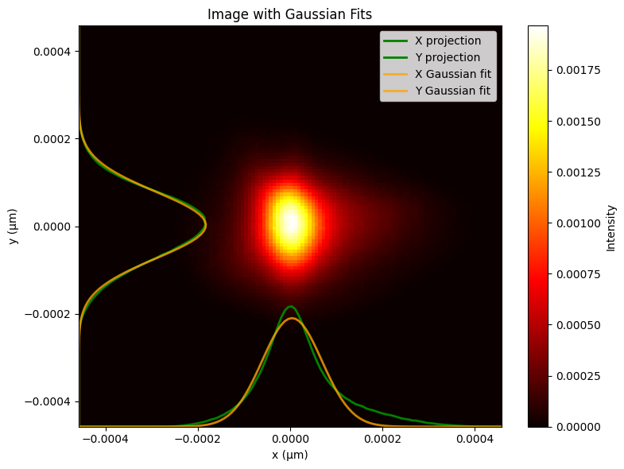
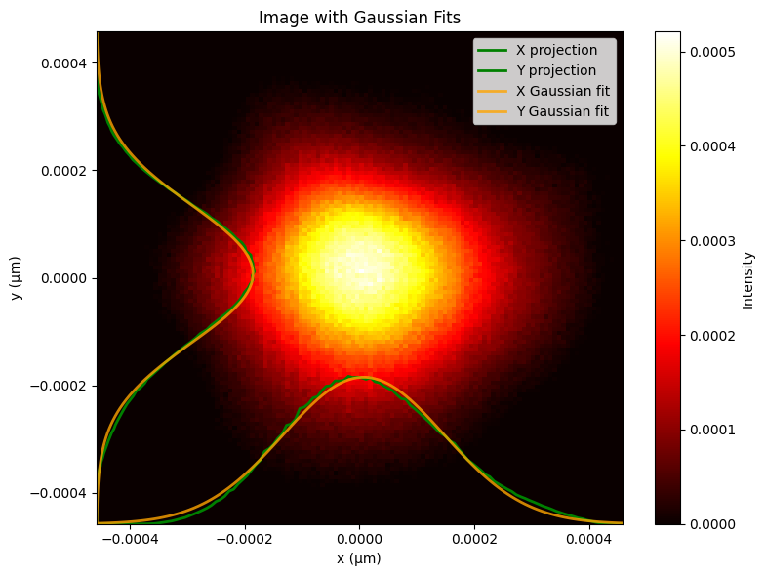
Is Gaussian fit reliable for this beam?
HARSH DER
‹#›

Slide 7
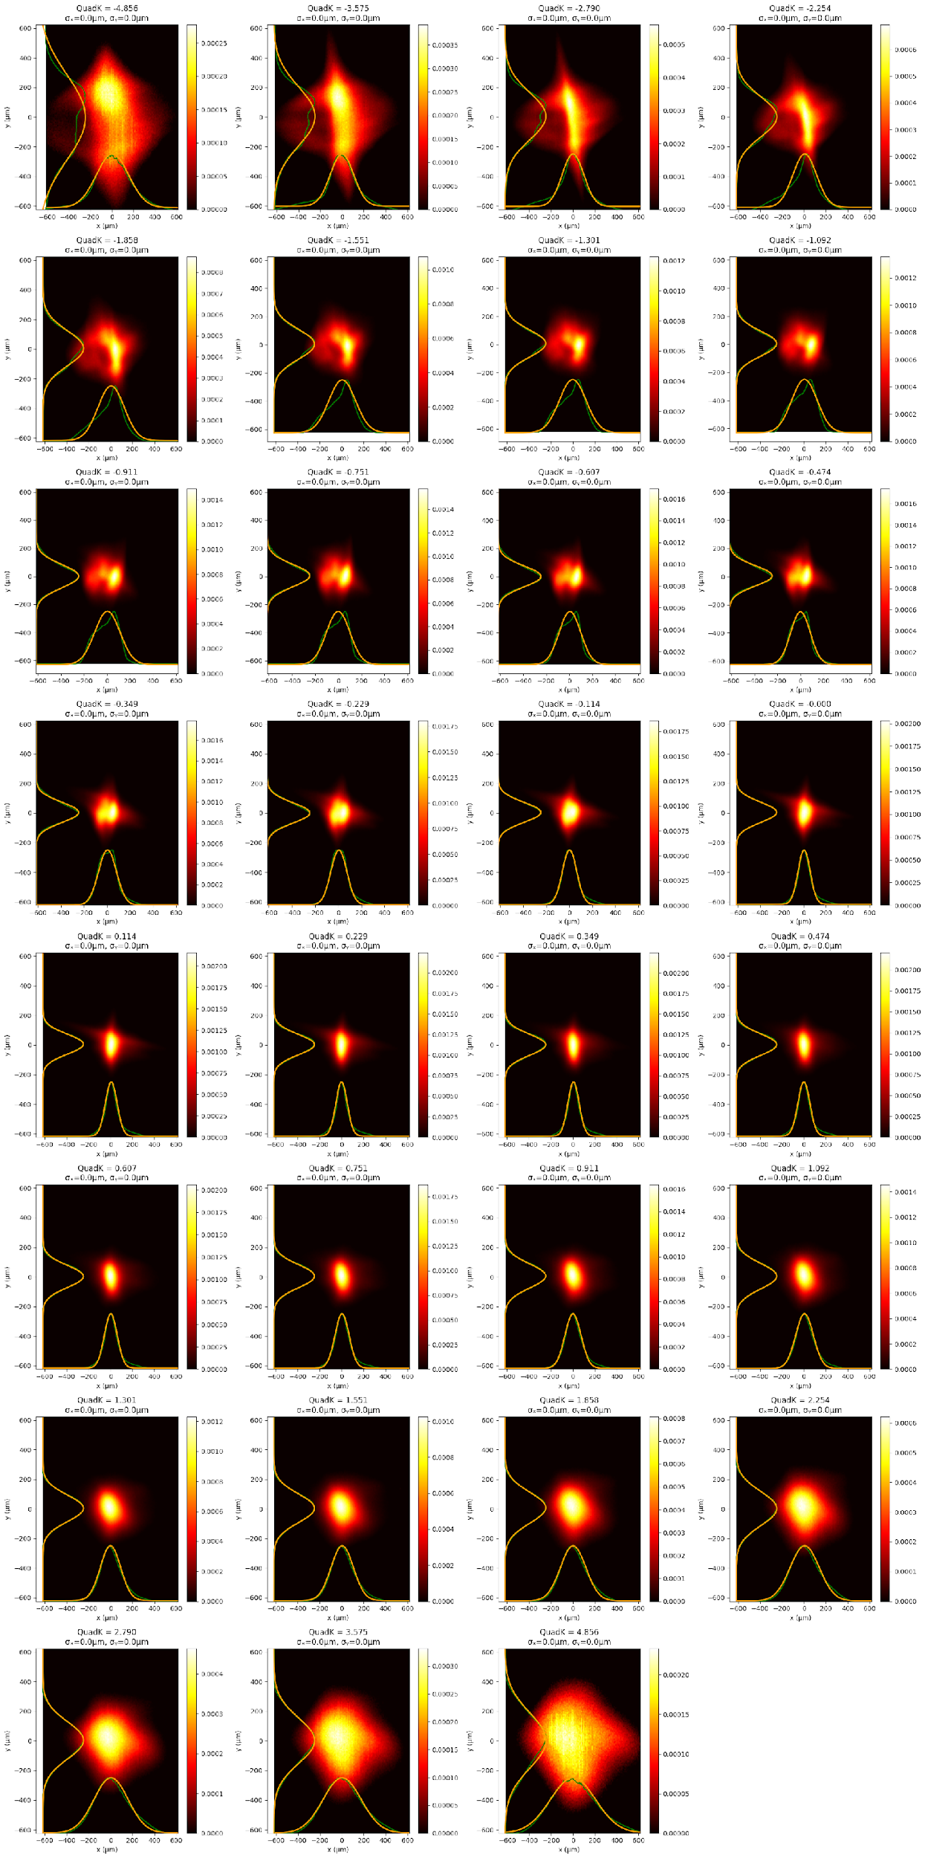
Fig. 5 Experimental screen imaging data with Gauss fit on projection of both dimensions from second dataset
HARSH DER
‹#›

Slide 8
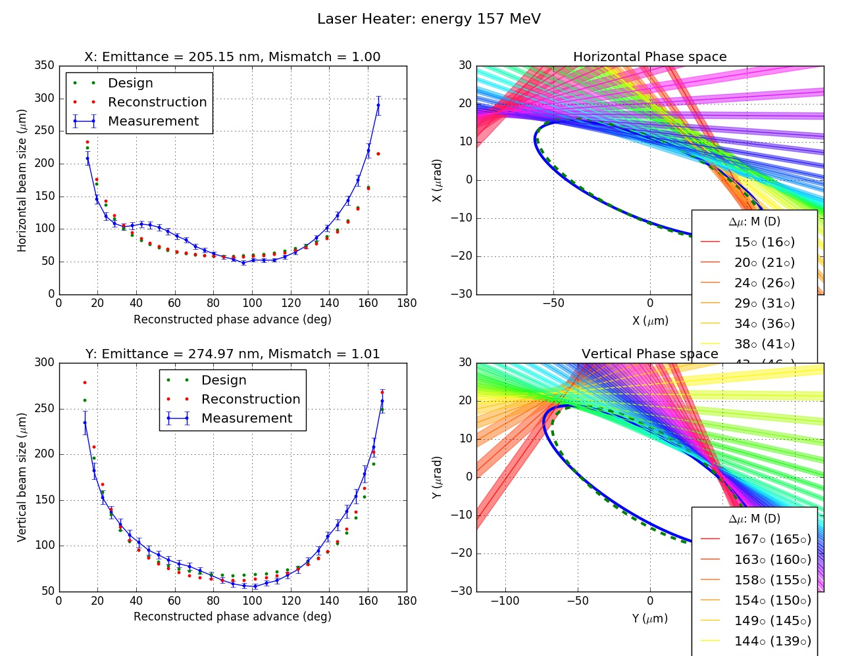
Emittance tool results
The emittance tool at SwissFEL measures beam properties by analyzing beam sizes from screen images at various betatron phase advances, determined by scanning quadrupole magnets.
This process uses Gaussian fits on transverse beam profiles to derive six key parameters: emittance (ϵ), alpha (α), and beta (β) in both the horizontal (x) and vertical (y) dimensions.
While effective for operational purposes, this method primarily relies on the beam's core, potentially underrepresenting complex beam dynamics like non-Gaussian tails or intricate correlations present in the full phase space.
Fig 4. Beam Size as obtained from Emittance tool
HARSH DER
‹#›

Slide 9
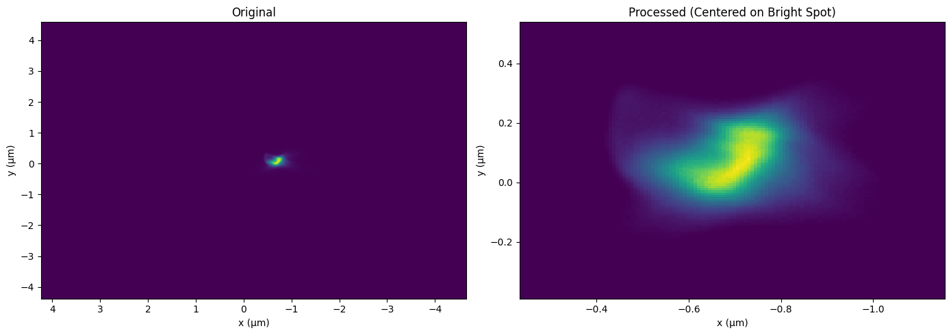
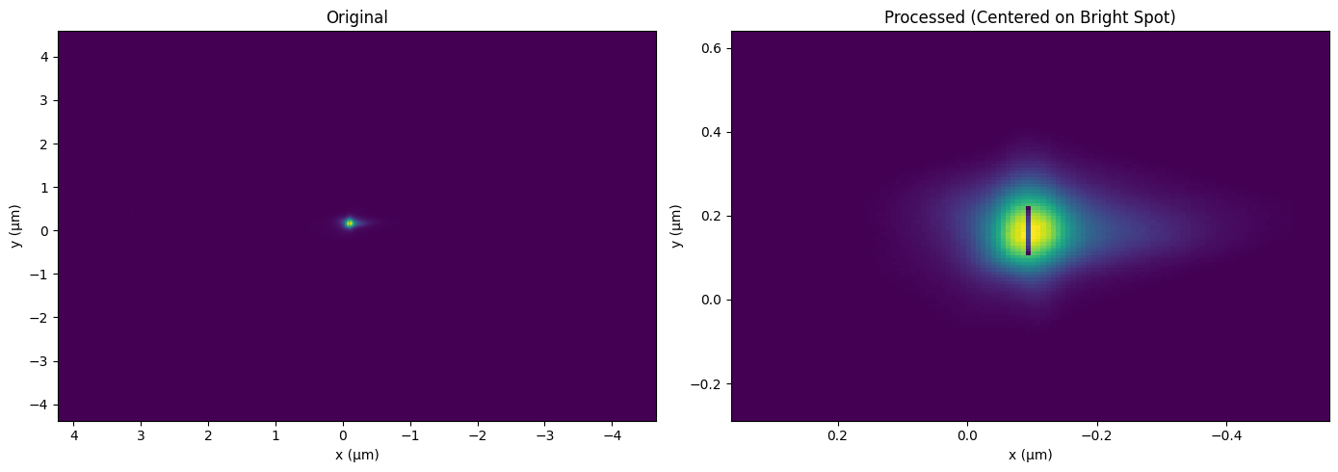
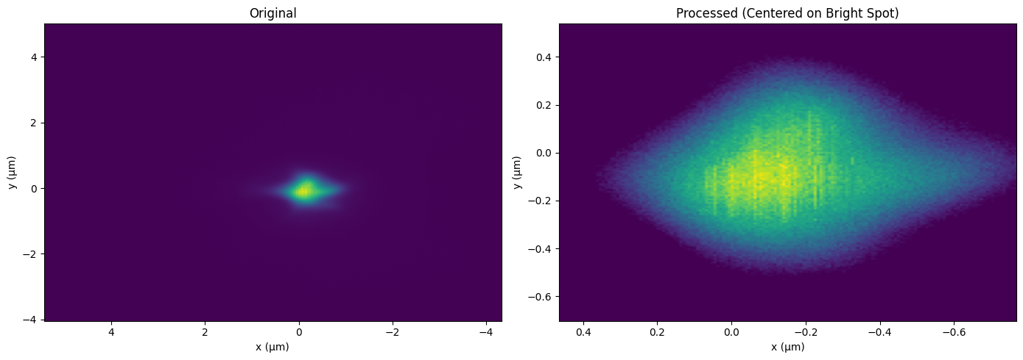
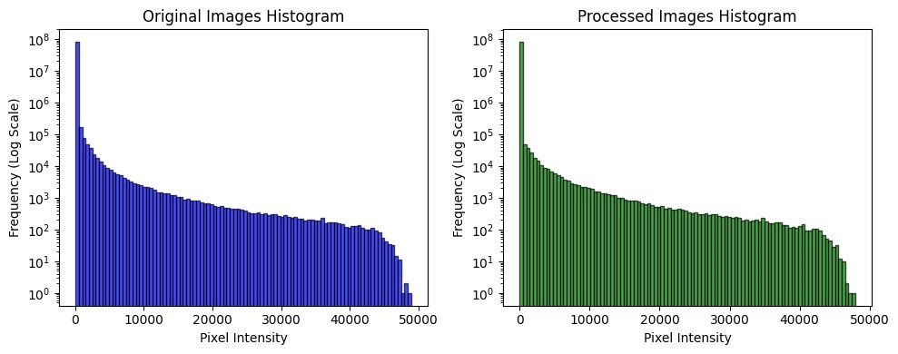
Data and its processing
Fig. 6. Cropped image around bright center (120x120 pixels) Dataset 1
Data used from projected emittance measurements at the SwissFEL laser heater:
  Emittance tool measurements from 22nd May, 2025
  Emittance tool measurements from 30th June, 2025
31 data points with different magnet strengths were captured.
Considered 20 data points rejecting faulty data for first dataset having issues like Screen defects or out of screen image.
Background subtraction technique.
Using Gaussian fitting to get center in x and y axis, and crop images to reduce data size without losing information.
120x120 size cropped images for first dataset while 160x160 size cropped images for second dataset.
Fig. 7. Rejected image due to screen defects (120x120 pixels) Dataset 2
Fig. 8. Second dataset cropped on bright spot image (160x160 pixels)
Fig. 9. Log scale frequency distribution before and after background subtraction
Dataset 1
HARSH DER
‹#›

Slide 10
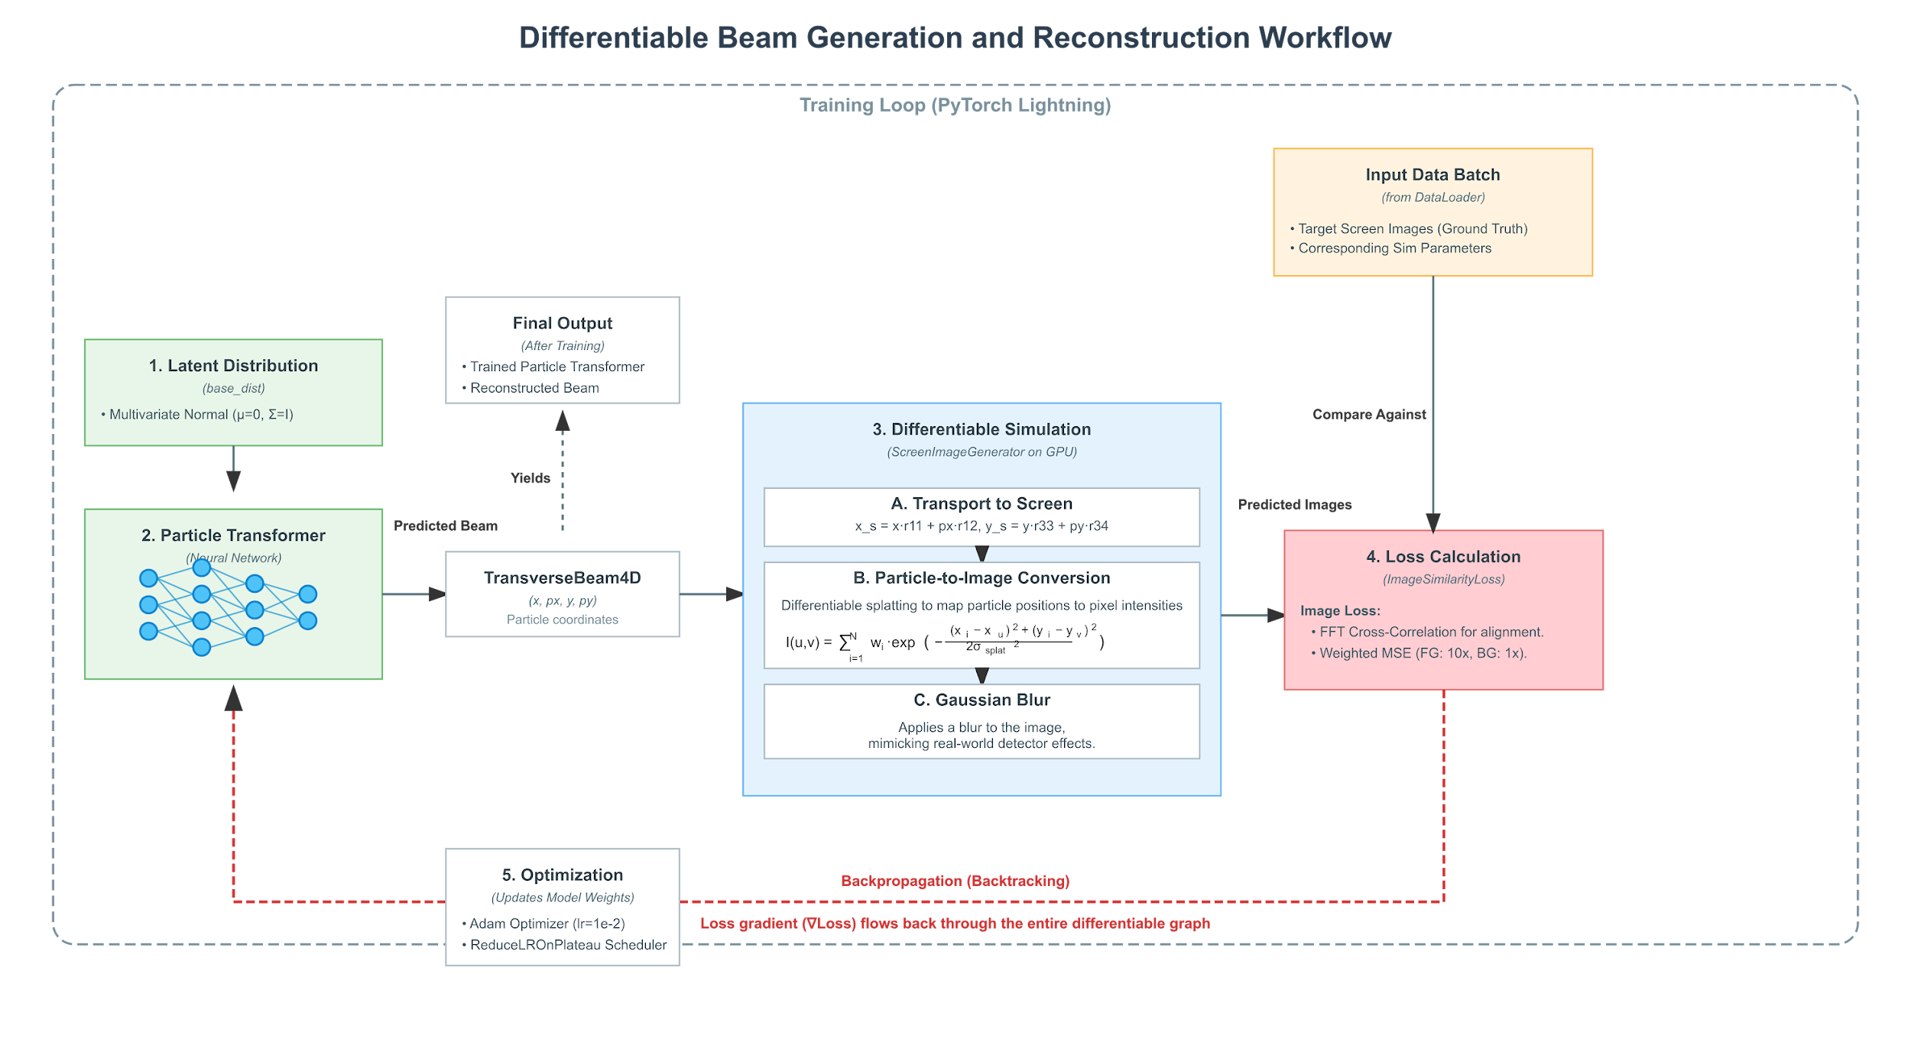
My contribution
Particle Transformer Network
Differentiable Simulation
Loss function and cross correlation
HARSH DER
‹#›

Slide 11
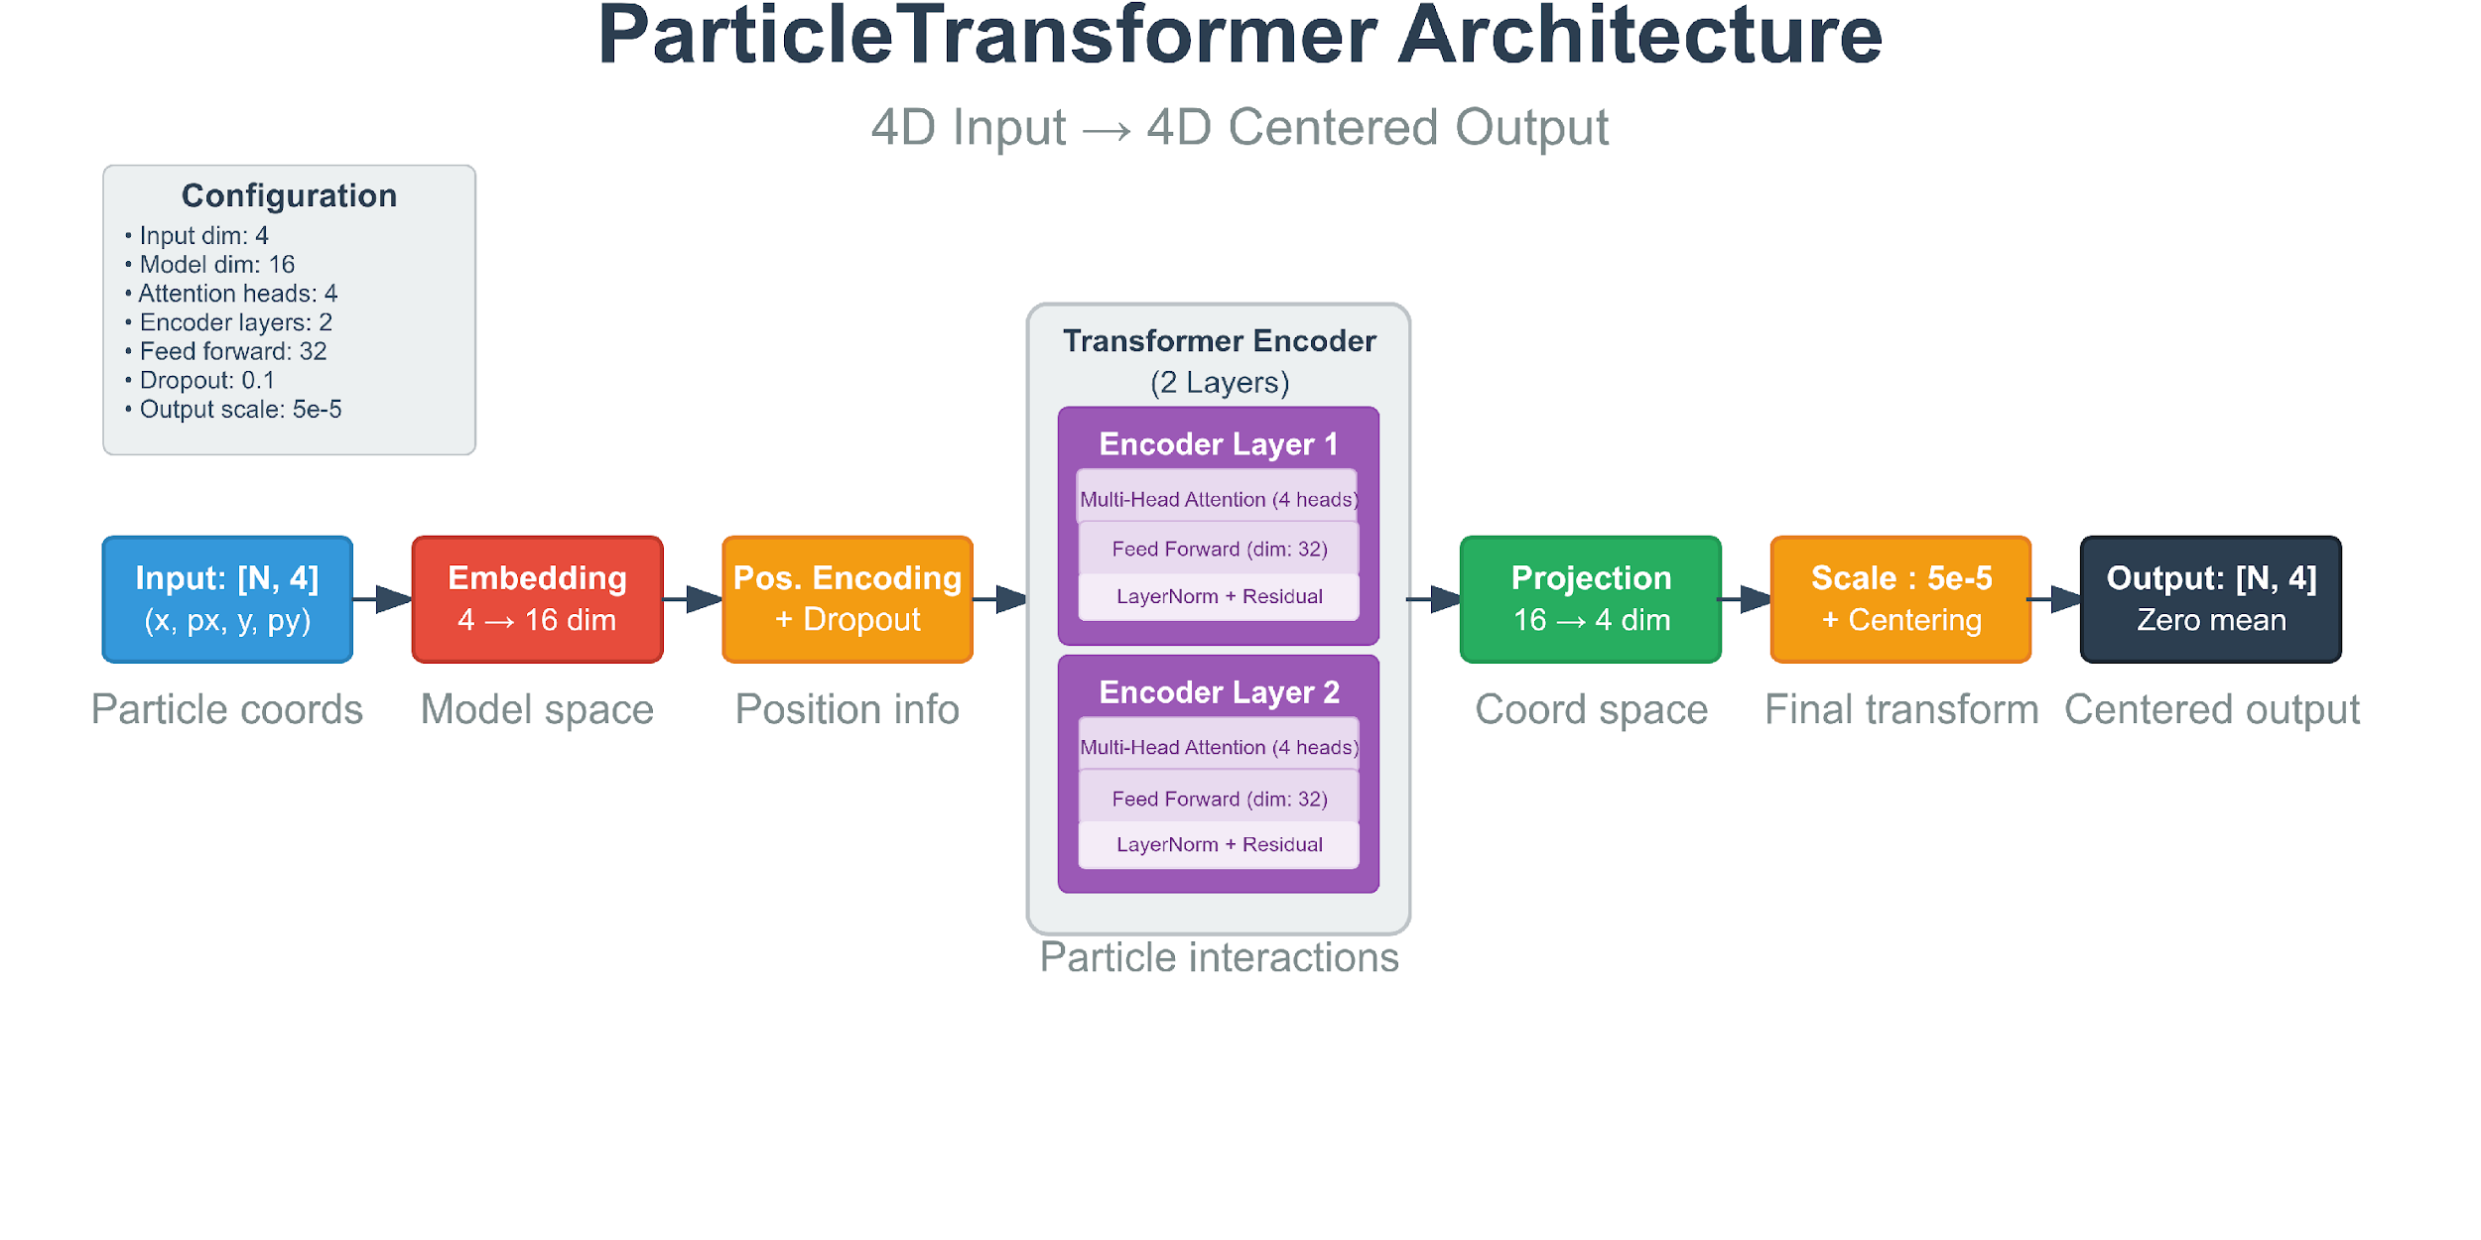
Fig. 11. Particle Transformer architecture for generating phase space
HARSH DER
‹#›

Slide 12
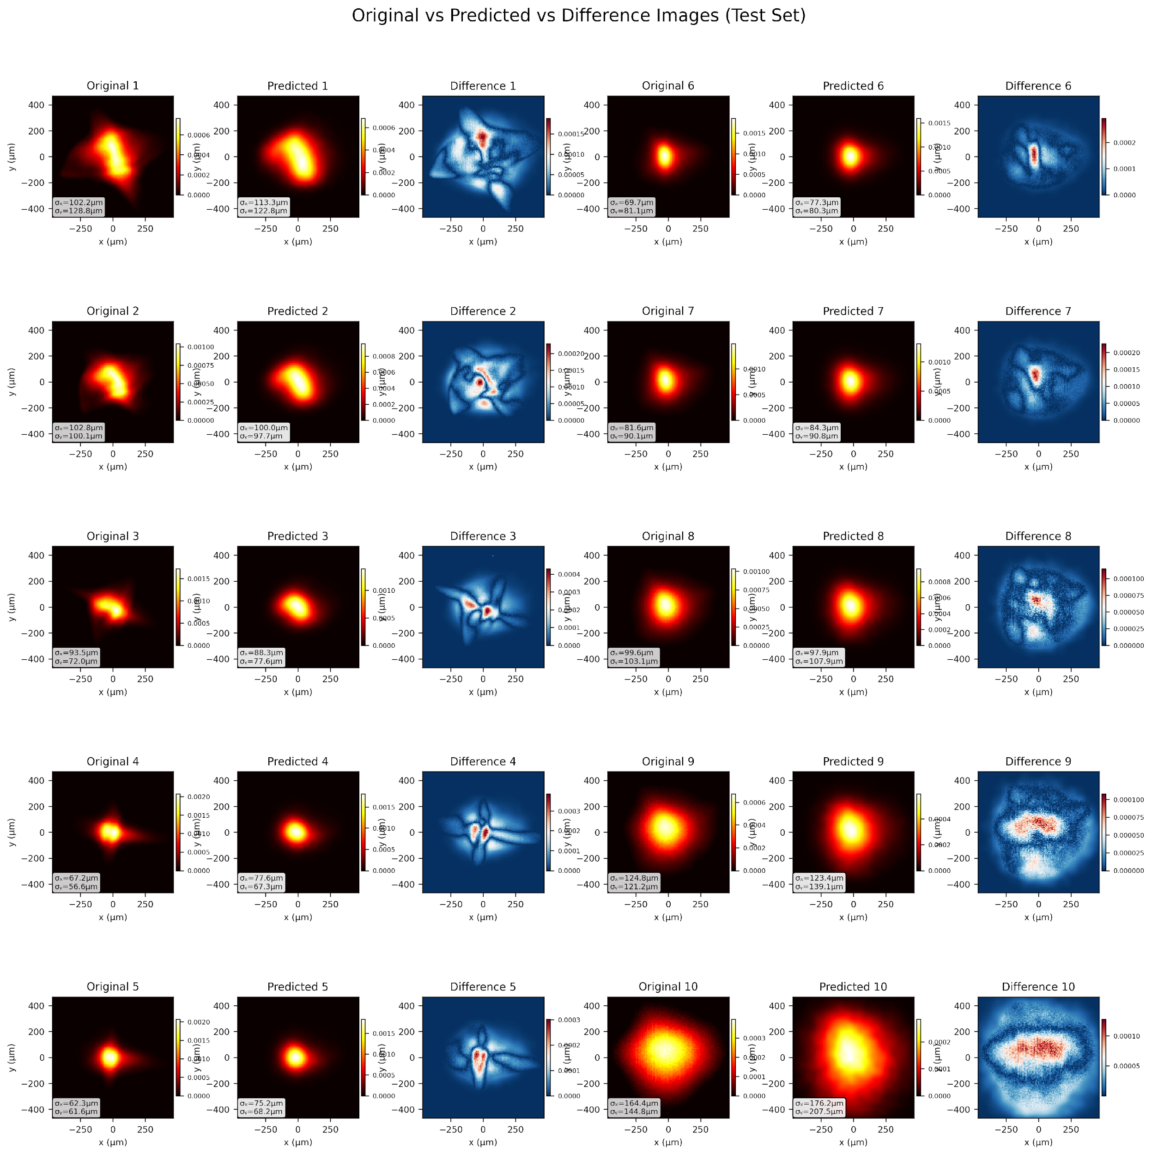
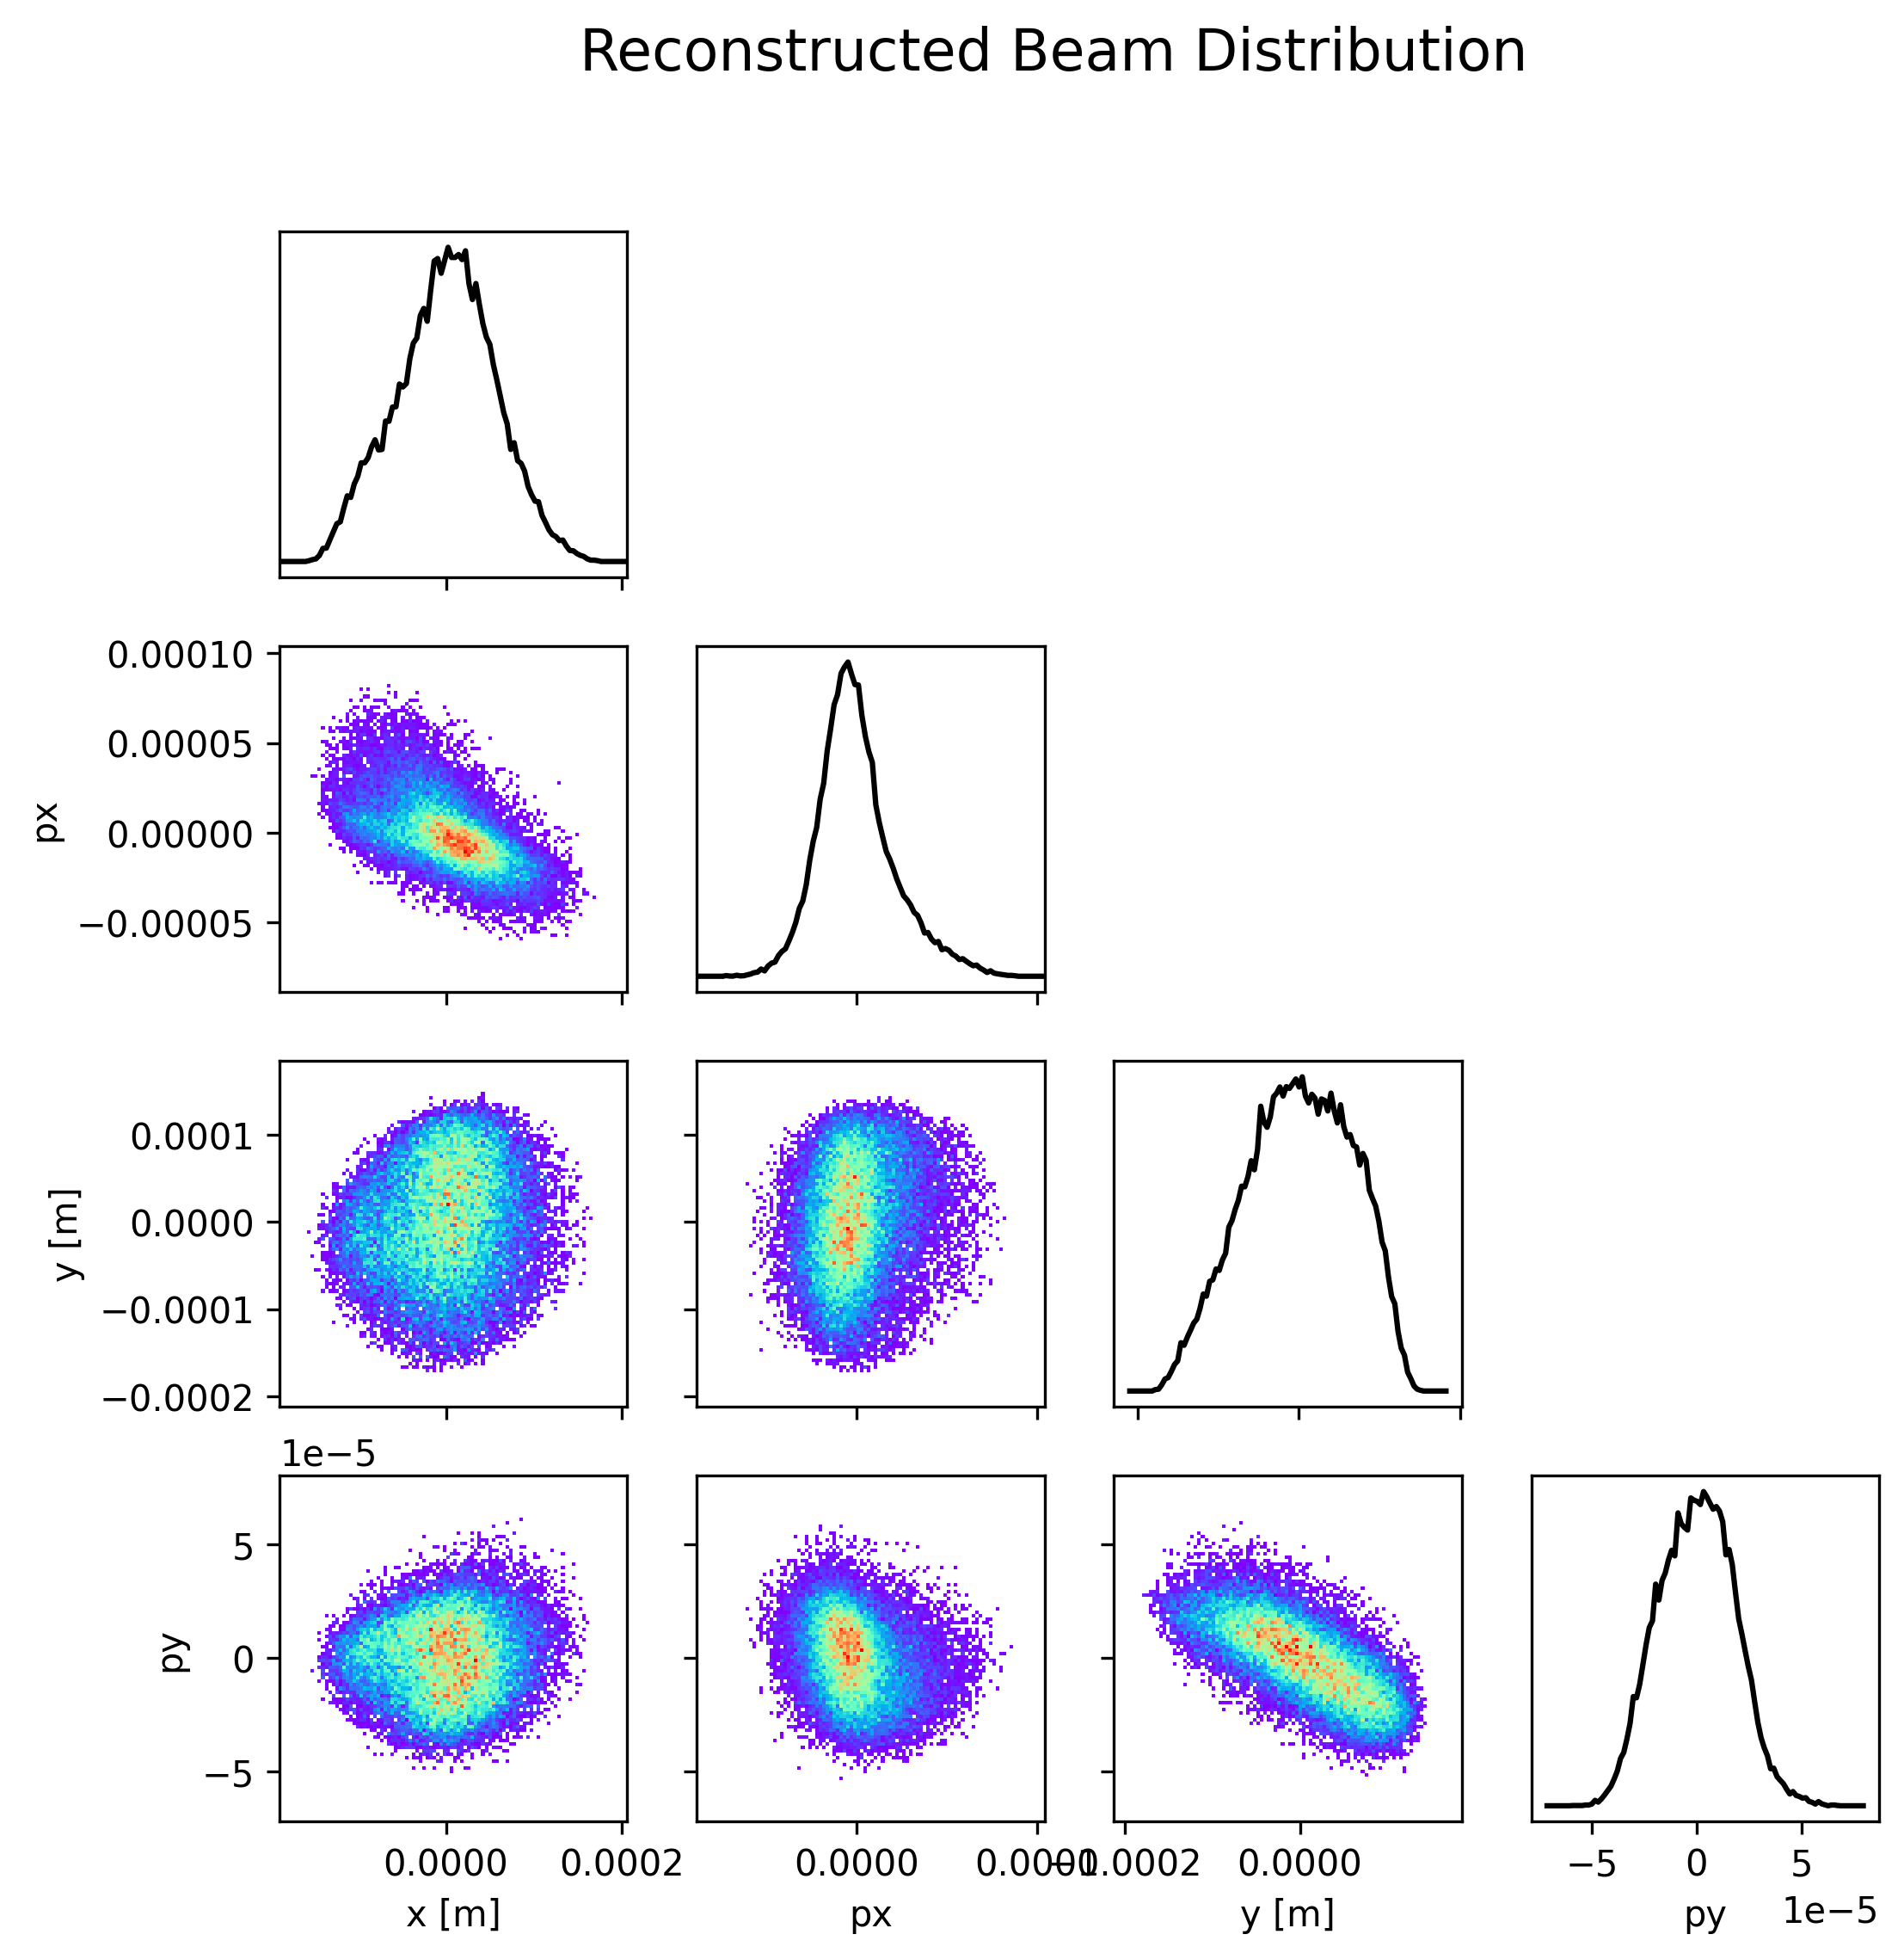
Obtained results
Fig. 12 Particle distribution
Dataset 1
HARSH DER
‹#›
Fig. 13 Original vs Predicted Screen images

Slide 13
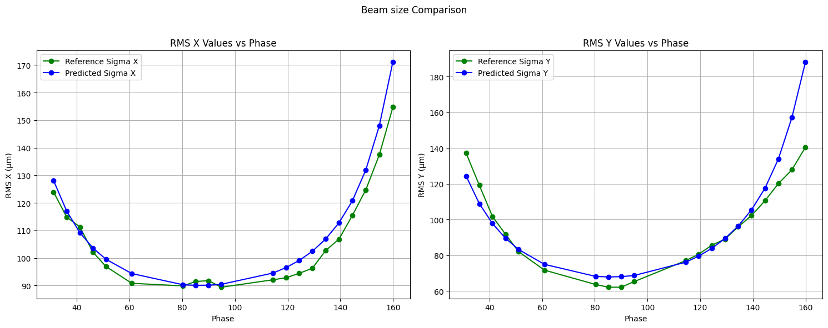
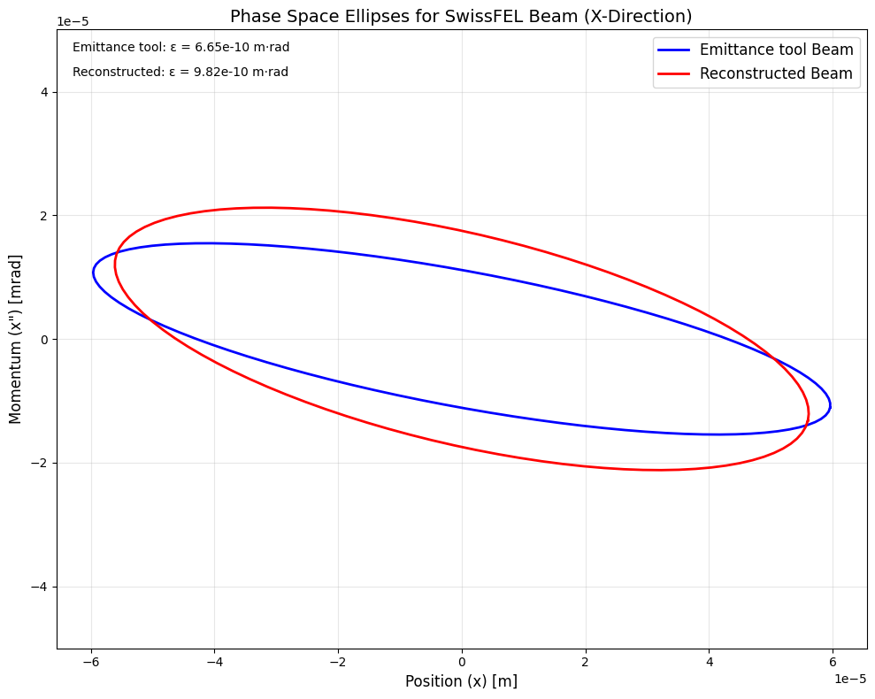
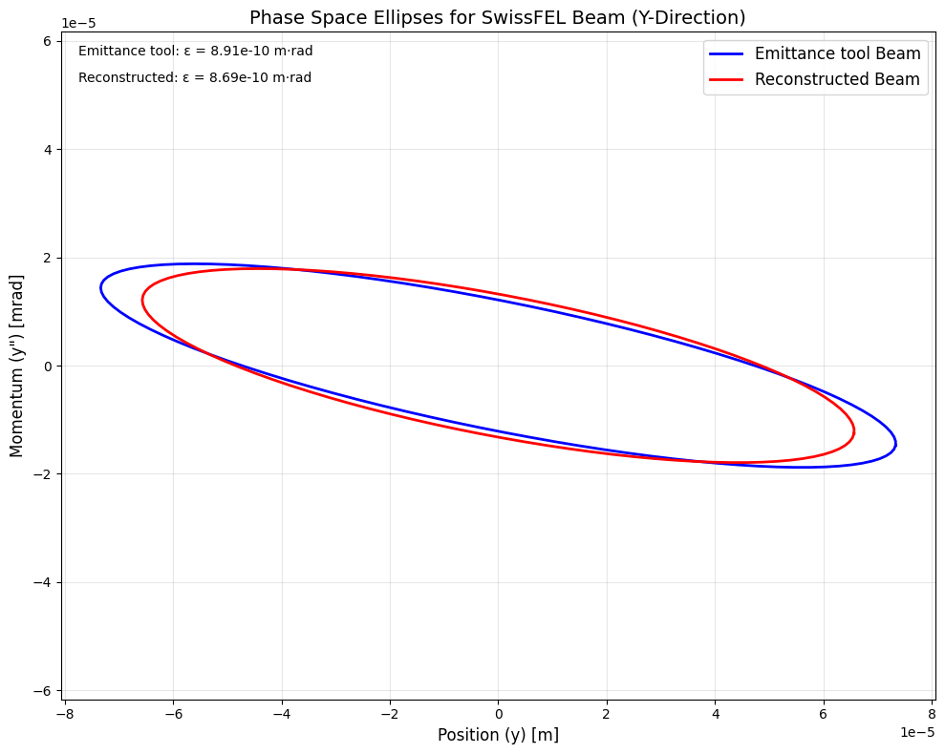
Beam Profile Analysis:
Reference vs. Predicted Comparison (Dataset 1)
 | From emittance tool | From generated particle distribution
Emittance (x) | 6.65e-10m.rad | 9.82e-10m.rad
Alpha (x) | 0.96 | 0.69
Beta (x) | 5.35m | 3.21m
Emittance (y) | 8.91e-10m | 8.69e-10m.rad
Alpha (y) | 1.18 | 0.91
Beta (y) | 6.05m | 4.97m
Fig 16. RMS Beam size vs Phase (Screen images (Reference) vs, Predicted images from model)
Mismatch: 1.14
Mismatch: 1.02
Table 1. Dimensional Distribution parameters
Fig 17. Bunch ellipse comparison obtained from Emittance tool and reconstructed beam
HARSH DER
‹#›

Slide 14
Limitations of using Neural Networks
Localized Overfitting: Reduced accuracy near data points with unknown surrounding behavior, while overfitting occurs on points with familiar neighboring patterns.
Computational requirements: The simulation of thousands of particles through any structure is computationally expensive, however current simulation requiring only 1 quadrupole and drift made it require less computational capabilities. But addition of other components to simulation would require extensive HPC or change in design mechanics of forward propagation of beam through structure which will still require a lot of time.
Time to reconstruct beam: Even with good computational resources, neural networks require a significant amount of time to reconstruct beam. Whereas Emittance tool provides results almost instantly.
Advantages Over Emittance Tool
Complete 4D phase space characterization (Quantitative) - The reconstructed distribution provides access to the full (x, x', y, y') parameter space, enabling comprehensive analysis of beam properties including higher-order moments, correlations, and complex beam dynamics that cannot be captured by emittance tool used at SwissFEL.
Beyond RMS limitations (Qualitative) - Unlike the Emittance tool which relies on second-order statistical moments that provide only approximate beam characterization, the reconstructed phase space delivers complete particle distribution information, allowing calculation of exact beam parameters and detailed analysis of non-linear effects.
HARSH DER
‹#›

Slide 15
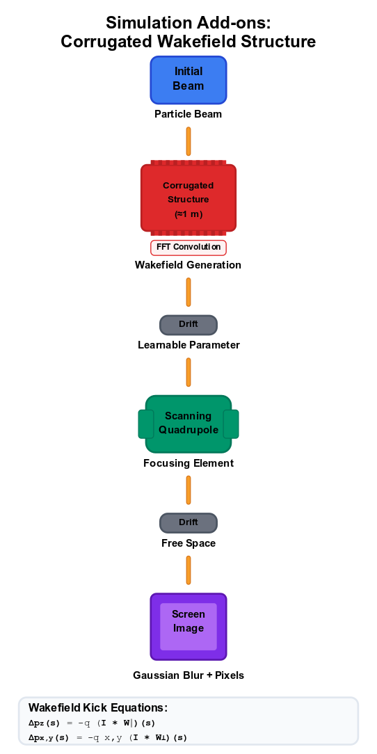
Further developments
Extending model to produce 6D particle space using streaking measurements [5].
Passive Streaker pipeline:
    The pipeline starts with experimental streaked beam images as input, employing a neural network to generate comprehensive 6D phase space distributions.
    These distributions are then forward-simulated through differentiable wakefield models to predict streaked images.
    The difference between simulated and experimental images is backpropagated to iteratively refine the 6D beam reconstruction, thereby eliminating the need for traditional iterative algorithms.
Simulation add-ons:
Corrugated wakefield section ( ≈ 1 m ) upstream of the scanning quadrupole [7]
    A single hyper-parameter d (distance from nearest structure surface to the particle) is exposed to the network; gradients flow through this parameter so the model can learn the optimal distance d.
Fig 22. Updated simulation pipeline to produce screen images with corrugated structure
HARSH DER
‹#›

Slide 16
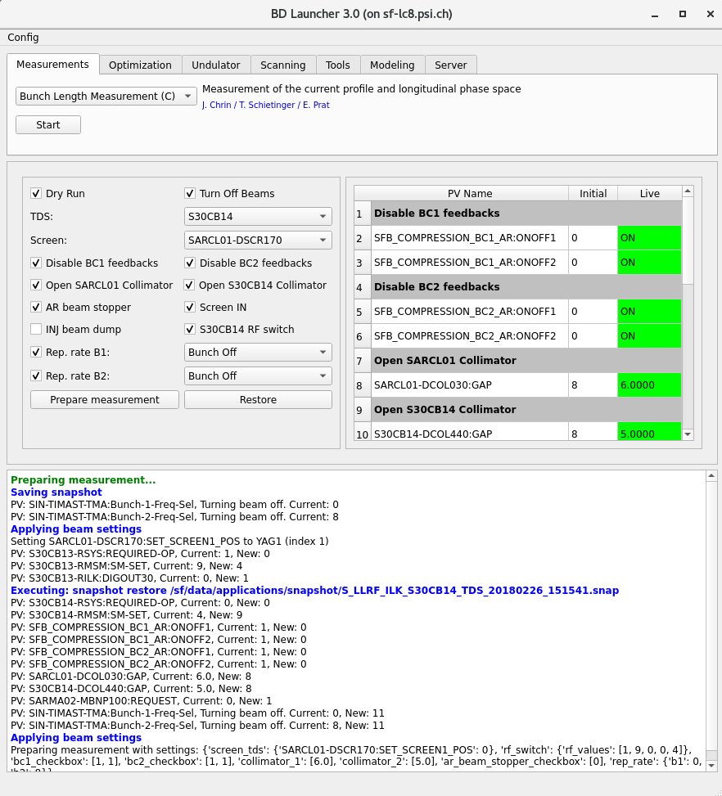
Sequencer
The sequencer is designed to prepare the machine for specific beam diagnostic tools, such as the Bunch Length Measurement or Passive Streaking tools. It ensures that the machine is configured according to the tool's requirements like setting appropriate PVs, taking snapshots.
Before applying any changes, the sequencer takes a snapshot of the machine's current state. This allows the machine to be safely restored to its original state after the operation, ensuring minimal disruption and maintaining system integrity.
The sequencer status table provides live updates on the current state of PVs and displays the target values they will be set to during the "Prepare Measurement" process. This feature simplifies interpretation for operators, enabling them to easily verify and understand the changes being applied.
The sequencer uses configuration files to define PV mappings, initial/target values, and UI elements. This approach allows easy customization for different tools without modifying the core logic, enabling seamless integration of new tools like the Passive Streaking tool.
HARSH DER
‹#›

Slide 17
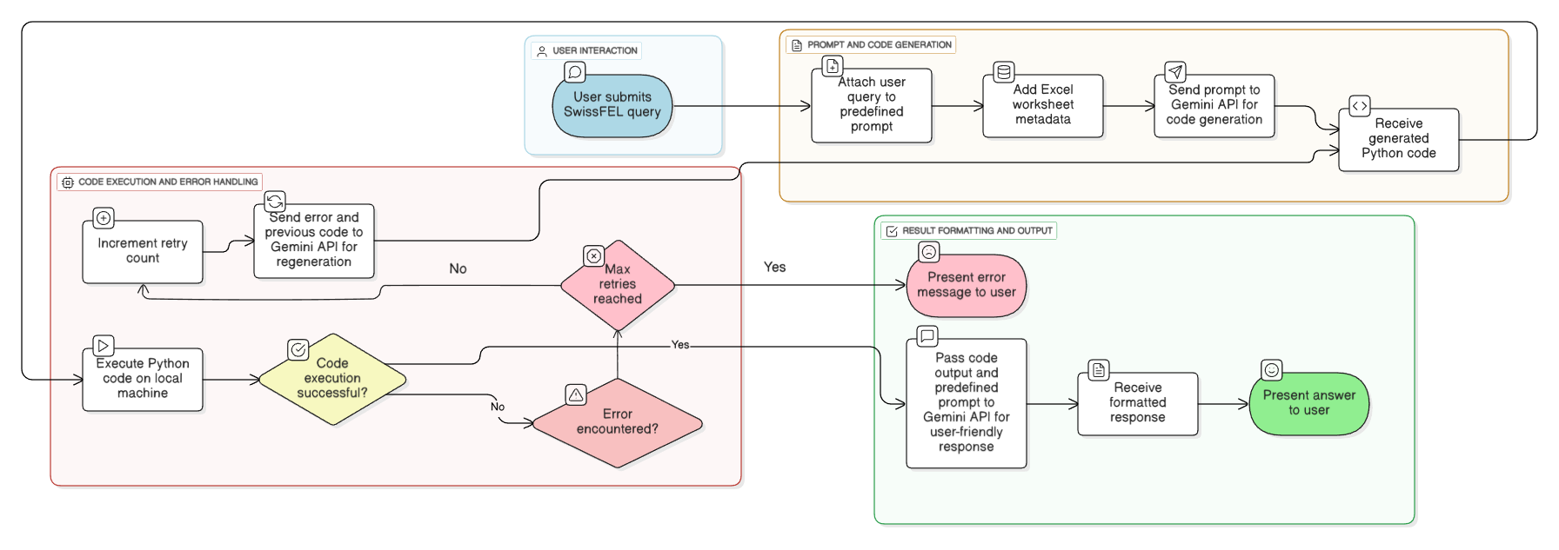
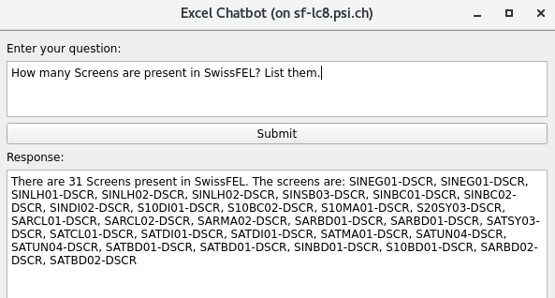
Excel Chat Bot
HARSH DER
‹#›

Slide 18
References
Ryan Roussel Code (https://github.com/roussel-ryan/gpsr) (Started with using his simulation but was incompatible with high number of particles so created my own simulation)
Phase Space Reconstruction from Accelerator Beam Measurements Using Neural Networks and Differentiable Simulations (https://journals.aps.org/prl/abstract/10.1103/PhysRevLett.130.145001)
Four-dimensional transverse beam matrix measurement using the multiple-quadrupole scan technique (https://journals.aps.org/prab/abstract/10.1103/PhysRevSTAB.17.052801)
Skew Quadrupole Effect of Laser Plasma Electron Beam Transport (https://www.mdpi.com/2076-3417/9/12/2447)
Self-synchronized and cost-effective time-resolved measurements at x-ray free-electron lasers with femtosecond resolution (https://journals.aps.org/prresearch/abstract/10.1103/PhysRevResearch.4.013017)
Generation and Characterization of Intense Ultralow-Emittance Electron Beams for Compact X-Ray Free-Electron Lasers (https://journals.aps.org/prl/abstract/10.1103/PhysRevLett.123.234801)
Corrugated wakefield structure at SwissFEL (https://accelconf.web.cern.ch/ipac2023/pdf/THPL153.pdf)
Symmetric single-quadrupole-magnet scan method to measure the 2D transverse beam parameters (https://www.sciencedirect.com/science/article/pii/S0168900214000291)
Attention Is All You Need (https://arxiv.org/pdf/1706.03762)
Efficient six-dimensional phase space reconstructions from experimental measurements using generative machine learning (https://journals.aps.org/prab/abstract/10.1103/PhysRevAccelBeams.27.094601)
HARSH DER
‹#›

Slide 19
Thank you
Open to answer your questions.
Special thanks to Philipp Dijkstal, Sven Reiche, and Eduard Prat for their guidance.
HARSH DER
‹#›

Slide 20

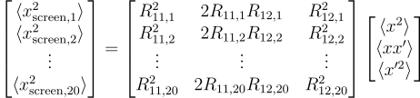



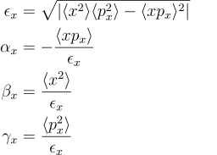
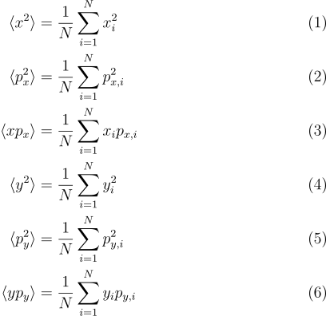
Appendix
Method in Emittance tool for estimating moments:
Method used with Neural Network for estimating moments:
HARSH DER
‹#›

Slide 21
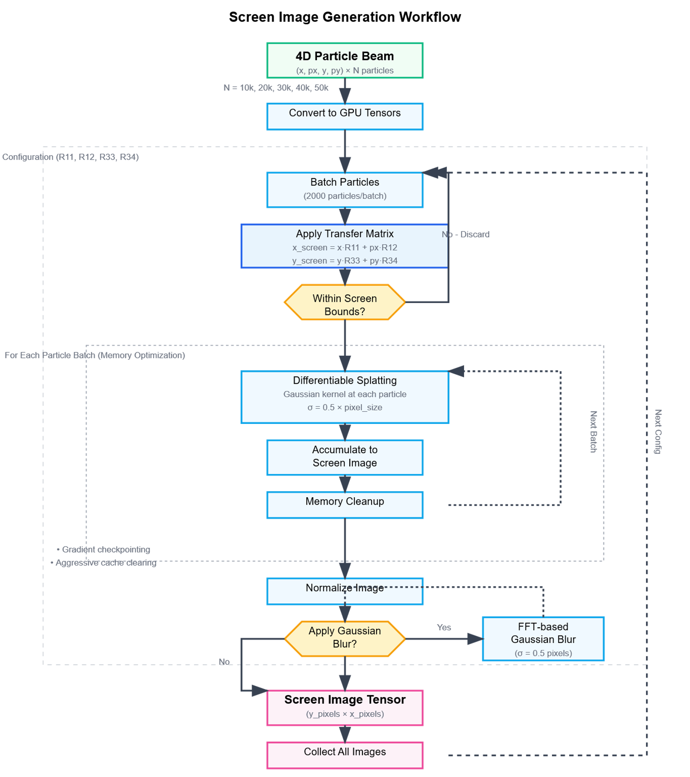
Appendix
HARSH DER
‹#›

Slide 22
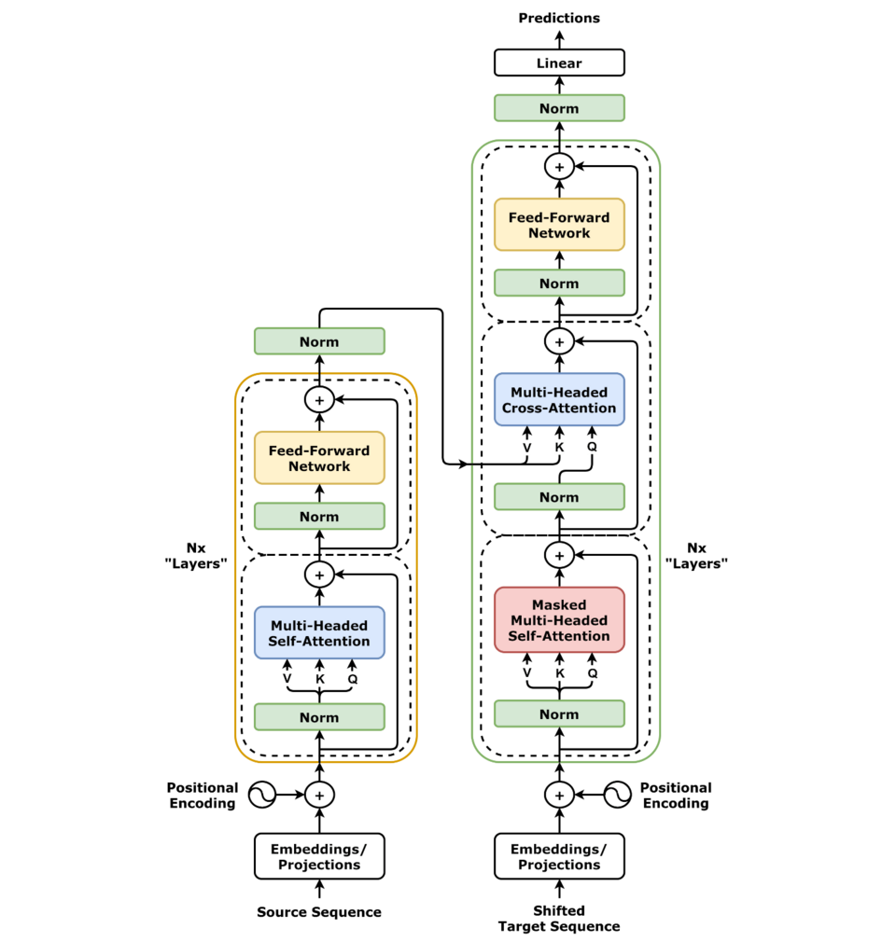
Transformer Encoder
Appendix
Key-Value-Query in Phase Space Context
Query (Q): What information this particle is looking for
Key (K): What information this particle offers
Value (V): The actual information to be shared
Why using Transformer here?
Each particle’s phase space coordinates (x, px, y, py) are used to generate Q, K, V.
The attention scores determine how much each particle’s state is influenced by others—capturing correlations and collective effects in the beam.
This allows the model to learn complex, non-local relationships between all phase space dimensions, not just local or pairwise ones.
Fig. 11. Transformer architecture [10]
HARSH DER
‹#›

