Slide 1


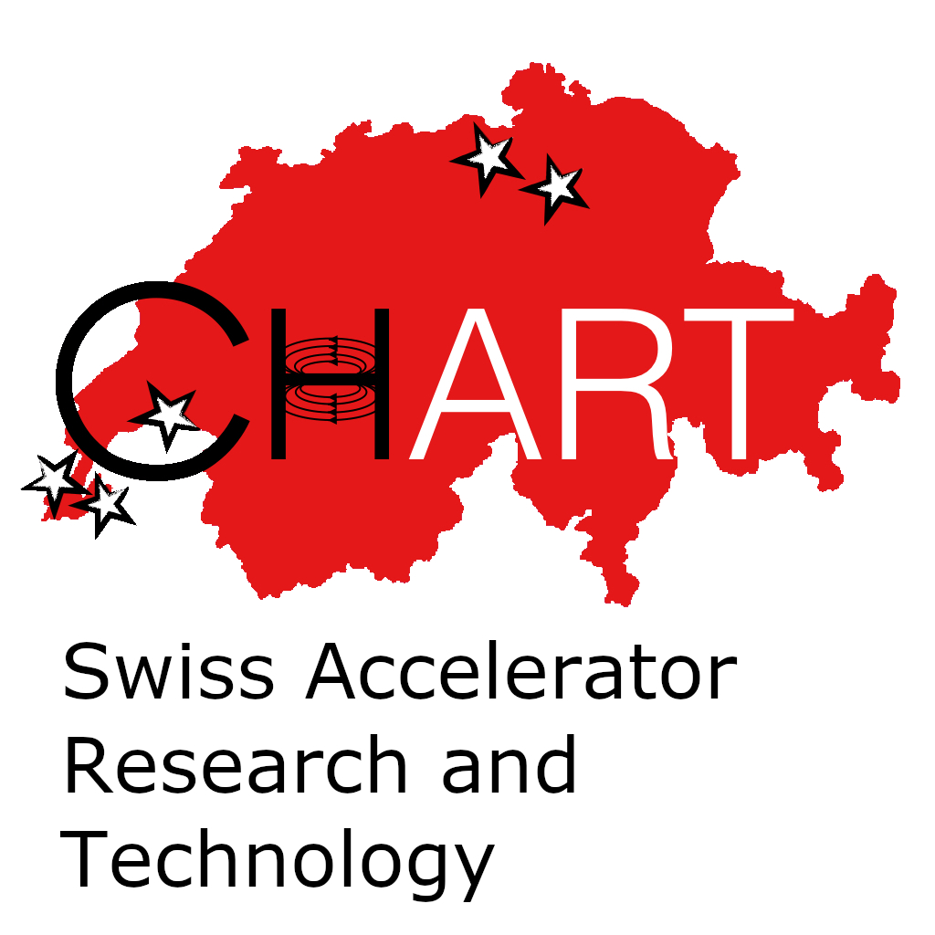

FCCee Lumi
Frank Zimmermann, CERN
CHART Workshop 2025, PSI, 12 November 2025

Slide 2
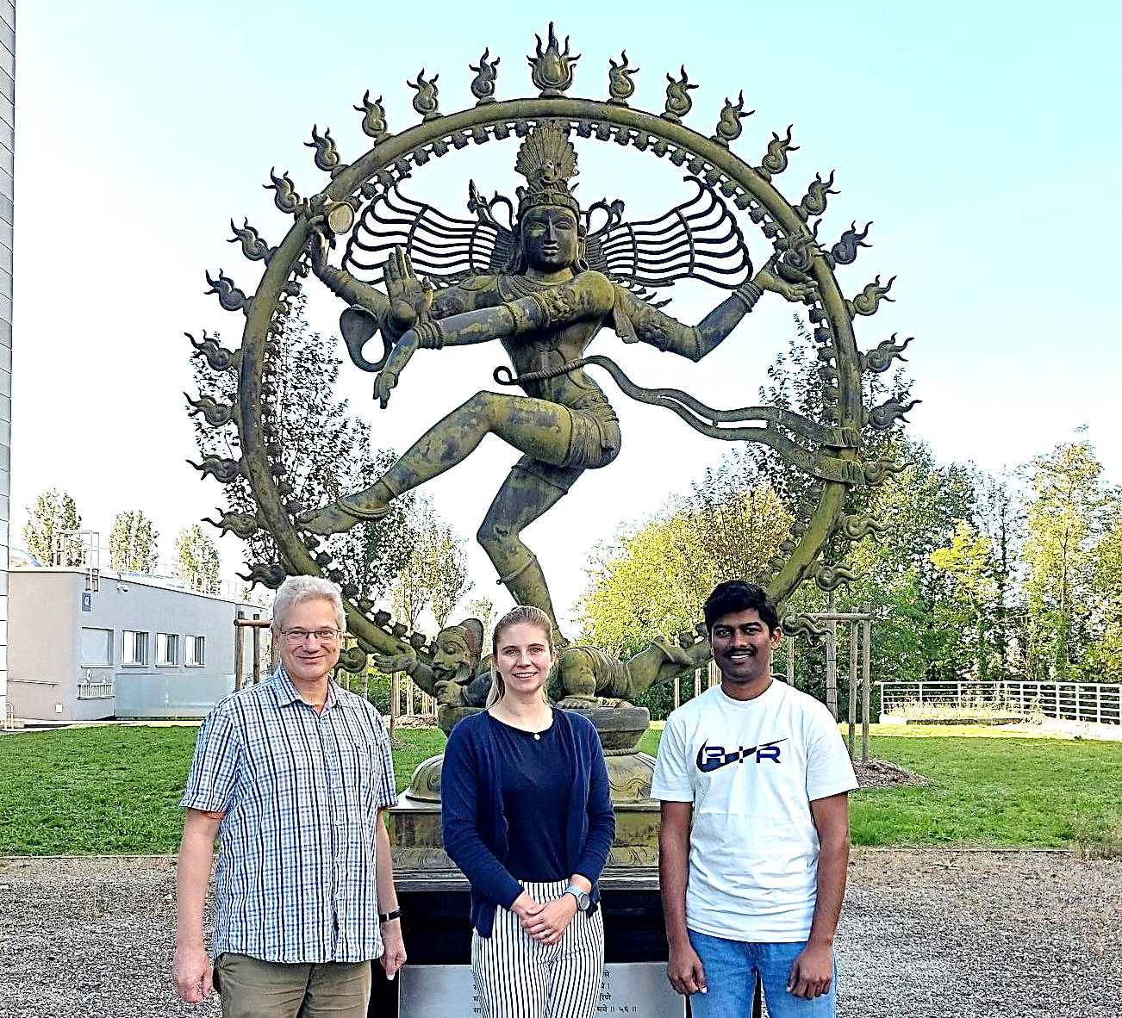
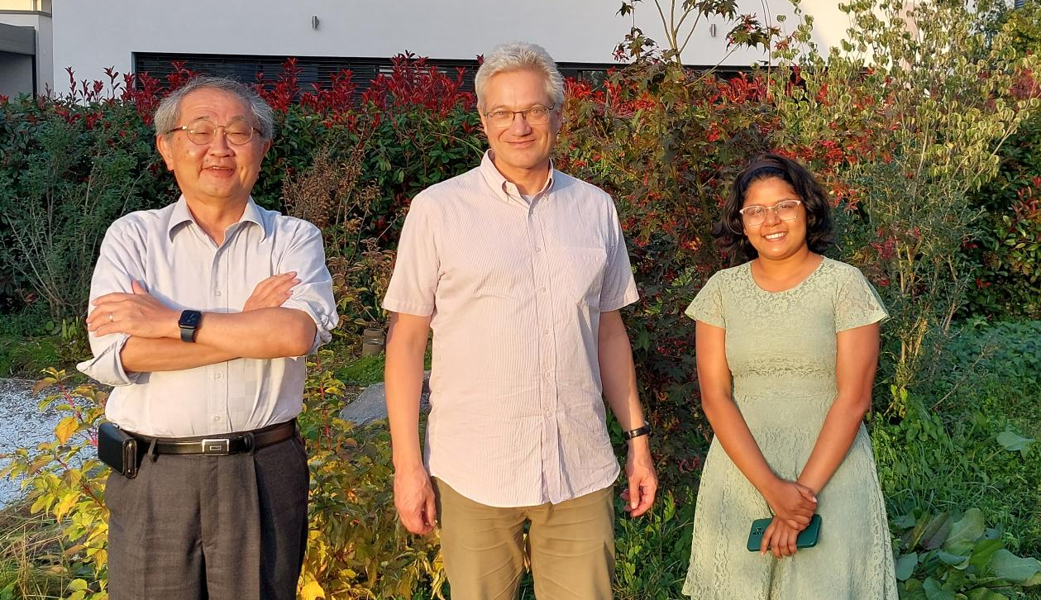
the players
Satya Sai Jagabathuni, doctoral student U. Geneva & CERN (master degree from La Sapienza, Rome)
Katsunobu Oide,
Visiting Professor at
U. Geneva (former KEK Accelerator Lab Director)
Frank Zimmermann,
CERN & FCC deputy study leader, CHART PI
Vaibhavi Gawas, doctoral student U. Geneva & CERN
(master degree from IIT Madras, Chennai)
Jacqueline Keintzel,
accelerator physics expert, CERN
Giuseppe Iacobucci and Tobias Golling,
U. Geneva, CHART Ex. Board
wonderful unwavering support from Michael Benedikt, Michael Hofer, Rogelio Tomas, …

Slide 3
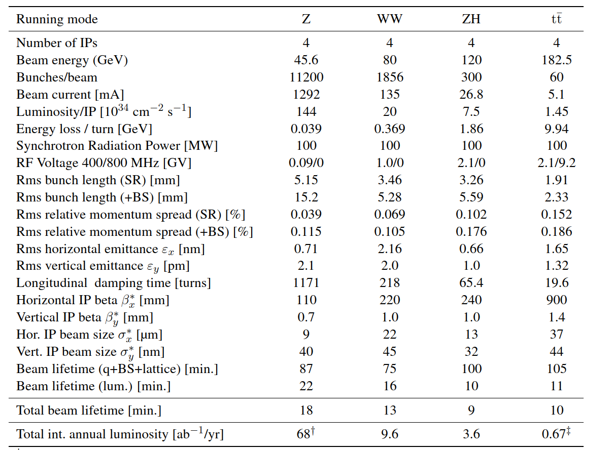
FCC-ee parameter development: feasibility study
Parameters for FCC Feasibility Study Report
K. Oide

Slide 4
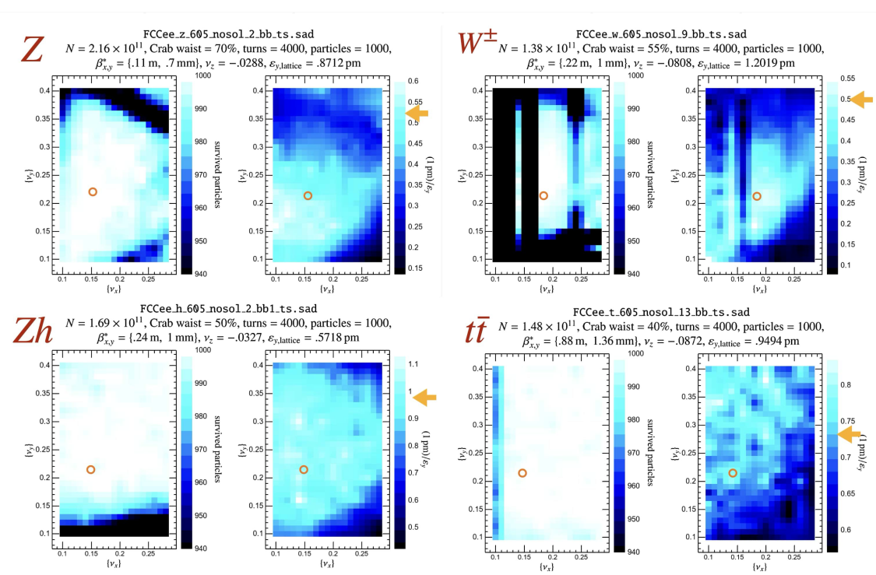
FCC-ee tune scans: beam-beam + lattice
K. Oide

Slide 5
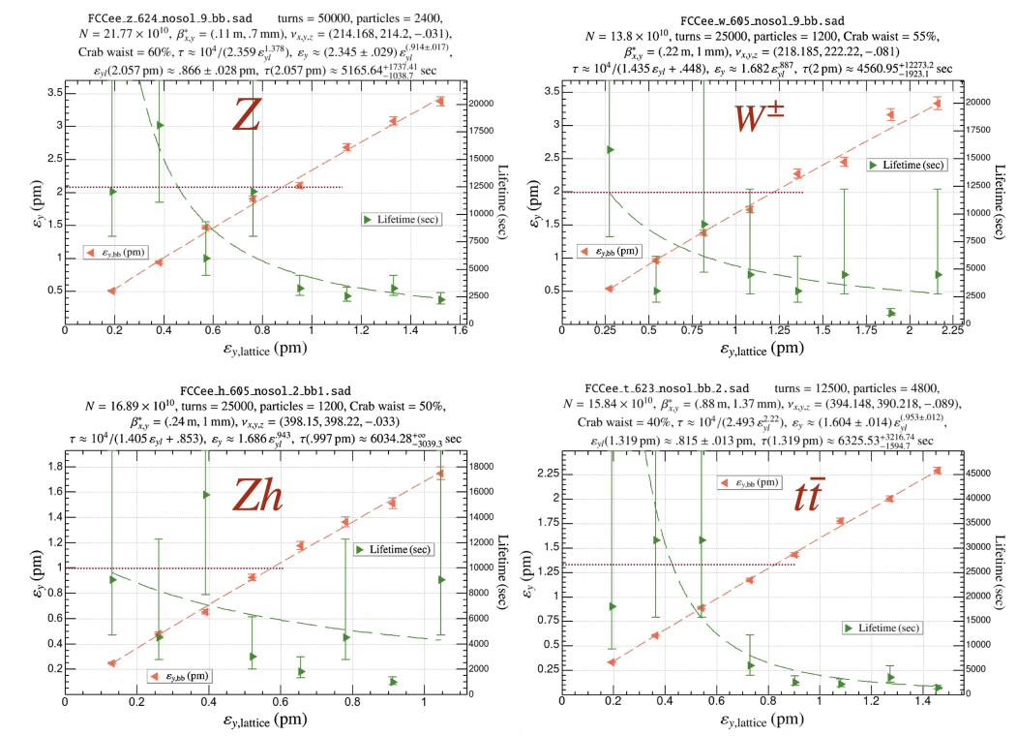
emittance blow up & beam lifetime versus lattice vertical emittance
K. Oide

Slide 6
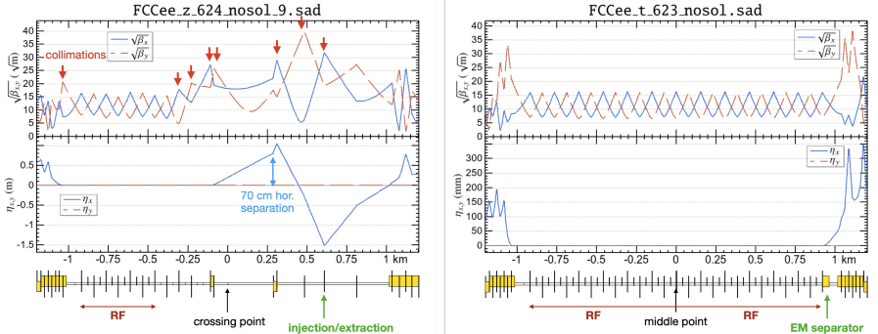
baseline optics for technical straights
Universal optics for all technical insertions in Z/W operation: RF, injection/extraction, & collimation
Optics for the common RF section
in ZH/ttbar operation
K. Oide
6
Maintaining perfect superperiodicity

Slide 7
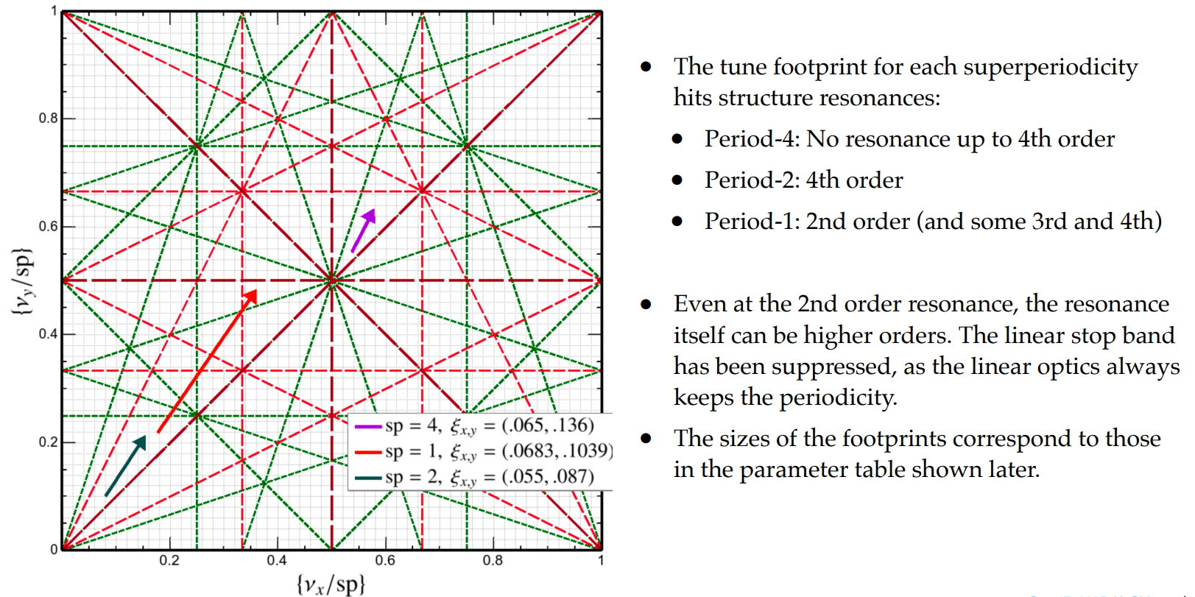
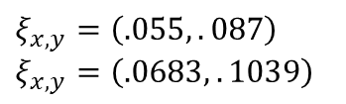
loss of superperiodicy for $t\overline{t}$ running
K. Oide
$$ξ_{x,y}=\left(.055,.087\right)$$
$$ξ_{x,y}=\left(.0683,.1039\right)$$

Slide 8
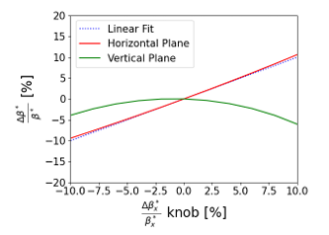
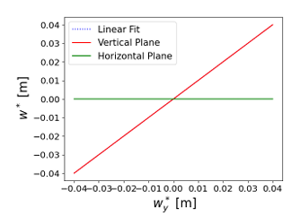
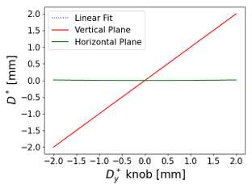
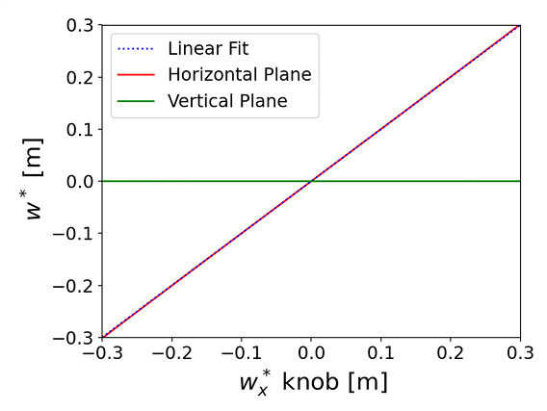
FCC-ee IP Tuning Knobs in Xsuite
S. Sai
𝛽∗_{x}, 𝑤* and 𝐷∗_{𝑦} knob behaviour in Xsuite

Slide 9
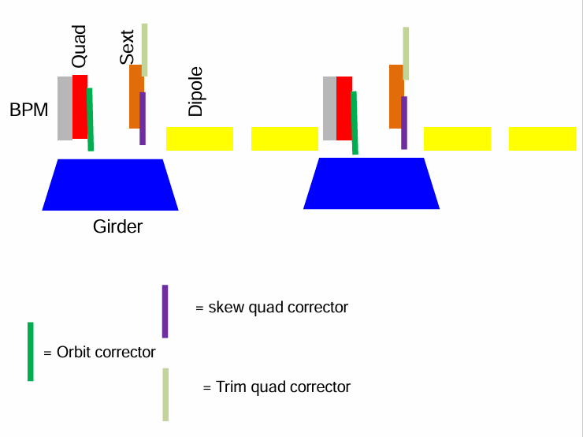
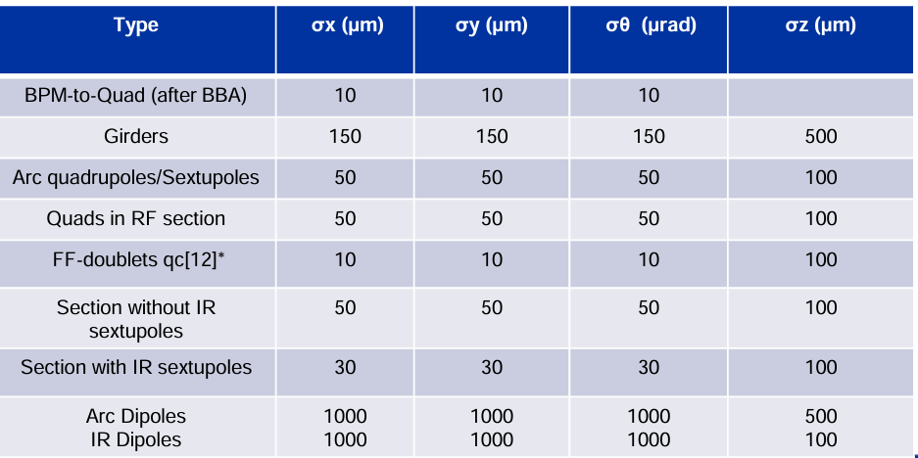
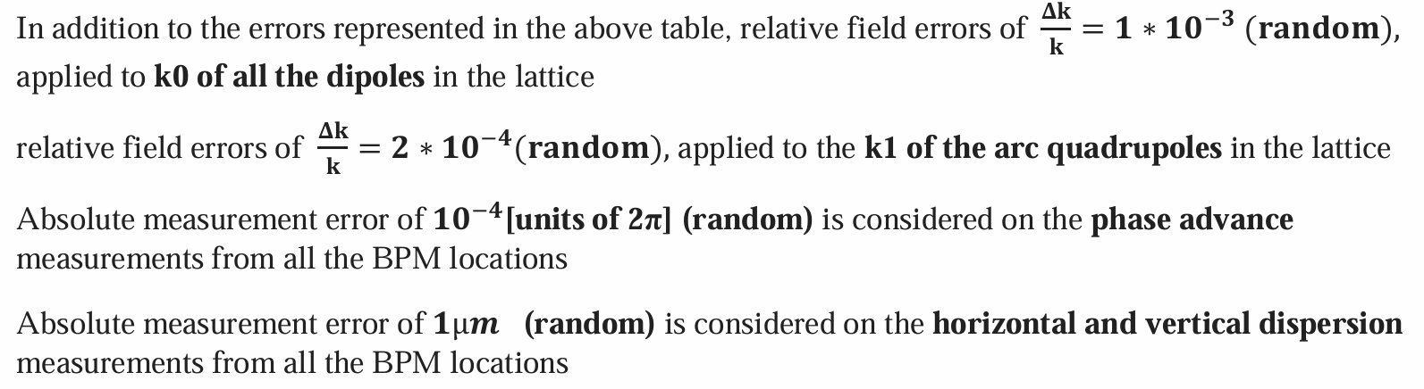
optics tuning studies
girder configuration in arc section
alignment errors
S. Sai
The desired strengths of the correctors are obtained by the pseudo-inverse of the response matrix.
• 1856 BPMs and orbit correctors
• 632 trim normal quadrupoles
• 632 trim skew quadrupole

Slide 10
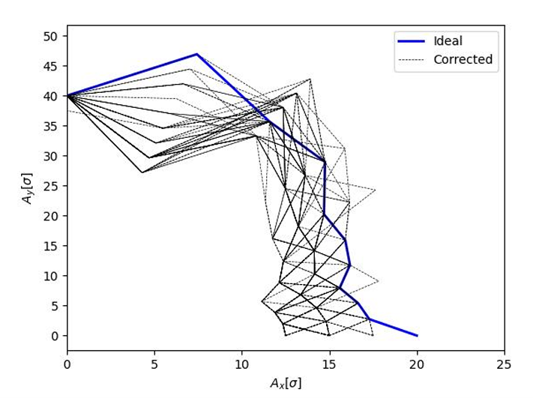
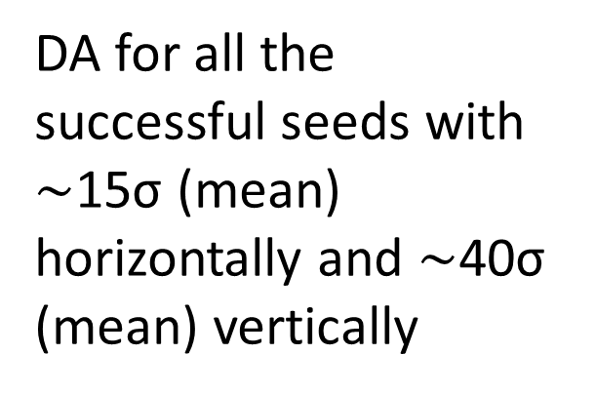
dynamic aperture after corrections
S. Sai
DA for all the successful seeds with $\sim$15σ (mean) horizontally and $\sim$40σ (mean) vertically

Slide 11
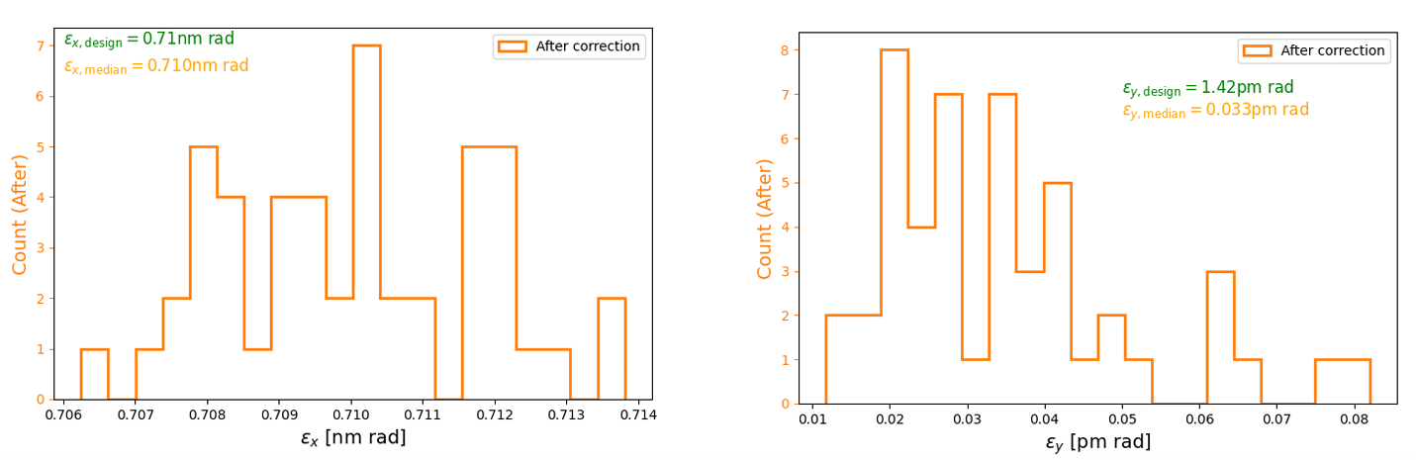
emittances after optics corrections
S. Sai
The median geometric horizontal and vertical emittances are computed as 0.71 nm rad and 0.033 pm rad, respectively. The design horizontal and vertical emittances are 0.71 nm rad and 1.42 pm rad

Slide 12
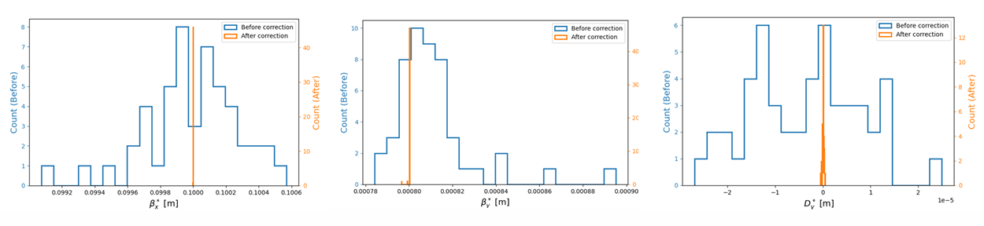
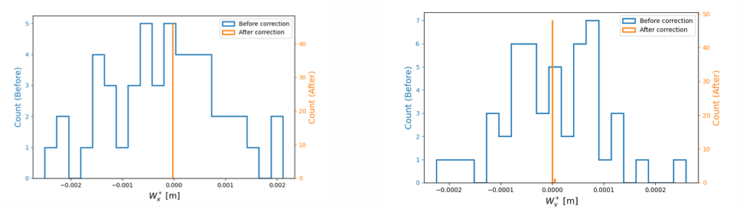
interaction-point optics correction using local tuning knobs
Histograms of 𝛽∗_{𝑥,y}, 𝑤 ∗ _{𝑥,y} and 𝐷∗_{𝑦} at IP2 before & after IP correction
S. Sai

Slide 13
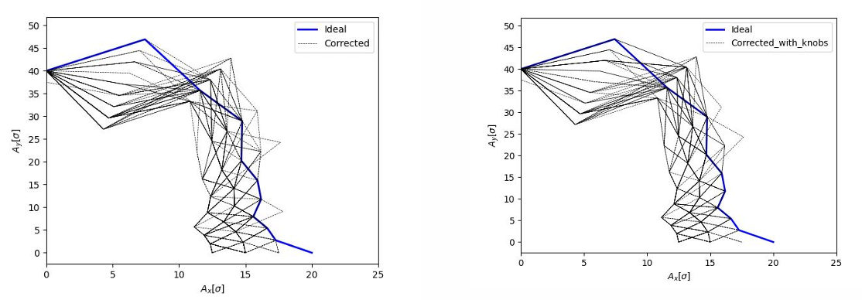
DA after applying local IP tuning knobs
The application of IP tuning knobs has no significant impact on the DA.
DA for all the successful seeds with $\sim$15σ (mean) horizontally and $\sim$40σ (mean) vertically:
S. Sai

Slide 14
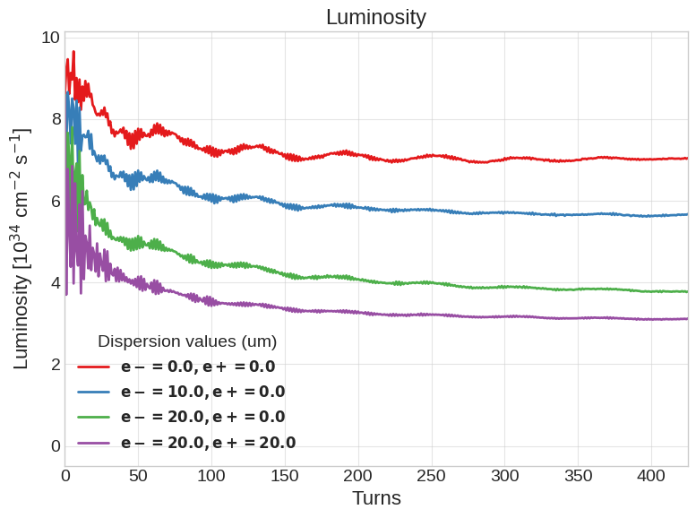
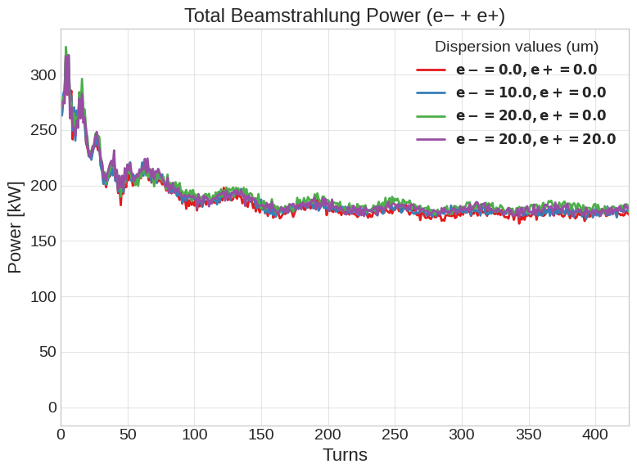
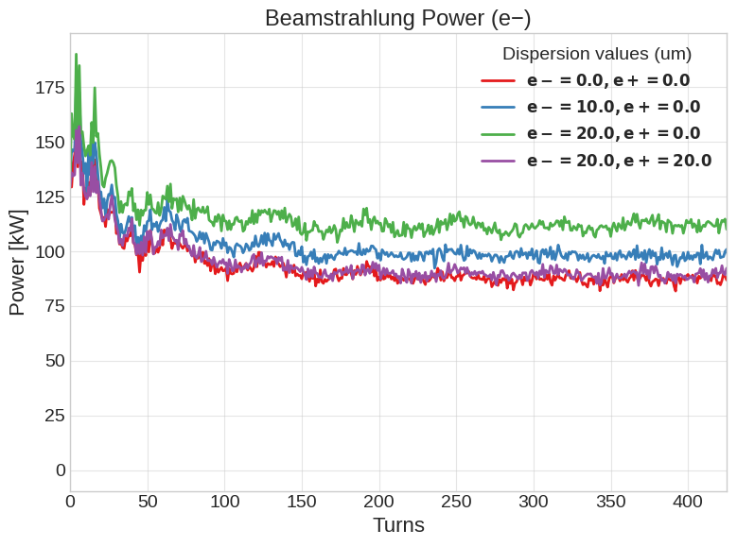
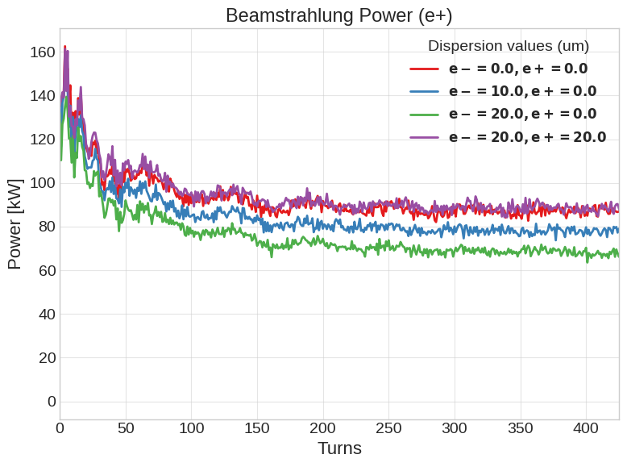
effect of spurious ${D }_{y,e−}^{∗}$ on luminosity & beamstrahlung
V. Gawas
ZH energy
larger beam (e-) radiates more; e⁺/e⁻ beamstrahlung signals complement luminosity information

Slide 15
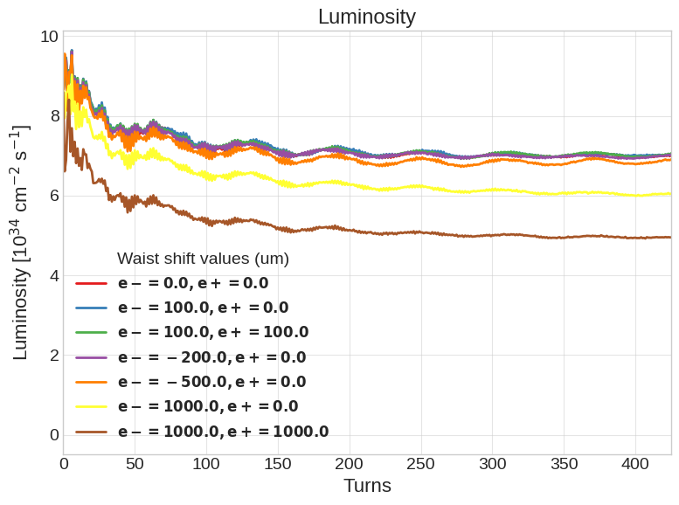
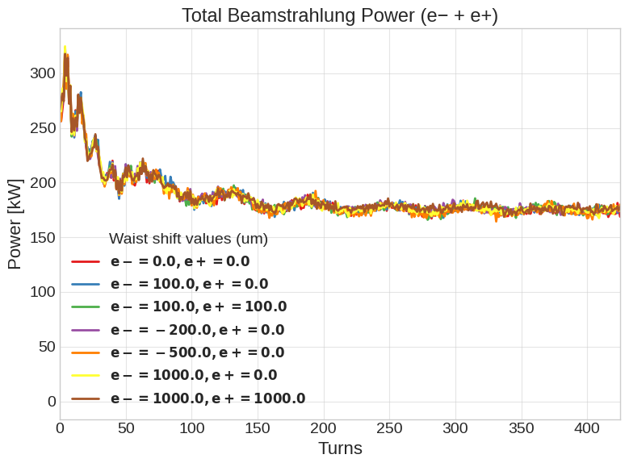
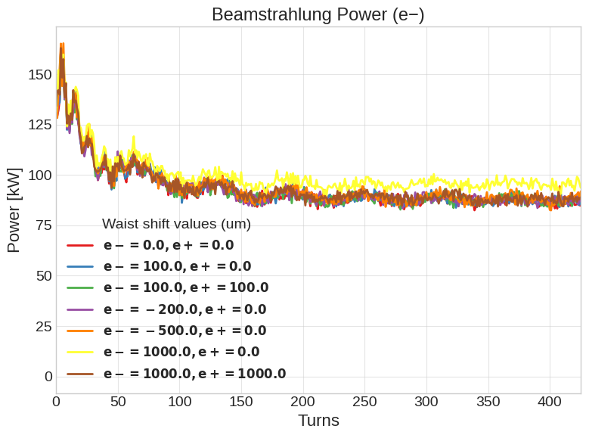

effect of spurious ${w }_{y}^{∗}$ on luminosity & beamstrahlung
V. Gawas
ZH energy
if both waists are shifted in opposite direction, luminosity decreases, but beamstrahlung signal remains symmetric

Slide 16
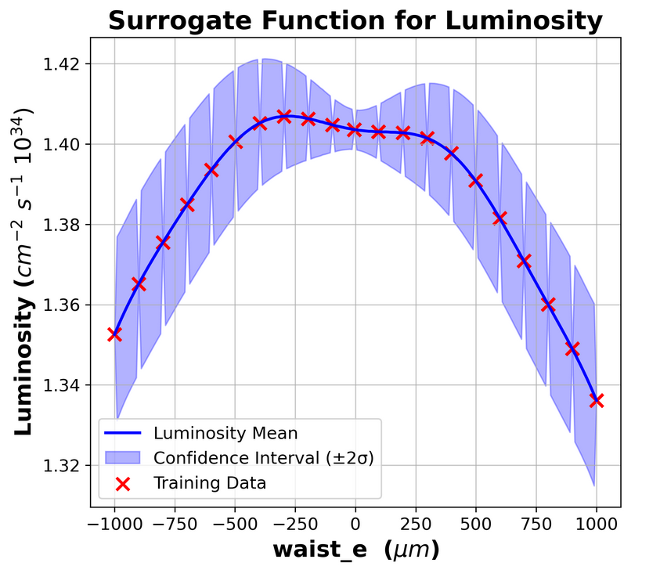
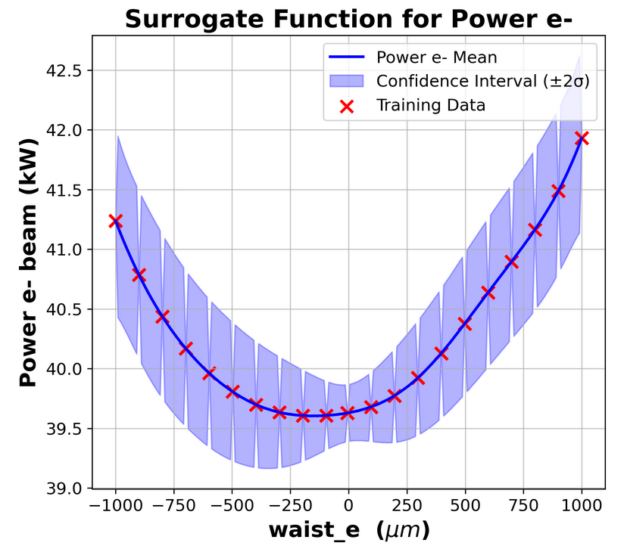
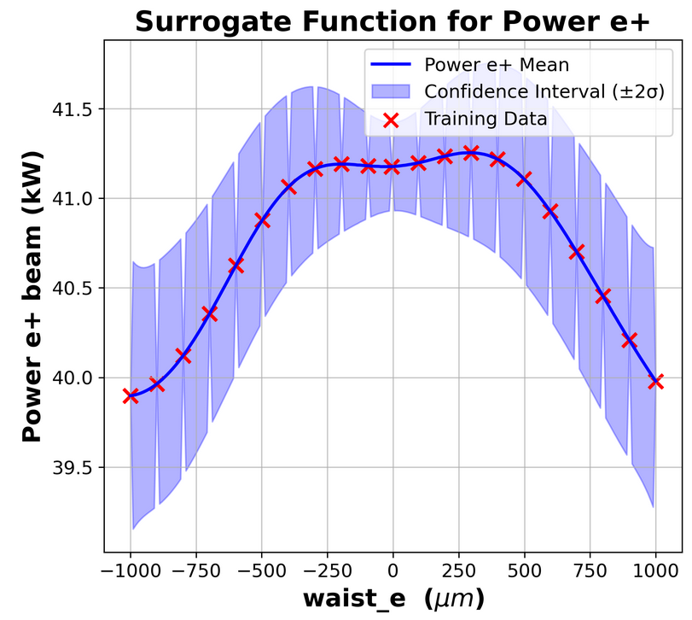

towards luminosity optimisation using Gaussian Process
V. Gawas
$\text{t}\overline{\text{t}}$ energy
Training Gaussian process-based model to predict the residual waist-shift (or dispersion or coupling) at the IP, based on the simulated or observed luminosity and beamstrahlung power signals (plus hits of secondaries in the vertex detector?)

Slide 17
Outlook – Possible Future Topics
weak-strong beam-beam simulations with crab-waisted strong beam (?)
repeat tuning simulations for other optics versions
additional IP tuning knobs: horizontal dispersion, chromatic coupling,… ?
simultaneous applications of two (or more) knobs: impact on useful knob range ?
applications of IP tuning knobs to study effect on steady-state beam-beam/luminosity-related signals for perfect machine
application of IP tuning knobs to optimise luminosity in a machine with errors
general tuning aspects:
include beam-beam for DA studies
re-iterate alignment tolerances in close collaboration with survey & alignments teams (kick-off meeting last week)
FCC-ee optics lattice w. errors & corrections provided by CHART “FCCee Lumi” are requested by many, many teams and they will be used by many more teams once made available

