Slide 1

HFM
High Field Magnets
Programme
MagDev
D. Araujo, B. Auchmann, A. Brem, M. Crescenti, M. Duda, N. Kehl, J. Kosse, C. Lindner, T. Michlmayr, C. Müller, I. S. P. Peixoto, K. Puthran, H. Rodrigues, J. Schmidt, D. Sotnikov, A. Stampfli, J. Van den Eijnden
CHART Workshop 2025, 12 November, 2025
This work was performed under the auspices of and with support from the Swiss Accelerator Research and Technology (CHART) program, http://chart.ch.

Slide 2
MagDev LTS Status and Plans

Slide 3


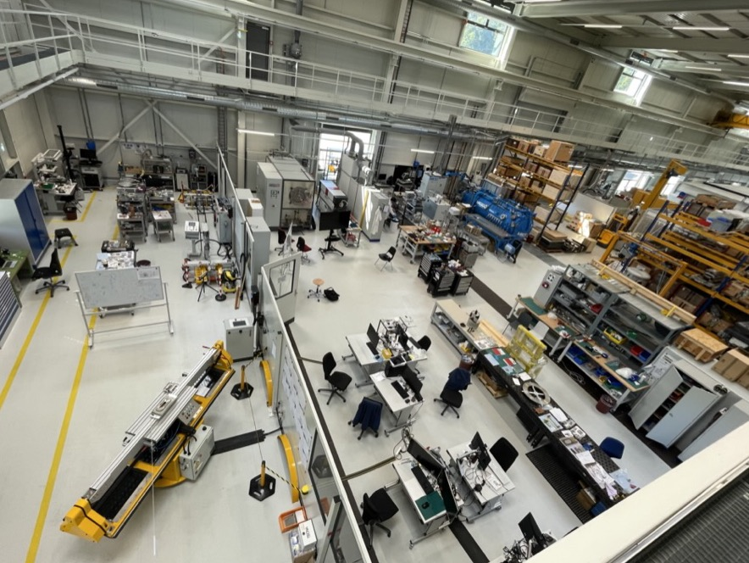














MagDev Laboratory
Douglas Araujo
Engineer LTS
Nicolas Kehl
Technician LTS
Jaap Kosse
Engineer ReBCO
Thomas Michlmayr
CAD, Technical Design
Colin Müller Mechanic LTS
Anna Stampfli
Technician Processes
Henrique Rodrigues
Process Engineer ReBCO
Jürgen Schmidt
Technician HTS
Dmitry Sotnikovs Design Engineer ReBCO
Christina Lindner
Technician HTS
André Brem
Material Scientist
Joep Van den Eijnden
PhD Student
Kirtana Puthran
Engineer ReBCO
Matteo Crescenti
PhD Student
Alejandro Carlòn Zurita
Technician HTS, CAD
Inês S. P. Peixoto
Magnet Engineer

Slide 4
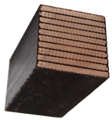


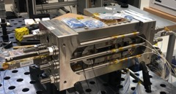
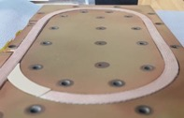
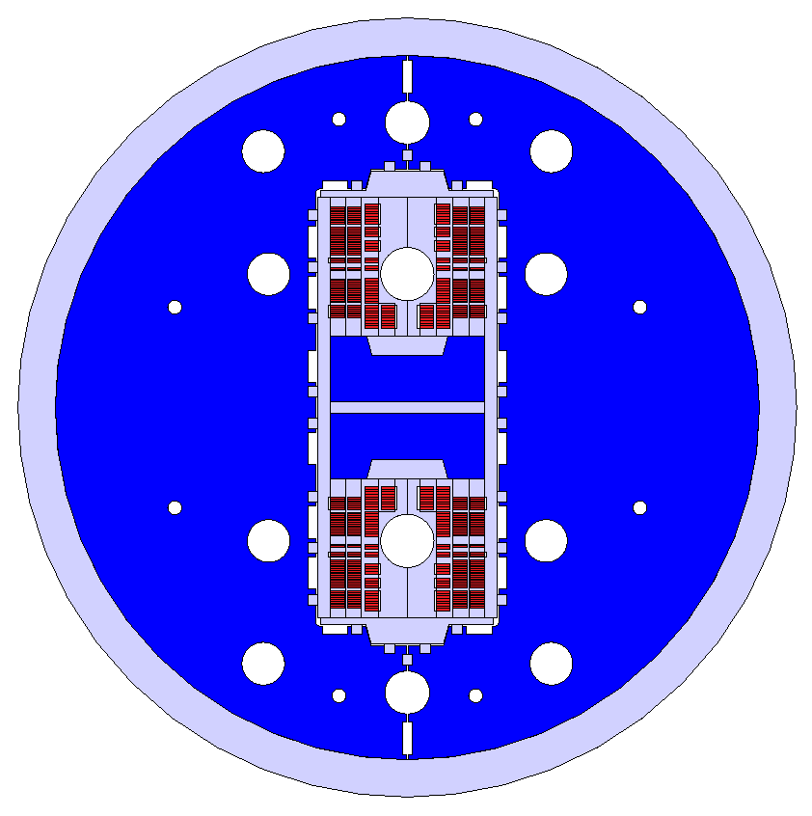

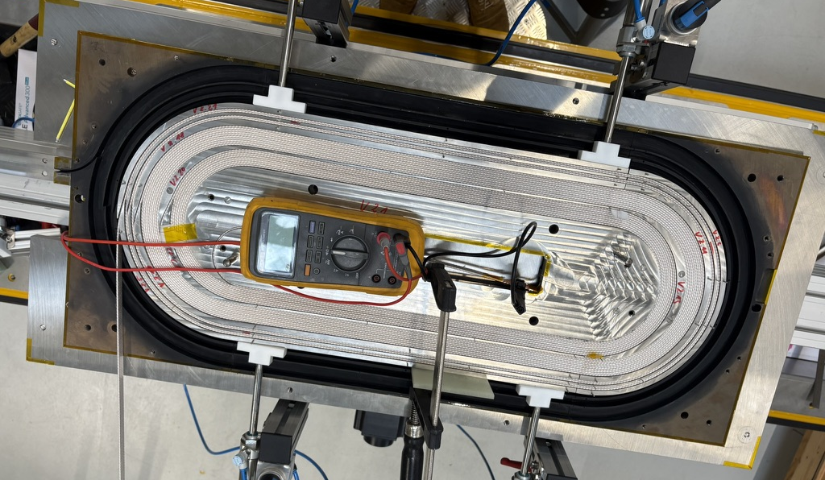

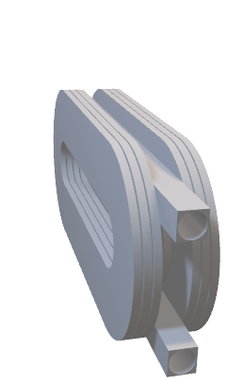
Fast-Turnaround Stress-Management R&D
Goal: Build industrializable Nb₃Sn high-field magnets that “just work”.
First deliverable
#Deliverables / year
2019
Materials and Composite Samples (not powered)
100s
2020
Powered Samples and Mechanical Models
10
2024
Sub-scale Magnets (5 T)
2-3
Short Magnets Ultimate Field (14…16T)
2025/26
0.5-1
Long Magnets Ultimate Field Magnets (14…16 T)
Long-magnet infrastructure available only at CERN.

Slide 5

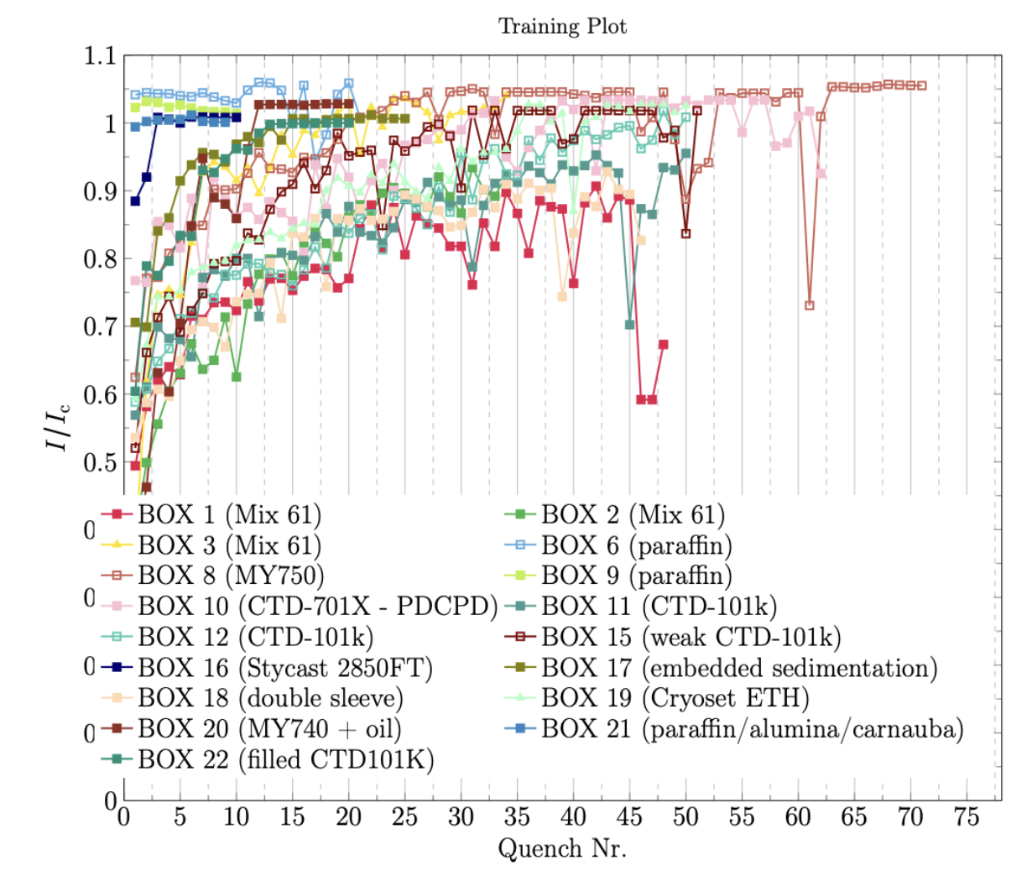
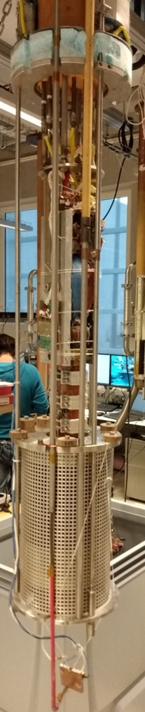
BOX Program
SC Transformer
Pictures by M. Daly, S. Sidorov, S. Otten
11-T solenoid
BOX (BOnding eXperiment) program with uTwente has shown a wide variety of results, from complete conductor degradation (no impregnation) to substantial training (epoxy) to no-training (wax, Stycast, filled wax), with 20 BOX samples successfully and tested to date.
Courtesy, A. Brem, S. Otten

Slide 6
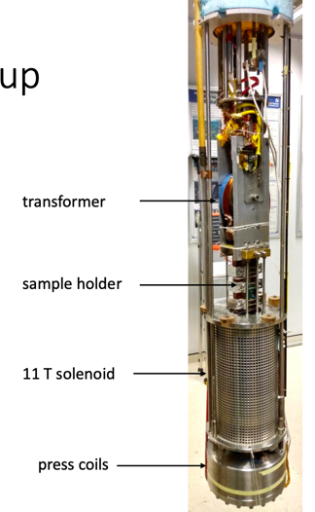
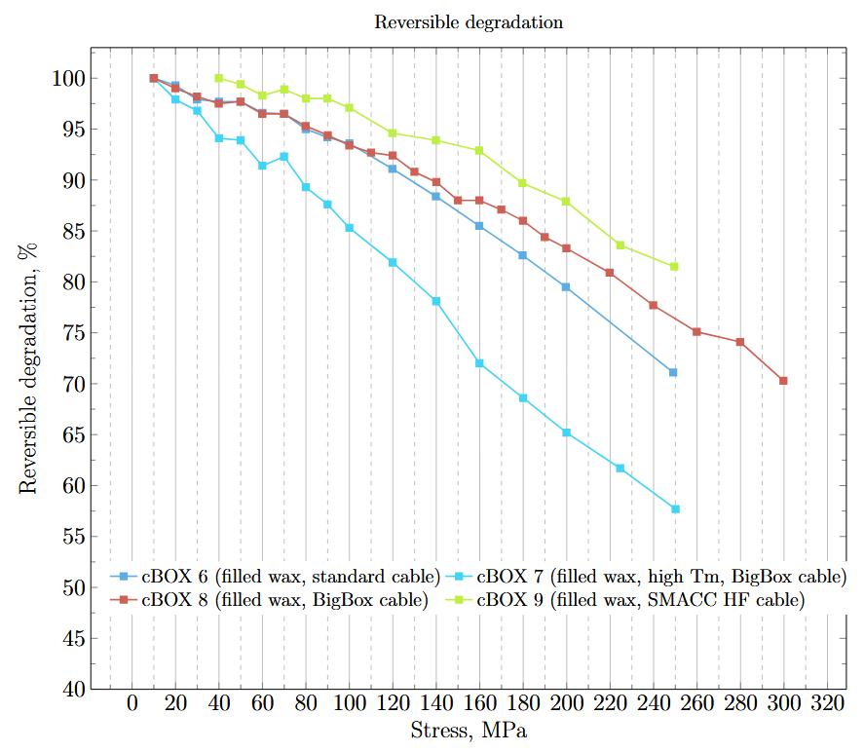
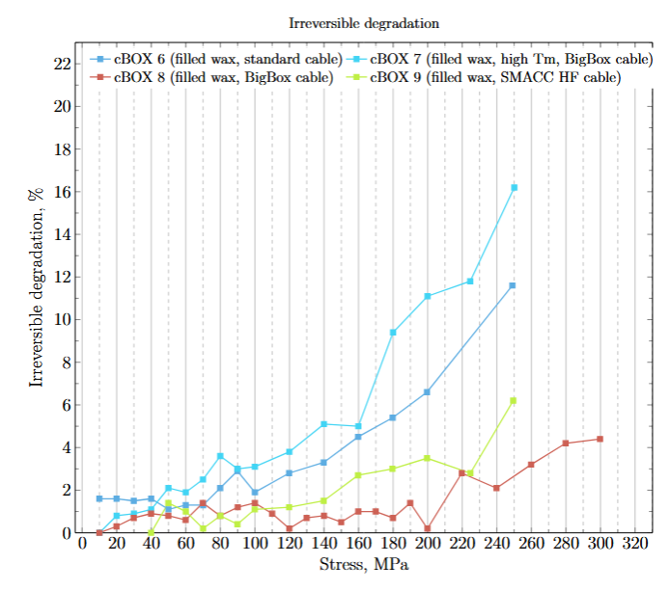
Compression BOX
Four tests with filled wax and three different cables.
cBOX6 performance equivalent to epoxy.
High-field cable of PSI high-field magnet demonstrator performs very well!
Courtesy M. Daly
Courtesy, A. Brem, S. Otten
Courtesy S. Ott et al.

Slide 7

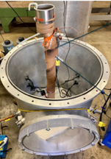
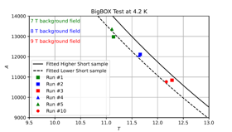
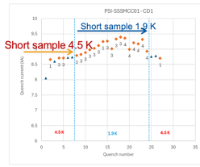

Magnets Using Filled-Wax
PSI/BNL BigBOX: a 13-turn SM racetrack.
No training at 12.3 T, 170 MPa with wax Filled-wax BigBOX2 awaiting test at BNL’s DCC17 test station.
LBNL sub-scale CCT (5 T) .
First Nb₃Sn CCT without training. Alumina-filled wax subCCT with a single training quench.
PSI subSMCC1 and 2 2-in1 dipole (5T)
Nb₃Sn common coil R&D magnet without training at 4.5 K. Support from LBNL/CERN.
LBNL CCT5w, re-build of CCT5, replacing epoxy by filled wax.
Magnet reached short sample current at 4.5 K and 1.9 K.
Next up: LBNL CCT6 and PSI’s SMACC1
11 T
10 T
9 T
8 T
7 T
CCT5w in LBNL (D. Arbaleaz, at HFM forum)

Slide 8
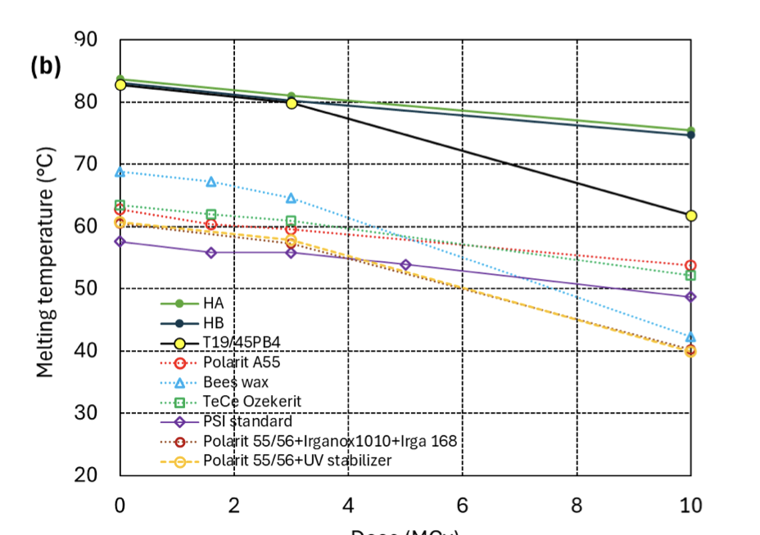
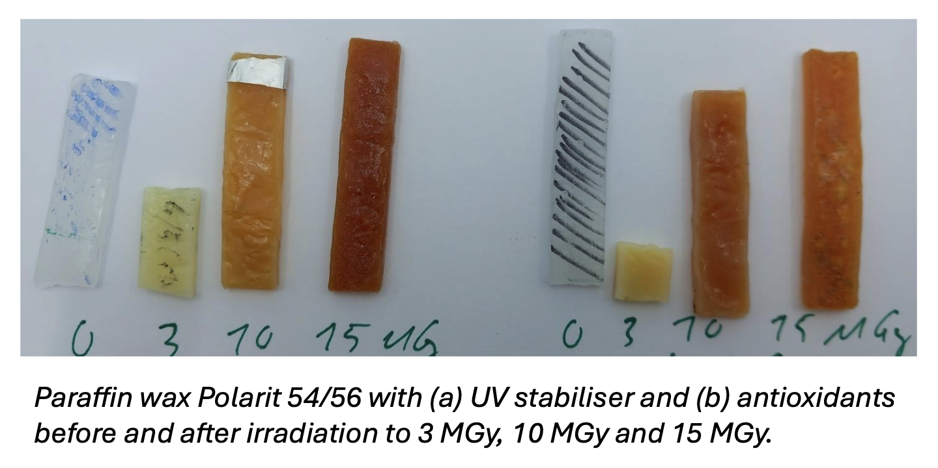
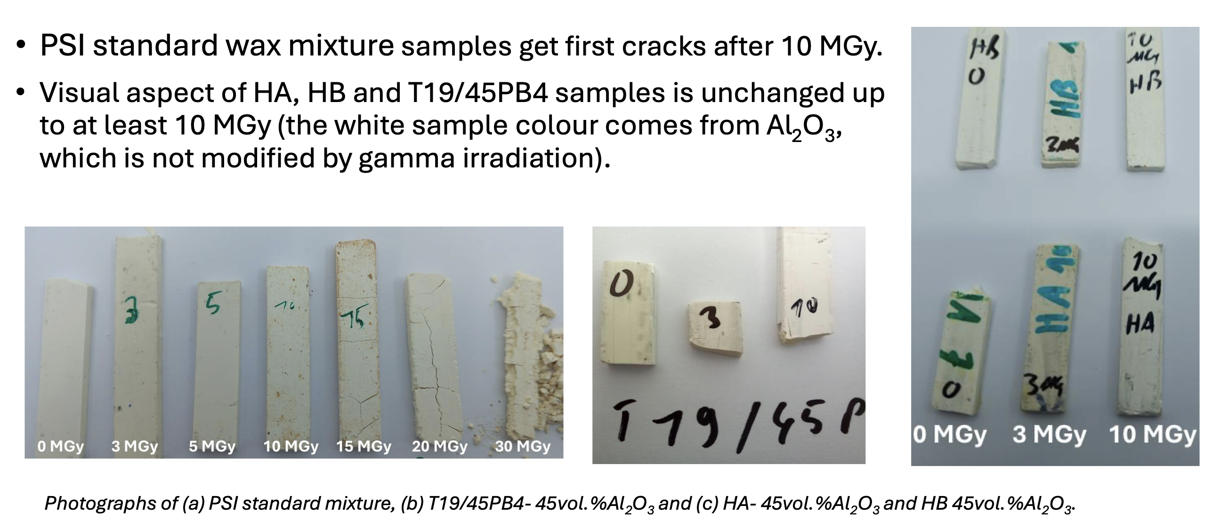
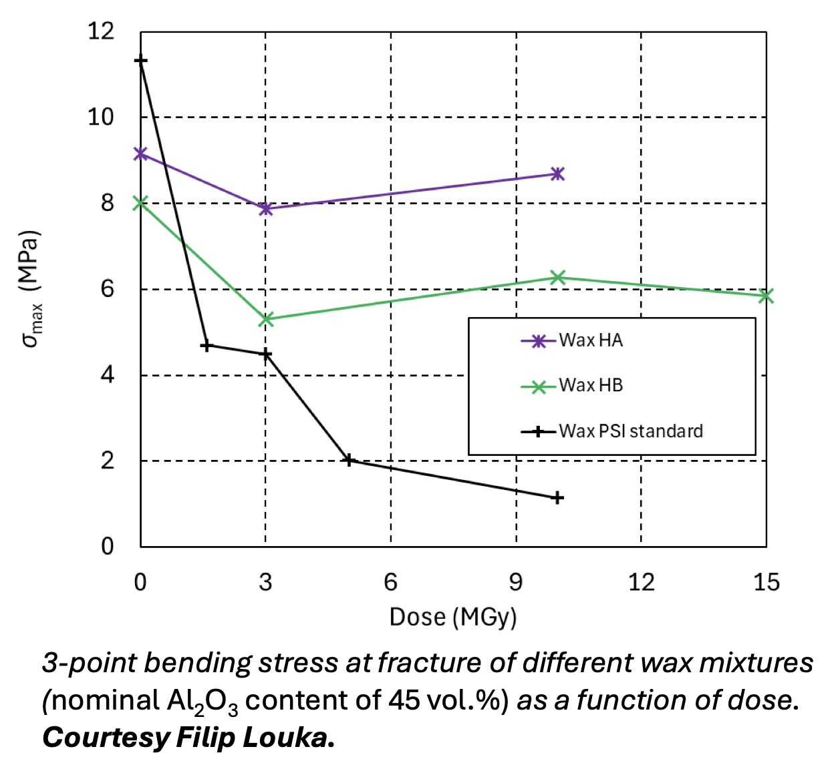
Wax Irradiation Tests at CERN
Irradiation study in atmosphere for paraffin wax, filled paraffin wax, and filled high-melting-temperature High-T_{m} waxes.
High-T_{m} waxes show very encouraging performance up to 10 MGy (max. tested to date).
Study by Christian Scheuerlein (CERN) and André Brem (PSI), presented at HFM Forum, 06.11.2025, https://indico.cern.ch/event/1599118/

Slide 9
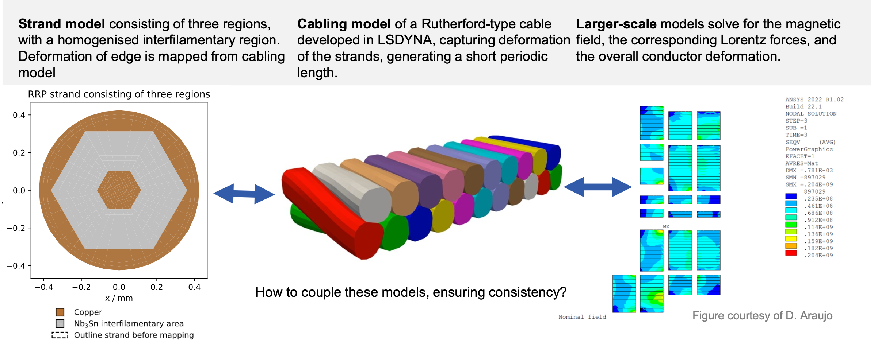
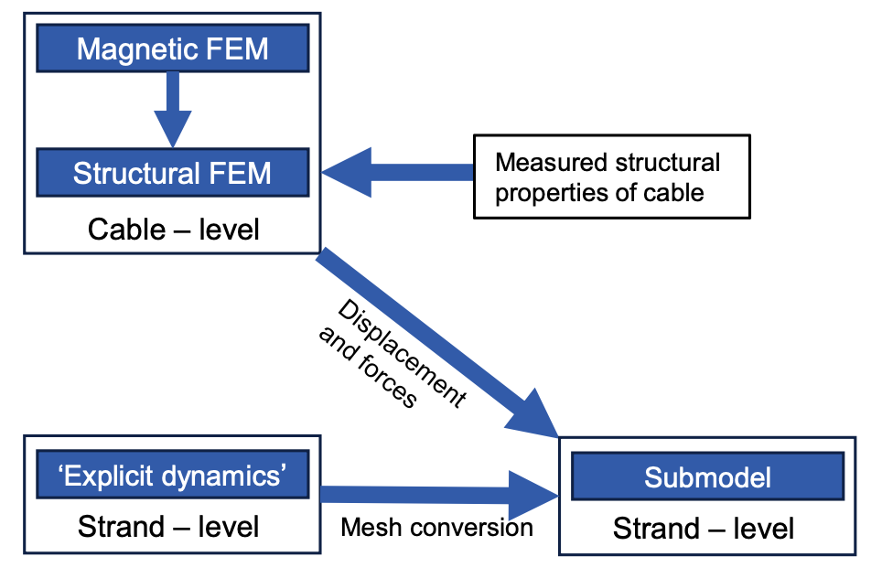
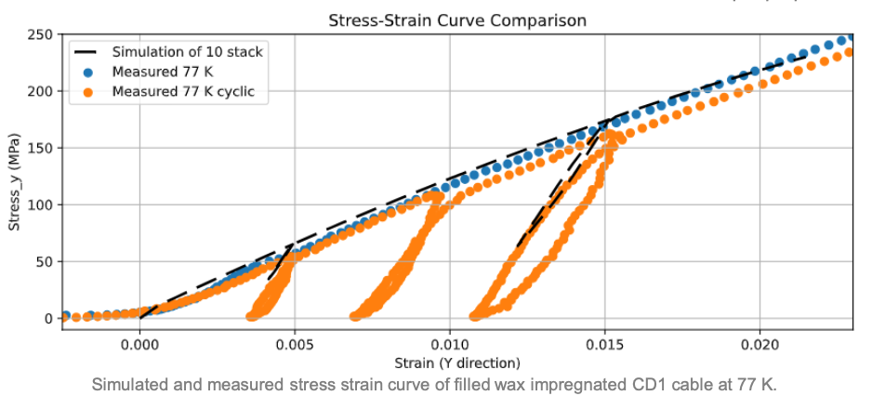
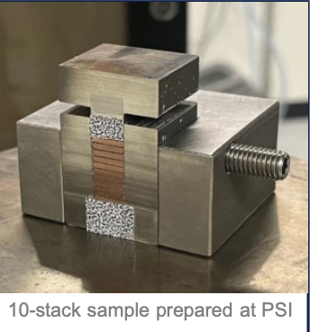

MagNum
Modeling
Workflow
Characterization
Measurements performed at EHTZ by X. Kong and T. Tervoort

Slide 10
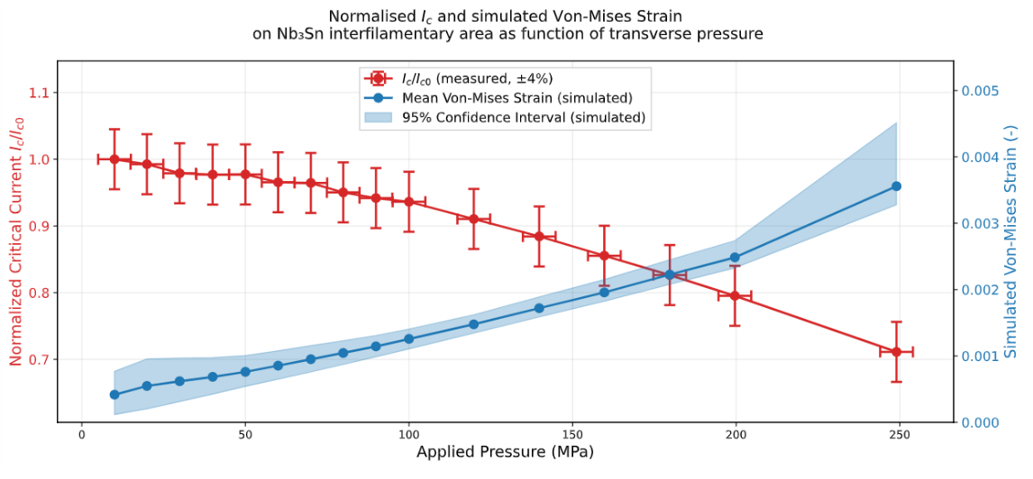
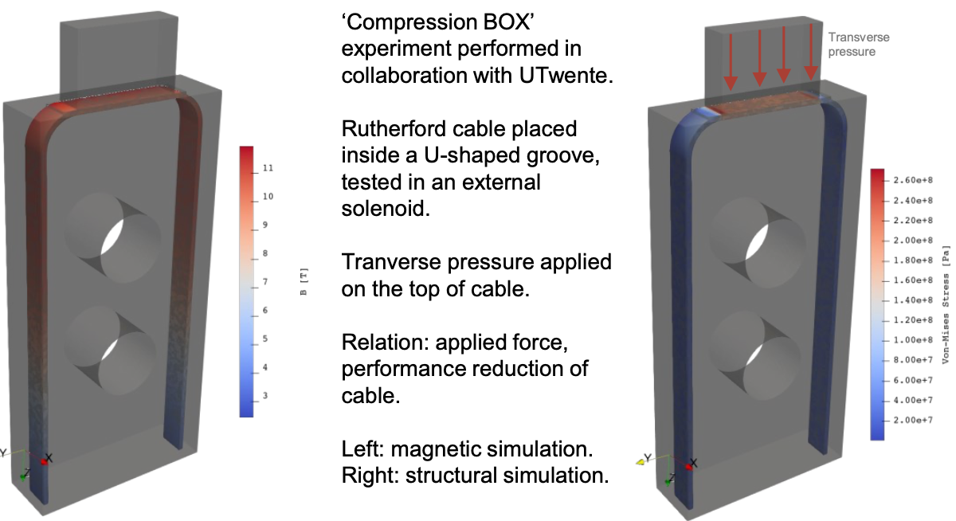

MagNum
Measurements
Experimental Validation
Measurements performed at Univeristy of Twente, S. Olten.

Slide 11
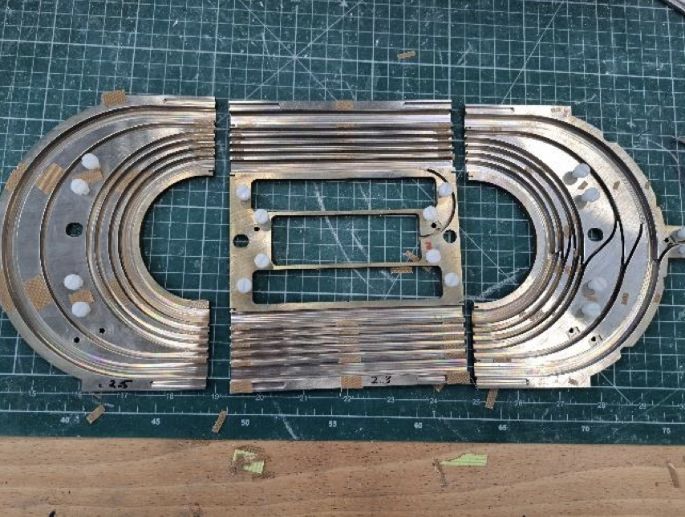
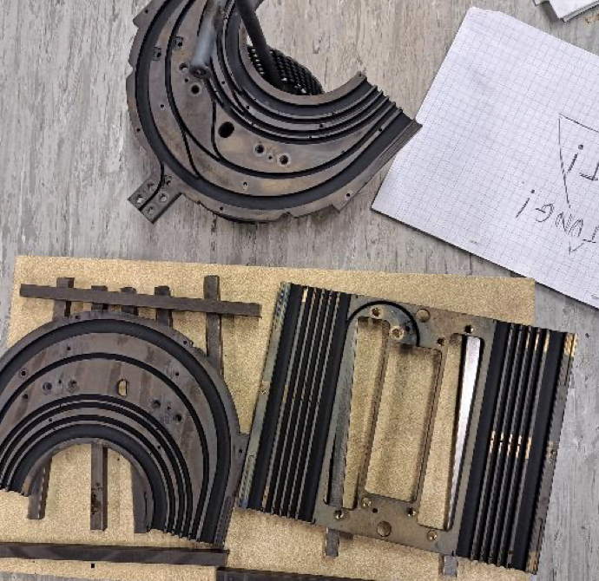
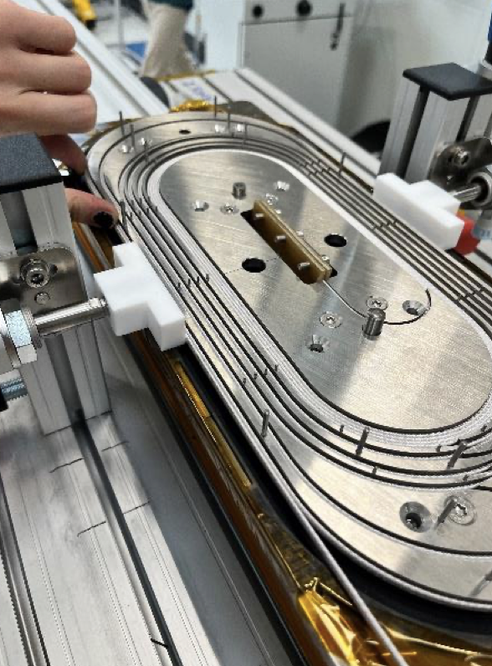
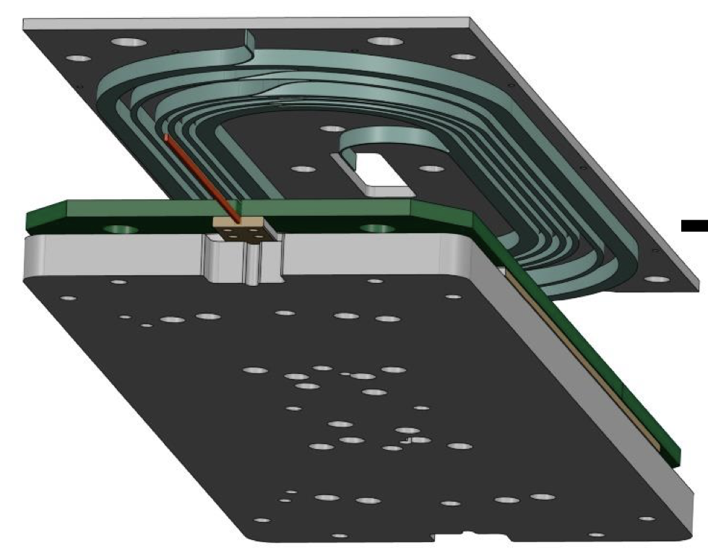
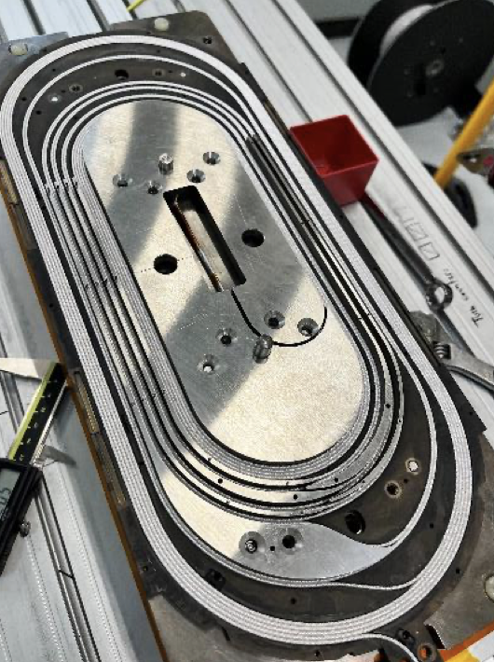
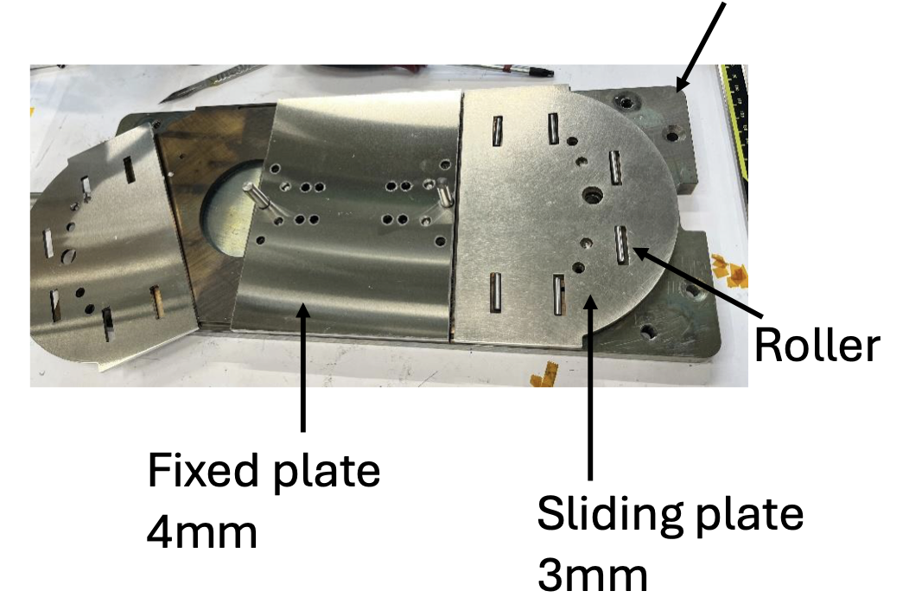
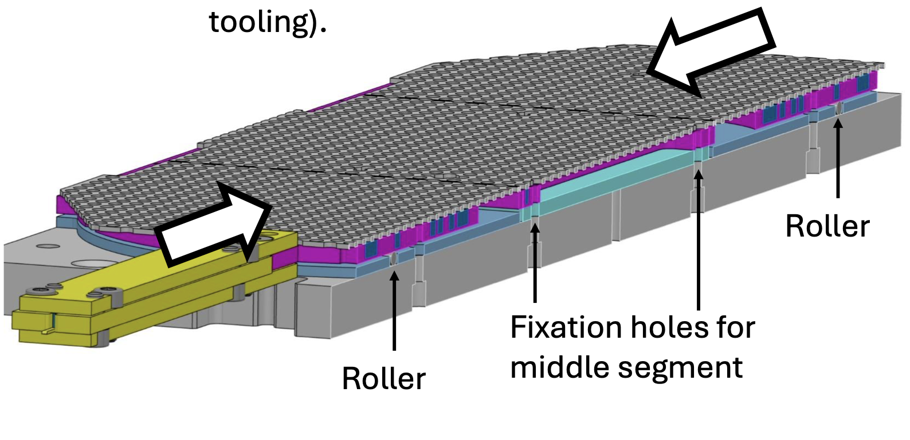
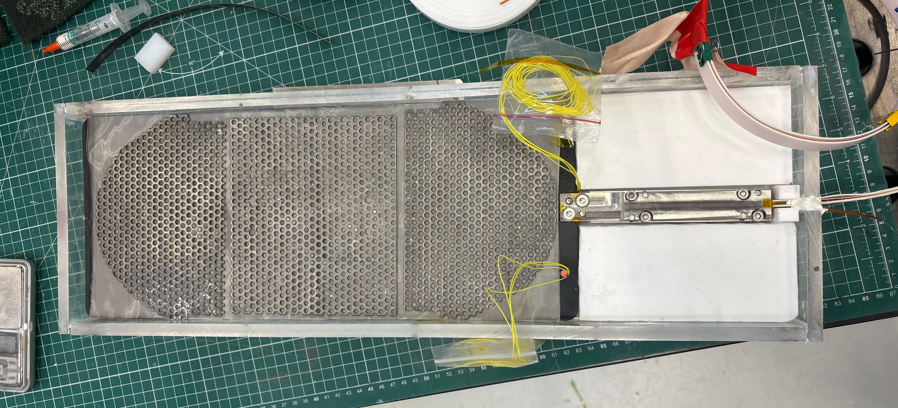
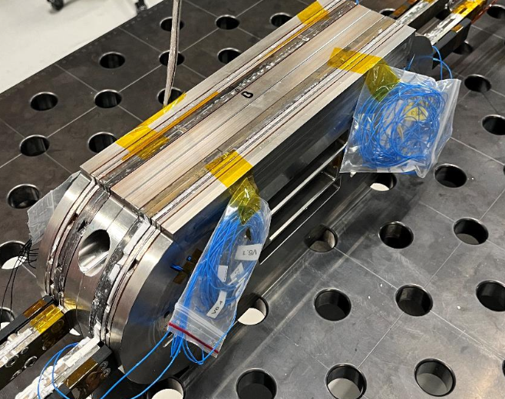
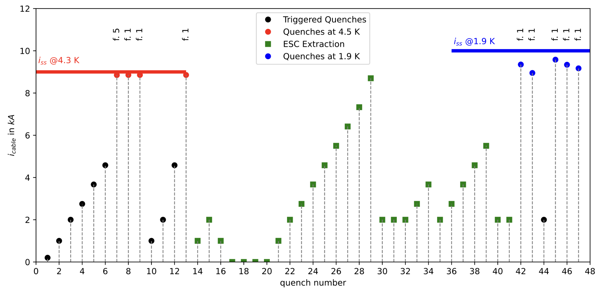
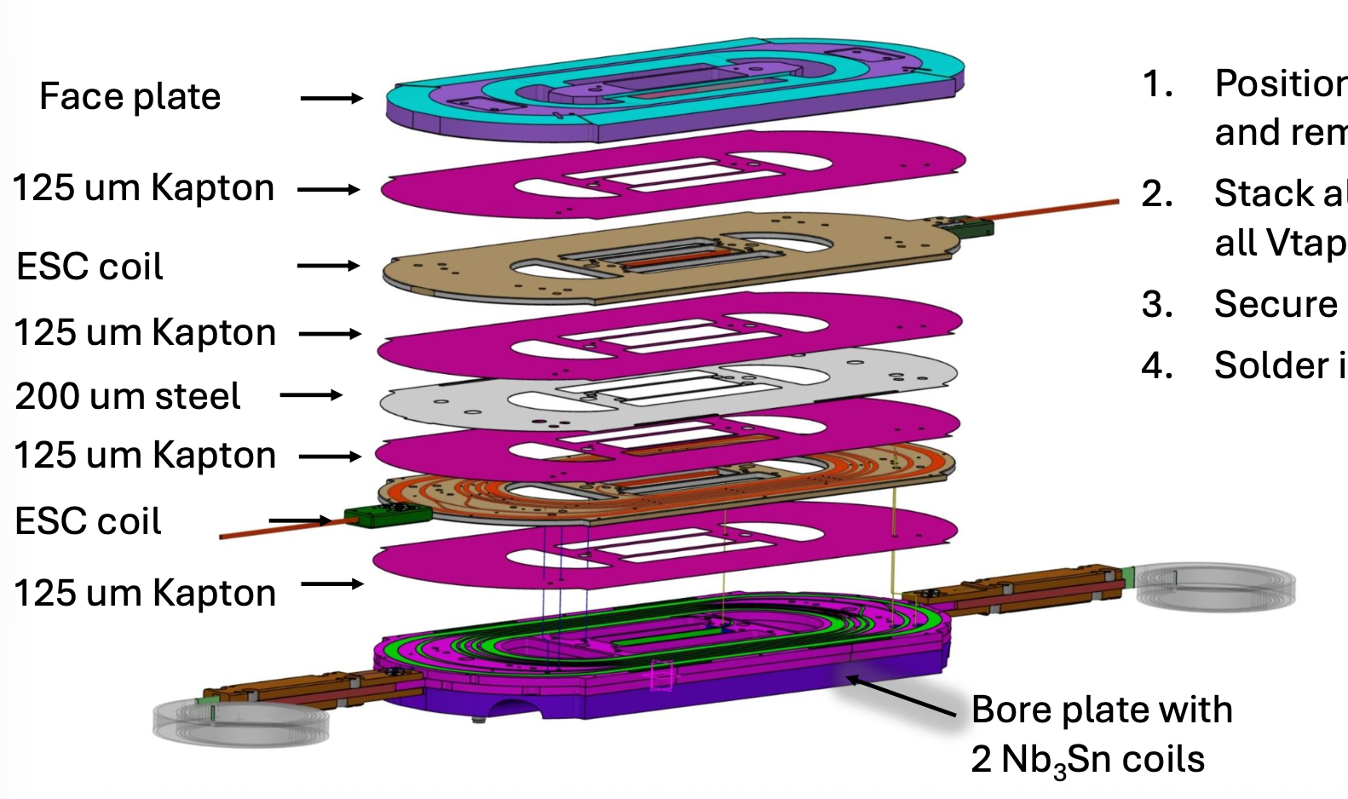
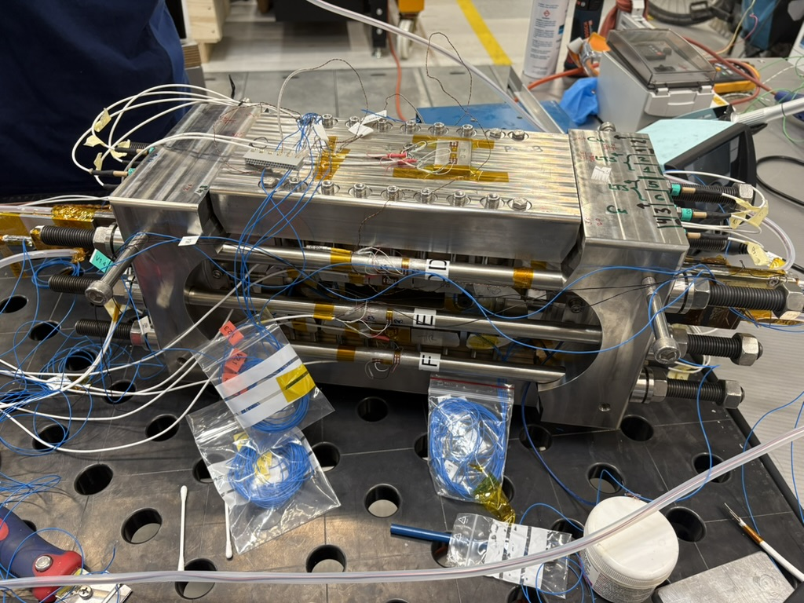
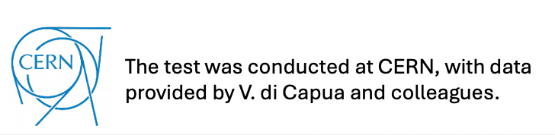
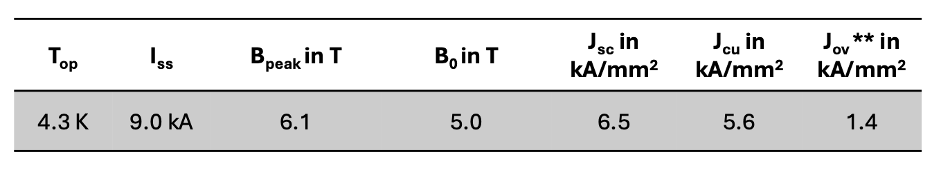
subSMCC1/2a
Subscale (5-T) Stress-Managed Common-Coil (subSMCC) magnet for process validation.
subSMCC2 has ESC protection coils

Slide 12
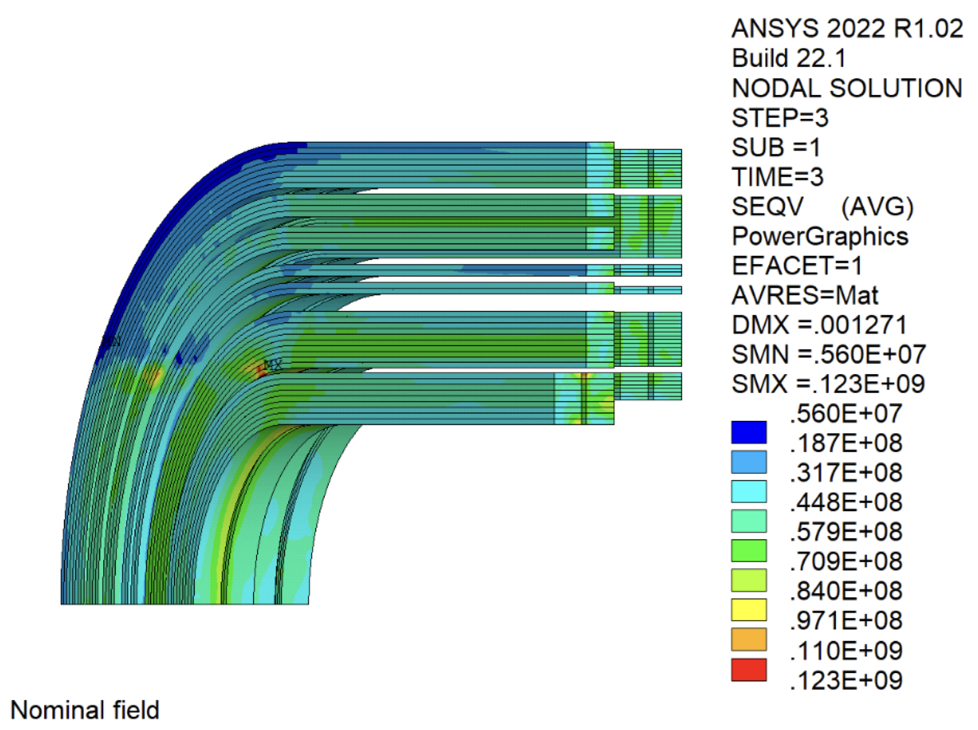
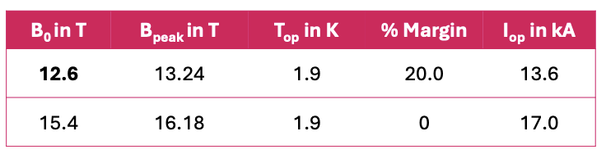
SMACC1 Design
SMACC1 is nominally a 12-T demonstrator for the HFM Programme.
Coil stress at 13 T reaches 125 MPa in simulations.
The record field for a single-aperture accelerator magnets is 14.5 T (92% of SMACC1 short sample field).
cBOX results indicate that filled-wax + stress management may get us there.
BUT, this is the first time we test our technologies at the high-field frontier!

Slide 13
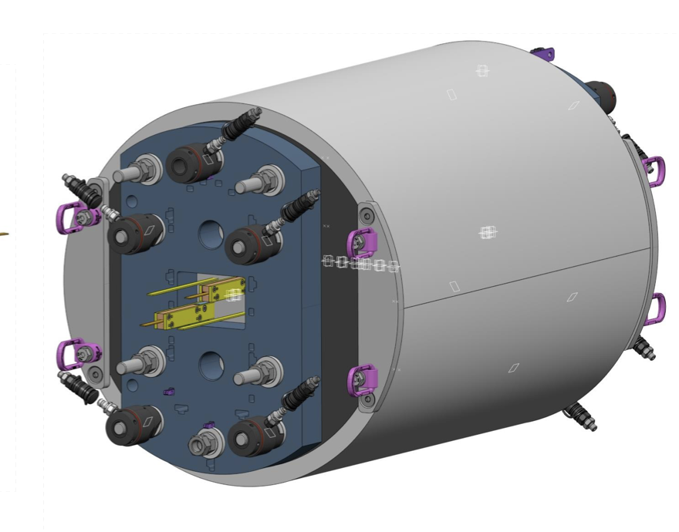
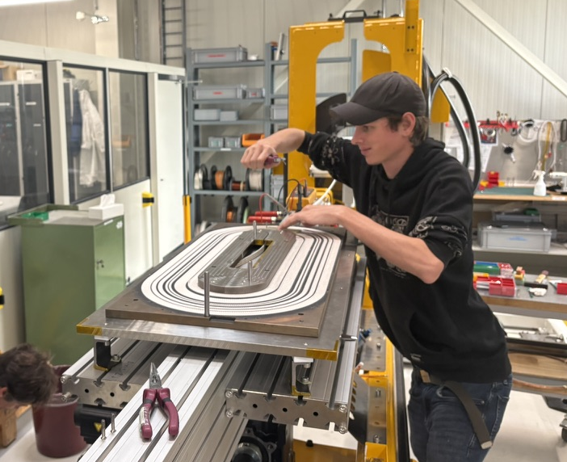
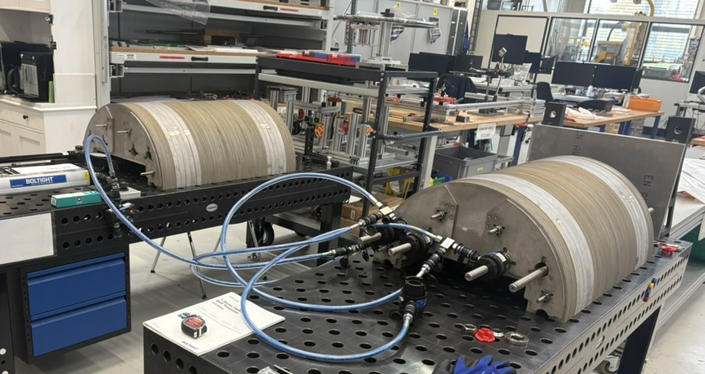
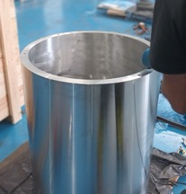
SMACC1 Construction
Two high-field coils have been wound.
Yoke stacking completed – awaiting re-machining.
Procurement of all components started.

Slide 14
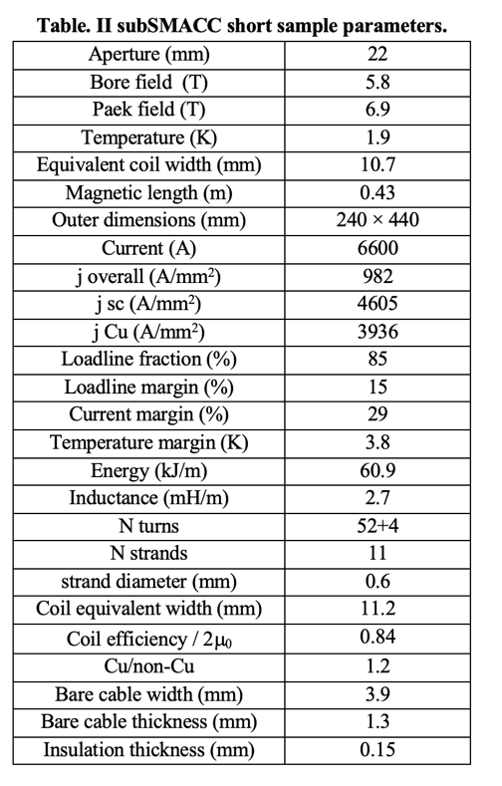
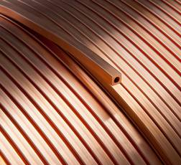
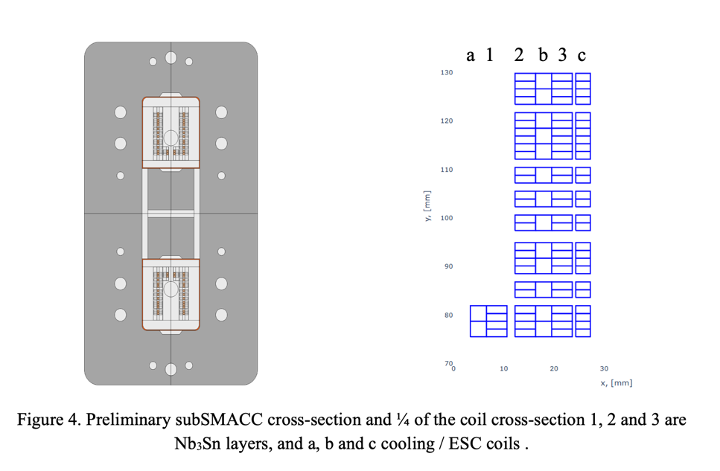
subSMACC1
D. M. Araujo, I. S. P. Peixoto, et al. Combined System for Cryogenics and Protection of High-Field Superconducting Magnets, submitted to IEEE TAS, Oct. 2025.
I. S. P. Peixoto, D. M. Araujo, et al. Subscale Stress-Managed Asymmetric Common Coil Design, submitted to IEEE TAS, Oct. 2025.

Slide 15
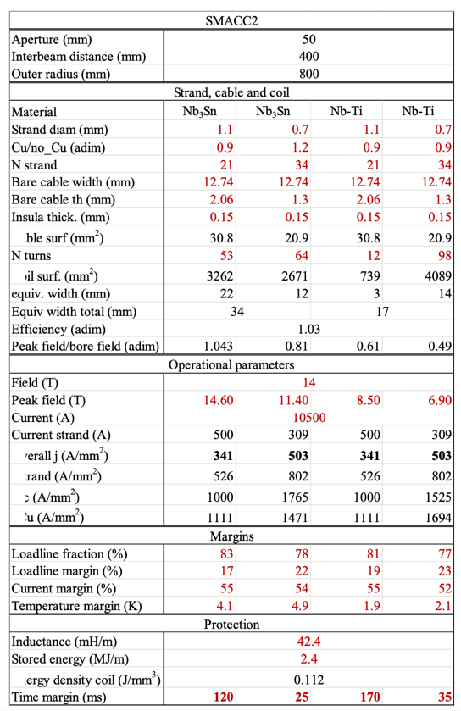
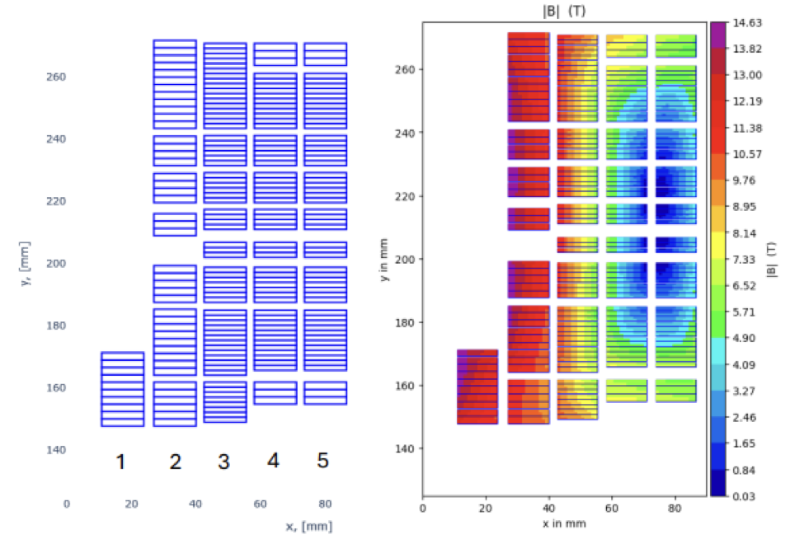
SMACC2
Hybrid Nb3Sn / Nb-Ti 14 T SMACC.
State-of-the art Nb-Ti wire from B-OST.
Mechanical structure and protection to be decided.
Testing foreseen for 2028.

Slide 16







Exchange of Ideas within HFM Programme
MagDev ideas in HFM
CERN joining BOX program
CERN building filled-wax SMC
CIEMAT aims for an asymmetric common coil
CERN proposed building a long SMACC mirror magnet to the HFM Steering Board
Heat-resistant coating introduced at CERN
Interest in novel “bullet gauges” to supervise end supports
Recent HFM ideas in MagDev
CIEMAT’s hybrid Nb₃Sn/Nb-Ti design adopted at CERN and PSI for SMACC2
CIEMAT’s horizontal-split structure considered for SMACC2
CERN’s ESC protection scheme tested on subSMCC2
In addition to the above, MagDev builds upon decades of CERN and US-LARP R&D in Nb₃Sn magnets.

Slide 17
MagDev HTS Status and Plans

Slide 18


UFOs in the FCC-hh?
UFOs in the LHC are dust particles in the beam pipe that
get ionized
get pulled into the beam via electric field
cause particle showers and get ionized to opposing charge before being ejected from the beam.
The particle showers deposit energy in the magnet coils and can quench magnets.
R~10 µm

Slide 19




UFOs in the FCC-hh?
For FCC-hh beam energy, we expect >30x higher energy deposition in the coil for a given UFO particle.
At the same time, due to the absence of superfluid helium inside the coil, the enthalpy margin drops ~2x.
As a result, smaller UFOs can cause a quench.
The prevalence of UFOs in the beamscreen has been found to scale 1/V². and FCC-hh has ~4x longer arcs.
If we need 70 to 100x higher enthalpy margins → do we have to operate at 20 K?
LHC MQED with HeII: 15-20 mJ/cm³

Slide 20






Main Challenges with ReBCO
Ramp losses and field quality
LTS wires have filament sizes of few microns (Nb-Ti) to 50 µm (Nb₃Sn).
ReBCO tapes are 2-12 mm wide. Screening currents and associated ramp losses are substantially increased.
Tape orientation matters!
High-current, low-loss cables with windability
Do we need full transposition (every tape in a cable ”sees” the same field, inductive loops are shortened)?
Can we pre-fabricate a cable, or do we need to assemble and insulate it “on the fly” during winding?
Can the cable withstand pressure of 400+ MPa?
[J. v. Nugteren, High Temperature Superconductor Accelerator Magnets. PhD thesis, UTwente, 2016.]
[Courtesy G. Kirby, J. v. Nugteren, J. S. Murtomäki, et al.]

Slide 21



HTS technology for HEP is at the level of 1970s LTS technology
Early options of cables for main dipoles in Isabelle accelerator at BNL:
Braided cable failed in series manufacturing.
Rutherford-cable development arrived too late, but underpinned Nb-Ti accelerators:
Tevatron (1983), Hera (1991), RHIC (2000), (SSC), LHC (2008)
[J. v. Nugteren, High Temperature Superconductor Accelerator Magnets. PhD thesis, UTwente, 2016.]
[M. Wilson, Pulsed Superconducting Magnets' CERN Academic Training May 2006]

Slide 22



Dynamic Effects
Intense macroscopic screening current distribution.
The wide variability in tape properties and contact resistances, adds on the challenge related to field reproducibility as well as stability.
HFM-PUB-RPT-0267 v.1 "Deliverables KE5943 / PSI-D2.1”, EDMS 3028682
Notes:
For LHC field sweep at injection energy

Slide 23



Field stability
Ironless
For comparison: An LHC dipole magnet has 2 $∙$10⁻⁴ in main field distortion due to persistent current magnetization. The REBCO dipole has 200 $∙$10⁻⁴ in field missing, with a drift by 50 $∙$10⁻⁴ units over a 1000 s plateau.
Every variation in tape/manufacturing parameters is, accordingly, amplified see Prof. Carmine earlier presentation (https://indico.cern.ch/event/1455509/contributions/6586182/).
HFM-PUB-RPT-0267 v.1 "Deliverables KE5943 / PSI-D2.1”, EDMS 3028682

Slide 24





REBCO Block-Coil Dipole Scaling Exercise
As expected, AC losses grow non-linearly with field due to larger field sweep and growth in coil-size.
In this exercise AC losses increase 4-fold from 14 to 20 T.
HFM-PUB-RPT-0267 v.1 "Deliverables KE5943 / PSI-D2.1”, EDMS 3028682

Slide 25



REBCO FCC-hh Dipole Scaling Exercise
Analogue study for scaling with temperature (5-30 K) for constant 14 T bore field indicates weak scaling of AC losses, notable cost increase.
HFM-PUB-RPT-0267 v.1 "Deliverables KE5943 / PSI-D2.1”, EDMS 3028682

Slide 26

AC Losses in Context
Break-even with basline Nb3Sn, 14 T in 1.9 K at ~17 T.
Presentation by A. Verweij (CERN) at HiTAT2, 23-24 Oct., 2025, https://indico.cern.ch/event/1455509/

Slide 27






After all, the price of REBCO is bound to keep falling ..
[B. Song, et al., https://indico.cern.ch/event/1347361/ (2025)]
[A. Molodyk, https://indico.cern.ch/event/1347361/ (2025)]

Slide 28



ReBCO Subscale 1 (RS1) - Cable
Insulated cable illustration 5 turns - block
RS1 magnetic simulations performed by D. Sotnikov
Param | Current | B_{peak} | B_{bore} | Inductance | E_{mag} | % of I_{c}
Value | 7.0 | 4.8 | 3.9 | 388 | 30.6 | 85
Unit | kA | T | T | uH | kJ/m | -
Protection studies performed @ PSI and CERN (M. Wozniak et al.)

Slide 29





RS1 - Cable and Coil Manufacturing
Insulating and
winding tools
Pusher roller and Insulating tool
Set-up developed by C. Linder and colleagues
Applying soldering paste and flux
Pocket for voltage taps
Co-winding copper tape reel
Coli former
HTS-cable
Tape supply
Soldering with thick plate, pre-heated with oven. T_{coil} = 194 °C.
Process developed by A. Stampfli and colleagues

Slide 30




RS1 – Impregnation, splicing and assembly
Impregnation set-up: heaters for the box
Cooling plate
Temperature sensors for box, former and cooling circuit
The coil dries overnight
The wax is injected under vacuum when the mold is at 80 to 90 °C
After 3 cycles (vacuum to atmospheric pressure), the cooling circuit is activated
Connection outer splice
Connection leads for powering
Cooling copper plates inner splice
View of inner splicing process: heater and cable
12 mm-based tapes and copper sheet used as shunt between the layers
Cooling copper plates inner splice
Connection leads for powering
Support frame
Clamping device of the coil pack

Slide 31


LN₂ Test Results: Magnetic field
2 cycles: 400 A x 5 and 410 A + 400 A x 5
Normalized to max field
First measurements on a pair of coils in LN₂ indicate the presence of strong screening currents.
RS1 magnet test at CERN expected for Q1 2026.

Slide 32



Next step: REBCO Subscale 2 - RS2
Field-angle optimized coil geometry
High-field coils wound cos-theta style between the apertures, where each block of windings in the high field follows a path like a midplane block in a cos-theta dipole, but with elliptical ends
Low-field turns wound common-coil style
Two winding positions (0° and 90°); intermediate positions are being implemented to improve field alignment.

Slide 33



REBCO Subscale 3 - RS3
Courtesy of A. Kario et al..
Explore a REBCO SMACC (re-use parts of Nb₃Sn SMACC1) with twisted striated cables.
https://indico.cern.ch/event/489475/contributions/1166833/attachments/1263291/1868932/
RS2 Could be wound with tape-stack cable or Roebel
N. Amemiya et al., “Effective reduction of magnetisation losses in copper-plated multifilament coated conductors using spiral geometry,” doi: 10.1088/1361-6668/ac3f9c.

Slide 34




REBCO Subscale 3 - RS3
Explore a REBCO SMACC (re-use parts of Nb₃Sn SMACC1) with twisted striated cables.
Modeling of REBCO twisted striated – based cables
Drawing of A. Carlón Zurita
Modeling: Inês S. P. Peixoto
Notes:
Add link to Amemiya, twente

Slide 35
Synergies

Slide 36



MagMu – Materials for a 40 T Muon Collider Solenoid
Study tunable partial insulation and metal-insulator switching materials:
Combine the advantages of insulated coils with the stability and protectability of no-insulation coils.
Pedot:Pss
measured @ PSI & Unige with R. Babouche
Courtesy Matteo Crescenti

Slide 37



SINQ and SLS2.0
High field solenoids for high-magnetic-field user facilities and increased physics reach in experiments.
10 mm
18-T split solenoid for SINQ (Swiss Spalliation Neutron Source)
3.6 cm
Compact solenoid for 6-T on target in the manipulator head for Resonant inelastic X-ray scattering (RIXS) in ACCESS2.0 beamline of the Swiss Light Source.

Slide 38






Small HTS Magnets for Quantum Material Research
Equip commercial AttoDry systems at ZHAW and ETHZ with NI coils and cryogenic power converters.
Increase the experimental field from currently 0.6 T to 1-3 T.
Additional interest for HTS magnets at D-PHYS: Penning-trap quantum computing and energy-saving accelerator-mass-spectroscopy at LIP.
Courtesy J. Huber, D. Zang

Slide 39






Proxima Fusion Collaboration
HEP success story attracts Munich startup to perform conceptual design and process development directly on the PSI campus.
Framework agreement, covering conceptual design, signed in June 2024.
Three project agreements signed.
Collaboration startup in MagDev laboratory 2024/25
400 m² laboratory on campus 2025/26,
1100 m² laboratory in Kleindöttingen 2026/27,
to date 20 Proxima employees in Argovia.

Slide 40
In summary, we need to
Demonstrate 14 T LTS magnets with an emphasis on cost and manufacturability.
Develop technology towards accelerator-quality REBCO magnets.
Realize the important synergies with PSI and Swiss academia.

