Slide 1





Advanced Niobium-Tin superconductors with enhanced current carrying capabilities
Francesco LONARDO, Gianmarco BOVONE, Marco ACOSTA, Florin BUTA, and Carmine SENATORE
Department of Quantum Matter Physics, University of Geneva, Switzerland
Department of Nuclear and Particle Physics, University of Geneva, Switzerland
Simon C. HOPKINS and Thierry BOUTBOUL
CERN, Switzerland

Slide 2
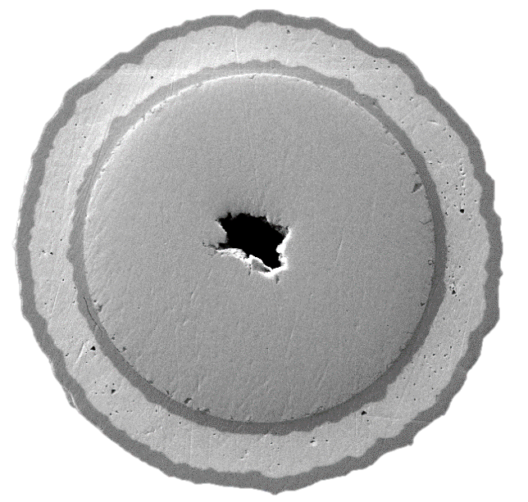
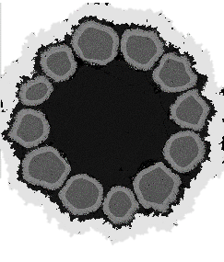
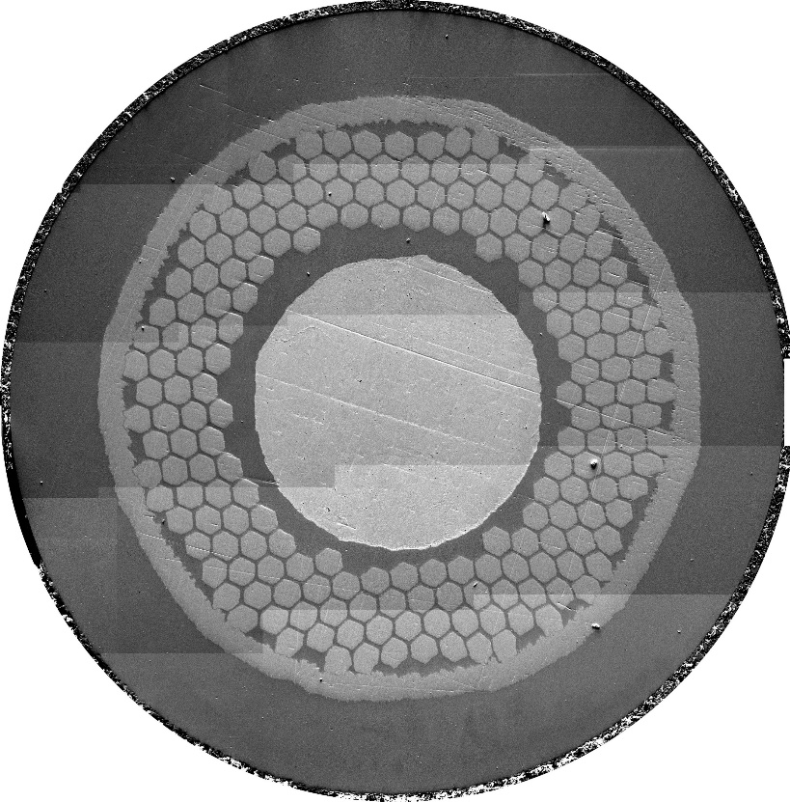
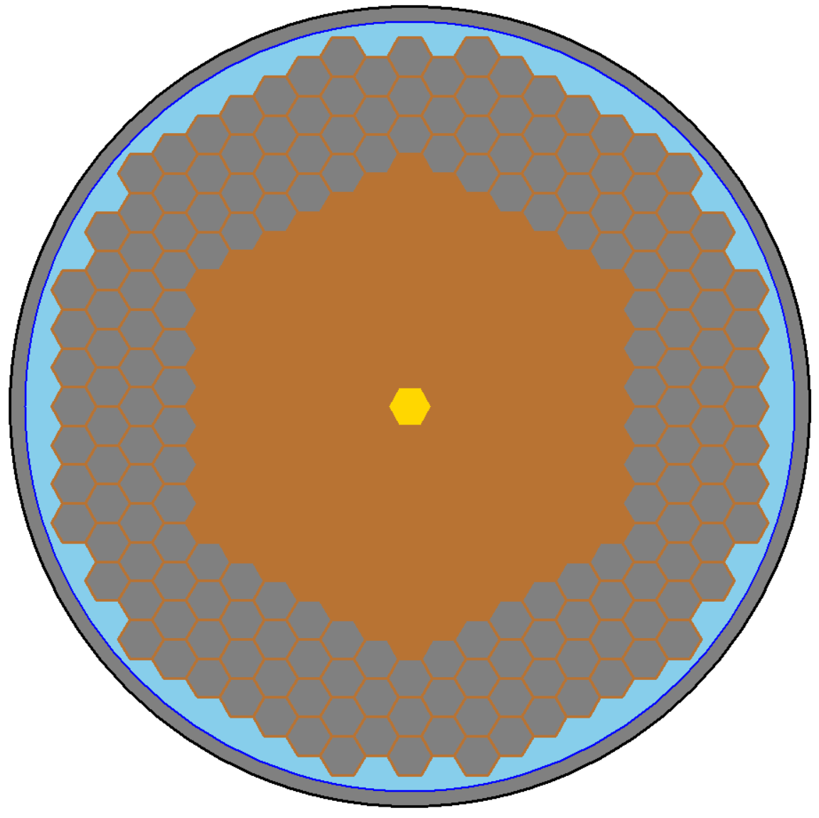
Outline of the presentation
  Filament with oxygen source
Context and previous results
  Microstructure and role of internal oxidation in superconducting properties
  Comparison between PIT and RRP wire technology
  Simplified subelement
RRP subelement produced at UniGe
Implementation of Internal Oxidation in RRP wires
Summary and Future work
  Simplified
  Subelement with oxygen source
  Subelement without
  oxygen source
  Subelement without oxygen source

Slide 3
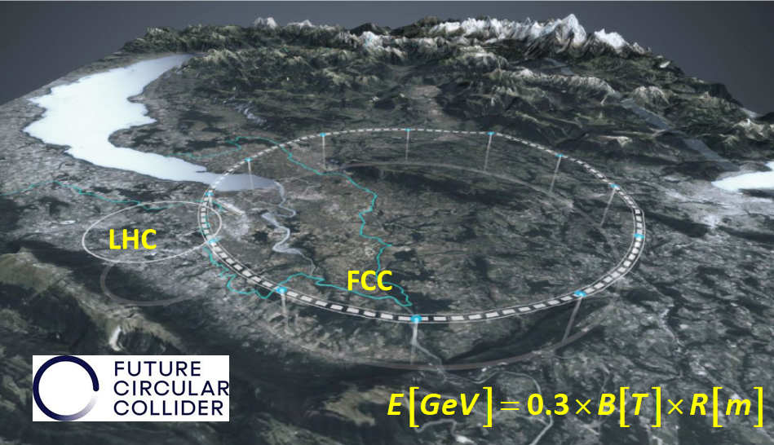
High Field Magnets for a FCC-hh 85 TeV
PARAMETER | FCC-hh CDR 2019 | FCC-hh FSR 2025
collision energy (c.m.s.) [TeV] | 100 | 85
dipole field [T] | 16 | 14
Circumference [km] | 97.8 | 90.7
beam current [A] | 0.5 | 0.5
synchr. rad. per ring [kW] | 2400 | 1200
peak luminos. [1034 cm⁻²s⁻¹] | 30 | 30
events/bunch crossing | 1000 | 1000
stored energy/beam [GJ] | 8.3 | 6.5
integr. luminosity / IP [fb-1] | 20000 | 20000
Increasing Nb₃Sn transport properties offers two possibilities:
For a given target dipole field, the necessary amount of material can be reduced → resulting in a more compact magnet
For a given magnet design and material amount → the produced dipole field can be increased
UPDATED BASELINE
The updated baseline of the FCC study:
91 km-ring
14 T-dipoles based on Nb₃Sn
collision energy of 85 TeV
How to increase the transport properties ?
Adapted from M. Benedikt, FCC Week 2025

Slide 4
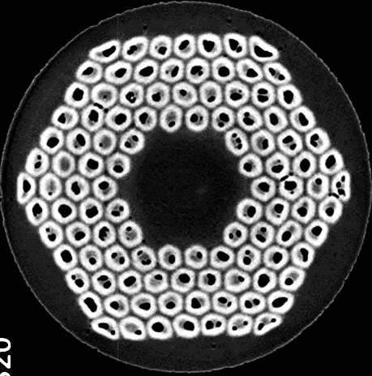
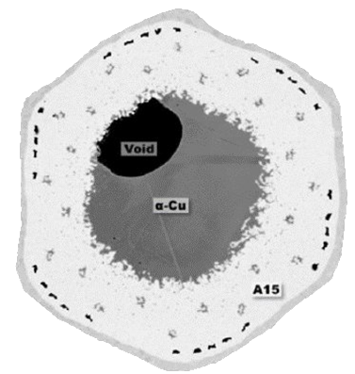
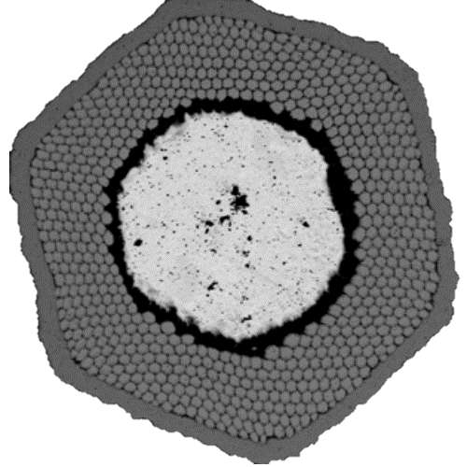

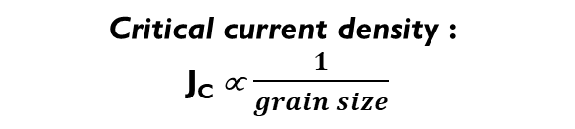
Internal Sn Nb₃Sn wire is made and current density
Nb₃Sn microstructure: grains formation and growth during the heat-treatment
Wire before heat-treatment
Wire after heat-treatment
⌀ 1 mm
$J_{c}$∝ 1/(grain size)
Nb filaments-alloy
Nb₃Sn is hard and brittle and cannot sustain deformation process. Nb₃Sn wires manufacturing starts from ductile metals (Nb, Sn, Cu). Nb₃Sn will form during a final heat-treatment
Sn
Ta or Nb barrier
$$\text{Critical} \text{current} \text{density}\text{ : }$$
$\text{J}\text{C}$∝ $\frac{1}{grain size}$
Nb₃Sn layer
Cu
Ta or Nb barrier
How to reduce the grain size?
Subelement after reaction
Subelement before reaction

Slide 5
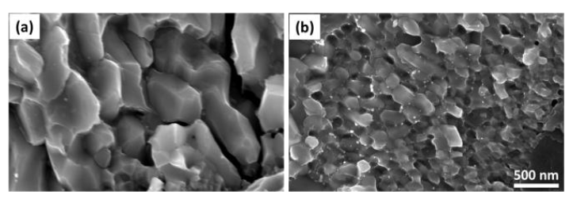
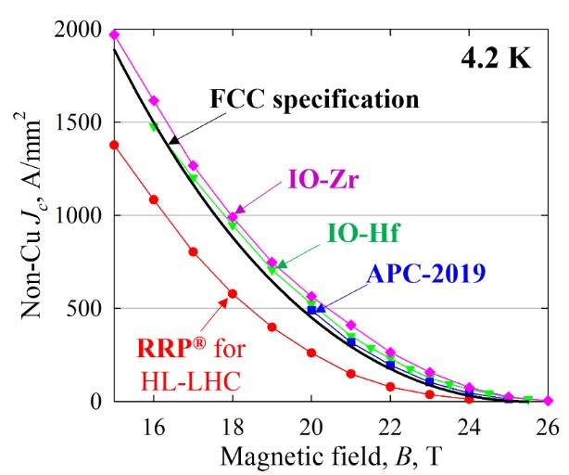

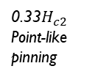

The importance of oxidation for Nb₃Sn
The transport properties of Nb₃Sn can be improved by reducing its grain size
Xu X. et al. Appl. Phys. Lett. 104, 082602 (2014) DOI: 10.1063/1.4866865.
Benz M. G. , Trans. Met. Soc. AIME, 242: 1067-70 (1968).
Rumaner L. E. et al. Metall Mater Trans A 25, 213–219 (1994) DOI: 10.1007/BF02646689.
Todesco E. , IEEE Transactions on Applied Superconductivity (2025)
Internal oxidation !
< 60 nm
Grain refinement induced by precipitation of oxide nanoparticles
Higher J_{c} due to grain refinement and oxide nanoparticles
> 100 nm
F_{P}=J_{C}×B
Total increase due to both effects
Grain refinement and the addition of nanoparticles of the appropriate size can enhance vortex pinning force
pinning force F_{P}
Increase the grain boundary density i.e. refine the grain size
Additional artificial pinning centers i.e. modify the pinning mechanism
Xu X. et al. Supercond. Sci. Technol. 36 085008 (2023) DOI: 10.1088/1361-6668/acdf8c.
Xu X. et al. Supercond. Sci. Technol. 36 035012 (2023) DOI: 10.1088/1361-6668/acb17a
Bovone G. et al. Supercond. Sci. Technol. 36 095018 (2023) DOI: 10.1088/1361-6668/aced25
0.2$H_{c2}$
Grain boundary pinning
0.33$H_{c2}$
Point-like pinning
$$H_{c2}$$
magnetic field H

Slide 6
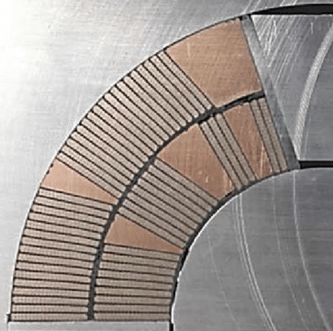
Commercial Nb₃Sn wires: RRP vs PIT
Senatore C. et al., Supercond. Sci. Technol., 36 (2023) 075001
DOI: 10.1088/1361-6668/acca50
Section of a Nb3Sn dipole magnet
PIT, Ø 1.0 mm
Tested in a 1.15 mm groove
RRP, Ø 0.85 mm
Tested in a 1.15 mm groove
Rutherford cable
σ_{irr} ≈ 110 MPa
σ_{irr} ≈ 175 MPa
RRP wires have higher transversal stress tolerance. They are mechanically more robust than current PIT wires
Brown M. et al. Supercond. Sci. Technol. 29 084008 (2016) DOI: 10.1088/0953-2048/29/8/084008
PIT wire: Distorted filaments are partly reacted due to Sn leak, lower I_{c}
Cabling induce wire distortion
Segal C. et al.,Supercond. Sci. Technol. 29 (2016) 085003 DOI: 10.1088/0953-2048/29/8/085003
Notes:
The first reason is the fact that cabling induce distortion of wire that in the case of the case of PIT cause Sn leak, reducing the Ic and the RRR of stabilizing Cu. The trasversal stress tolerance of RRP is higher. The irreversible stress llimit, that identify the stress that induce a permanent degradation of current of 5%, is higher for RRP.
Let’s move now to the challanges and problems of introducing an OS in the RRP

Slide 7

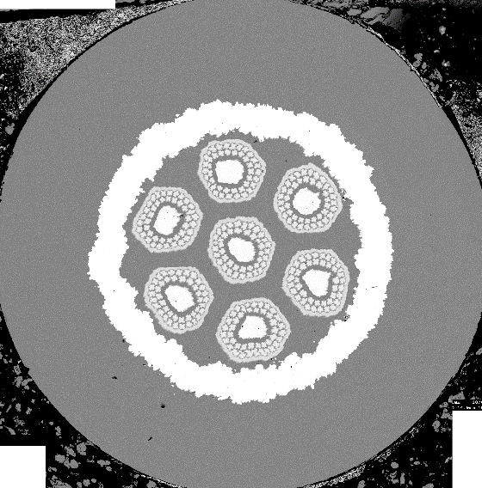
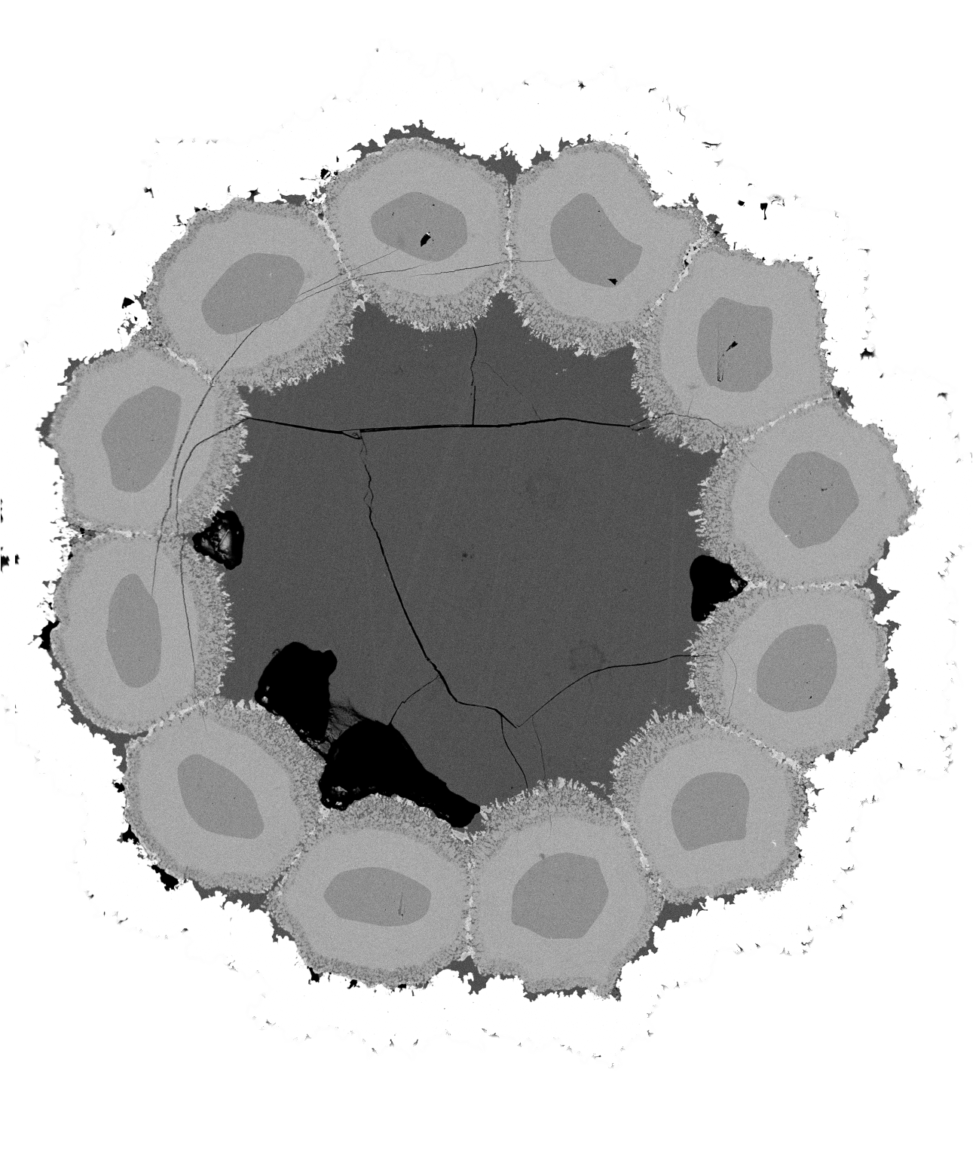
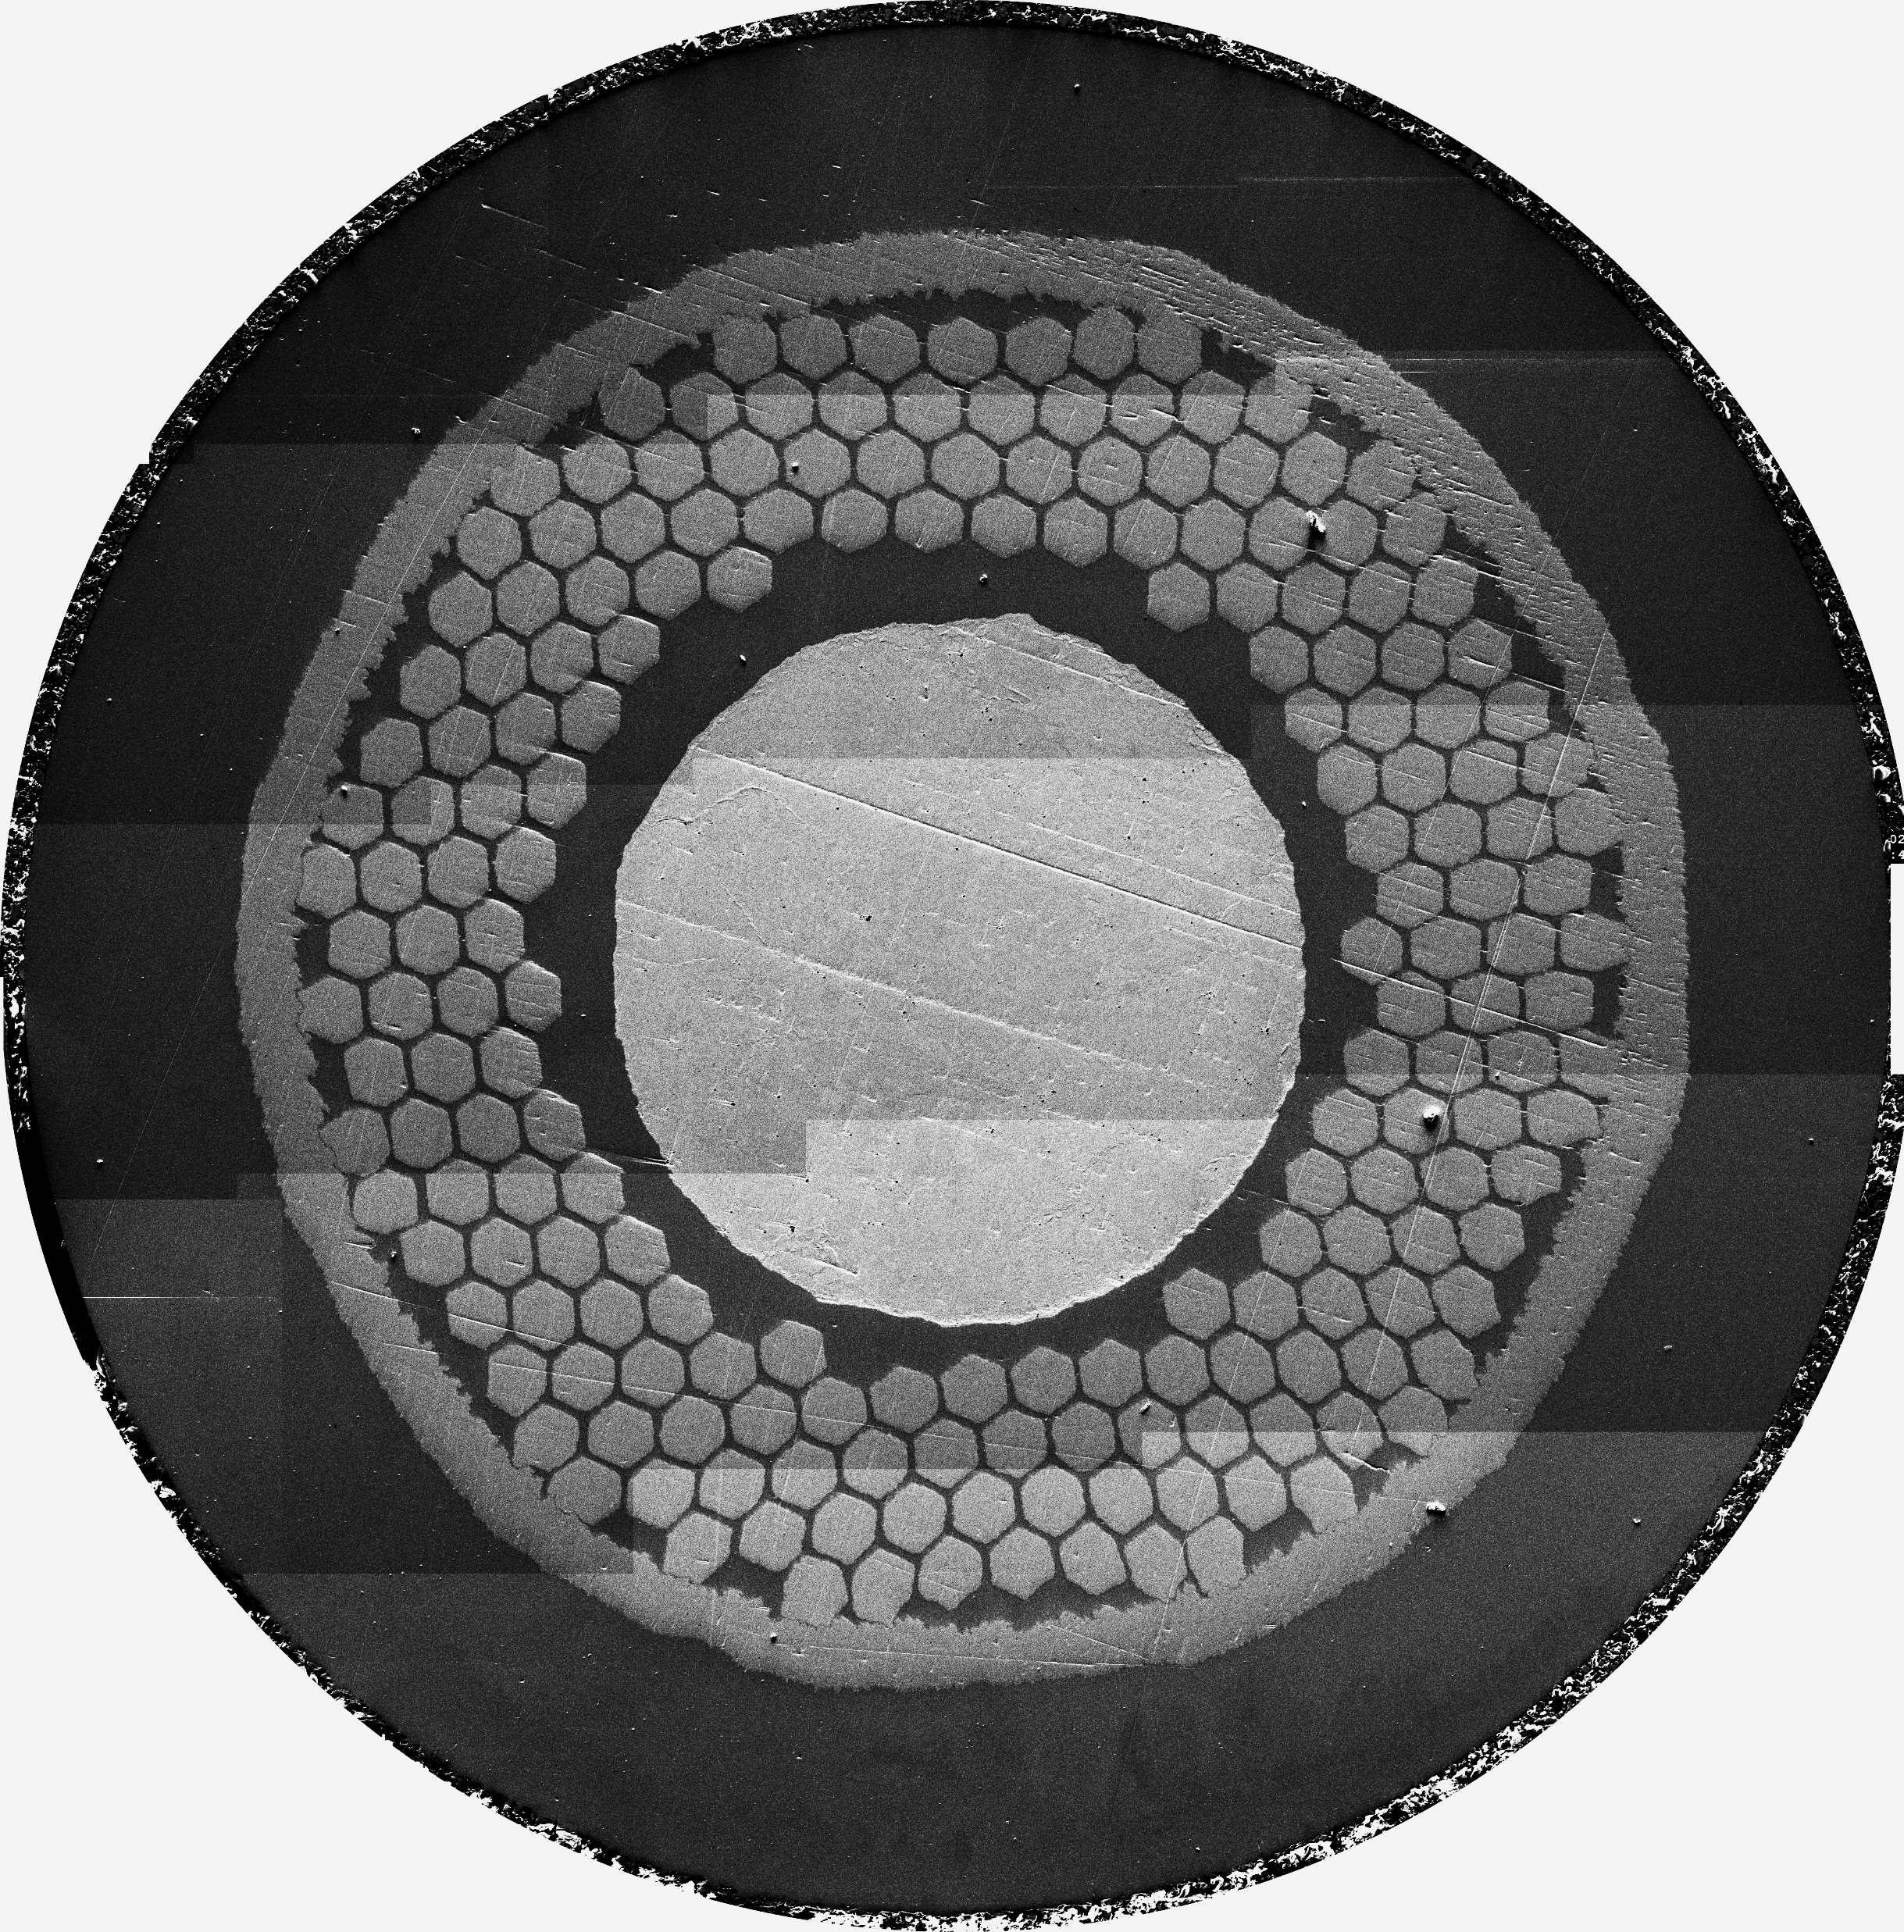
The challenges we are facing at
The study of internal oxidation in RRP wire
Enhancement of layer J_{C}
Material study
1. AnnularOS
Oxide powder between the Nb-alloy filament and the copper jacket
Test of various alloys and oxides (and their combinations) on monofilament
SnO₂
Modification of pinning mechanism
2. CoreOS
Oxide powder inside the Nb-alloy filaments
Determination of OS efficiency
Study of oxygen source configurations to optimize superconducting properties (I_{c}, B_{c2}, pinning) on simplified subelement
SnO₂
Enhancement of B_{C2}
OS stability during subelement manufacture
Verify OS stability during high temperature treatment along the preparation of a RRP subelement
T = 4.2 K
Notes:
We started from the study of the material ( different combination of alloy and oxygen source ) on single filaments. Then we produce simplified subelement studing different OS configuration observing enhancement of Jc modification of pinning mechanism and enhancement of Bc2
Now we are at the point of implement everything to a subelement and multifilamentary wires.
To understand various problematics related to the implementation of IO to RRP we need to understand the Process of fabrication of this type of wires

Slide 8
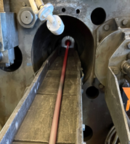
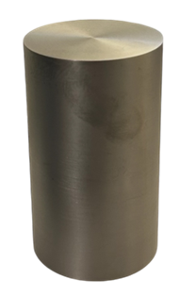

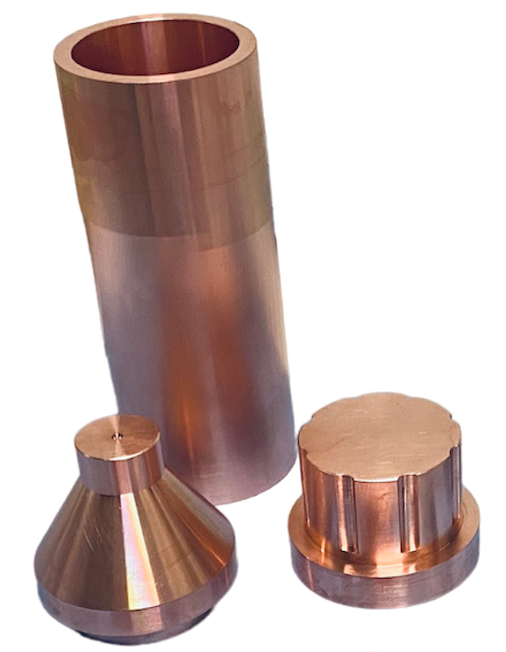
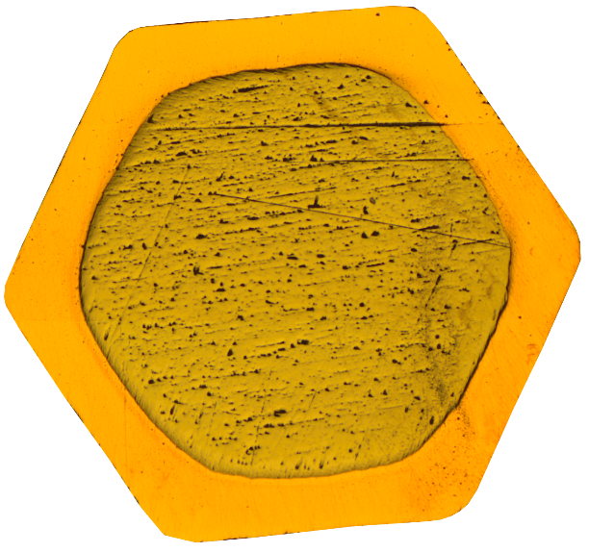

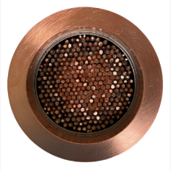
How it’s made: Nb₃Sn RRP wire
1. Filament processing
Simplified RRP wire made at UniGe
No powder in the wire layout!
Where should we add the OS?
RRP wire production involves 2 hot extrusion, and a hot isostatic pressing. Can we stabilize the OS to high temperature process?
Cold
Deformation
Hot Extrusion
2. Subelement processing
3. Wire processing
Example of practical multifilamentary wire
Hot Isostatic Pressing
Subelement restack and cold deformation to final diameter
Hot Extrusion
Sn rod insertion
and cold deformation
Notes:
The fabbrication of the filaments that then will be used for restack in the subelement request a first extrusion. Then the SE go trough the hot isostatich pressing and hot extrusion. After this the Sn is inserted an the subelement is deformed and restacked to

Slide 9
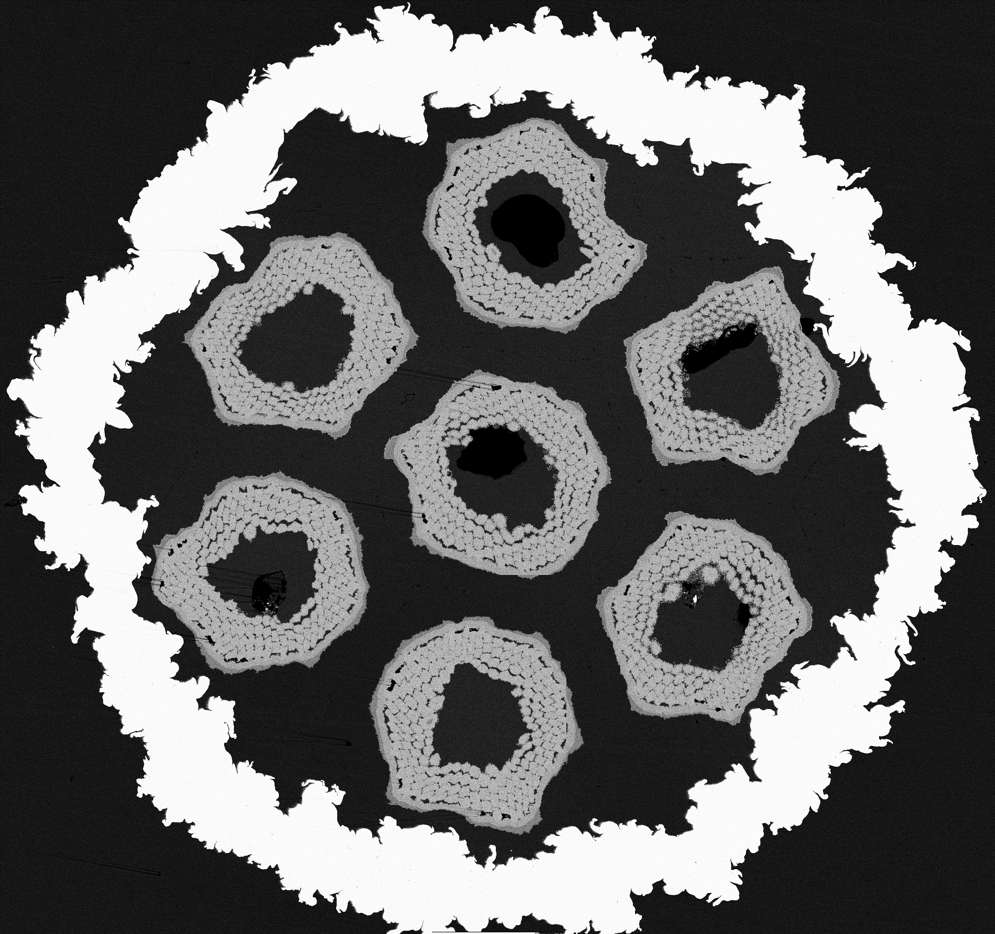
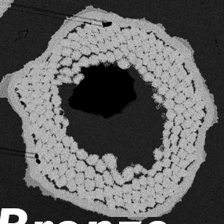
7/7 Bundle Barrier Internal Tin Nb₃Sn wire_noOS
HT: 210°C × 50 h + 400°C × 50 h + 650°C × 200 h
How to introduce the Oxygen Source into the subelement?
Stabilizer Cu
Stabilizer Cu
Good deformability without breakages and damage of the Subelement (SE).
Ta
Ta
The Bundle Barrier Internal Tin (BBIT) design is used as a reference to compare its non-cu J_{C} with that of wires with OS
Subelement properties
It doesn’t contain OS
Dimension: 130 μm
# Nb filaments: 192
Fully reacted
Filaments with OS
Oxygen Source Substituted for Nb filaments
Notes:
We fabricated a simplified multifilamentary wire. It is characterize by 7 subelelemnt bundle in a Ta barrier.
The subellemnt contain 192 filaments and their dimension is of 130 micron.
We deform this layout without breakages and obtaining Sn leaks inside the Ta barrier only due to an excess of Sn instead of damage of the subelement.
Regarding the non-Cu Jc the barrel of 1 m of wire show same performance then the short sample pof 5 cm , demonstrating good homogeneity along all the length
Here it is compare our wire with optimized RRP wires and the FCC target.
This means that we will use this design to produce multifilantary wire with OS and compare the performances.

Slide 10
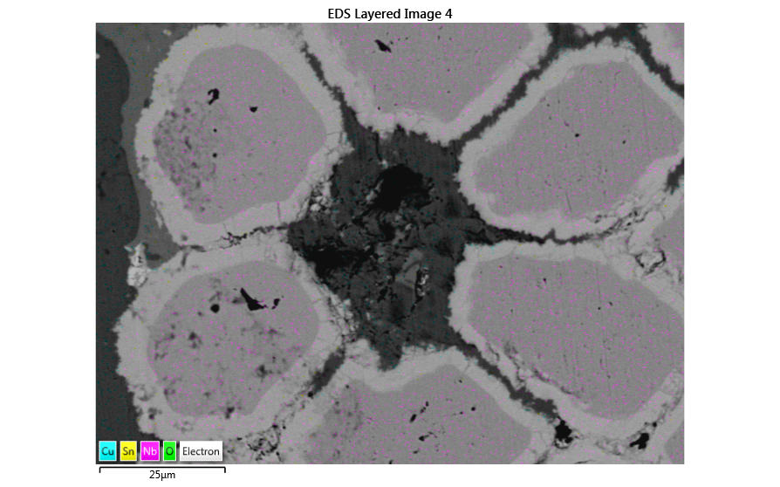
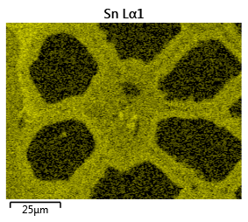
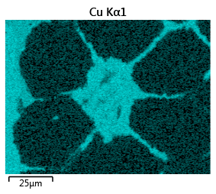
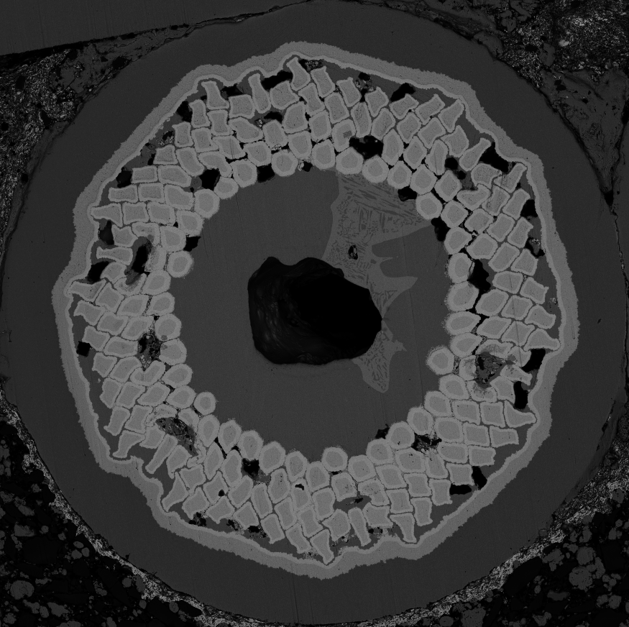
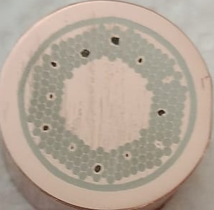
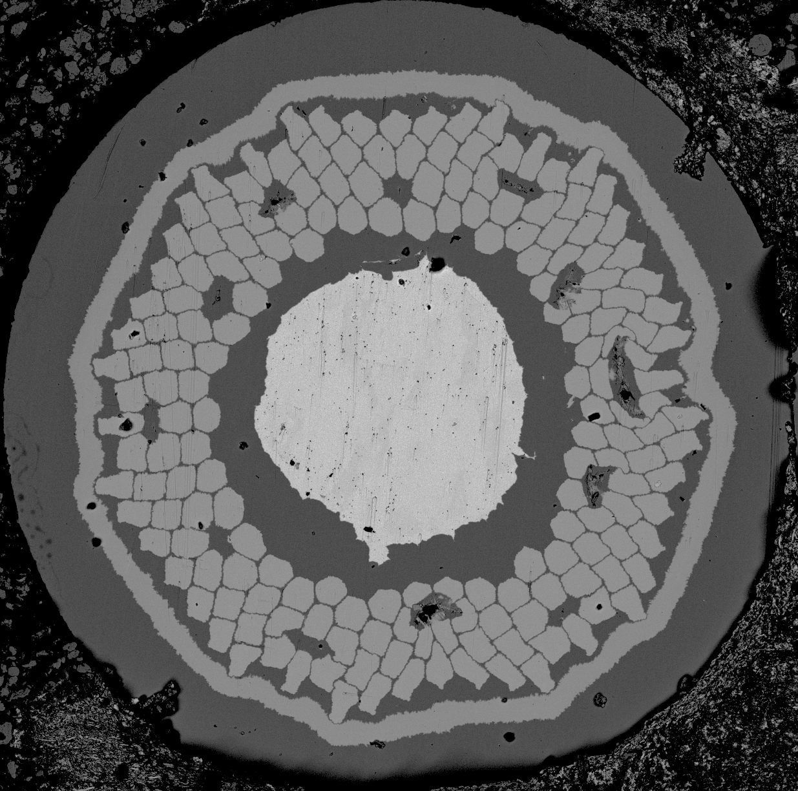
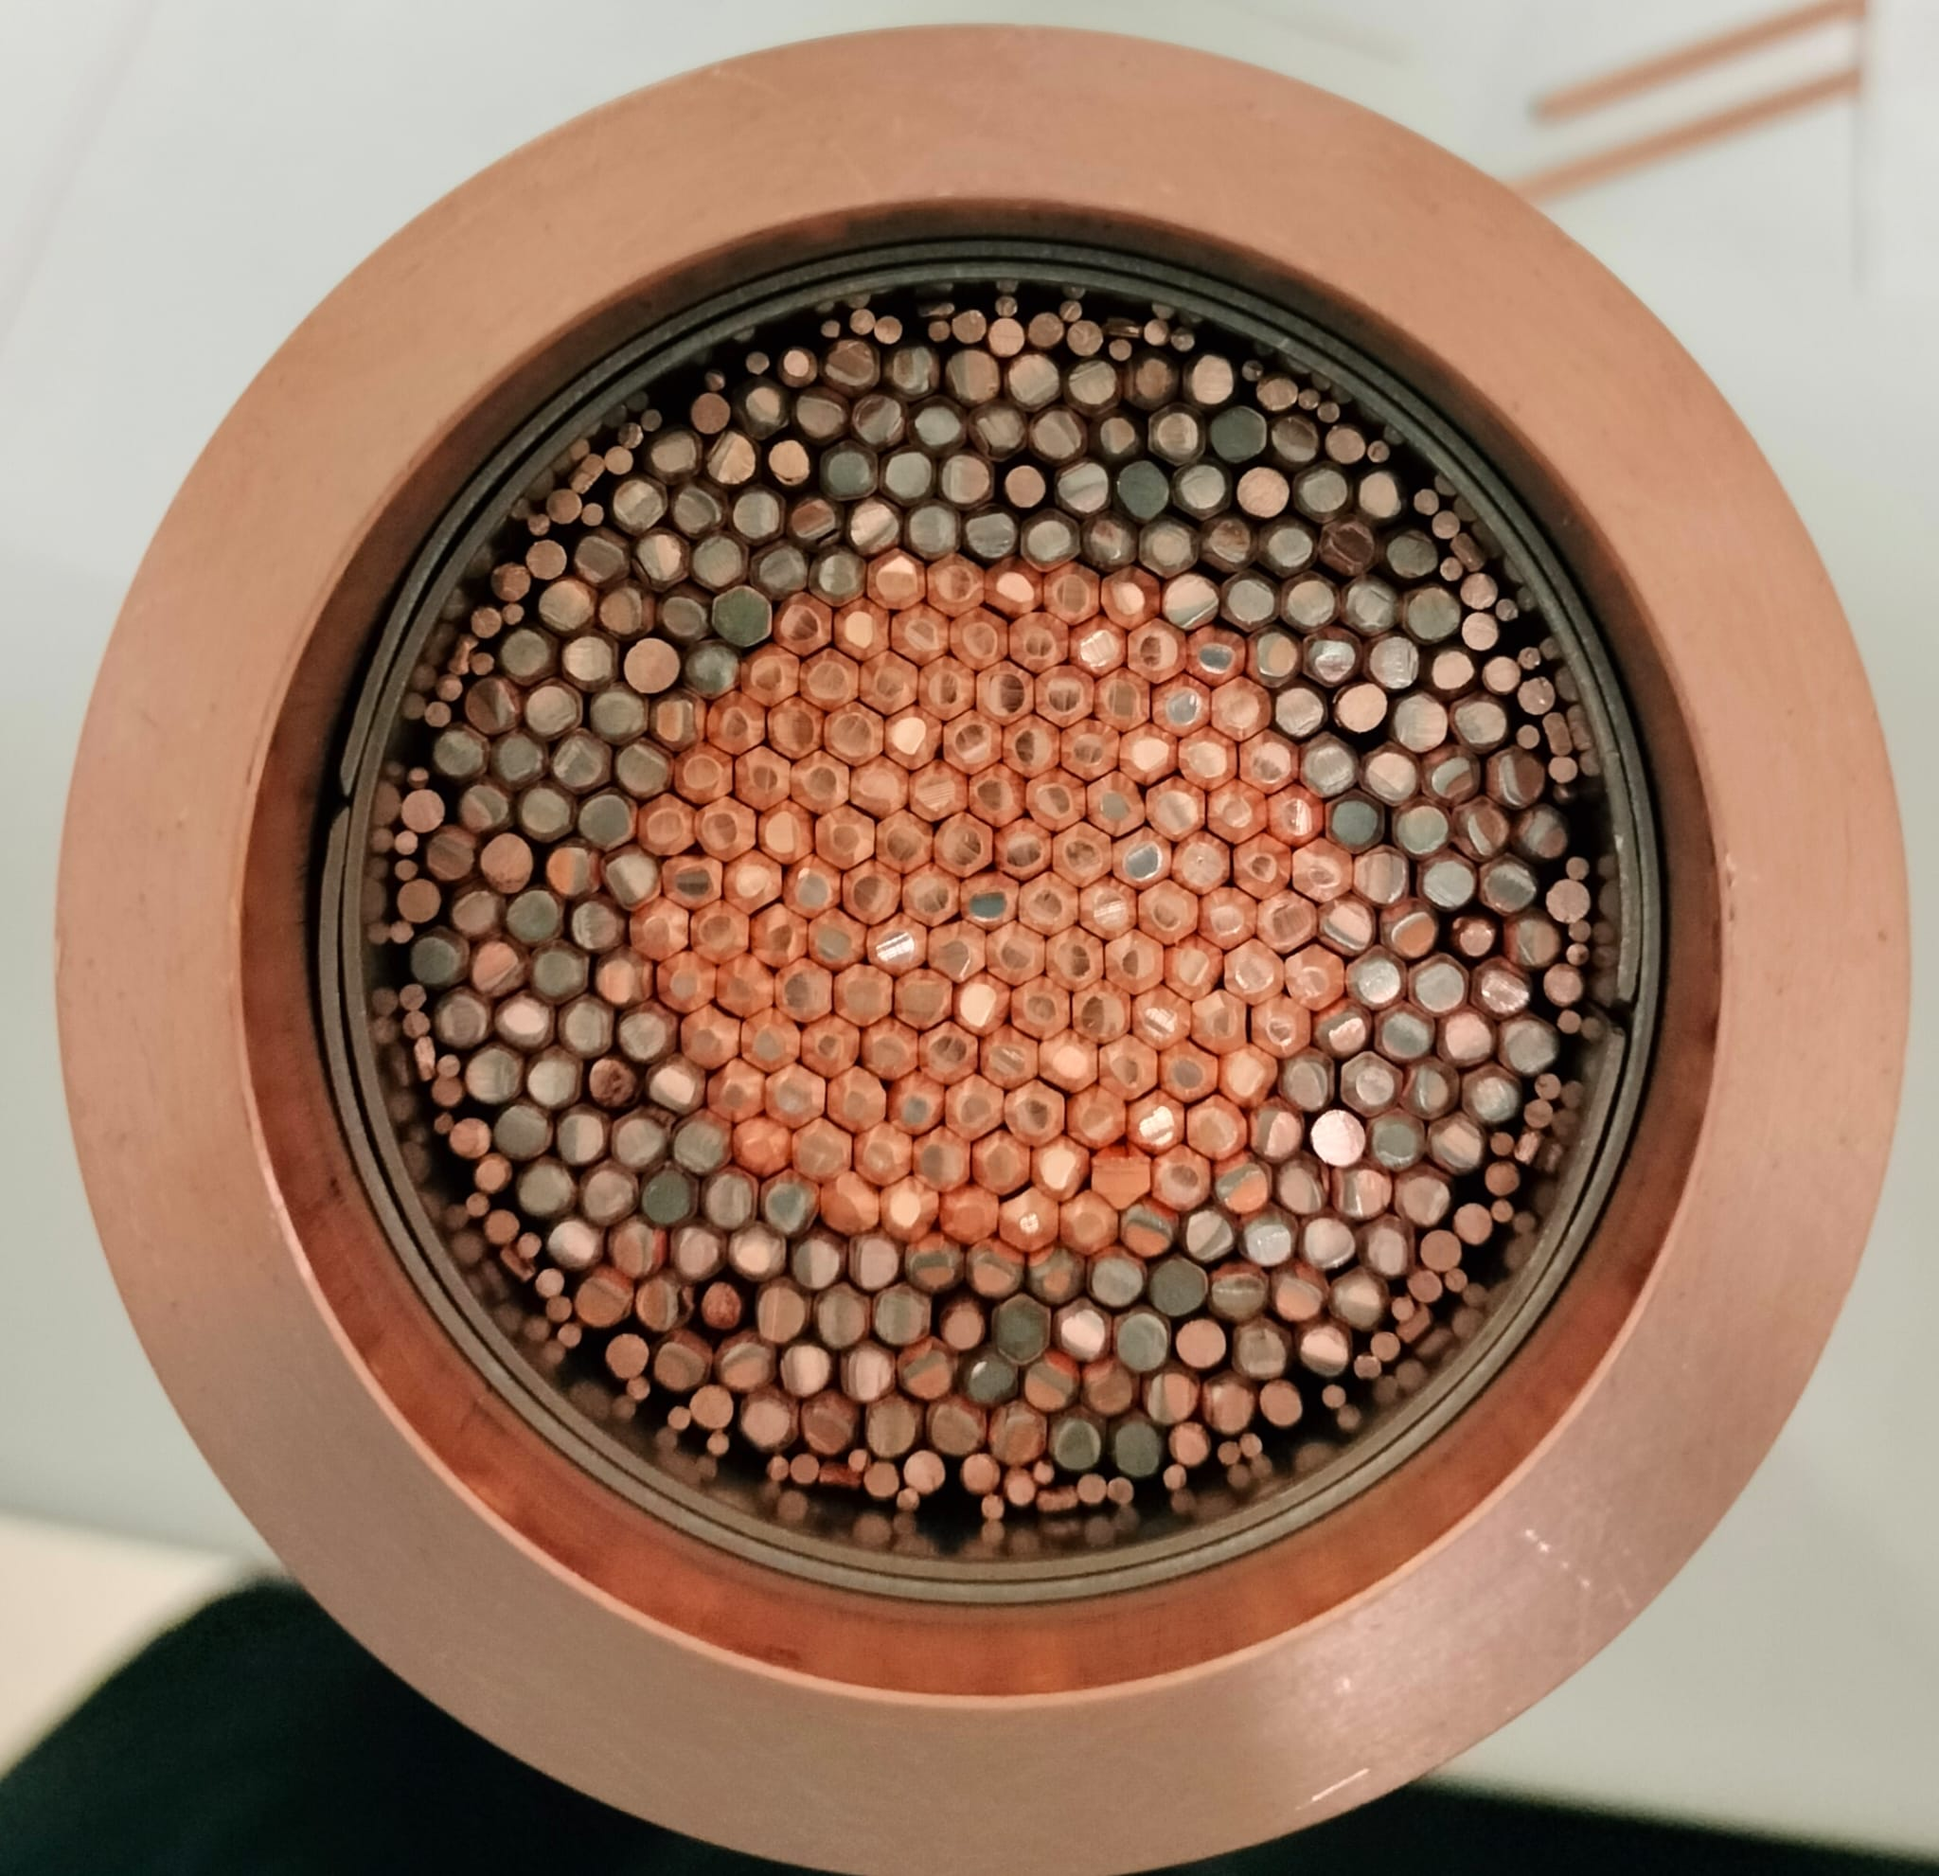
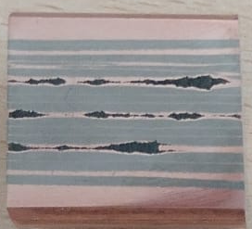
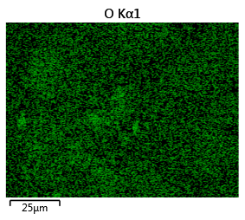
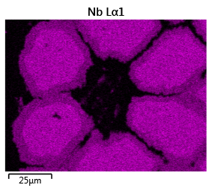
Substituted filament: Nb-Ta alloy
HT: 210°C × 50 h + 400°C × 50 h + 650°C × 200 h
After extrusion ∅ 18 mm
Before extrusion ∅ 70 mm
Drawn to ∅ 1.0 mm
c
Sausaging
No decomposition of OS: confirmed by hardness measurements, X-ray analysis
EDS measurements revealed no regions with a high oxygen concentration, confirming the decomposition of the OS during heat treatment
The next step involves:
the fabrication of a Subelement with the same layout and Nb-Ta-Hf alloy
Reduction of sausaging
SE and filaments properties:
180 Nb-Ta alloy filaments
12 Nb/Cu filaments substituted with SnO₂
Filaments produced by cold deformation
Notes:
We obtain successful extrusion without degradation, confirmed by hardness measurements and EDS analysis. We observe sausaging of the OS that we will reduce producing more uniform OS.
The goal of this attempt was done not only with the goal of introduce the oxygen source but also to demonstrate that we can control parameters as:
Total Nb content
Local Area Ratio
Nb barrier/ total Nb
With the goal of increase the Nb content inside the barrier.
As happen for the SE with the OS we have to solve two other problems: amount of Sn, that is directly related with the gundrilling process, that is not done by us at university, but we have ideas to solve it.

Slide 11
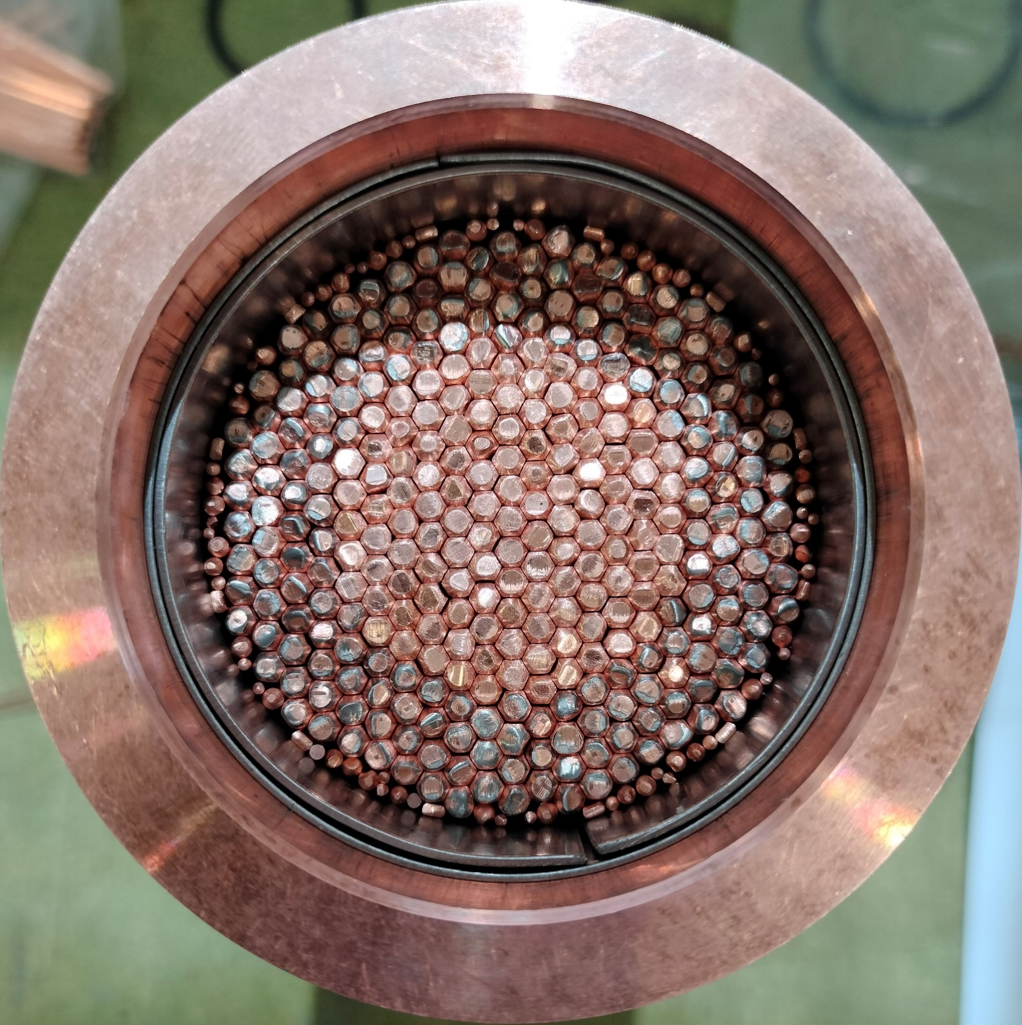
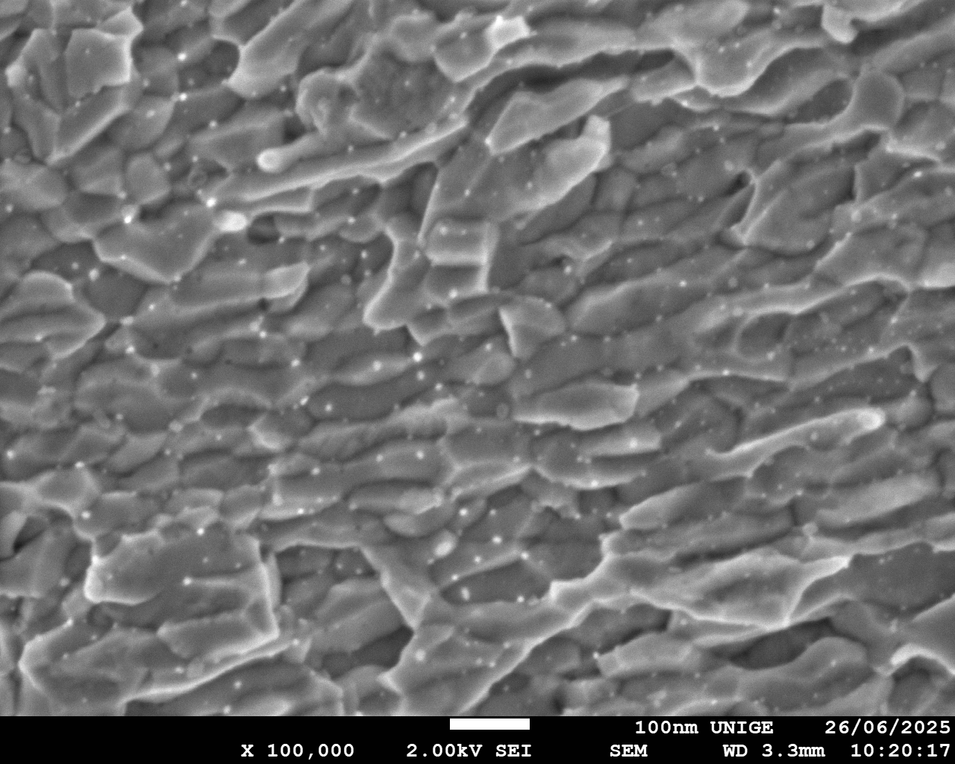
Filaments with OS: Nb-Ta-Hf alloy
c
Insertion of Sn in a 50 mm long segment, deformed down to 2.0 mm. Grain refinement observed
Grain size < 70 nm
SE and filaments properties:
192 Nb-Ta-Hf alloy filaments
Each filament contains powder
Filaments produced by cold deformation
Notes:
Here the same design with filaments produced by cold deformation and a modification of the OS.
This bring to successful extrusion in terms of non-decomposition of the OS. The analysis of the hardness after extrusion close and far to the OS demonstrate the absence of decoposition.
This subelement has been gun drilled for the insertion of the OS, deformed until 2 mm to and HT-ed. We can see in the microstructure of the Nb3Sn. The IO worked, there are oxide nanoparticle nanoparticles that cause the grain refinement. Regarding the transport properties

Slide 12
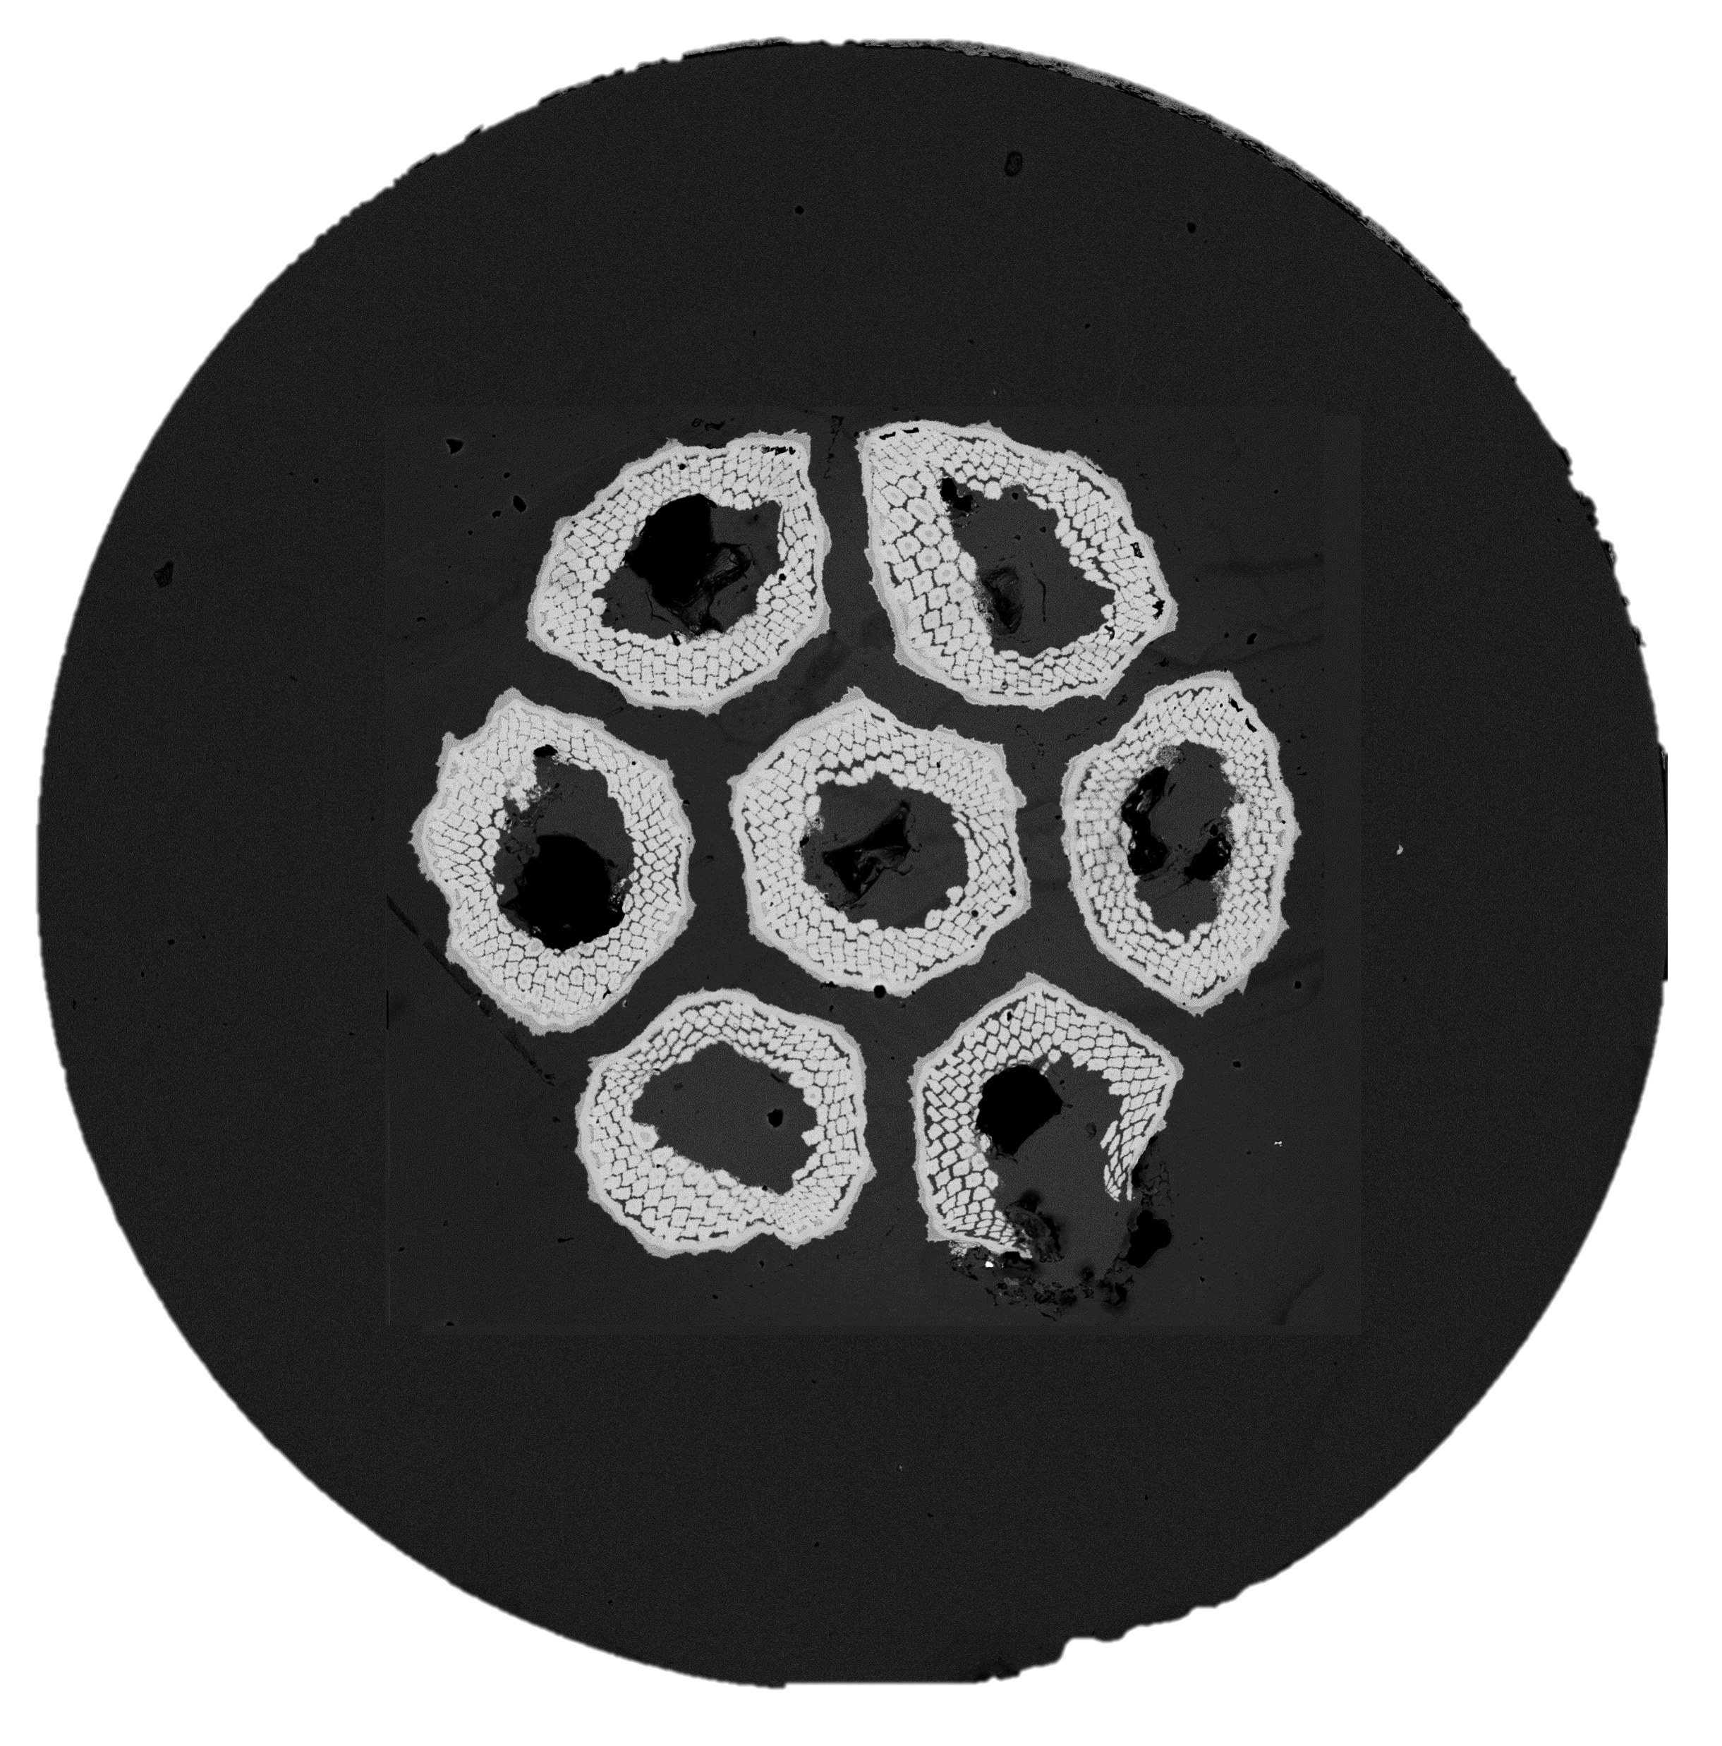
7/7 BBIT: filaments with OS
HT: 210°C × 50 h + 400°C × 50 h + 650°C × 200 h
T = 4.2 K
Criteria 0.1 μV/cm
OS doesn’t decompose during extrusion, and it does during the final HT
Large error on the determination of J_{c} due to thin and inhomogenous reaction layer.
It can be improved reducing the diameter of the wire and optimizing the Heat Treatment (HT) schedule!
Simplified RRP wire (7/7) made from cold deformed subelements (filaments and subelements are cold deformed)
Internal oxidation successfully implemented in a (simplified) Nb₃Sn RRP multifilamentary wire
Notes:
We manufacture a 7/7 bundle barrier multifilamentary wire. The number of filaments per subelelemt is reduced at 37 but are the same used for the previous extruded subelement. In this case we have to extrapolate from the layer Jc the non-cu Jc obtaining an increase respect the multifilamentary without OS. The range of uncertainty in the extrapolated value is due to thin and inhomogenous reaction layer. This can be solve by reducing the wire diameter and optimizing the HT schedule.
From the graph of the normalized pinning force we observe a peak of the force at about 0.33 at the reduce field, confirming the contribution of the nanoparticle due to the IO. Internal oxidation successfully implemented in a (simplified) Nb₃Sn RRP multifilamentary wire
This is one possibility for the introduction of the OS. Let’s move to the other option!

Slide 13
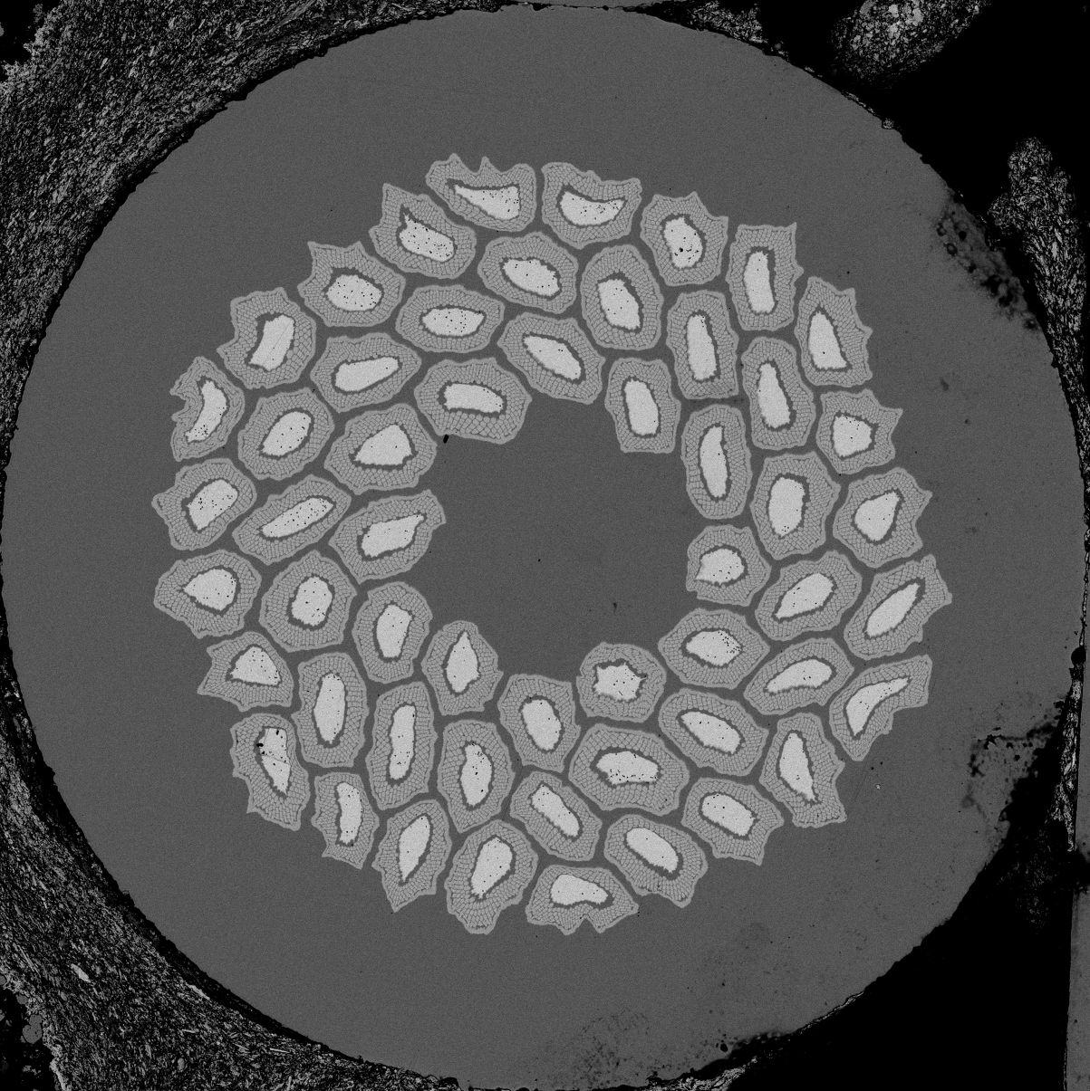
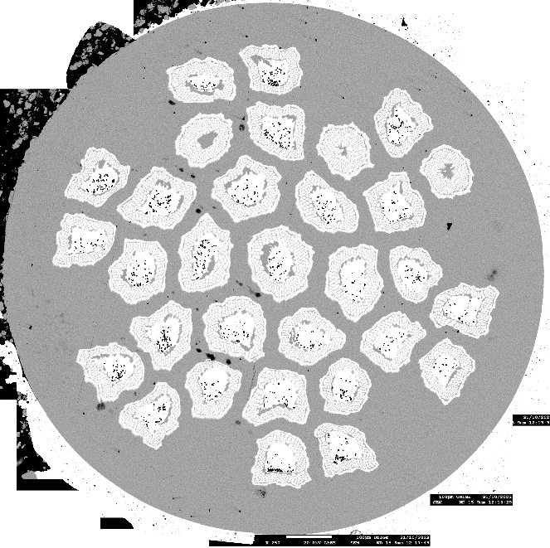
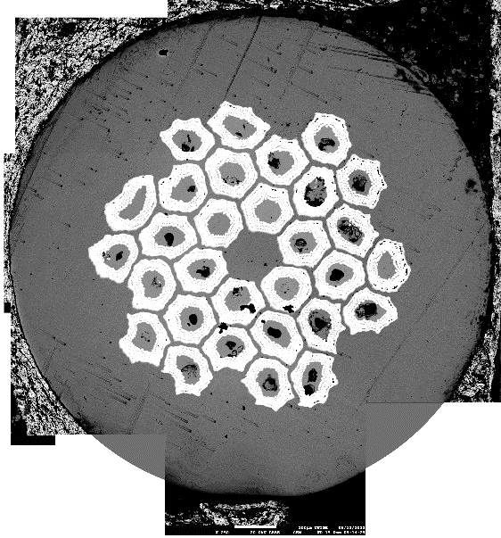
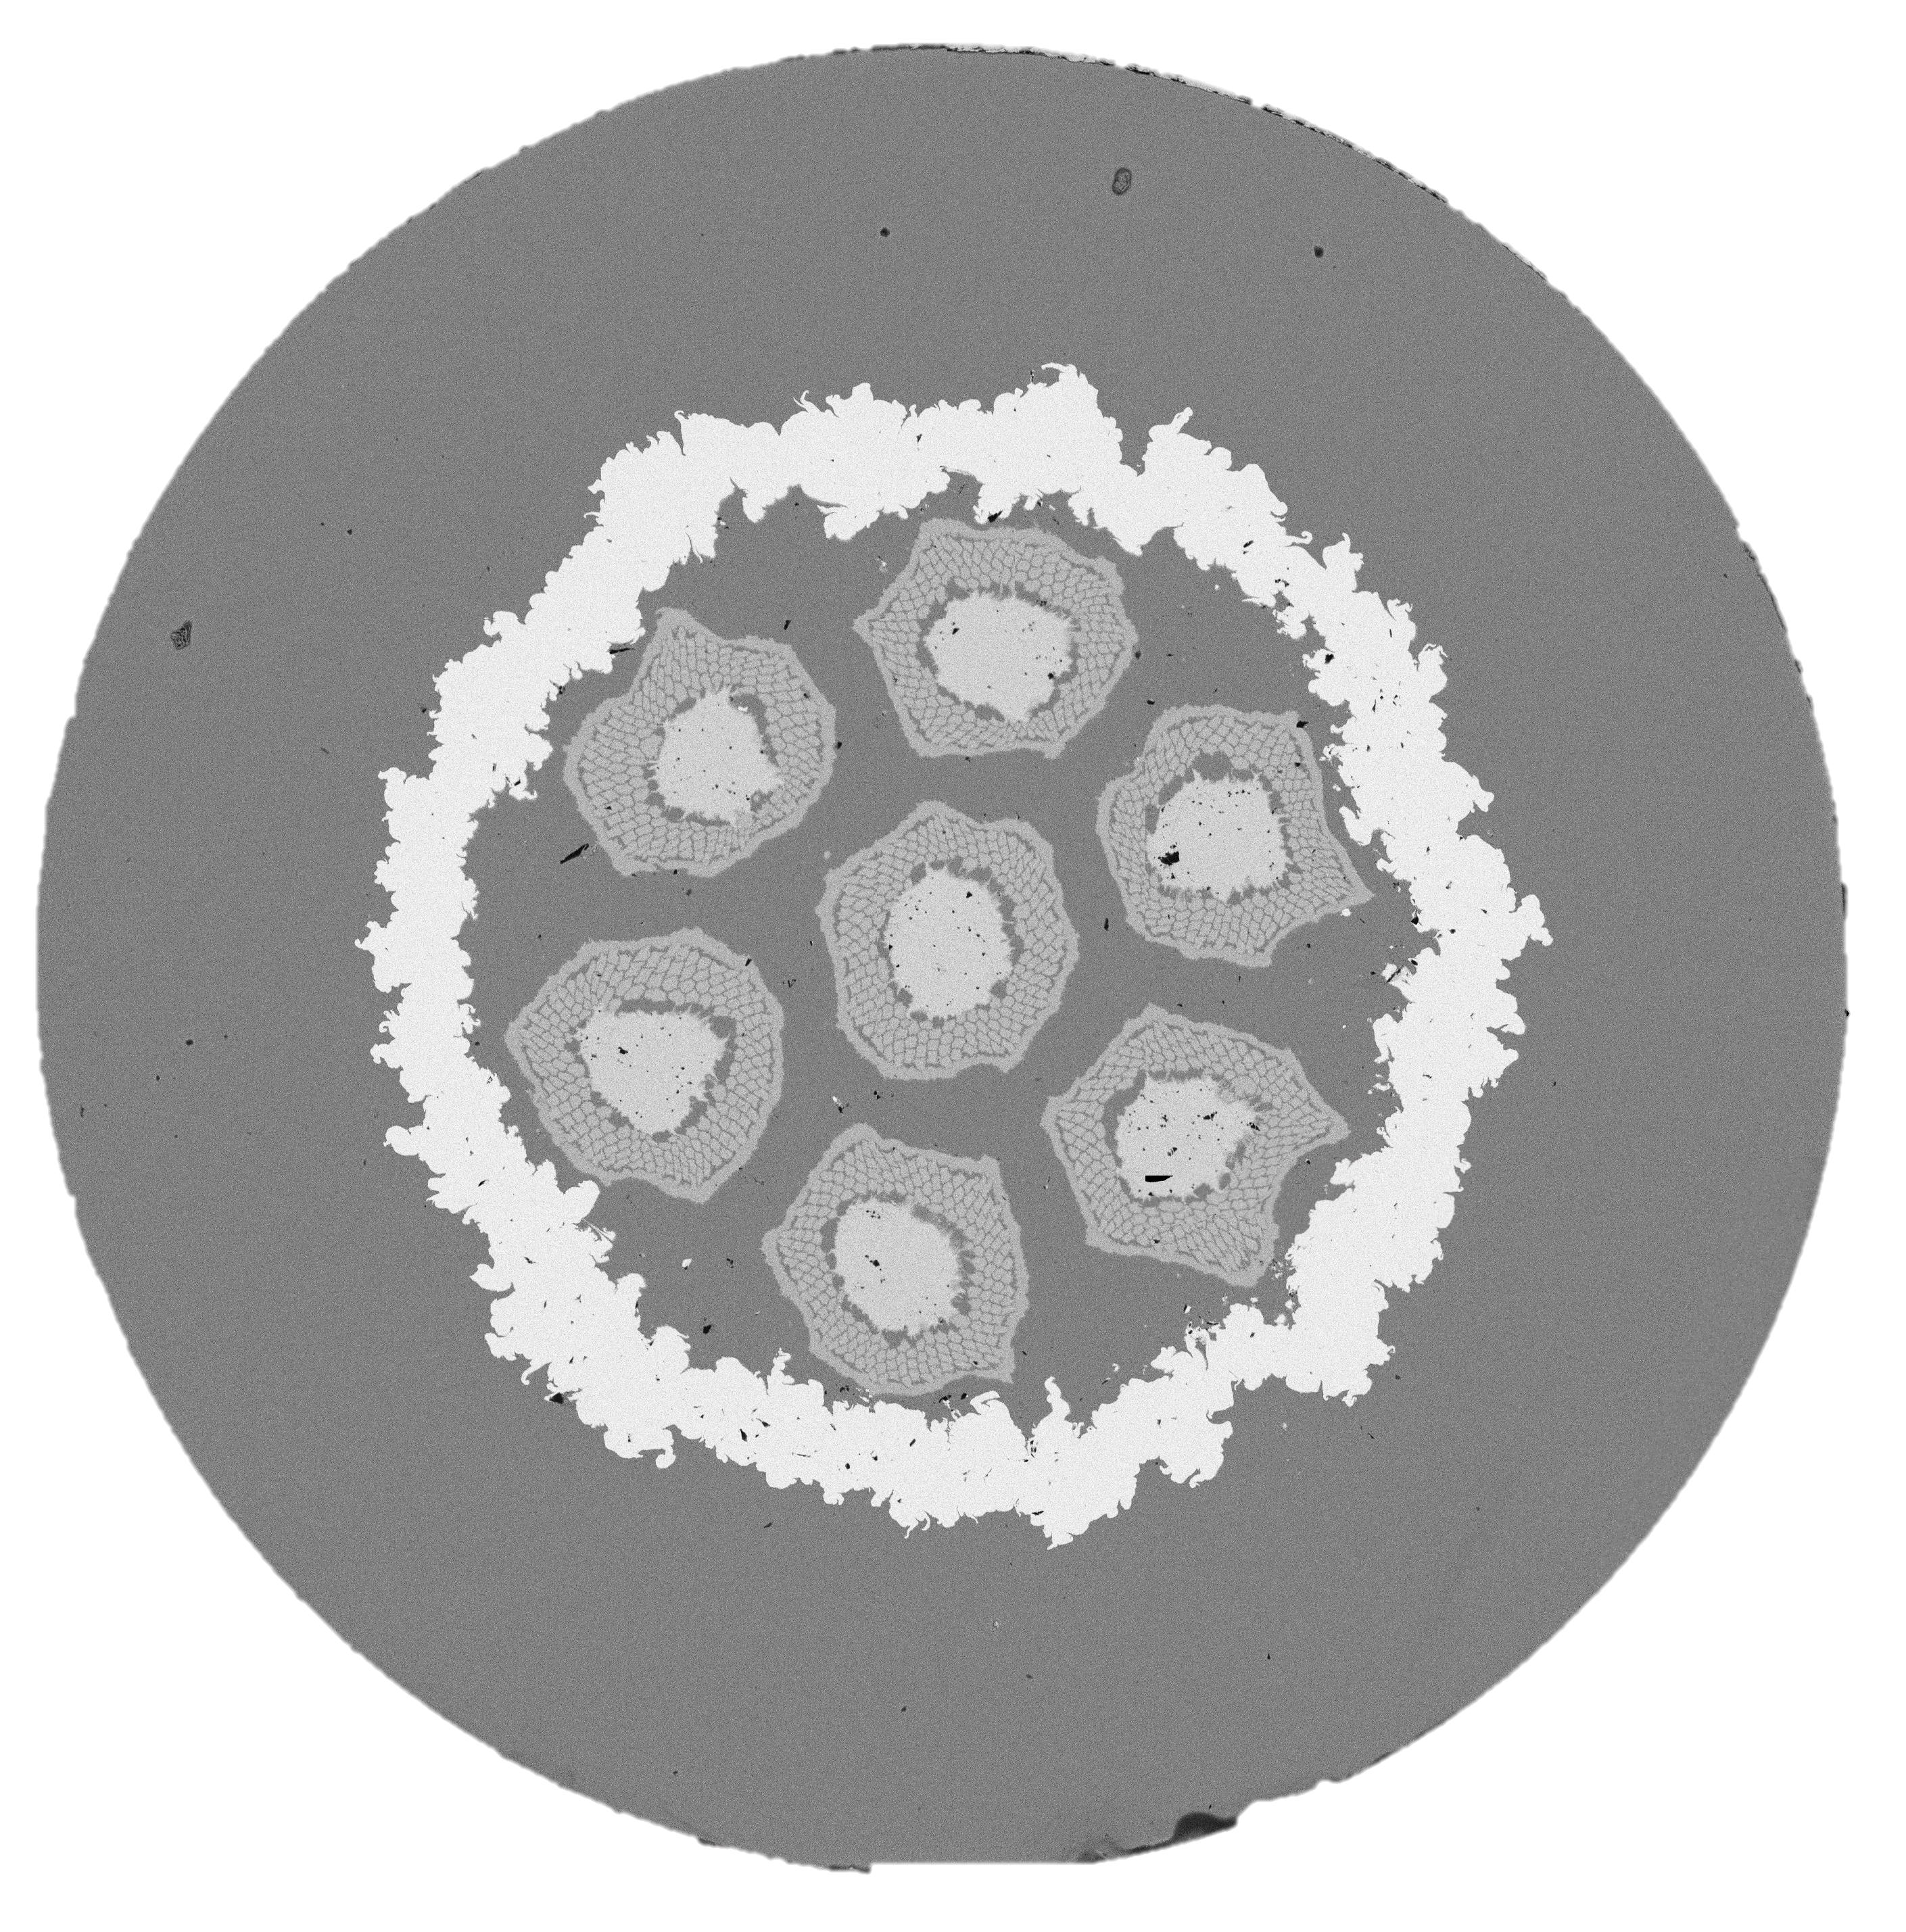
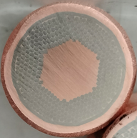
Multifilamentary Internal Tin Nb₃Sn wires
Subelement |  | Multifilamentary Wire
 | 192 filaments NbTa alloy Without oxygen source
 | 192 filaments NbTa alloy With oxygen source | To investigate the behaviour of the oxygen source in a multifilamentary wire
 | 390 filaments NbTa alloy Without oxygen source | To study how the subelement design influence on the deformability of multifilamentary wire
13/15

Slide 14

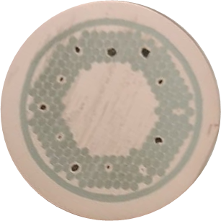
Summary and future work
Successful implementation of internal oxidation and APCs in a simplified RRP wire (7 subelements, cold deformed).
  Properties to be verified with additional high-magnetic field analysis
Successfully extrusion of two different layouts of RRP subelement without decomposition of SnO₂
  The OS decomposes during the final heat treatment to form Nb₃Sn.
  The extruded SE with OS Substitued to Nb filaments is being deformed to assemble a multifilamentary wire
Ready to extrude a Subelement with OS substituted to Nb filaments and with Nb-Ta-Hf alloy
Successfully extruded Nb Ta Hf and NbTa Zr filaments with OS (Cold deformation for restack to subelement level is in process)
Notes:
Wwhich are the pro and cons of the two technic: substituting filaments is good approach because the OS will go true only 1 extrusion respect the OS in each filaments that request extrusion of the filaments and then of the subelement. On the other side the layout with substituted filaments doesn’t guarantee the full oxidation of all the filaments, in particular the filaments far from the OS. This will need substitution of more filaments with OS decreasing the amount of Nb inside the subelement. The other design doesn’t have this problem since each filaments has its how OS.
To conclude we Successfully implemented internal oxidation in a simplified RRP wire and understood how to stabilize the OS for extrusion process both for filaments and subelement process.
We will make new subelement with filaments extruded and containing OS
We will make also subelement with OS substituted to filaments both with a Nb ta Hf alloy
we also have a method to increase the Sn content that we will apply to next SE and last, we know that we have a design that can work to tra to make RRP high specific heat SE substituting GdO2 to SnO2.

Slide 15
Thanks for your attention

Slide 16
Substituted filament: Nb-Ta alloy
X-ray analysis of SnO₂

Slide 17
Characterization on simplified sample
Wire Properties | Value | Ideal
Reaction % | 53.8 % | 100 %
Nb/non Cu Area % | 50.0 % | 50 – 60 %
Nb/Sn at | 3.1 | 3.1 – 3.6
Sn/Sn+Cu wt % | 45.1 % | 50 – 60 %
Excess of Cu and low Sn content causes the thin reaction layer.
0.33
Simplified RRP wire (7/7) made from cold deformed subelements (filaments and subelements are cold deformed)
Peak at 0.33 indicates APCs are contributing to the pinning force. More data (B_{c2} at high field and low field I_{c}) to confirm
Internal oxidation successfully implemented in a (simplified) Nb₃Sn RRP multifilamentary wire
FACULTY OF SCIENCES
DEPARTMENT OF QUANTUM MATTER PHYSICS
FACULTY OF SCIENCES
DEPARTMENT OF QUANTUM MATTER PHYSICS
3
Notes:
Foto migliori? Aggiungere Ic

Slide 18
Characterization on simplified sample
Wire Properties | Value | Ideal
Reaction % | 53.8 % | 100 %
Nb/non Cu Area % | 50.0 % | 50 – 60 %
Nb/Sn at | 3.1 | 3.1 – 3.6
Sn/Sn+Cu wt % | 45.1 % | 50 – 60 %
Excess of Cu and low Sn content causes the thin reaction layer.
Simplified RRP wire (7/7) made from cold deformed subelements (filaments and subelements are cold deformed)
Large error on the determination of J_{c} due to thin and inhomogenous reaction layer.
HT schedule to be optimized!
Internal oxidation successfully implemented in a (simplified) Nb₃Sn RRP multifilamentary wire
FACULTY OF SCIENCES
DEPARTMENT OF QUANTUM MATTER PHYSICS
FACULTY OF SCIENCES
DEPARTMENT OF QUANTUM MATTER PHYSICS
3
Notes:
Foto migliori? Aggiungere Ic

Slide 19
The challenges we are facing at
The study of internal oxidation in RRP wire
Enhancement of layer J_{C}
Material study
1. AnnularOS
Oxide powder between the Nb-alloy filament and the copper jacket
Test of various alloys and oxides (and their combinations) on monofilament
SnO₂
Modification of pinning mechanism
2. CoreOS
Oxide powder inside the Nb-alloy filaments
Determination of OS efficiency
Study of oxygen source (OS) configurations to optimize superconducting properties (I_{c}, B_{c2}, pinning) on simplified subelement
SnO₂
Enhancement of B_{C2}
OS stability during subelement manufacture
Verify OS stability during high temperature treatment along the preparation of a RRP Subelement
T = 4.2 K
Notes:
The research started from the study in single filaments the best combinations of alloy and oxygen sources to obtain grain refinement. Then we produce simplified subelement to understand what is the best configuration of the OS to optimize the superconducting properties. We obeserve the enhancement of Jc, modification of pinning mechanism, and enhancement of Bc2
Now we are at the point of implement everything to a subelement for multifilamentary wires.
To understand the challanges related to the implementation of IO to RRP SE we need to understand the Process of fabrication of this type of wires

