Slide 1
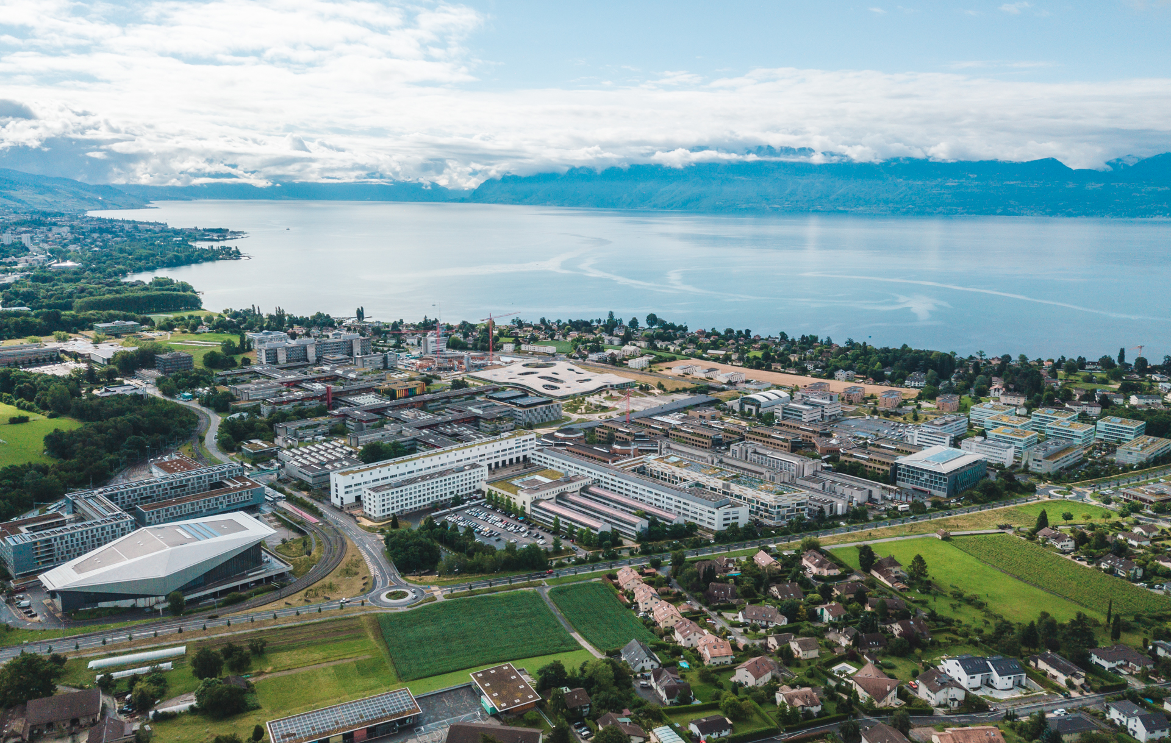


Beam Dynamics in FCC-ee
T. Pieloni, L.van Riesen-Hapt, L. Sabato, P. Kicsiny, M. Seidel, F. Carlier, C. Garcia, L. Vanheckec, Sietse
M. Hofner, R. Tomas, X. Buffat, G. Iadarola, K. Oide, F. Zimmermann
10 Years of CHART, 12th November 2025

Slide 2

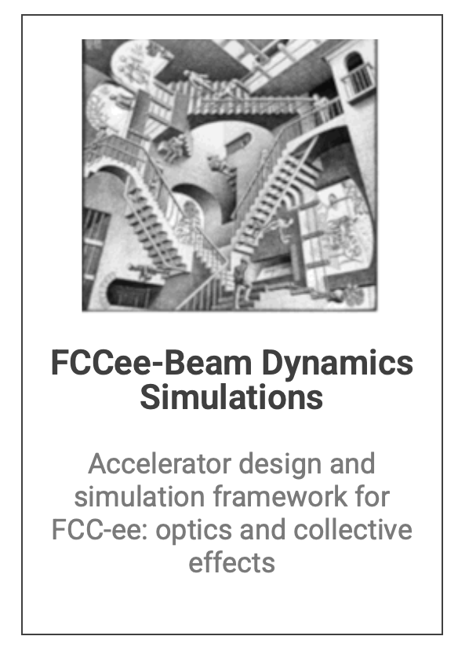
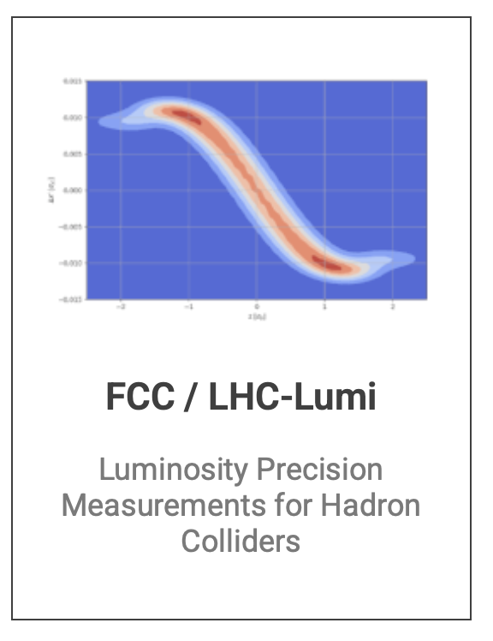

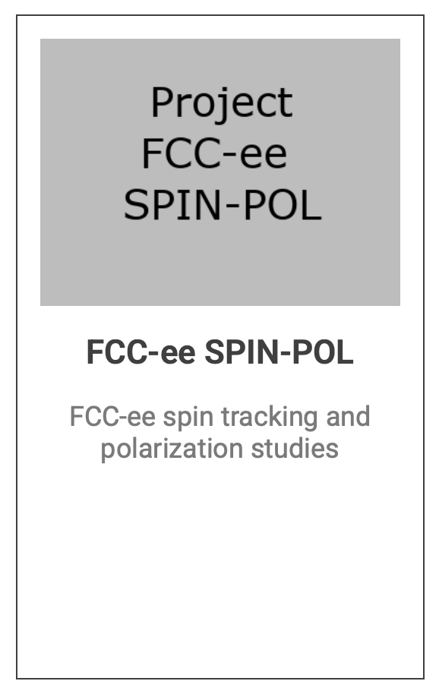
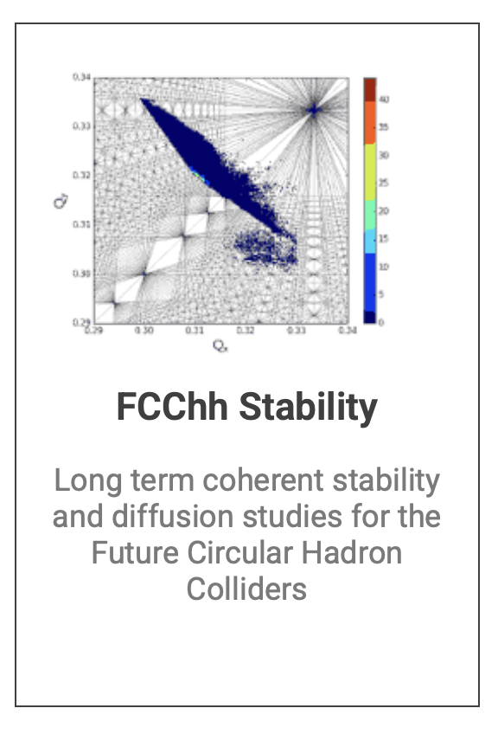

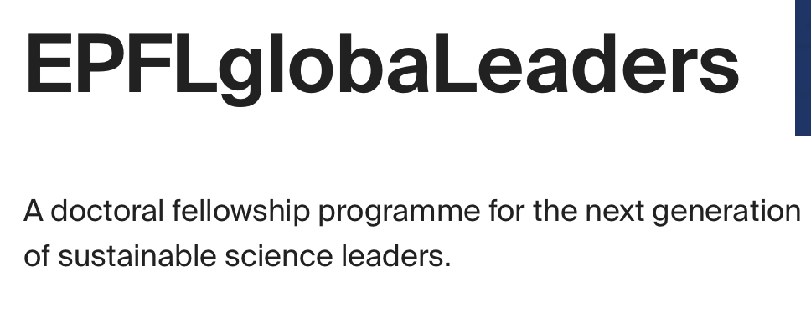
Competitive Fundings
Beam Dynamics FCC-ee
→ Robust design
→ Define tollerance
→ Explore Correction streategies
→ Alternative proposals/studies
ML4FCC Project
Surrogate Models for collider design
Innovate for Sustainable Accelerating Systems
ERL based collider
Alternative and sustainable Optics using nested Magnets

Slide 3
Outlook
FCC-ee feasibility Studies
  Beam-beam and rdaiation Models for Beam Dynamics Studies
  Tuning and Optimization
  Machine imperfections and tollerances: beam lifetimes, DA and luminosity
  Top up injection and stability studies
  Alternative optics with Nested Magnets
Sustainable collider design using ERL technology
ML4FCC surrogate models for colliders design (LHC/FCC)
Luminosity precision for LHC and FCC-hh
Muon Collider collective effects

Slide 4
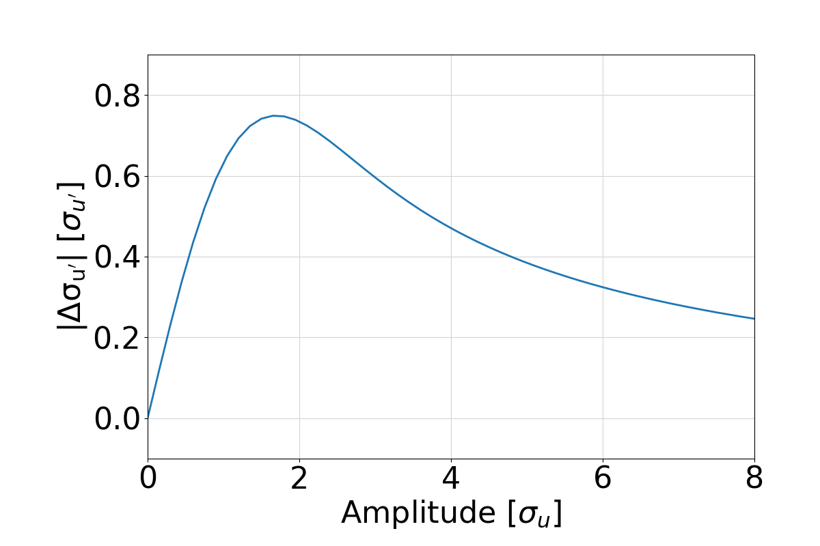

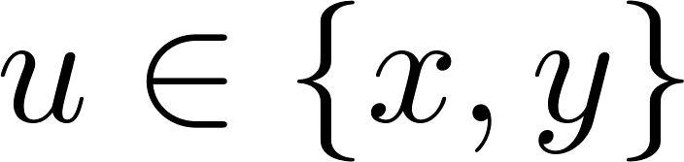
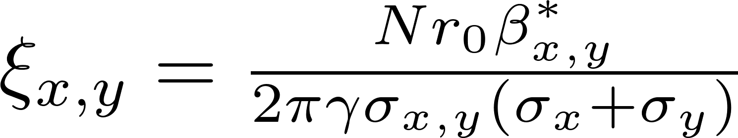
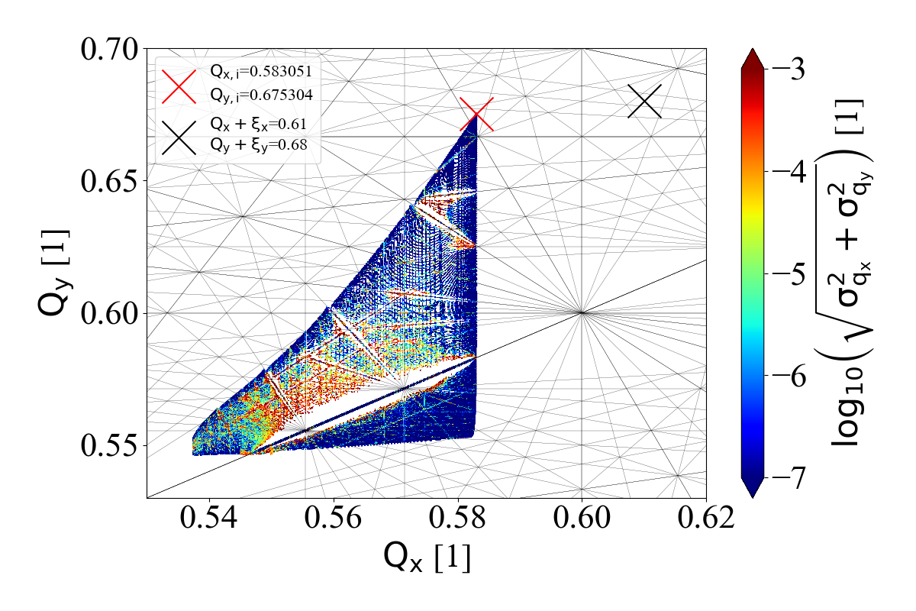
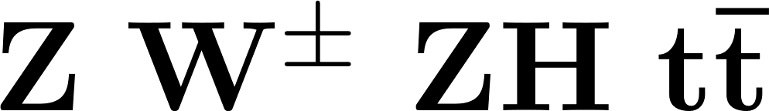
Interaction region: Beam-beam force
High lumi strong beam-beam force
Designing a collider means:
Mantain small/controlled Beam-Beam effects while keeping Luminosity at maximum
Study the effects in realistic machine
IP tuning & feedback, stability and Performances studies and tollerance definitions
Find possible solutions to overcome limitations
linear model
w/o radiation
Notes:
optmizations of the machine for high luminosity have already done for baseline design. but high lumi implies a strong bb force which can be characterized by the xi. but we want to consolidate these estimates eg lumi lifetimes with more detailed models using simulatons of radiation ip tuning topup and beam symm so these are the studies that i will highlight in this preso.
during beambeam collisions the beams experience the EM field of each other. This perturbation leads to a change in the optical beta function, called beta beating and causes an amplitude dependent tune shift. The consequnece of this is that the beam will have a lartge tune footprint which potentially crosses many resonance lines which can be dangeorus for the beam stability. the beambeam force that the particles experience from each other at collisions is highly nonlinear. For small amplitudes this beambeam force can be characterized by this parameter xi, shown in the top right plot, which can be expressed in terms of the beam parameters.
For the machine design a small value for xi is crucial, but at the same time luminosity has to be maximized. This is challenging as you can see the luminosity can be expressed as a function of the xi, so on one hand we minimize xi but also want to keep L at maximum.

Slide 5
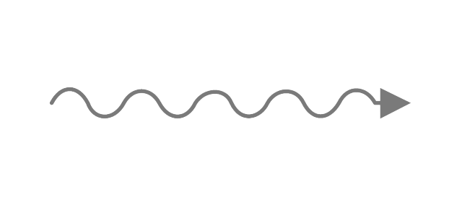
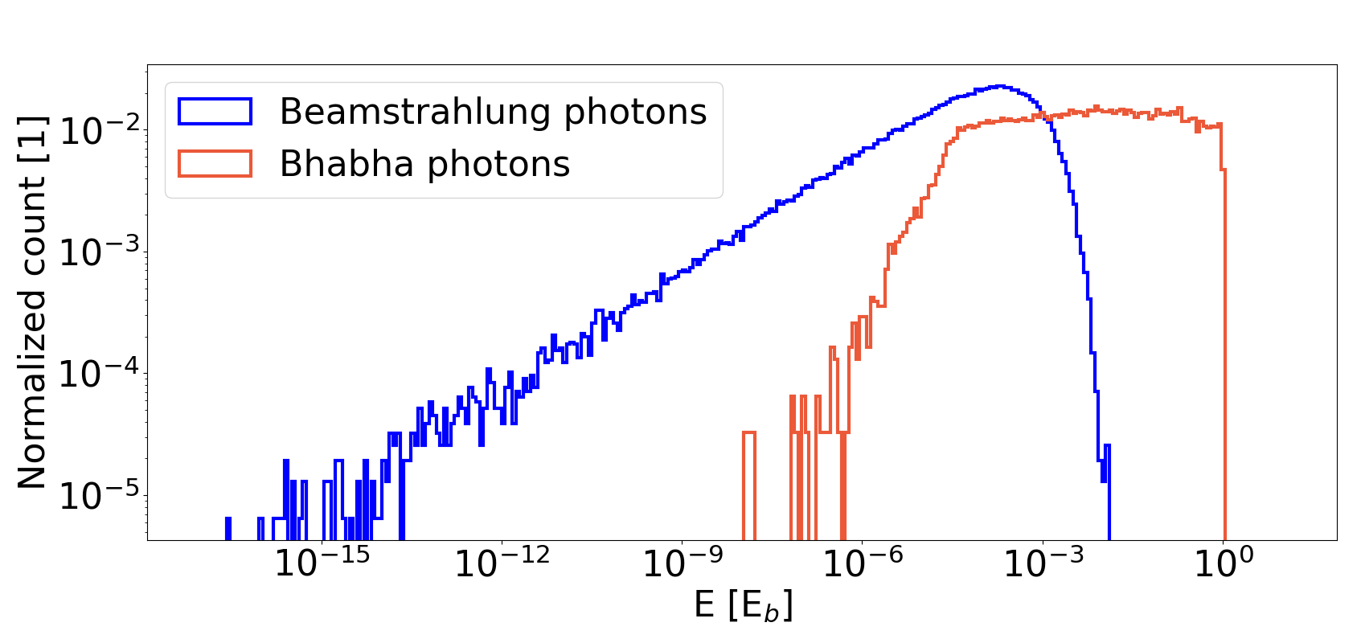




Radiation at FCC-ee collisions
Incoherent
Radiative Bhabha
scattering
Deflection in field of
single particle of opposite bunch
Collective
Beamstrahlung
Deflection in collective
field of opposite bunch
Radiation particle losses
lifetimes:
BS ~100 min
BH ~30 min
P. Kicsiny
Notes:
1 min
In addition to the beambeam force, the electrons and positrons at collisions can undergo radiation. Bhabha scattering is an incoherent effect and it is when a beam particle deflects due to the Coulomb field of another beam particle of the opposite bunch. Beamstrahlung is a collective effect, in this case the beam particle is deflected due to the collective EM field of the opposite bunch.
Both mechanisms can result in the emission of photons. On the plot you see an energy spectrum for these. Photons from Bhabha scattering are more rare than from beamstrahlung but they have typically a larger energy. The energy loss carried away by these photons leads to particle losses and therefore they also result in the decrease of luminosity. In the FCC-ee these mainly two types of radiation determine the beam lifetime.

Slide 6
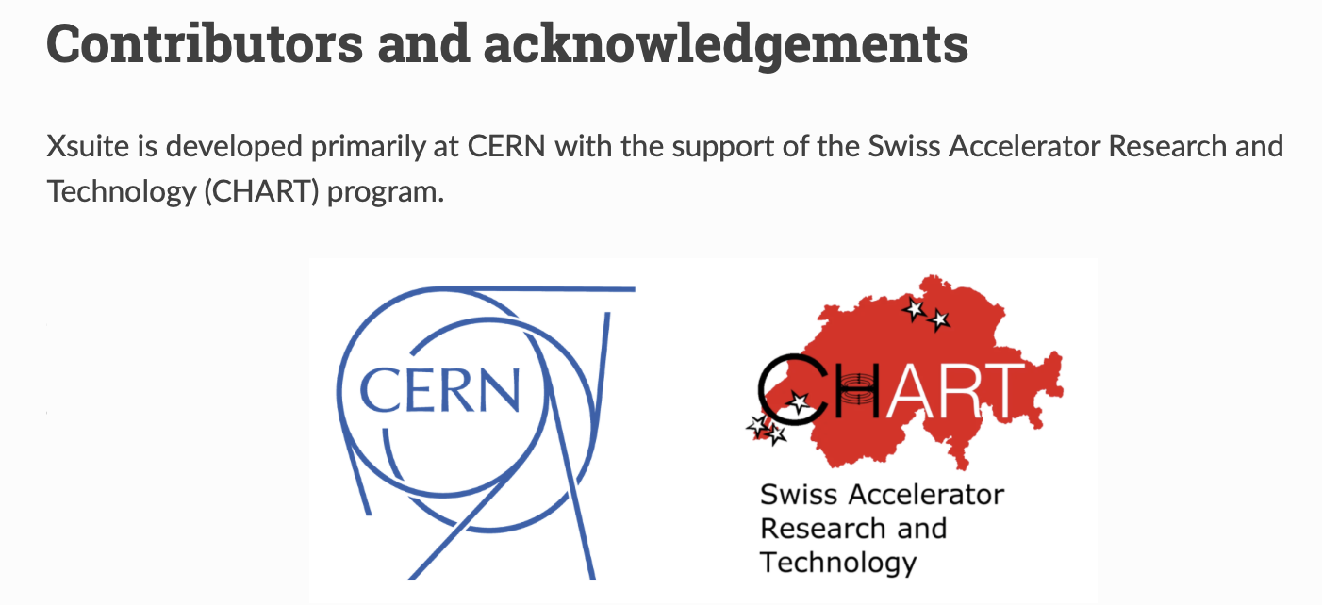

Tools
6
 | Weak-strong 6D | Quasi-strong-strong 6D | Strong-strong 6D |  | Beamstrahlung | Bhabha-scattering | Transverse wakefields | Longitudinal wakefields | Linear tracking | Nonlinear tracking | Open source
GUINEA-PIG [2]
COMBI [3]
BBWS [4]
BBSS [5]
SCTR [6]
IBB [7]
LIFETRAC [8]
BeamBeam3D [9]
Xsuite [10]
Strong-strong 6D SG
Strong-strong 6D PIC
Quasi-strong-strong 6D
Longitudinal wakefields
Beamstrahlung
Transverse wakefields
Runs on GPU
Weak-strong 6D
Bhabha-scattering
Lattice tracking
Linear tracking
Open source
Different beam-beam codes exist, with different features
FCC-ee: self-consistent & fast modeling needed including many effects
Xsuite: development driven by needs for FCC-ee
P. Kicsiny EPFL PHD Thesis
Available
Not available
Notes:
There exist several numerical tools to model the fccee beam-beam effects that are collected in this table. The columns show the various features that are important for the FCC-ee. You can see that each of them has different features but none is able to tick all the boxes. Therefore for many of these studies we are using xsuite, a new general purpose beam dynamics simulation tool, developed at CERN, that is developed by taking into account the simulation needs of the FCC-ee. We have a dedicated beam-beam working group working on various aspects of beam-beam effects.

Slide 7
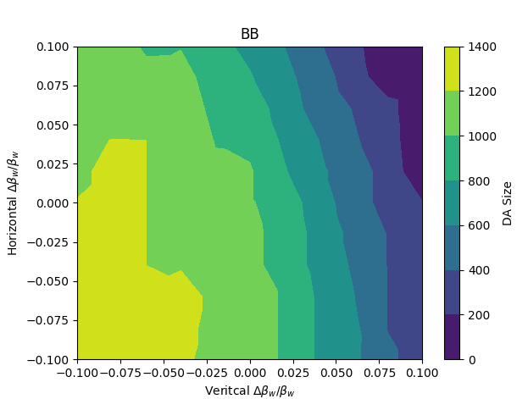
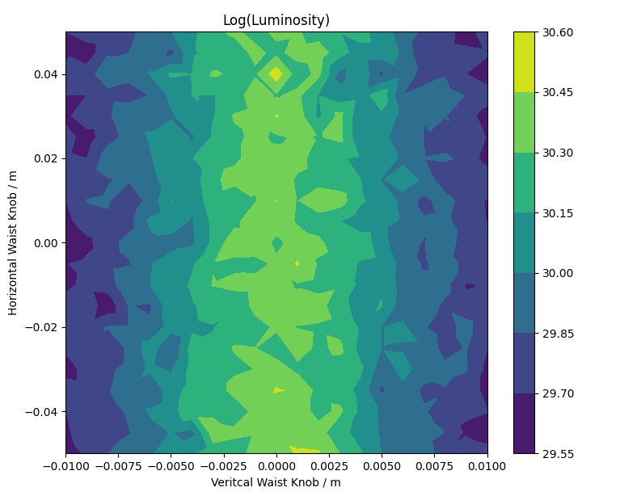
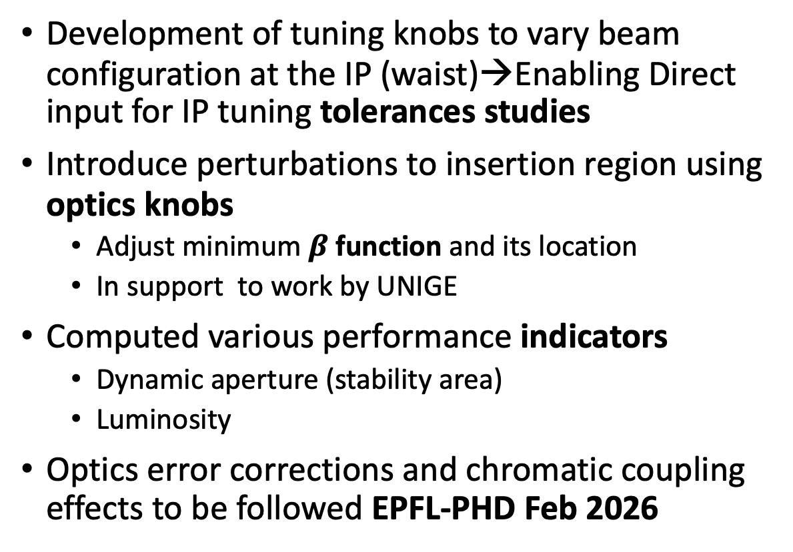
IP Tuning and Optimization
Development of tuning knobs to vary beam configuration at the IP (waist)→Enabling Direct input for IP tuning tolerances studies
Introduce perturbations to insertion region using optics knobs
  Adjust minimum $β$ function and its location
  In support to work by UNIGE
Computed various performance indicators
  Dynamic aperture (stability area)
  Luminosity
Optics error corrections and chromatic coupling effects to be followed EPFL-PHD Feb 2026
Xsuite, FCC ttbar
relaxed optics [11]
300 turns
1e5 macroparticles
L. Van Riesen-Haupt
Notes:
The moment we have the midels of BB and radiation is. We can use these to study the performances in terms of Dynamcis aperture (the largest area in x,y sace where particles performe stable motion in the accelerator top plot) andf in terms of luminosity eprformances bottom. Here knows for relax optical function at the IP have been developed and scanned to highlight the dependencies of our stability indicators (DA and Lumi) beghavive versus the changes in beta function ir waist. As a result f these studies tollernces on acceptable errors on beta values can be defined and robust design ensured. This preliminary developments and studies have enabkles and justified new PHD studies i.e. at UNIGE and new CHART 3 project on chromatic coupling and space charge.

Slide 8
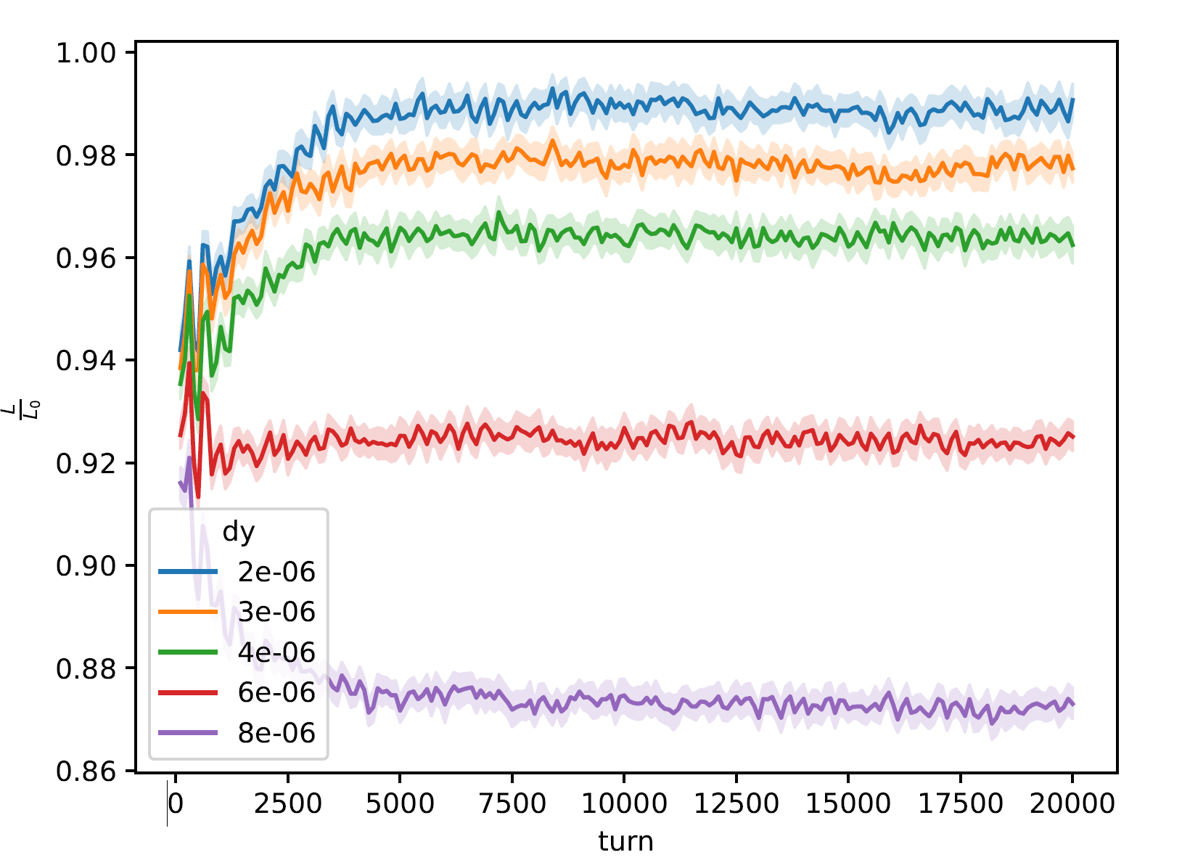
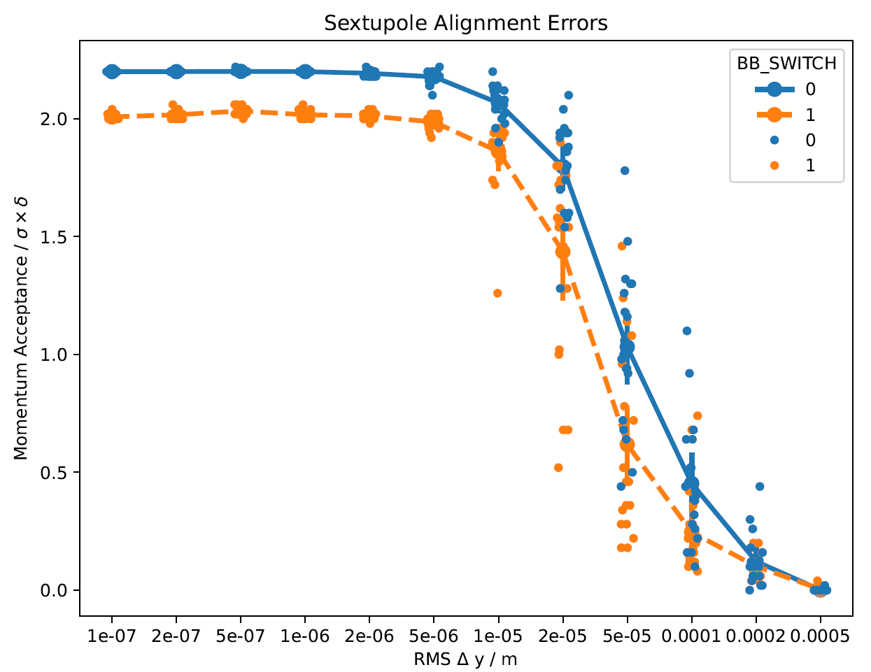
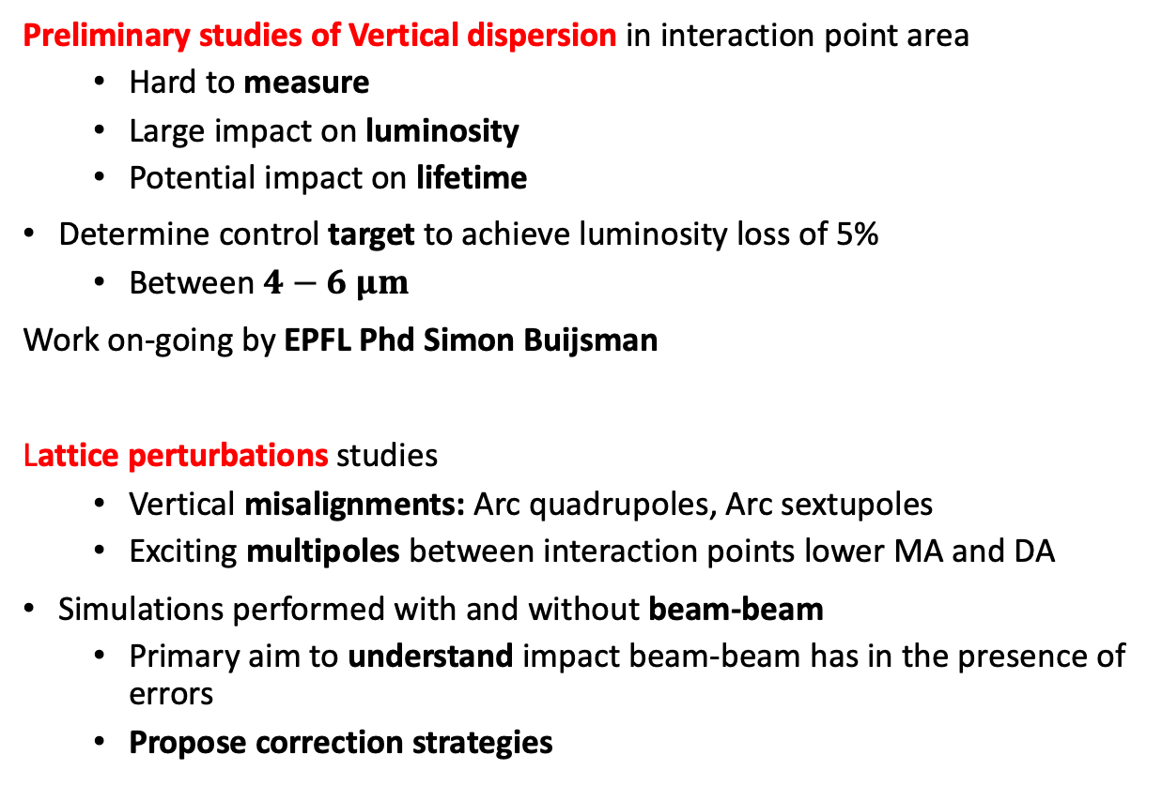
Insertion Region – Dispersion
Preliminary studies of Vertical dispersion in interaction point area
  Hard to measure
  Large impact on luminosity
  Potential impact on lifetime
Determine control target to achieve luminosity loss of 5%
  Between $4−6 μm$
Work on-going by EPFL Phd Simon Buijsman
Lattice perturbations studies
  Vertical misalignments: Arc quadrupoles, Arc sextupoles
  Exciting multipoles between interaction points lower MA and DA
Simulations performed with and without beam-beam
  Primary aim to understand impact beam-beam has in the presence of errors
  Propose correction strategies
Notes:
Another study that has highlighted the challenges of the IR desgn of the FCC-ee is the dispersion at the IR. Dispersion is an optical function that is used to quantify the orbt deviation that particles with energy deviation will have. As a result the beams will have much larger transverse spot at the collision that oes with D^2 ad delta/p^2. The IR design is such that dispersion is kept as close as possible to zero. But this has certain limitations. Introducing dispersion at the IP we can see the very stron impact to luminsoity that helps us defining our tollerances. A control at 5% on lumi results in exteremelly tight constrains on dispersion at mum level. In additionto to luminosity measing it at the IP is also an unsolved problem. In this context a new PHD project has started to developp possible measurements techniques and counter actions for correcting it at the mum level.

Slide 9
Top-up injection & asymmetry scans
Longitudinal top-up simulated
Perturbed bunch init. with 95% intensity
Track till equilibrium & top-up
Luminosity lower than in symmetric case (L₀) due to vertical blowup
  Should be avoided (e.g. working point optimization)
topup
Derived coarse tolerances for machine tuning
0.95N₀
lower due to asymmetric setup
N₀
EPFL PHD Thesis
arXiv:2501.04609
Phys.Rev.Accel.Beams 27 (2024) 9, 091001
Notes:
relative change in emittance (relative to nominal zeta=1)
the currently preferred injection scheme for the fccee is longiduitnal topup where low intensity bunches are injected with high frequency with an offset in energy to merge with the stored beam.
In such a setup there will always be an asymmetry in the bunch intensity of the 2 beams which can potentially trigger a blowup for one of the beams.
For this Xsuite is a particularly useful tool because the injection process and the beambeam can be simulated with the same tool. Here we simulated the longitudnal toputp which is currently the preferred injection option. In this example we initialized the first beam at nominal parameters and the second with a bunch intensit y5% lower athan nominal. Then we performed tracking with xsuite using a linear transfer mao fir the arc and the beambeam and track till equilibrium, then topup the weak beam and track again till convergence. The polots on the right show the rms and luminosity evolution over the turns. The luminosity is normalized to the nominal value and here it is about 10% smaller because of the asymmetric setup. This should be taken into acccount in the maching design by appropriate working point optimization.

Slide 10
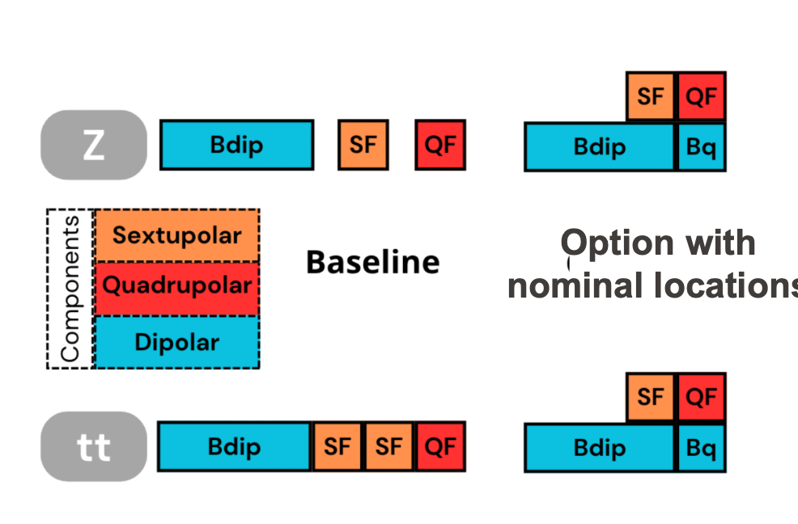
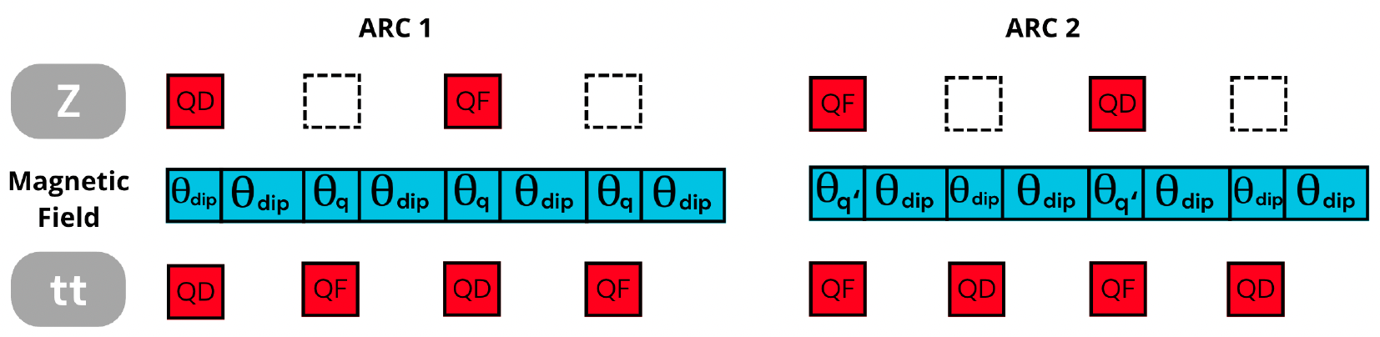
Alternative optics for FCC-ee: Nested Magnets
Odd Arcs
Even Arcs
Alternative optics for the FCC-ee arcs have been developed and it is fully trasparent to IR design GHC and LCC
Net reductions of SR is achieved respect to Baseline (50MW/beam): GHC (Oide) 17% and LCC(Pantaleo)7%
Optics differences are less than 1% beta-beating, phase differences, dispersion
Support possible application of Nested Magnets technology (i.e. CHART-PSI developments of HTS based magnets)
Need further investigation to quantify errors effect on dynamic aperture
EPFL-PHD C. Garcia

Slide 11
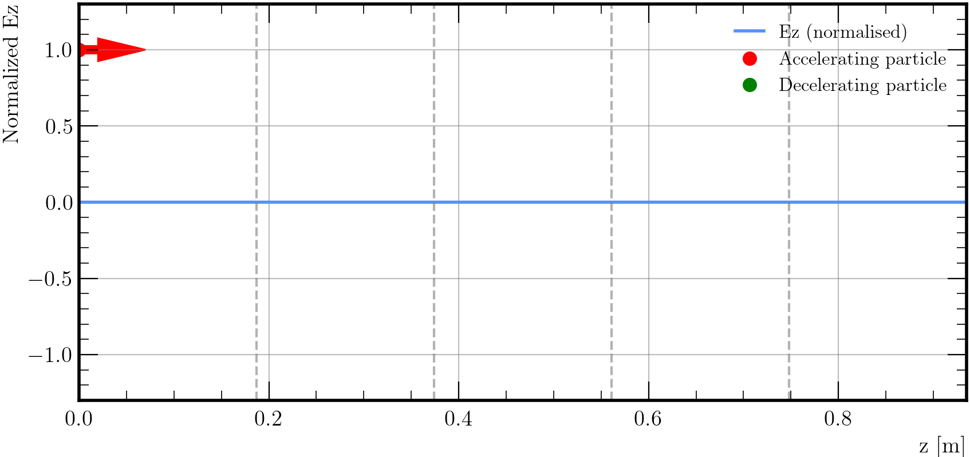
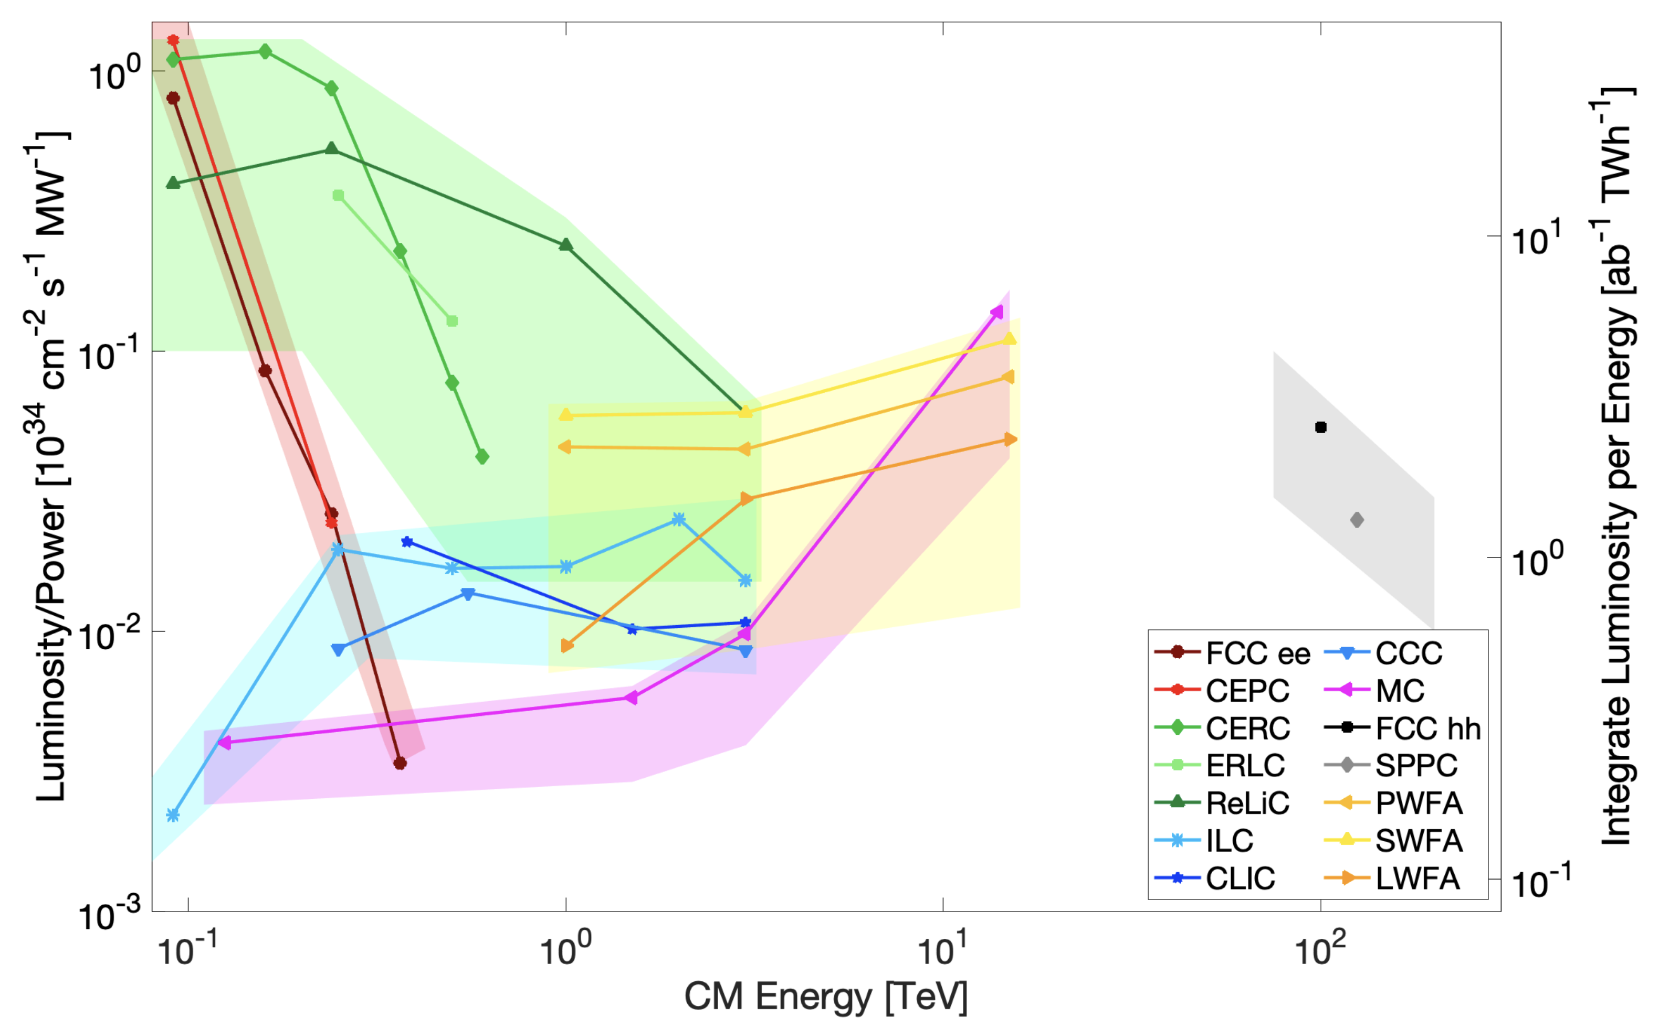
Energy Recovery Linac based collider
Can we make accelerators/colliders more sustainable and efficient?​
Pioneered in 1965 by M. Tigner​
Linear accelerator BUT recirculate SPEND beams into accelerating structure​
Recover kinetic energy of particles​
Use energy to accelerate fresh beams​
Model the recirculation of bunches after collision
in RF cavities for energy recovery and link to collider model (RF-Track+XSUITE)
Test and evaluate “realistic” performance for possible future colliders: linear and circular
→Start to end simulations to quantify efficiency, performances and limitations
Gif 1: Time-evolving axial electric field amplitude in a 5 half-wave cell cavity with particles accelerating and decelerating along the axis.
EPFL-PHD L. Vanhecke

Slide 12
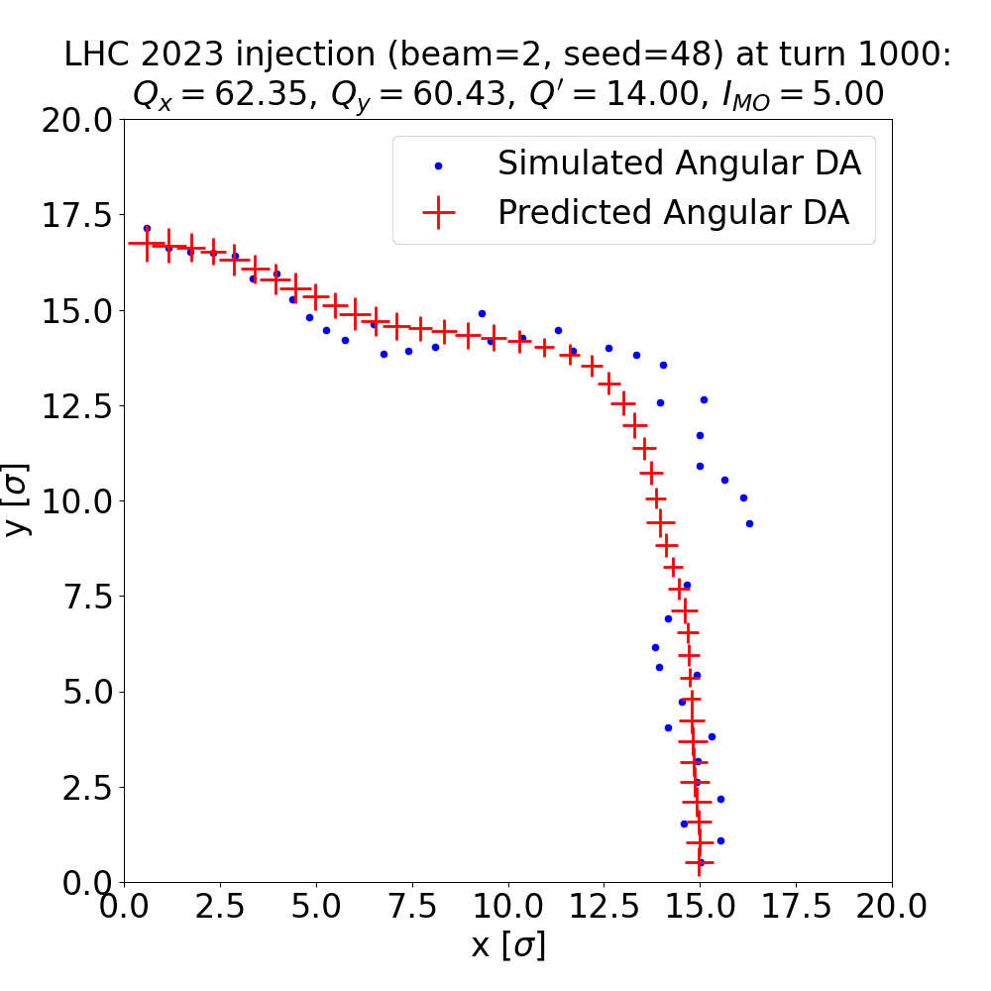
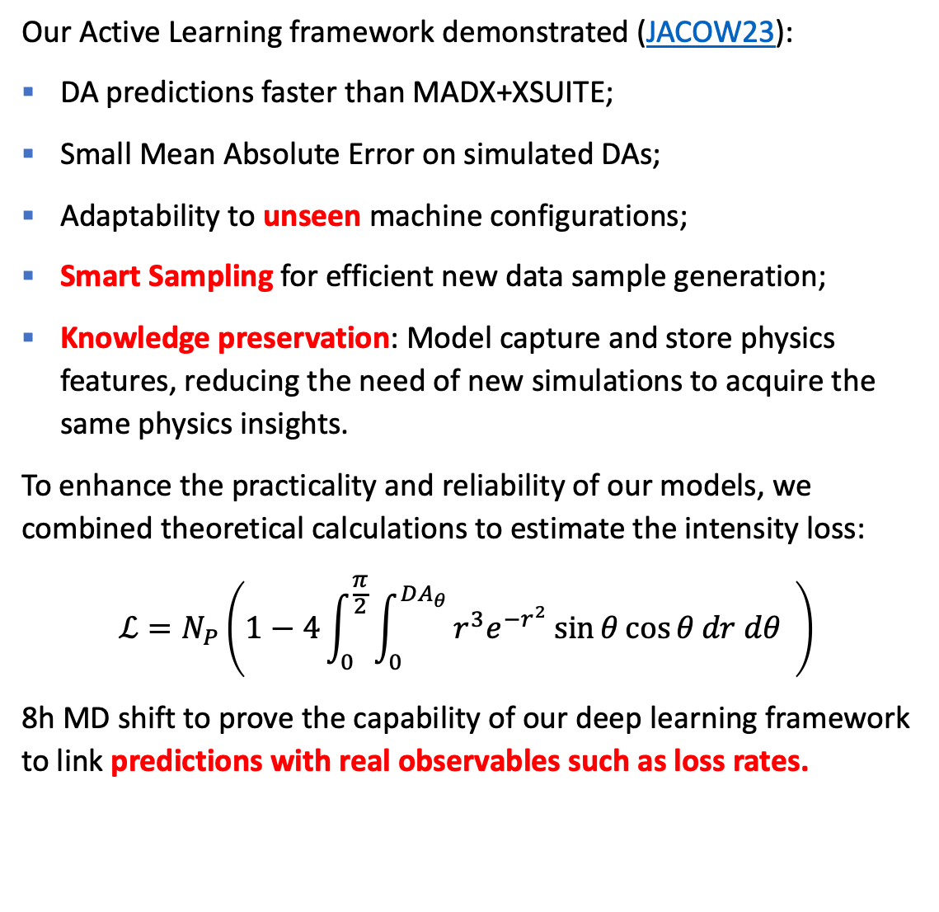
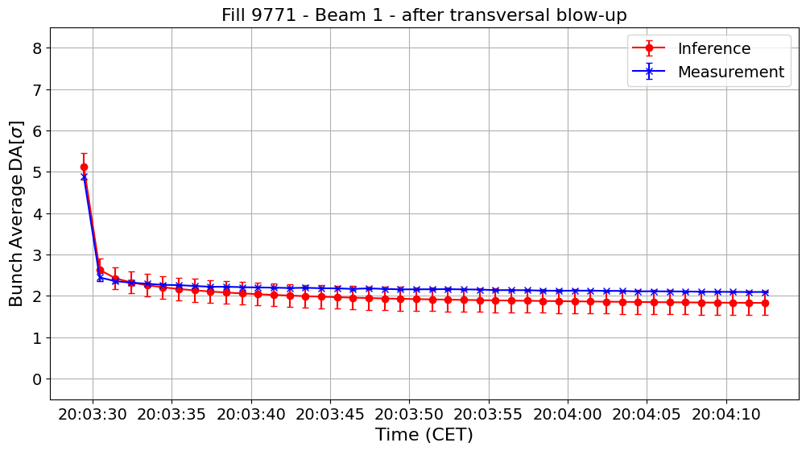
ML4FCC: Deep Learning for simulations
D. DiCroce et al.
Optimizing Dynamic Aperture Studies with Active Learning

Slide 13
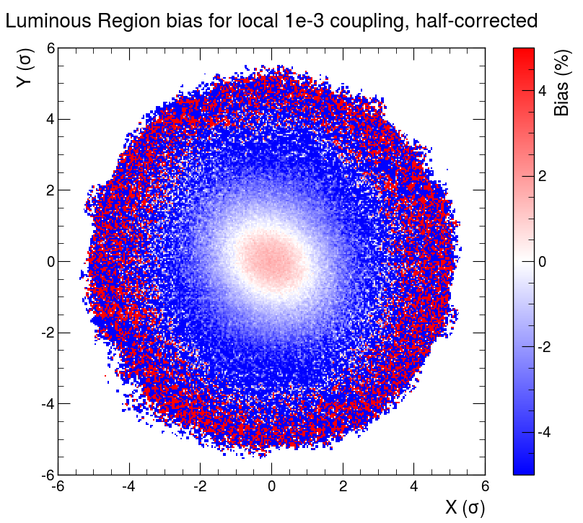
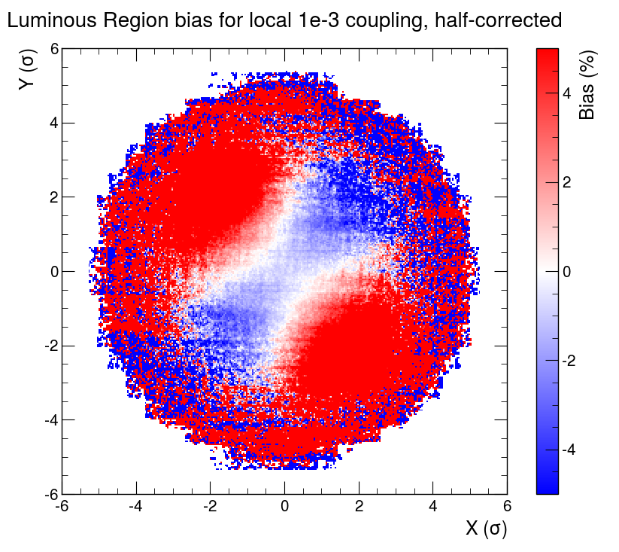
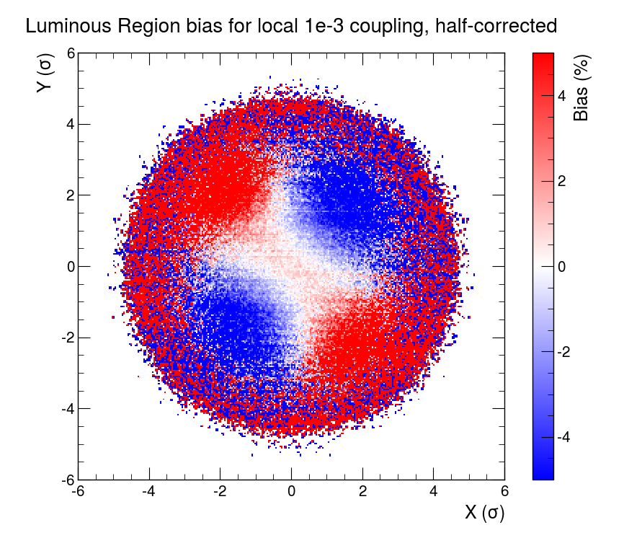
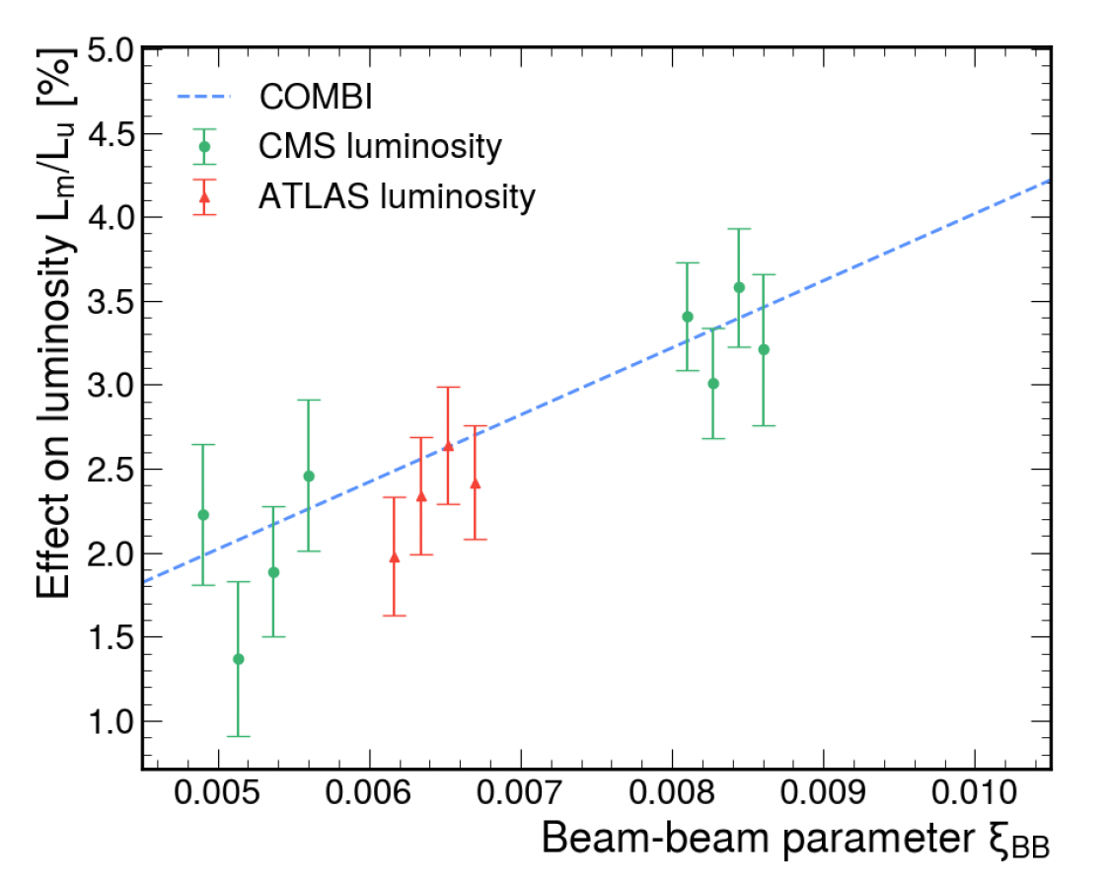



Luminosity precision in Hadron Colliders
Luminous region model inported and available in XSUITE
Understand luminosity and distribution changes due to BB and coupling
Benchmark to data at LHC
Provided valuable results to correct for luminosity biases from Beam-beam effects→ parametric correction fully implemented in ATLAS, CMS analysis
Proposed enhancing HL-LHC integrated lumi using Beam-beam → 4-7%
Beam-beam bias : $\frac{L_{bb+c}}{L_{c}}$
1e-3 coupling bias : $\frac{L_{bb+c}}{L_{bb}}$
Beam-beam + coupling bias : $\frac{L_{bb+c}}{L_{0}}$
DATA
J. Wanczik EPFL-PHD 2024
Future work FCC-ee EPFL-PHD possibly with benchmark to data at SuperkEKB

Slide 14
Conclusions and Outlook
Several studies have initiated under the auspice of CHART since 2015
→ Beam dynamics studies are possible today for different machine/options
Modern Numerical Models developed (XSUITE) for FCC-ee but also FCC-hh in mind
Systematic studies on beam-beam, radiation and errors feasible → DA, MA, lifetimes and luminosity
Correction schemes under development for orbit and imperfections
Alternative optics using NM allows reduction of SR 17%-7%
ERL based collider modelling, ML4FCC developments,Luminosity developments,Muon collider feasibility study.
All results have been summarized in the FCC-ee feasibility study report and many papers
Future:
Toward FCC-ee TDR
SuperKEKB benchmark
Electron Ion Collider opportunity toward FCC

Slide 15
Thanks to CHART we can continue improving our understanding of beam dynamics and design next generation collider on solid ground!

Slide 16

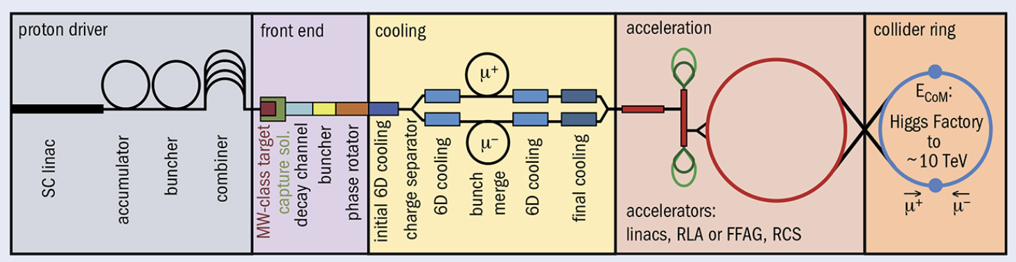
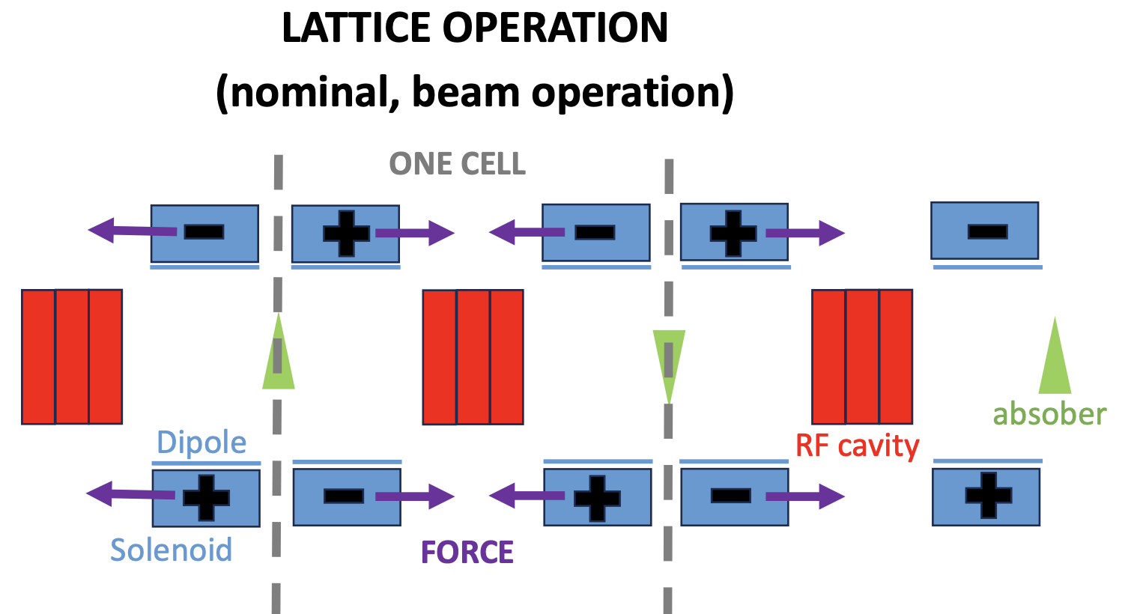
Collective effects and beam dynamics in the muon collider study
Impedance of elements along the cooling section up to the collider Muons will go through LiH absorbers for ionization cooling
  The impedance/wakefields generated in the absorbers must be evaluated
  3D electromagnetic simulations of beam through matter to compute wakefields
Beam dynamics: Investigate the limitations from collective effects in the cooling line, assessing beam losses and mitigation measures
  Start to end simulations of the whole process in RFTRACK+XSUITE!
J. Potdevin and D. Amorim
Presentations at IMCC annual meeting 2025: Update on RCS collective effects and Update on Collider collective effects. “Collective effects” chapter in the ESPPU submission

Slide 17
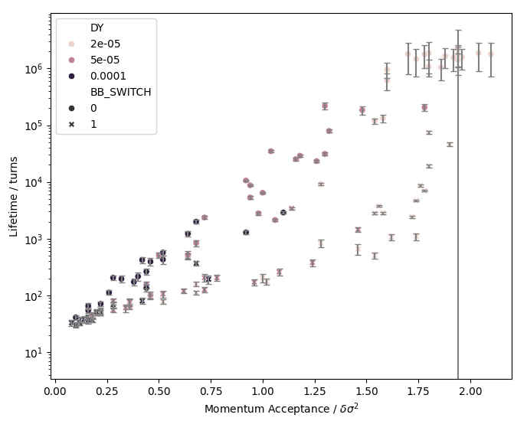
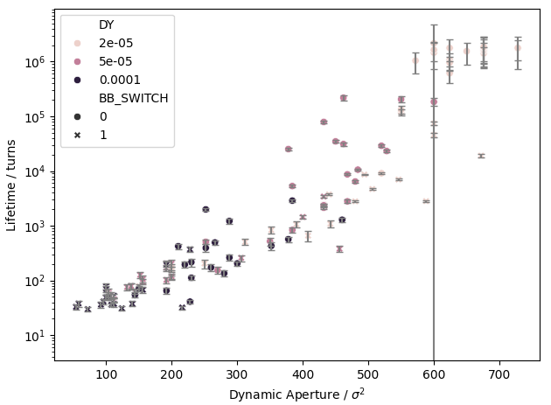
Dynamic Aperture vs Lifetime
Lifetime simulations significantly slower than computing DA/MA
  Traditionally optimise these with aim to maximise lifetime
Simulation with various sextupole misalignment seeds and amplitudes
  Compute DA, MA and lifetime
Clear trend between DA/MA and lifetime
  Additional variance by an order of magnitude
  Additional or better indicators needed to fully describe lifetime

