Slide 1
Progress of a meter-long bulk high-temperature superconducting undulator
Alexandre Arsenault
November 12, 2025

Slide 2
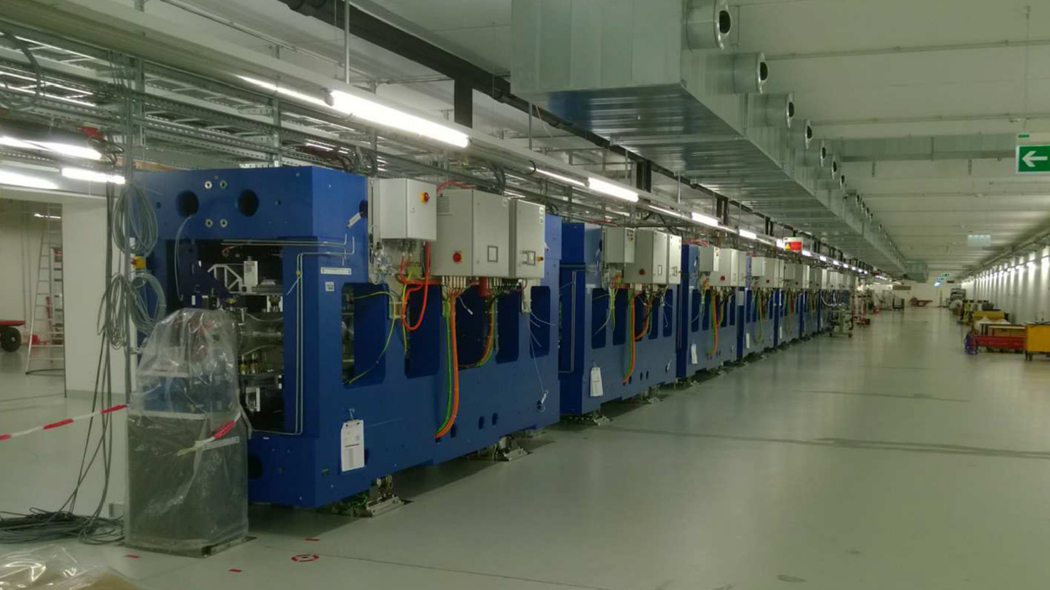
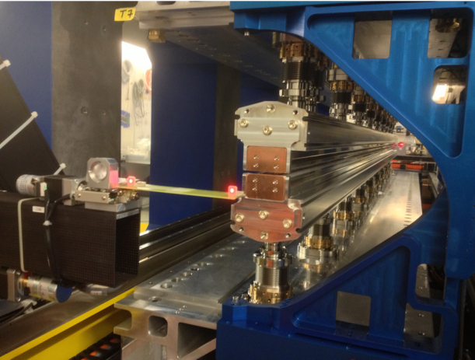
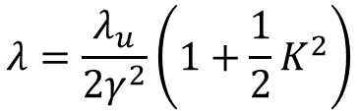

Introduction
Fe poles
B_{y}
Electrons
gap
Permanent magnets
Undulator period
Synchrotron radiation is achieved with the use of oscillating electrons, typically produced by undulators
$$λ=\frac{λ_{u}}{2γ^{2}}\left(1+\frac{1}{2}K^{2}\right)$$
$$K∝B_{0}λ_{u}$$

Slide 3
Introduction
Ho poles
B_{y}
Electrons
gap
HTS bulks
Undulator period

Slide 4
Introduction
Ho poles
B_{y}
Electrons
gap
HTS bulks
Solenoid

Slide 5
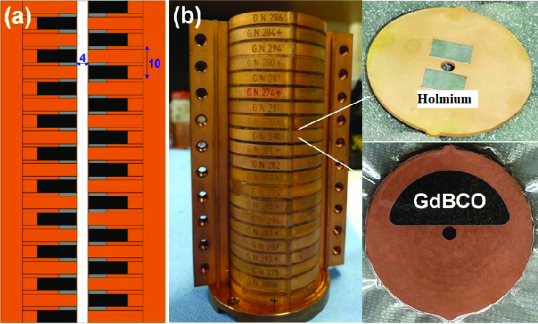
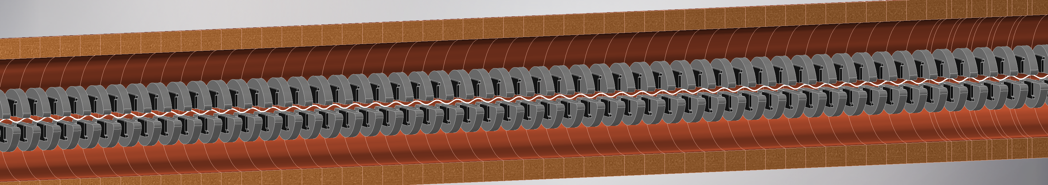
Introduction
Managed to get good experimental results on a 10 cm prototype
Next step, 200 bulks!

Slide 6
Introduction
Managed to get good experimental results on a 10 cm prototype
Next step, 200 bulks!

Slide 7
Outline
HTS undulator
Nb₃Sn solenoid
HTS bulks insert
HTS bulks sorting
Conclusion

Slide 8
Outline
HTS undulator
Nb₃Sn solenoid
HTS bulks insert
HTS bulks sorting
Conclusion

Slide 9
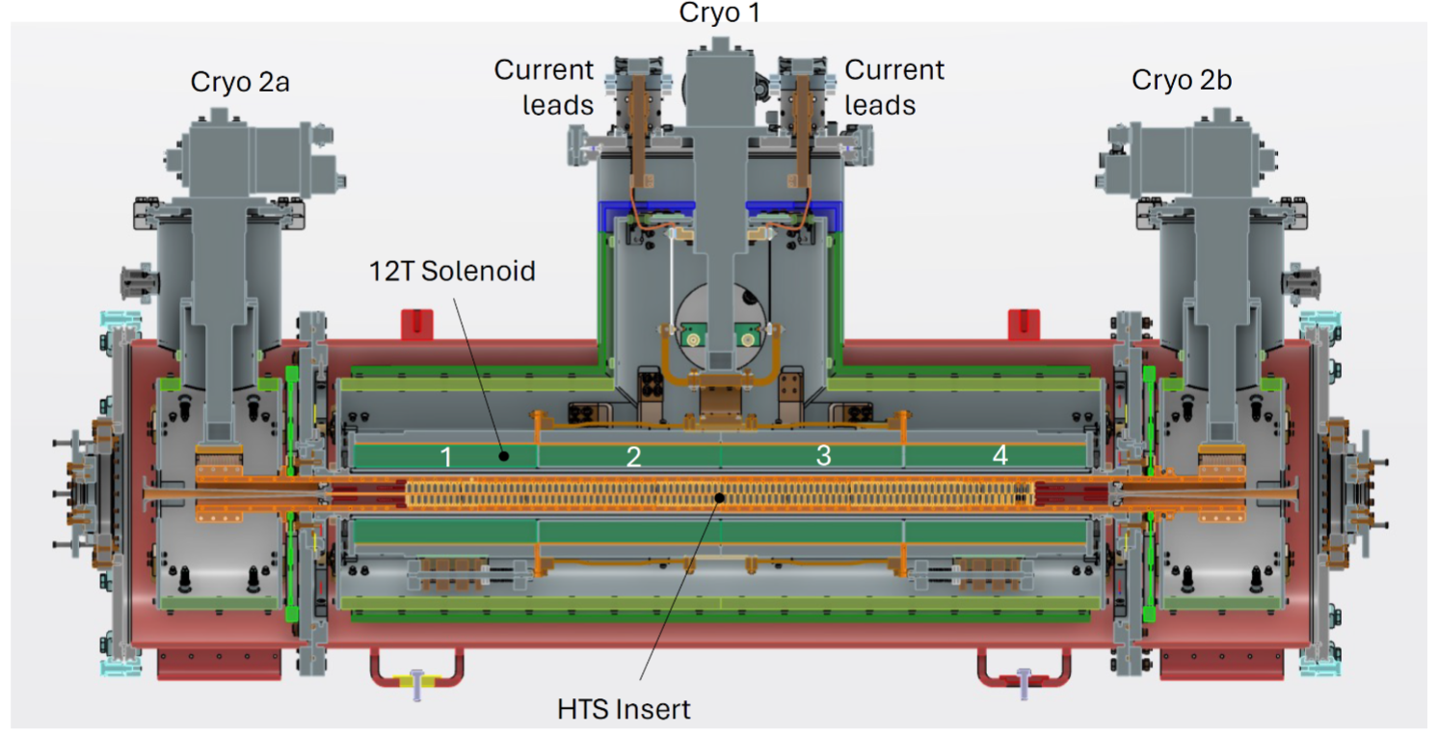
HTS undulator
Preliminary design of the full undulator

Slide 10
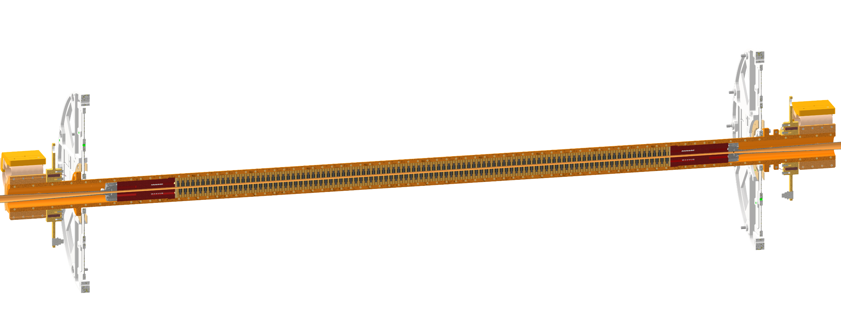
HTS undulator
HTS insert

Slide 11
HTS undulator
HTS insert cooling

Slide 12
HTS undulator
Solenoid cooling

Slide 13
HTS undulator
Aluminium thermal shields cooled by 1st stage cryocoolers

Slide 14
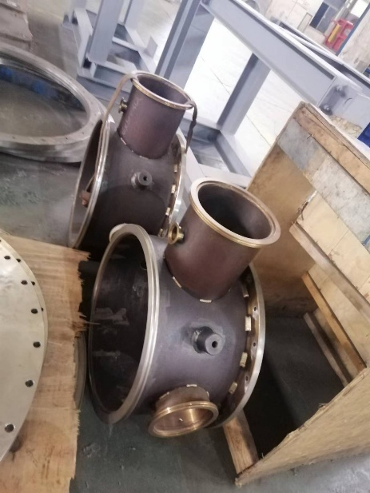
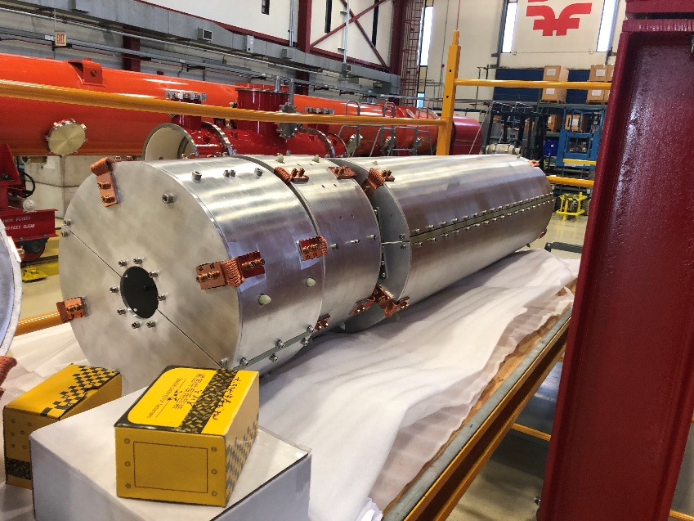
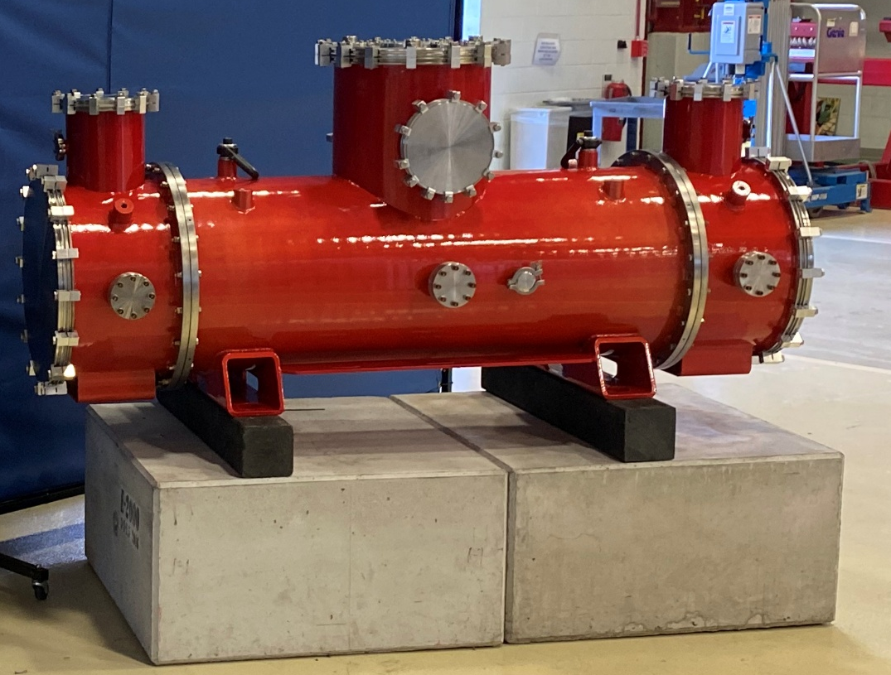
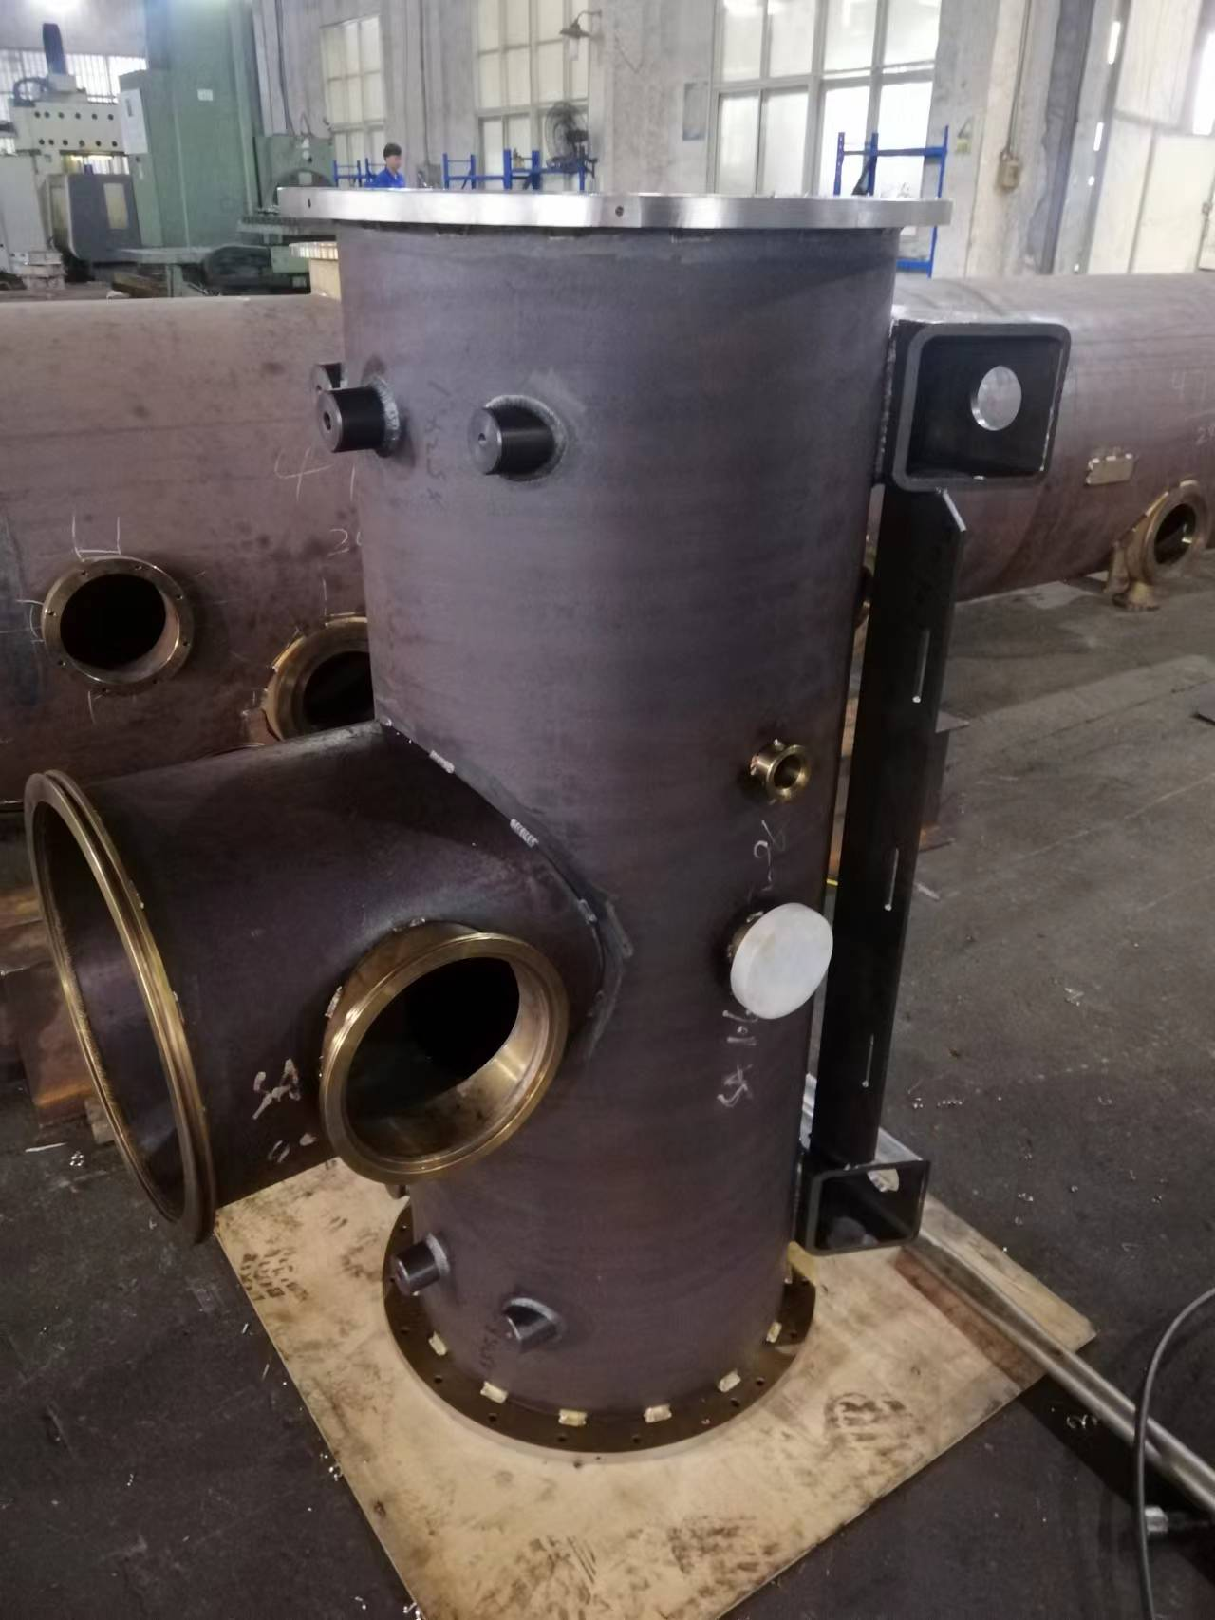
Cryostat

Slide 15
Outline
HTS undulator
Nb₃Sn solenoid
HTS bulks insert
HTS bulks sorting
Conclusion

Slide 16
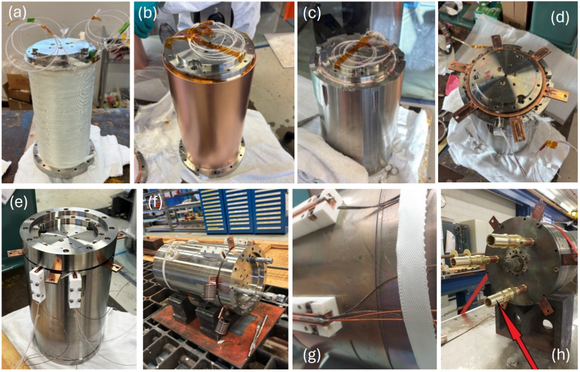
Nb₃Sn coil fabrication
Winding of glass fiber insulated Nb₃Sn wire

Slide 17
Nb₃Sn coil fabrication
Assembly of copper sleeve

Slide 18
Nb₃Sn coil fabrication
Assembly of stainless steel outer shell

Slide 19
Nb₃Sn coil fabrication
Installation of copper sleeve and stainless-steel shell

Slide 20
Nb₃Sn coil fabrication
Installation of upper flange and anchorage for internal connections

Slide 21
Nb₃Sn coil fabrication
In-vacuum oven for thermal treatment

Slide 22
Nb₃Sn coil fabrication
Fabrication of internal and external joints

Slide 23
Nb₃Sn coil fabrication
Thermal treatment and in-vacuum epoxy impregnation

Slide 24
Outline
HTS undulator
Nb₃Sn solenoid
HTS bulks insert
HTS bulks sorting
Conclusion

Slide 25
HTS bulks insert

Slide 26
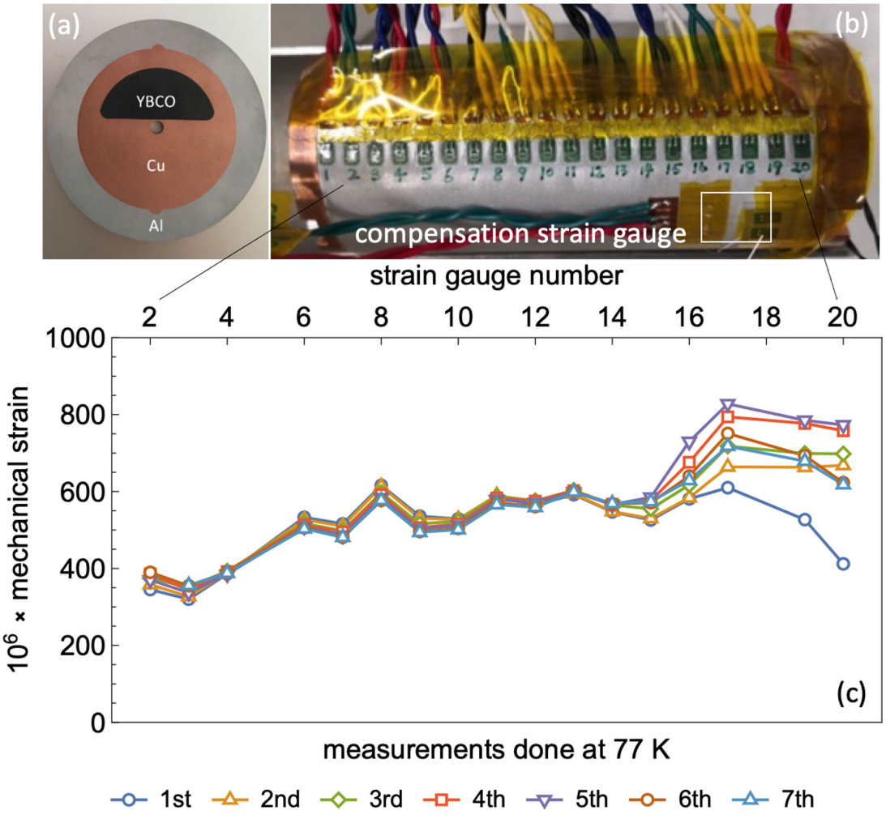
Strain measurement
Previously used aluminium outer shell to compress the disks
Need to measure the compression of copper shells on disks in liquid nitrogen

Slide 27
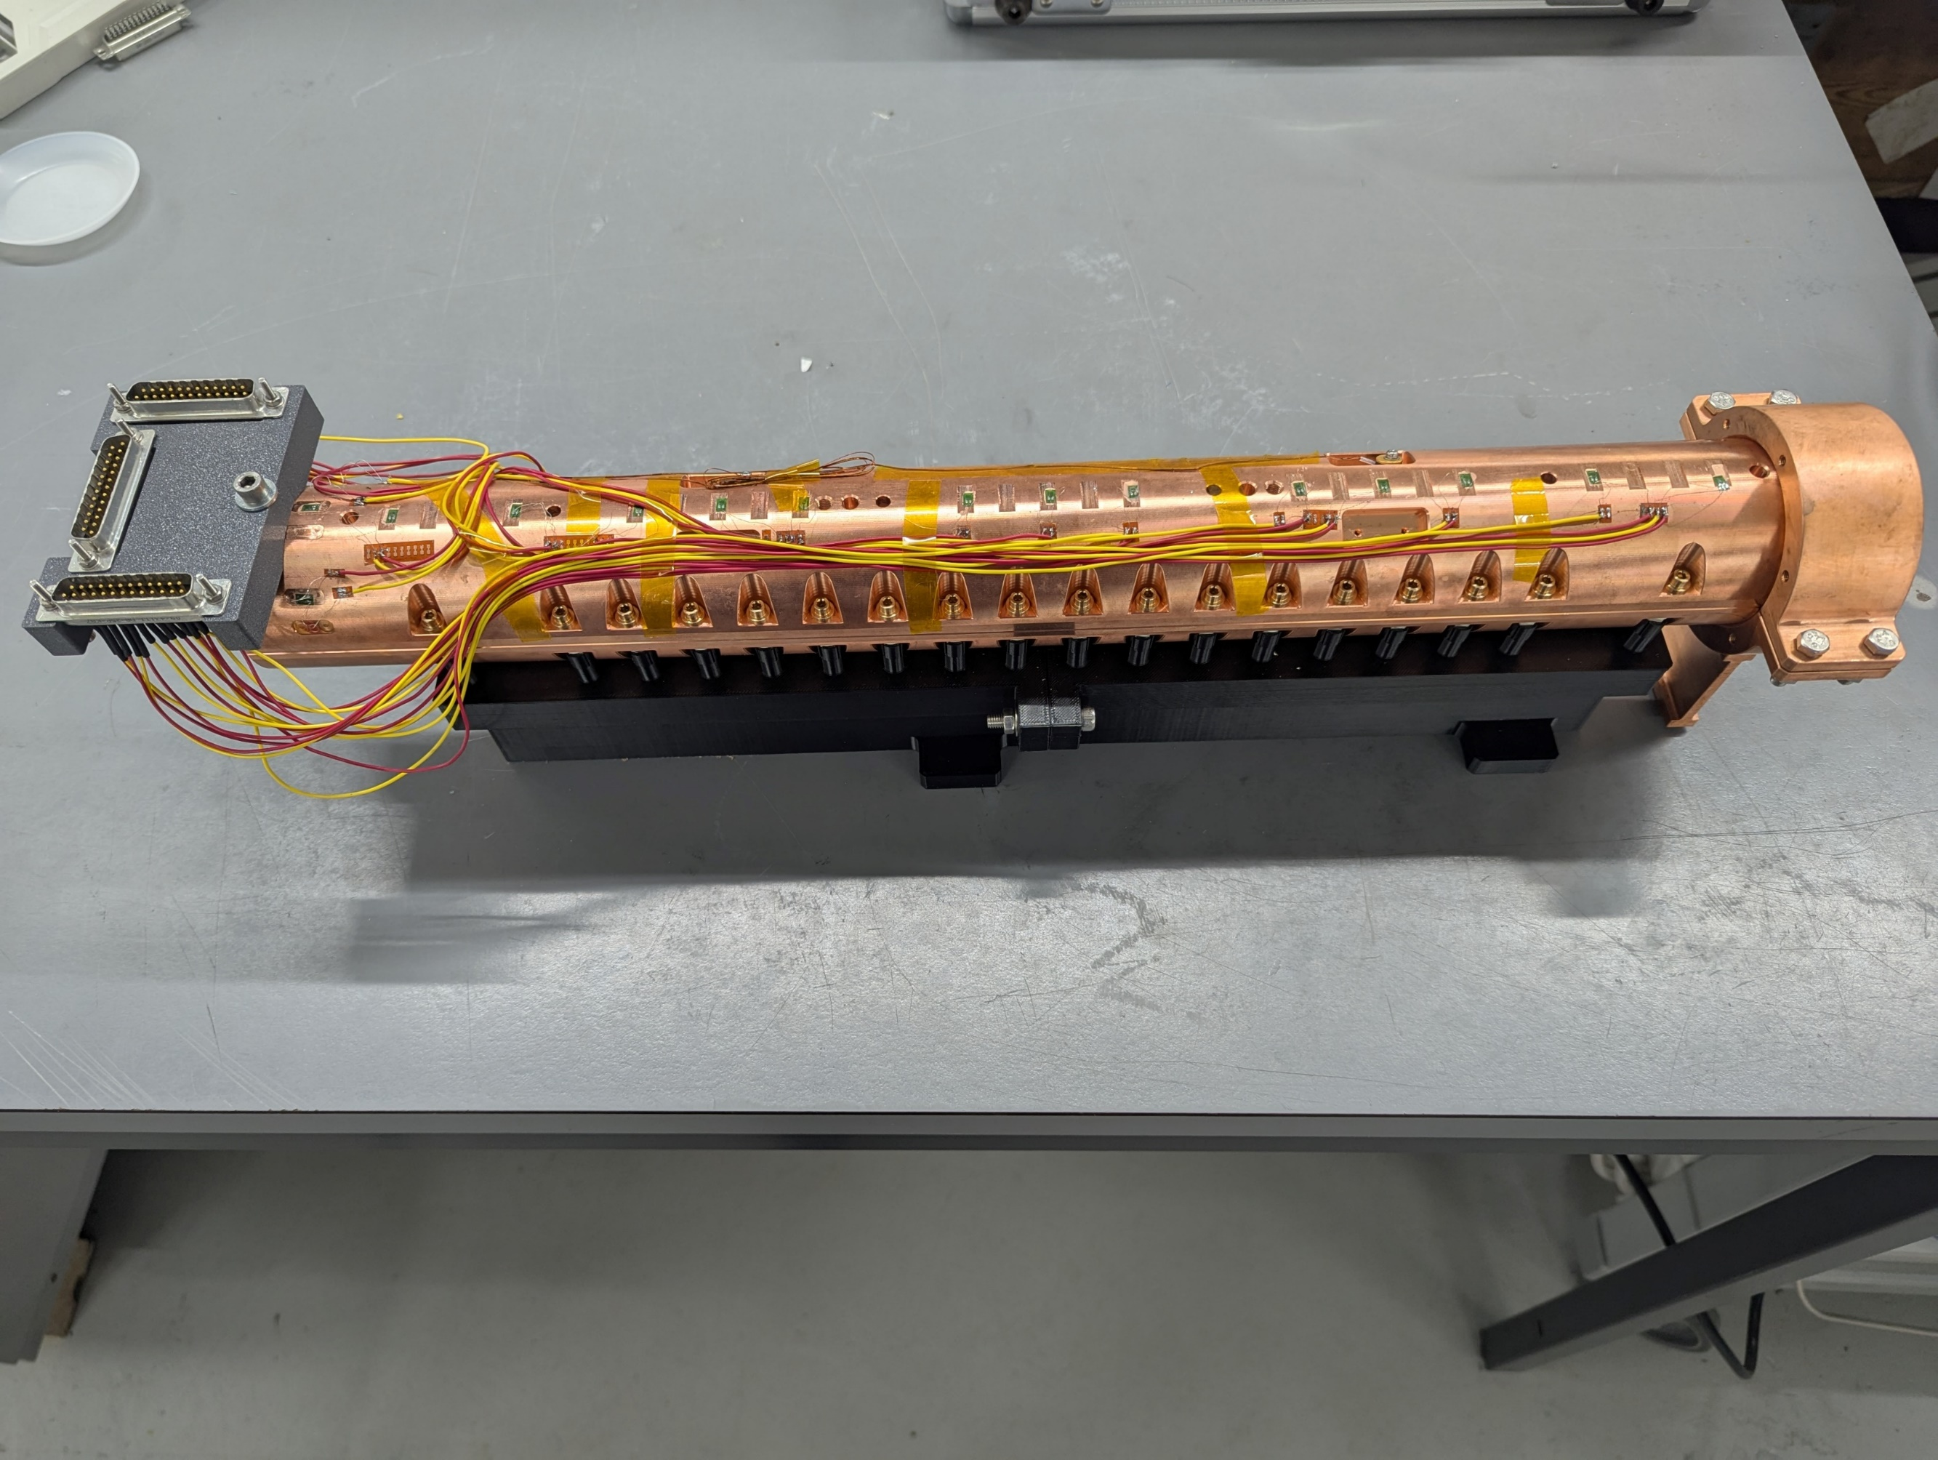
Strain measurement
Previously used aluminium outer shell to compress the disks
Need to measure the compression of copper shells on disks in liquid nitrogen
Strain gauges

Slide 28
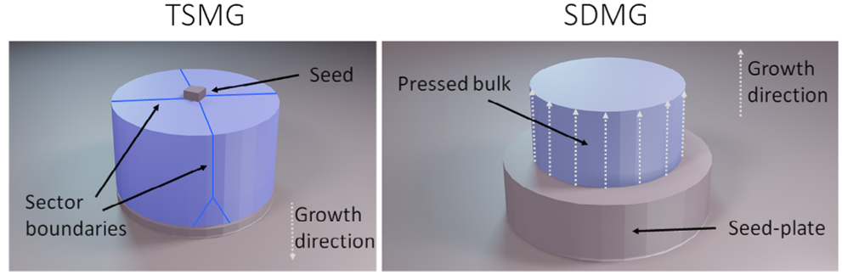

Single direction melt growth
Grown 130 bulks using Single Direction Melt Growth (SDMG)
Cut each bulk in half and shrink-fit into copper sleeves, yielding 260 pieces
Produced 250 holmium poles
Coated in 300 nm silver
Antončík F, et al. J Am Ceram Soc. 2024; 107: 2668–2678. https://doi.org/10.1111/jace.19566

Slide 29
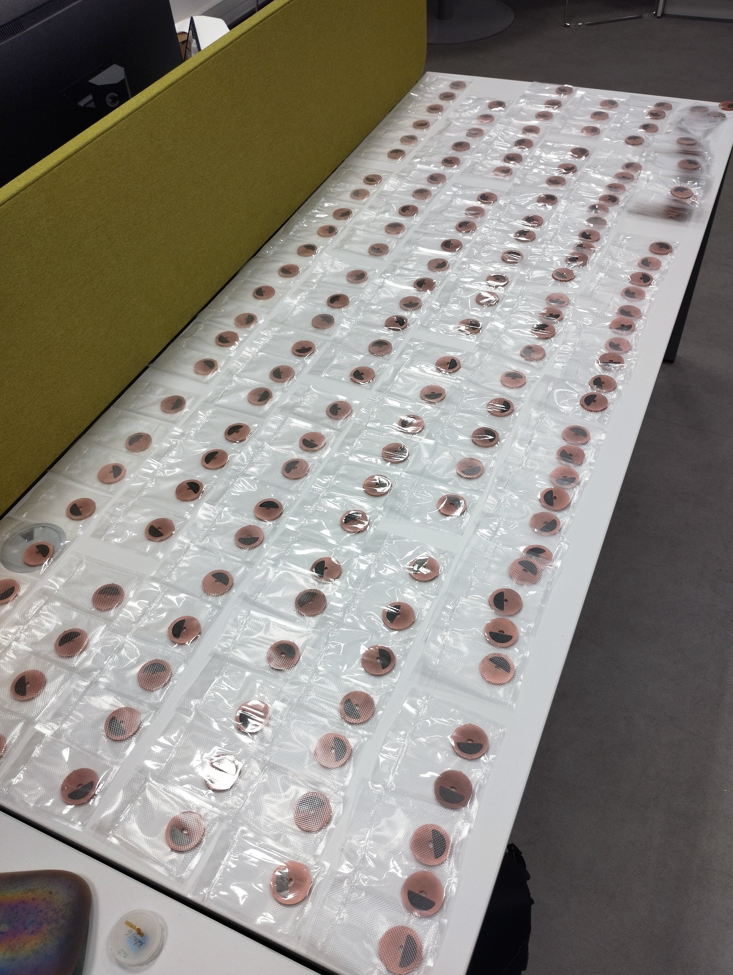
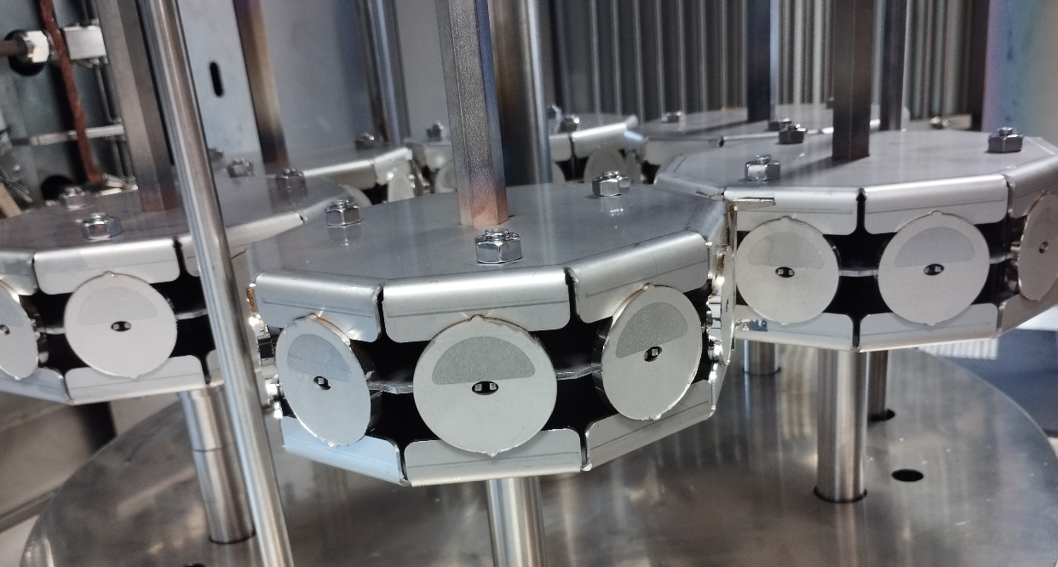
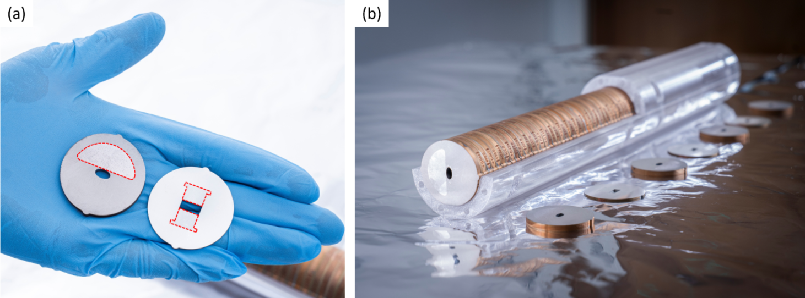
HTS bulks insert
Grown 130 bulks using Single Direction Melt Growth (SDMG)
Cut each bulk in half and shrink-fit into copper sleeves, yielding 260 pieces
Produced 250 holmium poles
Coated in 300 nm silver

Slide 30
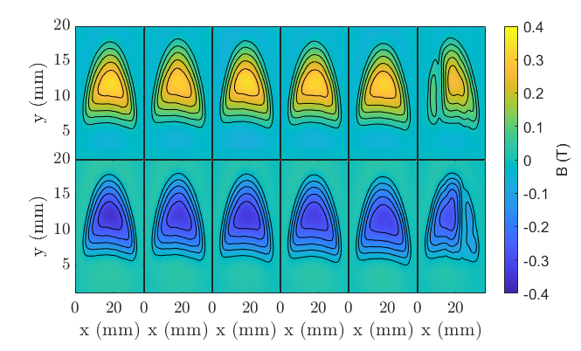
HTS bulks insert
(a)
1
2
3
4
5
6
1
2
3
4
5
6
Field maps measured on seeded and non-seeded surfaces at 1 T and 77 K
6 out of 260 half-moon bulks had visible defects

Slide 31
Outline
HTS undulator
Nb₃Sn solenoid
HTS bulks insert
HTS bulks sorting
Conclusion

Slide 32
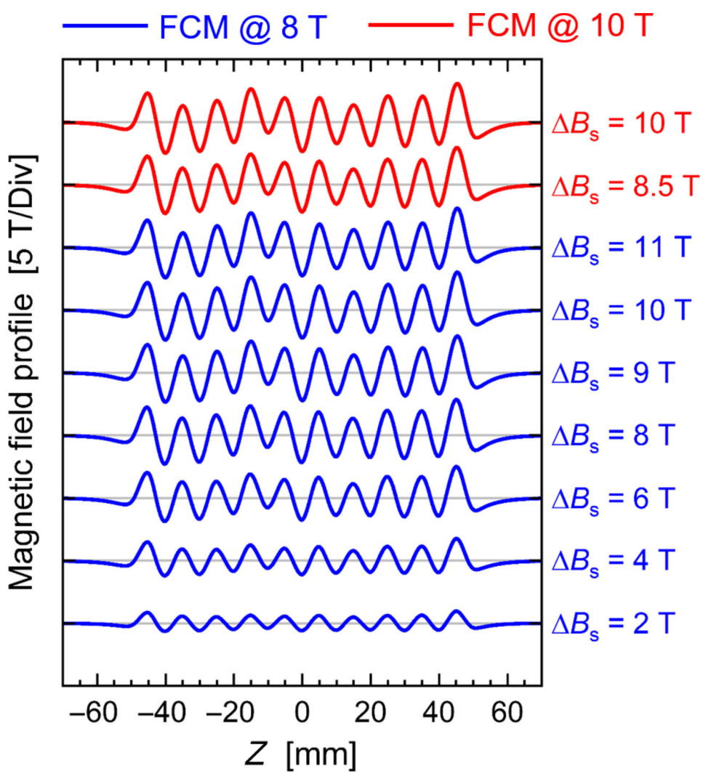
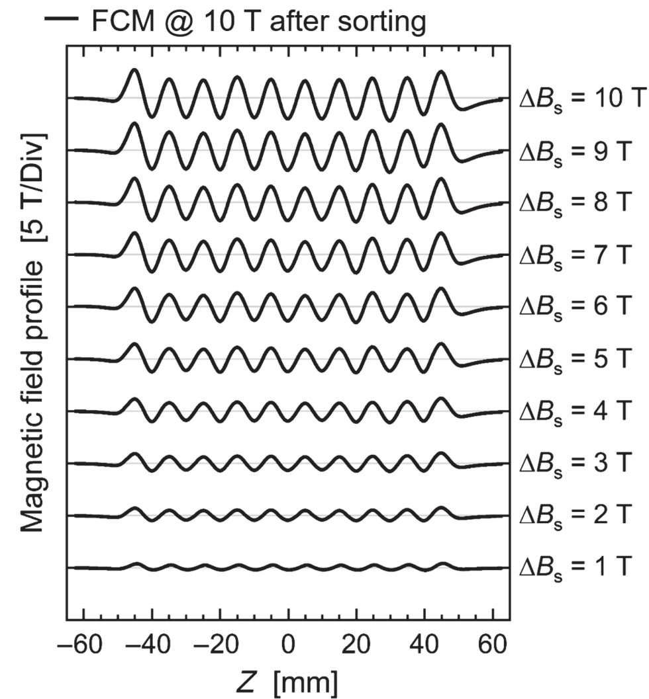
HTS bulks sorting
Sorting the bulks experimentally leads to an error reduction of a factor of 3.2

Slide 33
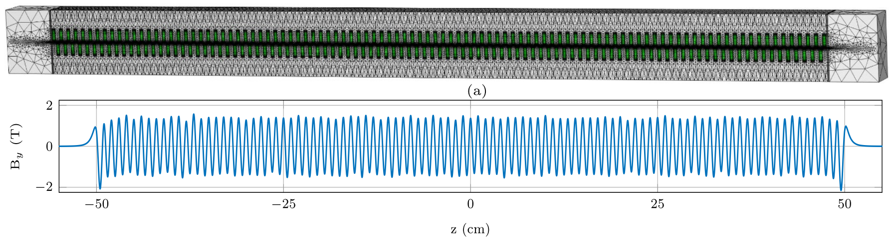
HTS bulks sorting
Sorting done by fitting experimental data to FEM simulation
For 200 bulks, one FEM simulation takes ~6 hours
Bulk HTS properties
FEM simulation
Local field integral (k)

Slide 34
HTS bulks sorting
Made a machine learning model that takes ~200 ms to get the same FEM result
Machine learning model
Bulk HTS properties
Local field integral (k)

Slide 35
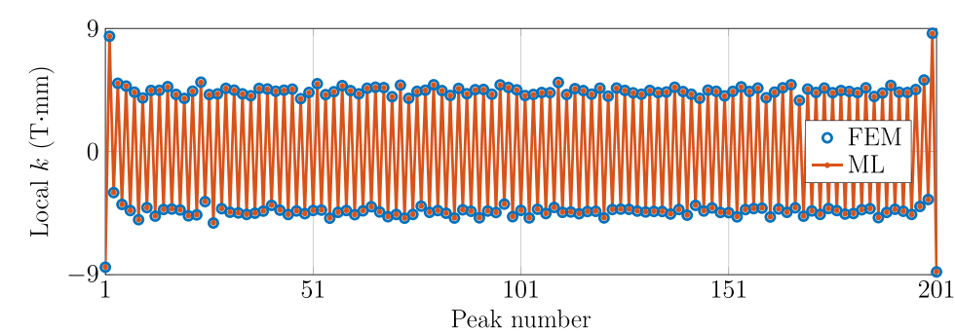
HTS bulks sorting
Made a machine learning model that takes ~200 ms to get the same FEM result
Machine learning model
Bulk HTS properties
Local field integral (k)

Slide 36
Outline
HTS undulator
Nb₃Sn solenoid
HTS bulks insert
HTS bulks sorting
Conclusion

Slide 37
Conclusion
Full design of HTS undulator complete
The solenoid is still under discussion
200+ GdBCO bulks have been made and embedded into copper
Produced a machine learning model to help with the magnetic field optimization

Slide 38

Acknowledgements
PSI : M. Calvi, X.Liang, S.Hellmann, L.Huber, S.Reiche, M.Bartkowiak, C.Calzolaio, Prof. M. Stampanoni, Prof L.Patthey, F. Marone & G.Lovric
CAN: Tomas Hlasek, Filip Antoncik & Jan Plechacek
EUXFEL: T. Schmidt
CHART : Prof. H.R.Ott & Prof. L.Rivkin
Uni Cambridge : J.Durrell, A.Dennis, Y. Shi
King's College London: M.Ainslie
Spring8 : T.Ishikawa, M.Yabashi, H.Tanaka
UniKyoto : R.Kinjo, T.Kii, H.Ohgaki
Uni Malta : N.Sammut, A.Sammut, J.Cassar
SENIS : Prof.R.Popovic, S.Spasic, S.Dimitrijevic
KIT : Prof. M.Noe
Fermilab: C.Boffo, M.Turenne, F.McConologue, V.Martinez, J.Hayman
Zhangjiang lab: K. Zhang, D. Wei

Slide 39
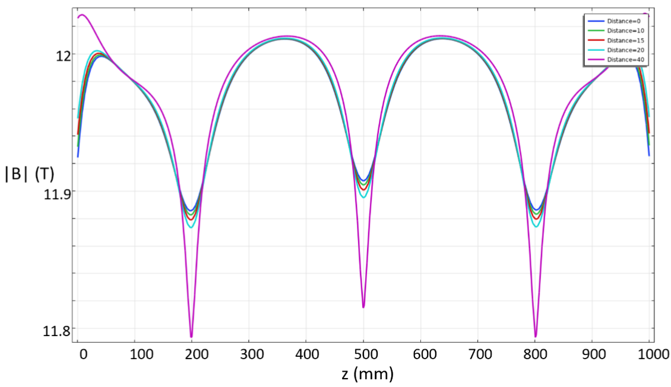
Magnetic field simulations
Split the solenoid into 4 coils
Calculated field uniformity of 1.12% within a radius of 15 mm
Field near 12 T with a nominal current of 235 A
z

Slide 40
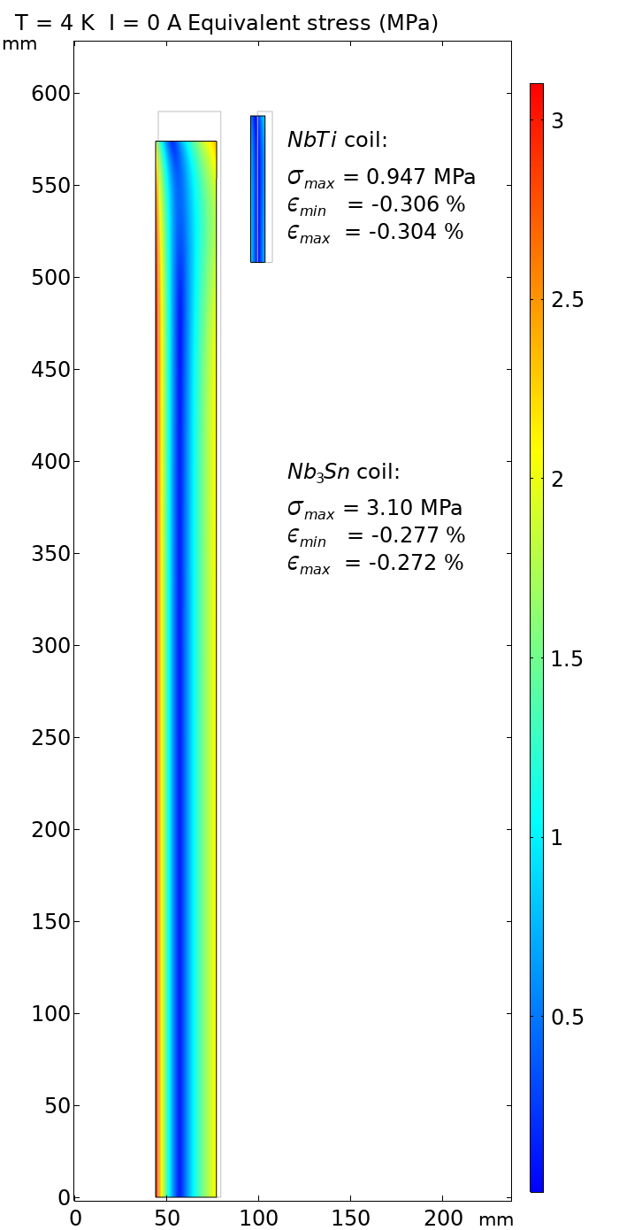
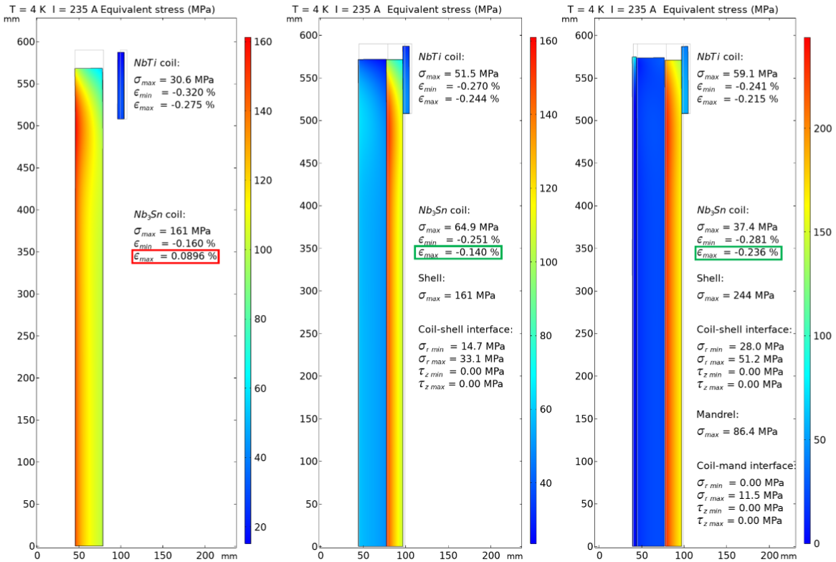
Mechanical analysis
FEM simulations show that a support is needed to reduce strain
SS304 outer shell was the best candidate found
Inconel 308 mandrel reduced strain further, but requires pre-load at room temperature
SS304 shell and Inconel 308 mandrel, powering
No support, cooling
No support, powering
SS304 shell, powering
Reference “zero” strain after cool-down

Slide 41
Mechanical analysis
FEM simulations show that a support is needed to reduce strain
SS304 outer shell was the best candidate found
Inconel 308 mandrel reduced strain further, but requires pre-load at room temperature
SS304 shell and Inconel 308 mandrel, powering
No support, cooling
No support, powering
SS304 shell, powering
Reference “zero” strain after cool-down

Slide 42
Mechanical analysis
FEM simulations show that a support is needed to reduce strain
SS304 outer shell was the best candidate found
Inconel 308 mandrel reduced strain further, but requires pre-load at room temperature
SS304 shell and Inconel 308 mandrel, powering
No support, cooling
No support, powering
SS304 shell, powering
Reference “zero” strain after cool-down

Slide 43
Mechanical analysis
FEM simulations show that a support is needed to reduce strain
SS304 outer shell was the best candidate found
Inconel 308 mandrel reduced strain further, but requires pre-load at room temperature
SS304 shell and Inconel 308 mandrel, powering
No support, cooling
No support, powering
SS304 shell, powering
Reference “zero” strain after cool-down

Slide 44
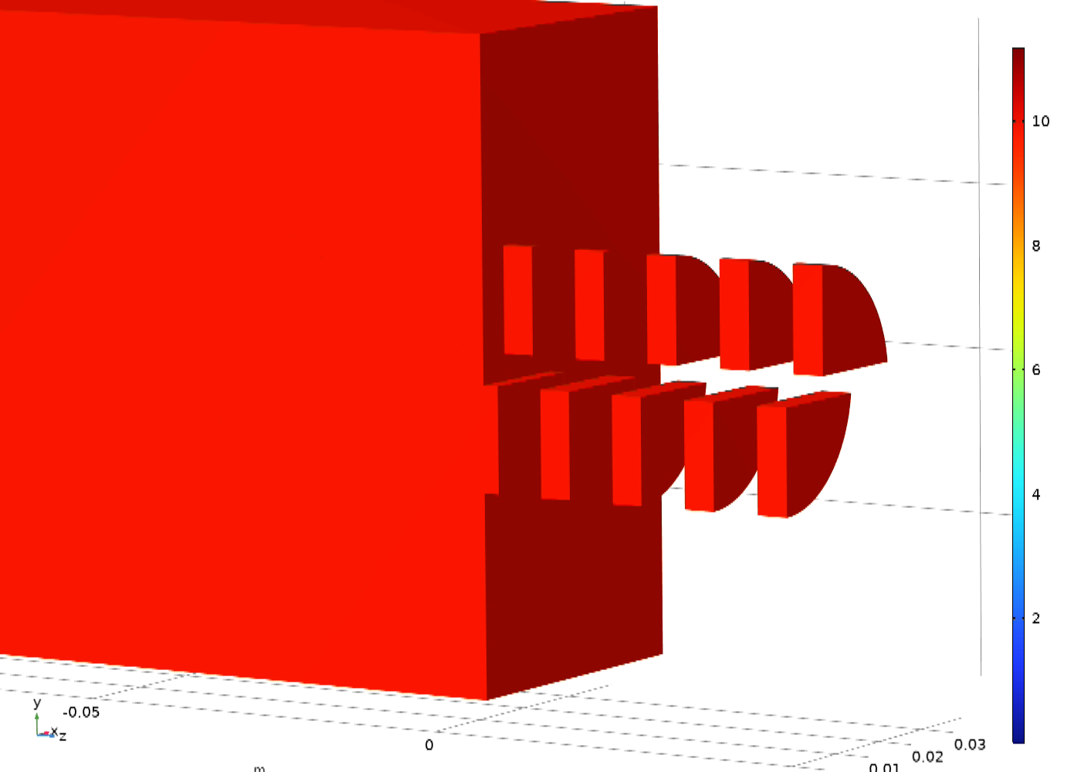
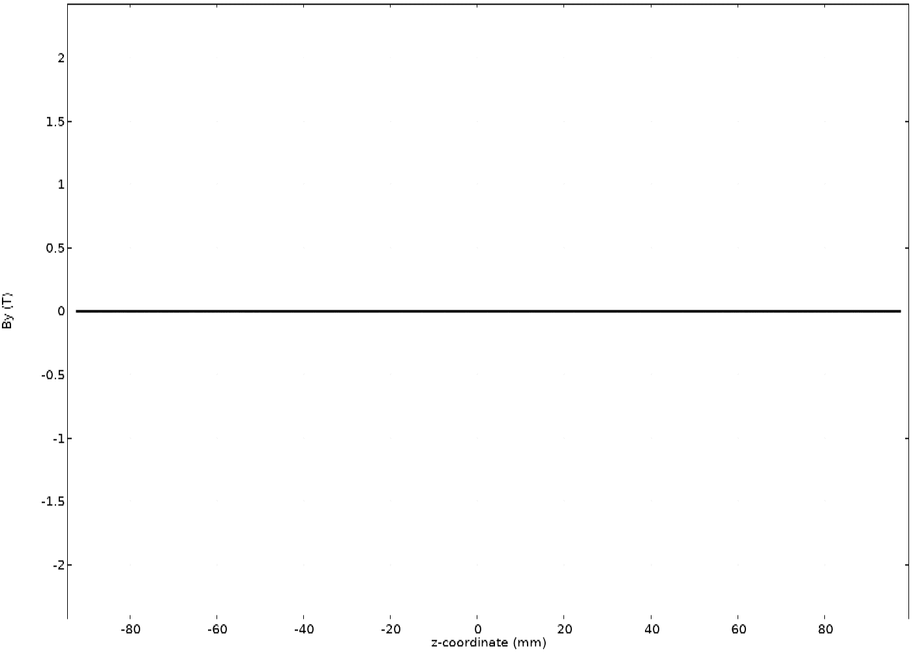
Introduction
HTSU field cool magnetized at 10K in a field of 10T

Slide 45
Introduction
To increase the flux and energy of synchrotron radiation, higher magnetic fields and lower undulator period
HTS
Nb₃Sn @ 4.2K
NbTi @ 4.2K
PrFeB @77K
SmCo @300K
magnetic gap = 4mm

