Slide 1
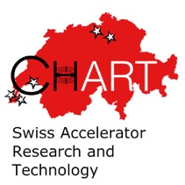
Welcome and Introduction
CHART Workshop 2025, 12 November, 2025

Slide 2
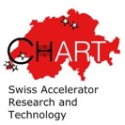


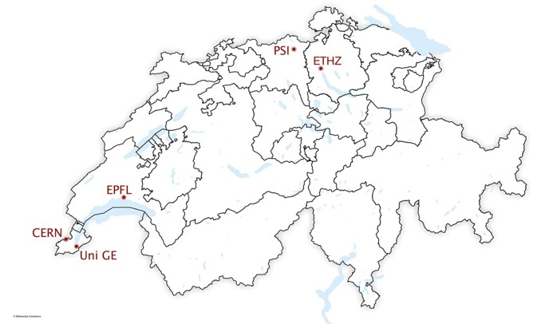





CHART since the 2015 Agreement
Initial agreement in October 2015
2015 – 2017: 2 MCHF
Continuation co-funded by SERI, ETH-domain and partners CERN, PSI, EPFL, ETHZ, UniGE
2018 - 2024: 40 MCHF (5 MCHF competitive)
2025 – 2028: 34 MCHF
> 30 projects
Goals:
development and innovation of future accelerator technologies;
synergy with synchrotron light sources, medical, industrial, and energy/fusion applications;
emphasis: high field magnets and FCC-ee injector.
CHART: open collaboration that brings cohesion and synergies to the accelerator driven fields of science.
Securing the future of CERN beyond LHC

Slide 3





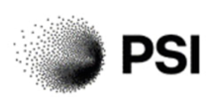
Mission-oriented R&D for the FCC
“The Swiss Accelerator Research and
Technology (CHART) programme is a good
example of a mission-oriented programme.
It aims at supporting the Future Circular
Collider at CERN. In this case the receiver of
the results is CERN. Such initiatives benefit
both science and Switzerland.”
(SSC Report 1/2023)

Slide 4
Mission-oriented R&D for the FCC
The next collider at CERN is a Swiss national science priority.
CHART is an umbrella for Swiss contributions to FCC accelerator science and technology in CHART institutes.
CHART reaches its full potential in collaborative interdisciplinary projects across institutes.
With support of SERI and ETH Council, CHART makes investments in fields of high strategic relevance.

Slide 5
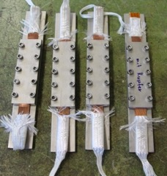
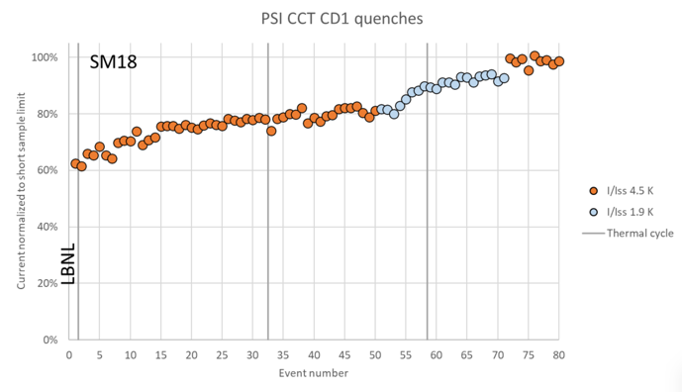
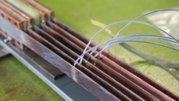
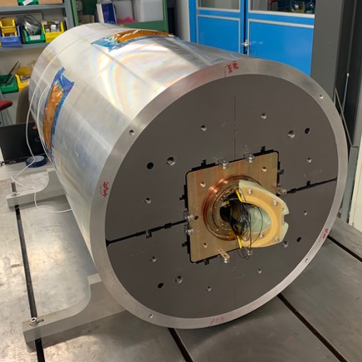
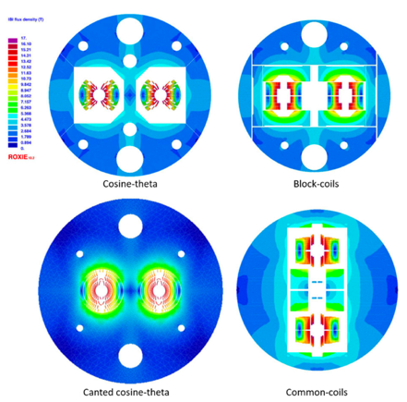
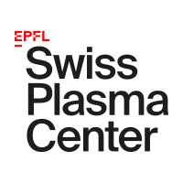


First CHART Projects 2015-2019
Development of reaction-resistant Nb₃Sn/Nb₃Sn splices.
Development of Nb₃Sn Canted Cosine Theta stress-management technology for FCC-hh.
[M. Kumar et al., Preliminary Tests of Soldered and Diffusion-Bonded Splices between Nb3Sn Rutherford Cables for Graded High-Field Accelerator Magnets, IEEE Trans. on Appl. SC., Vol 29(5), 2019.]
[B. Auchmann et al., Electromechanical Design of a 16-T CCT Twin-Aperture Dipole for FCC, IEEE Trans. on Appl. SC 28 (April, 2018) no. 3.]
[M. Benedikt et al., FCC Conceptual Design Report, Vol. 3 – The Hadron Collider (FCC-hh), January 2019.]
[M. Benedikt et al., FCC Conceptual Design Report, Vol. 3 – The Hadron Collider (FCC-hh), January 2019.]

Slide 6

CHART 2019-2024: Mission-oriented R&D for the FCC
Superconducting Magnets
Beam Dynamics
e+e- Injector
Geology/ Geodesy
build on existing expertise and infrastructure and
lay the groundworks for future progress:
create new and refurbishing existing infrastructure (not complete)
build new software platforms
establish international research networks
build momentum
educate the next generation of researchers in accelerator technologies

Slide 7
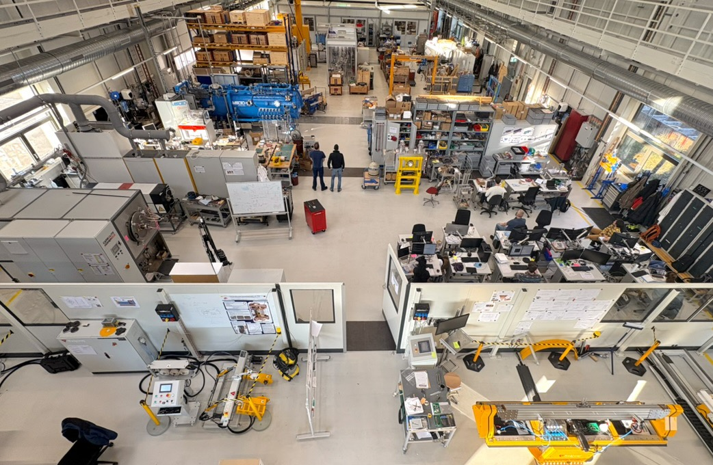
New Infrastructure
The MagDev Laboratory at PSI was opened in August 2020 and is today home to 17 researchers in LTS and HTS magnet technologies for the FCC at CERN and PSI facilities.

Slide 8
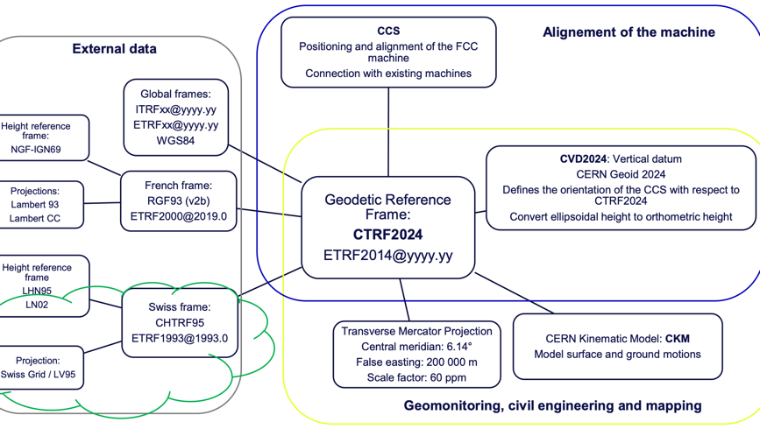
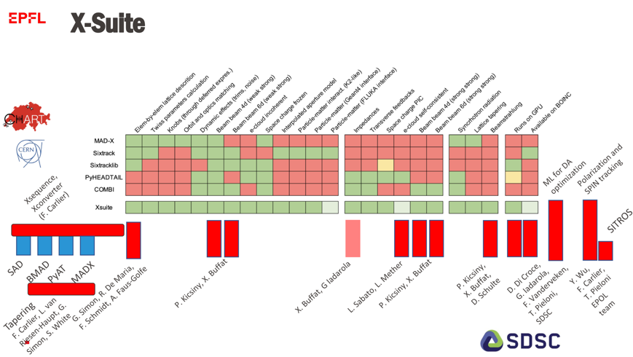
New Software Platforms
ETHZ Institute of Geodesy and Photogrammetry contributes to the development of CTRF2024, a new CERN Terrestrial Reference Frame being established to connect existing CERN reference frames to international and national systems.
EPFL LPAP contributes to the development of a collaborative simulation frame-work where the physics of leptons will be added to the established CERN standards for numerical simulations.

Slide 9
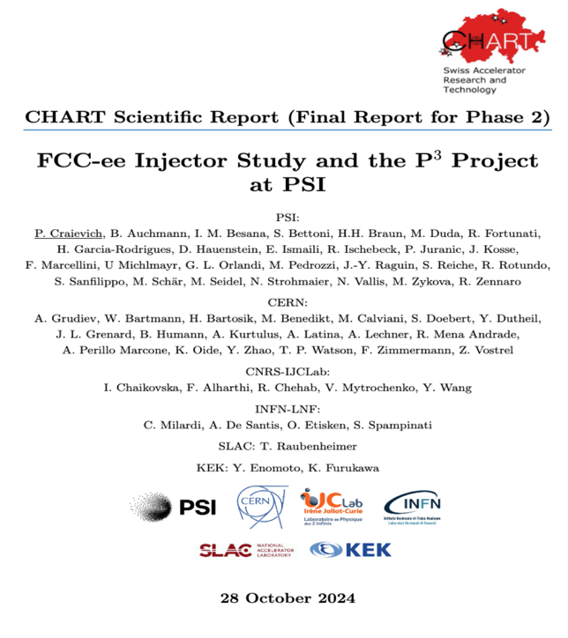
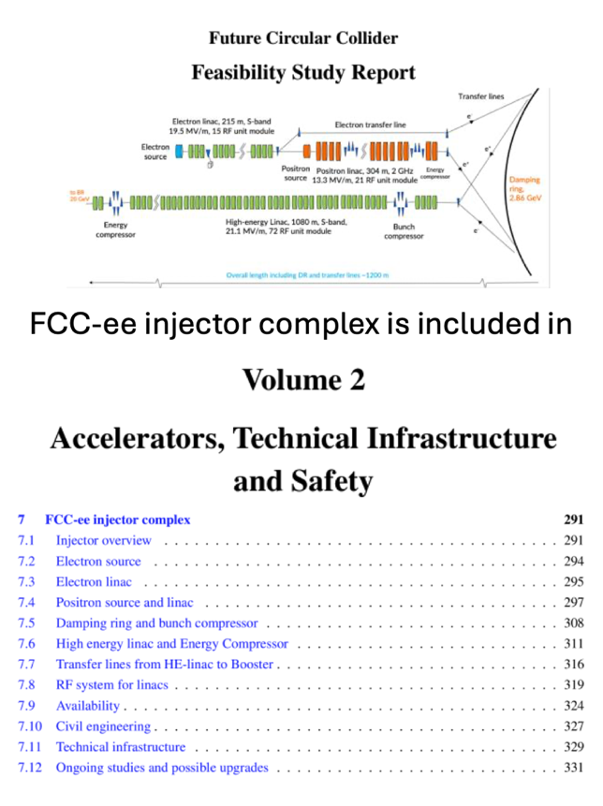
International Research Networks
The CHART FCC Injector at PSI project takes a lead role in an international collaboration for the design of the FCC-ee injector complex.

Slide 10
Collaborating international partners of CHART include:
TU Twente, Enschede, Netherlands
TU Darmstadt, Germany
USMDP Magnet Development Program, Berkeley, USA
University of Cambridge, UK
LEAPS, League of European Accelerator based Photon Sources
BNL, Brookhaven National Laboratory, USA
LBNL, Lawrence Berkeley National Laboratory, USA
KEK, High Energy Accelerator Research Organization, Tsukuba, Japan
IJCLab, Laboratoire de Physique des 2 infinis Irène Joliot-Curie, Orsay, France
INFN Frascati, Italy
SLAC National Accelerator Laboratory, Menlo Park, USA
University of Oxford, UK
FERMILAB, Fermi National Accelerator Laboratory, USA
RIKEN SPring-8 Center, Japan
Kyoto University, Japan
ESRF, European Synchrotron Radiation Facility, Grenoble, France

Slide 11
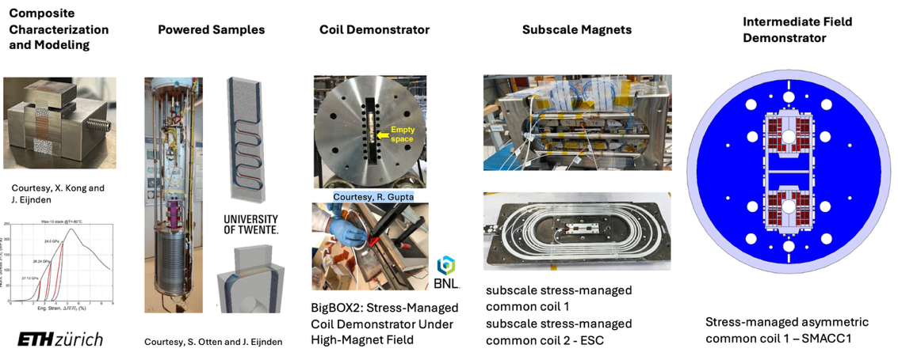
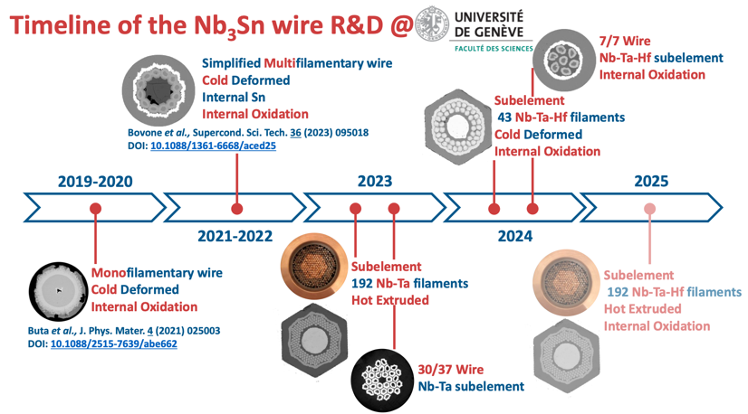
Building Momentum
The MagDev project(s) develop LTS and HTS magnet technology for FCC-hh. Fast-turnaround R&D at multiple scales enhances insights as well as competencies in the team.
WireDev and WireChar develop and characterize Nb₃Sn RRP wire for increased performance and with industrial processes.

Slide 12
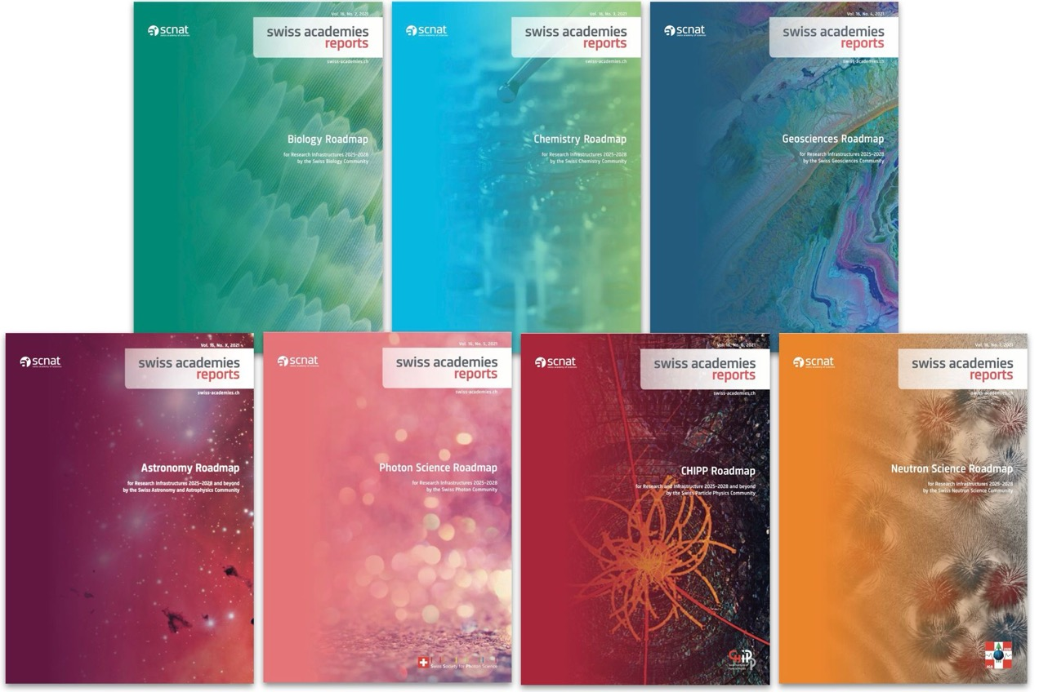
SCNAT Roadmaps for Research and Infrastructure 2025 – 2032
The Swiss Academy of Sciences (SCNAT) published a series of seven thematic roadmaps for research infrastructures
Almost all use accelerators
Themes:
Particle Physics (CHIPP)
Photon Science
Neutron Science
Biology
Chemistry
Geoscience
Astronomy

Slide 13
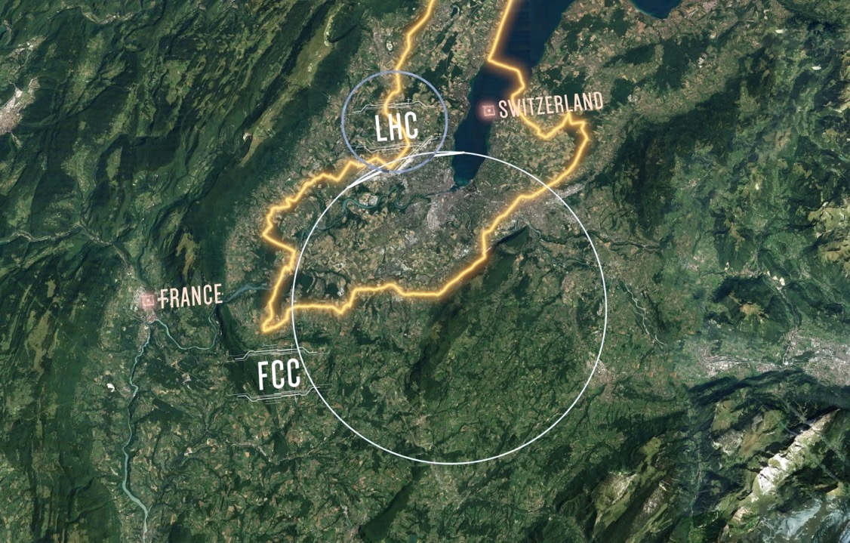
CHART 2025-2028
Build on the momentum and get ready to take it to the next level!

Slide 14
Workshop Overview
Coffe/arrival
Welcome with FCC status
Injector studies
Applied superconductivity I
Photo/Lunch
Applied superconductivity II
Beam dynamics
Coffee
Geology/Geodesy
Nanosecond Pulser
Have a good workshop!

Slide 15


