Slide 1

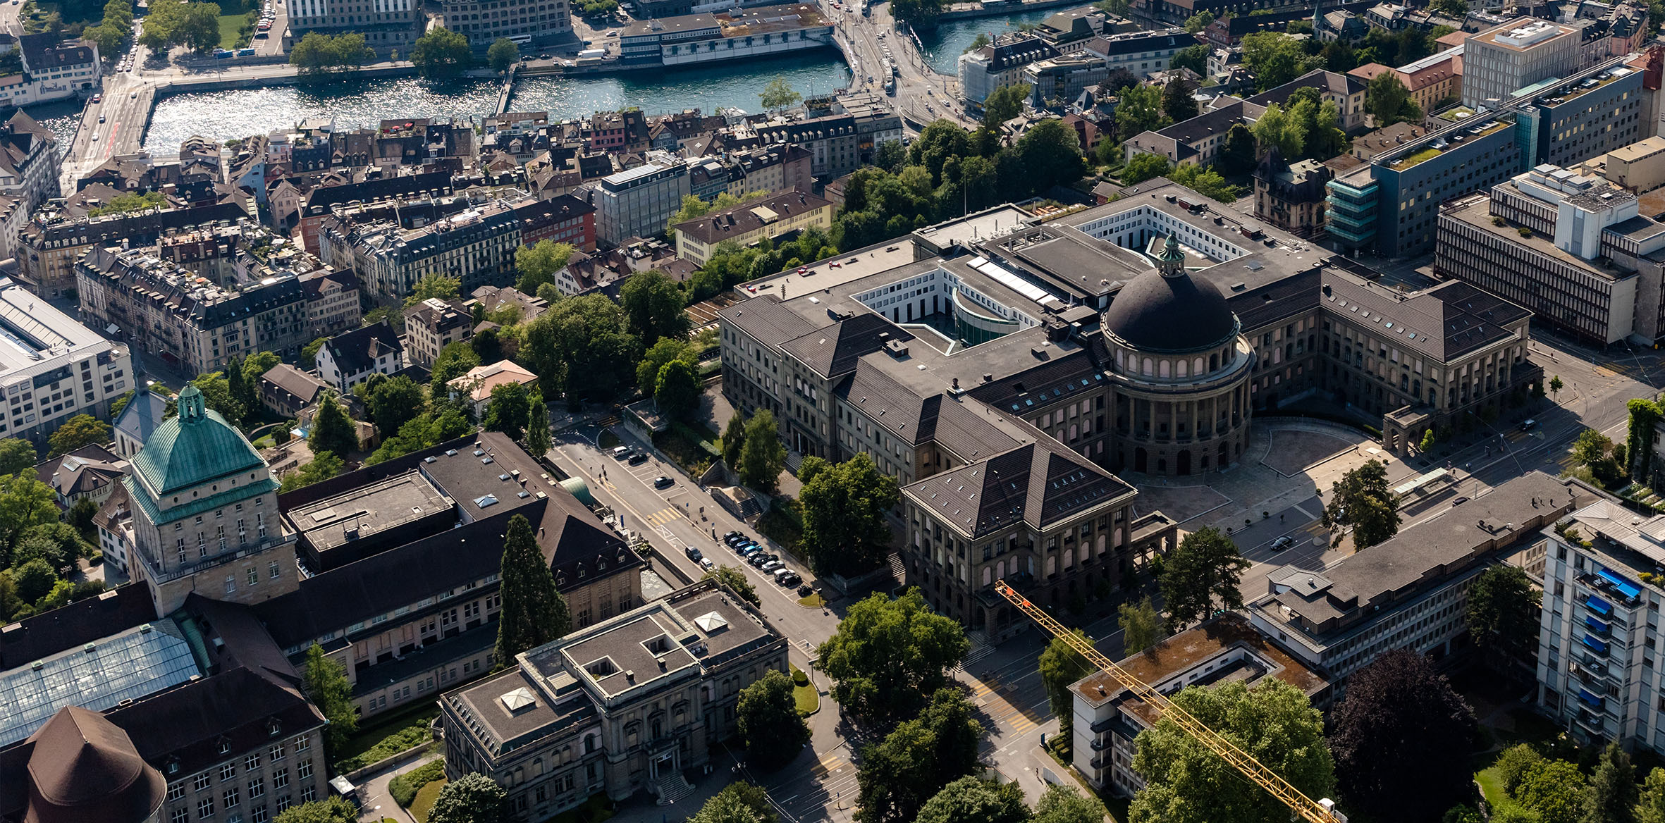

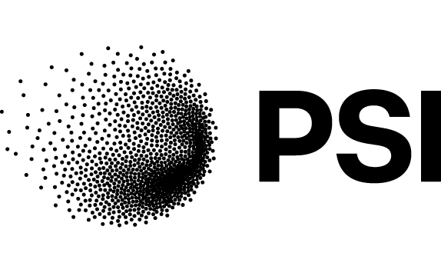
“Renaissance wax”:
Recent results of alumina-filled paraffin wax system
Organisationseinheit verbal
optional auf 2 Zeilen
Xiang Kong¹, Joep Van den Eijnden^{1,2}, André Brem², Douglas Martin Araujo², Bernhard Auchmann^{2,3} , Theo A. Tervoort¹
Department of Materials, ETH Zürich, Switzerland
Paul Scherrer Institution (PSI), Villigen, Switzerland
CERN, Geneva, Switzerland
November 12, 2025
CHART Workshop 2025 for the 10-year anniversary of CHART

Slide 2
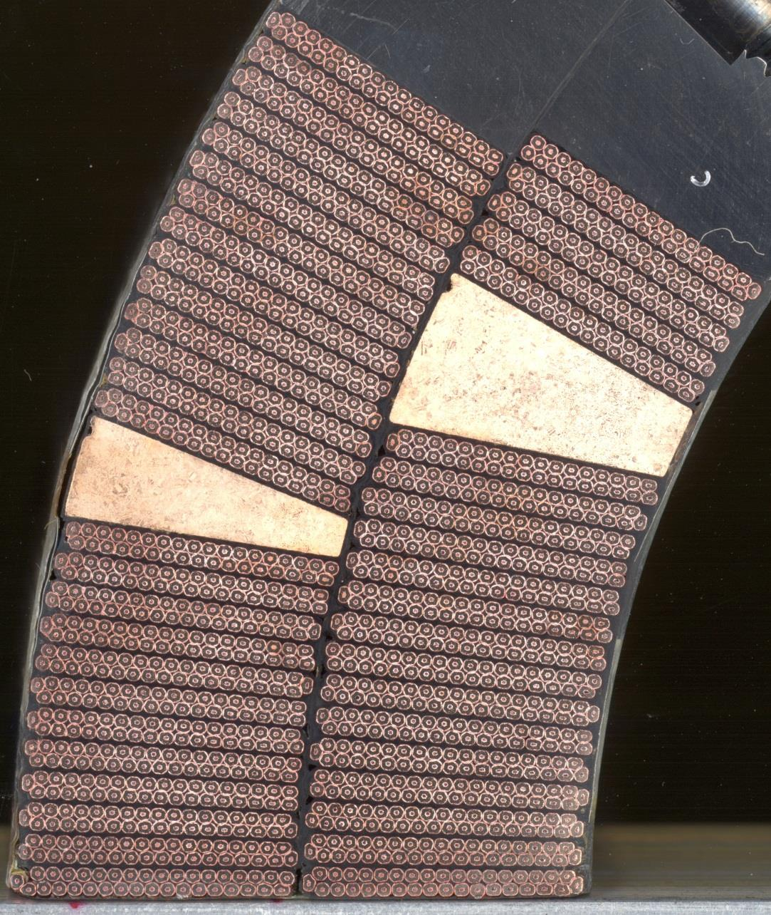
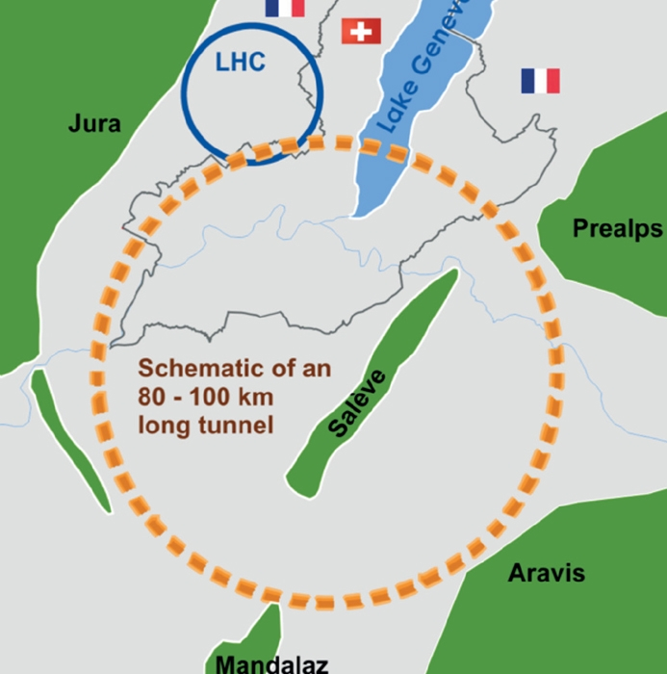
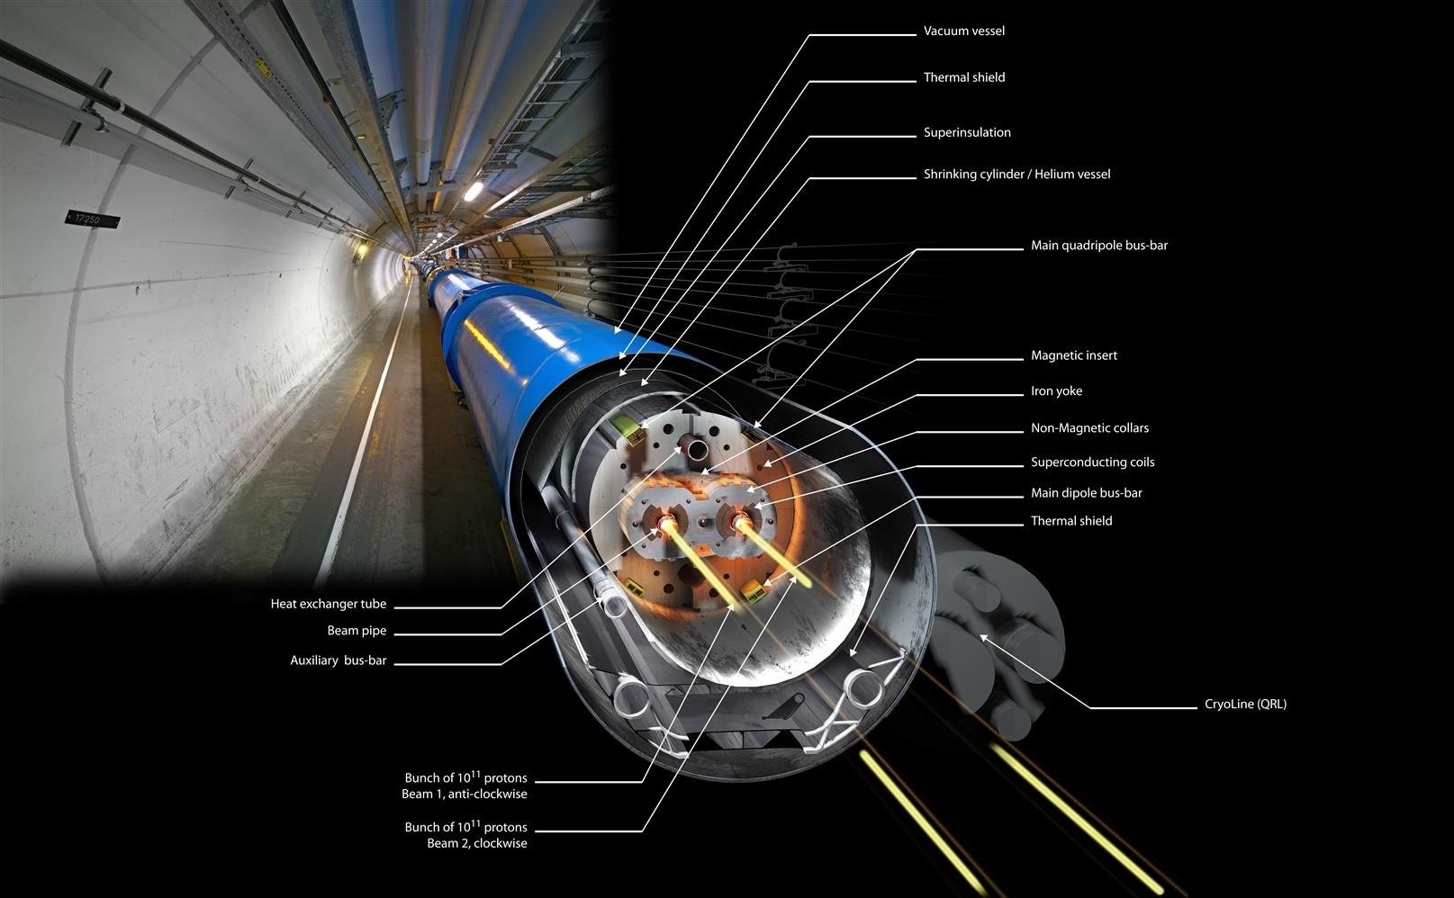

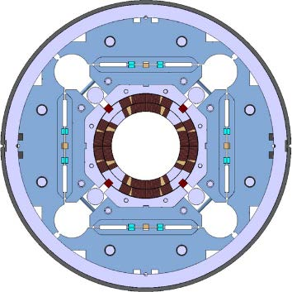
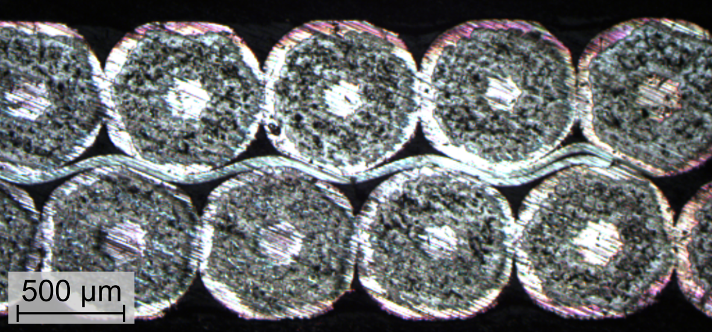
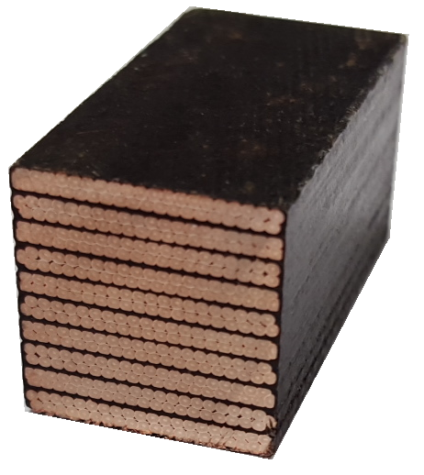
Introduction
CERN website
Rutherford cables
Ferracin et al. 2015
Daly et al. 2018
15 mm
Transverse
15 mm
Future circular collision (FCC) project
Common coil
20 mm
Axial
Radial
Extreme operating conditions:
Cryogenic temperatures
High stresses due to large Lorenz forces
High radiation exposure
10-stack cable
Insulation material

Slide 3
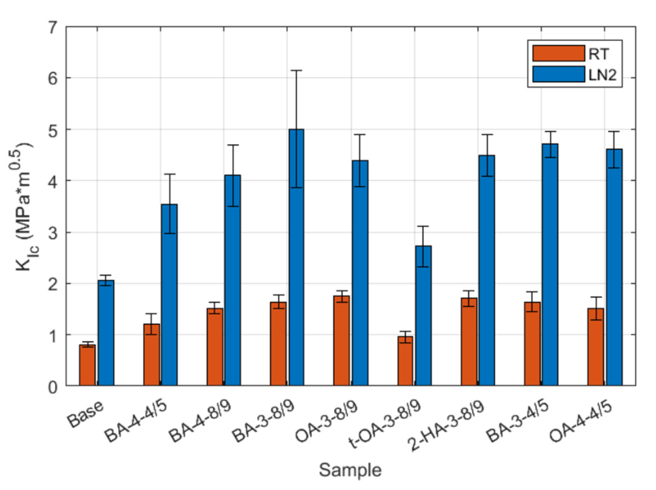
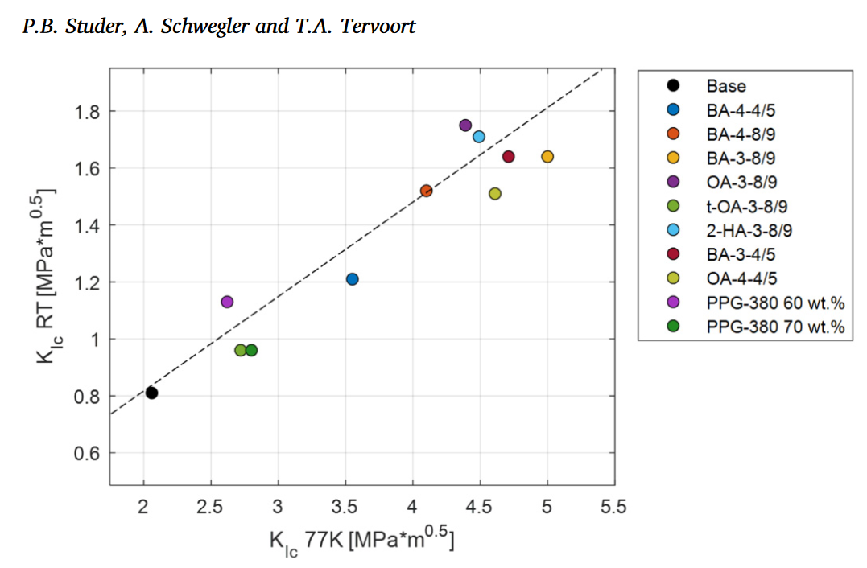
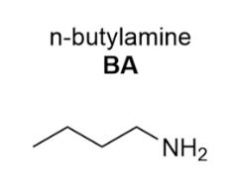
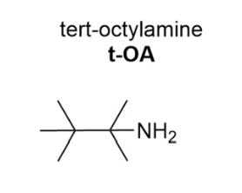
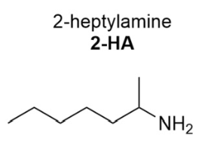
MagRes: epoxy materials with high toughness at cryogenic temperatures
Epoxy resin system development
Low viscosity (good impregnation)
Long “pot life” (slow curing reaction)
Moderate stiffness at RT (T_{g} > RT)
T_{g} slightly above room temperature to reduce built-up of thermal stresses (RT < T_{g} < 100°C)
High fracture toughness at LN₂
Studer et al. 2024, Cryogenics 143-103923.
Studer P. 2025, ETH doctoral thesis: Design of Epoxy Resin Insulation Materials for Cryogenic Applications.

Slide 4
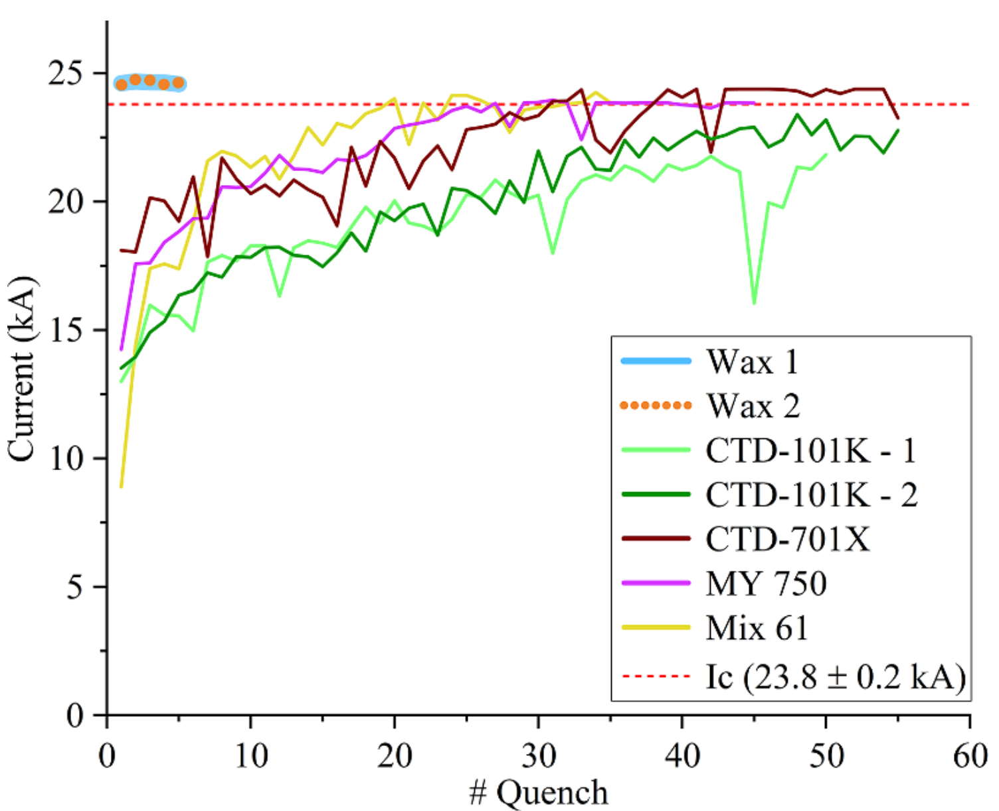
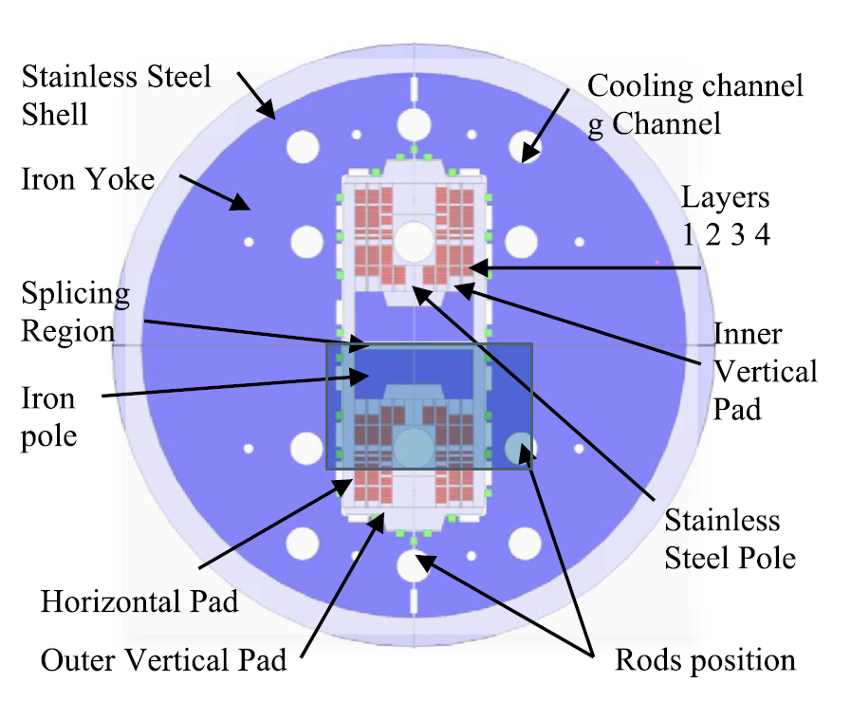
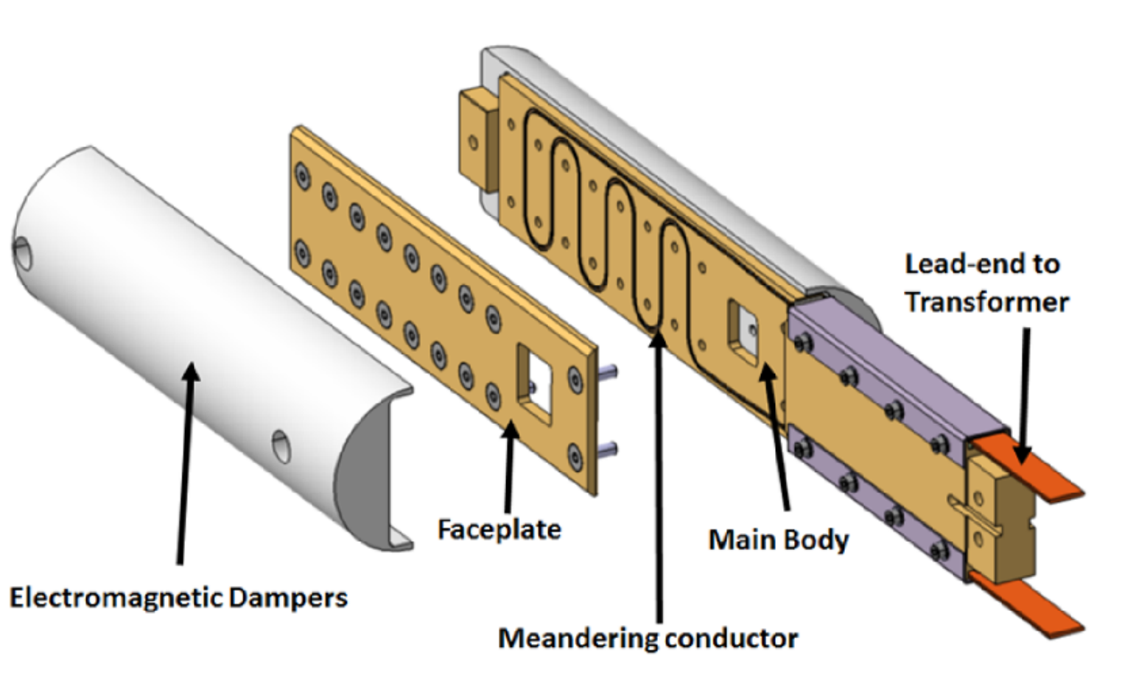
New insulation materials
Magnet training
  Stress-management common coil (SMACC) design
Daly et al. 2022
Daly et al. 2021
  Quench reasons:
  Frictional sliding → decrease surface adhesion
  Micro-cracking → increase K_{ic} but this needs plastic deformation behind the crack tip, which increases training
Daly et al. 2021, Supcon. Sci. Tech. vol 34.
Daly et al. 2022, Supcon. Sci. Tech. vol 34.
Araujo et al. 2024, IEEE Trans. Appl. Superconductivity, vol 34.
Araujo et al. 2025, IEEE Trans. Appl. Superconductivity, vol 35.
Aims:
Tailored design of insulation materials for superconductor cables
Cryogenic testing to assess anisotropic mechanical response of Rutherford cables
Constitutive model development to support computational design of next-generation superconductors
Notes:
Impregnation requirement: 1) 2) 3)
Friction → surface adhesion
Fracture dissipation → higher K1c
BOX sample no training with wax system!
Stress-management common coil (SMCC) design

Slide 5
Content
Materials: rigid epoxy vs. “soft” wax
Results: thermal, rheological and cryo-mechanical characterization
Conclusion & outlook

Slide 6
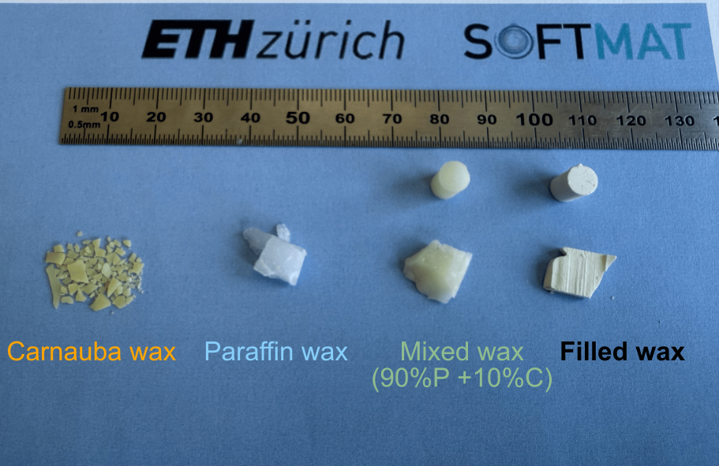
MagComp: Alumina-filled wax system
Highly filled system (45%)
Al₂O₃ particle
POLARIT
5% Carnauba wax → particles better dispersed in the matrix
Mixed wax system
Filled wax system
volume
volume
Brem et al. 2024, IEEE Trans. Appl. Superconductivity, vol 34-5.
Notes:
Paraffin wax + carnauba wax + 45% alumina
SEM

Slide 7
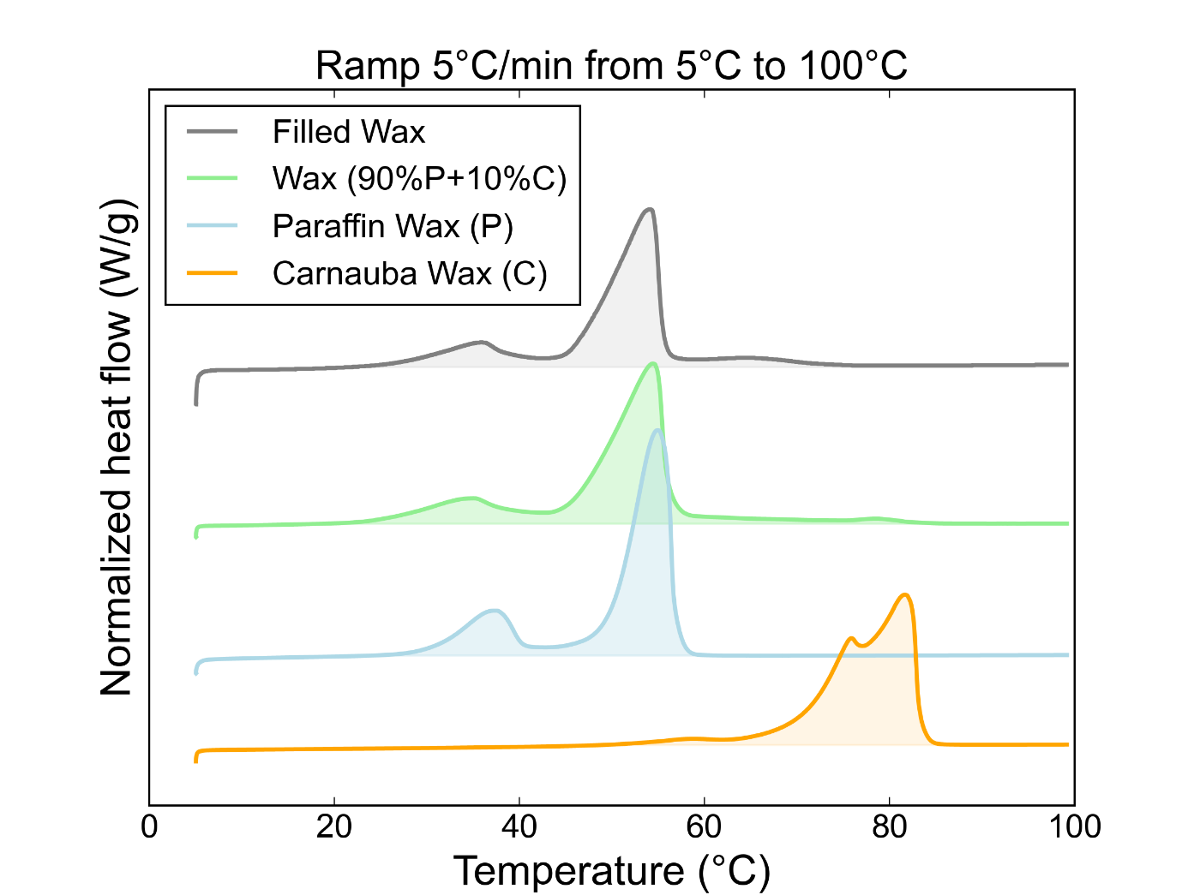
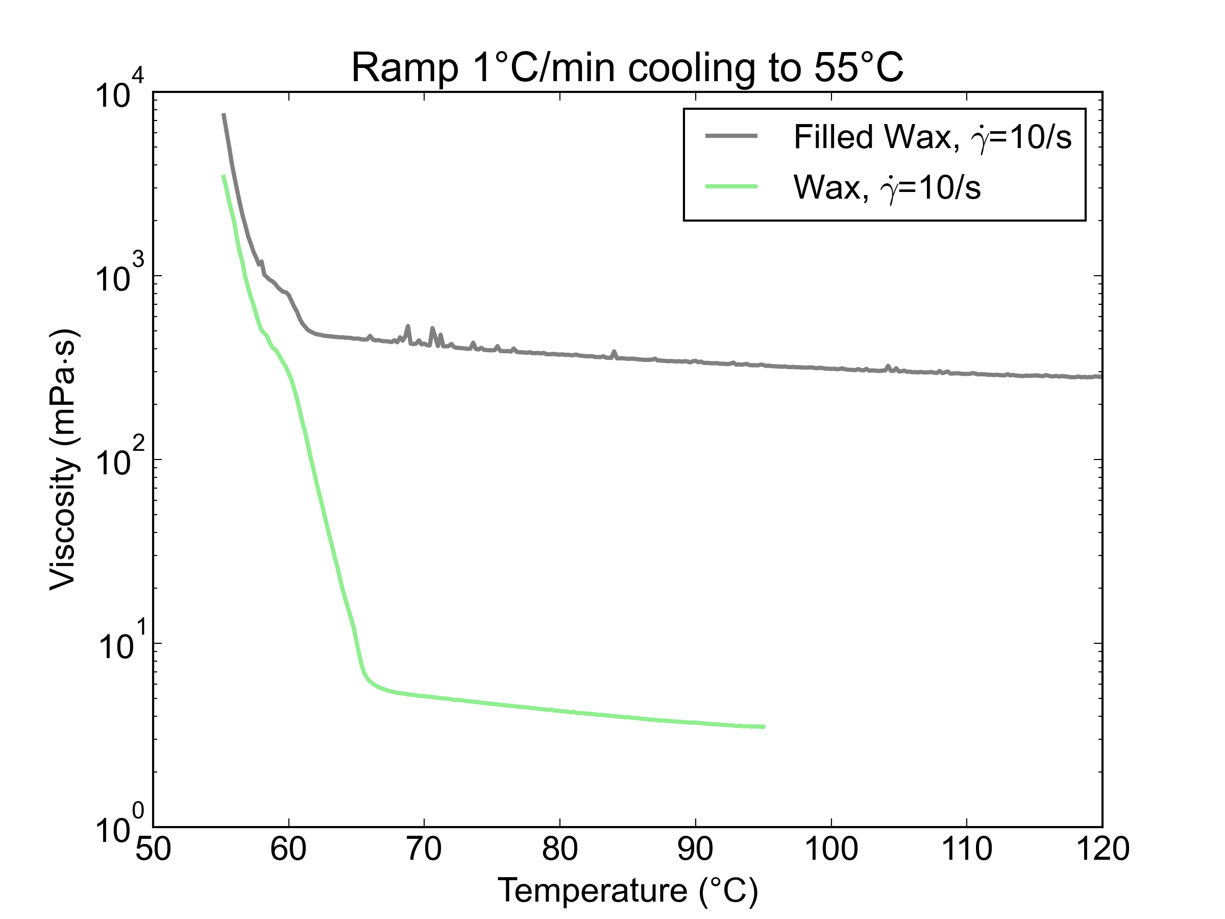
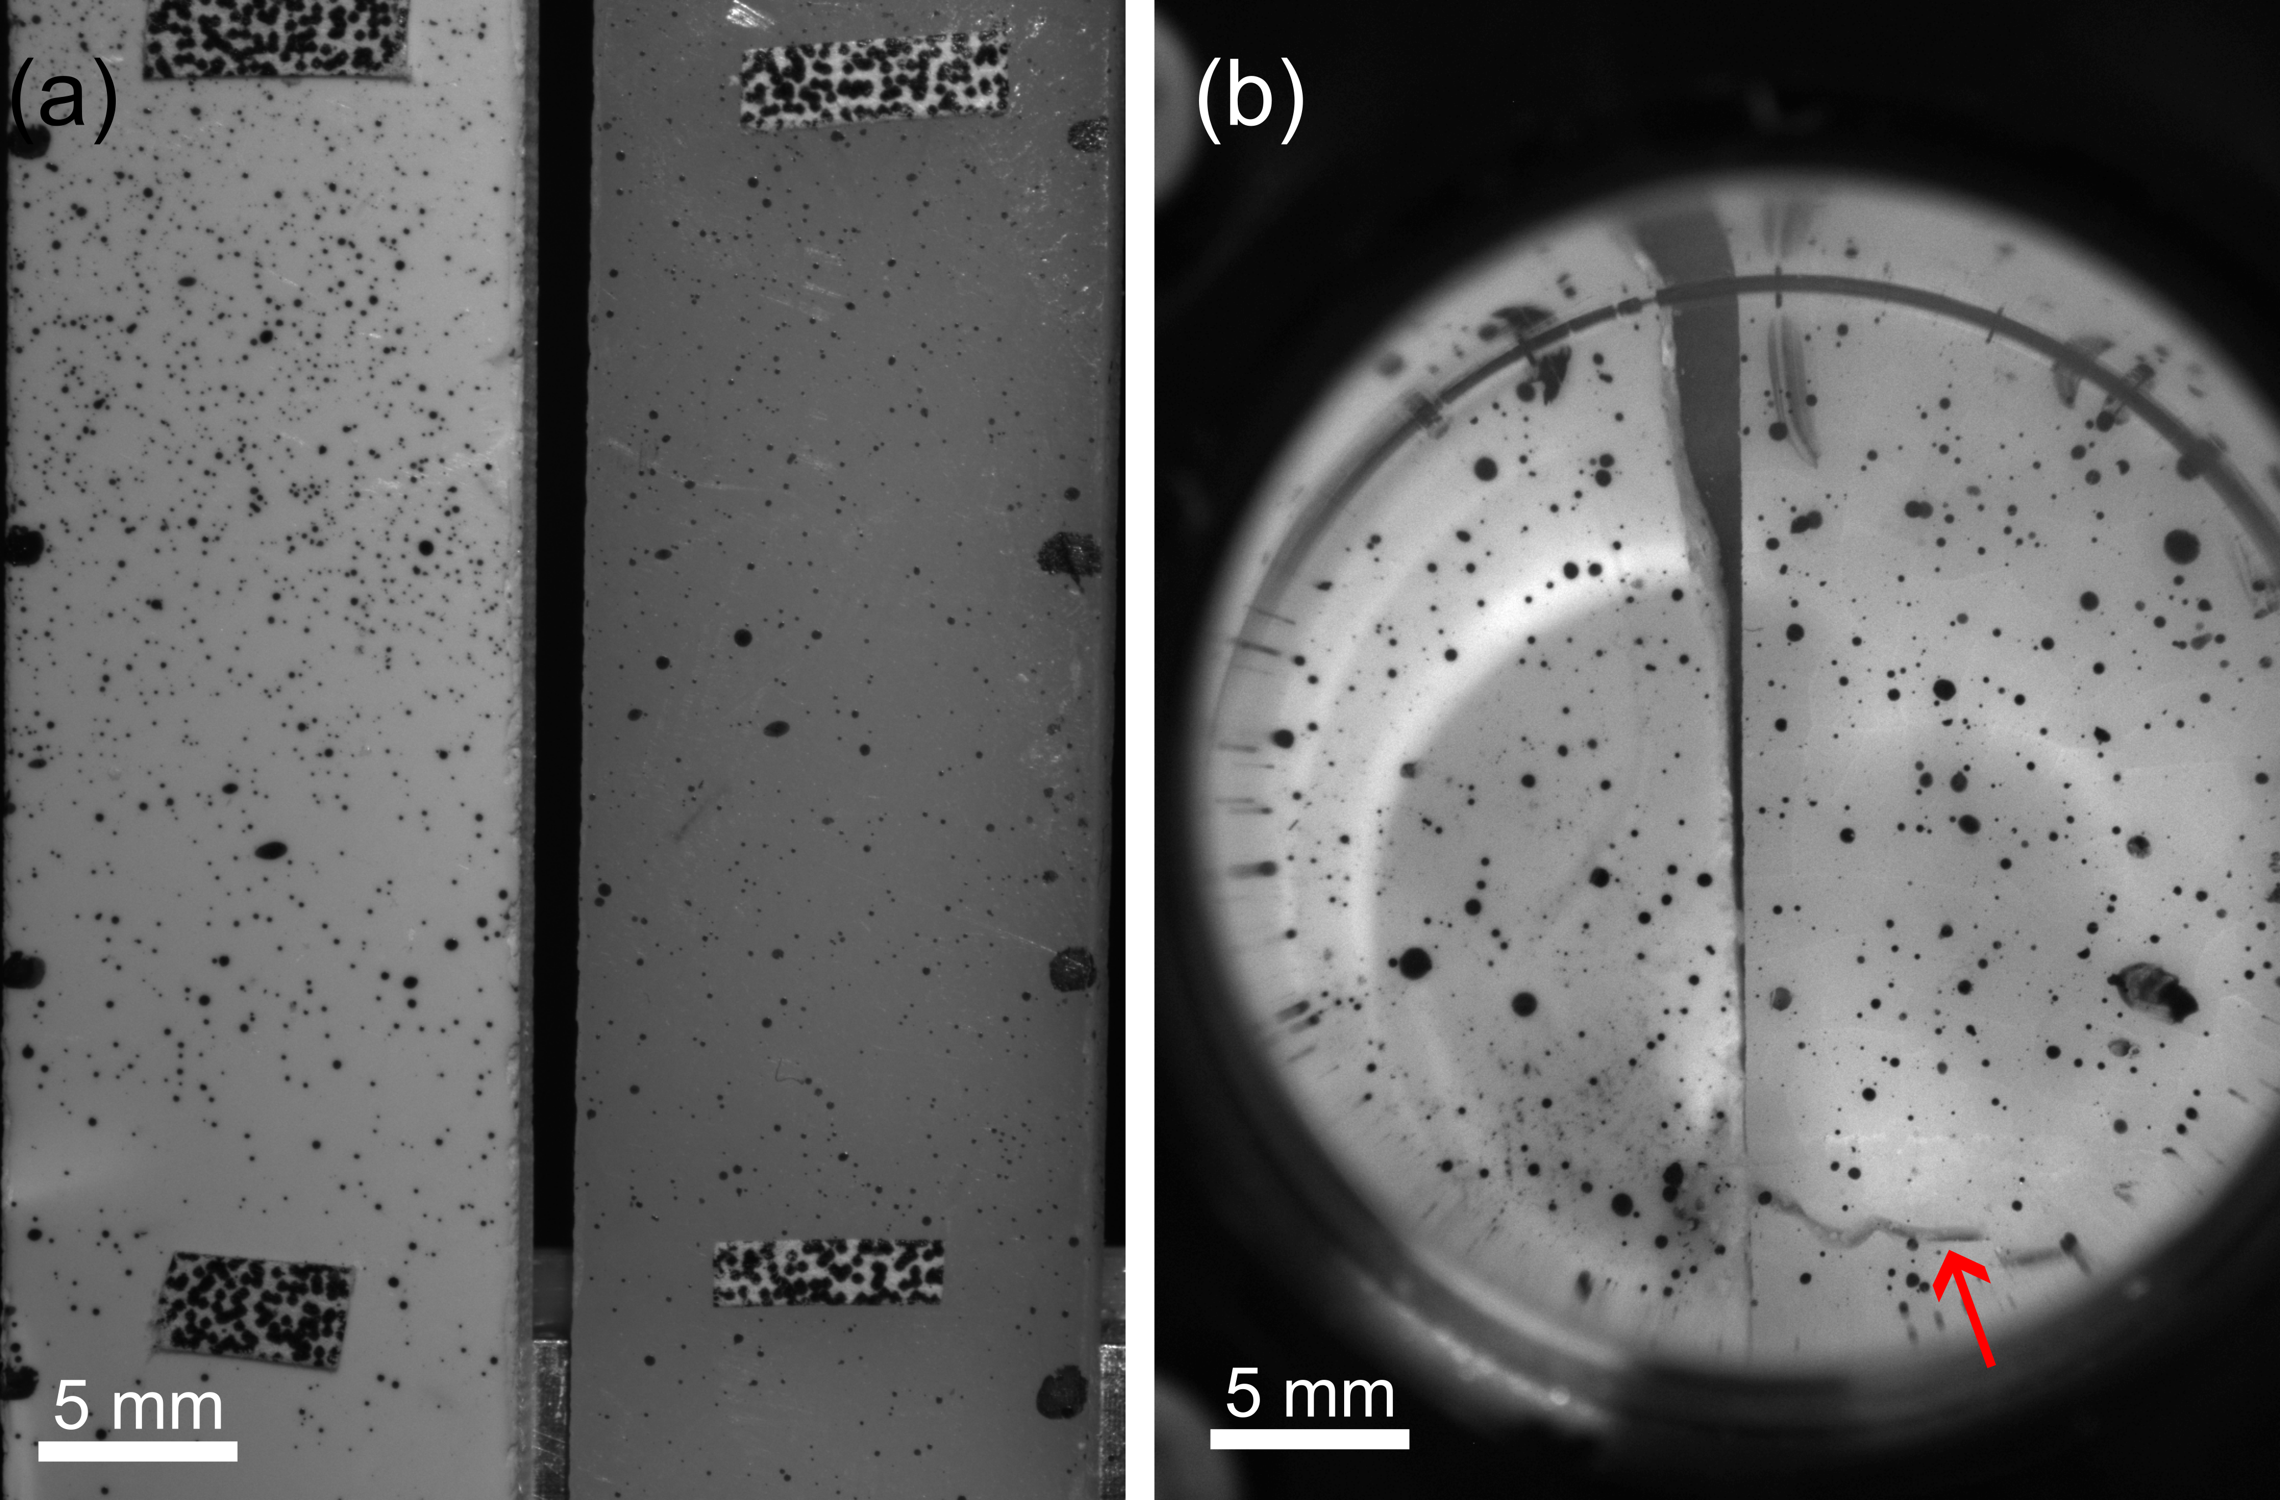
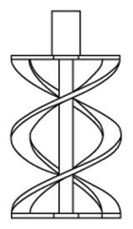
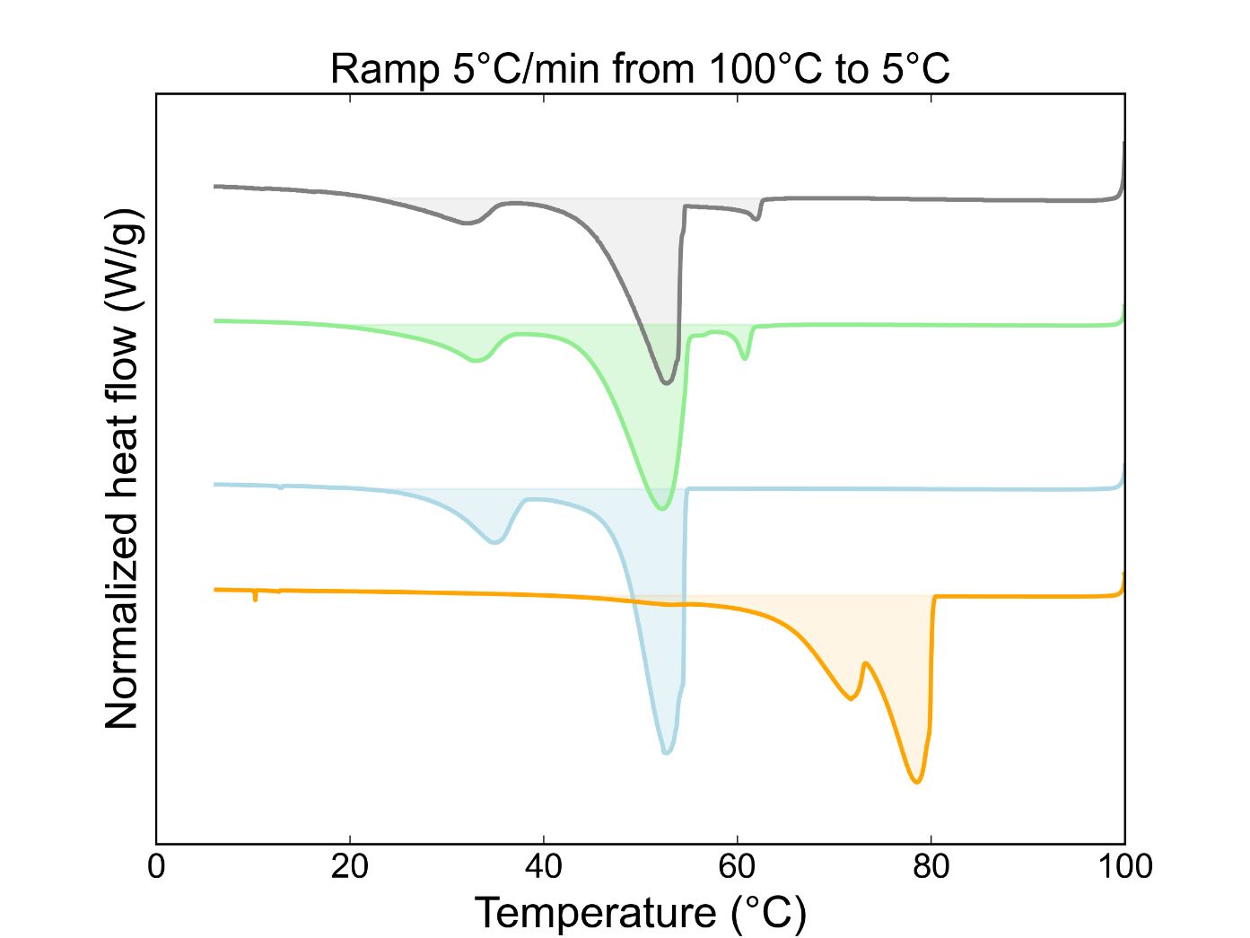
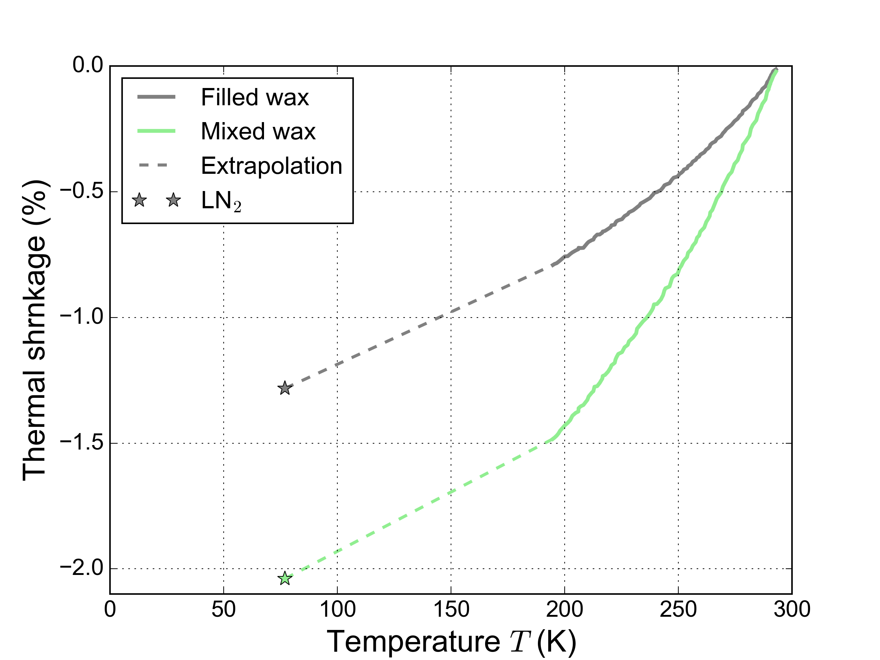
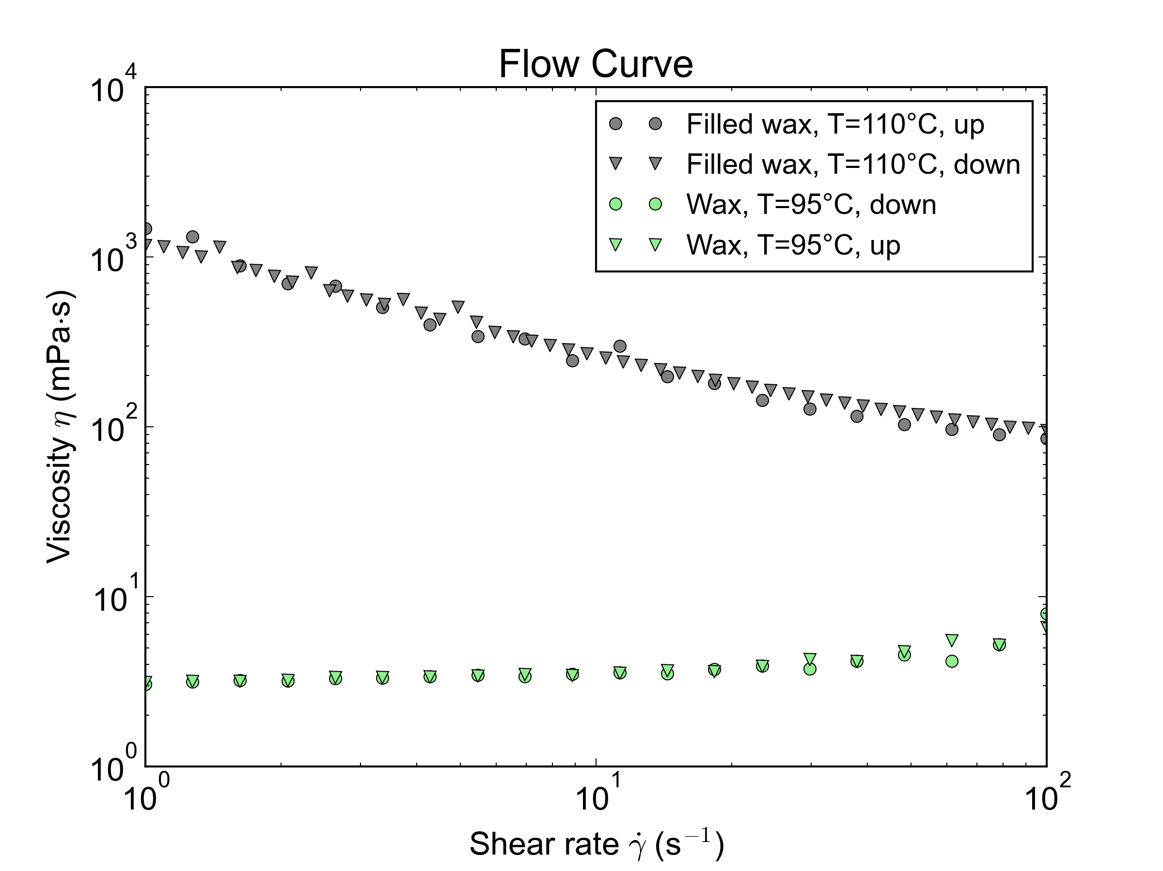
Thermal & rheological results
DSC: T_{melt} & T_{c}
CTE measurement
Rheology: low viscosity
Continuous cooling 2K/min from RT to 193K
Immersed at LN₂
Melt viscosity < 1 Pa⋅s
“shear thinning”
Notes:
Impregnation:
processibility → Tm and low viscosity
CTE match → avoid thermal strain/stress
DSC
TGA
CTE (!) relevant
Rheology

Slide 8
SEM observation
Sub-micrometer Al₂O₃ particles
Inter-strand impregnated insulation
Low melt viscosity → filled wax system well dispersed in magnets

Slide 9
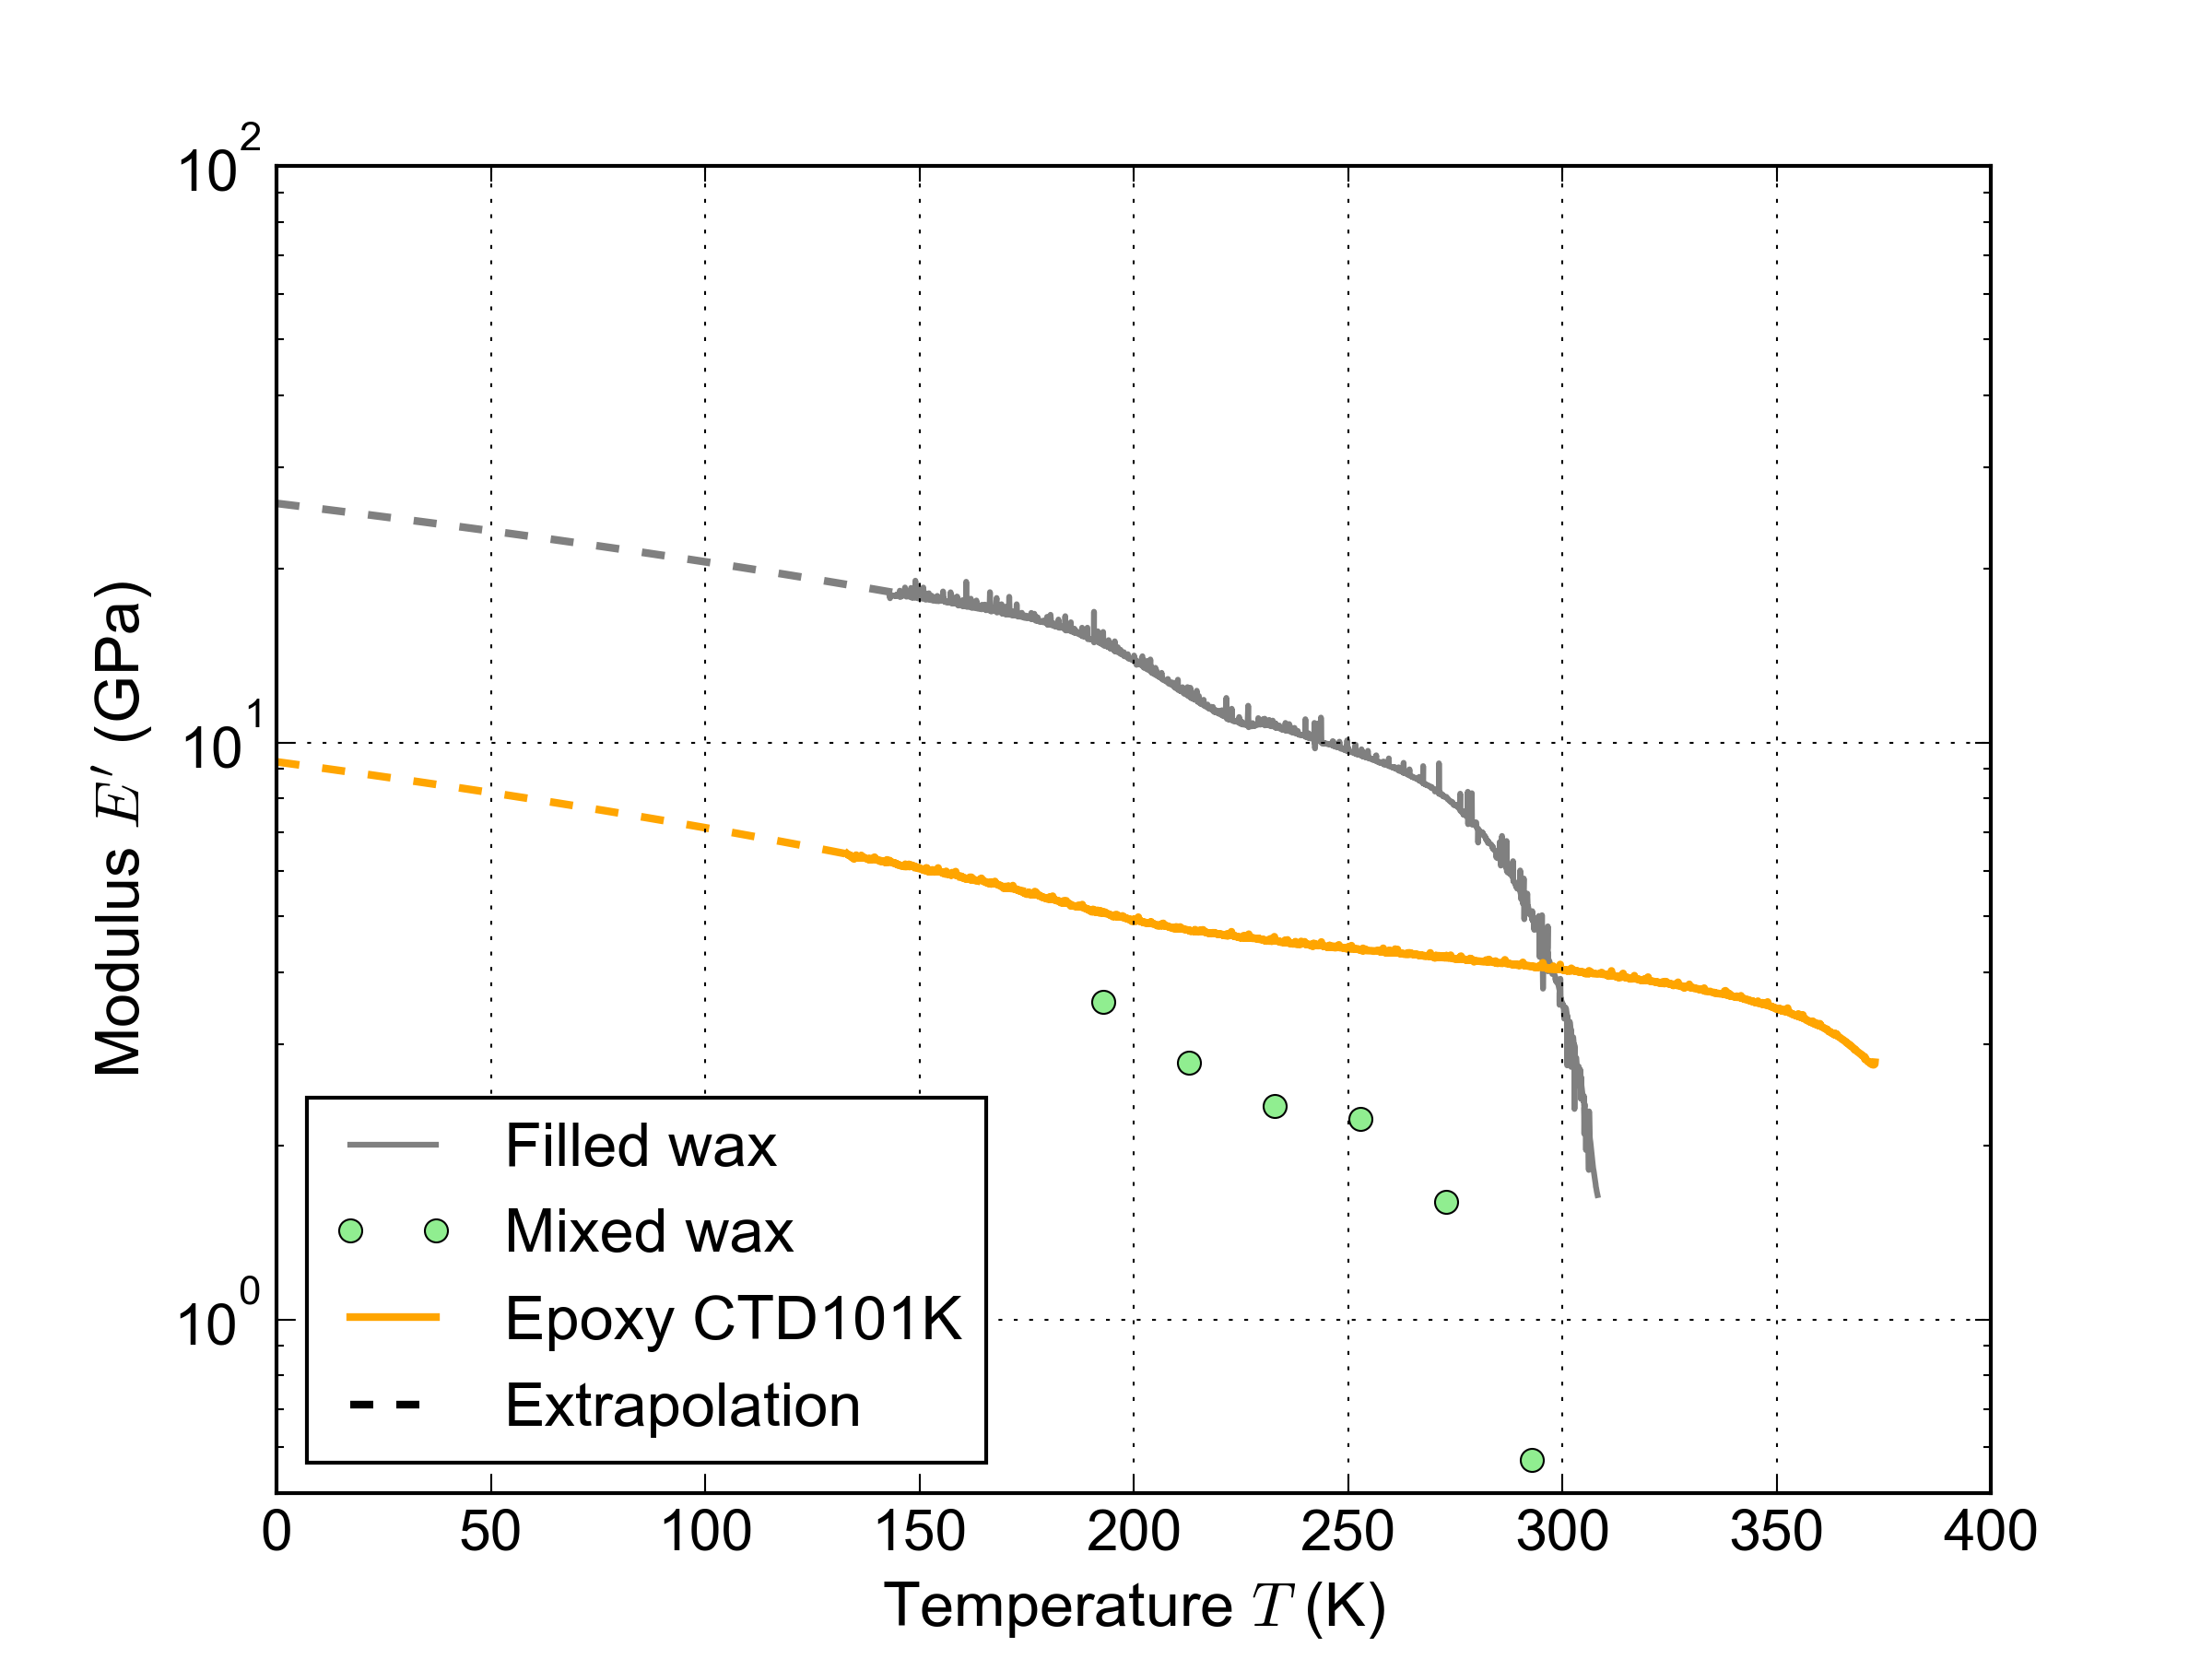
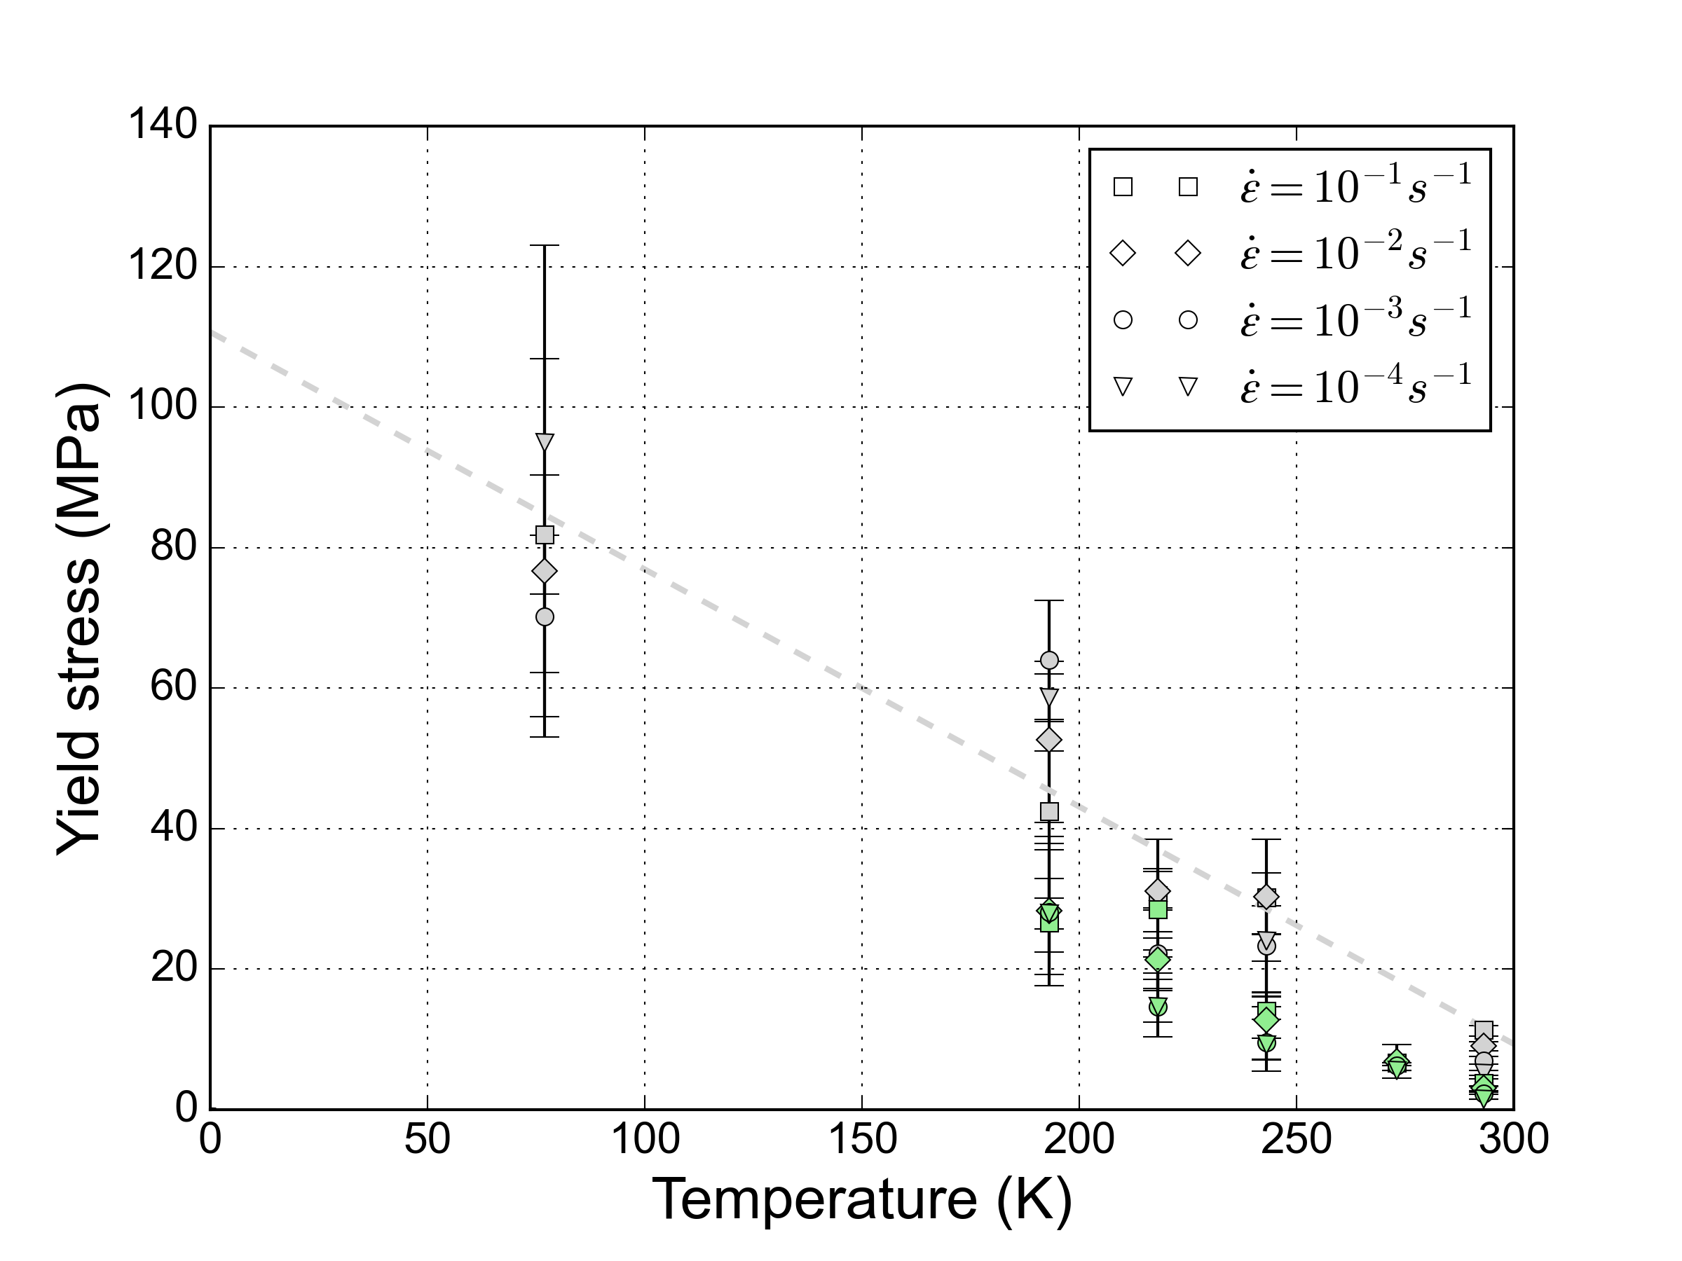
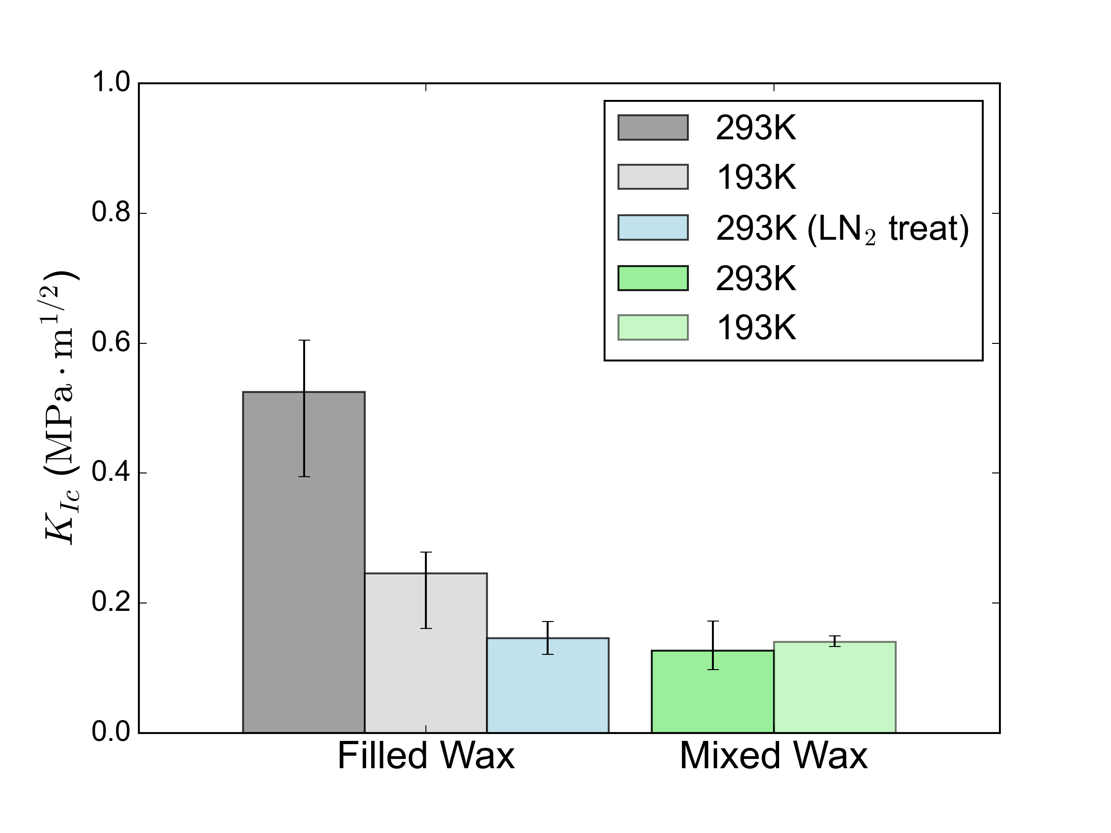
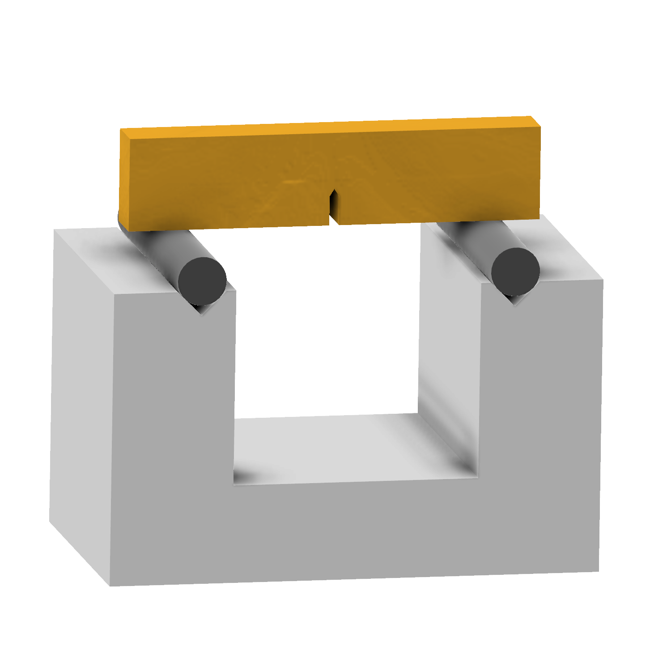
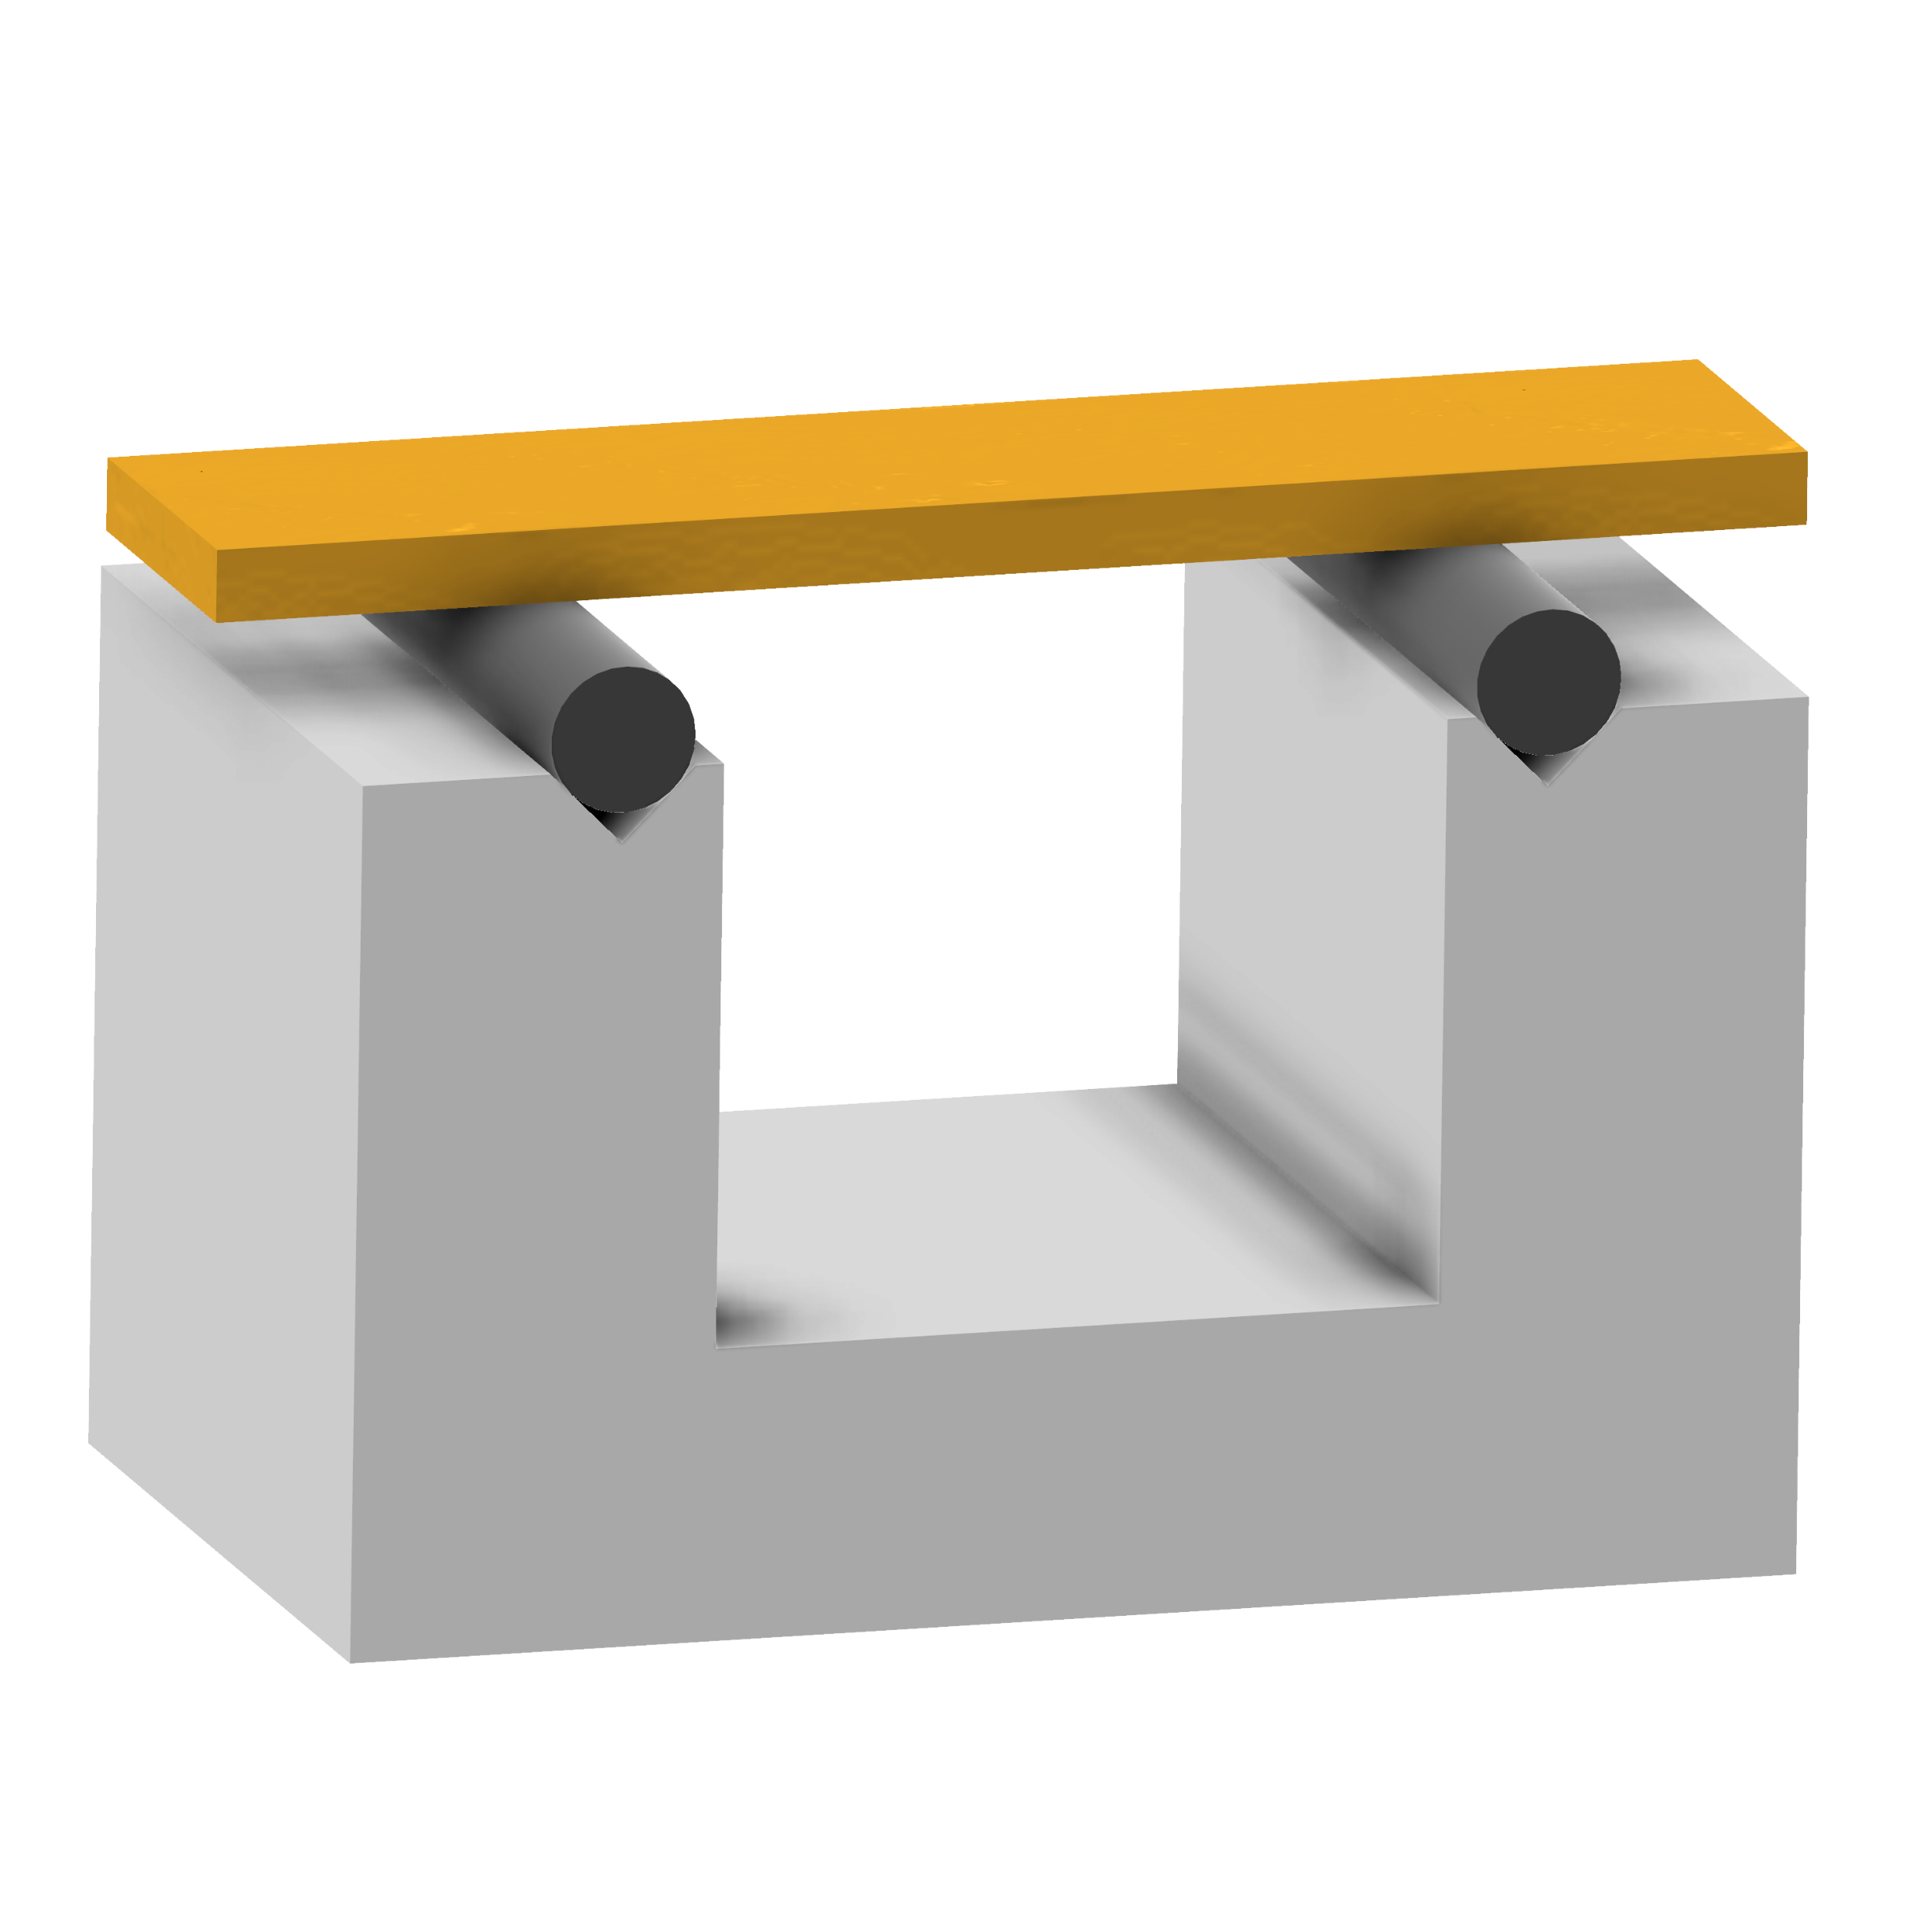
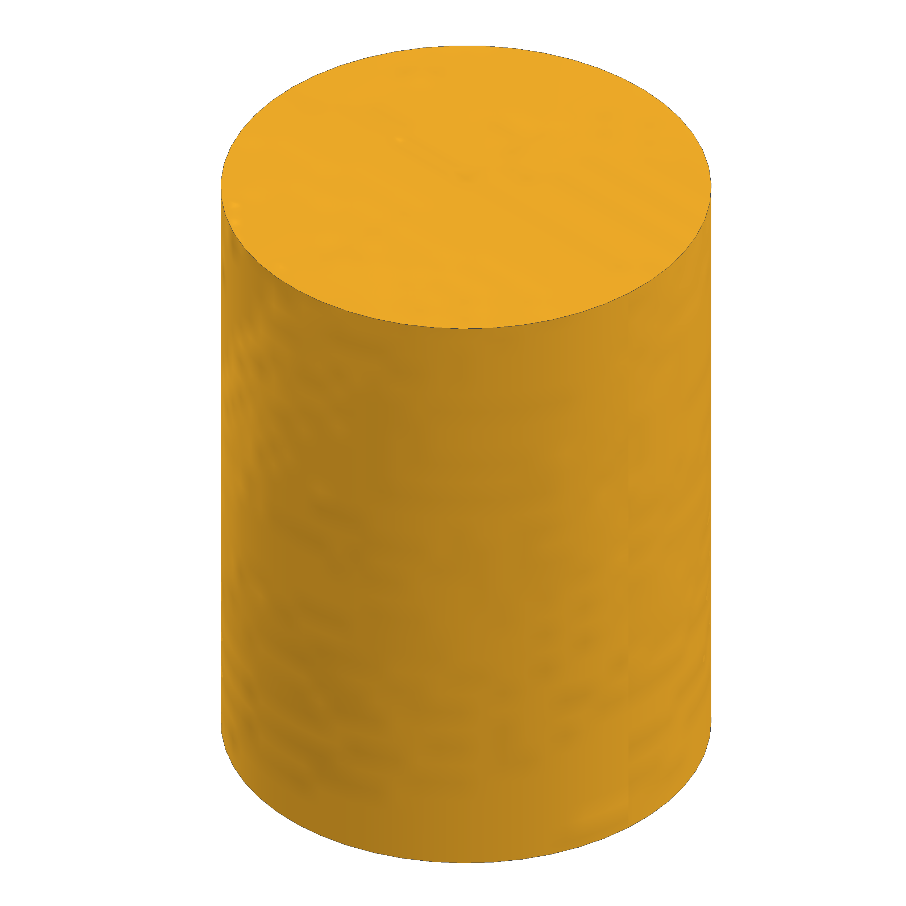
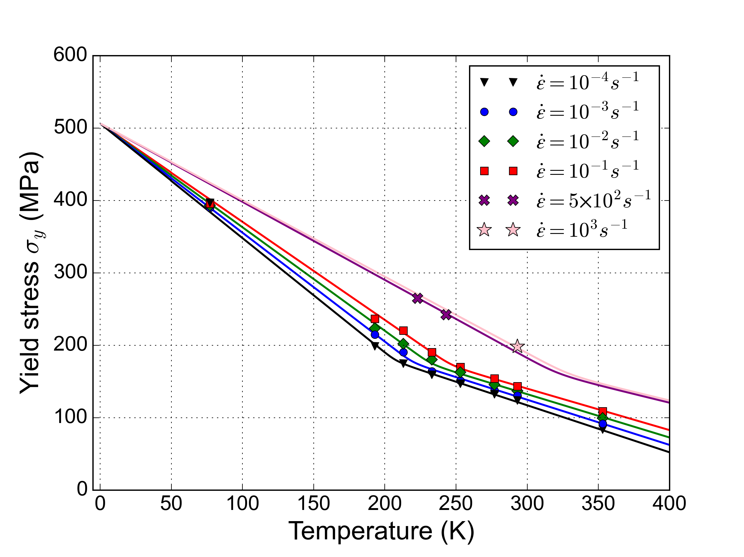
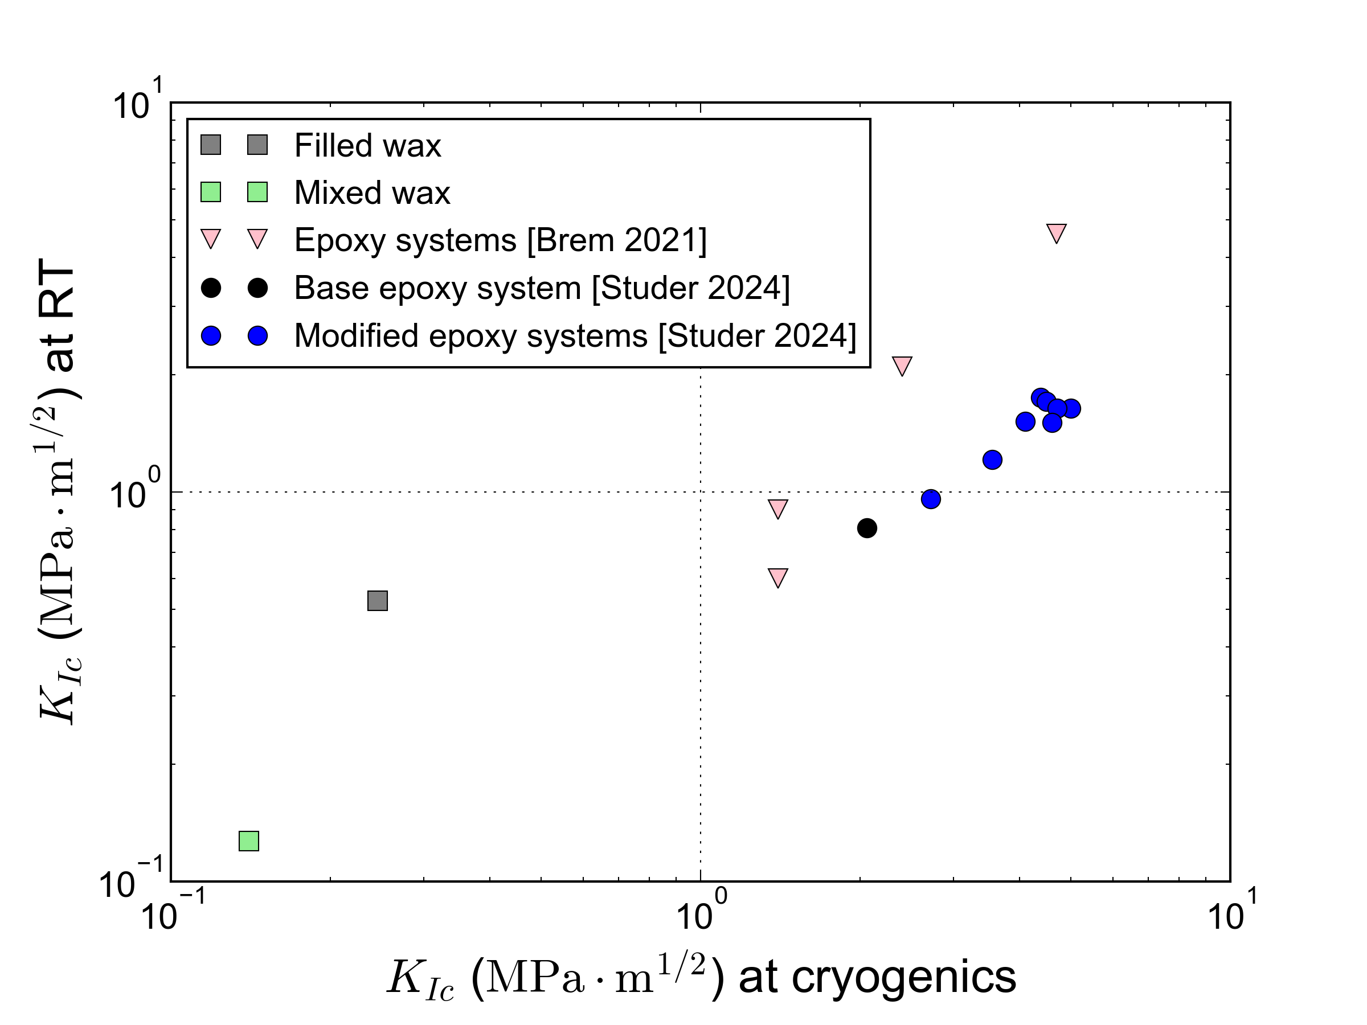
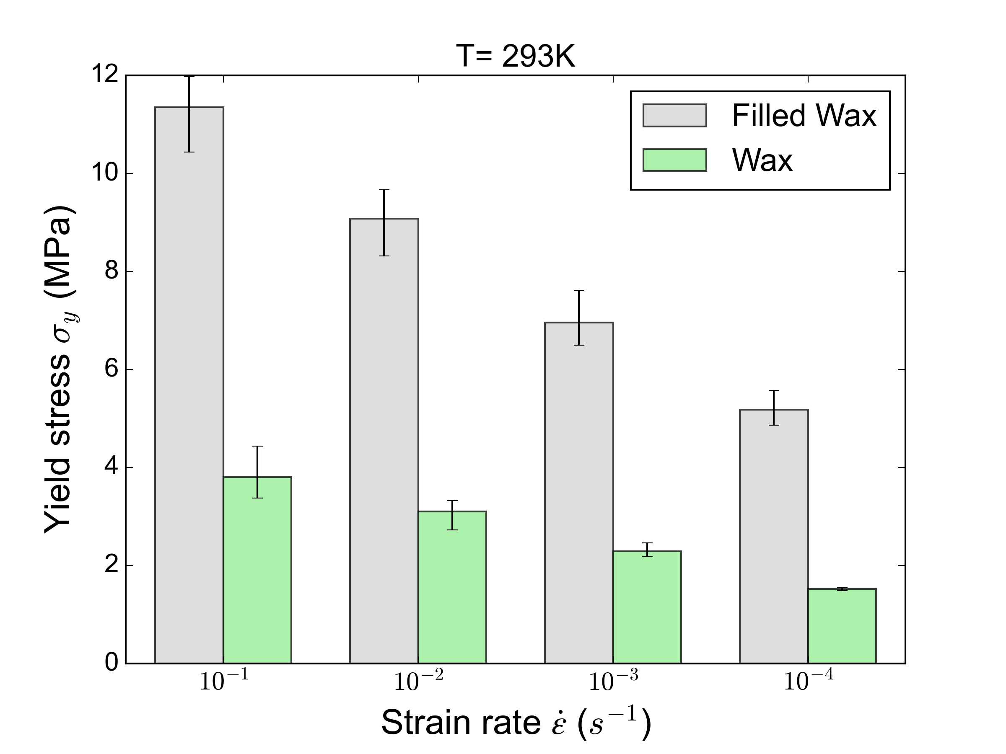
Cryo-mechanical results
3-point bending test
Uniaxial compressive test
Fracture toughness test
E_{77K}
20.2 GPa
Large scatter!
σ_{y} = -0.338T + 110.7
7.6 GPa
Filled wax
Mixed wax
Filled wax has larger stiffness at RT than epoxies due to Al₂O₃ fillers
Filled wax increases compressive strength and fracture toughness but less than for epoxy systems
Damage due to thermal shrinkage can lower fracture toughness.
Epoxy resin (CTD101K)
Brem et al. 2021, Cryogenics 115-103260.
Studer et al. 2024, Cryogenics 143-103923.
Notes:
Compression yield stress
Bending → modulus vs. temperature
Fracture toughness (!!!)

Slide 10
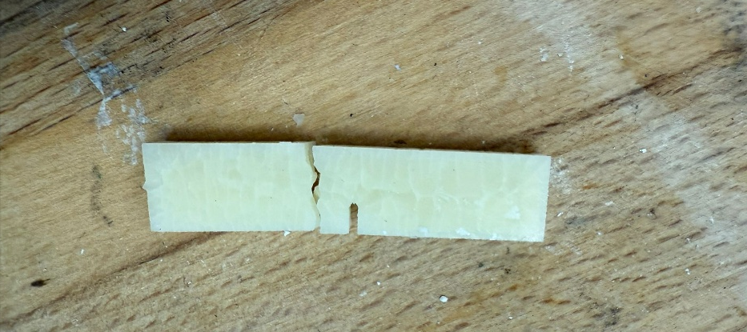
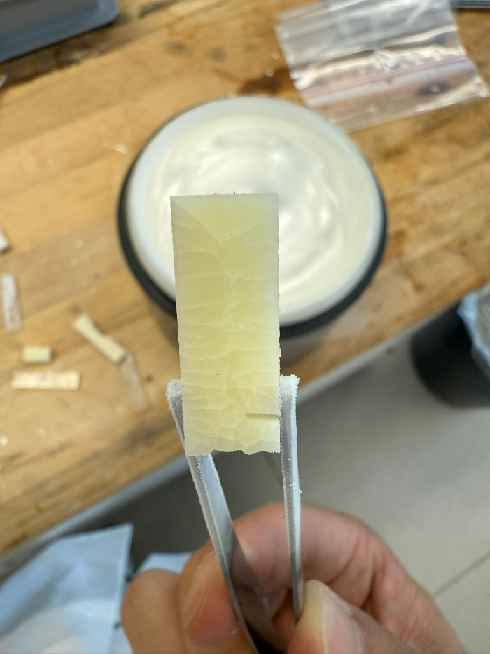
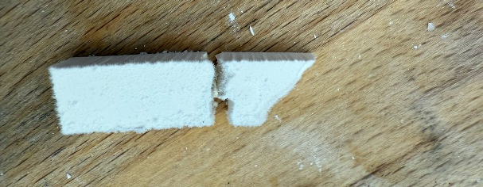
Thermal shock: from RT to LN₂
LN₂ (77 K)
Mixed wax
Thermal stresses arise from the CTE mismatch between wax and Al₂O₃, as well as from thermal gradients during cooling.
Due to the latter, a smooth cooling process is advantageous.
Filled wax
Mixed wax
After fast cooling to LN₂ temperatures, thermal cracks occur in the mixed unfilled wax due to its high CTE and the large temperature gradient. No visible cracks are observed in the filled wax but a decrease in K_{Ic} is measured.

Slide 11
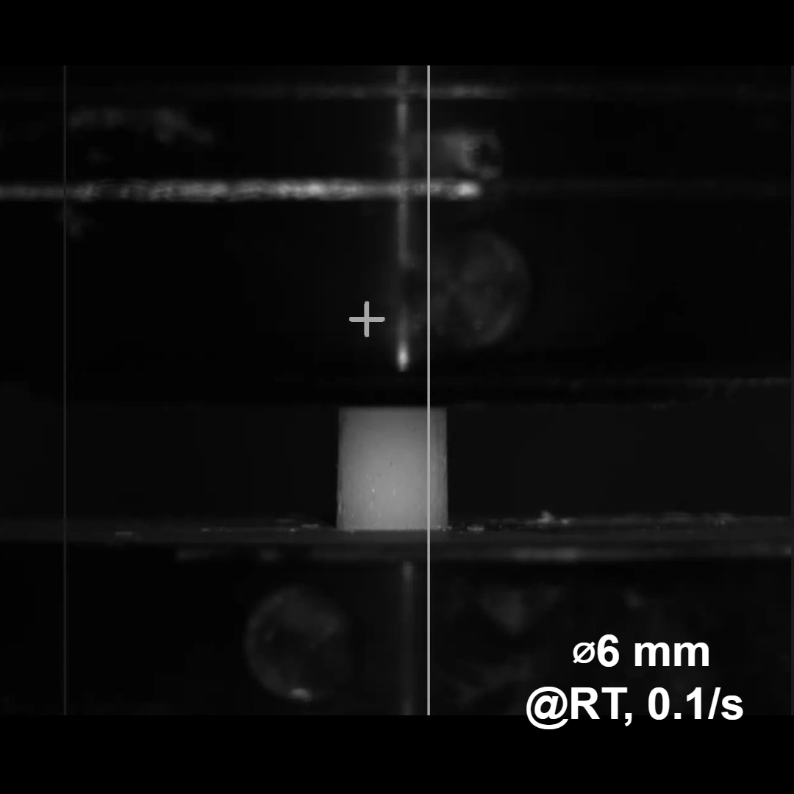
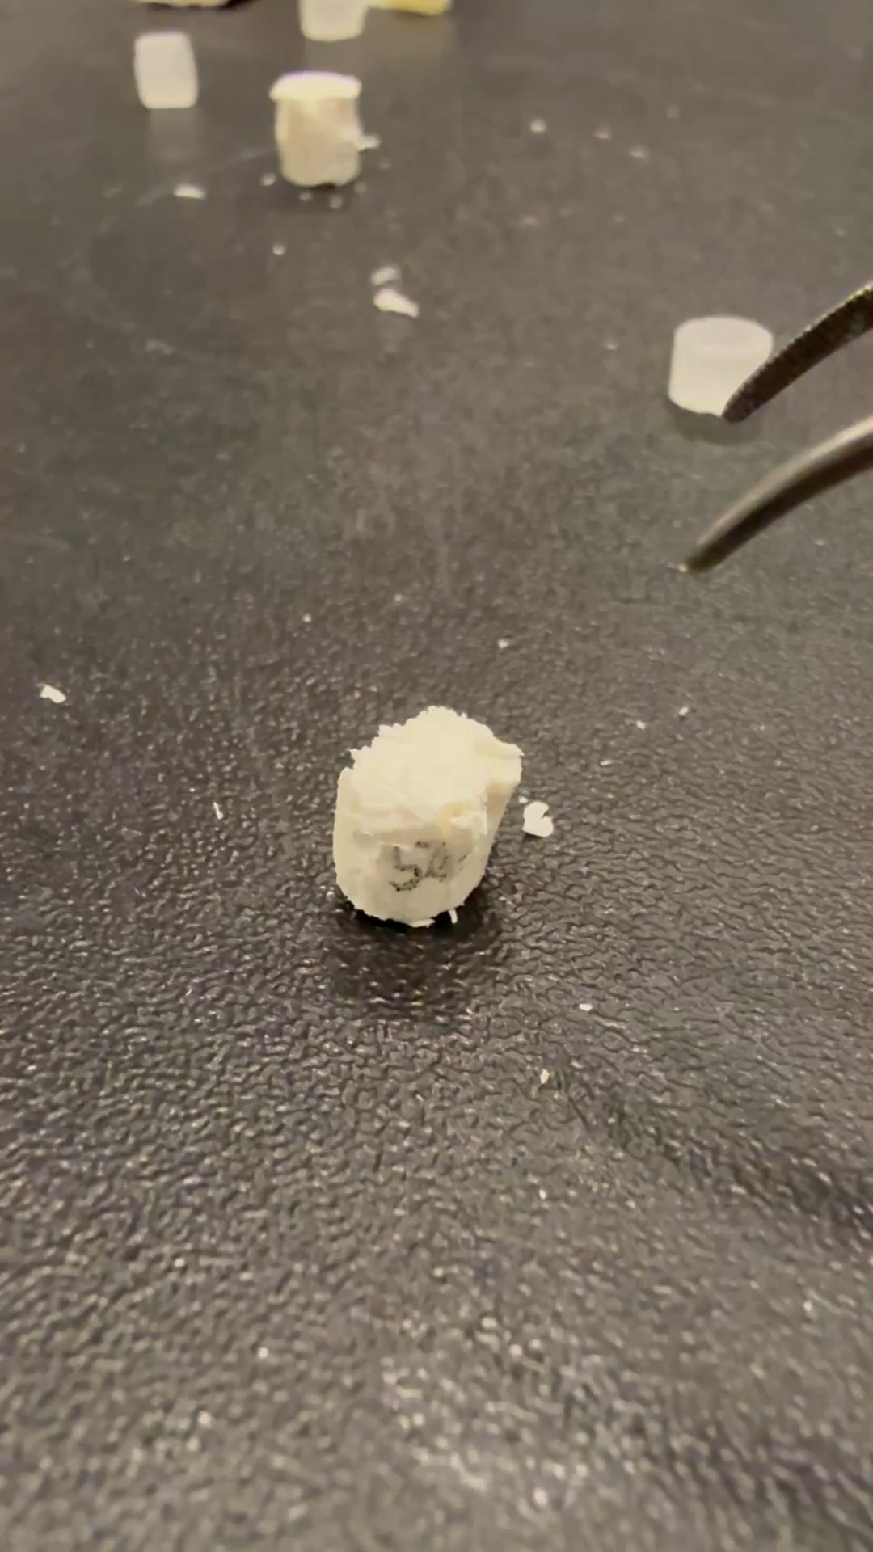
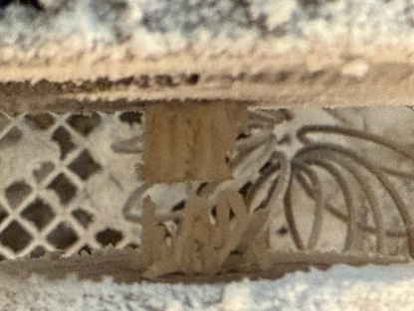
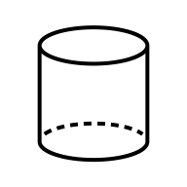
Damage mechanisms under uniaxial compression
Mixed wax at room temperature → Filled wax tested at -55°C (218K)
⌀6 mm
after @218K, 0.1/s
Classic 45° shear-band fracture is found at RT, while the vertical cracks are observed at -55°C (218K)

Slide 12
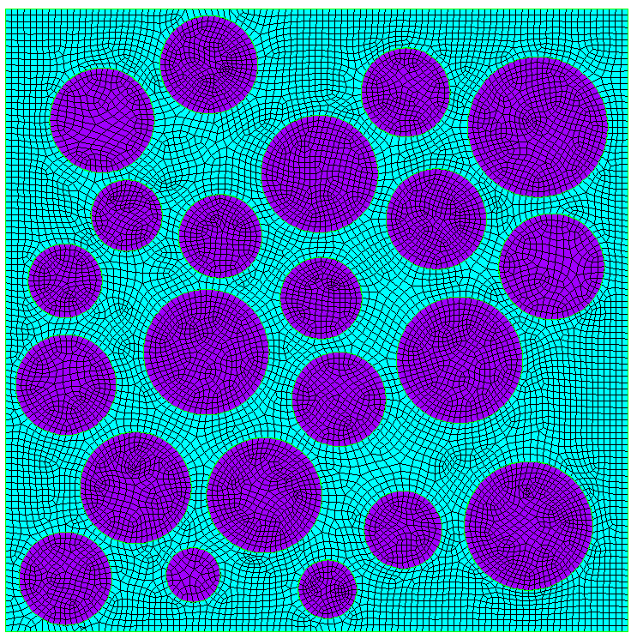
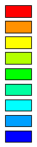
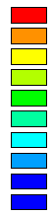
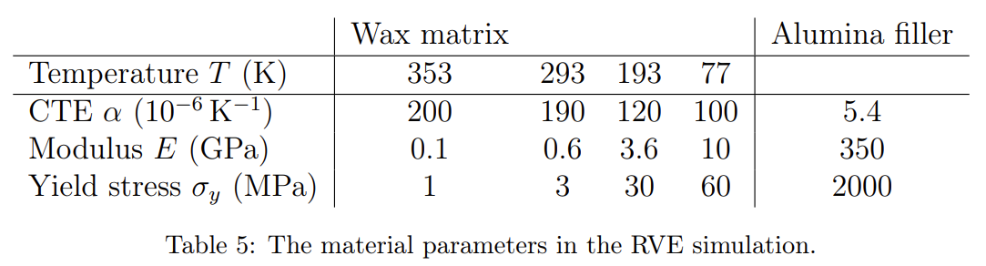
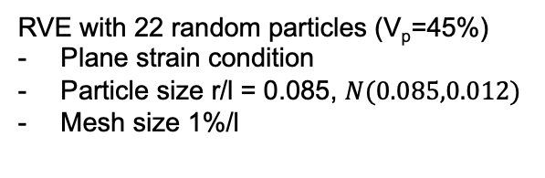
Representative volume element simulation
RVE with 22 random particles (V_{p}=45%)
Plane strain condition
Particle size r/l = 0.085, $N(0.085,0.012)$
Mesh size 1%/l
Step 1: thermal contraction 328K → 77K
Step 2: 3% compressive load at 77K
ε_{global} ~ 2%
ε_{vm} (%)
ε_{vm} (%)
18
16
14
12
10
8
6
4
2
0
45
40
35
30
25
20
15
10
5
0
U_{x}=0
U_{y}=0
Hydrostatic
σ_{h} (MPa)
Hydrostatic
σ_{h} (MPa)
50
40
30
20
10
0
-10
-20
-30
-40
-50
50
40
30
20
10
0
-10
-20
-30
-40
-50
Tensile stress + strain localization → fracture onset

Slide 13
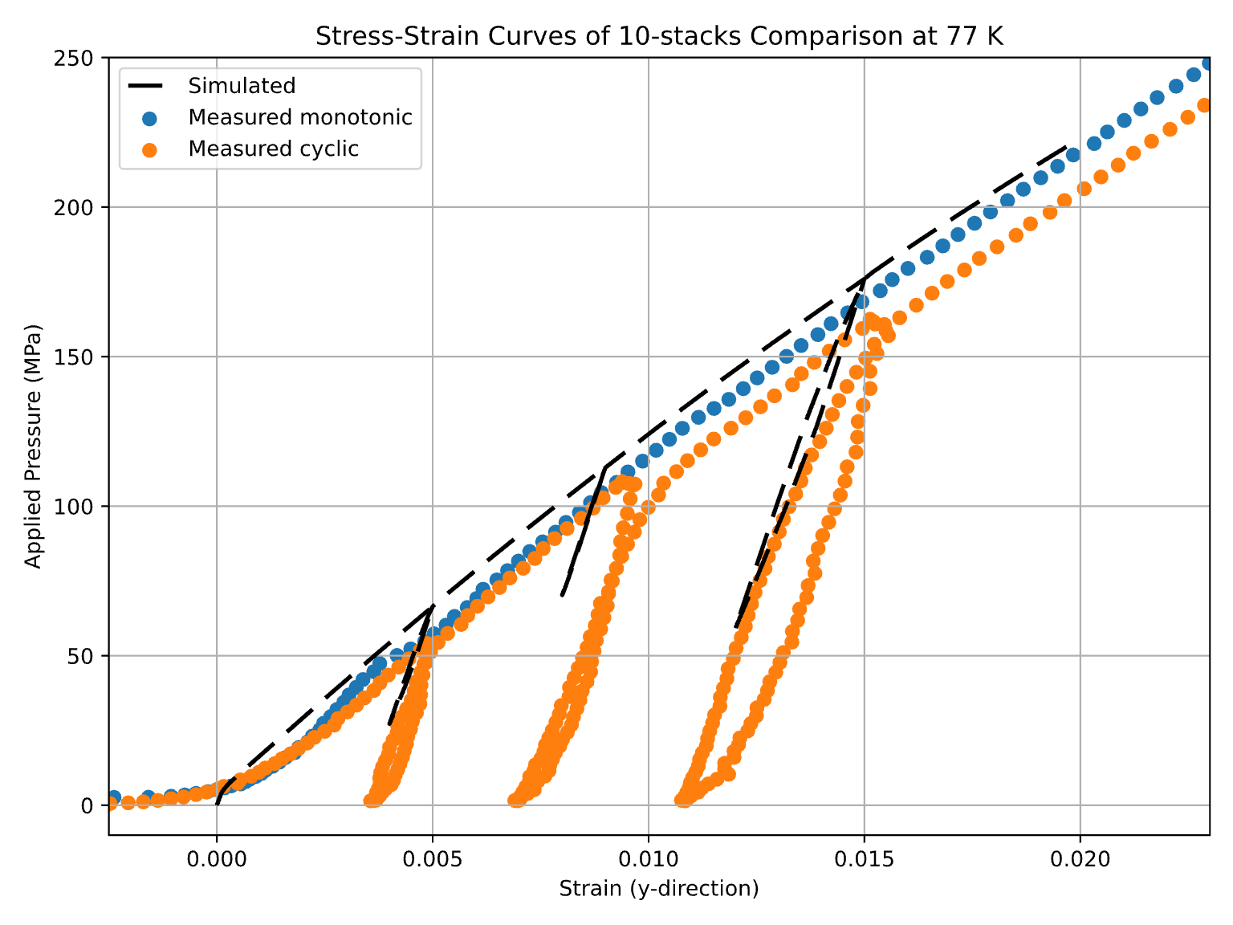
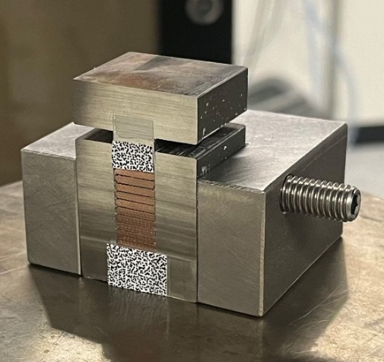
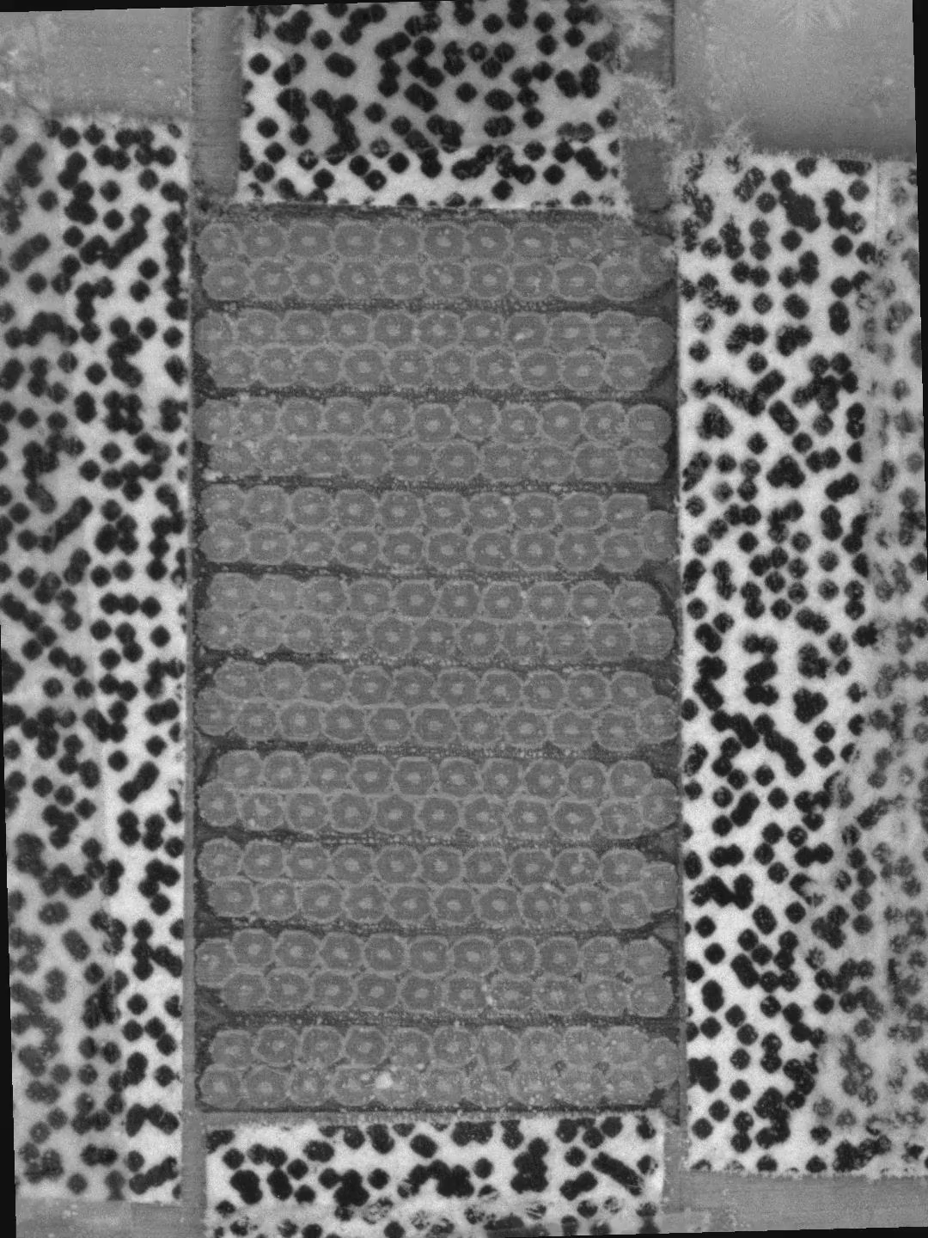


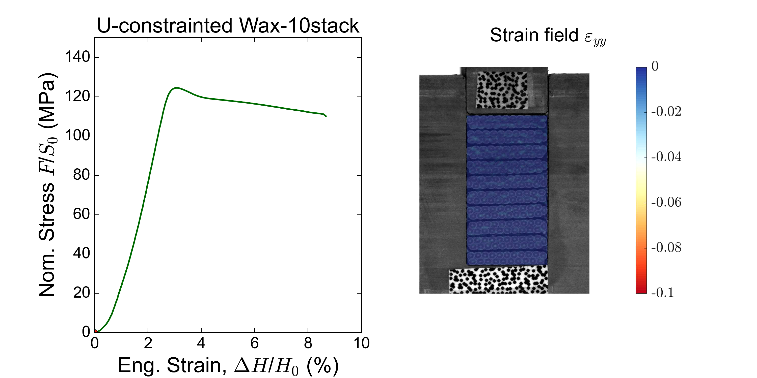
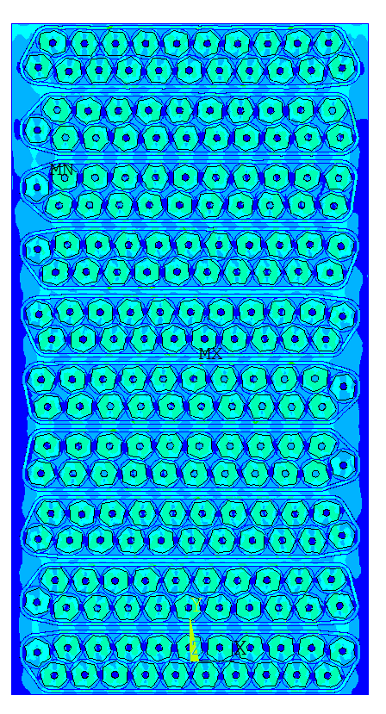

10-stack cables: experiment - simulation (PSI) at 77K
Liquid nitrogen
(T_{b} = –196°C, 77 K)
Ceramic plate
Courtesy of J. Van den Eijnden
Finite element modelling

Slide 14


Conclusion
Al₂O₃-filled wax system shows good mechanical and thermal performance at room and cryogenic temperatures, making it a promising insulation material for superconducting magnets.
Alumina fillers significantly enhance compressive strength and modulus and improve CTE matching, while the wax composition maintains a low viscosity.
The effect of thermal-stress is investigated via a simplified RVE model, that elucidates the mechanism of damage and stress evolution during thermal contraction and mechanical loading.
Unpublished data and under preparation for submission soon.

Slide 15


Acknowledgment
MagRes
MagComp
Jan Vermant, Kirill Feldman, Elena Tervoort, Chris Furrer
Thank you for your attention!

Slide 16


TGA test

Slide 17

GPC high temperature: molecular weight distribution
Sample | Mp | Mn | Mw | Mz | Mz+1 | Mv | PDI
Paraffin wax | 553 | 468 | 558 | 642 | 763 | 546 | 1.192
Carnauba wax | 1711 | 1017 | 1587 | 2215 | 3139 | 1506 | 1.560
PC wax | 566 | 486 | 616 | 793 | 1106 | 595 | 1.267

Slide 18

Representative volume element (RVE) simulation
CTE measurement
3-point bending test

Slide 19



Multiscale structure
Rutherford cable stack
Vallone, MDP Meeting 2022
Ebermann et al. 2018
~15 mm
~ 1 mm
~700 μm
~50 μm
Cubic level
Stack level
Strand level
Filament level
15
Epoxy resin
Strand
Insulation
Stainless-steel core
15
Copper matrix
Nb₃Sn micro filaments
Nb₃Sn filament
Copper matrix
Void
20
10-stack cable
Ebermann et al. 2018, Supercond. Sci. Technol. 31 (2018) 065009
Notes:
→ Mechanical compressive testing

