Slide 1





Electromechanical characterization of Nb₃Sn wires
Francesco LONARDO, Romain BABOUCHE, and Carmine SENATORE
Department of Quantum Matter Physics, University of Geneva, Switzerland
Department of Nuclear and Particle Physics, University of Geneva, Switzerland
Simon C. HOPKINS and Thierry BOUTBOUL
CERN, Switzerland

Slide 2
Outline of the presentation
Motivation of the work
The updated baseline for the high-field dipoles of the Future Circular Collider
Degradation mechanisms and irreversible reduction of Ic
Catalogue of the Wires
Results: Influence of the wire layout on the transverse stress tolerance
state-of-the-art PIT Nb₃Sn wires
state-of-the-art RRP Nb₃Sn wires
Summary

Slide 3
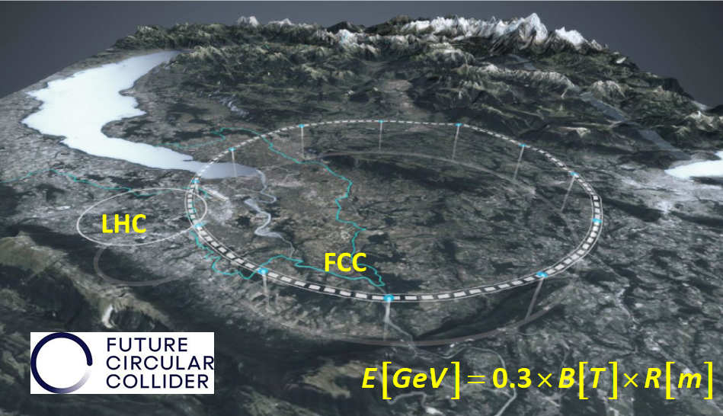
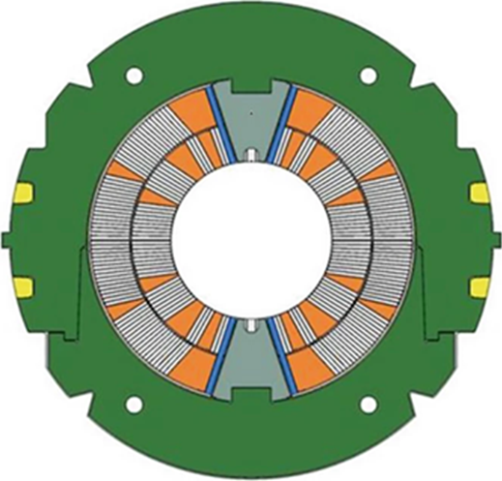
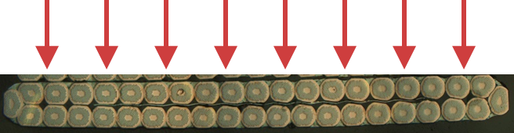
High Field Magnets for a FCC-hh 85 TeV
PARAMETER | FCC-hh CDR 2019 | FCC-hh FSR 2025
collision energy (c.m.s.) [TeV] | 100 | 85
dipole field [T] | 16 | 14
Circumference [km] | 97.8 | 90.7
beam current [A] | 0.5 | 0.5
synchr. rad. per ring [kW] | 2400 | 1200
peak luminos. [1034 cm⁻²s⁻¹] | 30 | 30
events/bunch crossing | 1000 | 1000
stored energy/beam [GJ] | 8.3 | 6.5
integr. luminosity / IP [fb-1] | 20000 | 20000
A combination of electromagnetic forces with pre-load and thermomechanical effects exposes the brittle and strain sensitive Nb₃Sn to the risk of degradation. The main stress component is in the transverse direction of the Nb₃Sn Rutherford cables
UPDATED BASELINE
The updated baseline of the FCC study:
91 km-ring
14 T-dipoles based on Nb₃Sn
collision energy of 85 TeV
Adapted from M. Benedikt, FCC Week 2025

Slide 4
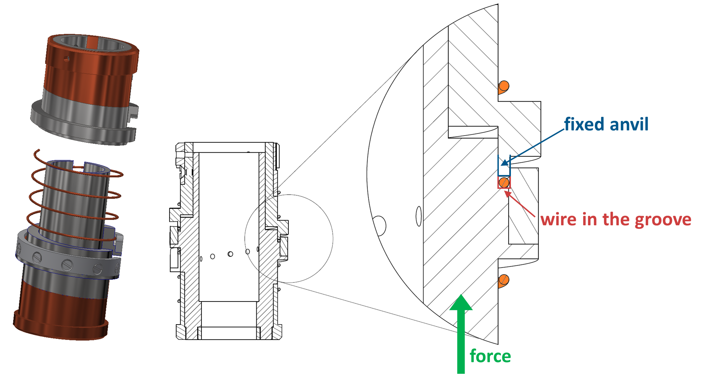
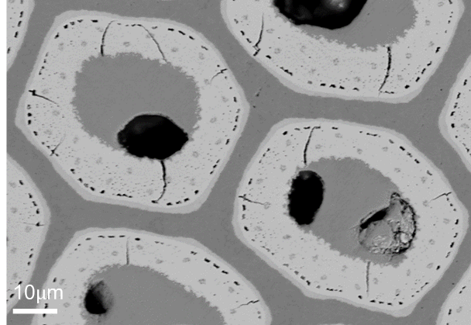
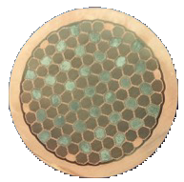
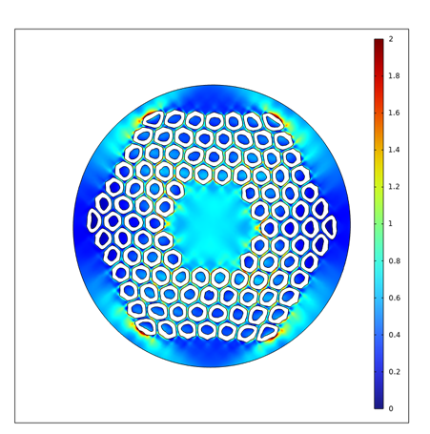
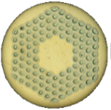
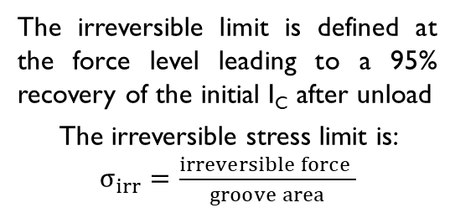
Degradation mechanisms and irreversible reduction of Ic
Two mechanisms govern the irreversible reduction of the critical current:
Formation of cracks in the Nb₃Sn subelements due, for instance, to the stress concentration at the voids.
Cracks generate a reduction of the current carrying cross section ⇒ I_{Cunload}/I_{C0} is independent of the magnetic field.
190 MPa
Electromechanical tests on Nb₃Sn wires impregnated with epoxy
The WASP concept was adapted to transverse loads by
B. Seeber et al., IEEE TAS 17 (2007) 2643, DOI: 10.1109/TASC.2007.897934
Plastic deformation of the Cu matrix and residual stress on the Nb₃Sn subelements.
The irreversible limit is defined at the force level leading to a 95% recovery of the initial I_{C} after unload
The irreversible stress limit is: $σ_{irr}=\frac{irreversible force }{groove area}$
Residual stress induces a permanent reduction of B_{C2} after unload ⇒ I_{Cunload}/I_{C0} depends on of the magnetic field.
155 MPa

Slide 5
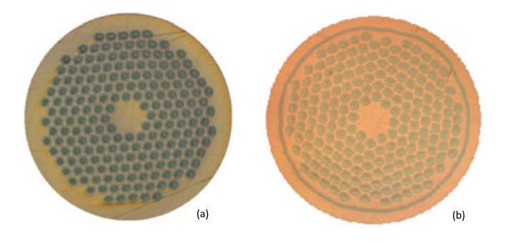




What has been tested – Catalogue of the Wires
Study of the effect of design on transverse stress tolerance:
Effect of an Nb barrier surrounding the filament bundle.
Influence of the Cu/non-Cu ratio.
Technology |  | # of subelements | Bundle Barrier | Cu/non-Cu | Diameter | Subelement size | HT | I_{c}(15T, 4.2K) Ti-barrel
PIT |  | 192 | No | 1.22 | 0.85 mm | 43 μm | 600°C×120h+ 625°C×200h
PIT Bundle Barrier |  | 192 | Yes | 1.2 | 0.85 mm | 43 μm | 415°C/48h+ 620°C/48h+ 645°C/50h | 411
RRP |  | 132/169 | No | 1.2 | 1.0 mm | 58 μm | 210C/48h+ 400C/48h+ 650C/50h | 780 A
RRP |  | 150/169 | No | 1.1 | 1.0 mm | 58 μm | 210C/48h+ 400C/48h+ 650C/50h | 730 A
RRP |  | 162/169 | No | 0.9 | 1.0 mm | 58 μm | 210C/48h+ 400C/48h+ 650C/50h | 880 A
MQXFS7
MQXFS7
FRESCA2
Falcon D

Slide 6
Outline of the presentation
Motivation of the work
The updated baseline for the high-field dipoles of the Future Circular Collider
Degradation mechanisms and irreversible reduction of Ic
Catalogue of the Wires
Results: Influence of the wire layout on the transverse stress tolerance
state-of-the-art PIT Nb₃Sn wires
state-of-the-art RRP Nb₃Sn wires
Summary

Slide 7
Irreversible stress limit of PIT and PIT BB
95 MPa
Both the wires (PIT and PIT BB) have σ_{irr} ̴ 95 Mpa.
The presence of the bundle barrier affects neither the irreversible stress limit, nor the general behaviour of the wire under stress.
The B_{C2} decrease is similar in the two wires. ΔB_{C2} (95 MPa ) ~ 0.5 T and ΔB_{C2} (210 MPa ) ~1.15 T.

Slide 8
Outline of the presentation
Motivation of the work
The updated baseline for the high-field dipoles of the Future Circular Collider
Degradation mechanisms and irreversible reduction of Ic
Catalogue of the Wires
Results: Influence of the wire layout on the transverse stress tolerance
state-of-the-art PIT Nb₃Sn wires
state-of-the-art RRP Nb₃Sn wires
Summary

Slide 9
Irreversible stress limit of RRP with different Cu/non-Cu
Cu/non-Cu = 1.2
Cu/non-Cu = 1.1
Cu/non-Cu = 0.9
172 MPa
203 MPa
213 MPa
The lower the Cu/non-Cu ratio, the higher the irreversible stress limit σ_{irr}
The ΔB_{C2} (210 MPa ) after unload is 0.6, 0.45 and 0.65 T.
Notes:
.

Slide 10
Irreversible stress limit of RRP with different Cu/non-Cu
RRP 162/169
Subelement Ø = 58 μm
HT 650C/50h
RRP 150/169
Subelement Ø = 58 μm
HT 650C/50h
RRP 132/169
Subelement Ø = 58 μm
HT 650C/50h
The lower the Cu/non-Cu ratio, the higher the irreversible stress limit σ_{irr}

Slide 11

Summary and future work
Powder in Tube wire (PIT and PIT with bundle barrier):
The irreversible stress limit σ_{irr} is approximately 95 MPa.
The σ_{irr} is not influenced by presence of the bundle barrier.
Restack Rod Process (RRP) wires:
The σ_{irr} for RRP Nb₃Sn wires > 170 MPa, and it can reach 210 MPa for wire as 162/169 used for Falcon D
A correlation between a lower Cu/non-Cu ratio and a higher irreversible stress limit has been observed
The permanent degradation of state-of-the-art RRP and PIT wires is primarily driven by residual stresses
ΔB_{C2} (210 MPa) is ~ 0.6 T for RRP wires and >1.1 T for PIT wires

Slide 12
Thanks for your attention

Slide 13
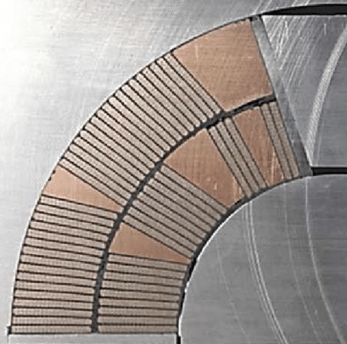
Commercial Nb₃Sn wires: RRP vs PIT
Section of a Nb3Sn dipole magnet
PIT, Ø 1.0 mm
Tested in a 1.15 mm groove
RRP, Ø 0.85 mm
Tested in a 1.15 mm groove
Rutherford cable
σ_{irr} ≈ 110 MPa
σ_{irr} ≈ 175 MPa
RRP wires have higher transversal stress tolerance. They are mechanically more robust than current PIT wires
Senatore C. et al., Supercond. Sci. Technol., 36 (2023) 075001
DOI: 10.1088/1361-6668/acca50
PIT wire: Distorted filaments are partly reacted due to Sn leak, lower I_{c}
Brown M. et al. Supercond. Sci. Technol. 29 084008 (2016) DOI: 10.1088/0953-2048/29/8/084008
Cabling induce wire distortion
Segal C. et al.,Supercond. Sci. Technol. 29 (2016) 085003 DOI: 10.1088/0953-2048/29/8/085003
Notes:
The first reason is the fact that cabling induce distortion of wire that in the case of the case of PIT cause Sn leak, reducing the Ic and the RRR of stabilizing Cu. The trasversal stress tolerance of RRP is higher. The irreversible stress llimit, that identify the stress that induce a permanent degradation of current of 5%, is higher for RRP.
Let’s move now to the challanges and problems of introducing an OS in the RRP

