Slide 1

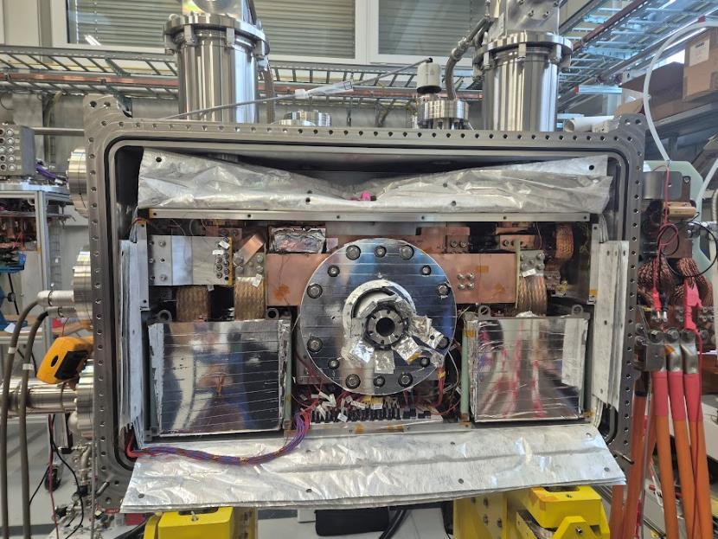
NI HTS Solenoid for PSI Positron Production Experiment
B. Auchmann, A. Brem, M. Duda, H. Garcia Rodrigues, J. Haack, J. Kosse, T. Michlmayr, G. Montenero, S. Mueller, R. Riccioli, S. Sanfillipo
CHART Day 12/11/2025
This work was performed under the auspices of and with support from the Swiss Accelerator Research and Technology (CHART) program

Slide 2
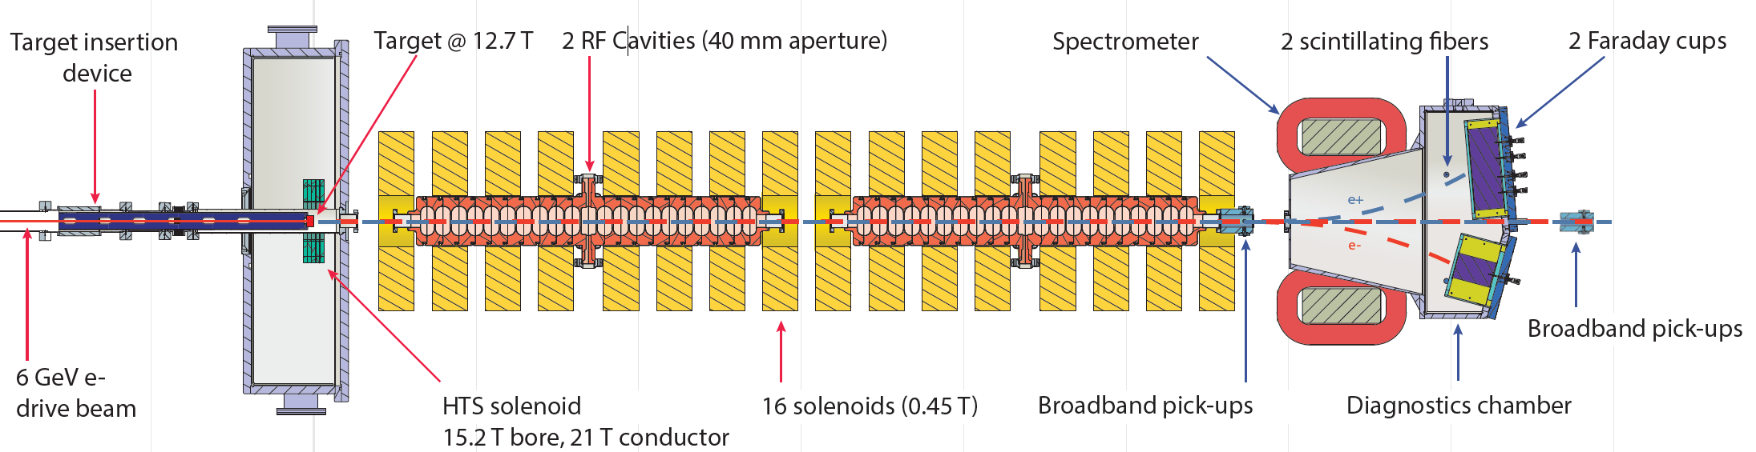
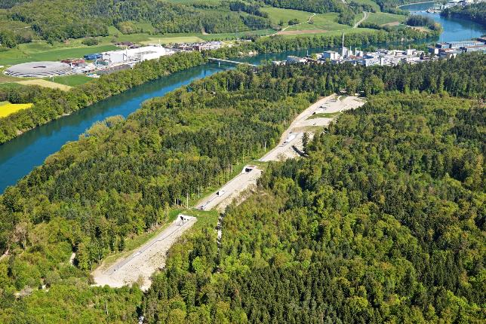
PSI Positron Production ($P^{3}$) Experiment
Aims to demonstrate high yield positron source
N. Vallis, https://doi.org/10.1103/PhysRevAccelBeams.27.013401
SwissFEL
Part of CHART project FCCee-injector

Slide 3

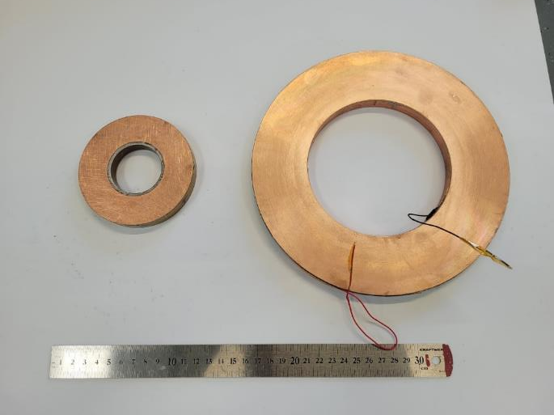
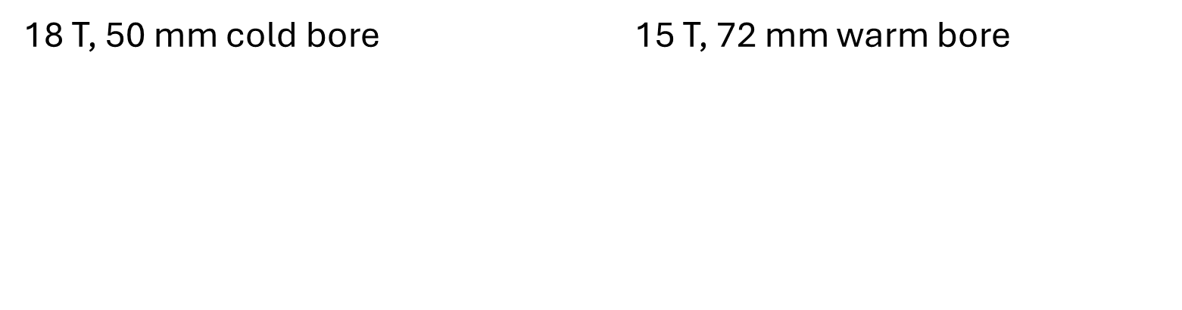
Upscaled version of 18 T PSI NI solenoid
18 T, 50 mm cold bore 15 T, 72 mm warm bore
4 coils
Demonstrator
5 coils
Full scale magnet
Coil manufacturing: H. Garcia Rodrigues

Slide 4
Non-insulated coils
P3 solenoid design
P3 solenoid assembly and testing

Slide 5
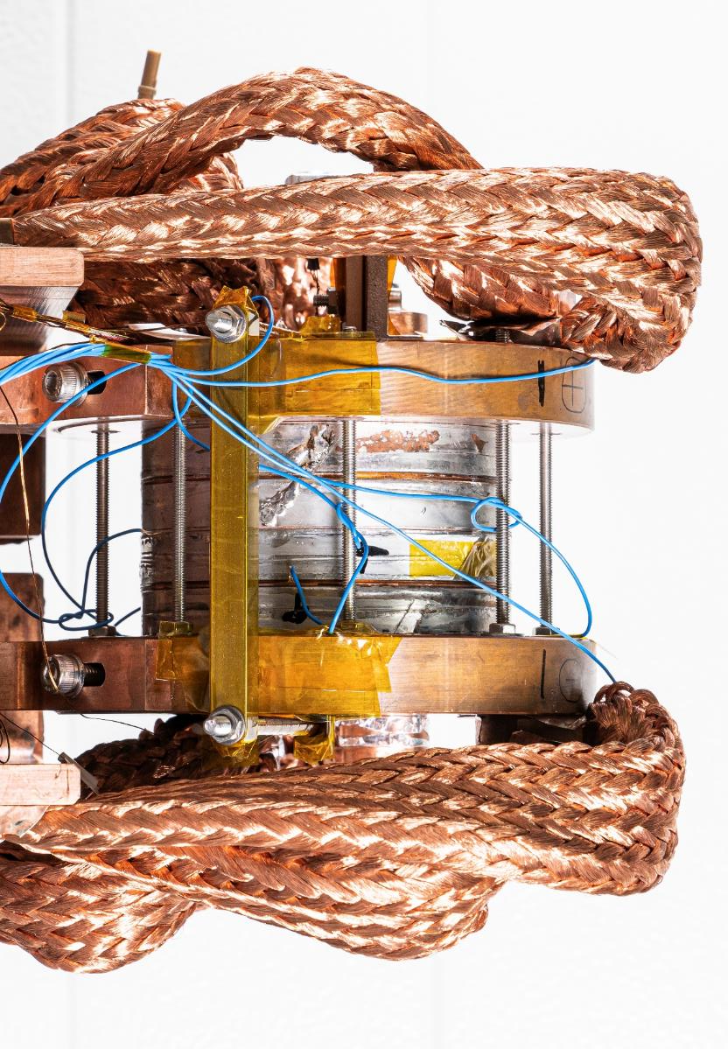
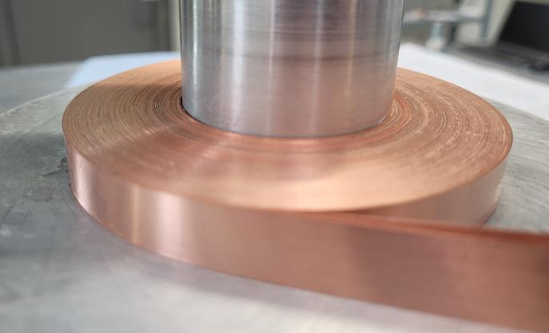
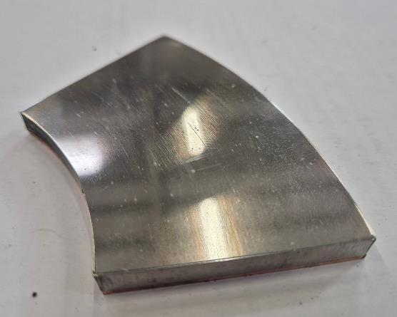
Non-insulated (NI) high-temperature superconductor (HTS)
Single-layer pancake coil wound from bare HTS tape
Solder-impregnated
4x 12 mm wide coil
100 mm
Coil manufacturing: H. Garcia Rodrigues

Slide 6
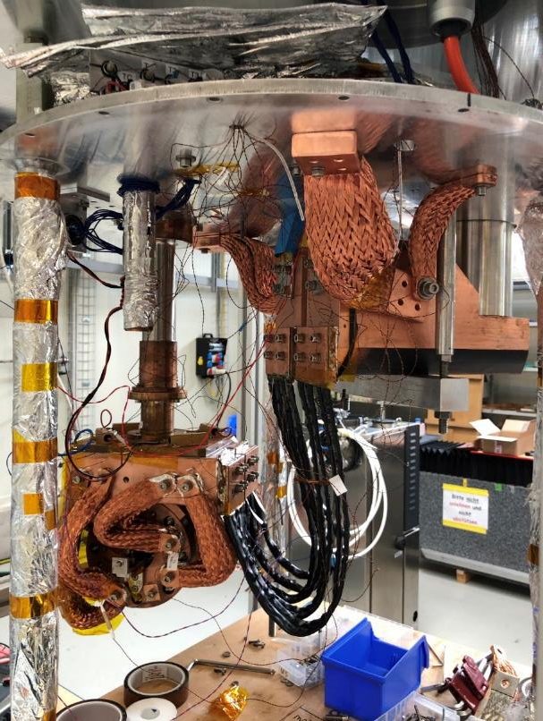
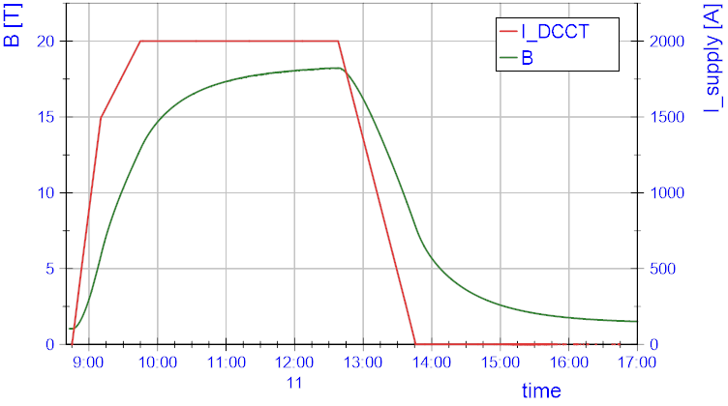
Cryogen-free test stand
2nd cryocooler
radiation shield
top plate
18 T by 4 stack at 2 kA, 12 K
1st cryocooler
4 K coldhead
Central bore field [T]
stack of 4 NI HTS coils with
connectors
HTS leads
Test stand thermals & electrical integration: M. Duda, H. Garcia Rodrigues

Slide 7



Non-insulated (NI) HTS Technology Solenoid
NI coil electrical representation:
Inductor (HTS spiral path)
Resistor (turn-turn contact)
Charging time constant $τ=L/R$
Large NI magnets (large L) take a long time
18 T by PSI 4 stack at 2 kA, 12 K
$$L$$
$$R$$

Slide 8
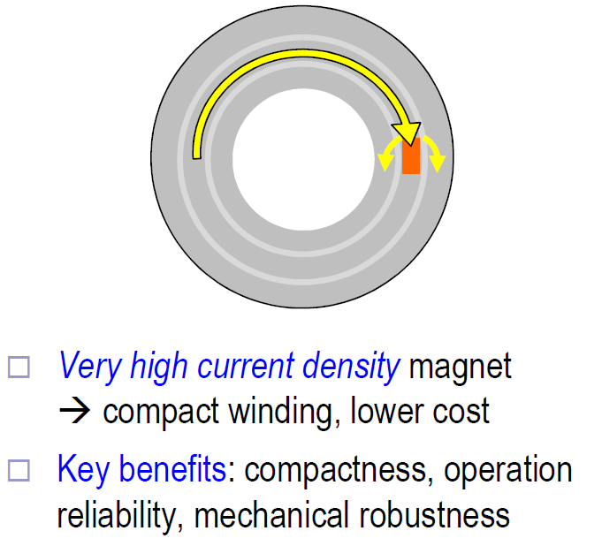
Non-insulated (NI) HTS Technology Solenoid
NI coil electrical representation:
Inductor (HTS spiral path)
Resistor (turn-turn contact)
Charging time constant $τ=L/R$
Large NI magnets (large L) take a long time
$$L$$
$$R$$
Thermal conductivity, radiation robustness
S. Hahn, D. Park, J. Bascuñán, and Y. Iwasa,
“HTS Pancake Coil without Turn-to-Turn Insulation,” IEEE TAS, 2011.

Slide 9
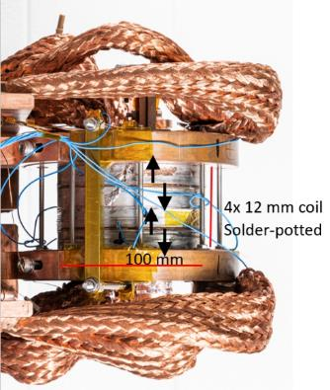
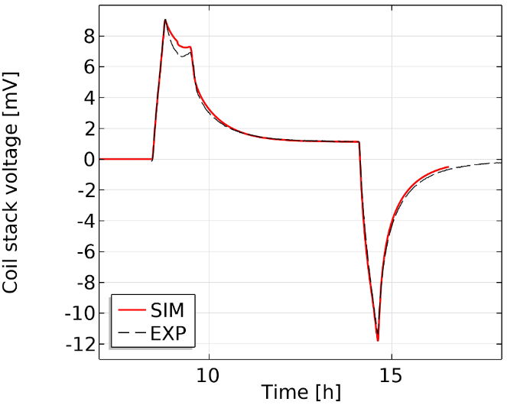
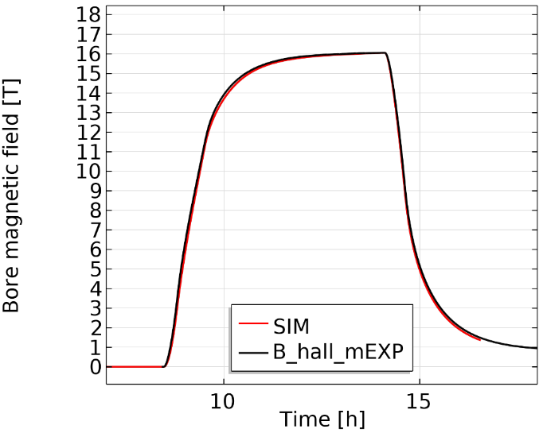

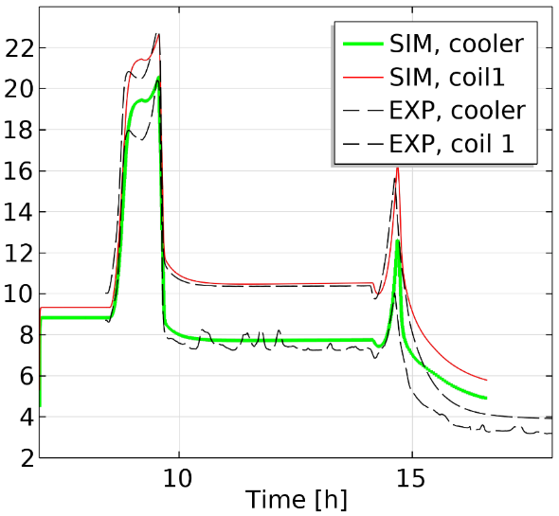

Experiment vs model
Turn-turn resistance used a fitting parameter
$$ρ_{turnturn}∝ρ_{copperRRR20}\left(B,T\right)$$
Works reasonably over a 15-77 K range
Example: 1.8 kA at 15 K in cryogen-free setup

Slide 10
Non-insulated coils
P3 solenoid design
P3 solenoid assembly and testing

Slide 11
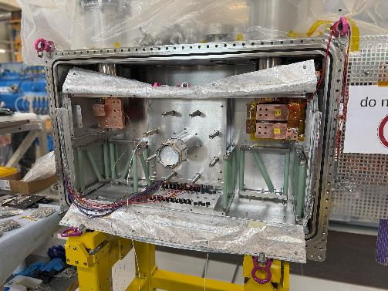
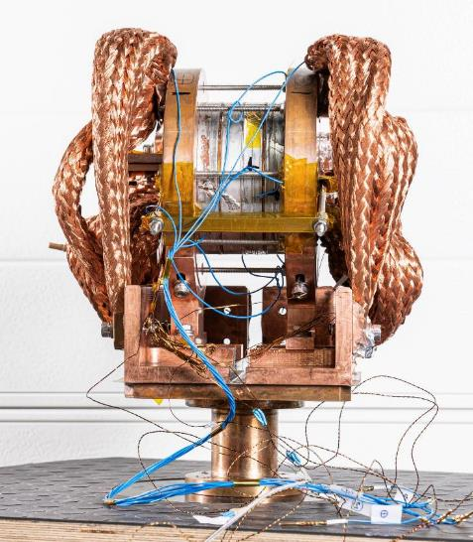
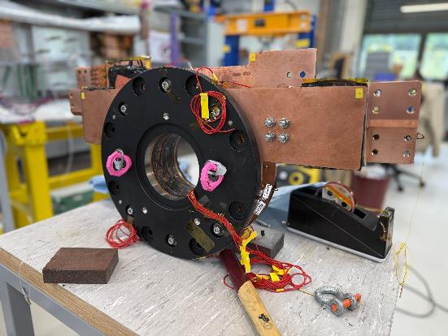
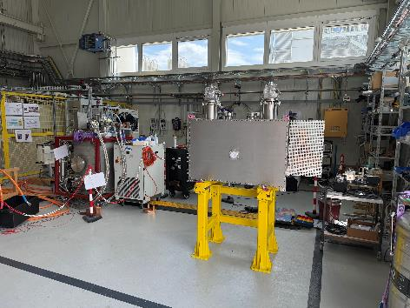
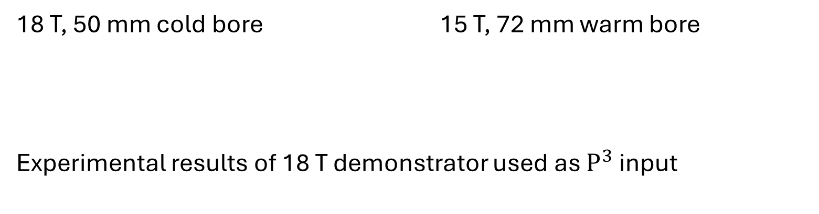
Upscaled version of 18 T PSI NI solenoid
18 T, 50 mm cold bore 15 T, 72 mm warm bore
Experimental results of 18 T demonstrator used as $P^{3}$ input
4 coils
Demonstrator
5 coils
Full scale magnet

Slide 12
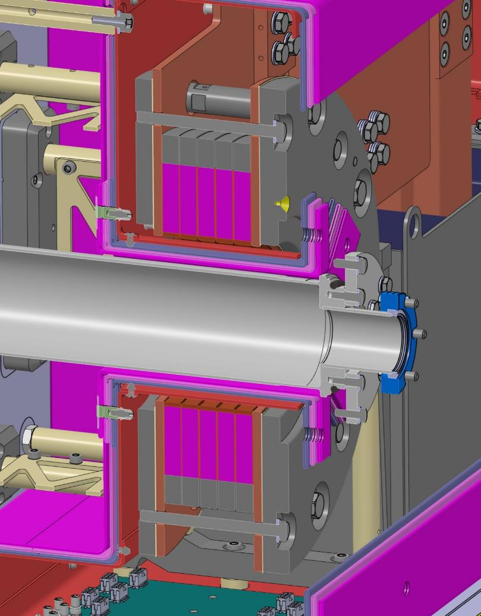
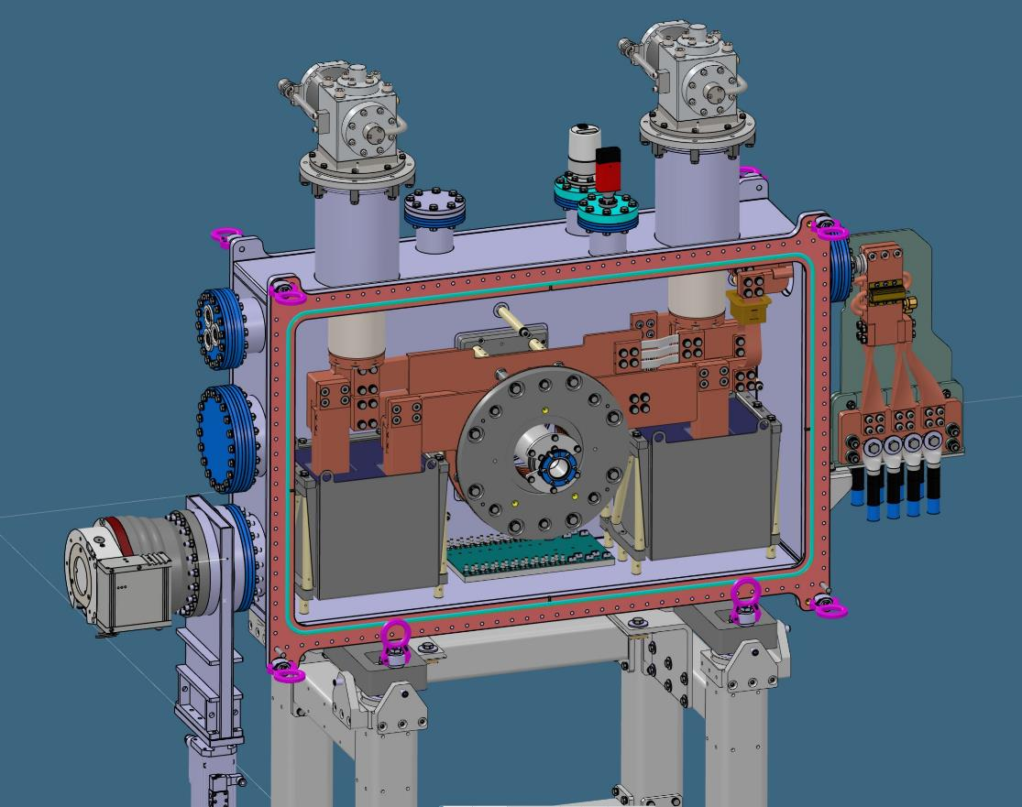

Conduction-cooled system
15 T bore, 21 T conductor @ 1.3 kA, 15-20 K
G10/SS support
Cryocooler
Current leads
Current terminals
Solenoid stack
HTS coils
72 mm
$$e^{−}$$
Target
1.07 m
Pb mass
Thermal shield
MLI
CAD design: S. Mueller, T. Michlmayr

Slide 13
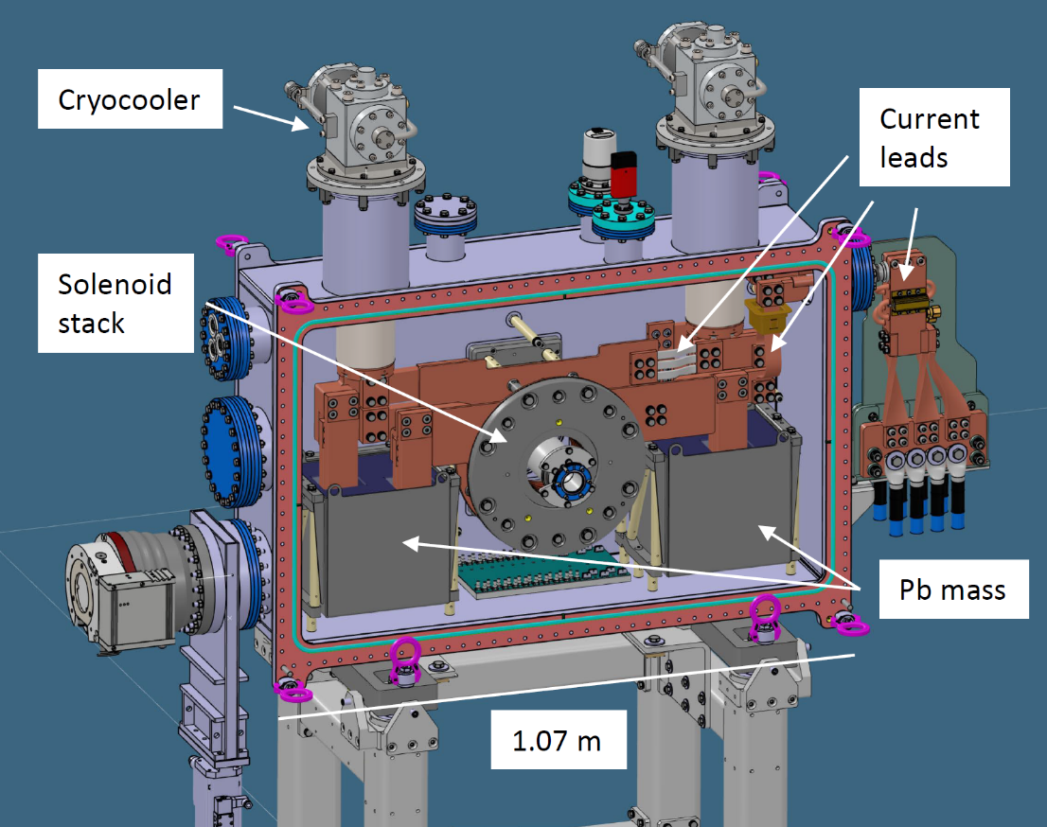
Fault scenario:
Around 0.7 MJ stored in
the magnetic field
Coolers stop
Open circuit
R_turnturn
HTS path
Stored magnetic energy gets
Dissipated in coils+buffers

Slide 14
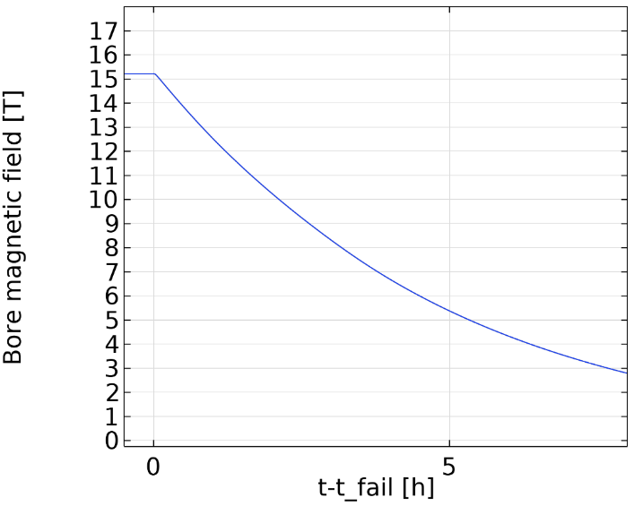
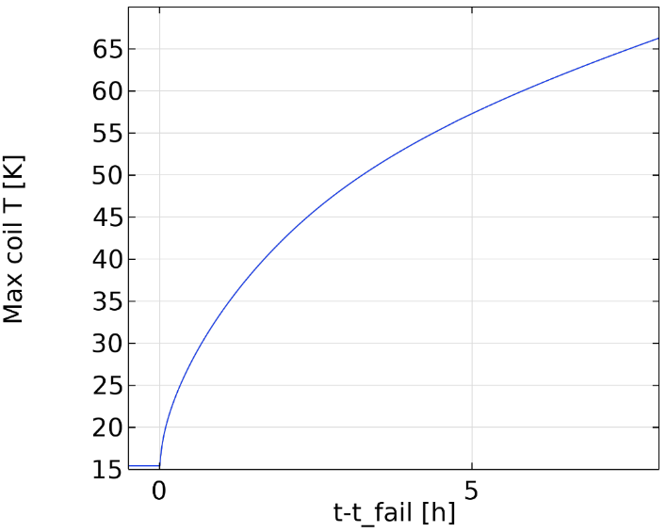
Buffer sizing
Less mass
more mass
Slow ramp-down

Slide 15
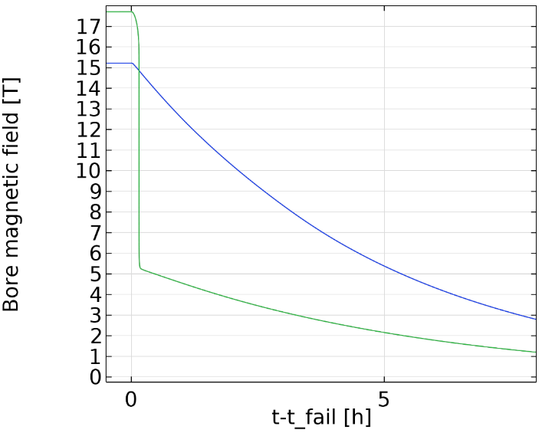
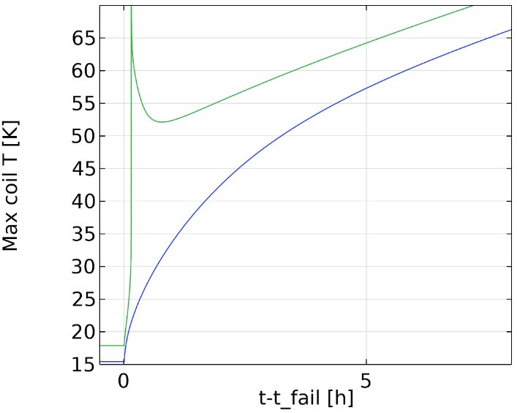
Buffer sizing
Less mass
Quench
more mass
Slow ramp-down

Slide 16
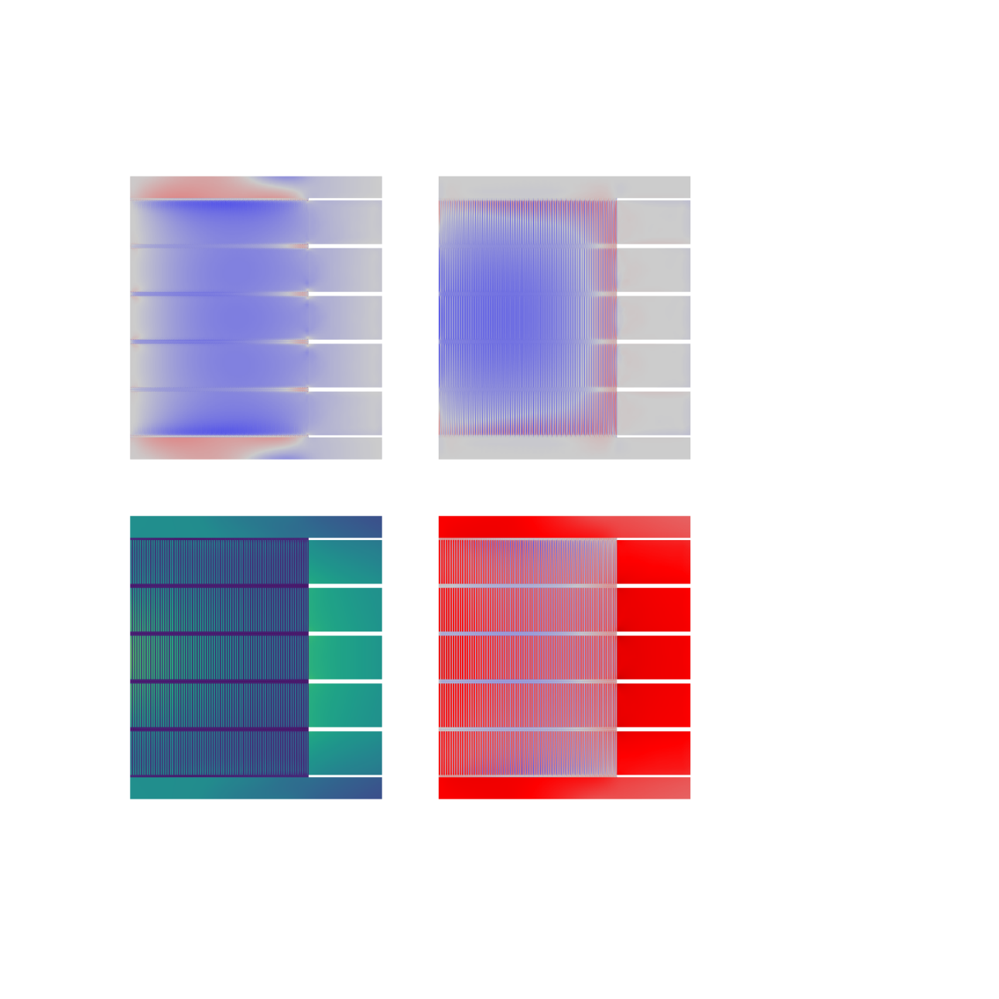
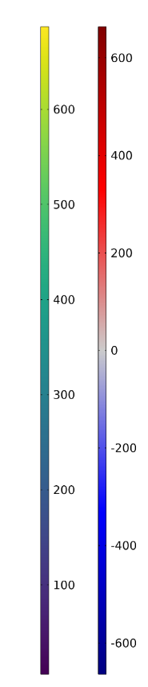
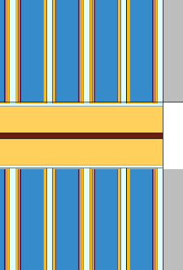
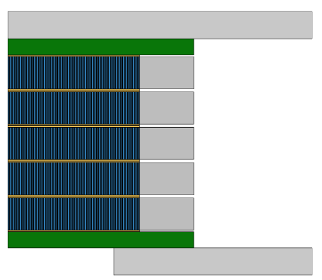


Mechanical
Stress [MPa]
a) Radial
b) Axial
Stainless steel flange
$$z$$
Copper terminal plate
Frictional
interface
$r$
Field’s metal
Stainless steel
overband
Axial plate
HTS tapes
Tape structure explicitly modeled to capture
-differential thermal contraction
-plasticity
c) Mises
d) Hoop
Max radial stress 2 MPa
Min axial stress -150 MPa
Max hoop stress (substrate) 373 MPa

Slide 17
Non-insulated coils
P3 solenoid design
P3 solenoid assembly and testing

Slide 18
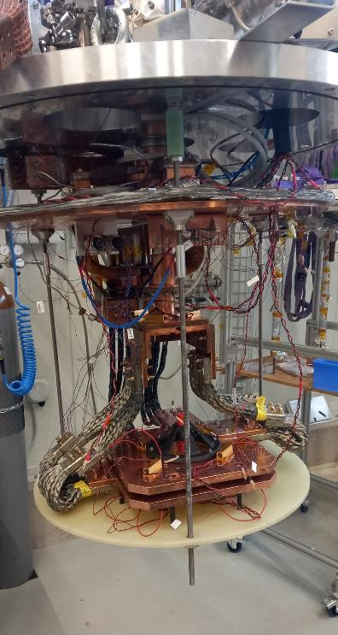
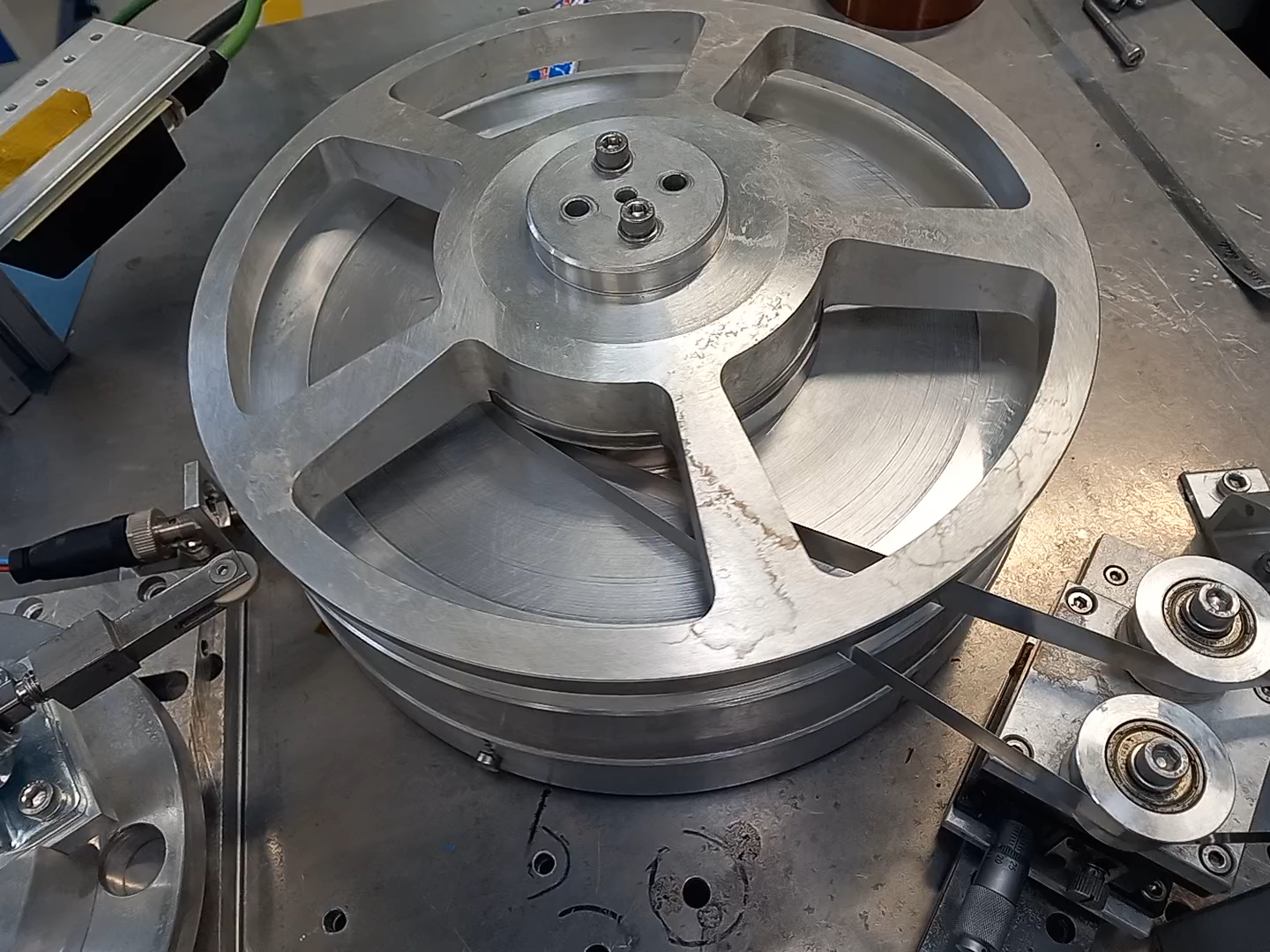
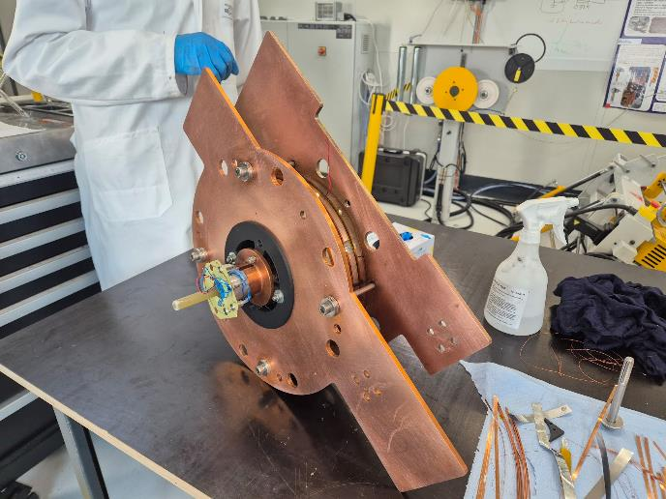
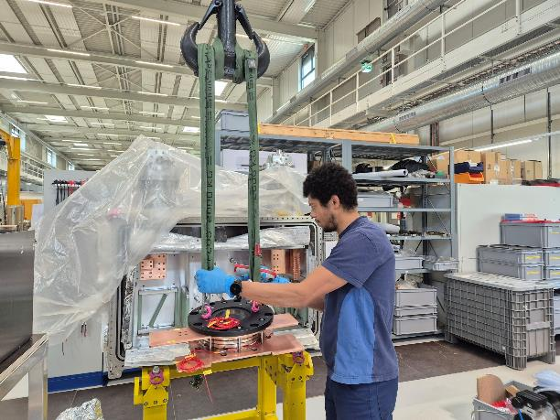
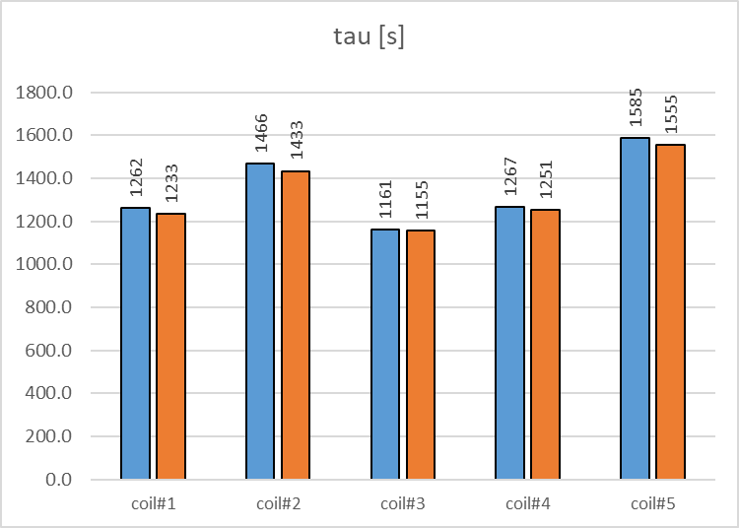
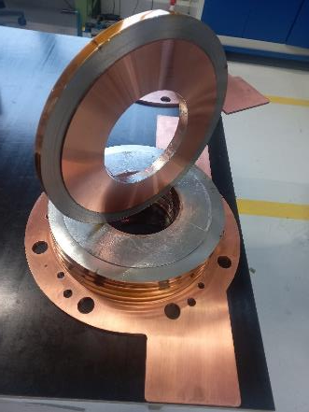
Coil manufacturing & testing
Coil manufacturing:
H. Garcia Rodrigues
M. Duda, H. Garcia Rodrigues

Slide 19

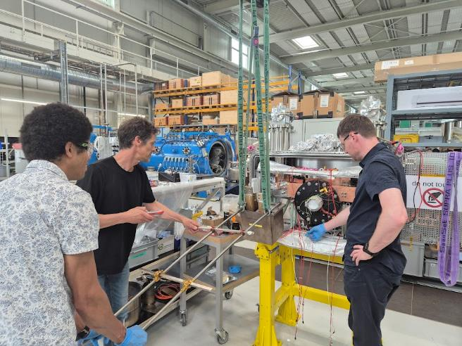
Assembly
Assembly team: M. Duda, H. Garcia Rodrigues,
T. Michlmayr, Y. Studer, N. Strohmaier, M. Zykova, J. Haack

Slide 20
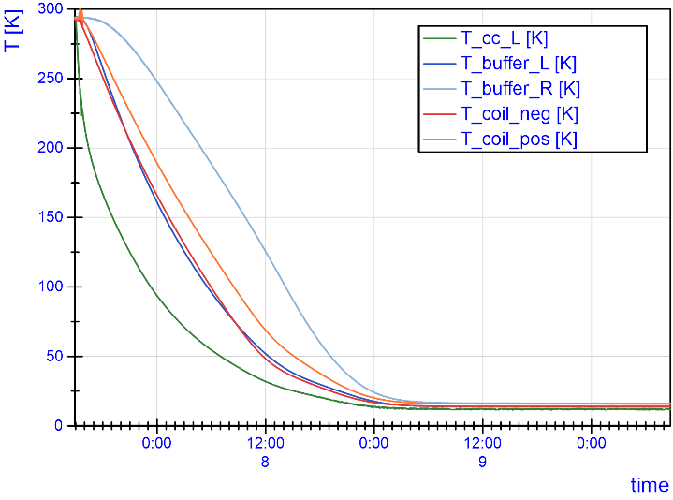
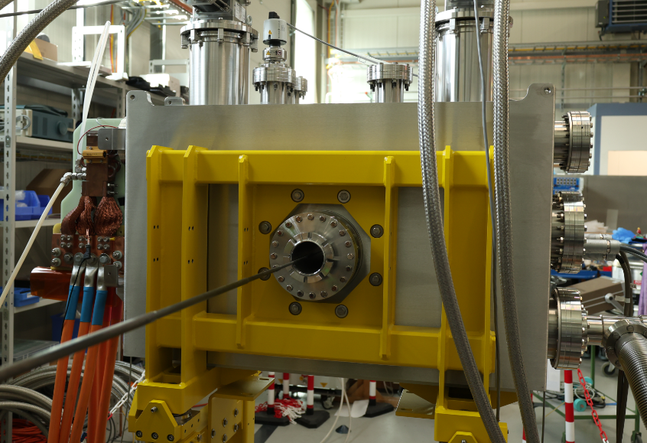
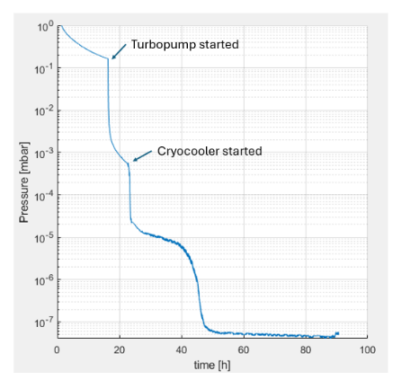
Magnet being commissioned
Bore field
Magnetic field measurements:
R. Riciolli, G. Montenero, R. Deckardt
Pressure
First-of-a-kind system: after reaching 77% of nominal current, we introduced some enhancements. Testing restarted this week.
Measurements: M. Duda

Slide 21
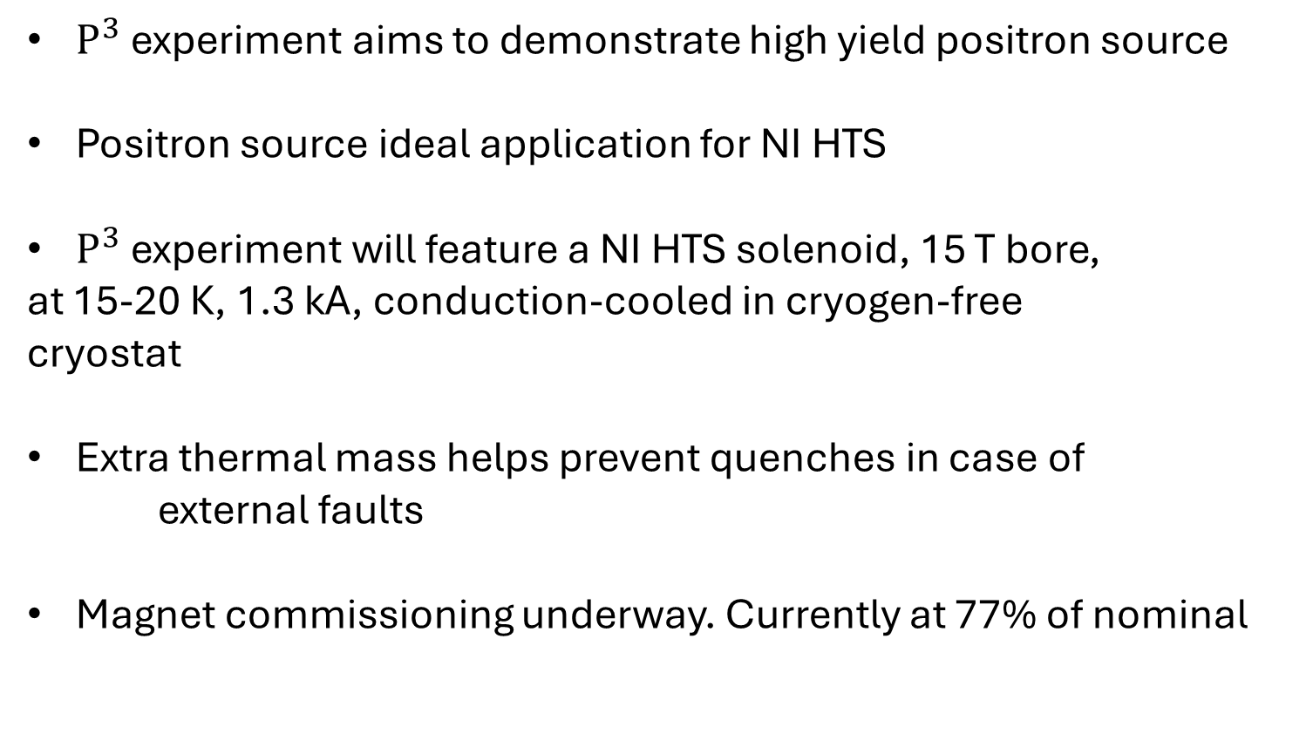
Conclusions
$P^{3}$ experiment aims to demonstrate high yield positron source
Positron source ideal application for NI HTS
$P^{3}$ experiment will feature a NI HTS solenoid, 15 T bore,
at 15-20 K, 1.3 kA, conduction-cooled in cryogen-free
cryostat
Extra thermal mass helps prevent quenches in case of
external faults
Magnet commissioning underway. Currently at 77% of nominal

Slide 22
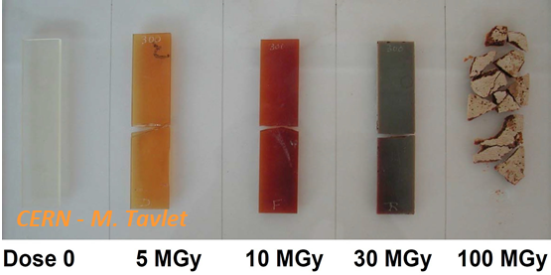
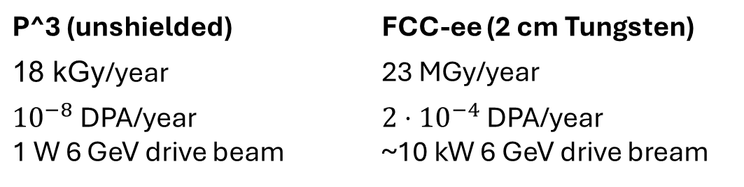
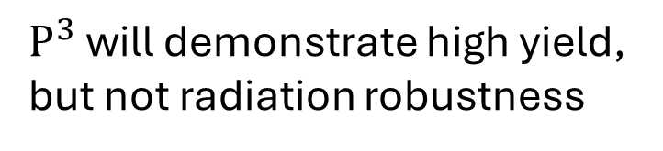
Radiation
Radiation damage on Epoxy
$P^{3}$ will demonstrate high yield,
but not radiation robustness
P^3 (unshielded) | FCC-ee (2 cm Tungsten)
18 kGy/year | 23 MGy/year
${10}^{−8}$ DPA/year 1 W 6 GeV drive beam | $2⋅{10}^{−4}$ DPA/year ~10 kW 6 GeV drive bream
B. Humann, doi:10.18429/JACoW-IPAC2022-THPOTK048

Slide 23
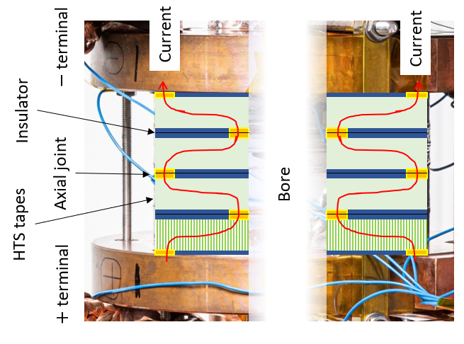

Non-insulated (NI) HTS
Axial current injection
4x 12 mm wide coil
100 mm
Rapidly develop infrastructure
via license agreement with
Tokamak Energy

Slide 24
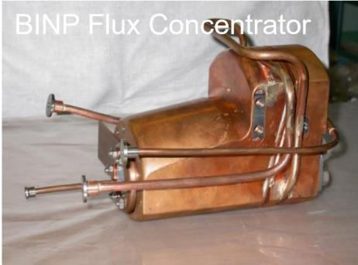





FCC-ee injector
Flux Concentrator (FC)
Pulsed copper device
Yield=$\frac{N_{e^{+}}}{N_{e^{−}}}≈3$[3]
P. Martyshkin, BINP
$$e^{−}$$
Electrons shot at target produce particles
Charged particles are captured by a magnet
We want to do better by using HTS
Yield=$\frac{N_{e^{+}}}{N_{e^{−}}}=7 [3]$
[3] N. Vallis https://doi.org/10.18429/JACoW-LINAC2022-TUPORI16

Slide 25
FCC-ee injector
$$e^{−}$$
Field profile and target location result from
numeric and analytical optimization
Y Zhao. Optimisation of the FCC-ee Positron Source Using a HTS
Solenoid Matching Device, 2022.
Y Zhao. Comparison of Different Matching Device Field Profiles for
the FCC-ee Positron Source, 2021.
R. Chehab et al., “An adiabatic matching device for the Orsay linear positron accelerator”, IEEE Trans. Nucl. Sci., 1983.

