Slide 1
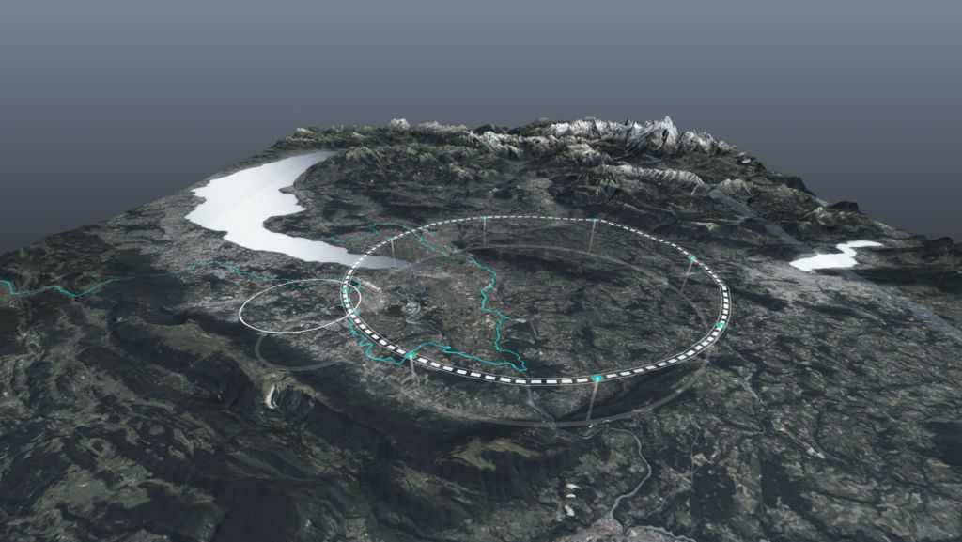









Status of the FCC Project
CHART Workshop 2025 for the 10-year anniversary of CHART
PSI, 12 November 2025
Michael Benedikt
on behalf of the FCC collaboration
http://cern.ch/fcc
Work supported by the European Commission under the HORIZON 2020 projects EuroCirCol, grant agreement 654305; EASITrain, grant agreement no. 764879; iFAST, grant agreement 101004730, FCCIS, grant agreement 951754; E-JADE, contract no. 645479; EAJADE, contract number 101086276; and by the Swiss CHART program
photo: J. Wenninger

Slide 2




Feasibility Study Report published on 31 March 2025
Structure:Three Volumes
Vol. 1: Physics, Experiments and Detectors
Vol. 2: Accelerators, Technical Infrastructures, Safety Concepts
Vol. 3: Civil Engineering, Implementation & Sustainability
Three FSR volumes & other FCC-related input to 2025/26 European Strategy Update posted at https://indico.cern.ch/event/1534205/
Input for the Update of European Strategy for Particle Physics
prepared with Overleaf and submitted for publication to EPJ (Springer-Nature)

Slide 3
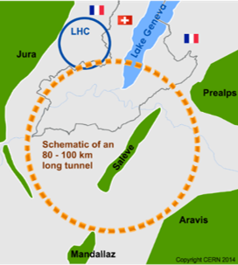
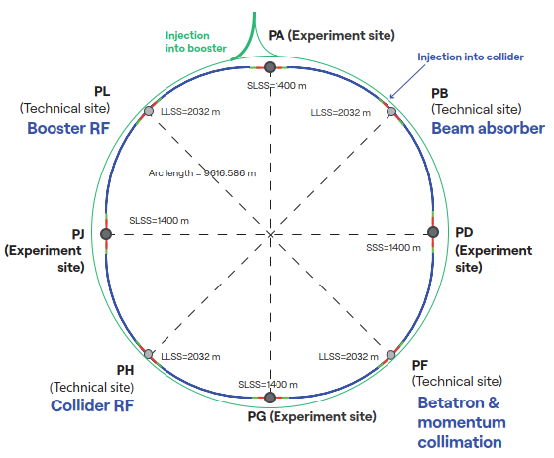
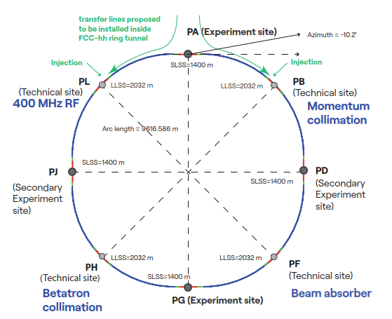
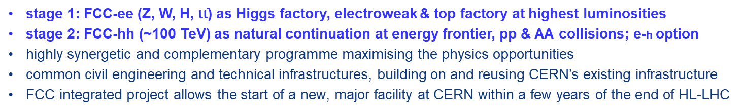
Future Circular Collider integrated program – scope
stage 1: FCC-ee (Z, W, H, $\text{t}\overline{\text{t}}$) as Higgs factory, electroweak & top factory at highest luminosities
stage 2: FCC-hh (~100 TeV) as natural continuation at energy frontier, pp & AA collisions; e-h option
highly synergetic and complementary programme maximising the physics opportunities
common civil engineering and technical infrastructures, building on and reusing CERN’s existing infrastructure
FCC integrated project allows the start of a new, major facility at CERN within a few years of the end of HL-LHC
FCC-ee
FCC-hh
2020 - 2045
2048 - 2062
~2075 - ~2100

Slide 4
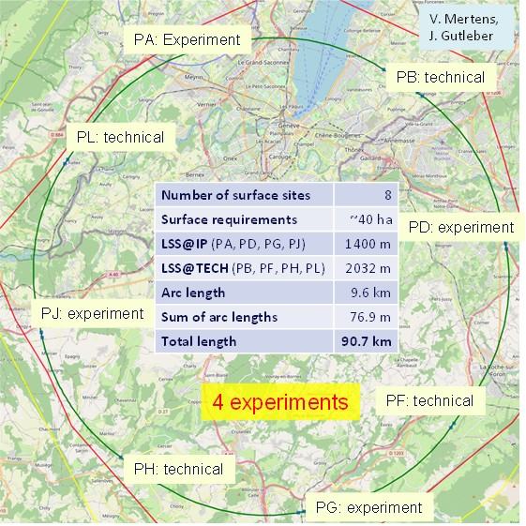
Reference layout and implementation:PA31 - 90.7 km
Layout chosen out of ~ 100 initial variants, based on several criterias:
geology,
surface constraints (land availability, urbanistic, etc.),
environment, (protected zones),
infrastructure (electricity, transport),
machine performance
“Avoid-reduce-compensate” principle of EU and French regulations.
Overall lowest-risk baseline:
90.7 km ring, 8 surface points,
4-fold symmetry

Slide 5
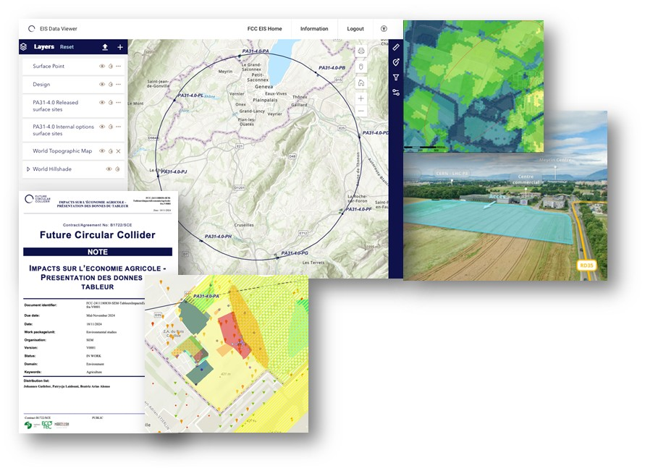
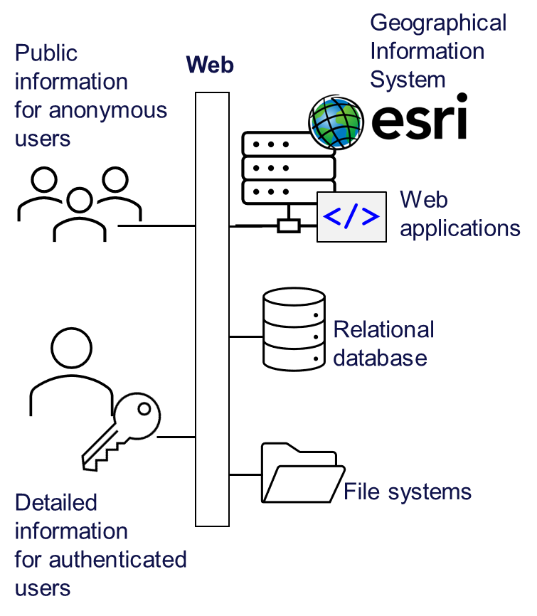
Environmental initial state analysis
Environmental information system
  The environmental initial state analysis at the eight surface site locations (~600 ha covered) did not reveal principal showstoppers for the project.
  Basis for detailed optimisation of surface sites.
  Reference for the environmental impact assessment.

Slide 6
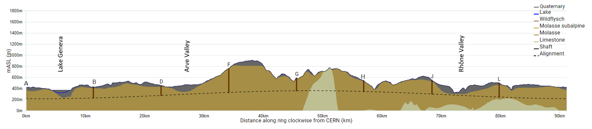
Optimum placement of FCC tunnel and geology
  Tunneling mainly in molasse layer (soft rock), well suited for fast, low-risk TBM construction.
  6,25 million m³ excavated volume → ~8.5 million m³ excavation material on surface (expanded)
  CE Designs of all underground structures developed
  Average shaft depths ~240 m
  To fix the vertical position of the tunnel, interfaces between geological layers have to be known

Slide 7
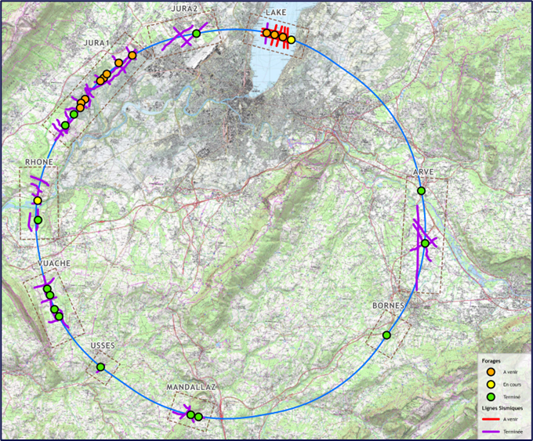
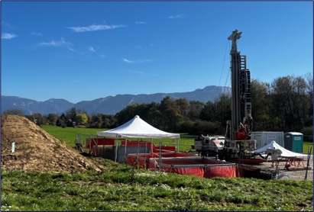
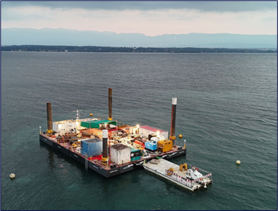
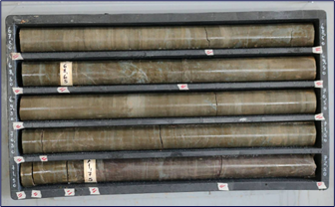
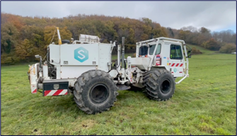
Geological investigations
Focused on 8 zones improve prêcision of geological model and identify the intercased moraine – molasse and molasse – limestone.
80 km of seismic investigations completed
15 of 27 bore holes completed
Completion of bore holes ~June 2026
Results so far confirm 3D geological model

Slide 8
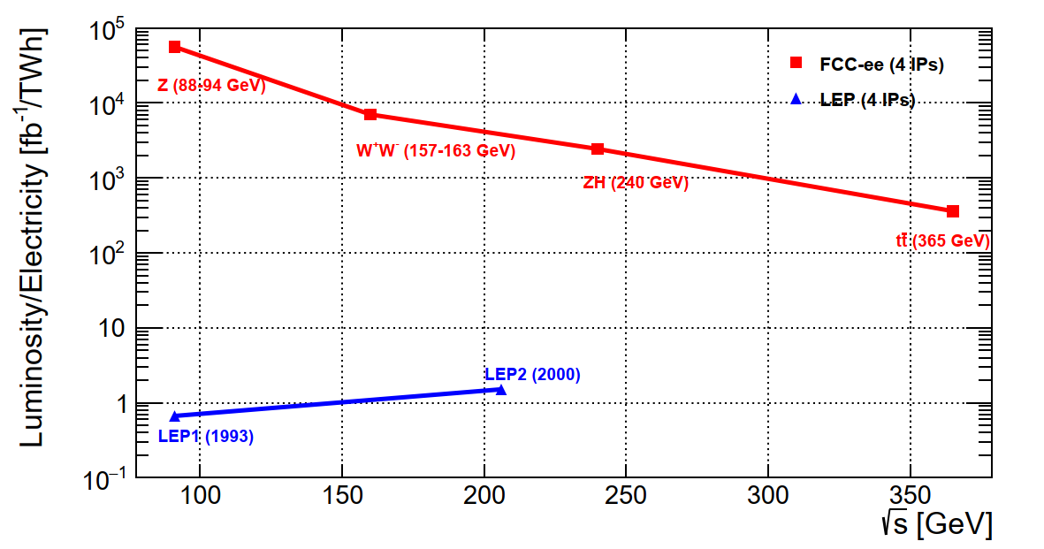
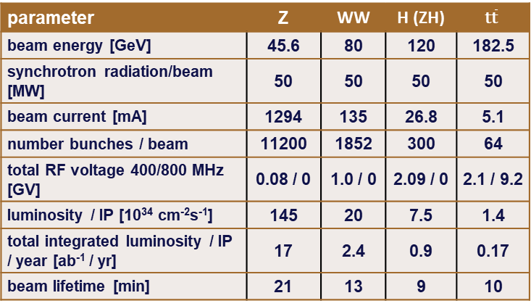
Stage 1: e⁺e⁻ collider FCC-ee
Combining concepts from past and present lepton colliders and using high-efficiency SRF system results in a giant step in efficiency:
Consolidated main parameters
parameter | Z | WW | H (ZH) | $$\text{t}\overline{\text{t}}$$
beam energy [GeV] | 45.6 | 80 | 120 | 182.5
synchrotron radiation/beam [MW] | 50 | 50 | 50 | 50
beam current [mA] | 1294 | 135 | 26.8 | 5.1
number bunches / beam | 11200 | 1852 | 300 | 64
total RF voltage 400/800 MHz [GV] | 0.08 / 0 | 1.0 / 0 | 2.09 / 0 | 2.1 / 9.2
luminosity / IP [10³⁴ cm⁻²s⁻¹] | 145 | 20 | 7.5 | 1.4
total integrated luminosity / IP / year [ab⁻¹ / yr] | 17 | 2.4 | 0.9 | 0.17
beam lifetime [min] | 21 | 13 | 9 | 10
4 years
6 x 10¹² Z
LEP x 10⁵
2 years
> 10⁸ WW
LEP x 10⁴
3 years
> 2x10⁶ H
5 years
2 x 10⁶ tt
→10⁴–10⁵x luminosity/el.energy of LEP
→ sustainable physics

Slide 9

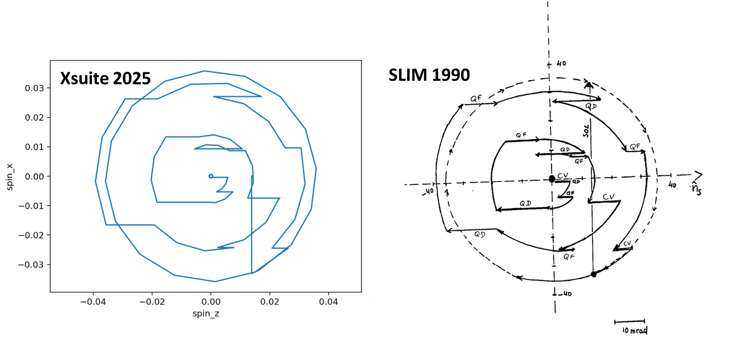
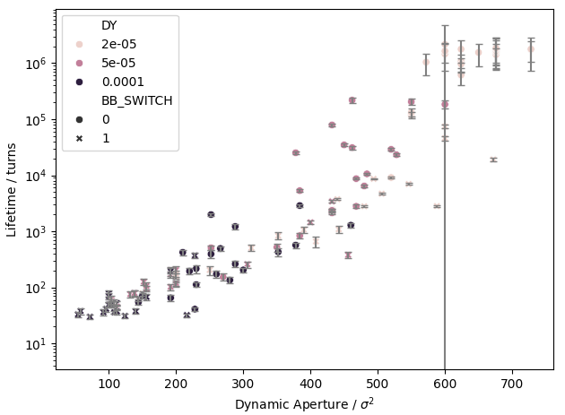
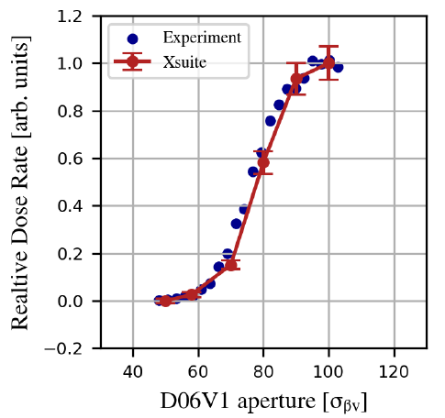
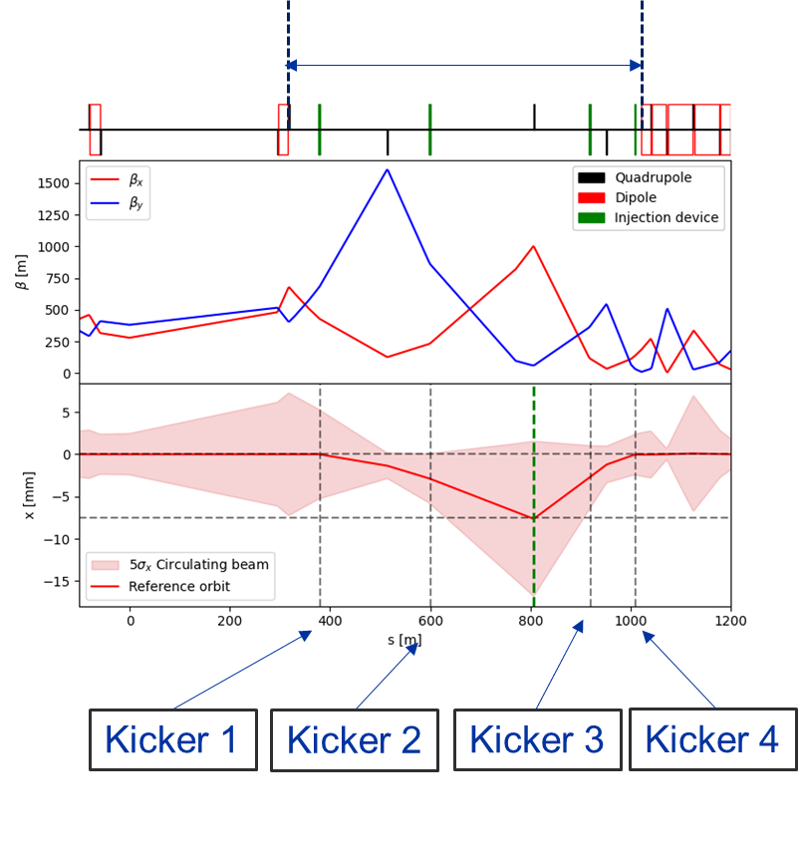
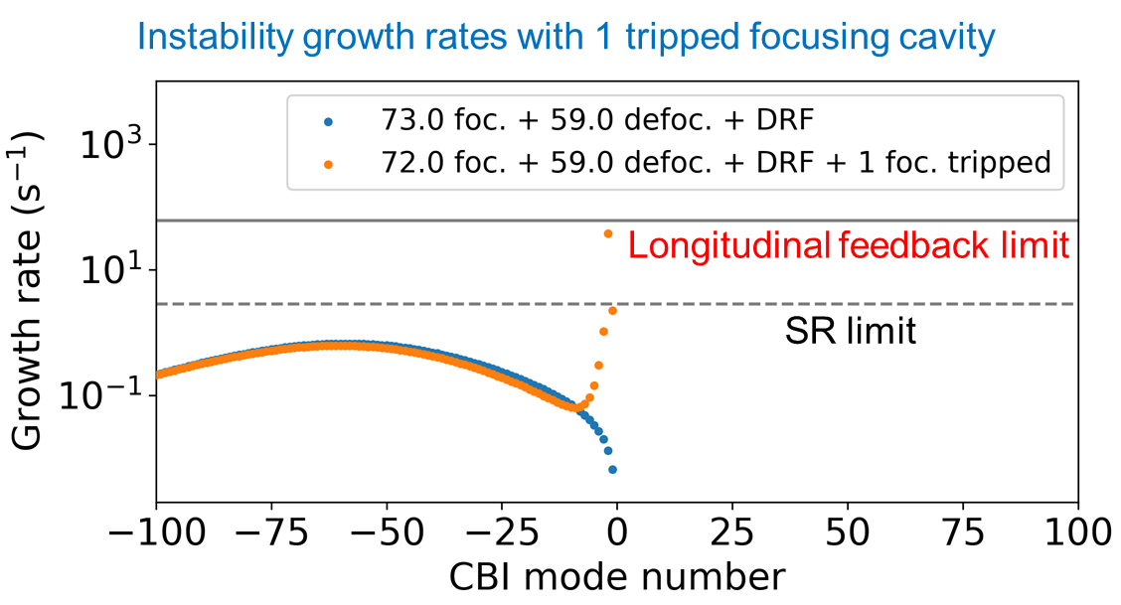
Various optics and beam dynamics activities
effect of beam-beam interaction & sextupole alignment
on dynamic aperture and beam lifetime - correlations
spin tracking
:
code development for FCC-ee
benchmarking case of LEP1 with orbit bumps to compensate precession in the experimental solenoids; good agreement with classical SLIM simulations
benchmarking at SuperKEKB
Touschek & beam-gas scattering for different collimator settings, including collimator-matter interaction –
Xsuite-simulated response of Belle-II diamond detector
:
on-axis injection studies
cavity trip in RPO scheme

Slide 10
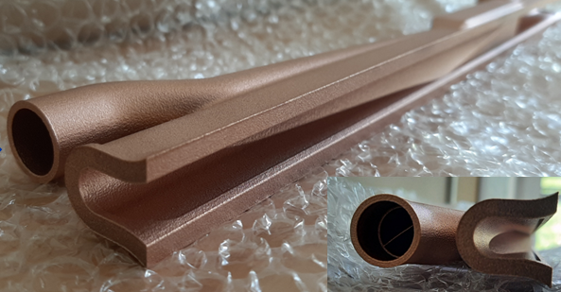
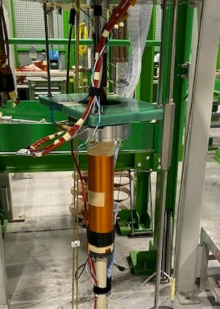
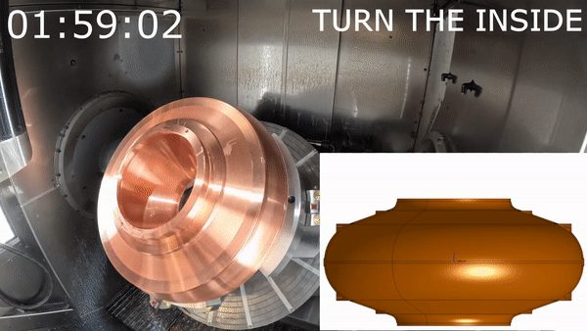
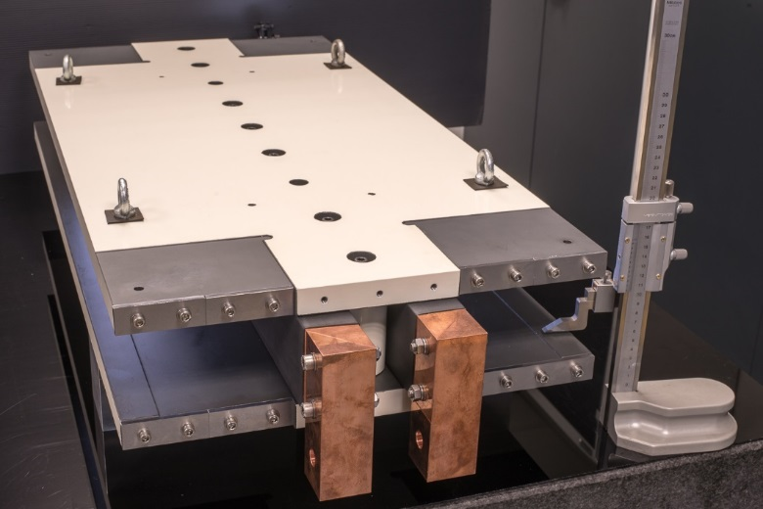
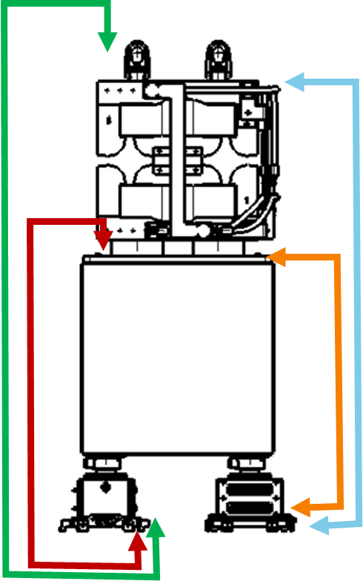
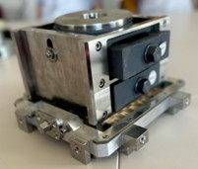
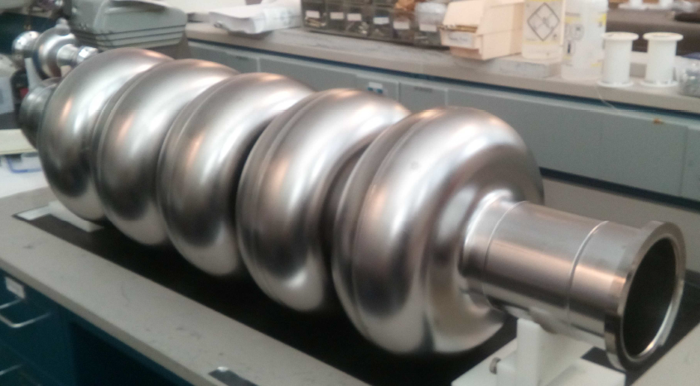
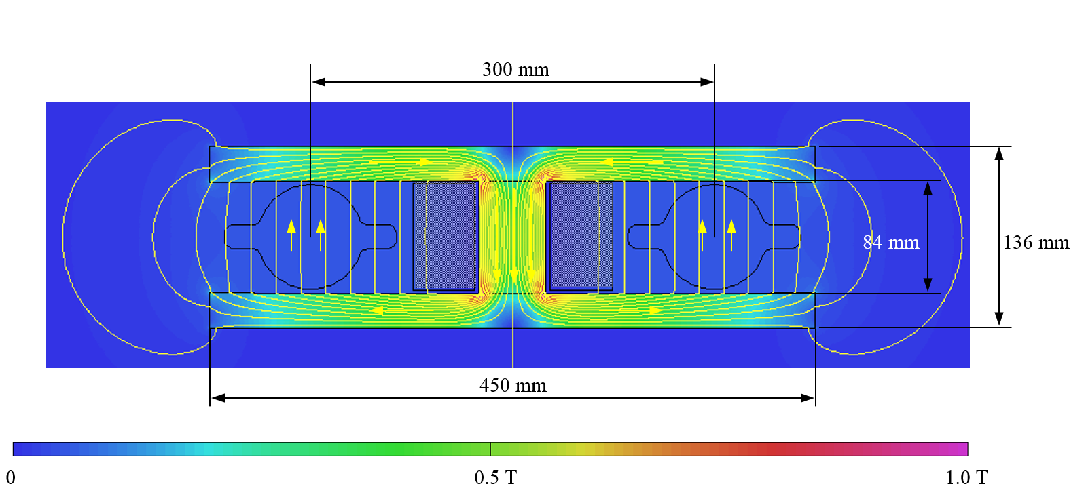

Various R&D and prototyping activities
Q1 prototype tested at cold
400 MHz monoblock prototype cavity
3D printed synchrotron radiation absorber
800 MHz bulk Nb 5-cell cavity
Twin-dipole design with 2× power saving 16 MW
(at 175 GeV)
Vibration studies with girder on PSI jacks

Slide 11



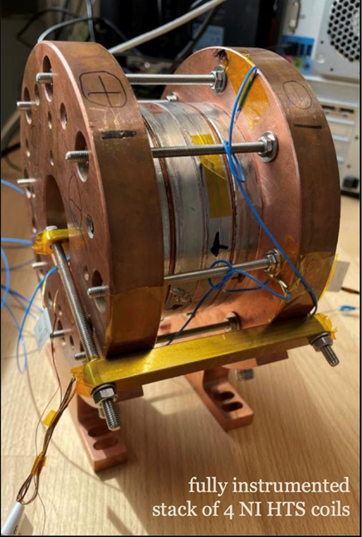
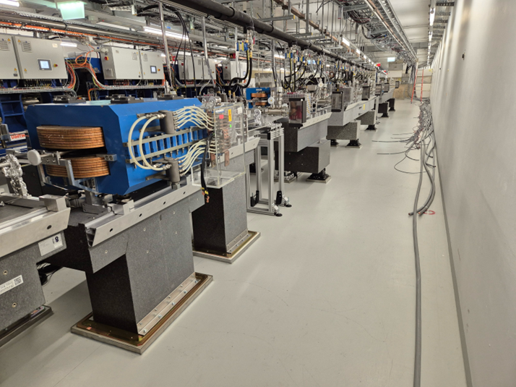
FCC-ee injector design
Main linac 20 GeV S-band, based on SwissFEL structures.
  new accelerating structures with higher shunt impedance;
  gradient 22.5/20.5 MV/m; repetition rate 100 Hz.
  overall power consumption < 30 MW
Novel positron source
  HTS solenoid (15 T on axis, tested 18 T @ 12 K)
  proof-of-principle beam tests at PSI SwissFEL from 2026

Slide 12
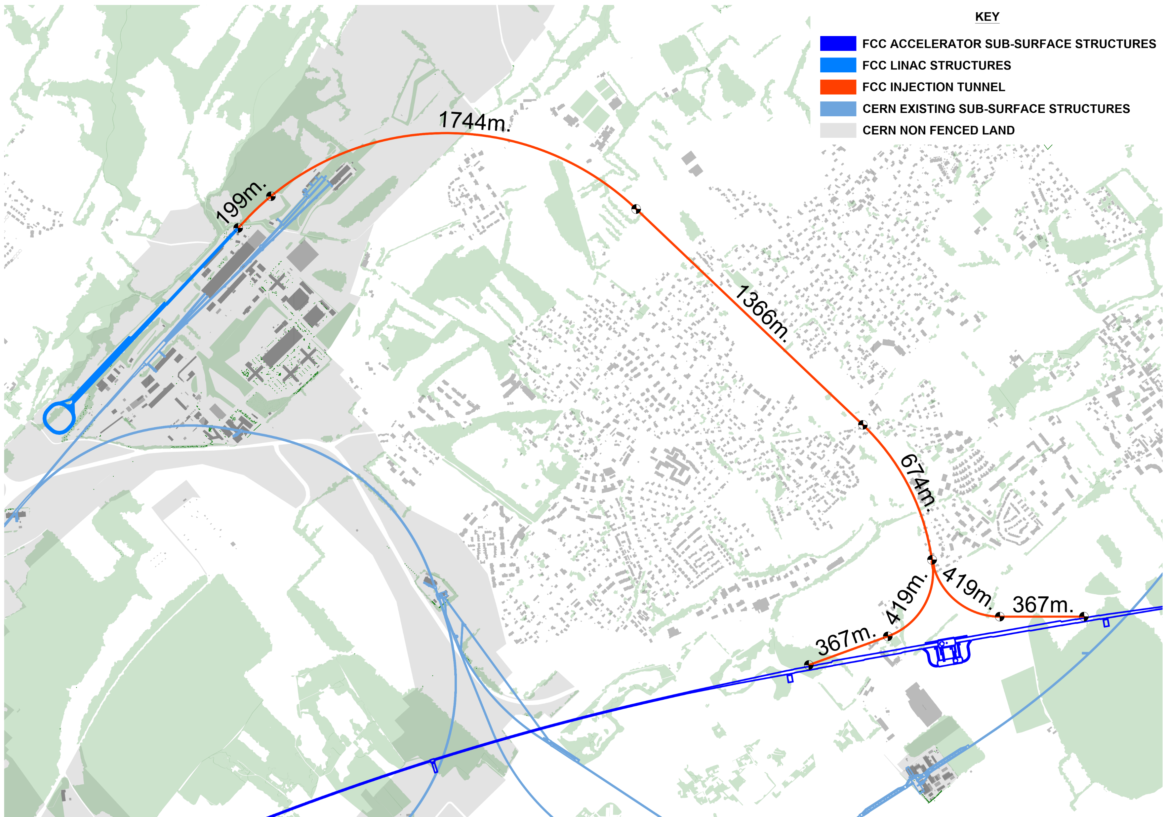
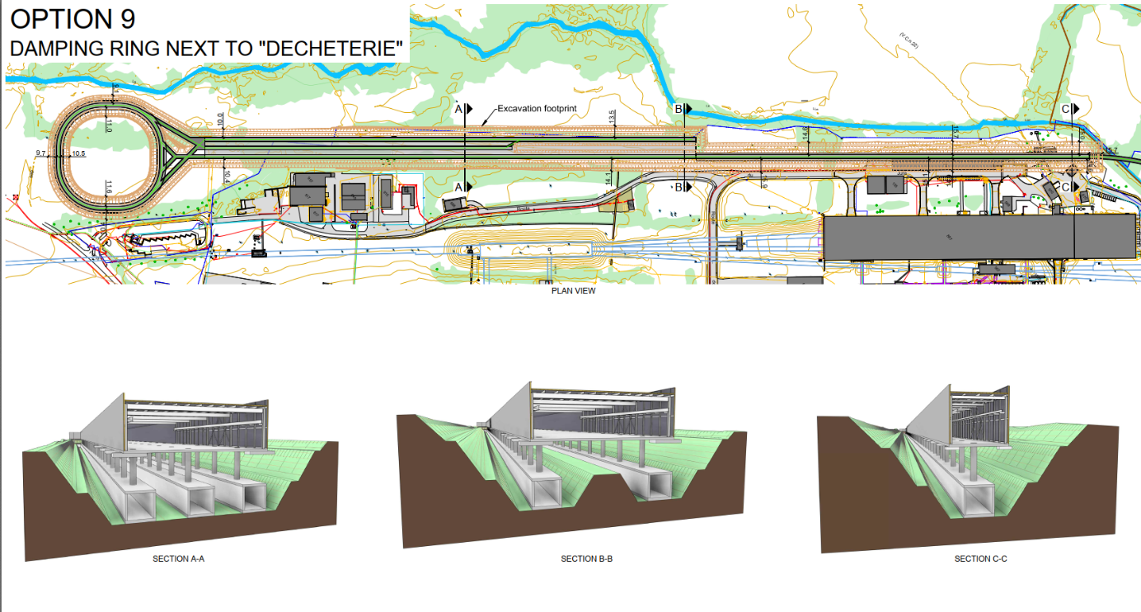
FCC-ee injector implementation
Located on CERN Prévessin site
possible connection to North Area to enable non-collider physics
transfer line to FCC PA (LHC P8)
“cut and cover” construction

Slide 13
FCC-ee cost estimate (FSR 2025)
Capital cost (2024 CHF) for construction of the FCC-ee is summarised below. This cost includes construction of the entire new infrastructure and all equipment for operation at the Z, WW and ZH working points.
Domain | Cost [MCHF]
Civil engineering | 6,160
Technical infrastructures | 2,840
Injectors and transfer lines | 590
Booster and collider | 4,140
CERN contribution to four experiments | 290
FCC-ee total | 14,020
+ four experiments (non-CERN part) | 1,300
FCC-ee total incl. four experiments | 15,320
Note: Upgrade of SRF (800 MHz) & cryogenics for ttbar operation corresponds to additional cost of 1,260 MCHF.

Slide 14
Stage 2: hadron collider FCC-hh
Parameter optimization to lower electricity consumption (~max. consumption of FCC-ee)
Magnetic field considered realistic with today’s technologies (Nb₃Sn, ~14T, 1.9 K)
Main parameters FSR 2025
FCC-hh functional layout
parameter | FCC-hh | FCC-hh CDR | HL-LHC
collision energy cms [TeV] | 85 | 100 | 14
dipole field [T] | 14 | 16 | 8.33
circumference [km] | 90.7 | 97.8 | 26.7
beam current [A] | 0.5 | 0.5 | 1.1
synchr. rad. per ring [kW] | 1200 | 2400 | 7.3
peak luminos. [10³⁴ cm⁻²s⁻¹] | 30 | 30 | 5 (lev.)
integr. luminosity / IP [fb⁻¹] | 20000 | 20000 | 3000
For Nb3Sn @ 1.9 K: 355 MW el, consumption and 2.3 TWh/y
For Nb3Sn @ 4.5 K potential to reduce to ~1.8 TWh/y as FCC-ee.

Slide 15
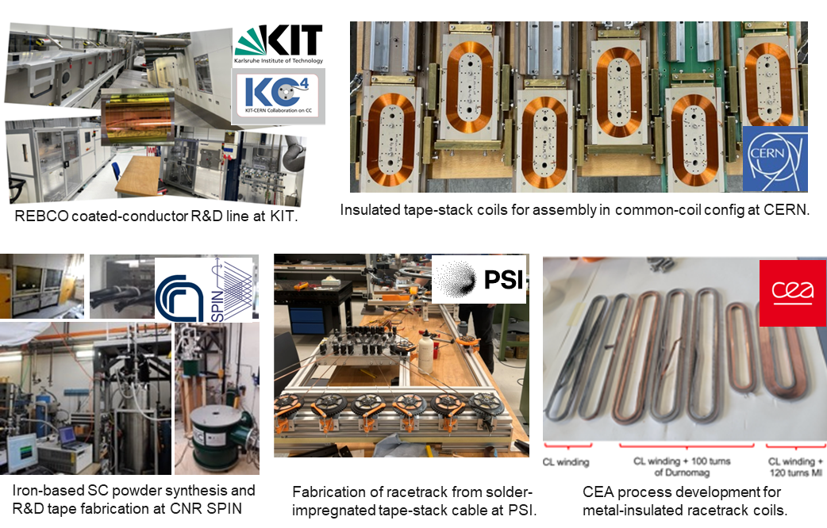
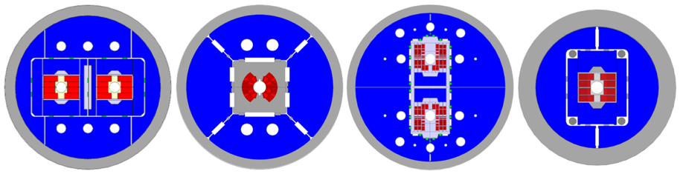


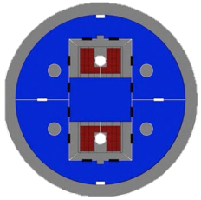



FCC-hh High-Field Magnet Nb₃Sn and HTS R&D
Nb₃Sn:
12- and 14-T short demonstrators
Different coil geometries
tests scheduled for 2026
HTS R&D in various domains:
REBCO and IBS Conductor R&D
Racetrack coil developments
Down selection of technology by 2035-2040

Slide 16
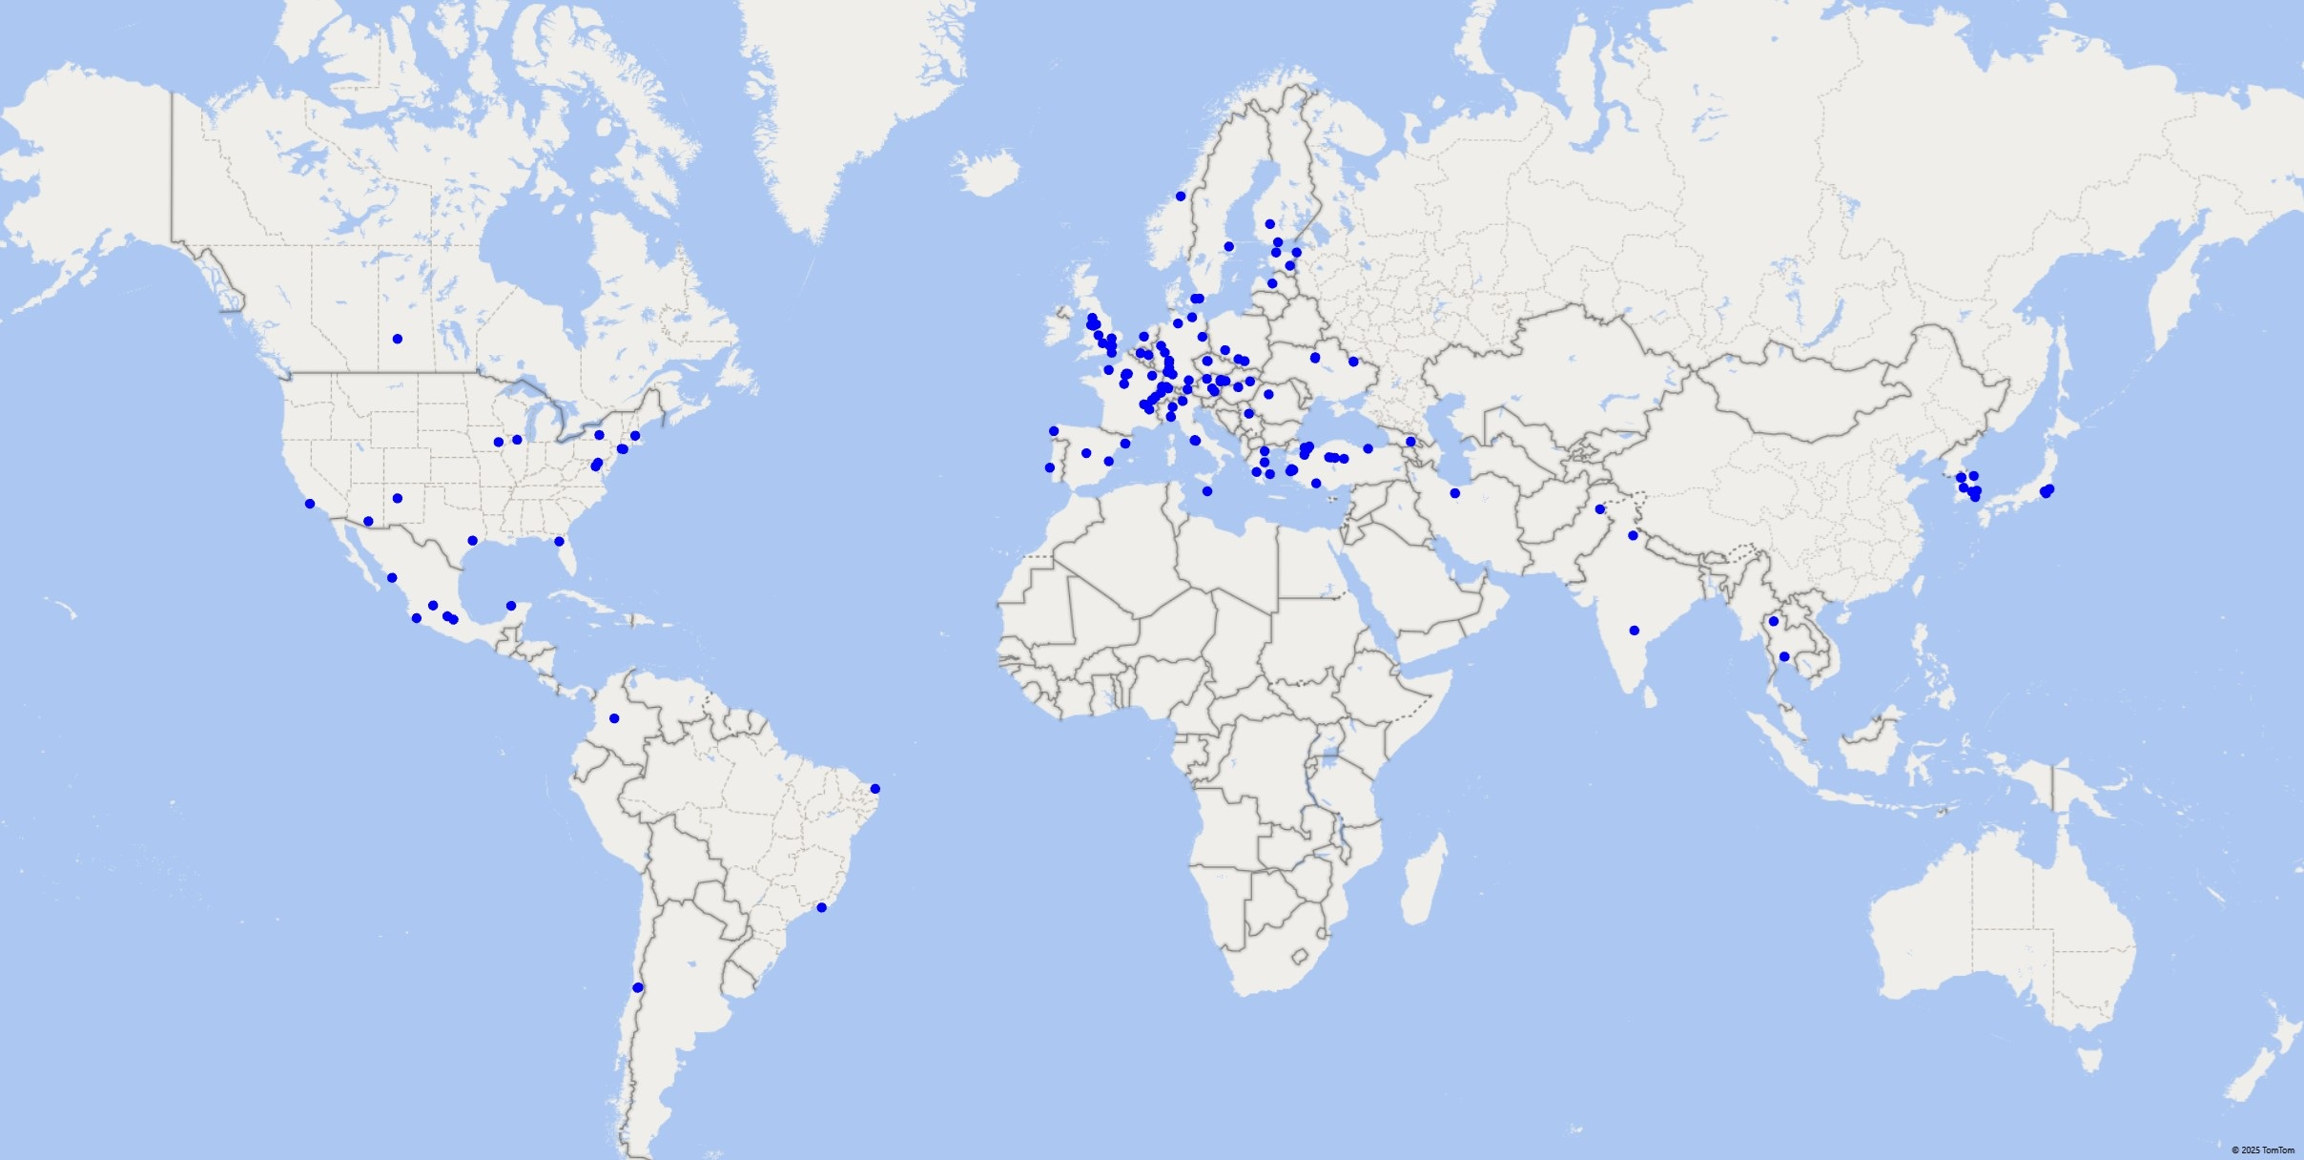


Status of the FCC Global Collaboration
Increasing international collaboration is a prerequisite for success:
→links with science, research & development and high-tech industry will be essential to further advance and prepare the implementation of the FCC
→Next step is preparation of a plan with national laboratories for in-kind contributions to the project
38 Participating Countries
Austria – Belgium – Brazil – Canada – Chile – Colombia – Czech Republic – Denmark – Estonia – Finland – France – Georgia – Germany – Greece – Hungary – India – Iran – Italy – Japan – Latvia – Malta – Mexico – Netherlands – Norway – Pakistan – Poland – Portugal – Republic of Korea – Romania – Serbia – Spain – Sweden – Switzerland – Thailand – Türkiye – Ukraine – United Kingdom – United States of America
162 Institutes
38 Countries
+
CERN

Slide 17
Conclusions
The technical part of the FCC Feasibility Study has been concluded with the submission of the Feasibility Study Report to the ESPP end March 2025
A coherent baseline design for the FCC integrated programme has been developed, including a well-advanced territorial implementation scenario, in line with desired CE construction start by 2033.
FCC-ee design level enables moving towards technical design and prototyping phase, well aligned with overall schedule and towards preparing input for potential project decision by 2028.
The FCC collaboration with CHART as a key partner was essential for the successful completion of the FCC Feasibility Study

Slide 18
From CERN Council Conclusions on FCC FS
The Council, being committed to maintaining CERN as a world leader in science and technology:
…. congratulates the CERN Management and all the personnel involved in the FCC Feasibility Study, both at CERN and in the collaborating institutes, for their comprehensive and detailed work over the past five years;….
….. considers that the FCC would provide the platform for a visionary physics programme addressing many of the open questions in particle physics,…..
….. and concludes that:
a. the FCC Feasibility Study provides the basis for the FCC studies to continue and
b. the funding scenarios presented and the financial pledges obtained so far provide the basis for the continuation of the work towards securing the full financial commitments required for approval of the FCC project.

Slide 19
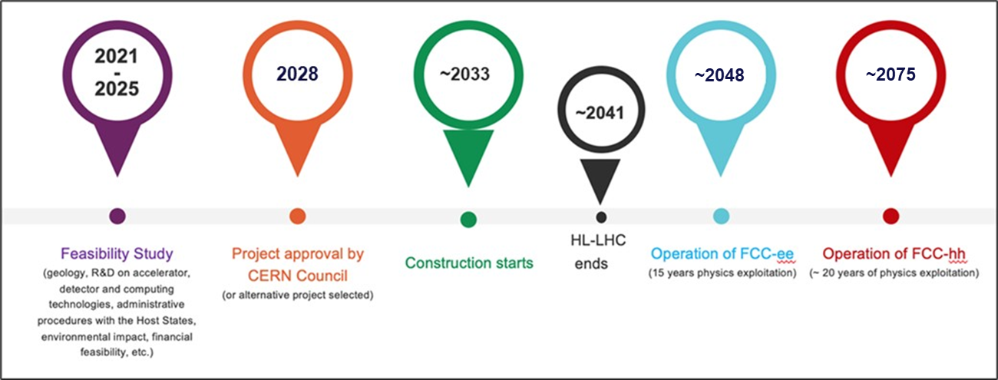
FCC integrated program – timeline
Ambitious schedule taking into account:
past experience in building colliders at CERN
approval timeline: European Strategy for Particle Physics Update, CERN Council decision
that HL-LHC will run until 2041
constraints imposed by present assumptions in funding model
project preparatory phase with adequate resources immediately after Feasibility Study

Slide 20
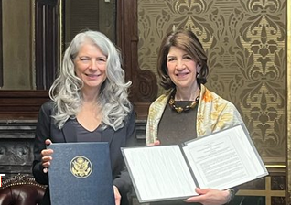
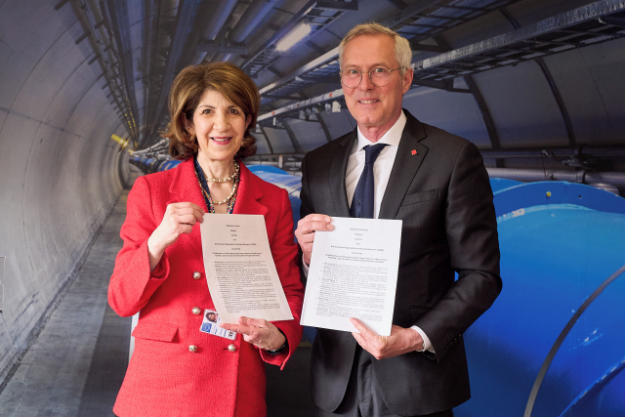
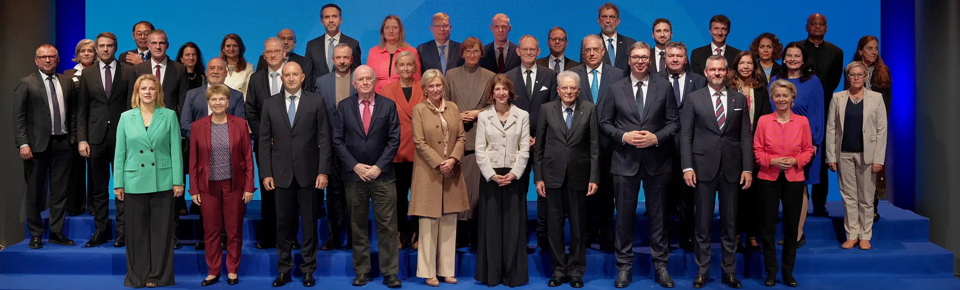
Progress and support towards funding
Strong support from European Union expressed in the recent EU Competitiveness Report stating inter alia that
“One of CERN’s most promising current projects, with significant scientific potential, is the construction of the Future Circular Collider… ...Refinancing CERN and ensuring its continued global leadership in frontier research should be regarded as a top EU priority”
Statements of intent to collaborate on with CERN on construction and exploitation of FCC-ee, signed with US and with Canada.
26 April 2024
White House Office of Science and Technology Policy Principal Deputy U.S. Chief Technology Officer Deirdre Mulligan signed for the United States while Director-General Fabiola Gianotti signed for CERN.
9 April 2025
CERN Director-General, Fabiola Gianotti, and His Excellency Mr Patrick Wittmann, Ambassador of Canada to Switzerland and Liechtenstein, exchanging signed copies of the joint Statement of Intent between CERN and Canada.
“I am proud that we have financed the feasibility study for CERN’s Future Circular Collider (FCC)...”
Ursula von der Leyen, President of the European Commission,
during CERN 70 anniversary celebrations
For 2028-2034 budget plan, a 3 BEuro budget line for FCC is proposed by the European Commission, to be approved by European Parliament in 2027.

Slide 21
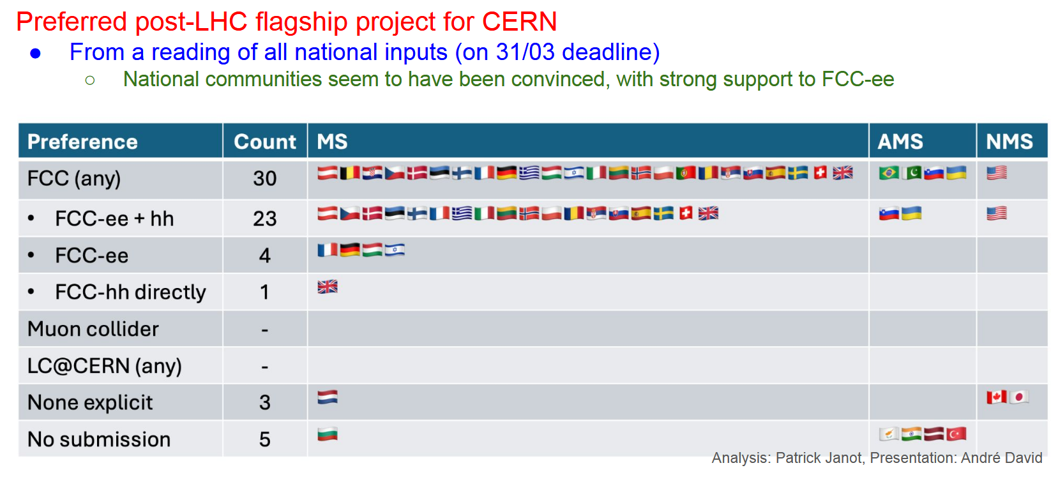
National HEP communities – input to European Strategy Update

Slide 22

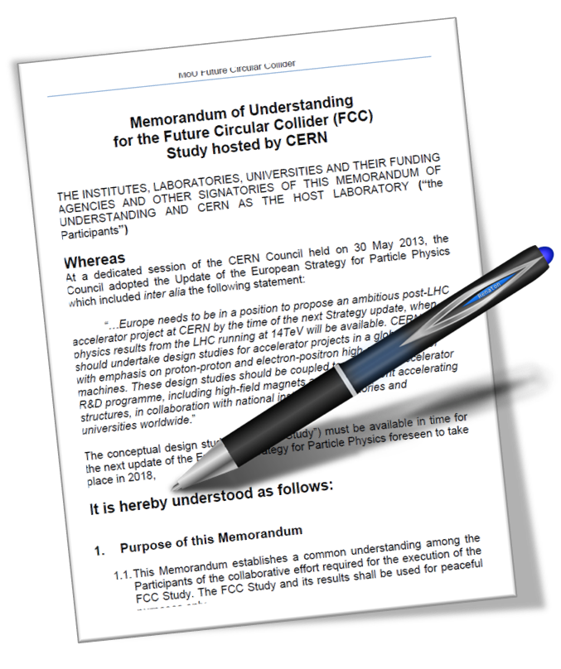
FCC collaboration framework
A consortium of partners based on a
Memorandum Of Understanding (MoU)
Working together on a
best effort basis
Incremental & open to
academia and industry
Individual projects defined in specific addenda
Next FCC collaboration meeting is the FCC WEEK 2026 in Helsinki, Finland
Entire community is invited and welcome!

Slide 23
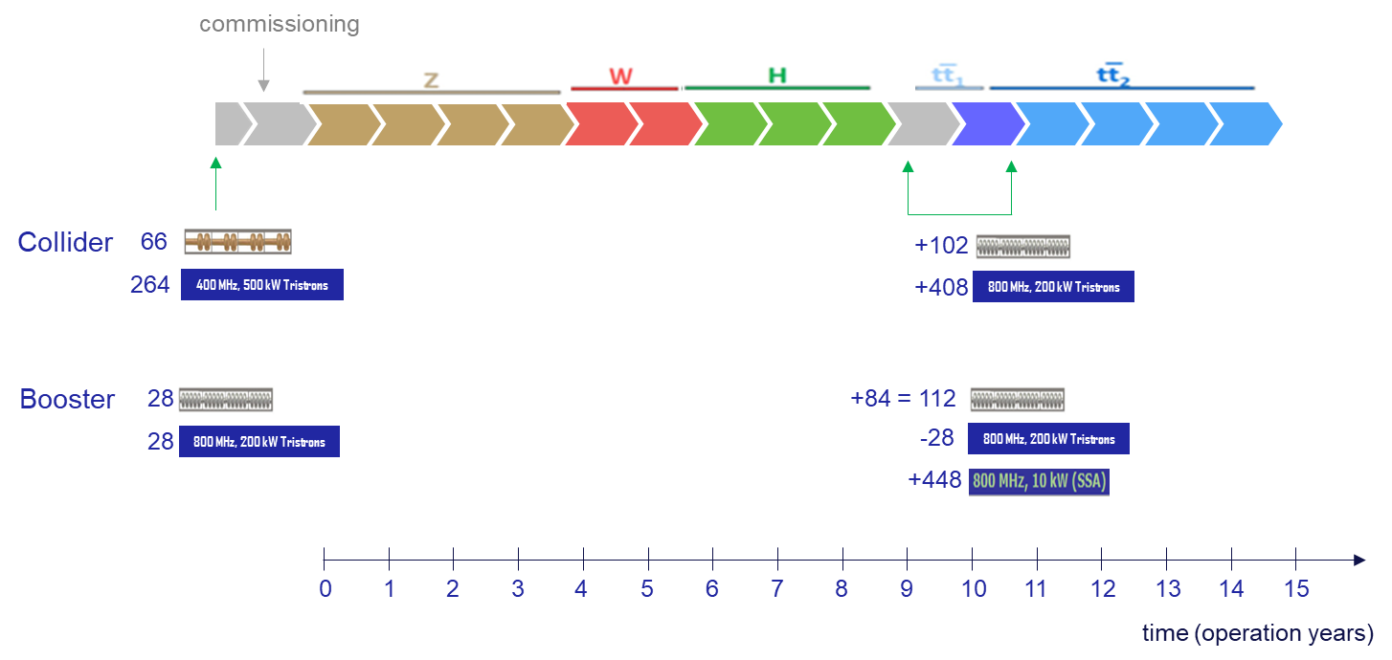
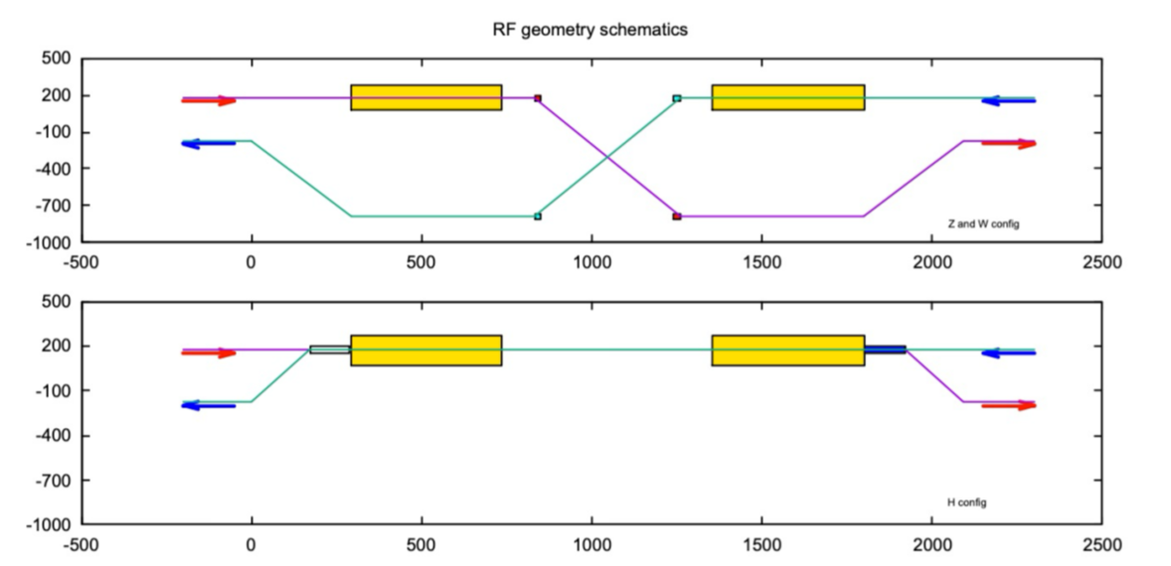
FCC-ee operation sequence and SRF concept
400 MHz RF layout and beam switching
Flexible sequence Z – W - H
Z, WW operation
ZH operation
2-cell 400 MHz SRF system for Z, W and ZH, entire system installed at operation start
  flexibility for switching between Z, WW, ZH operation
  reverse phase operation at Z allows constant cavity coupling
  suppression of the single-cell 400 MHz system
  reduced R&D, installation, commissioning, etc…
6-cell 800 MHz SRF system for collider ttbar operation and booster at all energies

