Slide 1


New CHART Project: ns Pulser
Jürgen Biela, Ulrike Grossner

Slide 2
ns-Pulser
Project Overview
“Solid-state nanosecond HV pulse generator based on drift step recovery diodes”
  Based at ETH Zurich, D-ITET
  High Power Electronics Laboratory (HPE), Prof. Dr. Jürgen Biela
  Advanced Power Semiconductor Laboratory (APS), Prof. Dr. Ulrike Grossner
Partial funding through CHART
  Two PhD students (HPE, APS)
  Material and cleanroom costs for first prototypes
Own contributions include more personnel, material, characterization, cleanroom costs

Slide 3
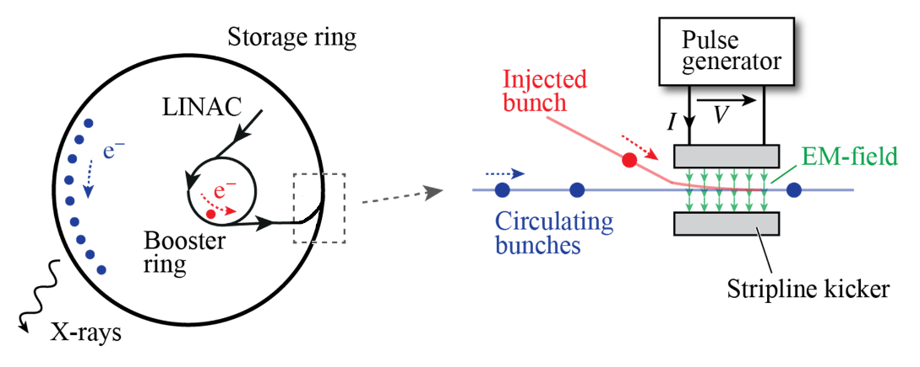
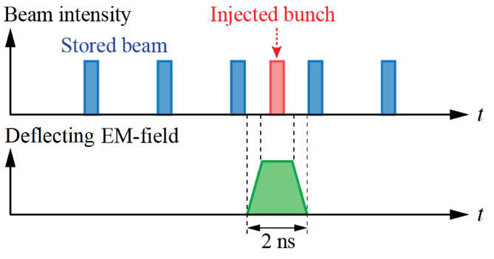

The Application and the Requirements
V_{RRM, tot.} = 15 kV
  5 Devices: V_{RRM, 5} = 3.5 kV
  10 Devices: V_{RRM, 10} = 1.8 kV
  Leave margin for transient overvoltage (~20%)
I_{F,peak} = 200 – 300 A:
  All diodes must ideally survive reverse snap-off current
t_{rr} $≤$ 100 ps:
  Stack cannot limit $≤$ 400 ps rise/fall requirement

Slide 4
The Project Plan
4 year project, started June 2025
Resulting in prototype ns pulser

Slide 5
Peculiarities
Semiconductor part of the project is heavily regulated → Information is strictly classified
CHART community is highly acknowledged as users of the ns-pulser technology
          Goal: Manufacturer of devices identified at end of the project

Slide 6
Thank you!
Websites: www.aps.ee.ethz.ch, https://hpe.ee.ethz.ch

