Slide 1
A novel approach to dynamic computing using Slurm
AWI Department Meeting
DARI
22 July 2025

Slide 2




Old online cluster
Resources statically assigned to beamlines
Very limited slurm usage (only one BL). Mostly direct access
Each group/BL had its own set of "pets"
Everything very custom
Consequences and drawbacks
Spiky usage at best
Request to get additional resources for a limited amount of time impossible
Request to get access to different CPU architectures / GPU impossible

Slide 3
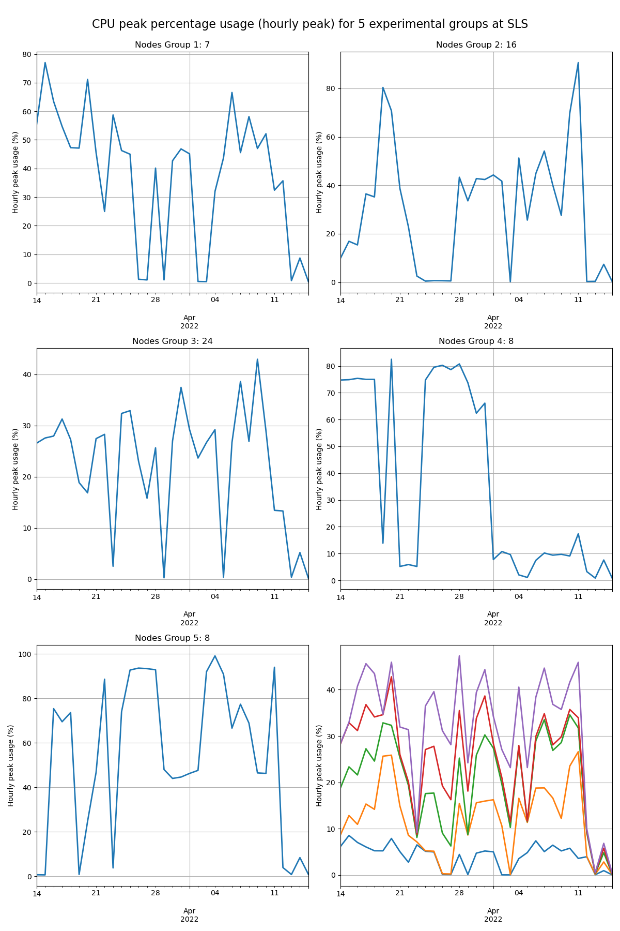
Peaky compute nodes usage at SLS
Historically we saw various scenarios:
Idling resources
Flat usage below statically assigned resources (e.g. bought with some fixed budget)

Slide 4

Ra cluster
Shared compute resources
Slurm based
All nodes are "identical"

Slide 5
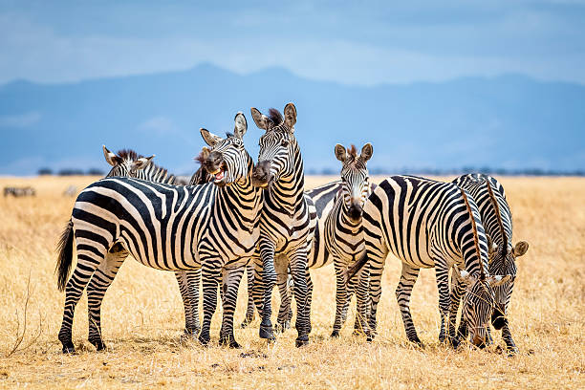


New setup – core idea
Online Slurm Cluster
Ra Slurm Cluster
Small static baseline
In case of need,
Ra resources can be lent
Used for the requested time
And then moved back

Slide 6
Usage requirements
1. Enable scientists to have a baseline amount of compute resources, if needed
2. Enable scientists to request additional compute resources during an experiment
3. Support reproducible customization based on the scientist community, including storage mountpoints (e.g. put filesystem in RW/RO)
4. Get the allocated compute resources from a common pool of compute nodes
5. Enable self-service, so that the whole process can be triggered by authorized scientists (with certain rules)

Slide 7
Technical requirements
Use as many off-the-shelf technologies as possible
Re-use as many known technologies and tools possible
Make it as automatic as possible
Do not reinvent the wheel
Do it with spare manpower, and not distracting resources for operations and upgrade project
Be pragmatic
Be commensurate wrt our resources
  We have hundreds of nodes, not thousands
  Most users are content with O(10) nodes

Slide 8
Step one: cordon resources
If only we had a way to manage compute resources...
--> Slurm!
If only we had a way to dynamically register nodes to different slurm clusters...
--> Slurm configless mode and dynamic nodes!
If only we could select resources in advance for the move...
--> Slurm reservations!

Slide 9
Step one: cordon resources
Create a special reservation that select resources: <prefix>-<cluster>-<partition>-<id>
Change SLURMD_OPTIONS='-Z --conf-server cluster1-slurmctl' to '-Z --conf-server cluster2-slurmctl'
Somehow restart slurmd
The node is in the new cluster
What if we want to customize also other aspects, as:
Additional services
MOTD
Filesystems?

Slide 10
Step two: coordinate services
We can code every customization as a systemd unit, triggering proper scripts
Systemd has a powerful way of defining dependencies and order
Targets are ways to group together units that are needed
Ideas:
Create a target per slurm cluster
Switch target
Reboot (optional)
Done!

Slide 11
Step three: more customization
SLS
MX
Special experiment
Tomcat
Special experiment
Cluster
Group
Special
What about partitions in the new cluster, e.g one partition per experimental group?
Targets can include targets!
Default target: cluster name
Then if additional services needed: group target
Use labels to create nodesets, assign them to partitions
SLURMD_OPTIONS='-Z --conf Feature=MX --conf-server cluster2-slurmctl'
dynamic_compute.conf:
Nodeset=mx-dynamic Feature=MX
Slurm.conf:
PartitionName=mx Nodes=mx-dynamic

Slide 12
Step four: come back
Reservation end defines how long the compute node stays in destination cluster
No end: permanent move
Otherwise: automatically create back reservation to origin cluster, unlimited time
  This will trigger the same mechanism that moved the node
And back to the beginning

Slide 13
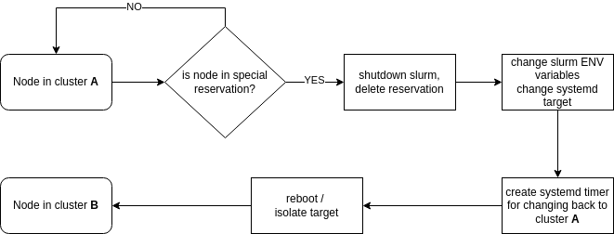
All together

Slide 14
Current status
We gave it a silly name: flurm (Flexible slurm? Floating slurm? )
Under test with selected user groups
Presented by Leo at ISC 25
Example code will come on github: https://github.com/paulscherrerinstitute/flurm
Will need to be modified and customized for every setup
  Our code is just to provide an example

Slide 15
Strong and weak points
Strong:
Simple
Uses available tools
Very flexible
Users are used to use Slurm in this way
Weak:
Full node only
Limited customization (bound to base OS and configuration)
Resources can only be moved when they are free
Usage of units might get out of control
Interplay between central config system (puppet) and flurm can be difficult

Slide 16
What next?
Collect feedback in production
  Focusing on functionality, and how much customization we do need
Revise requirements based on experience
Improve tools, metrics and monitoring
Further test reboot vs target switch
Explore if we need more sophisticated mechanisms (virtualization, containerization, …) in addition

Slide 17
Thanks for your attention!

Slide 18
Implementation
flurm-move_node: a timer on the worker node that regularly checks for a suitable reservation
flurm-switch: a script to change Slurm configuration, including automatically filling Features as CPU arch, Memory
flurm-reserve_nodes: a script to create proper reservations, and trigger the move
The eventual move back: create a drop-in, self-removing file for flurm-move_node, creating the back-reservation after the move

Slide 19
Implementation
# Node is in the base cluster
[root@ra2-c-007 ~]# flurm-status
Current cluster ra
No pending moves
Next move check active. Next run: Tue 2025-05-27 21:10:00 CEST
# Creation of a reservation to trigger the move to dynamic cluster
[root@ra2-c-007 ~]# flurm-reserve_nodes -p mx -c sls -n 1 -d 1
Reservation flurm_sls_mx_20250527210439_0 created
# Reservation is registered, will be applied at the next timer run
[root@ra2-c-007 ~]# flurm-status
Current cluster ra
Moving to cluster=sls and partition=mx at 2025-05-27T21:04:39
Next move check active. Next run: Tue 2025-05-27 21:10:00 CEST
# Timer has been fired, after reboot the node is in the dynamic cluster. A timer to trigger the move back to the base cluster is visible
[root@ra2-c-007 ~]# flurm-status
Current cluster sls
Moving to cluster=ra and partition=ra at 2025-05-28T17:09:02
Next move check active. Next run: Tue 2025-05-27 21:10:00 CES

