Slide 1
SwissFEL RC report, week 35, G.L. Orlandi

Slide 2
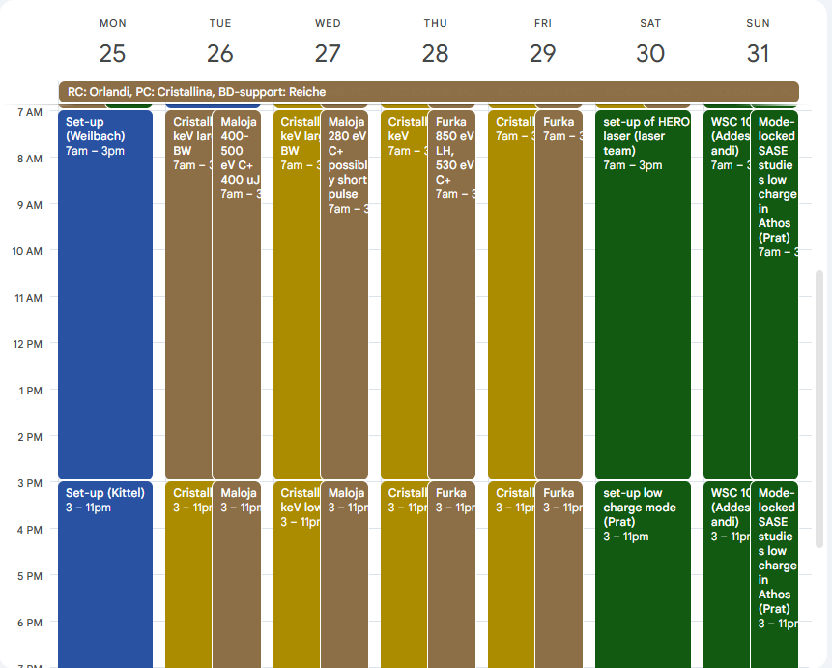
FEL and MD plans, week 35
Aramis (Mon-Fri):
  Cristallina 12 & 15 keV, large and normal BW
Athos (Mon-Fri):
  Maloja 400-500 eV C+ 400 uJ
  Maloja 280 eV C+, short pulse
  Furka 850 eV LH, 530 eV C+
MD shift (Sat-Sun):
  HERO laser set-up (Laser Group)
  Low charge mode set-up (BD group)
  Mode-locked SASE studies low charge in Athos (BD&Laser groups)
  Wire-scanner measurements (Addesa)

Slide 3
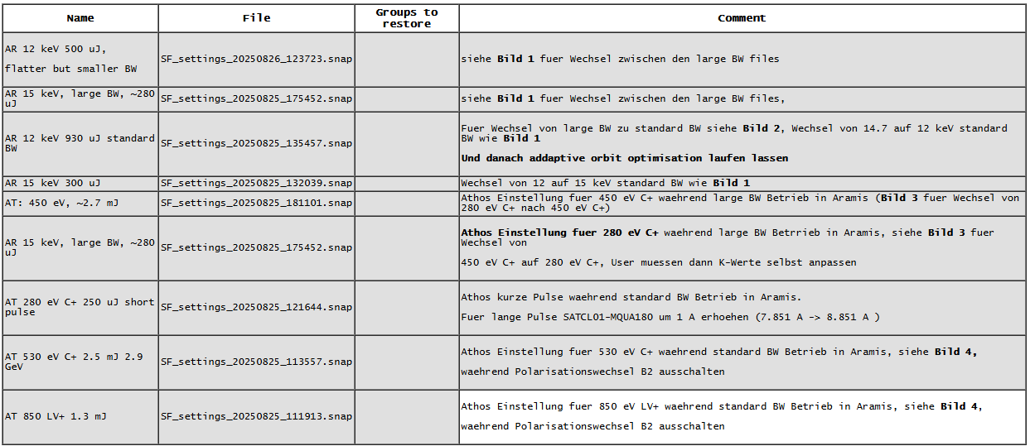

Slide 4
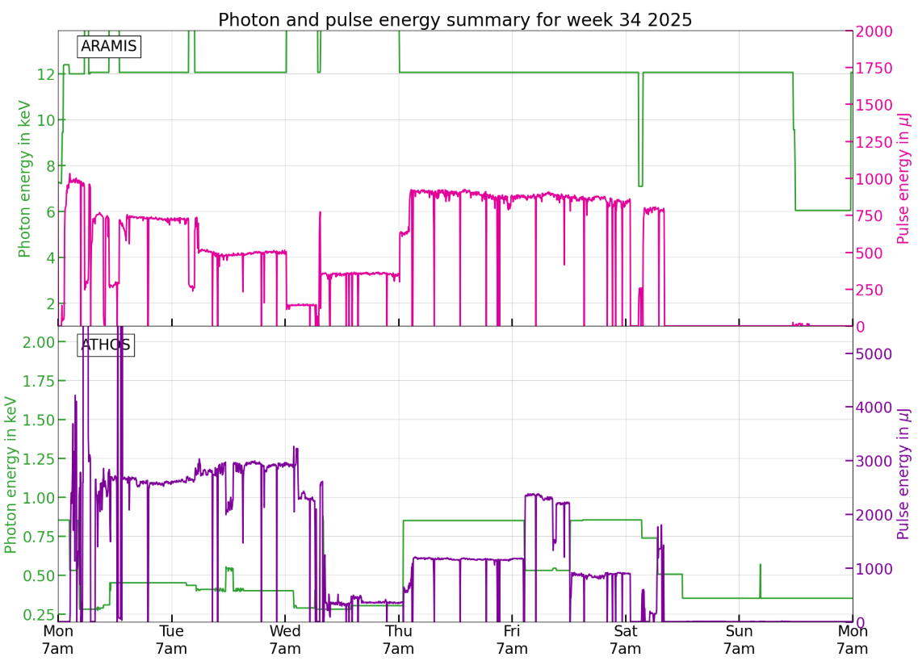

Slide 5
Issues
orbit-feedback issue of previous week: BPM issue fixed by a cable swapping and normal operation of feedback-orbit restored
Vacuum valve issue in SATMA01 (SATMA01-VPNG-B050)
S30CB07 RF issue fixed by RF picket intervention
SINXB01 RF issue fixed by RF picket intervention

