Slide 1
SF RC Report 2025 Week 36
Nicole Hiller
N. Hiller
PSI 8.9.2025

Slide 2
Week 36 Mon 1.9. – Mon 8.9.
Bernina 10.5 – 11.3 keV
Furka 850 eV with LH and LV

Slide 3
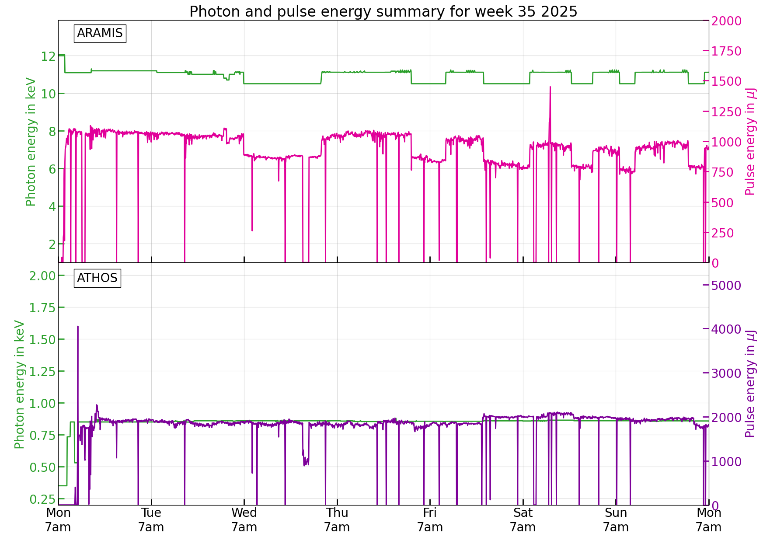
Issues during the week
Generally a pretty quiet week
  One longer RF failure (linac 3) Wed night
  -> pikett had to come in
  Trains were strongly visible on the Aramis FEL signal
  In the end 10.5 keV was used a lot more than anticipated (we did not optimise there) and scaling up and down a lot, does affect the performance at some point
  Furka
    Gateway issue on Tue night
    SATUN06 was stuck
  Bernina
    Issues with the pump laser synchronisation

