Slide 1
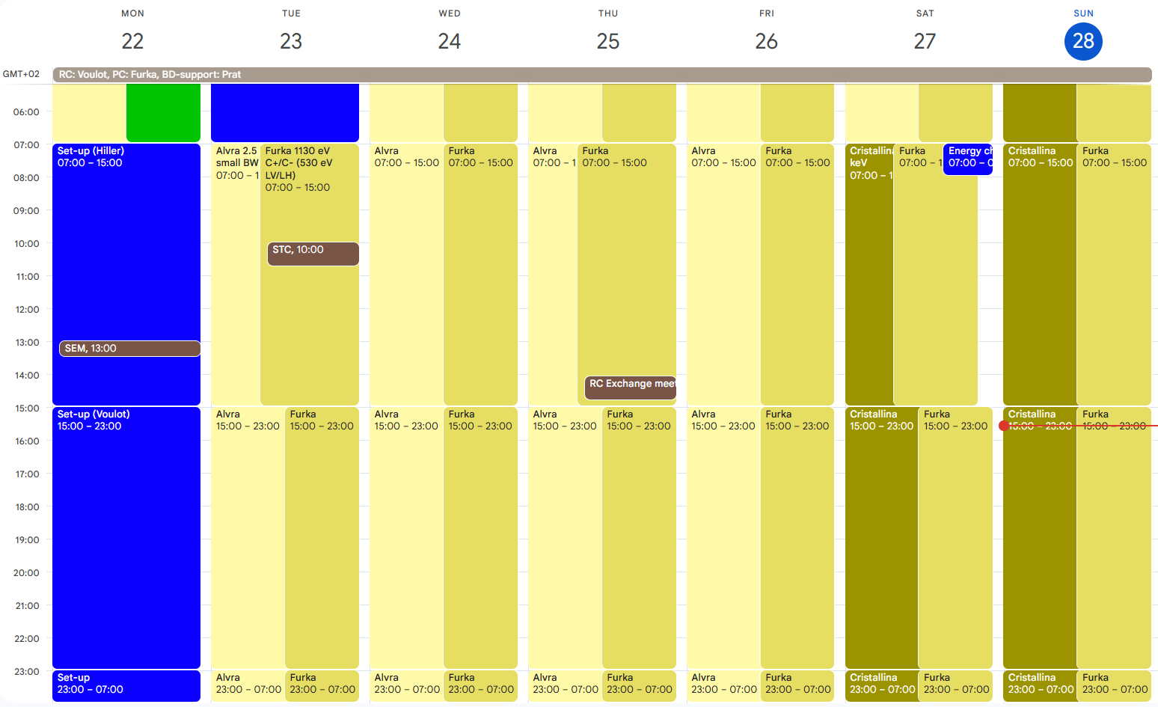
Aramis: Alvra 2.5 keV small BW, Cristallina 9.8 keV
Athos: Furka 1130 eV C+/C- and 530 eV LV/LH, Sunday: Furka extension (MD was unused)

Slide 2
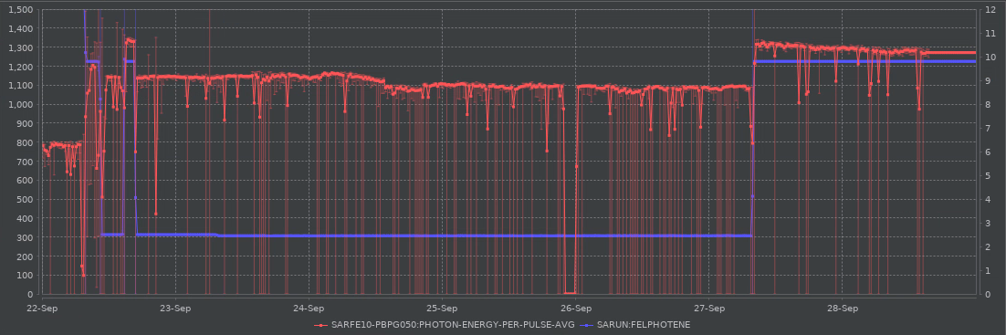
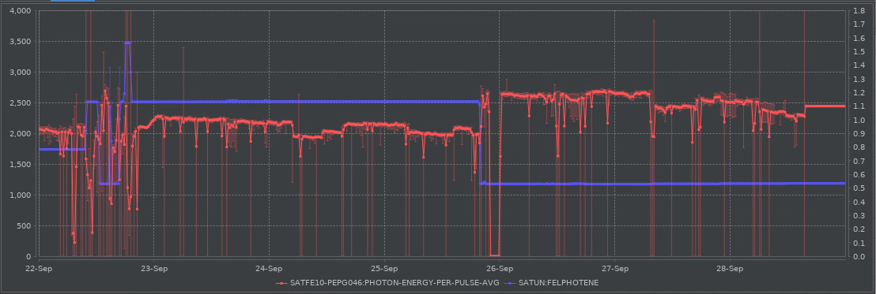
setup
Alvra
Cristallina
X-band
setup
Furka 1.13 keV C+/C-
Furka 0.53 LV/LH
1.56 keV test

Slide 3
Athos 1.56 keV test on Monday
1.56 keV C+ 920 uJ
1.56 keV LH 500 uJ
Energy change works well also from tender to hard X-ray
Downtime
Thursday: X-band failure (PLC) (2h)
Other issues
Wednesday: SATUN21 was stuck

