Slide 1
SwissFEL RC report, week 44, G.L. Orlandi

Slide 2
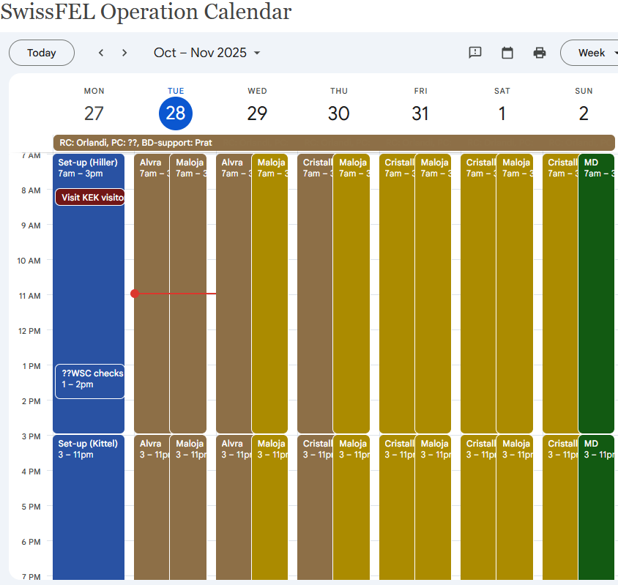
FEL and MD plans, week 44
Aramis:
Cristallina Thur - Mon:
Photon energy: 12 keV
Pulse energy: >500 uJ
Pulse length: 25-45 fs (FWHM)
BW: standard
Alvra Tue - Wed:
Main energy 7.4 keV, narrow BW,, min 1 mJ.
Additional energies
6.4 keV narrow BW
7.9 keV narrow BW (lower priority)
6.9 keV narrow BW (lower priority)
Athos: Maloja➔to be rescheduled in week 45
Short pulse mode with tilting (down to shortest possible) and adjustable pulse duration at 400eV
Two-color X-ray mode in fresh slice with color1=401eV and color2=398eV, pulses as short as possible

Slide 3
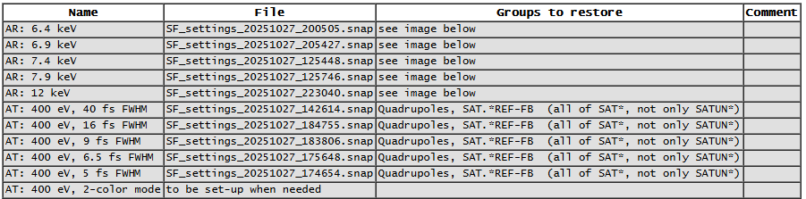

Slide 4
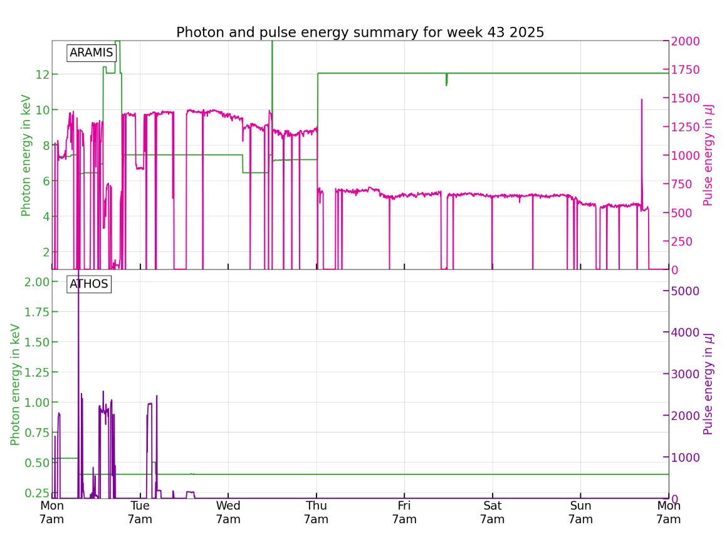
super-period synchronization box failure;
Switch to internal clock of the box
Alcor laser failure: controller interlock;
Issue with rebooting macro
SPS alarm: cooling system failure and RF interlock
Power glitch in SINBC02-MBND100;
SINB04 RF failure
pre-amplifier RF station S30CB11 failure: one transistor broken;
workaround RF picket
Mizar laser oscillator timing jitter issue: give a try two different oscillators; power supply replacement for suspected overheating

