Slide 1
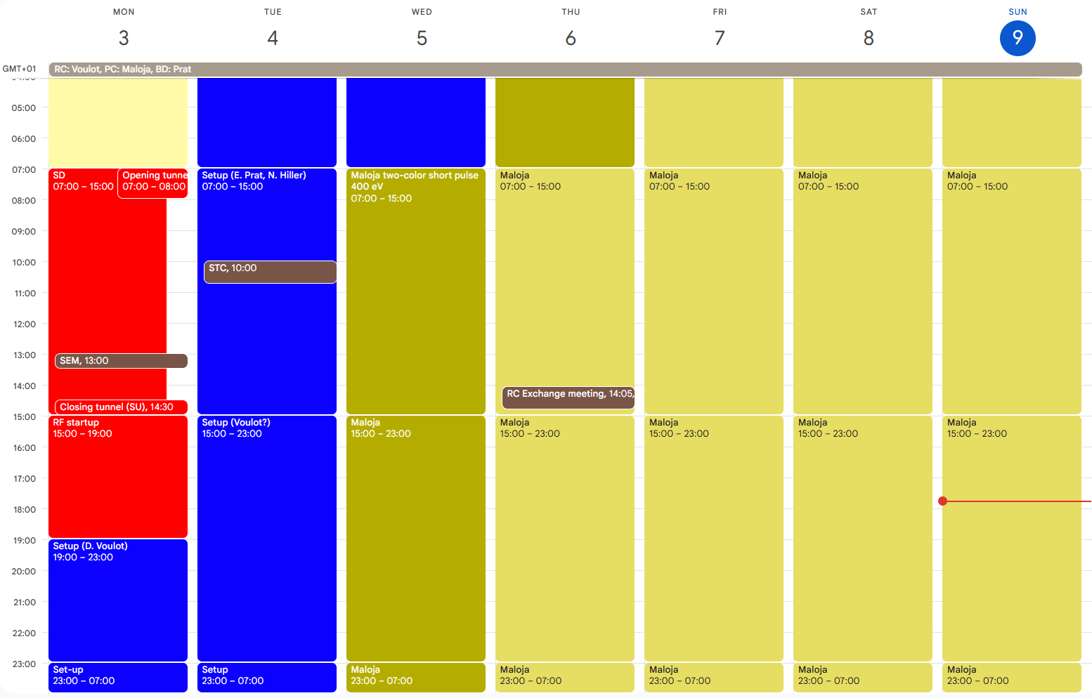
Aramis: no operation
Athos: Maloja two-color short pulse 400 eV

Slide 2
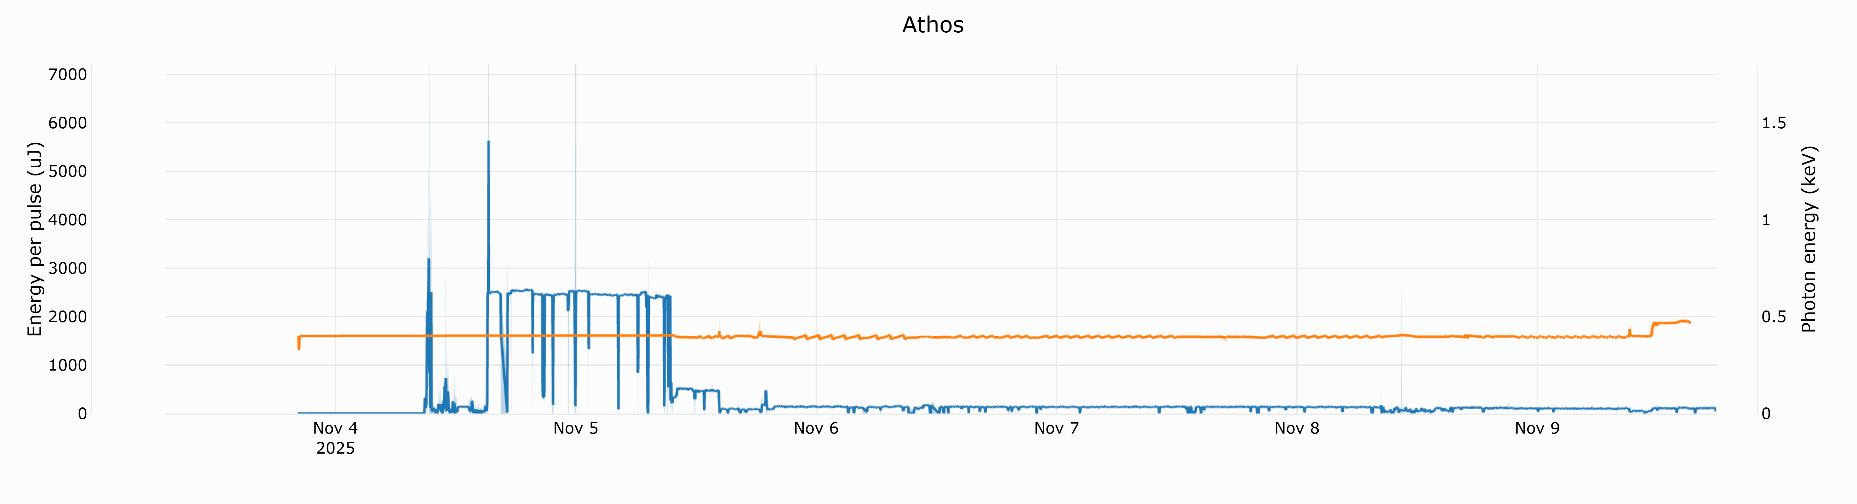
Service day
setup
Standard pulse
10 fs
5 fs
Two-color

Slide 3
Switching to bunch1 in Athos worked very smoothly.
Two color set-up is quite difficult to reload. The pointing and focusing of both colors in the ES is not straight forward. Many thanks to Eduard for the support.
Large losses in the Athos undulators during the weekend (2-color), increase limit to 3 reset per 24h. Should investigate how to minimize these losses without spoiling the beam parameters.
Downtime
Thursday: starting from 4am, loss of connection with epics channels from different systems (RF, DRPS, diagnostics, RK…). The migration to gitea took place on Wednesday but is unlikely to have caused the problem. Some panels were missing which added to the confusion, but this was not the root cause. A network problem is suspected but AIT could not identify any problems. The situation was fully restored by lunchtime. Many thanks to controls and RF for their support!

