Slide 1
SF RC Report 2025 Week 47
Nicole Hiller
N. Hiller
PSI 24.11.2025

Slide 2
Week 47 Mon 17.11. – Mon 24.11.
Aramis:
  Tue-Sun Bernina 2.86 keV
  Since this morning Alvra 2.46 keV
Athos:
  Started to use the Mizar (with the “old” T&S oscillator) for testing since Mon afternoon -> so far it looks good (initially we had some very small oscillations, but they could be eliminated now)
  Optimised the beam on Wed to restore full performance (2.6 mJ at 780 eV LH) -> laser performance is definitely good enough for routine operation
  Changed to 530 eV LH on Friday (3 mJ)

Slide 3
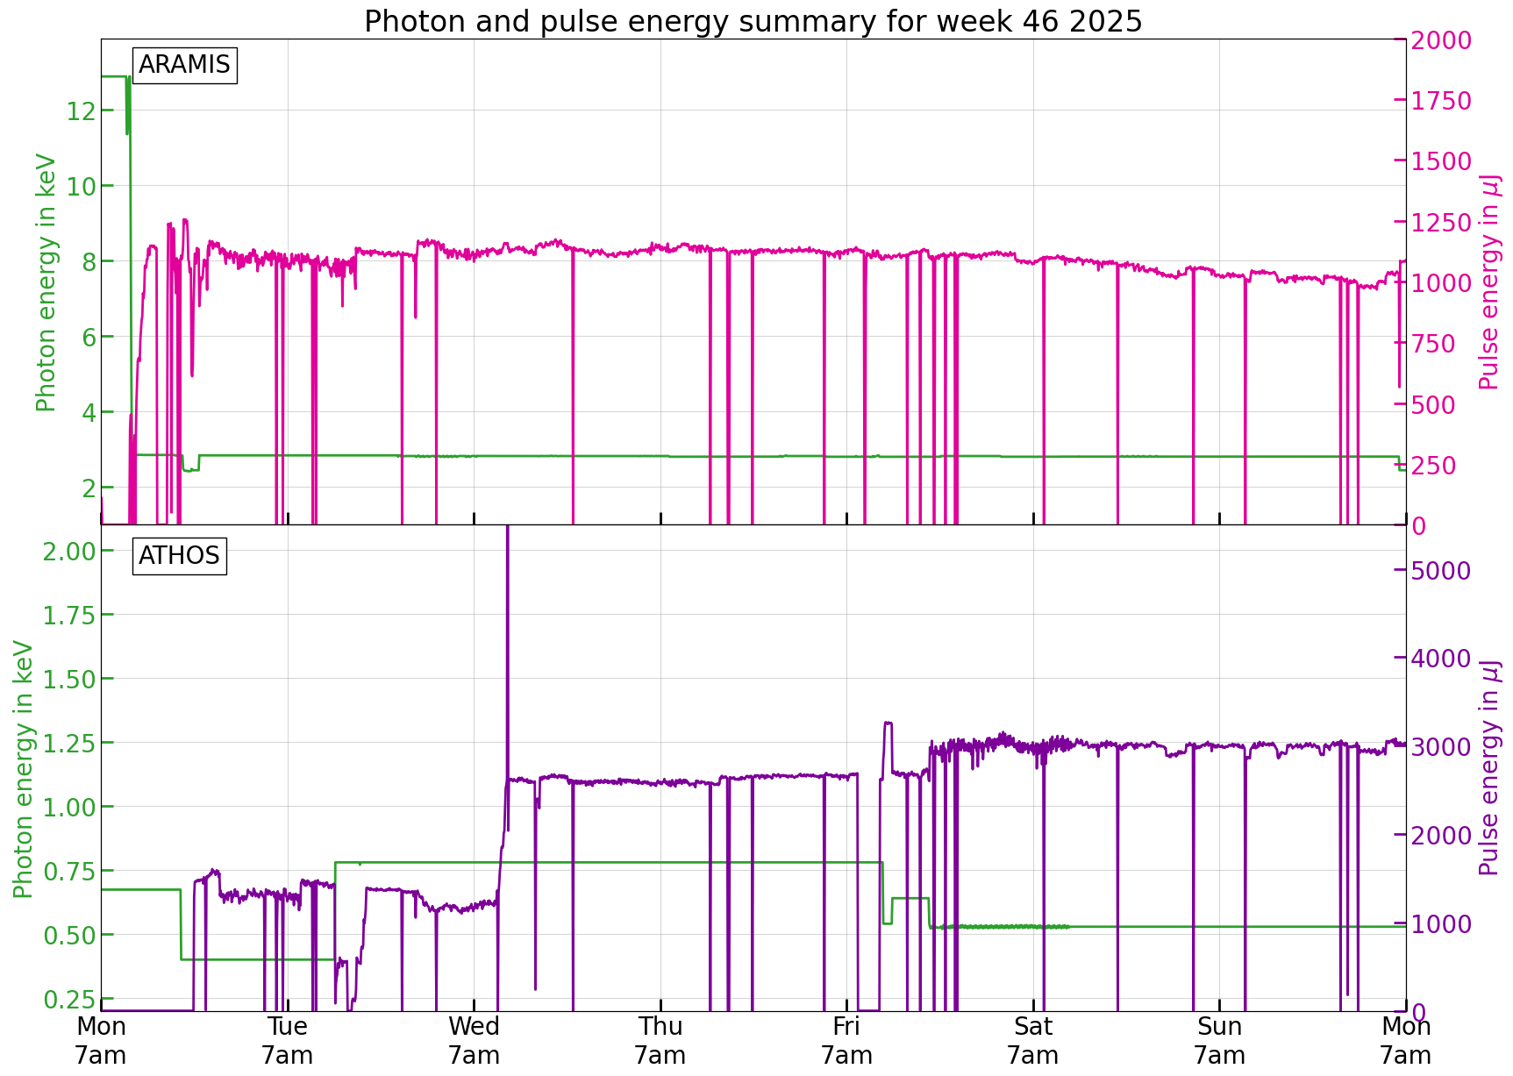
Issues during the week
Until Tue afternoon: Beam instabilities (mainly Aramis) -> finally identified a faulty corrector power supply in the injector (turned it off) -> will be replaced in winter shutdown
For Aramis just some small technical issues (could all be fixed routinely)
Over the weekend a slight Aramis degradation
~2 hours B2 stopped on Friday to find the source for Mizar instabilities

