Slide 1
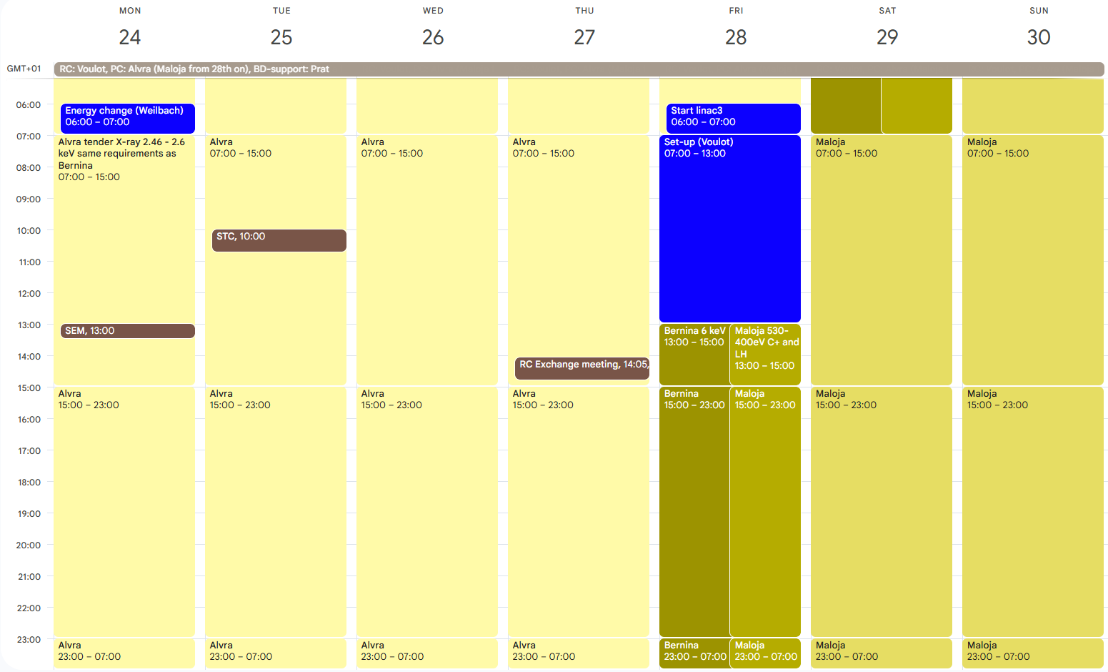
Aramis: Alvra tender X-ray 2.46 - 2.6 keV / Bernina 6 keV
Athos: Maloja 530-400eV C+, LH and LV+ (weekend)

Slide 2
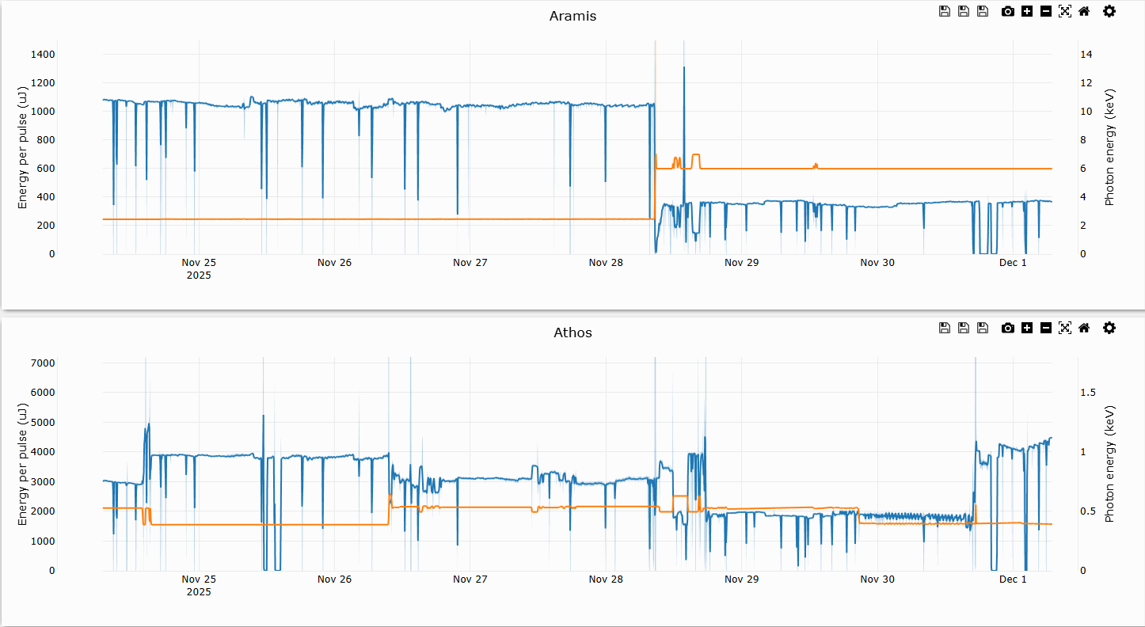
Alvra 2.46-2.6 keV
Bernina/Cristallina 6 keV
S30CB07
DRPS
Mizar test / MD / Maloja?
Maloja 530-400eV C+, LH, LV
DRPS

Slide 3
No set-up this week.
Small energy change on Aramis on Monday 6am.
Energy change 2.5 -> 6 keV on Friday. A bit of confusion due to miscommunication but was done in 1h30. We did not change the compression in the main branch to avoid retuning Athos. Lower pulse energy for Aramis.
Athos set-up was done in advance (Mon, Wed) as Mizar was available again. No bunch destination change on Friday.
Next set-up tomorrow Tuesday
(Does not work so bad... Do we really need 24h set-up per week?)
Athos pulse length was measured on Tuesday (80 fs, 66987) and corrected on Wednesday (40 fs FW, 66994). The pulse length should not be affected by a simple photon energy or polarization change.
The Google calendar is our reference (only calendar with detailed timetable and descriptions).
https://intranet.psi.ch/de/node/47023
Please check it and let us know if it is not consistent with your expectations: beam parameters and set-up time/planned energy changes. Photon coordination task?
Downtime
Sunday: S30CB07 failed, switched to S30CB09 (1h30)
Sunday: DRPS problem (low data rate) (1h)

