Slide 1
SwissFEL RC report, week 50, G.L. Orlandi

Slide 2
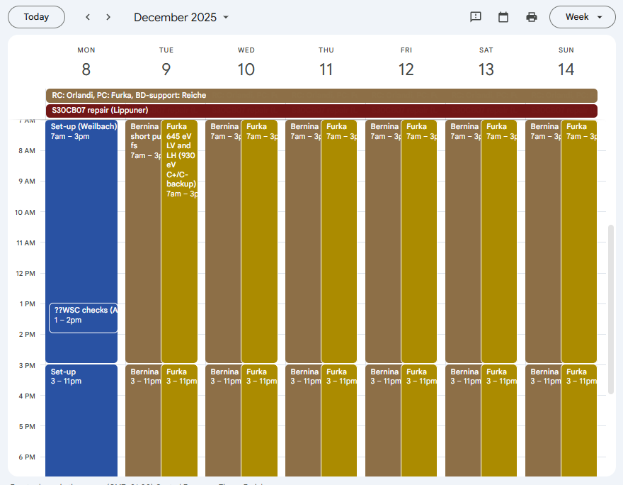
FEL users’ plan, week 50
Aramis:
Bernina: 7.1 - 7.7 keV short pulse <20 fs
Test of optimized compression for future Bernina experiments (shorter bunch-length with de-chirper adjustment, Tobias) on Sunday Dec 14 but beam-losses too high
Athos:
Furka: 645 eV LV and LH (930 eV C+/C- backup)

Slide 3
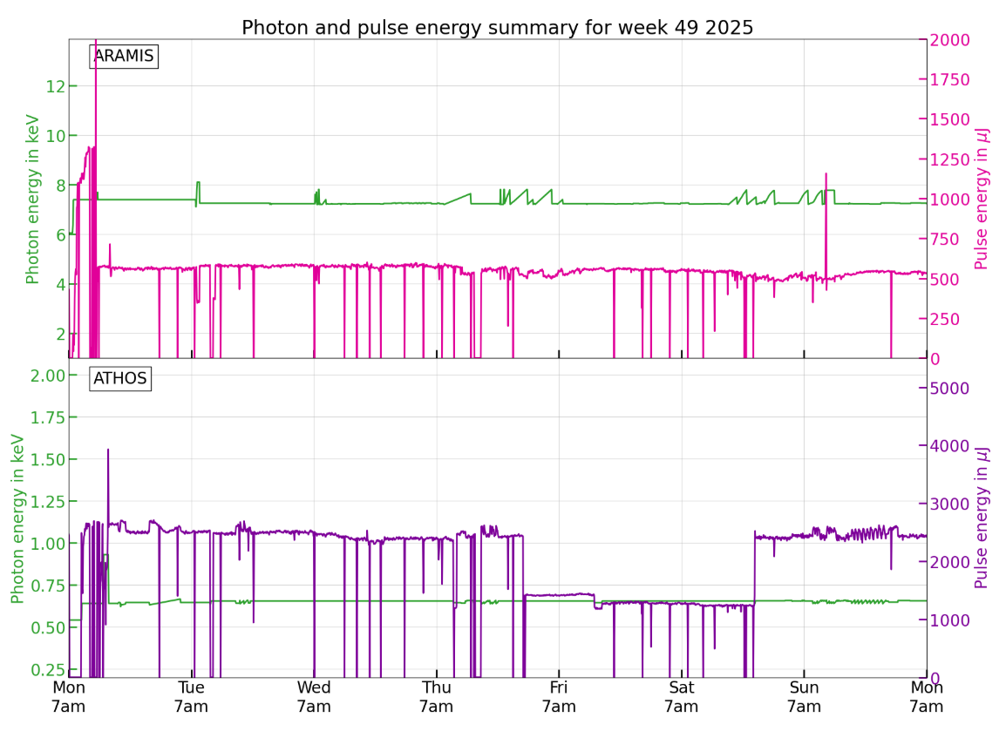
Wire-scanner test: courtesy BERNINA&FURKA
LH polarization not correctly set, pulse energy dropped down to 1.2mJ
CR intervention to restore the right polarization and pulse energy back to ~2.6mJ

Slide 4
Machine issues:
Short electron pulse setting for Bernina (beam off-center in the de-chirper)➔ higher beam losses physiological for this machine setting: Alarm limit of SARUN12/13-DDRM030 to be reset every ~20 hours
SATDI01-DBPM090: hardware repair planned for next week (workaround in the meantime). Memory leak due to mis-functioning electronic board unit EPICS/BS_Read: data transfer from IOC to BS_Read should take no longer than 10 min otherwise the IOC can crash because of memory overload.

