Slide 1
The AMORE Detector
An aircraft and balloon-borne particle telescope for secondary cosmic-ray measurements
Justin Dante Tabbett, Gabriele Auriemma
Paul Scherrer Institut, LTP(izza)hD, 17 September 2025

Slide 2
space WEATHER
“Space weather” refers to conditions on the Sun and in the solar wind, magnetosphere, ionosphere, and thermosphere that can influence the performance and reliability of space-borne and ground-based technological systems and can endanger human life or health.

Slide 3
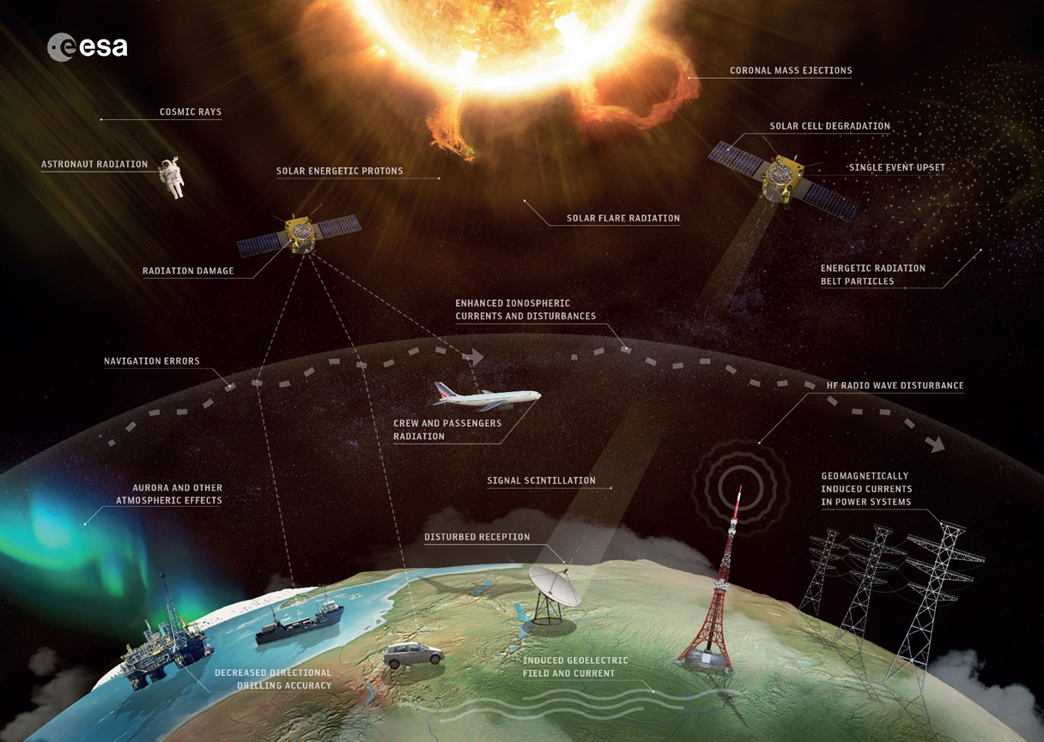
Space Weather: An Introduction
Effects of solar activity
Microelectronics radiation damage (e.g. SEE, TID)
Telecommunications disturbances
Global Navigation Satellite Systems (GNSS) failure
Induced currents (geomagnetic and geoelectric)
High radiation exposure for aircrews and passengers
Positive aspects: Aurora Borealis

Slide 4
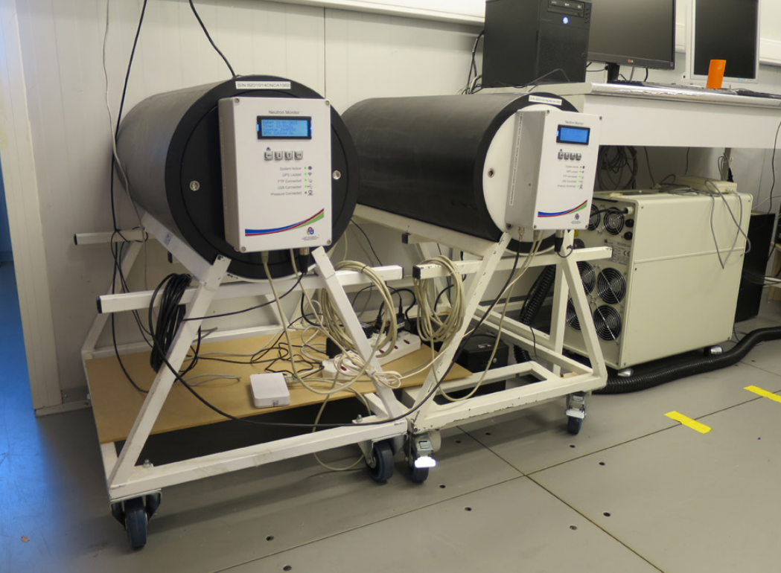
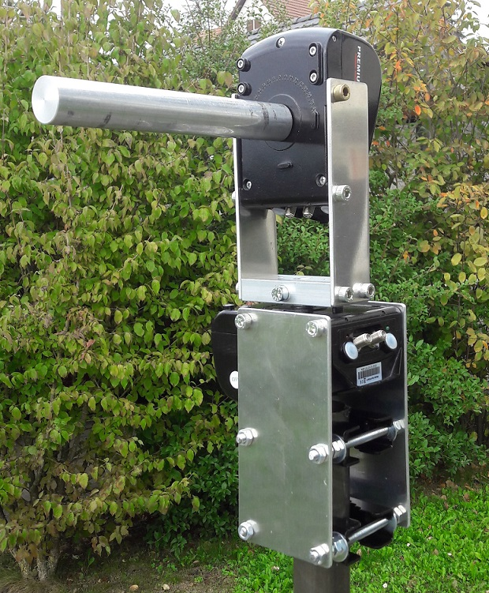
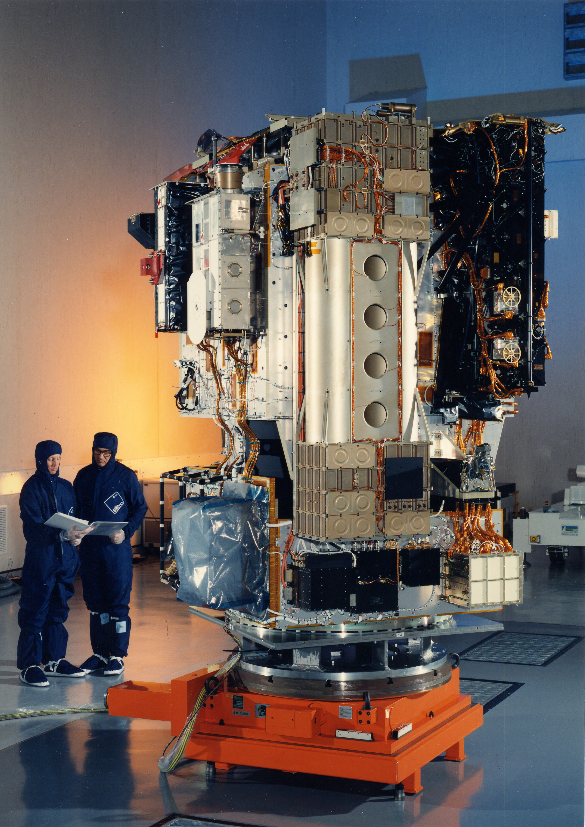
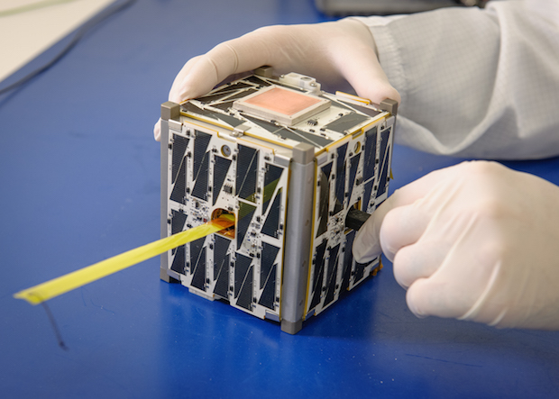
Space Weather: Monitoring
Mini neutron monitors
eCALLISTO
Ground-based Monitoring System
Solar Telescopes
Magmetometers (The geomagnetic Kp Index)
Radio Spectrograph (eCALLISTO)
GNSS Networks
Ionosphere Monitoring
Cosmic Rays Neutron Monitors
Space-Based Monitoring Systems
Solar and Heliosperic Observatory (SOHO)
The Vigil Mission (ESA)
DSCOVR (NASA)
Satellites Payloads (including SmallSats and CubeSats)
SOHO space craft
1U CubeSat

Slide 5
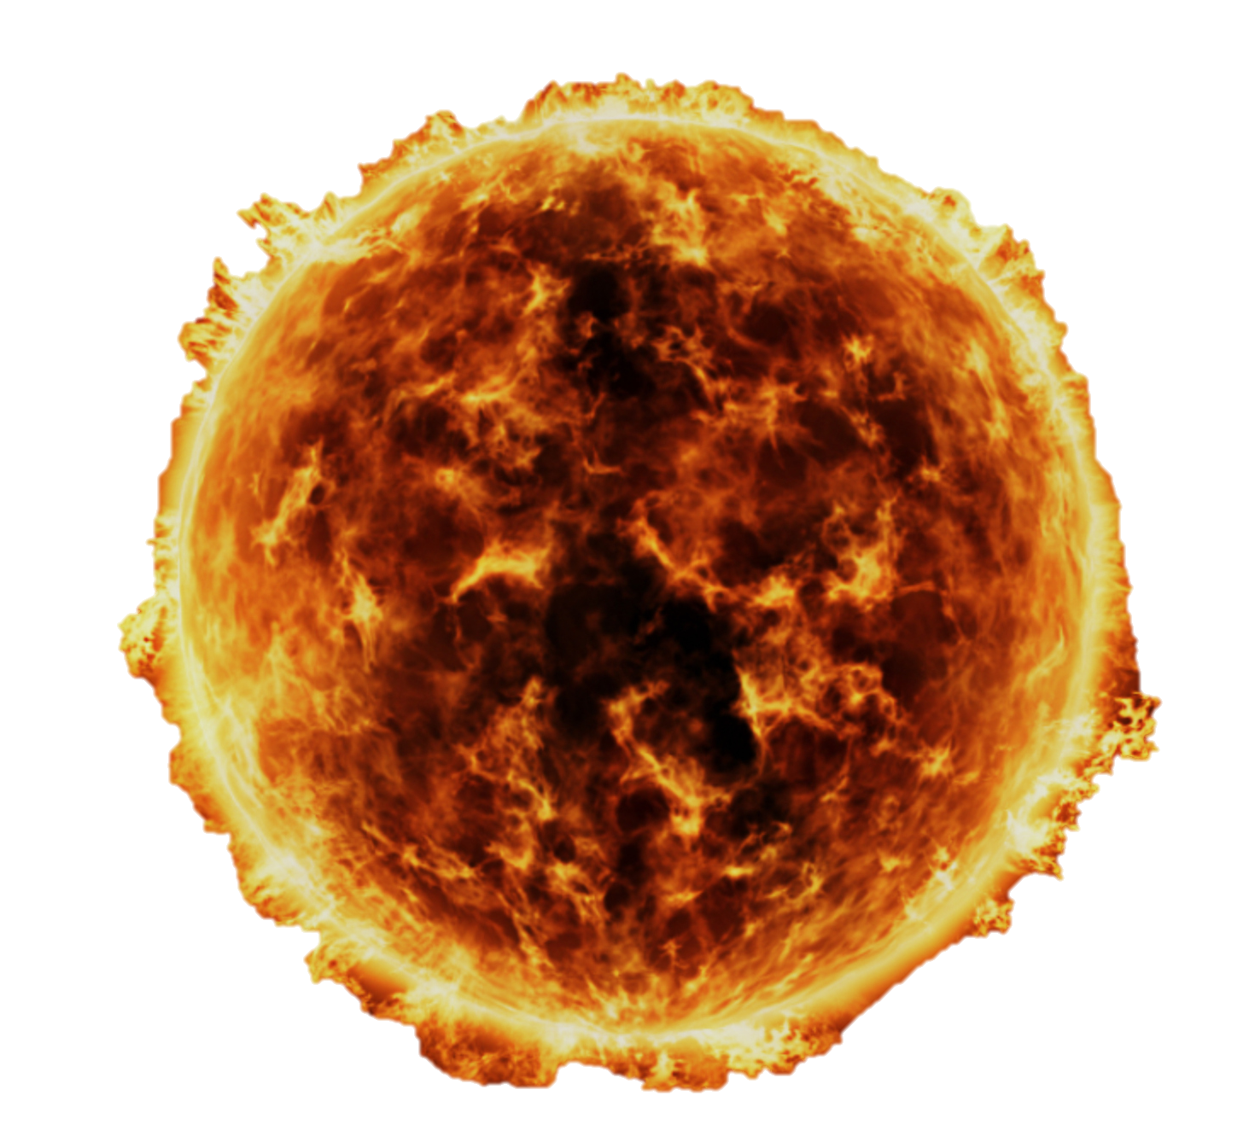
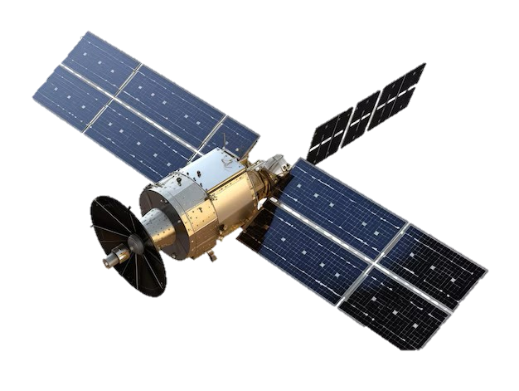
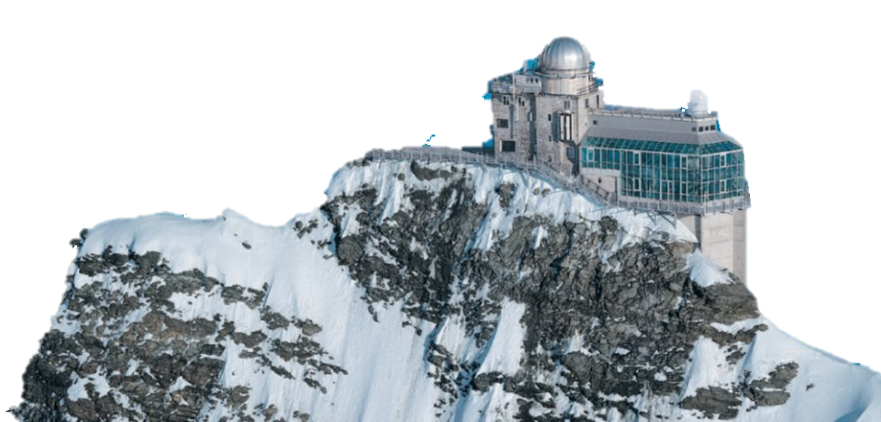
Space Weather: Monitoring
Radiation Monitoring
Ground-based Monitoring System
Solar Telescopes
Magmetometers (The geomagnetic Kp Index)
Radio Spectrograph (eCALLISTO)
GNSS Networks
Ionosphere Monitoring
Cosmic Rays Neutron Monitors
Space-Based Monitoring Systems
Measurements of Solar Wind (Flux, Density)
Photospheric Magnetographic Imagers
Heliospheric Imagers
Plasma Analysers
Radiation Monitors, Particle Telescopes
400 km up to 1.5 Ml Km
Low Earth Orbit
Lagrange Points
Geostationary Orbits
Something’s missing
3-4 km down to sea level
Mountains Summit
Sea Level

Slide 6
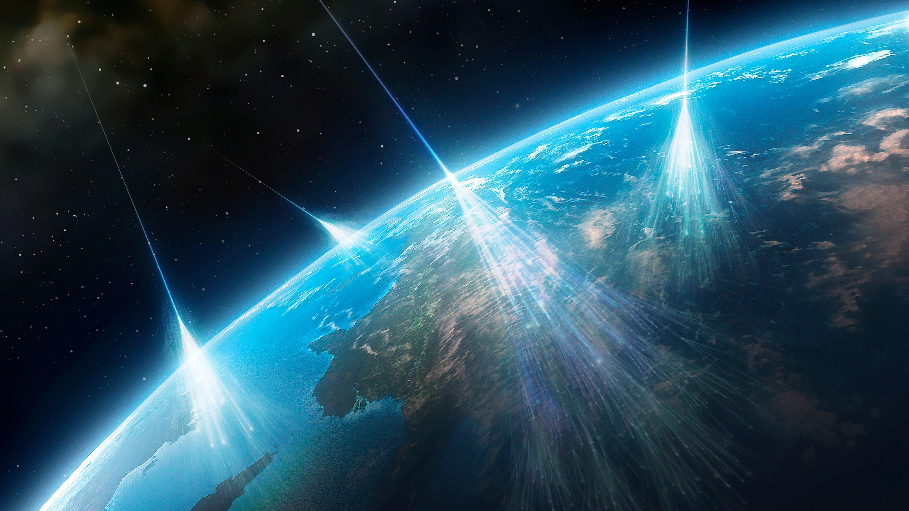
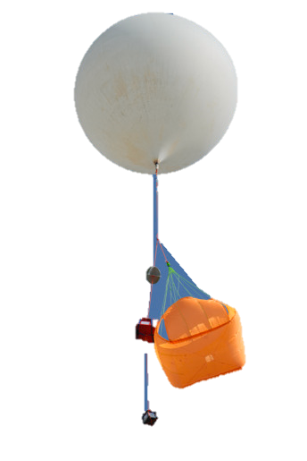

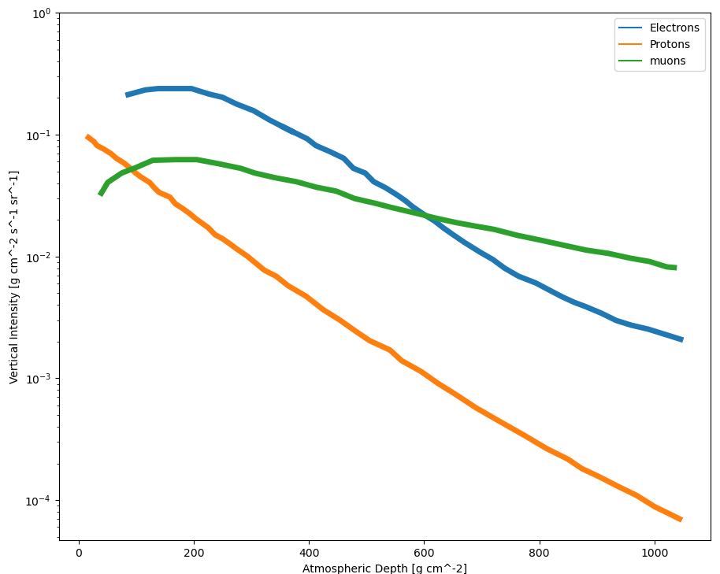
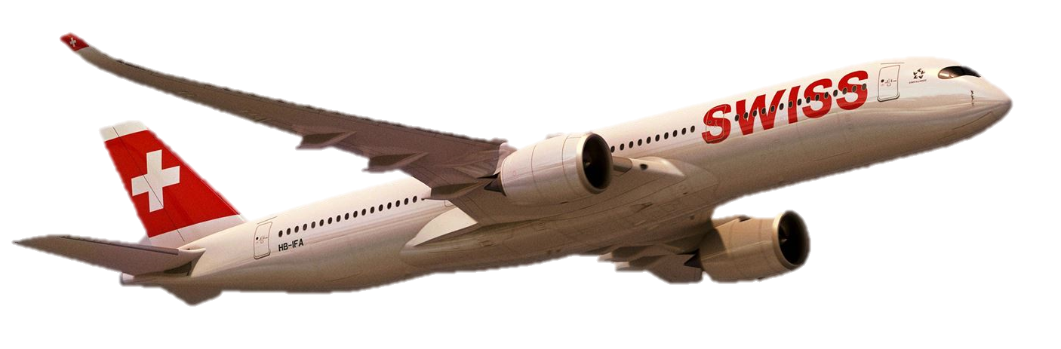
The Atmospheric Region
Previous Studies
~30 km (Stratosphere)
Mainly simplified instrumentation (Gamma-Ray Detectors)
~10 km (Troposhere)
Mainly Dosimetric Studies (Aircrew exposure)
Gaps of Knowledge:
Energy spectrum
Particle composition
Direction of particles
Readapted from Cosmic Rays at Earth
Researcher's Reference Manual and Data Book(2001)

Slide 7
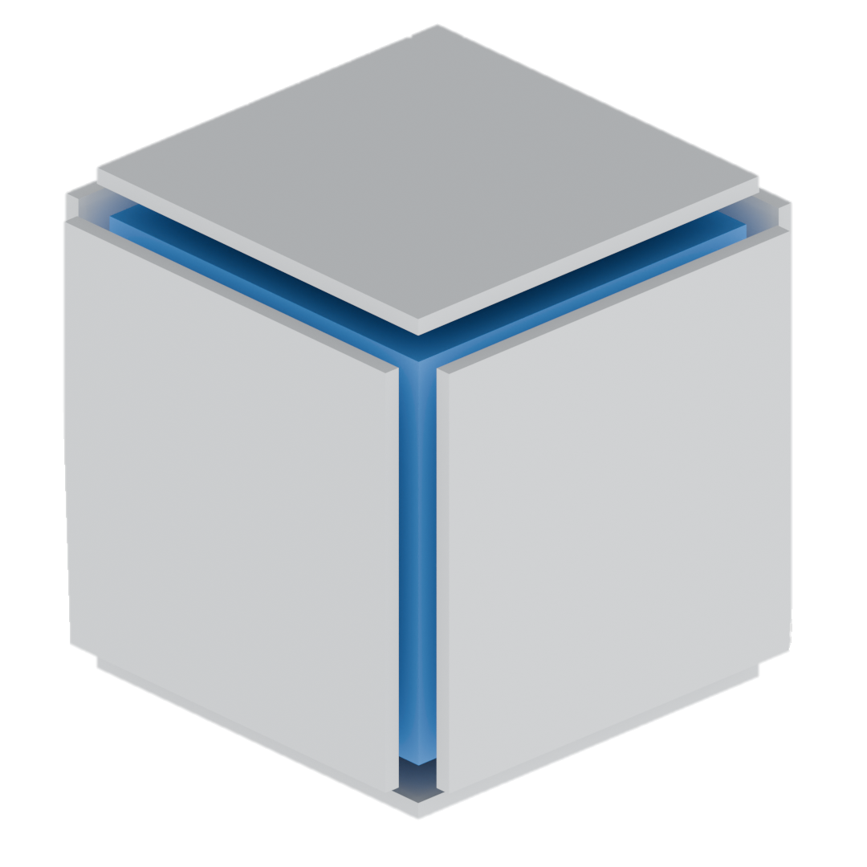
The AMORE Instrument
The Airspace Measurements Of Radiation Environment Instrument
Particle Telescope ΔE-E-ΔE
Planar BC-400 Scintillator surrounding Cubic NaI(Tl)
AMORE Features
Low mass, size & power consumption
Sensitive to neutral and charged particles
Directional sensitivity - 4π FOV
Energy range up to 100s of MeV
Final design illustration

Slide 8
building AMORE

Slide 9
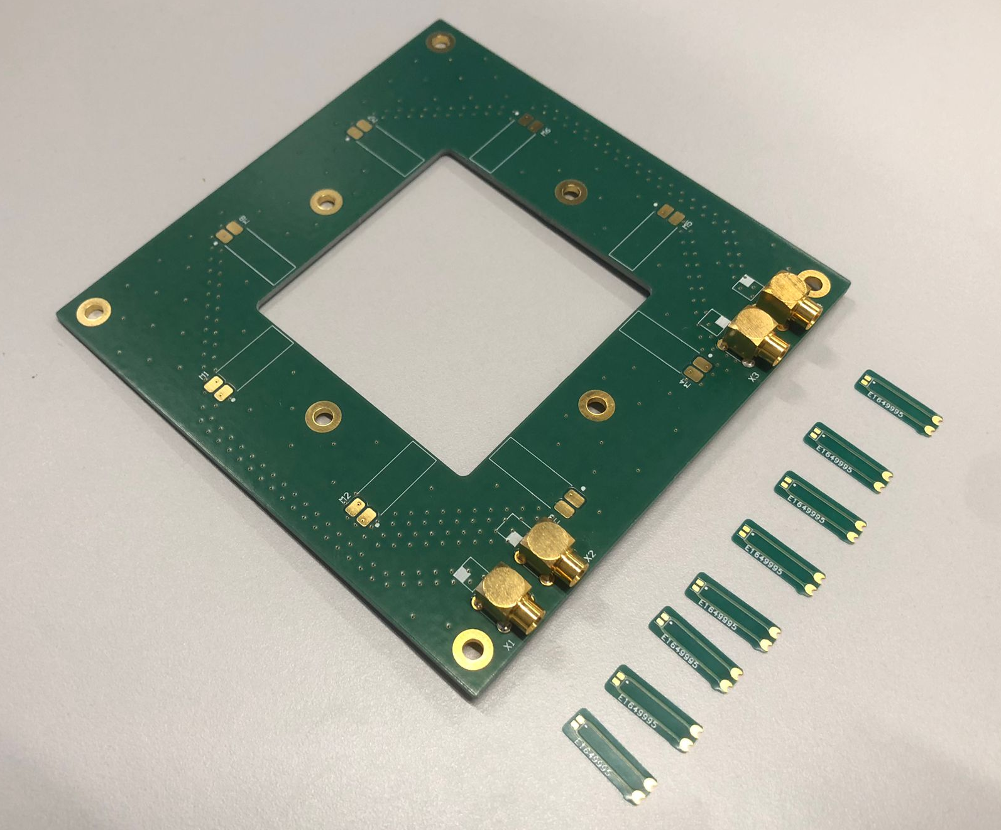
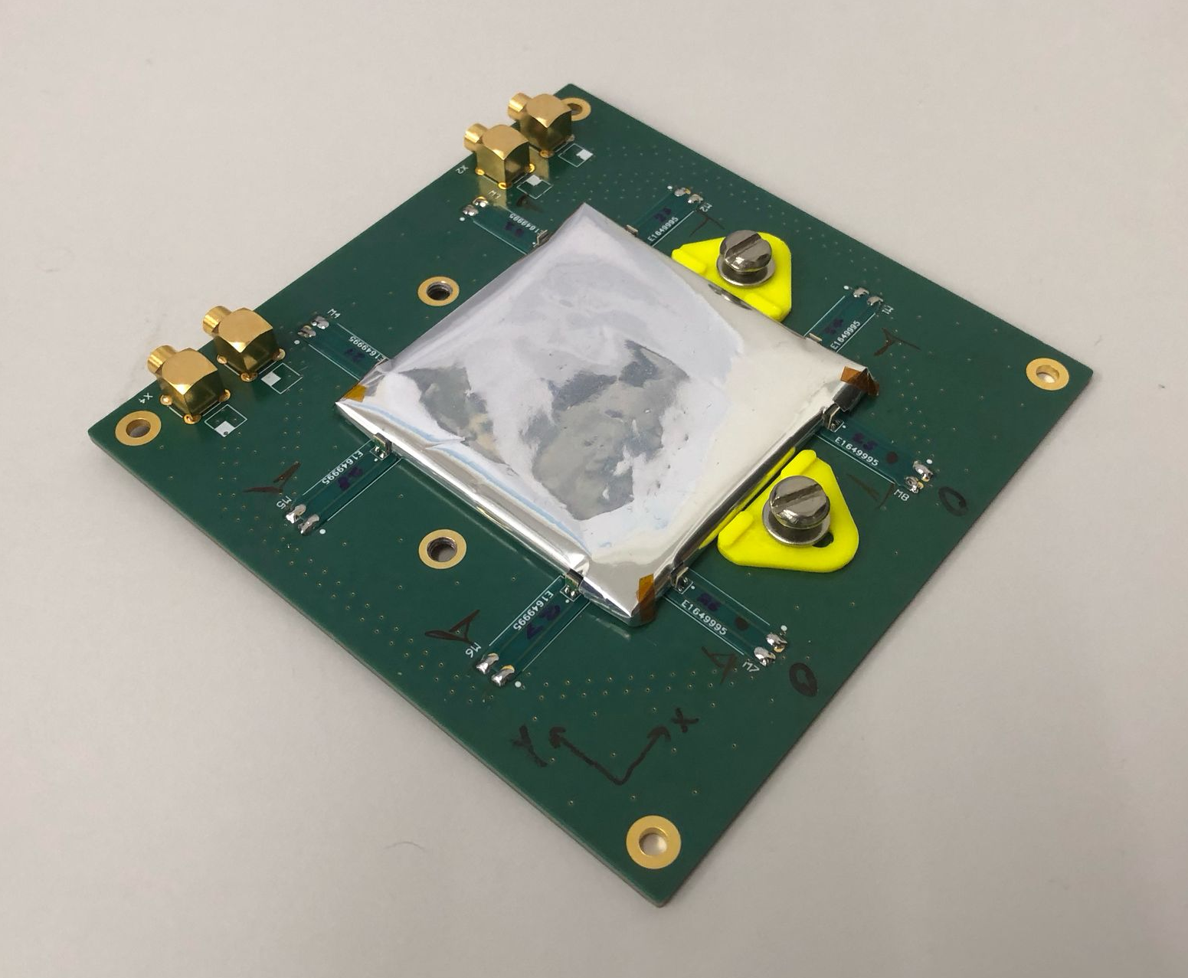
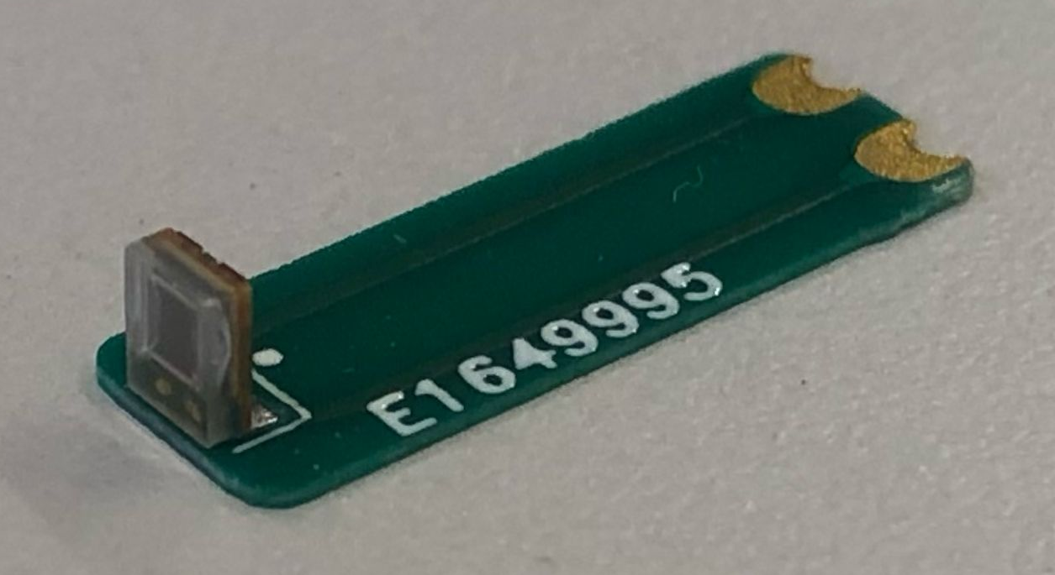
AMORE ΔE (dE) Detector
First version – Luka Marjanovic’s Master’s Thesis
52x52x2 mm³ BC-400 plastic scintillator
8x SiPM 1.3x1.3 mm² optical readout
4 channels of 2 SiPMs
Investigating
Light output with different wrappings (paper, Aluminium, Vikuiti, none)
Position sensitivity
Single channel
1.3x1.3 mm²

Slide 10
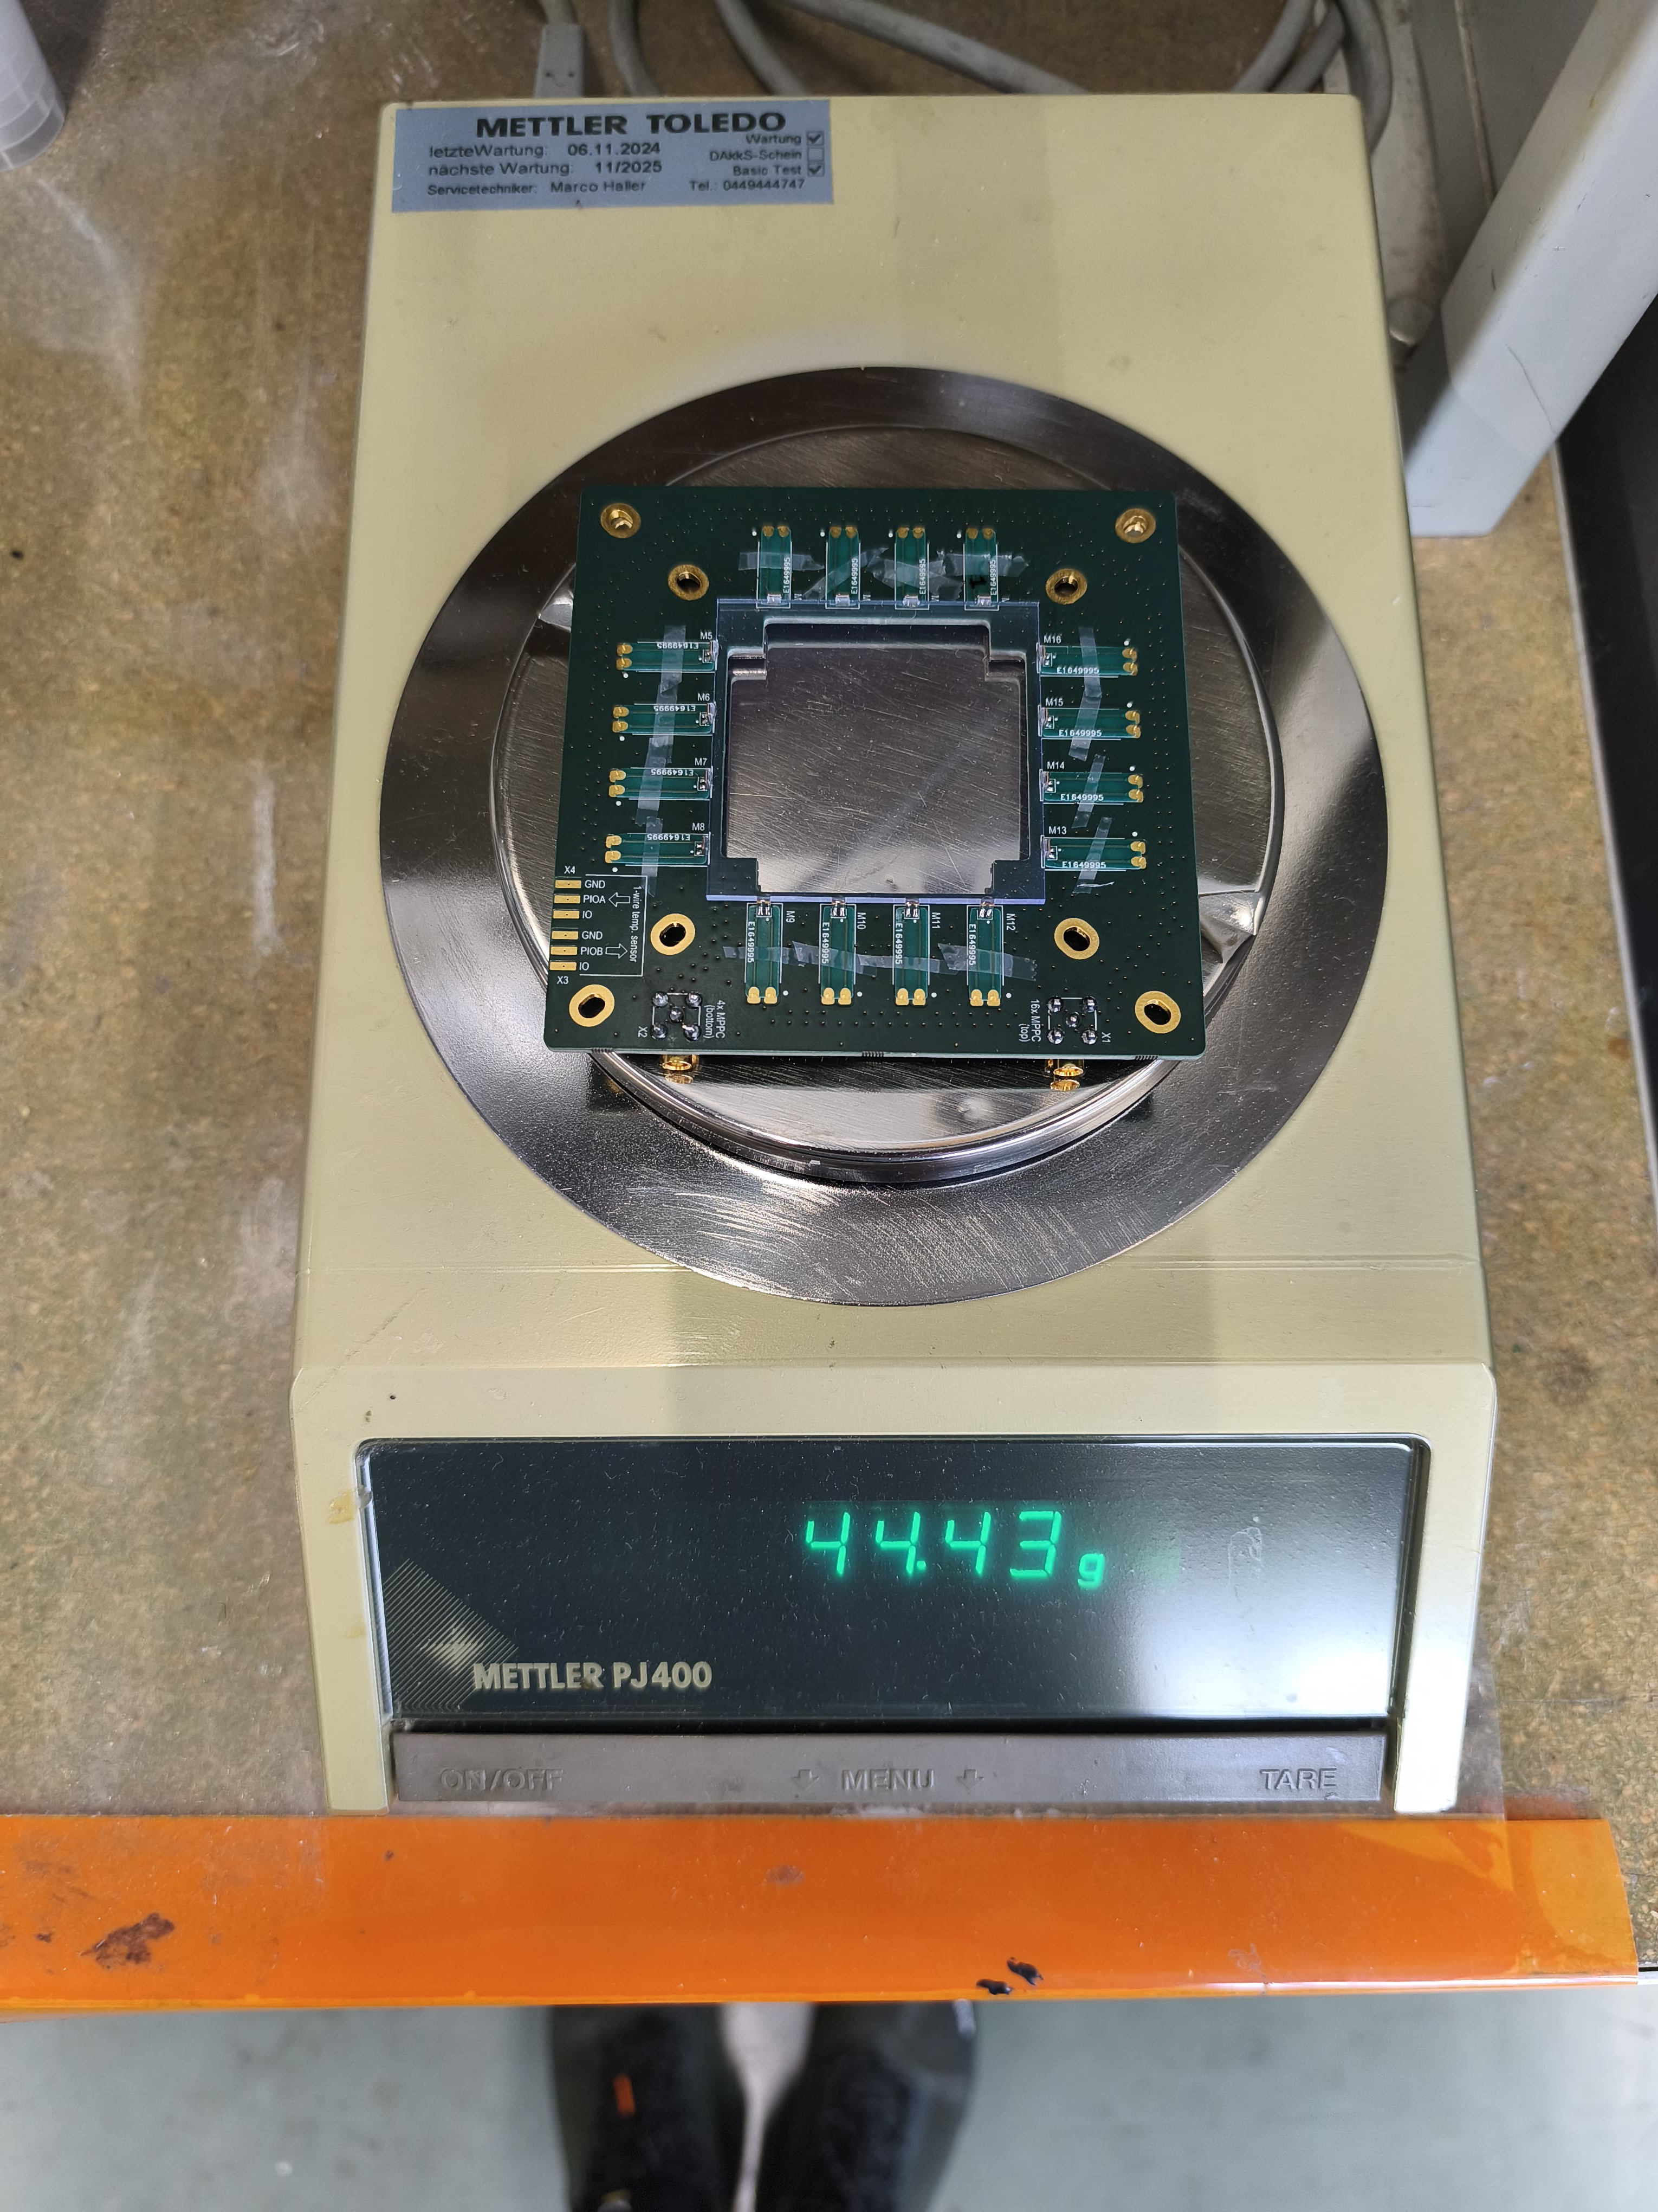
AMORE ΔE (dE) Detector
Current version
52x52x2 mm³ BC-400 plastic scintillator
16x SiPM 1.3x1.3 mm² optical readout
Single channel
Changes made for the Demonstration Model (DM)
Simplify the design → Future version will combine both iterations
10x10 cm²
dE scint.
1x SiPM

Slide 11
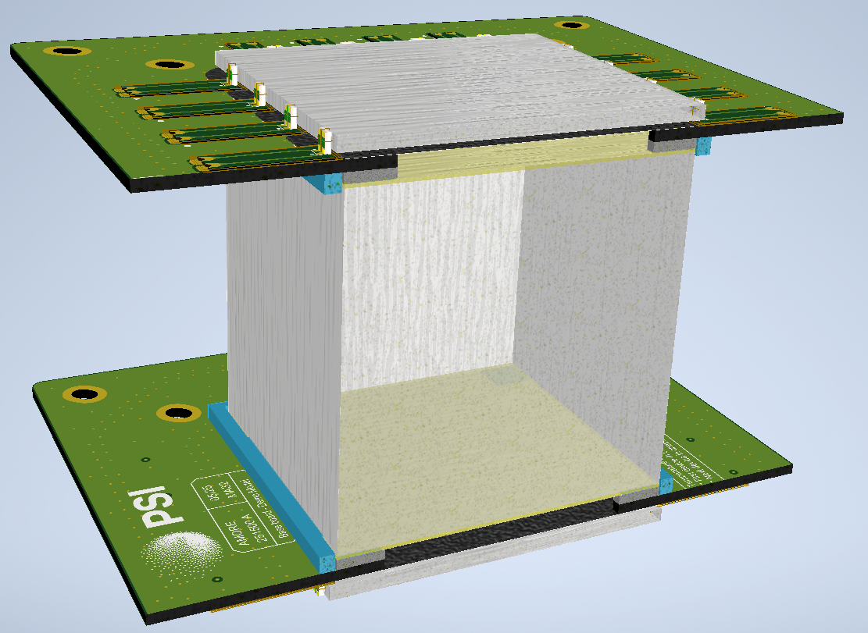
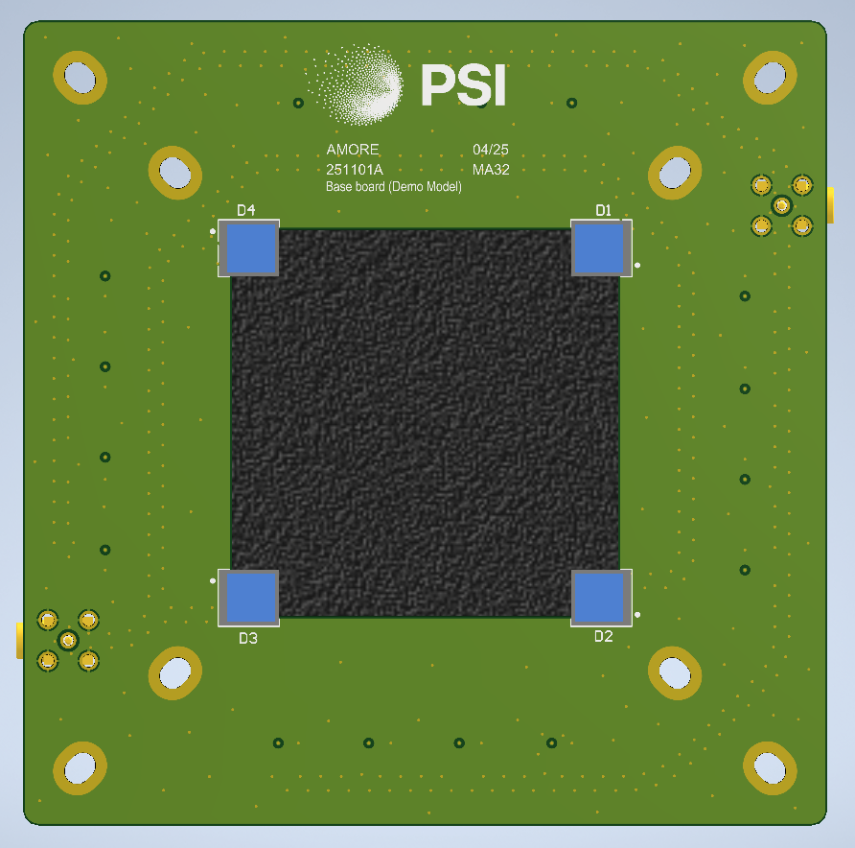
AMORE E Detector
dE scint.
Current version
50x50x50 mm³ BC-400 plastic scintillator
8x SiPM 3x3 mm² optical readout
2 channels of 4 SiPMs
One channel at top of E volume
One channel at bottom of E volume
E scint.
SiPMs

Slide 12
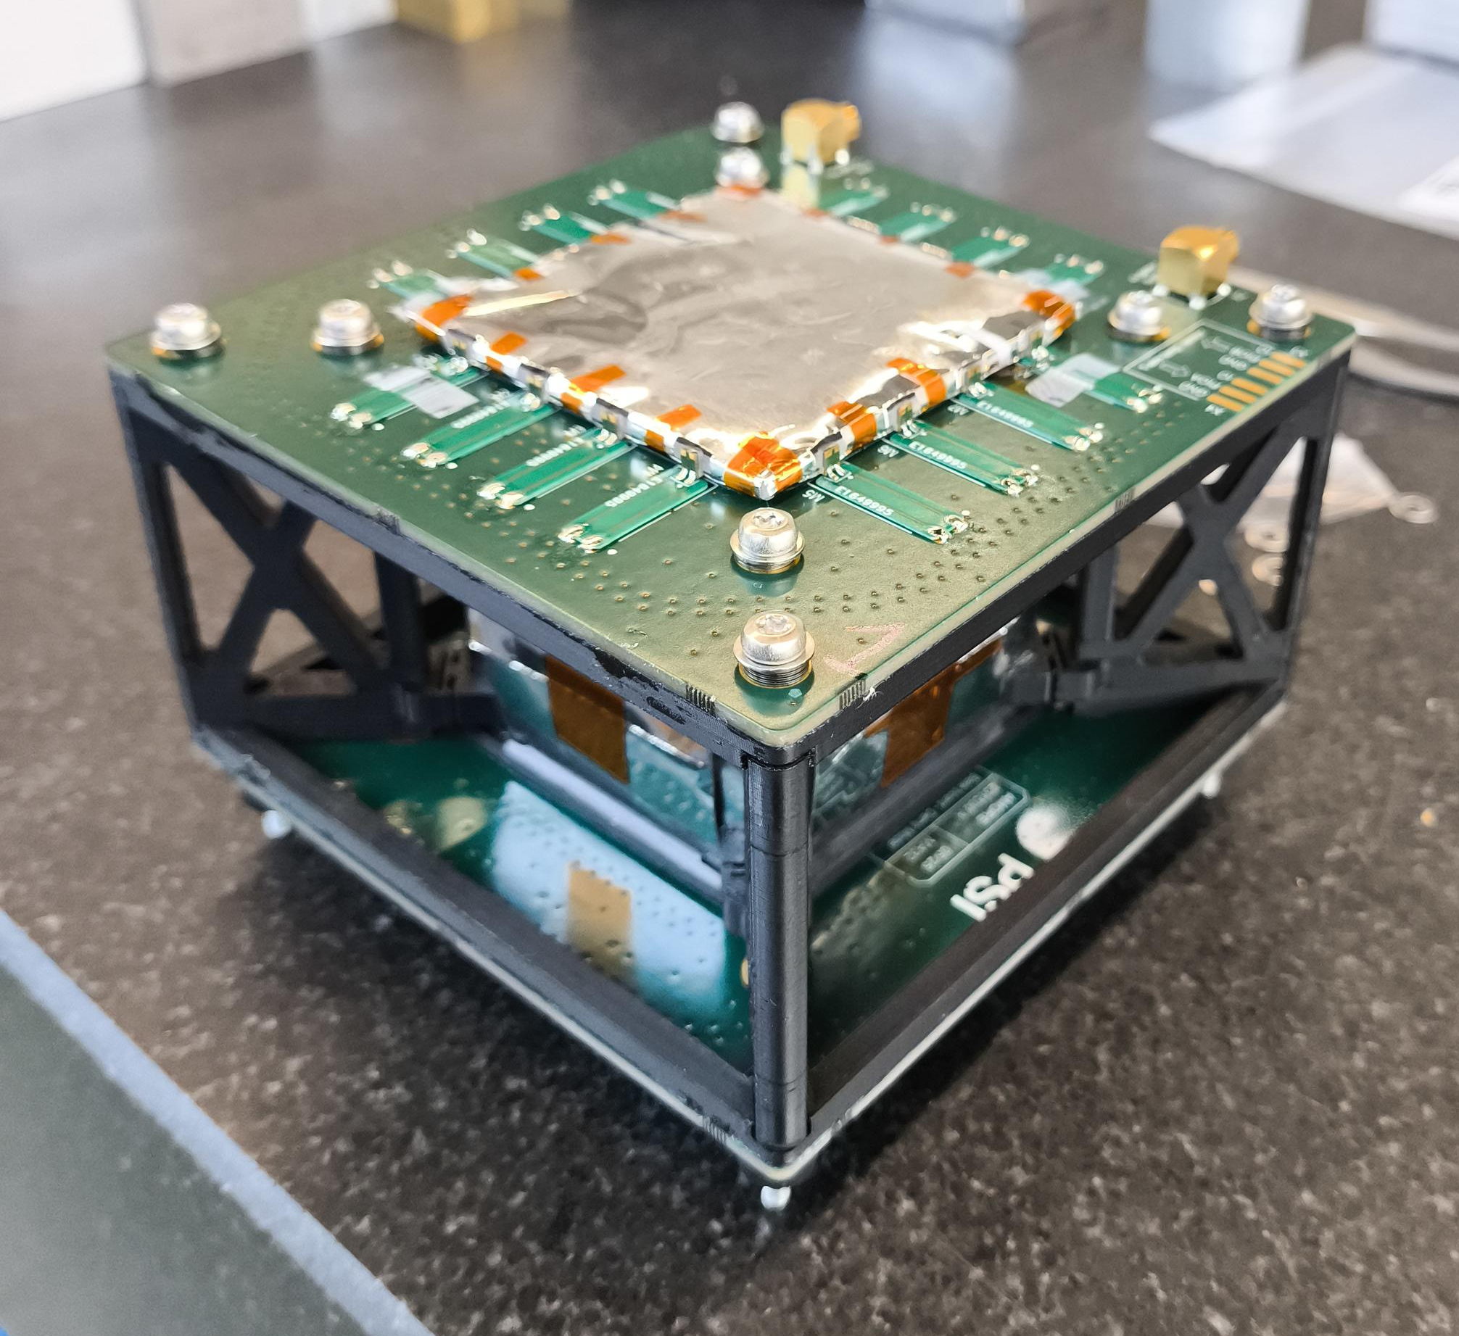
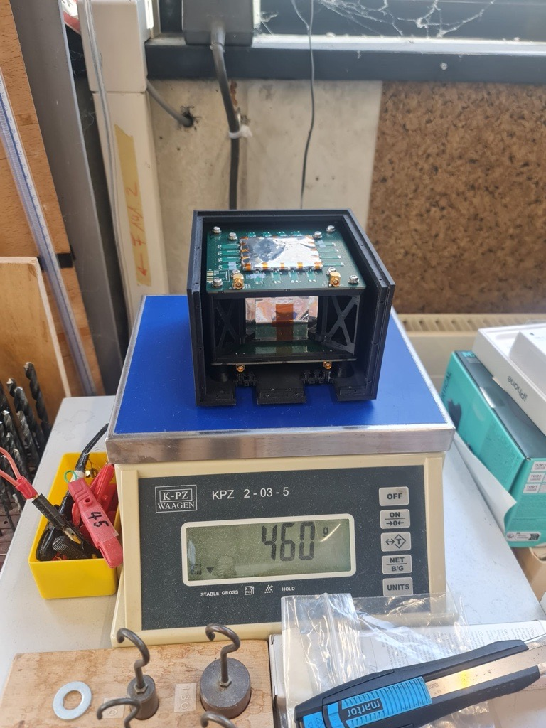
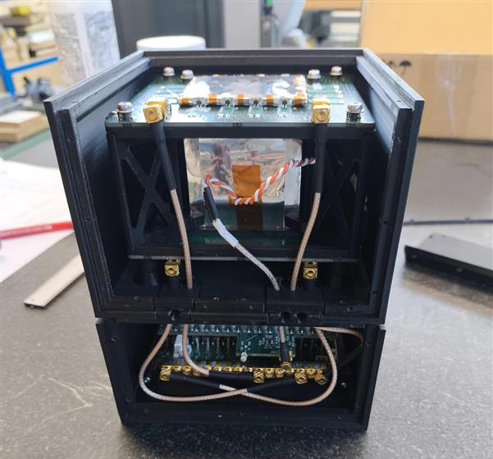
AMORE Demo Model: Full Assembly
Top Case
Detector Head
Head + WaveDream,

Slide 13
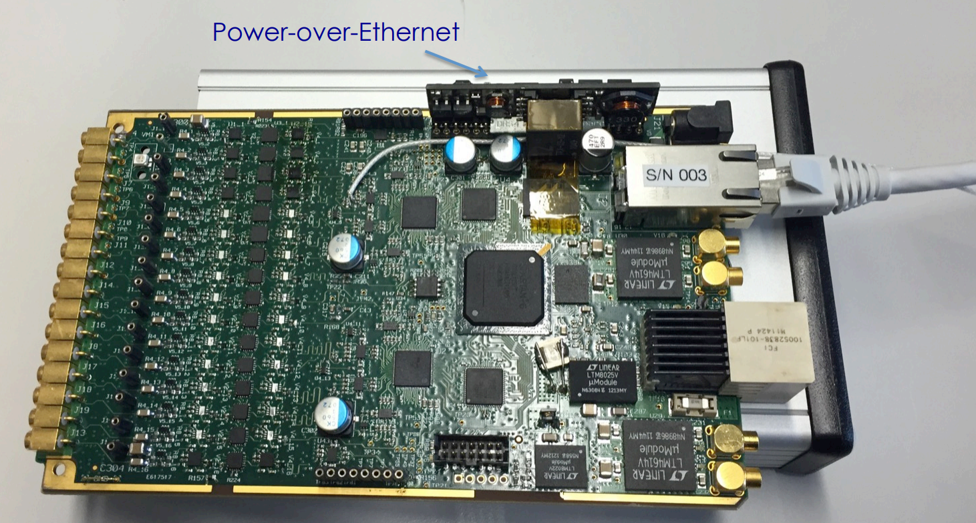
Data Acquisition System
WaveDREAM Board (WDB)
DRS4 based readout module
Developed for the MEG II Experiment
For our use
HV supply to SiPMs
Variable gain multiplication
Temperature corrections
Waveform measurements
Channel inputs
Power socket
Ethernet
Credit: Stefan Ritt, PSI

Slide 14
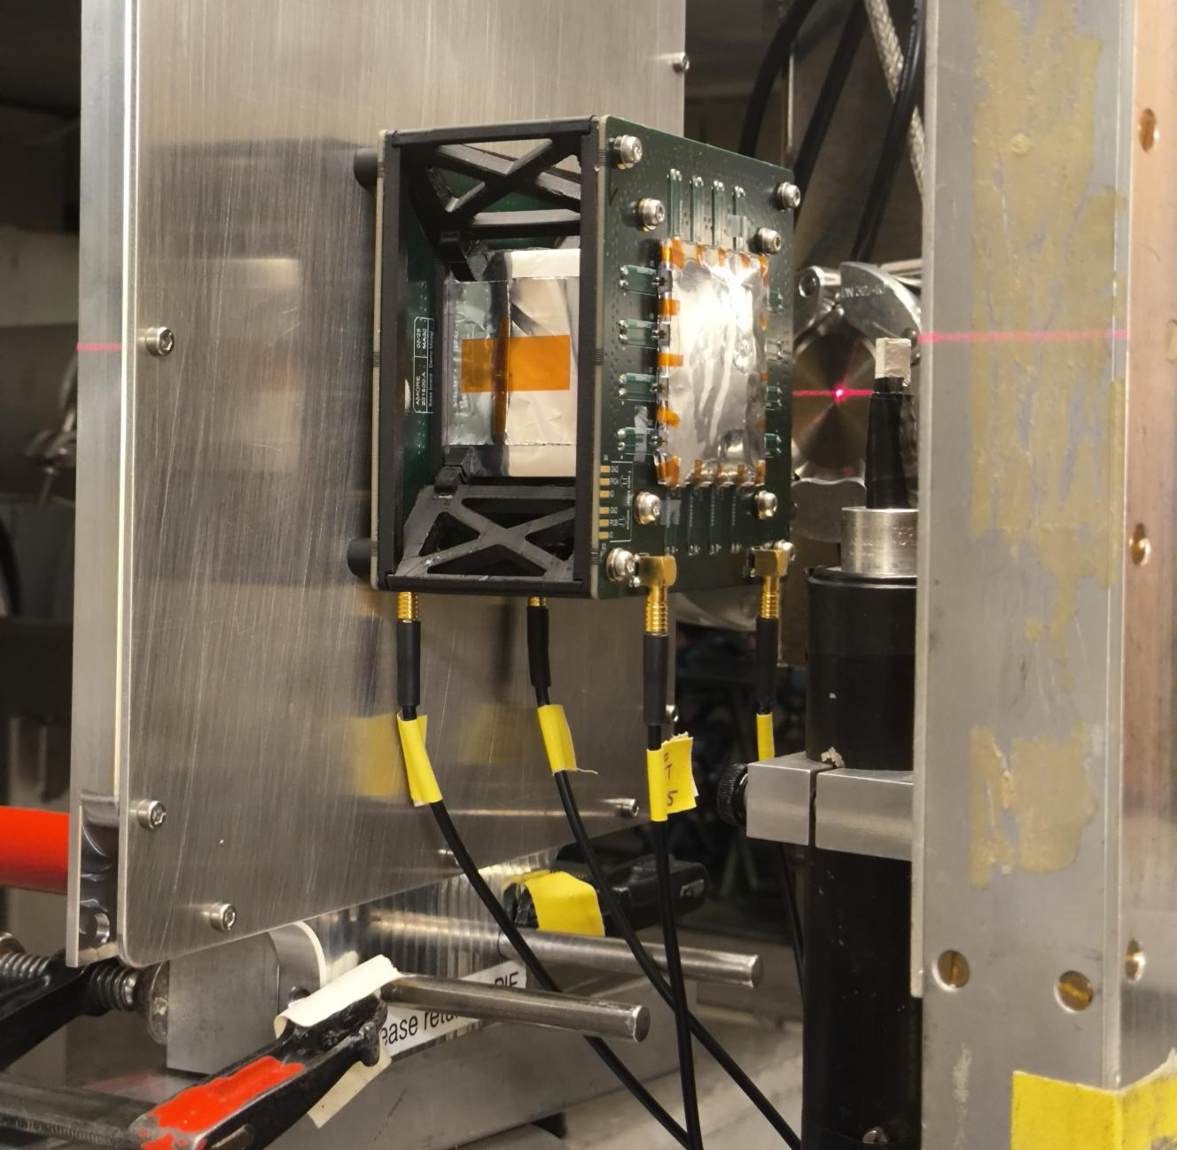
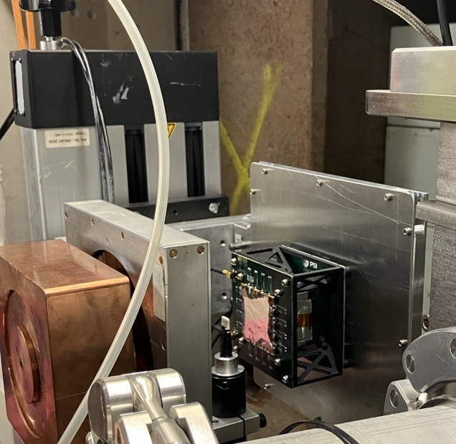
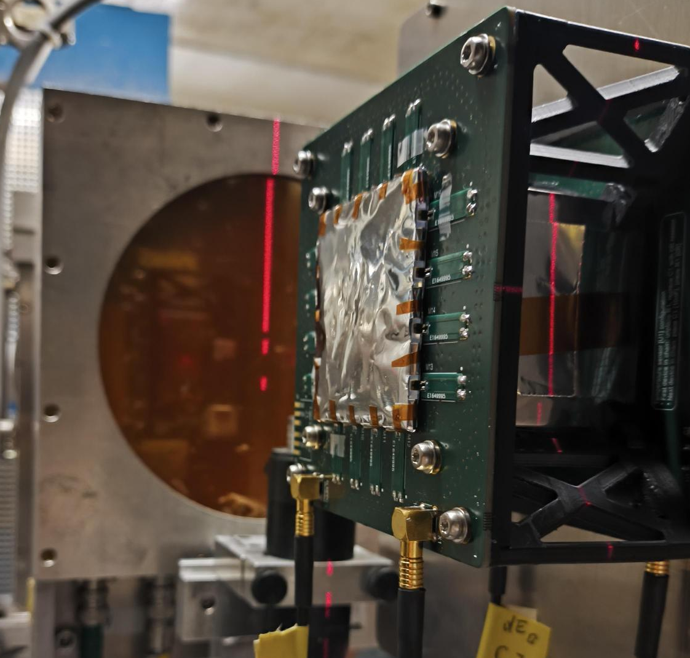
Proton Measurements
0°
Beam Setup :
Low flux: 3E3 p/cm2/s
5x5 mm square collimator
Energy Scans: 200, 150, 100, 70, 50, 30 MeV
90°
Tests:
X,Y scans
Angle scans: -90° to 90°
Background
X,Y Table

Slide 15
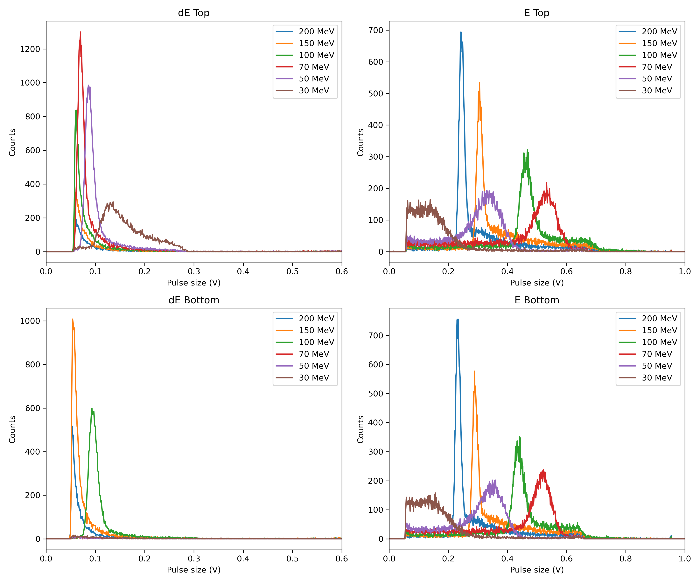
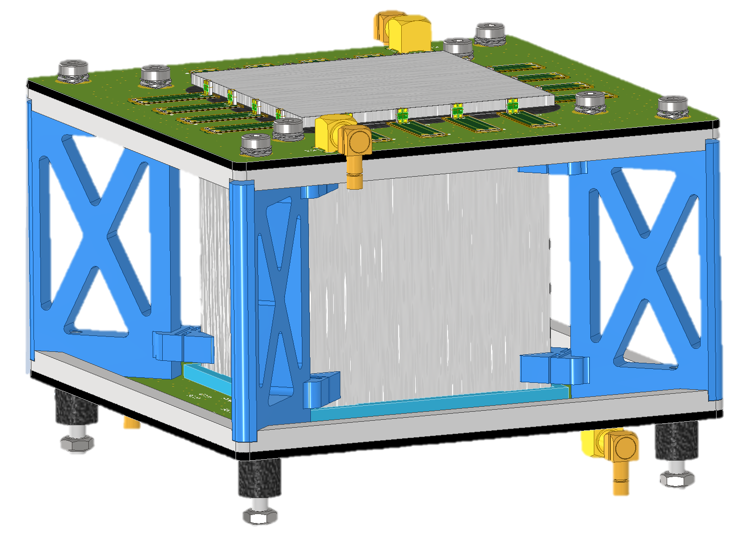
Proton Spectra
Example of Energy scan
Perpendicular and centered beam
Fixed Acquisition Parameters (Gain, HV, Trigger threshold, Trigger patterns)
OR Trigger Logic

Slide 16
flying AMORE

Slide 17
Primary Objectives for Commercial Aircraft Flights
Instrument Tuning
Initial Performance
Radiation Response
Use flight measurements to iterate upon AMORE performance
Tuning & optimisation
Preparation for autonomous operation
Determine in-situ AMORE performance
Aircraft vibrations
Environmental effects
Operational aspects
Measure secondary cosmic radiation onboard
Study instrument characteristics in-situ
Initial observations of particles and rates
Measurements as a function of altitude and latitude

Slide 18
AMORE Operation
Power socket
Power socket
Equipment setup
Laptop charger connected to power socket
AMORE detector connected to power socket
Two cables between AMORE detector and laptop
USB and ethernet
100 W power
Cable ~1.5 m length
<22 W power
Cable < 1 m length
USB cable
AMORE Detector unit
Ethernet cable
Laptop

Slide 19
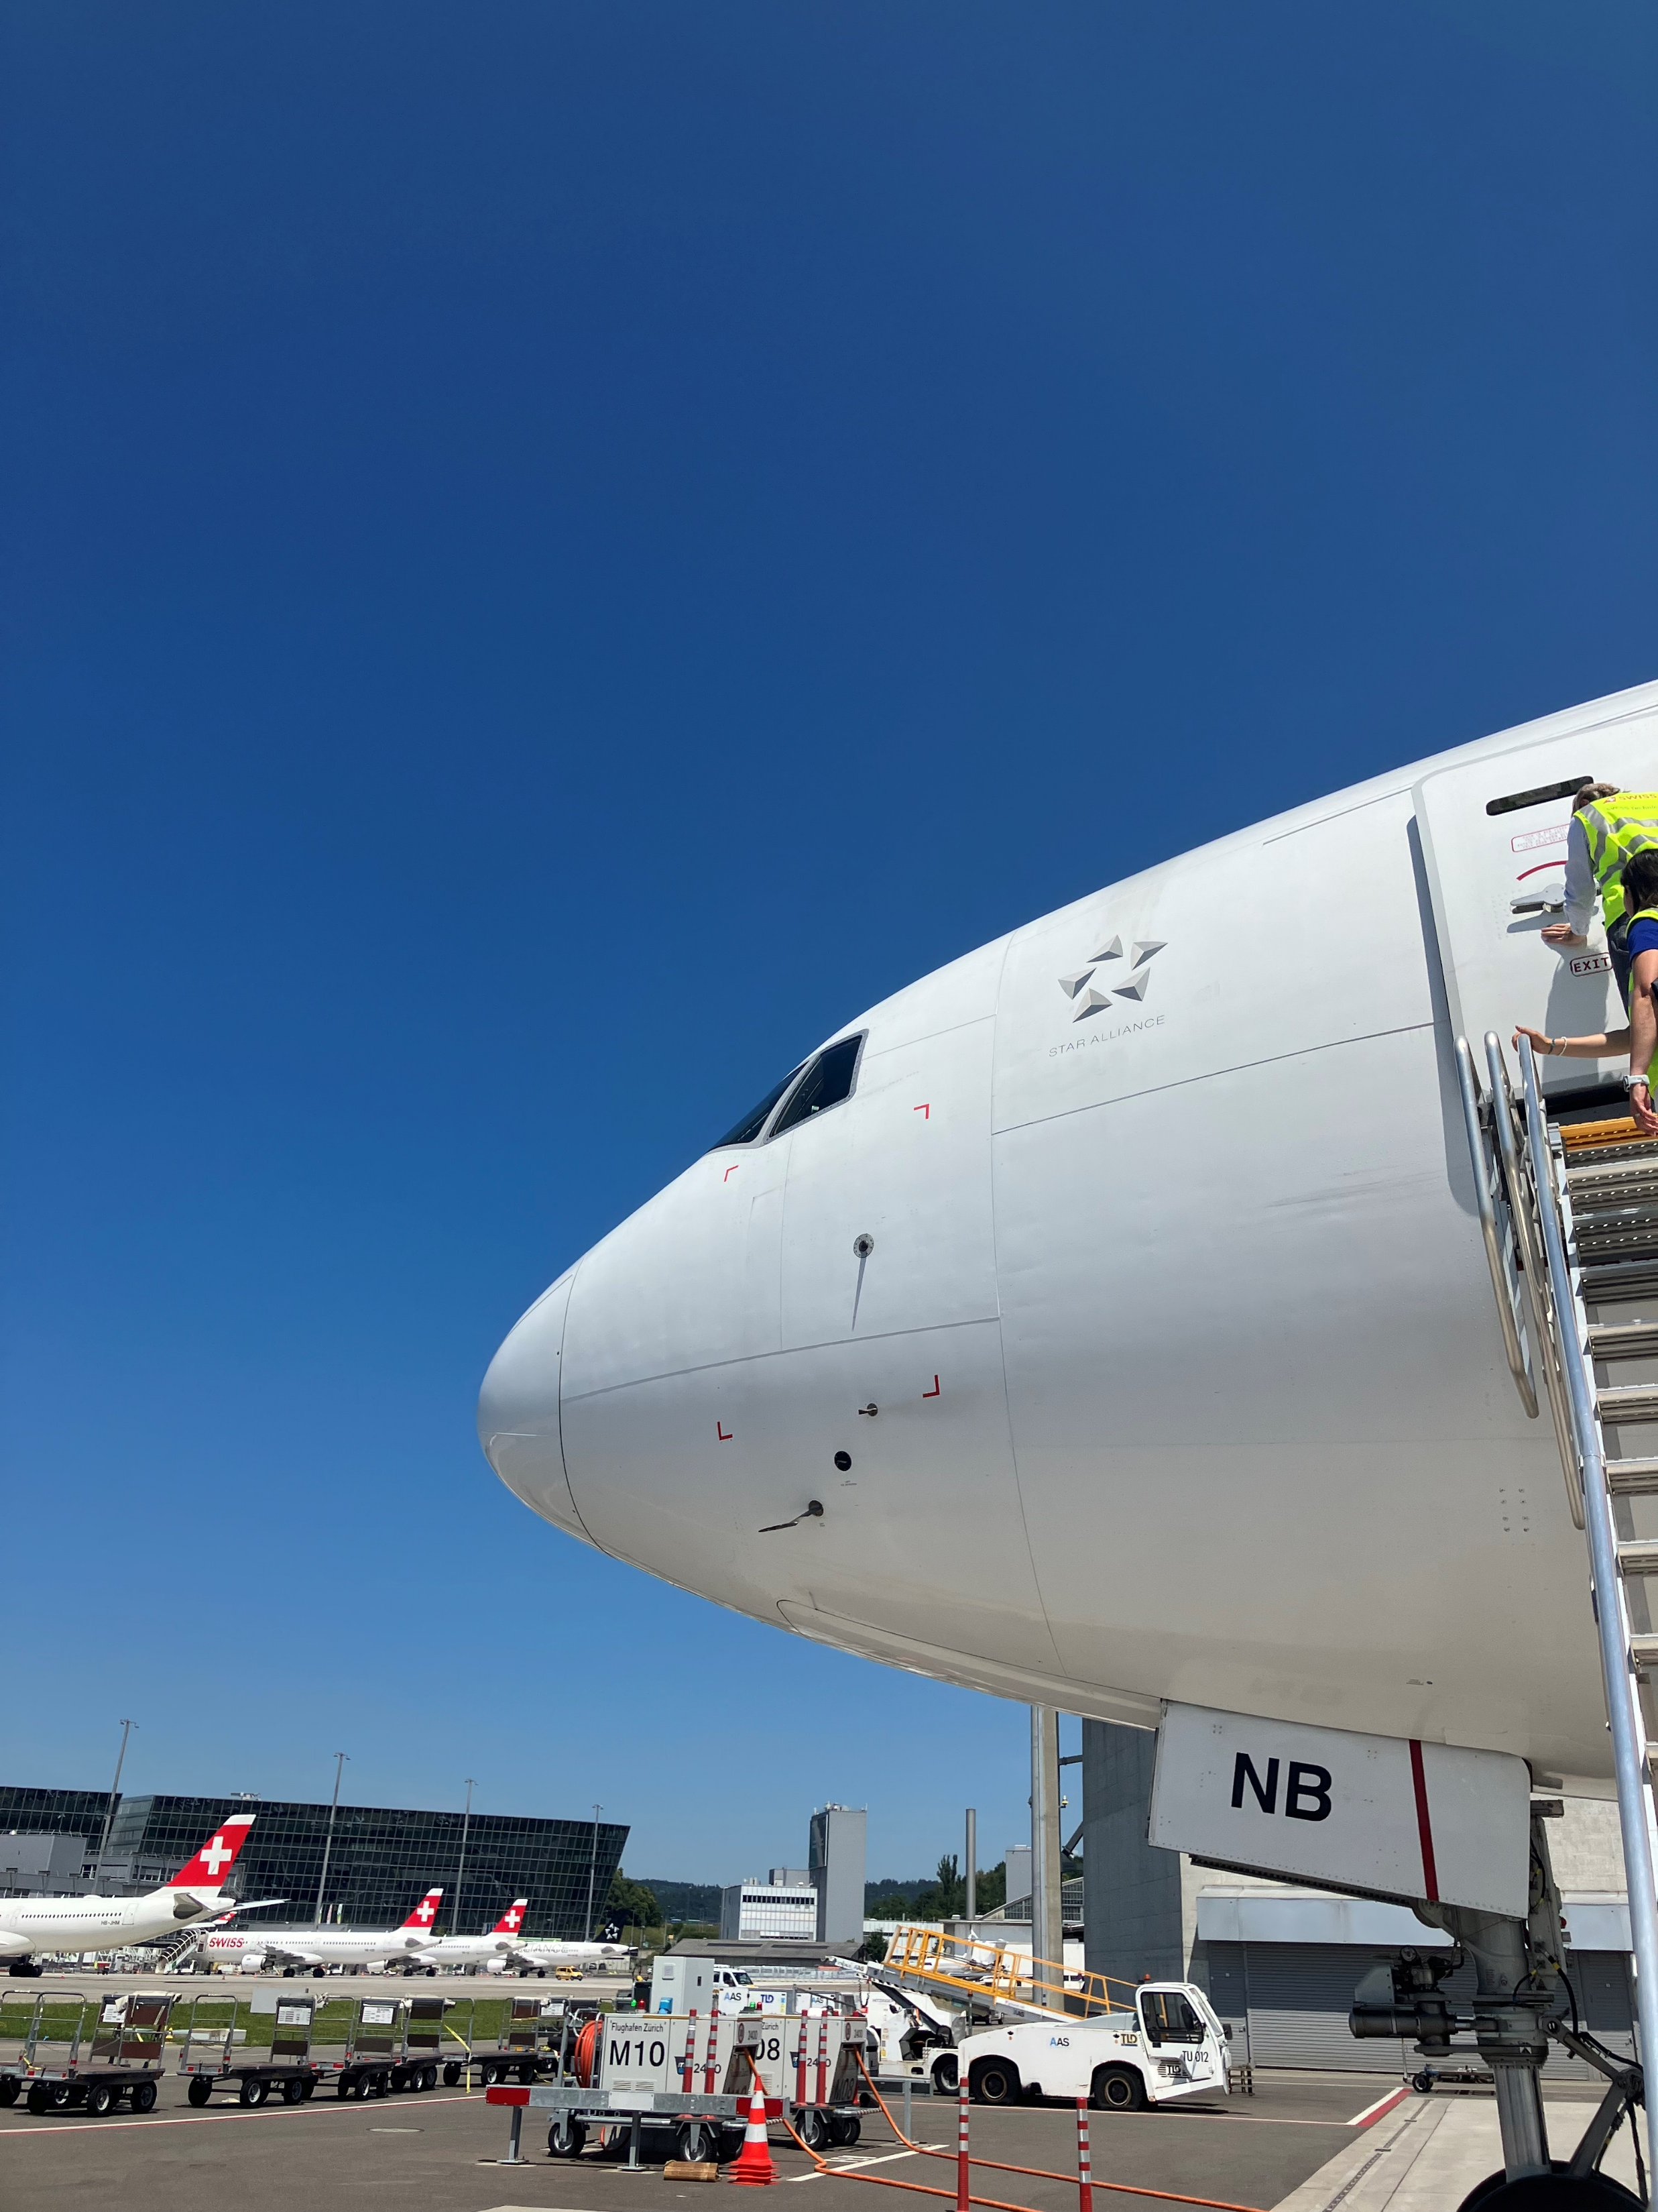
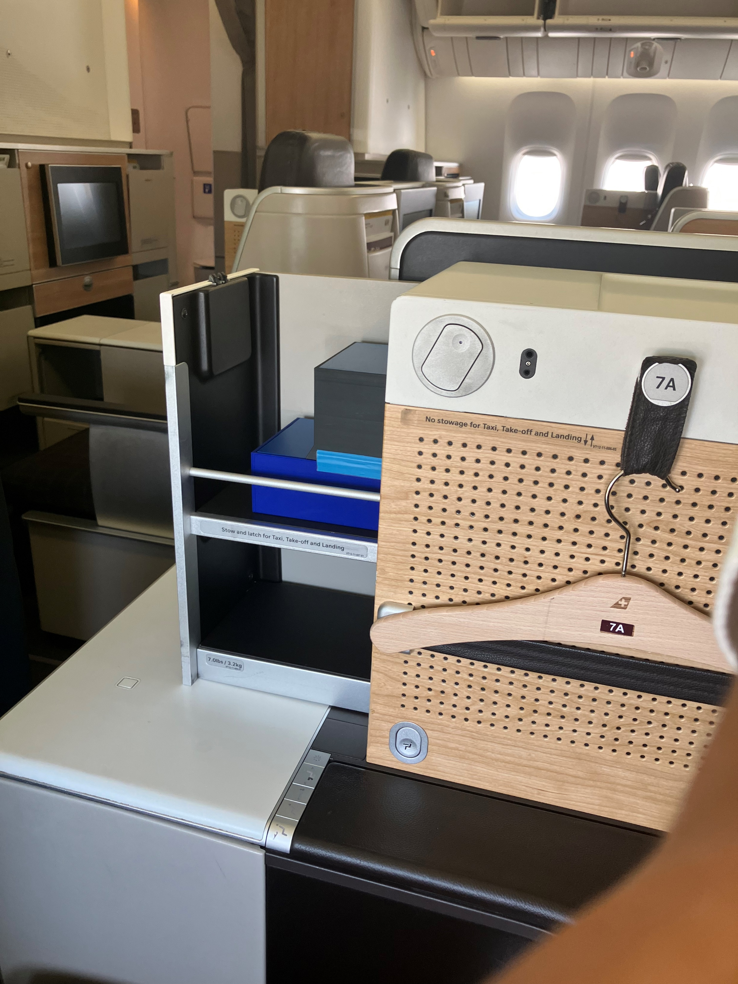
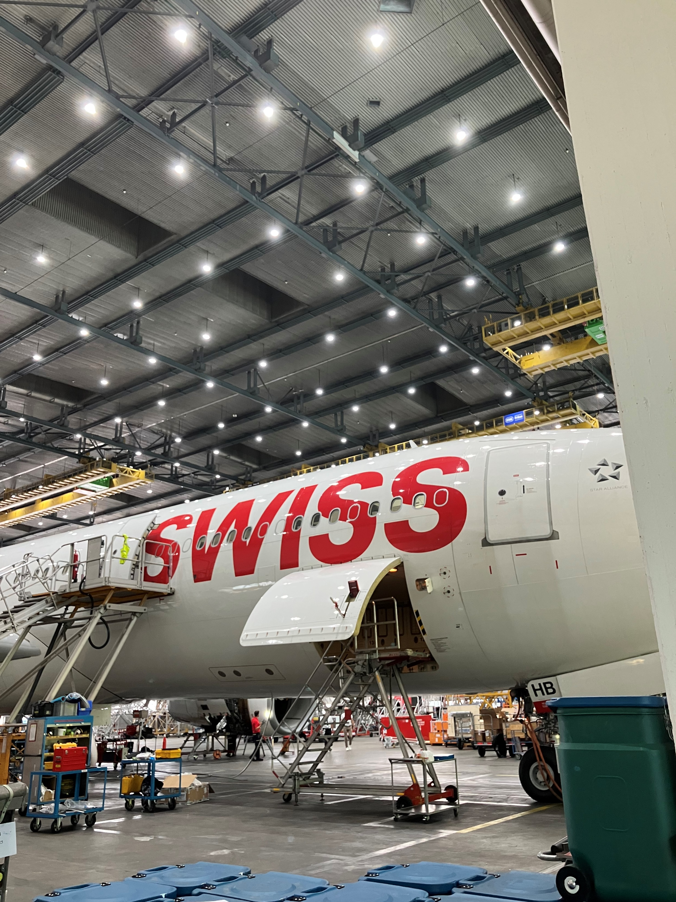
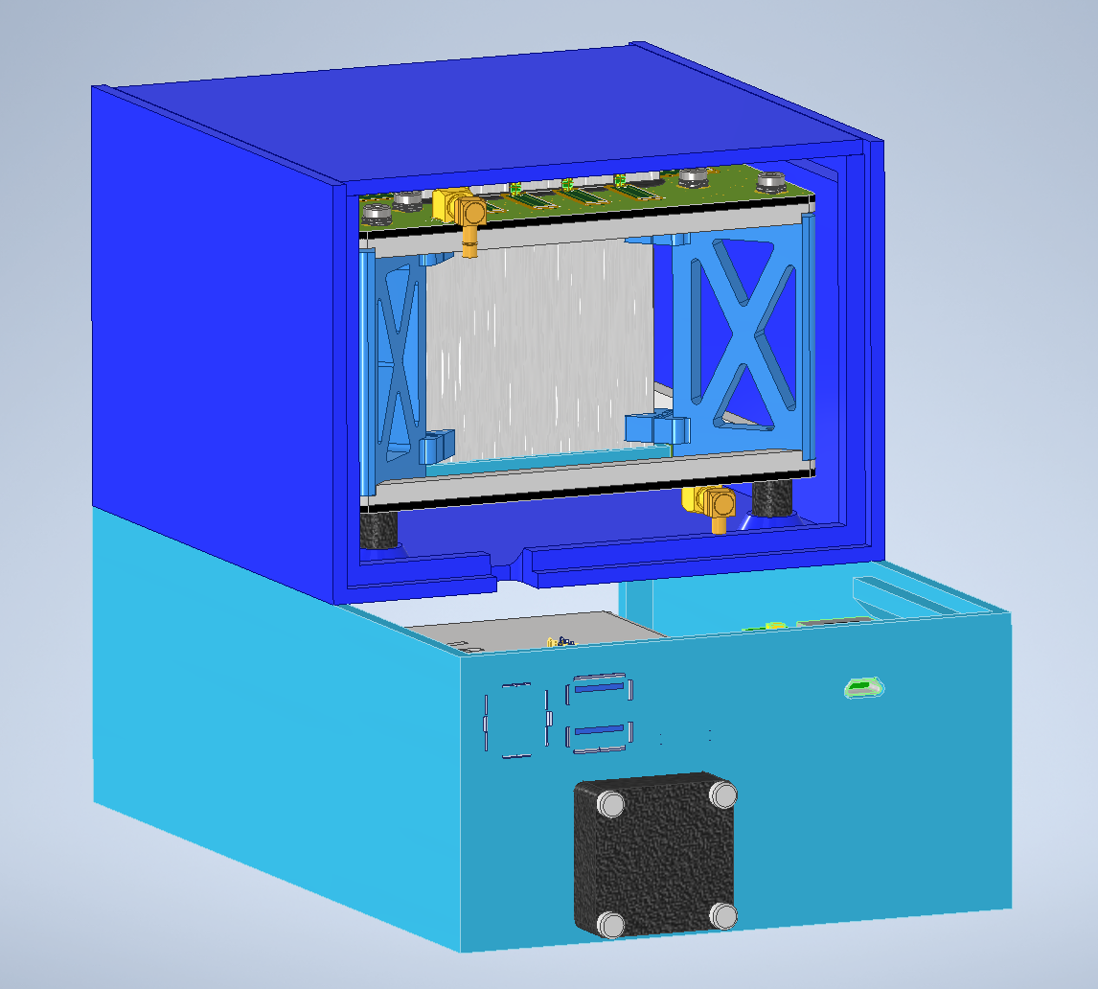
SWISS
Boeing 777
Hopefully flying in the next couple of months!
Airbus A330

Slide 20
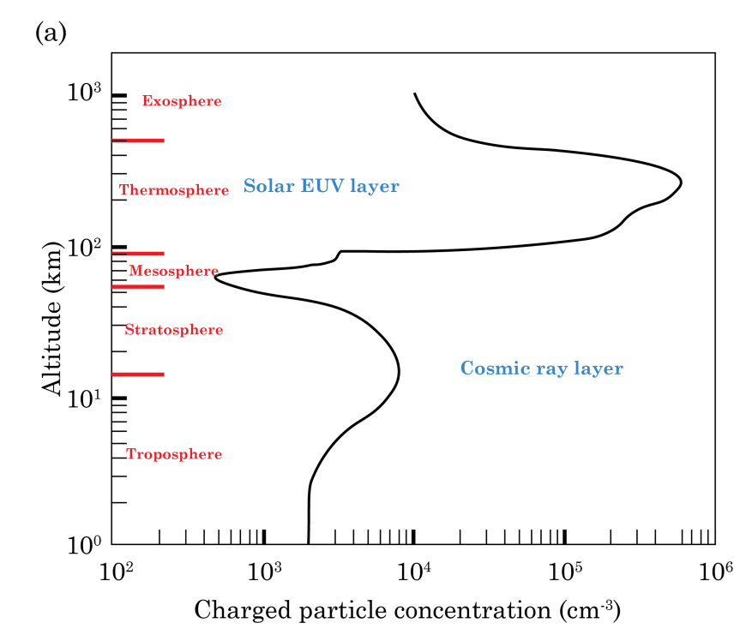
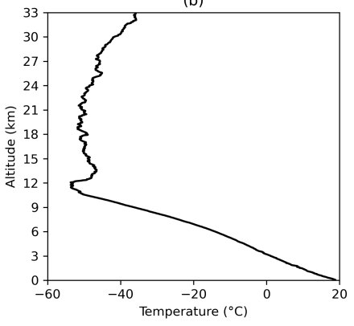
Balloon Flights
Charged particle concentration-altitude profile.
Adapted Y. I. Stozhkov, 2003.
Dramatic difference in the radiation environment from 0 km → 10 km → 33 km
For higher than 10 km we need to use balloons
WDB is incompatible with balloon environment
It’s cold!
Ice formation on electronics due to air cooling
WDB is heavy
“High” power consumption
New front-end electronics being developed
Temperature-altitude profile for balloon flight

Slide 21

Balloon Schematic
Balloon
Max weight 1.2 kg
Equipment setup
xyz
Batteries
Power distributor
Amplifiers
DRS4 Eval. Board
AMORE Detector unit
USB cable for Sensor board

Slide 22
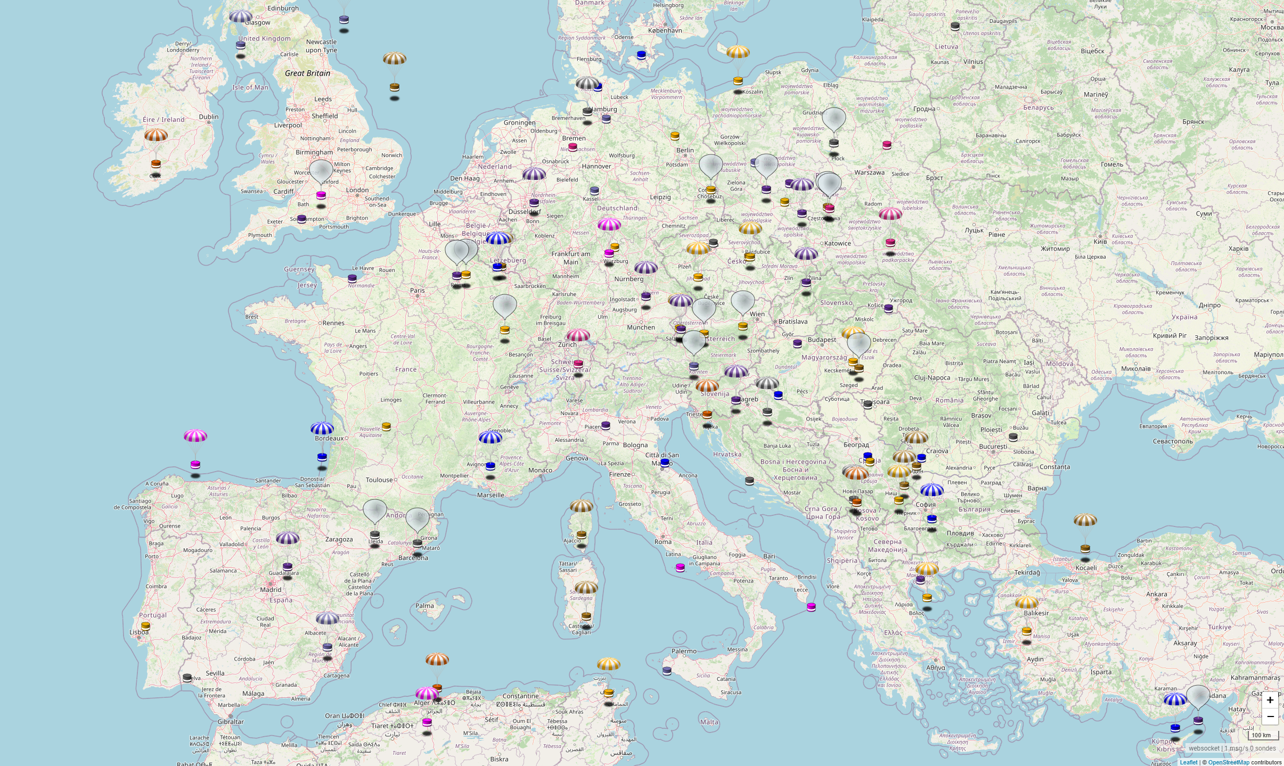
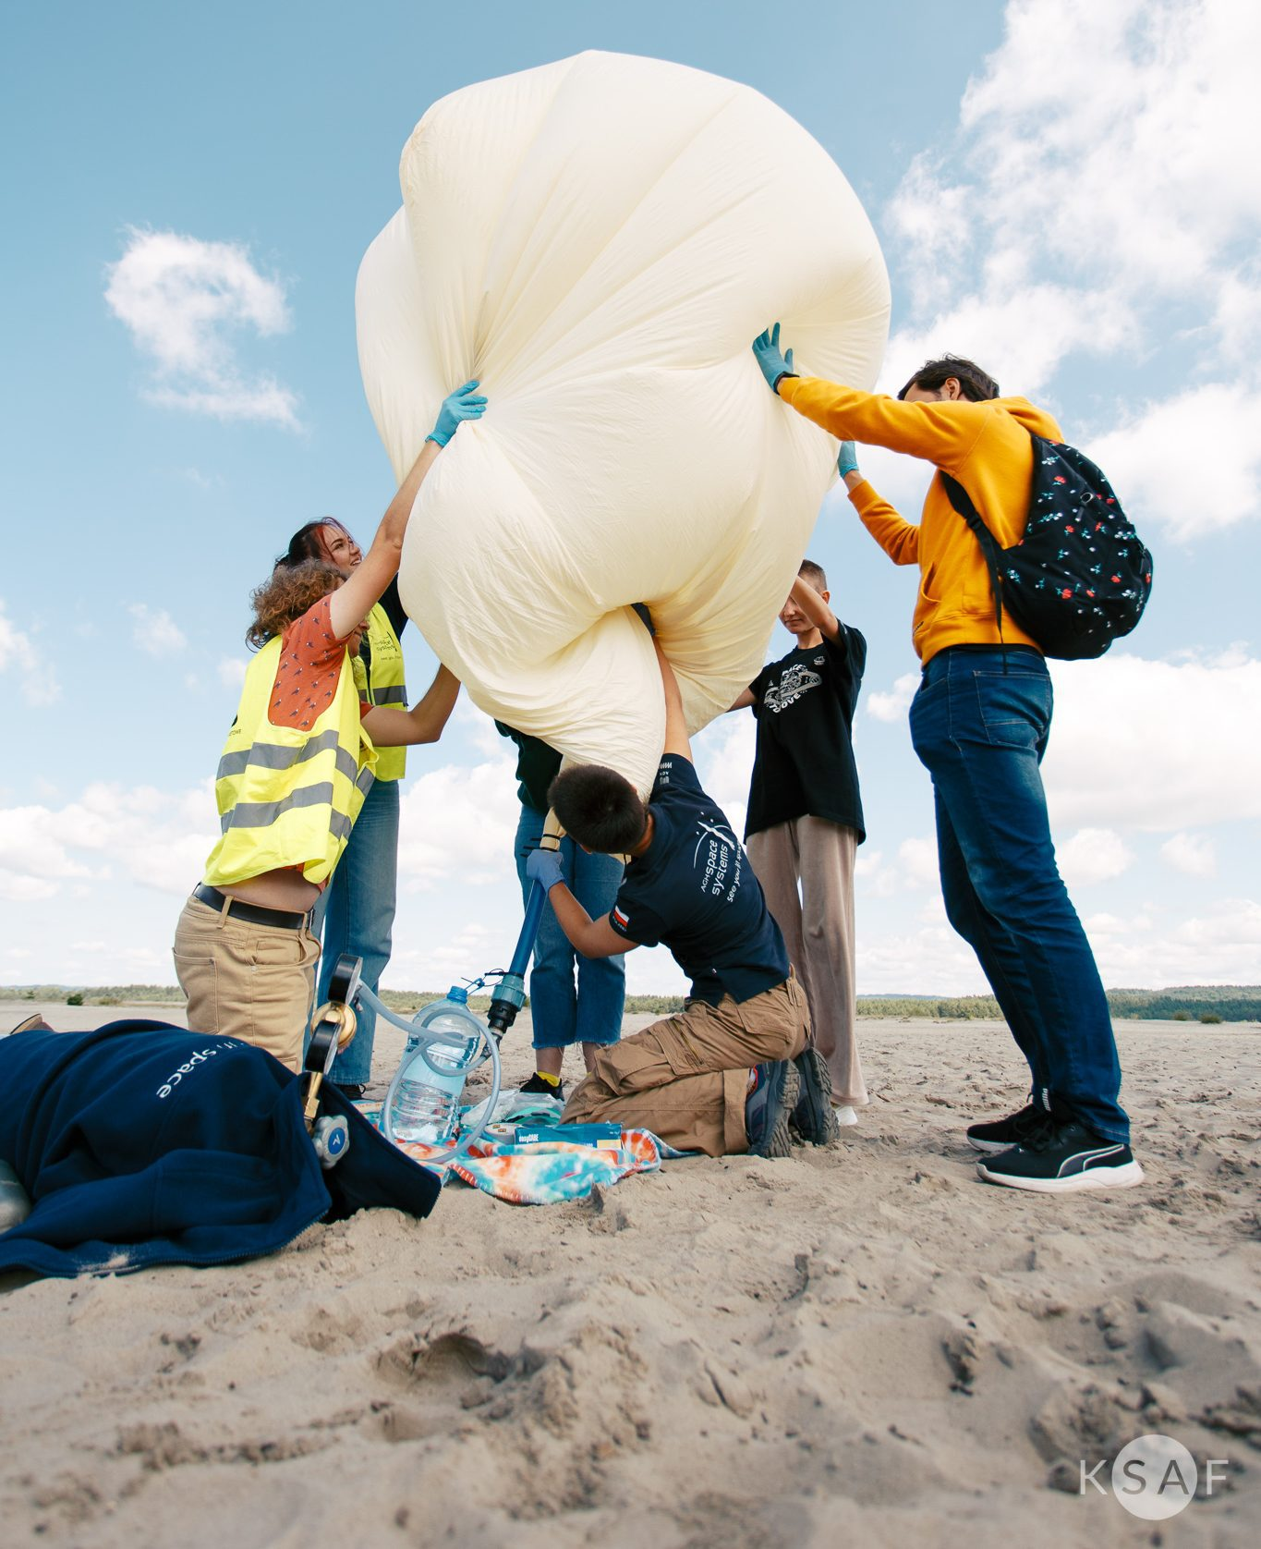
Balloon Flights
Partnered with AGH University of Science and Technology, Kraków, Poland
Infrastructure to launch & recover payloads
Balloons from Sunday 10:30 pm to Monday 10:30 am. Credit SondeHub
Filling balloon with helium. Credit: AGH

Slide 23
Summary
Developing a ΔE-E-ΔE particle telescope
Demonstration Model is assembled and undergoing calibrations
Flights on commercial airplanes are planned for the coming months
Balloon flights within the next year
Characterising the airspace radiation environment
Thank you for listening
Are there any questions?
Acknowledgments
Wojtek Hajdas – AMORE lead
Michael Müller – AMORE electronics
Mike Gantert – AMORE Technician
Malte Hildebrandt – Detector Group lead

Slide 24
Additional Slides

Slide 25
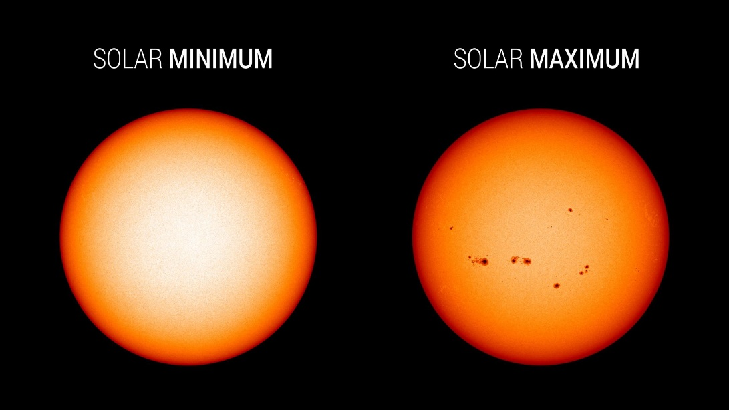
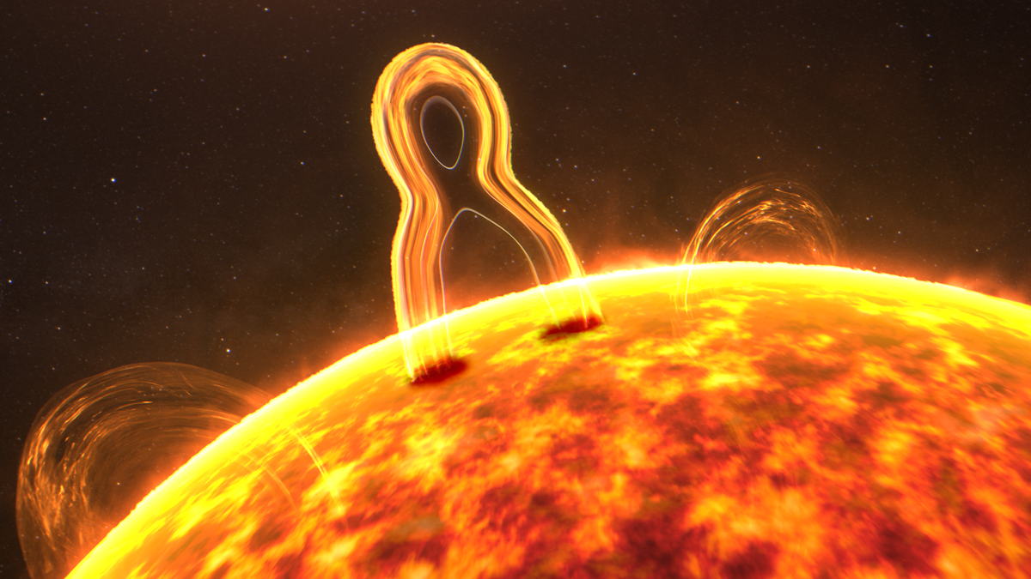
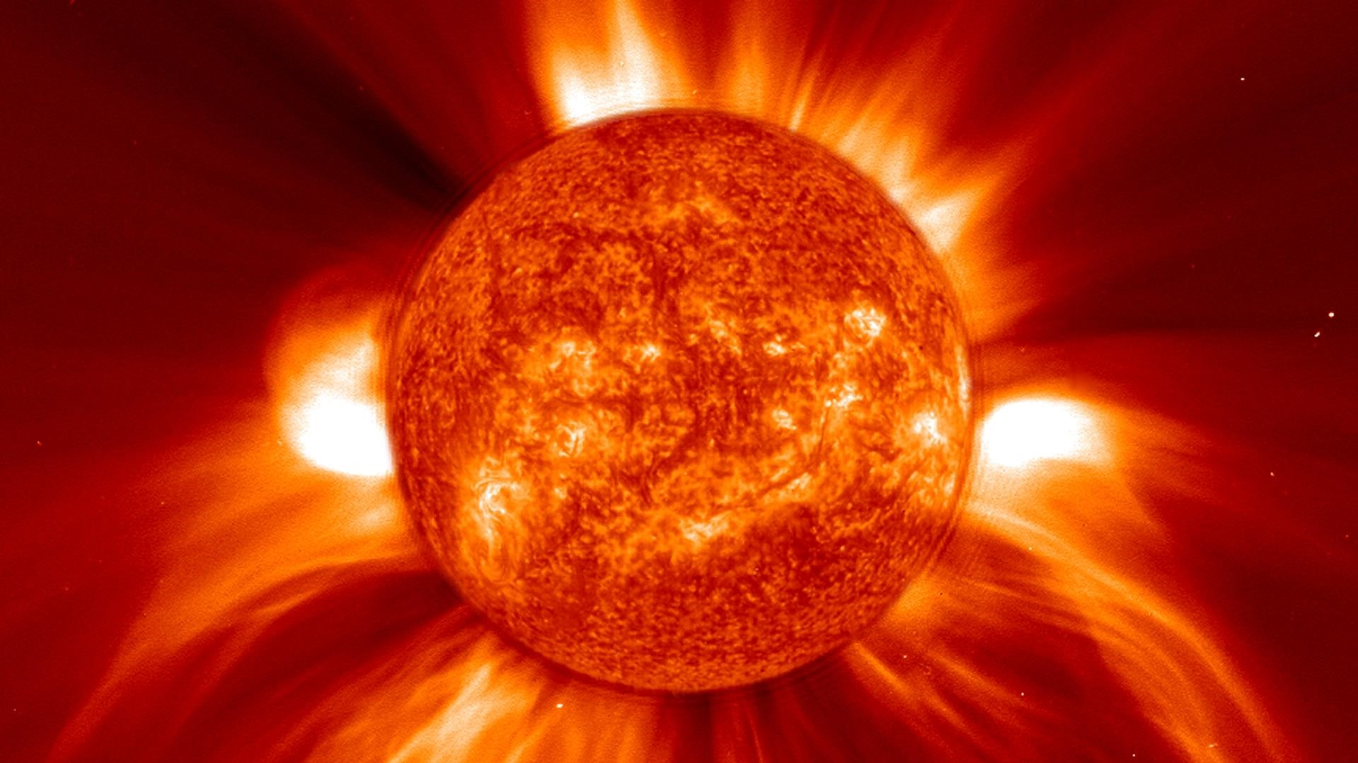
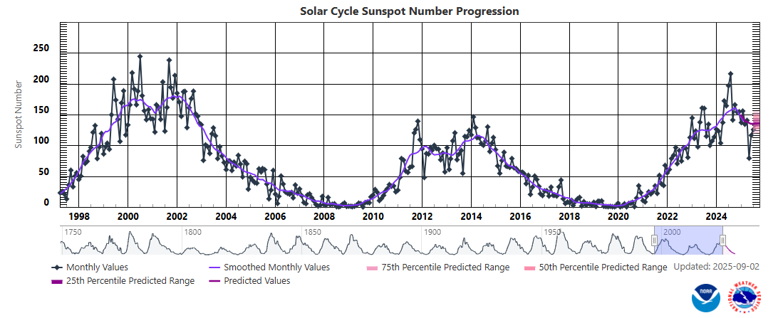
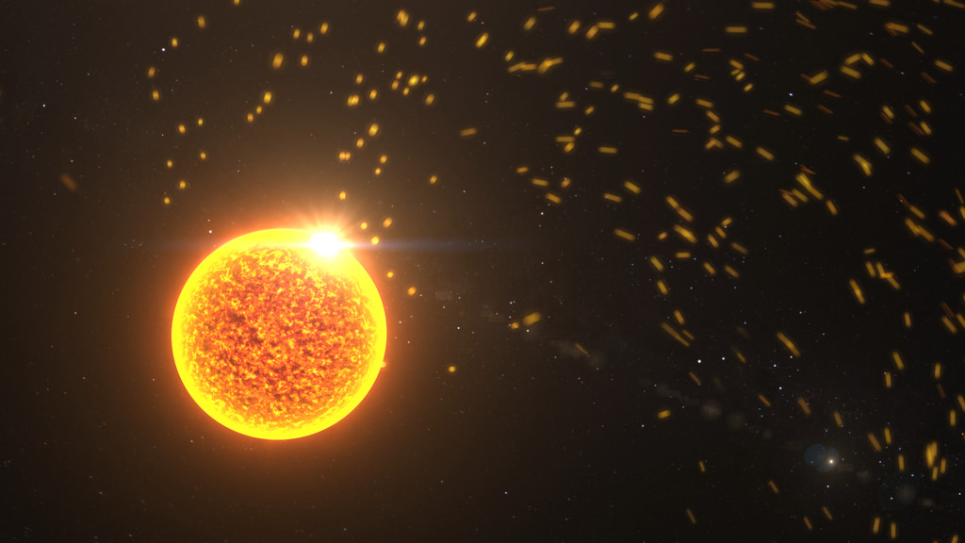
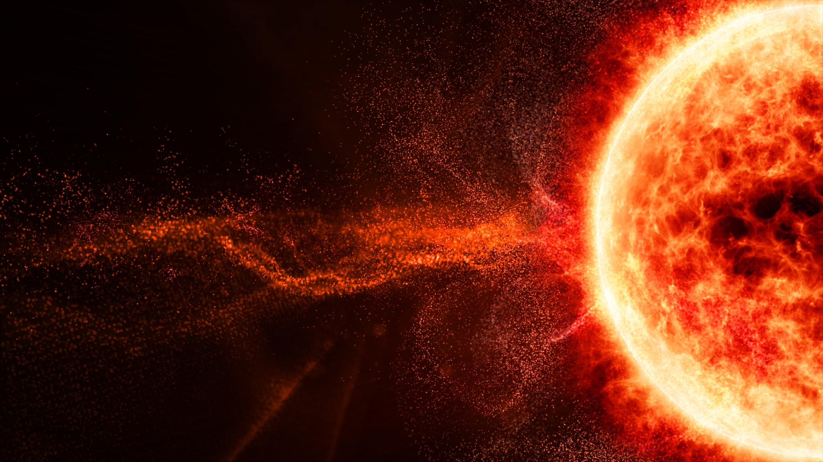
The Solar Activity
Associated Events:
Solar flares
Coronal mass ejections (CMEs)
Solar particle events
The solar wind
Sunspots
Images from NASA’s Solar Dynamics Observatory highlight
https://www.swpc.noaa.gov/products/solar-cycle-progression

Slide 26


