Slide 1
SμS SAC Meeting 2026
Thomas Prokscha
Hotel du Parc, Baden, 22/23 January 2026

Slide 2
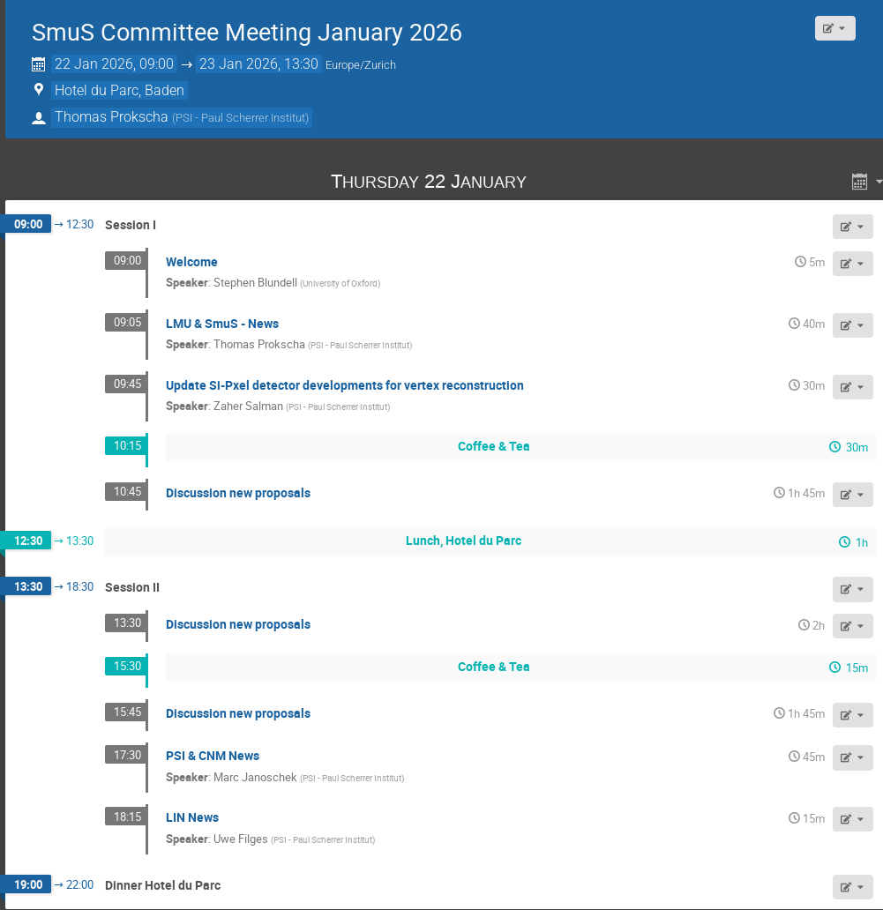
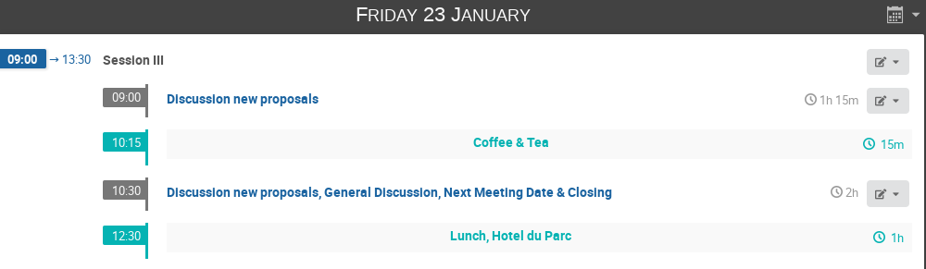
SμS SAC Update

Slide 3
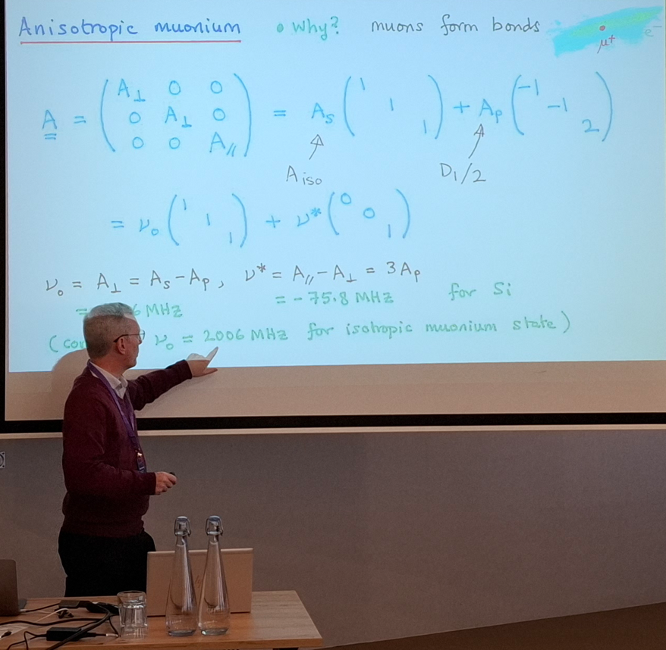
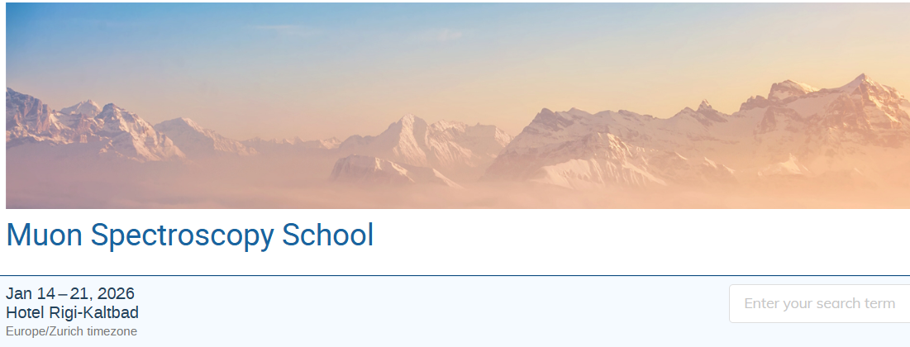
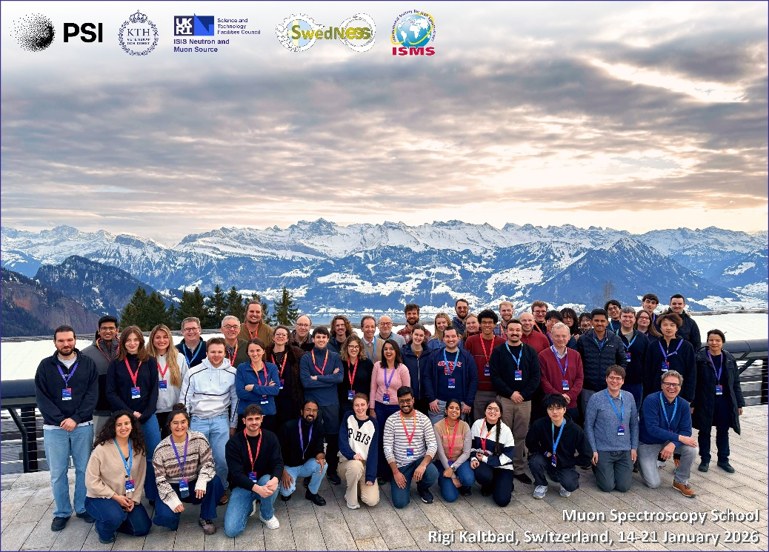
SμS SAC Update
Steven Blundell leaving SμS SAC after 17 years (8 years as chairperson)

Slide 4
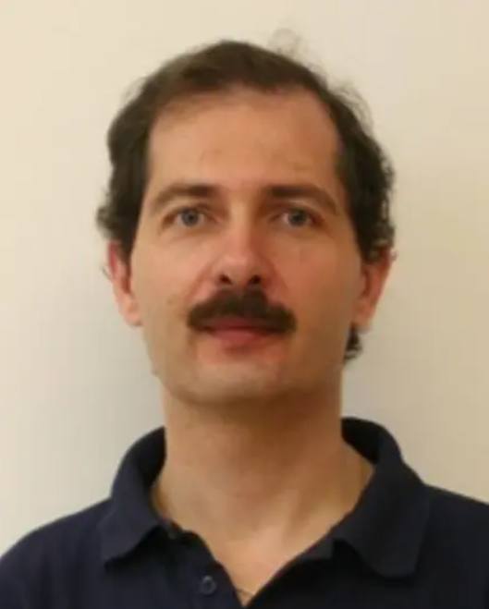
SμS SAC Update
Steven Blundell leaving SμS SAC after more than 15 years (7 years as chairperson)
Oliver Stockert will take over as chair of the committee

Slide 5
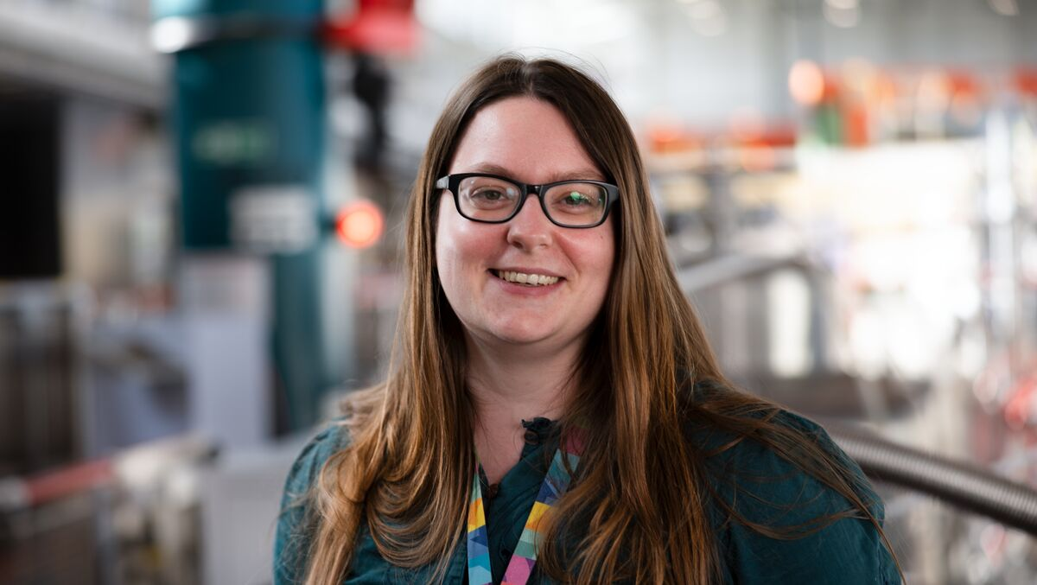
SμS SAC Update
Stephen Blundell leaves SμS SAC after more than 15 years in the SAC (7 years as chairperson)
Oliver Stockert will take over as chair of the committee
Rhea Stewart from the ISIS Muon Group will succeed Stephen in the SAC

Slide 6
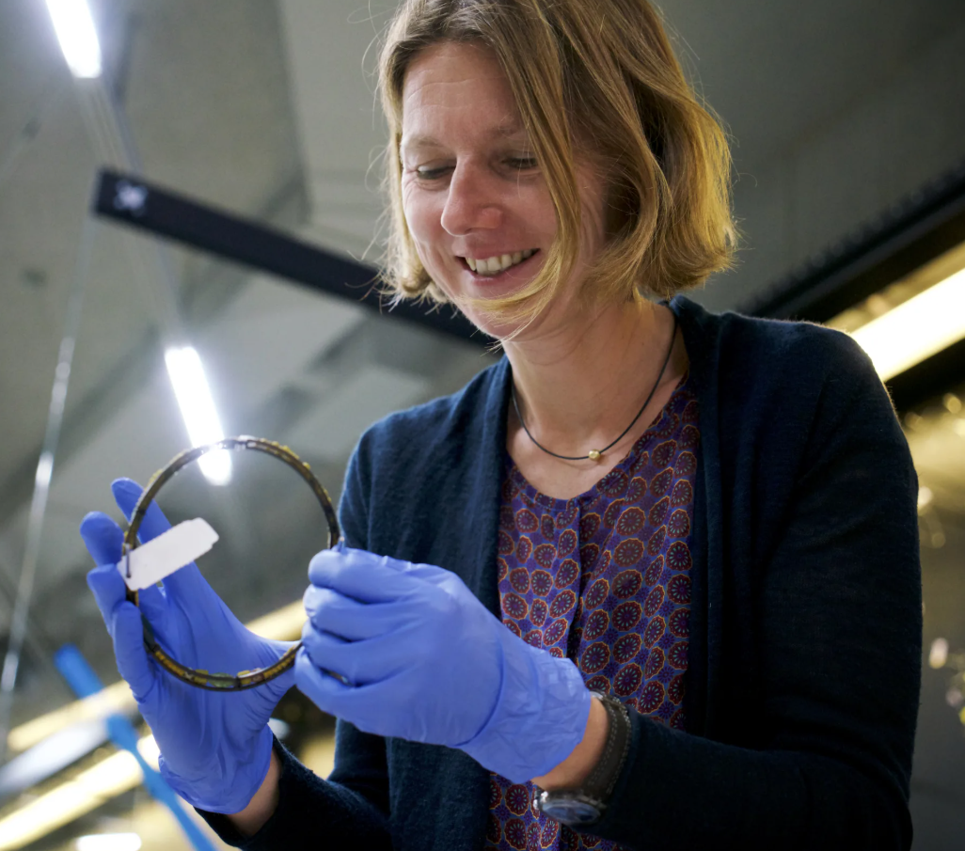
SμS SAC Update
Stephen Blundell leaves SμS SAC after more than 15 years in the SAC (7 years as chairperson)
Oliver Stockert will take over as chair of the committee
Rhea Stewart from the ISIS Muon Group will succeed Stephen in the SAC
Welcome Katharina Schmidt-Ott from the Swiss National Museum

Slide 7
SμS SAC Update
Stephen Blundell leaves SμS SAC after more than 15 years in the SAC (7 years as chairperson)
Oliver Stockert will take over as chair of the committee
Rhea Stewart from the ISIS Muon Group will succeed Stephen in the SAC
Welcome Katharina Schmidt-Ott from the Swiss National Museum
Order of discussion of proposals:
  Proposals of Katharina as reviewer
  Proposals of Martin as reviewer

Slide 8
SμS SAC Update, last year’s discussion and measures
Detector know-how in LMU: merge 2 PostDoc positions to 1 Tenure-Track (instrument scientist & detector developments) and 1 PhD student in 2026/2027.
Letter of Support for NCCR ‘Muoniverse’: done. Muoniverse entered the shortlist of 11 proposals (out of 78 submitted). 6 – 9 projects will be funded, notification “at the beginning of 2026”.
GIANT (MIXE) as a new SμS instrument: opened for the first time in this call.
New name for DOLLY: VMS (Versatile Muon Spectrometer)
Simplify remote access for users to SμS instrument PCs: done. Users need to apply for an ext-USERNAME account with multi-factor-authentication (MFA). Login to nx.psi.ch.
Catering situation at PSI: New “Food market” with vending machines from Selecta in Time-Out, starting on Jan 26. Payment by credit card, no app needed.
Improvements in review process? Put pressure on users to publish. To be done.

Slide 9
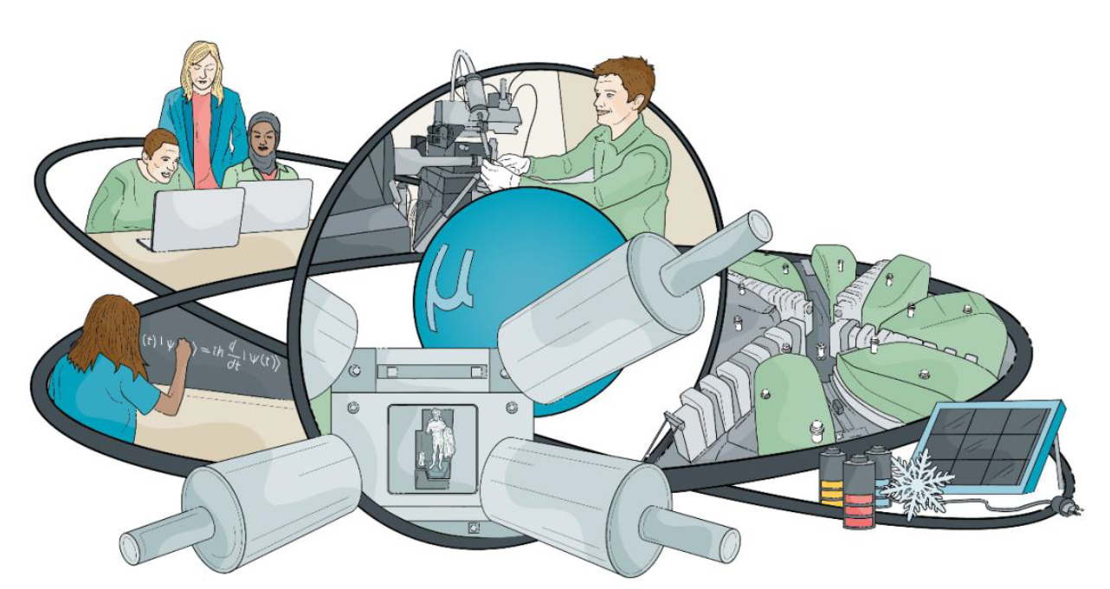
Muoniverse – A Swiss Muon Science Initiative
In the wake of the IMPACT/HIMB project (but not restricted to it) an initiative was launched in 2024 within Switzerland to foster muon science and collaborations – Muoniverse
Swiss partners from
  Universities
  Research institutes
  Museums
Fundamental science, technology and applications
  Particle physics
  Condensed matter physics
  Material science
  Electrochemistry and batteries
  Cultural heritage and archeology
Example
  PSI and University of Zürich are working on the appointment of a joint professorship on µSR
Courtesy of Hubertus Luetkens

Slide 10
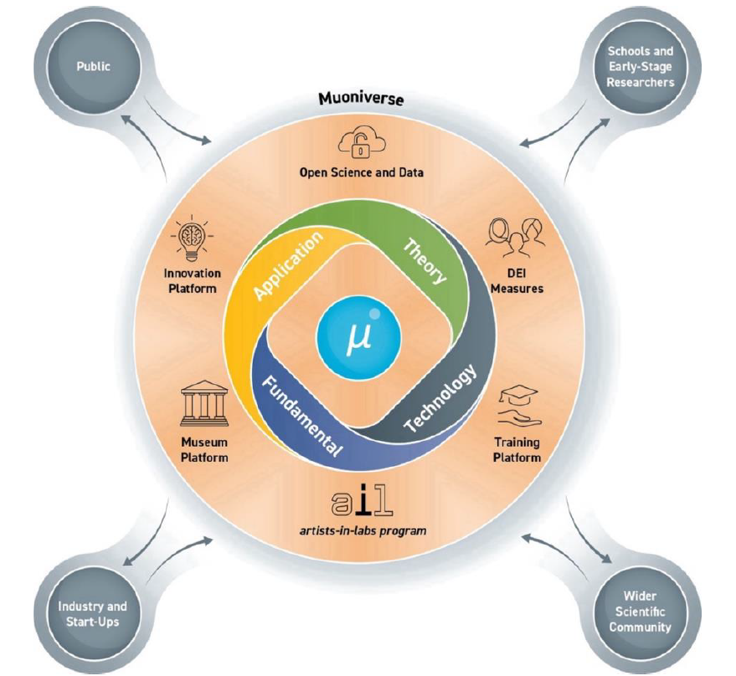
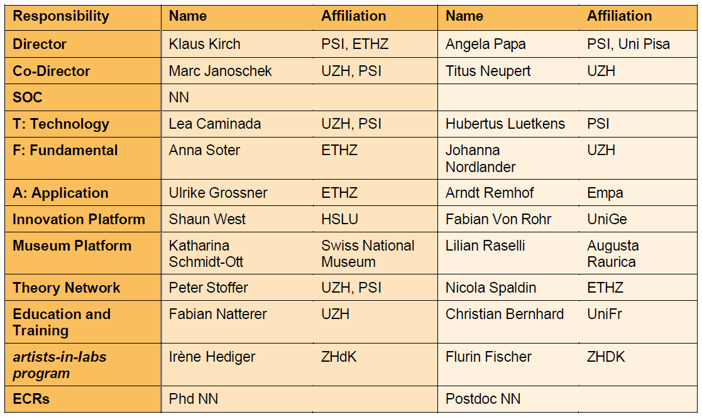
Muoniverse – A Swiss Muon Science Initiative
Possible initial board:

Slide 11
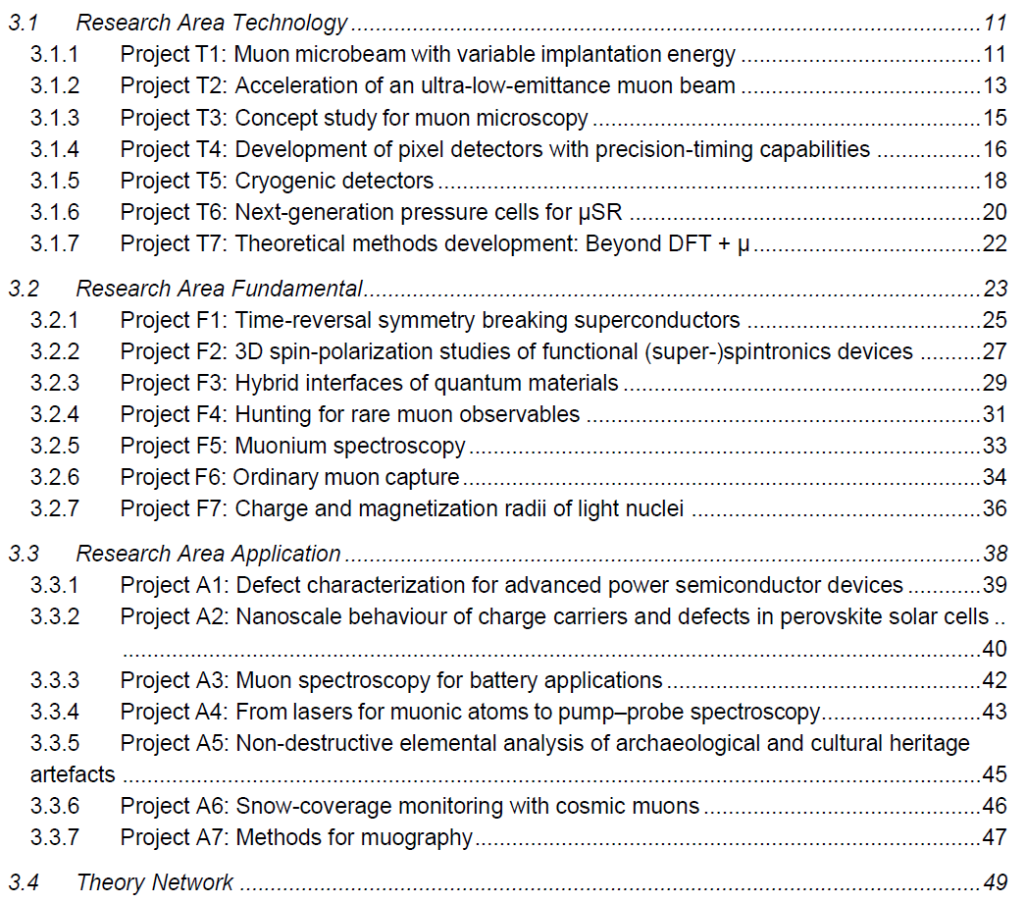
Muoniverse – A Swiss Muon Science Initiative

Slide 12
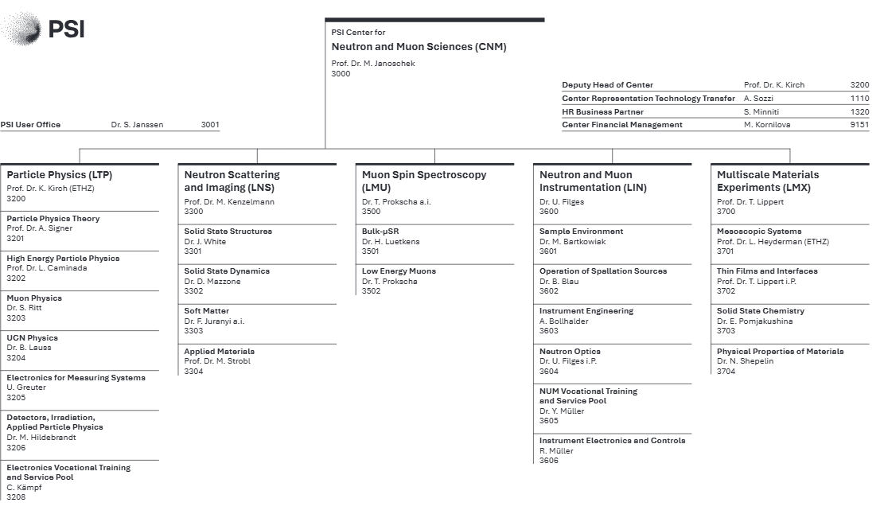
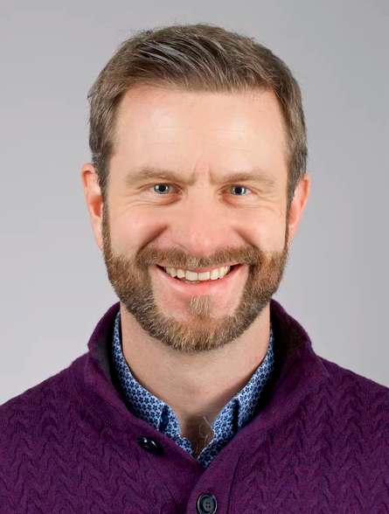
CNM Update
New Head of Center for Neutron and Muon Sciences since June 1, 2025: Marc Janoschek

Slide 13
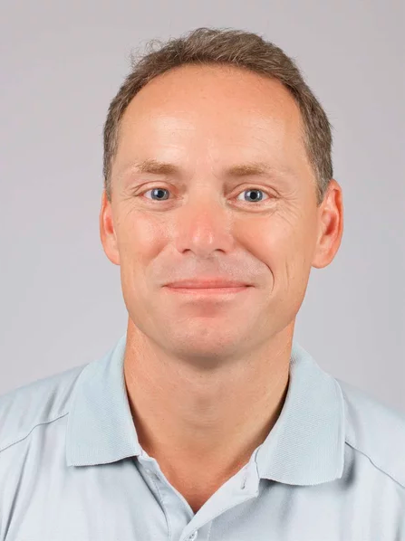
CNM Update
New Head of Lab. for Neutron and Muon Instrumentation (LIN) since Nov 1, 2025: Uwe Filges

Slide 14
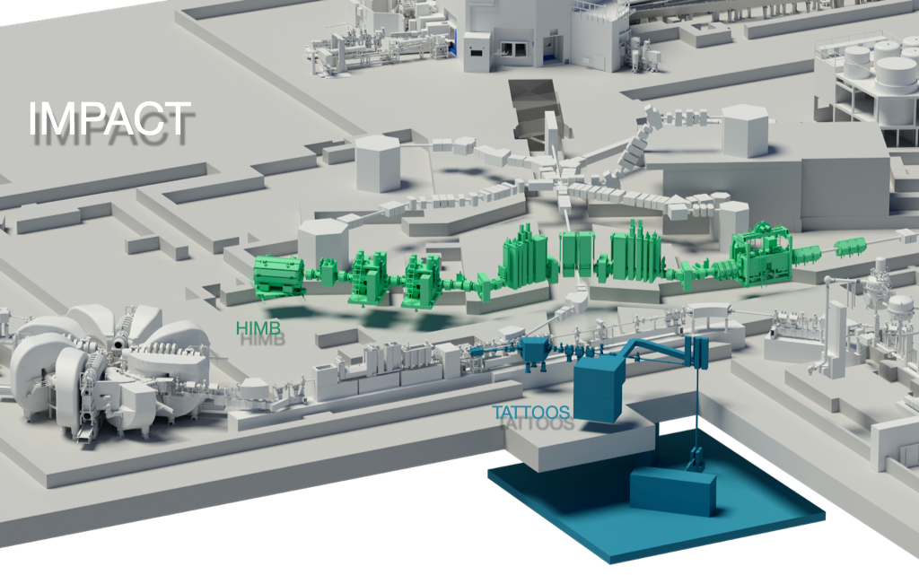
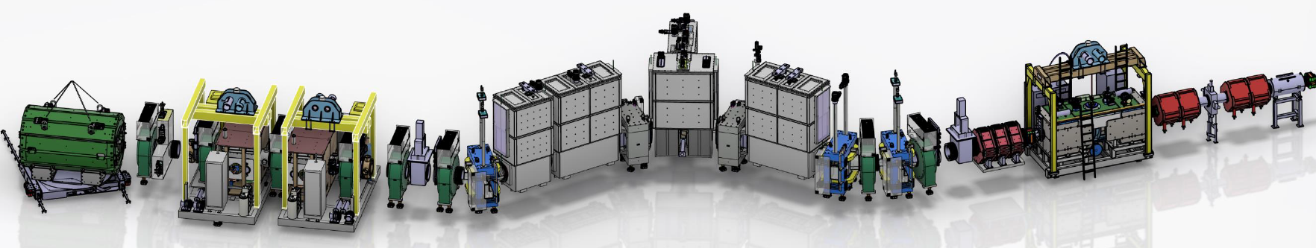
IMPACT – a Major Upgrade for HIPA
IMPACT: Isotope and Muon Production using Advanced Cyclotron and Target technologies
Major upgrade of HIPA within the Swiss Roadmap for Research Infrastructures 2025 – 2028
  12/2024 final approval by Swiss Parliament
  TATTOOS (Targeted Alpha Tumor Therapy and Other Oncological Solutions)
  HIMB (High-Intensity Muon Beams): Upgrade of target M and beam transport
    Particle physics beamline MuH2
    SµS material science beamline MuH3 (GPS and FLAME)
    → 10 – 100x high muon rate

Slide 15
IMPACT – a Major Upgrade for HIPA
  total costs of IMPACT : 78 MCHF
  18-month HIPA shutdown 2027 – 6/2028 → postponed in 12/2025 by one year due to delivery problems with vacuum chambers and radiation hard coils
  10 – 100 times higher muon rates for GPS and FLAME require:
    the development of a new muon/positron tracking spectrometer, vertex-reconstructed μSR (vx-μSR), based on monolithic Si-pixel detector technology: LMU, LTP, LIN, U Zurich, Mu3e collaboration (U Heidelberg, U Mainz) → see Zaher’s presentations
    funding by SNF project “MuSIP” (270 kCHF) and CNM project AMS (Advanced Muon Spectroscopy, 1.5 MCHF), 2025 – 2029

Slide 16
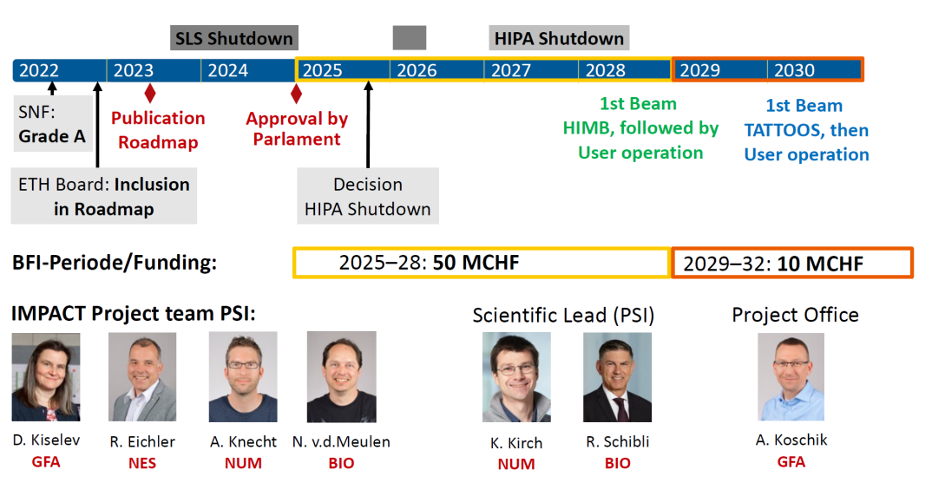
IMPACT – a Major Upgrade for HIPA
Postponed by 1 year
CAS
NES
CNM
CLS
CNM
CLS
CAS

Slide 17
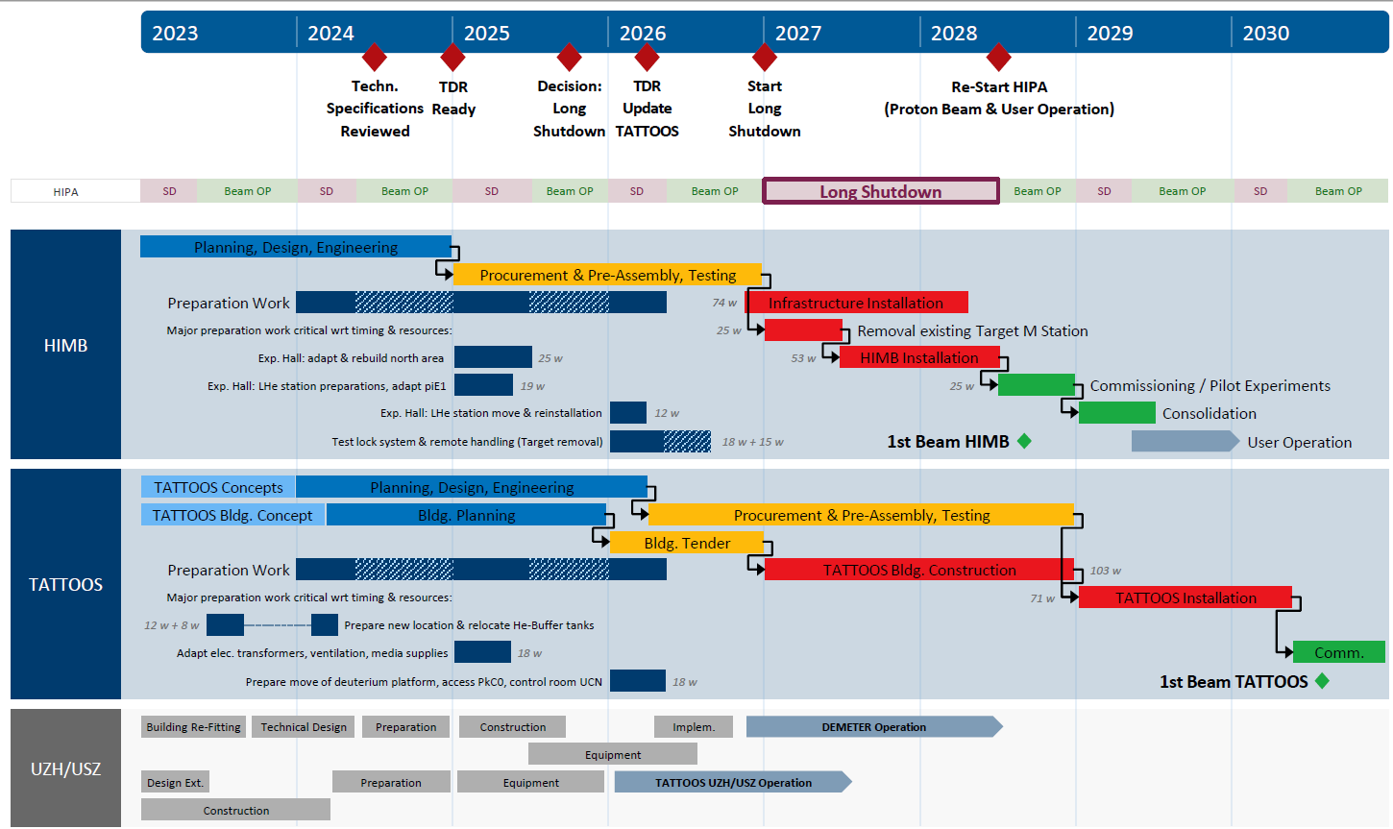
HIMB/TATTOOS Schedule
Postponed by 1 year

Slide 18
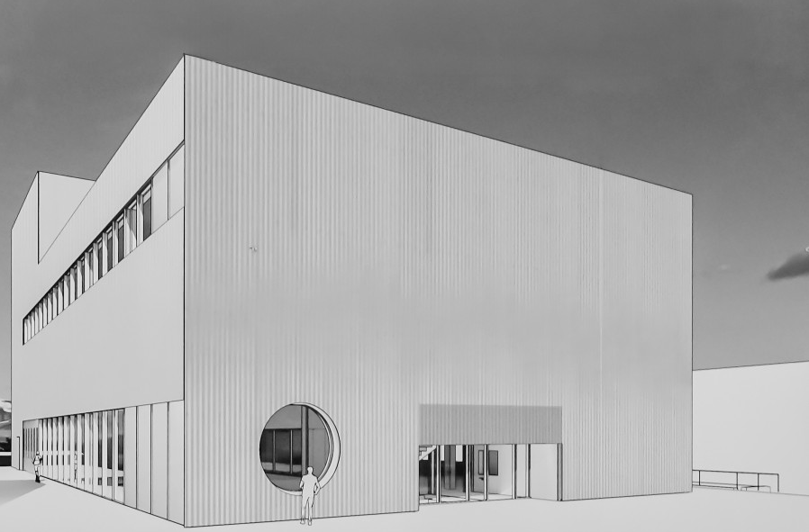
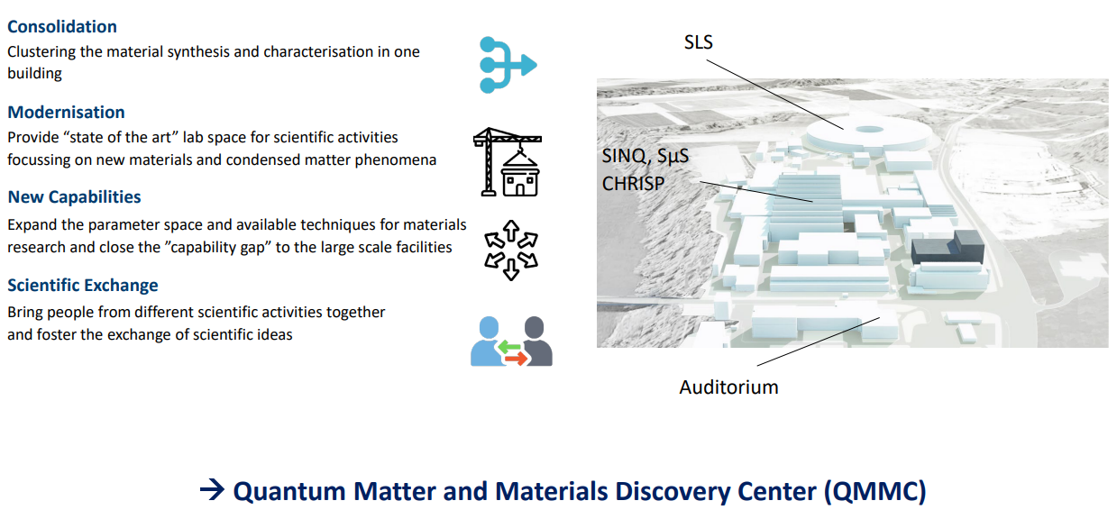
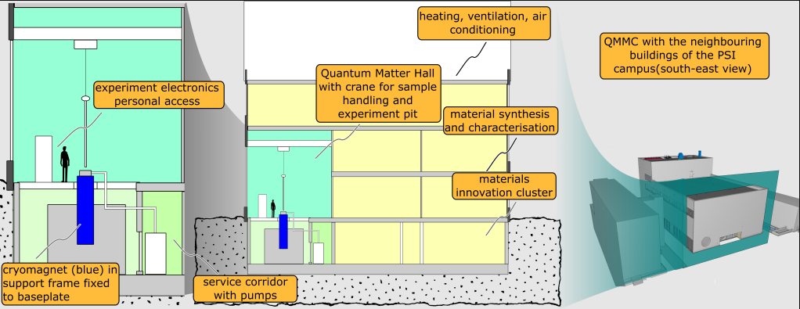
CNM QMMC Building

Slide 19
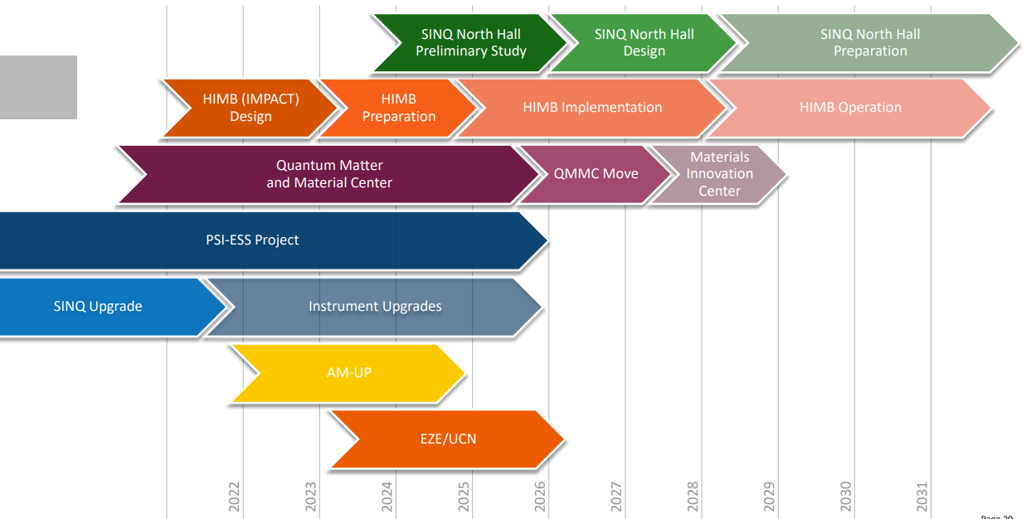
CNM Large Projects

Slide 20
Key developments for the benefit of SμS
IMPACT – a Major Upgrade for HIPA
  HIMB – High Intensity Muon Beam, 10 – 100x higher muon rates at GPS and FLAME
Vertex Reconstructed μSR (vx-μSR) / Channeling using Si Pixel Detectors
  SNF project MuSiP – Project leader: Zaher Salman, 1 PhD, Pascal Isenring
  CNM project Advanced Muon Spectroscopy (AMS) – Project leader: Zaher Salman
    1 PhD (04/2026), 1 PostDoc (05/2026), software support
    Hardware (Si-pixel chips, timing detectors, cryostats, redesign of GPS and beamline optics)
  PSI Research Grant (DIR, CNM, LMU, LTP): μSPEC - muon Sites from Positron Emission Channeling Project leader: Jonas Krieger, 1 PhD
NCCR Muoniverse Application to SNF
  Related to HIMB and vx-μSR, but not exclusively!
  Up to 3x 4 years (= 12y) funding periode
    30 positions (20 for research projects) (PhD and PostDoc) in each periode, distributed into different groups
    In-kind contributions from PSI, UniZ and all other participating partners
    Increased user base / synergies with particle physics/ collaborations with Swiss and international community

Slide 21
SμS Instrument Request, Overbooking 1/2026
Call 1/2026: May 22 – September 30 (111 d): FLAME, GIANT/MIXE, GPD, GPS, HAL, LEM, VMS (call 1/2025 data)
Instrument | Proposals | Days requested | Days available | Overbook. | Allocated
VMS(Dolly) | 20(13) | 82(78) | 38 | 2.6(2.1) | 0
FLAME | 19(28) | 66(87) | 32 | 3.0(3.3) | 0
GIANT/MIXE | 18(0) | 37(0) | 14 | 2.6(0.0) | 0
GPD | 13(0) | 125(0) | 68 | 2.3(0.0) | 8
GPS | 48(34) | 159(96) | 57 | 3.5(3.6) | 0
HAL | 10(14) | 70(89) | 66 | 1.2(1.7) | 0
LEM | 29(23) | 152(138) | 78 | 2.3(2.3) | 4
LMU-Dev./Si-Pixel | 1(1) | 25(10) | 17 | 1.5(1.0) | 0
Total | 158(113) | 716(498) | 370(274) |  | 12
Backlog from 2024
For calculation of overbooking:
Weekend-days after HIPA service and backlog days are subtracted from available days
Available days = 70% of beam days
30% of beam days for setup, tests, compensation of lost user time, urgent beam time requests

Slide 22
Key numbers SμS since 2019
 | 2019 | 2020 | 2021 | 2022 | 2023 | 2024 | 2025
Instruments | 5 | 5 | 5 | 5 | 6 | 6 | 6
Experiment-Days | 609 | 536 | 871 | 783 | 746 | 734 | 734
Experiments | 222 | 187 | 286 | 290 | 226 | 240 | 261
User Visits | 197 | 44 | 130 | 227 | 234 | 206 | 229
Individual Users | 156 | 30 | 84 | 158 | 158 | 149 | 170
New Proposals (calls 1&2) | 178 | 199 | 299 | 260 | 295 | 255 | 209
2019 – 2020: 1 cycle, 6 months, 5 instruments
2021 – 2022: 2 cycles, 8 months, 5 instruments
2023 – 2025: 2 cycles, 7 months, 6 instruments
2026: 2 cycles, 7 months, 7 instruments (with GIANT/MIXE for the 1st time)
2027: 2 cycles, IMPACT/HIMB postponed by 1 year, SμS committee meeting in January 2027
2028: 0 cycles, IMPACT/HIMB, 20 months long shutdown
2029: 1 cycle, 4 months, 7? instruments

Slide 23
SμS proposal submission history
2013 – 2017: 2 cycles, 8 months, 6 instruments
2018 – 2020: 1 cylce, 6 months, 5 instruments
2021 – 2022: 2 cycles, 8 months, 5 instruments
2023 – 2025: 2 cycles, 7 months, 6 instruments

Slide 24
SμS proposal submission history
2019 – 2020: 1 cycle, 6 months, 5 instruments
2021 – 2022: 2 cycles, 8 months, 5 instruments
2023 – 2025: 2 cycles, 7 months, 6 instruments

Slide 25
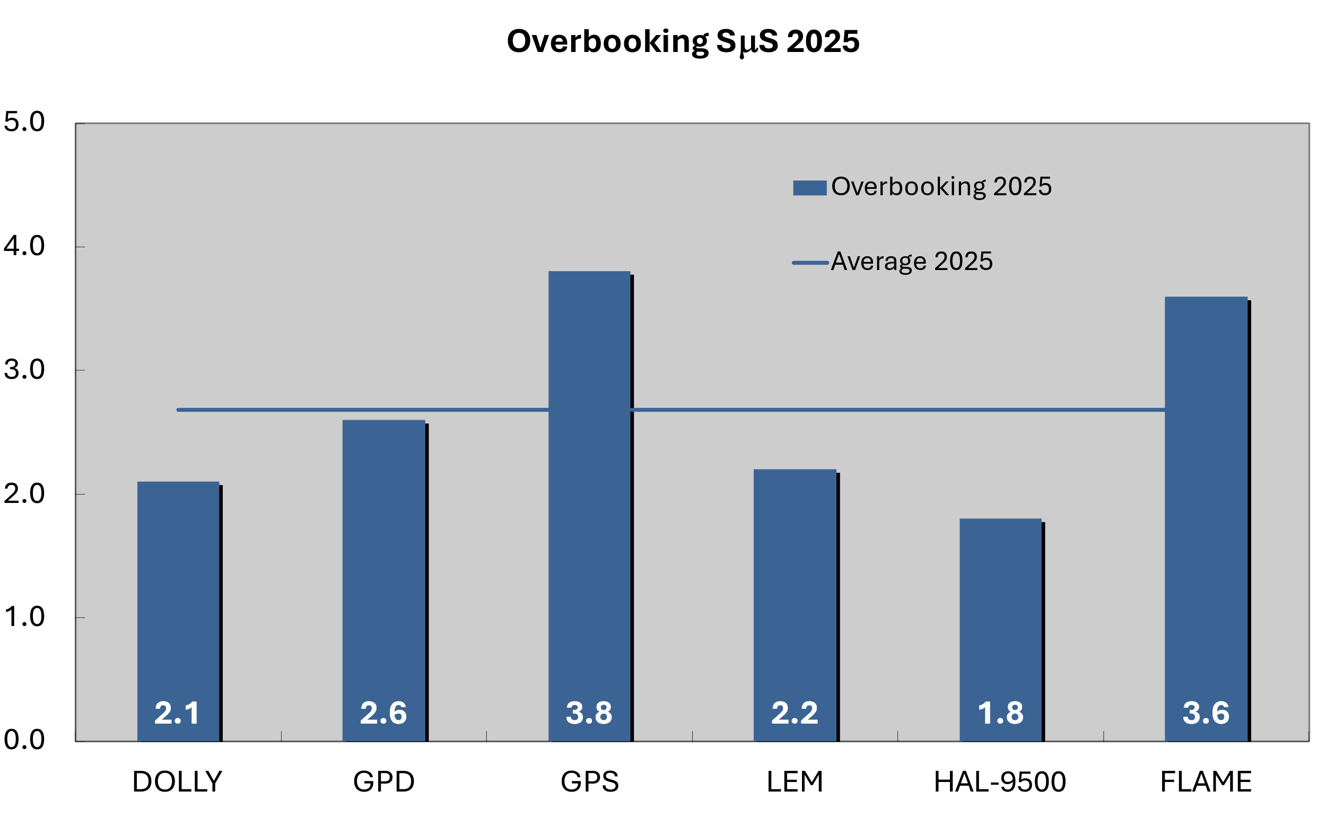
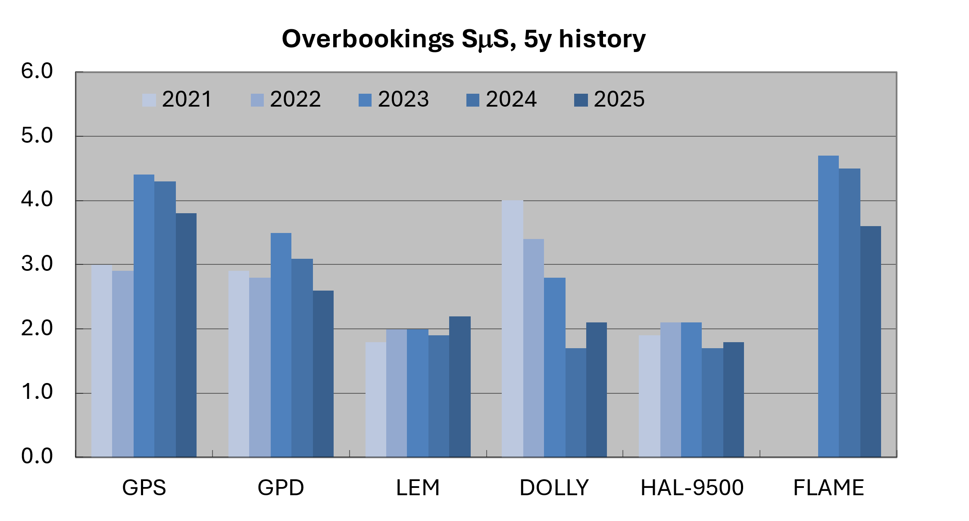
SμS instrument overbooking history

Slide 26
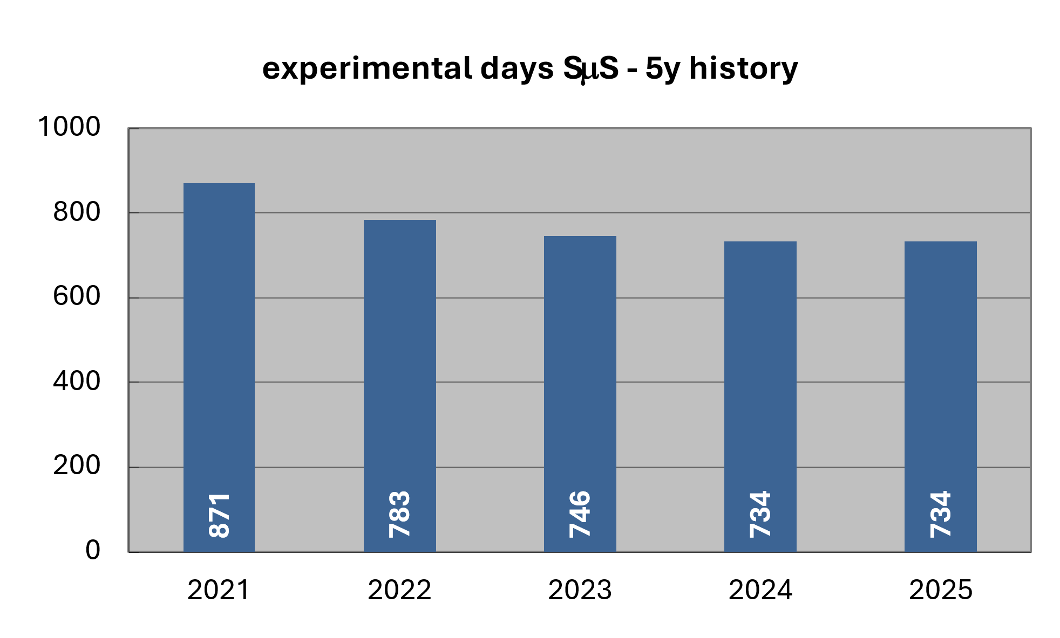
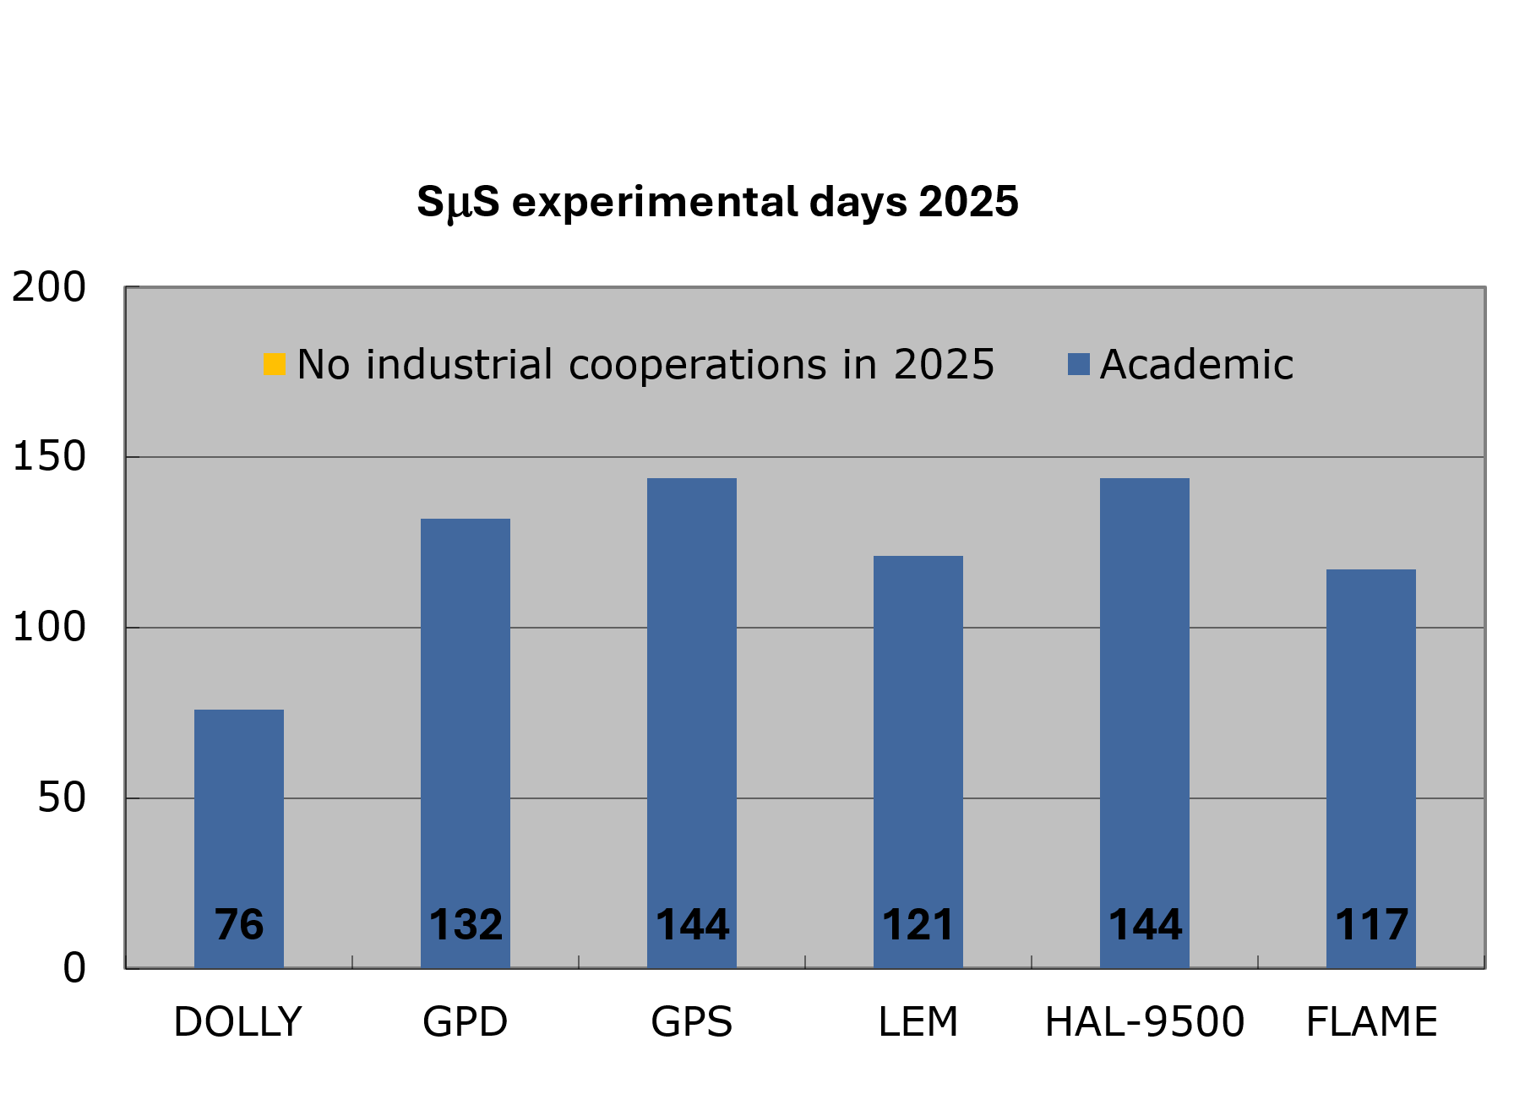
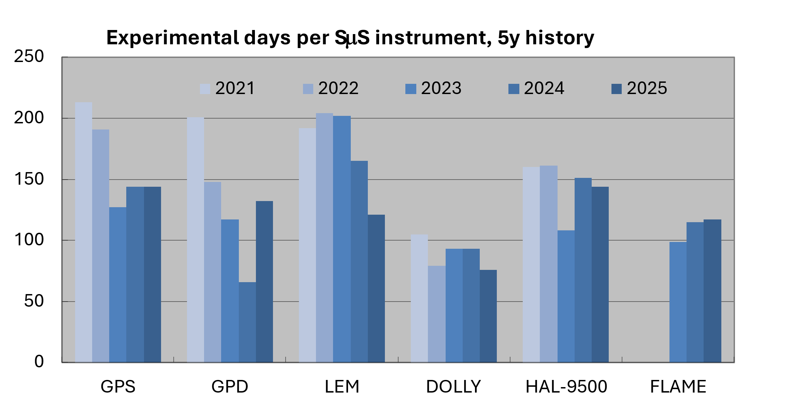
SμS experimental days history

Slide 27
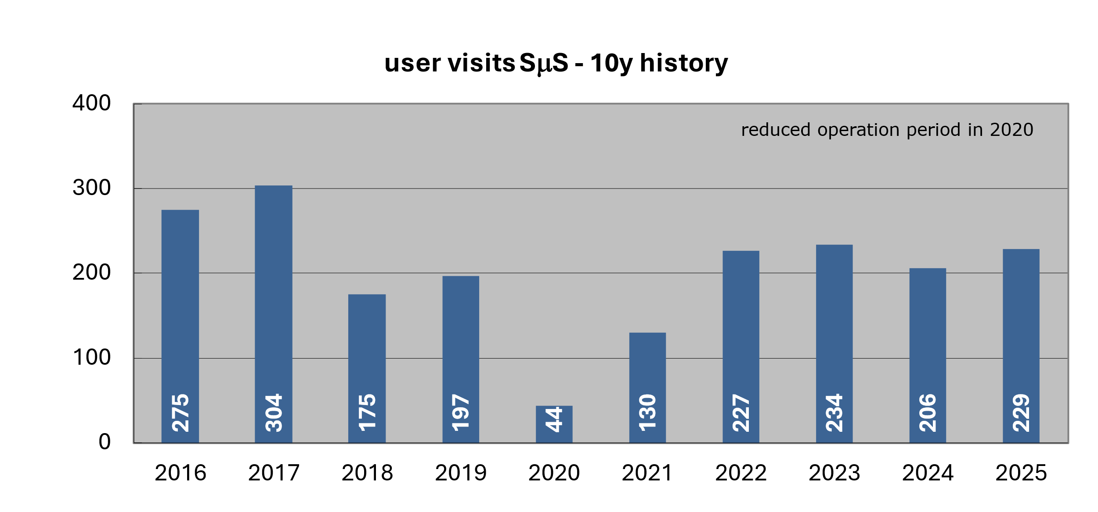
SμS user visits history

Slide 28

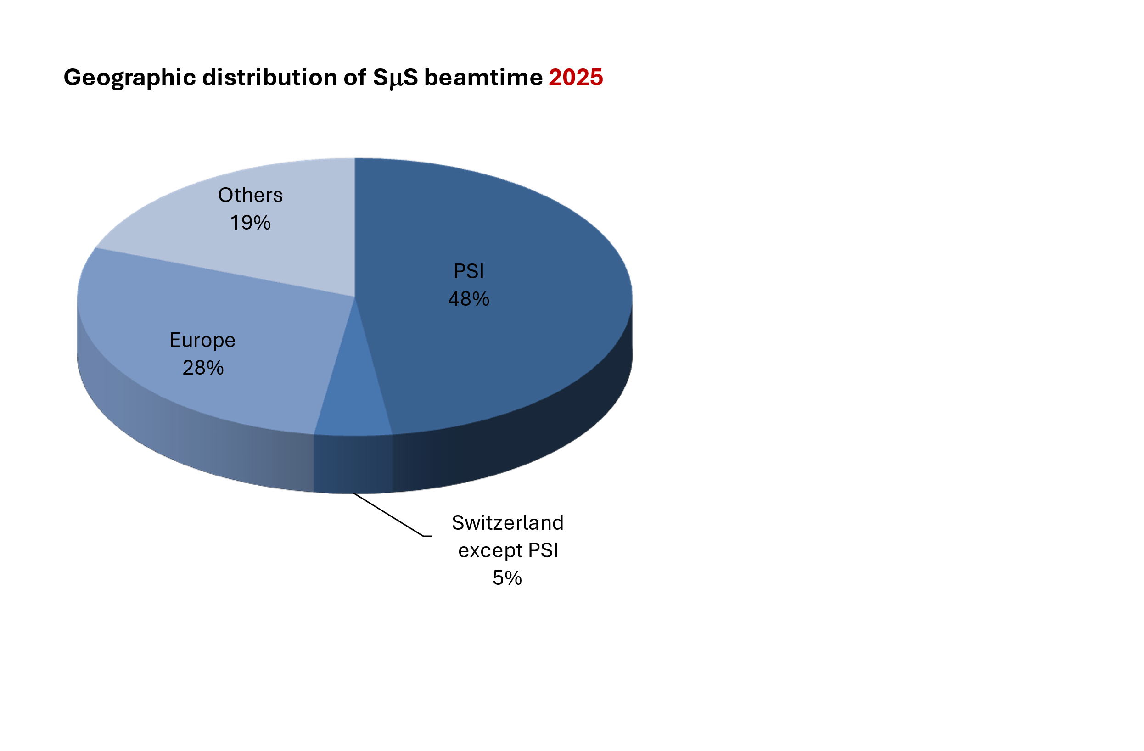
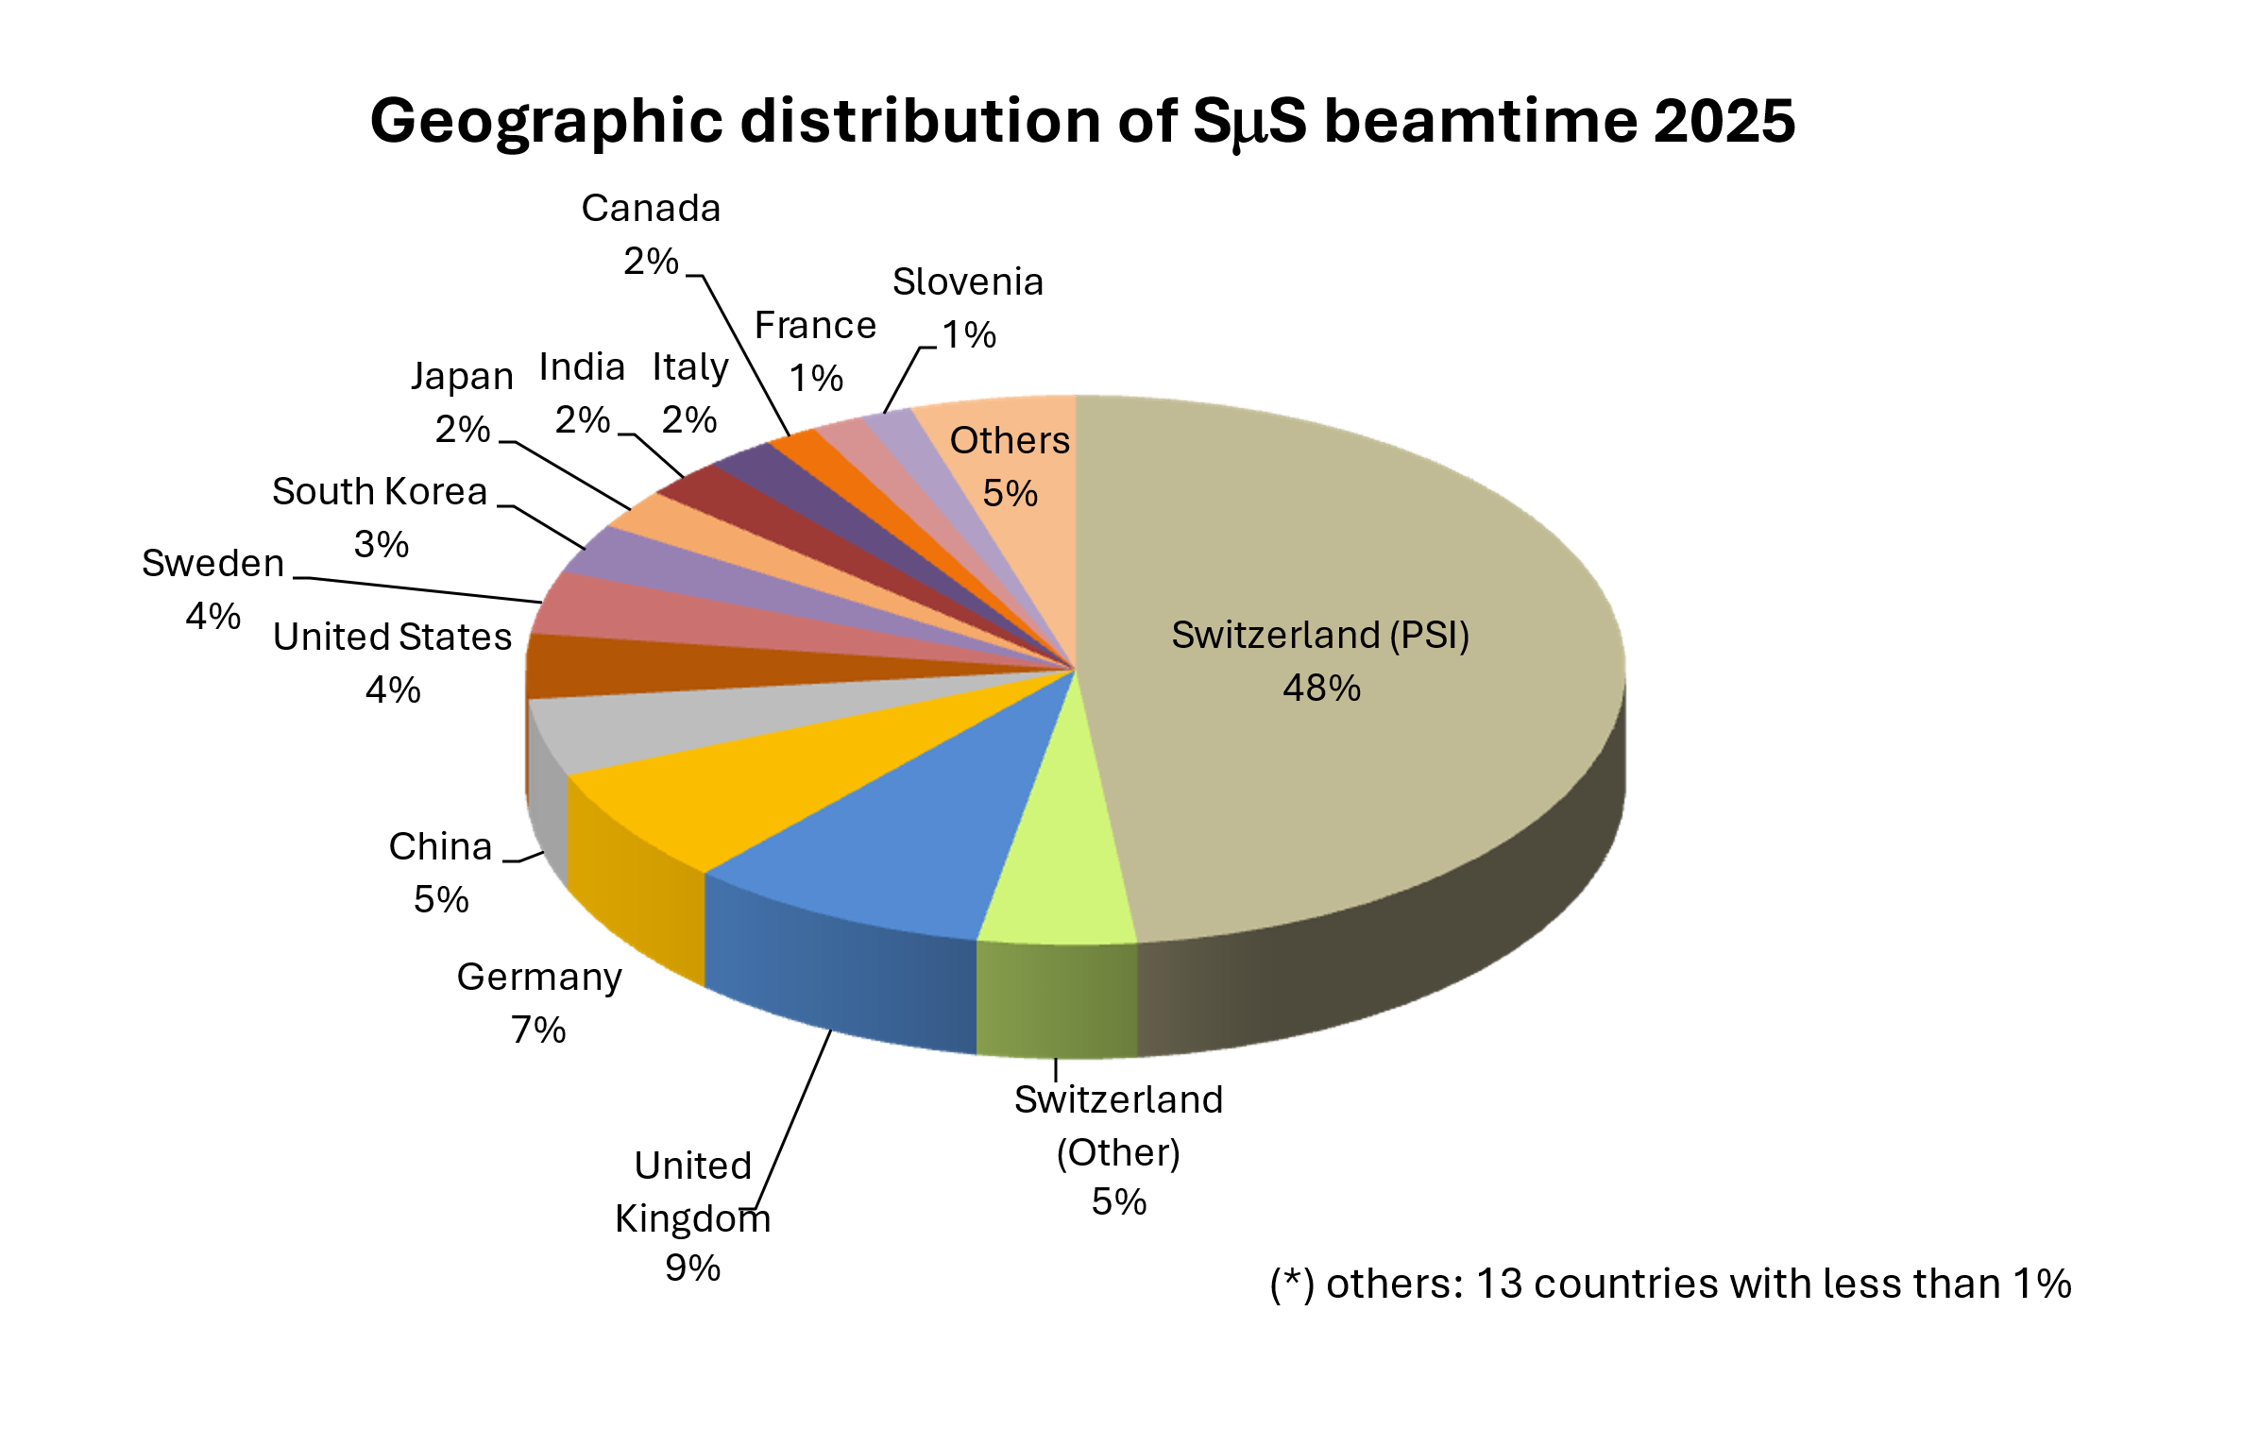
Use of beamtime 2025 SµS

Slide 29
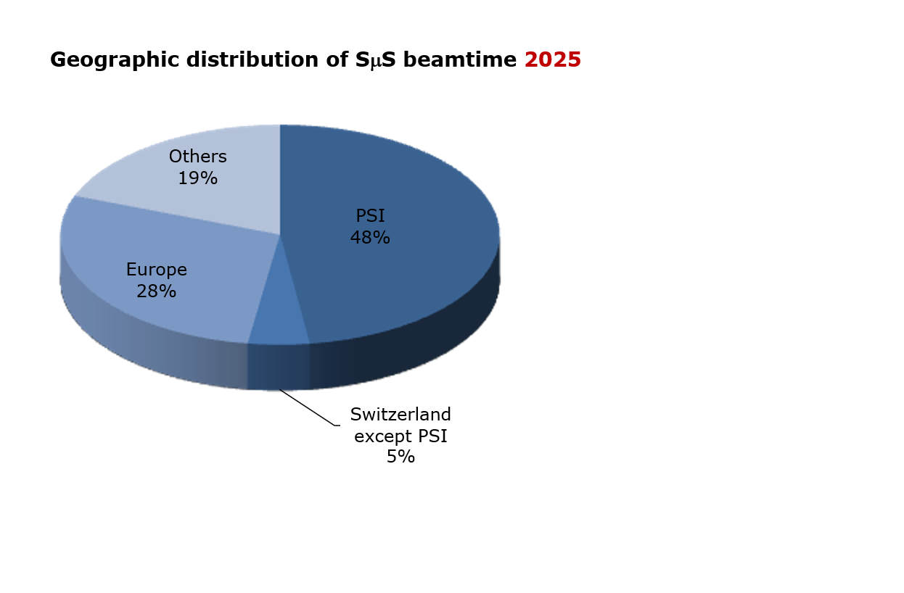
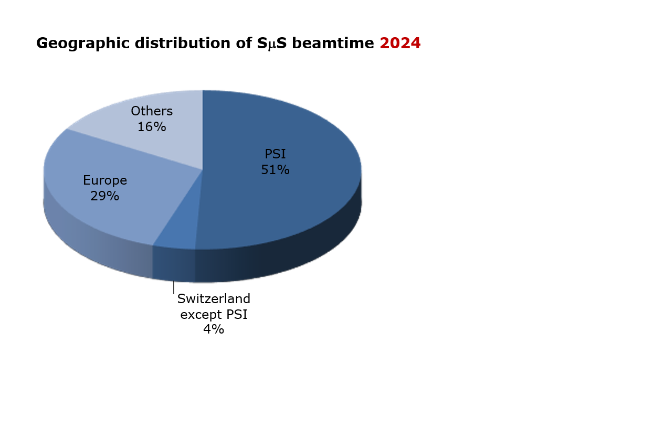
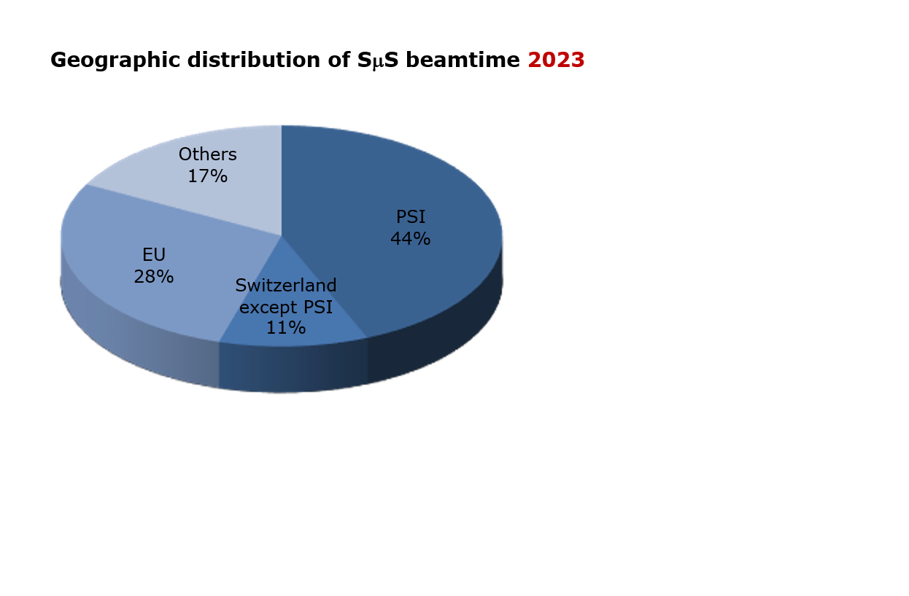
Use of beamtime
2025 / 2024 /2023

Slide 30
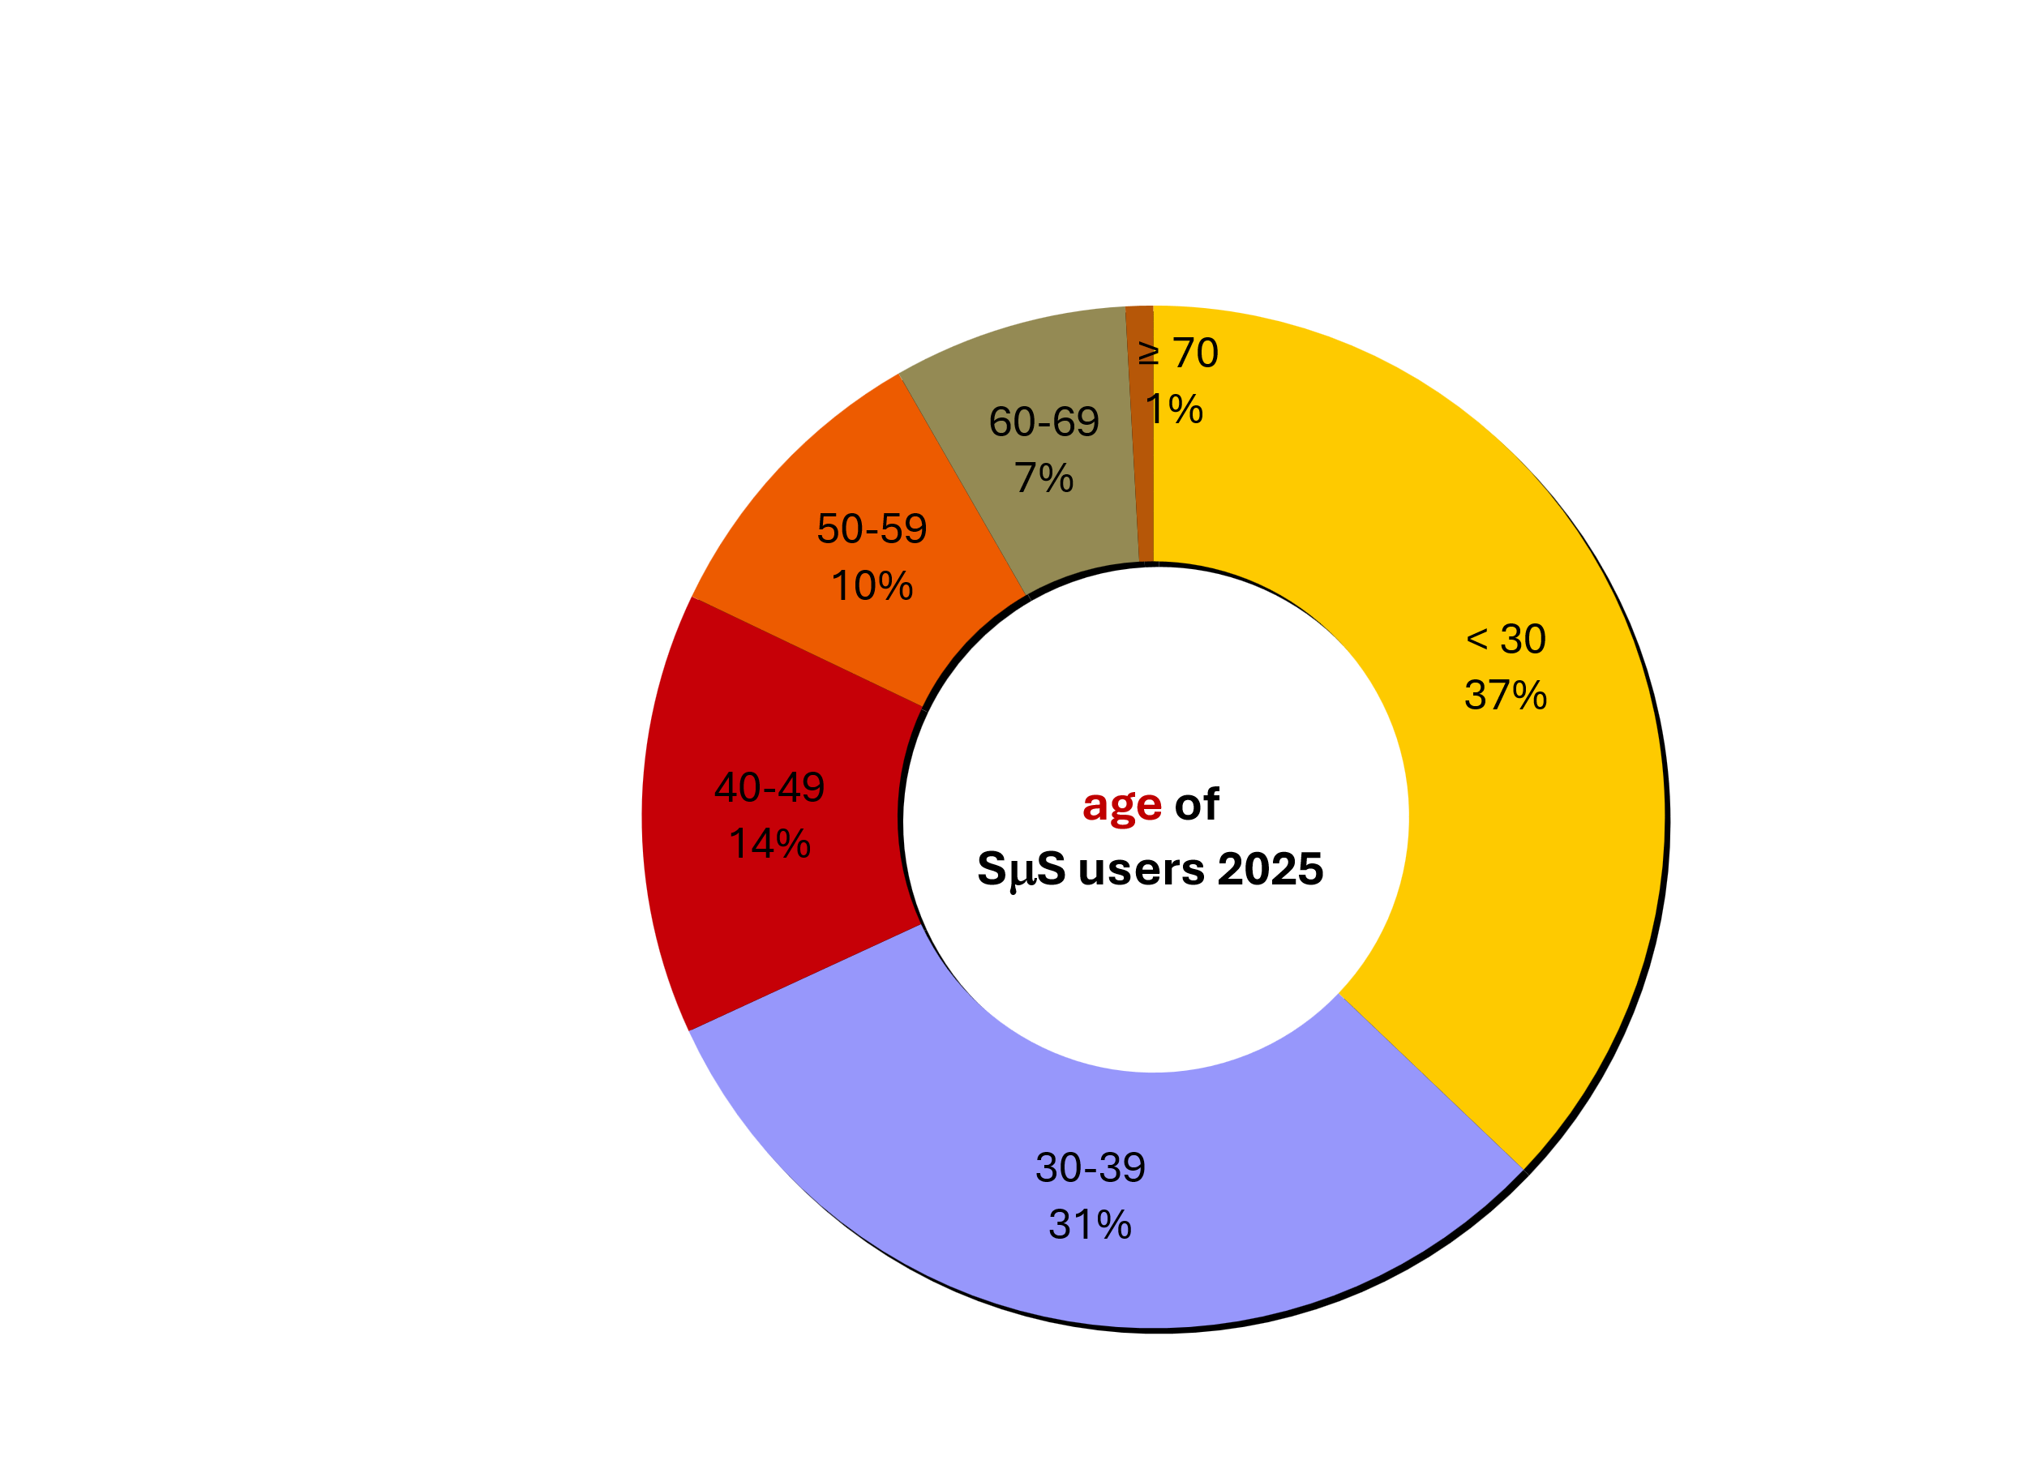
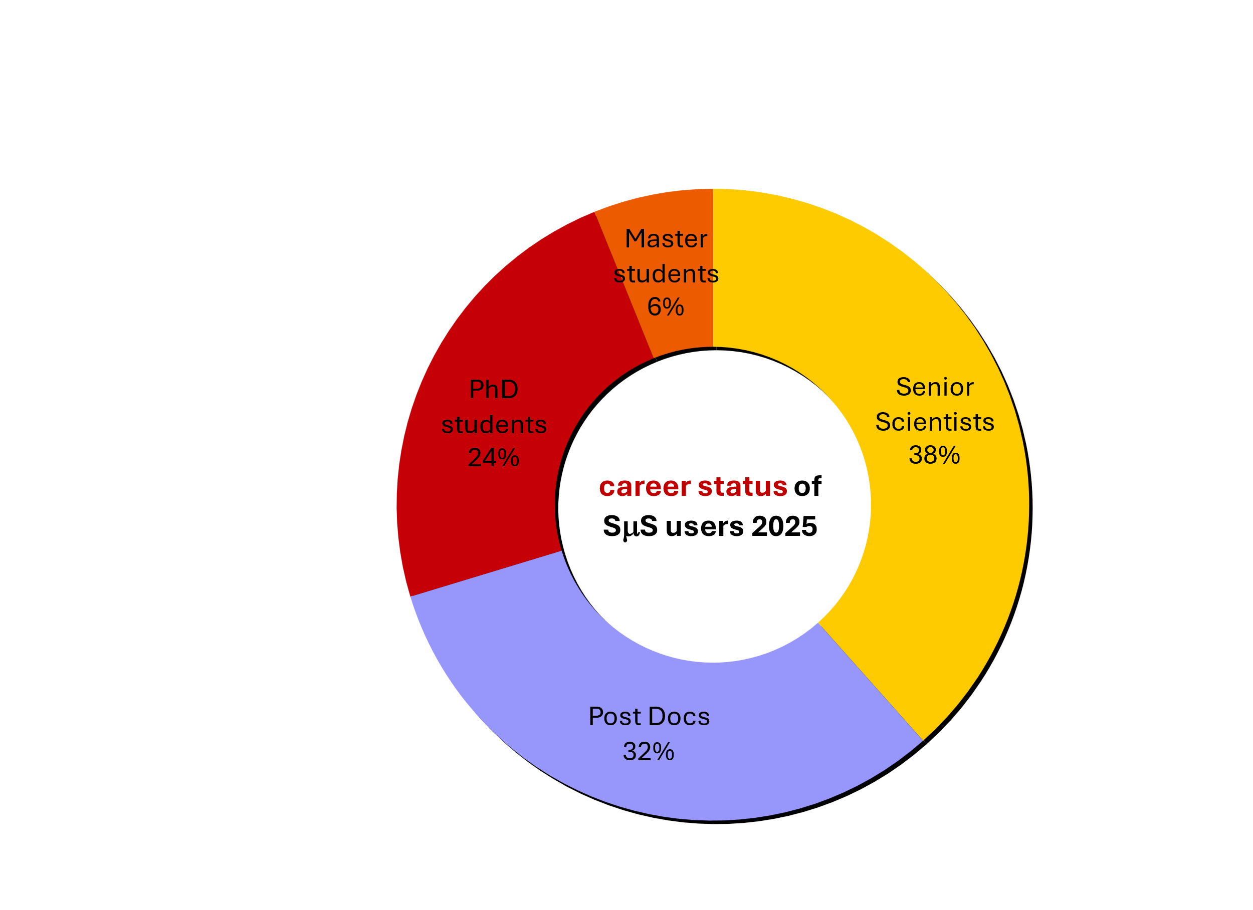

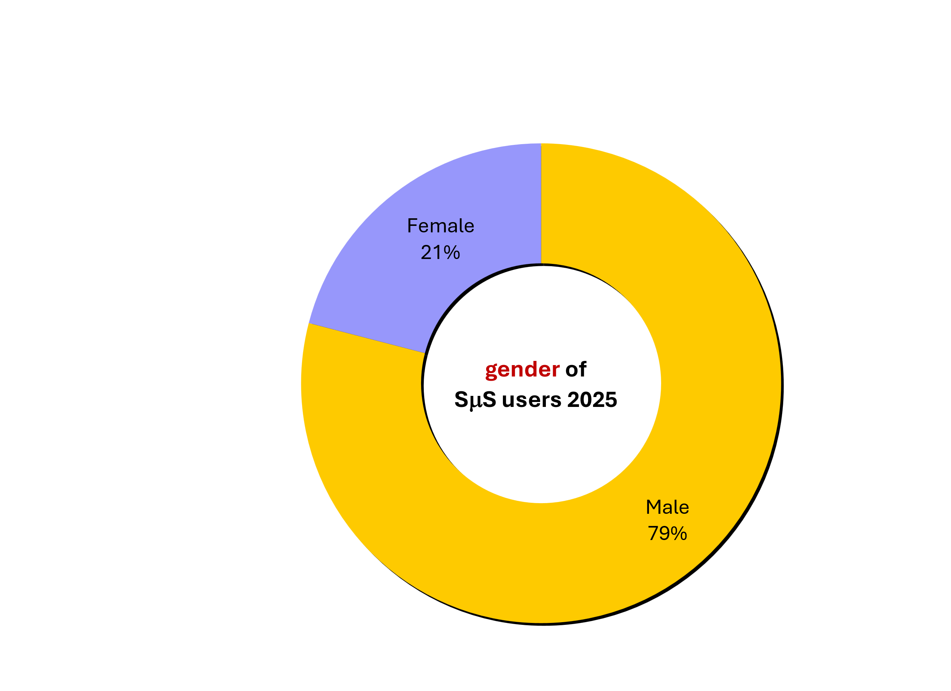
User community SµS 2025

Slide 31

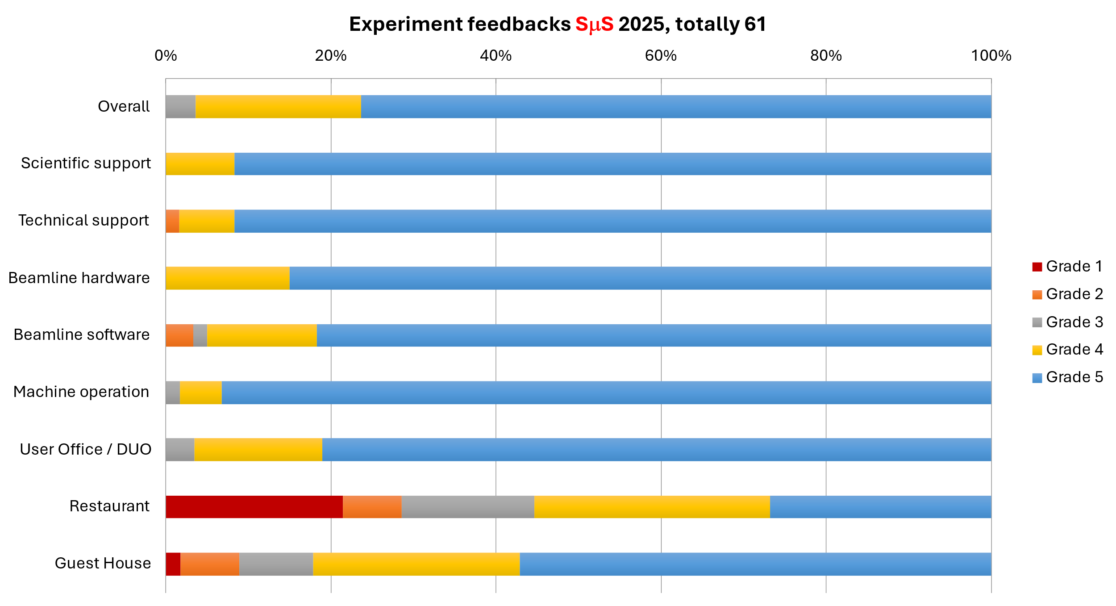
user satisfaction 2025 – feedback results
Overall average: 4.73 / 5.00
2024: 4.54

Slide 32
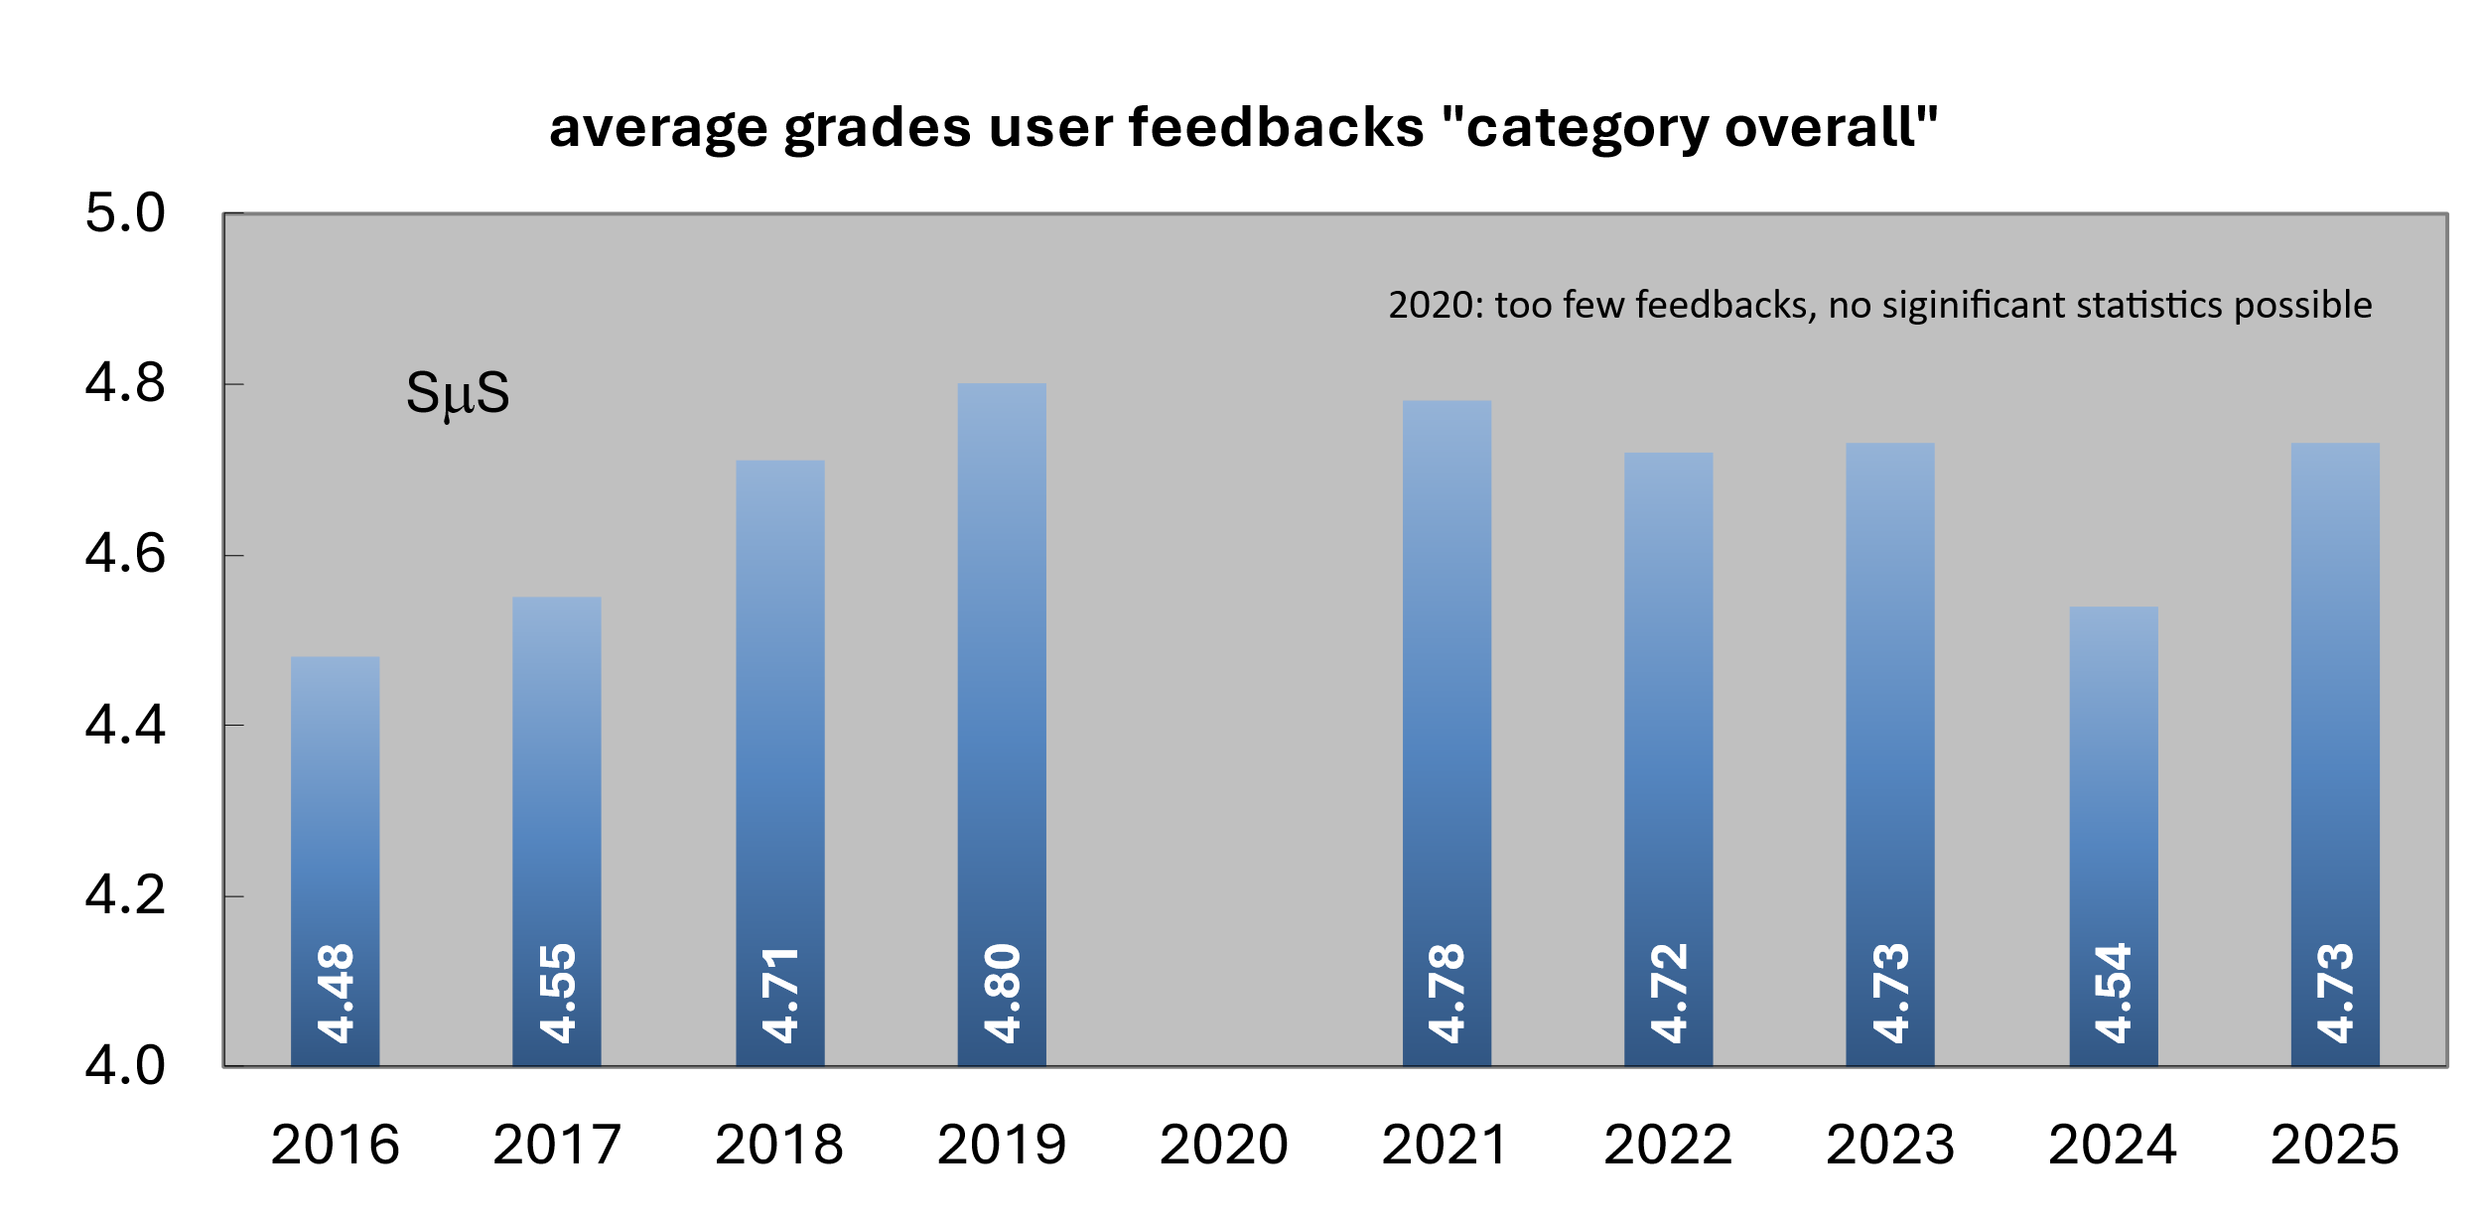
feedback results – development
2020: number of feedbacks too low for calculating a reasonable average
2024/25: main criticism – lack of catering options

Slide 33
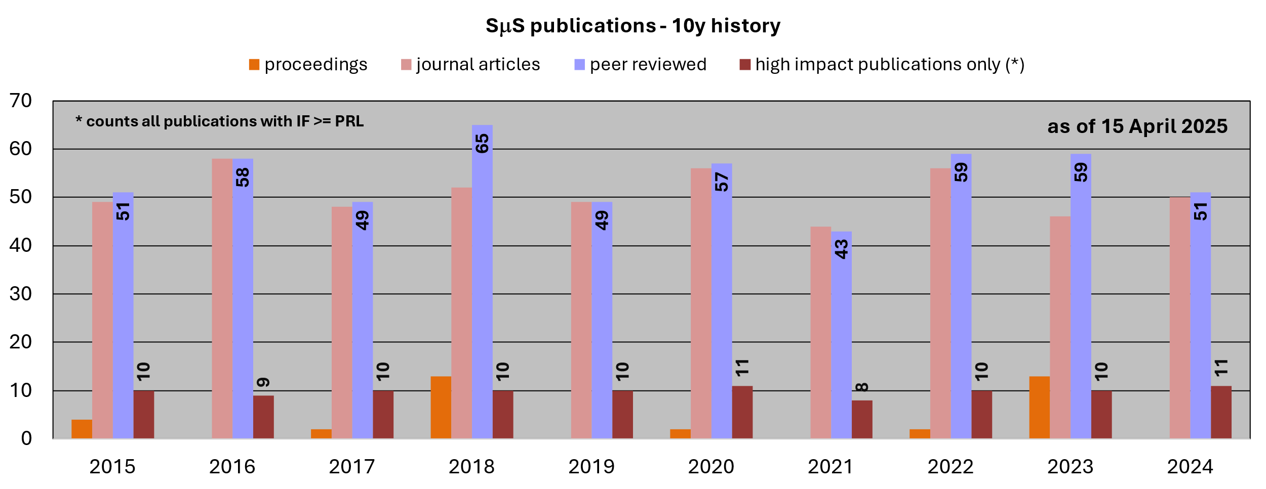
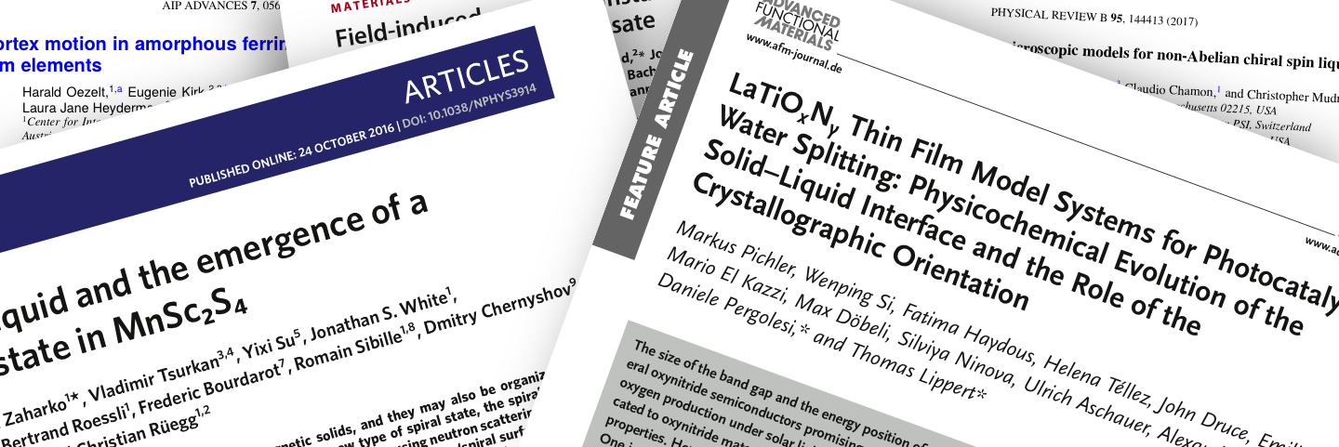
Publications SμS –10y history
Update will follow

Slide 34
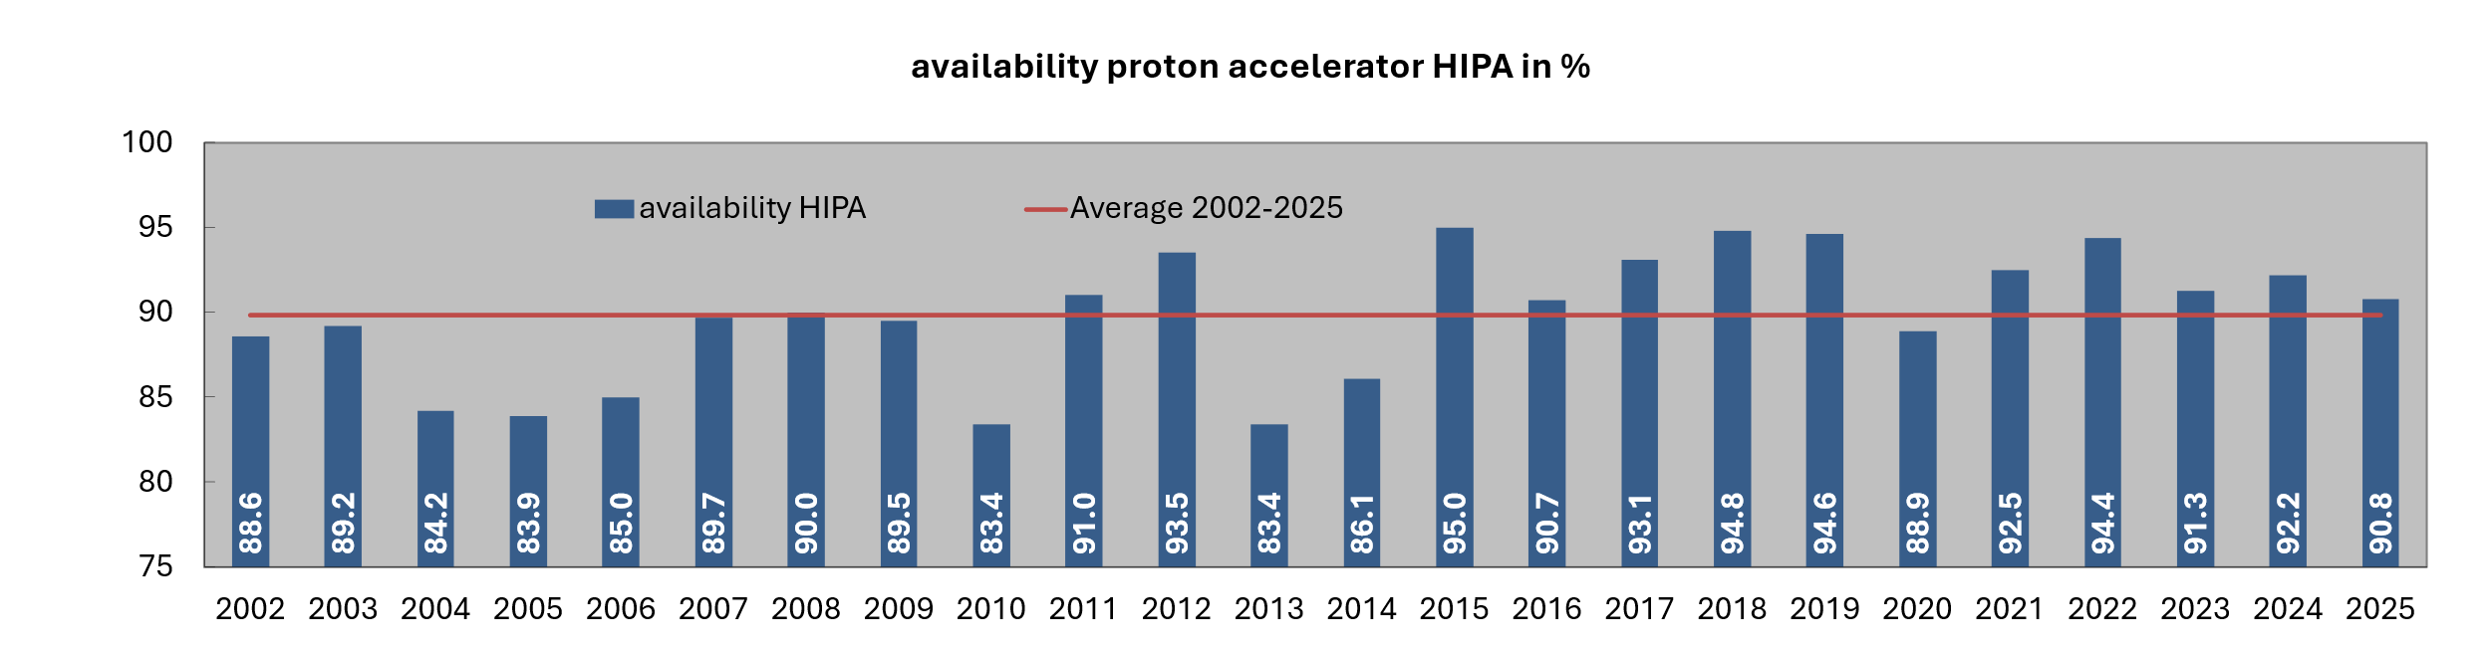
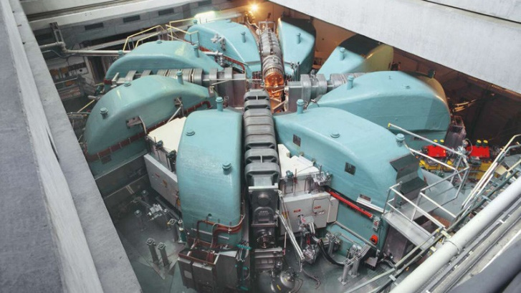
Availability HIPA
2025: 90.8%

Slide 35
HIPA operation 2021 – 2029
2021: 2.0 mA, slanted 4-cm target E uses “Japanese“ bearings (J-PARC); no target failures anymore, user operation Apr 12 – Dec 23 (215 d)
2022: 1.8 mA, May 2 – Dec 18 (194 d)
2023: 2.0 mA, May 25 – Dec 22 (180 d)
2024: 2.0 mA, after Injector 2 upgrade (1 out of 2 new resonators in operation), Jun 3 – Dec 23 (172 d)
2025: 2.2 mA, (2nd new resonator in operation), Jun 2 – Dec 23 (174 d)
2026: 2.2 mA+, tests up to 2.4 mA, May 22 – Dec 23 (183 d)
2027: 2.2 mA+, end of May – Dec 23 (~180 d), earlier shutdown of μE4 and πM3 in Nov 2027 due to HIMB upgrade
2028 – mid of 2029: long shutdown for HIMB upgrade, postponed in Dec 2025 by one year due to delivery problems with vacuum chambers and radiation hard coils

Slide 36
Future of HIPA
Approval of IMPACT/HIMB (60 MCHF) in Dec 2024 by CH Parliament
RF systems of HIPA are 30 – 45 years old and need to replaced
Investment needed to renew RF system to run HIPA at 2.4 mA: 24 MCHF (3.0 mA as future option)
PSI Management promised to provide 24 MCHF, distributed over 8 years
In 2024, establishment of SHAPE: Strategic HIPA Advisory & Planning Executive
  Discussion of long-term strategy, shaping the future direction of HIPA
  Incorporation of user facility requirements (CNM members: heads of CNM, LIN, LMU, LNS, LTP)
  Define time scale, milestones, resources
In 2026: project start of refurbishment program

Slide 37
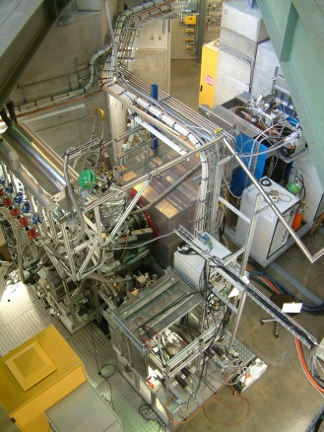
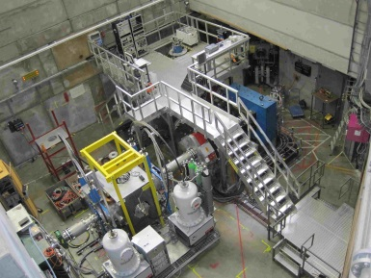
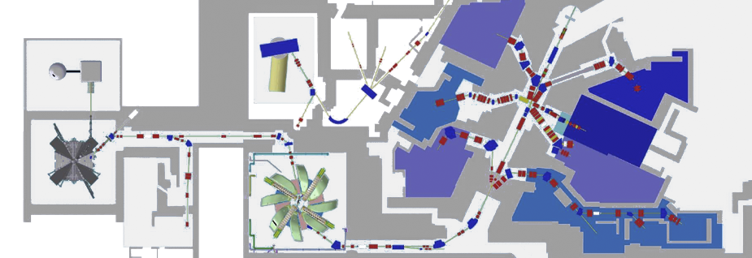
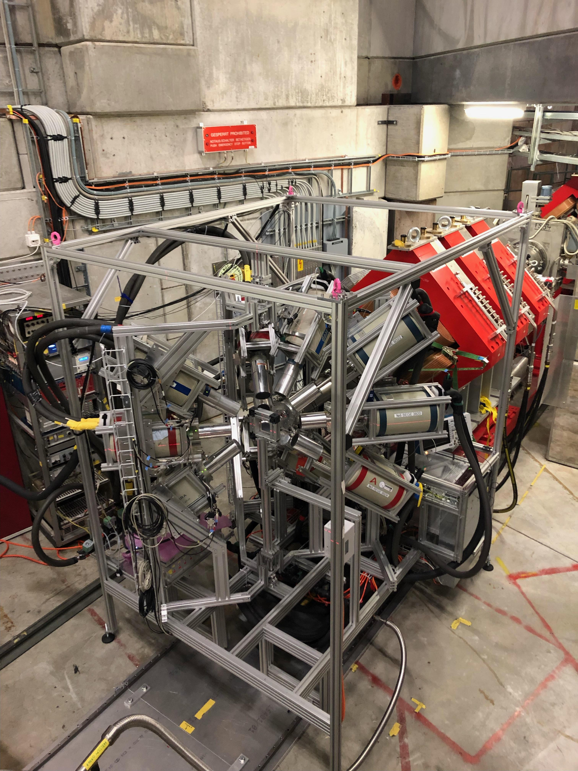
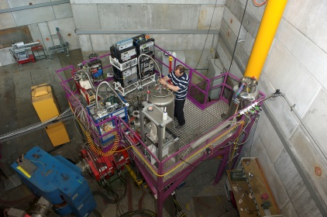
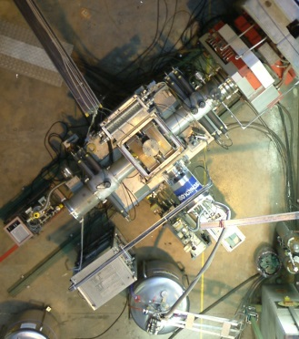
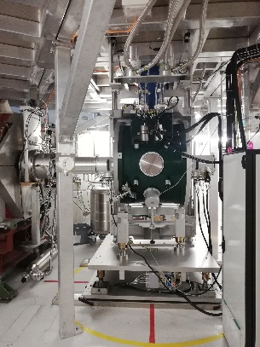

Instruments at the SμS (Swiss Muon Source)
LEM
Thin films, devices
VMS
Uniaxial pressure, 1 GPa
0.3 T
2.5 - 600 K
Low Energy Muon Facility
Muon Energy: 4 MeV (μ⁺)
πE1 beam line shared with LTP, in operation 50% of the year
Muon Energy: 1-30 keV (μ⁺)
0.8 T
0.25 - 300 K
1 GPa uniaxial
GPD
Hydrostatic pressure,
3 GPa
Goal:
Enable new research directions by the extension of
experimental capabilities at the SμS user facility
General Purpose Decay Channel
Instrument (for Pressure Studies)
GIANT
Muon Energy: 5-60 MeV (μ⁺/ μ‒)
0.6 T
0.3 - 500 K
3 GPa
MIXE, 1 – 15 MeV (μ-)
elemental analysis
3 weeks per year
HAL-9500
9.5 T, 10 mK
High Field and Low Temperature
Muon Energy: 4 MeV (μ⁺)
GPS
FLAME
General Purpose Surface
Muon Instrument
Veto at mK
multi-sample
MORE
Very fast
MORE
FLexible Advanced
MuSR Environment
Muon Energy:
4 MeV (μ⁺)
Shared Surface Muon Beam
Muon on Request (MORE)
Muon Energy: 4 MeV (μ⁺)
9.5 T
0.01 – 300 K
Δt ~ 60 ps
0.8 T
1.6 - 1000 K
3.5 T
0.02 - 310 K

Slide 38
SμS News 2026
DOLLY became VMS (Versatile Muon Spectrometer)
New detector system (similar to FLAME) based on SiPM installed in shutdown 2025
Renewal of cabling, new pre-amplifier and power supplies

Slide 39



Upgrade of Dolly to SiPM Technology for 2025 Beamtime
Detector geometry optimized by Geant4 simulations
Plastic scintillators with SiPM readout
Time resolution: 160 ps
Passive (Pb) and active scintillating collimators
Active F / B vetos: small samples / low background
  Minimal sample size: 2x2 mm² (better 4x4 mm²)
  Minimal sample mass: >12 mg (better 50 mg)
Temperature range: 250mK – 300 K
  Heliox ³He insert (T = 250 mK – 80 K)
  Variox ⁴He cryostat (T = 1.5 – 300 K
Field range: 0 – 0.8 T
  Main field up to 0.8 T
  ZF, <20mG with active zero field compensation
Sample rotation
In-situ piezoelectric uniaxial pressure device (1 GPa)
Project: In-situ cold press 500kg
Backward Veto
SiPM
beam
Courtesy of M. Lamotte and T. Shiroka

Slide 40

SμS News 2026
DOLLY became VMS (Versatile Muon Spectrometer)
New detector system (similar to FLAME) based on SiPM installed in shutdown 2025
Renewal of cabling, new pre-amplifier and power supplies
Slides by Toni Shiroka and Maxime Lamotte

Slide 41

SμS News 2026
Slides by Toni Shiroka and Maxime Lamotte

Slide 42

SμS News 2026
Slides by Toni Shiroka and Maxime Lamotte

Slide 43

SμS News 2026
Slides by Toni Shiroka and Maxime Lamotte

Slide 44

SμS News 2026
Slides by Toni Shiroka and Maxime Lamotte

Slide 45

SμS News 2026
Slides by Toni Shiroka and Maxime Lamotte

Slide 46

SμS News 2026
Slides by Toni Shiroka and Maxime Lamotte

Slide 47

SμS News 2026
DOLLY became VMS (Versatile Muon Spectrometer)
New detector system (similar to FLAME) based on SiPM installed in shutdown 2025
Renewal of cabling, new pre-amplifier and power supplies

Slide 48


SμS News 2026
SμS DAQ
MIDAS DAQ of the bulk μSR instruments (FLAME/GPD/GPS/HAL/VMS) is a fork that cannot be maintained after retirement of Andrea Raselli in 2/2026
Jonas Krieger, with support from Stefan Mathis/Edward Wall (LIN), worked on upgrading the MIDAS DAQ to “vanilla MIDAS” which can be maintained and further developed
Successfully implemented in FLAME in Nov/Dec 2025, running the first in-house user experiments with the upgraded MIDAS system

Slide 49
SμS News 2026
SμS DAQ
MIDAS DAQ of the bulk μSR instruments (FLAME/GPD/GPS/HAL/VMS) is a fork that cannot be maintained after retirement of Andrea Raselli in 2/2026
Jonas Krieger, with support from Stefan Mathis/Edward Wall (LIN), worked on upgrading the MIDAS DAQ to “vanilla MIDAS” which can be maintained and further developed
Successfully implemented in FLAME in Nov/Dec 2025, running the first in-house user experiments with the upgraded MIDAS system
Upgrade schedule for other instruments:
  FLAME and VMS should run with the new system in 2026
  GPD, GPS, and HAL during 2026 and in shutdown 2027
  GPS, GPS, and HAL will continue to run the MIDAS fork, maintained by Andrea Raselli: after his retirement, he works on an hourly basis up to 20 percent until end of 2026

Slide 50
SμS News 2026
FLAME/GPS
Problems in cooling of superconducting FLAME magnet solved with Sumitomo in shutdown 2025
GPS: overhaul of M counter and backward detector (Maxime Lamotte)
MORE kicker (Muons On REquest) is back in operation
GPD
GPD was back in normal operation after cancelling the proposal round 1/2025 due to failure of the He liquefier
A larger GPD platform will be installed in shutdown 2026 in the μE1 area to accommodate the new high-pressure equipment, that is being developed as part of the SNF R’Equip «ExtremeP» by M. Janoschek (LIN) und R. Khasanov (LMU) : push pressure limit from 2.5 to 5 GPa

Slide 51






Repair of Muons On Request (MORE) on GPS and FLAME
MORE
Kicker
Repair of MORE Kicker in 2024 by Chris Gough
Kicker ensures that only one muon is in the instrument during the measurement
Measurements show
practically no positron
background
πM3.1
Spin rotator
GPS
FLAME
Courtesy of Hubertus Luetkens

Slide 52


Repair of Muons On Request (MORE) on GPS and FLAME
Low transverse field (3 and 5 mT)
High transverse field (3.458 T)
Small relaxation rates
Small samples (veto)
Small relaxation rates
Small samples (veto)
High frequency resolution
Courtesy of Jonas Krieger

Slide 53



Pressure Development Project (R’EQUIP ExtremeP) for 2025 - 2026
In-situ press system: 20t version
(piston cylinder cell)
In-situ press system: 80t version
(Paris-Edinburg cell)
In-situ press system: 500kg version
(uniaxial pressure cell)
Courtesy of R. Khasanov and M. Janoschek

Slide 54
SμS News 2026
FLAME/GPS
Problems in cooling of superconducting FLAME magnet solved with Sumitomo in shutdown 2025
GPS: overhaul of M counter and backward detector (Maxime Lamotte)
MORE kicker (Muons On REquest) is back in operation
GPD
GPD was back in normal operation after cancelling the proposal round 1/2025 due to failure of the He liquefier
A larger GPD platform will be installed in shutdown 2026 in the μE1 area A larger platform to accommodate the new high-pressure equipment, that is being developed as part of the SNF R’Equip «ExtremeP» by M. Janoschek (LIN) und R. Khasanov (LMU) : push pressure limit from 2.5 to 5 GPa
HAL-9500
New counting room for users after installation of the new platform for the He liquefier in the experimental hall

Slide 55

SμS News 2026
New HAL counting room

Slide 56

SμS News 2026: πE1 preparation for IMPACT/HIMB in shutdown 2025

Slide 57
SμS News 2026
LEM
Preparation for μE4 upgrade: installation of WSY solenoid in front of moderator in 3/2026
GIANT/MIXE
Michael Heiss started his tenure-track position on Jan 1, 2025; he is running and developing GIANT together with 2 dedicated PostDocs (Issa Briki, Xiao Zhao), Maxime Lamotte (PostDoc detector developments), and Sebastian Mühle (technician); Issa Briki and Gianluca Janka will leave PSI at the end of Jul 2026.
Continuation of GEM/TPC development in collaboration with U Helsinki/CERN for 3D tomography
GIANT/MIXE opened for the 1st time for the user community in call 1/2026
μE1 modification in 2027

Slide 58





LEM μE4 Upgrade in 2026
Upgrade μE4 beamline in 2026 to increase LEM rate by 50%: smaller samples, higher external stimuli (illumination, electric fields), faster measurements, T_{min} = 100 mK (2.5 K now).
L.-P. Zhou et al., Physical Review AB 25, 051601 (2022), minimum fringe fields in LEM (confirmed in 2024)
Total costs: ~300 kCHF (WSY 185 kCHF, 125 kCHF manpower + infrastructure), funded by PSI
Delivery of all magnet parts in 2024, assembly in 2025, magnet ready for installation in 1/2026
SD23? Magnet group busy with SLS 2.0: SD24…
Increase number of surface muons on moderator by ~1.5
WSY
WSY

Slide 59


μE1 Use of U- and Z-configuration (GPD & GIANT/MIXE) in 2027
Idea: GIANT/MIXE could be running in μE1 instead of πE1, where competition with CHRISP and SμS is high.
Beam simulation results by Cong Chen (PhD guest student from IHEP-CSNS in 2023) look promising…
20°

Slide 60
LMU News
Foster further collaborations within CNM and other PSI divisions
  Instrument, detector and DAQ hardware and software developments and maintenance: LIN, LTP, CAS
  Unification of LMU DAQ software, using javascript based MUDAS web interface. Upgrade µSR electronics to replace VME – CFD – TDC in 2027 – 2035
  High-pressure cells: LMU is the leading lab in high-pressure applications. SNF R’Equip «ExtremeP» by M. Janoschek (LIN) und R. Khasanov (LMU) : push pressure limit from 2.5 to 5 GPa
  Novel quantum materials and characterization with other spectroscopic techniques: LMX, LNS, LIN, CPS, new QMMC (Quantum Matter and Materials Center) building: «Materials Innovation Cluster for Materials Science and Engineering» (MIC, Daniele Pergolesi & Thomas Lippert)
  New analysis and simulation software based on GPU’s: LSM/CSD
  DFT modelling: LMS/CSD
  Condensed matter theory support in general: LTC/CSD
  Science IT and infrastructure (Linux!): AWI/CSD
New LMU Head with professorship at U Zurich (2026/2027)
SNSF NCCR Muoniverse (proposal came on the shortlist of 11 projects, decision beginning of 2026)

Slide 61

LMU Personnel News
10/2025: Maria Mendes Martins, PhD student of Thomas & Ulrike Grossner (ETHZ), successfully finished
03/2026: Jennifer Graham, PostDoc in Zurab’s team, leaves LMU to take up a position as an assistant professor at Lund University (neutron scattering in strongly correlated electron systems, ESS)
04/2026: Kimia Mirbaghestan, PhD student of Zaher in the AMS project
05/2026: Julian Wollrath, PostDoc of Zaher in AMS project
2026/2027: New LMU Head will have professorship at the University of Zurich. Selection committee is defined. Job posting expected by end of March 2026.
Retirements:
06/2025: Isolde Fuchs: successor Irena Berc Fountoulis started 09/2025
02/2026: Andrea Raselli (LIN, LMU DAQ): successor Stefan Mathys started 08/2024
05/2028: Robert Scheuermann
03/2029: Thomas Prokscha
03/2031: Rustem Khasanov
11/2031: Andreas Suter
Jennifer Graham

Slide 62
LMU Organization 2026+
3500 LMU: “Laboratory for Muon Spectroscopy”
LMU Head with professorship at UZH, 0.3 secretary, 1 PostDoc Detector Developments
3501 Bulk-µSR + EQuP (SNSF Starting Grant Group of Zurab Guguchia, 2023-2028)
FLAME, GPD, GPS, HAL-9500, VMS
7 scientists, 4 PostDocs, 1 PhD student, 1 Technician
3502 “DMS or DMuS: Depth-resolved Muon Spectroscopy”?
LEM facility and µE4 beamline
MIXE/GIANT (Muon Induced X-ray Emission/GermanIum Array for Non-destructive Testing)
4 scientists, 3 PostDocs, 1 PhD student, 1 Technician
Leave Renaming/Restructuring to the new lab head?

Slide 63
Day 2 of SμS SAC meeting

Slide 64
Scientific Events
μSR conference 2028, June 25 – 30, Arosa, organized by LMU
LMU made a successful bid for the 2028 conference at the last mSR conference in St. John’s, Canada. The 2028 μSR conference will be held in Switzerland, 50 years after the 1st μSR conference in Rorschach/CH.

Slide 65


Celebrating the 50th anniversary since μSR 1 in Rorschach
1978 Rorschach
2028 Arosa
2014 Grindelwald
1999 Les Diablerets

Slide 66


Easy to reach from Zurich airport in ~2:50 h

Slide 67




mSR 2028, June 25 – 30, Arosa, Switzerland
Arosa, Sports and Conference Centre

Slide 68
Scientific Events
μSR conference 2028, June 25 – 30, Arosa, organized by LMU
LMU made a successful bid for the 2028 conference at the last mSR conference in St. John’s, Canada. The 2028 μSR conference will be held in Switzerland, 50 years after the 1st μSR conference in Rorschach/CH.
Muon Spectroscopy School 2026, January 14 – 21, Hotel Rigi-Kaltbad, Switzerland
Joint organization with ISIS muon group and KTH Stockholm
Follow-up of the 2019 Advanced Muon School at ISIS/UK
38 participants (PhD students and PostDocs)
Visit of PSI large-scale facilities on Jan 21

Slide 69

Muon Spin Spectroscopy School 2026, Jan 14 – 21
Jointly organised by PSI, ISIS, KTH
Jointly organised by PSI, ISIS, KTH

Slide 70

Muon Spectroscopy School 2026, Jan 14 – 21

Slide 71

Muon Spectroscopy School, Hotel Rigi-Kaltbad, 2026, Jan 14 – 21
Jointly organised by PSI, ISIS, KTH
Jan 11, 2026

Slide 72


Slide 73
SμS SAC Discussion
Suggestions to improve in review process, put pressure on users to publish.
  At ISIS: list 4 recent publications related to ISIS; there is a link to the data base and people can select there; J-PARC; list relevant publications which are from J-PARC
  Adjust competence factor in DUO
  Proposers should give doi’s in proposal; check template files; pop-up window in DUO when submitting pdf?
  PSI SLS: possibility to link recent publications related to SLS in DUO?
  Send pdf grading report to committee members before the meeting
  Feasibility comments of the beamline scientists should be provided for all proposals
    E.g. Speed of cooling, thin magnetic surface layers (state explicitly, that it is possible), ZF on HAL
  Scheduling, get updated information from users when proposals are approved

Slide 74
SμS SAC Discussion
Next SAC meeting:
  Wed/Thu Jan 20/21 or Jan 27/28 2027? (check PSI Directorate meeting calendar); Jan 20/21 preferred
  Same location: yes
Lei Shu editor of National Science Review (NSR)

Slide 75


Slide 76





学科覆盖广泛，栏目内容丰富
社论 (Editorial)
综述 (Review)
研究论文 (Research Article)
访谈 (Interview)
快讯 (Brief Communication)
观点 (Perspective)
争鸣 (Critique & Debate)
论坛 (Forum)
评论 (Commentary)
研究亮点 (Research Highlight)
新闻 (News)
论文类（Research）
新闻类（News）

Slide 77
SμS SAC Discussion
aob

