Slide 1
Self-Introduction and LIN News
Dr. Uwe Filges
SµS SAC , Baden, 22.01.2026

Slide 2
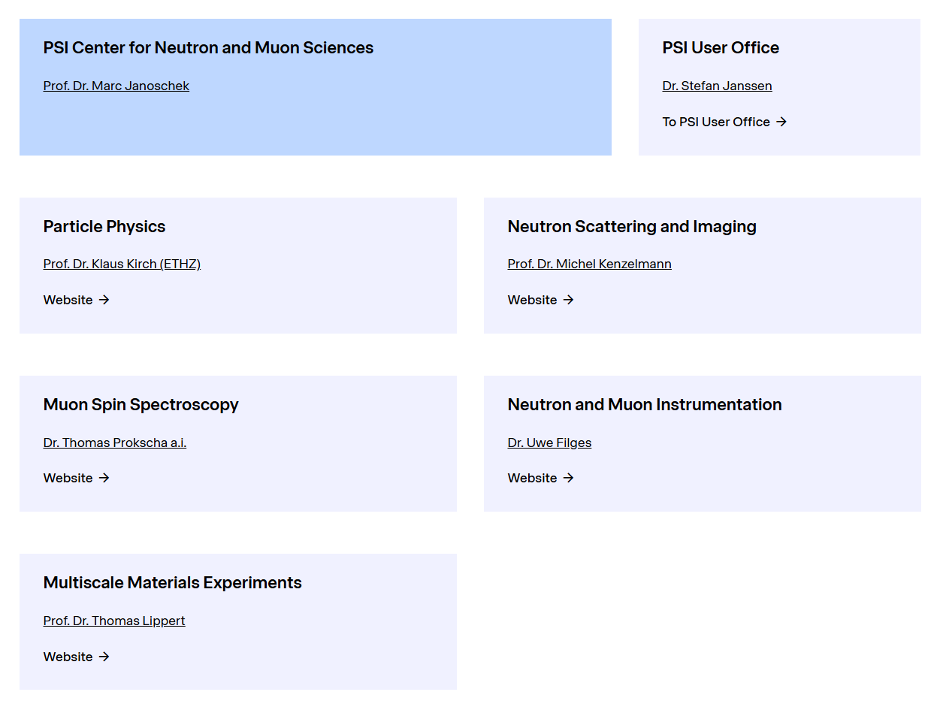
Laboratory of Neutron and Muon Instrumentation
since 1.11.2025

Slide 3
Mission of LIN
Maintenance/support of the existing Neutron and Muon instruments
– field of engineering, mechanics, electronics, software and
sample environment
Operation of the neutron spallation sources SINQ & UCN
Building/Upgrade of instruments and sample environment
Engineering science and education
Prio 1

Slide 4
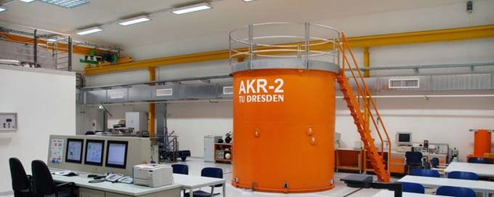
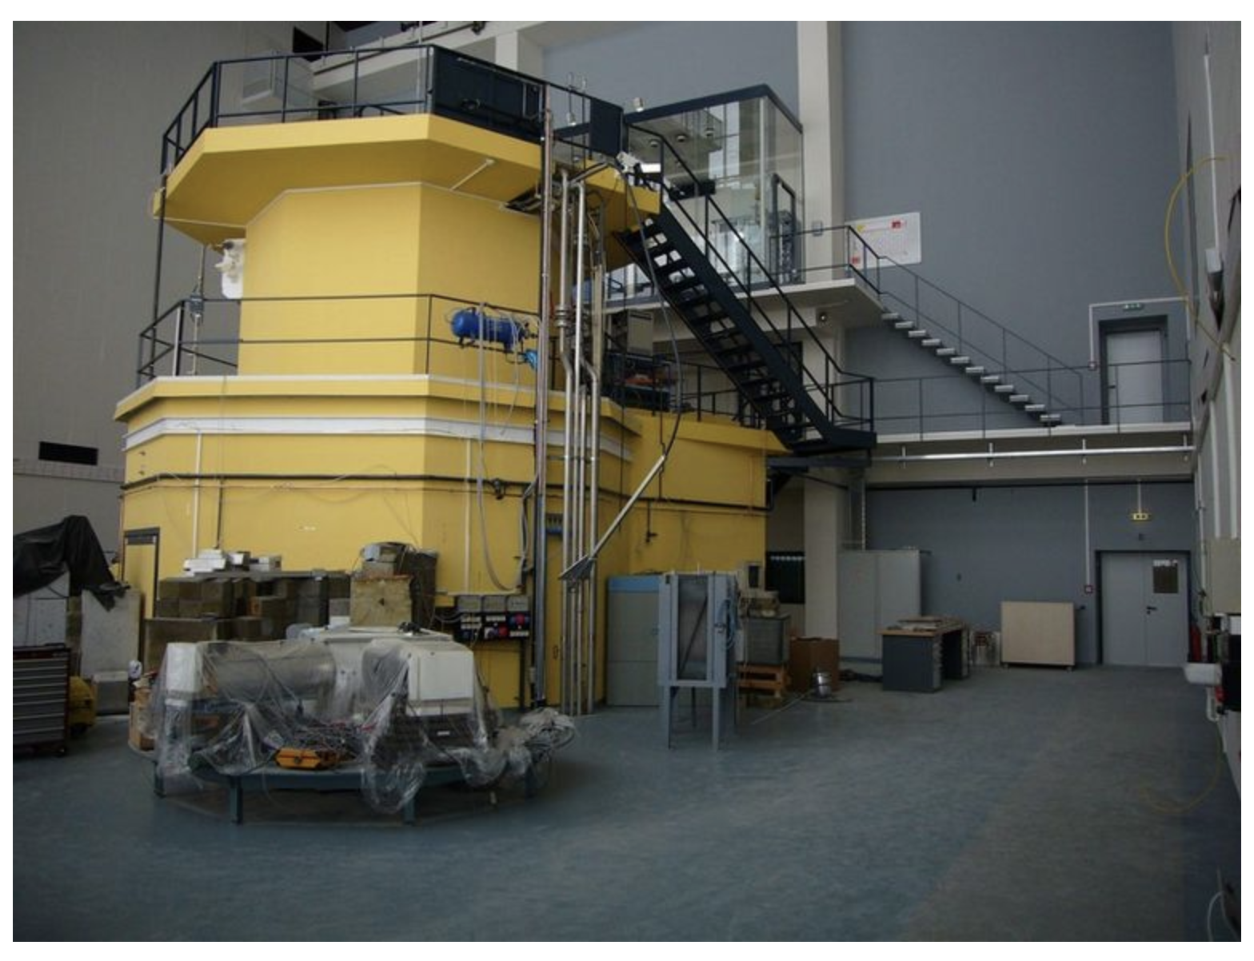
Self-Introduction
TU Dresden
Atominstitut Vienna
Master of Science in nuclear engineering at Technical University Dresden (1989 – 1994)
Scientific assistant at the Technical University Dresden (1994 -2001)
PhD in nuclear physics (TUD / IAEA joint project ) (1997 – 2001)
developing a nuclear material verfication method for research reactors (Safeguards)
MCNP simulations and neutron spectroscopy measurements for european research reactors
Programming of data analysis software (mainly C/C++)
2001: Software engineer position at PSI/Laboratory for Neutron Scattering

Slide 5
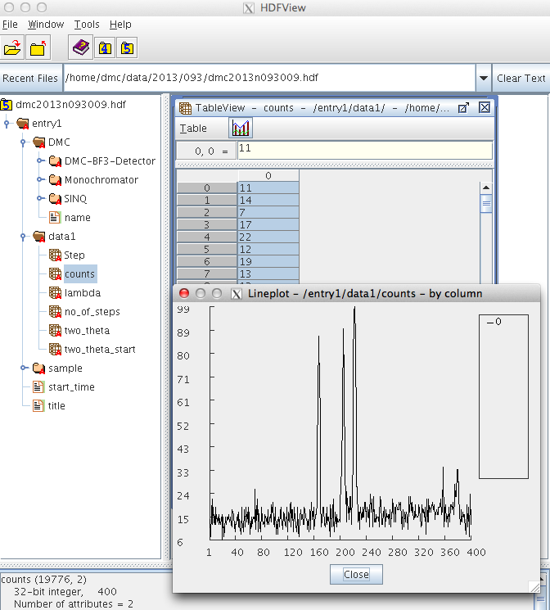
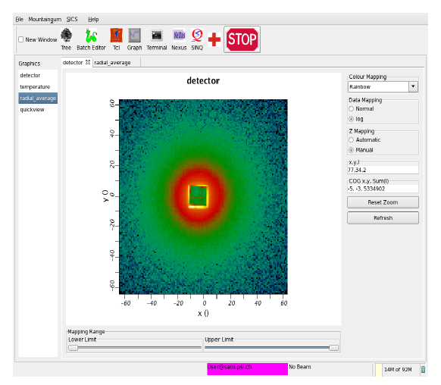
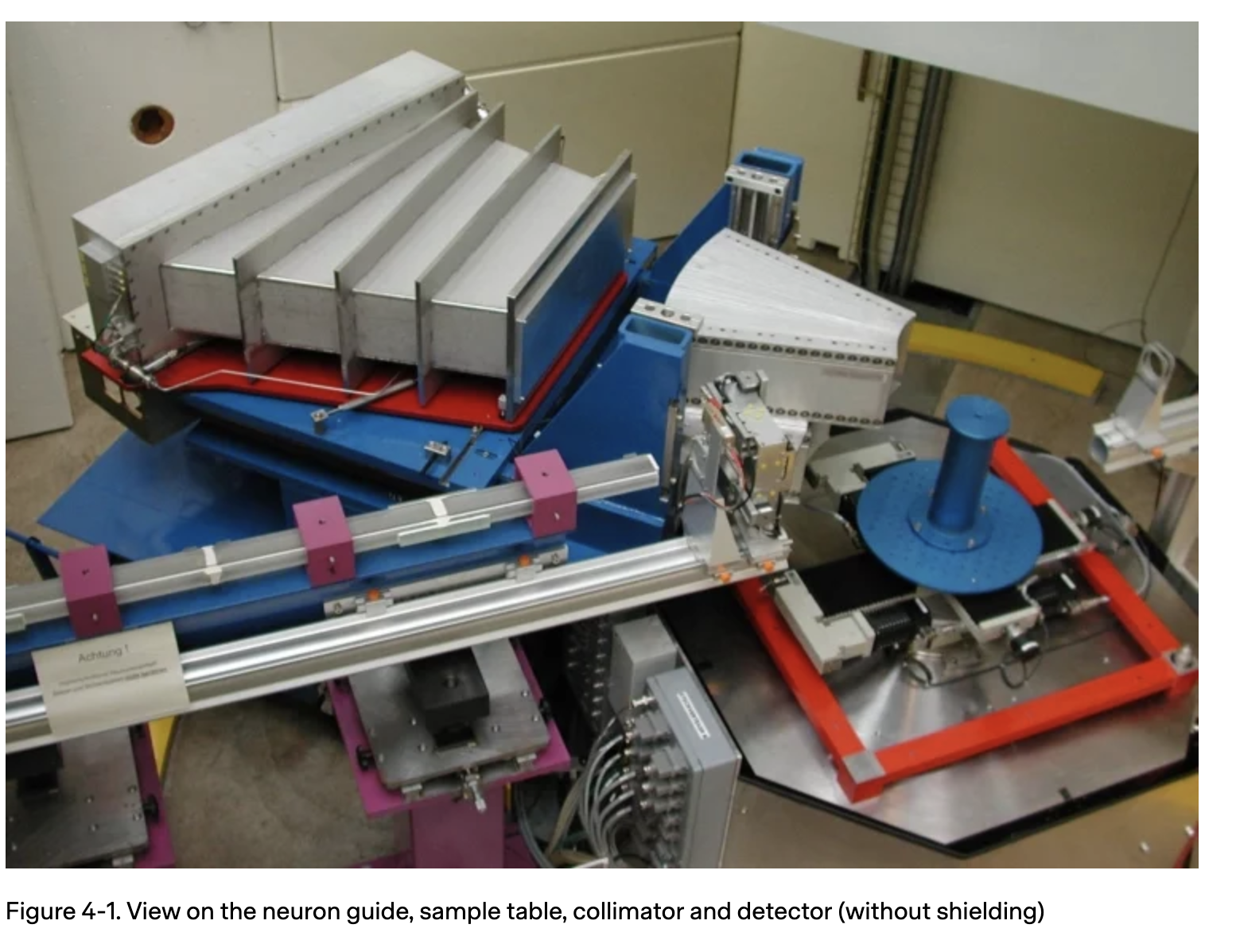
(1) Paul Scherrer Institut - 25 years of exciting challenges
Software developments
programming the NeXus-API (HDF5)
part of a EU project
programming the SICS-DAQ system for Poldi

Slide 6
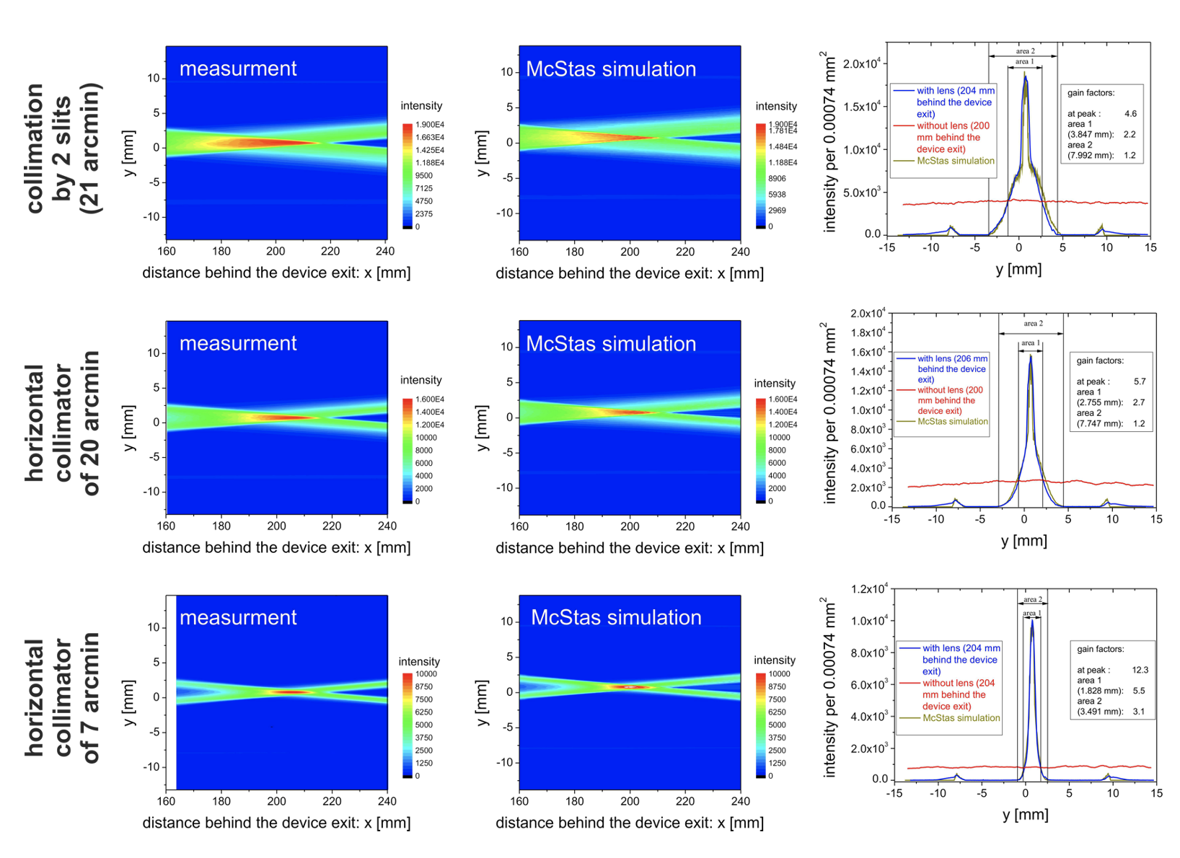
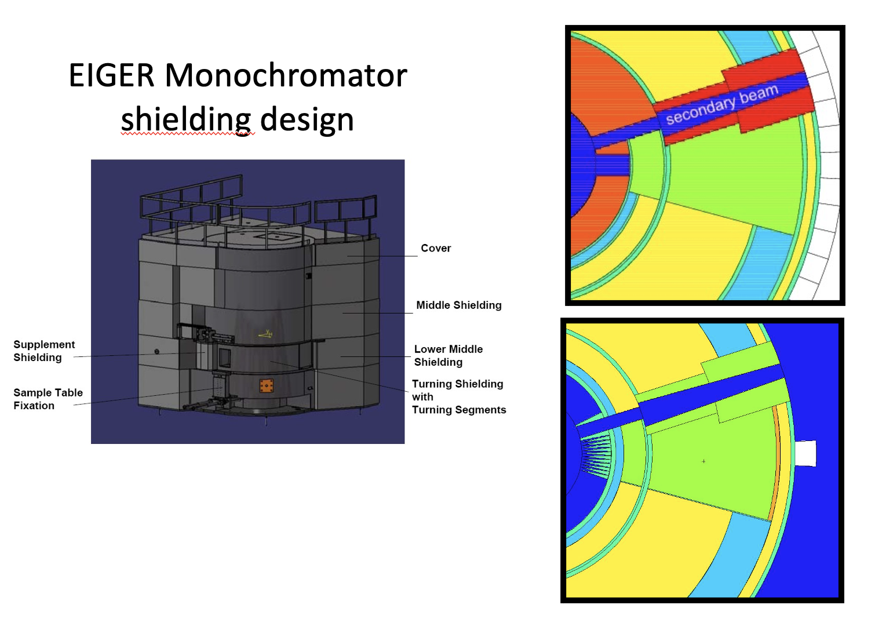
(2) Paul Scherrer Institut - 25 years of exciting challenges
McStas and MCNP Shielding simulations
Advanced McStas Simulations for all SINQ Instruments
Programming of McStas components (Member of the Core developer team)
developing/simulations of different compositions
of heavy concrete (magnetic & non-magnetic)
with a density of approx. 5.1 g/cm³

Slide 7
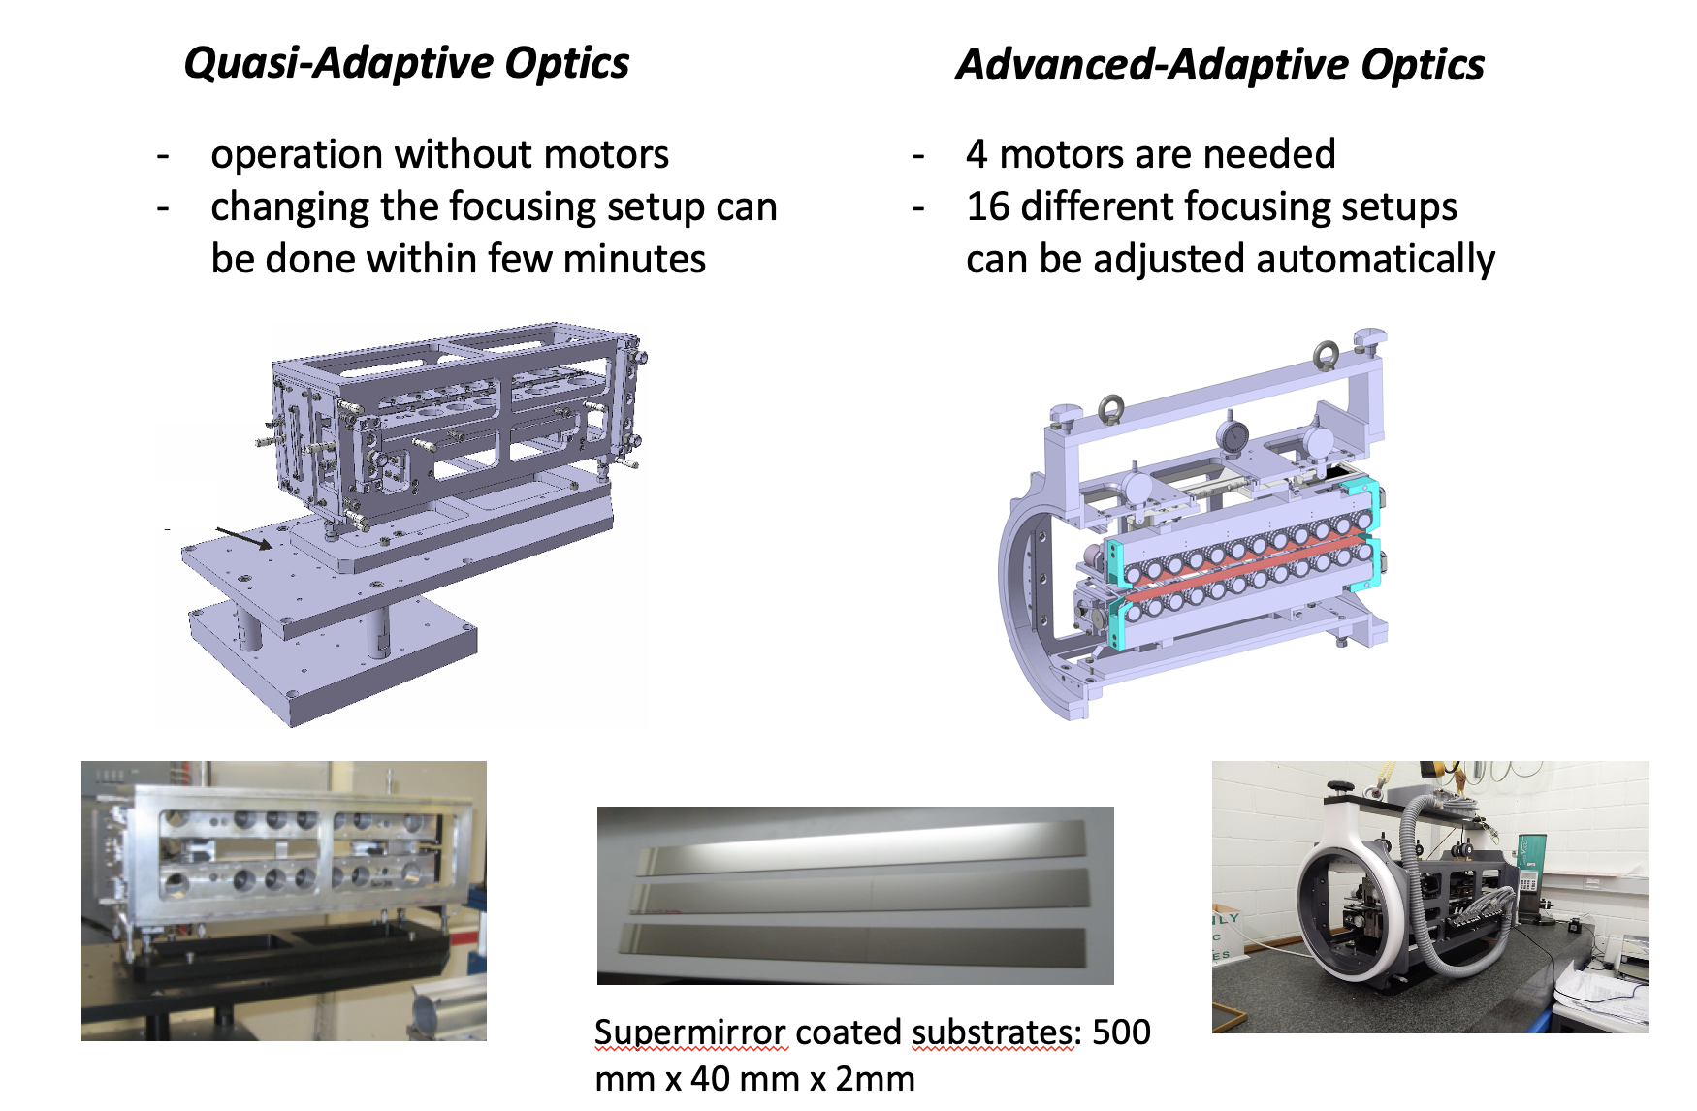
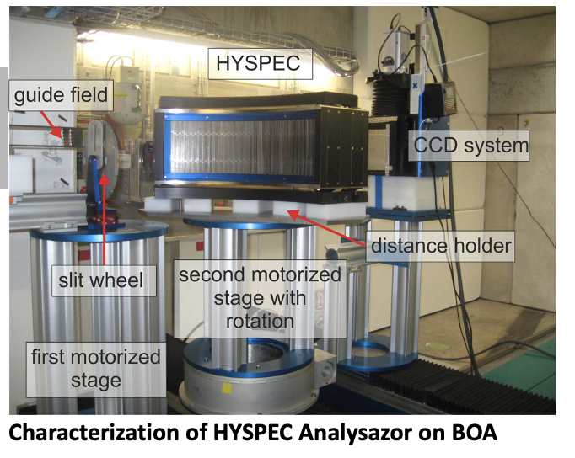
(3) Paul Scherrer Institut - 25 years of exciting challenges
Developing neutron optical devices
design and realisation of the HYSPEC wide angle polaristion analyser
developing an adaptive optics device
collaboration with research Institute Riken and the Kyoto University (Japan)

Slide 8
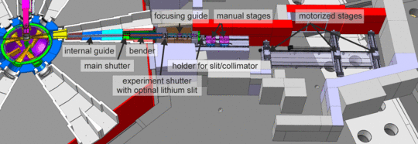
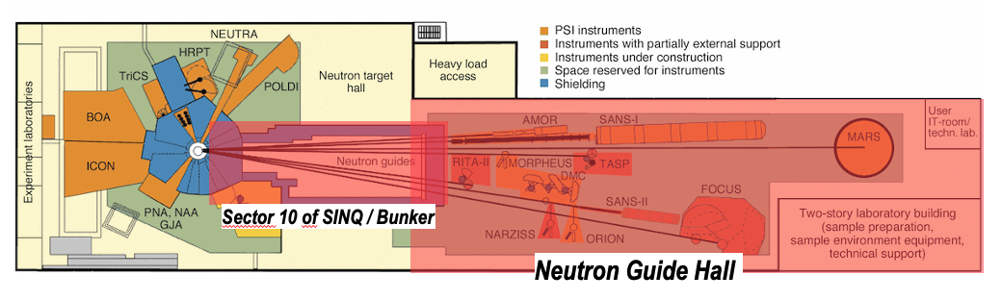
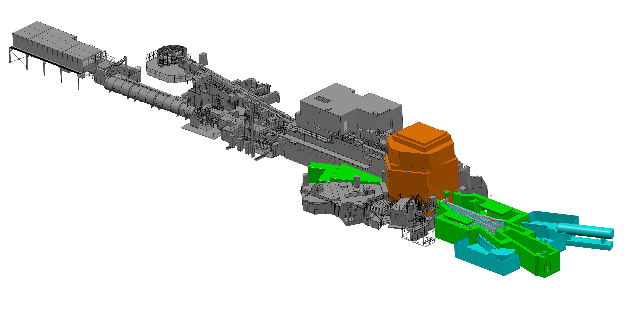
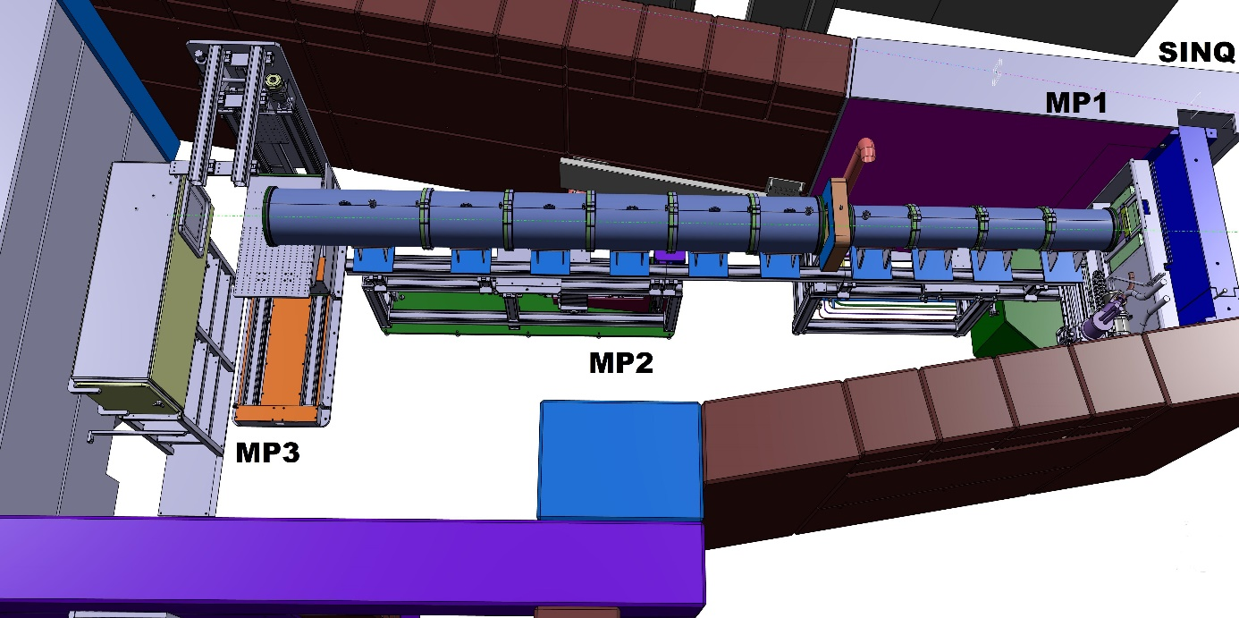
(4) Paul Scherrer Institut - 25 years of exciting challenges
Building Instruments and MORE
SINQ Guide Upgrade (2017 – 2020)
BOA (2011/2012)
SINQ++ Pre-Study (since 2024)
Neutra (2022-2026)

Slide 9
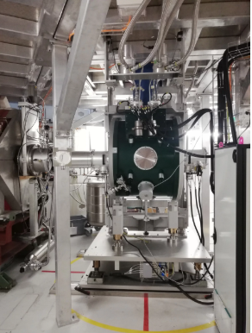
MIDAS Migration for Bulk SµS Instruments
TASK: Migration to a stable/supported MIDAS version for 5 instruments
Drivers
Around 55 drivers have to be re-compiled with a modern MIDAS + Cmake + afterwards intensive testing (24 are done)
Frontends
Other
automated instrument PC setup (inc. installation of Struck card driver, ROOT and MIDAS) realized via Puppet
NFS synchronization successfully tested
First successful user operation are done on FLAME in Dez. 2025
FLAME «ready to measure» at the end of SD 2026
VMS will be continued as soon as SD 2026 work is done
GPD will be continued as soon as Flame is in operation with new MIDAS
VMS, GPD, GPS and HAL-9500 will be updated after SD 2026 (until 2027)

Slide 10
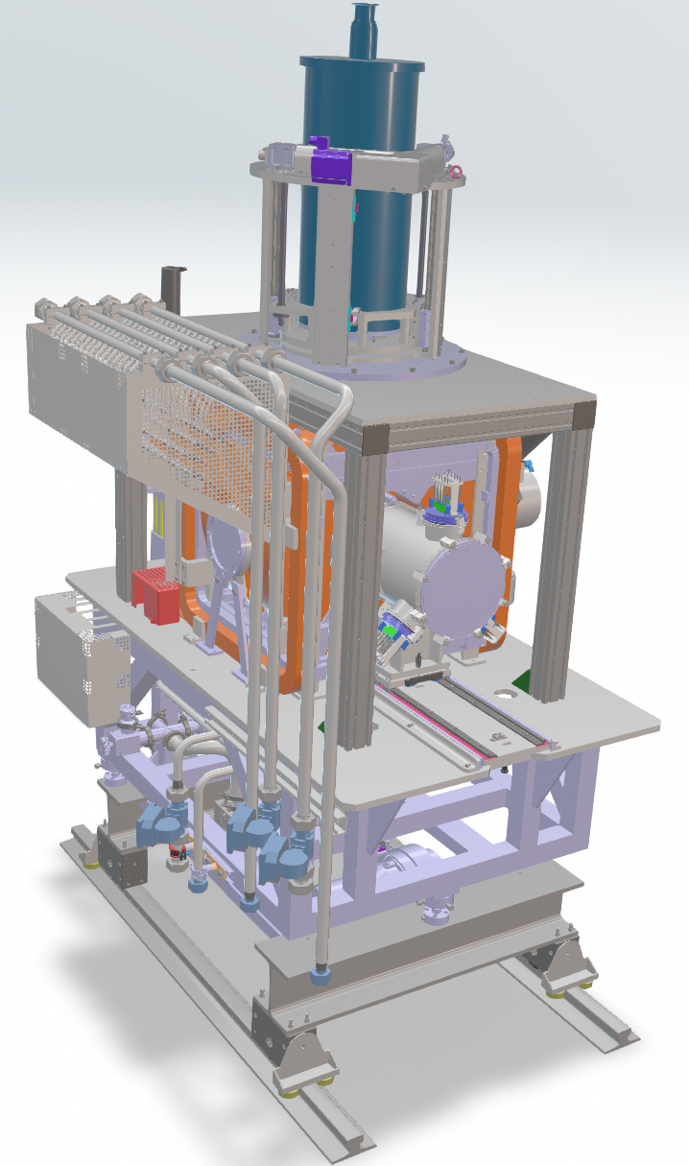
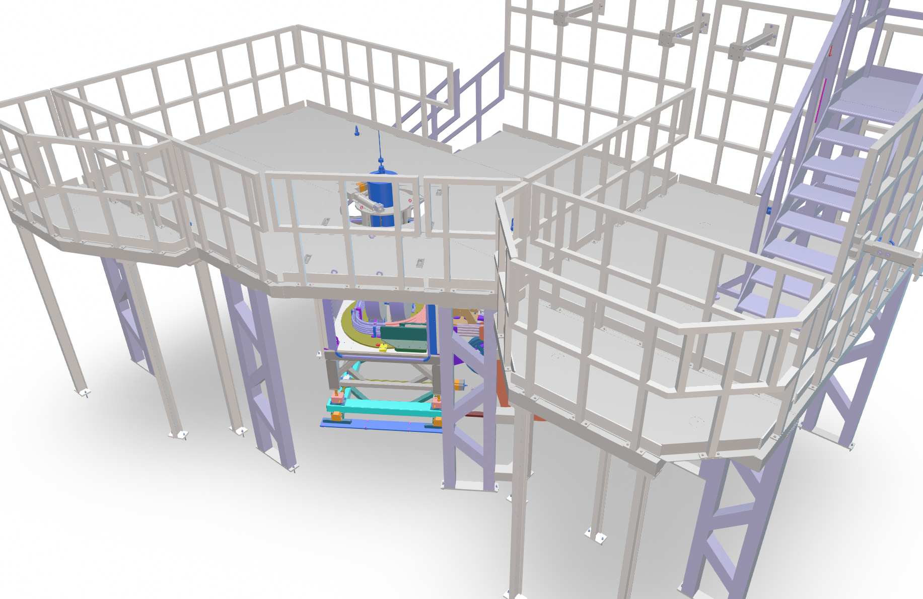
Upgrading SµS Instruments
Upgrate of z-Translation for Dolly and GPD was realized in SD 25 - > more stable and precisly operation of sample environment
new platform for GPD
Dolly
GPD

Slide 11
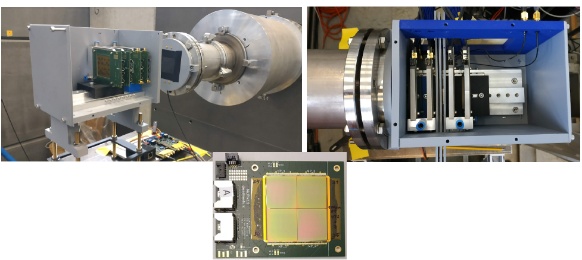
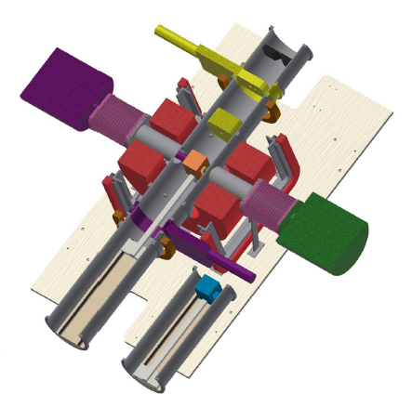
Support for the Avanced Muon Spectroscopy (AMS) Project
in general, LIN engineering group (magnet group) and myself (shielding) supports the Impact Project
Advanced Muon Spectroscopy (AMS) with Si-Pixel Detectors is a very high priority project for CNM (success of the Impact project)
upgrading the GPS Instrument will be supported by LIN (first information exchange has been started)
Modification/Upgrading of the existing GPS sample environment (magnetic field and cryogenics),
the beam line (collimators and slits) as well as motion controls (movable detector system
and cryostat) to host the Si-pixel based detector system.

Slide 12
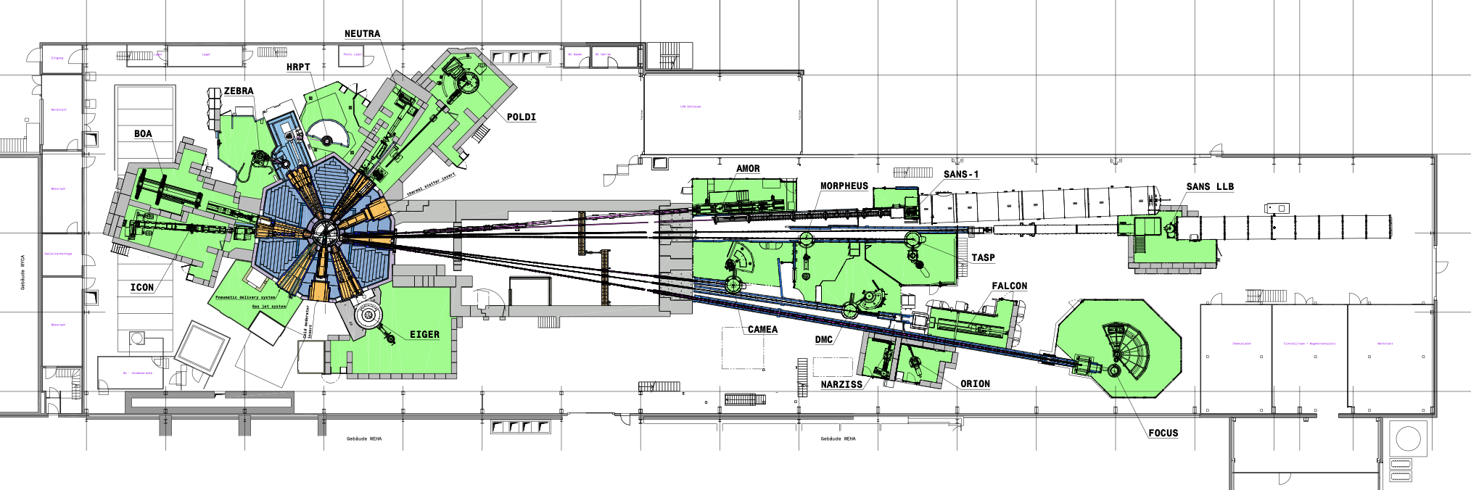
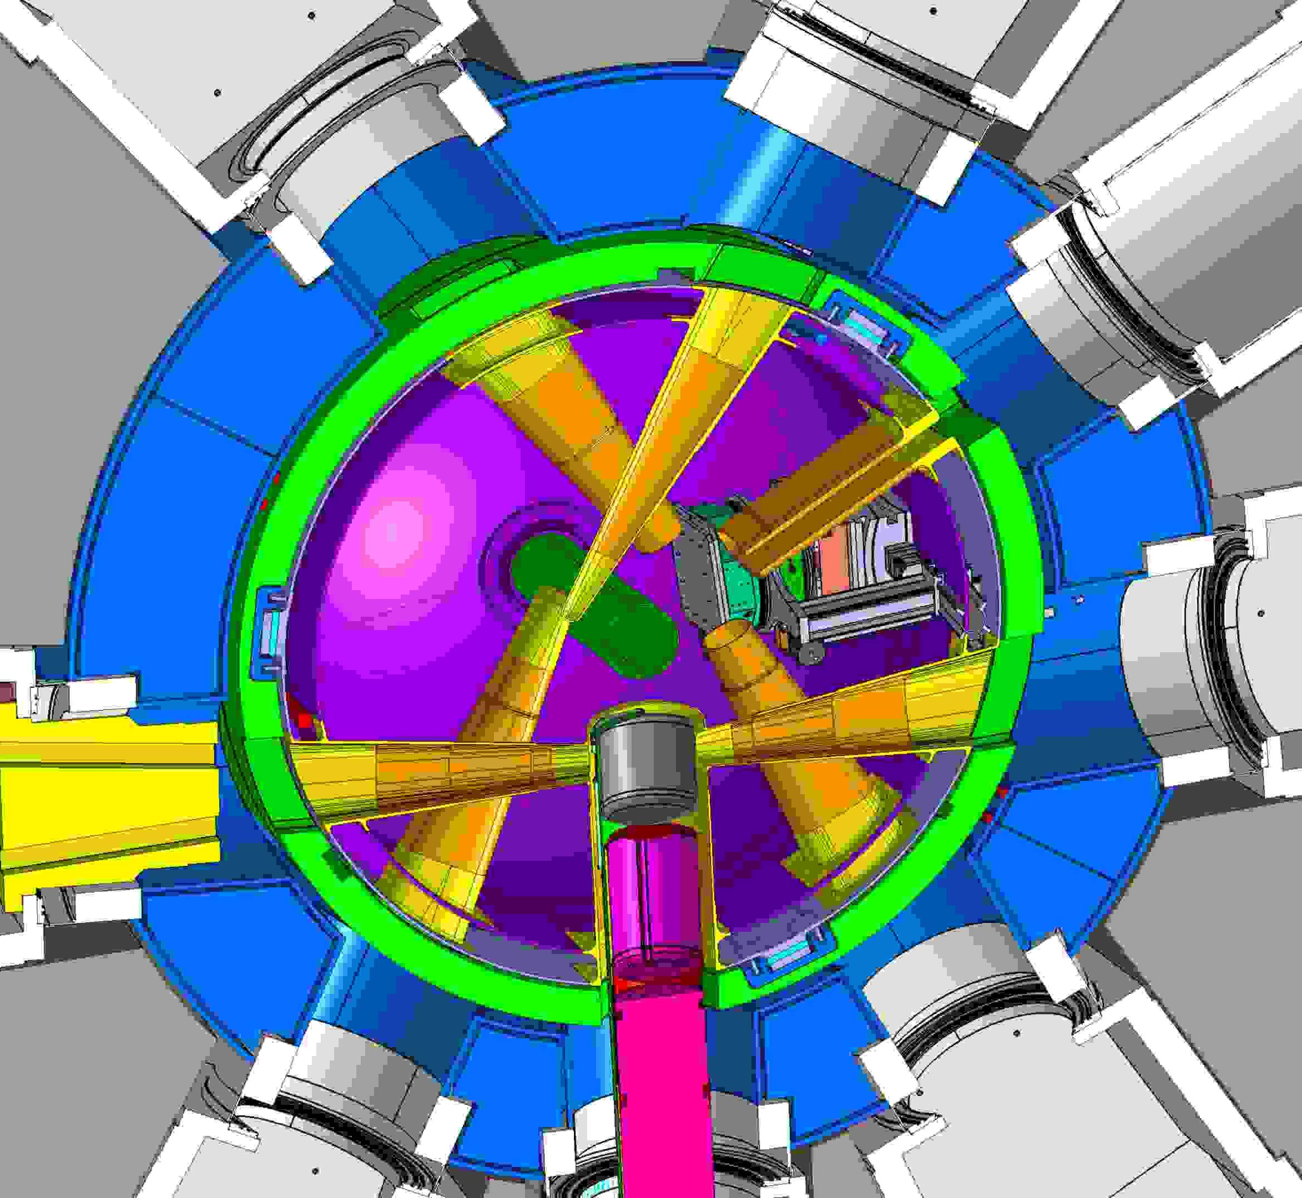
30 years SINQ operation
Present SINQ Facility / Instruments
Target Hall
Guide Hall South
SINQ Moderator Tank
Central Tube
(never exchanged - live time is about 30 years)
Project preparation for exchanging the central tube
Pre-study of the SINQ cold moderator exchange/upgrade
D₂ Cold Neutron Source
(ones exchanged - live time of present CS is about 30 years)
Realization: after 2030

Slide 13
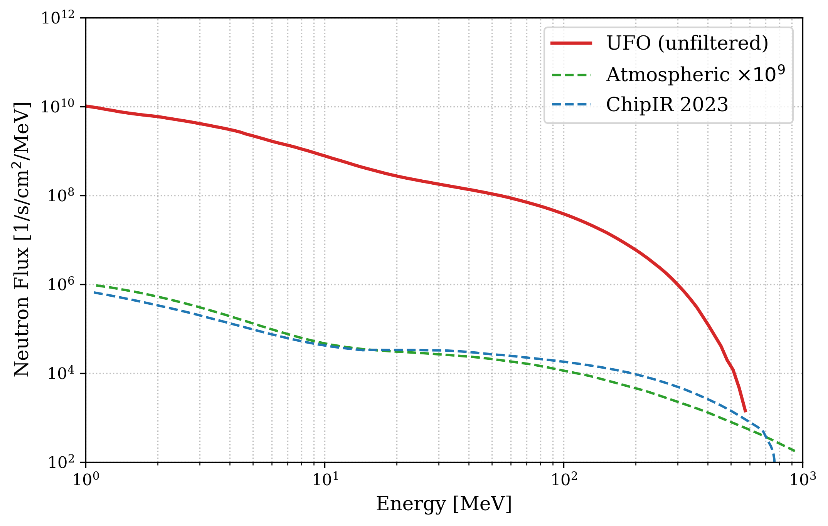
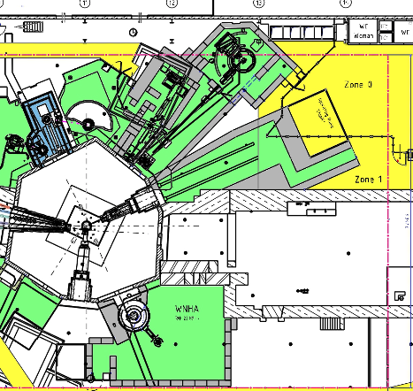
Irradiation Beamline UFO – Ultra Fast neutron irradiation for large Objects
Testing of electronics with a cosmic-ray spectrum
Pre-Study
Target Hall
Guide Hall South
SINQ Moderator Tank
Fast neutron irradiation beamline UFO
(the only port with direct view to the target)
UFO

Slide 14
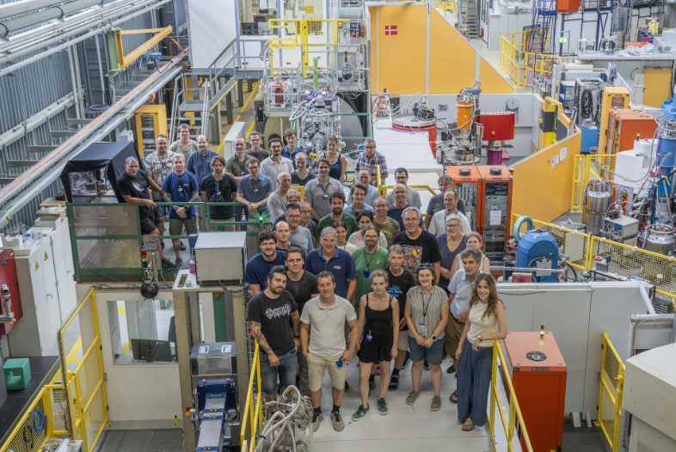
Around 50 LIN experts guarantee the stable operation of the instrument.

