Slide 1
WLHA Electron Source Test Facility
Activities 2026 onwards
Thomas Lucas with input from Cezary and Carlo
Ort, TT. Monat JJJJ

Slide 2








Work packages, milestones and deliverables
FCC-ee project
Injector linacs and sources
Coordination (WP0)
Collaborations
WP1
Electron and positron linacs
WP2
Electron source
WP3
Positron source and linac
WP4
Damping ring and transfer lines
WP5
Towards TDR
M1.1: working frequency
M2.1: Concept for
electron source
M3.1: working frequency
D4.1: Physics design
Damping ring and TLs
D5.1
Unified Global Requirement
M1.2, M1.3: RF prototypes
D2: demostration charge
modulation up to 5 nC
D3.1: TD and integration
target and capture system
D5.2
Physics Requirements Docs
e-, p- and HE-linac
M1.4: High power test, BDR
D3.2: P-cubed project:
positron production @SF
Functional Specifications Documents
D1.1: Industrialization
processfor RF structues
not in the CHART proposal
Eng. specifications docs
TDR chapers
Specifications
for CE and TI
Involvement of technical groups from CERN and PSI

Slide 3
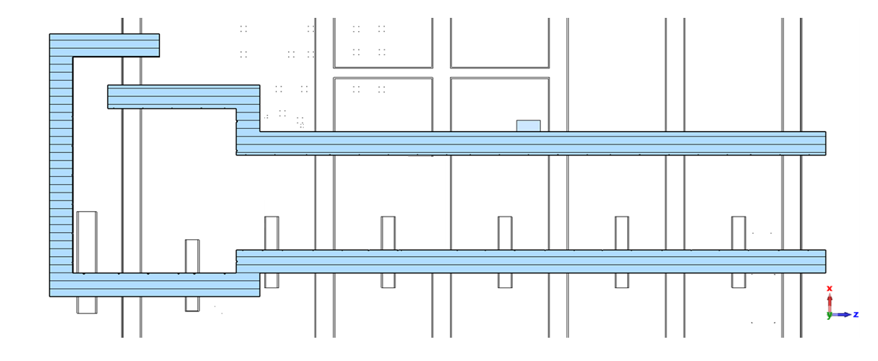
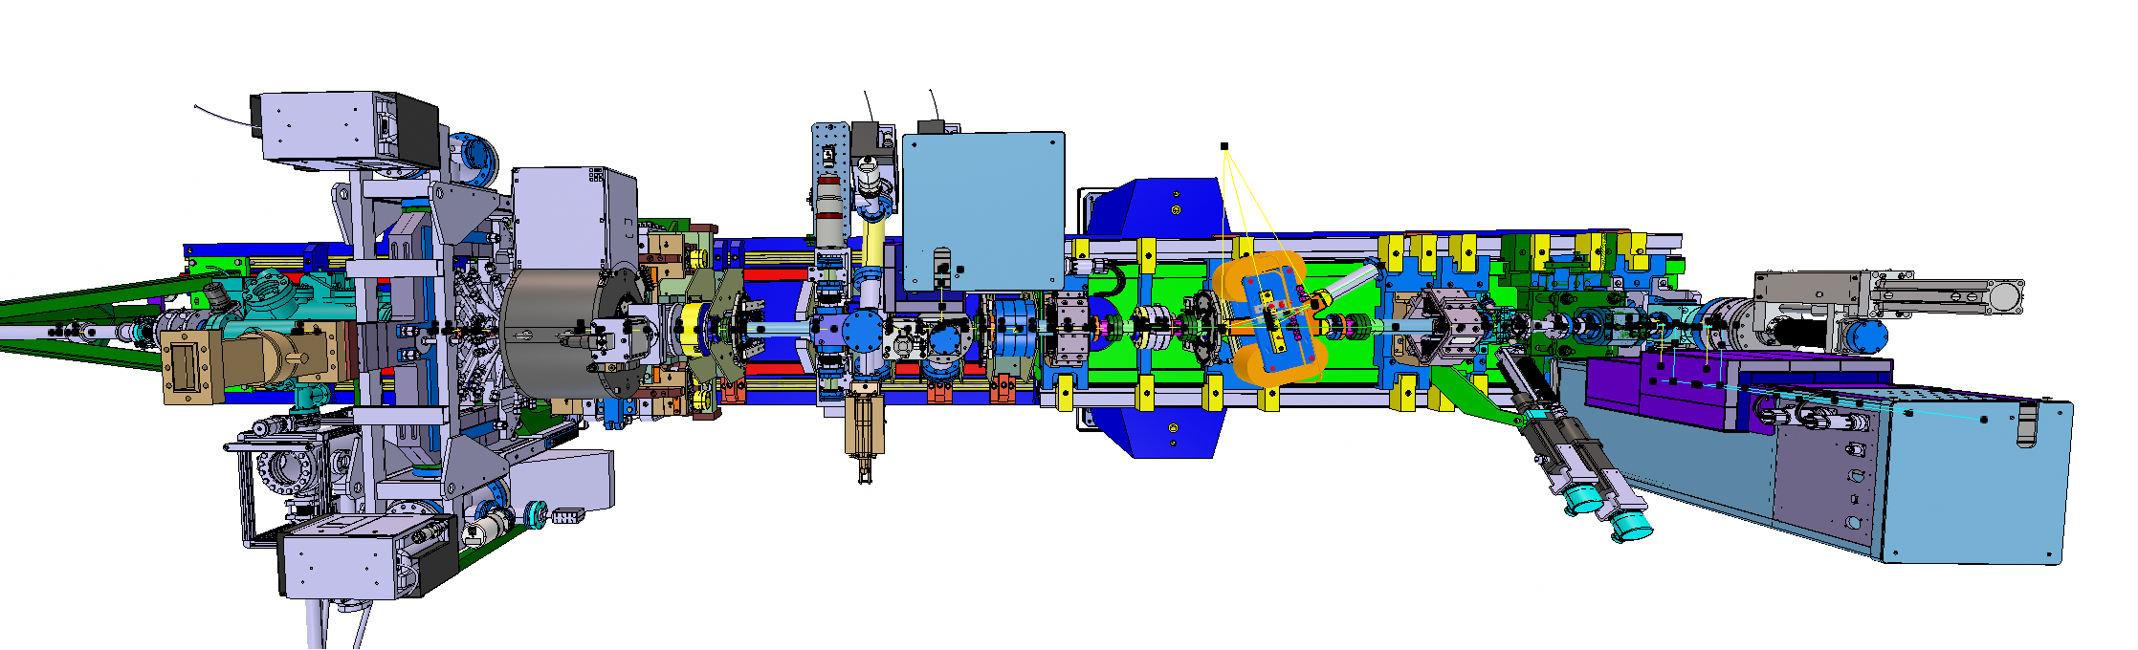
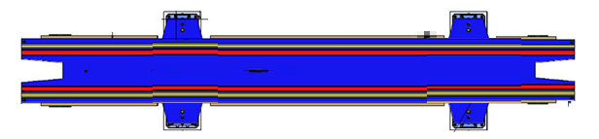
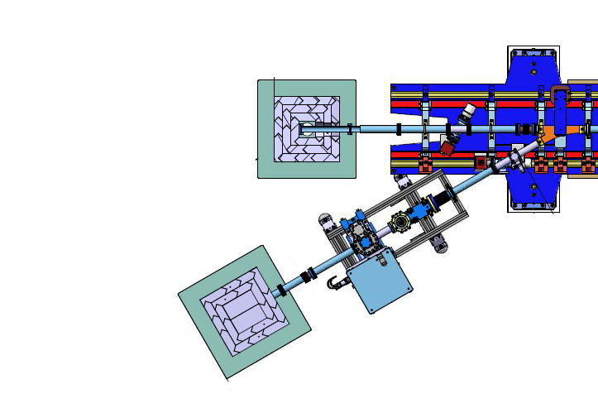
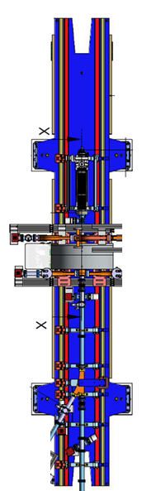
2026-2028: Electron Source Test Facility (CHART and EPITA)
Photocathode Laser
Laser
Development
Area
EPITA Test Place
Chillers
Water
Water
Water
Water
C-band
Modulator
(TW Gun or Acc 1)
S-band
Modulator for
Electron Source
Test Place
With RF Load
Storage and
loading Area

Slide 4
2026-2028: Electron Source Test Facility (CHART and EPITA)
Photocathode Laser
We will build a replica of the SwissFEL electron gun.
Laser
Development
Area
EPITA Test Place
Chillers
Water
Water
Water
Water
C-band test stand to continue to run.
C-band
Modulator
(TW Gun or Acc 1)
S-band
Modulator for
Electron Source
Test Place
With RF Load
Storage and
loading Area

Slide 5
2026-2028: Electron Source Test Facility (CHART and EPITA)
Photocathode Laser
Photocathode Laser for S-band Gun must be synchronised to the S-band RF System.
We would like to have at least a C-band source synchronised to the S-band too. X-band would be a luxury
Laser
Development
Area
EPITA Test Place
Chillers
Water
Water
Water
Water
C-band
Modulator
(TW Gun or Acc 1)
S-band
Modulator for
Electron Source
Test Place
With RF Load
Storage and
loading Area

Slide 6
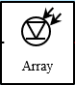
First Concept
Separate Oscillator
Switch
Switch
Separate Oscillator
2.998 GHz
2.9988 GHz
5.712 GHz
5.712 GHz
Synchronisation Box
Laser oscillator
Reference to fix drift
To Amplifier
Frequency comb
Fr=142.8 MHz
142.8 MHz
Feedback

Slide 7
Fcc-ee photocathode laser layout
Trigger single shot – 100 Hz Timing System
Oscillator
@142.8 MHz
Pulse Picker
Laser
Amplifier
Compressor 1
Main Output
T=600 fs FWHM
E=2.5mJ @ 1040 nm
Synch Unit
Reference
Compressor 2
Aux. Output
T=600 fs FWHM
E=2.2mJ @ 1040 nm
To be discussed
Rejected Pulse @142.8 MHz DIAGNOSTICS+FEEDBACK
Compressor 3
Short Probe Output
T=600 fs FWHM
E=0.3mJ @ 1040 nm

Slide 8
Fcc-ee photocathode laser layout
Trigger single shot – 100 Hz Timing System
Menhir Photonics
RR=142,8 MHz
@1040 nm
CPA amplifier
Amplitude
@ 1040 nm
RR=100 Hz
Compressor 1
Main high
energy
output
Pulse Picker
Optical
Switch
Main Output
T=600 fs FWHM
E=2.5mJ @ 1040 nm
Synch Unit
Compressor 2
Auxiliary high
energy output
Aux. Output
T=600 fs FWHM
E=2.2mJ @ 1040 nm
PSI Reference Clock
Rejected Pulse train @142.8 MHz
T= sub-200 fs FWHM
P=60 mW @ 1040 nm
Compressor 3
Short probe
output
Short Probe Output
T=600 fs FWHM
E=0.3mJ @ 1040 nm

Slide 9
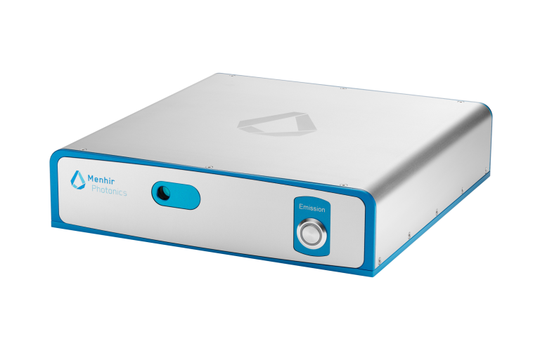
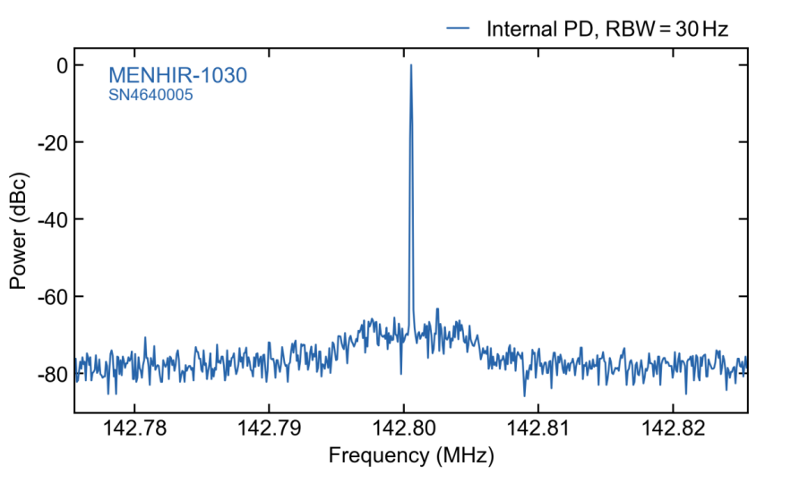
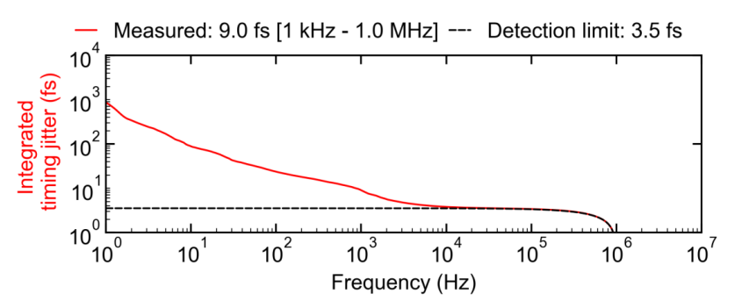
Laser oscillator
Low noise femtosecond oscillator
Specification
  Wavelength 1040 nm
  Pulse duration 200 fs
  Power 150 mW
  Rep rate 140.8 MHz
  Piezos tuning range
    Fine 150 Hz
    Coarse 3 kHz (worse case scenario)
    SwissFEL has very good temperature
    and humidity stability.
RF spectrum
Free running noise

Slide 10
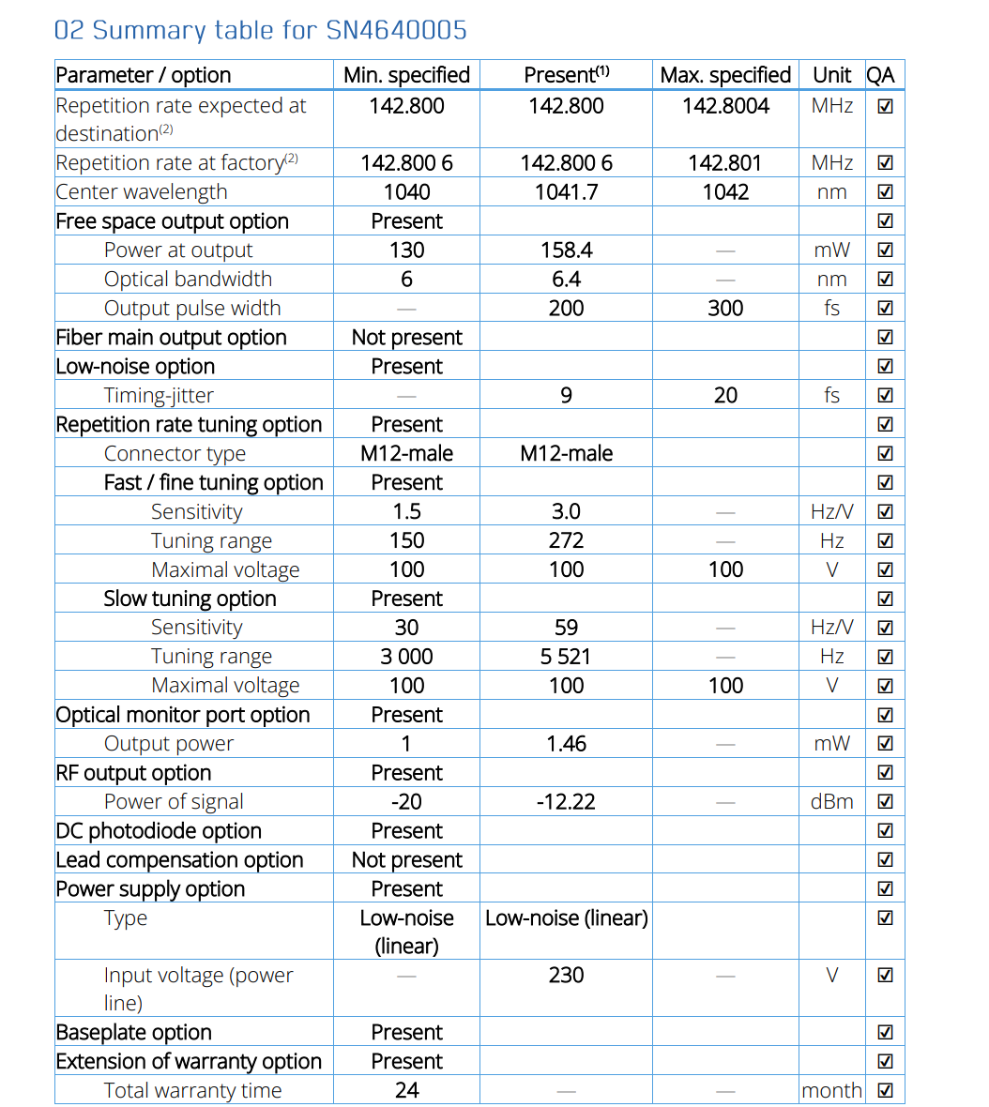

Slide 11
T&S
Function | Name | Estimated cost | Comment
2.9988GHz reference | Rohde&Schwarz SMA100B | 36kCHF | Same for SwissFEL and SLS2: easy spare situation
Laser oscillator | Menhir 143 | 70kCHF | Frequency comb generation
Harmonic extraction | Custom build | 10kCHF | An improved version is in progress, the old one could be used for “free”
Laserlock | Custom build “SOM-DLL” | 10kCHF | Should be finished soon, for the above laser oscillator and harmonic extraction
RF distribution | LiberaSync | 40kEu-65kEU | Cost is for TX&RX combination and depends on ordering numbers
142.8MHz distribution | Custum build by Sintec | 20kEU | For one transmitter and one receiver
Function | Name | Estimated cost | Comment
8GHz reference | Rohde&Schwarz SMA100B | 36kCHF | This source is EVERYWHERE now
Laserlock | Custom build “SOM-DLL” | 10kCHF | For the gun laser
Function | Name | Estimated cost | Comment
2.9988GHz reference | Rohde&Schwarz SMA100B | 36kCHF | PSI “Standard” RF source now
Laserlock | Custom build “SOM-DLL” | 10kCHF | For the gun laser
(2.9988GHz-2.9988GHz/21)*2 | Frequency conversion (to be build!) | 10kCHF | Cost: wild guess / upper limit!

Slide 12
Notes
IMPACT shutdown is start 2027.
Optical Master Oscillator is the laser.
Separation is the interface of the 2.998 GHz cable to the LLRF.
Require 15 dBm for all frequencies.
Responsiblilites
  Carlo: Laser (OMO)
  Cezary: photodiode, frequency generator 142 MHz, 2998 MHz, 5712 MHz and amplifcation to >20 dBm (after cable)
  Mark: S-band and C-band LLRF for S-band and C-band modulators.
  Tom to contact Romain Vallotton

