Slide 1
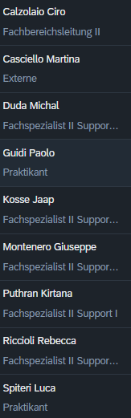
Magnet Section meeting
Highlights and perspective:
Group “Magnetdesign und Messungen (8431)”
PSI- 12 December 2025

Slide 2
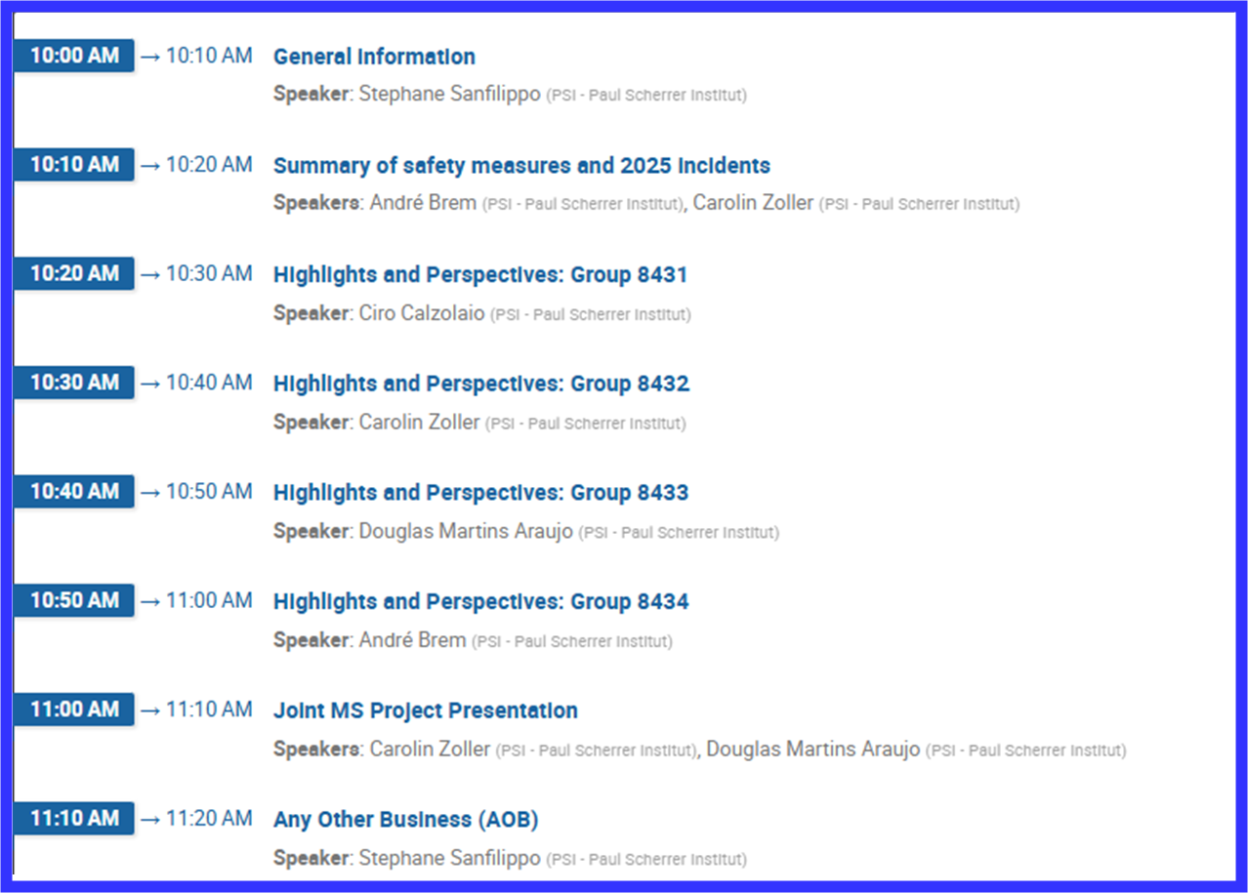
Agenda

Slide 3
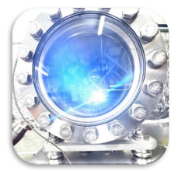
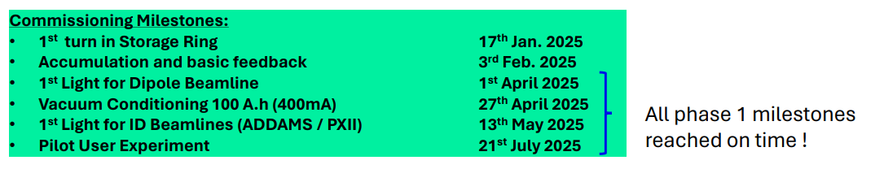
Highlights 2025 (large PSI projects)
SLS2.0

Slide 4
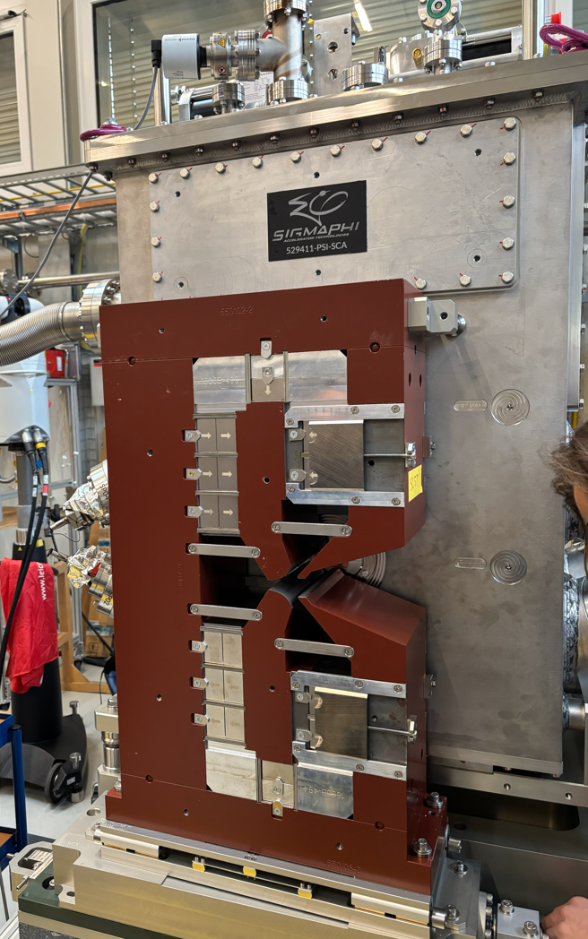
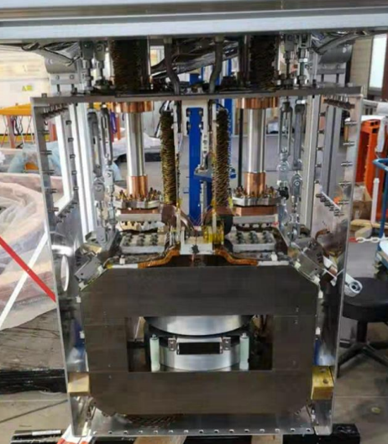

Highlights 2025 (large PSI projects)
SLS2.0
Usually after phase 1 comes a phase 2….
On Monday we should have it cold…

Slide 5
Highlights 2025 (large PSI projects)
Impact, HIMB magnets
A lot of efforts to
improve the cooling;
Improve the manufacturing process;
Develop solutions to ensure compliance with the project timeline;
…

Slide 6
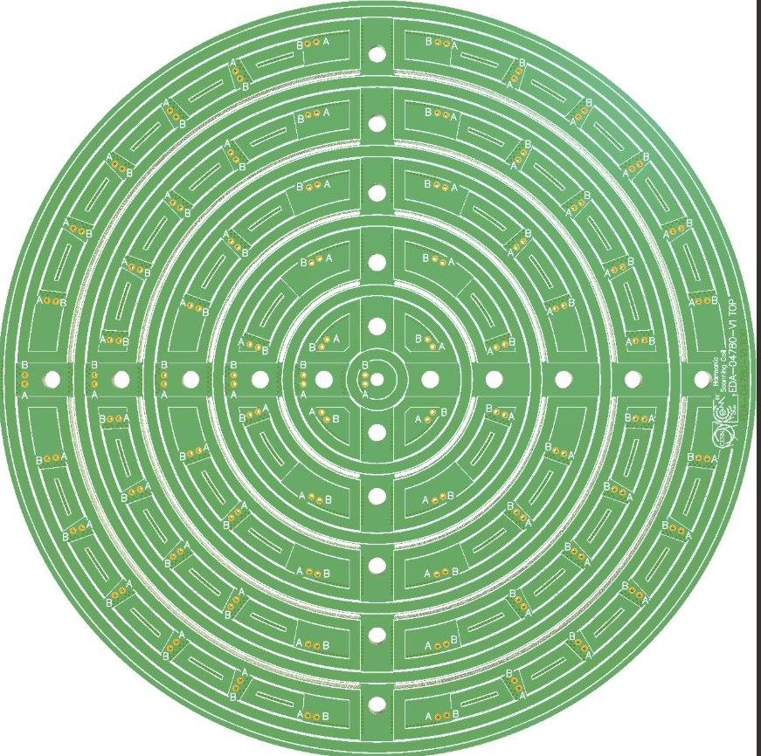
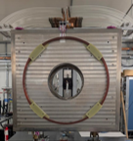
Magnetic measurements
Design, simulations, and preliminary implementation of a translating flux meter for solenoids;
Standardization of field mappers measurement benches: SW and HW;
Procedure for Measuring the Axis Position of Solenoids (P3, HIMB, WSY,…);
Field quality for SubScale2 at room temperature;
Preparation for the HIMB magnets measurements (ongoing at WLHA);
Commissioning of the Magnus field mapper (measurement of WSY magnet);
Assembly and preparation of new field mapping bench at the test stand;
Measurement of the high field P3 solenoid;

Slide 7
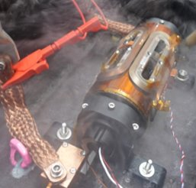
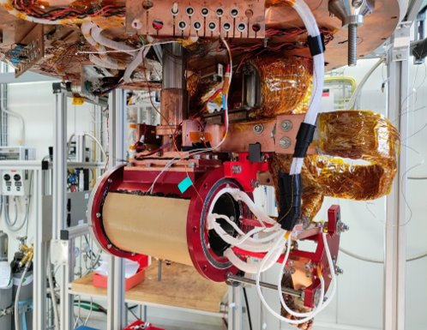
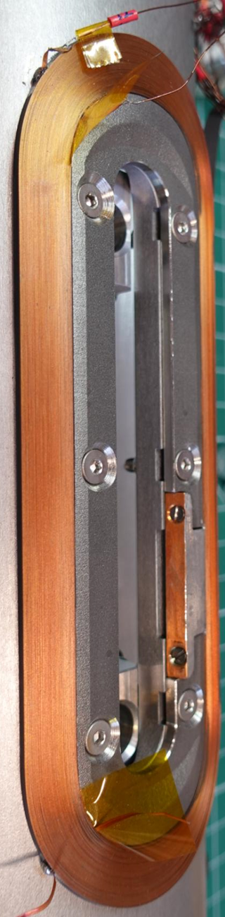
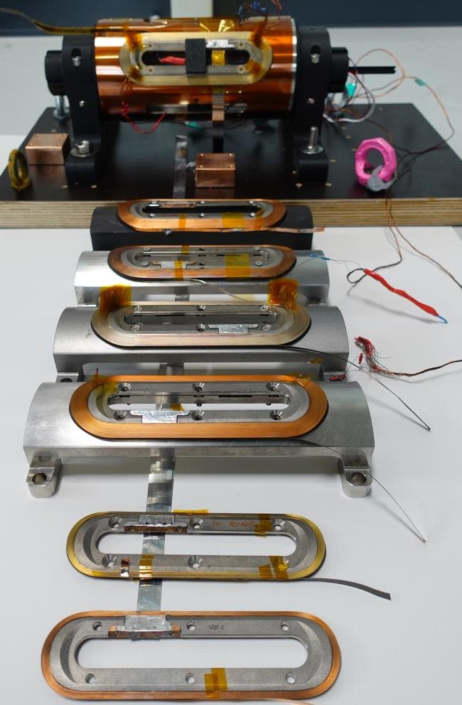
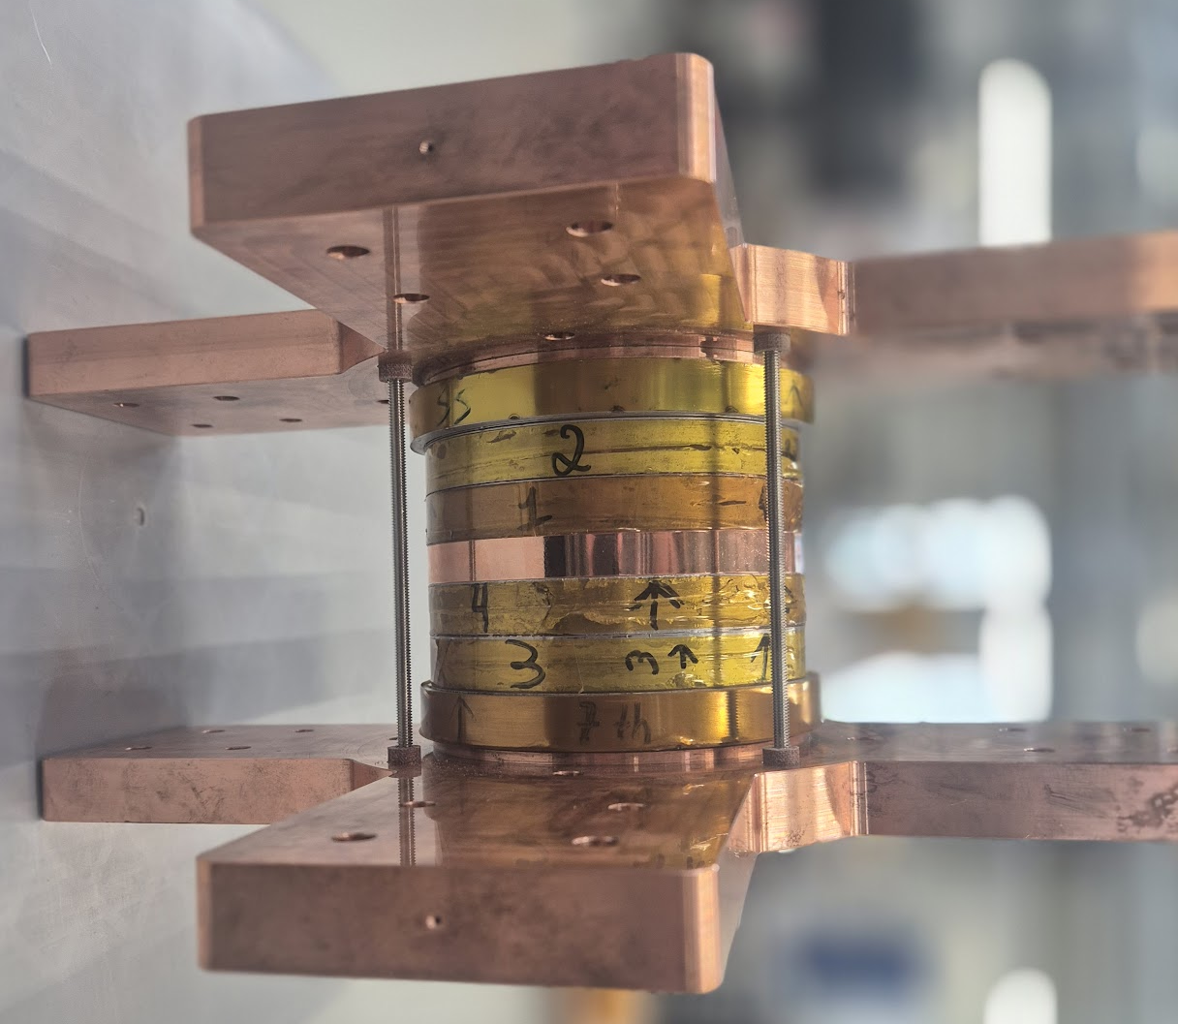
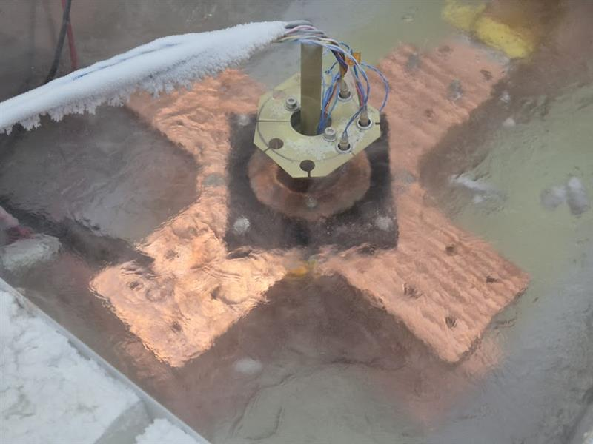
Highlights 2025 (Test stand)
Tests of chart splices different designs and HTS RS coils;
Test of joints and coils for Proxima Fusion;
Several tests for PHPs;
Several tests for small HTS coils (coils for HTS demonstrator in radiation environment, coils for AC losses assessment,…)
Tests for HTS4 coils
Split NI solenoid for n scattering;
P3 final assembly and test…

Slide 8
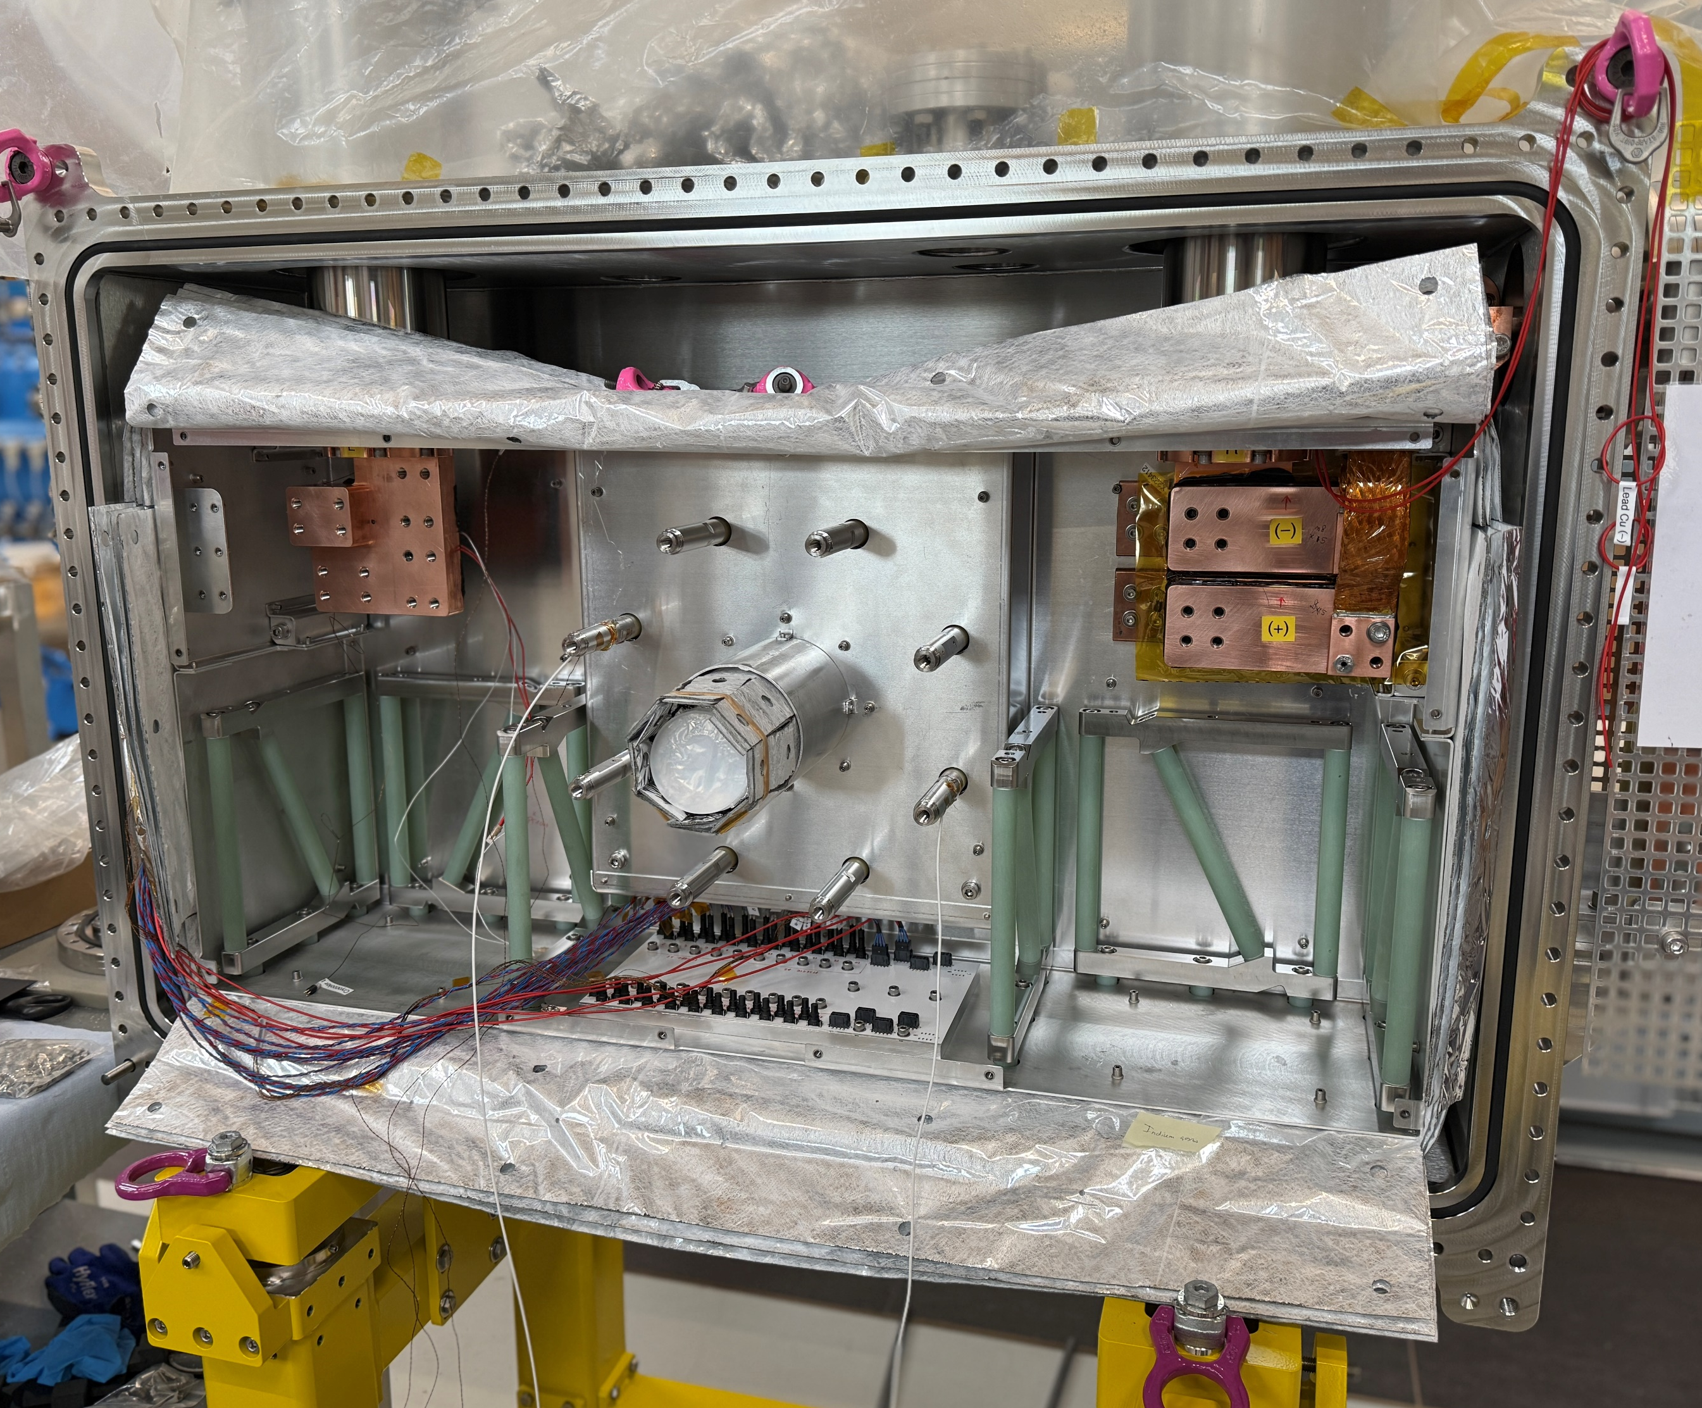
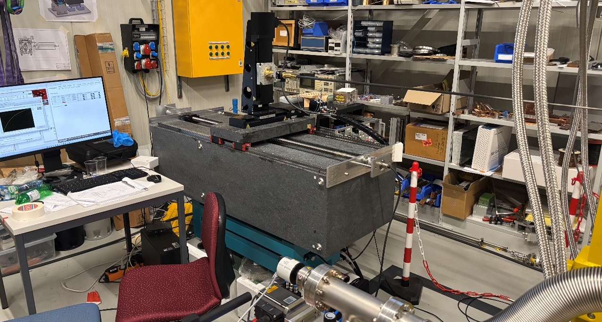
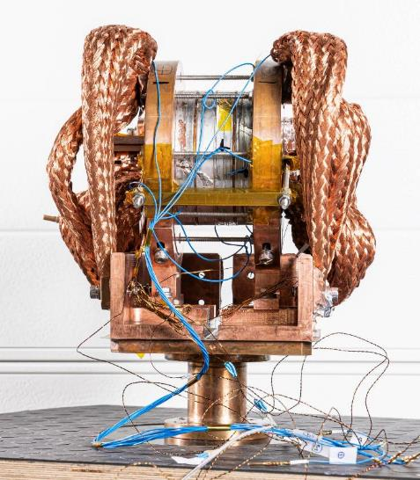
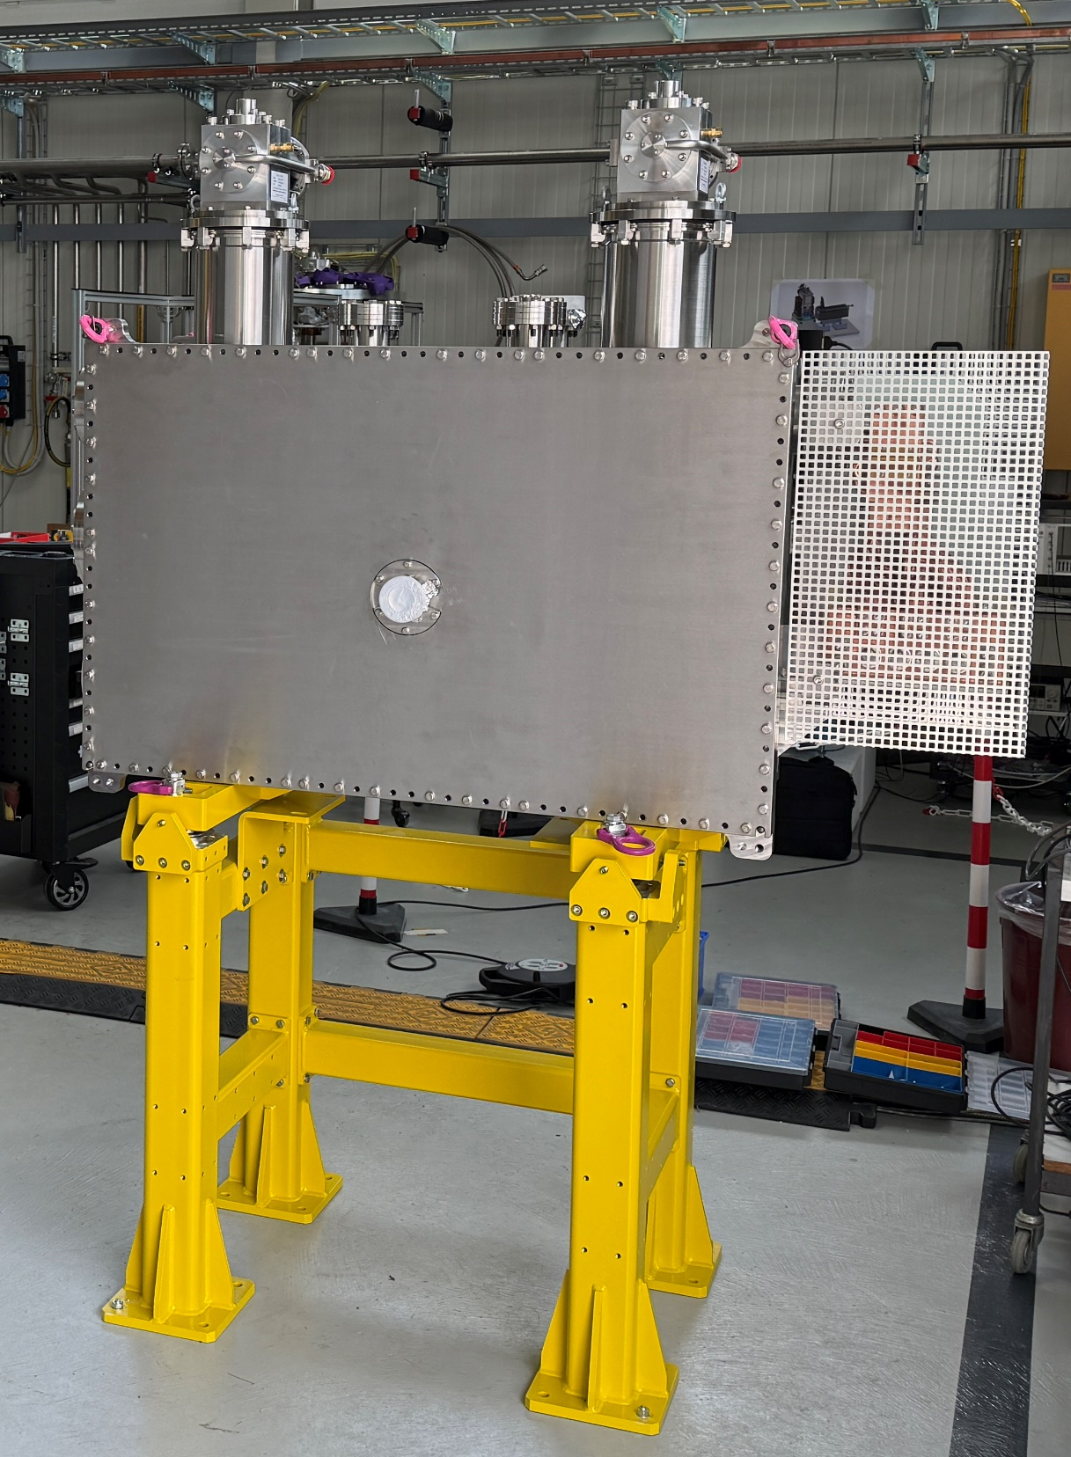
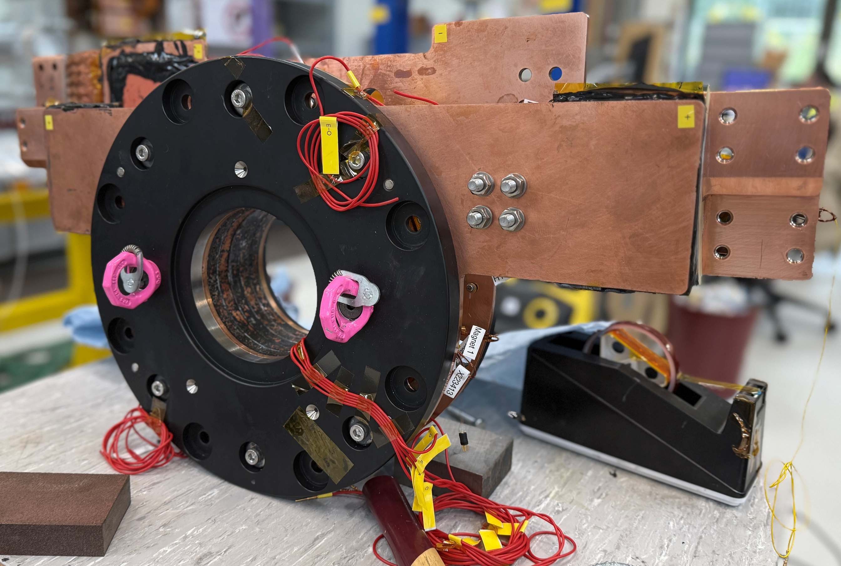
Highlights 2025 (Test stand)
P3 final assembly and test…

Slide 9
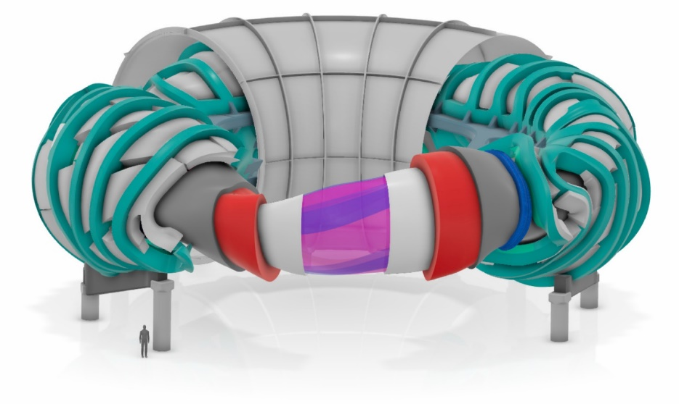
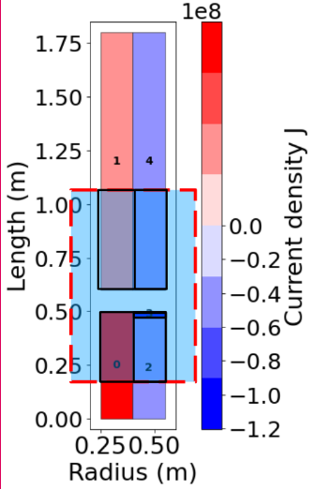
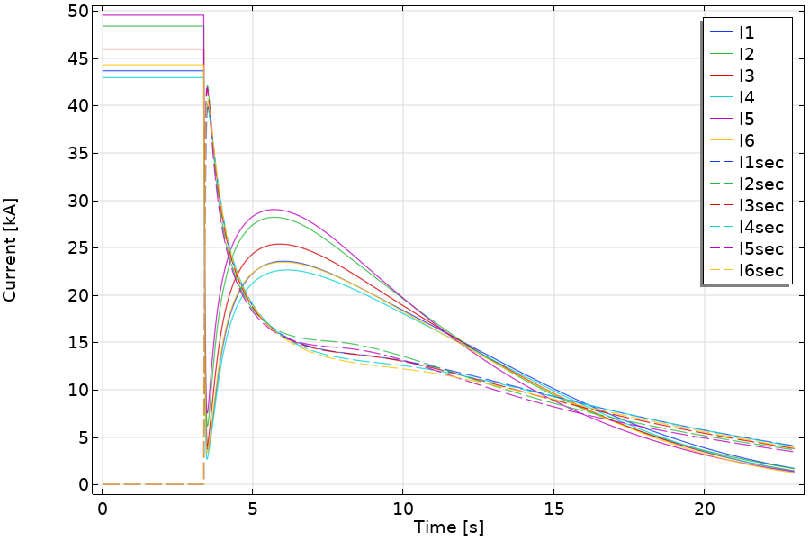
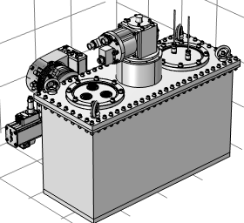
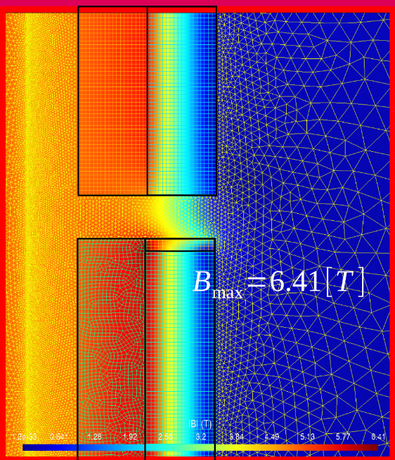
Highlights 2025 (Design)
Simulates quench protection using a close-coupled secondary on stellarator scale
Investigation of Radiation Resilience in ReBCO Materials
A compact frozen-spin storage trap for the measurement of charged
particle EDMs at the Paul Scherrer Institute

Slide 10
…wishes for 2026…
Strengthen teamwork by finding projects for
cross-group collaboration

Slide 11
Thank you for your attention

