Slide 1
High-Field Magnets for Accelerators Material Processes and Instrumentation 2025 Highlights and Perspectives for 2026
Magnet Section Annual Meeting
D. Araujo, B. Auchmann, A. Brem, M. Crescenti, N. Kehl, C. Lindner, T. Michlmayr, C. Müller,
I. S. P. Peixoto, D. Sotnikov, A. Stampfli, Y. Studer and J. Van den Eijnden and A. C. Zurita
This work was performed under the auspices of and with support from the Swiss Accelerator Research and Technology (CHART) program. This work received financial support from and contributed to the HFM Programme, hosted at CERN.
12 December 2025

Slide 2
Agenda
Conclusion of the CHART MagDev2 Project and MagDev3 Perspectives for 2026
BOX Programme
subSMCC2: subscale Stress-Managed Common Coils magnet 2
Winding, Impregnation, and Pre-Load Processes
subSMACC: subscale Stress-Managed Asymmetric Common Coils magnet
Winding, Impregnation, Splicing, and Cooling-Circuit Pressure Tests
SMACC1: Stress-Managed Asymmetric Common Coils magnet 1
Former Coating and Bladder-and-Key Trials

Slide 3
Agenda
RS1: REBCO Subscale magnet 1 – standard common coils configuration
Soldering and Instrumentation
RS2: REBCO Subscale magnet 2 – modified common coils configuration
REBCO Cable Development
CHART/MagMu
CHART/MagNum2
Participation in the CHART/P3 and CHART/HTS4
Lab reorganization

Slide 4


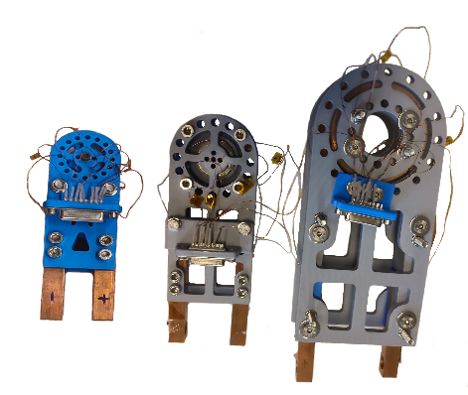
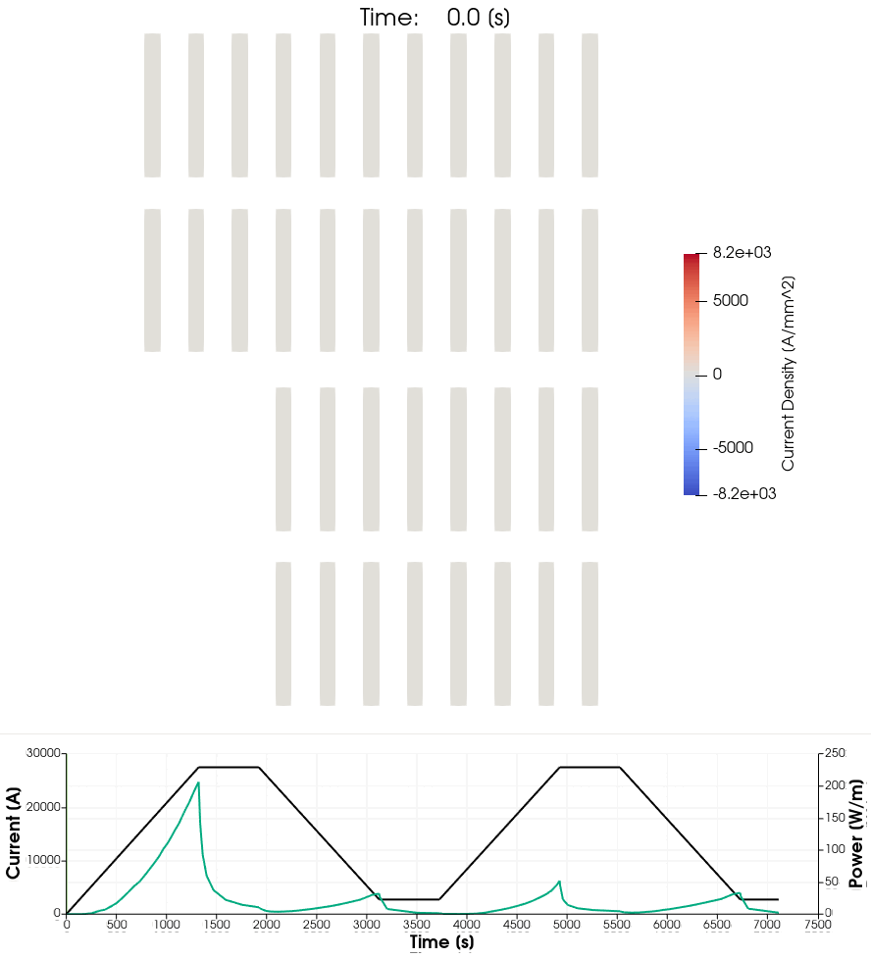
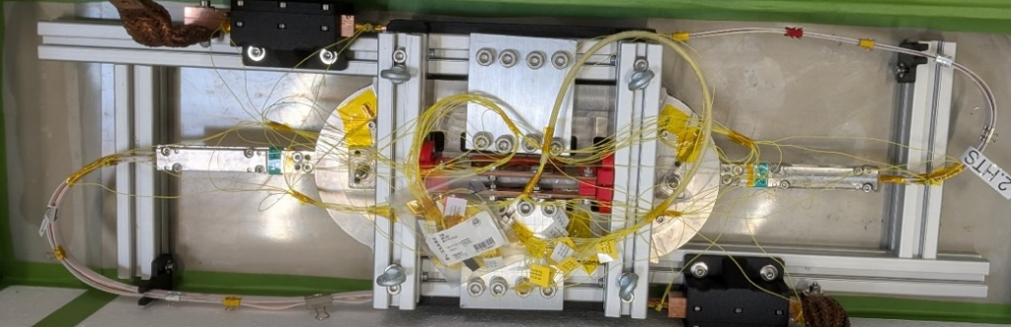
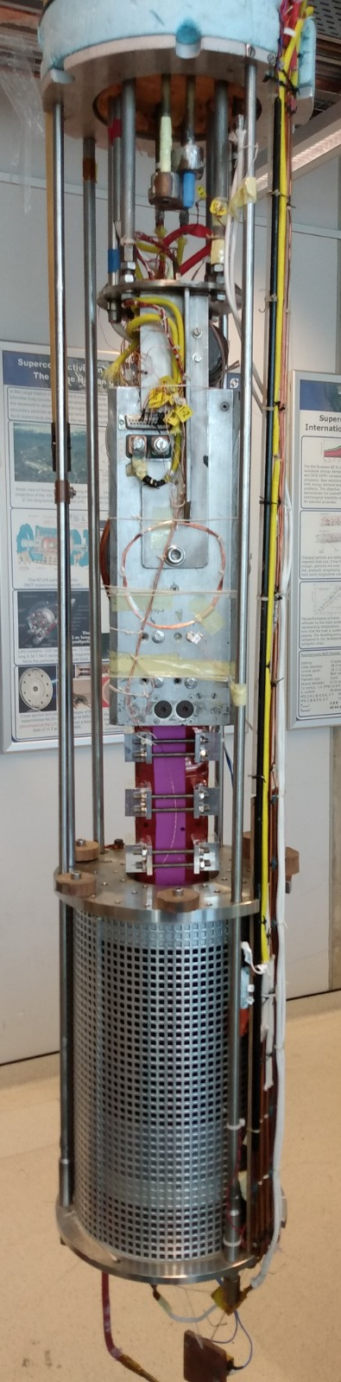
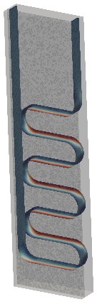
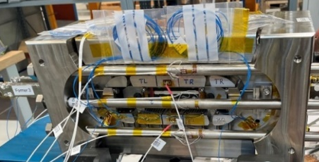
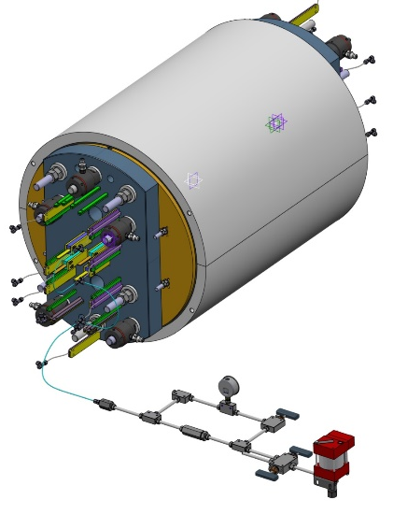
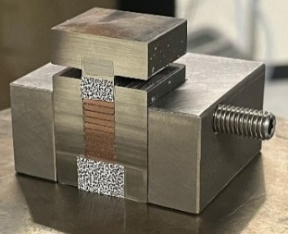
Conclusion of the CHART MagDev2 Project
RD2* | D1 | HTS Roadmap Conceptual Report
RD2 | D2 | REBCO Cable Test Report
RD2 | D3 | Technology Racetrack Test Report
RD3 | D1 | BOX Powered-Sample
RD3 | D2 | subSMCC1
RD3 | D3 | SMACC1 Conceptual Design
RD3 | D4 | SMACC1 Technical Design
RD3 | D5 | Reel-to-reel Inspection and Stack Characterization of Cables
HFM-PUB-RPT-0267 v.1 "Deliverables KE5943 / PSI-D2.1”, EDMS 3028682
Baby HTS, D. Sotnikov
subSMCC
10-stack,
J. Van den Eijnden
X. Kong
Double Racetrack tested at PSI
C. Linder,
A. Stampfli et al.
SMACC1, T. Michlmayr
BOX Programme
A. Brem, UT team et al.
*RD refers to the Research and Development lines of the HFM Program (https://hfm.web.cern.ch).

Slide 5

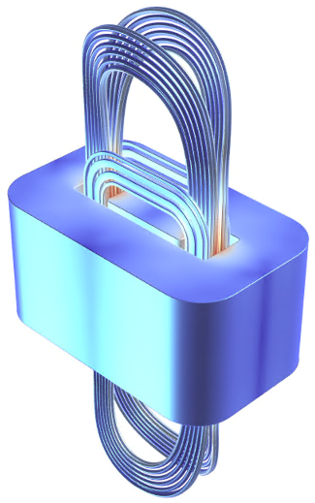
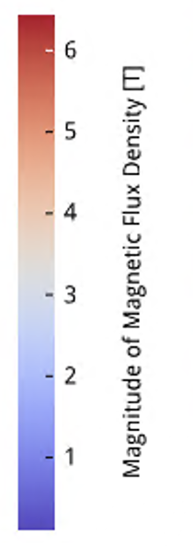
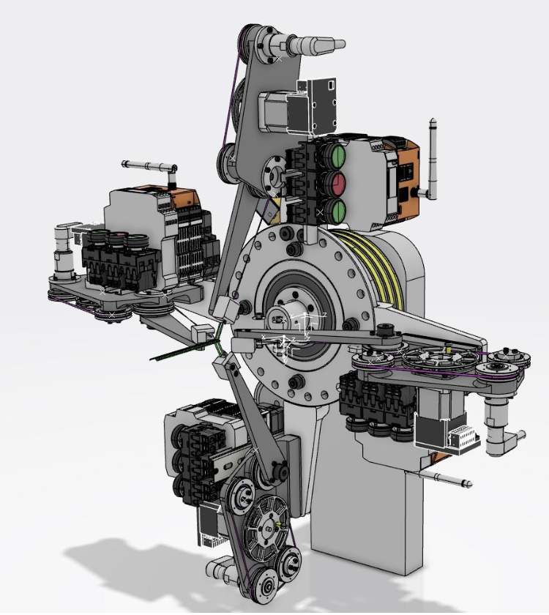
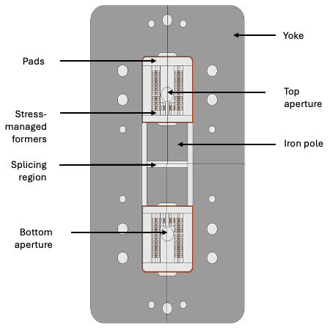
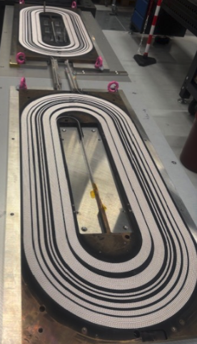
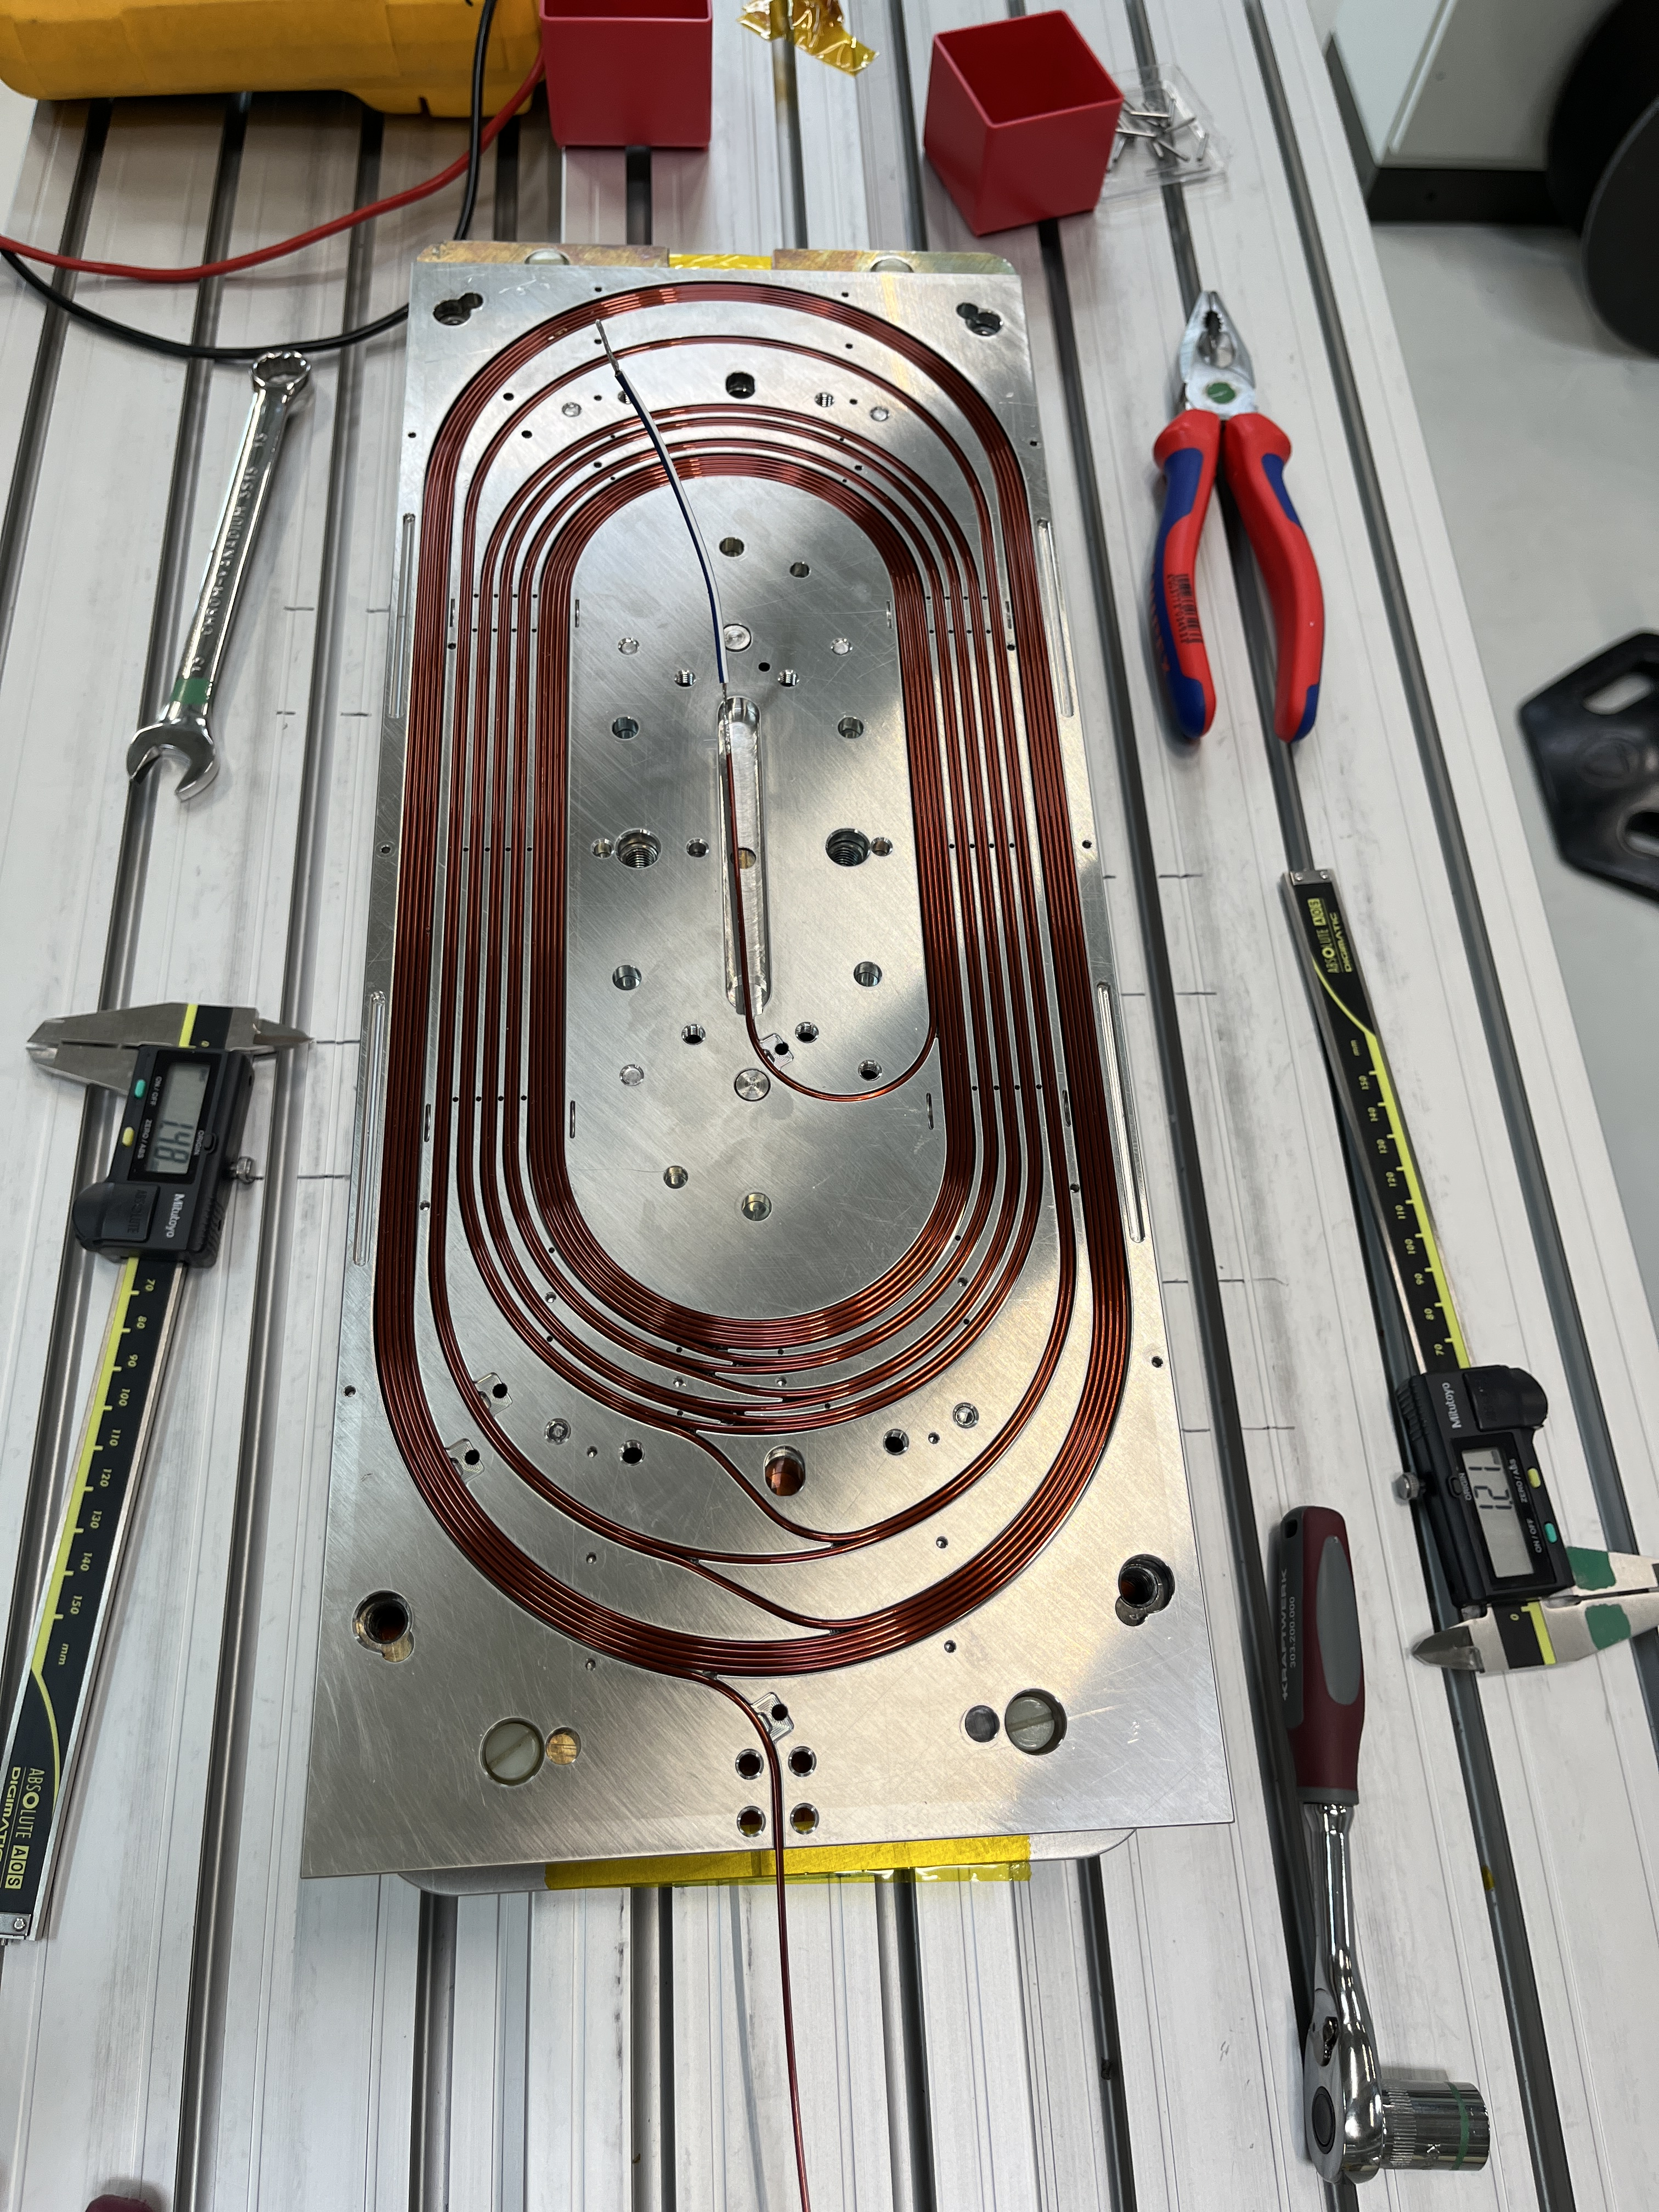

CHART MagDev3 Perspectives for 2026
RS1 | Magnet Assembly and Tests at PSI (LN₂) and CERN (4.5 K and 20 K)
RS2 | Conceptual Design Finalization, Coil Manufacturing Development, and LN₂ Testing
REBCO Cable Development | Short-Length Sample Production and LN₂ Testing
subSMCC2b | Magnet Test at CERN
SMACC1 | Coil Manufacturing and Structural Parts Completion, Assembly, and Testing at CERN
subSMACC | Finalization of the Engineering Design, Complete Magnet Manufacturing, and Assembly
A. C. Zurita et al.
I. S. P. Peixoto et al.

Slide 6




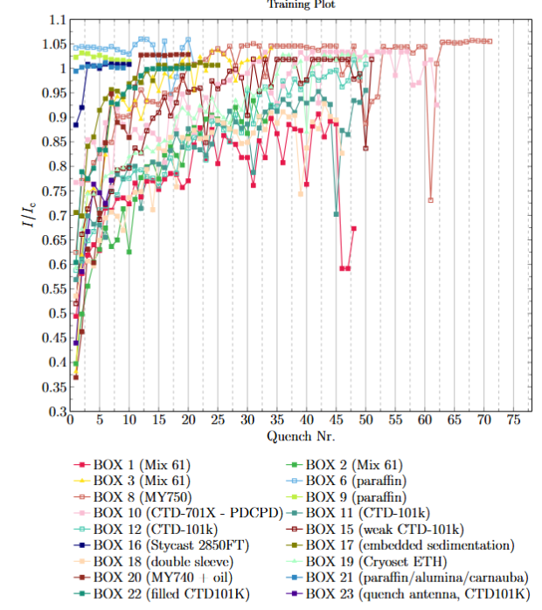
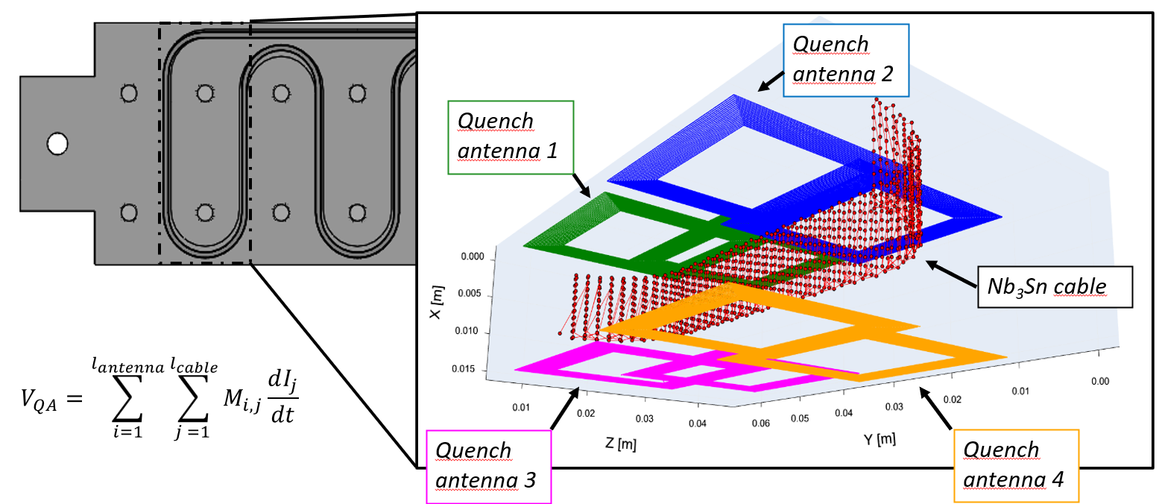
BOX Program - Standard BOXES
Standard BOX upgraded with quench antenna (UT)
First BOX test from CERN (POLAB) in January 2026
subscale RRP and high-cp BOX test (LBNL, FermiLab, CERN and UT)
REBCO BOX with RS1 cable in 2026

Slide 7
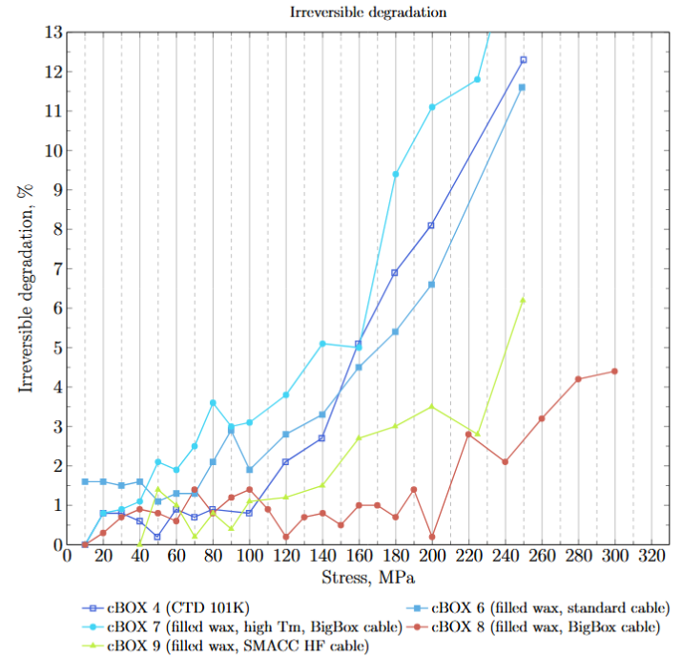
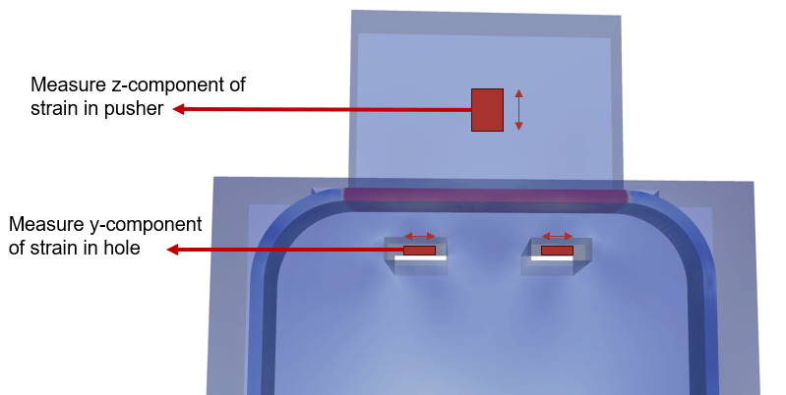
BOX Program – Compression BOXES
Compressio BOX upgrade with additional strain gauges
cBOX adapted to different cable geometries
test for cable performance in current and future projects

Slide 8
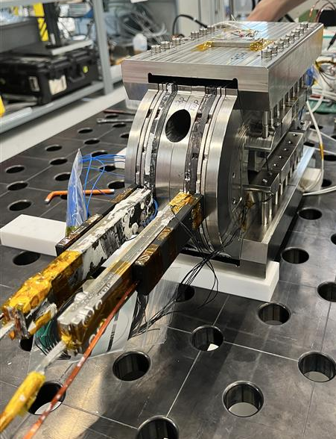
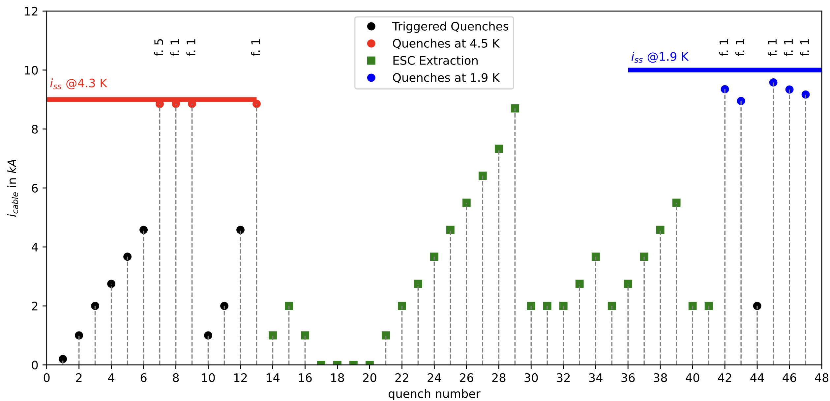
subscale Stress-Managed Common Coils magnet 2
The test was conducted at CERN, with data provided by V. di Capua and colleagues.
During the integration of the magnet into the cryostat insert and cool-down, at CERN, a weak spot appeared between one of the four ESC coils and the magnet mass.
Coils 1 and 2 showed a perfect memory over the thermal cycle and re-assembly.
Additional work on the magnet measurements and rotating-coil alignment is needed to conclude on the magnet’s field quality.

Slide 9
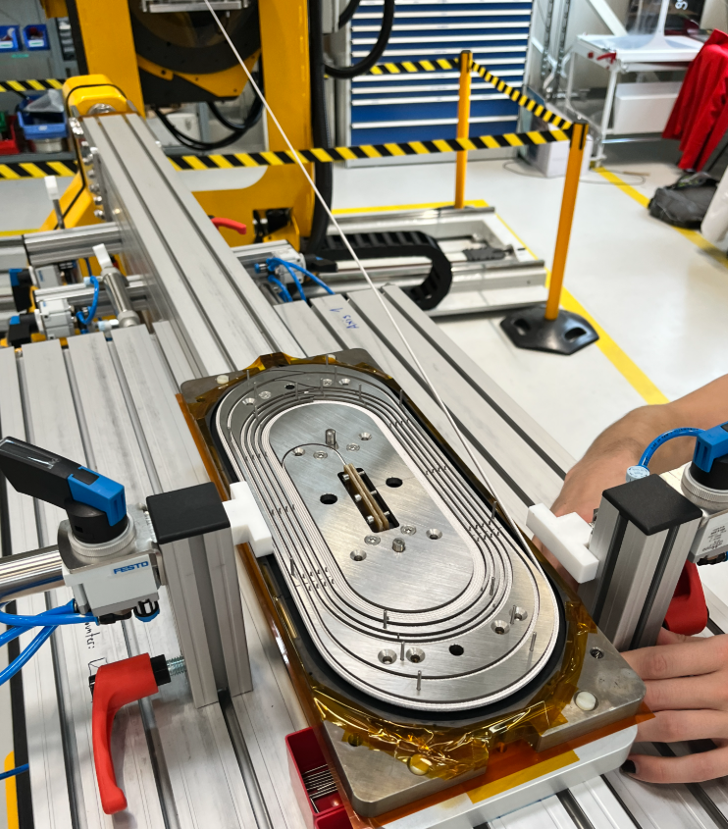
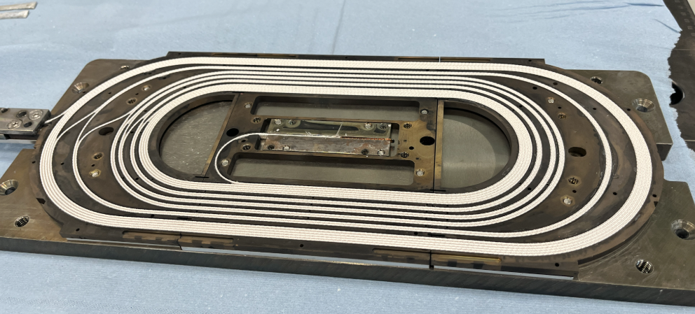
subSMCC2: Winding

Slide 10
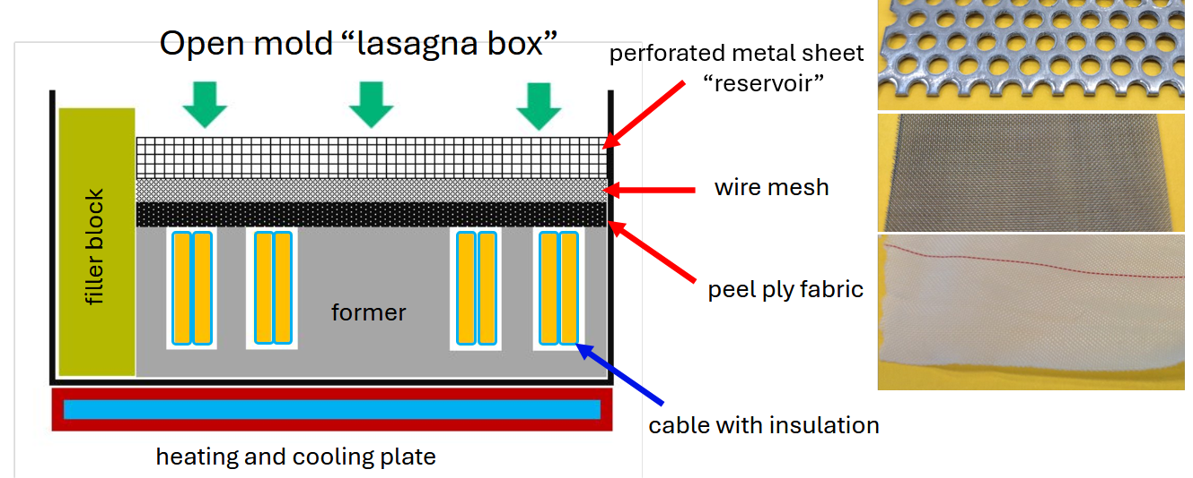
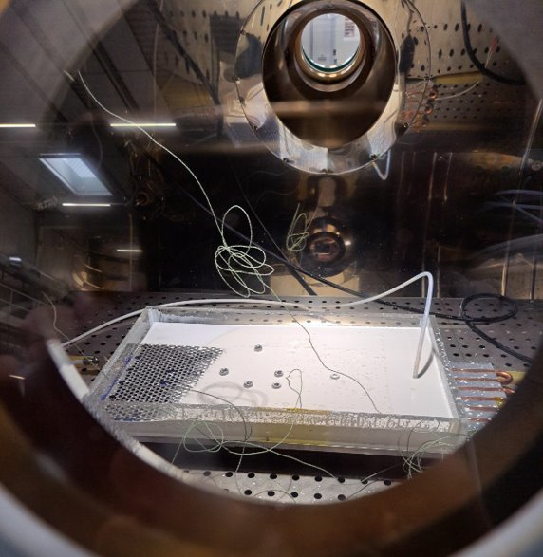
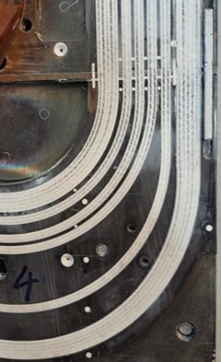
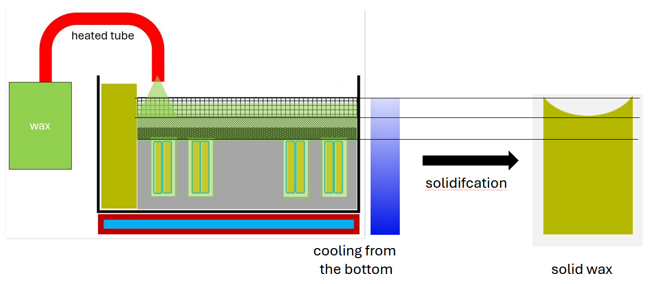
subSMCC2: Impregnation

Slide 11
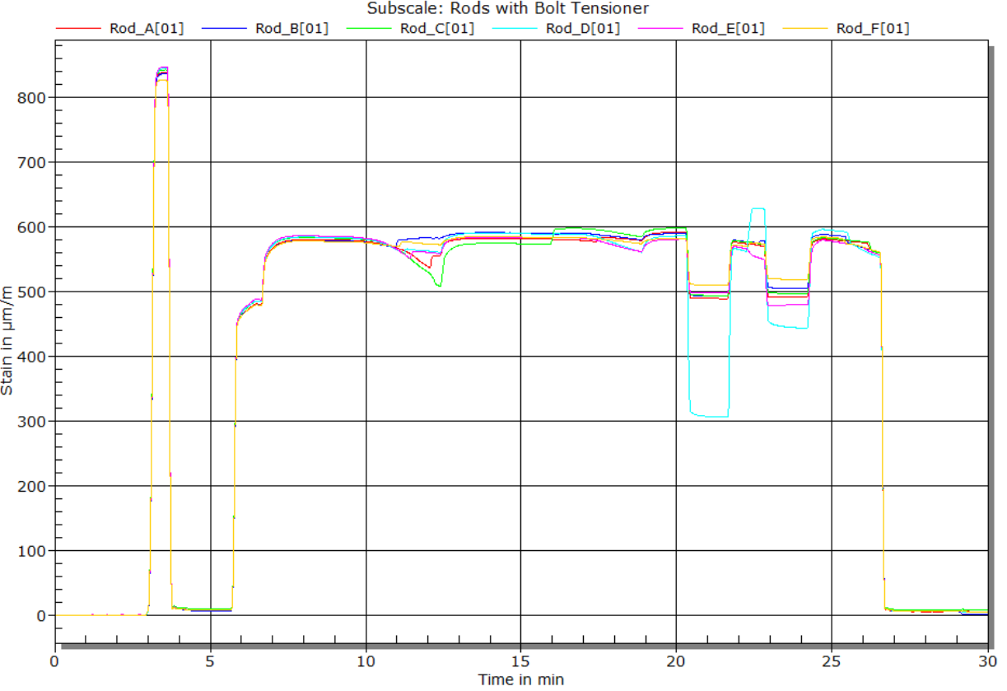
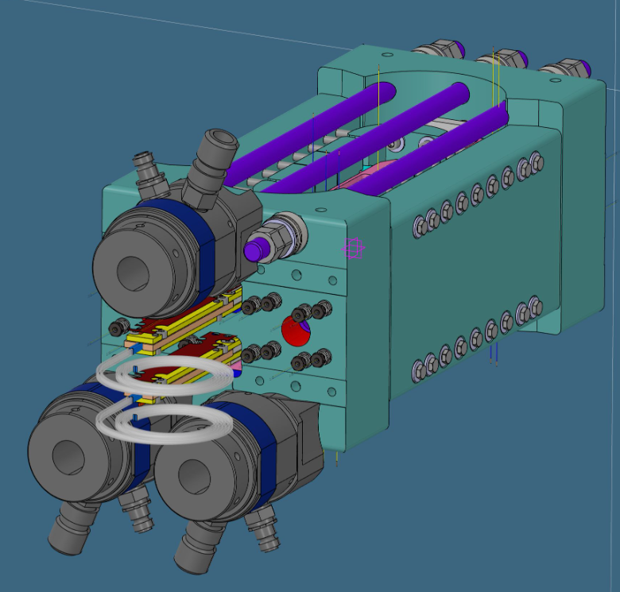
subSMCC2: Pre-Load Processes

Slide 12
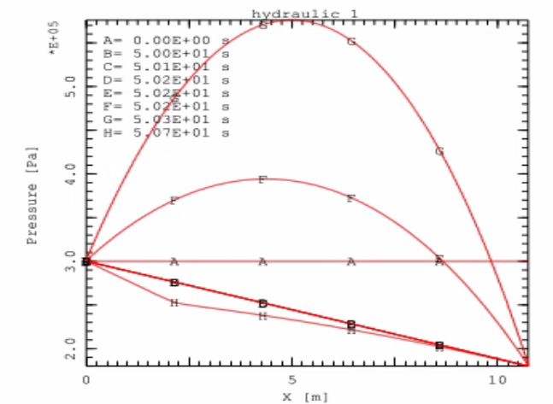
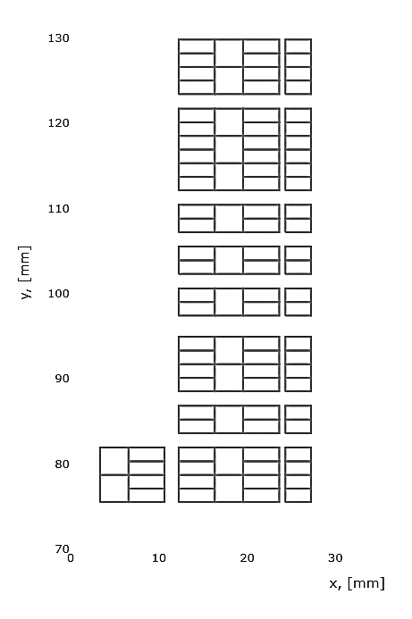
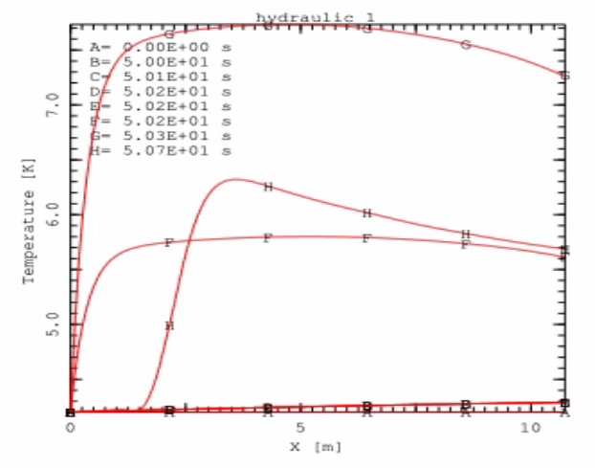
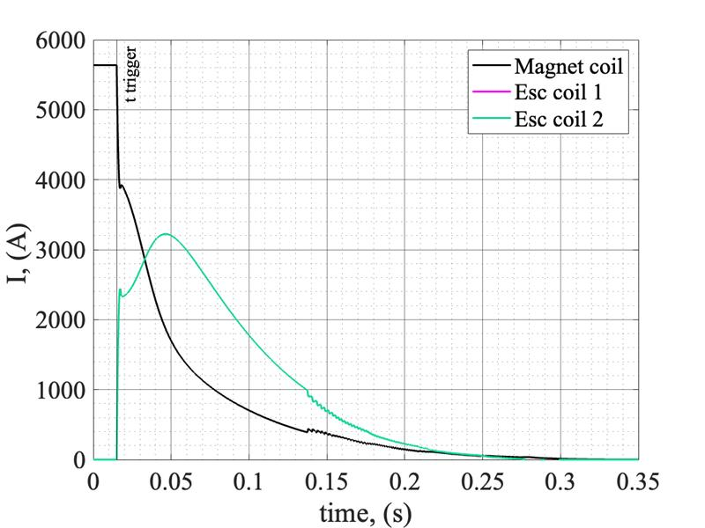
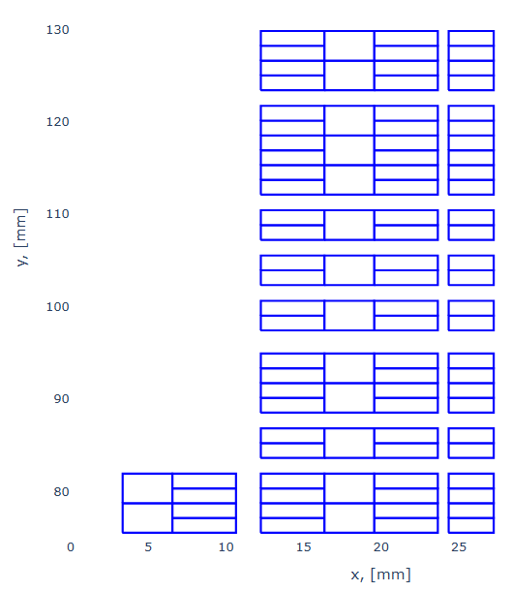
subscale Stress-Managed Asymmetric Common Coils magnet
THEA, Support on forced-flow simulation from D. Biek and K. Sedlak from EPFL/SPC and L. Bottura from CERN
The goal is to design, manufacture, and test a subscale, stress-managed, asymmetric common-coil magnet to demonstrate the following:
a mechanical structure suitable for high-field magnets using collars and yoke;
the elimination of rods in high-field magnets to react the axial forces;
the combined use of Cu-based auxiliary coils for cooling and protection.
On top of the 2D and 3D magnetic and mechanical models, the development of quench-protection and forced-flow models was carried out to complete the magnet design.
Nb₃Sn
Cu
Magnet current is fully discharged to the ESC unit
ESC coil 1
y
ESC coil 2
x
Cooling / ESC coils
ESC coils
I. S. P. Peixoto et al.

Slide 13
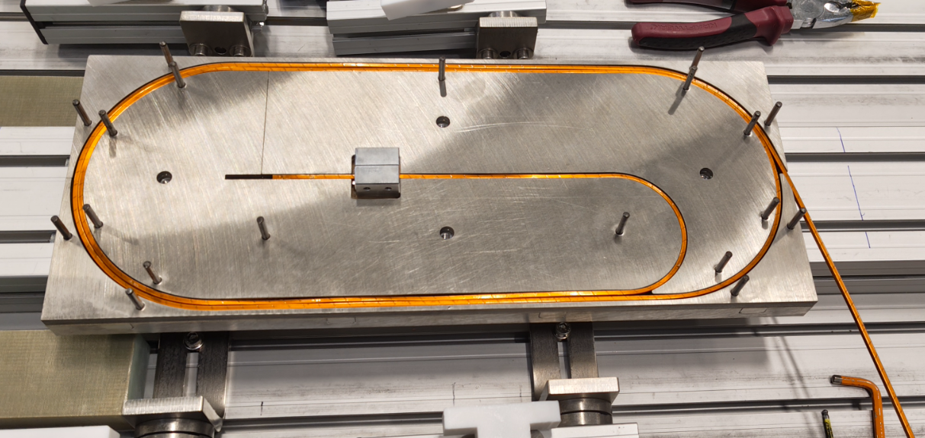
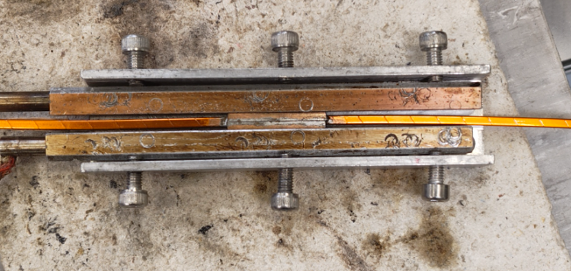
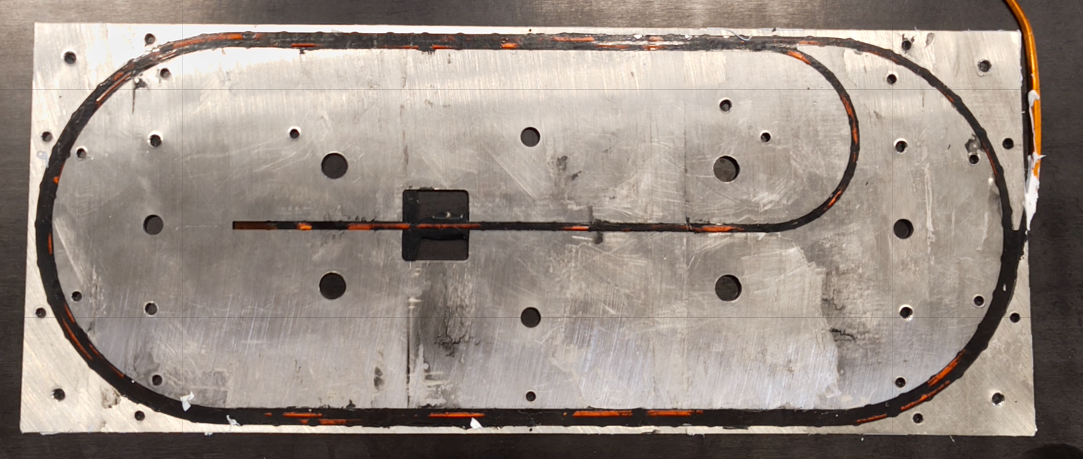
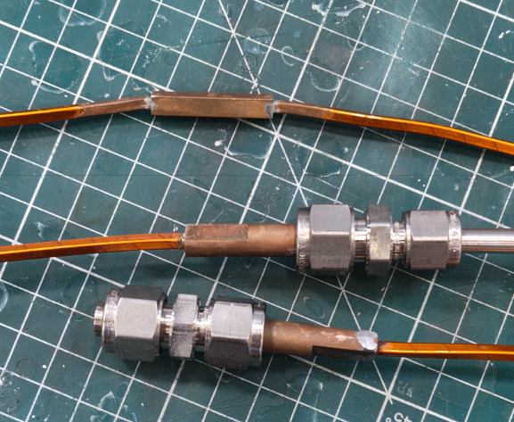
subSMACC: Winding, Impregnation, Splicing, and Cooling-Circuit Pressure Tests
successful pressure tests up to 20 bar of He together with Quentin

Slide 14
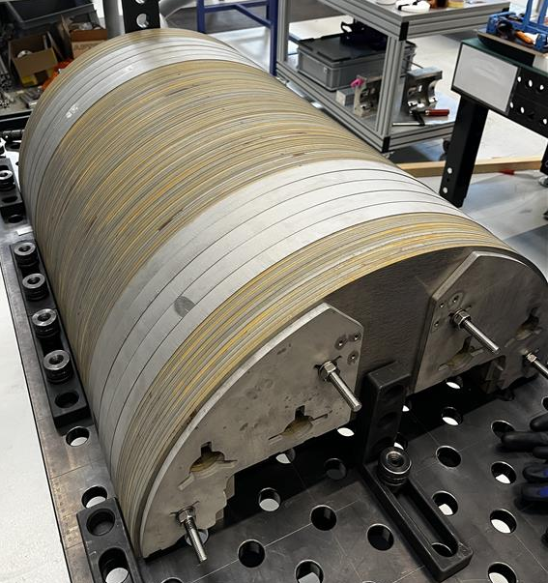
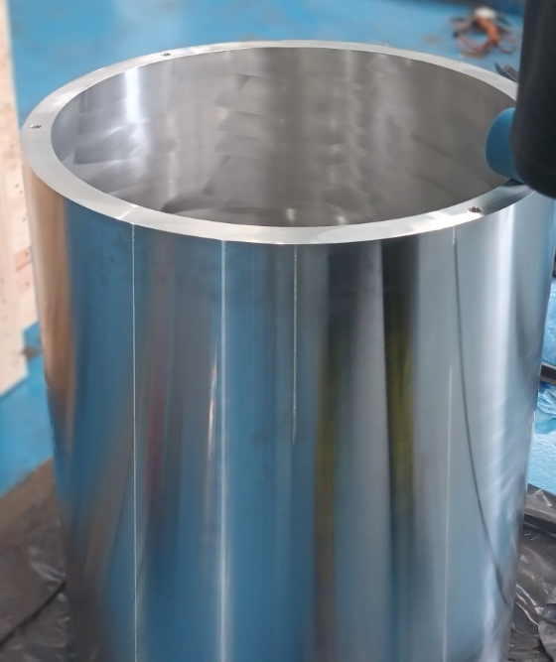
SMACC1: Stress-Managed Asymmetric Common Coils magnet
The goal is to design, manufacture, and test a stress-managed, asymmetric, intermediate-field common-coil magnet to demonstrate the following:
the feasibility of the stress-managed common-coil configuration with respect to all coil-manufacturing aspects;
the assessment of magnet performance with respect to engineering margin, field-quality reproducibility, and endurance;
the use of recently developed technologies, such as the fielded-wax impregnation system and ceramic-coated formers.
Overall manufacturing status:
coil tooling completed;
two of eight coils wound nonconformities in the parts order are delaying coil fabrication;
components waiting to be machined at the PSI workshop: yoke and end plates;
ongoing production of pads and reaming of structural parts (C. Müller).
2 x SMACC1 Layer 2 SM Nb₃Sn coils
One of the two half-yokes assembled
SMACC1 stainless-steel shell
39.65 mm thick

Slide 15
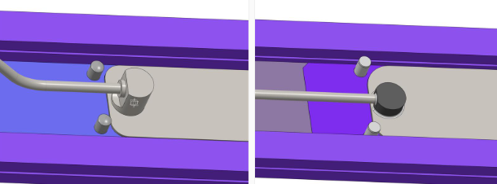
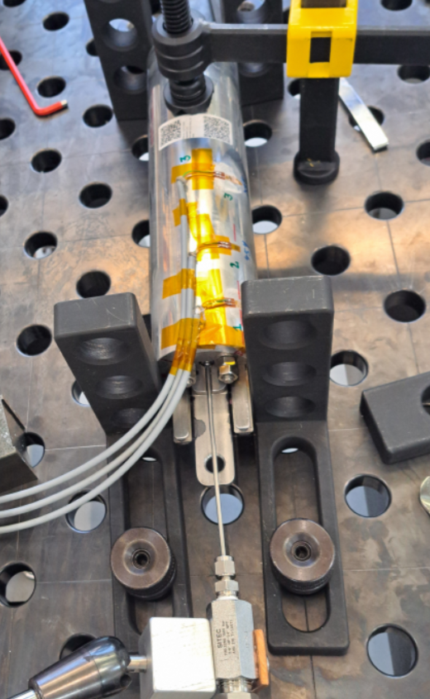
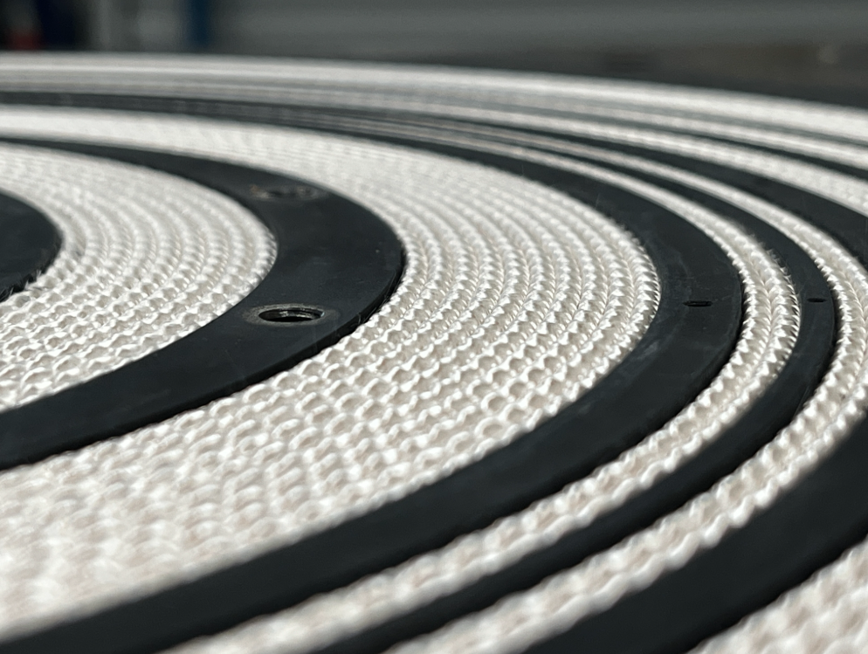
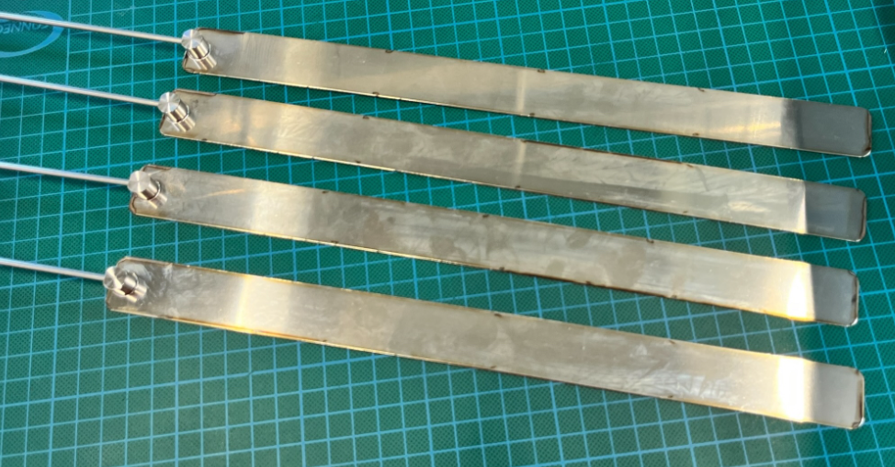
SMACC1: Former Coating and Bladder-and-Key Trials
3 cycles (flattening of bladder between cycles)
500 bar
2x 500 bar
burst at 750 bar

Slide 16
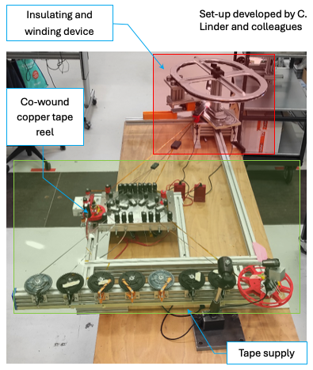
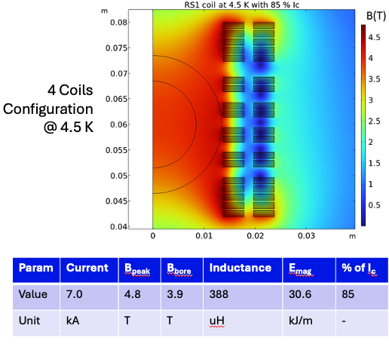
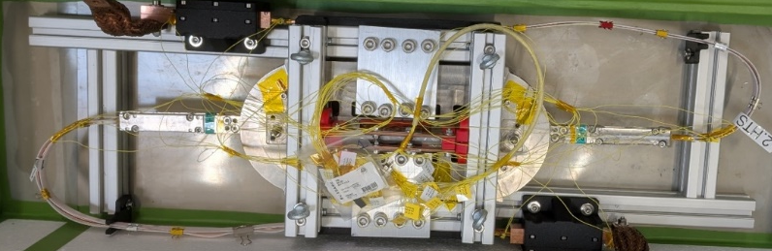
REBCO Subscale magnet 1 (RS1)
The goal of the RS1 magnet is to manufacture and test a REBCO insulated soldered-tape-stack cable–based magnet with the following features: a double-aperture REBCO magnet and REBCO stress-managed impregnated coils.
On the process side, we aim to develop cabling and winding, soldering, and layer splicing techniques. The magnet uses the subSMCC coil geometry and magnet structure.
The tests at LN₂, 4.5 K, and 20 K will contribute to AC-loss modeling validation, protection studies, and the assessment of field quality and time constants.
LN₂ Test Results of Double-Racetrack at PSI (M. Duda)
Protection studied by D. Sotnikov and M. Woznick (CERN)

Slide 17
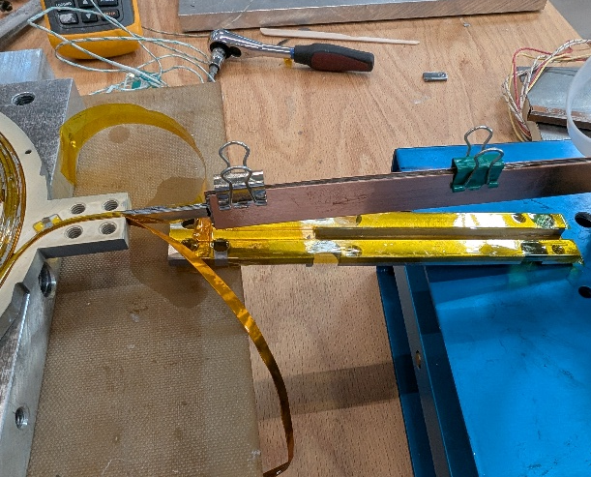
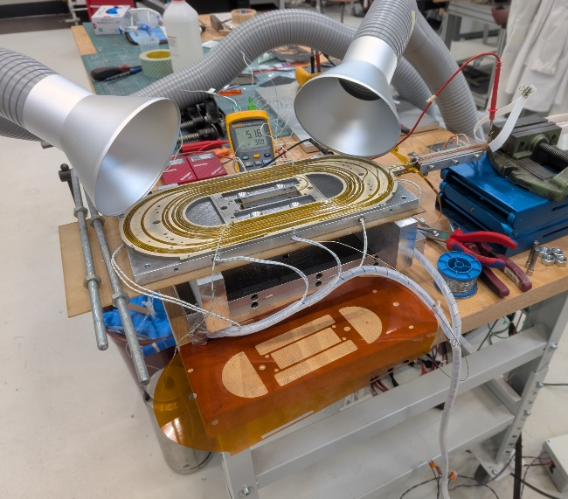
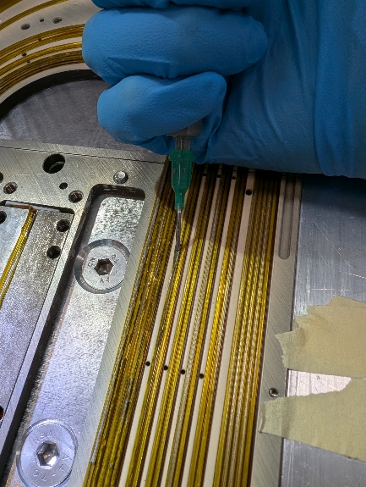
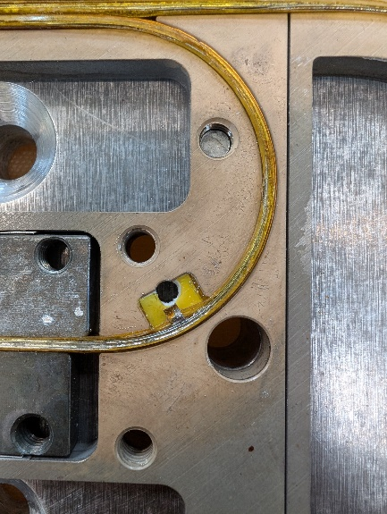



RS1: Soldering and Instrumentation
Applying soldering paste and flux
Pocket for voltage taps
ReBCO 12 mm-based leads and co-winding
Set-up with heaters
Soldering with thick plate, pre-heated with oven. T_{coil} = 194 °C.
Soldered coil Zoom showing the 6 blocks with 2 or 5 turns and co-winding
Process developed by A. Stampfli and colleagues
View of inner splicing process: heater and cable

Slide 18





REBCO Subscale magnet 2 (RS2)
The goal of the RS2 magnet is to conceptualize, engineer, manufacture, and test a double-aperture REBCO insulated (soldered) tape-stack cable–based magnet with a field-angle-optimized coil geometry.
The concept is to wind the high-field coils in a cos-theta style between the apertures, where each block of windings in the high-field region follows a path similar to a midplane block in a cos-theta dipole, but with elliptical ends. The low-field coils can be wound using a standard common-coil configuration.
The magnet tests should assess the impact of this coil geometry on engineering current density, AC losses, field quality, and time constants.
RS2 Ongoing Conceptual
Design
Racetrack winding
Each coil block is a “floor”
Bending after winding
https://indico.cern.ch/event/489475/contributions/1166833/attachments/1263291/1868932/

Slide 19






REBCO Cable Development
The MagDev3 REBCO work package also explores alternative cable and coil configurations to RS1 and RS2.
The goal is to manufacture a twisted (multifilament) REBCO cable, with a rectangular-core option being considered to match the SMACC concept.
N. Amemiya et al., “Effective reduction of magnetisation losses in copper-plated multifilament coated conductors using spiral geometry,” doi: 10.1088/1361-6668/ac3f9c.
A. C. Zurita
I. S. P. Peixoto

Slide 20

MagMu - project
Short mean lifetime of muons ( ) = new challenges, new technologies…
… for high luminosity, very high field superconductingmagnets 40+ T
Op. temperature: 4.5 K (forced flow LHe)
o Current ramp time ≤ 6 h
o Stored magnetic energy (@ 40T): ~ 4 MJ

Slide 21


MagMu - test, coating line

Slide 22






CHART MagNum2: goals and status
Thesis goals: Understand and predict influence of mechanical stress on Nb₃Sn conductor performance
Extension of submodelling framework to ReBCO
Planning: Start Finish
WP1: Thesis proposal Q2-24 Q1-25
WP2: Submodelling of Nb₃Sn Rutherford cable Q2-24 Q1-26
WP3: Submodelling of ReBCO based cable Q1-26 Q3-27
WP4: Dissemination Q2-24 Q1-28
Status: developed a validated multiscale model that captures the mechanical response and $I_{c}−$reduction of Nb₃Sn Rutherford cables under transverse loading. The approach provides will be applied to magnets designs and is currently being parametrized.

Slide 23



Participation in the CHART/P3, CHART/HTS4, and Proxima Projects
coating line
impregnation
design, Pb battery, instrumentation, assembly

Slide 24


Lab reorganization

