Slide 1
subSMCC2a: ongoing magnetic measurements and analysis being carried out at PSI
PSI/CERN LTS WP Progress Meeting
D. Araujo, B. Auchmann, A. Brem, N. Kehl, C. Lindner, T. Michlmayr, C. Müller, I. S. P. Peixoto,
A. Stampfli and J. Van den Eijnden.
This work was performed under the auspices of and with support from the Swiss Accelerator Research and Technology (CHART) program. This work was partially funded by the HFM program.
November 2025

Slide 2
Agenda
subSMCC2a test campaign
subSMCC2a cold magnetic measurements
subSMCC2a magnetic measurements at PSI

Slide 3


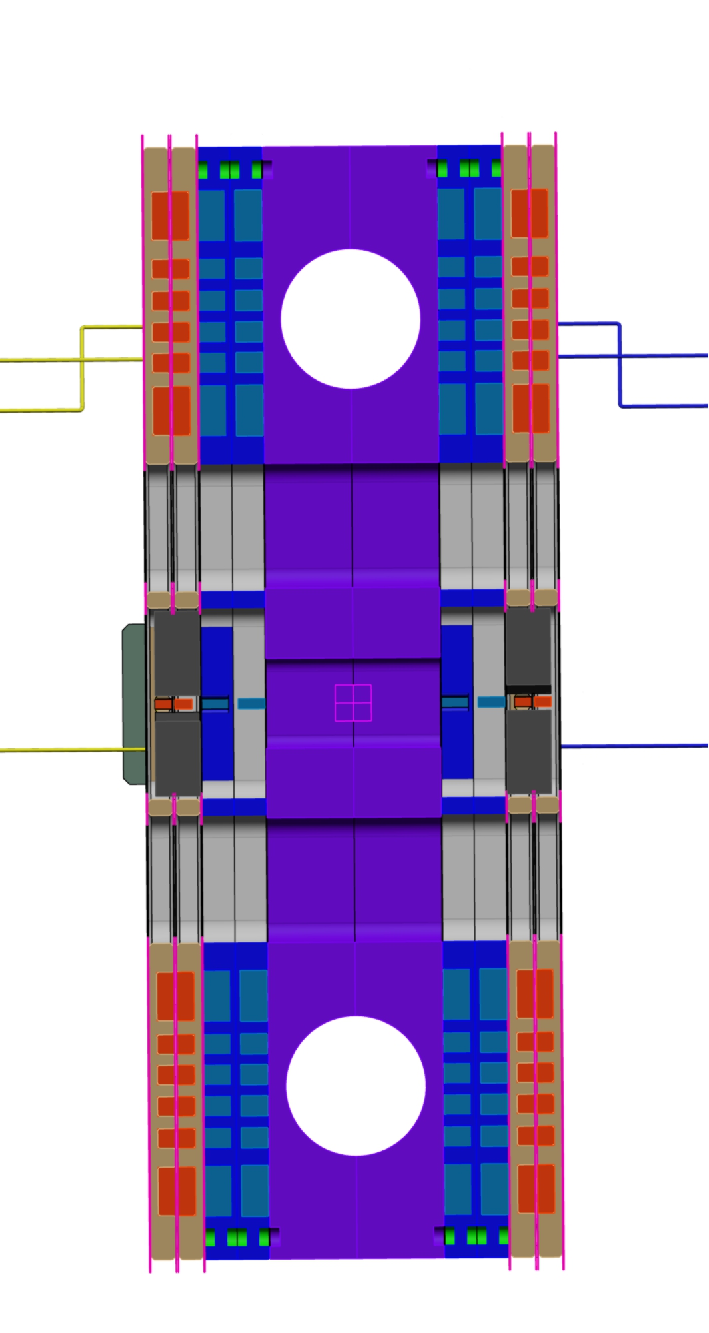
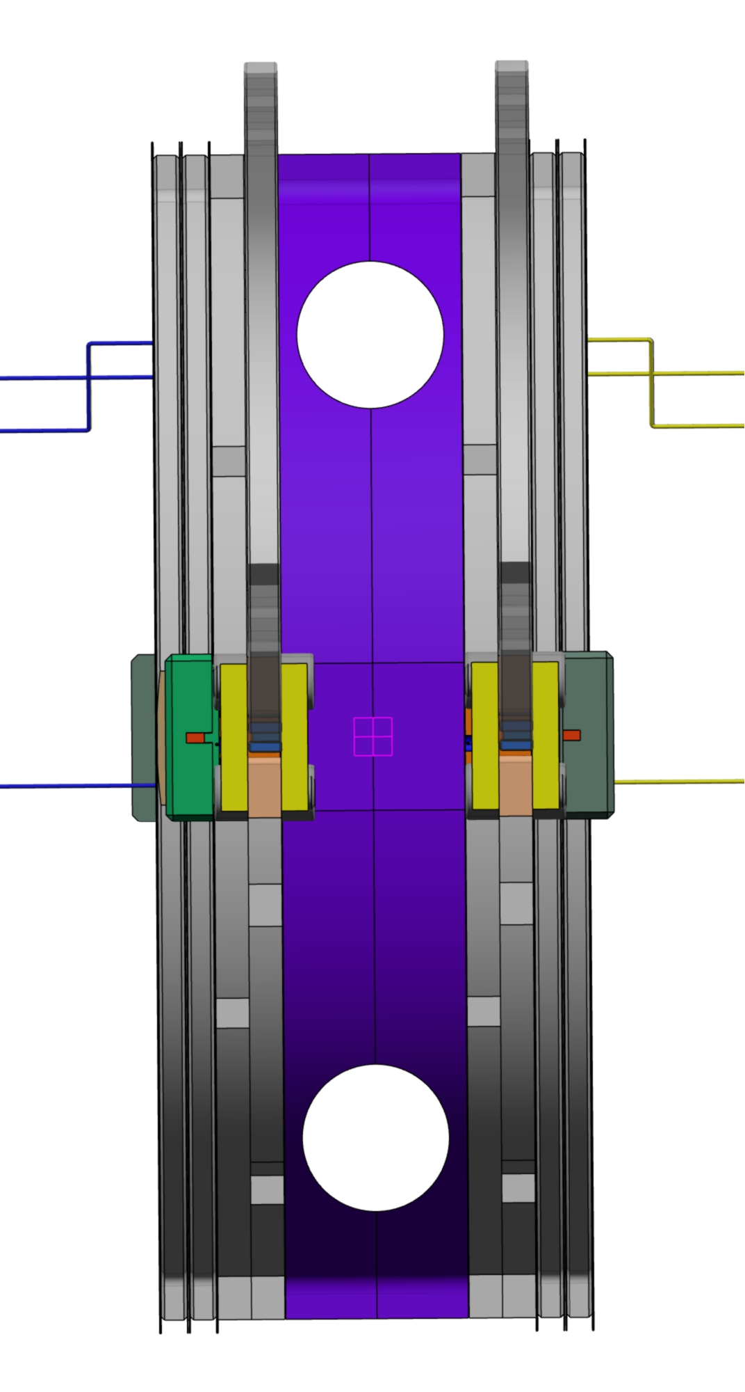
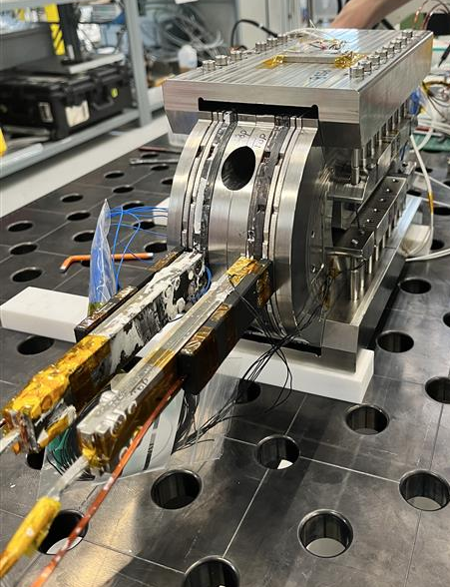
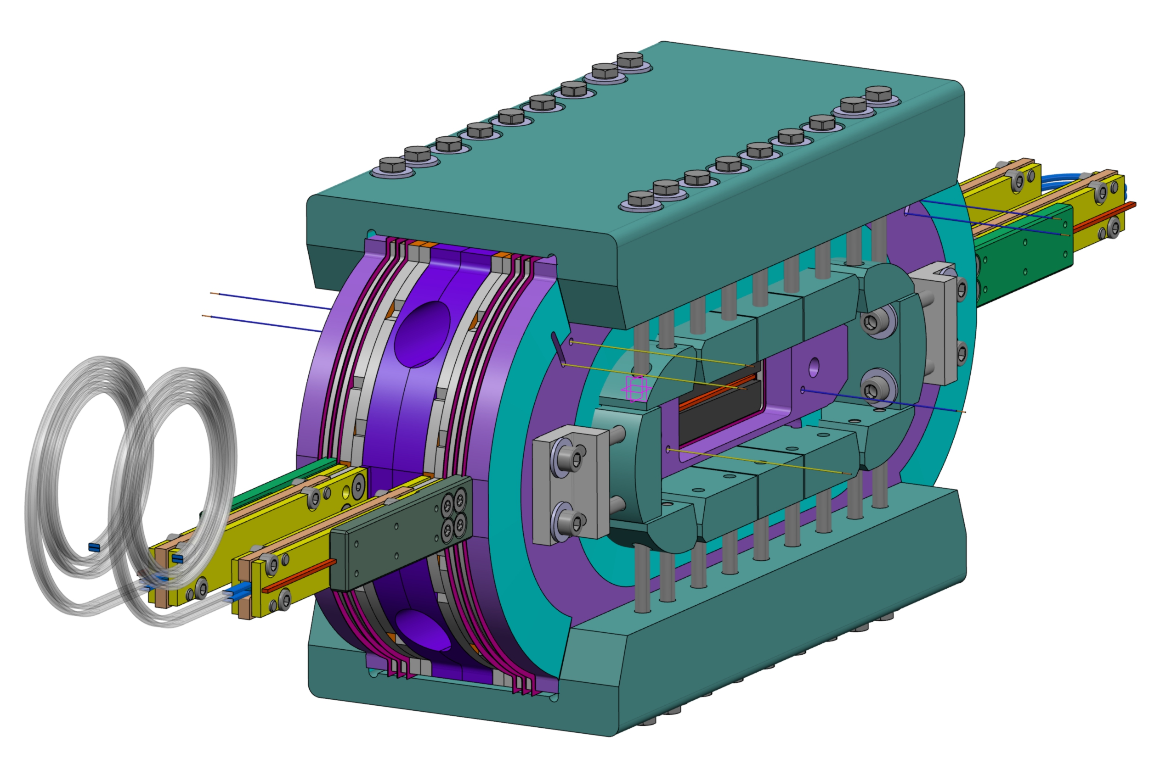
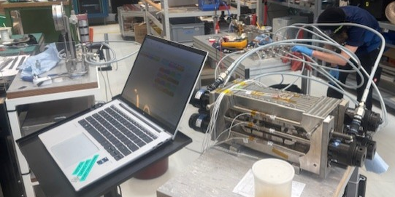
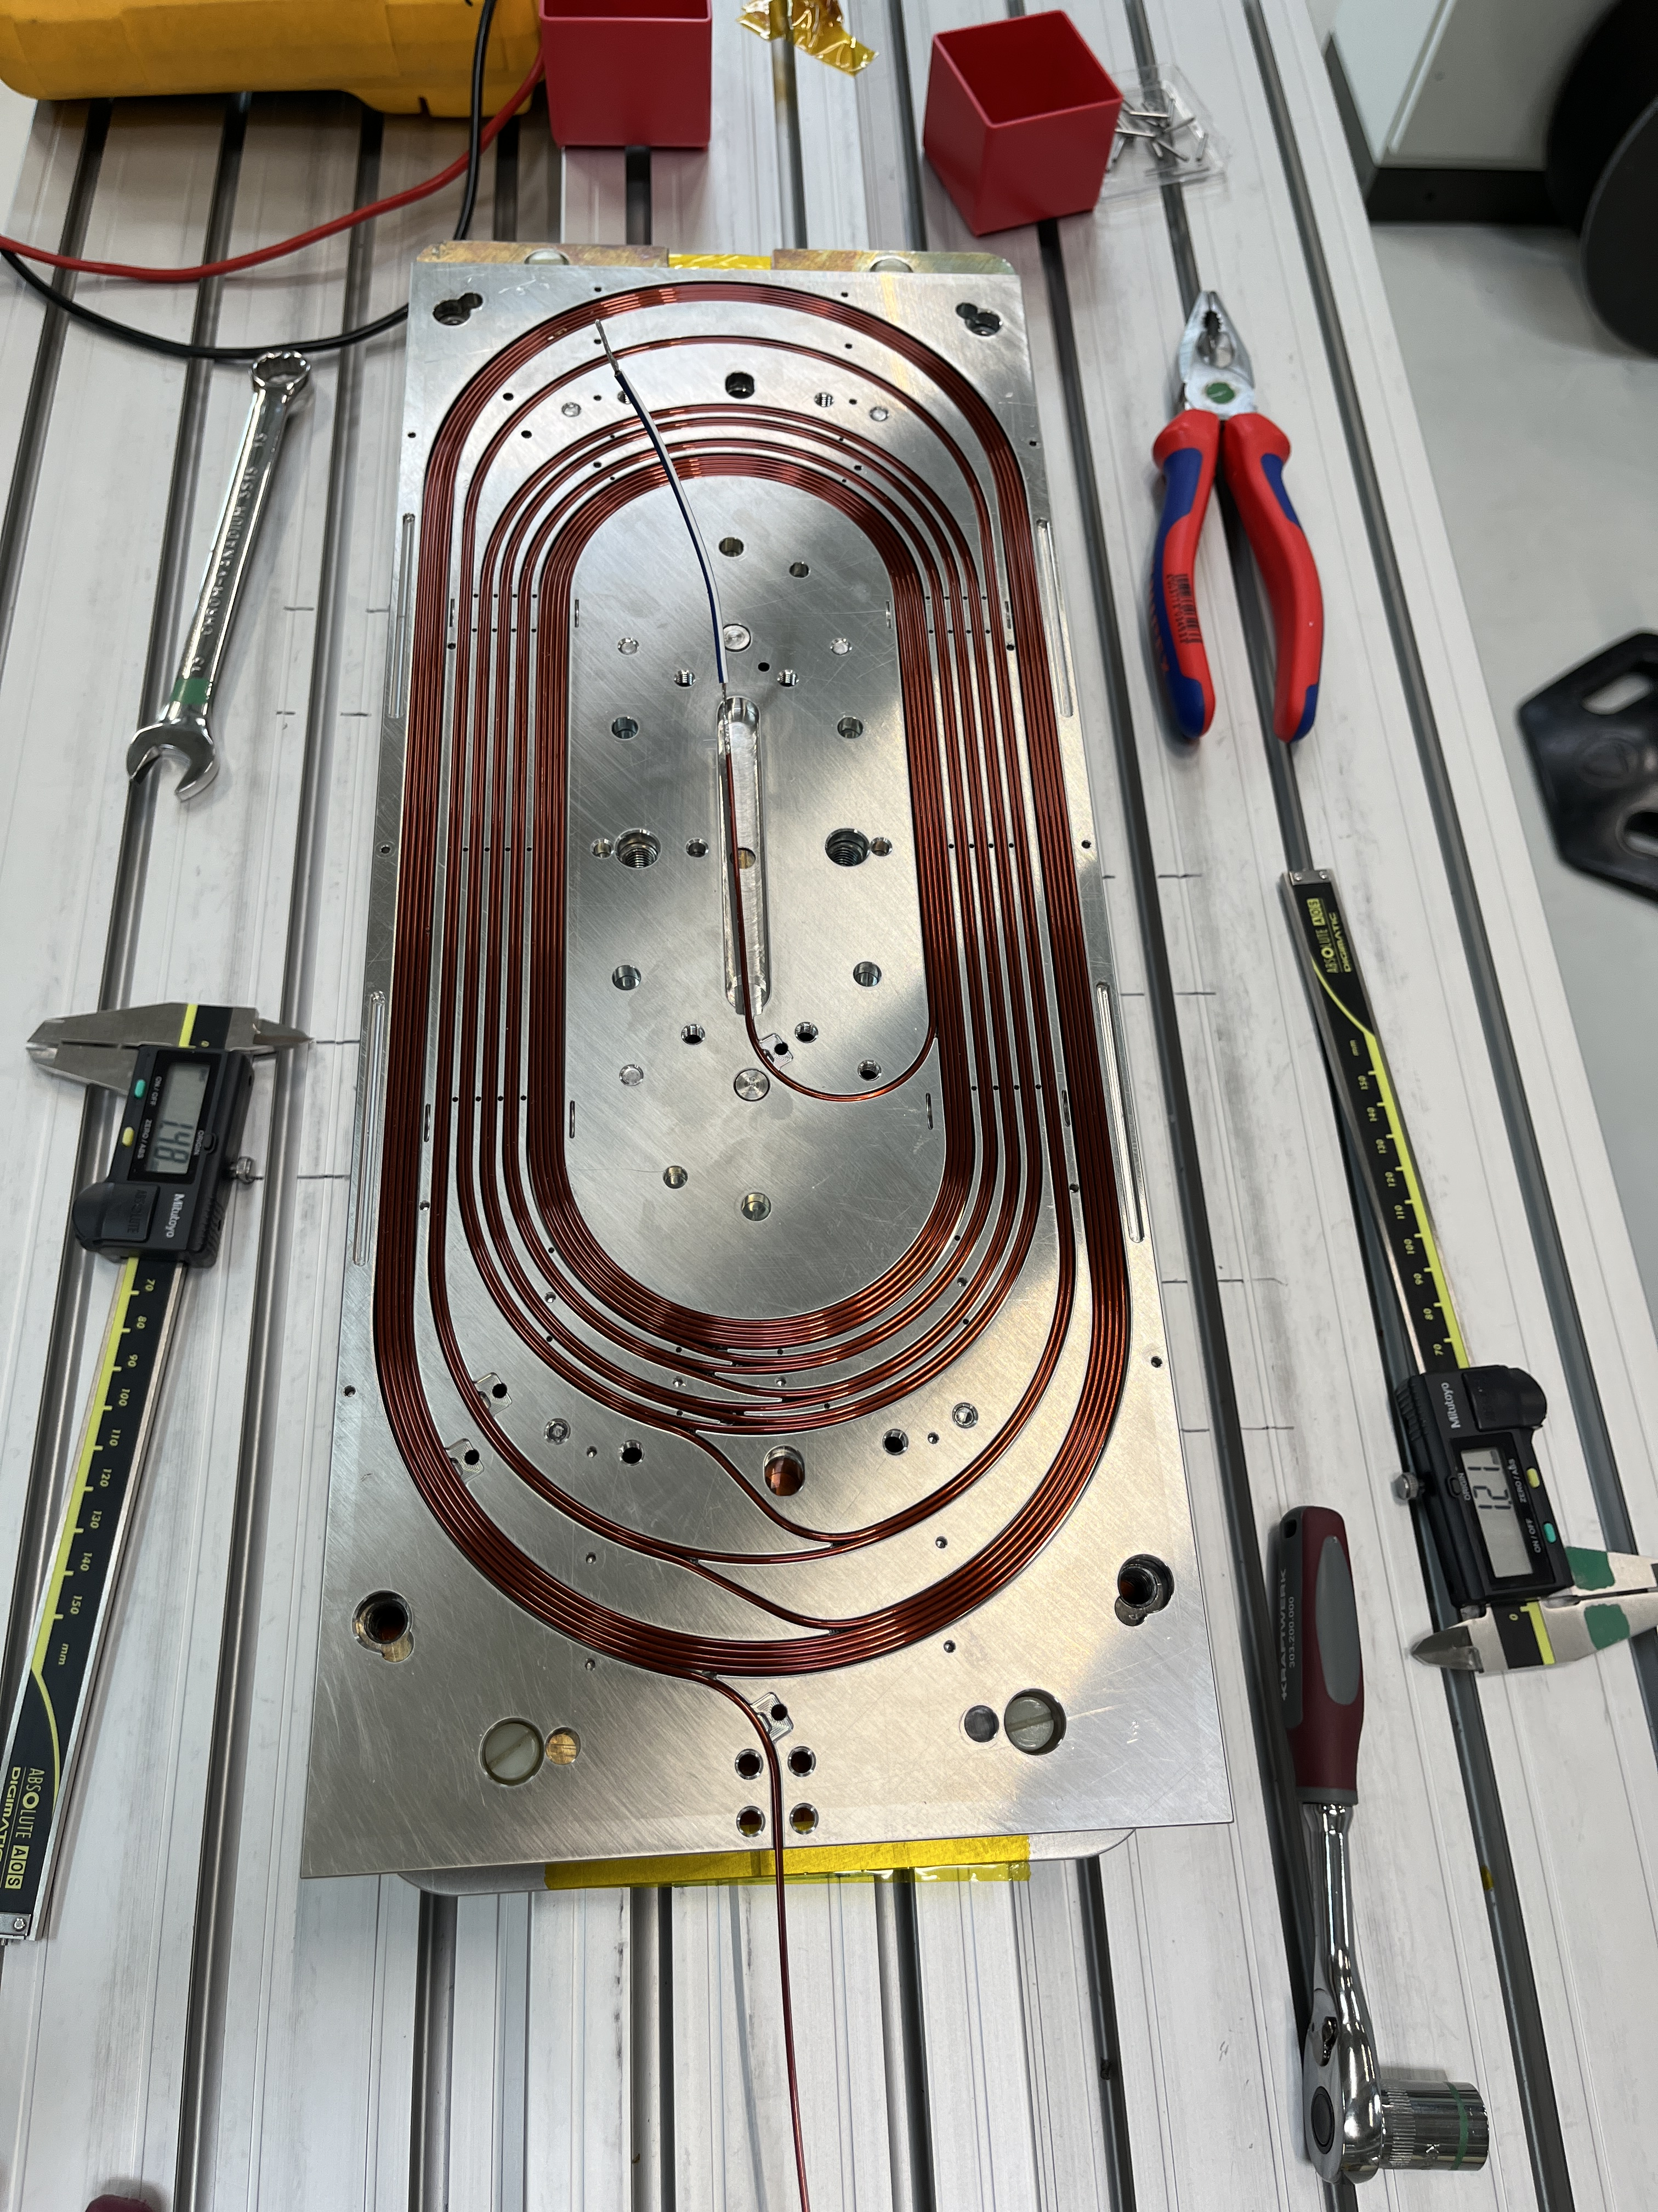
subSMCC2 test campaign
During the integration of the magnet into the cryostat insert and cool-down, at CERN, a weak spot appeared between one of the four ESC coils and the magnet mass.

Slide 4
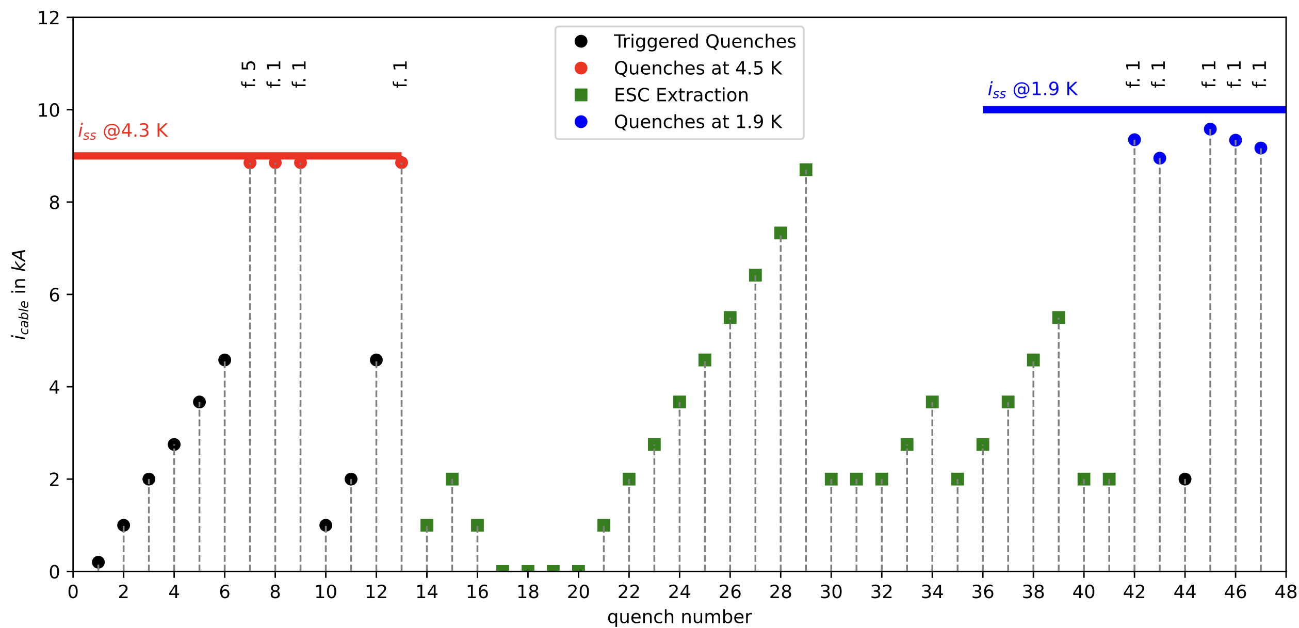

The test was conducted at CERN, with data provided by V. di Capua and colleagues.
Coils 1 and 2 showed a perfect memory over the thermal cycle and re-assembly.

Slide 5
Agenda
subSMCC2a test campaign
subSMCC2a cold magnetic measurements
subSMCC2a magnetic measurements at PSI

Slide 6
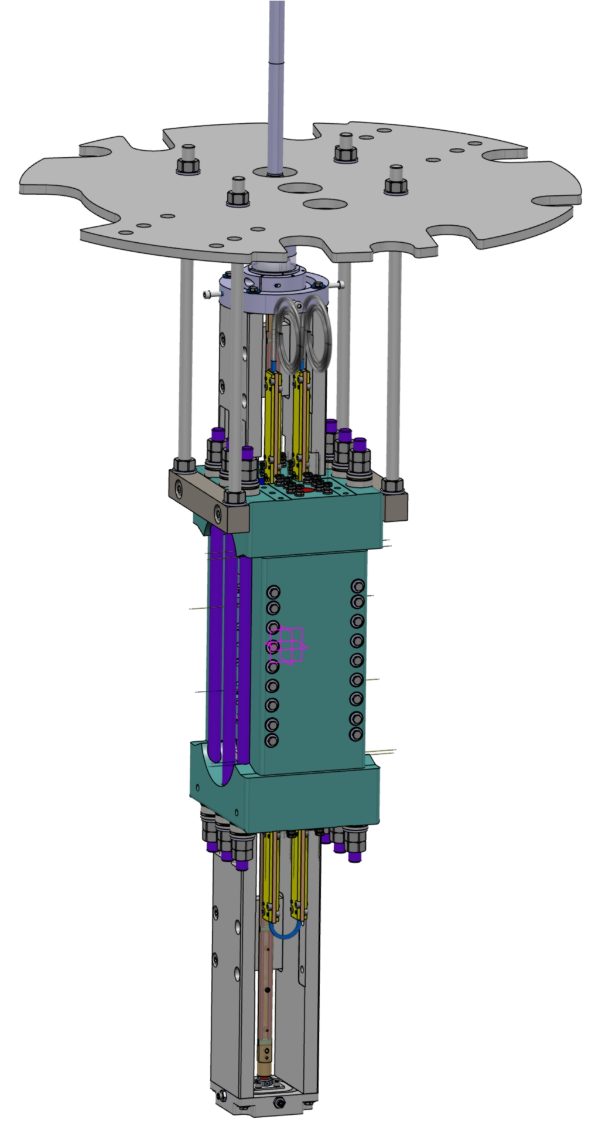
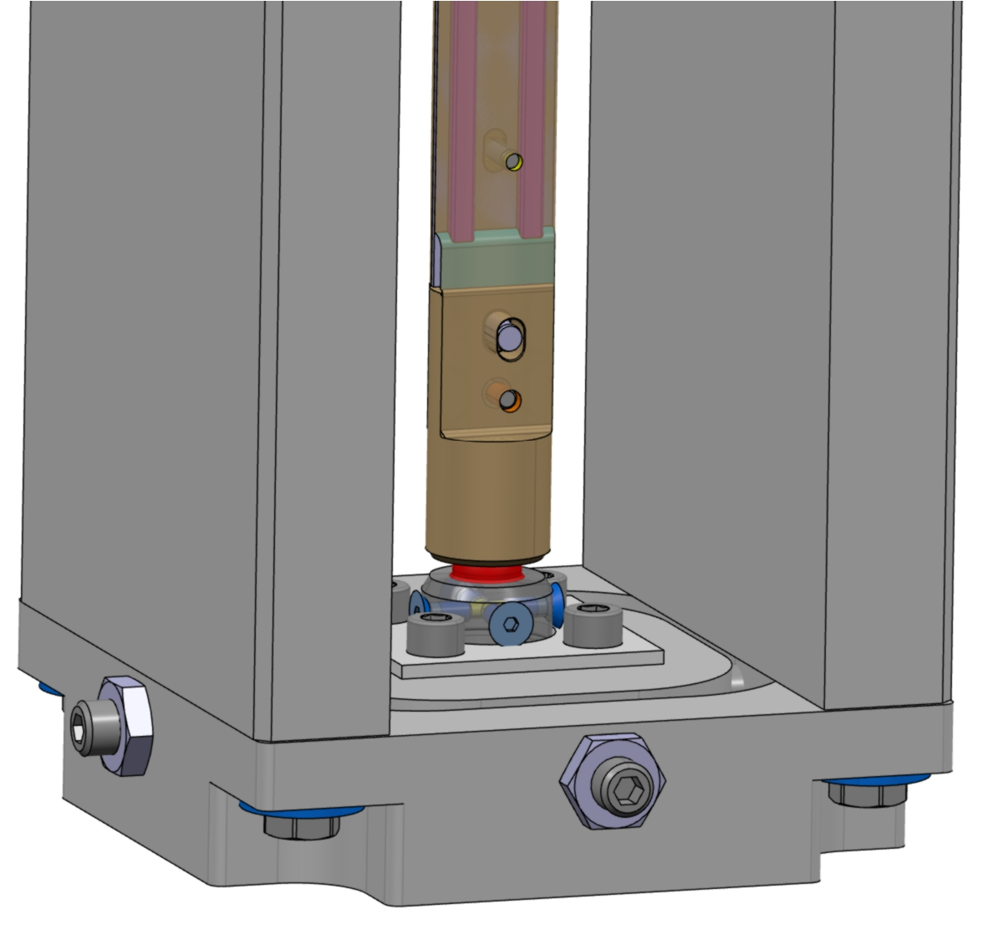
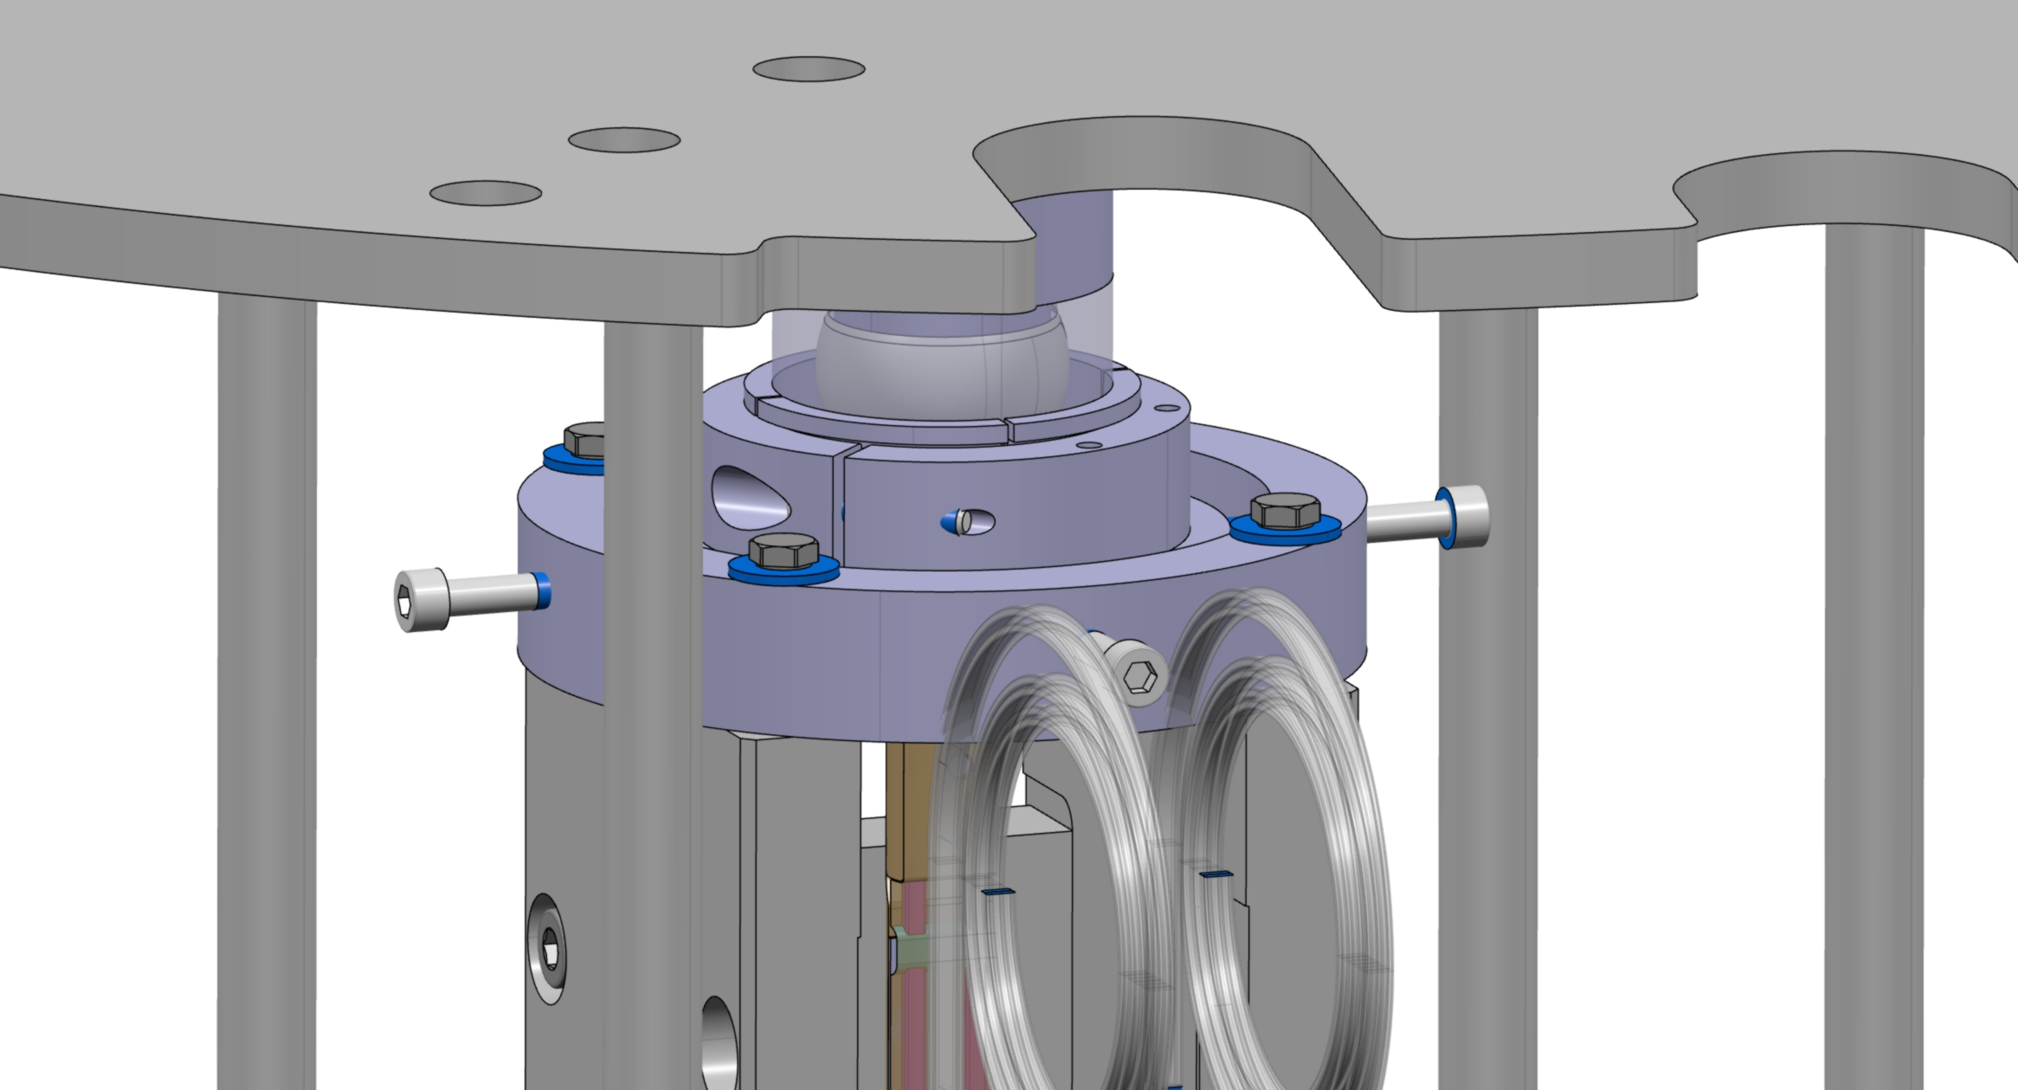
subSMCC2a cold magnetic measurements
Magnetic measurement performed at CERN with 5 segments magnetic shaft
subSMCC clear bore is 22 mm
Magnetic shaft diameter is 18 mm

Slide 7
subSMCC2a cold magnetic measurements
Parametric analysis with central segment +/- ~70 units / mm
The nominal value is on the order of 60 units, while the measured one is greater than 100 units.
Central segment length of ~145 mm
subSMCC clear bore is 22 mm
Magnetic shaft diameter is 18 mm

Slide 8
Agenda
subSMCC2a test campaign
subSMCC2a cold magnetic measurements
subSMCC2a magnetic measurements at PSI

Slide 9
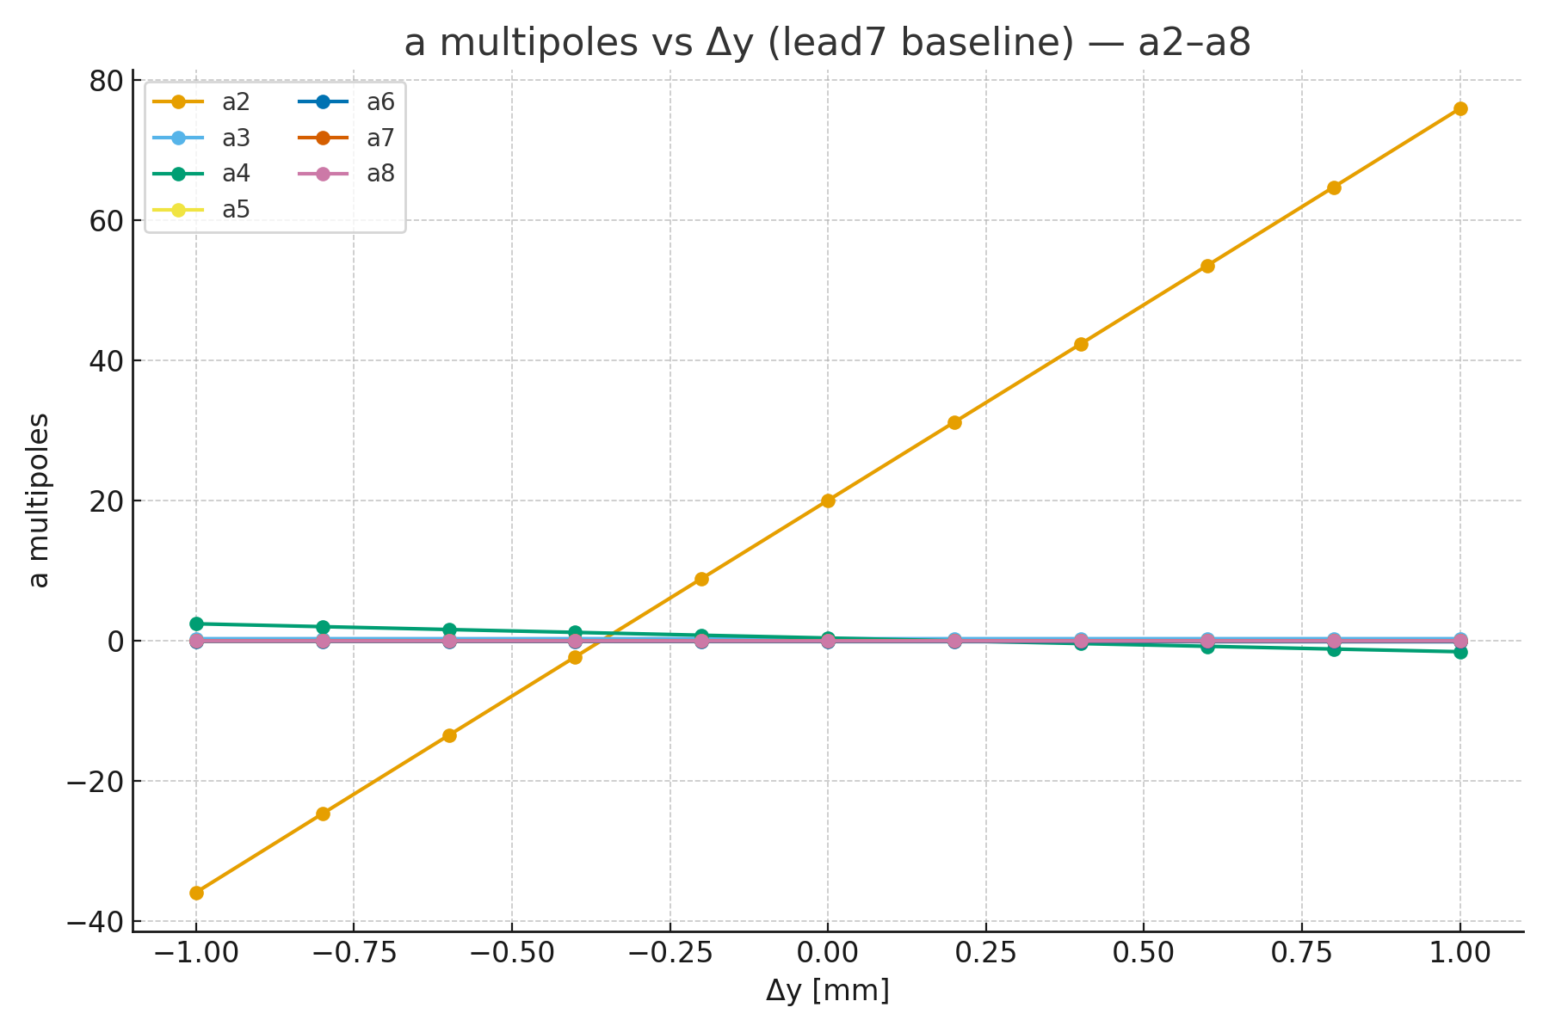
subSMCC2a cold magnetic measurements at PSI
Good agreement for a2 between simulated and measured
Parametric analysis with central segment +/- 55 units / mm
The measured value (analysis in progress) show 50.4 units / mm
subSMCC clear bore is 22 mm
Magnetic shaft diameter is 18 mm
PSI: segment length of 500 mm, coil diameter of 21.5 mm considering the curved shape
Measurements performed by G. Montenero (PSI)

