Slide 1

SMACC1
Progress in Procurement and Coil Winding
T. Michlmayr, D. Araujo, B. Auchmann, A. Brem, C. Lindner, A. Stampfli, C. Müller
"This work was performed under the auspices of and with support from the Swiss Accelerator Research and Technology (CHART) program.“ “This work was partially supported by HFM program”
CHART PSI
2025/11/19

Slide 2
Procurement of Raw Material 316LN
Price/kg from Jiuli (CHN) 23.30 – 28.50 US$ (terms DDP)
Price/kg from Imbach&CIE (CH) 83.05 CHF (e.g. raw material former layer 2)
Parts | Supplier | Amount | Order | Delivery Time
Raw Material Formers | Jiuli | 16 Plates 400 x 900 x 16 | Batch 1 28.10.2024 arrived | 2.5 / 3.5 Months (Air / Sea Fright)
Raw Material Shell | Jiuli | 2 Plates 900 x 1530 x 50
Raw Material End Plates | Jiuli | 2 Plates 670 x 410 x 110 | Batch 2 31.7.2025 arrived | 3.5 Months (Sea Fright)
Raw Material vertical/ horizontal Pads | Jiuli | 3 Plates 895 x 410 x 28
Huzhou Jiuli Yongxing High Performance Metals Co.,Ltd.

Slide 3
Procurement of Raw Material Ni40
Price/kg from Remy Stahl (D) 26.80 € Price/kg from (CH)
Parts | Supplier | Amount | Status | Delivery Time
Raw Material Rods M24 | Remy Stahl (D) | 11 Rods D24 x 1400 | arrived | 6 Weeks

Slide 4
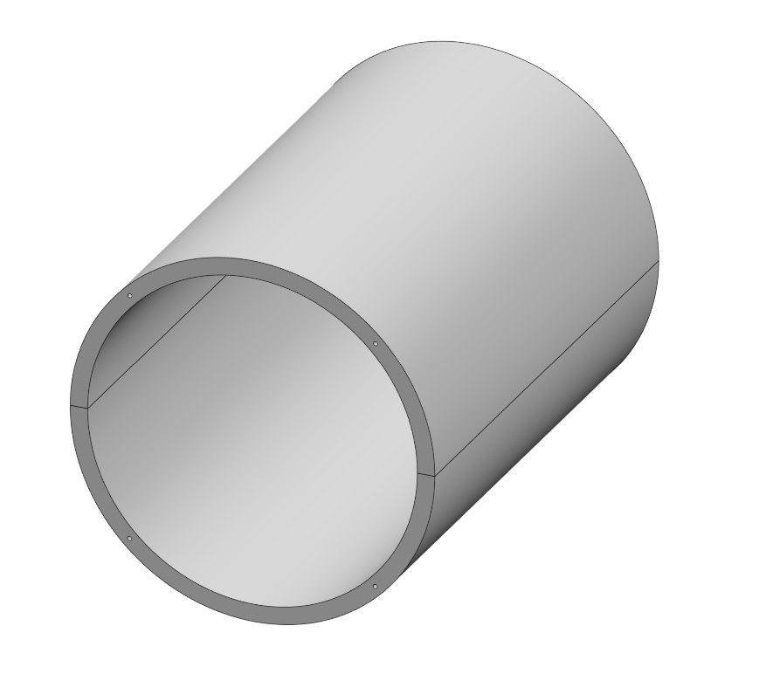
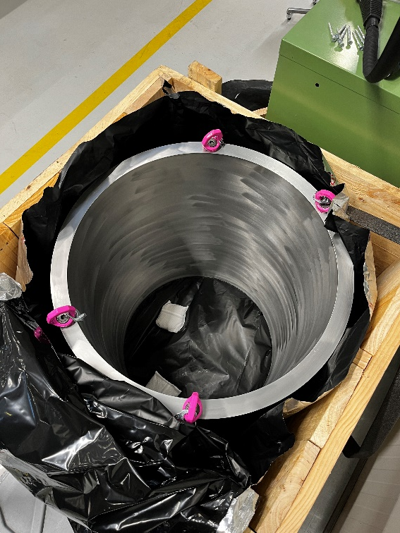
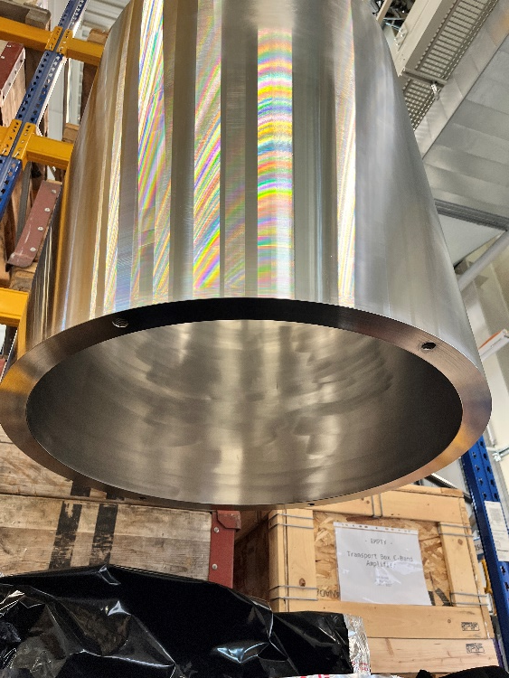
Status of the SHELL Production
-
Parts | Supplier | Amount | Status | Delivery Time
Shell | Asturfeito (E) | 1 | arrived | 3.5 Months

Slide 5
Status of the Coil Production
Formers machining and Coil winding
Parts | Supplier | Amount | Status | Remarks
Formers Layer 2 | HABA AG PSI Ramseier | 2 (3) | Grinded to 15.85mm(4) Machined (3) EMD cut (3) Insulation Coated (2) Wound (2)
Formes Layers 3&4 | HABA AG Baumgartner AG Ramseier | 4 | Grinded to 14.58mm(7) Machined (2) | Delay in delivery 10 weeks so far
Formers Layer 1 | HABA AG Baumgartner AG Ramseier | 4 | Grinded 15.45mm (5) | Delay in delivery 1 week so far
Dummy Formers for Blank Assembly | HABA Baumgartner | 1(L2) 4(L3&4) | Grinded to nominal | Delay in delivery 1 week so far

Slide 6
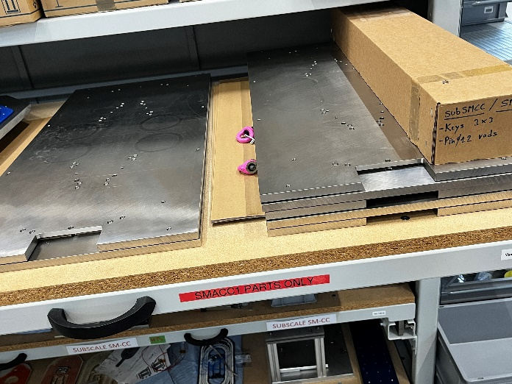
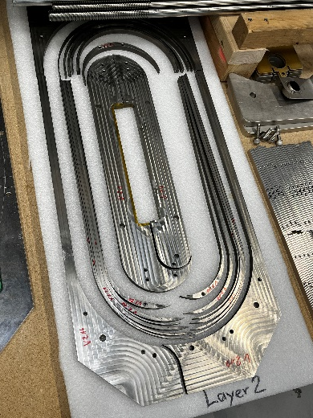
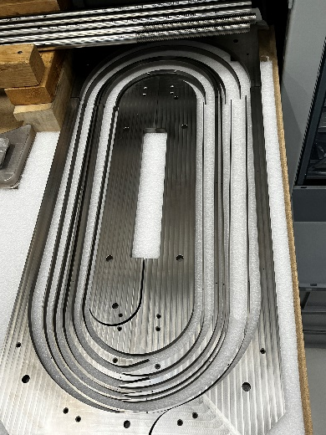
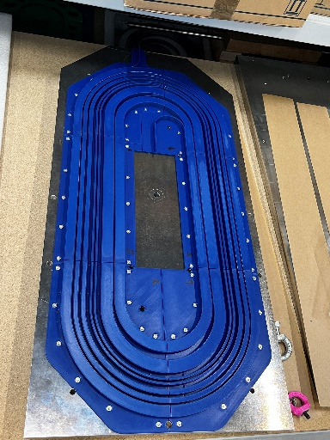
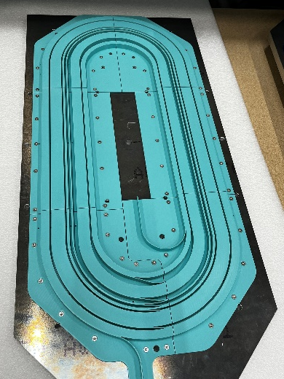
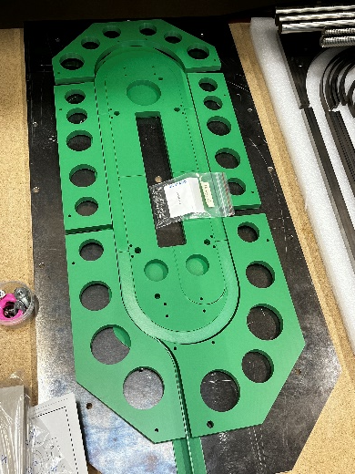
Status of the Coil Production
Winding Tooling
Parts | Supplier | Amount | Status | Remarks
Winding Tooling Formers Layer 2 | Locher Erodiertechnik (D) | 1 | Delivered | 1.4404
Winding Tooling Formes Layers 3&4 | Locher Erodiertechnik (D) | 1 | Delivered | 1.4404
Winding Tooling Formers Layer 1 | PSI | 1 | 3D Printed | PLA
Pushers Support Plates F2, F3&4, F1 | PSI | 1+1+1 | Machined | 3.2315
Pusher F2, F3&4, F1 | PSI | 1+1+1 | 3D Printed | PLA
Making Plate | Swissneutronics | 9 | Machnied | 1.4404

Slide 7
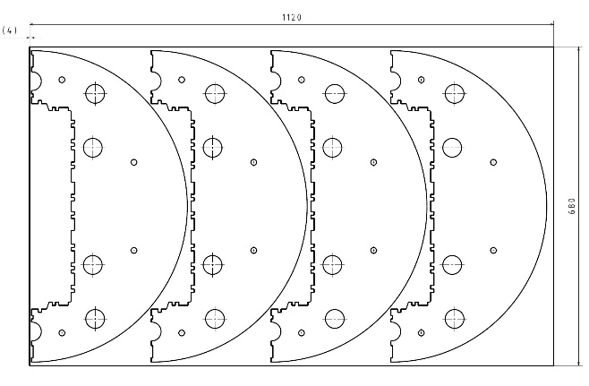
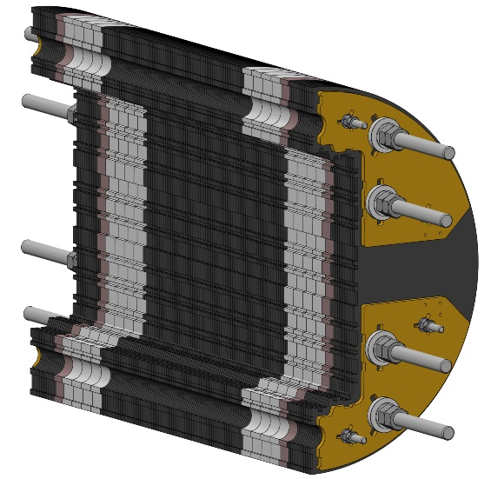
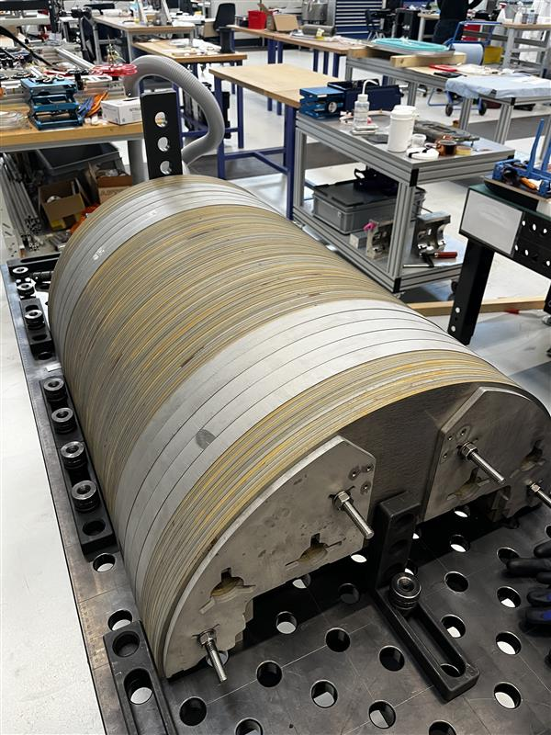
Machining Status of the YOKE
Raw material supplied by CERN, 5.8mm sheets of ARMCO Iron
Parts | Supplier | Amount | Status
5.8mm ARMCO Lamina | CERN Grobatech AG | 210 | delivered
30mm 316L Lamina | Grobatech AG | 16 | delivered
23.4mm 316 Lamina | Grobatech AG | 4 | delivered
Central Iron section is 2.6mm short.
Grinding spare laminas and insert.

Slide 8
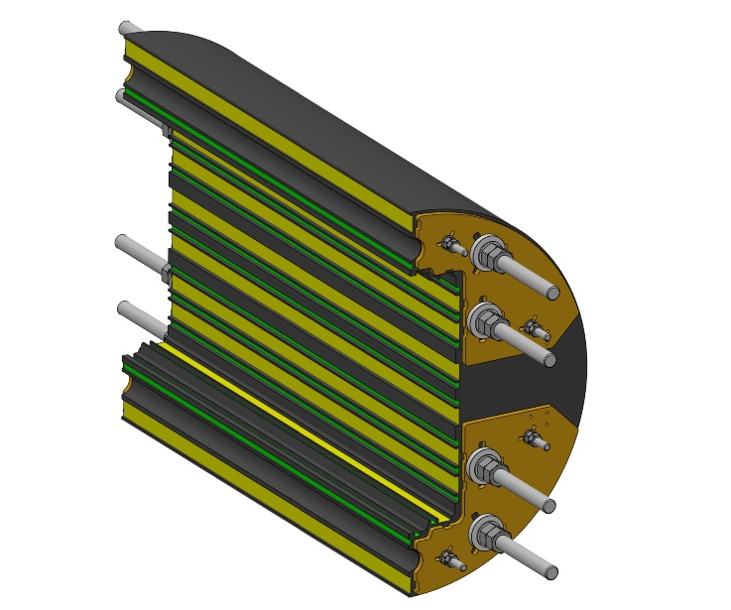
Machining Status of the YOKE
Raw Material supplied by CERN, 5.8mm sheets of ARMCO Iron
Parts | Supplier | Amount | Status
5.8mm ARMCO Lamina | CERN Grobatech AG | 210 | delivered
30mm 316L Lamina | Grobatech AG | 16 | delivered
23.4mm 316 Lamina | Grobatech AG | 4 | delivered
Central Iron section is 2.6mm short.
Grinding spare laminas and insert.
Parts | Supplier | Amount | Status
YOKE Remachined | PSI | 2 | ordered

Slide 9
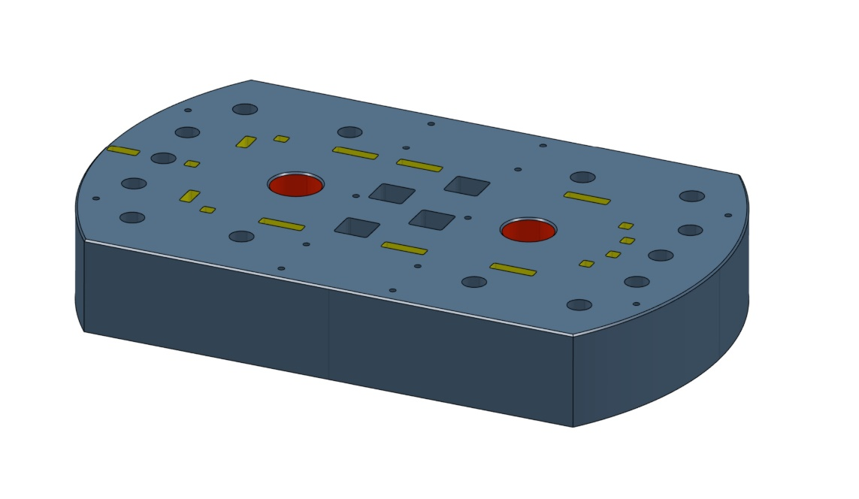
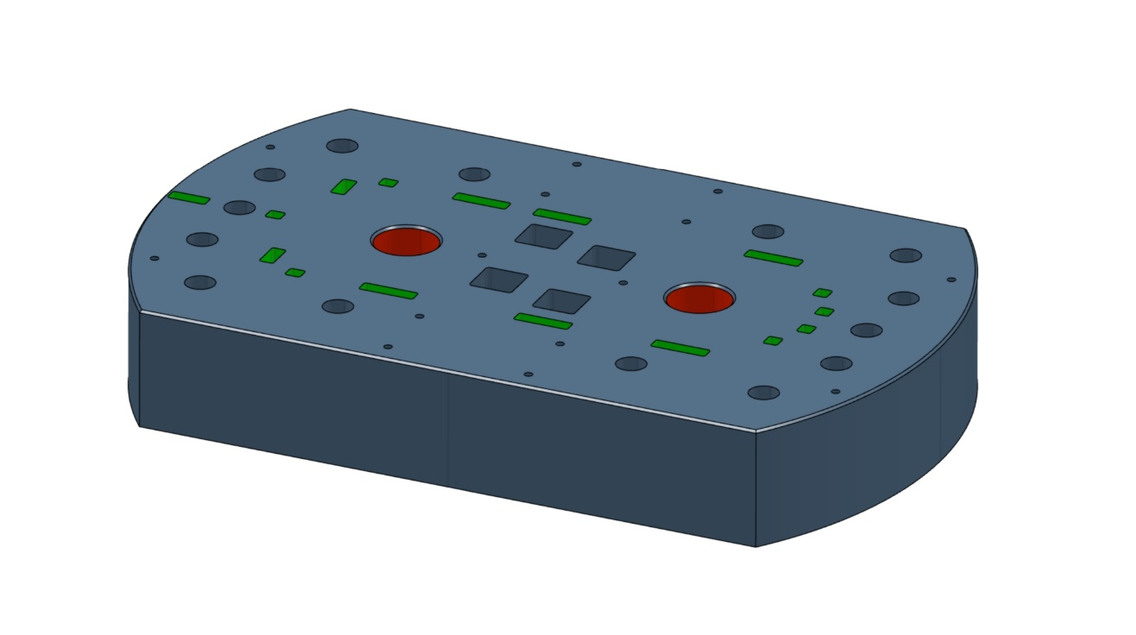
Status of the END PLATES Production
Raw Material supplied by Jiuli
Parts | Supplier | Amount | Status
End Plate Lead Side | Juli PSI | 1 | arrived ordered
End Plate Return Side | Juli PSI | 1 | arrived ordered

Slide 10
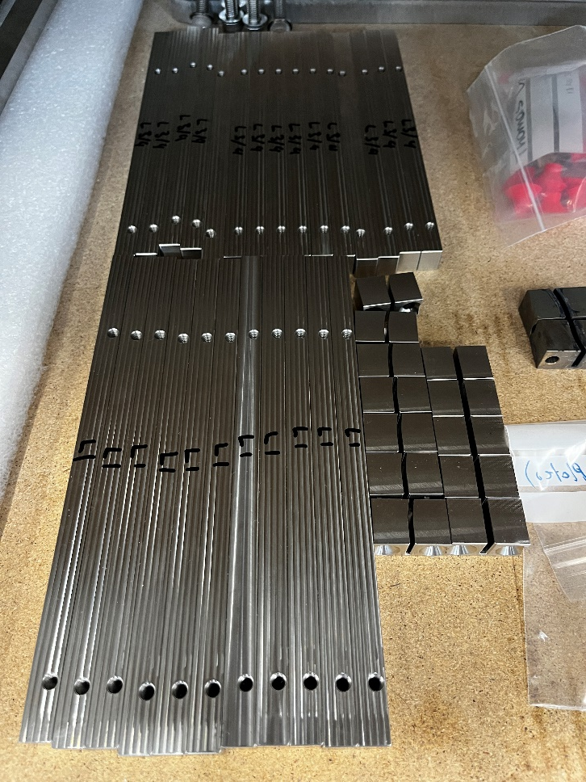
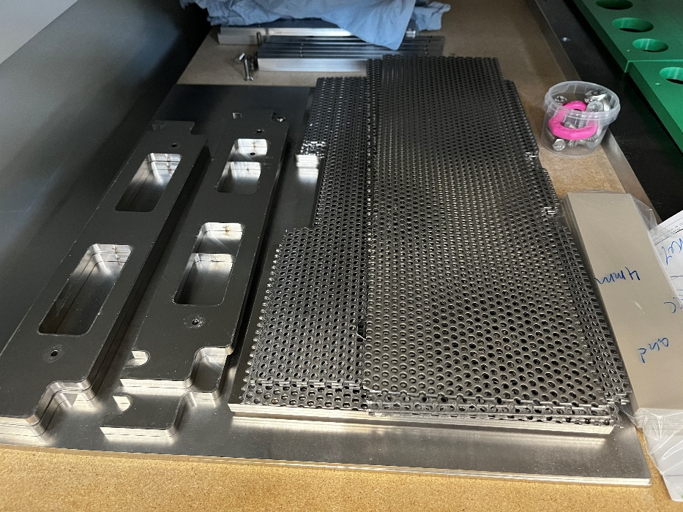
Machining Status of the additional Parts
Formers machining and Coil winding
Parts | Material | Amount | Status
Horizontal Pad | 316LN | 2 | Machining
Vertical Pad | 316LN | 2 | Machining
Outer Bore Plate | 316L | 2 | Machining
Inner Bore Plate | 316L | 2 | Machining
Iron Pole | ARMCO | 2 | Machining
Iron Pole Pad | 316L | 2 | Machining
Former Extensions Lead Fillers L2, L3&4, L1 | 316L | 16 + 4 + 8 +4 | Machined
Reaction Tooling | 316L | 1 set | Machined

Slide 11
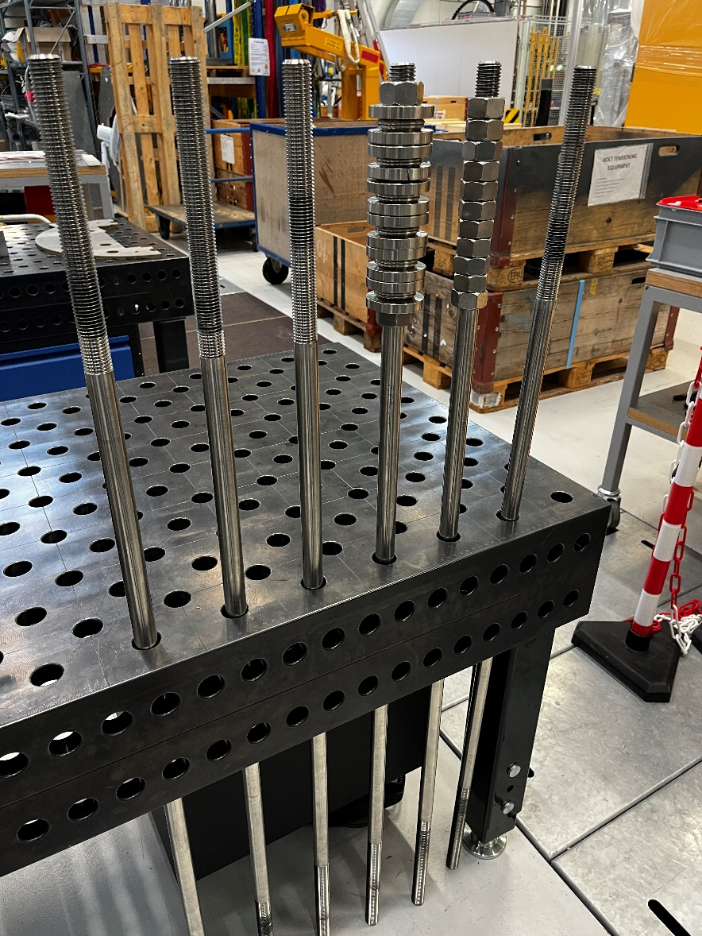
Machining Status of Rods
Parts | Material | Amount | Status
Tie Rods M12 | 316L | 9 | Machined
Rods M24 | Ni40 | 11 | Machined

Slide 12
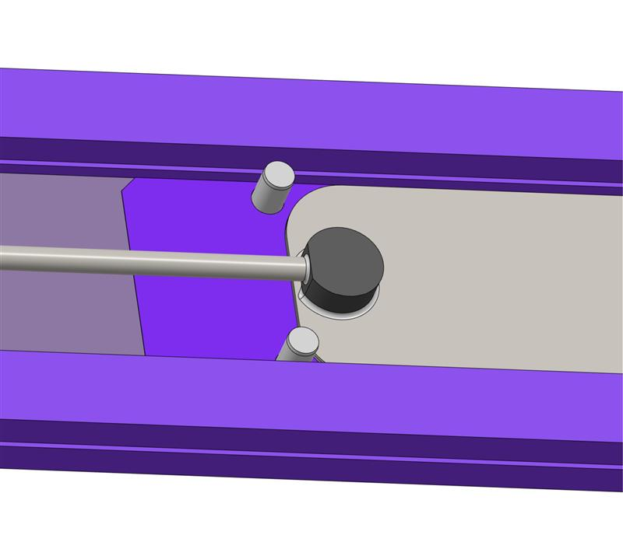
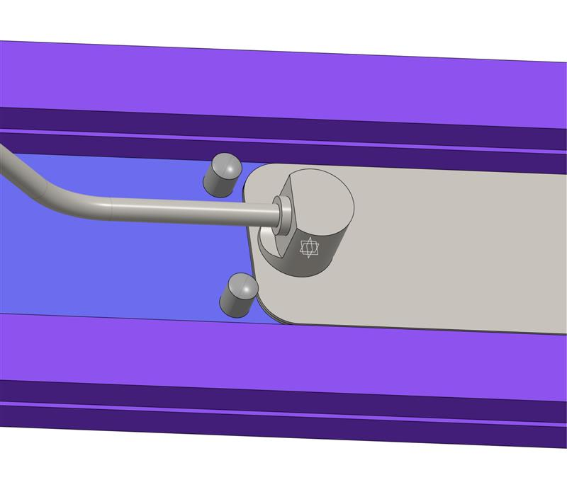
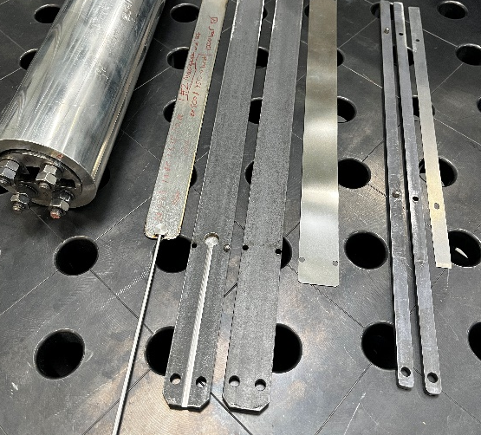
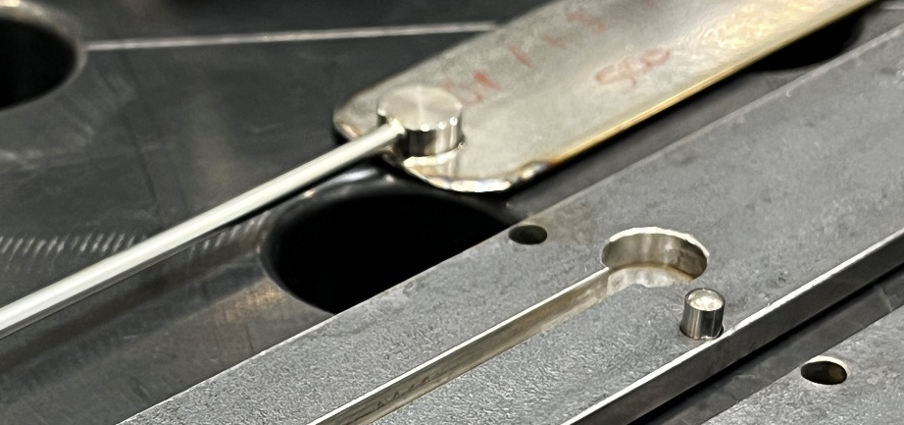
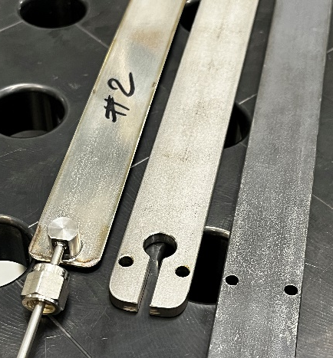
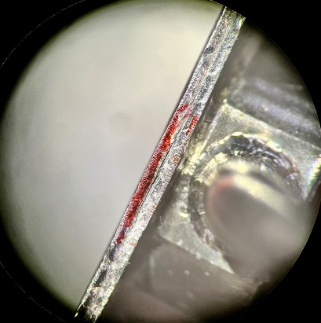
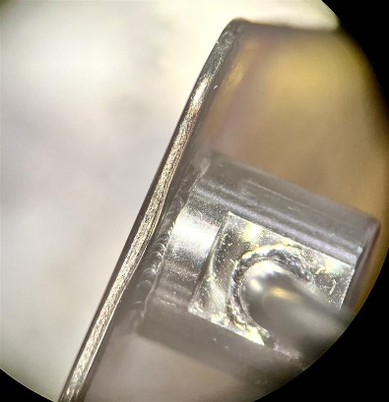
Status of Bladder and Key System
Final version
0.4mm blades
Rounded corners
Fully encapsulated
23mm and 29mm version
1000bar
Trials
0.3mm, 0.4mm blades
Rounded corners
750bar
Connector support
not satisfying
Parts | Material | Amount | Status
Test Bladders, Keys, Shims | 316L | 8 | Tested
Bladders, Keys, Shims | 316L | 25 + 4 | To be ordered

Slide 13
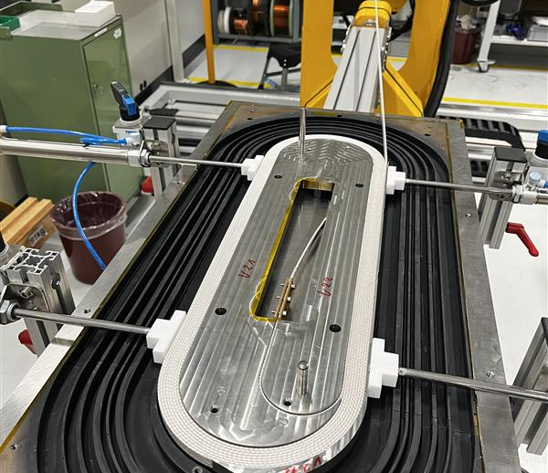
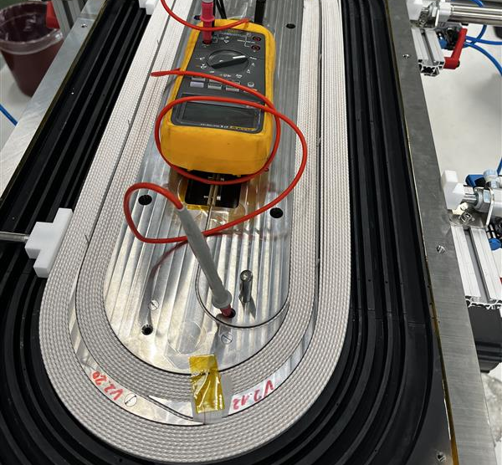
SMACC1 Coil Winding Layer 2
Coil 1 Block 1
Tension 120N
Tension loss due to problems with the winding machine
Compactness of block 1 not good
Pinning of tooling ribs difficult
Coil 1 Block 2
Tension 200N
Over-Tension due to problems with the winding machine
Compactness of block 2 better
Pinning of tooling ribs difficult

Slide 14
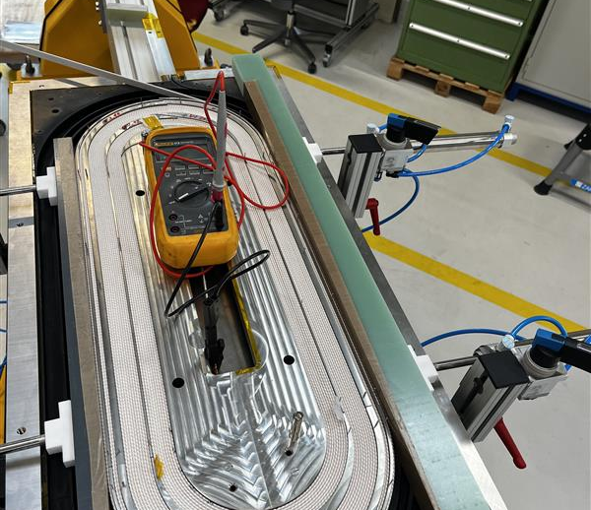
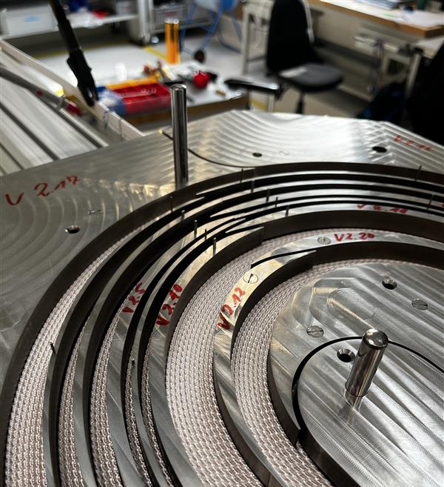
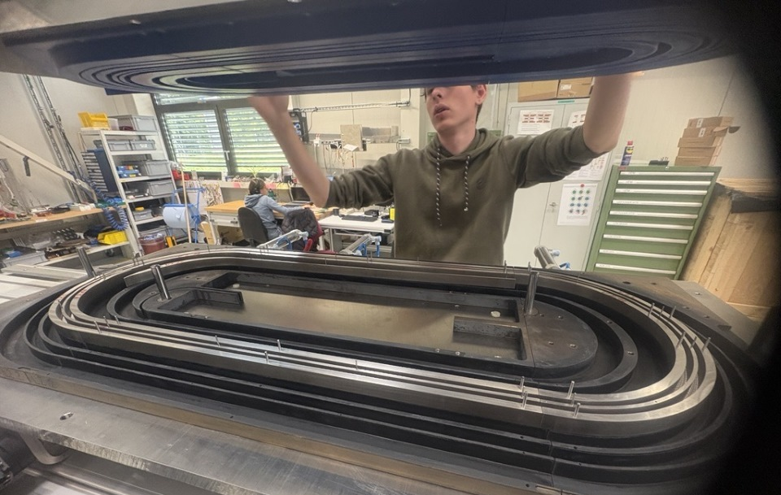
SMACC1 Coil Winding Layer 2
Coil 1 Block 3 - 7
Tension 150N
Improved pusher support for straight section
Compactness of blocks good
Pinning of tooling still ribs difficult
Pushing down
3D Printed pushers with Al support plate
Pushing down with 12 M8 screws quasi-simultaneously
Image from winding trials

Slide 15
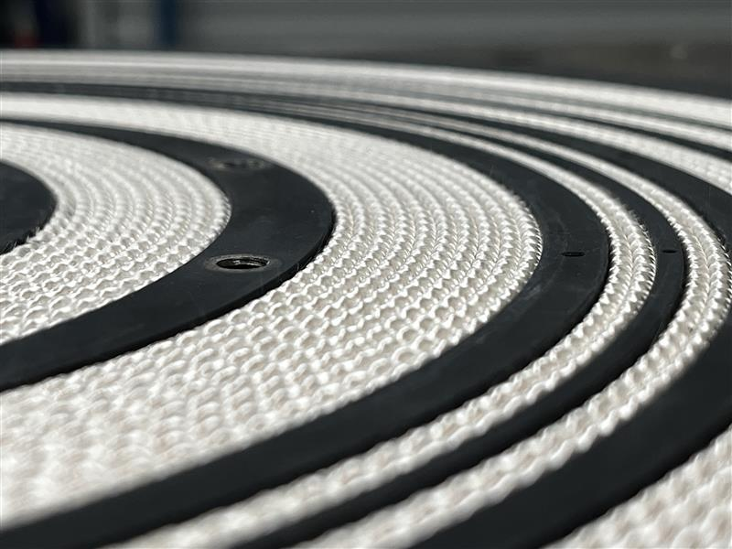
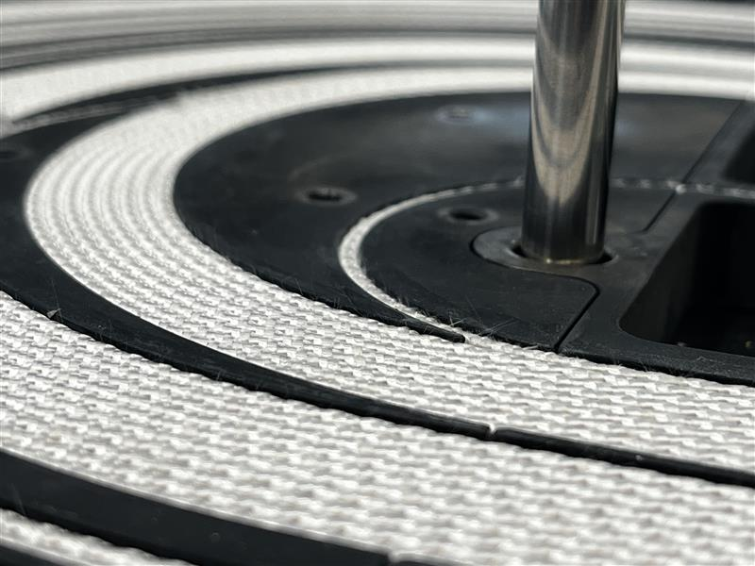
SMACC1 Coil Winding Layer 2
Coil 2 (all blocks)
Winding machine firmware update
Tension 150N
Compactness of blocks good
Pinning of tooling much easier
Winding worked so much better than for coil 1, we completely forgot to take pictures.
Reworking cable into the channels
After pushing down to cable was at some places protruding the channels
Working down the cable by hand section by section

