Slide 1

subSMACC Magnet Design Overview
I. S. P. Peixoto, D. Araujo, B. Auchmann, A. Brem, N. Kehl, T. Michlmayr
Acknowledgements to Q. Gorit (VDL) and D. Biek (SPC)
19.11.2025.
This work was performed under the auspices of and with
support from the Swiss Accelerator Research and Technology
(CHART) program, http://chart.ch.
This work was partially funded by the HFM program

Slide 2


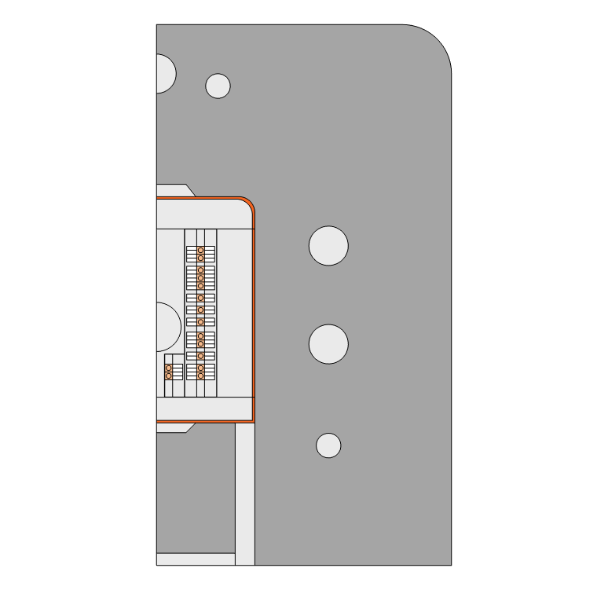
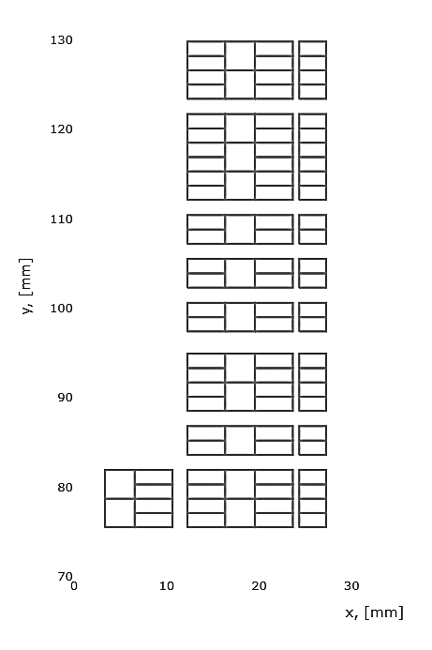
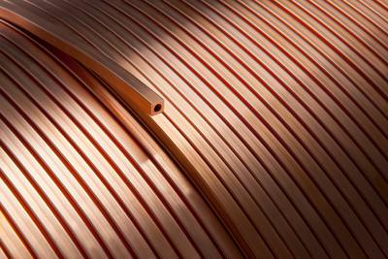

Magnet conceptual design
The magnet has 194 mm intra beam distance
Number of turns needs to be even number to fit conduction cooling cables
Coils of Lines 2 and 3 must be equal to reduce fabrication cost
Conduction cooling system will be reutilized for quench protection
Magnet yoke is kept at 77K to reduce cooling requirements
Nb₃Sn
Cu
y
x

Slide 3
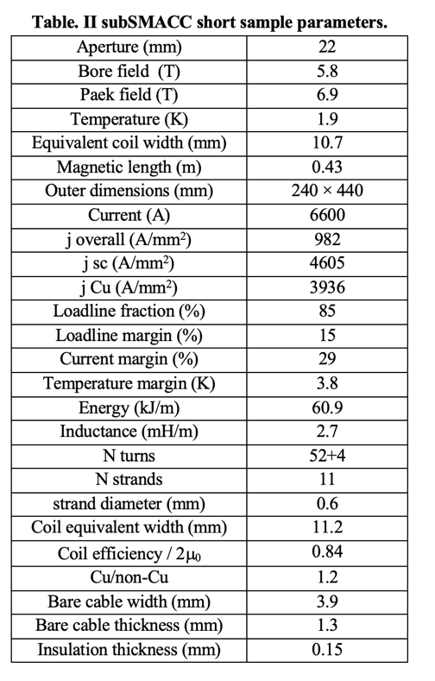
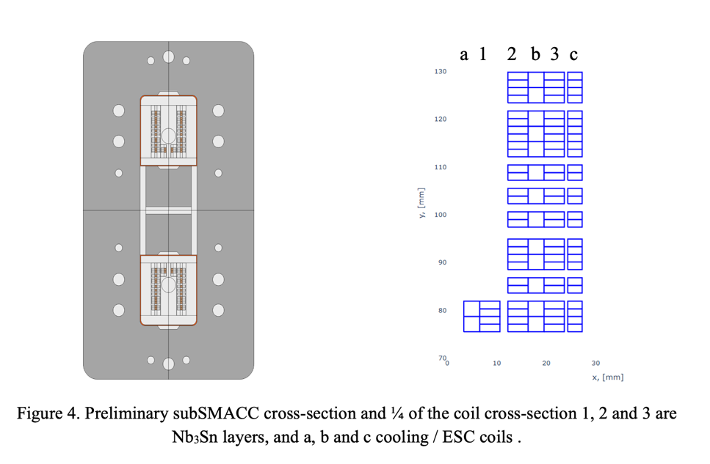
Magnet Specifications
D. M. Araujo, I. S. P. Peixoto, et al. Combined System for Cryogenics and Protection of High-Field Superconducting Magnets, submitted to IEEE TAS, Oct. 2025.
I. S. P. Peixoto, D. M. Araujo, et al. Subscale Stress-Managed Asymmetric Common Coil Design, submitted to IEEE TAS, Oct. 2025.

Slide 4
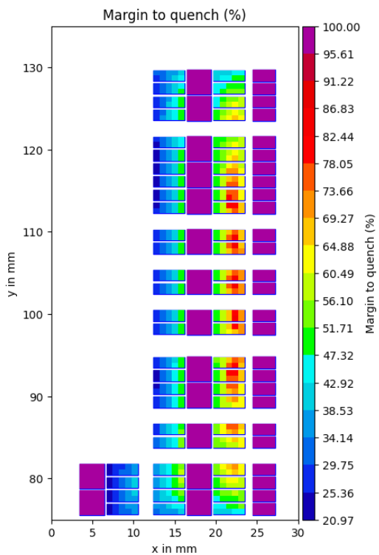
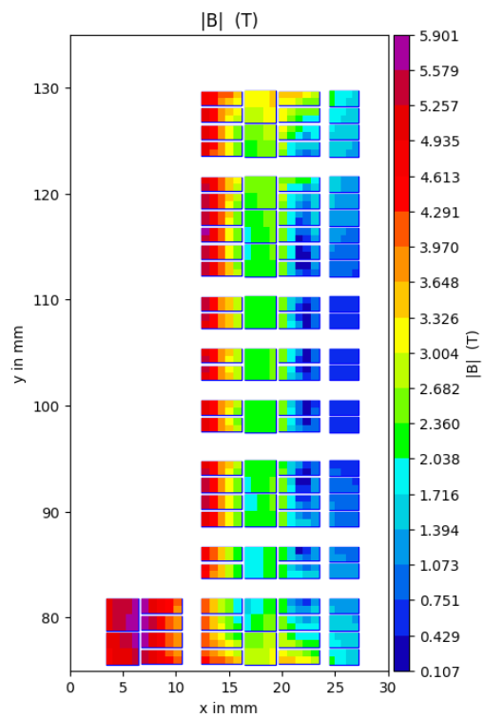
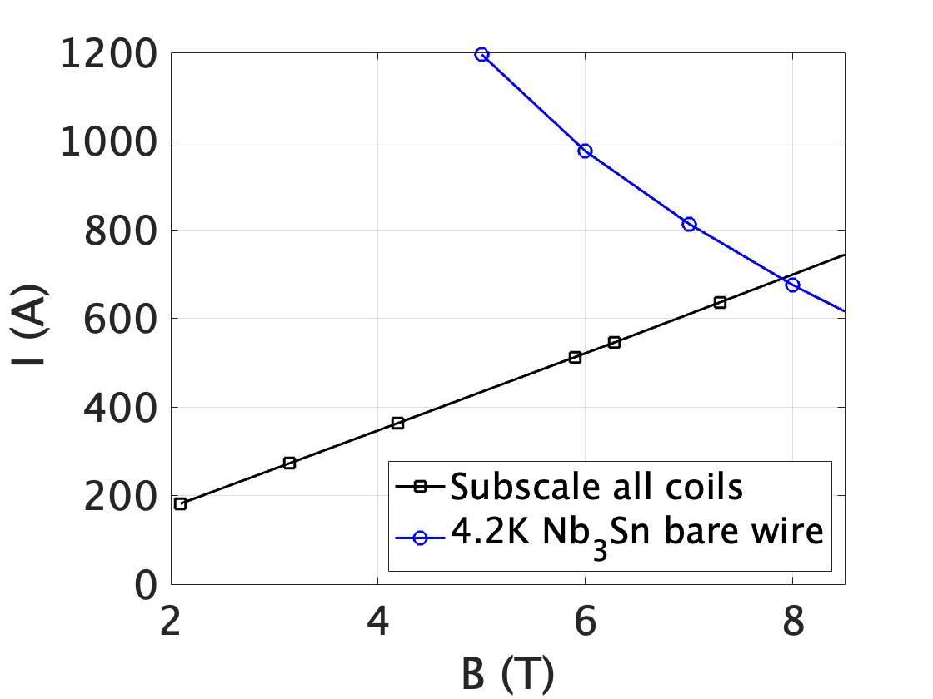
Electromagnetic Optimization
Multipole value < 10 units
Conductors and spacers are placed to have similar margin in layers 1 and 2 to use the conductor efficiently
I=5760 A @ 20% Margin (4.2 K)
D. M. Araujo, I. S. P. Peixoto, et al. Combined System for Cryogenics and Protection of High-Field Superconducting Magnets, submitted to IEEE TAS, Oct. 2025.
I. S. P. Peixoto, D. M. Araujo, et al. Subscale Stress-Managed Asymmetric Common Coil Design, submitted to IEEE TAS, Oct. 2025.

Slide 5
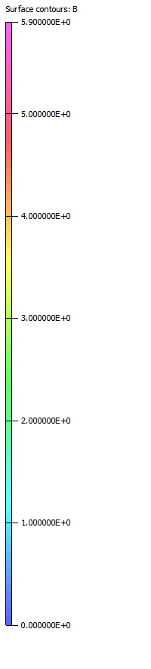
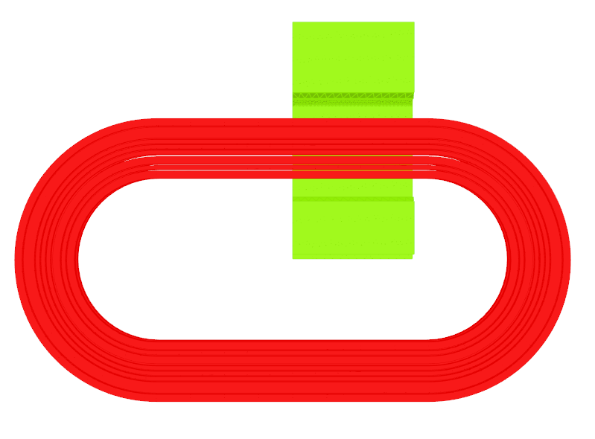
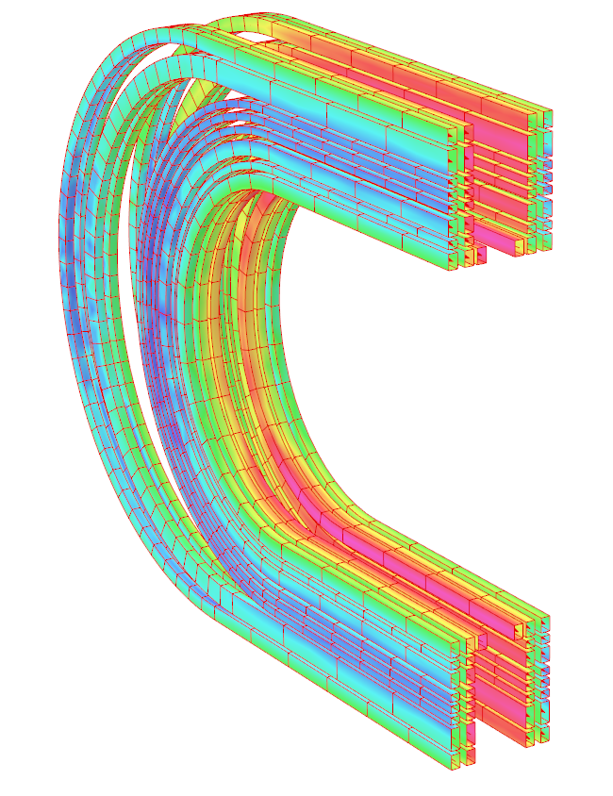

Electromagnetic Optimization
B (T)
5.9
Initial 3D model
5.0
4.0
3D model Considers yoke influence
Numeric algorithm finds most efficient distance for each coil block to keep multipole value <10 units
3.0
2.0
y
x
1.0
z
0
Optimized coil and core
D. M. Araujo, I. S. P. Peixoto, et al. Combined System for Cryogenics and Protection of High-Field Superconducting Magnets, submitted to IEEE TAS, Oct. 2025.
I. S. P. Peixoto, D. M. Araujo, et al. Subscale Stress-Managed Asymmetric Common Coil Design, submitted to IEEE TAS, Oct. 2025.

Slide 6
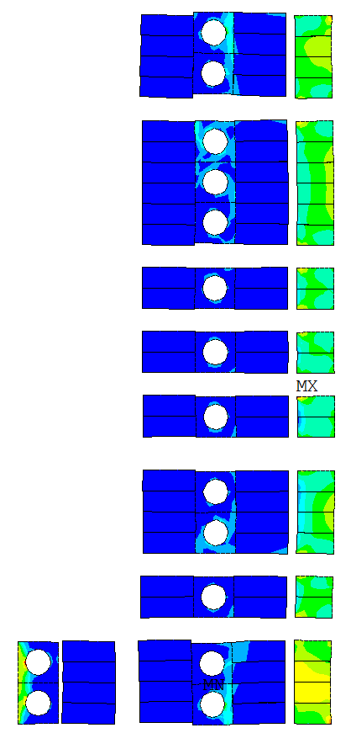
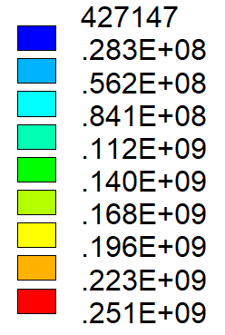
Mechanical Model (ANSYS)
Stress solution at nominal field (4.2 K, 5640 A)
Magnet integrity (no excessive movement in the pieces)
Different material stress limits are respected
Coil formers
keys
Stress limit Nb₃Sn
150 MPa
Stress limit Cu 450 MPa
Magnet aperture
bladder
(Pa)
Cu coil former
y
x
D. M. Araujo, I. S. P. Peixoto, et al. Combined System for Cryogenics and Protection of High-Field Superconducting Magnets, submitted to IEEE TAS, Oct. 2025.
I. S. P. Peixoto, D. M. Araujo, et al. Subscale Stress-Managed Asymmetric Common Coil Design, submitted to IEEE TAS, Oct. 2025.

Slide 7
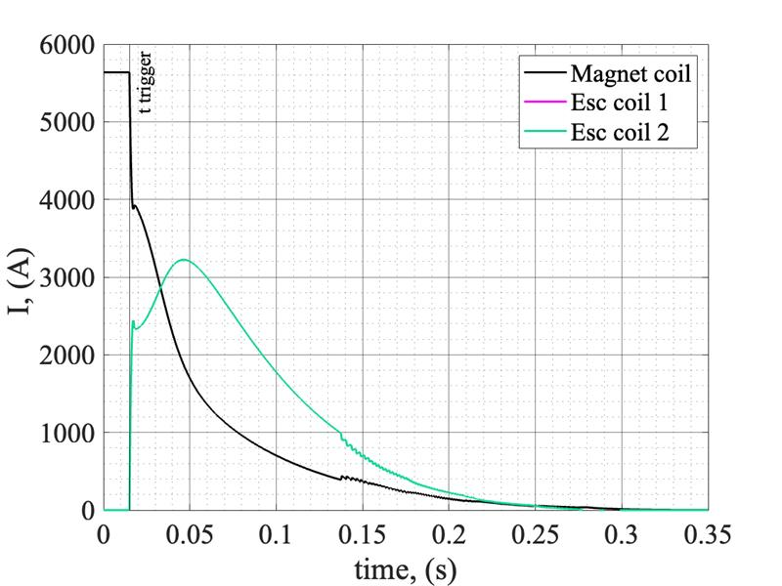
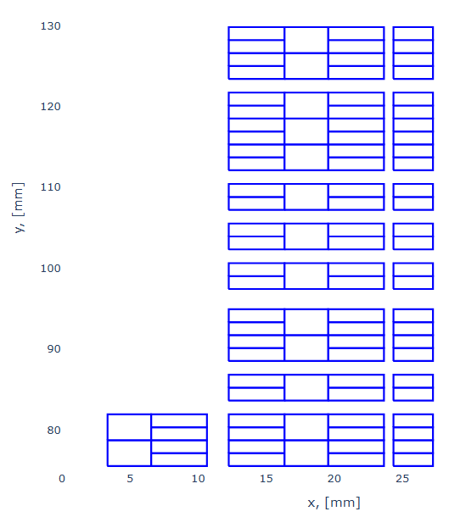

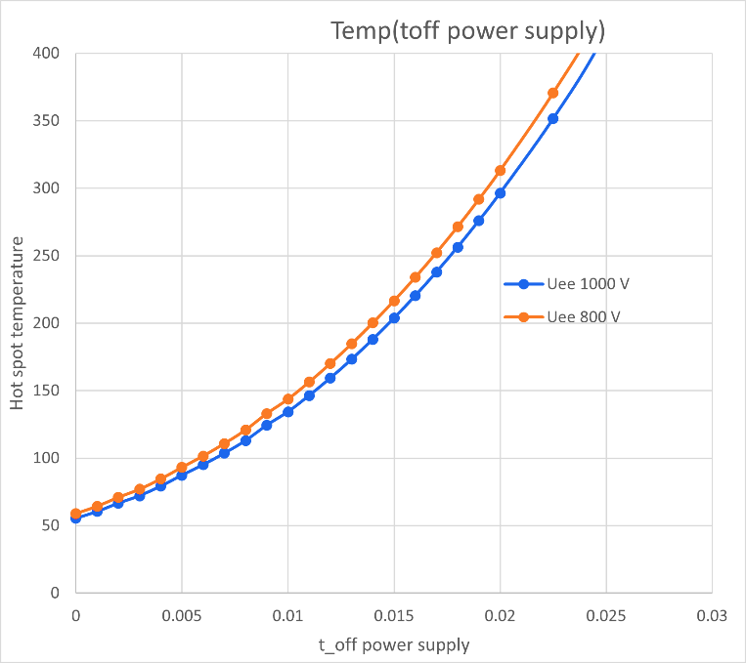
Transient Analysis: Quench Protection
Magnet current is fully discharged to the ESC unit
Analyses with LEDET-STEAM framework on the possible ESC and EE configurations can lead to protected or unprotected solutions.
ESC coil 1
ESC coil 2
Protected
t trigger = 15 ms
Magnet coils
Copper coils
Magnet can be protected by energy extraction or energy shift with coupling
D. M. Araujo, I. S. P. Peixoto, et al. Combined System for Cryogenics and Protection of High-Field Superconducting Magnets, submitted to IEEE TAS, Oct. 2025.
I. S. P. Peixoto, D. M. Araujo, et al. Subscale Stress-Managed Asymmetric Common Coil Design, submitted to IEEE TAS, Oct. 2025.

Slide 8
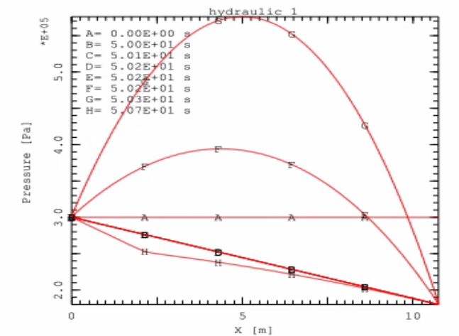
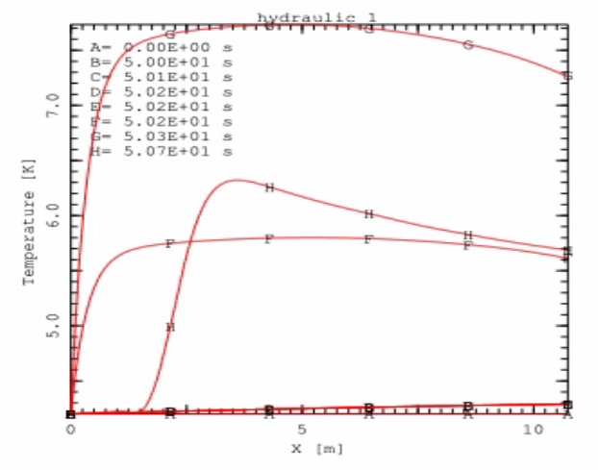

Thermal Model (THEA)
For a specific ESC solution, a thermal simulation is performed on the cooling cables’ maximum pressure and temperature when the discharge occurs:
Cooling cables maximum pressure reached 5.5 bar and max temperature 7.5 K
The result show that magnet heating is controlled and limit pressure in the cooling cables is within safety limits.
ESC coil 1
ESC coil 2
Support on forced-flow simulation from D. Biek and K. Sedlak from EPFL/SPC and L. Bottura from CERN.
Support on the testing set-up from P. Borges de Sousa and F. Mangiarotti from CERN.

Slide 9
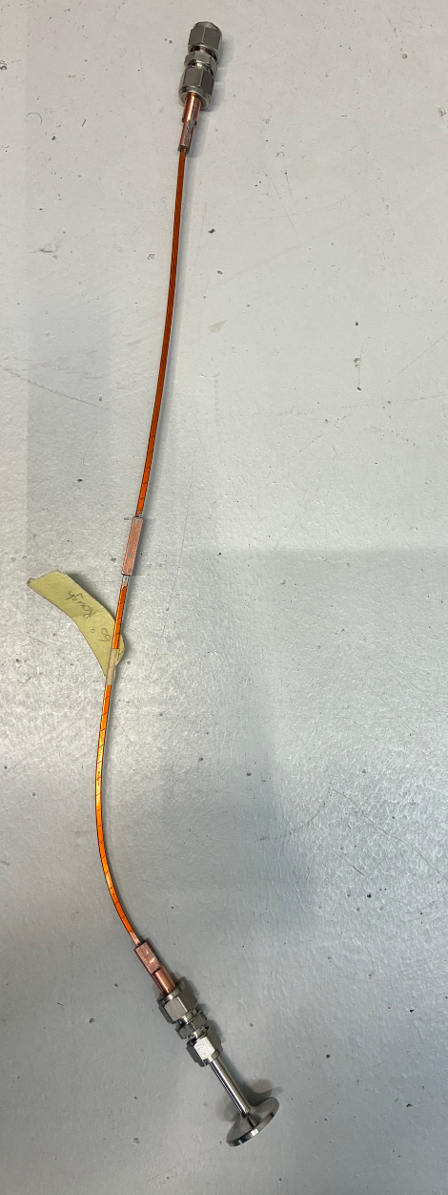
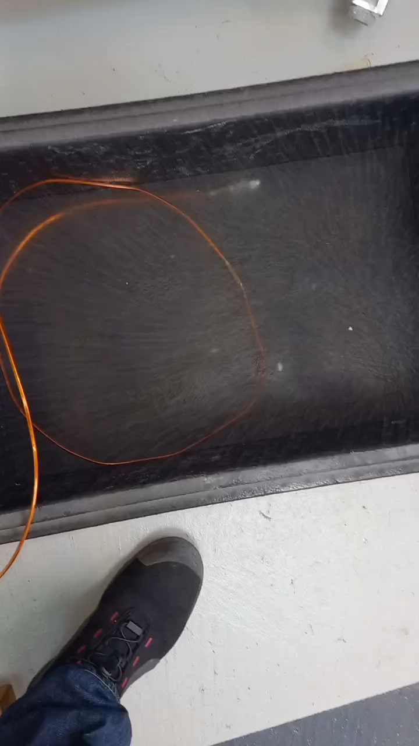
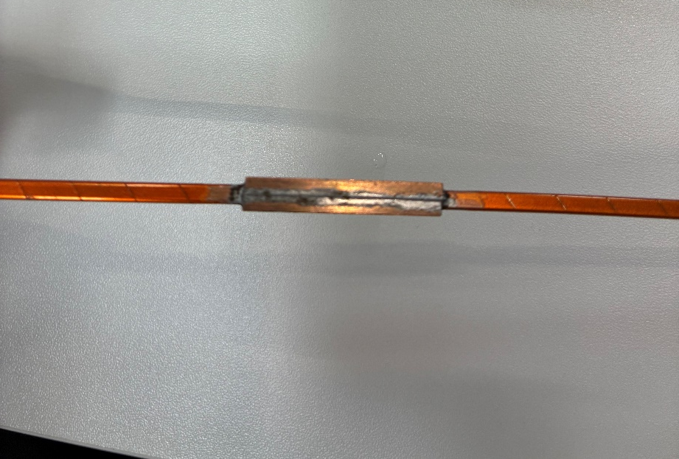
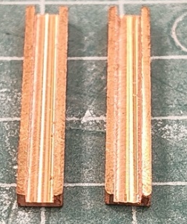
Pressure tests
Closed end
The samples are prepared with one cooling circuit connection and one closed end.
The splice is done by adding two copper shells around the connected cables and soldering the shells to make a sleeve.
Two samples were tested with gaseous He:
The samples were exposed repeatedly to LN₂ and ambient temperatures (thermal cycle)
Gaseous He was inserted in the channel at varying pressures (up to 22 bar) to verify the samples are leak tight
For each pressure value the valves were closed, and no pressure drop was observed
Cooling circuit connection
Samples prepared by N. Kehl
The test was conducted at PSI, video provided by Q. Gorit

Slide 10
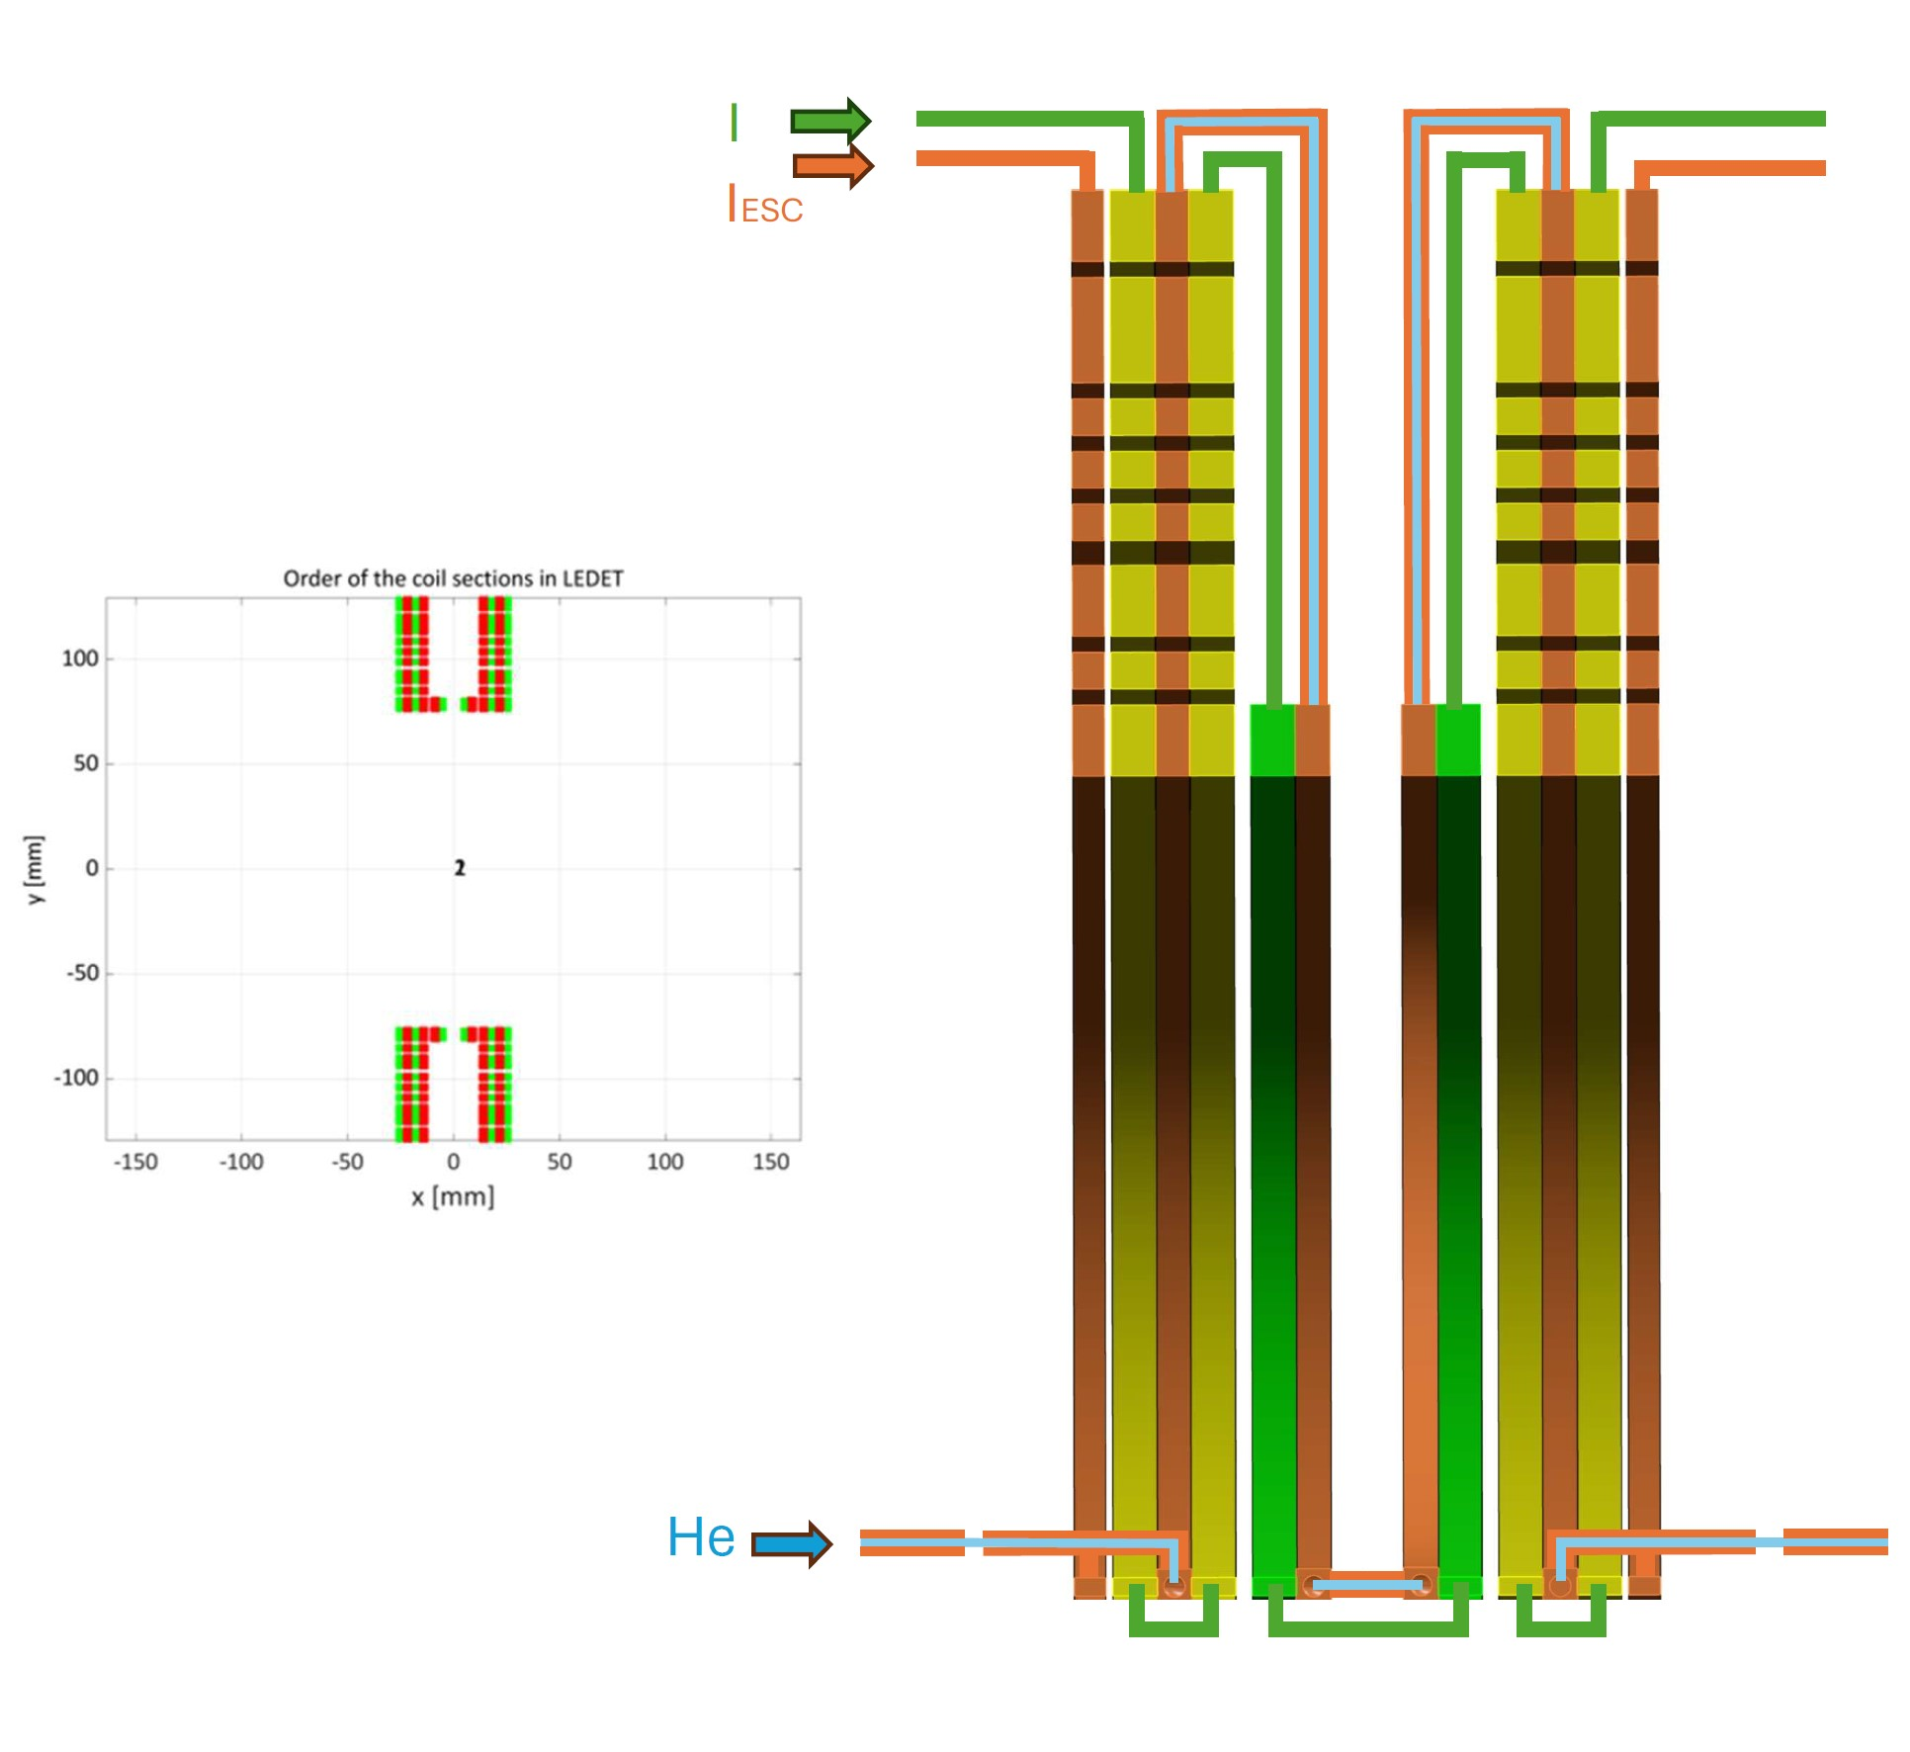
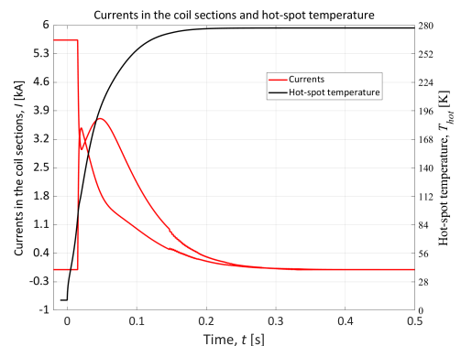
Engineering Design
ESC solution is chosen based on engineering design
ESC coil
Protected
t trigger = 15 ms
Engineering Design by T. Michlmayr

Slide 11
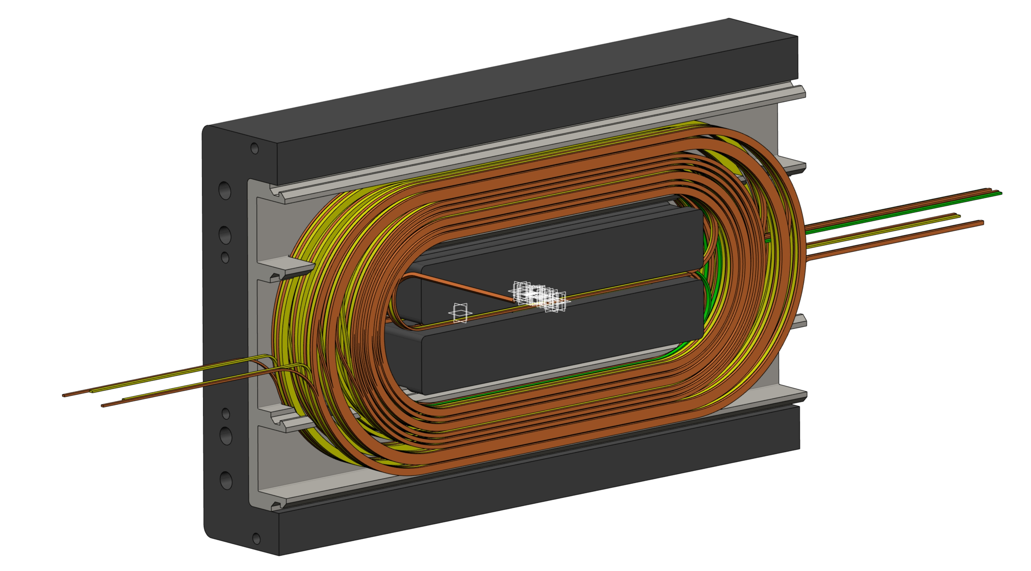
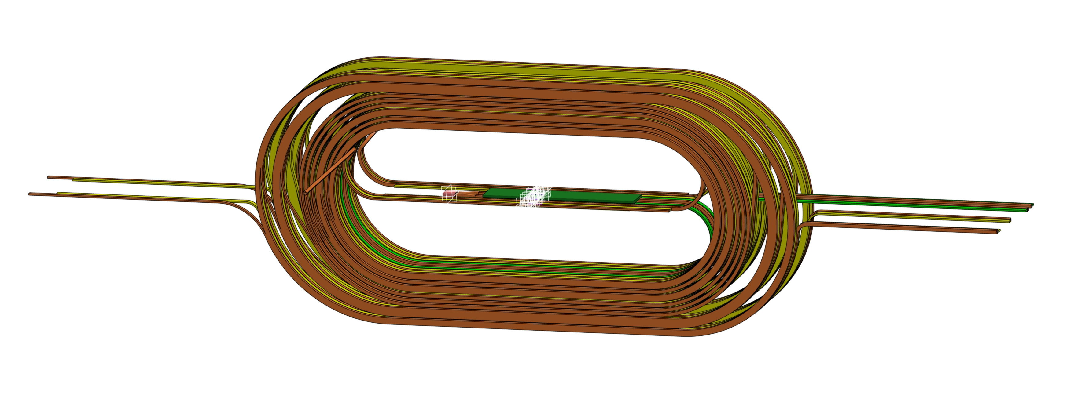
Engineering Design
ongoing CAD model
geometry update → magnet electromagnetic optimization
Engineering Design by T. Michlmayr

