Slide 1
subSMACC winding trials for the auxiliary coils
D. Araujo, B. Auchmann, A. Brem, N. Kehl, C. Lindner, T. Michlmayr, C. Müller, I. S. P. Peixoto,
A. Stampfli and J. Van den Eijnden.
Nicolas Kehl
November 2025

Slide 2
Agenda
Auxiliary coils:
Design
Winding trial
Impregnation
Splicing

Slide 3


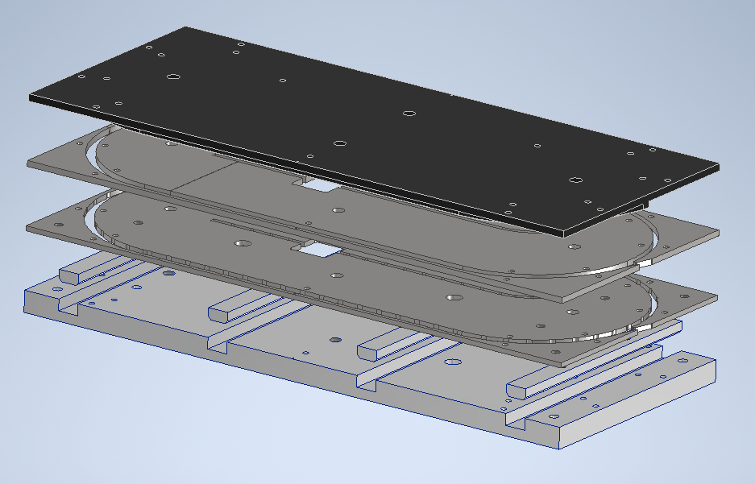
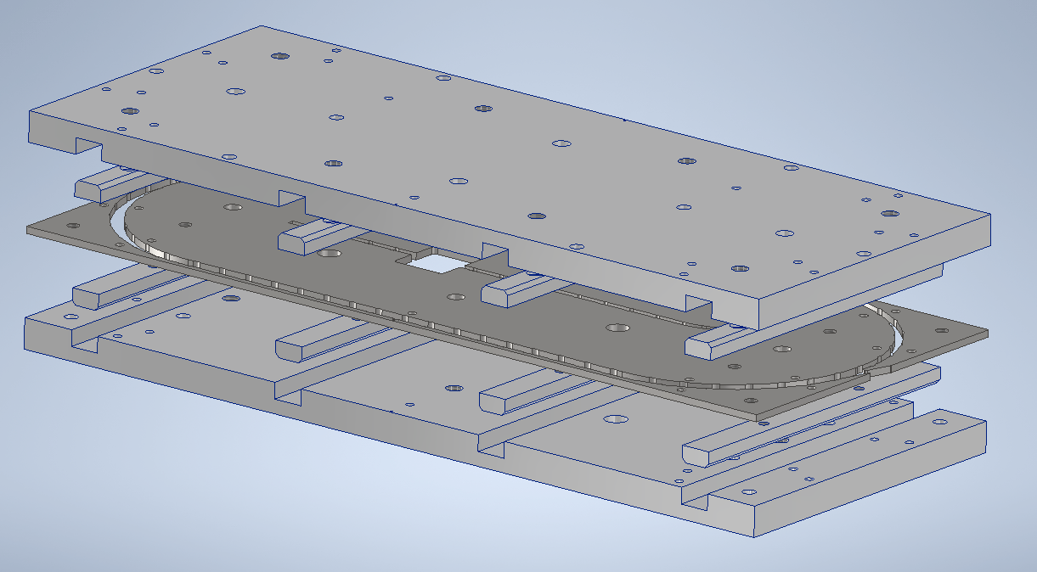
subSMACC winding trials for the auxiliary coils
Design
Winding-Setup
Pusher
Impregnation-Setup
Tooling
Lid
Former
Baseplate
Ejectors

Slide 4
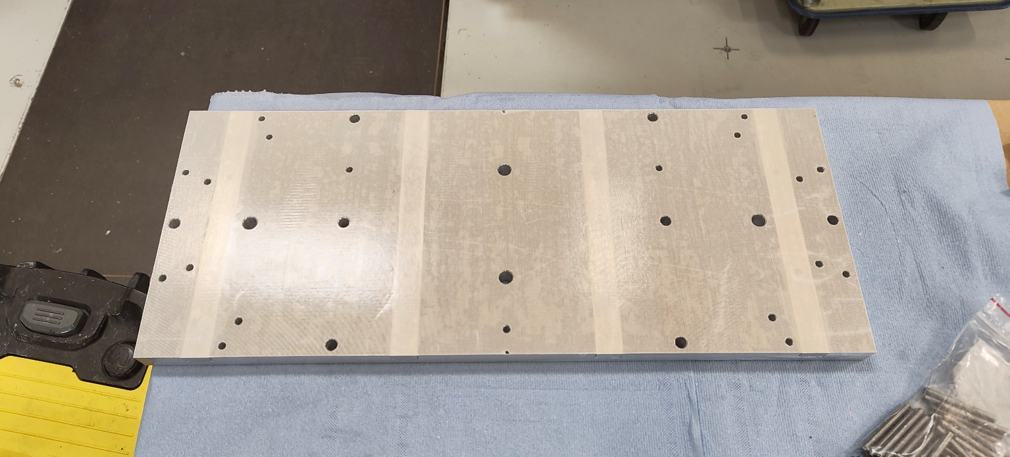
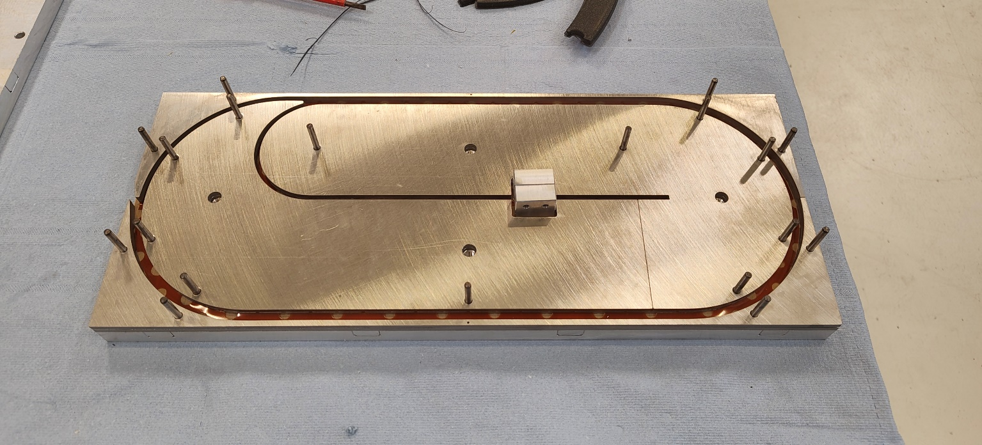
subSMACC winding trials for the auxiliary coils
Design
Teflon cover
Winding

Slide 5
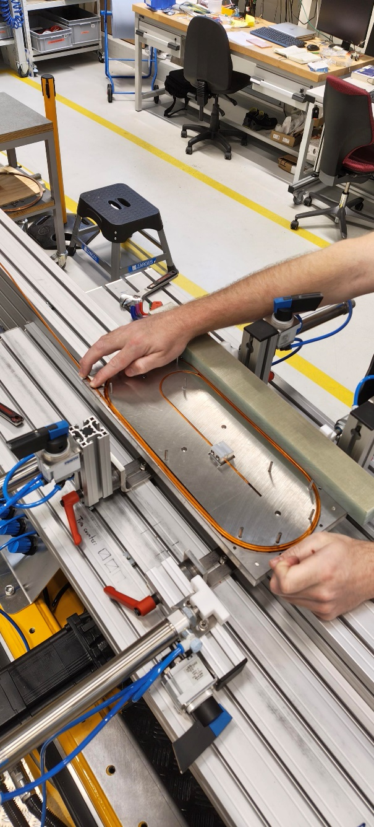
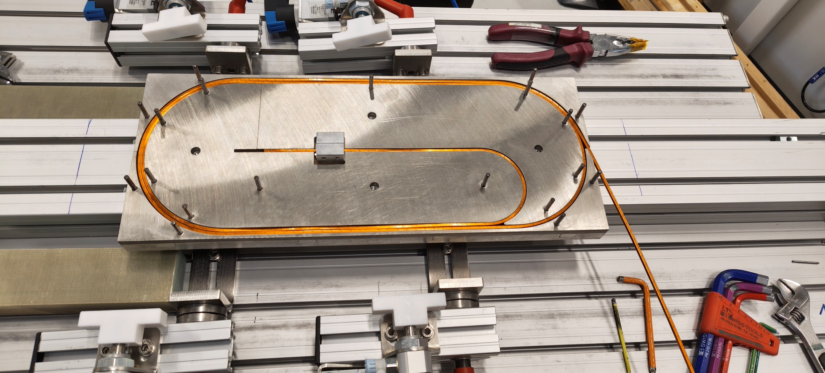
subSMACC winding trials for the auxiliary coils
Winding trial

Slide 6
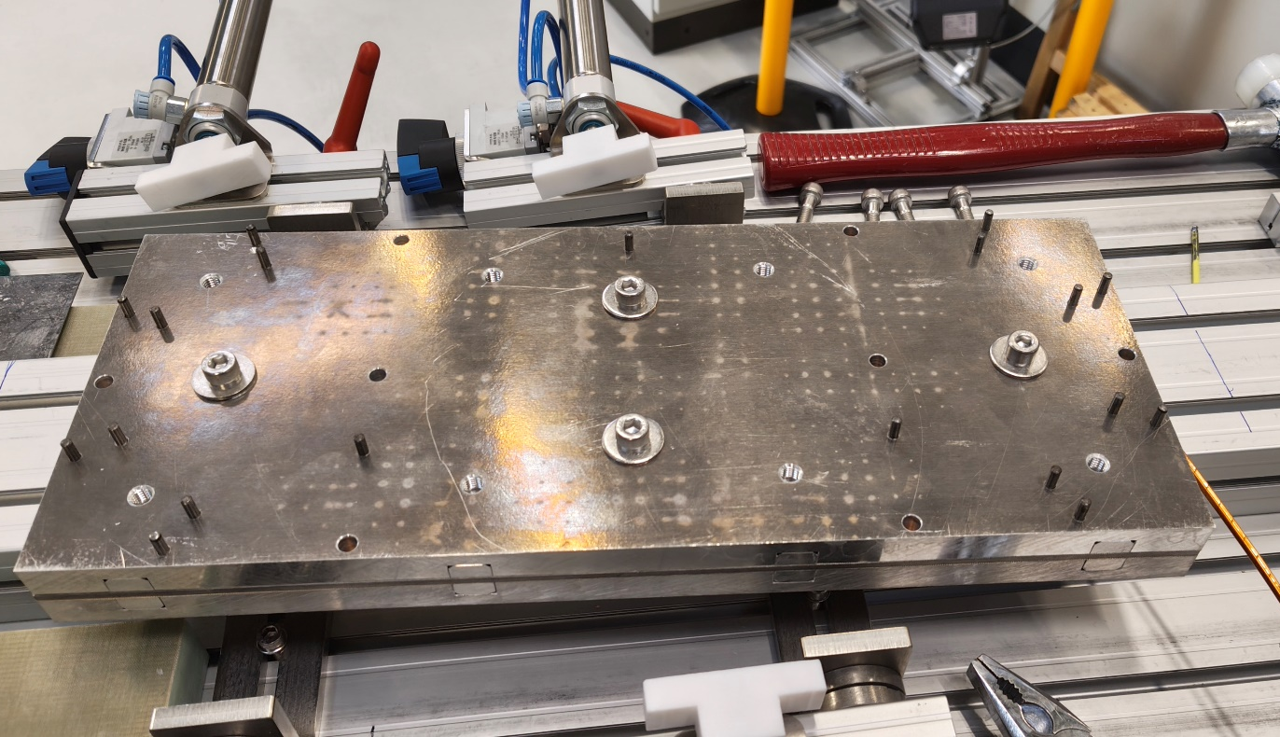
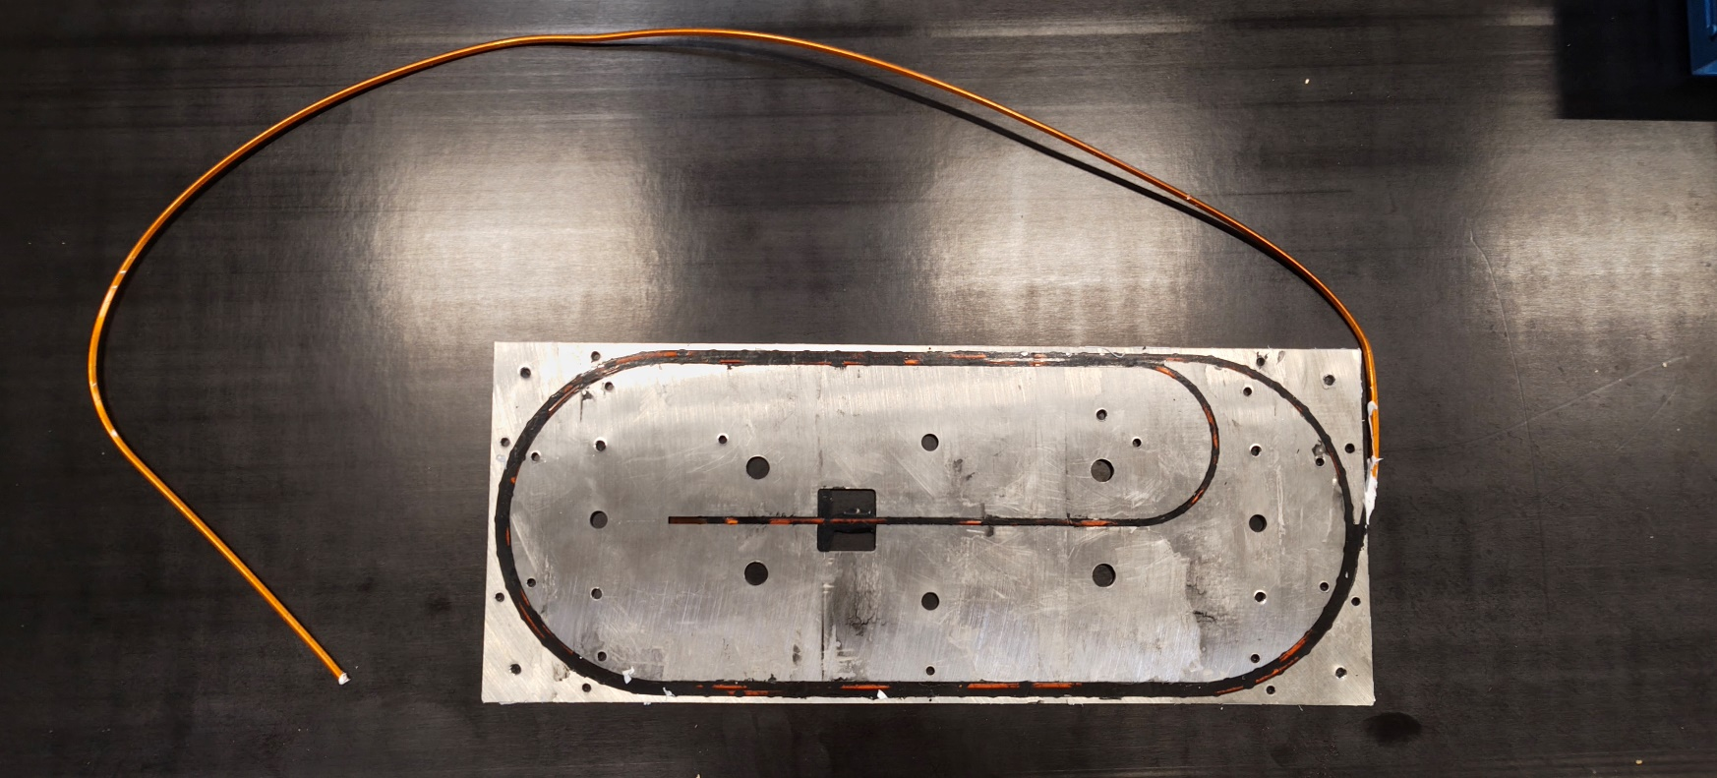
subSMACC winding trials for the auxiliary coils
Impregnation
Impregnation-Setup
Impregnated coil

Slide 7
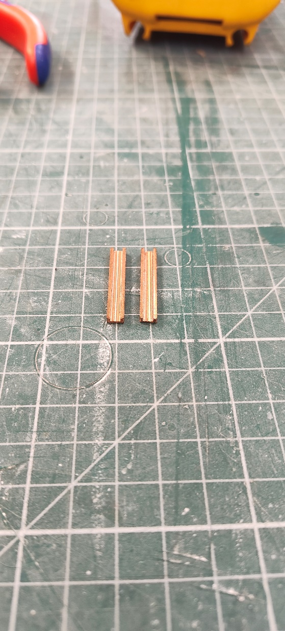
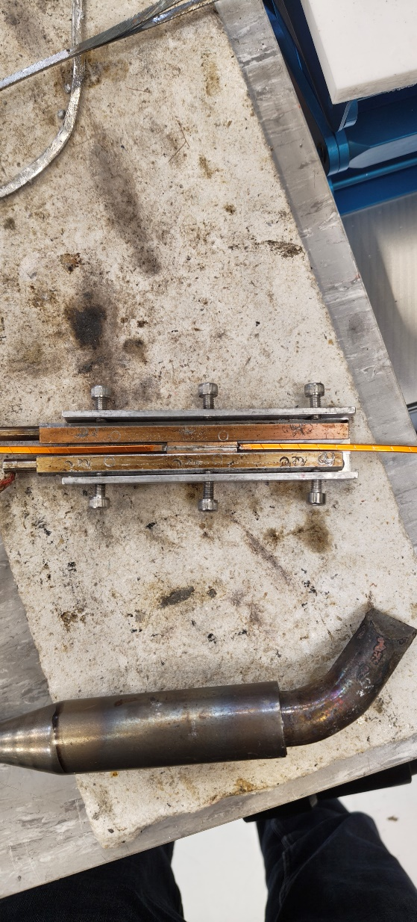
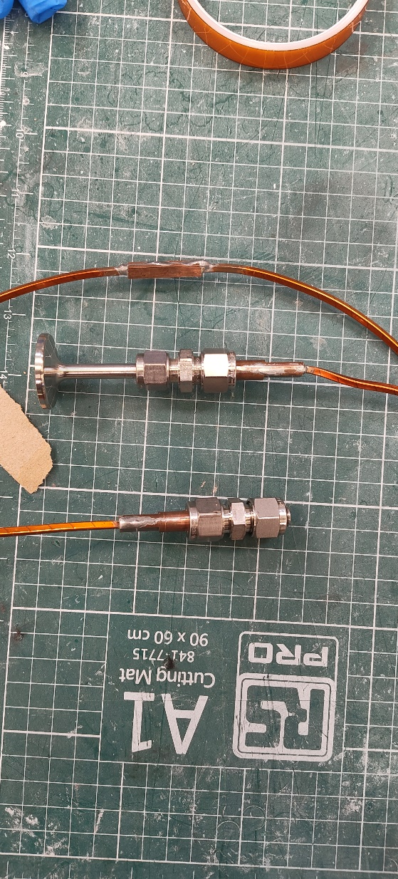
subSMACC winding trials for the auxiliary coils
Splicing
Splice cover
Splice-Setup
Splice for pressure test

