Slide 1



PhD Research Progress: Nb₃Sn Characterization and 10-Stack Studies
D-ITET
Institute of Electromagnetic Fields
Joep Van den Eijnden^{1,2}, Juerg Leuthold¹, Jasmin Smajic¹, Xiang Kong³, Theo Tervoort³, Douglas Araujo², Bernhard Auchmann^{2,4} and André Brem².
¹Institute of Electromagnetic Fields, ETH Zurich
²Paul Scherrer Institute;
³Department of Materials, ETH Zurich;
⁴CERN, European Organization for Nuclear Research.
Work supported by the Swiss State Secretariat for Education, Research and Innovation SERI.
This work was performed under the auspices and with support from the Swiss Accelerator Research and Technology (CHART) program

Slide 2
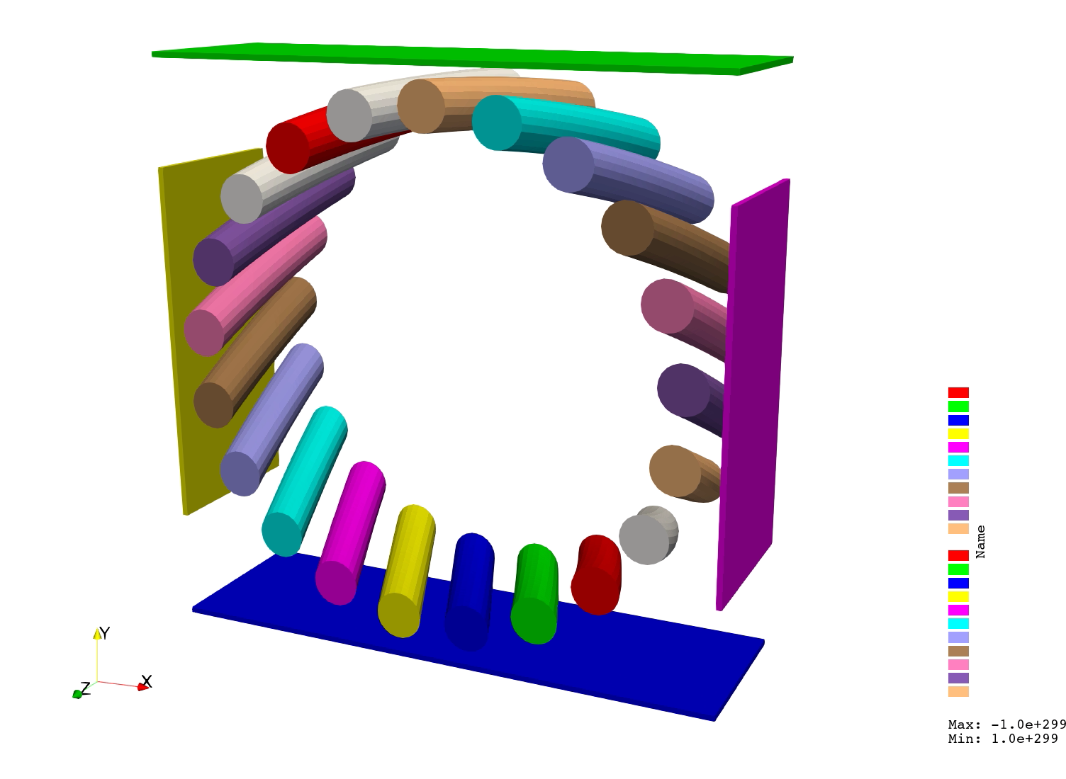
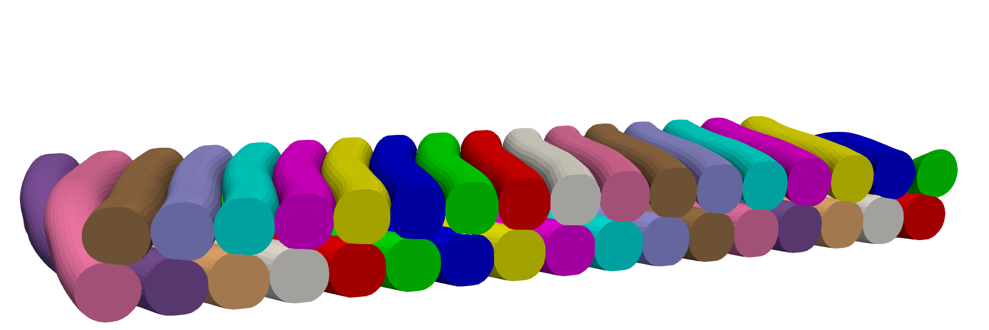
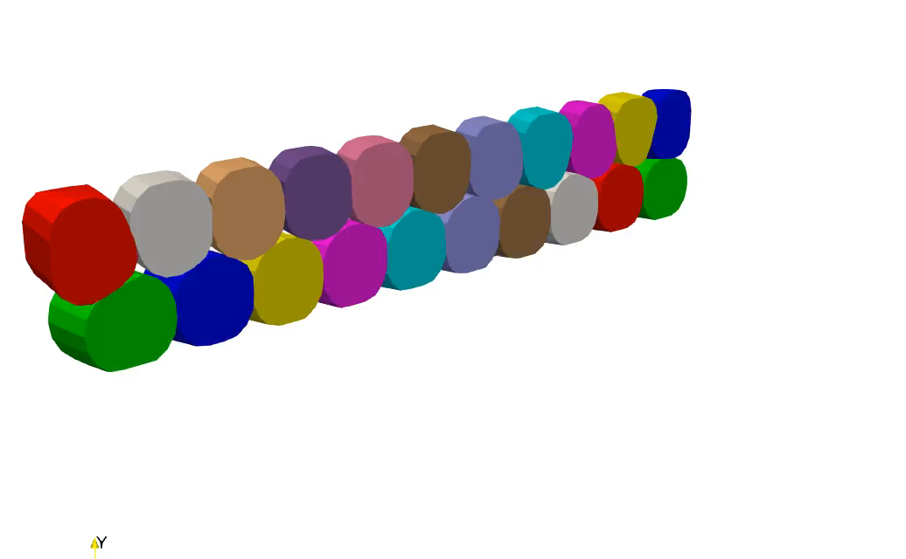
Development of geometric cabling model
LS-DYNA – generating a RVE.
Geometric – moving planes – inspired by [3].
Parametrisation under development
Cable | CD1 [1] | SMACC-LF [2]
Strand diameter [mm] | 0.85 | 0.7
#Strands | 21 | 34
Dimensions* [mm] | 9.55 x 1.62 | 12.74 x 1.31
Pitch [mm] | 64 | 79
Magnetic FEM
Structural FEM
Measured structural properties of cable
Cable – level
^{*Reacted bare cable}
Deformations
‘Explicit dynamics’
Submodel
Strand – level
Mesh conversion
Strand – level
[1] B. Auchmann et al., "Test Results From CD1 Short CCT Nb3Sn Dipole Demonstrator and Considerations About CCT Technology for the FCC-Hh Main Dipole," in IEEE Transactions on Applied Superconductivity, vol. 34, no. 5, pp. 1-6, Aug. 2024
[2] D. Araujo et al., "Electromechanical Design of Nb₃Sn Stress Managed Asymmetric Common-Coils," in IEEE Transactions on Applied Superconductivity, vol. 35, no. 5, pp. 1-5, Aug. 2025
[3] F. Nunio et al., "CoCaSCOPE-Mesh Generator: A Tool to Generate 3D Numerical Models of Rutherford Cables," in IEEE Transactions on Applied Superconductivity, vol. 34, no. 5, pp. 1-5, Aug. 2024

Slide 3
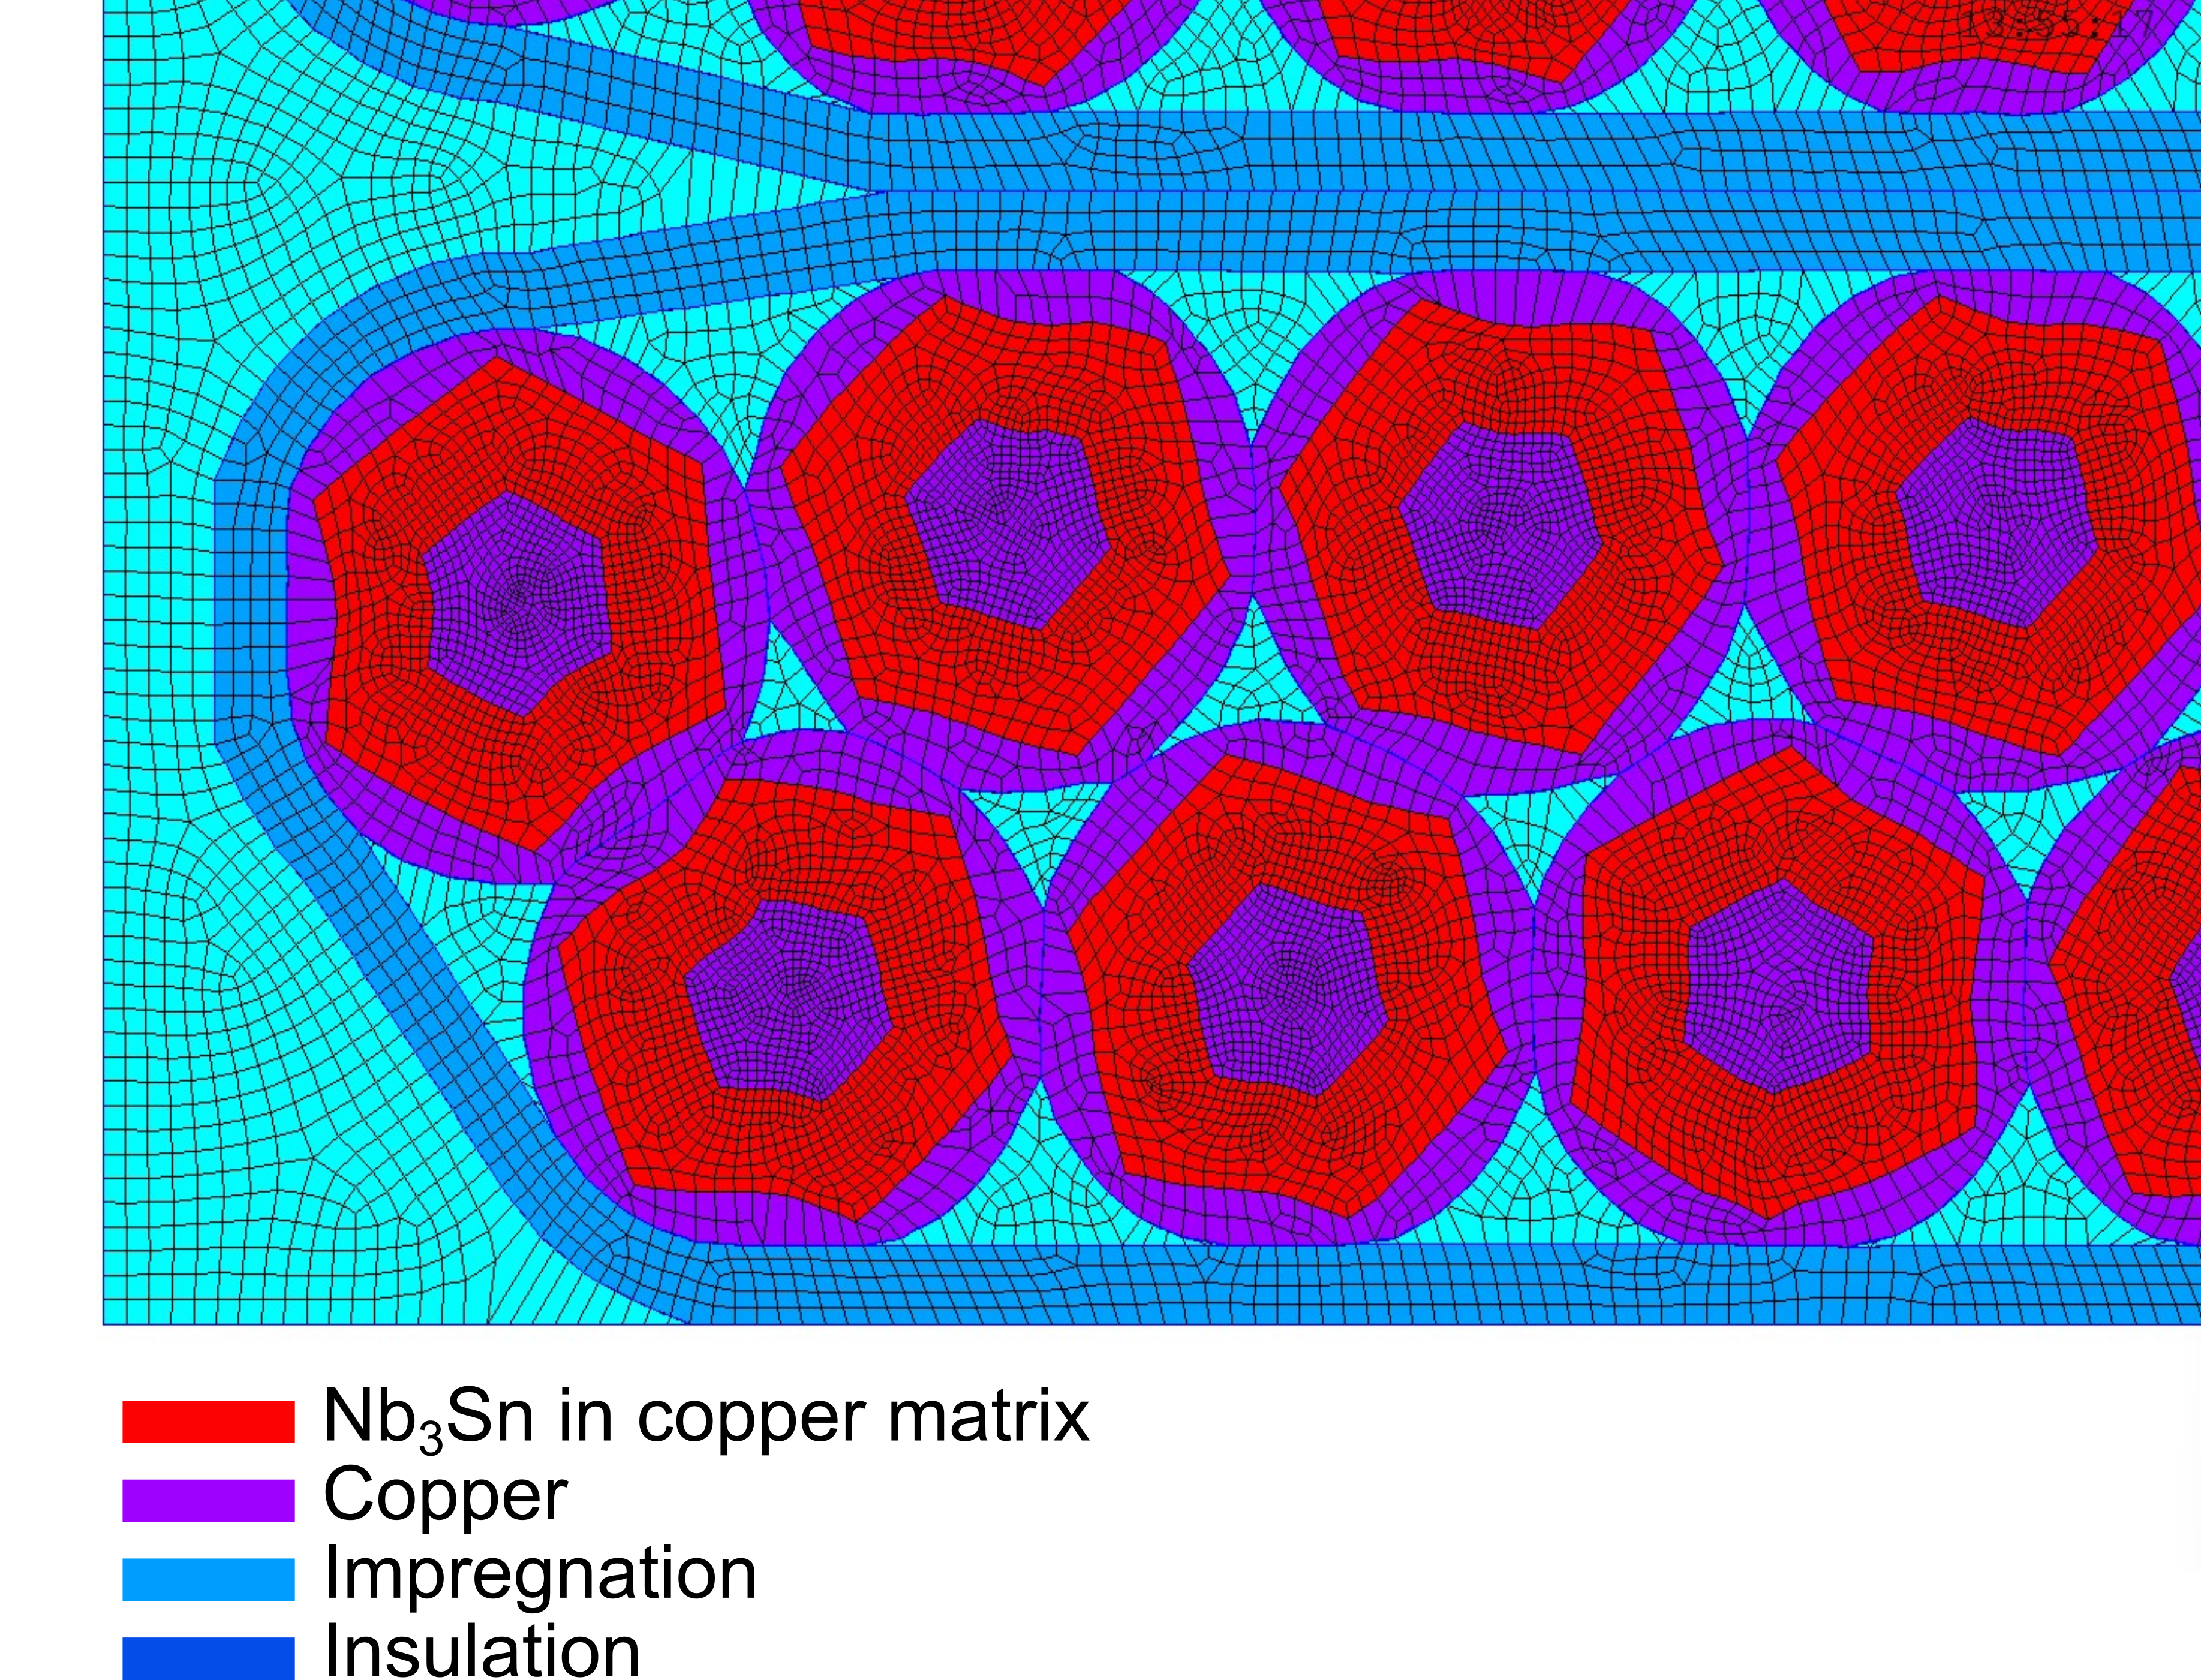
Downscaling procedure
Write deformation of cable model to file
Mesh conversion
Reading mesh from LS-DYNA
Interpolate LS-DYNA mesh to create 2D cross-section
Map deformation of outside nodes
Create watertight geometry for strands
Mesh ‘impregnation’ area
Magnetic FEM
Structural FEM
Measured structural properties of cable
Cable – level
Deformations/Forces
‘Explicit dynamics’
Submodel
Strand – level
Mesh conversion
Strand – level

Slide 4
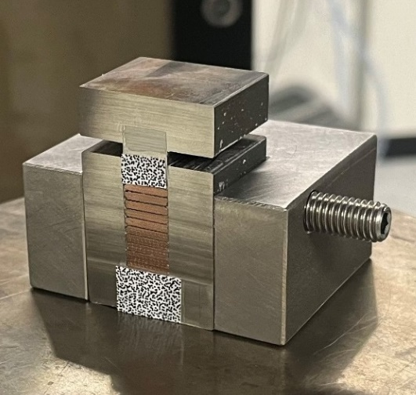
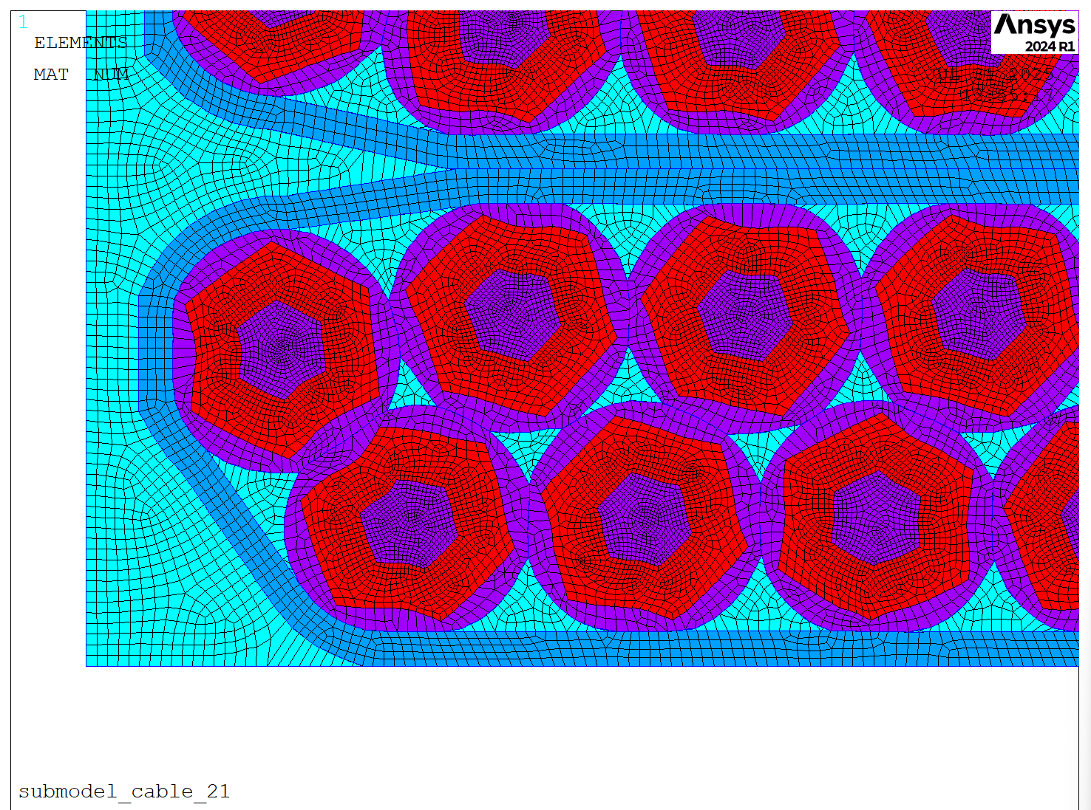
Filled wax impregnated 10-stacks - measurements and simulations.
CHART collaboration with D-MATL of ETHZ: dr. Xiang Kong and Prof. Theo Tervoort
Mechanical testing from 77 K to RT
Materials: filled wax, epoxy, copper, filaments
Impregnated conductor stacks
Input for structural model
Material properties
Composite properties
Validation of detailed modelling
Cables currently under test
Cable | Uniaxial | Constrained
 |  | Transverse | Radial
CD1 | Transverse LN2 RT | LN2 -80°C RT | LN2 -80°C RT
SMACC-LF | -- | LN2 -80°C | LN2 -80°C
SMACC-HF | -- | LN2 -80°C | LN2 -80°C
10-stack sample prepared at PSI

Slide 5
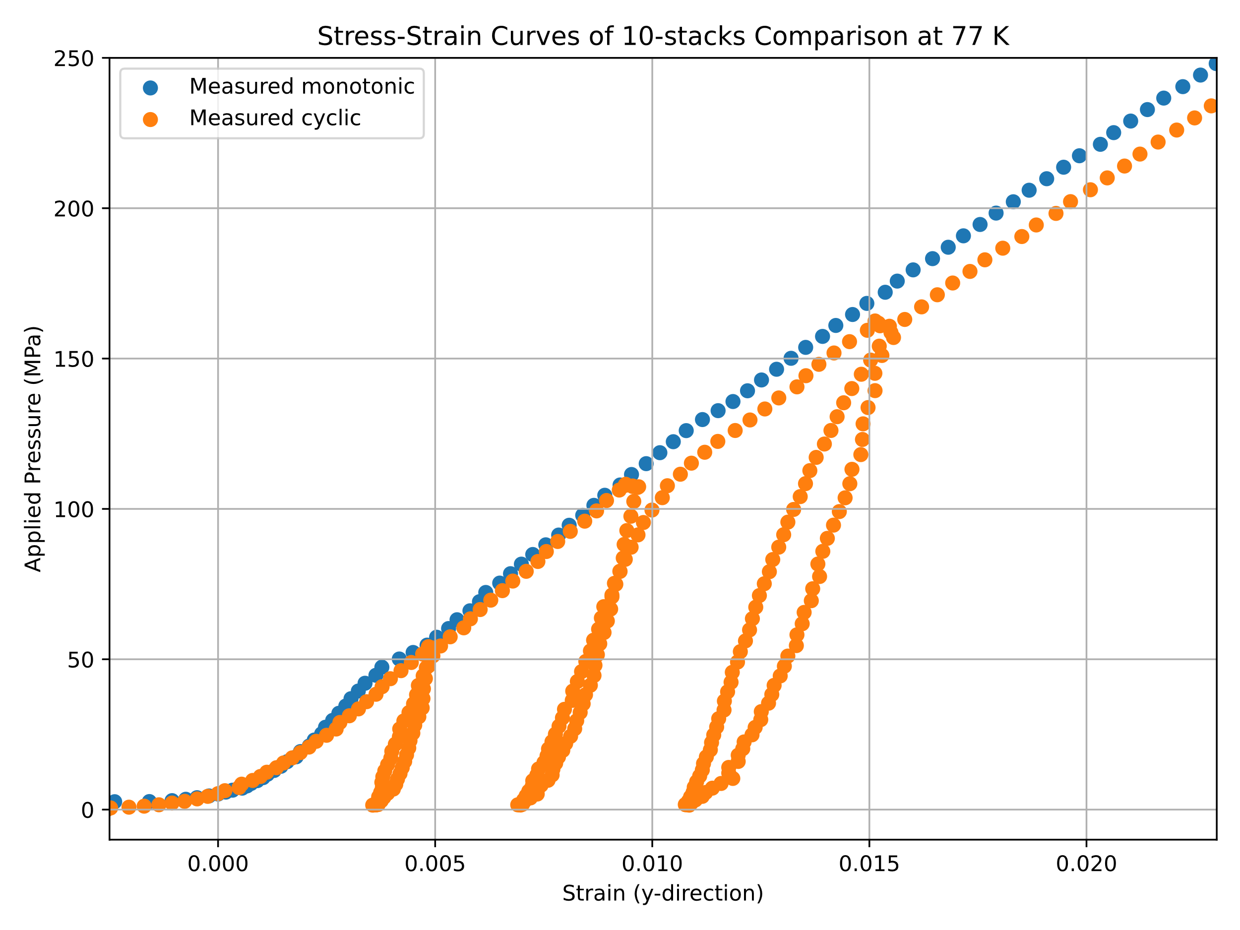
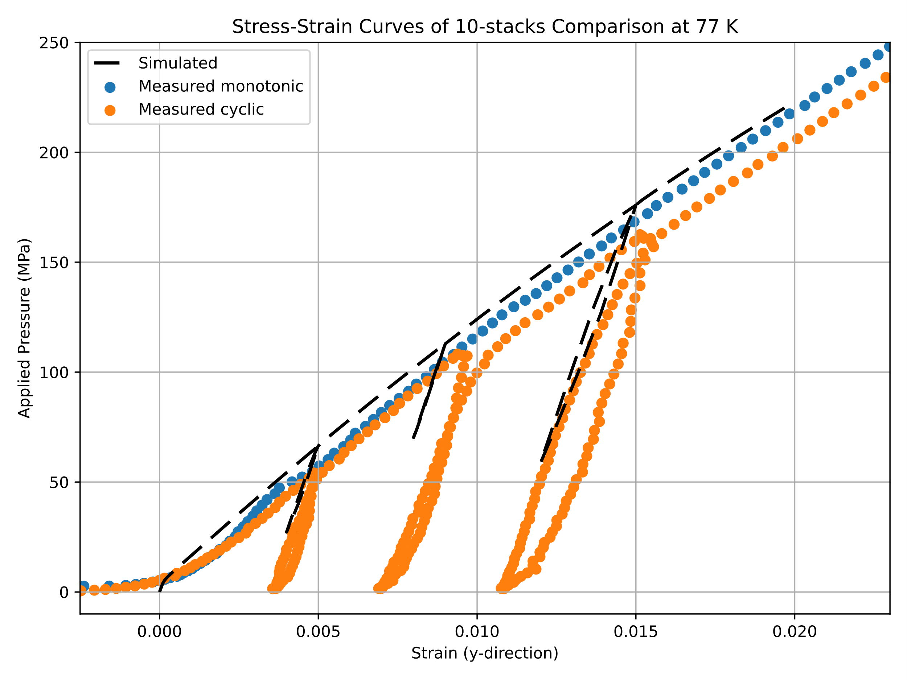
Localisation and quantification of stress/strain in CD1 cable at 77 K
Measured and simulated stress–strain curves of the 10-stack at 77 K show similar behaviour.
Reload stiffening is linked to copper hardening; the reloading slope is mainly governed by the insulation and impregnation elasticity.
Simulation material properties are based directly on experimental measurements.
Can be used as constitutive model for magnet design.
10-stack sample prepared at PSI

Slide 6
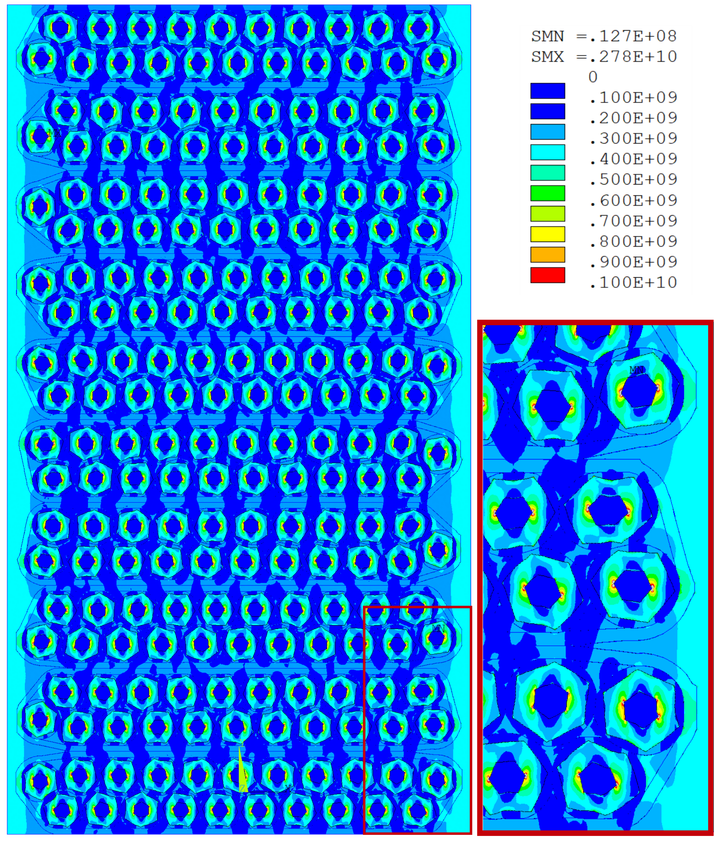
Localisation and quantification of stress/strain
Simulated von Mises stress shows that load is channelled through the stiffer Nb₃Sn regions.
Imperfect wire alignment in the model leads to curved stress “pillars”.
Highest stress concentrations in sumulation occur at sharp corners of the interfilamentary region, especially at vertical midpoints.
An X-shaped stress pattern appears within the strand, consistent with previous single-strand and image-based studies.
Simulated von Mises stress distribution (Pa) in the 10-stack under 2% applied vertical strain, showing stress concentrations in the Nb₃Sn regions and an X-shaped stress-pattern in the interfilamentary region of the strands.

Slide 7

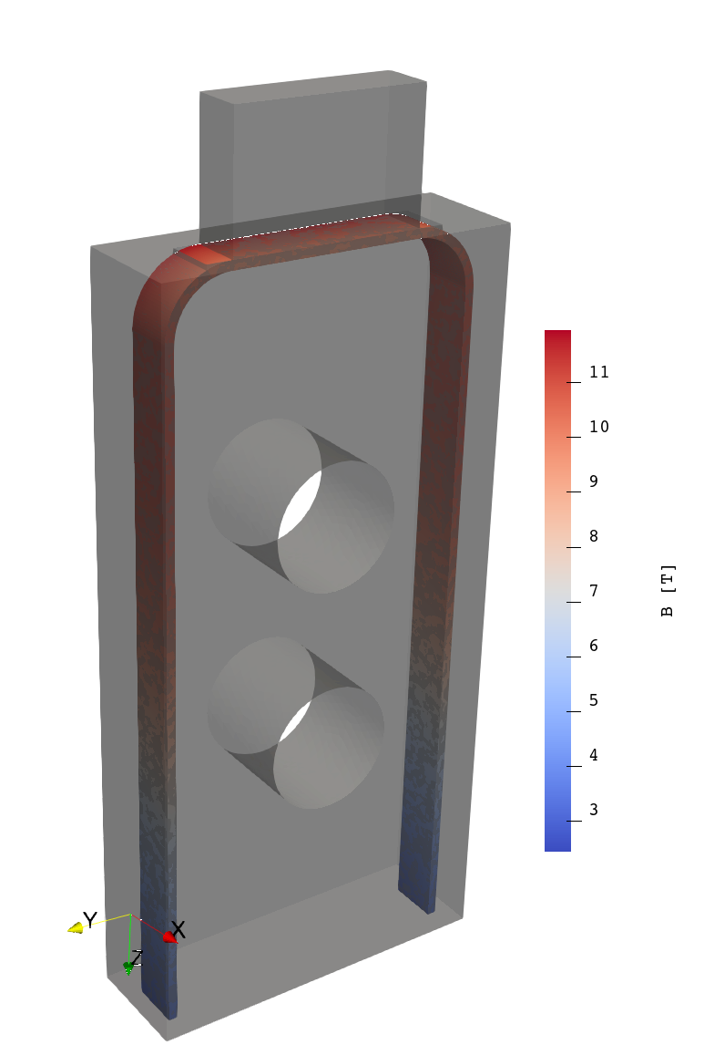
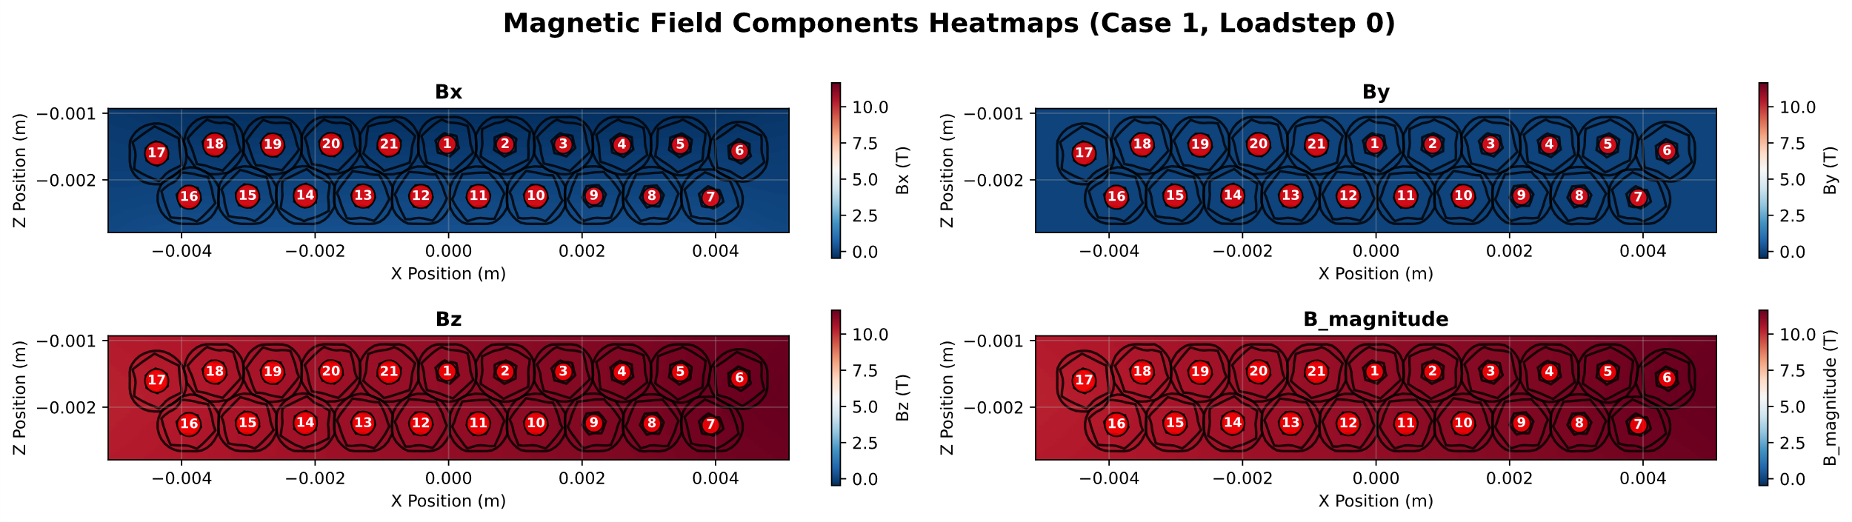
Modelling reduction of I_{c} as function of transverse pressure.
Rutherford cable overlaid on field
Simulated B-field overlayed on the Rutherford cable, used to calculate Lorentz forces in the mechanical model. The strands are numbered.
Lorentz forces computed using simulated field, and current from experiment.
Pressure on pusher from experiment.
Filled wax impregnation
Contacts:
Strand – strand, strand – insulation, strand – impregnation 2 – no separation (sliding permitted)
Insulation – impregnation 3 – bonded
Impregnation – steel former 0 – standard

Slide 8
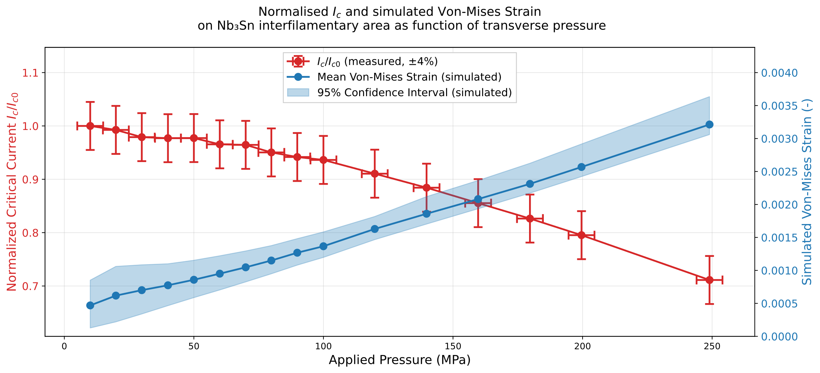
Normalised reduction of I_{c} and simulated strain

Slide 9
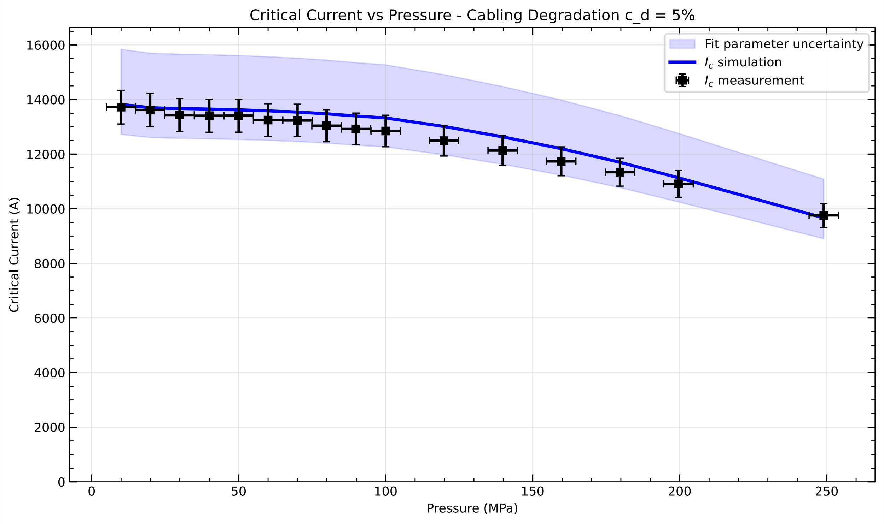
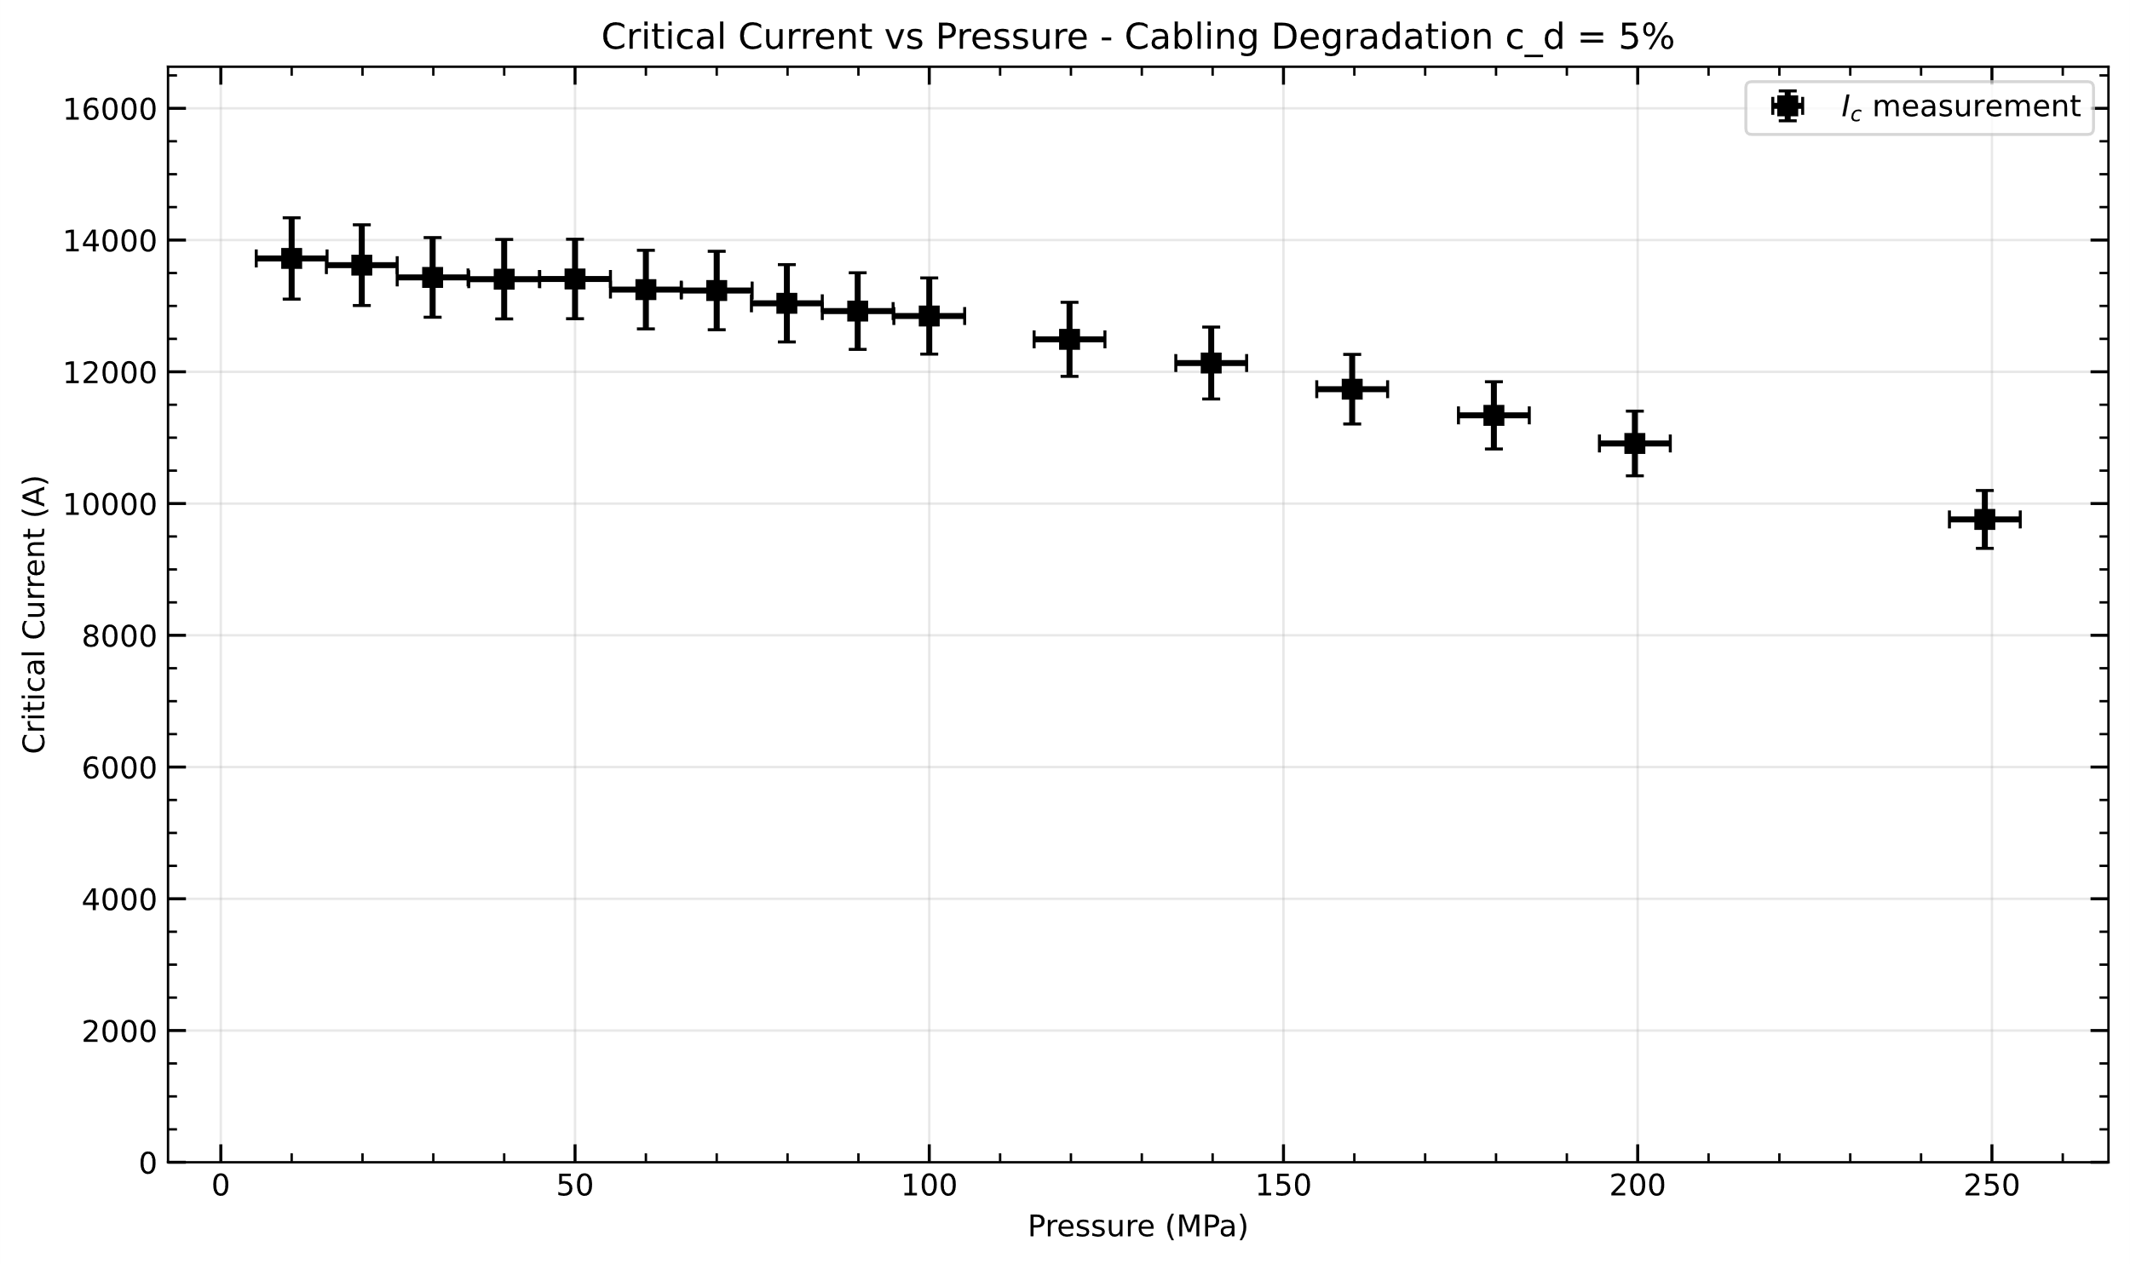
Measured and simulated reduction of critical current as function of transverse pressure, in 11 T background field.
_{[4]}$I_{c}\left(B_{p},T,ε\right)=\frac{C_{0}}{B_{p}}{\left[s\left(ε\right)\right]}^{σ}{\left[\left(1−t^{3/2}\right)\left(1−t^{2}\right)\right]}^{η/2}b^{p}{\left(1−b\right)}^{q}$
[4] G. De Marzi et al., "Magnetic and Electromechanical Characterization of a High-JC RRP Wire for the HL-LHC MQXF Cable," in IEEE Transactions on Applied Superconductivity, vol. 32, no. 6, pp. 1-5, Sept. 2022, Art no. 6001505

Slide 10


