Slide 1
SMACC2: feasibility study and initiative on Nb-Ti wire and cable with low copper content
PSI/CERN LTS WP Progress Meeting
D. Araujo, B. Auchmann, A. Brem, N. Kehl, C. Lindner, T. Michlmayr, C. Müller, I. S. P. Peixoto,
A. Stampfli and J. Van den Eijnden.
This work was performed under the auspices of and with support from the Swiss Accelerator Research and Technology (CHART) program. This work was partially funded by the HFM program.
November 2025

Slide 2
Agenda
Feasibility study
Initiative on Nb-Ti wire and cable with low copper content

Slide 3


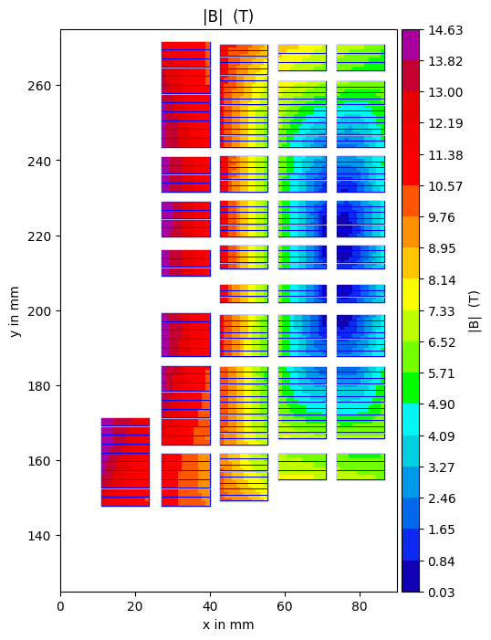
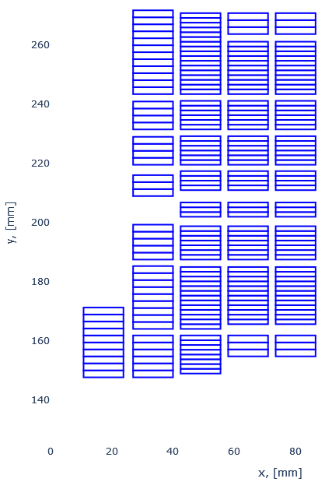
Magnet Parameters (V4)
parameter | value | unit
Bore | 50 | mm
Intra-beam | 400 | mm
T_{op} | 1.9 | K
B₀ | 13.97 | T
B_{peak} | 14.63 | T
I_{op} | 10.5 | kA
Load line Margin | 18 | %
Fx | 17.8 | MN/m
Fy | 0.5 | MN/m
1
2
3
4
5

Slide 4
Magnet Parameters (V4)
@14 T Multi poles | value | unit
a2 | 2.6 | 10⁻⁴
a4 | -8.5
a6 | 10.7
a8 | 2.7
b3 | 12.0
b5 | -1.6
b7 | -2.6
b9 | -0.8
1
2
3
4
5

Slide 5
Cable Parameters (V4)
Nb₃Sn
Nb-Ti
Layer | LTS Type | Turns
1 | Nb₃Sn | 10
2 |  | 43
3 |  | 64
4 | NbTi | 6 + 49
5
Layer | Number of strands | Strand type and diameter in mm
1 | 21 | RRP 162/169 - 1.1
2
3 | 34 | RRP 78/91 - 0.7
4 - LF | 34 | Nb-Ti 0.7
5 - LF
4 - HF | 21 | Nb-Ti 1.1
5 - HF
1
2
3
4
5
In this version, the Nb₃Sn and Nb-Ti HF and LF cables have the same number of strands and the same strand diameter.

Slide 6
Magnet Parameters (V4)
Layer 4 thin conductor peak field >
On Layer 4 thick conductor
The inner blocks could use the thin conductor
1
2
3
4
5

Slide 7
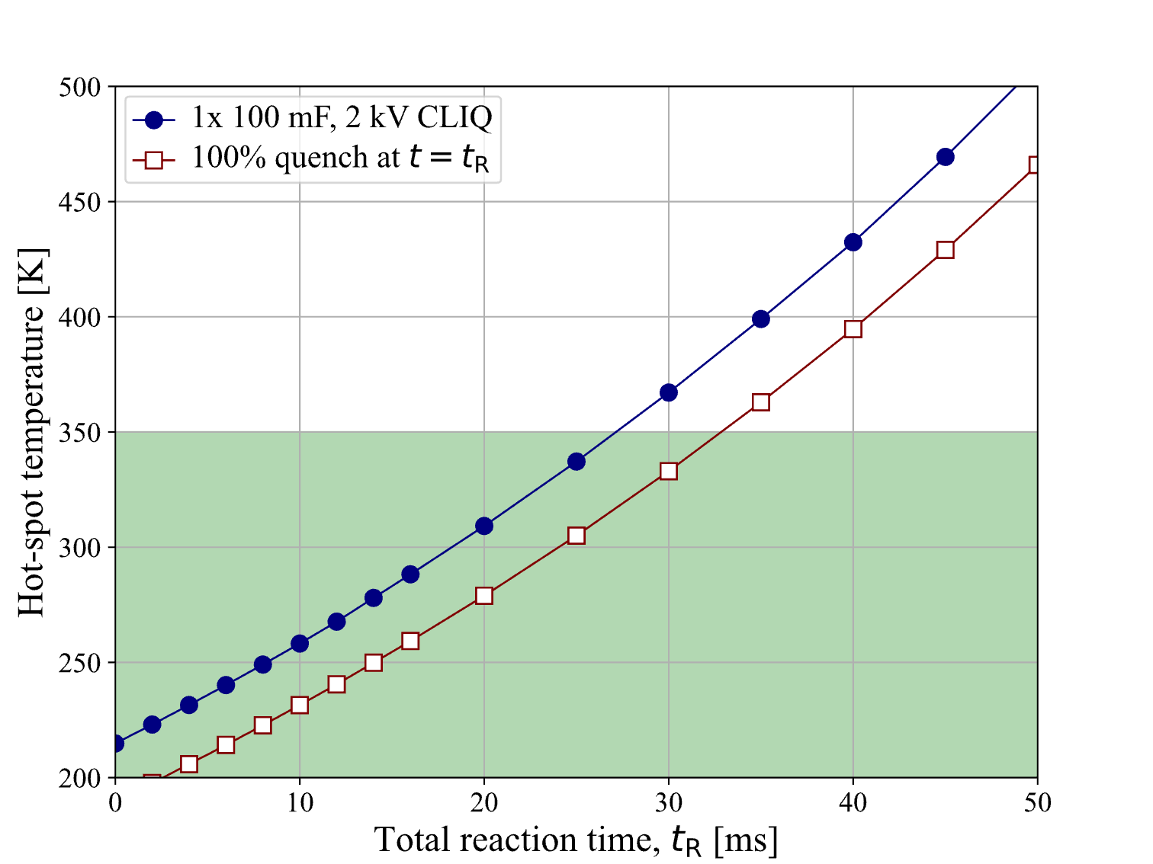


Hot-spot temperature as a function of total reaction time
The total reaction time t_{R} is the sum of quench detection time, validation time, and trigger time.
The adiabatic hot-spot temperature can be kept
<300 K with t_{R}<18 ms
<350 K with t_{R}<27 ms

Slide 8
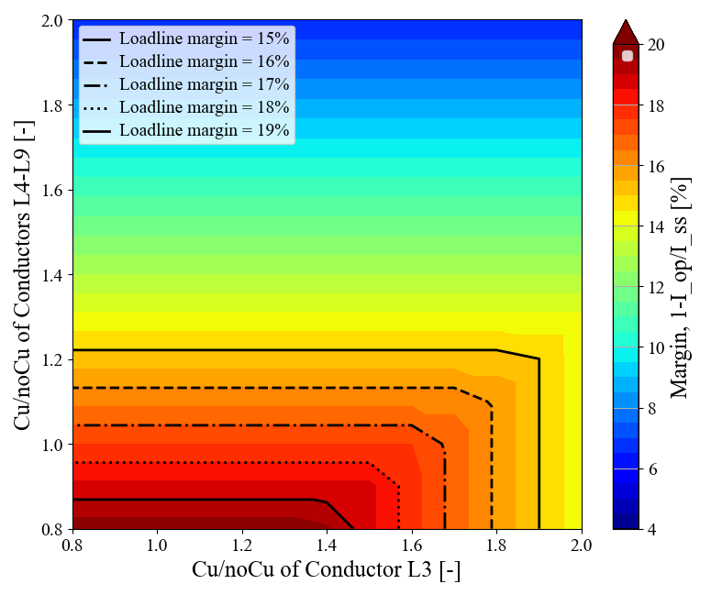
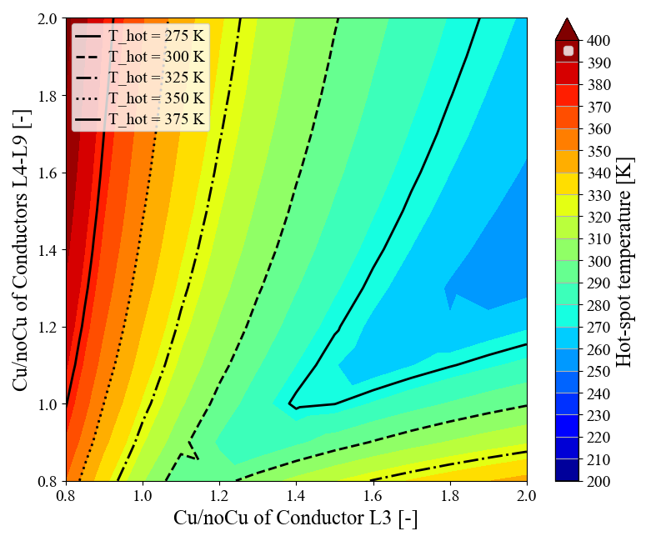
SMACC2_V4 parametric study – Varying Cu/noCu in L3 and L4-9
Margin 1-I_{op}/I_{SS} in L3-9
Hot-spot temperature
375 K
350 K
325 K
300 K
275 K
15%
16%
17%
18%
19%

Slide 9
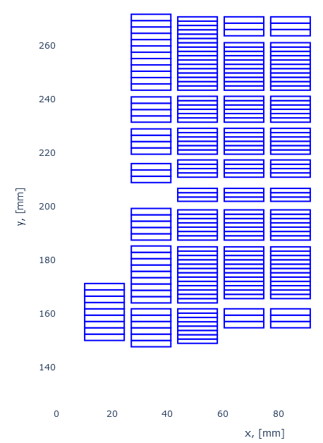
Magnet Parameters (V4&V5)
V4
V5
parameter | V4 | V5
Bore | 50 mm
Intra-beam | 400 mm
T_{op} | 1.9 K
B₀ | 14 T
B_{peak} | 14.63 | 14.61
I_{op} in kA | 10.5 | 10.78
Load line Margin in % | 18.5 | 19.5 + 1 %
Strand Area in mm² | 13667 | 14822 + 8.5%
1
2
3
4
5
1
2
3
4
5

Slide 10
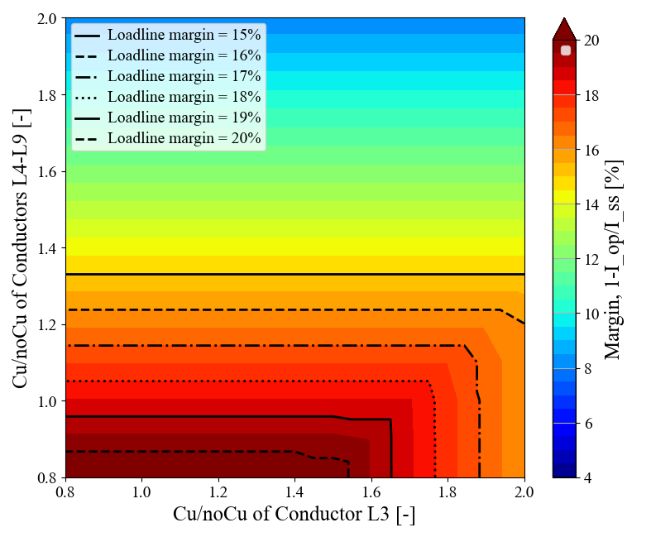
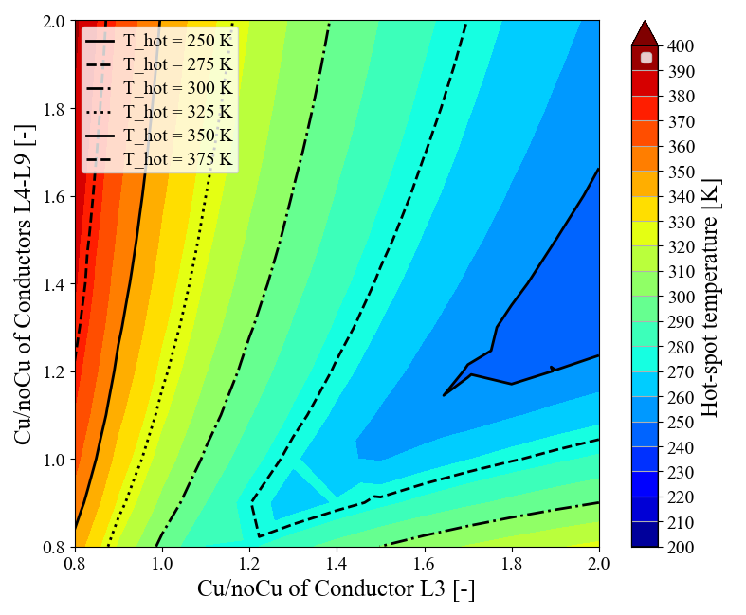
SMACC2_V5 parametric study – Varying Cu/noCu in L3 and L4-9
Margin 1-I_{op}/I_{SS} in L3-9
Hot-spot temperature
350 K
325 K
300 K
275 K
250 K
15%
16%
17%
18%
19%
20%

Slide 11
Agenda
Feasibility study
Initiative on Nb-Ti wire and cable with low copper content

Slide 12
Nb-Ti Conductor
We discussed with Nb-Ti wire manufactures and the conductor with a Cu/Non-Cu ratio of 0.9 to match the SMACC2 requirements can be produced.
Such a wire is not an existing product and would require 8 to 10 months of lead time.
The manufacturability of the Rutherford cable, due to the low copper content, which may require post-heat-treatment optimization, is to be studied.
One of the manufactures currently has Nb-Ti conductor (diameter of ~1.5 mm) with a Cu/Non-Cu ratio of 0.85 but lower Ic available off the shelf. This material could be used to manufacture a test cable and to try different post-heat-treatment to assess manufacturability and Ic degradation due to cabling.

Slide 13
Nb-Ti / Nb₃Sn Conductor: tentative plan
 | Q3/2025 | Q4/2025 | Q1/2026 | Q2/2026 | Q3/2026 | Q4/2026 | Q1/2027 | Q2/2027 | Q3/2027 | Q4/2027 | Q1/2028
Procurement of existent Nb-Ti 0.85 Cu/Ncu
Cabling with 2 or 3 different heat treatments
Ic round vs extracted samples
Winding trials
Finalize SMACC2 Cable Design
Procurement of final wire
Cabling with final wire and insulation Nb-Ti type 1
Cabling with final wire and insulation Nb-Ti type 2
Beginning of SMACC2 Nb-Ti coils production
Nb₃Sn Cable manufacturing and insulation run type 1
Nb₃Sn Cable manufacturing and insulation run type 2
Beginning of SMACC2 Nb₃Sn coils production
The PO for Nb-Ti wire for post-heat-treatment, sharp-bending tests,
cabling, and Ic-reduction studies has been placed.

