Slide 1
SMACC1: open questions
PSI/CERN LTS WP Progress Meeting
D. Araujo, B. Auchmann, A. Brem, N. Kehl, C. Lindner, T. Michlmayr, C. Müller, I. S. P. Peixoto,
A. Stampfli and J. Van den Eijnden.
This work was performed under the auspices of and with support from the Swiss Accelerator Research and Technology (CHART) program. This work was partially funded by the HFM program.
November 2025

Slide 2
Agenda
Requests to CERN
316 LN plates
I Iron pole raw material
Kapton for SMACC1 coils
SMACC1 spare conductor

Slide 3


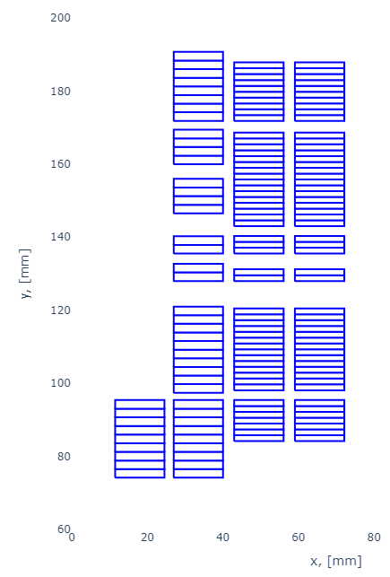
Cable Unit Lengths
Type | High-Field | Low-Field
Wire type | Nb₃Sn RRP® 162/169 | Nb₃Sn RRP® 78/91
CERN Wire Denomination | DEM-1.1 | ERMC-0.7
N wire x dia in mm | 21 x 1.1 | 34 x 0.7
Cu/nCu | 0.9 | 1.2
Bare Cable dimensions in mm | 12.74 x 2.06 | 12.74 x 1.31
Insulation thickness in mm | 0.155 | 0.155
Cable Originally Designed for | R2D2 HF | SMACC1 LF
Layers | 1 | 2 | 3/4
Cable Type | High-field | High-field | Low-field
Number of turns | 9 | 39 | 52/52
*Coil unit length in m | 15 | 75 | 100
W_{eq} in mm | 20.1 |  | 19.1
Area of insulated cable in mm² | 2954 |  | 4367
1 2 3 4
Design based on existent cable

Slide 4
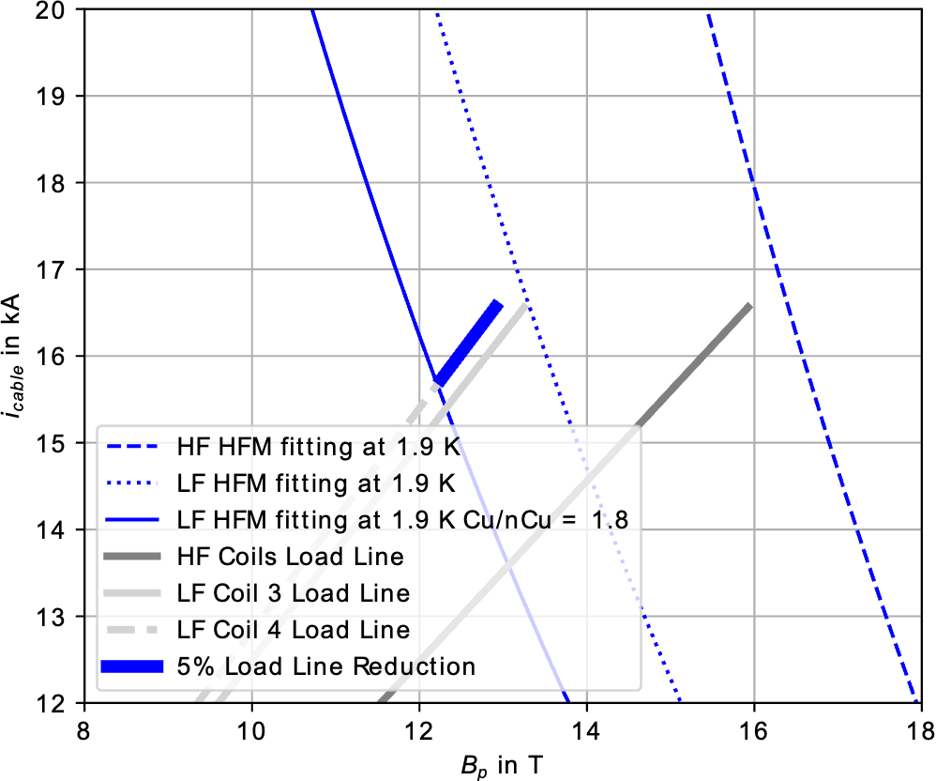
Use of R2D2 LF cable
For the low-field cable, an alternative would be to use the R2D2 low-field cable (layer 4), based on a Cu/nCu conductor of 1.8 instead of 1.2 (SMACC1 low-field cables). This would represent a reduction by 5% of the load line margin.
Possible risk mitigation, tbd:
Mutualizing the spare conductor between SMACC1 and R2D2.
Producing spare cables on “need basis”.

