Slide 1
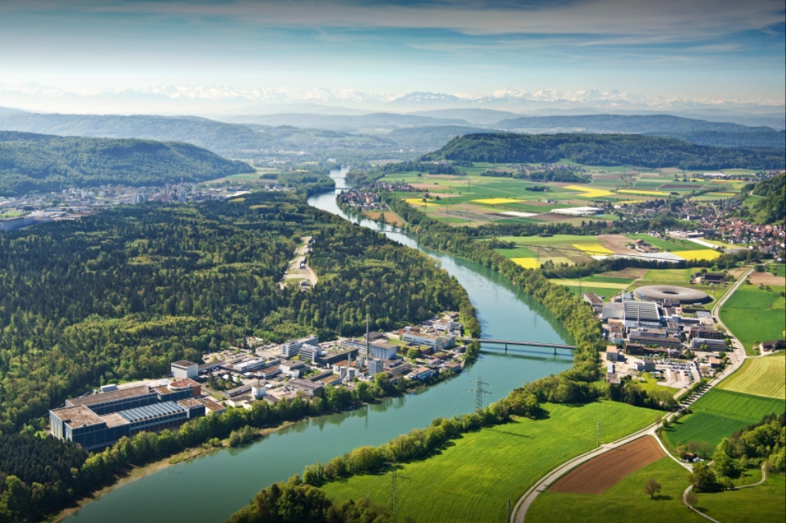
Introduction and Welcome EPFL-SPC
Kamil Sedlak
January 14, 2026

Slide 2
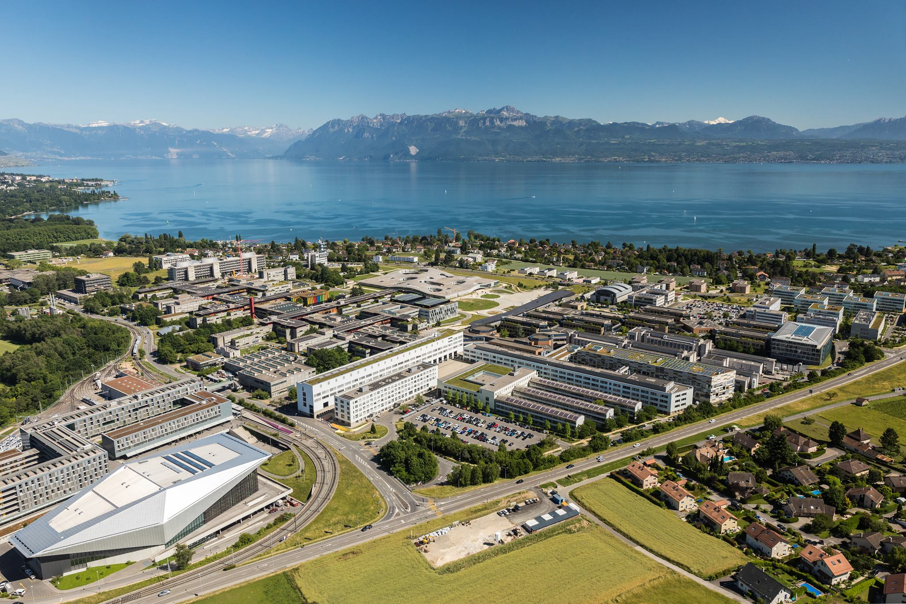
SPC – the Largest Laboratory of EPFL in Lausanne

Slide 3
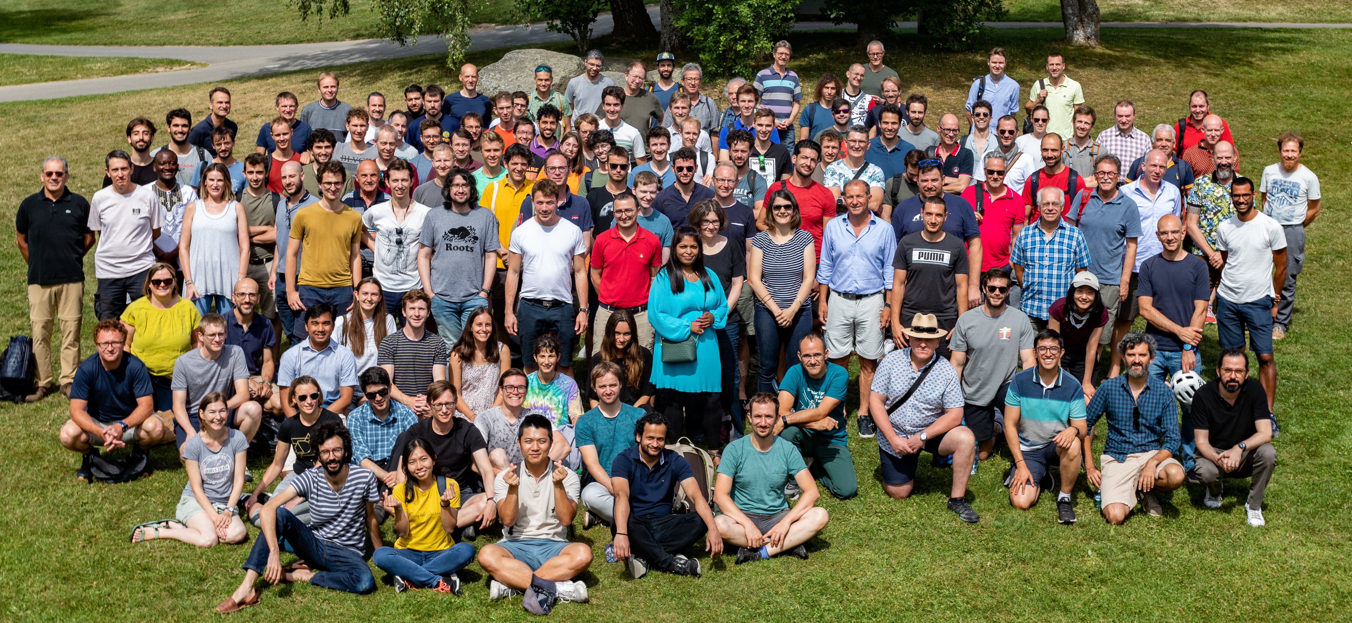
SPC Now Counts 200 Staff Members
Majority of SPC (180 people) works on plasma research in Lausanne.
20 people working on applied superconductivity is based at premises of PSI in Villigen.

Slide 4
Research Lines of SPC
Tokamak Physics - TCV
Plasma Heating
FALCON: testing of ITER Gyrotron components
T-Rex: experiment to understand electron cloud formation
Theory
Studies of core and boundary turbulences in plasma
Plasma control
Advanced modelling on powerful computing clusters
Low Temperature Plasma and Application
Applied Superconductivity

Slide 5
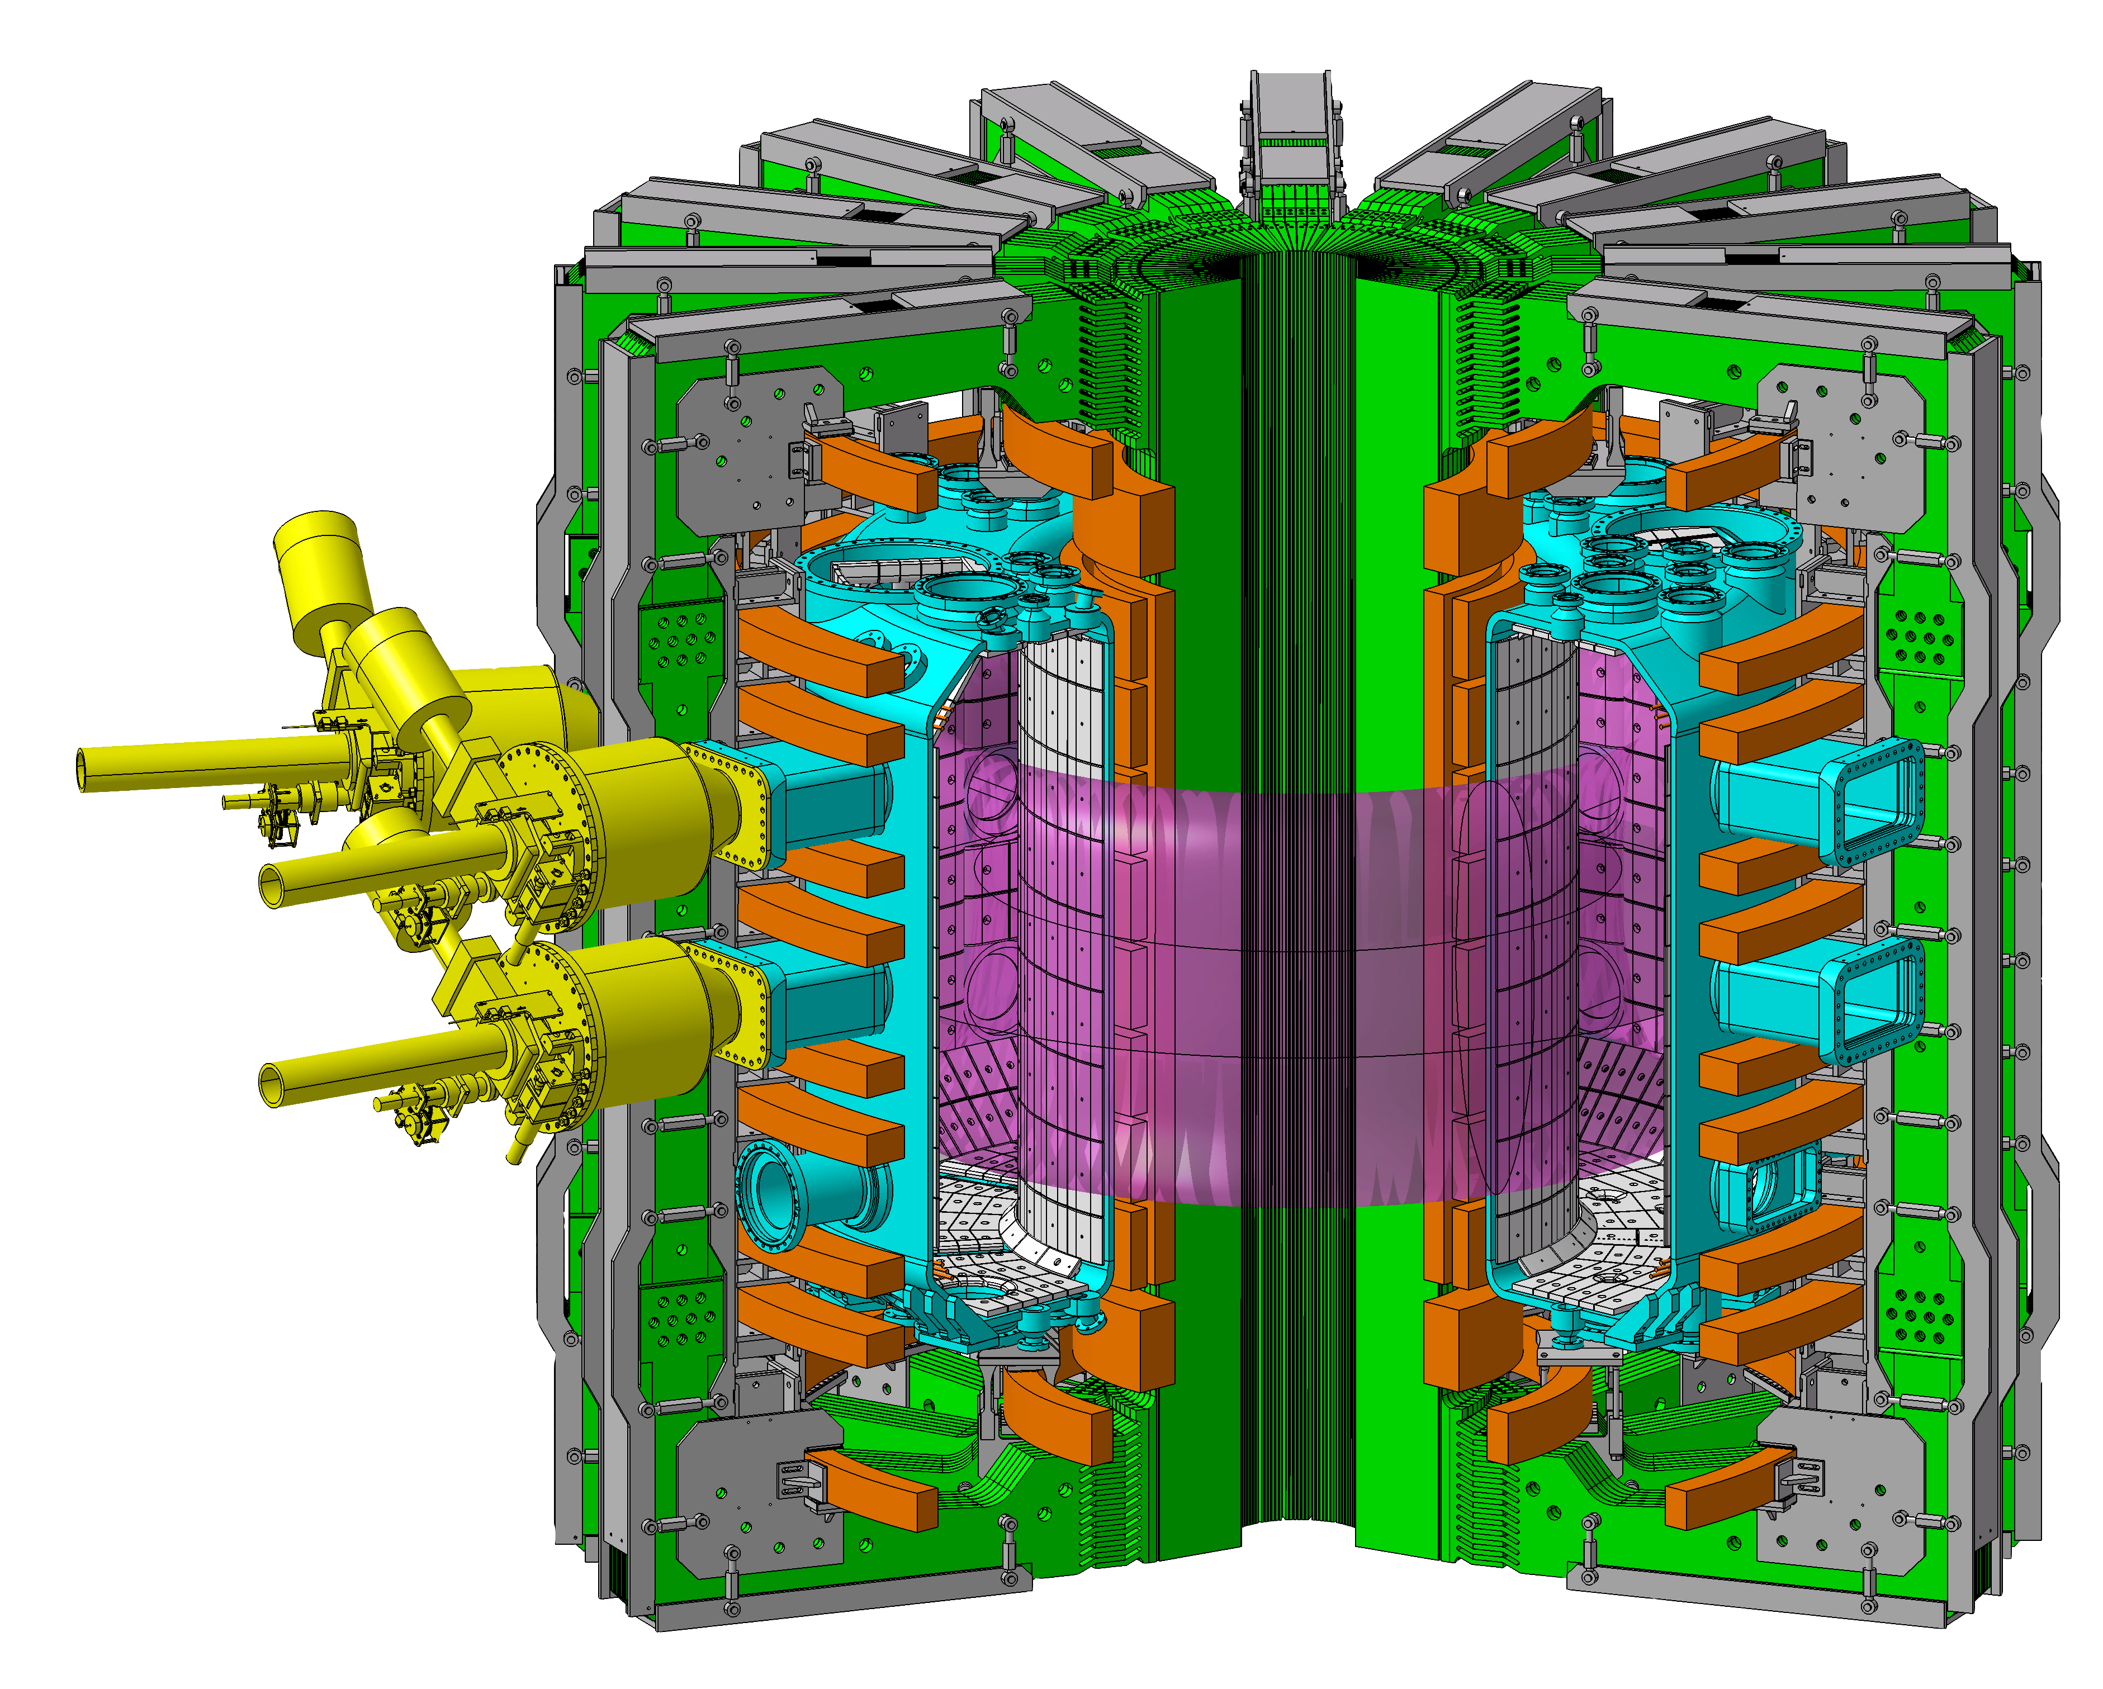
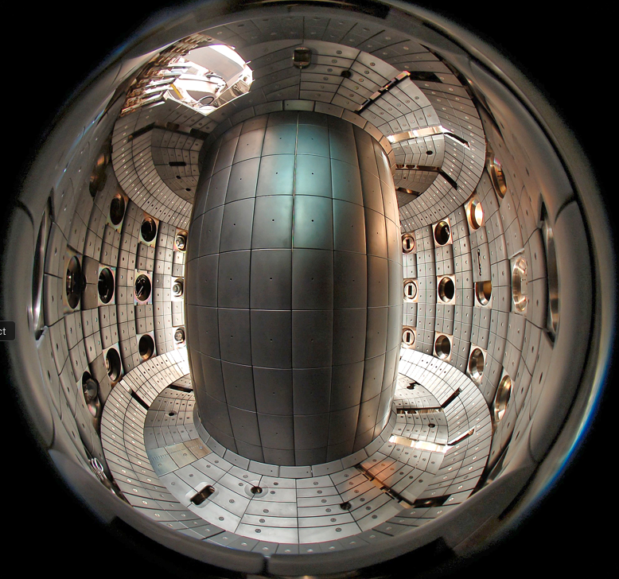
TCV: the Most Flexible Tokamak Worldwide
R_{major} = 0.9 m
R_{minor} = 0.25 m
I_{p} < 1 MA
B_{T} < 1.54 T
2.3 MW NBI heating
3.75 MW ECRH
Independently powered
16 shaping coils
2 OH coils
1 internal vertical control coil
κ < 3, -0.6 < δ < 0.9
Graphite tiles
Internal divertor baffles
a=0.25 m
R=0.88 m
graphite walls
More than 40 international institutions participate in the TCV program

Slide 6
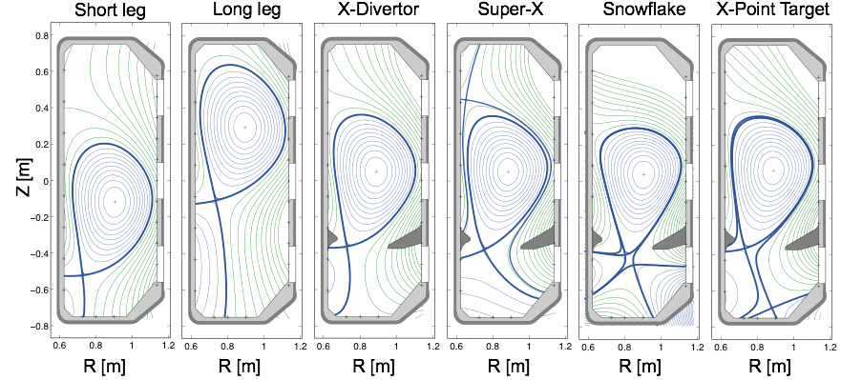
Built-in Flexibility and Versatility of TCV Tokamak
Fasoli et al., Nucl. Fusion 2020

Slide 7
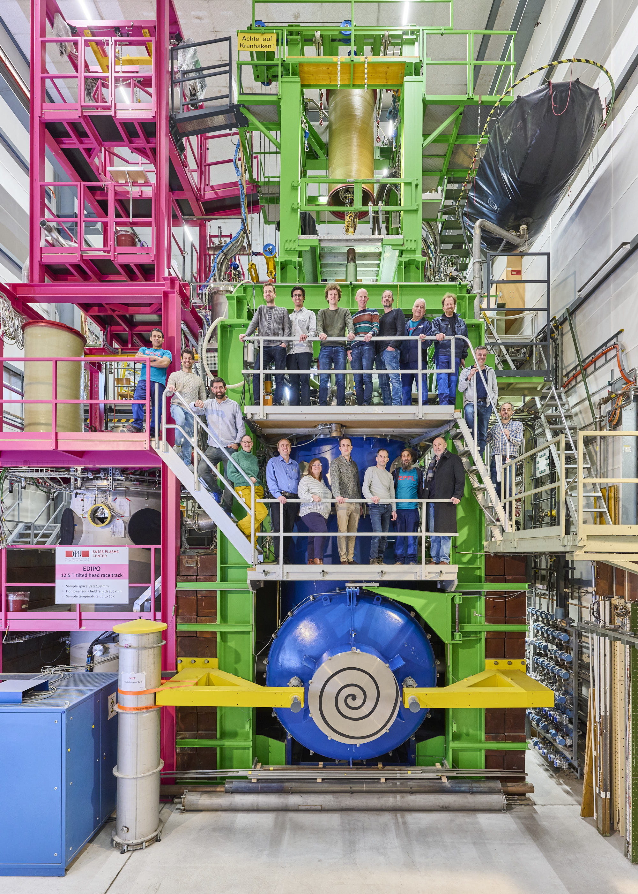
Applied Superconductivity Group
Testing of superconductors for fusion magnets:
Sample assembly (conductors and joints)
Sample testing
Maintenance and upgrades of existing test facilities SULTAN, EDIPO and the smaller one JORDI.
R&D on fusion-size superconductors within EUROfusion programs:
DEMO, VNS, stellarator
Quench behaviour in HTS, fusion-relevant samples
Quench detection based on non-voltage methods (optical fibers; co-wound superconducting strands; thermocouples)
Other collaborations, e.g. with Bruker Biospin and CERN

Slide 8
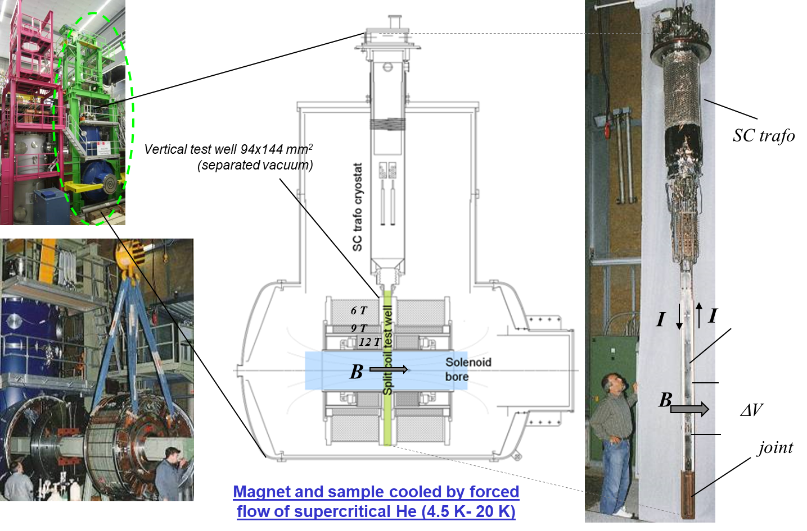
SULTAN Test Facility – DC Field up to 10.9 T

Slide 9
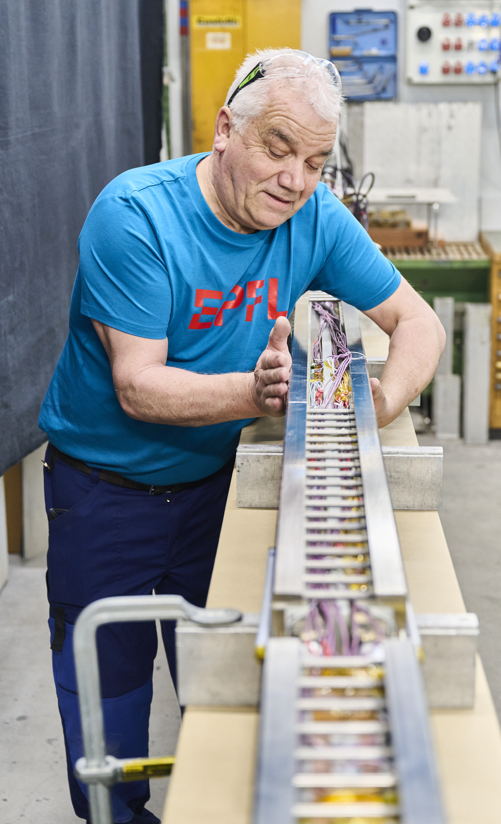
Tests in SULTAN
 | SULTAN | EDIPO II
status | in operation | to be upgraded after accident
Matnetic field | 11 T | 15 T
Sample space | 94x144 mm² | 144x144 mm²
Temperature | 4.5-50 K | 4.5-50 K
Possible use of the SULTAN/EDIPO test facilities:
Test of superconducting cables for fusion magnets (ITER, EU DEMO, CFS, BEST, CFETR, DTT, …) up to 100 kA.
Test of joints (fusion and accelerator cables).
Quench experiments (only up to 15 kA).
Test of sub-size accelerator coils (e.g. Feather HTS magnets for CERN).

Slide 10
Organisatory Comments

Slide 11
Tour to SULTAN Test Facility
Wednesday 14.1. approx. at 17:15 (after the presentations)
guide: Kamil Sedlak.
Notes:
Nicht aktualisiert

Slide 12
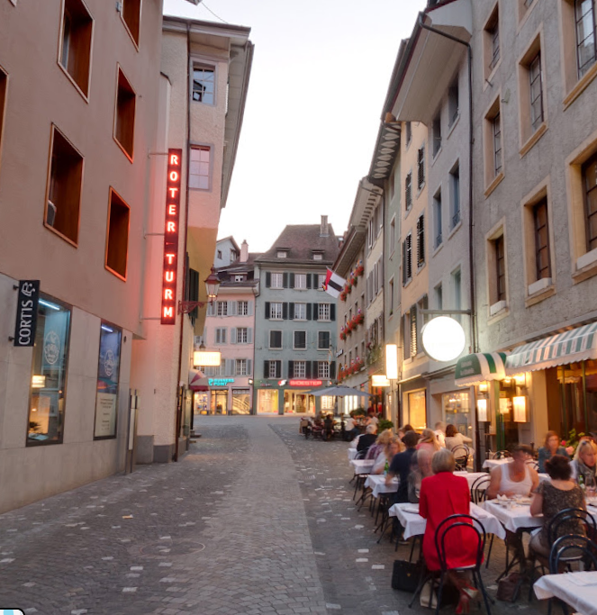
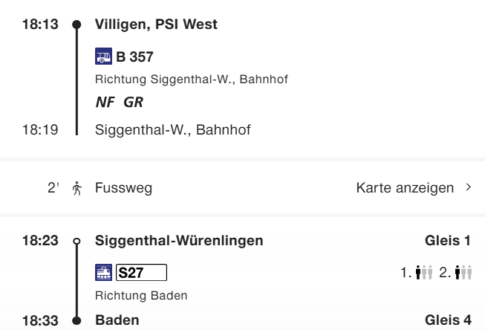
Workshop Dinner
On Thursday 16.1. at 19:00 in Restaurant Roter Turm in Baden, Rathausgasse 5, 5400 Baden
How we get there: by public transportation: bus + train (www.sbb.ch)

Slide 13
Workshop Dinner
Menu meat:
Green salad with house dressing *** Chicken breast with herb cream sauce, Potato gratin and vegetables
*** Chestnut mousse in a glass
CHF 50.00 CHF (excl. drinks)
Vegetarian alternative:
Green salad with house dressing *** Truffle ravioli with Noilly Prat and chervil sauce and diced pumpkin *** Chestnut mousse in a glass
CHF 44.00 CHF (excl. drinks)

Slide 14
Enjoy the Workshop!

