Slide 1
WPMAG - CEA IRFM Design 14/01/2025
A. Torre

Slide 2
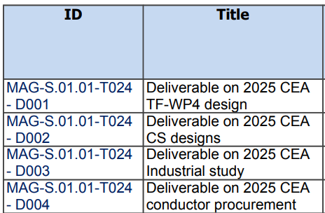
2025 CEA TS Design / Ind Study / Procurement

Slide 3
2025 CEA TS Design / Ind Study / Procurement
MAG-S.01.01-T024-D001
Deliverable on 2025 CEA TF-WP4 design

Slide 4

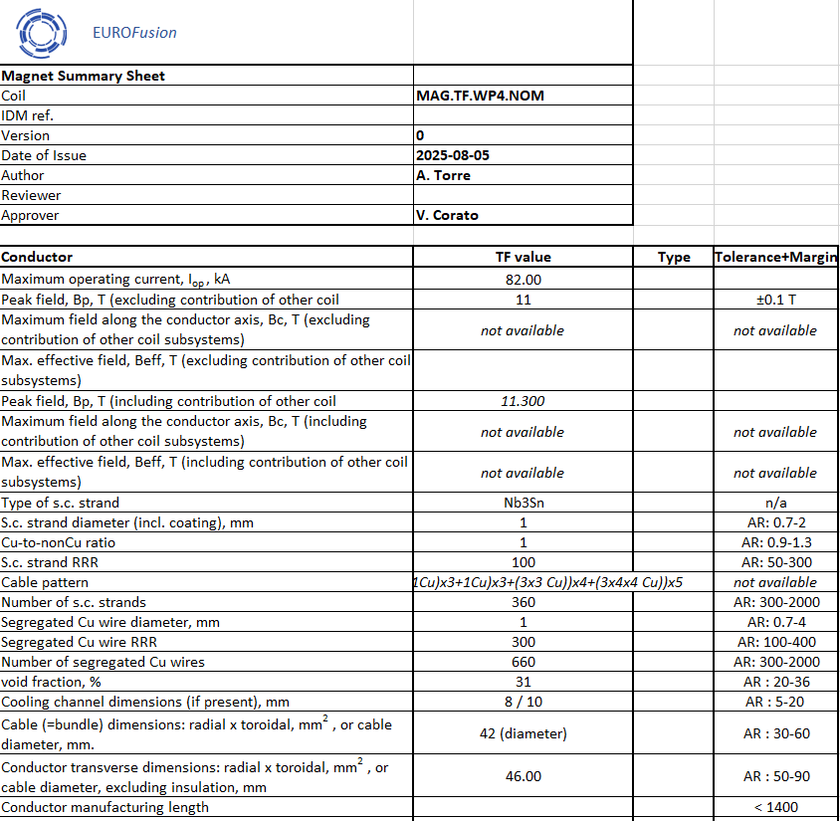
2025 CEA TS Design / Ind Study / Procurement
MAG-S.01.01-T024-D001 Deliverable on 2025 CEA TF-WP4 design
Since no major changes were foreseen in 2025 on the TF design, this task was used to make a sorting/regroupoing work in view of the 2025 Gate Review, trying to provide the Work Package Leader and DCT a clear view of the latest design, along with what had been done in terms of analysis. Summary sheets were also provided.

Slide 5
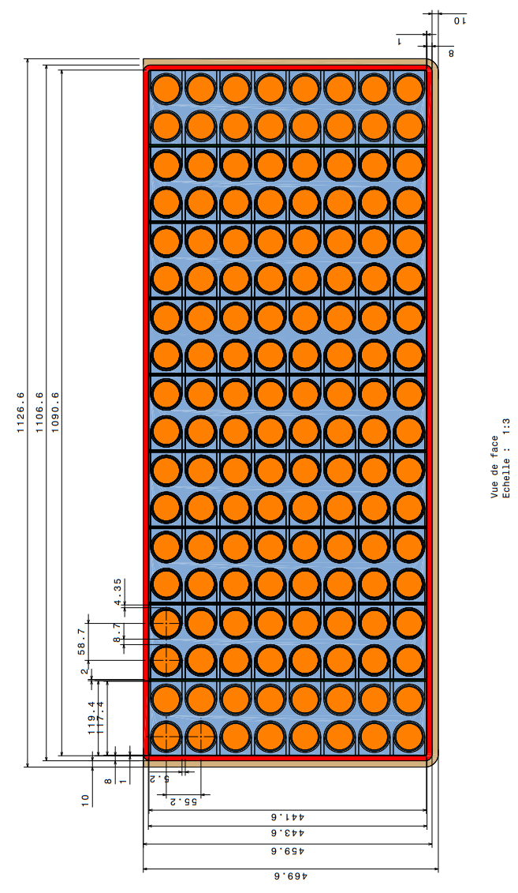
2025 CEA TS Design / Ind Study / Procurement
MAG-S.01.01-T024-D001 Deliverable on 2025 CEA TF-WP4 design
Since no major changes were foreseen in 2025 on the TF design, this task was used to make a sorting/regroupoing work in view of the 2025 Gate Review, trying to provide the Work Package Leader and DCT a clear view of the latest design, along with what had been done in terms of analysis. Summary sheets were also provided.
A detailed 2D drawing was also added to the preparatory documents for Gate Review.

Slide 6
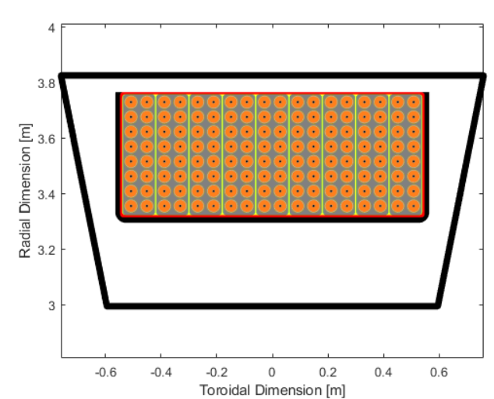
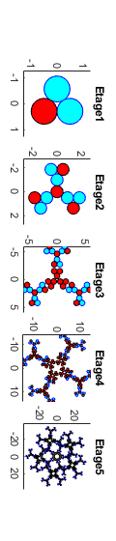
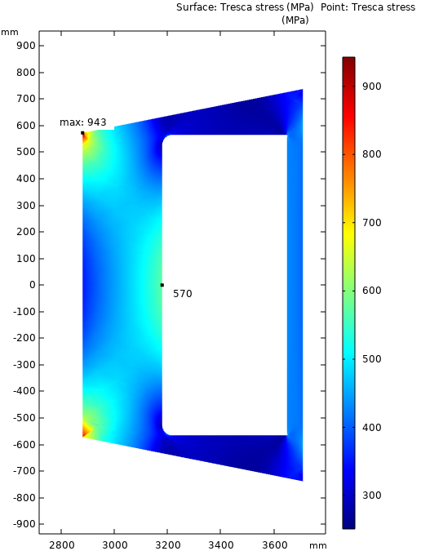
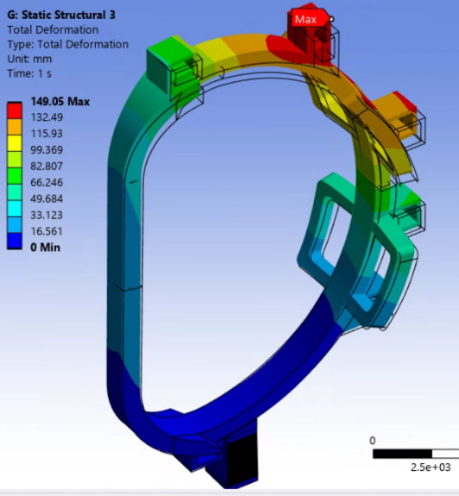
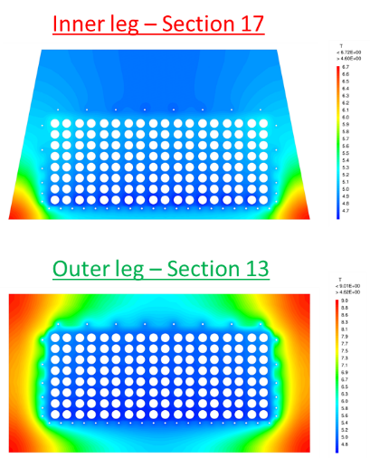
2025 CEA TS Design / Ind Study / Procurement
Design and conductor cabling
MAG-S.01.01-T024-D001 Deliverable on 2025 CEA TF-WP4 design
2D Mech Analysis
Finally, after some discussion with WP-Leader and DCT, the report itself grouped and referenced the analyses that had been made to constitute a reference document for TF-WP4 design.
3D Mech Analysis (preliminary)
FSD thermal analysis

Slide 7
2025 CEA TS Design / Ind Study / Procurement
MAG-S.01.01-T024-D001 Deliverable on 2025 CEA TF-WP4 design
What could be added in the report is a parametric mechanical study of structural supports using the CIRCE toolbox.

Slide 8
2025 CEA TS Design / Ind Study / Procurement
MAG-S.01.01-T024-D002
Deliverable on 2025 CEA CS designs

Slide 9
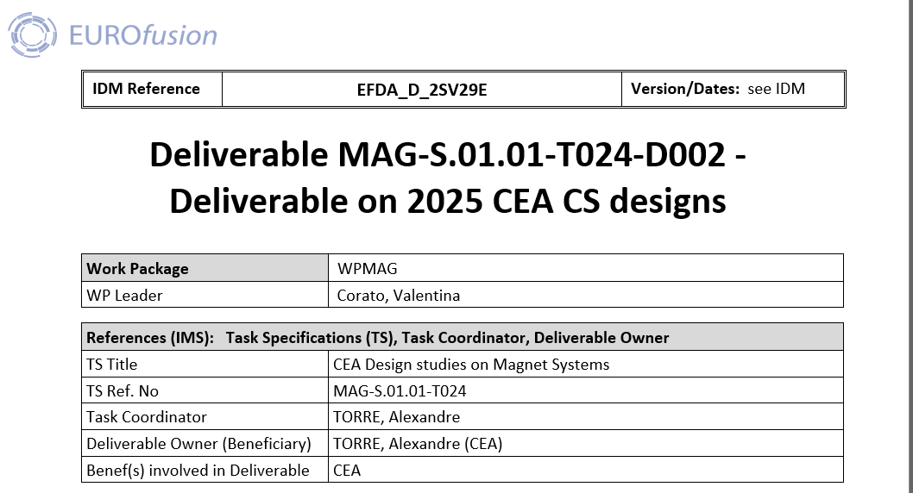
2025 CEA TS Design / Ind Study / Procurement
MAG-S.01.01-T024-D002 Deliverable on 2025 CEA CS designs
Here again, we proposed an initial version of the reportwith a CS Design Overview for the 2025 Gate Review, trying to provide the Work Package Leader and DCT a clear view of the latest design, along with what had been done in terms of analysis.

Slide 10
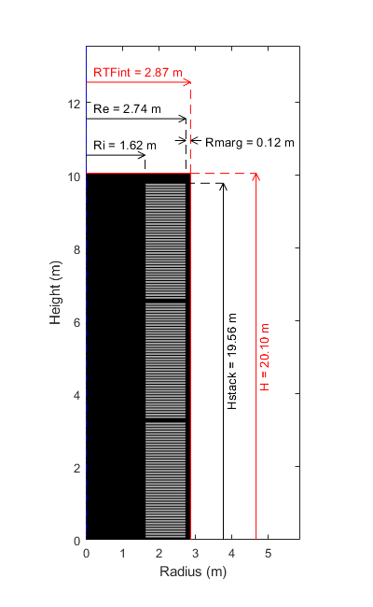
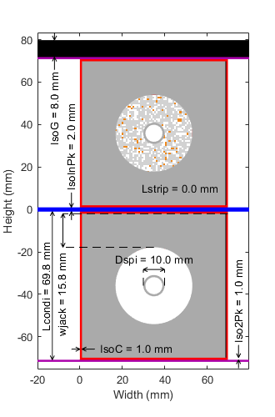
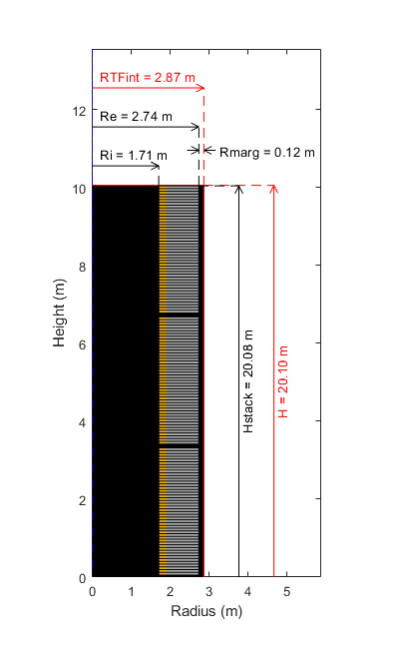
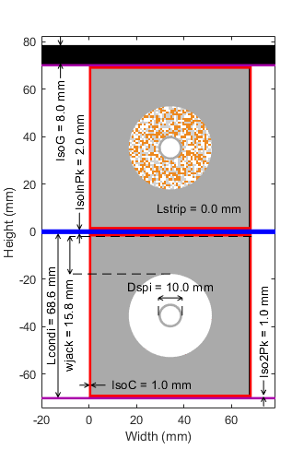
2025 CEA TS Design / Ind Study / Procurement
MAG-S.01.01-T024-D002 Deliverable on 2025 CEA CS designs
We summarized the basline CS proposed (LTS/JK2LB/218Wb), and discussed briefly the potential impact of alternative configurations (CHSN01 or hybrid)
Baseline: ITER-like LTS / JK2LB – 218Wb
Hybrid design: Using CHSN01 (ex N50H) and HTS inner turns – 239Wb
Using CHSN01 (ex N50H) on Baseline design – 228Wb
Optimum LTS-CHSN01 design – 232Wb
“Constant Tension” using a co-wound steel strip – 228Wb

Slide 11
2025 CEA TS Design / Ind Study / Procurement
MAG-S.01.01-T024-D002 Deliverable on 2025 CEA CS designs
Our goal before submitting final report is to provide additional analyses for CS, in particular a mechanical analysis that should be done by CEA IRFU (F. Nunio / R. Cubizolles).
Their feedback is that they are on track to do it in the next month or so.

Slide 12
2025 CEA TS Design / Ind Study / Procurement
MAG-S.01.01-T024-D003
Deliverable on 2025 CEA Industrial study

Slide 13
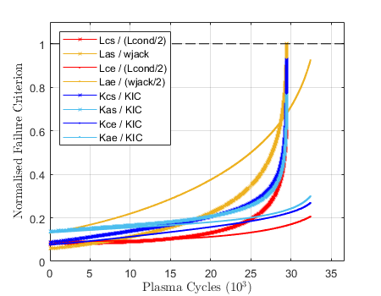
2025 CEA TS Design / Ind Study / Procurement
MAG-S.01.01-T024-D003 Deliverable on 2025 CEA Industrial study
We had planned to make an industrial study to get a feedback on the fatigue methodology used in CS conductor jacket design and on cryogenic tests of N50H/CHSN01
This was also linked, but in parallel, to the DCT fatigue workgroup.

Slide 14


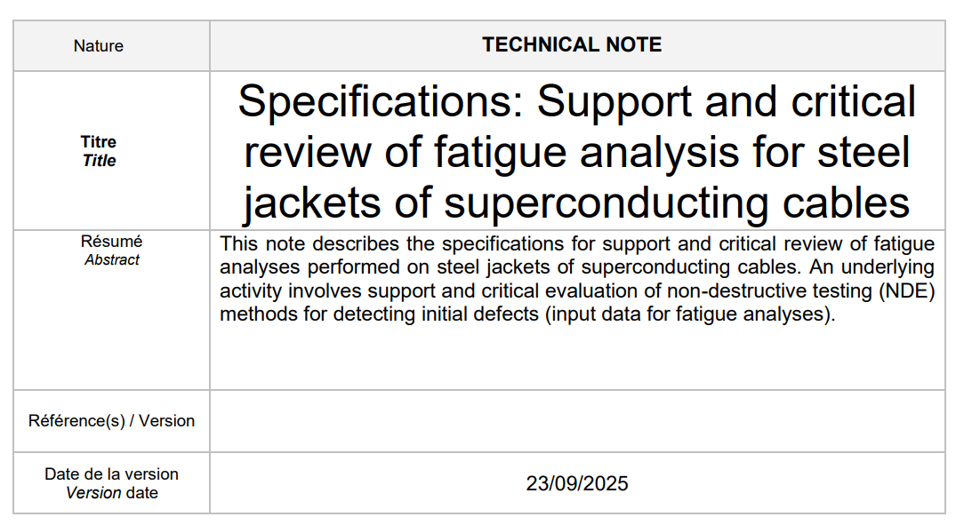
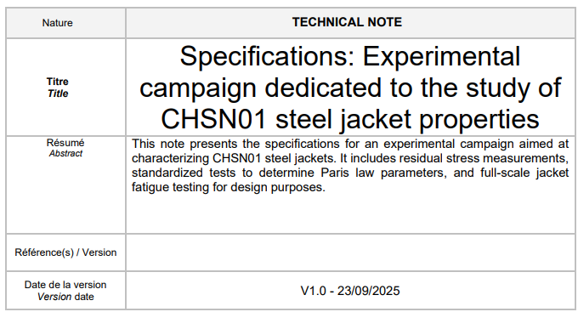
2025 CEA TS Design / Ind Study / Procurement
MAG-S.01.01-T024-D003 Deliverable on 2025 CEA Industrial study
We wrote 2 Tech Specs and sent it out to :
- BeBlue Cryotech [Belgium]
- CETIM [France]
Review & Methodology
Tests and characterization

Slide 15
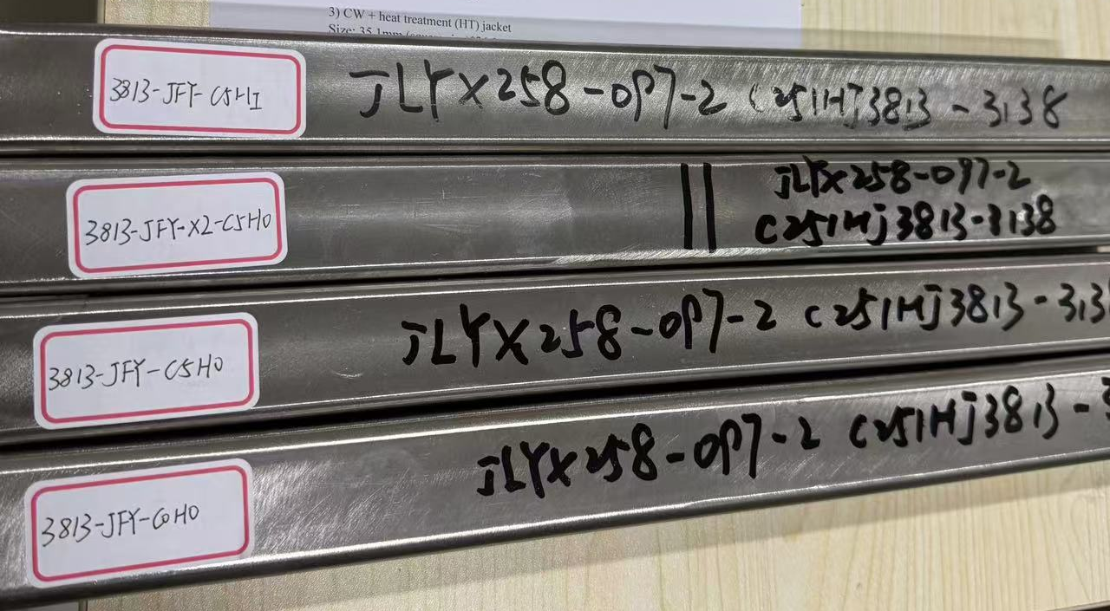
2025 CEA TS Design / Ind Study / Procurement
MAG-S.01.01-T024-D003 Deliverable on 2025 CEA Industrial study
We also discussed with ASIPP to procure some test specimens (~400mm long)
1) Initial jacket
2) Cold working (CW) jacket
3) CW + heat treatment (HT) jacket
4) Weld joint

Slide 16
2025 CEA TS Design / Ind Study / Procurement
MAG-S.01.01-T024-D003 Deliverable on 2025 CEA Industrial study
Clarification meetings have been done with the companies, with some of them that could do only part of the expected work.
The CHSN01 conductor jackets are only now arriving in France...
We've had mail answers regarding potential prices and planning for these tests.
Unfortunately, the delay for obtaining these offers means we only could have the tests in June-July. Thus we could either propose to:
- Launch this 2025activity in 2026 (if still possible)
- Wait for 2026 activities to see if we could fit it in.
- Cancel this activity

Slide 17
2025 CEA TS Design / Ind Study / Procurement
MAG-S.01.01-T024-D004
Deliverable on 2025 CEA conductor procurement

Slide 18
2025 CEA TS Design / Ind Study / Procurement
MAG-S.01.01-T024-D004 Deliverable on 2025 CEA conductor procurement
In 2025, we proposed the procurement of small diameter HWRC (Helically Wound Rebco Cables), like CORC@ wires or STAR@ wires, in view of a multi-wire cable in SULTAN.
For this we wrote a Tech Spec with the following points:
~3kA@(18T,4,2K) HWRC wires
~48mm-width of HTS Rebco tapes
Total length 100m

Slide 19
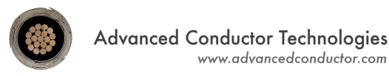
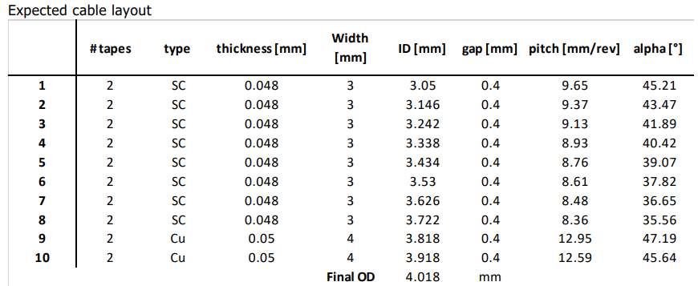
2025 CEA TS Design / Ind Study / Procurement
MAG-S.01.01-T024-D004 Deliverable on 2025 CEA conductor procurement
Offers were received in September.
ACT (CORC-wires) was the best offer.
8 layer wire
2 tapes of 3mm per layer
OD 4mm
Order is being processed
(to be finalized feb 2026)

