Slide 1
WPMAG - CEA IRFM Electromagnetic analysis 14/01/2025
B. Boudes, Q. Le Coz, A.Torre

Slide 2
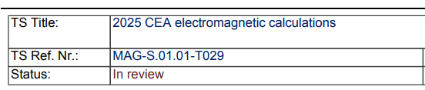
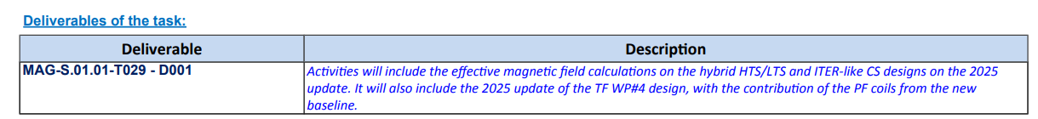
2025 CEA TS Electromagnetic analysis
MAG-S.01.01-T029 - D001
2025 CEA electromagnetic calculations

Slide 3
2025 CEA TS Electromagnetic analysis
In 2024, we reported on the EMag analysis of TF/CS magnets for LAR Baseline 2024.
Since no major change has been adopted in 2025, we focused on complementary analyses.

Slide 4
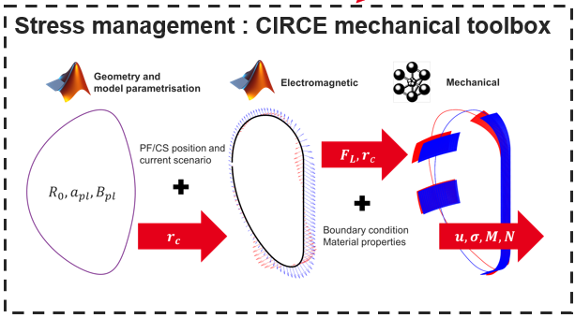
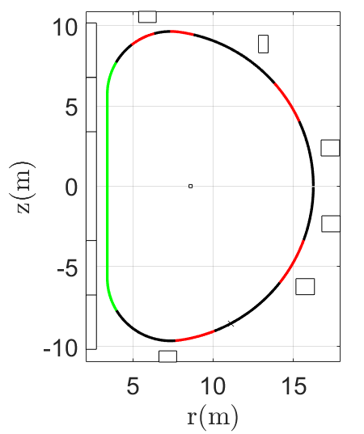
2025 CEA TS Electromagnetic analysis
CIRCE: Geom/EMag/Mech Toolbox
At CEA, there is a new tool developed by Baptiste Boudes, for:
- Geometrical analyses
- Electromagnetic analyses
- Loads computation
- Mechanical pre-design
The DEMO LAR CIRCE Model was built
Geometrical analyses: General coil Trajectory
Definition of portions:
- Wedged interface
- OIS interfaces
- Gravity support

Slide 5
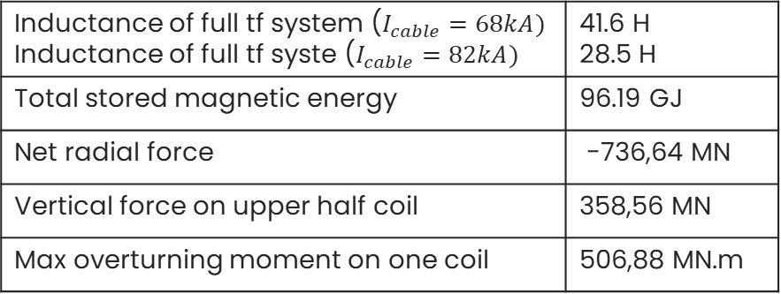
2025 CEA TS Electromagnetic analysis
Inductance of full tf system ($I_{cable}=68kA)$ Inductance of full tf syste ($I_{cable}=82kA)$ | 41.6 H 28.5 H
Total stored magnetic energy | 96.19 GJ
Net radial force | -736,64 MN
Vertical force on upper half coil | 358,56 MN
Max overturning moment on one coil | 506,88 MN.m
CIRCE: Geom/EMag/Mech Toolbox
Main Electromagnetic results:
Full TF System Matrix inductances -------------->($N_{turns}^{1coil}$)^2
Here for Icable=82kA, Nturns=144

Slide 6
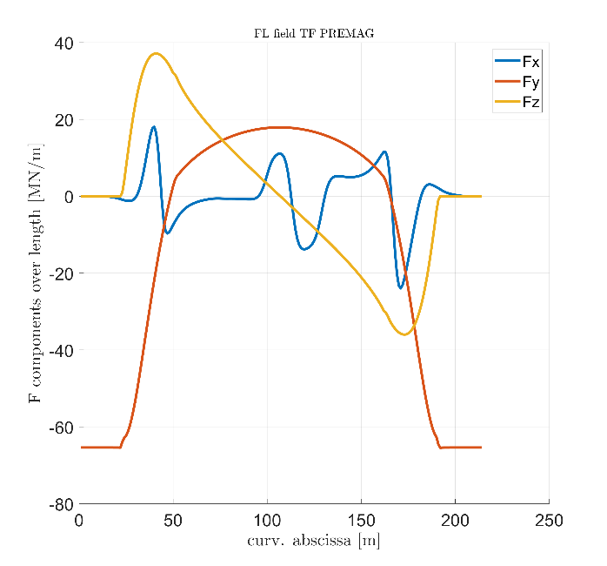
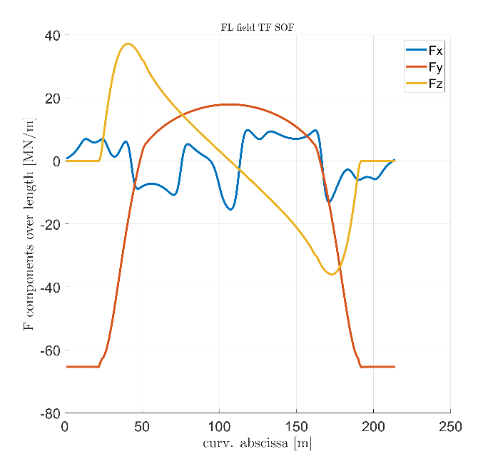
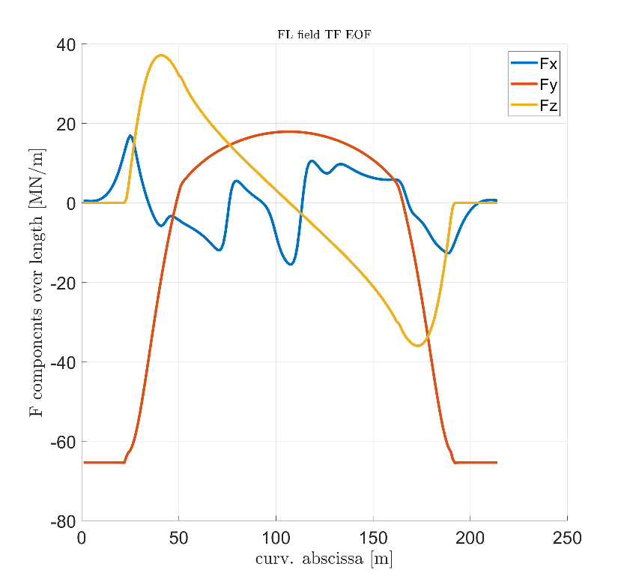
2025 CEA TS Electromagnetic analysis
CIRCE: Geom/EMag/Mech Toolbox
Main Electromagnetic results: Load computation
CIRCE
Input data: [4] TF_coil_shape_selection_2RUQCM_v1_1
3DFEM

Slide 7
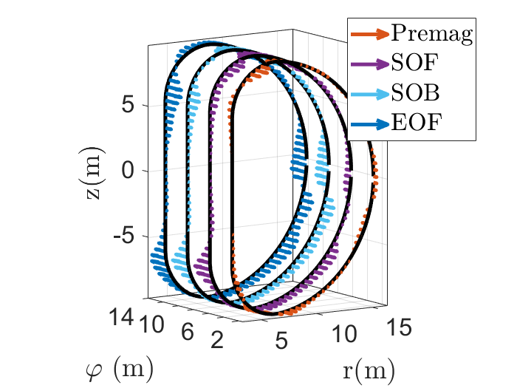
2025 CEA TS Electromagnetic analysis
Main Electromagnetic results: Load computation - OUT OF PLANE
CIRCE: Geom/EMag/Mech Toolbox

Slide 8
2025 CEA TS Electromagnetic analysis
Main Electromagnetic results: Load computation - OVERTURNING MOMENT
CIRCE: Geom/EMag/Mech Toolbox

Slide 9
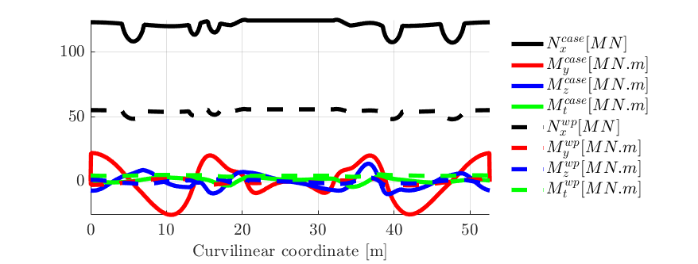
2025 CEA TS Electromagnetic analysis
CIRCE: Geom/EMag/Mech Toolbox
The CIRCE Model has been used to provide the 3D mechanical model with 3D load maps, and can also run some mechanical analyses which will be included in 2025 reports (Design, EMag or Mechanical to be defined).
$$θ$$
$$u_{z}$$
$$u_{y}$$
$$u_{x}$$

Slide 10



2025 CEA TS Electromagnetic analysis
FSD of TF magnet and induced currents
The total energy stored in the TF system is
$$E_{mag}=96GJ$$
A [Case-RP-VV-Coil] coupled system was built based on best inputs available, and the FSD is triggered to compute the induced currents in all components, along with heat generated.
Discharge time constant is based on the VV requirements
$$L_{TF}^{system}=28.5H$$
$$_{dis}=22s$$

Slide 11
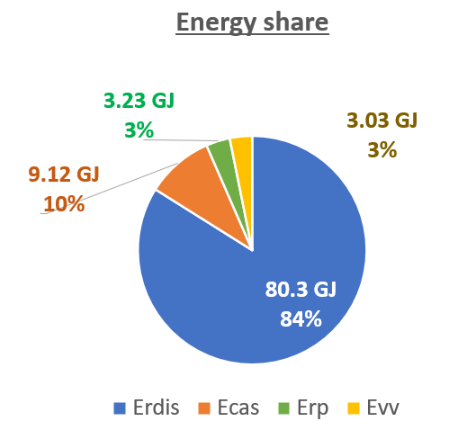
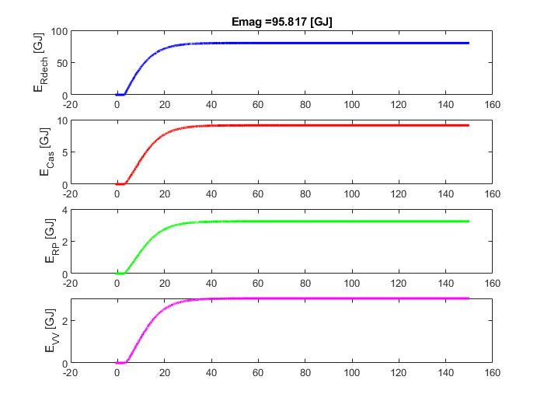
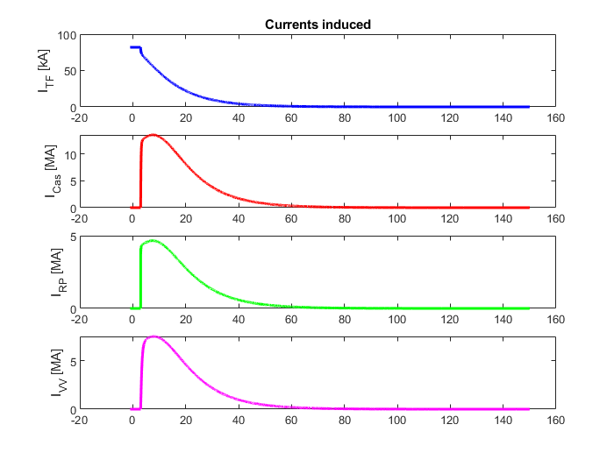
2025 CEA TS Electromagnetic analysis
FSD of TF magnet and induced currents
Induced currents in all elements are computed, and magnetic energy extraction can be computed.

Slide 12
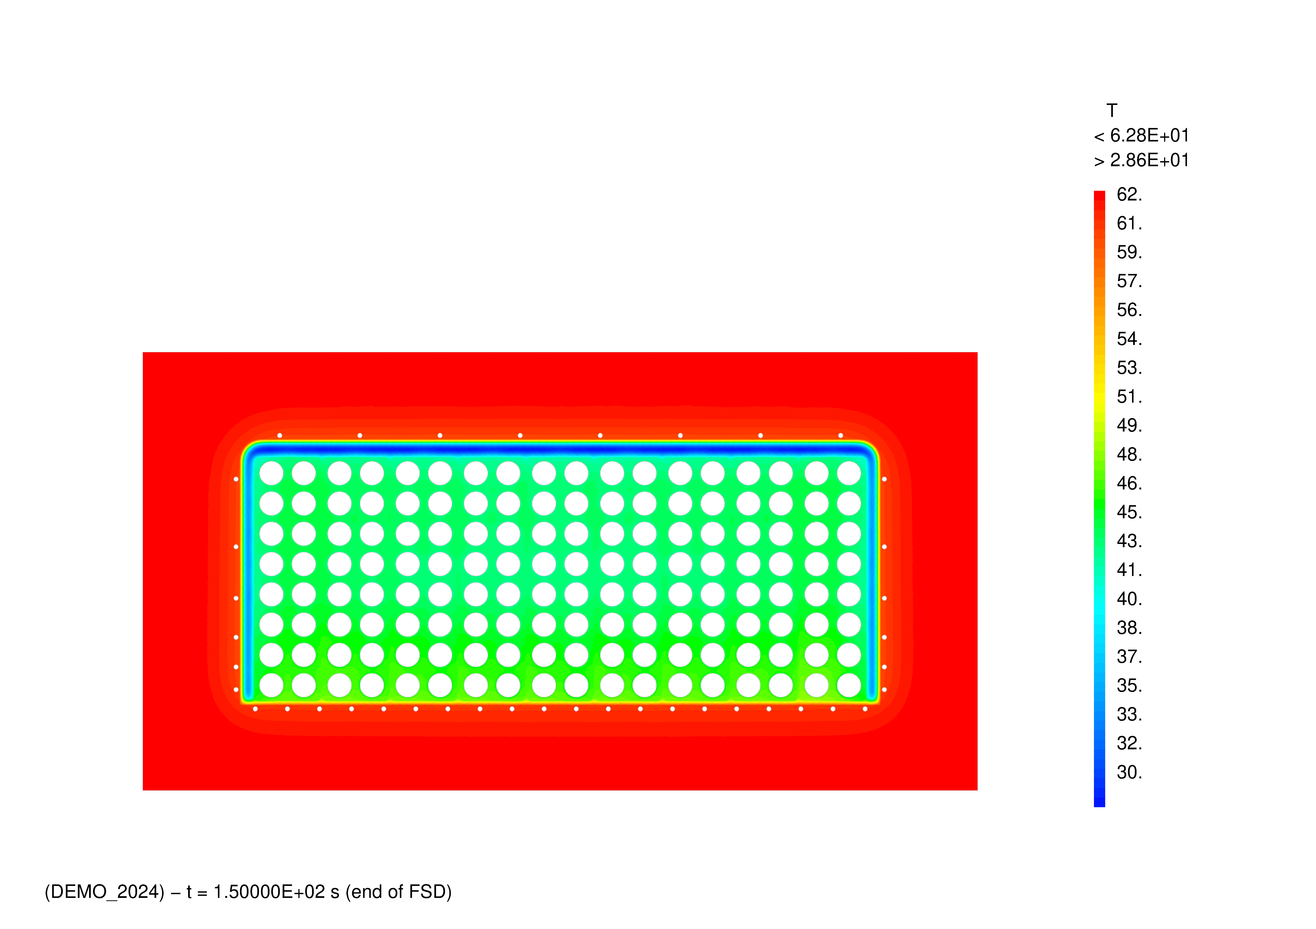
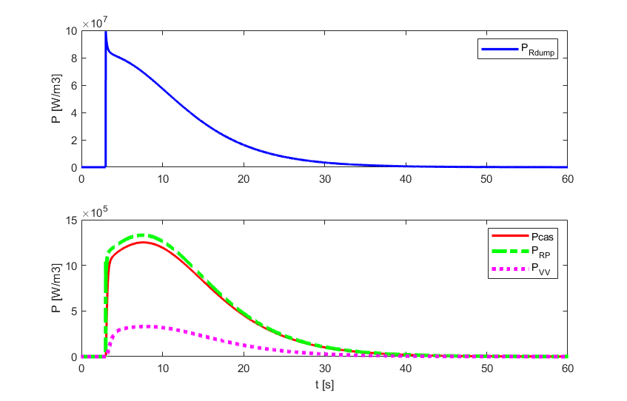
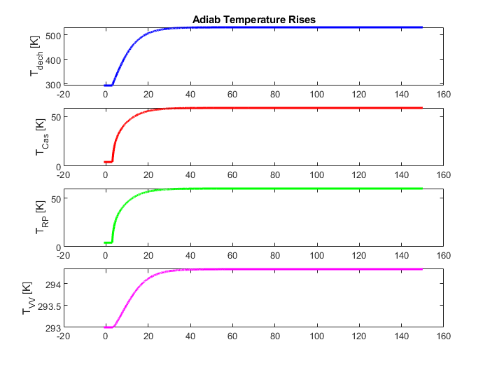
2025 CEA TS Electromagnetic analysis
FSD of TF magnet and induced currents
Power deposition is found and can be given to Thermohydraulic model.

