Slide 1

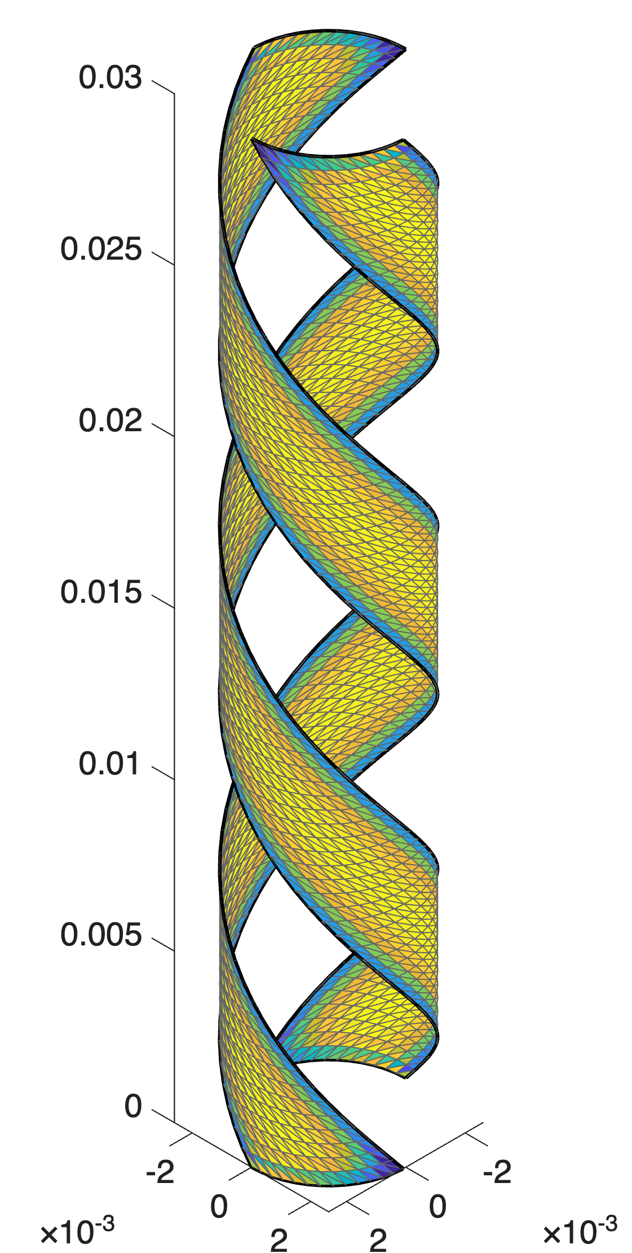
Development of a Synthetic Database for CORC® Cables
MAG-S.01.01-T030-D002
Fabio Freschi
Laura Savoldi
Department of Energy – Politecnico di Torino

Slide 2
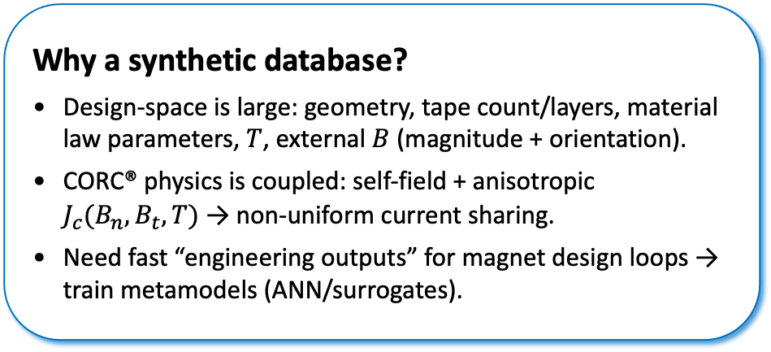



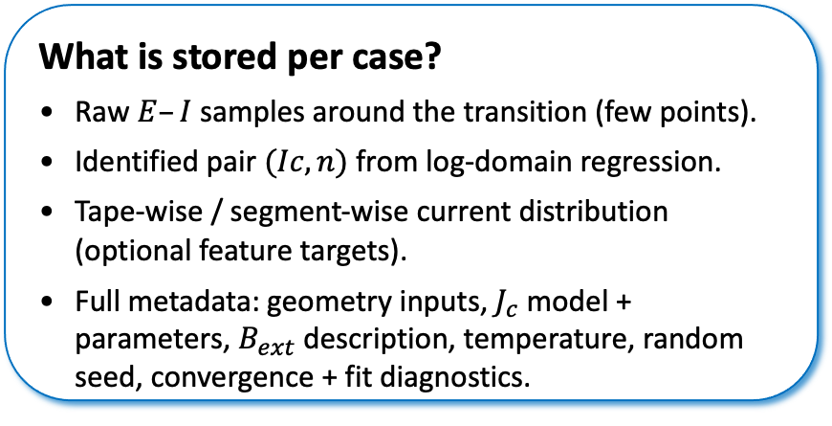
Motivation & End-Product
Why a synthetic database?
Design-space is large: geometry, tape count/layers, material law parameters, $T$, external $B$ (magnitude + orientation).
CORC® physics is coupled: self-field + anisotropic $J_{c}(B_{n},B_{t},T)$ → non-uniform current sharing.
Need fast “engineering outputs” for magnet design loops → train metamodels (ANN/surrogates).
What is stored per case?
Raw $E–I$ samples around the transition (few points).
Identified pair $(Ic, n)$ from log-domain regression.
Tape-wise / segment-wise current distribution (optional feature targets).
Full metadata: geometry inputs, $J_{c}$ model + parameters, $B_{ext}$ description, temperature, random seed, convergence + fit diagnostics.
ML-ready outputs (what the metamodel predicts)
$$I_{c}(B_{n},B_{t},T,geometry)$$
$$n(B_{n},B_{t},T,geometry)$$
$E−I$ curve features
Current sharing metrics
→ A metamodel is only as good as the dataset: Inputs must encode the same physics used by the solver: geometry, material law, and operating field.
→ trained surrogate enables rapid scans / optimization loops with uncertainty bands
Notes:
[Sources]
- Project deliverable: MAG-S.01.01-T030-D002 v1.0 (docx), Executive Summary + Sec. 13.
[/Sources]

Slide 3
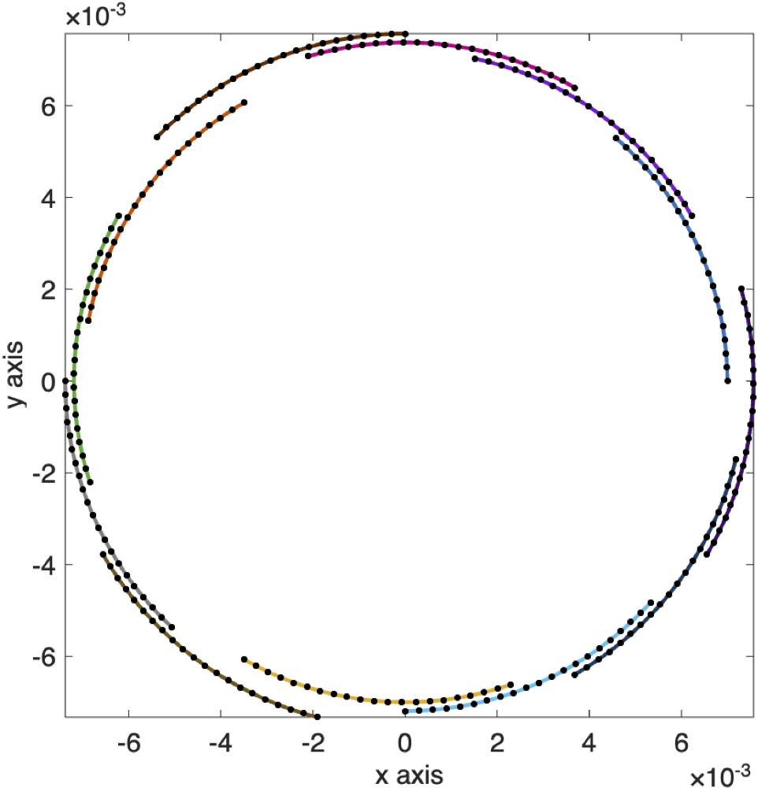
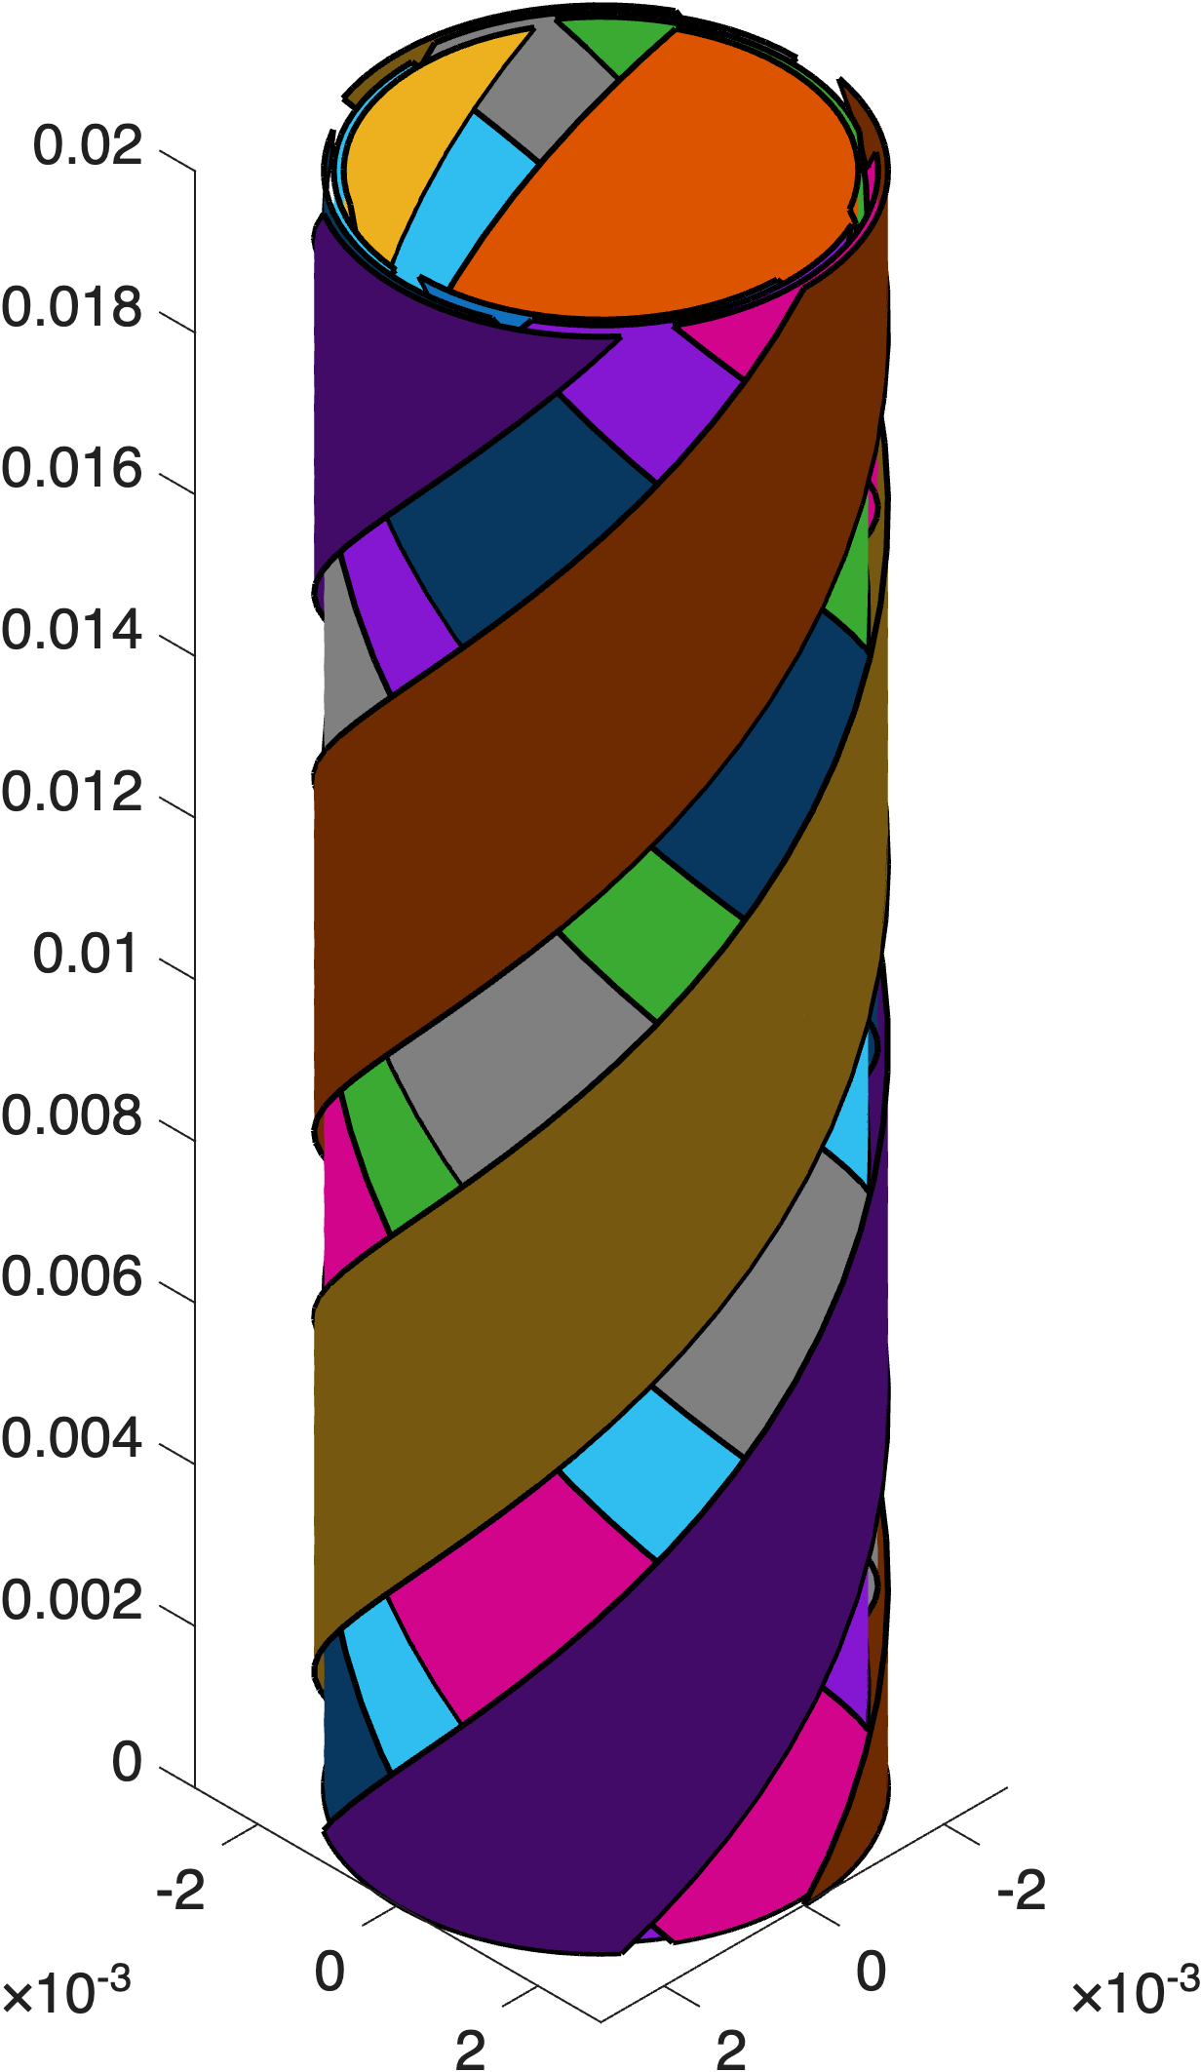
Simulation engines used to generate the synthetic database
STAR2d (2‑D DC, cross-section)
Unknowns: segment currents + one shared cable voltage.
Self-field via Biot–Savart (no air mesh).
Best for: fast parameter sweeps, sensitivity studies, dataset scale-out.
4 layers – 3 tapes per layer
STAR3d (3‑D stream-function on tape surfaces)
Captures axial/helical effects (pitch), terminations, non-uniform field along axis.
More expensive; used selectively as high-fidelity anchors.
Voltage inferred from power loss; includes automatic outlier rejection in fit.
Notes:
[Sources]
- Project deliverable: MAG-S.01.01-T030-D002 v1.0 (docx), Sec. 9 Results (COMSOL benchmark) and timing statement.
[/Sources]

Slide 4

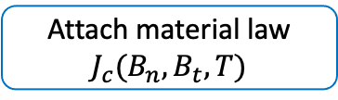
Step 1 — Geometry parameterization and discretization (STAR2d)
Geometry pre-processor inputs
Tape width w, SC thickness (SC-only in DC model).
No. layers, No. tapes per layer, layer-to-layer spacing.
Inner/core radius (first layer).
Target segment size → discretization density.
Feasibility check: first-layer circumference must fit tapes
Case instantiation
Geometry params
Discretize tapes
Cache Biot-Savart kernels
Attach material law
$$J_{c}(B_{n},B_{t},T)$$
→ fast re-use across current sweeps and parameter scans

Slide 5
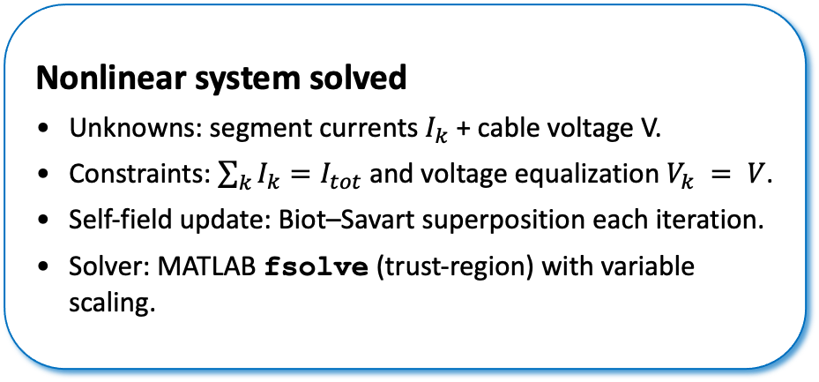
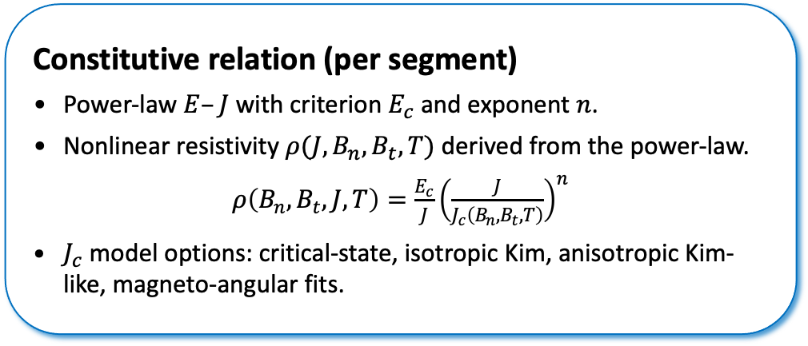
Step 2 — Material law and nonlinear solution
Constitutive relation (per segment)
Power-law $E–J$ with criterion $E_{c}$ and exponent $n$.
Nonlinear resistivity $ρ(J,B_{n},B_{t},T)$ derived from the power-law.
$ρ\left(B_{n},B_{t},J,T\right)=\frac{E_{c}}{J}{\left(\frac{J}{J_{c}\left(B_{n},B_{t},T\right)}\right)}^{n}$
$J_{c}$ model options: critical-state, isotropic Kim, anisotropic Kim-like, magneto-angular fits.
Nonlinear system solved
Unknowns: segment currents $I_{k}$ + cable voltage V.
Constraints: $\sum_{k}{I_{k}=I_{tot}}$ and voltage equalization $V_{k} = V$.
Self-field update: Biot–Savart superposition each iteration.
Solver: MATLAB fsolve (trust-region) with variable scaling.
Numerical robustness
Continuation: reuse previous current-point solution as initial guess
Mesh adaptivity: refine until ΔV between refinements < 5% (fixed per geometry)
Cache geometry kernels (fixed layout) → cheap iterations
→ stable E–I samples over many decades of E (critical for log-fit)

Slide 6

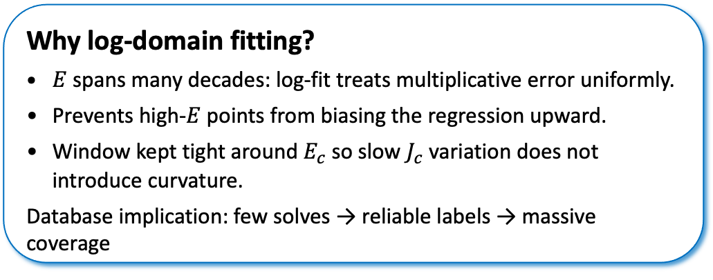



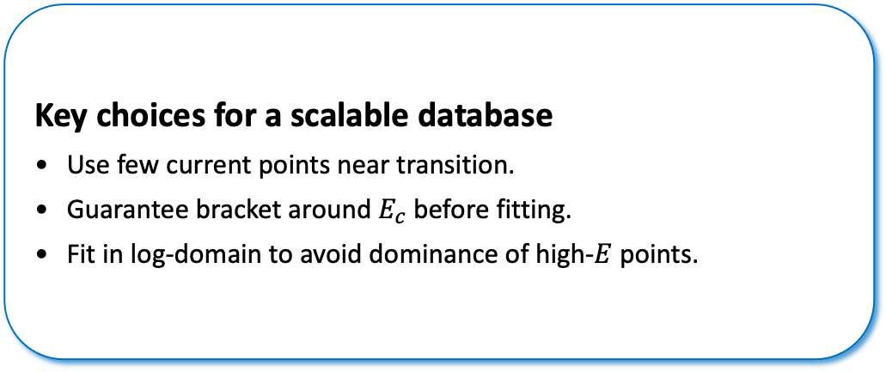
Step 3 — Identify $(I_{c}, n)$ from a small $E–I$ sample set
Key choices for a scalable database
Use few current points near transition.
Guarantee bracket around $E_{c}$ before fitting.
Fit in log-domain to avoid dominance of high‑$E$ points.
Identification algorithm
Provisional $I_{c} ≈ J_{c}(B_{ext})·A_{tot}$
Solve at currents around $I_{c}$ (continuation)
Check bracket: $E(I_{k}) < E_{c} < E(I_{k+1})$
Why log-domain fitting?
$E$ spans many decades: log-fit treats multiplicative error uniformly.
Prevents high‑$E$ points from biasing the regression upward.
Window kept tight around $E_{c}$ so slow $J_{c}$ variation does not introduce curvature.
Database implication: few solves → reliable labels → massive coverage
Log–log linear regression near crossing
Return: $n$ (slope), $I_{c}$ from $E=E_{c}$

Slide 7
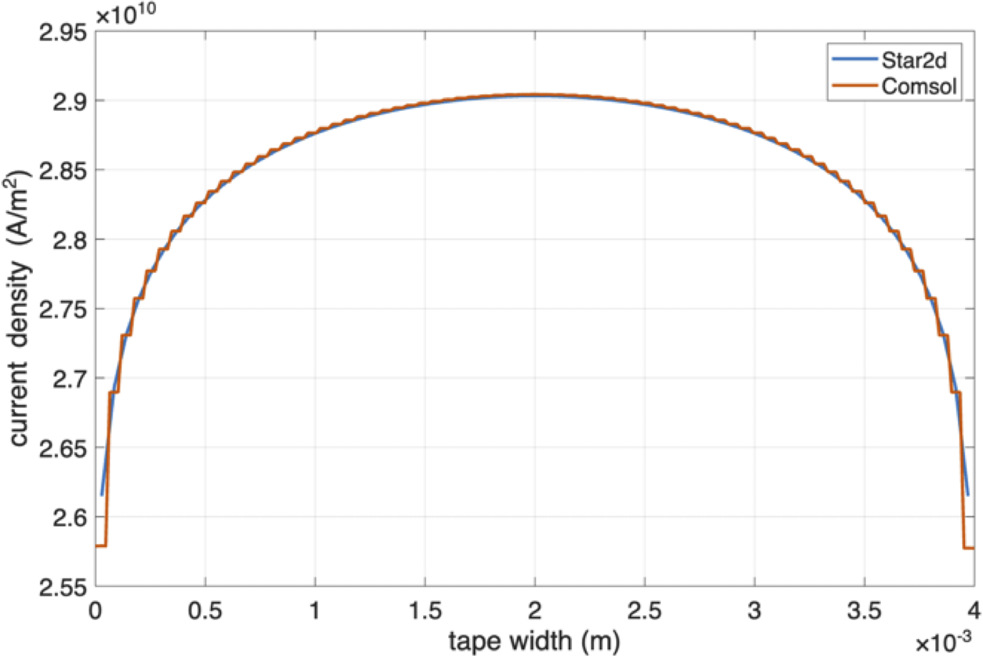
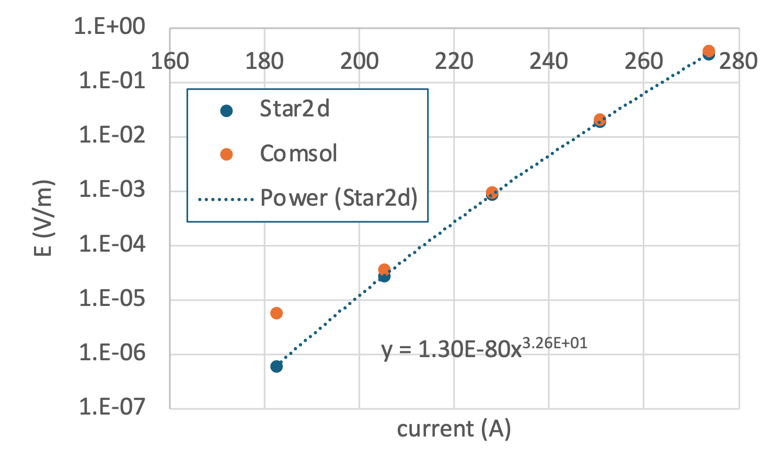

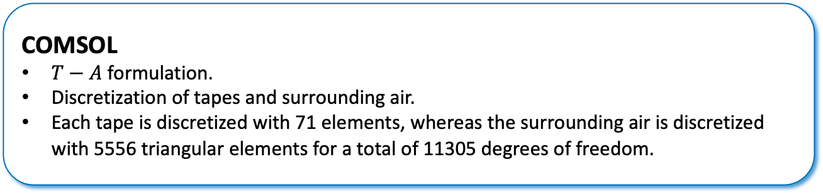
Cross-check vs COMSOL
Local J profile across tape width matches closely
$I_{c}$ and $E–I$ behavior consistent near transition
Faster solution time
seconds
COMSOL
$T−A$ formulation.
Discretization of tapes and surrounding air.
Each tape is discretized with 71 elements, whereas the surrounding air is discretized with 5556 triangular elements for a total of 11305 degrees of freedom.

Slide 8
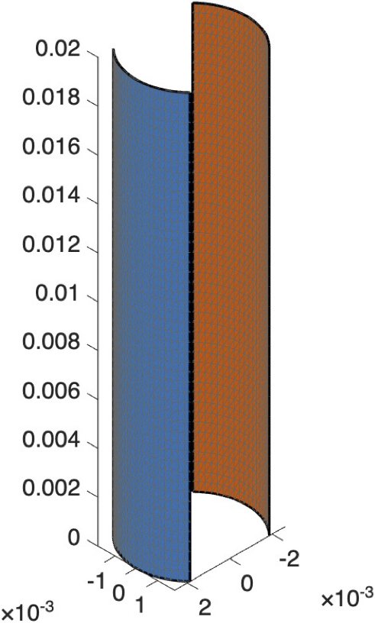
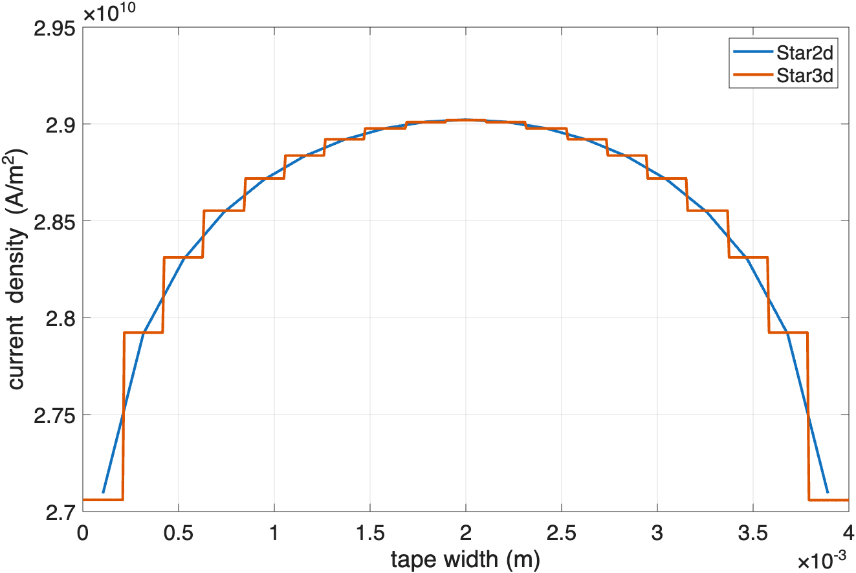
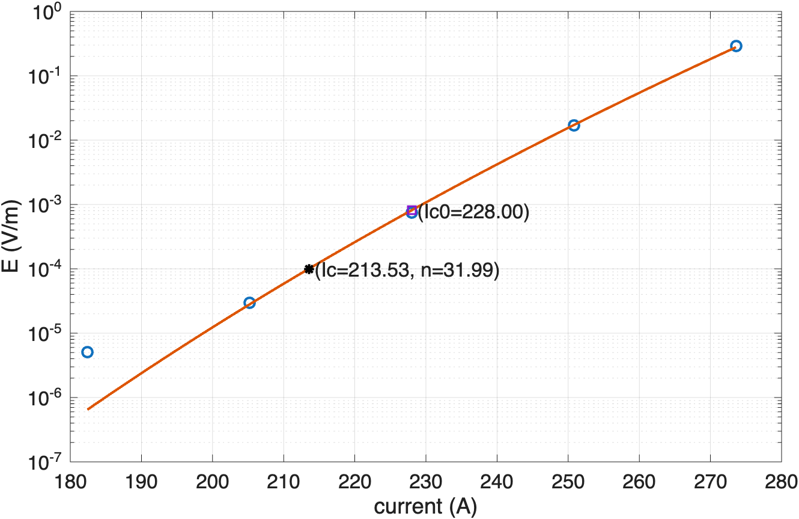

3-D extension: STAR3d
STAR3d
Representation of a thin-surface
No air mesh
Nodal-based unknowns
The calculation kernels for B are cached
Connections (inlet/outlet sections) effect
Computational expensive but necessary: “true results”
STAR2d: $I_{c}=213.55 A, n=32.53$

Slide 9
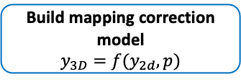
2-D/3-D interaction and development of the database
Define configuration space
Geometry + materials + T + operating conditions
Generate candidate set X₂
Large: 10³-10⁶
Select 3-D anchor set X₃
DoE + active learning
Role of 2-D simulations
Essential environment for physics and numerics exploration
Intermediate training database (parameter sensitivity, extrapolation
2-D/3-D combination through ML-based correction model
Run STAR2d on X₂
Compute fields + Solve + E-I
D₂: 2-D DB
Dense, Lo-Fi
Run STAR3d on X₃
Expensive Hi-Fi solution
D₃: 3-D DB
Sparse, Hi-Fi
Label extraction
I_{c}, n, QC metrics, E-I curve
Label extraction
I_{c}, n, QC metrics, E-I curve
Adjust numerics
Adjust numerics
No
QC
pass
No
QC
pass
Yes
Yes
Build mapping correction model
$$y_{3D}=f(y_{2d},p)$$
Augmented multi-fidelity DB
D = {D₂, D₃, mapping}
Train ML metamodels

Slide 10
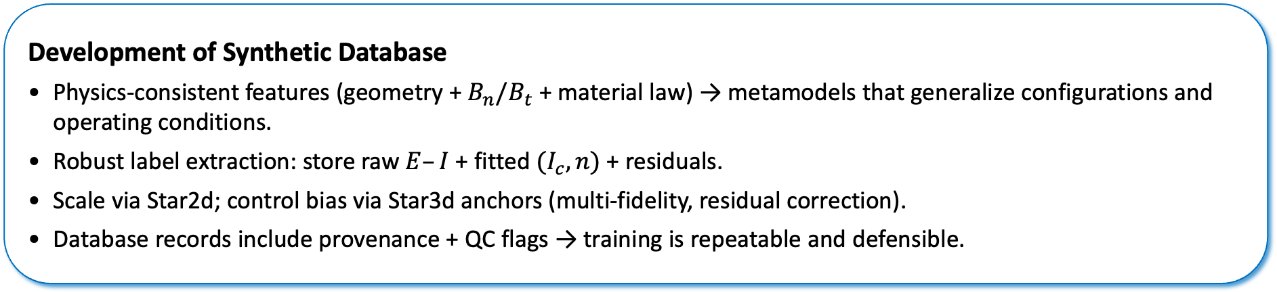
Takeaways
Development of Synthetic Database
Physics‑consistent features (geometry + $B_{n}/B_{t}$ + material law) → metamodels that generalize configurations and operating conditions.
Robust label extraction: store raw $E–I$ + fitted $(I_{c}, n)$+ residuals.
Scale via Star2d; control bias via Star3d anchors (multi‑fidelity, residual correction).
Database records include provenance + QC flags → training is repeatable and defensible.

