Slide 1

CS coil preconceptual design and electromagnetic analysis for the 2024 DEMO baseline
J. Greenwood
14.01.2026
MAG-T.01.01-T031-D001
MAG-T.01.01-T031-D003

Slide 2
Outline
LAR-DEMO CS requirements + inputs
SPC’s CS preconceptual design with 316LN jackets
How to increase the premagnetisation flux?
Summary

Slide 3
Baseline Requirements & Assumptions
30,000 plasma cycles
Premagnetisation flux of 235 Wb
Outer radius of ≤2.735 m (including outer precompression structure)
CS design should be independent of PF and TF design choices
SPC also assume:
115 mm of radial space for the precompression structure
Maximum steel jacket thickness of 16 mm

Slide 4
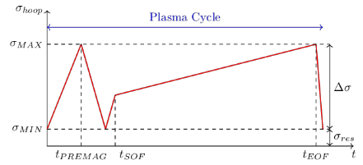
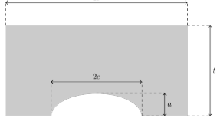
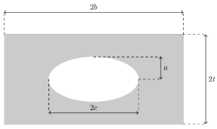
FCGR Studies: 316LN, JK2LB, N50H/CNHS01
The FCGR studies performed in the previous baseline were repeated
The same safety factors and assumptions were used. No relaxation
Steel | Maximum Hoop Stress
316LN | 250 MPa
JK2LB | 300 MPa
N50H | 380 MPa
See presentation on MAG-S.01.04-T021-D001

Slide 5
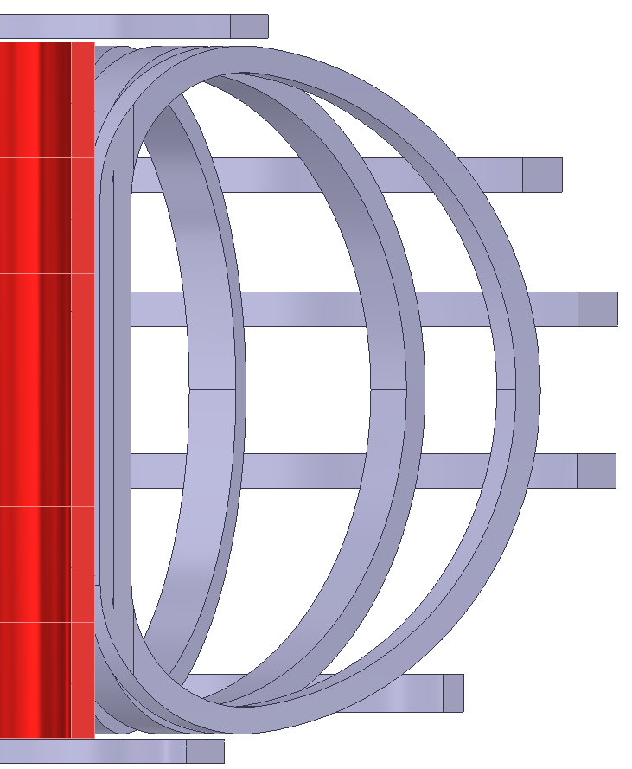
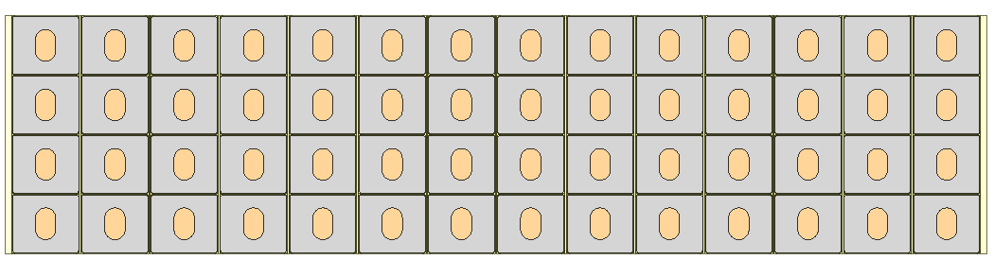
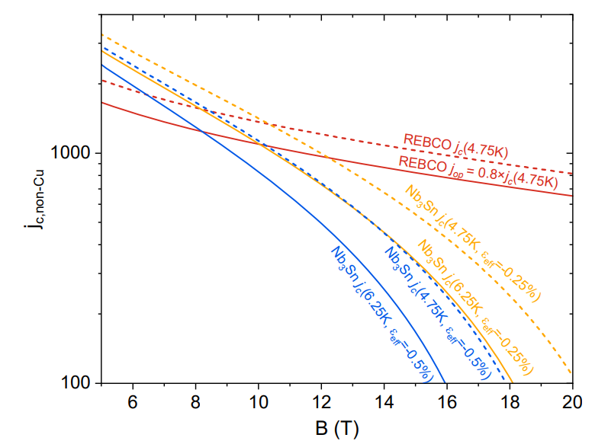
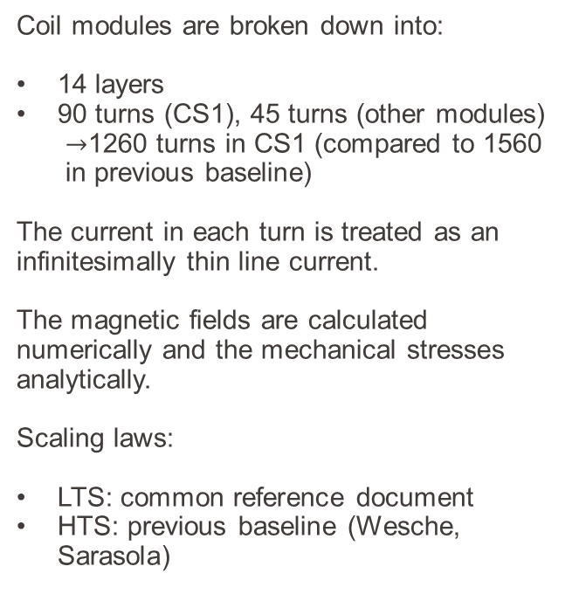
Uniform $J_{eng}$ Predimensioning
Coil modules are broken down into:
14 layers
90 turns (CS1), 45 turns (other modules)
$→$1260 turns in CS1 (compared to 1560 in previous baseline)
The current in each turn is treated as an infinitesimally thin line current.
The magnetic fields are calculated numerically and the mechanical stresses analytically.
Scaling laws:
LTS: common reference document
HTS: previous baseline (Wesche, Sarasola)
(A/mm²)
DOI: 10.1109/TASC.2023.3252489

Slide 6
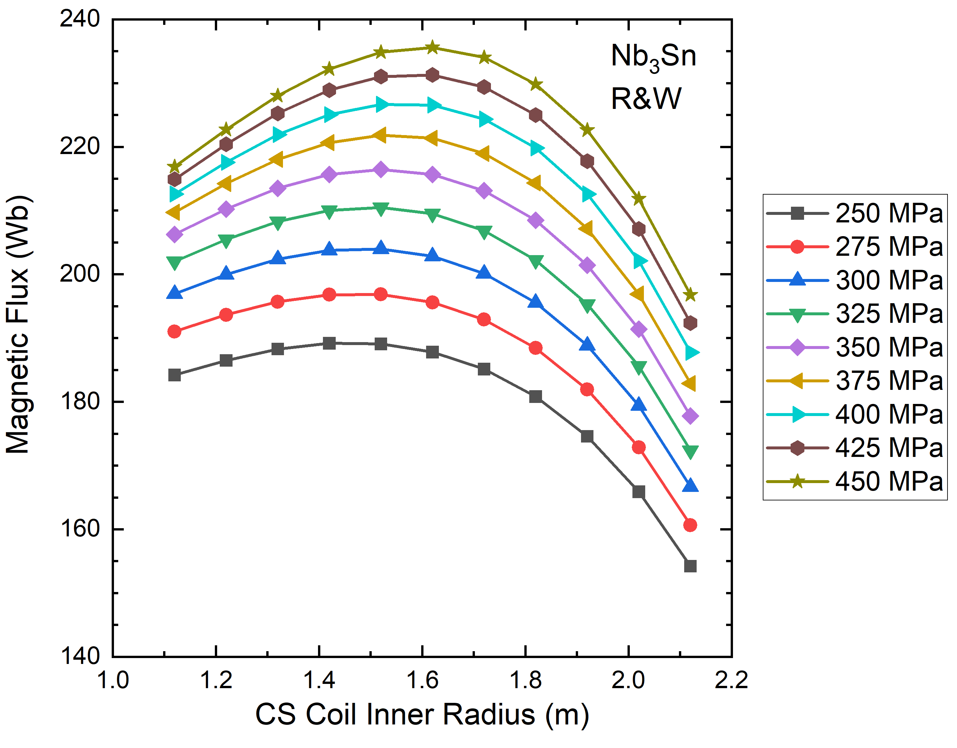
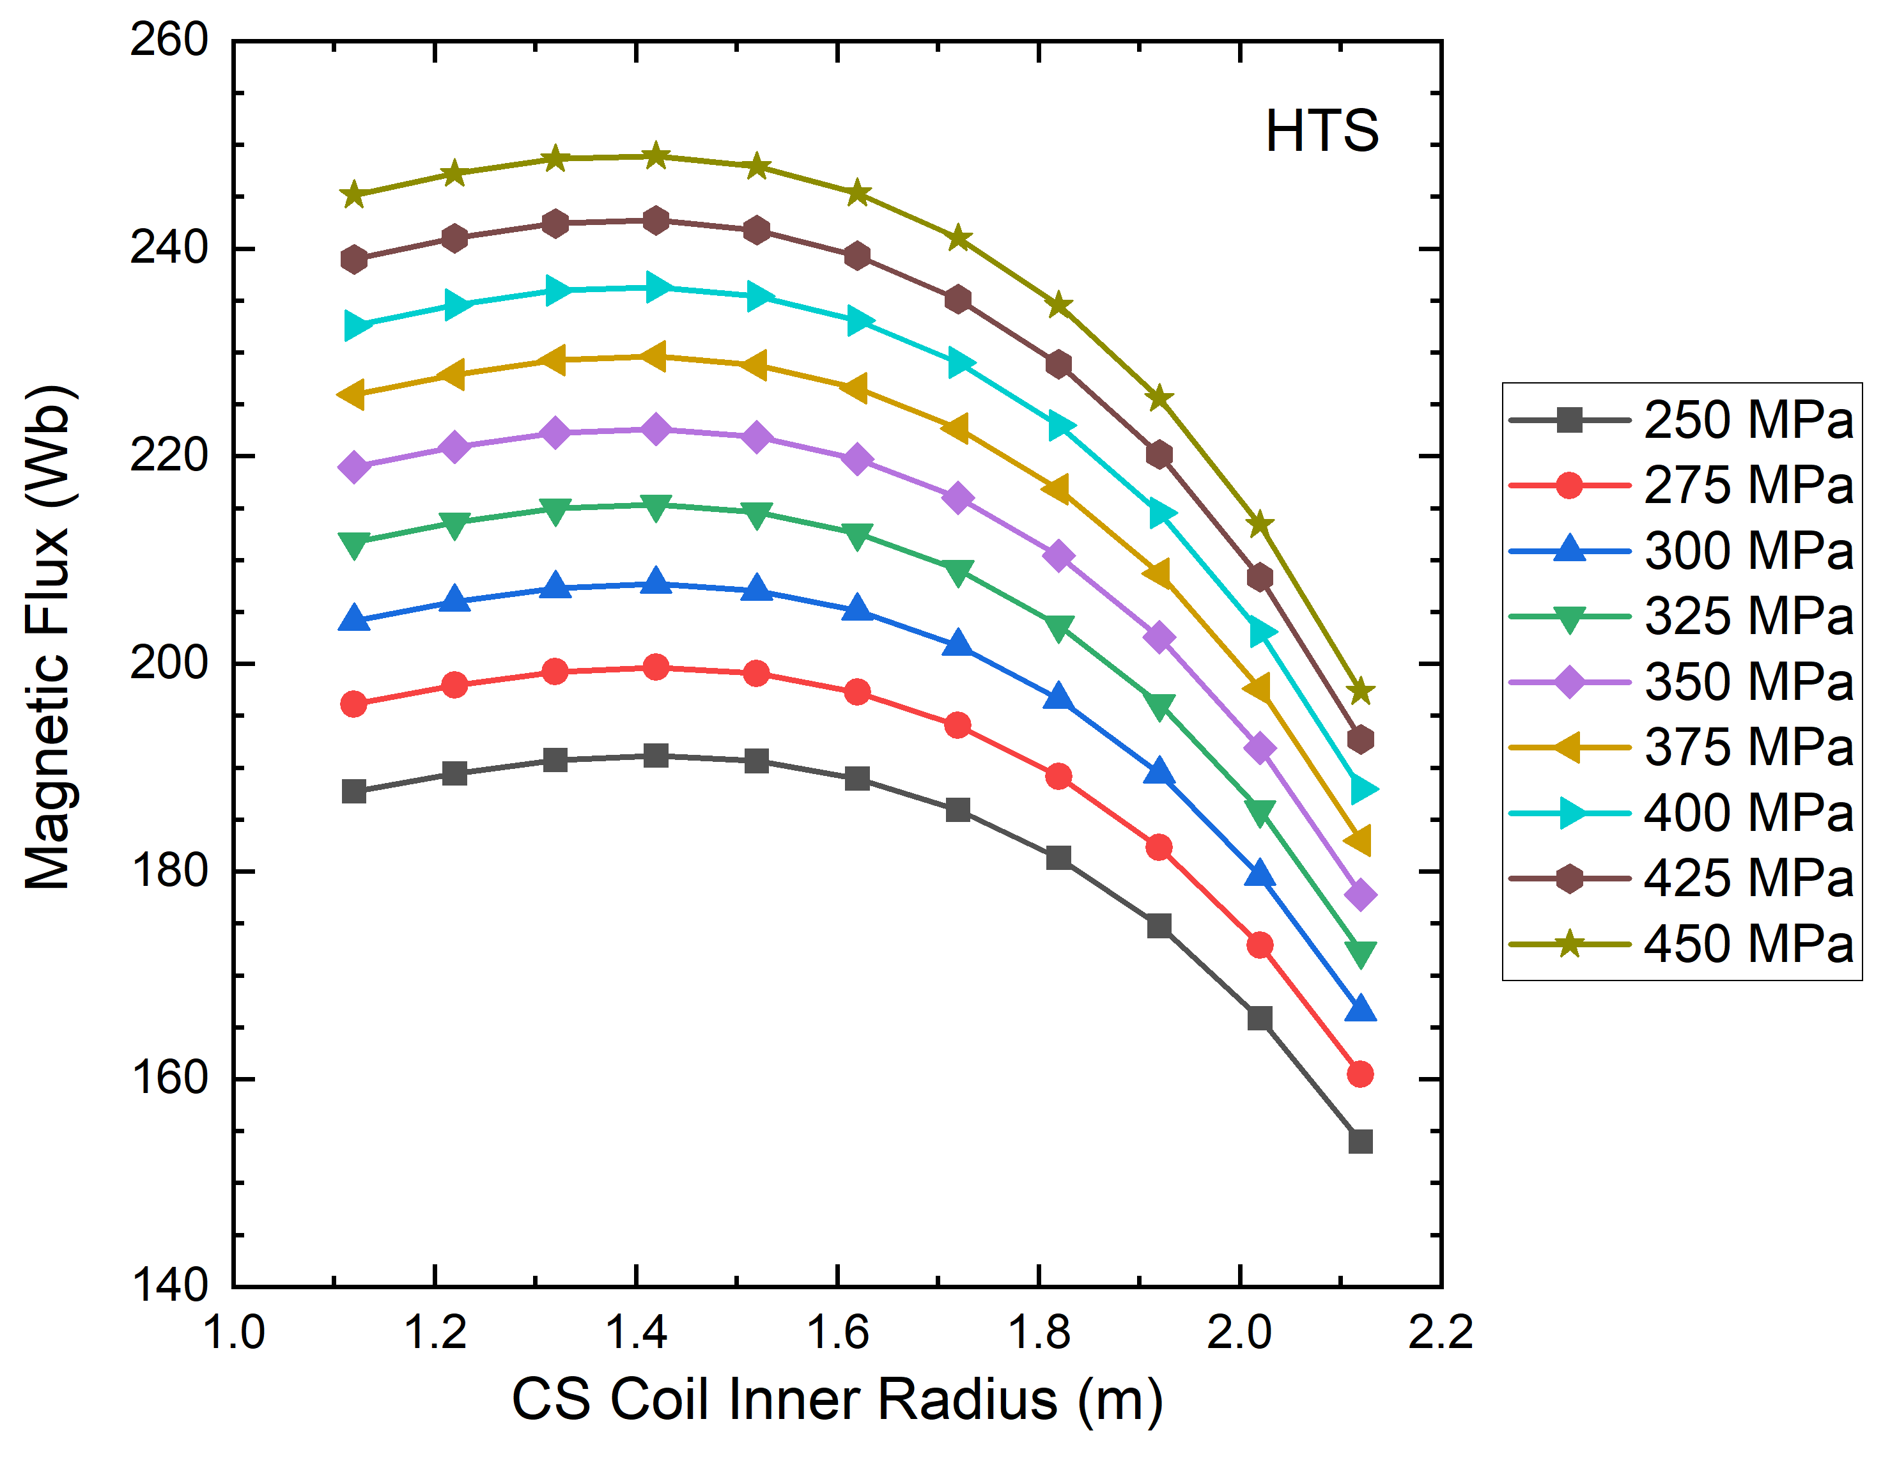
Premagnetisation Flux – UCD Solenoid Studies
UCD solenoids cannot get close to 235 Wb unless the allowable hoop stress is very high
For 316LN (250 MPa), the flux boost from HTS is quite small (<5 Wb)

Slide 7
Next Step
Grading the superconductor and steel

Slide 8
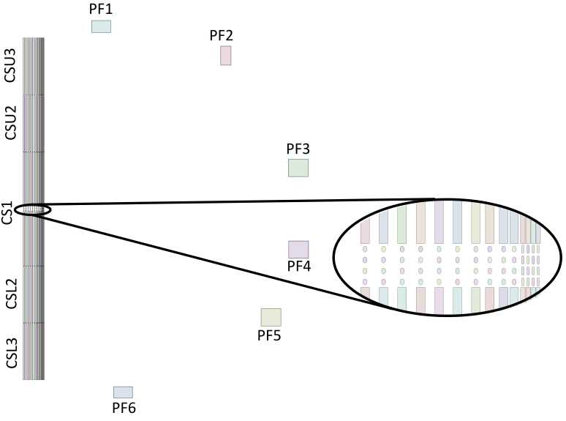
2D Axisymmetric EM + Mech. Simulations

Slide 9
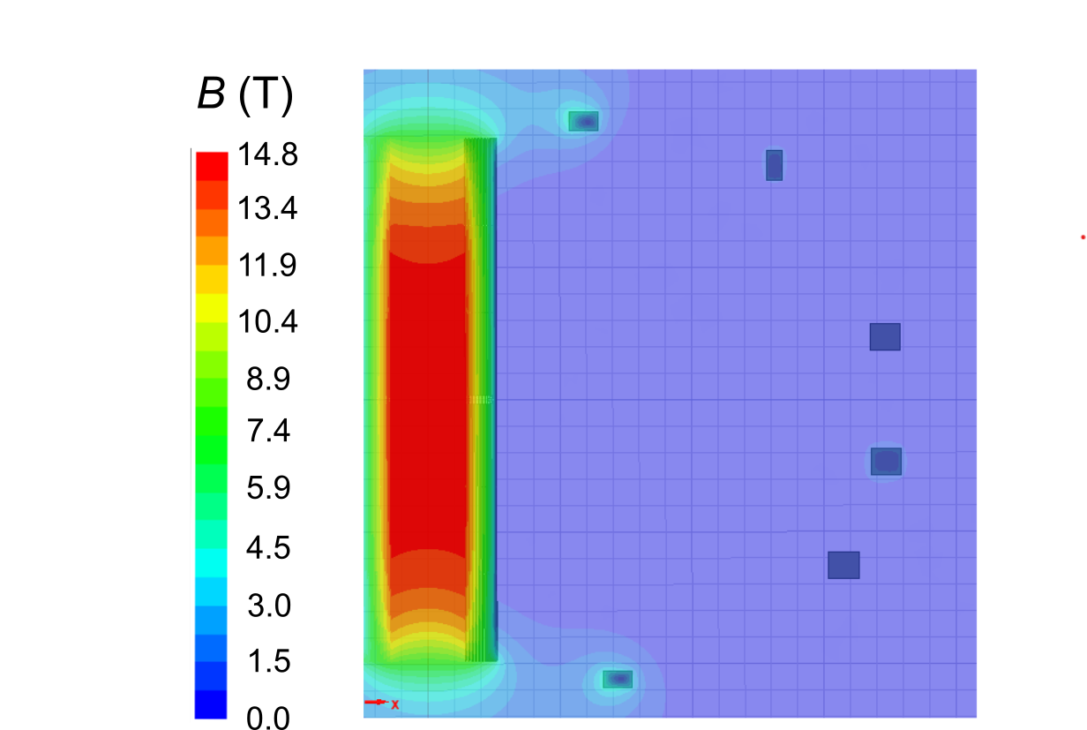
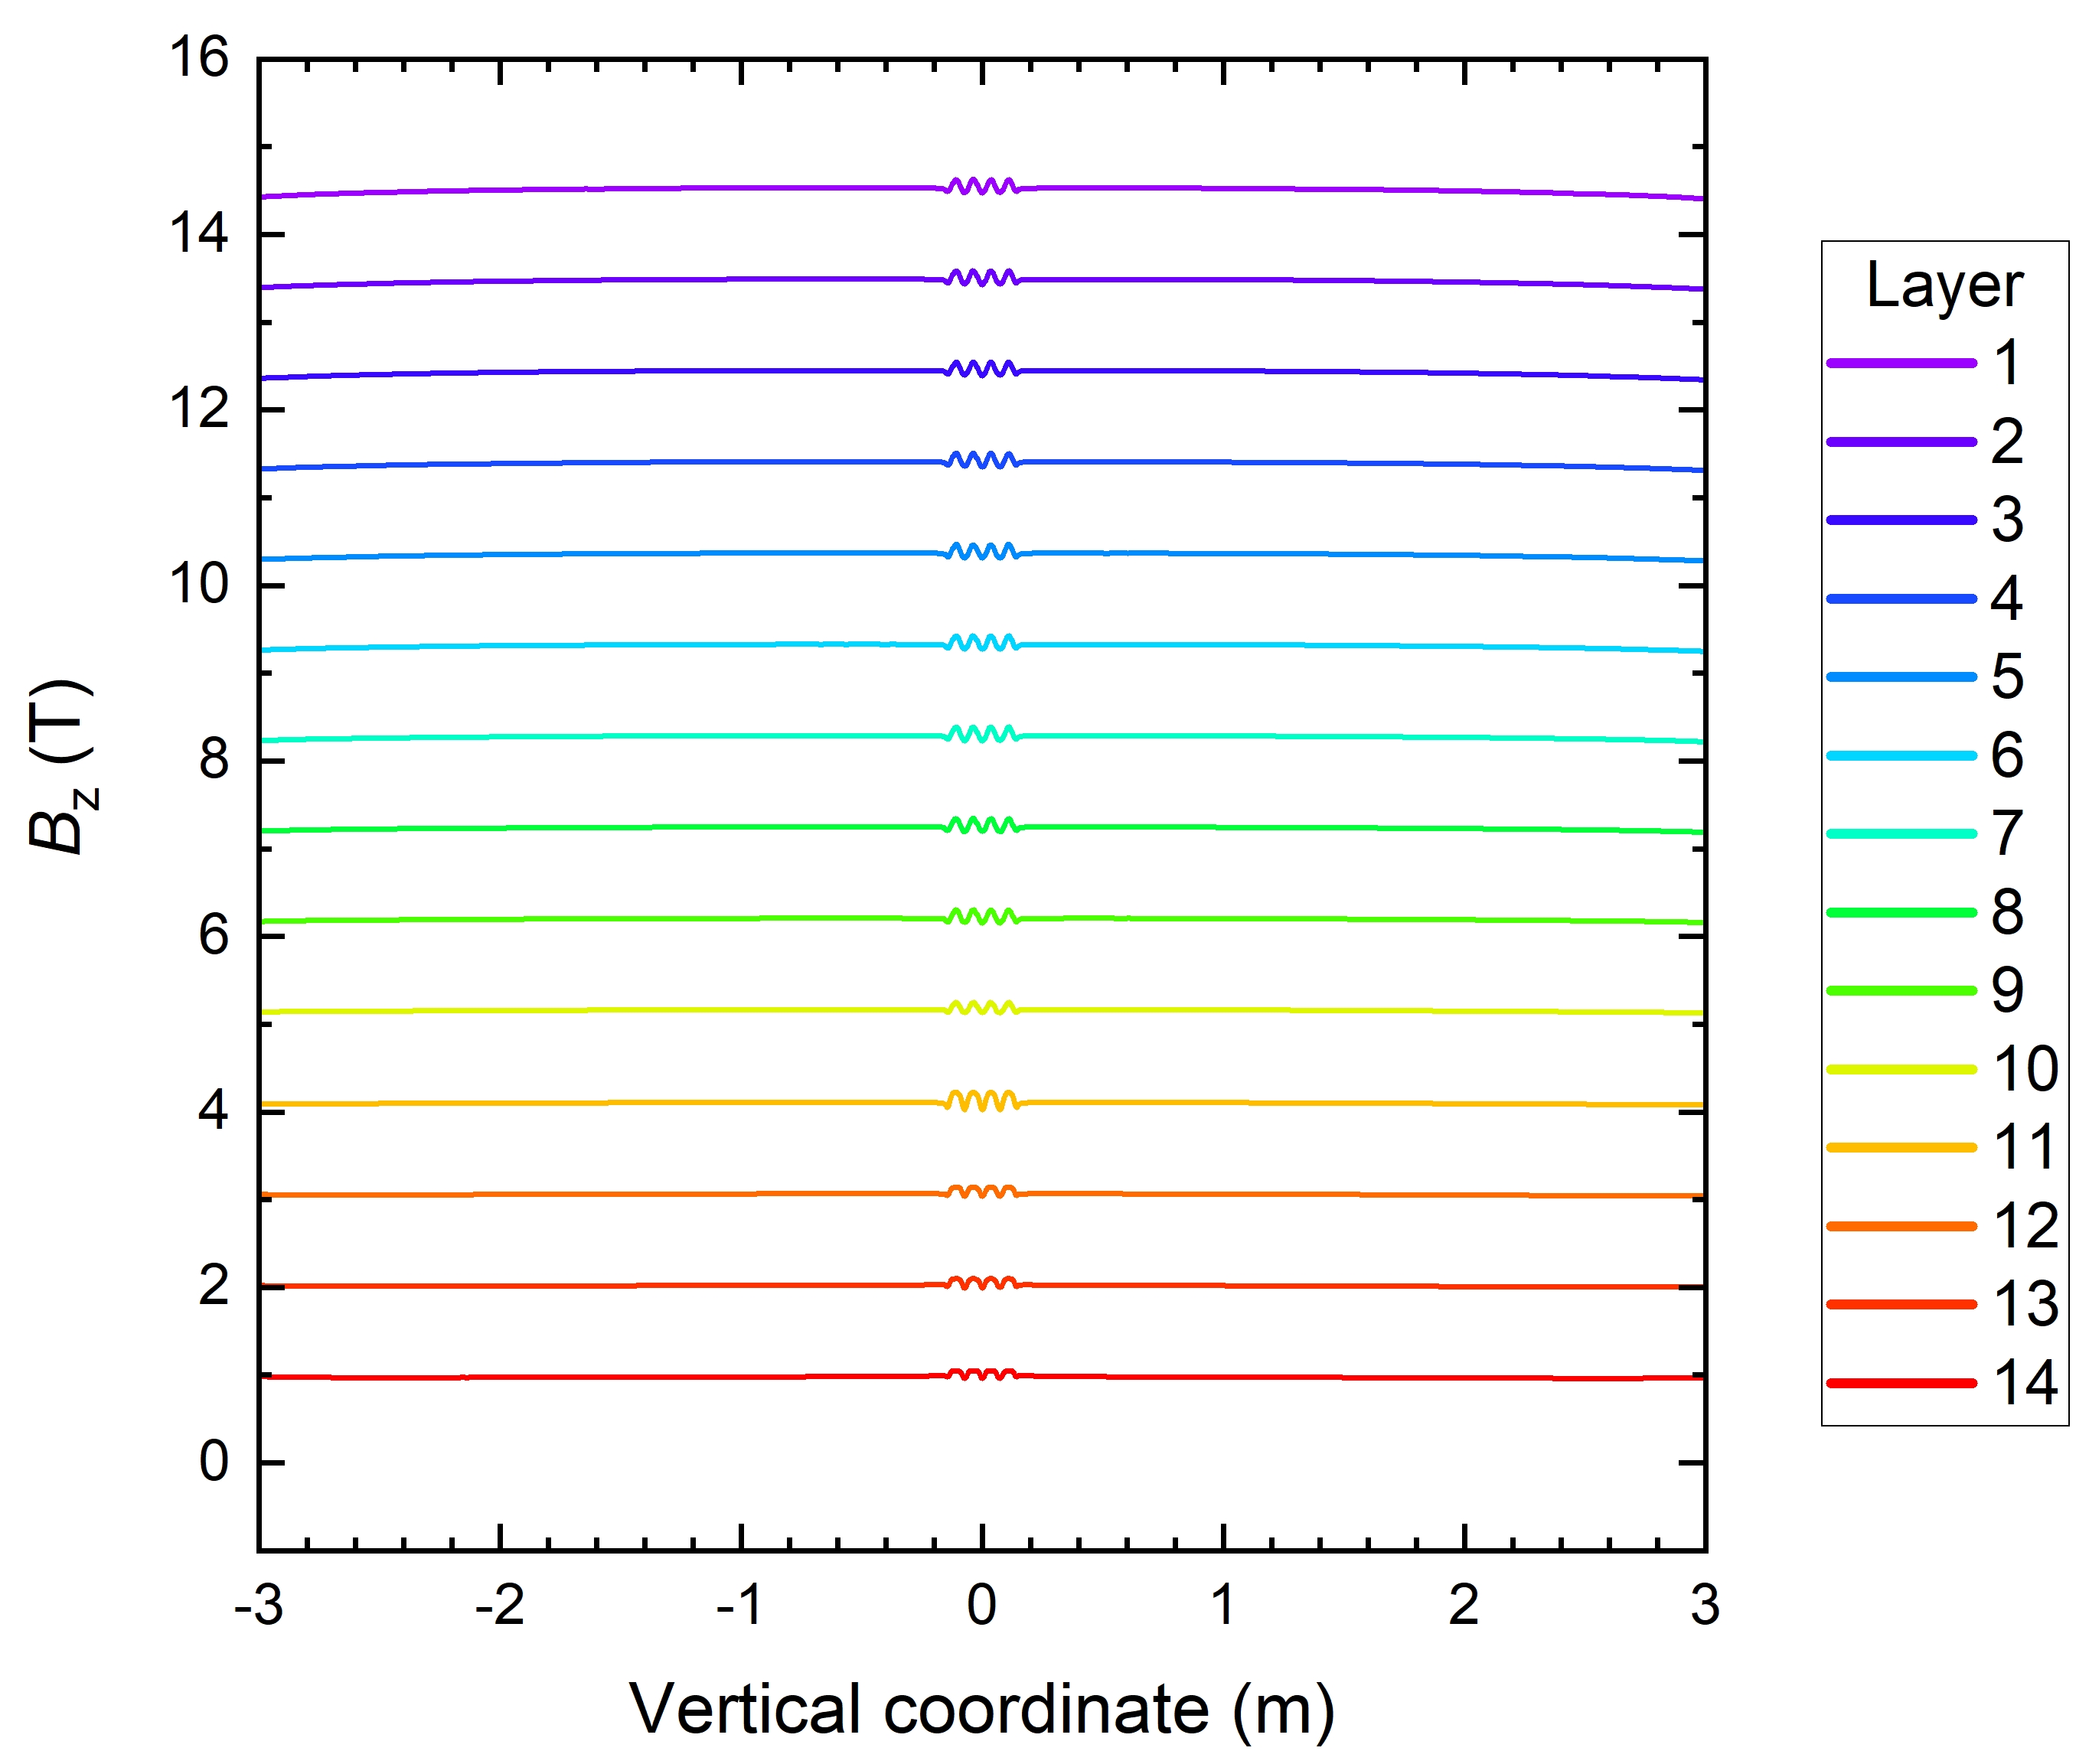
2D Electromagnetic Simulations - Premagnetisation
Flux: 192 Wb
Decreasing R

Slide 10
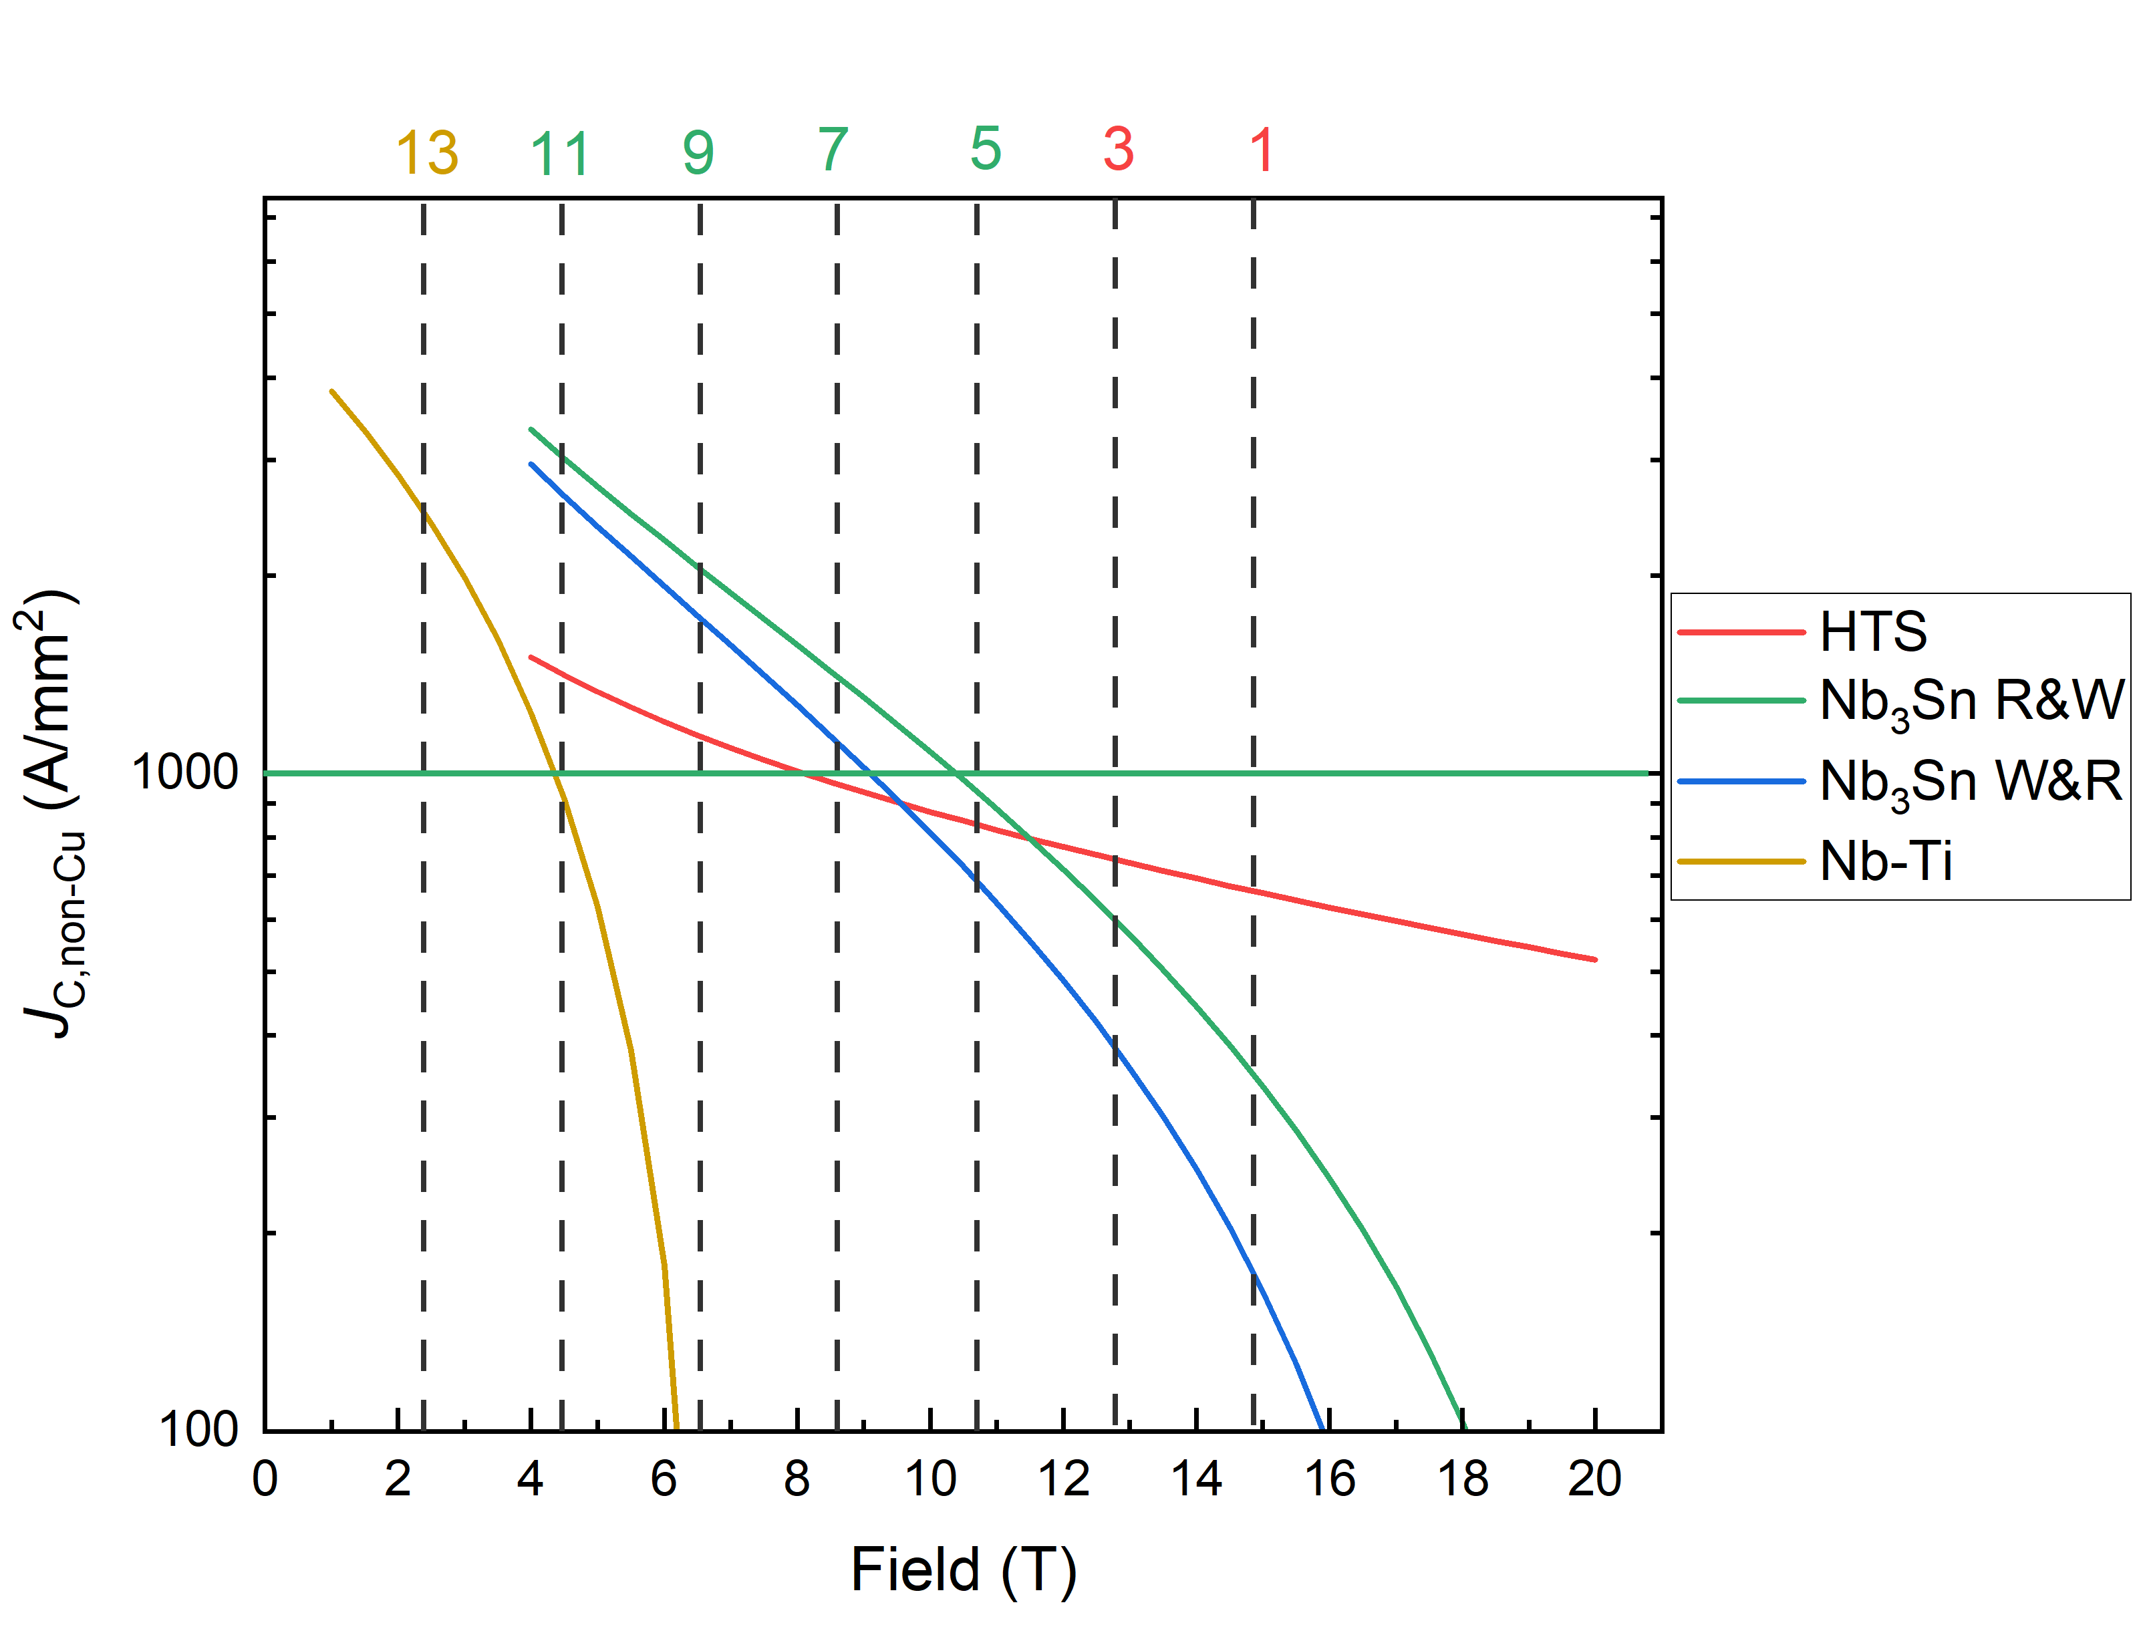
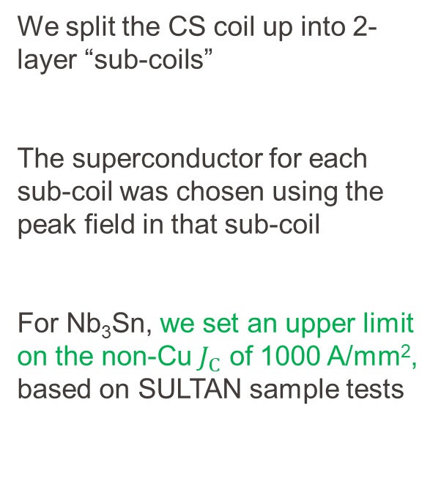
Grading the Superconductor
We split the CS coil up into 2- layer “sub-coils”
The superconductor for each sub-coil was chosen using the peak field in that sub-coil
For Nb₃Sn, we set an upper limit on the non-Cu $J_{C}$ of 1000 A/mm², based on SULTAN sample tests

Slide 11
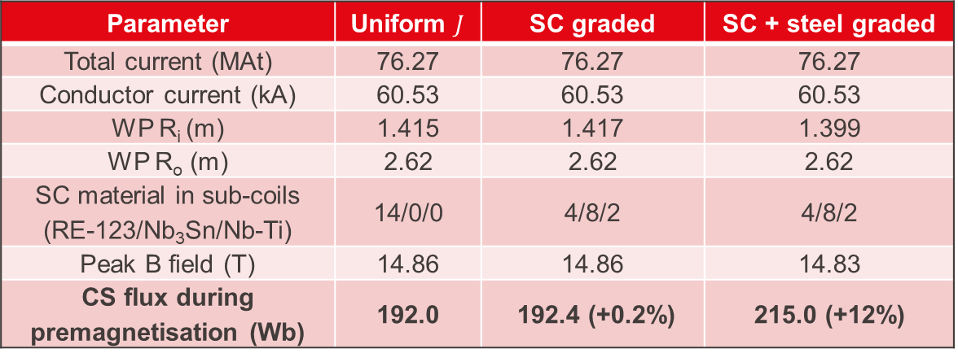
Key Coil Design Parameters – 316 LN Design
Parameter | Uniform $J$ | SC graded | SC + steel graded
Total current (MAt) | 76.27 | 76.27 | 76.27
Conductor current (kA) | 60.53 | 60.53 | 60.53
WP R_{i} (m) | 1.415 | 1.417 | 1.399
WP R_{o} (m) | 2.62 | 2.62 | 2.62
SC material in sub-coils (RE-123/Nb₃Sn/Nb-Ti) | 14/0/0 | 4/8/2 | 4/8/2
Peak B field (T) | 14.86 | 14.86 | 14.83
CS flux during premagnetisation (Wb) | 192.0 | 192.4 (+0.2%) | 215.0 (+12%)
Mechanics are in presentation on MAG-S.01.04-T021-D001

Slide 12
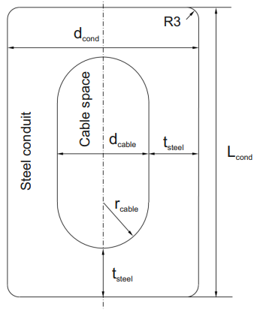
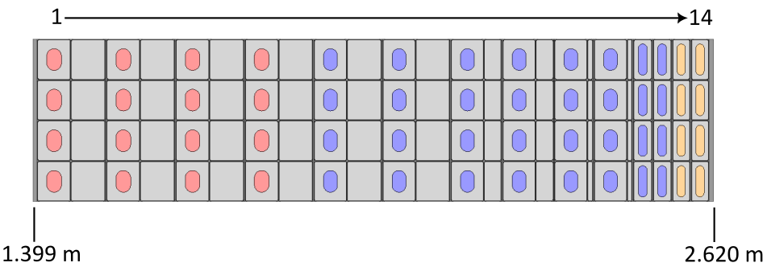
Conductor Dimensions - 316LN
A large amount of steel grading using thick co-wound steel strips (or multiple thin strips) is needed to achieve 215 Wb of flux
HTS
R&W Nb₃Sn
Nb-Ti
Layer | L_{cond} (mm) | d_{cond} (mm) | d_{cable} (mm) | t_{steel} (mm) | d_{strip} (mm)
1 & 2 | 71.0 | 58.2 | 26.2 | 16.0 | 60.0
3 & 4 | 71.0 | 58.0 | 26.0 | 16.0 | 60.0
5 & 6 | 71.0 | 56.8 | 24.8 | 16.0 | 60.0
7 & 8 | 71.0 | 56.8 | 24.8 | 16.0 | 30.0
9 & 10 | 71.0 | 56.8 | 24.8 | 16.0 | 8.0
11 & 12 | 71.0 | 30.8 | 15.8 | 7.5 | -
13 & 14 | 71.0 | 29.7 | 14.8 | 7.5 | -

Slide 13
Boosting the Flux

Slide 14
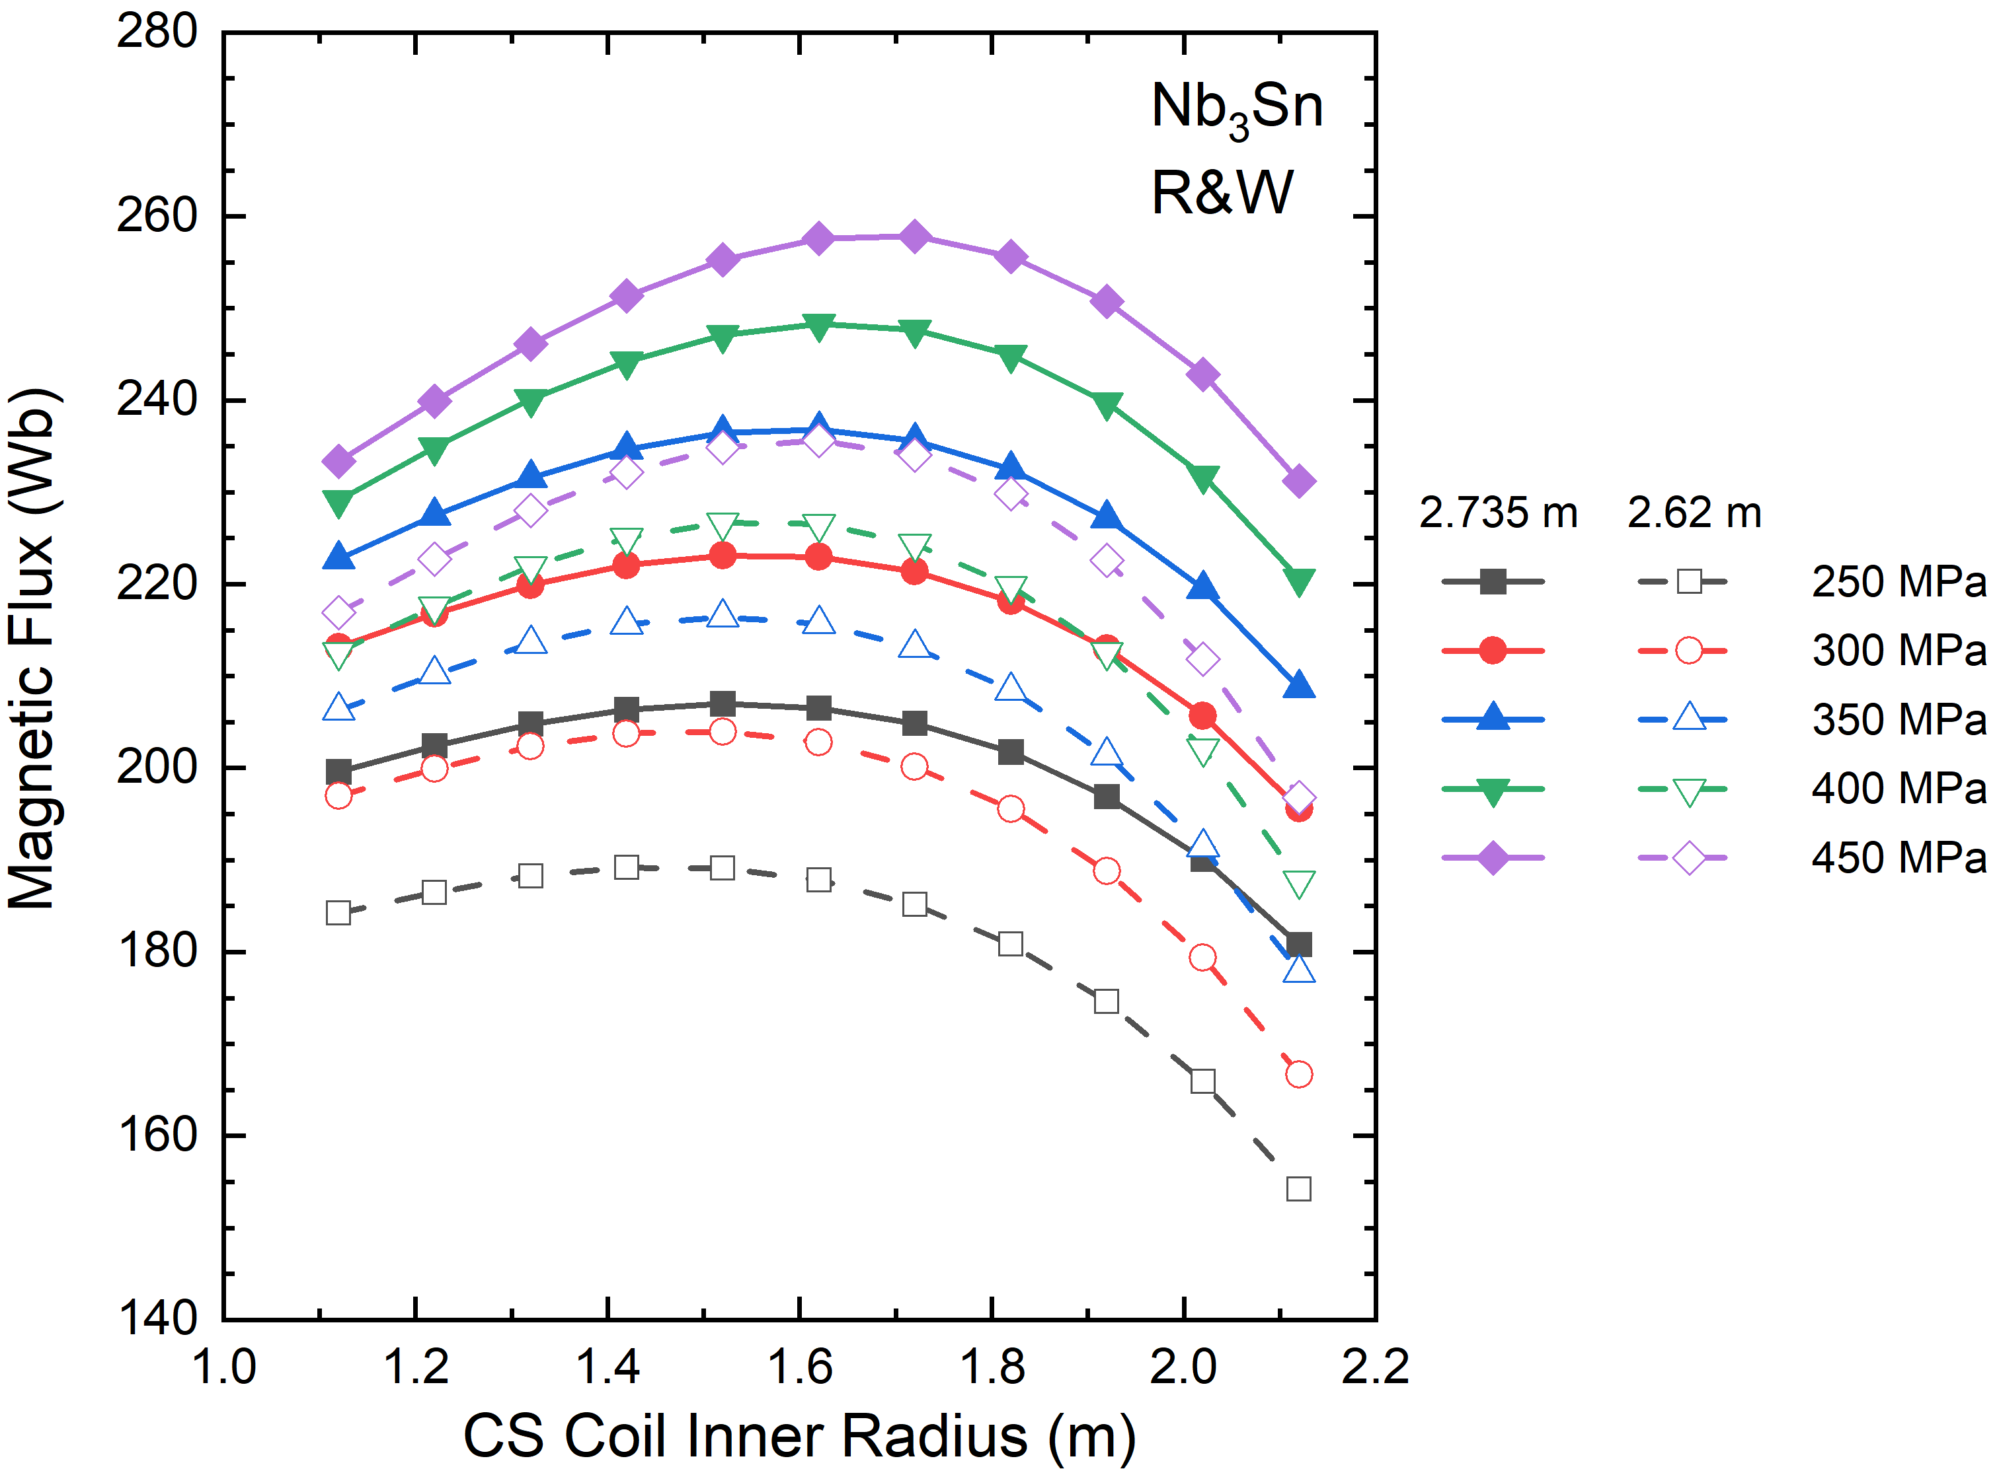
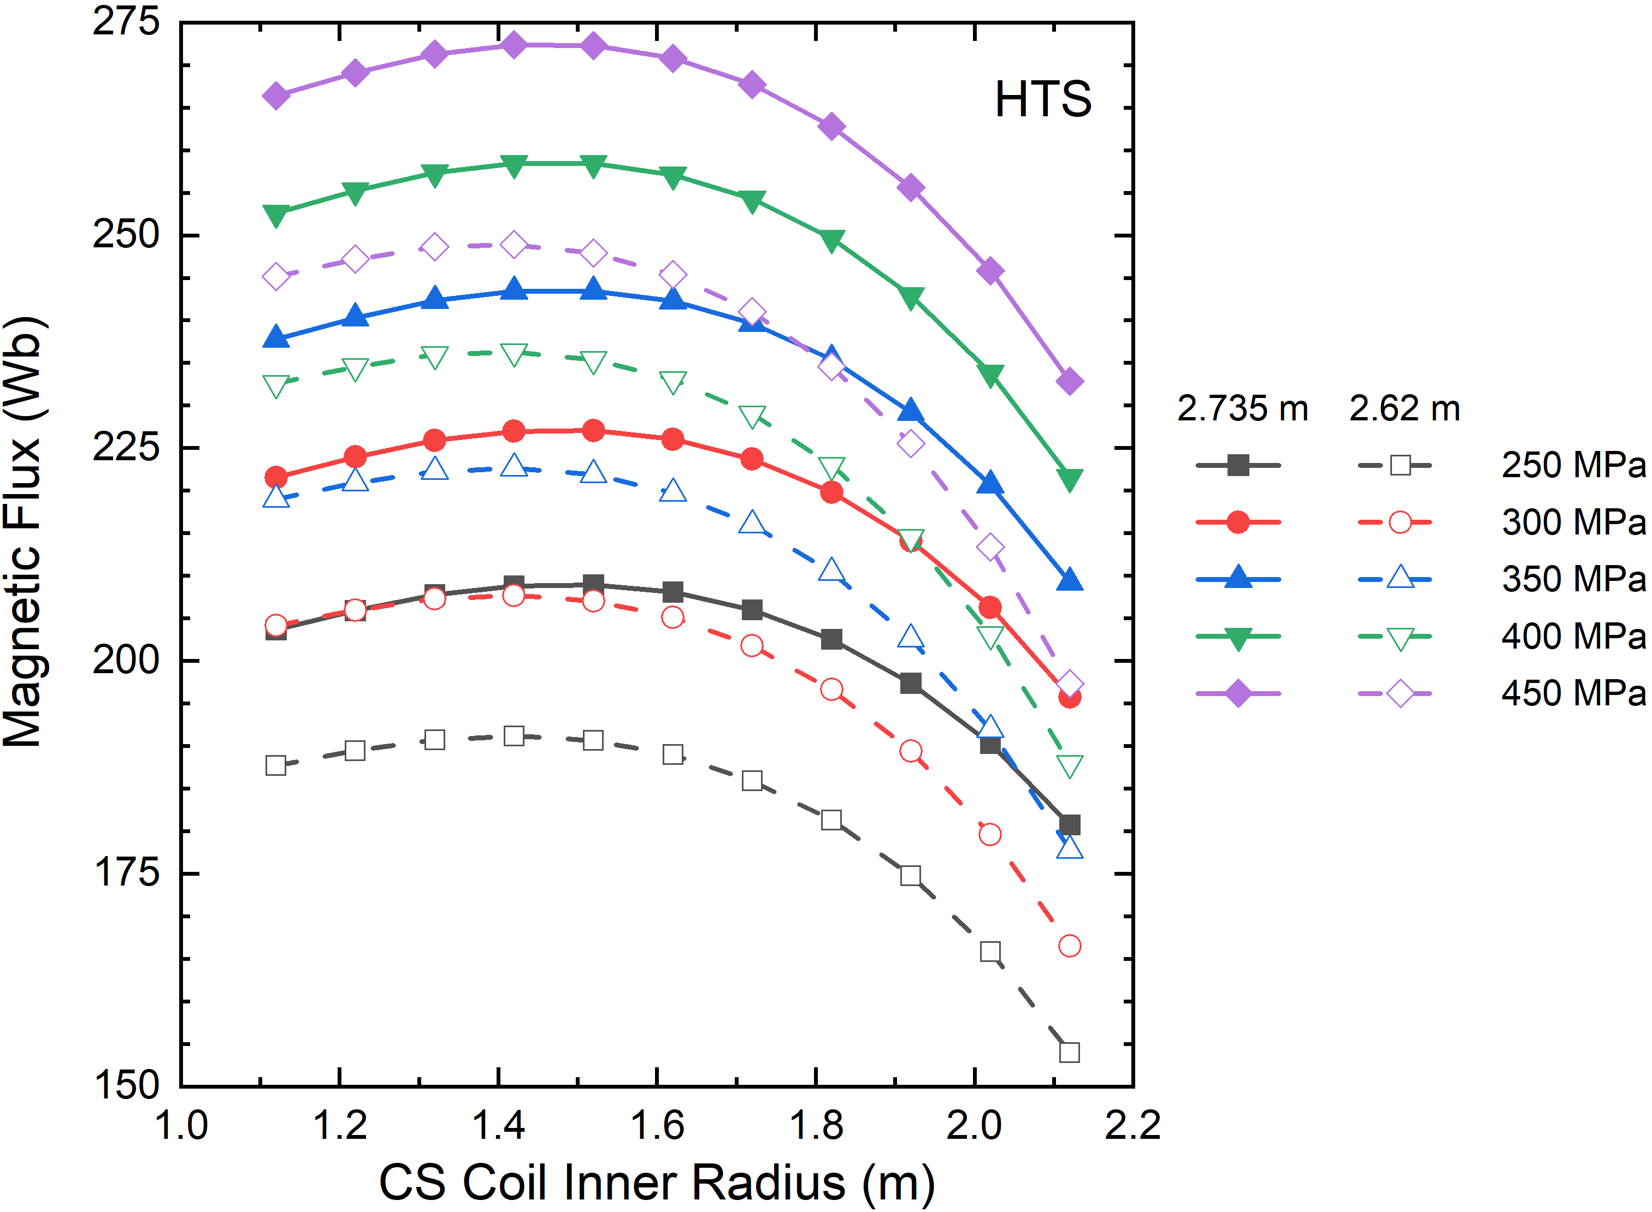
Option 1: Increasing the CS Outer Radius
The UCD solenoid simulations were repeated for an outer radius of 2.735 m
A flux boost of ~20 Wb is possible for 316LN

Slide 15
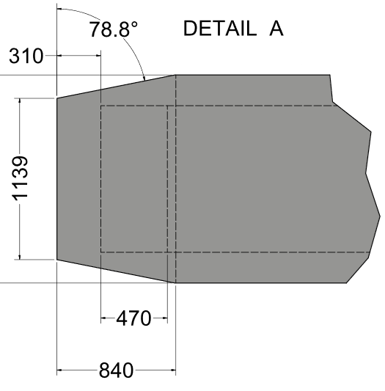
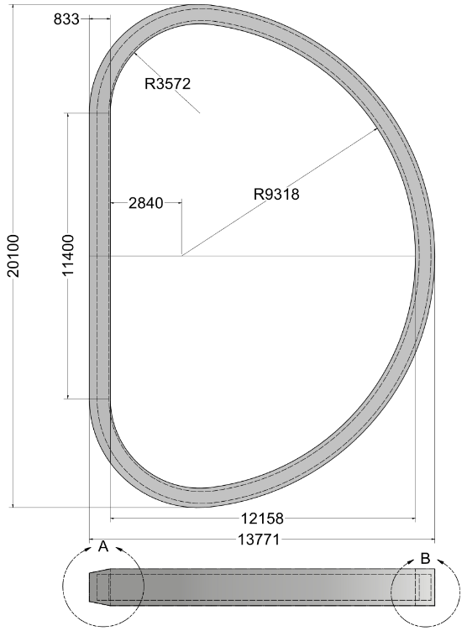
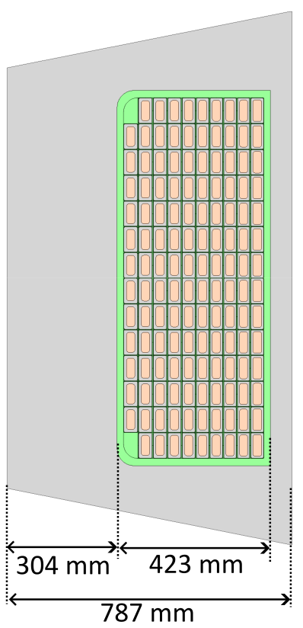
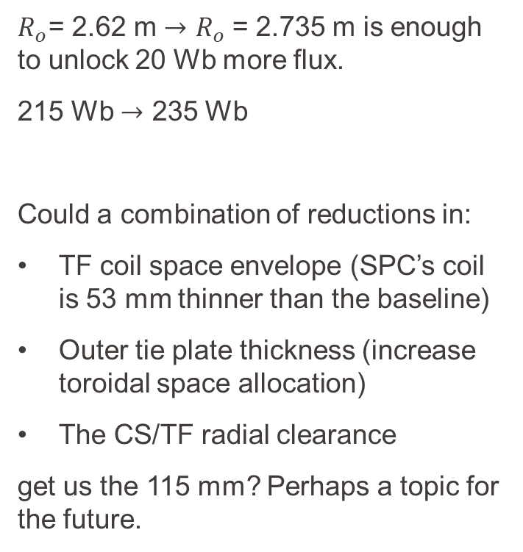
Option 1: Does it Fit?
$R_{o}$= 2.62 m $→$ $R_{o}$= 2.735 m is enough to unlock 20 Wb more flux.
215 Wb $→$ 235 Wb
Could a combination of reductions in:
TF coil space envelope (SPC’s coil is 53 mm thinner than the baseline)
Outer tie plate thickness (increase toroidal space allocation)
The CS/TF radial clearance
get us the 115 mm? Perhaps a topic for the future.
✓

Slide 16
Option 2: Allowing Higher Hoop Stresses
Parameter | UCD |  | SC graded |  | SC + steel graded
 | JK2LB | N50H | JK2LB | N50H | JK2LB | N50H
Total current (MAt) | 82.87 | 92.15 | 82.87 | 92.15 | 82.87 | 92.15
Conductor current (kA) | 65.77 | 73.13 | 65.77 | 73.13 | 65.77 | 73.13
WP R_{i} (m) | 1.415 | 1.415 | 1.418 | 1.418 | 1.418 | 1.422
SC material in subcoils (RE-123/Nb₃Sn/Nb-Ti) | 14/0/0 | 14/0/0 | 4/8/2 | 6/6/2 | 4/8/2 | 6/6/2
Peak B field (T) | 16.11 | 17.95 | 16.11 | 17.86 | 16.06 | 17.82
Layer 1 Average Hoop Stress (MPa) | 286.5 | 344.1 | 287.2 | 361.4 | 299.0 | 378.0
CS magnetic flux (Wb) | 207.9 | 230.4 | 208.5 (+0.3%) | 231.2 (+0.3%) | 235.3 (+13.1%) | 258.4 (+12.2%)
The overall conductor dimensions in each layer are similar to the 316LN design. The main differences are the conductor currents and peak fields.

Slide 17
Summary
We have designed a hybrid HTS-LTS CS coil for LAR-DEMO, with graded superconductor and 316 LN steel, including thick co-wound steel strips:
14 layers and 90 turns (CS1) or 45 turns (other modules)
Outer radius: 2.62 m
Magnetic flux during premagnetisation: 215 Wb
Peak field: ~15 T – benefit from HTS is quite small
2 possible options have been identified to reach 235 Wb during premagnetisation:
Increase the CS outer radius (gives a 20 Wb flux boost)
Choose a more fatigue resistant steel (JK2LB or N50H)

