Slide 1
VNS TF coils
MAG-S.01.01-T032-D001:
Feasibility studies for an alternative LTS solution
WPMAG EUROFusion Final meeting (2025)
January 14th, 2026 – EPFL-SPC Paul Scherrer Institut
Aldo Di Zenobio & Francesco Giorgetti

Slide 2
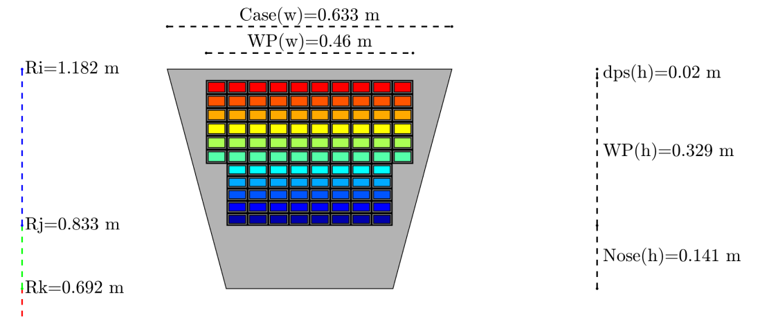
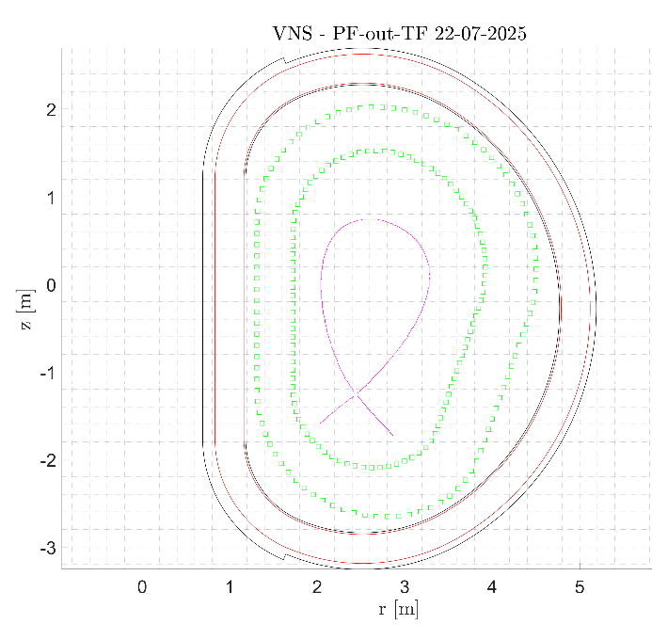


Inputs by L. Giannini
​ | PF-out-TF
Pulse​ | Steady-state​
R0​ | 2.67 m​
a​ | 64 cm​
A​ | 4.25​
B0​ | 5.6 / 13.2 T​
Pfus​ | 37.9 MW​
PNB, PEC​ | 42 / 8 MW​
NWL peak​ | 0.50 MW/m²​
k95​ | 1.38​
bN [Tm/MA]​ | 2.76 %​
q95/Pl. Current​ | 3.02/2.5 MA​
T consumption ​ | 2.1 kg / fpy​
Electricity cons.​ NB​ EC​ Total​ | ​ 118.5 MW​ 20 MW​ 161.5 MW​
WPMAG Final Meeting – A. Di Zenobio – 14/01/2026

Slide 3
React & Wind study
457,2mm
325,0 mm
383,0 mm
WPMAG Final Meeting – A. Di Zenobio – 14/01/2026

Slide 4
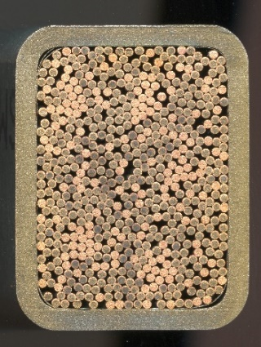
React & Wind study
457,2mm
325,0 mm
383,0 mm
Based on a strand similar to DTT TF
(0,82mm OD, Cu-nonCu: 0.95)
6 Double Pancakes
rDP
sDP
Conductor
SC strand # | 432 | (0,82mm OD)
Cu strand # | 240 | (1,00mm OD)
Total strand # | 672
SS Wrap thickness | 0,1 | mm
SS Wrap overlap | 30,0 | %
I_{op} | 47,20 | kA
B_{peak} | 13,2 | T
T_{inlet} | 4,5 | K
Max ΔT_{margin} | 1,4 | K
Applied strain (R&W) | -0,4%
Width (outer) | 34,6 | mm
Height (outer) | 24,0 | mm
Jacket thickness | 2,0 | mm
Inner corner radius | 4,0 | mm
VF | 26,8 | %
Winding Pack
Total turns (1 coil) | 132
MAturns (1 coil) | 6,230
Total DP # | 6
Turn insulation | 1,0 | mm
DP insulation | 0,5 | mm
WP insulation | 6,0 | mm
Radial turns | 12
HF zone toroidal turns | 12
LF zone toroidal turns | 10
HF radial dimension | 156,5 | mm
LF radial dimension | 156,5 | mm
WP radial dimension | 325,0 | mm
HF zone toroidal dimension | 457,2 | mm
LF zone toroidal dimension | 383,0 | mm
WPMAG Final Meeting – A. Di Zenobio – 14/01/2026

Slide 5
Wind & React study
0,454m
0,185m
WP(h)=0,338m*
* = with to-ground insulation
0,139m
0,391m
VNS Magnet Design meeting – A. Di Zenobio – 13/11/2025

Slide 6
Wind & React study
0,454m
0,185m
WP(h)=0,338m*
* = with to-ground insulation
0,139m
0,391m
Based on a strand similar to DTT TF
(0,82mm OD, Cu-nonCu: 0.95)
rDP
sDP
7 Double Pancakes
Conductor
SC strand # | 540
Cu strand # | 0
Total strand # | 540
SS Wrap thickness | 0,05 | mm
SS Wrap overlap | 30,0 | %
Iop | 33,9 | kA
Bpeak | 13,2 | T
Tinlet | 4,5 | K
Max ΔTmargin | 1,4 | K
Applied strain (R&W) | -0,6%
Width (outer) | 28,6 | mm
Height (outer) | 21,0 | mm
Jacket thickness | 2,0 | mm
Inner corner radius | 4,0 | mm
VF | 26,8 | %
Winding Pack
Total turns (1 coil) | 184
MAturns (1 coil) | 6,230
Total DP # | 7
Turn insulation | 1,0 | mm
DP insulation | 1,0 | mm
WP insulation | 6,0 | mm
Radial turns | 14
HF zone toroidal turns | 14
LF zone toroidal turns | 12
HF radial dimension | 185,0 | mm
LF radial dimension | 139,0 | mm
WP radial dimension | 338,0 | mm
HF zone toroidal dimension | 454,4 | mm
LF zone toroidal dimension | 391,2 | mm
Similar to DTT TF conductor
WPMAG Final Meeting – A. Di Zenobio – 14/01/2026

Slide 7
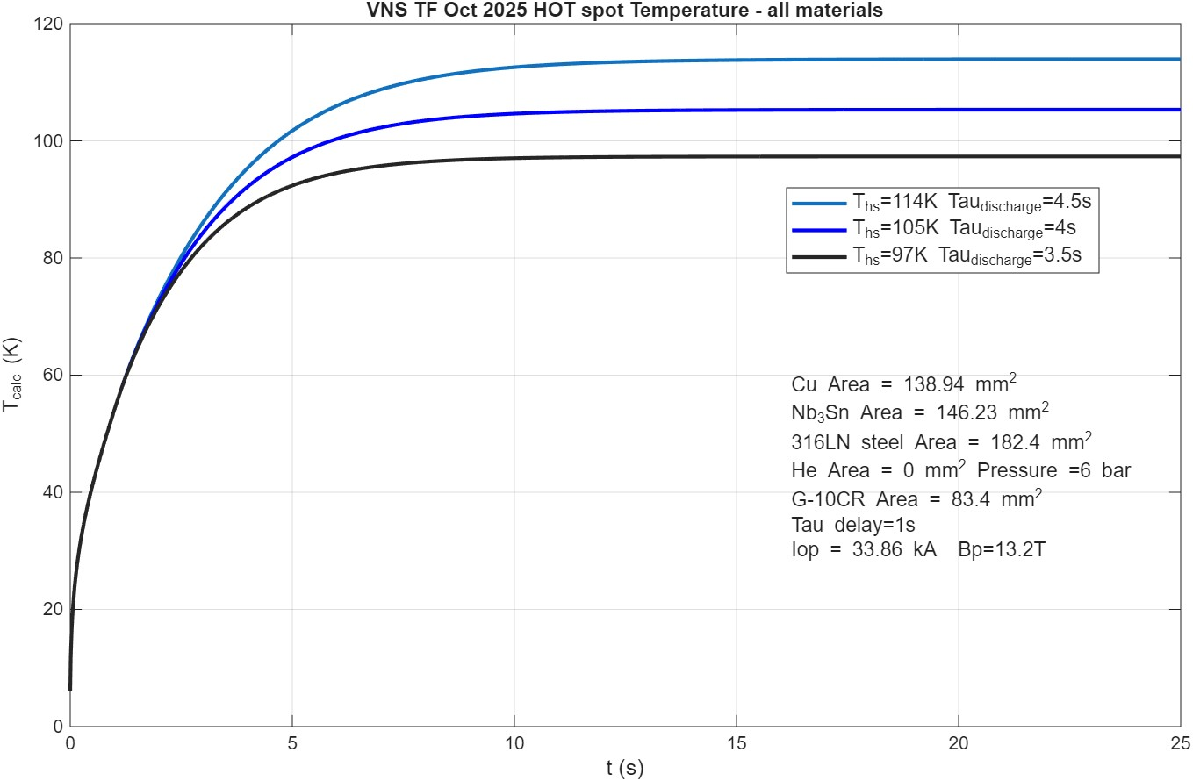
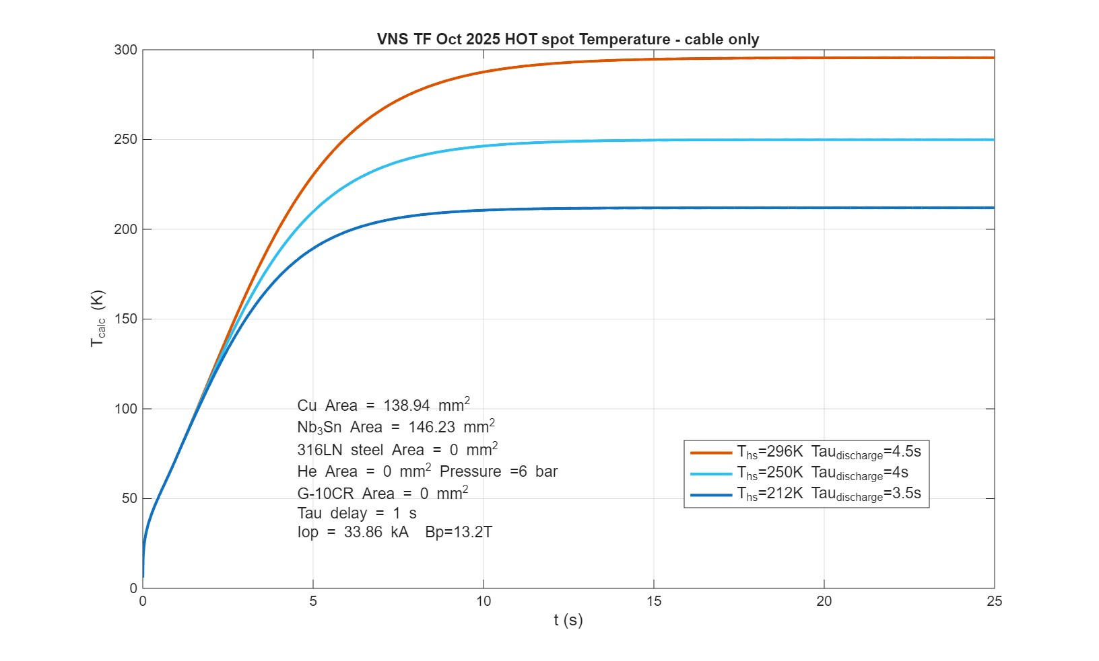
τ_{discharge} = 4.0 s
t_{delay} = 1.0s
Calculated by Chiarasole Fiamozzi Zignani
Based on a strand similar to DTT TF
(0,82mm OD, Cu-nonCu: 0.95)
rDP
sDP
7 Double Pancakes
Conductor
SC strand # | 540
Cu strand # | 0
Total strand # | 540
SS Wrap thickness | 0,05 | mm
SS Wrap overlap | 30,0 | %
Iop | 33,9 | kA
Bpeak | 13,2 | T
Tinlet | 4,5 | K
Max ΔTmargin | 1,4 | K
Applied strain (R&W) | -0,6%
Width (outer) | 28,6 | mm
Height (outer) | 21,0 | mm
Jacket thickness | 2,0 | mm
Inner corner radius | 4,0 | mm
VF | 26,8 | %
Winding Pack
Total turns (1 coil) | 184
MAturns (1 coil) | 6,230
Total DP # | 7
Turn insulation | 1,0 | mm
DP insulation | 1,0 | mm
WP insulation | 6,0 | mm
Radial turns | 14
HF zone toroidal turns | 14
LF zone toroidal turns | 12
HF radial dimension | 185,0 | mm
LF radial dimension | 139,0 | mm
WP radial dimension | 338,0 | mm
HF zone toroidal dimension | 454,4 | mm
LF zone toroidal dimension | 391,2 | mm
Similar to DTT TF conductor
WPMAG Final Meeting – A. Di Zenobio – 14/01/2026

Slide 8
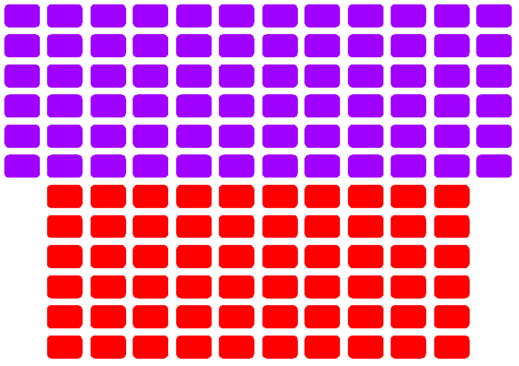
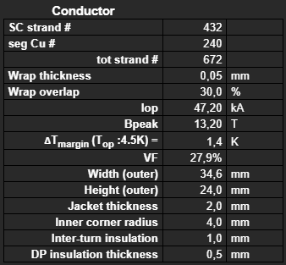
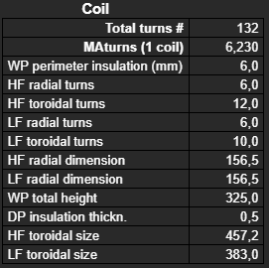
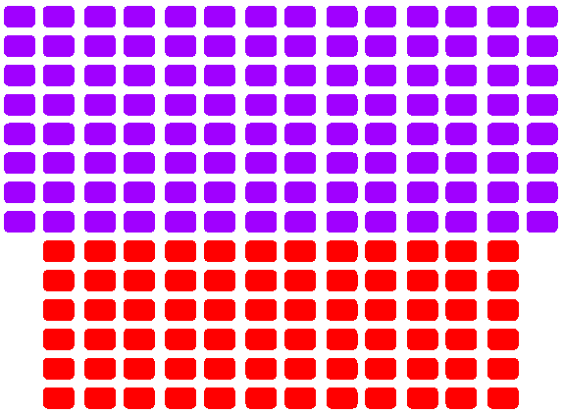
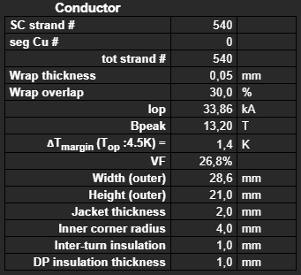
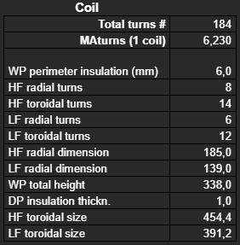
VNS TF COIL EM AND STRUCTURAL SIMULATIONS
Reference: VNS - PF-in-TF (LTS) 07-03-2025
12 (6DP)
Version:
  W&R with 6 Double Pancakes
  “Standard” R&W with 7 Double Pancakes
6
26
6
36,6
10
14 (7DP)
8
23
6
30,6
12

Slide 9
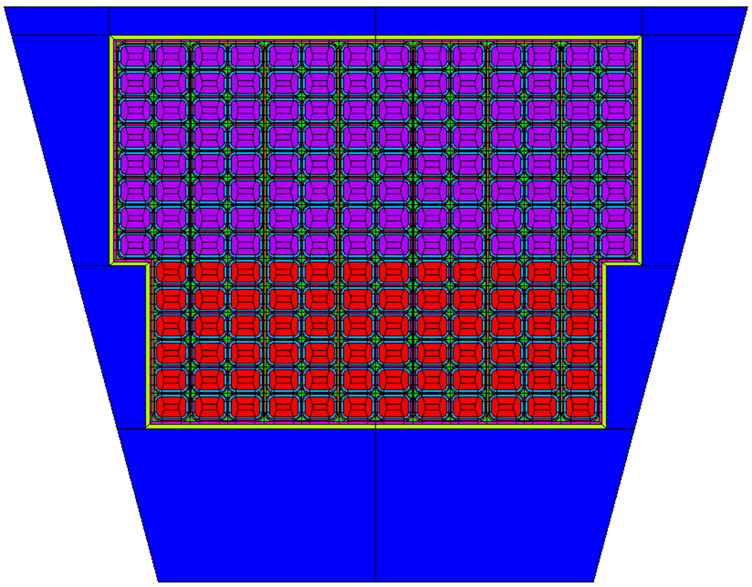
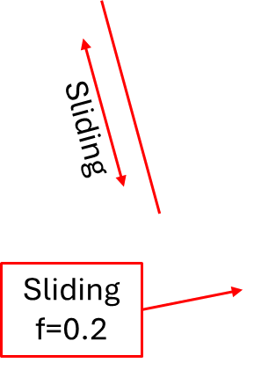
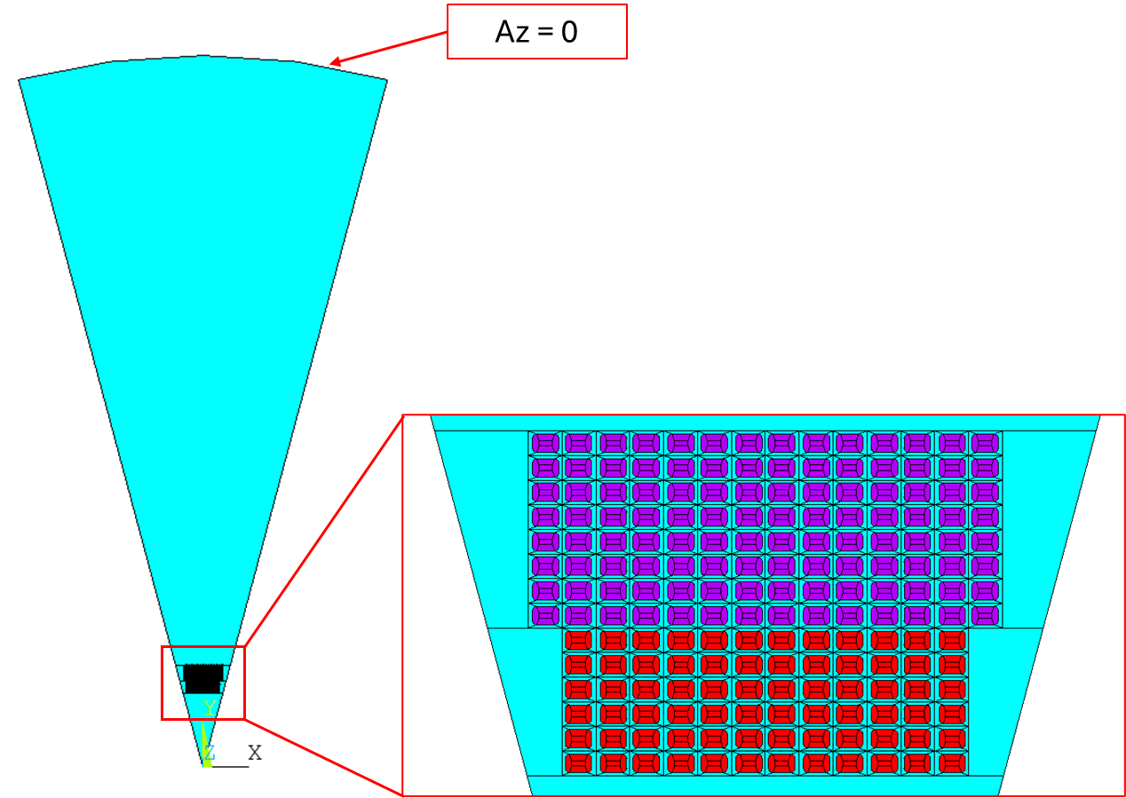
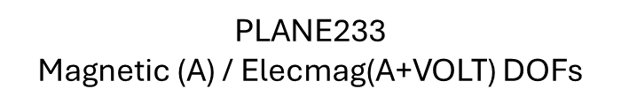
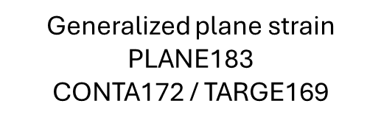
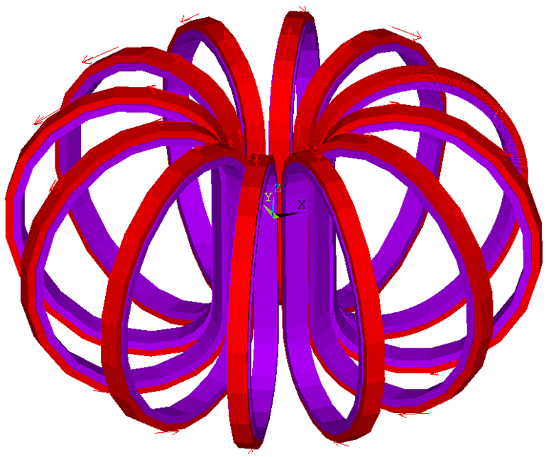

FEA models
2D STRUCTURAL MODEL
2D EM MODEL
Cable EM forces
Vertical EM Force
*The step is not definitive; indeed, we intend to remove it.
3D EM MODEL

Slide 10
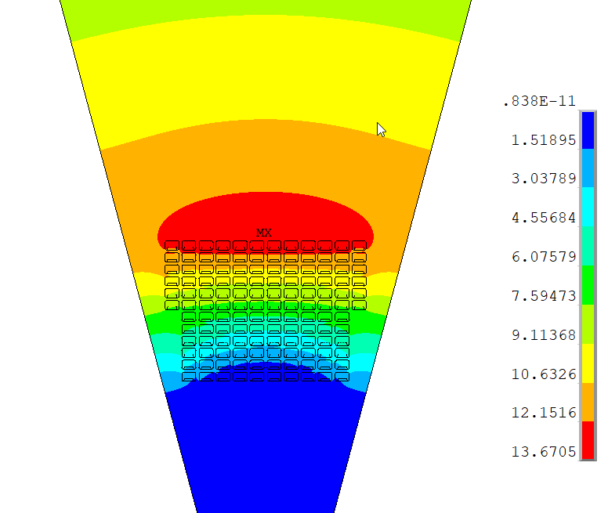
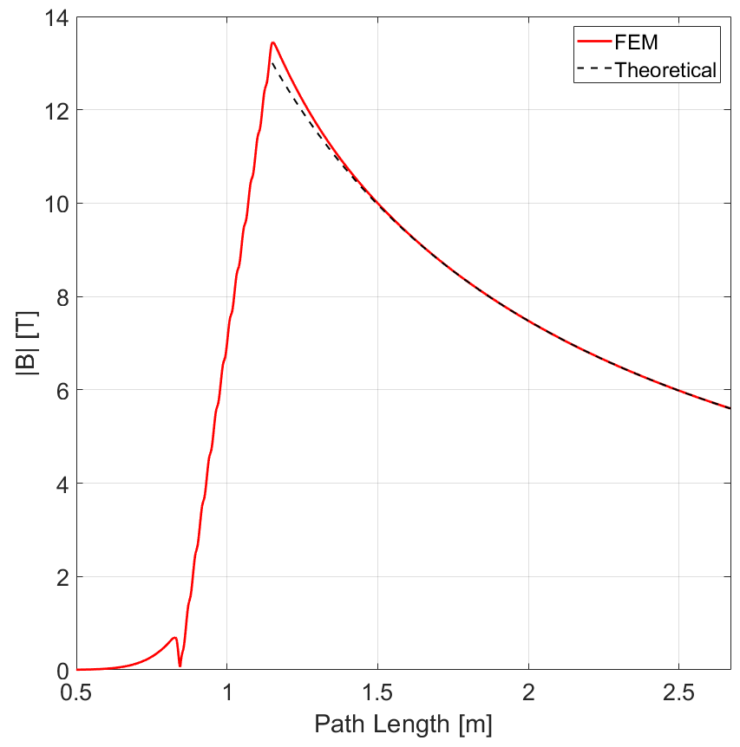
2D EM MODEL: Version 1 (6DP)
Radial path (x=0)
B_{peak}=13.45 T
B=5.6 T
@ r=2.67m

Slide 11
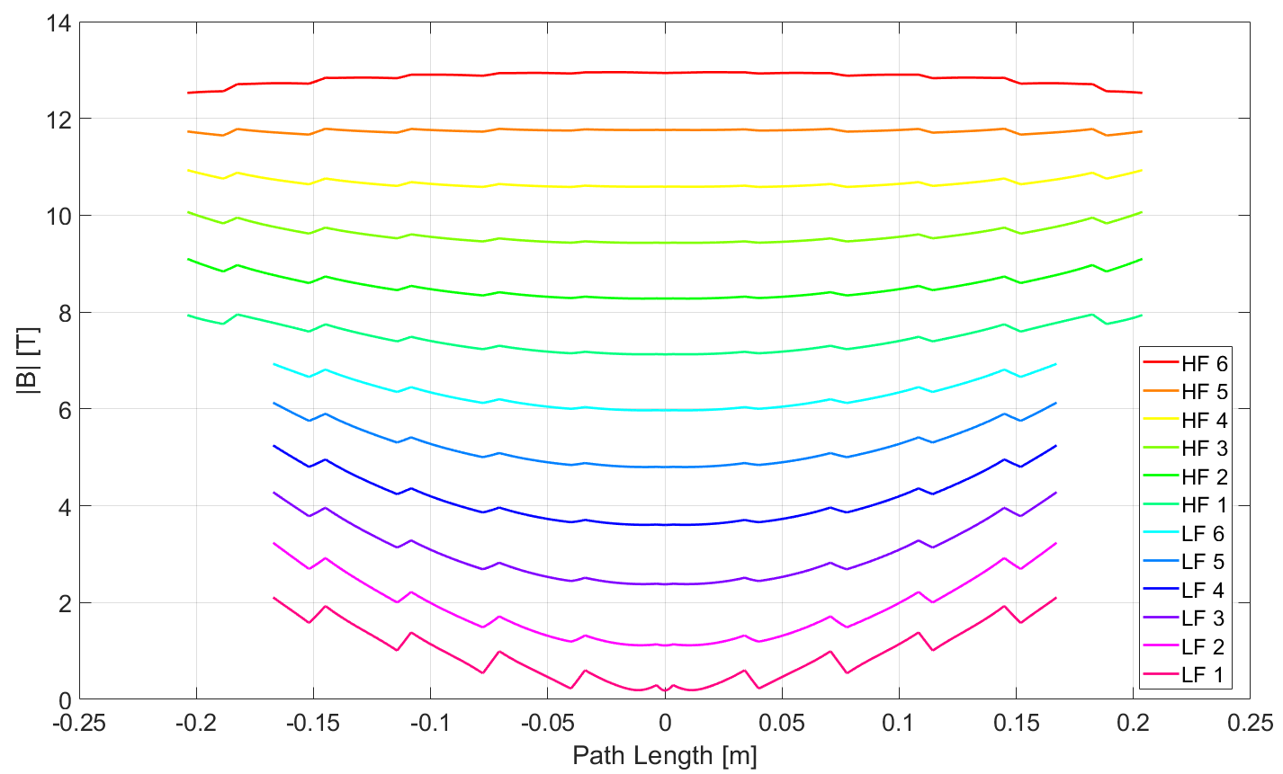
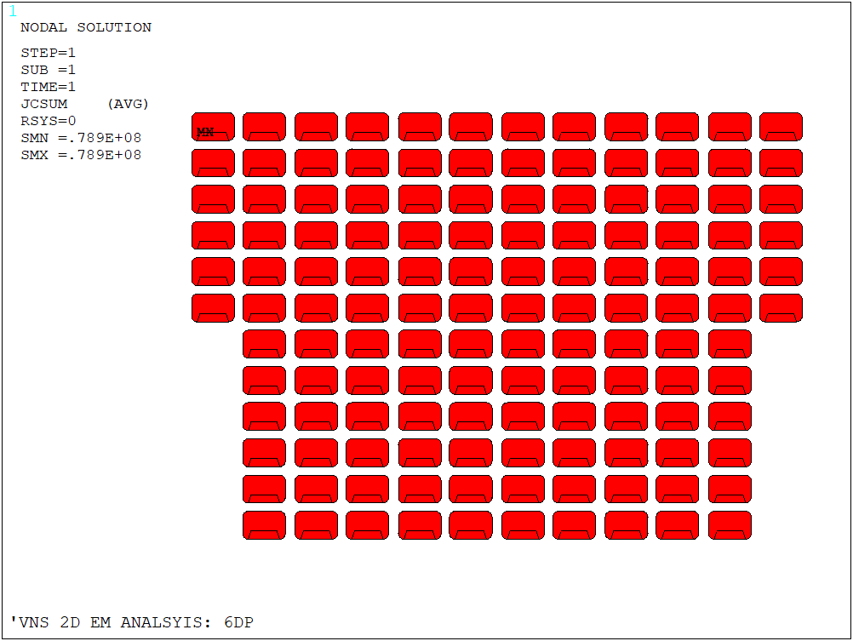
2D EM MODEL: Version 1 (6DP)
Toroidal paths (Center of cables)
Current density
J_{eng} LF = 47.2 A/mm²
J_{eng} HF = 47.5 A/mm²

Slide 12
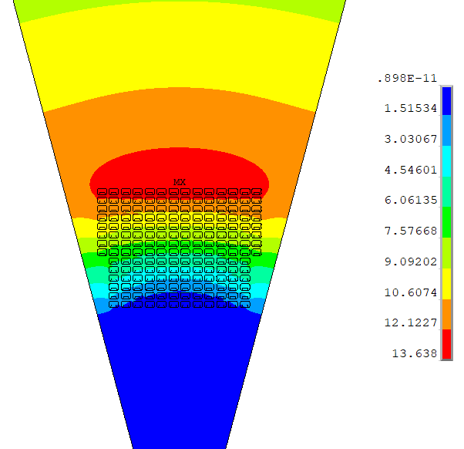
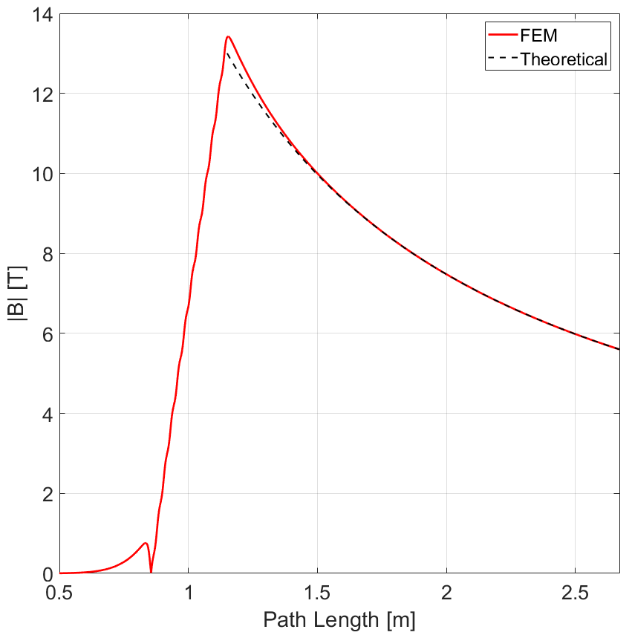
2D EM MODEL: Version 2 (7DP)
Radial path
B_{peak}=13.45 T
B=5.6 T
@ r=2.67m

Slide 13
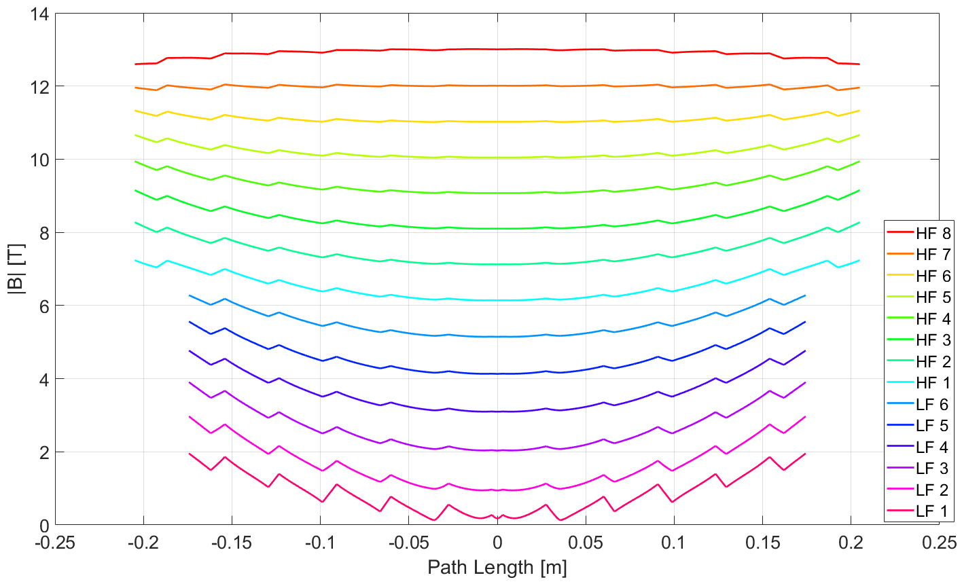
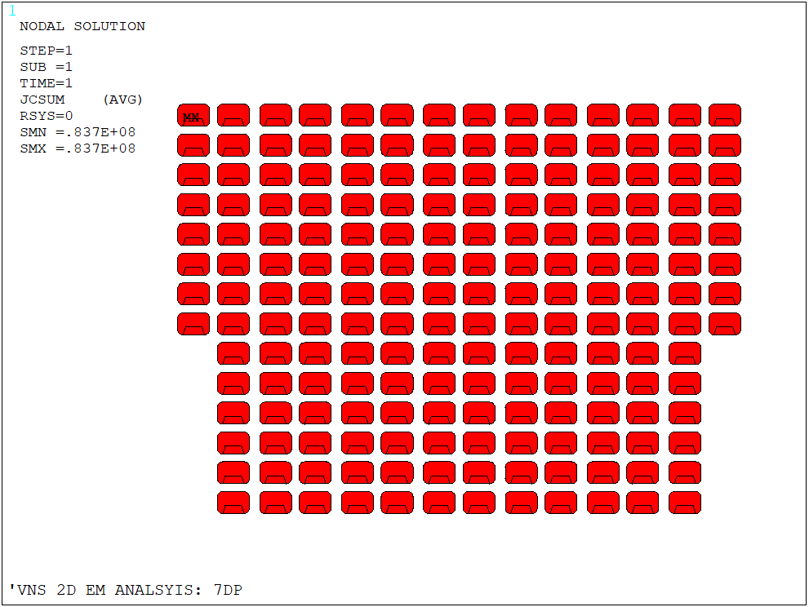
2D EM MODEL: Version 2 (7DP)
Toroidal paths (Center of cables)
Current density
J_{eng} LF = 44.8 A/mm²
J_{eng} HF = 45.1 A/mm²

Slide 14
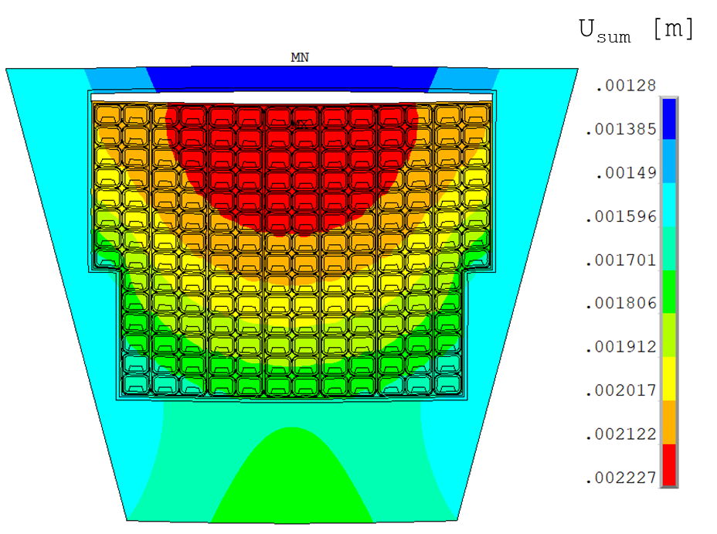
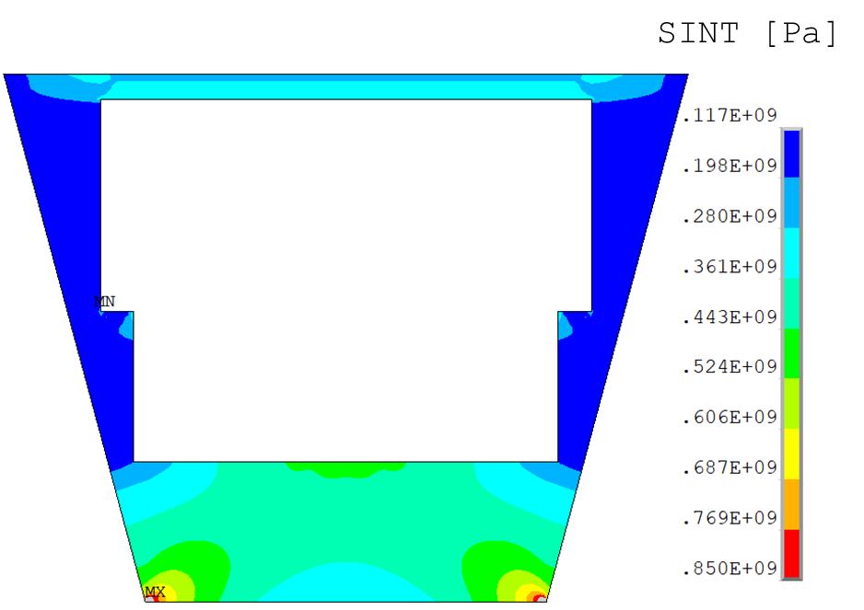
2D STRUCTURAL MODEL: Version 2 (7DP)
20x Displacement scaling

Slide 15
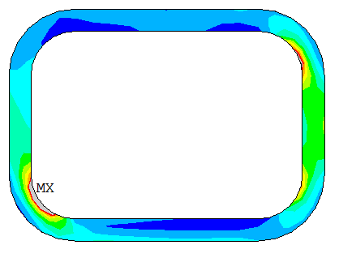
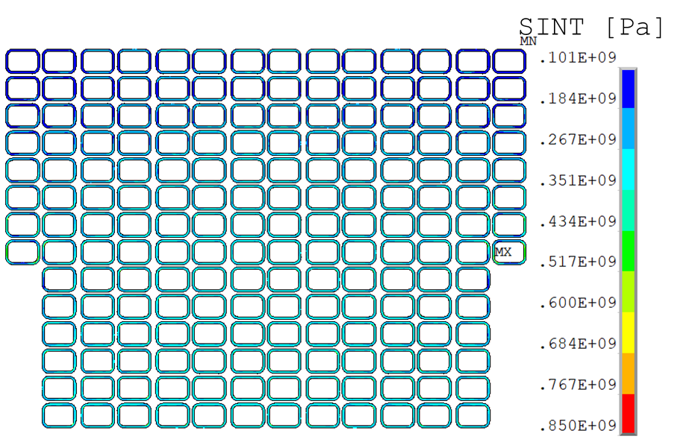
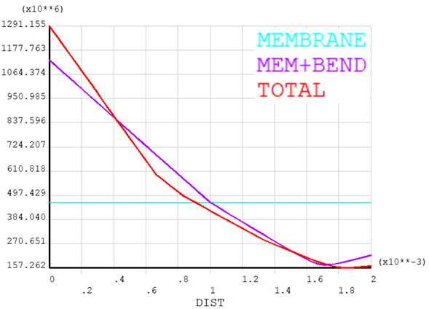
2D STRUCTURAL MODEL: Version 2 (7DP)
Path
σ_{m} = 463.7MPa
σ_{m+b} = 1131MPa

Slide 16
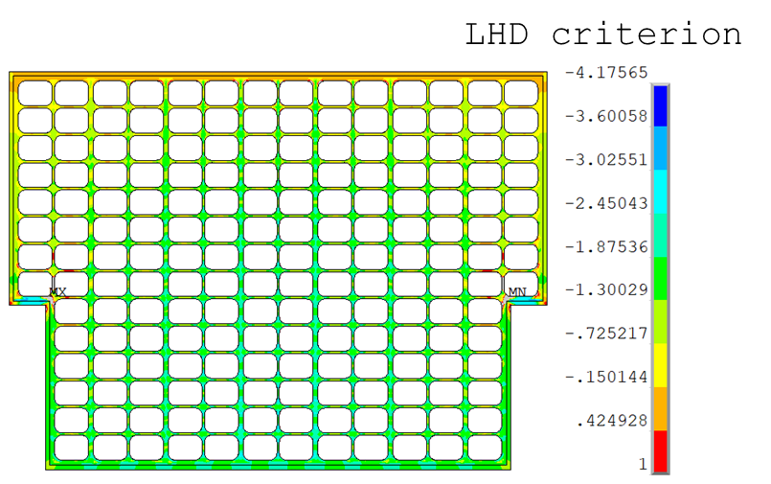
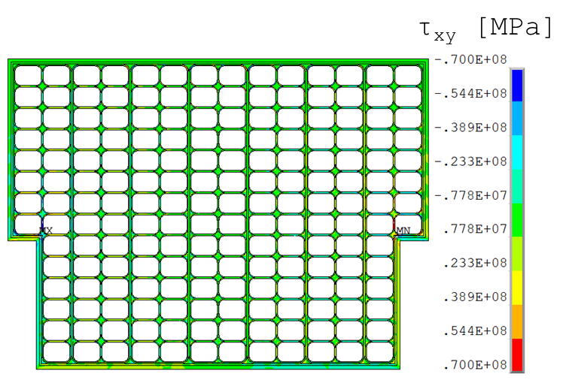
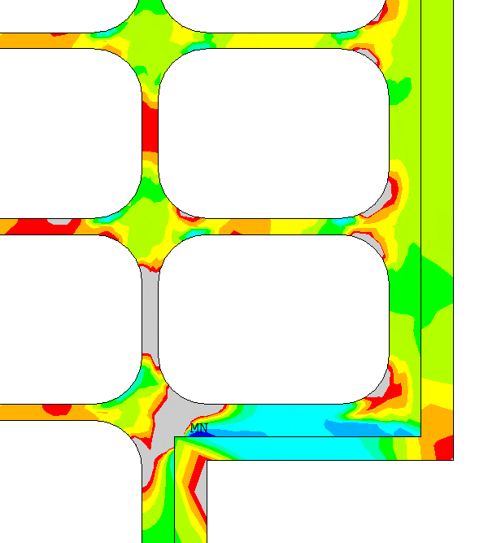
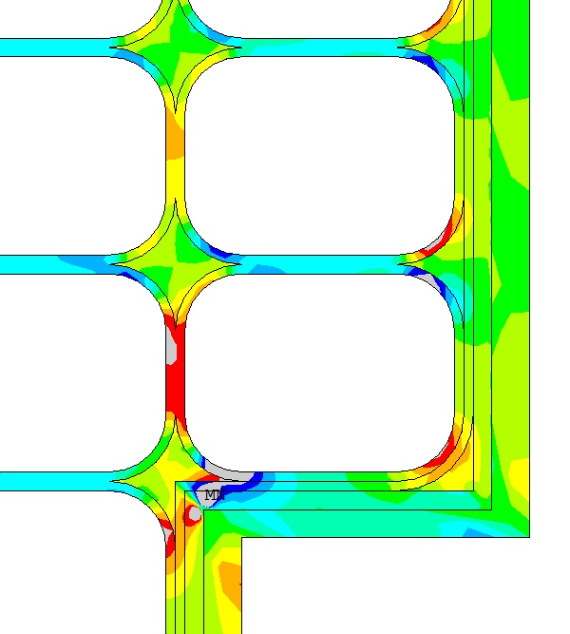
2D STRUCTURAL MODEL: Version 2 (7DP)

Slide 17
Thank you

