Slide 1


MAG-S.01.03-T028-D001/02
MAG-S.01.03-T028 - D001: Deliverable on Coordination of ThermalHydraulic Analysis and Cryogenics and HTS Hot Spot Design Criteria
MAG-S.01.03-T028 - D002: Deliverable on LTS and HTS CS Thermohydraulics tool and Application
DEMO WPMAG Final Meeting, 15/01/2026
S. Nicollet
CEA / DRF/ IRFM / GAIM (Magnet Group)

Slide 2
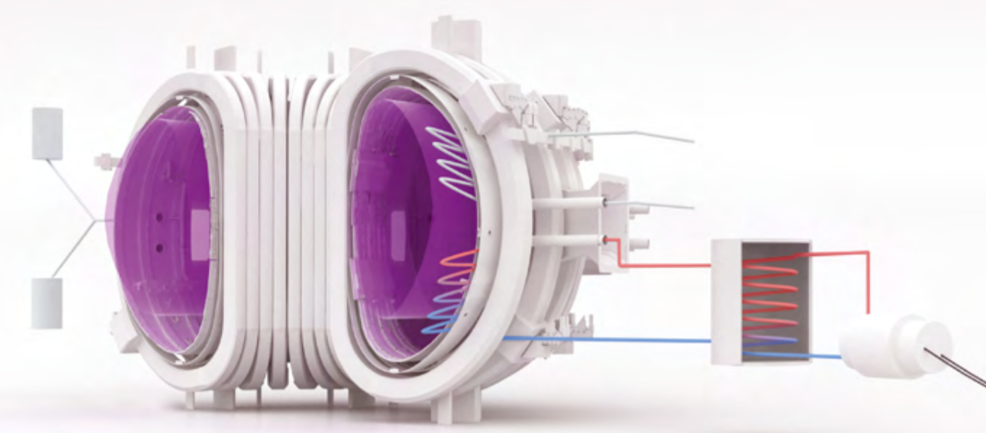

Plan
MAG-S.01.03-T028 TASK
HTS Hot Spot Design Criteria Models & Previous Studies
HTS Conductors Quench Experiments: Hot Spot Results
MAG-S.01.03-T028-D001 Conclusion & TH Studies Challenges
ANNEXES

Slide 3
MAG-S.01.03-T028
1

Slide 4
1. MAG-S.01.03-T028-D001/02
Tasks as Specified: 2025 Thermohdyraulics and Cryogenics Coordination with HTS Hot Spot Criteria and CEA HTS/LTS Thermohydraulics Studies and Analyses
MAG-S.01.03-T028 - D001: Deliverable on Coordination of ThermalHydraulic Analysis and Cryogenics and HTS Hot Spot Design Criteria
HTS Coil and Magnets Hot spot Criteria determination and assessment memo within the help of all stakeholders institute Thermohydraulics and Cryogenics Coordination
Assists the Project Leader in the development and execution of design activities in TH analysis and Cryogenics
Gathers status information of activities in TH analysis and Cryogenics and advises the Project Leader of any discrepancies
Organises periodic meetings and creates the minutes
Reviews the deliverables produced by the Project Team in their area of TH analysis and Cryogenics
MAG-S.01.03-T028 - D002: Deliverable on LTS and HTS CS Thermohydraulics tool and Application
HTS Coil thermohydraulics (hot spot, quasi-steady state with AC losses and Jc) implementation in Design process
First Analysis and Application of the Hot Spot criteria and Hydraulical tools to the CEA Hybrid CS.
Thermohydraulics Study and Analysis of CEA ITER-like LTS CS Design

Slide 5
HTS Hot Spot Design Criteria Models & Previous Studies
2

Slide 6


2.1 HTS HOT SPOT Calculation Model &
Electrical QPV – Polito-SPC-ENEA
$$\int_{Tt}^{Tmax}{\frac{Cp\left(T\right)∗S}{R^{′}\left(T\right)}}∗dT=\int_{0}^{t}{I^{2}\left(t\right)∗dt}$$
Assuming adiabatic quench propagation, heat balance equation is:
Where: C(T)S = ( ρcpS ) stabilizer + f • ( ρcpS ) jacket, ρ mass density, cp is the temperature dependent specific heat capacity and S is the cross-section, f is a parameter (between 0 and 1) which depends on how much heat capacity of the jacket is available, i.e., thermally coupled, with the stabilizer; Rʹ(T) resistance per unit length, computed as Rʹ (T) = (ρel(T)/S), ρel(T) electric resistivity of the stabilizer (for copper, dependence on B & RRR is taken account), I(t) current carried by the conductor, Tt and Tmax are the so-called transition temperature and maximum temperature reached at each instant t.
Tt not known a priori, but with several possible approximations based on TCS and TC (in range between 35 K and 50 K), retrieved from measured quench propagation velocity.
$$QPV=I∗\sqrt{\frac{R^{′}\left(Tt\right)∗k\left(Tt\right)∗S}{Cp\left(Tt\right)∗S∗\int_{T0}^{Tt}{Cp\left(T\right)SdT}}}$$
Where K (T) thermal conductivity of the stabilizer and T0 is the operating temperature far away from the normal propagating zone. Unlike the approach presented in [7], the maximum temperature considered in Eq. (1) is not the largest measured temperature measured by sensors, but that reconstructed from the voltage measured. The latter gives a more accurate approximation of the actual maximum temperature reached in the quenched region throughout the quench propagation.
The reconstructed, also called “virtual”, temperature is derived from the local voltage measured in the high field zone
VHFZ(t) = ρel(T(t)) • (L/S) • I
Where L distance between the voltage taps (typically 10 cm). Eq. (3) can be solved for T(t) with an implicit equation solver. The assumptions behind Eq. (3) are mainly that the whole stabilizer is assumed to be at the same temperature and the current is only carried by the stabilizer itself (and not in jacket and HTS tapes anymore).
A. Zappatore, H. Bajas, N. Bykovskiy, P. Bruzzone, G. Celentano, G. Colombo, J. Greenwood, A. Masi, K. Sedlak, D. Uglietti, V. Corato, DC and quench performance assessment from the EUROfusion HTS Quench Experiment campaign and projection to magnet operation, Cryogenics, Volume 150, 15 September 2025, 104158, https://doi.org/10.1016/j.cryogenics.2025.104158

Slide 7
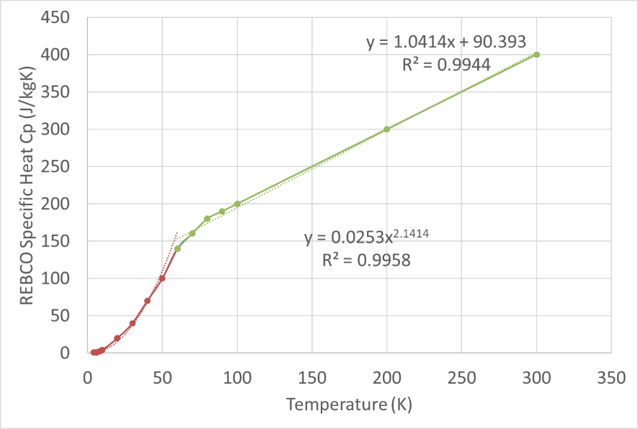
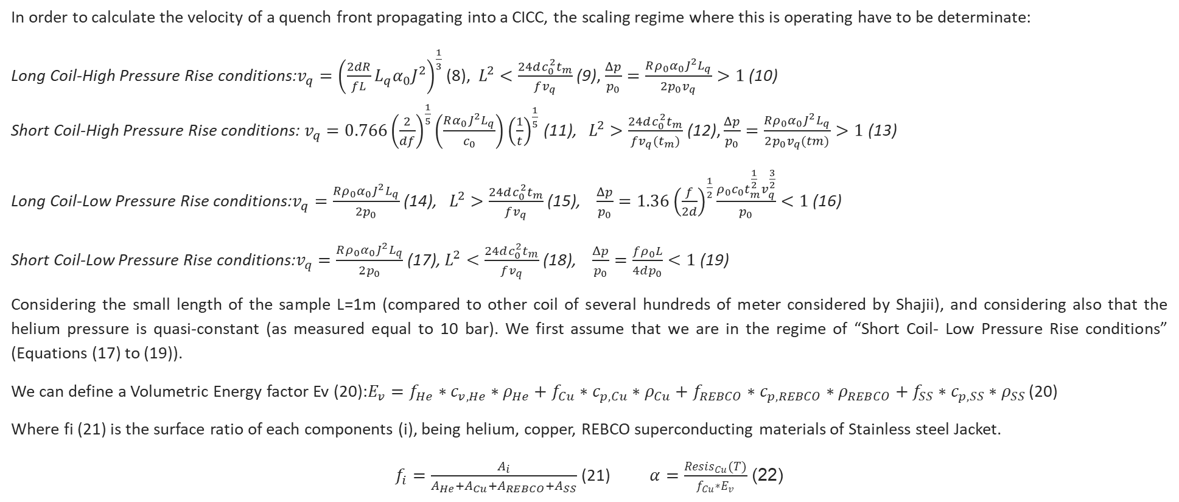
2.2 Shajii-Freidberg HTS Hydraulical QPV
In order to calculate the velocity of a quench front propagating into a CICC, the scaling regime where this is operating have to be determinate:
Long Coil-High Pressure Rise conditions:$v_{q}={\left(\frac{2dR}{fL}L_{q}α_{0}J^{2}\right)}^{\frac{1}{3}}$ (8), $L^{2}<\frac{24dc_{0}^{2}t_{m}}{fv_{q}}$ (9), $\frac{Δp}{p_{0}}=\frac{Rρ_{0}α_{0}J^{2}L_{q}}{2p_{0}v_{q}}>1$ (10)
Short Coil-High Pressure Rise conditions:$v_{q}=0.766{\left(\frac{2}{df}\right)}^{\frac{1}{5}}\left(\frac{Rα_{0}J^{2}L_{q}}{c_{0}}\right){\left(\frac{1}{t}\right)}^{\frac{1}{5}}$ (11), $L^{2}>\frac{24dc_{0}^{2}t_{m}}{fv_{q}(t_{m})}$ (12), $\frac{Δp}{p_{0}}=\frac{Rρ_{0}α_{0}J^{2}L_{q}}{2p_{0}v_{q}(tm)}>1$ (13)
Long Coil-Low Pressure Rise conditions:$v_{q}=\frac{Rρ_{0}α_{0}J^{2}L_{q}}{2p_{0}}$ (14), $L^{2}>\frac{24dc_{0}^{2}t_{m}}{fv_{q}}$ (15), $\frac{Δp}{p_{0}}=1.36{\left(\frac{f}{2d}\right)}^{\frac{1}{2}}\frac{ρ_{0}c_{0}t_{m}^{\frac{1}{2}}v_{q}^{\frac{3}{2}}}{p_{0}}<1$ (16)
Short Coil-Low Pressure Rise conditions:$v_{q}=\frac{Rρ_{0}α_{0}J^{2}L_{q}}{2p_{0}}$ (17), $L^{2}<\frac{24dc_{0}^{2}t_{m}}{fv_{q}}$ (18), $\frac{Δp}{p_{0}}=\frac{fρ_{0}L}{4dp_{0}}<1$ (19)
Considering the small length of the sample L=1m (compared to other coil of several hundreds of meter considered by Shajii), and considering also that the helium pressure is quasi-constant (as measured equal to 10 bar). We first assume that we are in the regime of “Short Coil- Low Pressure Rise conditions” (Equations (17) to (19)).
We can define a Volumetric Energy factor Ev (20):$E_{v}=f_{He}∗c_{v,He}∗ρ_{He}+f_{Cu}∗c_{p,Cu}∗ρ_{Cu}+f_{REBCO}∗c_{p,REBCO}∗ρ_{REBCO}+f_{SS}∗c_{p,SS}∗ρ_{SS}$ (20)
Where fi (21) is the surface ratio of each components (i), being helium, copper, REBCO superconducting materials of Stainless steel Jacket.
$f_{i}=\frac{A_{i}}{A_{He}+A_{Cu}+A_{REBCO}+A_{SS}}$ (21) $α=\frac{{Resis}_{Cu}(T)}{f_{Cu}∗E_{v}}$ (22)

Slide 8
2.3 Non Adiabatic Hot Spot Model: Electrical
& Hydraulical QPV
Lquenched(n+1)=Lquenched(n)+(2* QPVelec*dt);
Lhydrau(n+1)=Lhydrau(n)+ (2*QPVhydrau*dt);
dEJ(n)=(ResisCu(n)*Lquenched(n)/ACu)*current(n)^2*dt;
dEJADIAB(n)=(ResisCuADIAB(n)*Lquenched(n)/ACu)*current(n)^2*dt;
R(n)=(ResisCu(n)*Lquenched(n)/ACu);
RADIAB(n)=(ResisCuADIAB(n)*Lquenched(n)/ACu);
U(n)=R(n)*current(n);
UADIAB(n)=RADIAB(n)*current(n);
UHFZ(n)=(ResisCu(n)*LHFZ/ACu)*current(n);
UHFZADIAB(n)=(ResisCuADIAB(n)*LHFZ/ACu)*current(n);
Tcomp(n+1)=Tcomp(n)+((dEJ(n)-EconvHe(n))/(Lquenched(n)*(ACu*RhoCu*CpCu(n)+ASC*RhoSC*CpSC(n))));
TCuADIAB(n+1)=TCuADIAB(n)+((dEJADIAB(n))/(Lquenched(n)*(ACu*RhoCu*CpCuADIAB(n))));
THe(n+1)=THe(n)+(dEconvHe(n)-dEconvJA(n))/(Lhydrau(n)*AHe*RhoHe(n)*CvHe(n));
TJA(n+1)=TJA(n)+(dEconvJA(n)/(Lhydrau(n)*AJA*RhoJA*CpJA(n)));
Electrical Quench Propagation Velocity QPVelec
Calculation of Resistance, Voltage, EJ in Stabilizer (Copper)
Hydraulical Quench Propagation Velocity QPV hydrau
Calculation of Helium and Jacket Temperature with the convective heat transfer coefficient and Energy

Slide 9
HTS Conductors Quench Experiments: Hot Spot Results
3

Slide 10
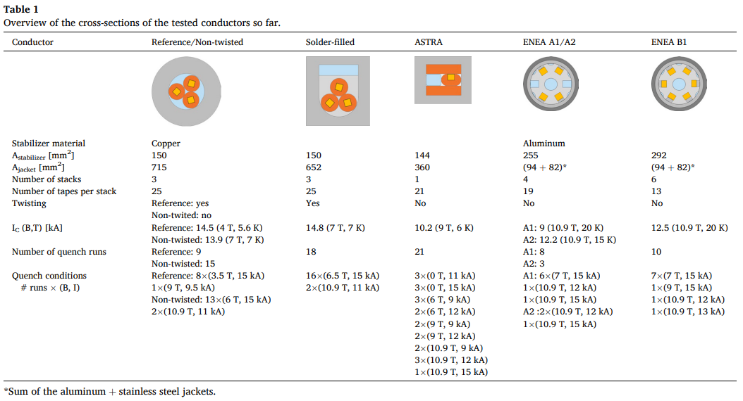
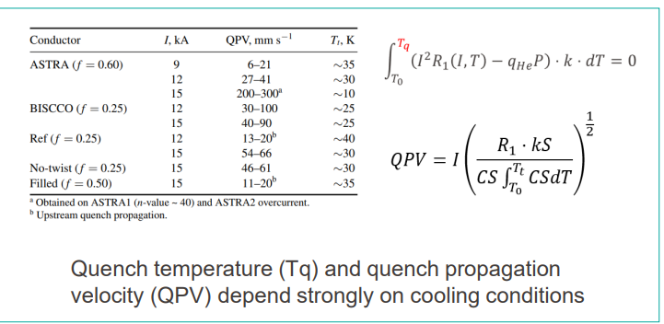
3.1 HTS Tests of High Current Conductors
Seven different high current conductors for fusion applications, made of High Temperature Superconducting stacked tapes, have been successfully tested in the Quench Experiment campaign supported by EUROfusion and carried out in SULTAN. The aim of this extensive experimental campaign is to explore the quench initiation and propagation in different conditions as well as different conductor design.
F fraction of Jacke 0.12 to 0.25 0.5 0.55 0.3 0.3
QPV (m/s) 0.058 0.013 0.034 0.026 0.018
A. Zappatore, H. Bajas, N. Bykovskiy, P. Bruzzone, G. Celentano, G. Colombo, J. Greenwood, A. Masi, K. Sedlak, D. Uglietti, V. Corato, DC and quench performance assessment from the EUROfusion HTS Quench Experiment campaign and projection to magnet operation, Cryogenics, Volume 150, 15 September 2025, 104158, https://doi.org/10.1016/j.cryogenics.2025.104158

Slide 11





3.2 HTS Conductors Quench Experiments
Conductor | Reference/ Non-twisted | Solder-filled | ASTRA | ENEA A1/A2 | ENEA B1
Ic (B, T) (kA) | Reference: 14.5 (4T, 5.6K) Non-twisted: 13.9 (7T,7K) | 14.8 (7T,7K) | 10.2 (9T,6K) | A1: 9 (10.9T, 20K) A2: 12.2 (10.9T,15K) | 12.5 (10.9T,20K)
Quench runs Number | Reference : 9 Non-twisted: 15 | 18 | 21 | A1: 8 A2: 3 | 10
Quench @9kA | Reference: 1 (9T, 9.5 kA) |  | 3(6T,9kA) 2(9T,9kA) 2(10.9T,9kA)
QPV@9 kA Tq (mm/s) |  |  | 6 – 21 (35K)
Quench @11kA | Non-Twisted: 2 (10.9T, 11kA) | 2(10.9T,11kA) | 3(0T,11kA)
QPV@11kA, Tq (mm/s)
Quench @12kA | 12 kA |  | 2(6T, 12kA) 2(9T,12kA) 3(10.9T,12kA) | A1: 1(10.9T,12kA) A2: 2(10.9T,12kA) | 1(10.9T,12kA)
QPV @ 12 kA (mm/s) | 13-20 (40K) |  | 27-41 (30K)
Quench @13kA |  |  |  |  | 1(10.9T,13kA)
QPV@13kA
Quench @15kA | Reference: 8 (3.5T, 15 kA) Non-twisted: 13 (6T, 15 kA) | 16 (6.5T, 15kA) | 3(0T,15kA) 1(10.9T,15kA) | A1: 6(7T,15kA) A1: 1(10.9T,15kA) A2: 1(10.9T,15kA) | 7(7T,15kA) 1(9T,15kA)
QPV @15 kA (mm/s) | Ref:54-66 (30K) NT:46-61(30K) | 11-20(35K) | 200-300 (10K)
QPV (mm/s) | 55 | 13 | 34 | 26 | 18 to 24
F Jacket | 0.12 | 0.5 | 0.55 | 0.3 | 0.3
F Jacket (TBC) | 0.25 TBC | 0.5 TBC | 0.6 TBC
Maximum Hot Spot Temperature (K) [SPC] | Ref: 220 NT: 260 | 170 | 300 | A1: 200
Conductor | Reference/ Non-twisted | Solder-filled | ASTRA | ENEA A1/A2 | ENEA B1
Conductor Diam.(mm) | 35.3 | 30.35
Cable Diameter (mm) | 18.3 | 18.3
Strand diameter (mm) | 8.5 | 8.5
Stabilizer material | Copper | Copper | Copper | Aluminium | Aluminium
A stabilizer (mm²) | 150 | 150 | 144 | 255 | 292
Cu/NonCu Ratio | 4 | 4
A Jacket (mm²) | 715 | 652 | 360 | (94 + 82)ª | (94 + 82)ª
Width of tapes (mm) | 3 | 3 | 3.3
Number of stacks | 3 | 3 | 1 | 4 | 6
Number of tapes per stack | 25 | 25 | 21 | 19 | 13
Superconductors cable section (mm²) | 16.88 | 16.88
Helium Section (mm²) | 93 | 93
Helium wetted perimeter (mm) | 137 | 47
Hydraulical diameter (mm) | 2.715 | 7.915
Twisting | Reference: Yes Non-twisted:No | Yes | No | No | No
a Sum of the aluminium + stainless steel Jacket

Slide 12
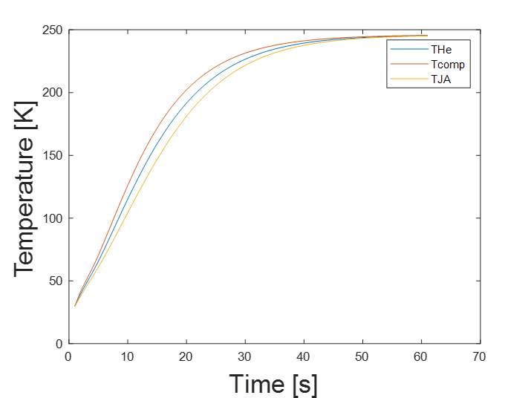
3.3 HTS Conductors Q.E.: Reference & Non-Twisted
REFERENCE, Quench conditions: 3T,15kA, F Jacket: 0.12
QPV@15 kA [SPC] (mm/s): Ref:54-66 (30K)
Ref : QPVelec=0.054 m/s, QPVhydrau=0.036 m/s
T Hot spot= 220 K, QPV hydrau, max= 0.06m/s
NON-TWISTED: Quench conditions: 6T,15 kA, F Jacket=0.12
QPV@15 kA [SPC] (mm/s): NT:46-61(30K)
QPVelec=0.061 m/s, QPVhydrau=0.036 m/s
T hot spot= 250 K, QPV hydrau, max= 0.06m/s

Slide 13
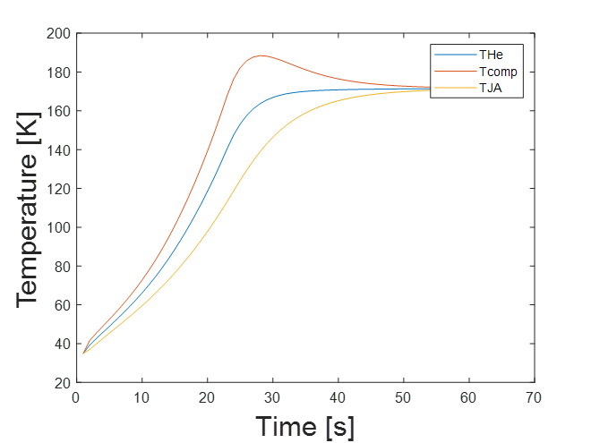
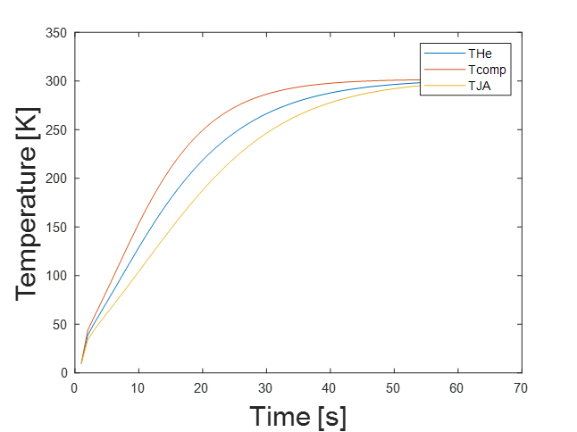
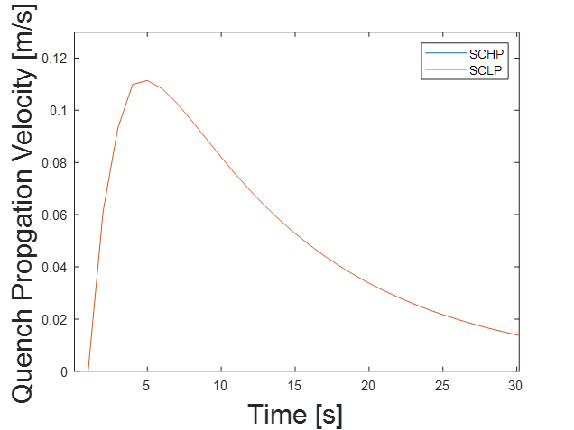
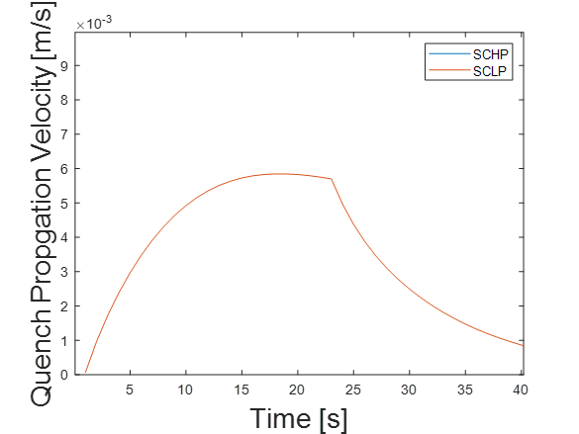
3.4 HTS Conductors Q. E.: Solder Filled & ASTRA
SOLDER-FILLED: Quench conditions: 6.5T, 15 kA, F Jacket = 0.5
QPV@15 kA [SPC] (mm/s): 11-20(35K)
QPVelec=0.008 m/s, QPVhydrau=0.016 m/s
T Hot Spot= 170 K, QPV hydrau, max= 0.006m/s
ASTRA: Quench conditions: 10.9T, 15 kA, F Jacket= 0.55
QPV@15 kA [SPC] (mm/s): 200-300 (10K)
QPVelec=0.300, QPVhydrau=0.036
T hot spot= 300 K, QPV hydrau, max= 0.11 m/s

Slide 14
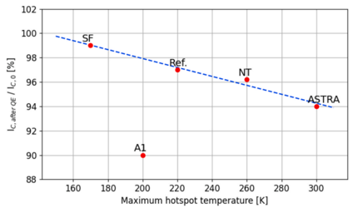
3.5 HTS Conductors Q.E.: Maximal Hot Spot Temperature
Conductor | Reference/ | Non-twisted | Solder-filled | ASTRA
QPV@15 kA [SPC] (mm/s) | Ref:54-66 (30K) | NT:46-61(30K) | 11-20(35K) | 200-300 (10K)
 | 3T,15kA | 6T,15 kA | 6.5T, 15 kA | 10.9T, 15 kA
F Jacket | 0.12 | 0.12 | 0.5 | 0.55
Hconv=HconvJA | 2000 W/m²K | 2000 W/m²K | 2000 W/m²K | 2000 W/m²K
 | Ref : QPVelec=0.054; QPVhydrau=0.036 | QPVelec=0.061 QPVhydrau=0.036 | QPVelec=0.008 QPVhydrau=0.016 | QPVelec=0.300 QPVhydrau=0.036
Thot Spot (K) | 220 | 250 | 170 K | 300 K
QPVhydrau,max | 0.06m/s | 0.06m/s | 0.006m/s | 0.11 m/s
A. Zappatore, H. Bajas, N. Bykovskiy, P. Bruzzone, G. Celentano, G. Colombo, J. Greenwood, A. Masi, K. Sedlak, D. Uglietti, V. Corato, DC and quench performance assessment from the EUROfusion HTS Quench Experiment campaign and projection to magnet operation, Cryogenics, Volume 150, 15 September 2025, 104158, https://doi.org/10.1016/j.cryogenics.2025.104158

Slide 15
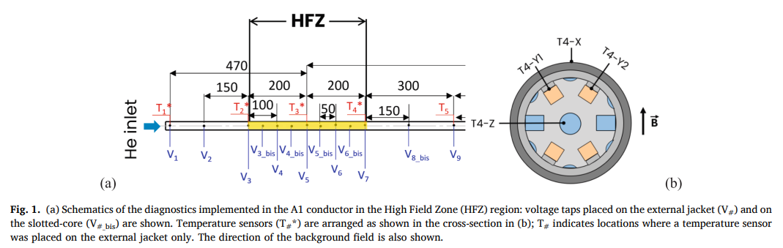
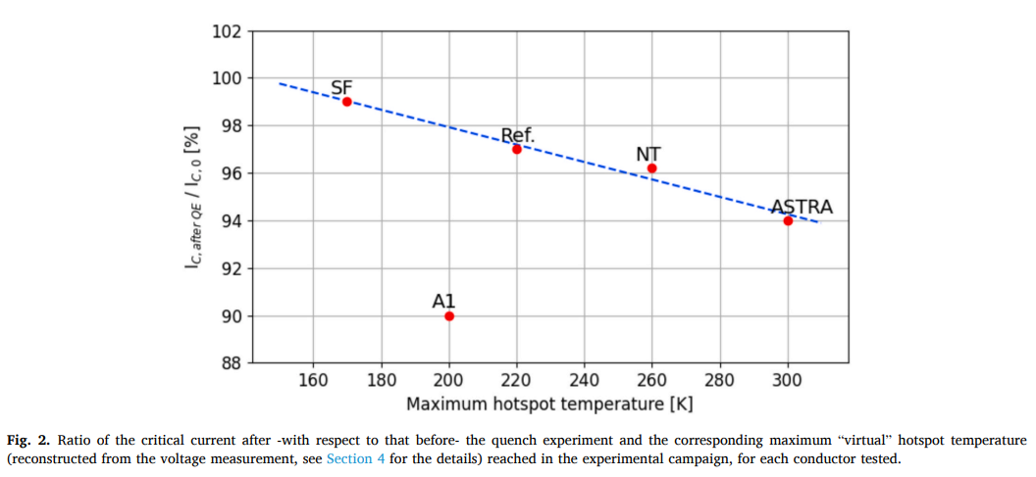
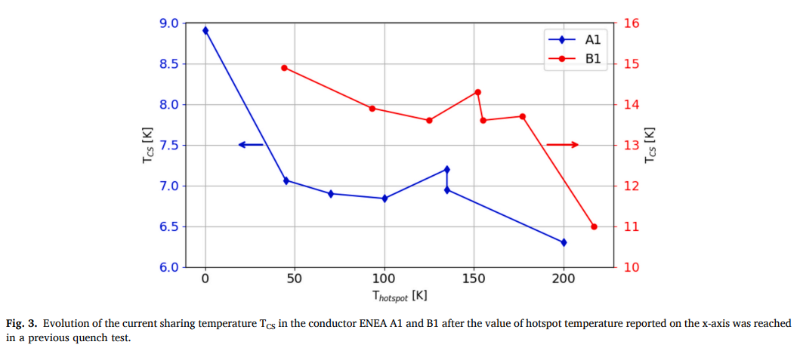
1. MAG-S.01.03-T028-D001/02
The measurements show that there is a common behaviour to all layouts, i.e., the DC performance of such conductors have degraded after the quench test campaign, and more systematic DC experiments showed that it is likely that a temperature peak beyond 150 K on the stack may lead to the degradation. This allowed identifying a reference threshold for the safe operation in a real magnet.
→ Through a simple analytical model, based on the assumption of adiabatic quench propagation, the projection to the expected performance in the magnet configuration is carried out, focusing on the maximum hotspot temperature reached, depending on the layout.
→ It is shown that conductors with a larger effective heat capacity, although having a smaller quench propagation velocity, end up having lower hotspot temperature.
A. Zappatore, H. Bajas, N. Bykovskiy, P. Bruzzone, G. Celentano, G. Colombo, J. Greenwood, A. Masi, K. Sedlak, D. Uglietti, V. Corato, DC and quench performance assessment from the EUROfusion HTS Quench Experiment campaign and projection to magnet operation, Cryogenics, Volume 150, 15 September 2025, 104158, https://doi.org/10.1016/j.cryogenics.2025.104158

Slide 16
MAG-S.01.03-T028-D001 Conclusion & TH Studies Challenges
4

Slide 17
4. Coordination of Thermal-Hydraulics and Cryogenics 2025, MAG-S.01.03-T028-D001
Through a simple analytical model, based on the assumption of adiabatic quench propagation, the projection to the expected performance in the magnet configuration is carried out, focusing on the maximum hotspot temperature reached.
It is shown that conductors with a larger effective heat capacity, although having a smaller quench propagation velocity, end up having lower hotspot temperature.
the DC performance of such conductors have degraded after the quench test campaign, and more systematic DC experiments showed that it is likely that a temperature peak beyond 150 K on the stack may lead to the degradation.
Some Hydraulical Quench Propagation Velocities with Shajii-Freidberg Short Coil Low Pressure have been determined from models: they agree well with the average input parameters, thus confirming these values
Through a Simple non-adiabatic analytical model [CEA] with the electrical QPV [Polito-SPC-ENEA] & hydraulical QPV [Shajii-Freidberg]: the results of this model is in good agreement with the maximal observed hot spot temperature during Quench Experiments in SULTAN (HTS Conductors: Reference, Non-Twisted, Solder-Filled ASTRA)
Some improvement of non-adiabatic model are needed for ENEA A1/A2/B1 Conductors (with Aluminium Stabilizer)
Correlation has to be find between QPV electrical, and QPV Hydraulical, mainly depending of cooling channels & cooling capacities (Helium A, Dh, Pw, Hconv, Tin, Pin) and heat capacities of Jacket
The Idea here was to confirm the different models, in order to validate the maximal hot spot temperature reached in SULTAN Quench Experiement (Q.E. with helium) and then to be able to extrapolate to HTS DEMO Coils Quench
The Hot Spot Criteria of 150 K could be retained for the moment (with degradation for greater temperature), but should be confirmed with other HTS conductors Q.E.
Some Further calculations & Results are foreseen for real EU-DEMO CS Coils with these potential HTS Conductors (with current, magnetic field, quench temperature, helium pressure as parameters, and assumed identical QPV) → MAG-S.01.03-T028-D002

Slide 18
Merci
IRFM/STEP/GAIM
S. Nicollet
Sylvie.Nicollet@cea.fr
Bld 513
0442254979

