Slide 1

Mechanical analysis of the 2024 CS coil designs (SPC variant)
J. Greenwood
15.01.2026
MAG-S.01.04-T021-D001

Slide 2
Outline
Mechanical analyses to support SPC’s CS design for LAR-DEMO:
Crack growth studies
2D winding pack analysis
2D precompression structure analysis

Slide 3
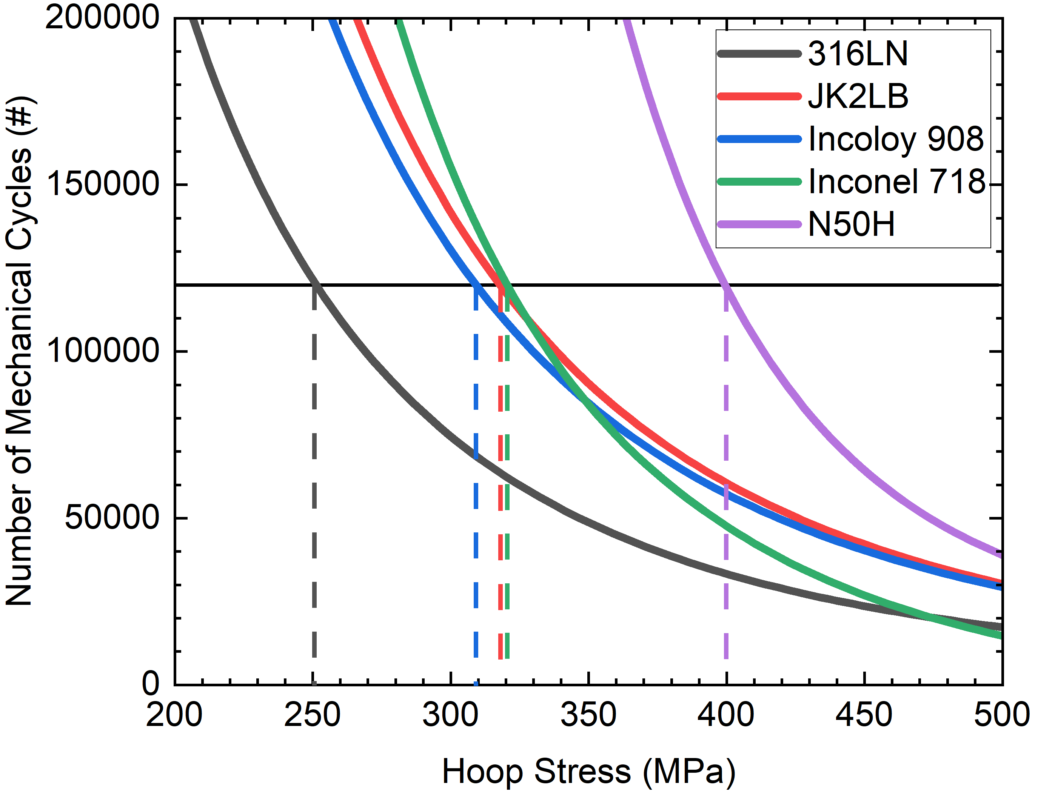
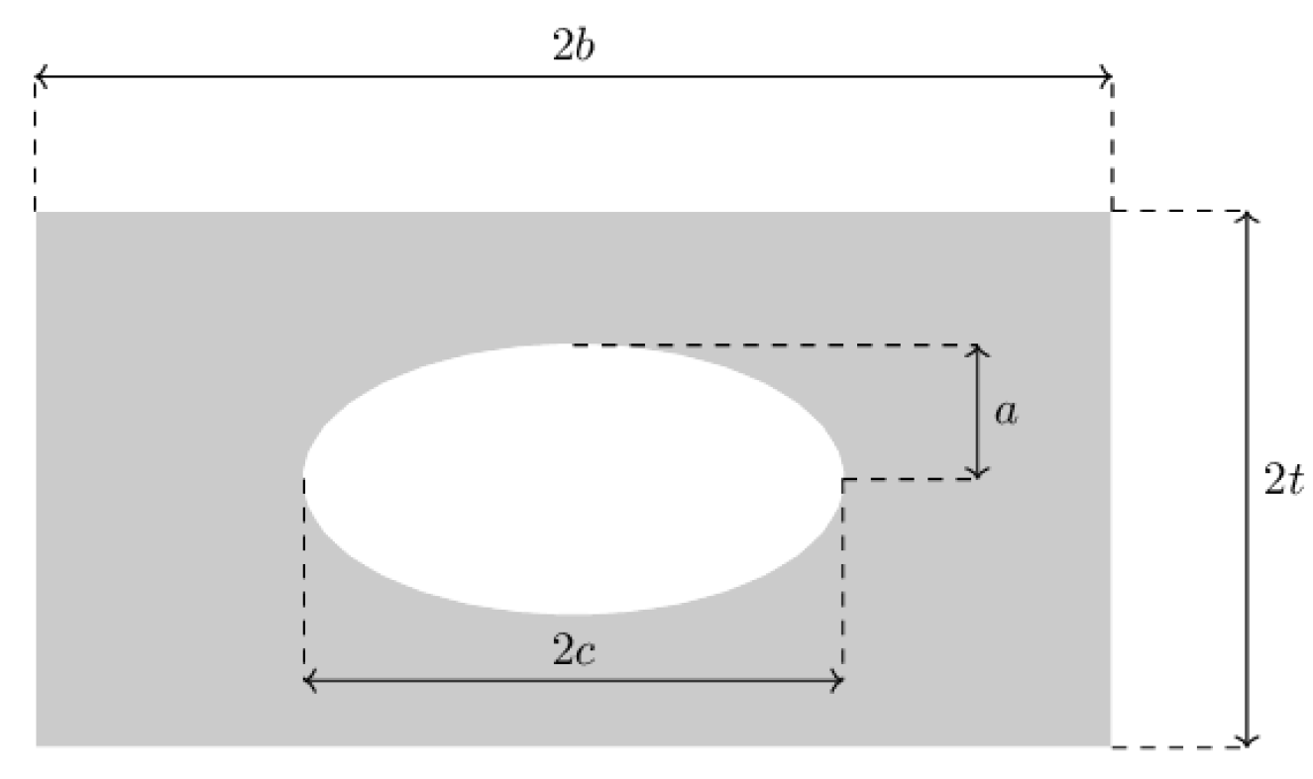
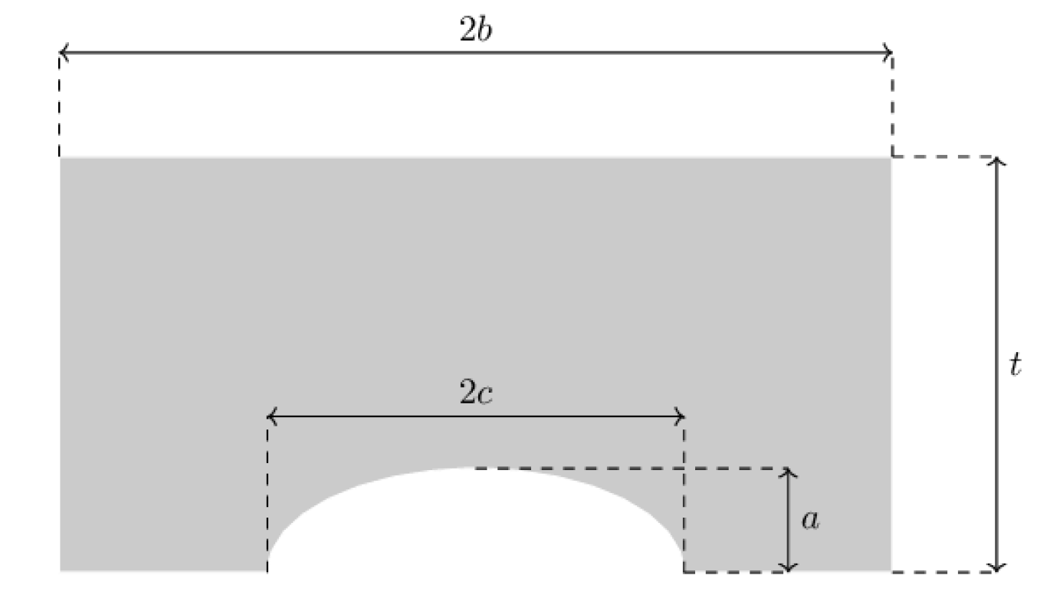
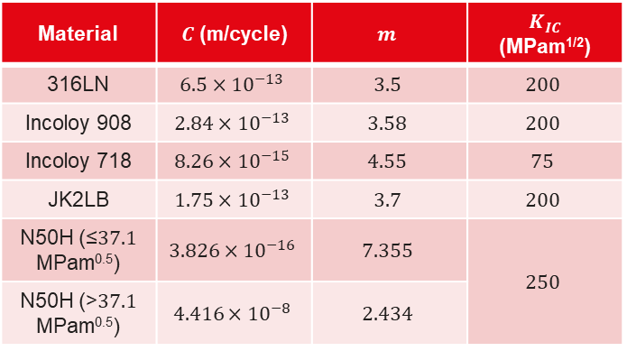
FCGR Studies
Material | $C$ (m/cycle) | $$m$$ | $K_{IC}$ (MPam^{1/2})
316LN | $$6.5×{10}^{−13}$$ | $$3.5$$ | $$200$$
Incoloy 908 | $$2.84×{10}^{−13}$$ | $$3.58$$ | $$200$$
Incoloy 718 | $$8.26×{10}^{−15}$$ | $$4.55$$ | $$75$$
JK2LB | $$1.75×{10}^{−13}$$ | $$3.7$$ | $$200$$
N50H (≤$37.1$ MPam^{0.5}) | $$3.826×{10}^{−16}$$ | $$7.355$$ | $$250$$
N50H (>$37.1$ MPam^{0.5}) | $$4.416×{10}^{−8}$$ | $$2.434$$
Cracks are iteratively grown in plates according to the Paris Law
The same safety factors and assumptions were used. No relaxation
71 mm wide plates
Residual stress 240 MPa
Initial defect size: 2 mm² (surface), 5 mm² (embedded)
2 load cycles per plasma cycle
2x number of cycles (safety factor)
2x initial area (safety factor)
…
W: 71 mm
T: 16 mm
Surface Crack
(Initial size 2mm²)

Slide 4
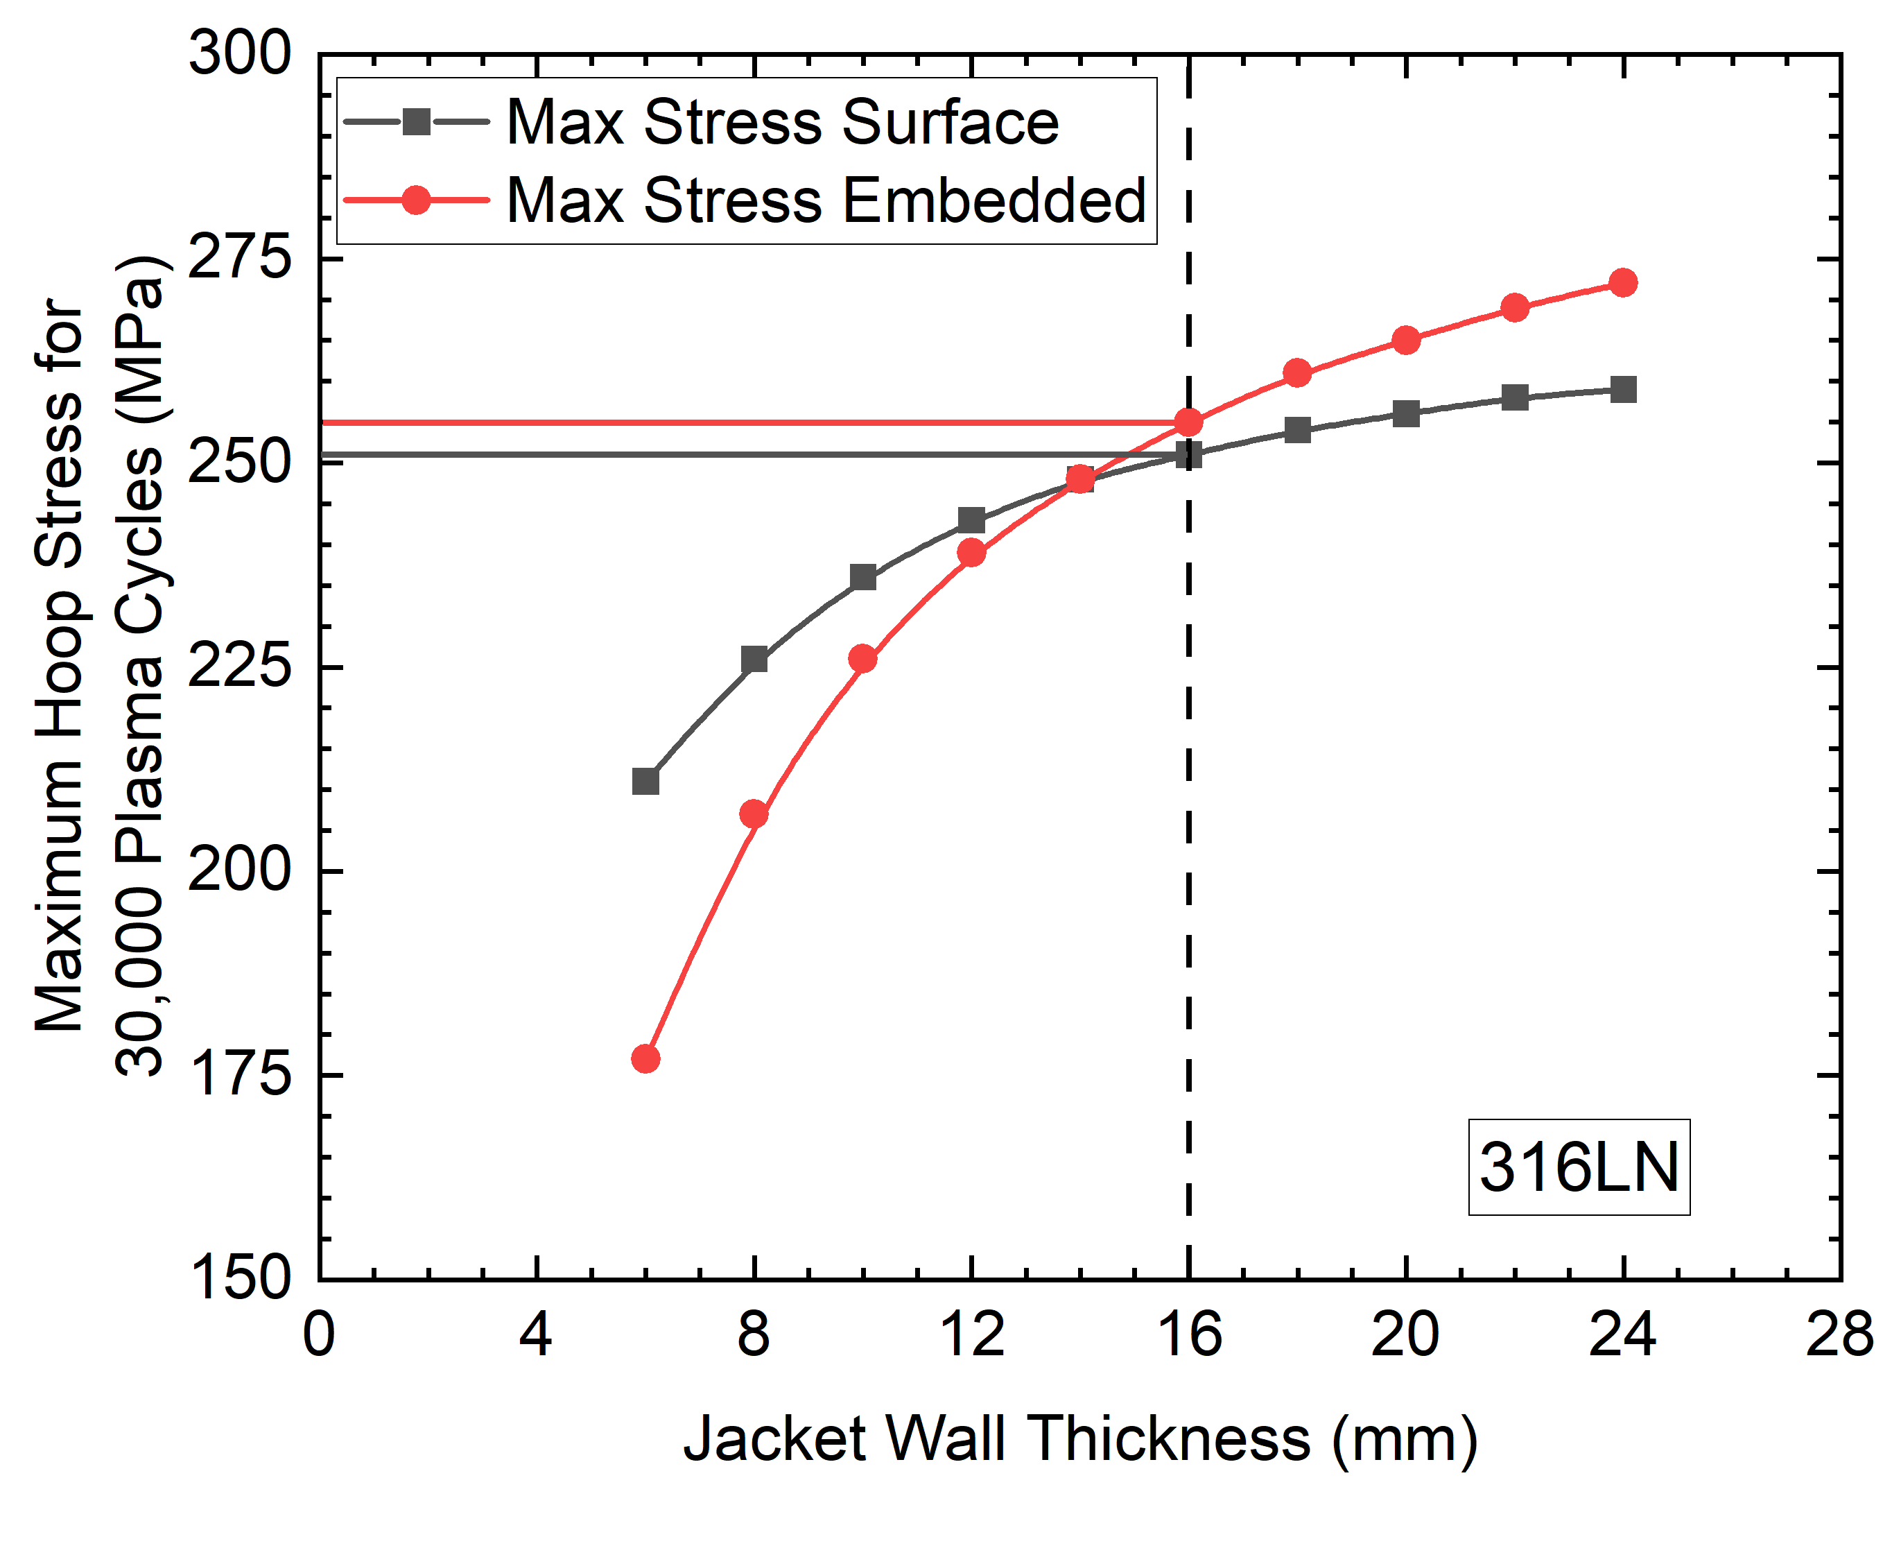
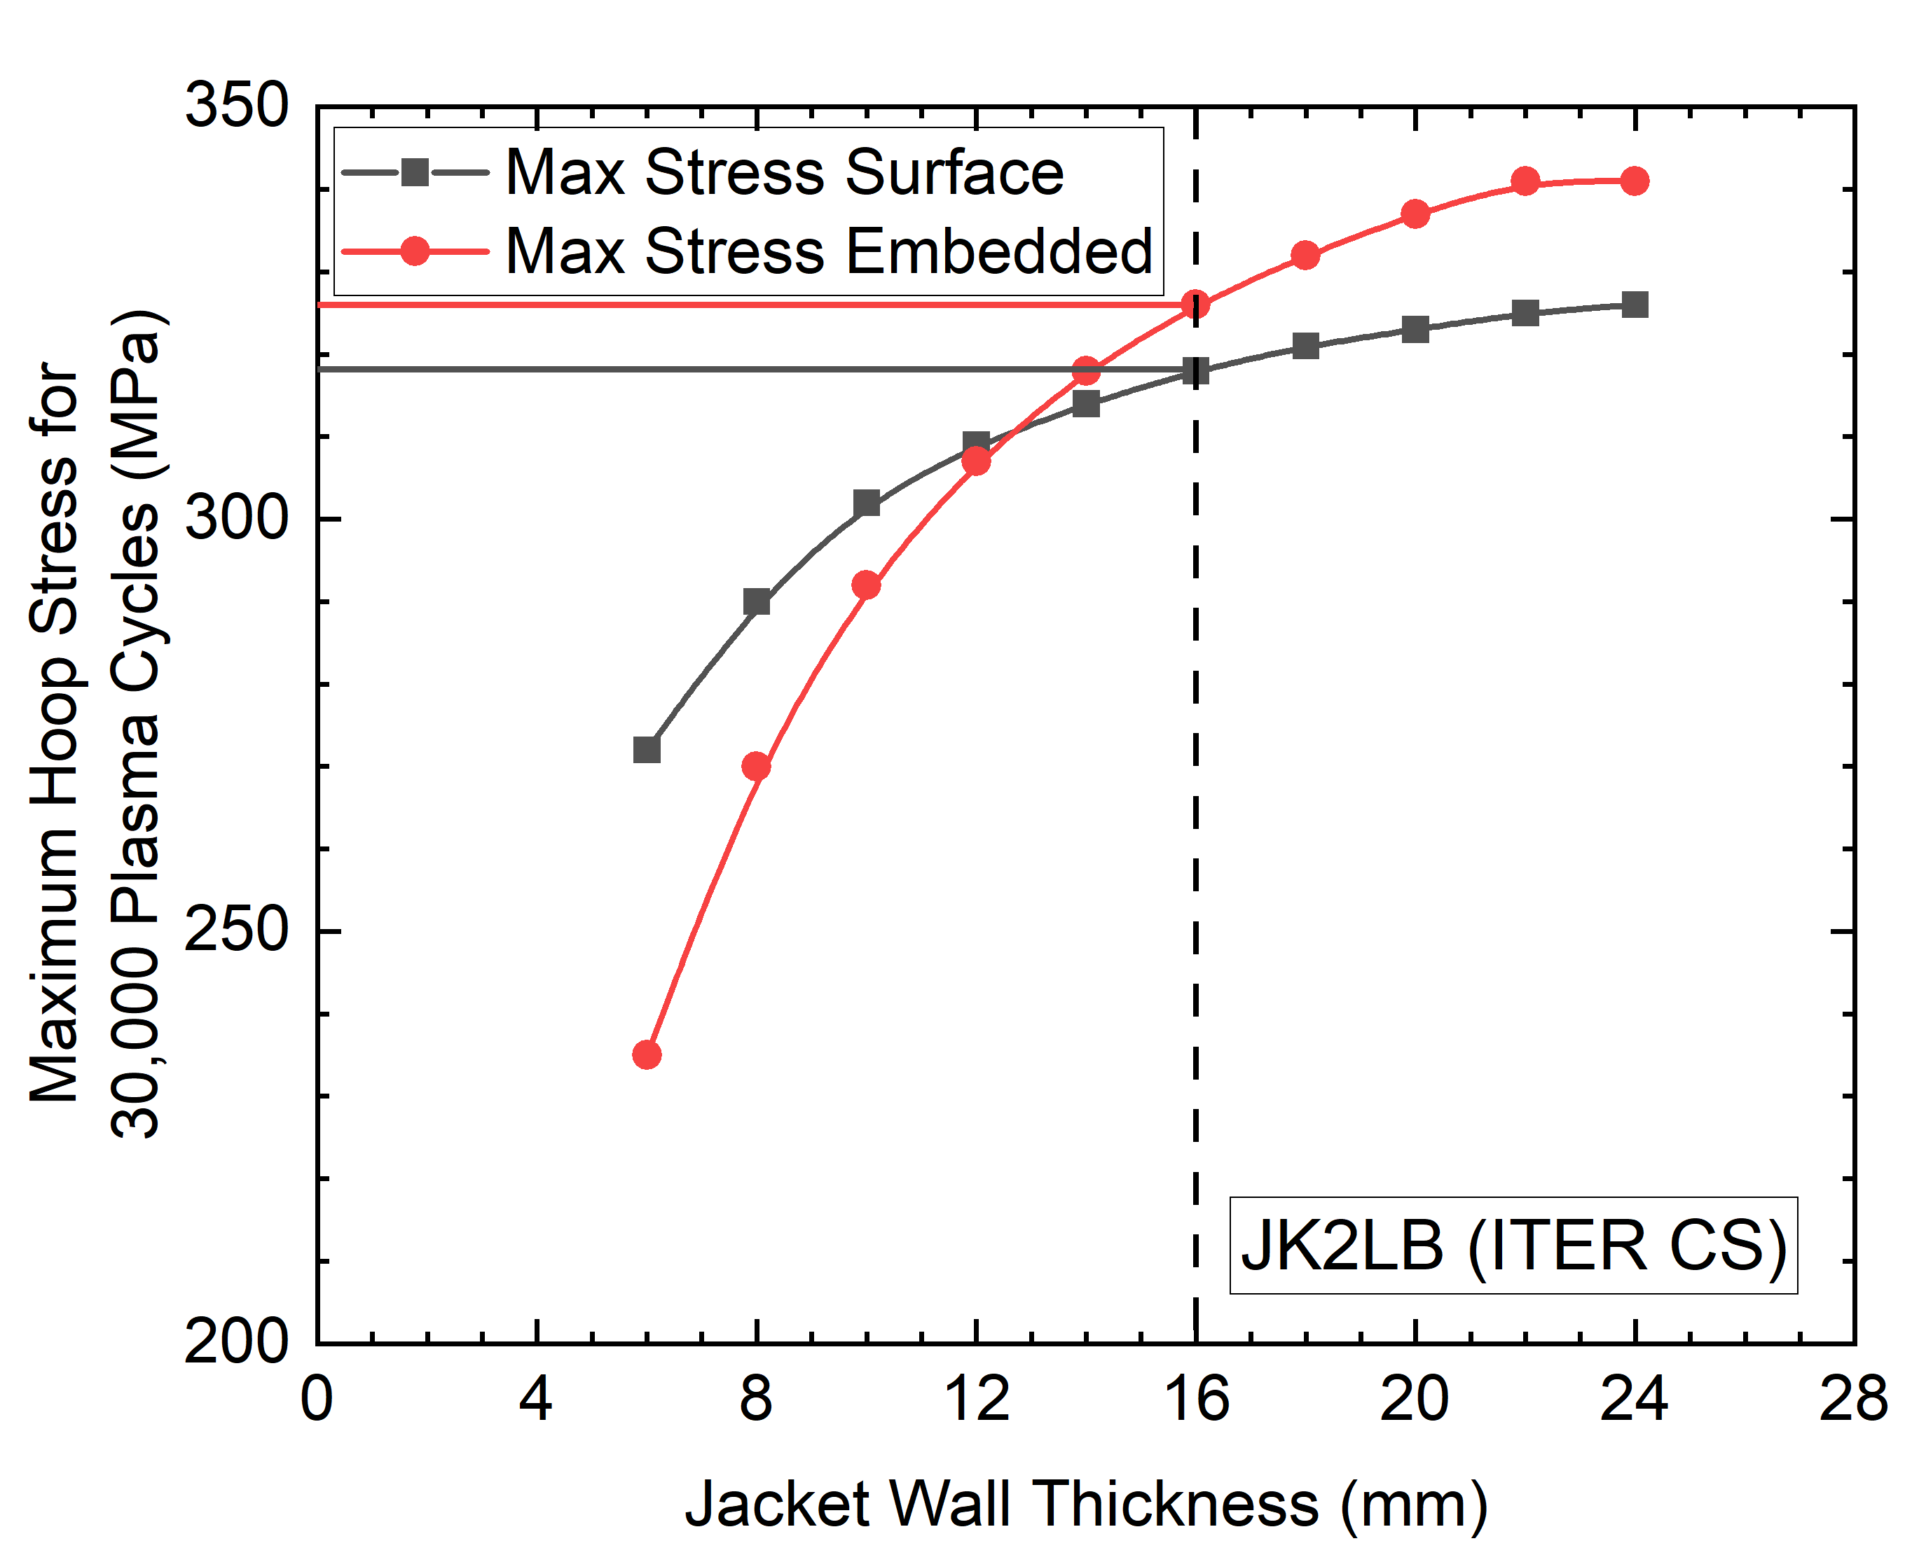
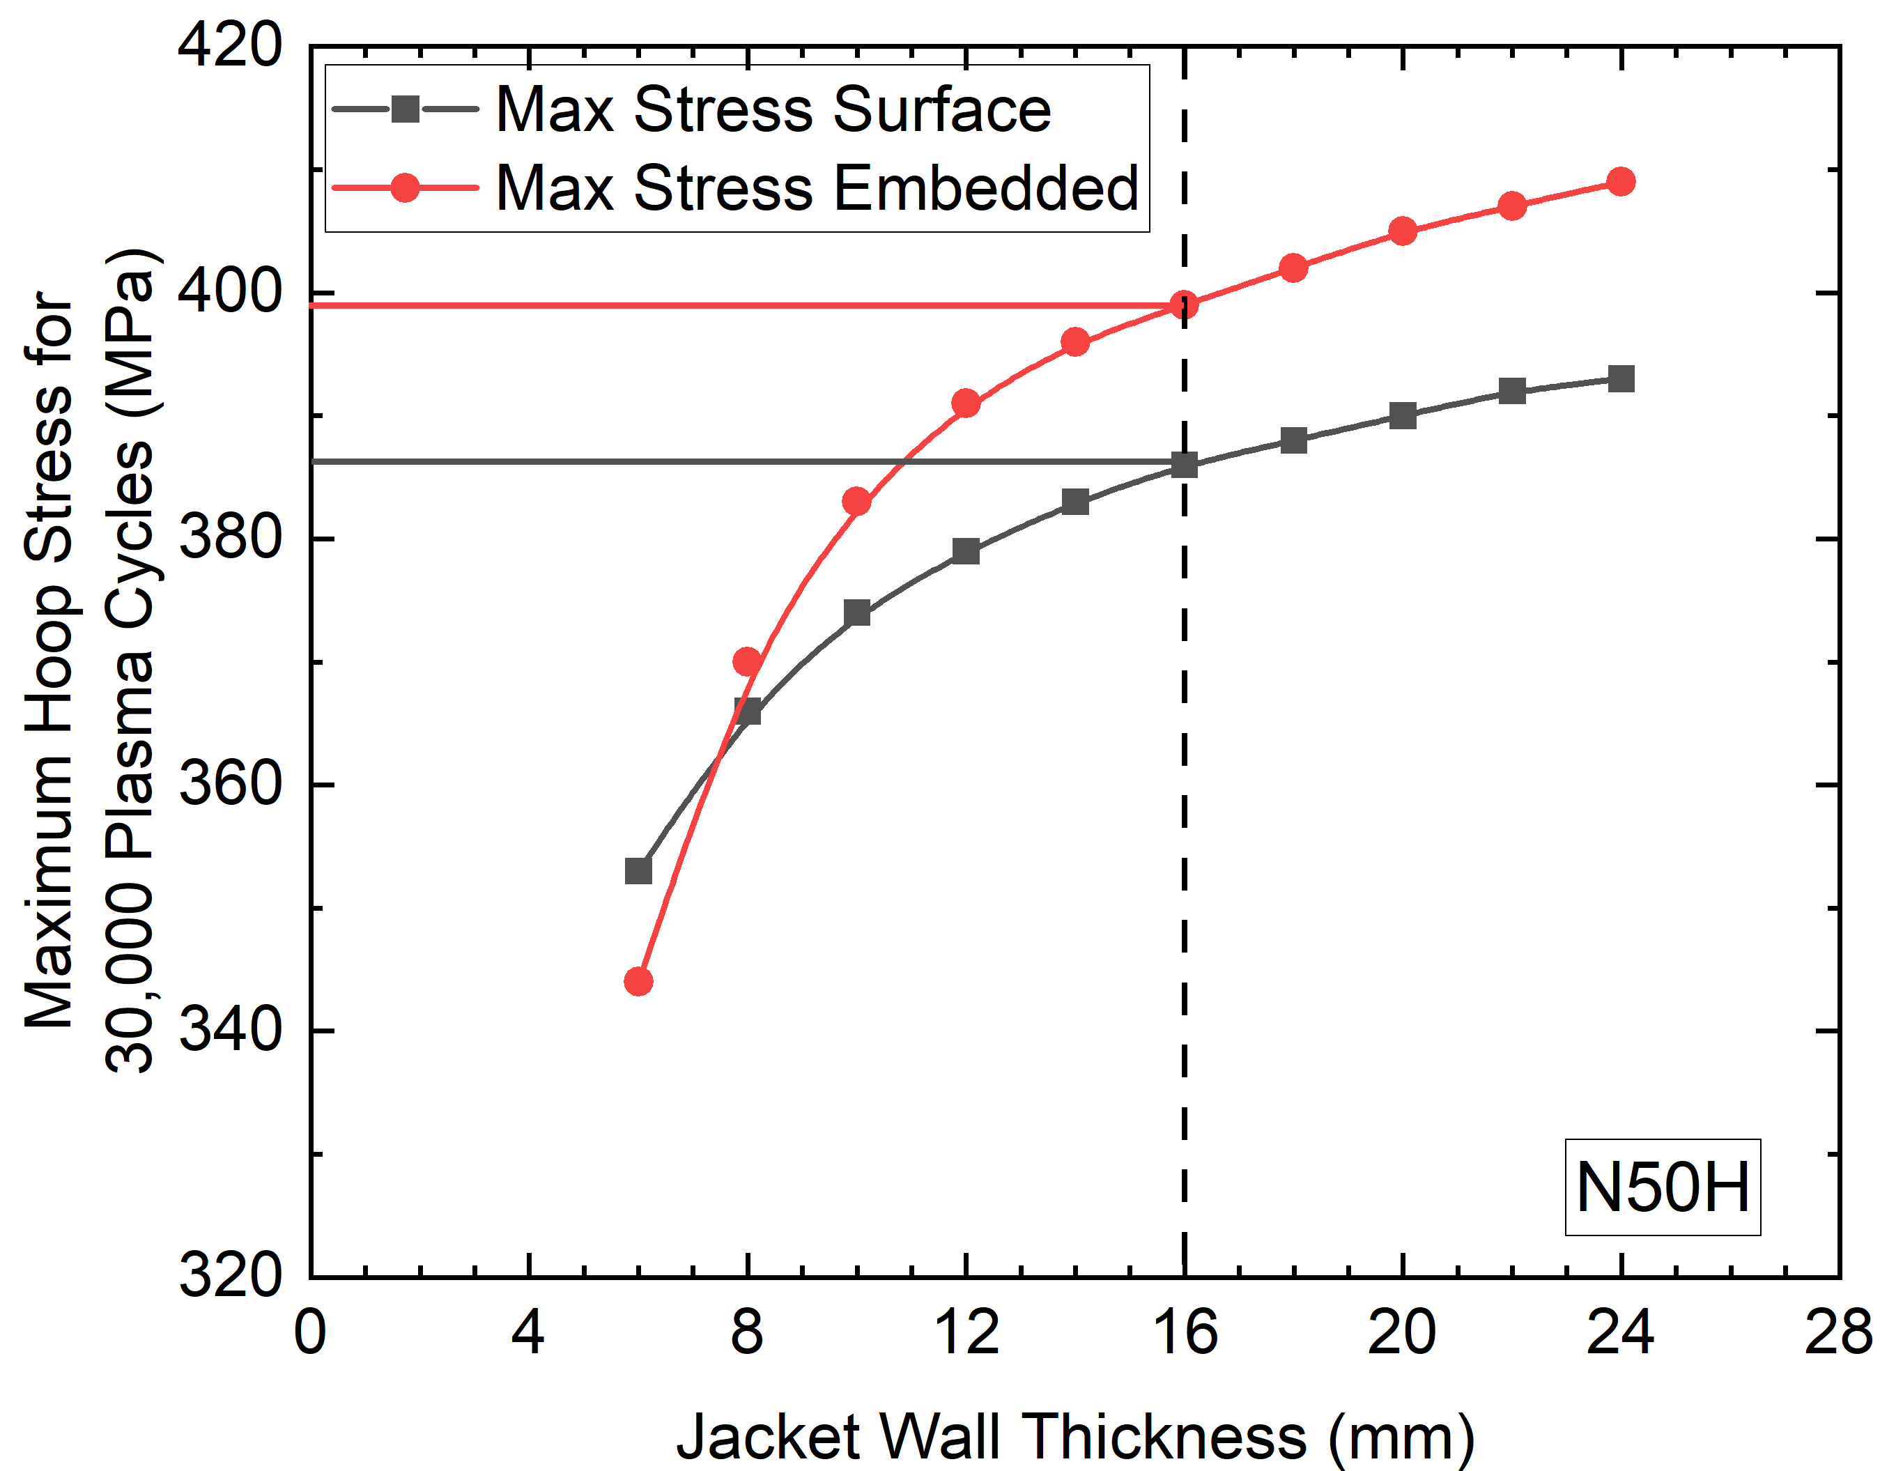
Maximum Hoop Stresses for 30,000 Plasma Cycles

Slide 5
FCGR Results & Observations
For T=16 mm, surface cracks generally lead to failure first
There is little lifetime to be gained by thickening the jacket wall beyond ~16 mm
316LN, JK2LB, and N50H were considered for SPC’s CS
Material | Maximum Hoop Stress for 30,000 Plasma Cycles
316LN | 250 MPa
JK2LB/Inconel/Incoloy | ~300 MPa
N50H | 380 MPa

Slide 6
2D Winding Pack Analysis

Slide 7
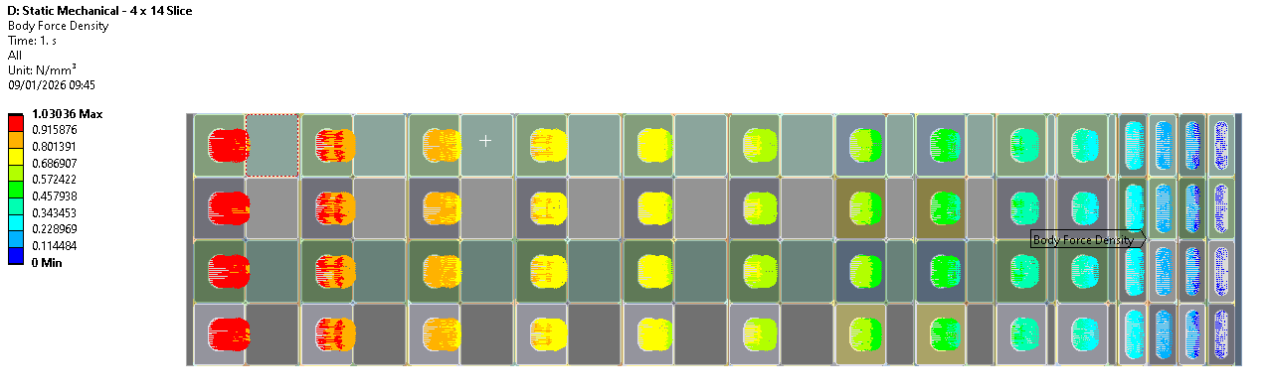
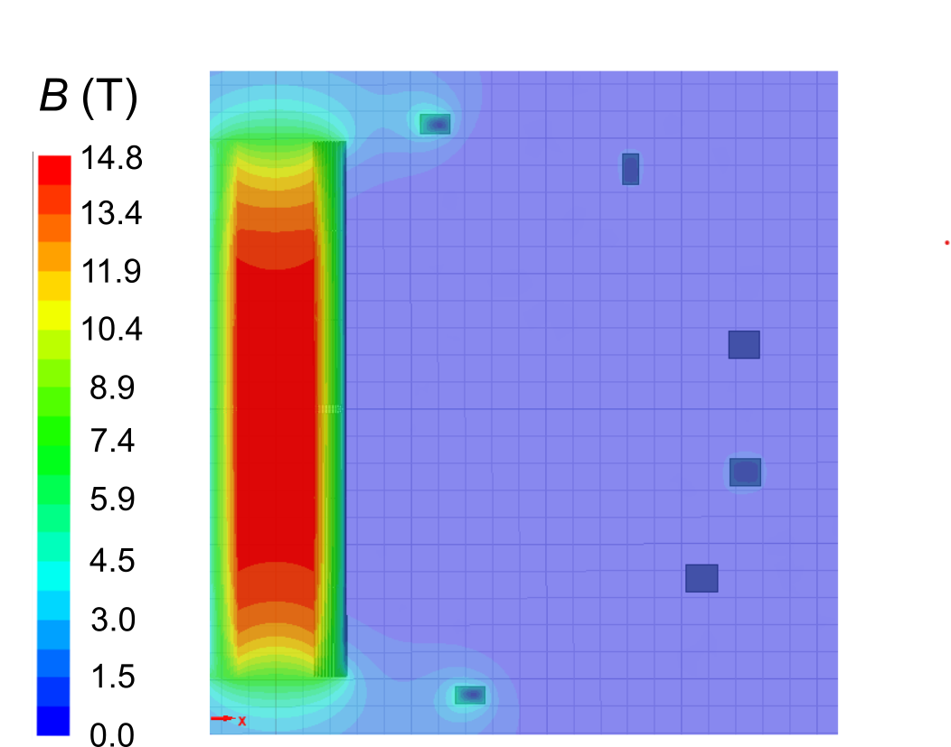
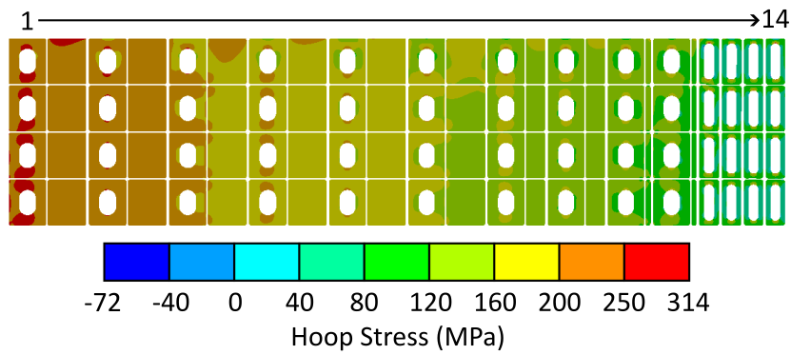
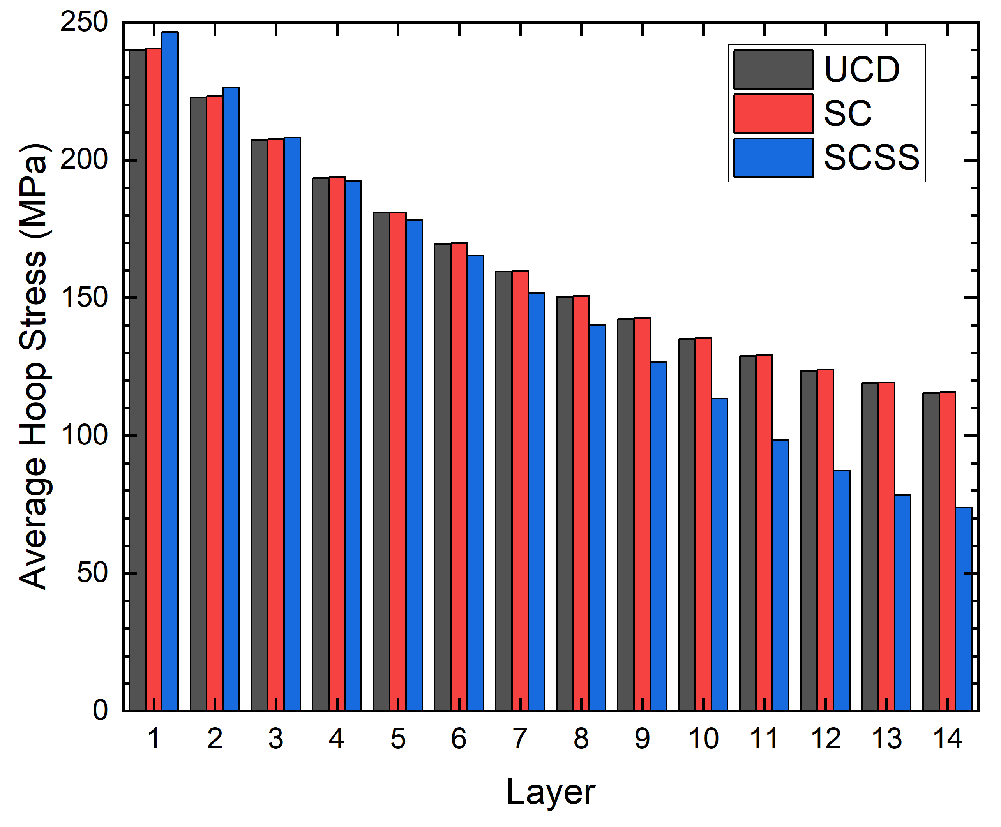
2D Winding Pack Analysis
Axisymmetric simulation; axial and radial forces are included.
Average and peak stresses are extracted for each layer.

Slide 8
Key Coil Design Parameters – 316 LN Design
Parameter | UCD | SC graded | SC + steel graded
Total current (MAt) | 76.27 | 76.27 | 76.27
Conductor current (kA) | 60.53 | 60.53 | 60.53
WP R_{i} (m) | 1.415 | 1.417 | 1.399
WP R_{o} (m) | 2.62 | 2.62 | 2.62
SC material in sub-coils (RE-123/Nb₃Sn/Nb-Ti) | 14/0/0 | 4/8/2 | 4/8/2
Peak B field (T) | 14.86 | 14.86 | 14.83
CS flux during premagnetisation (Wb) | 192.0 | 192.4 (+0.2%) | 215.0 (+12%)

Slide 9
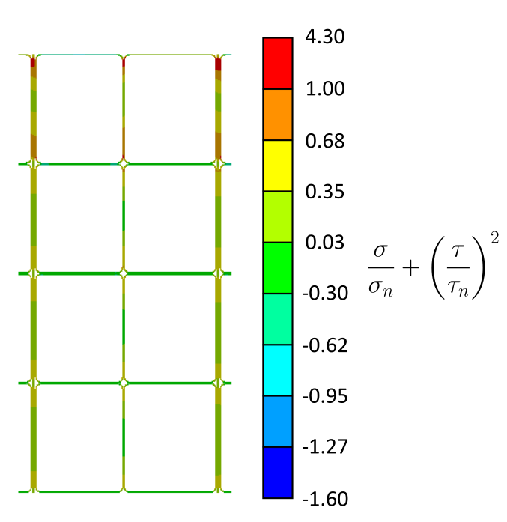
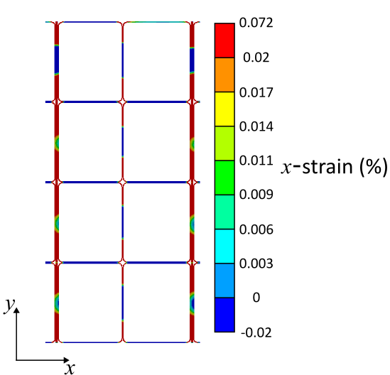
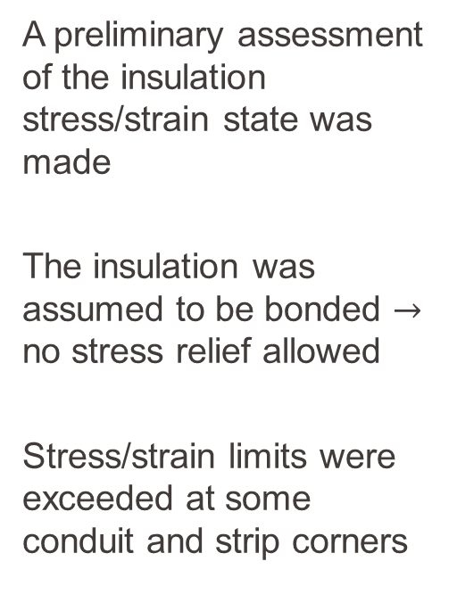
Insulation Stresses & Strains
A preliminary assessment of the insulation stress/strain state was made
The insulation was assumed to be bonded $→$ no stress relief allowed
Stress/strain limits were exceeded at some conduit and strip corners

Slide 10
Precompression Structure

Slide 11

Module Force Directions in Different Scenarios
Premagnetisation
Start of Flat Top
U3
U2
1
L2
L3

Slide 12
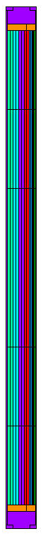
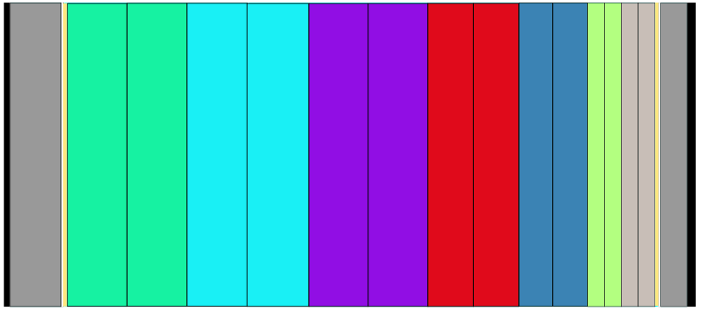
Precompression Structure
Forces calculated for SPC’s CS with 316LN jackets (215 Wb)
CSU3
 | Premag. | SOF | EOF
F_{z, CSU3} (MN) | -651.95 | -2.55 | -155.76
F_{z, CSU2} (MN) | -124.71 | 25.87 | -460.68
F_{z, CS1} (MN) | -5.55 | -5.63 | -140.92
F_{z, CSL2} (MN) | 78.96 | 130.07 | 337.85
F_{z, CSL3} (MN) | 786.10 | -156.07 | 465.75
CSU2
CS1
CSL2
Material | Radial thickness (mm)
 | Inner tie plates | Outer tie plates
Nitronic 50 | 148 | 92
316 LN | 210 | 110
Tie plates
CSL3

Slide 13
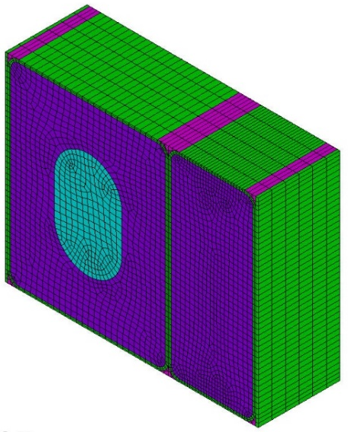
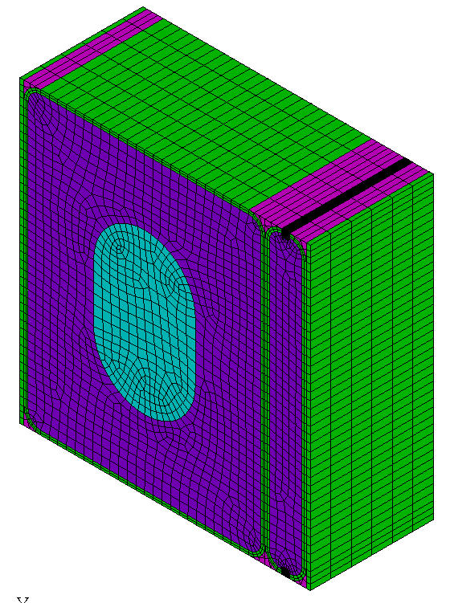
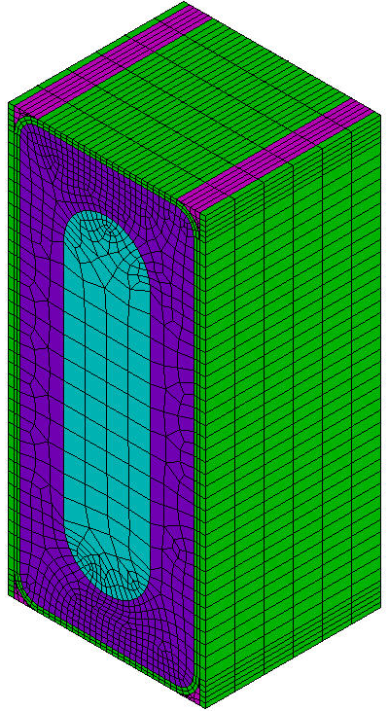
Smeared Properties
Unit cell:
1 conductor
Co-wound strip (if present)
Insulation
All components are bonded
Property | Sub-coil number
 | SC01 | SC02 | SC03 | SC04 | SC05 | SC06 | SC07
E_{x} (GPa) | 100.26 | 100.19 | 99.78 | 85.62 | 72.11 | 28.30 | 27.49
E_{y} (GPa) | 127.09 | 127.19 | 128.08 | 118.31 | 104.68 | 81.86 | 83.56
E_{z} (GPa) | 171.79 | 171.87 | 172.37 | 163.20 | 151.6 | 112.13 | 113.24
G_{xy} (GPa) | 31.36 | 31.40 | 31.49 | 27.19 | 22.68 | 6.27 | 6.29
G_{yz} (GPa) | 49.32 | 49.50 | 49.74 | 46.59 | 42.57 | 33.05 | 33.64
G_{xz} (GPa) | 40.41 | 40.32 | 40.28 | 34.80 | 29.69 | 14.87 | 14.59
ν_{xy} | 0.227 | 0.227 | 0.225 | 0.218 | 0.221 | 0.140 | 0.140
ν_{yz} | 0.1215 | 0.215 | 0.216 | 0.210 | 0.200 | 0.210 | 0.212
ν_{xz} | 0.175 | 0.175 | 0.174 | 0.159 | 0.146 | 0.0789 | 0.0761
α_{x} (1/K) | 1.10×10⁻⁵ | 1.10×10⁻⁵ | 1.10×10⁻⁵ | 1.12×10⁻⁵ | 1.15×10⁻⁵ | 1.20×10⁻⁵ | 1.20×10⁻⁵
α_{y} (1/K) | 1.06×10⁻⁵ | 1.06×10⁻⁵ | 1.06×10⁻⁵ | 1.06×10⁻⁵ | 1.05×10⁻⁵ | 1.04×10⁻⁵ | 1.04×10⁻⁵
α_{z} (1/K) | 1.01×10⁻⁵ | 1.01×10⁻⁵ | 1.01×10⁻⁵ | 1.01×10⁻⁵ | 1.00×10⁻⁵ | 9.95×10⁻⁶ | 9.94×10⁻⁶

Slide 14
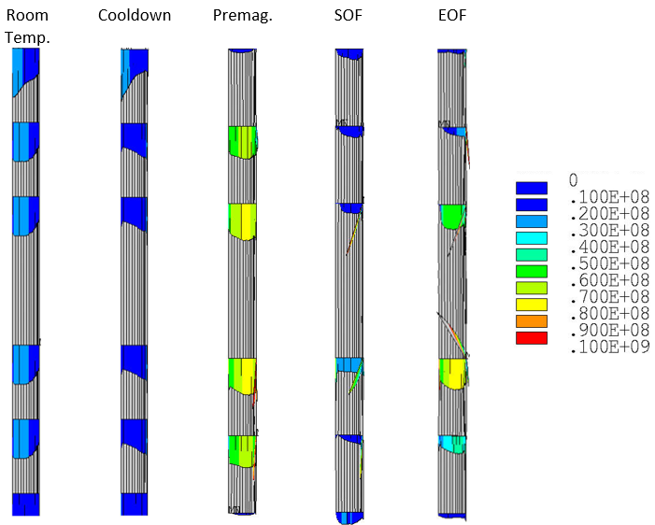
Results and Observations
ITER criteria:
≥25% of module boundaries remain in contact
Contact forces are ≥ 15 MN
Tie plates do not exceed membrane stress limits at room temperature
Both 316LN and N50 tie plates are viable
Fatigue lifetimes of plates have not yet been considered in detail
Contact
Pressure
(Pa)
✓
✓
 | Radial thickness (mm)
 | Inner tie plates | Outer tie plates
Nitronic 50 | 148 | 92
316 LN | 210 | 110

Slide 15
Summary
FCGR studies:
Winding pack analyses: grading the steel and including thick co-wound strips (or multiple strips) leads to a ~10% increase in flux. For 316LN (and Ro=2.62 m), the premagnetisation flux is 215 Wb. Some insulation stress/strain issues remain.
Precompression structure: viable solutions using 316LN or N50 tie plates have been found, with ≤115 mm radial space for the outer tie plates. The precompression is limited by the room temperature stress.
Material | Maximum Hoop Stress for 30,000 Plasma Cycles (16 mm thick jacket wall)
316LN | 250 MPa
JK2LB/Inconel/Incoloy | ~300 MPa
N50H | 380 MPa
Notes:
To summarise…

Slide 16
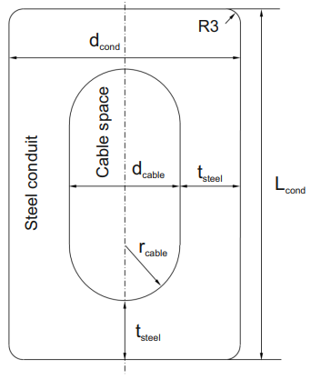
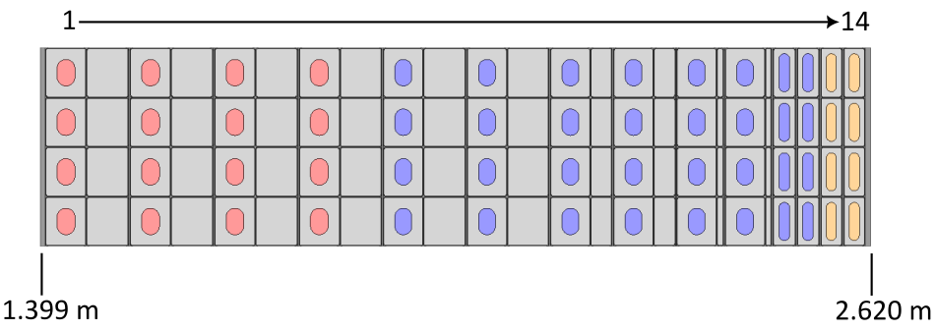
Conductor Dimensions - 316LN
A large amount of steel grading using thick co-wound steel strips (or multiple thin strips) is needed just to achieve 215 Wb of flux
HTS
R&W Nb₃Sn
Nb-Ti
Layer | L_{cond} (mm) | d_{cond} (mm) | d_{cable} (mm) | t_{steel} (mm) | d_{strip} (mm)
1 & 2 | 71.0 | 58.2 | 26.2 | 16.0 | 60.0
3 & 4 | 71.0 | 58.0 | 26.0 | 16.0 | 60.0
5 & 6 | 71.0 | 56.8 | 24.8 | 16.0 | 60.0
7 & 8 | 71.0 | 56.8 | 24.8 | 16.0 | 30.0
9 & 10 | 71.0 | 56.8 | 24.8 | 16.0 | 8.0
11 & 12 | 71.0 | 30.8 | 15.8 | 7.5 | -
13 & 14 | 71.0 | 29.7 | 14.8 | 7.5 | -

Slide 17
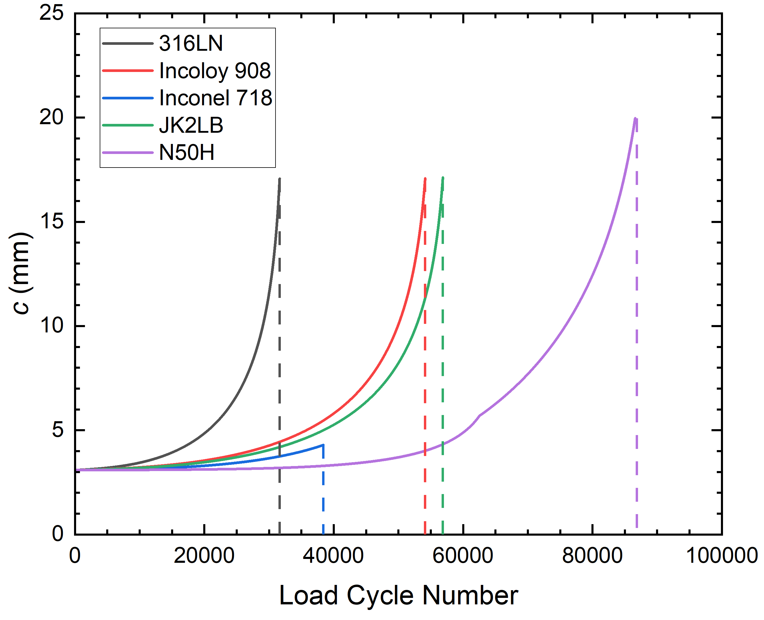
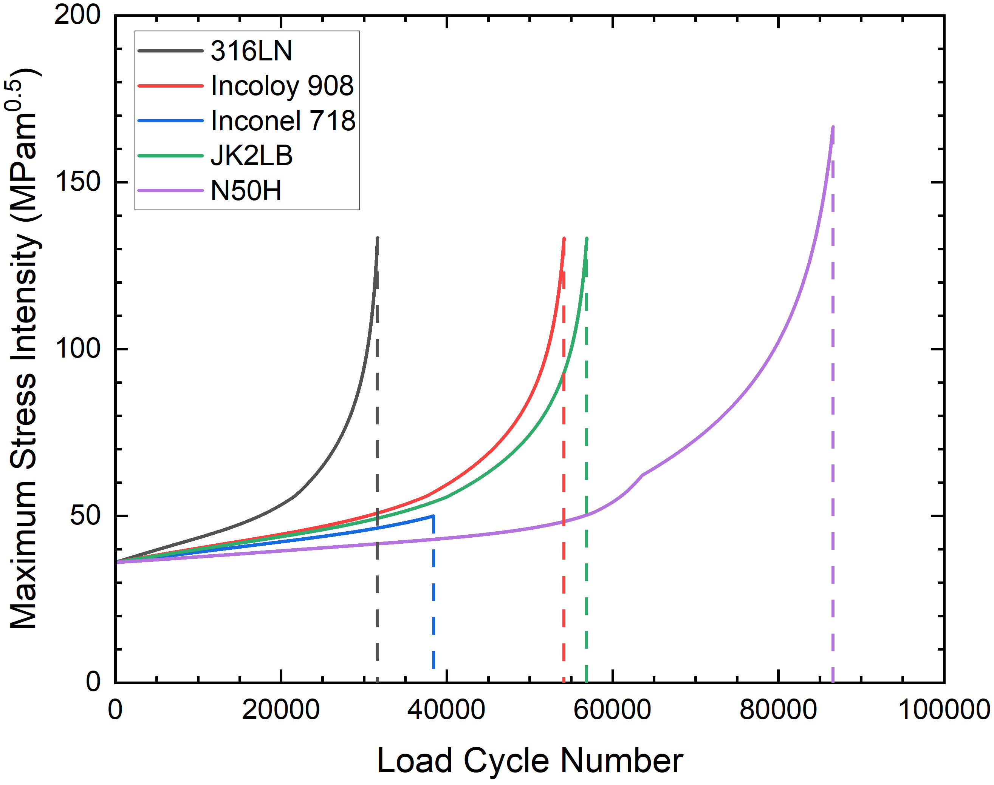
Example: Surface Crack Growth
Hoop stress: 400 MPa
The iterative model terminates when:
the stress concentration factor somewhere around the crack perimeter exceeds the safe limit
or
the crack has grown sufficiently large
The inputs/assumptions/safety factors are the same as those used in previous SPC analyses:
71 mm wide plate
Initial defect size: 2 mm² (surface), 5 mm² (embedded)
2 load cycles per plasma cycle
2x number of cycles (safety factor)
2x initial area (safety factor)
…
[1] J. Lorenzo and X. Sarasola, "Fatigue Stress Assessment via crack growth analysis based on LEFM," 2021. Available: https://idm.euro-fusion.org/?uid=2PBDRG

Slide 18
Crack Growth in N50H Jackets
Both embedded and surface cracks are considered
$\frac{da}{dN}=C{\left(ΔK_{a}\right)}^{m}$, $\frac{dc}{dN}=C{\left(ΔK_{c}\right)}^{m}$
$$K_{a}=K\left(σ_{m}+σ_{r},\frac{π}{2}\right)−K\left(σ_{r},\frac{π}{2}\right)$$
$$K_{c}=K\left(σ_{m}+σ_{r},0\right)−K\left(σ_{r},0 \right)$$
$$K\left(σ_{m} , Φ\right)=\left(σ_{m}+H_{j}σ_{b}\right)\sqrt{π\frac{a}{Q}}F_{j}\left(Φ\right)$$
[1] ITER Structural Material Database. Art. 2 Metallic Material Database. https://user.iter.org/?uid=223BAC
[2] J. Lorenzo and X. Sarasola, "Fatigue Stress Assessment via crack growth analysis based on LEFM," 2021. Available: https://idm.euro-fusion.org/?uid=2PBDRG

