Slide 1
Thermo-mechanical analyses and tests on laser welding process
Rafal Ortwein, Jakub Tabin, Tomasz Ślęzak
Acknowledgement: Xabier Sarasola (SPC), Kamil Sedlak (SPC), Montanstahl
WPMAG 2025 Final meeting (14-16.01.2025)

Slide 2
Content
1. Introduction
2. FEM model of welding
3. Residual stresses: measurements vs FEM
4. Sensitivity study
5. Welding trial (July 2025) – lessons learned
6. New thermal model
7. Residual stress measurements
8. Conclusions/next steps

Slide 3
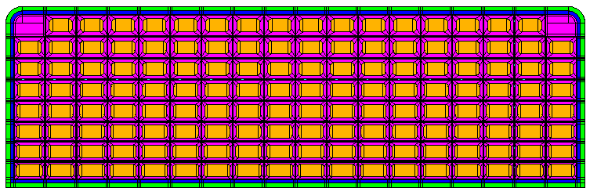
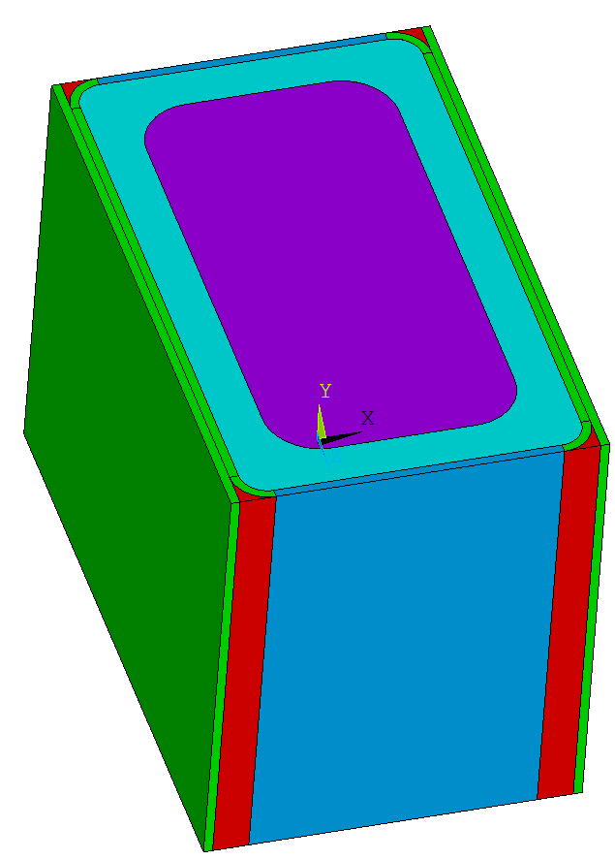
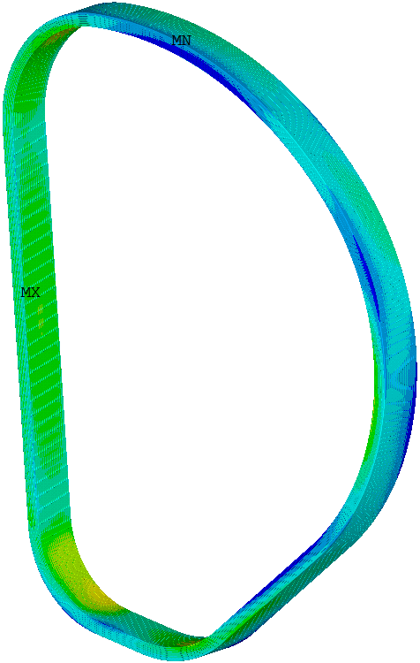
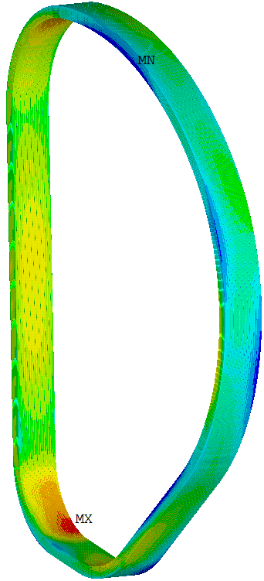
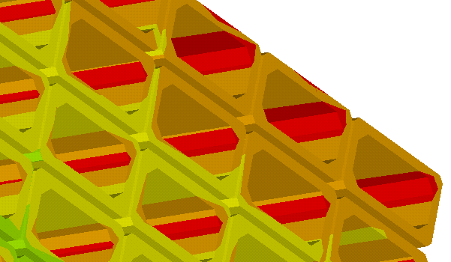
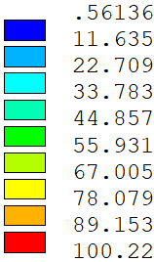
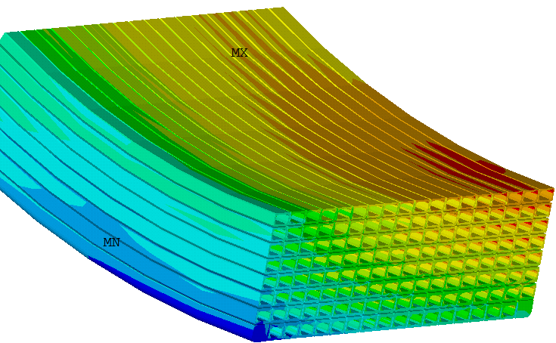
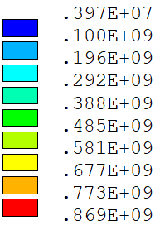
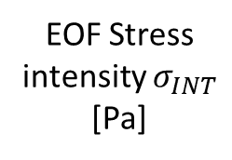

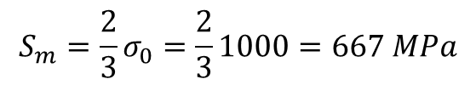
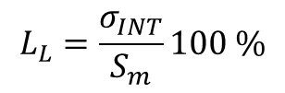
1. Introduction & motivation (1/4)
Mechanical analysis of the DEMO winding packs (2023) (2RCXLZ v1.1)
$$S_{m}=\frac{2}{3}σ_{0}=\frac{2}{3}1000=667 MPa$$
$$L_{L}=\frac{σ_{INT}}{S_{m}}100 \%$$
EOF Stress intensity $σ_{INT}$
[Pa]
$$L_{L}[\%]$$

Slide 4
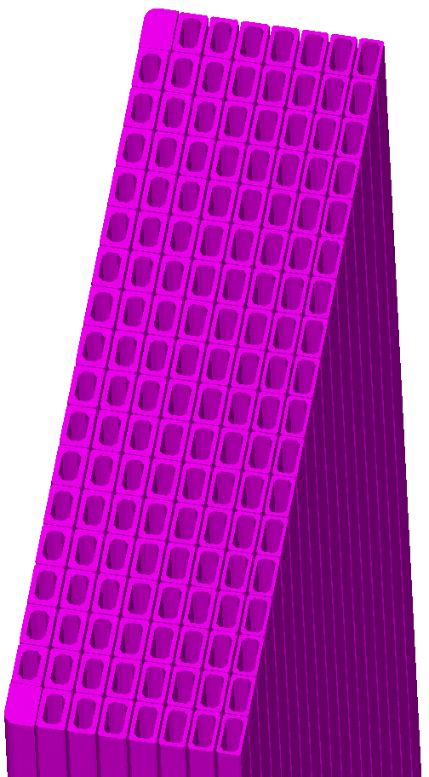
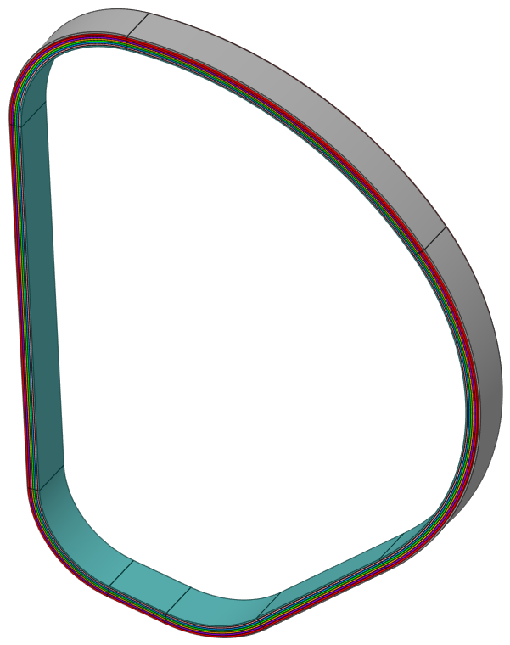
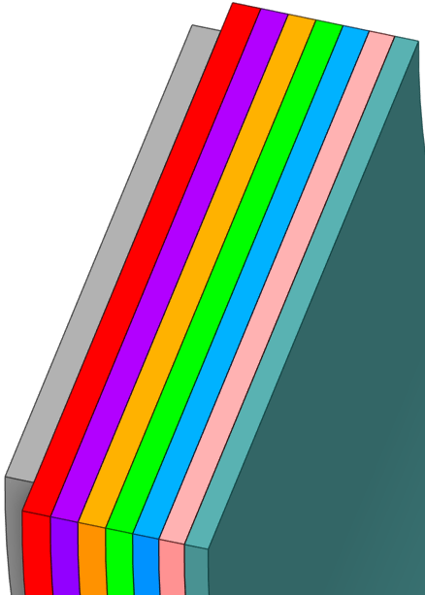
1. Introduction & motivation (1/4)
Layer [-] | ~Jacket length [m] | Length of seam weld [m]
1 | 847 | 1694
2 | 852 | 1704
3 | 857 | 1714
4 | 863 | 1725
5 | 868 | 1736
6 | 874 | 1747
7 | 879 | 1759
8 | 787 | 1573
 | Total | 13652

Slide 5



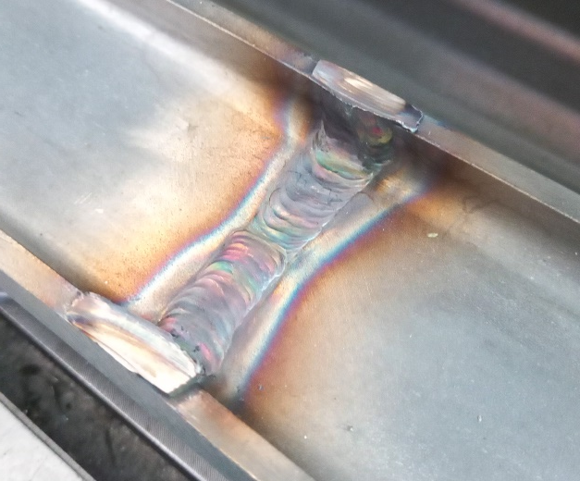
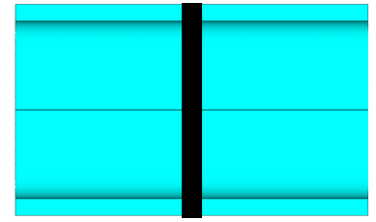
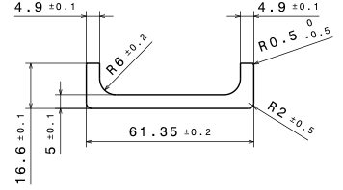
1. Introduction & motivation (1/4)
Seam (longitudinal weld) – laser welding
Automatic method
History of welding trials:
Cryotech (2023)
Montanstahl (2025)
Continuous pieces of 100 m length, manufactured with hot rolling

Slide 6
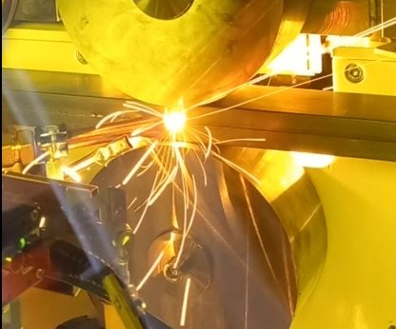




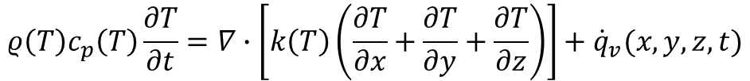
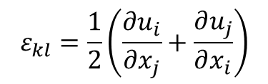
2. FEM model of welding
Moving heat source model
Thermal model
$$ρ\left(T\right)c_{p}\left(T\right)\frac{∂T}{∂t}=∇∙\left[k\left(T\right)\left(\frac{∂T}{∂x}+\frac{∂T}{∂y}+\frac{∂T}{∂z}\right)\right]+{\dot{q}}_{v}(x,y,z,t)$$
For the laser welding
$$\frac{∂σ_{ij} }{∂x_{i}}+b_{j}=0$$
Equilibrium equations
$$σ_{ij}=C_{ijkl}\left(ε_{kl}−ε_{kl}^{p}−ε_{kl}^{t}\right)$$
Constitutive equations
$$ε_{kl}=\frac{1}{2}\left(\frac{∂u_{i}}{∂x_{j}}+\frac{∂u_{j}}{∂x_{i}}\right)$$
Mechanical model
Strain-displacement relations
$$f^{yield}=σ_{eqv}−σ_{y}(T)$$
Yield function
$$ε_{kl}^{t}=α(T)\left(T−T_{0}\right)$$
Thermal strain

Slide 7
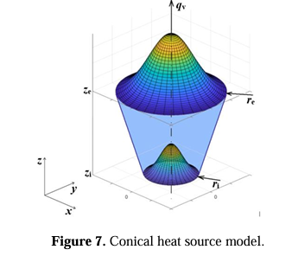
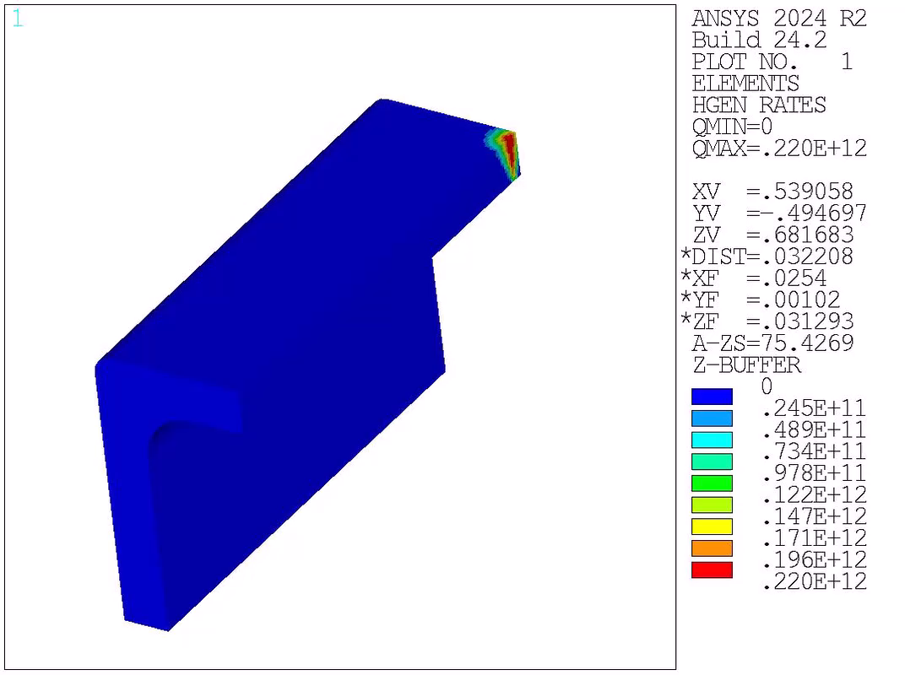

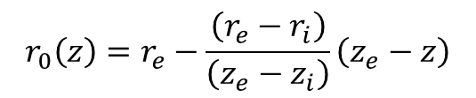
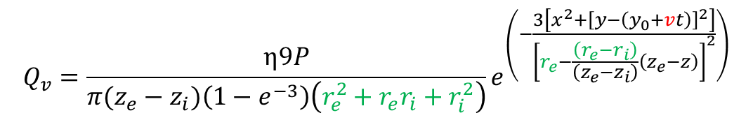
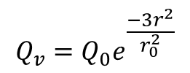
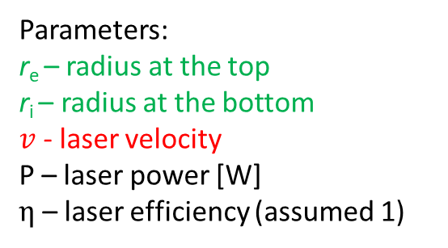
2. FEM model of welding
$$Q_{v}=Q_{0}e^{\frac{−3r^{2}}{r_{0}^{2}}}$$
$$r_{0}\left(z\right)=r_{e}−\frac{\left(r_{e}−r_{i}\right)}{\left(z_{e}−z_{i}\right)}\left(z_{e}−z\right)$$
$$r^{2}=x^{2}+{\left[y−\left(y_{0}+vt\right)\right]}^{2}$$
$$Q_{v}=\frac{η9P}{π(z_{e}−z_{i})\left(1−e^{−3}\right)\left(r_{e}^{2}+r_{e}r_{i}+r_{i}^{2}\right)}e^{\left(−\frac{3\left[x^{2}+{\left[y−\left(y_{0}+vt\right)\right]}^{2}\right]}{{\left[r_{e}−\frac{\left(r_{e}−r_{i}\right)}{\left(z_{e}−z_{i}\right)}\left(z_{e}−z\right)\right]}^{2}}\right)}$$
Green – parameters related to the size of the laser beam
Red – laser velocity
Parameters:
r_{e} – radius at the top
r_{i} – radius at the bottom
$v$ - laser velocity
P – laser power [W]
$η$ – laser efficiency (assumed 1)

Slide 8


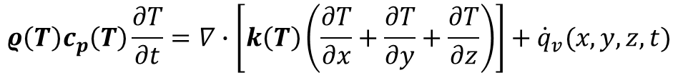

2. FEM model of welding
$$ρ\left(T\right)c_{p}\left(T\right)\frac{∂T}{∂t}=∇∙\left[k\left(T\right)\left(\frac{∂T}{∂x}+\frac{∂T}{∂y}+\frac{∂T}{∂z}\right)\right]+{\dot{q}}_{v}(x,y,z,t)$$
$$ρ\left(T\right)$$
$$cp\left(T\right)$$
$$k\left(T\right)$$
Temperatures above melting are of no importance for the residual stress analysis
 | References | Year
1 | J.R. Chukkan et al. Simulation of laser butt welding of AISI 316L stainless steel sheet using various heat sources and experimental validation. Journal of Materials Processing Technology, 219 2015, 48-59 | 2015
Thermal properties of 316L

Slide 9
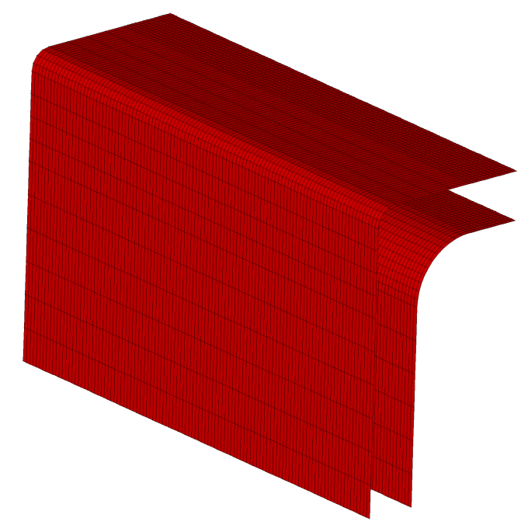

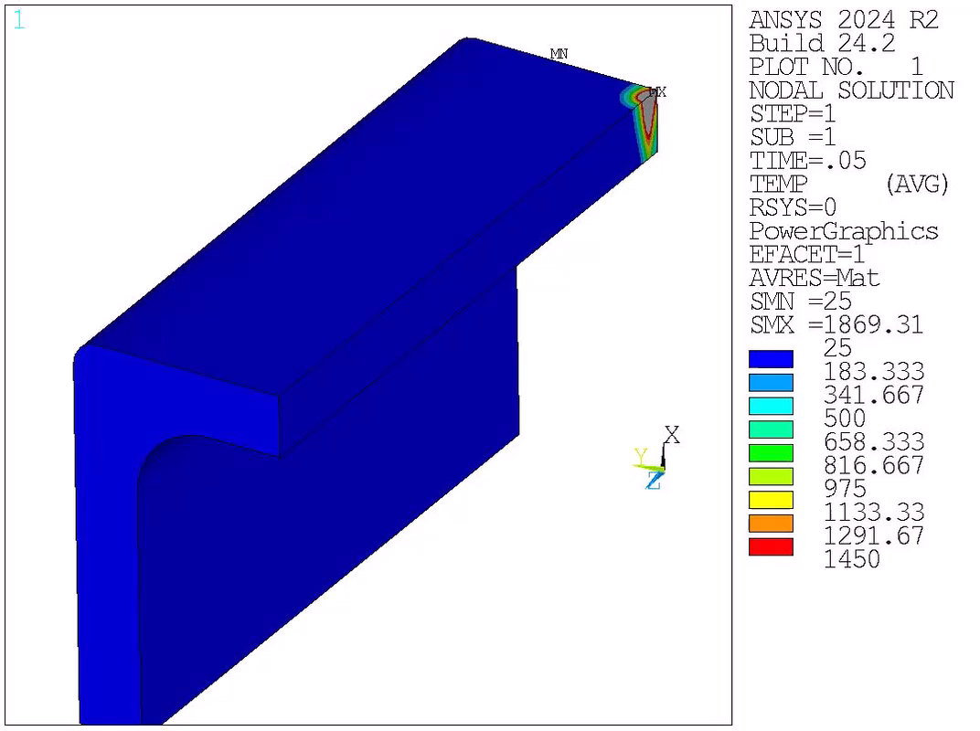
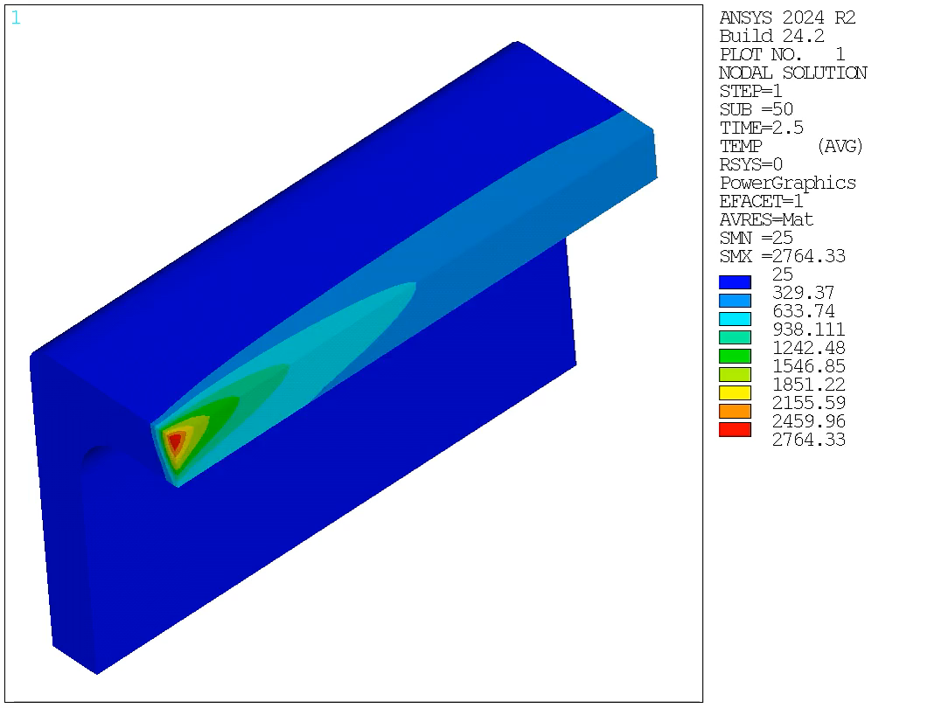



2. FEM model of welding
H=2.4$∙{10}^{−3}εT^{1.61}$
$$ε=0.9$$
$$adiabatic interfaces$$

Slide 10
2. FEM model of welding
Moving heat source model
Thermal model
$$ρ\left(T\right)c_{p}\left(T\right)\frac{∂T}{∂t}=∇∙\left[k\left(T\right)\left(\frac{∂T}{∂x}+\frac{∂T}{∂y}+\frac{∂T}{∂z}\right)\right]+{\dot{q}}_{v}(x,y,z,t)$$
For the laser welding
$$\frac{∂σ_{ij} }{∂x_{i}}+b_{j}=0$$
Equilibrium equations
$$σ_{ij}=C_{ijkl}\left(ε_{kl}−ε_{kl}^{p}−ε_{kl}^{t}\right)$$
Constitutive equations
$$ε_{kl}=\frac{1}{2}\left(\frac{∂u_{i}}{∂x_{j}}+\frac{∂u_{j}}{∂x_{i}}\right)$$
Mechanical model
Strain-displacement relations
$$f^{yield}=σ_{eqv}−σ_{y}(T)$$
Yield function
$$ε_{kl}^{t}=α(T)\left(T−T_{0}\right)$$
Thermal strain

Slide 11
2. FEM model of welding
Ref4 | FEM analysis of thermal and residual stress profile in selective laser melting of 316L stainless steel
Ref5 | Experimental and numerical study on residual stress and geometric distortion in powder bed fusion process

Slide 12
2. FEM model of welding
T [◦C] | E [ Gpa] | Poisson’s ratio [-] | sig0 [Mpa] | Tan. Mod [Mpa] | CTE [1/K)
26.85 | 194.7 | 0.25 | 246 | 2281 | 1.48E-05
126.85 | 190 | 0.23 | 217.4 | 2023 | 1.56E-05
226.85 | 184.5 | 0.285 | 188.8 | 1765 | 1.63E-05
326.85 | 178.2 | 0.319 | 165.2 | 1531 | 1.69E-05
426.85 | 171 | 0.322 | 154.9 | 1363 | 1.74E-05
526.85 | 161.7 | 0.305 | 144.7 | 1195 | 1.79E-05
726.85 | 141 | 0.291 | 124.2 | 858.6 | 1.87E-05
826.85 | 127.3 | 0.24 | 111.1 | 693.6 | 1.90E-05
926.85 | 112.5 | 0.24 | 73.6 | 558.2 | 1.93E-05
1026.9 | 95 | 0.24 | 36 | 423 | 1.95E-05
1126.9 | 73 | 0.24 | 18.4 | 293.4 | 1.96E-05
1226.9 | 51 | 0.24 | 15 | 265 | 1.98E-05
1372 | 51 | 0.24 | 15 | 265 | 1.99E-05
 | T1 | T2 | T3 | T4 | T5 | T6 | T7 | T8 | T9 | T10 | T11 | T12 | T13
Plastic str. | 26.85 | 126.85 | 226.85 | 326.85 | 426.85 | 526.85 | 726.85 | 826.85 | 926.85 | 1026.9 | 1126.9 | 1226.9 | 1372
0 | 246 | 217.4 | 188.8 | 165.2 | 154.9 | 144.7 | 124.2 | 111.1 | 73.6 | 36 | 18.4 | 15 | 15
0.2 | 702 | 622 | 541.8 | 471.4 | 427.5 | 383.7 | 295.92 | 249.82 | 185.24 | 120.6 | 77.08 | 68 | 68

Slide 13
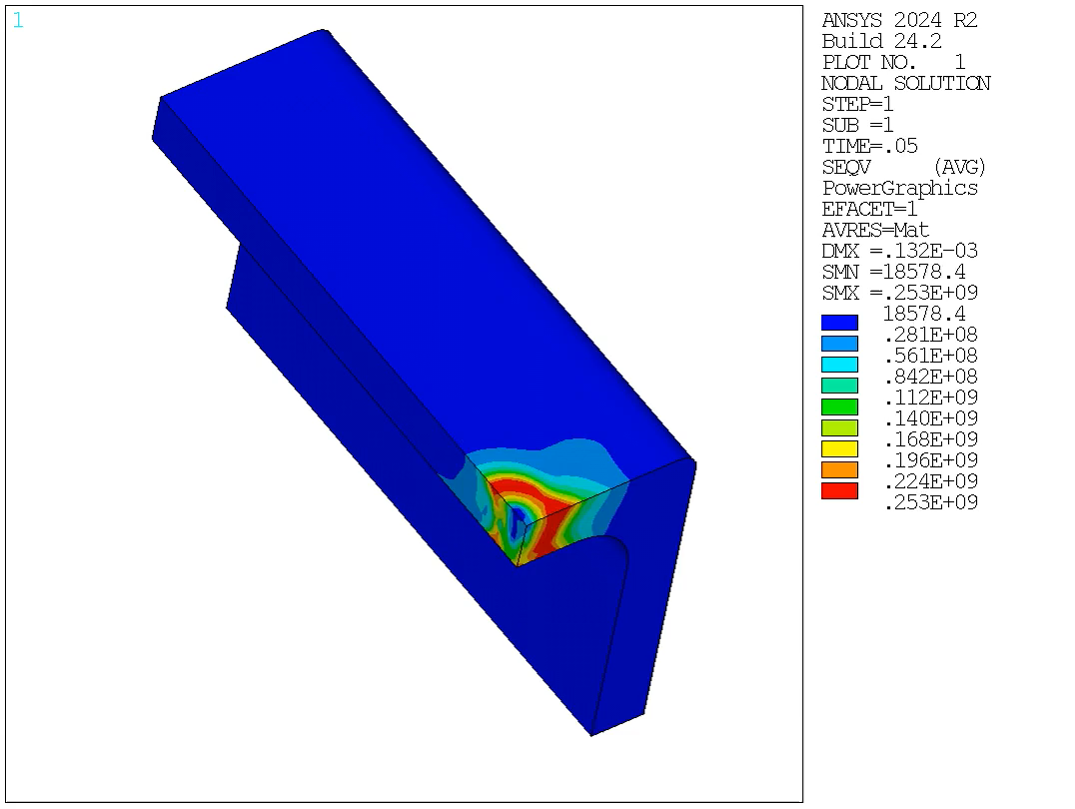
2. FEM model of welding

Slide 14
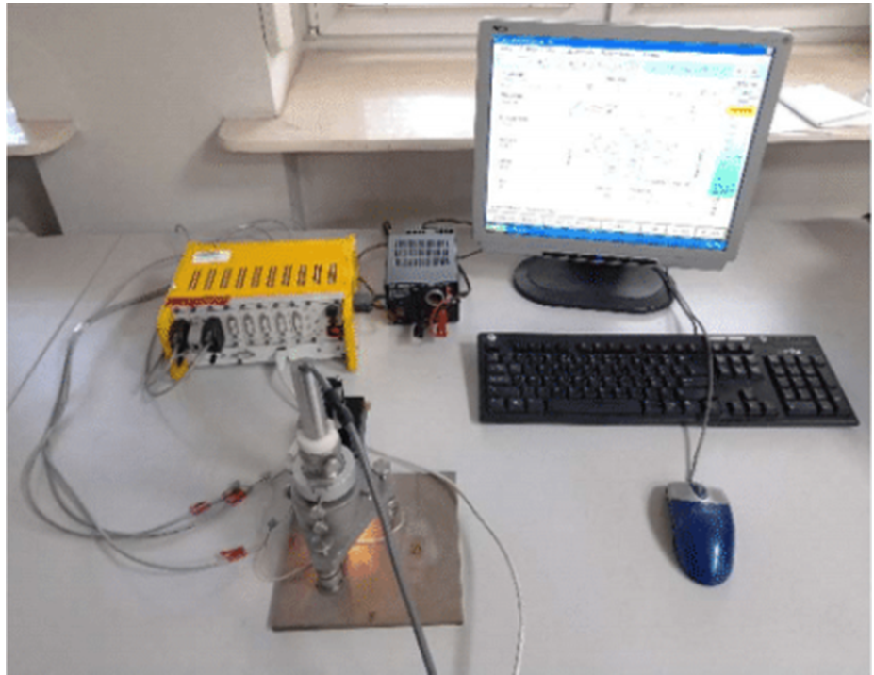
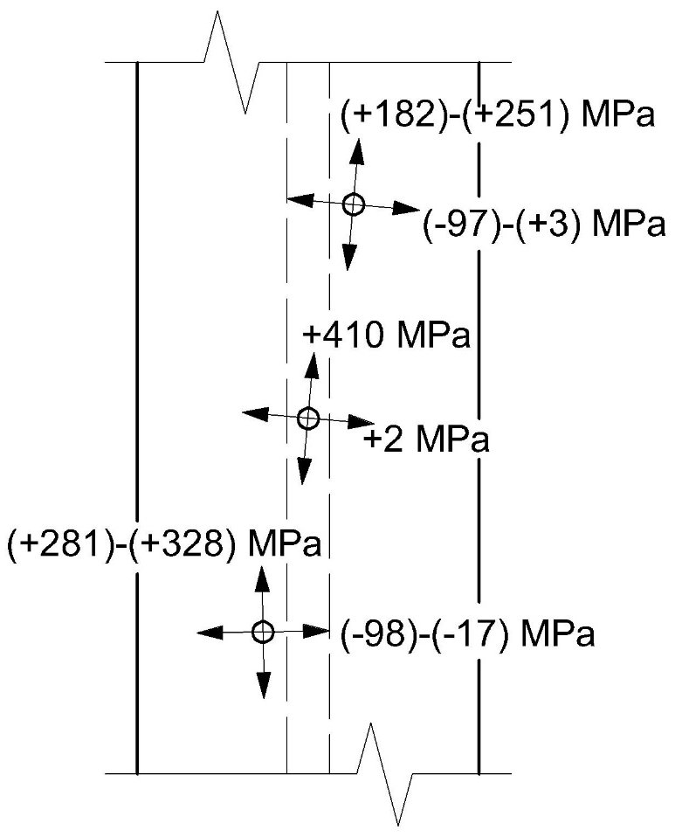
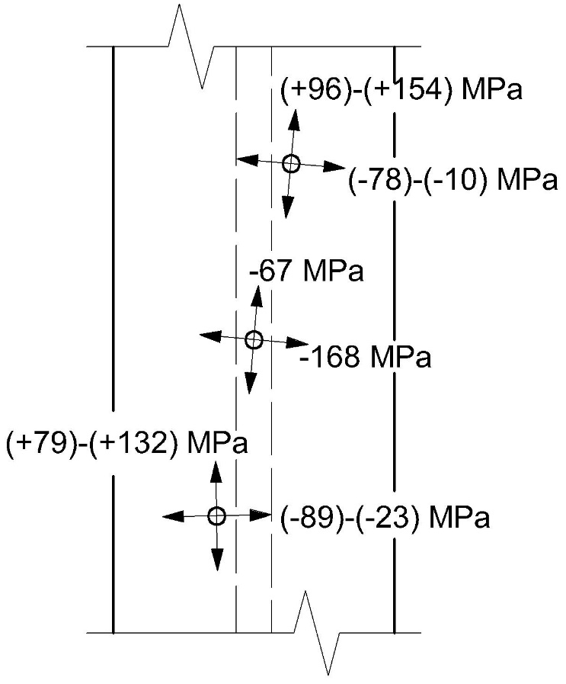
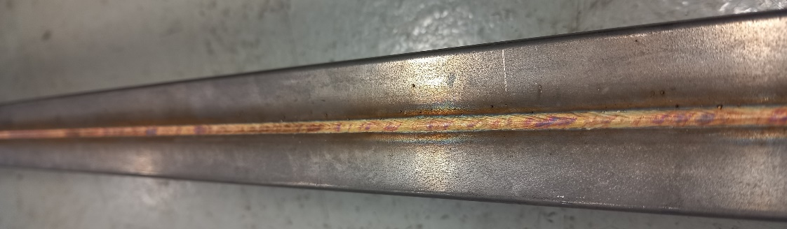
3. Residual stresses: measurements vs FEM
3.5±0.5 mm
Hole drilling strain gauge method
Depth ~0.25 mm
Depth 0.5-0.8 mm
J. Tabin et al. Microstructure, mechanical properties and residual stress of welded stainless-steel jackets for React & Wind conductor in EU-DEMO. Fusion Engineering and Design 222 (2026) 115503

Slide 15
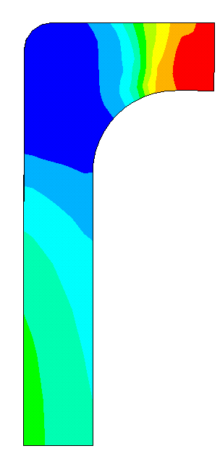
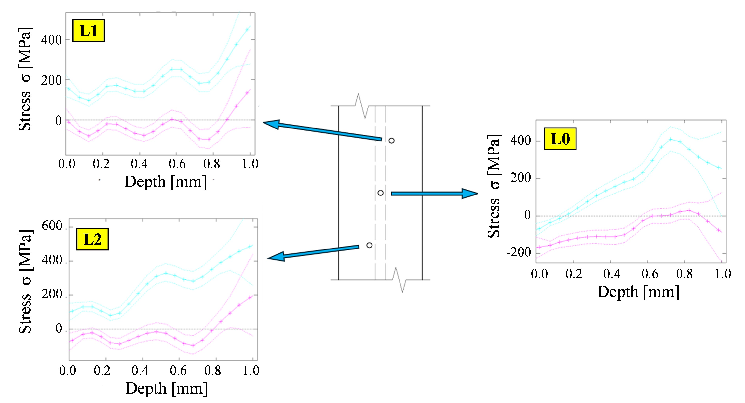
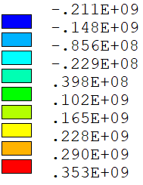
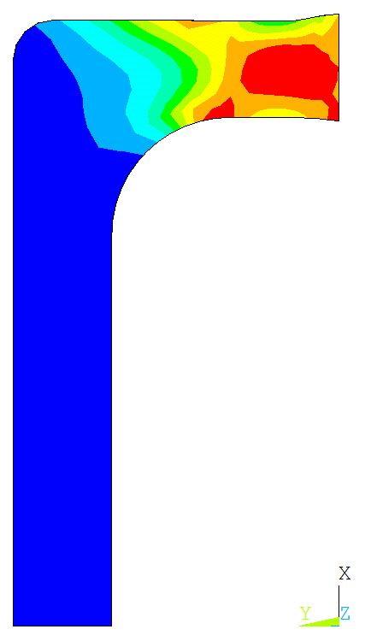
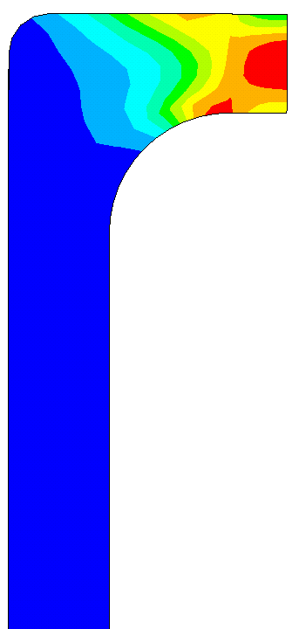
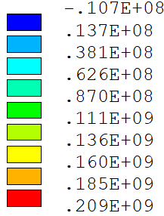
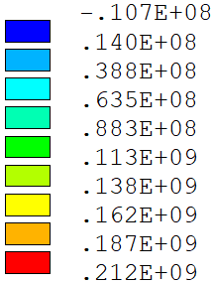
3. Residual stresses: measurements vs FEM
σ_{Z} (σ₁) [Pa]
353 MPa
190 MPa
σ_{Y} (σ₂) [Pa]
160 MPa
σ_{Y} (σ₂) [Pa]

Slide 16
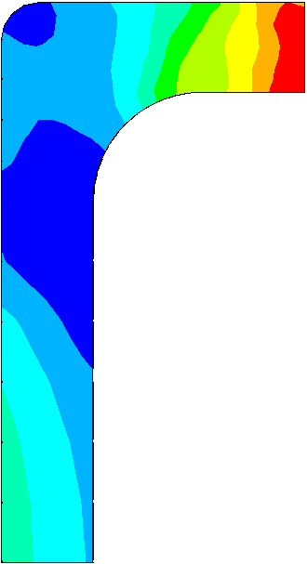
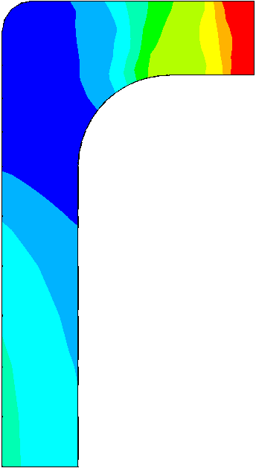
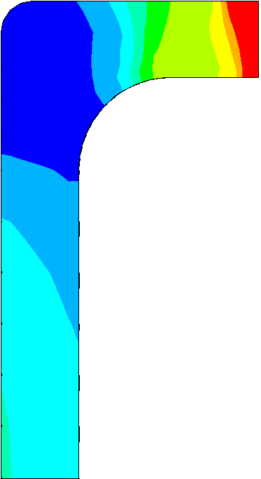

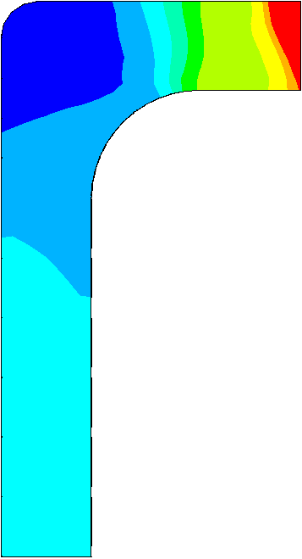
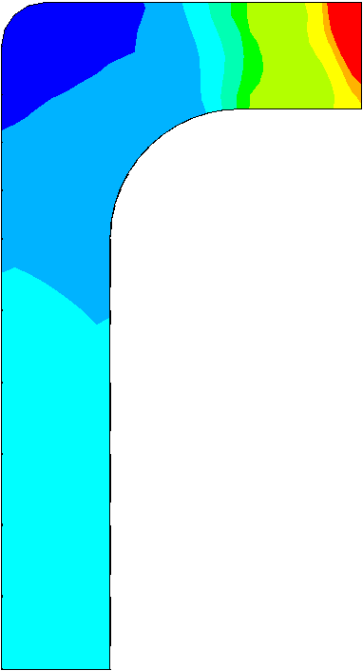
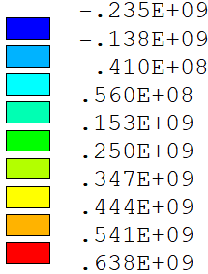












4. Sensitivity study
σ_{Z} (σ₁)
Welding velocity
Stress σ_{Z}
$v$=0.6 m/s
$v$=0.9 m/s
$v$=1.2 m/s
$v$=1.5 m/s
$v$=1.8 m/s
$v$=2.4 m/s
σ_{Z} [Pa]
$$Max:$$
$$638 MPa$$
$$Max:$$
$$671 MPa$$
$$Max:$$
$$683 MPa$$
$$Max:$$
$$706 MPa$$
$$Max:$$
$$712 MPa$$
$$Max:$$
$$758 MPa$$

Slide 17




















4. Sensitivity study
σ_{Z} (σ₁)
Laser power
$$P=2000 W$$
$$P=3000 W$$
$$P=4000 W$$
$$P=5000 W$$
$$P=6000 W$$
σ_{Z} [Pa]
σ_{Z} [Pa]
σ_{Z} [Pa]
σ_{Z} [Pa]
σ_{Z} [Pa]
$$Max:$$
$$655 MPa$$
$$Max:$$
$$676 MPa$$
$$Max:$$
$$683 MPa$$
$$Max:$$
$$694 MPa$$
$$Max:$$
$$706 MPa$$

Slide 18





















4. Sensitivity study
Laser beam size
$$(×0. 5)$$
$$(×0.75)$$
$$(×1)$$
$$(×1.25)$$
$$(×1.5)$$
$$\text{re}\text{=0.75 }\text{mm}$$
$$\text{ri}\text{=0.25} \text{mm}$$
$$\text{re}\text{=}\text{1}\text{.}\text{12}\text{5 }\text{mm}$$
$$\text{ri}\text{=}\text{0}\text{.}\text{37}\text{5} \text{mm}$$
$$\text{re}\text{=}\text{1}\text{.5 }\text{mm}$$
$$\text{ri}\text{=0.}\text{5 }\text{mm}$$
$$\text{re}\text{=}\text{1}\text{.}\text{8}\text{75 }\text{mm}$$
$$\text{ri}\text{=0.}\text{6}\text{25} \text{mm}$$
$$\text{re}\text{=}\text{2}\text{.}\text{2}\text{5 }\text{mm}$$
$$\text{ri}\text{=0.}\text{7}\text{5} \text{mm}$$
σ_{Z} [Pa]
$$Max:$$
$$717 MPa$$
$$Max:$$
$$697 MPa$$
$$Max:$$
$$683 MPa$$
$$Max:$$
$$673 MPa$$
$$Max:$$
$$656 MPa$$

Slide 19

5. Welding trial (July 2025) – lessons learned
Spooling +
air cooling
hot rolling
Straightening
Bending in the hall
Machining to tolerance welding surfaces
Laser welding

Slide 20

5. Welding trial (July 2025) – lessons learned
Test at Montanstahl
Test at ICAS

Slide 21

5. Welding trial (July 2025) – lessons learned

Slide 22


5. Welding trial (July 2025) – lessons learned
Vertical compression with a force of ~2.7 kN
Laser welding

Slide 23



5. Welding trial (July 2025) – lessons learned
Laser 2
Laser 1
Laser size
0.4-0.5 mm
Laser 2 | Laser 1
1000 W | 1500 W
3300 W | 3700 W
Laser velocity
2 m/min

Slide 24




5. Welding trial (July 2025) – lessons learned
~40 m
Ultrasound system
~50 cm
Table with rollers
~90 cm
~70 cm
Up to ~120 C

Slide 25
5. Welding trial (July 2025) – lessons learned
~70 cm
~2.1 m
~42.1 m
V=2 m/min=0.033 m/s
t=1263 s
t=63 s
t=21 s

Slide 26









5. Welding trial (July 2025) – lessons learned

Slide 27







6. New thermal model
$$Q_{v1}=\frac{9P_{1}}{π(z_{e}−z_{i})\left(1−e^{−3}\right)\left(r_{e}^{2}+r_{e}r_{i}+r_{i}^{2}\right)}e^{\left(−\frac{3\left[x^{2}+{\left[y−vt\right]}^{2}\right]}{{\left[r_{e}−\frac{\left(r_{e}−r_{i}\right)}{\left(z_{e}−z_{i}\right)}\left(z_{e}−z\right)\right]}^{2}}\right)}$$
$$Q_{v2}$$
$$Q_{v2}=\frac{9P_{2}}{π(z_{e}−z_{i})\left(1−e^{−3}\right)\left(r_{e}^{2}+r_{e}r_{i}+r_{i}^{2}\right)}e^{\left(−\frac{3\left[x^{2}+{\left[y−\left(y_{0}+vt\right)\right]}^{2}\right]}{{\left[r_{e}−\frac{\left(r_{e}−r_{i}\right)}{\left(z_{e}−z_{i}\right)}\left(z_{e}−z\right)\right]}^{2}}\right)}$$
$$Q_{v1}$$
$Q_{v}$=$Q_{v1}$+$Q_{v2}$
$$y_{0}$$
$$y$$

Slide 28

6. New thermal model
200 mm long piece (4x longer than the previous model)
re=1.2e-3
ri=0.5e-3
75% power on the sample

Slide 29



7. Residual stress measurements
Mill cutter broke at 0.2 mm
LW1
Mill cutter broke at 0.7 mm
Stresses in both directions are positive (tensile), which are more dangerous than compressive

Slide 30
7. Residual stress measurements
After welding by ICAS:
After welding by Montanstahl
Possible reason:
Work hardening of the material due to hot rolling and bending before welding, causing higher yield stress

Slide 31
8. Conclusions and next steps
For this task:
Performing mechanical analysis for the Montanstahl like set-up
Including higher heat transfer coefficient
Including the vertical pressure from the rollers
Future work:
Thermal simulation of the full RW conductor, to see the values of temperatures and the potential for damage.
Measuring mechanical properties of the welded material (316L) at high temperatures -> to better calibrate the model

