Slide 1
Advanced finite element modeling to support the experimental test
MAG-S.01.04-T023-D001
WPMAG 2025 Final Meeting, 15-Jan-2026
F. Giorgetti

Slide 2
Outline
Overview of the ENEA PC-RINGS Testing Facility.
FE model to support the experimental test and determine the testing cycle amplitude.
Code developed for crack growth analysis.

Slide 3
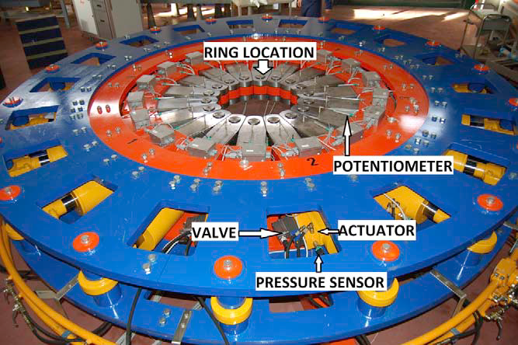
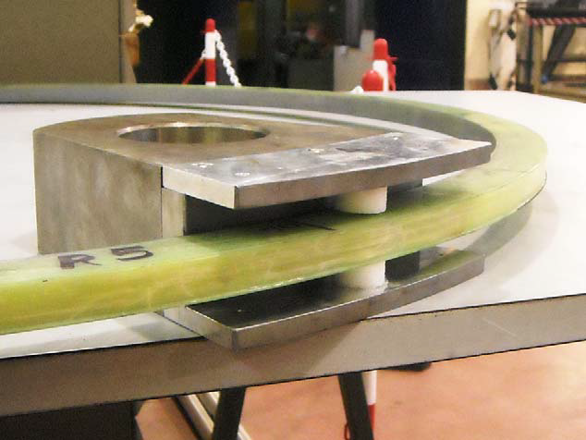
ENEA PC-RINGS Testing Facility
Facility Key features
Based on eighteen (18) hydraulic cylinders with maximum pulling capability of 57tons and a maximum stroke of 70mm each, thus total σ_{Hmax} is 1.6MN.
Position control precision is 0.1mm (below 0.1mm radial movement accuracy cannot be guaranteed).
Mounting and demounting procedures are very time-consuming (intermediate disassembly not recommended).
Cycle duration 10s÷20s (after software modification)
Testing requirements
Ring mock-up dimensions: Internal diameter of 1005mm±1mm, maximum cross section of 45x45mm.
Maintaining the ring below the yielding.
The tests need to be always supervised.
Ring holder

Slide 4
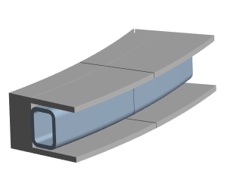

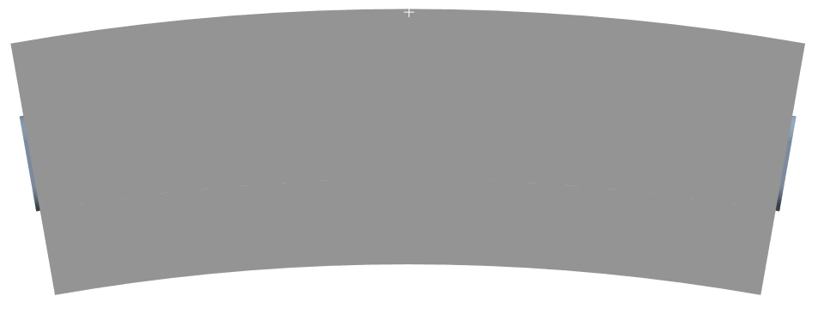
FEM simulation of jacket ring
L=22.7mm
Holder
Jacket Ring
R=502.5mm
H=29.1mm
Cyclic symmetry with 20° sectors (only jacket)
Ring/holder contact
Imposed displacements to holder (0.1mm steps)
Yielding of 316LN @20°C is 220MPa (E=200GPa)*
20°
0.5mm
*ITER Appendix A, Materials Design Limit Data (222RLN)

Slide 5
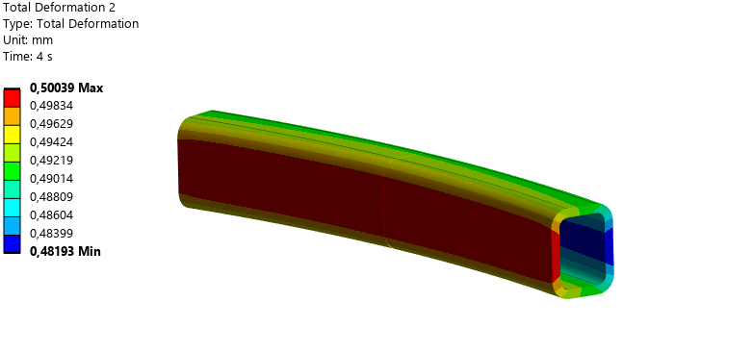
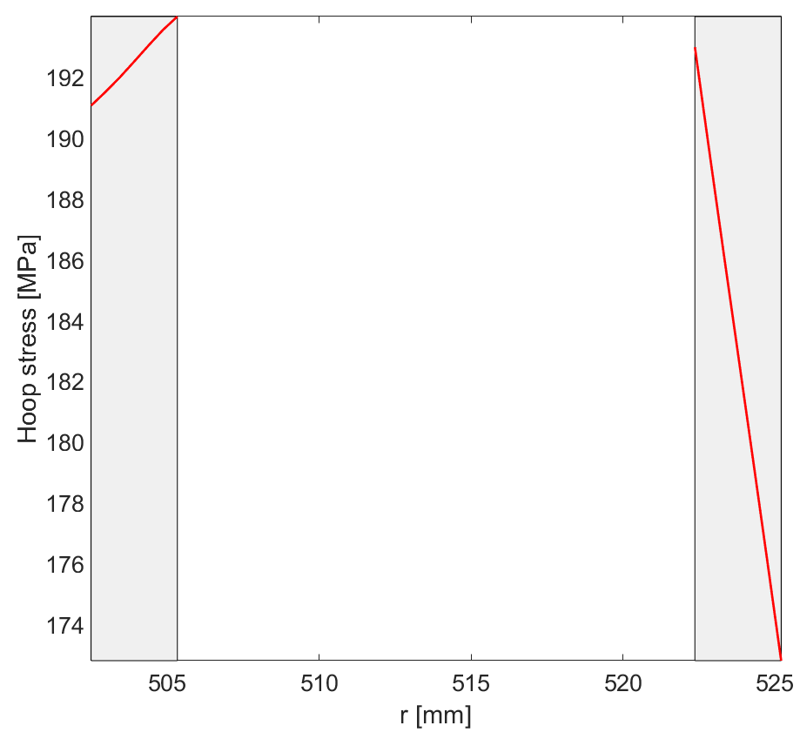
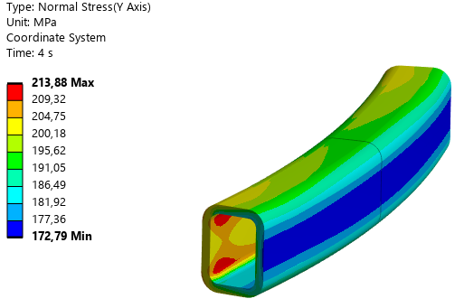
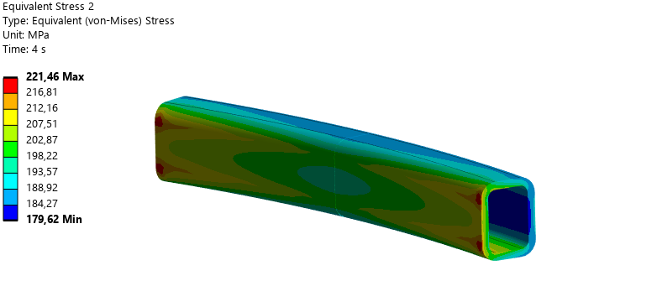
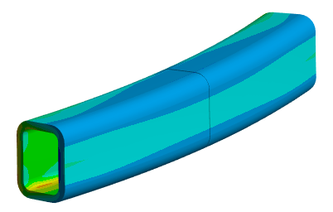
FEM simulation of jacket ring
Maximum allowable radial displacement is 0.5mm
Estimated loading cycle: 0.1mm to 0.5mm.
 | Internal | External
σ_{H} max [MPa] | 193.98 | 192.97
σ_{H} min [MPa] | 191.10 | 172.79

Slide 6
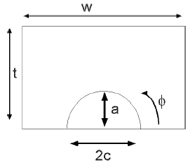
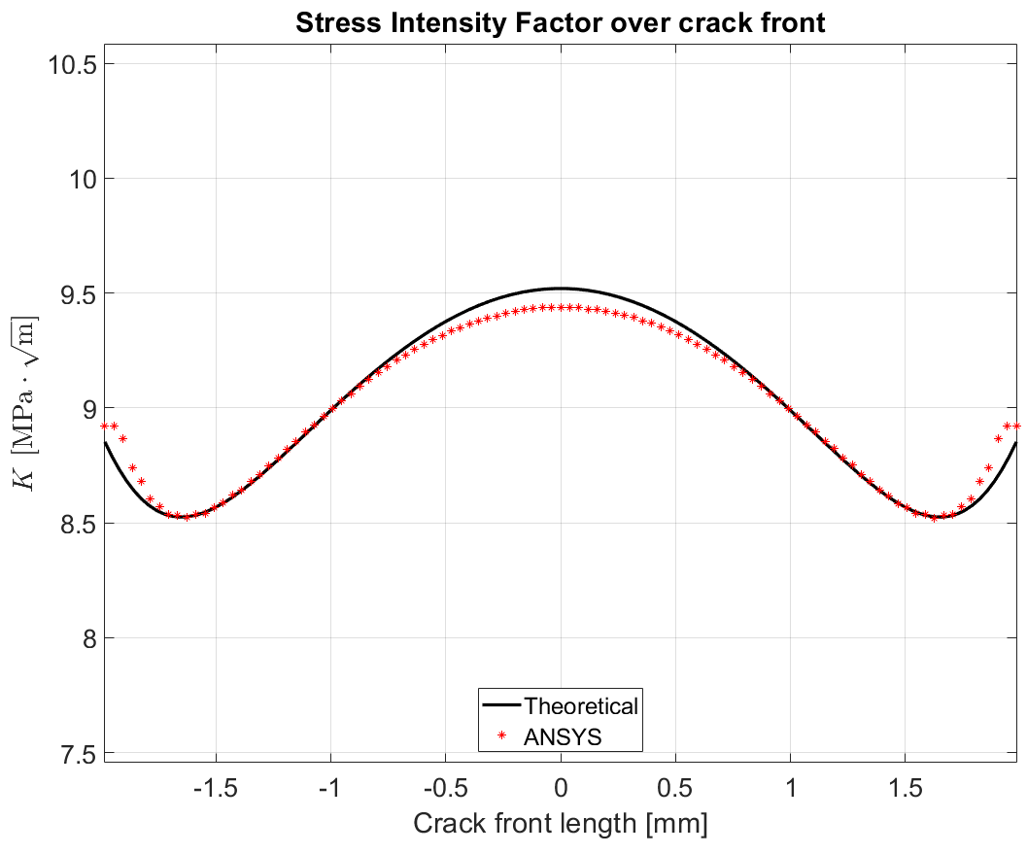
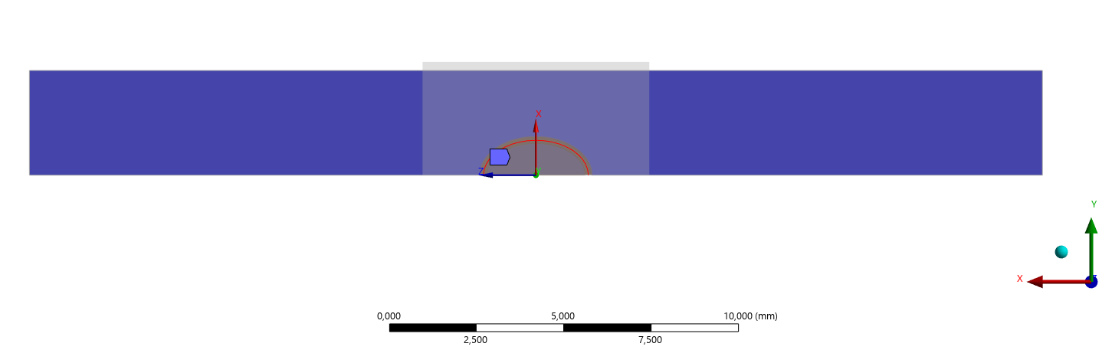
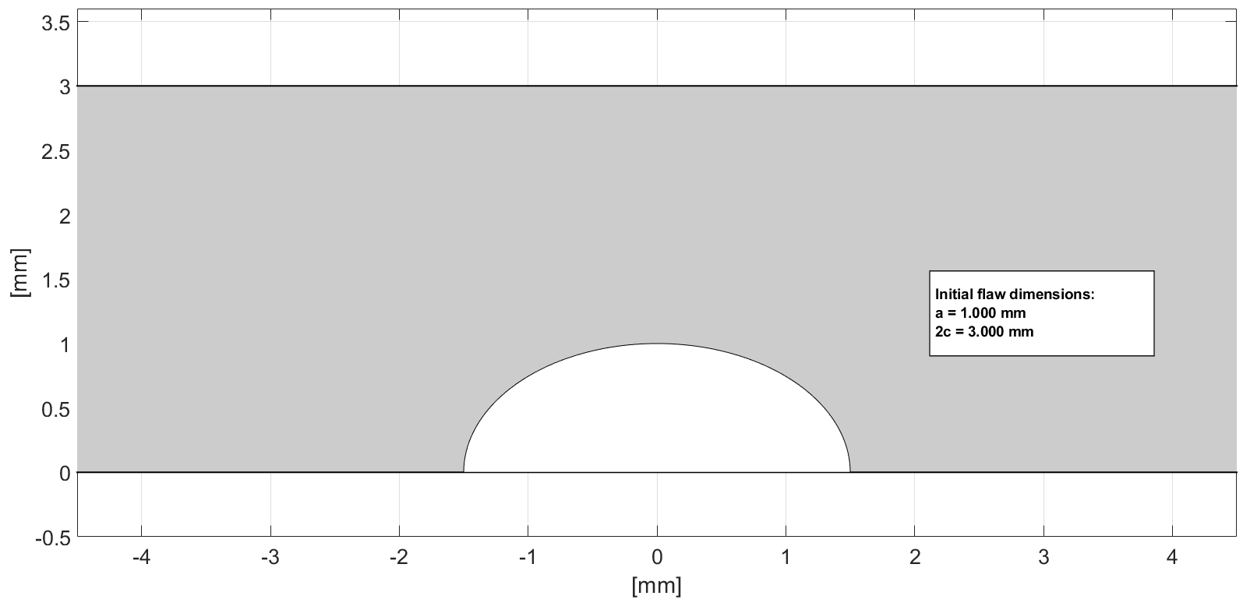

Fracture mechanics simulation
A code for the simulation of crack growth has been developed following the ITER codes*
The results are cross-checked (in terms of stress intensity factors) with FEA results
Input data:
  a=1mm; 2c=3mm
  t=3mm; w=29mm
  σ_{t}=200MPa
*ITER Magnet Structural Design Criteria Part 1: Main Structural Components and Welds (2FMHHS)

Slide 7
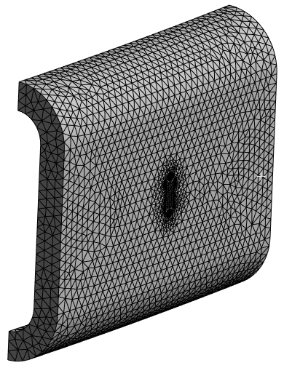
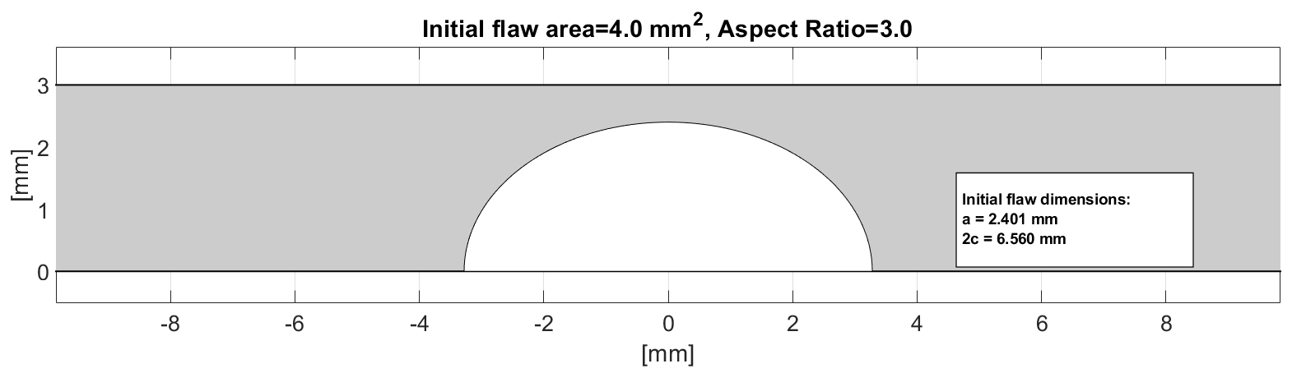
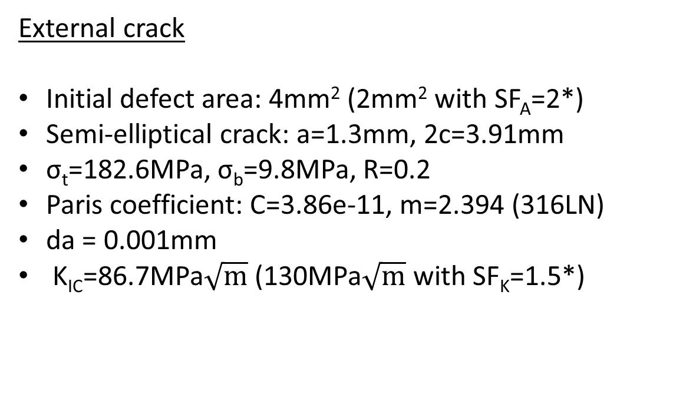
Crack simulation on jacket ring: external crack
External crack
Initial defect area: 4mm² (2mm² with SF_{A}=2*)
Semi-elliptical crack: a=1.3mm, 2c=3.91mm
σ_{t}=182.6MPa, σ_{b}=9.8MPa, R=0.2
Paris coefficient: C=3.86e-11, m=2.394 (316LN)
da = 0.001mm
K_{IC}=86.7MPa$\sqrt{m}$ (130MPa$\sqrt{m}$ with SF_{K}=1.5*)
*ITER Magnet Structural Design Criteria Part 1: Main Structural Components and Welds (2FMHHS)

Slide 8
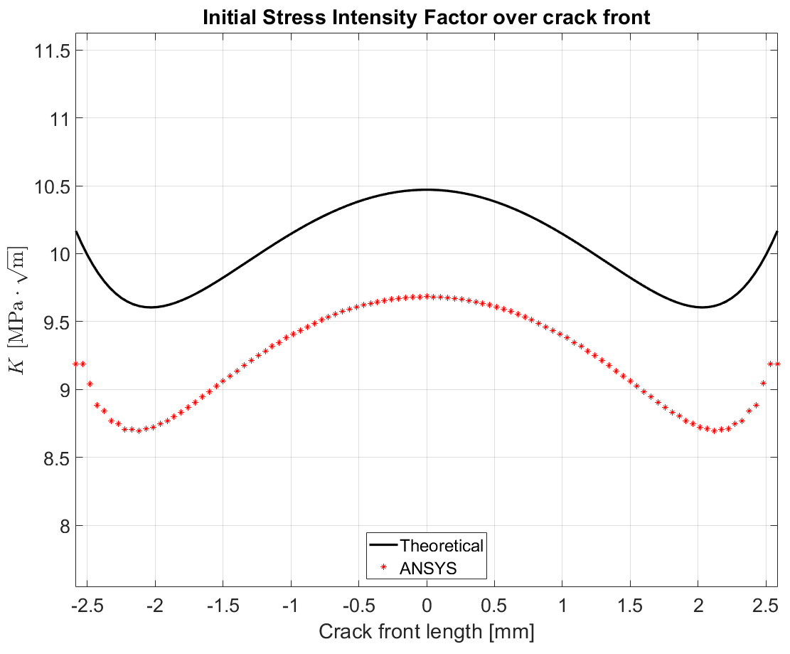
Crack simulation on jacket ring: external crack
Analytical vs Numerical:
Similar trend
Analytical model provides greater values (~8%) with respect to numerical ones
This discrepancy can be attributable to:
  the conservative nature of the analytical solution
  inherent structural stiffness of the ring geometry, which provides greater crack-closure constraint compared to the equivalent flat plate model

Slide 9
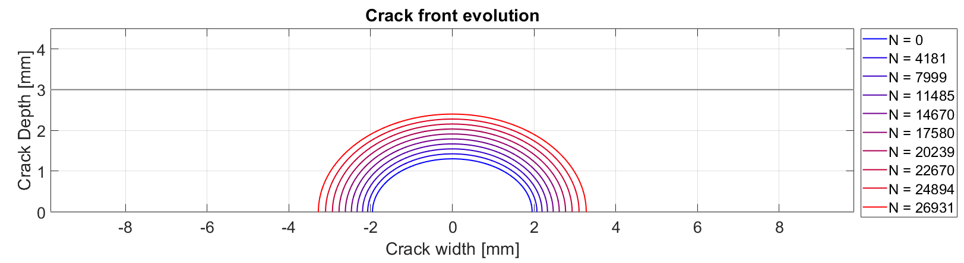
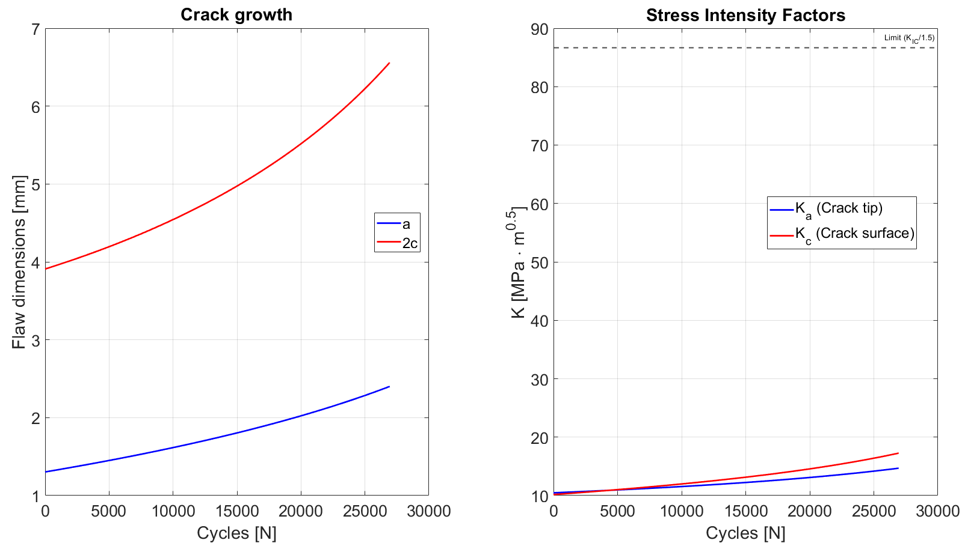
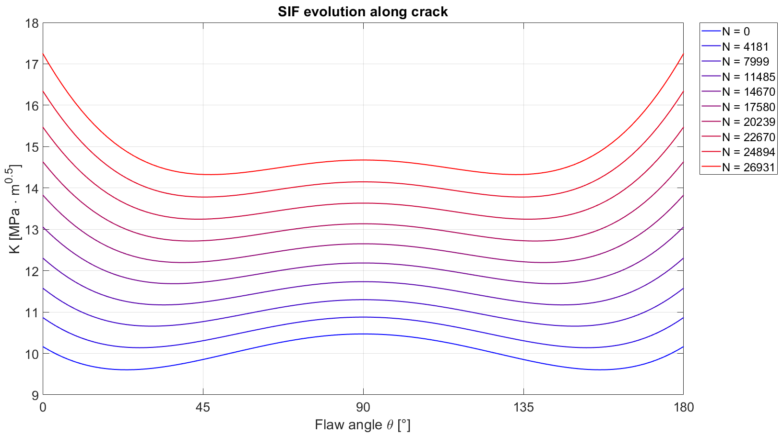
Crack simulation on jacket ring: external crack
Number of cycles before failure: 26931 (with SF_{N}=2)
Failure mode: a=0.8·t
K<<K_{IC}
Minimum 25 days test
(20s/cycle - 6h/d - no issues)

Slide 10
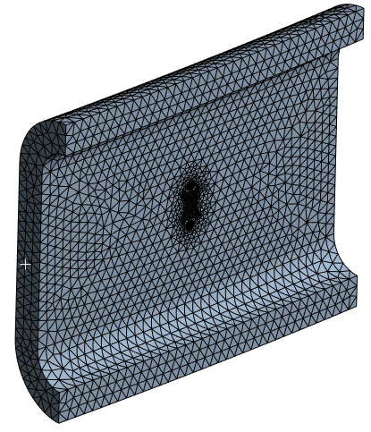
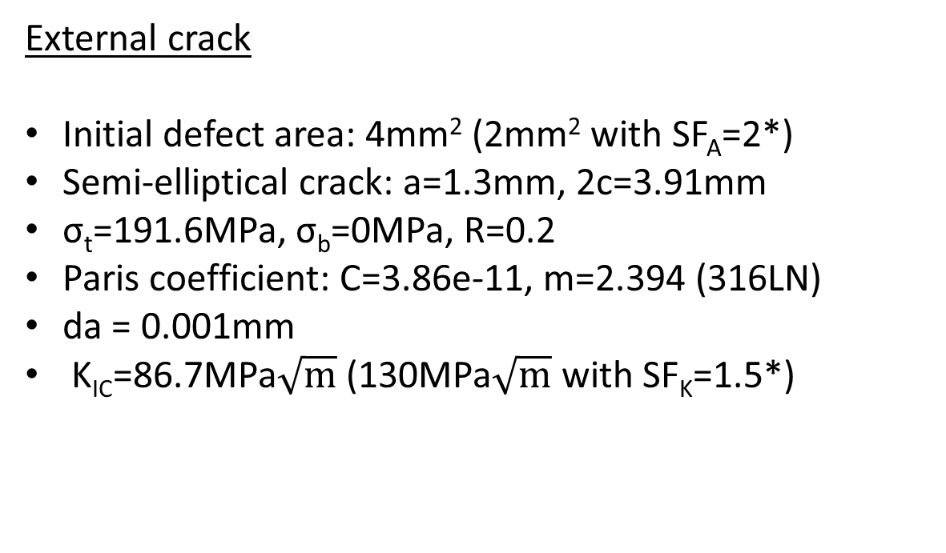
Crack simulation on jacket ring: Internal crack
External crack
Initial defect area: 4mm² (2mm² with SF_{A}=2*)
Semi-elliptical crack: a=1.3mm, 2c=3.91mm
σ_{t}=191.6MPa, σ_{b}=0MPa, R=0.2
Paris coefficient: C=3.86e-11, m=2.394 (316LN)
da = 0.001mm
K_{IC}=86.7MPa$\sqrt{m}$ (130MPa$\sqrt{m}$ with SF_{K}=1.5*)
*ITER Magnet Structural Design Criteria Part 1: Main Structural Components and Welds (2FMHHS)

Slide 11
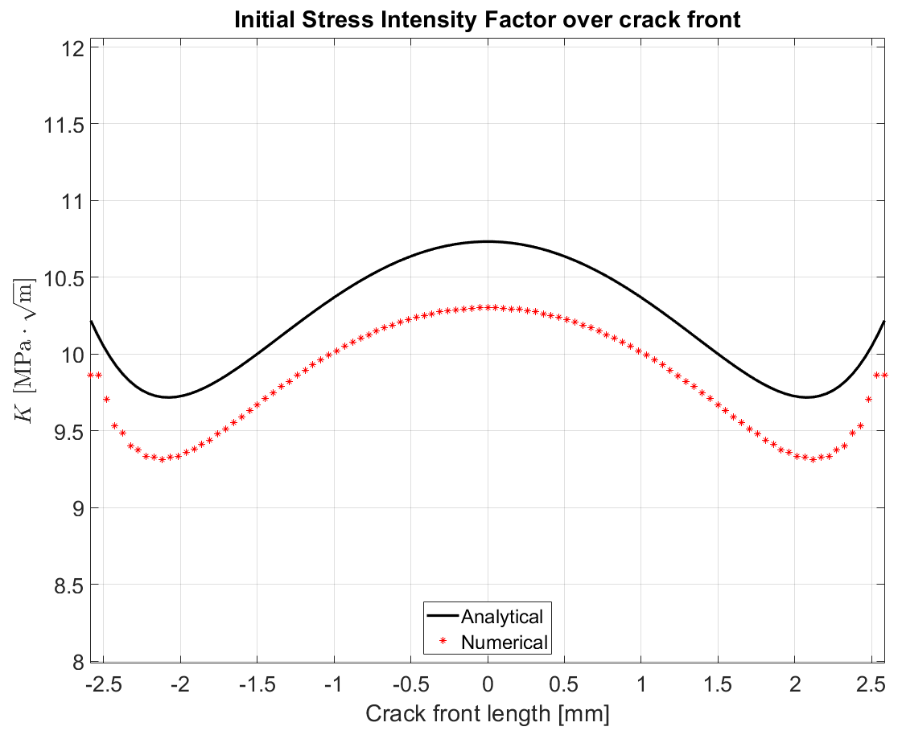
Crack simulation on jacket ring: Internal crack
Analytical vs numerical:
Similar trend.
Analytical model provides greater values (~4%) with respect to numerical ones.
As for the external crack, the overestimation can be attributed to the conservative nature of the analytical solution and to the ring geometry.

Slide 12
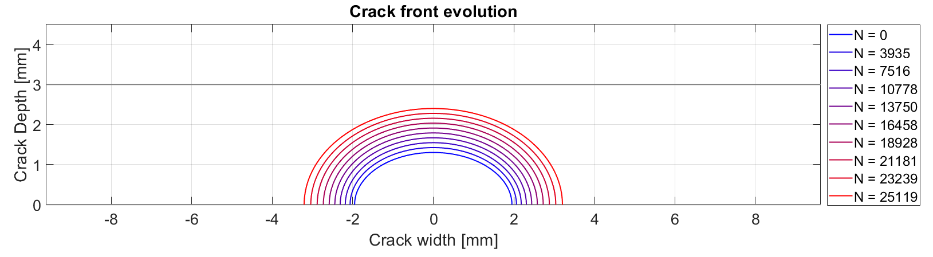
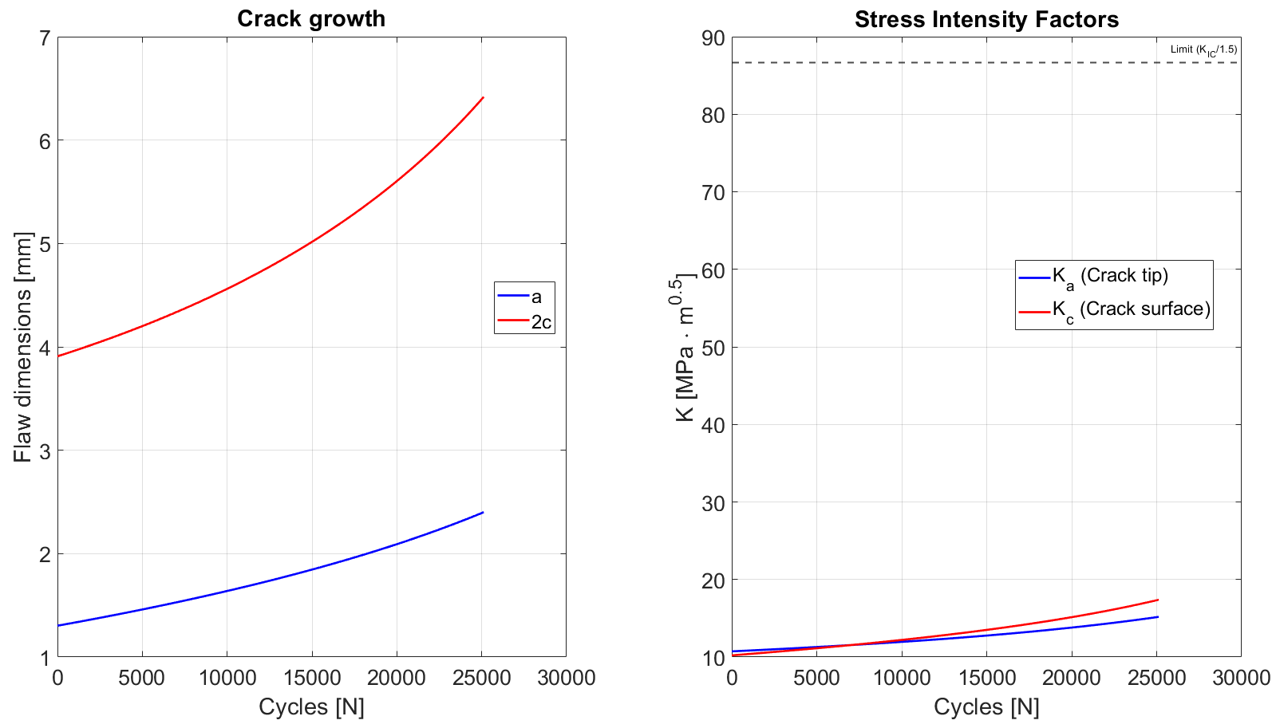
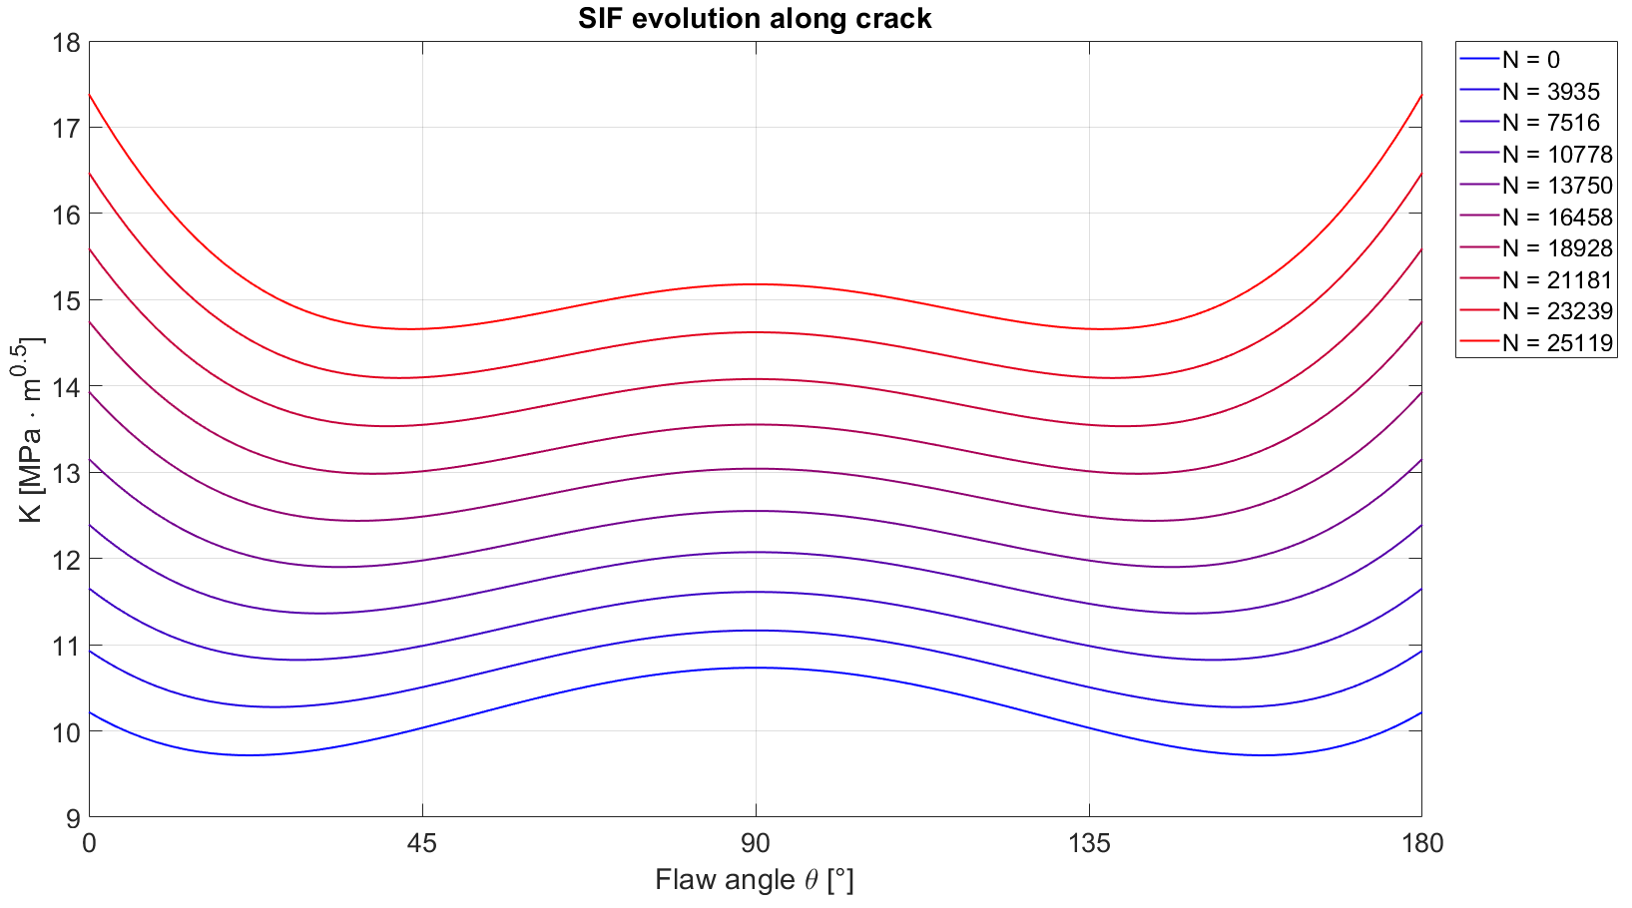
Crack simulation on jacket ring: Internal crack
Number of cycles before failure: 25119 (SF_{N}=2)
Failure mode: a=0.8·t
K<<K_{IC}
Minimum 23 days test
(20s/cycle - 6h/d - no issues)

Slide 13
Summary
A FEM model of the jacket has been developed and used to evaluate the experimental loading cycle amplitude, considering all the boundary constraints.
A code the crack growth has been developed based on ITER design codes. The results, in terms of SIF along crack front, were successfully cross-checked against numerical simulations.
Once available, the experimental results will be compared to those obtained by the developed code.

Slide 14
Advanced finite element modeling to support the experimental test
MAG-S.01.04-T023-D001
WPMAG 2025 Final Meeting, 15-Jan-2026
F. Giorgetti

Slide 15
Scope of the work
Compare the crack propagation, on metallic components, predicted by means ITER design codes and experimentally derivate.
A series of tests are planned to study the evolution of artificial defects on a steel jacket. Specifically, tests will be performed on a linear jacket (with a 4-point bending test) and on a ring jacket.
Ring jacket test will be performed at ENEA making use of the Testing Facility already developed to test the ITER pre compression rings.

