Slide 1



Lumped parameter circuit model for hysteresis losses in sector shaped HTS cables
Antonio Macchiagodena¹, Marco Breschi¹,
Gianluca De Marzi², Francesco Grilli³, and Laura Savoldi⁴
1 Alma Mater Studiorum - Università di Bologna, Italy
2 ENEA, Italy
3 Karlsruhe Institute of Technology, Germany
4 Politecnico di Torino, Italy
WPMAG final meeting 2026
January 15th 2026,
EPFL-SPC, Villigen

Slide 2

Outline
Evolution of the CALYPSO code for HTS devices modelling
Model description
Application to HTS-CICC twisted stacked cables
Simulation results and benchmarking of numerical codes
Conclusions & Perspectives
2

Slide 3
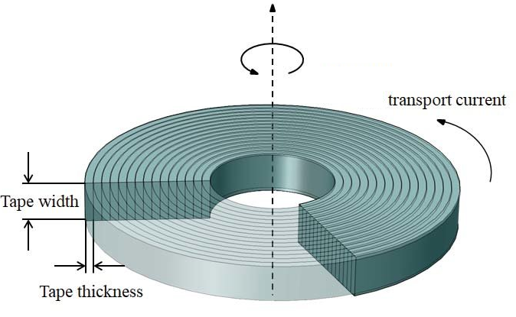
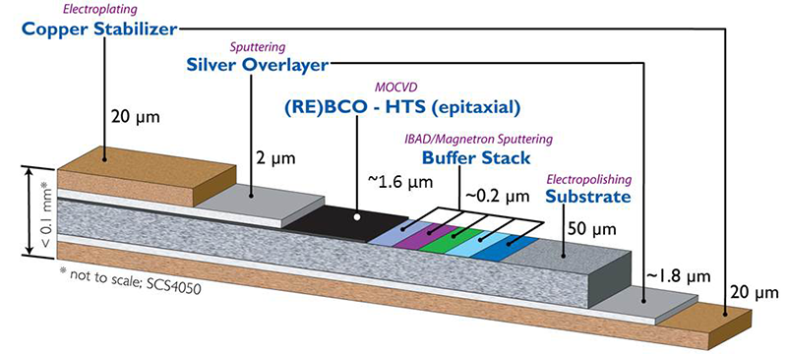
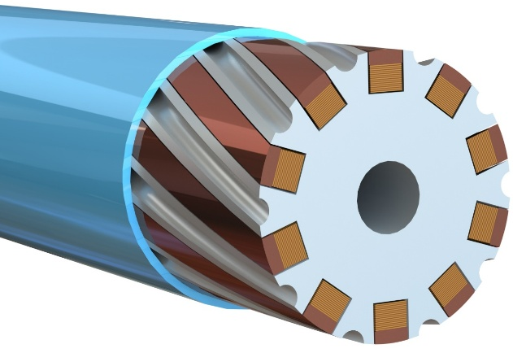
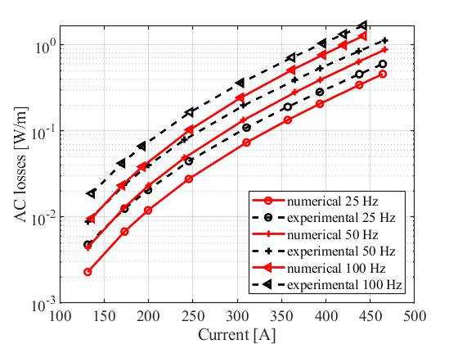
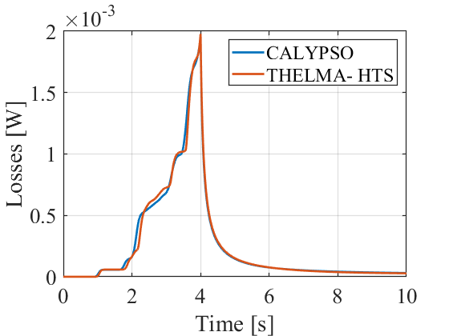
CALYPSO case study
In recent years, the CALYPSO code was developed at UNIBO.
HTS tapes
HTS NI coils
HTS Twisted Stacked Cables
benchmark
benchmark
[*] M. Breschi, et al IEEE Trans. Appl. Supercond., vol. 34, n. 3, 4604505, 2024.
[*] M. Breschi, et al. IEEE Trans. Appl. Supercond., vol 35, n. 5, 4902305 2025.
[*] A. Macchiagodena, et al. accepted for publication on IEEE Trans. Appl. Supercond.
3

Slide 4
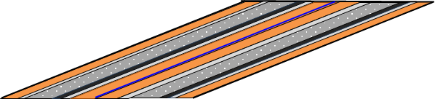
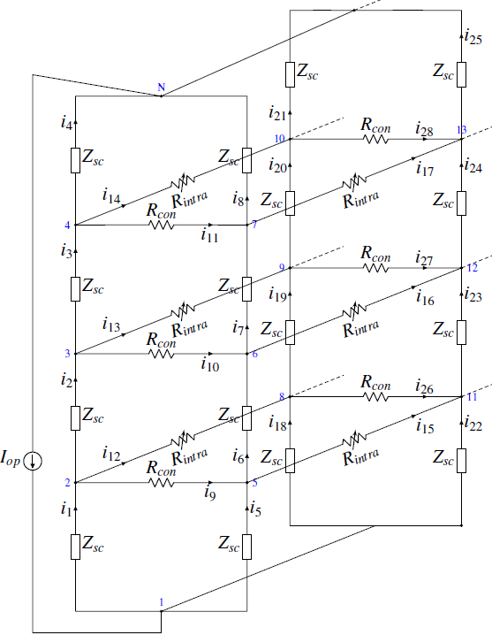

Model description (1/2)
Circuit model for a 2-tapes
TSTC
Each tape is subdivided across its width into N_{N} sub-elements.
The tapes are further divided along their length into N_{D} longitudinal elements.
Cable
length
Tape
width
4

Slide 5
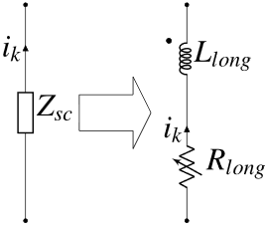
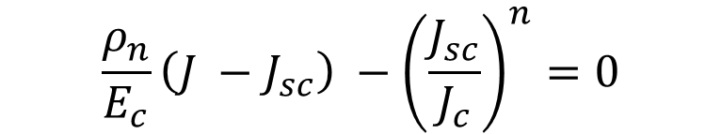
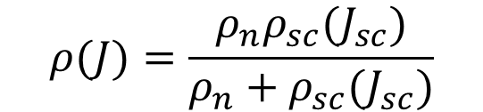
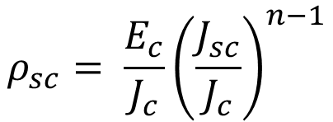
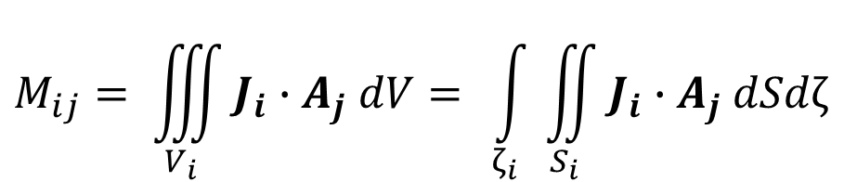
Model description (2/2)
Longitudinal elements modeled as a superconducting element in parallel with the stabilizer and in series with an inductor.
All inductors are mutually coupled.
Numerical calculation of the mutual inductance matrix.
Integration over the cross-section of the superconducting layer of the longitudinal elements, and along the local axial coordinate ζ.
$$ρ(J)=\frac{ρ_{n}ρ_{sc}(J_{sc})}{ρ_{n}+ρ_{sc}(J_{sc})}$$
$$M_{ij}= \iiint_{V_{i}}{J_{i}{∙A}_{j}dV= }\int_{ζ_{i}}{\iint_{S_{i}}{J_{i}{∙A}_{j}dSdζ}}$$
$$\frac{ρ_{n}}{E_{c}}\left(J −J_{sc}\right) −{\left(\frac{J_{sc}}{J_{c}}\right)}^{n}=0$$
$$ρ_{sc}= \frac{E_{c}}{J_{c}}{\left(\frac{J_{sc}}{J_{c}}\right)}^{n−1}$$
ζ
5

Slide 6
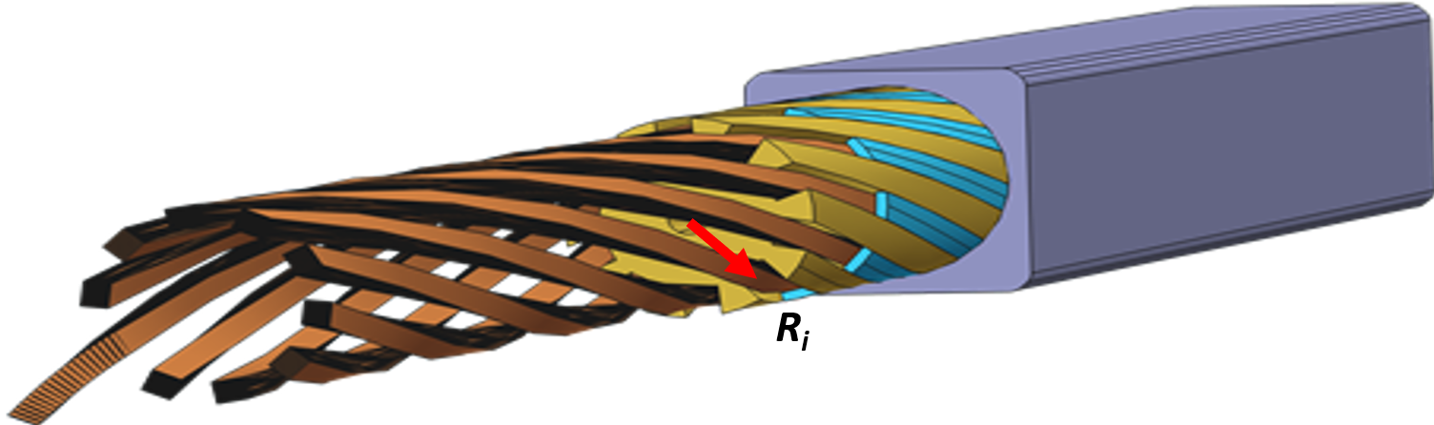
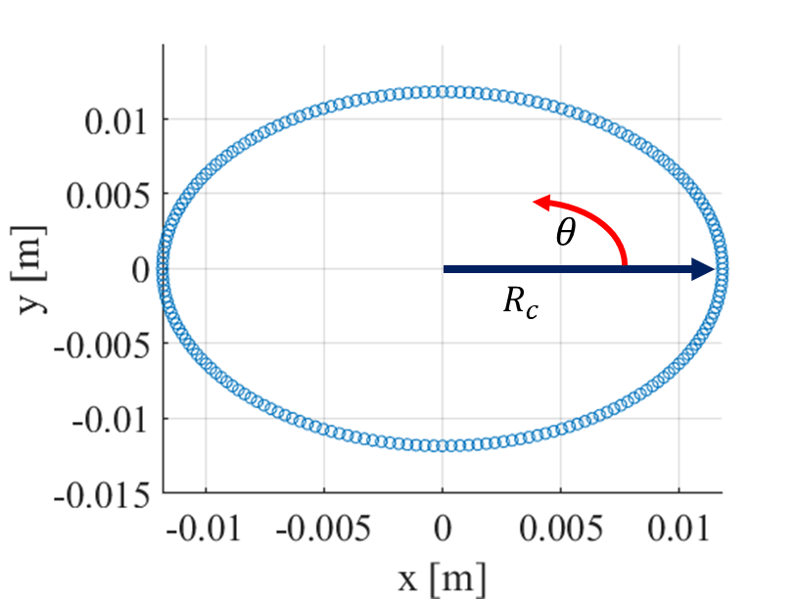
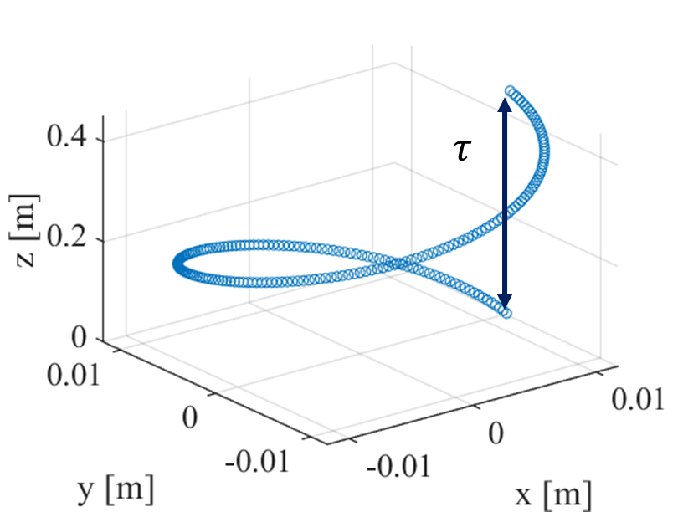
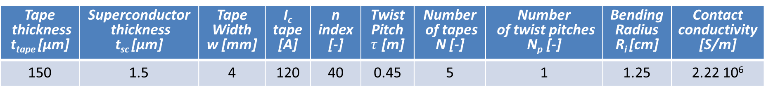
Analysis of REBCO tapes twisted stack
HTS twisted stacked cable
The CALYPSO model was applied to the study of one twist pitch of an HTS-CICC with twisted stacked configuration.
CALYPSO was benchmarked against the results of the validated THELMA code developed at UNIBO [*], and a 2D COMSOL model (T-A formulation).
Stack axis trajectory
Tape thickness t_{tape} [µm] | Superconductor thickness t_{sc} [µm] | Tape Width w [mm] | I_{c} tape [A] | n index [-] | Twist Pitch $τ$ [m] | Number of tapes N [-] | Number of twist pitches N_{p} [-] | Bending Radius R_{i} [cm] | Contact conductivity [S/m]
150 | 1.5 | 4 | 120 | 40 | 0.45 | 5 | 1 | 1.25 | 2.22 10⁶
[*] P. Ribani, et al “Thelma code analysis of bronze route Nb₃Sn strand bending effect on Ic,” IEEE trans. on app. Supercond., vol. 16, no. 2, 2006.
6

Slide 7
Model benchmark
Case study
A set of simulations was performed with a transport current ramp up to 75 % of the stack critical current (450 A) in 4 s, followed by a current plateau of 196 s.
J_{c} is kept constant throughout the simulation.
7

Slide 8
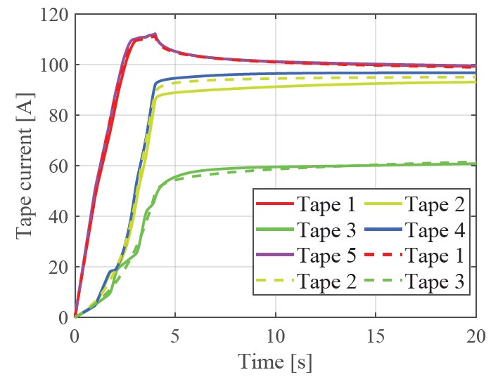
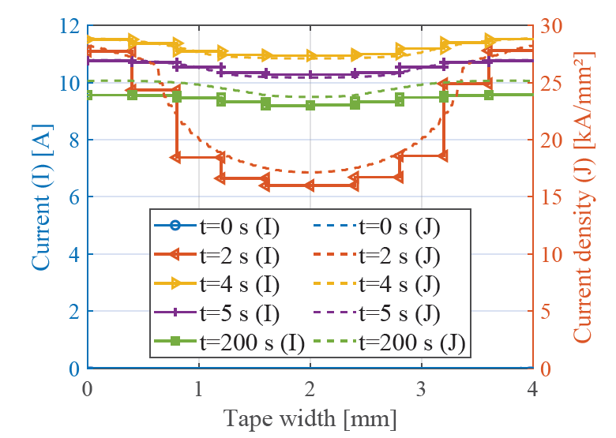
Current distribution inside the tape/stack
Within each tape, a larger fraction of the transport current concentrates near the edges.
In the stack, tapes in the outermost position exhibit higher current levels.
Uneven current distribution between the tapes persists even after 200 s.
8

Slide 9
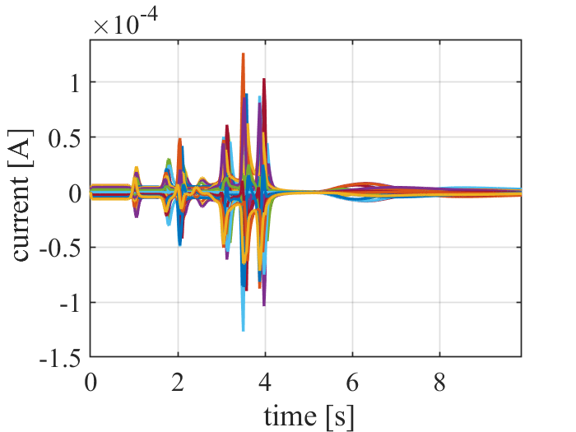
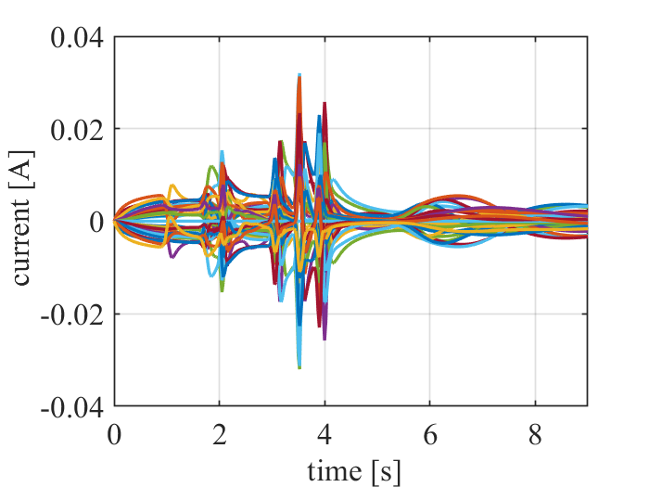
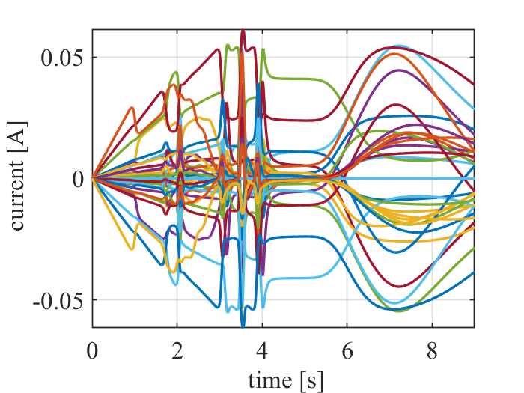
Losses dependence on contact resistance
The current in the contact resistances between tapes increases with the contact conductance.
The impact of the coupling losses between tapes on the total losses is, however, negligible.
Reference case
Contact resistance x 10⁻³
Contact resistance x 10⁻⁶
9

Slide 10
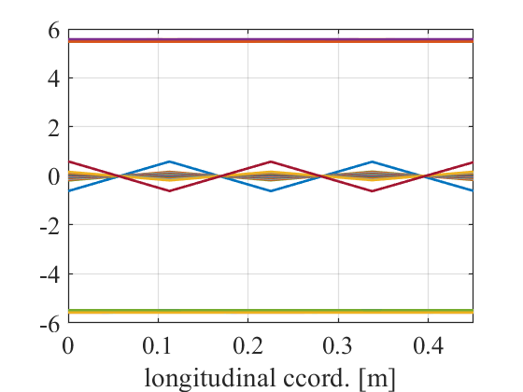
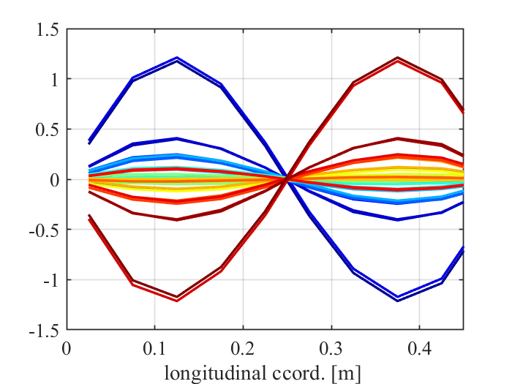
External magnetic field
External magnetic fields are incorporated into the model through inductive coupling with three large solenoids, which reproduce the three components (Bx, By, Bz) of the desired magnetic field. Two cases were investigated, field parallel/orthogonal to the cable axis, without transport current.
Mutual inductances have also been introduced for the non-longitudinal elements. These mutual inductances are only between the considered elements and the external solenoids.
THELMA results
CALYPSO results
Parallel field
Orthogonal field
Parallel field
Orthogonal field
10
10

Slide 11
Conclusions & Perspectives
The CALYPSO code developed at UNIBO was adapted to compute AC losses during electrodynamic transients in twisted stacked conductors.
The model computes both the magnetization currents flowing in individual tapes and the transverse currents flowing from tape to tape.
CALYPSO results were successfully benchmarked against those of the THELMA code and of a 2D COMSOL model.
The simulations indicate that the losses during the transport-current plateau are not negligible with respect to those computed during the ramp-up phase and should therefore be included in loss estimations.
The introduction of an external time varying magnetic field in the model was completed. Given some discrepancies with other models, further investigations are required on the updated model and results.
11
11

Slide 12
Thank you for your kind attention !
Antonio Macchiagodena, Marco Breschi,
Gianluca De Marzi, Francesco Grilli, and Laura Savoldi
Antoni.macchiagoden2@unibo.it

Slide 13
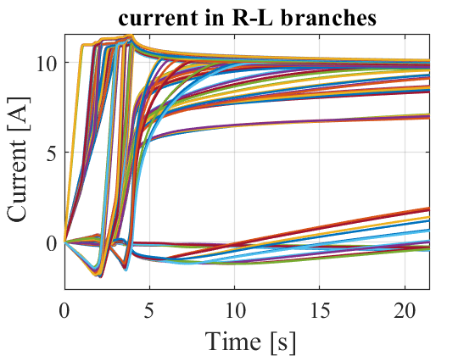
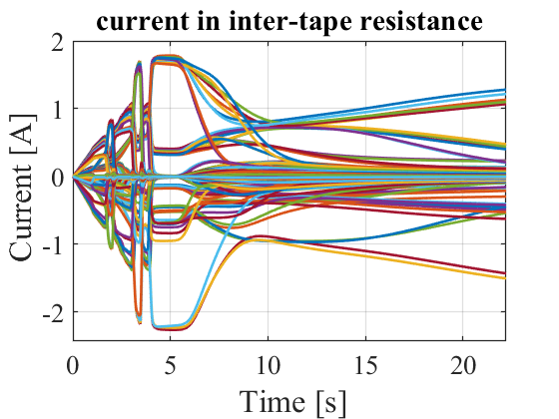
Results on HTS twisted stack (2/3)
Convergence is reached with at least 10 elements across the tape width and 10 along the twist pitch.
While analytical models predict zero losses during the plateau, simulations show magnetization losses during the plateau comparable to those of the ramp-up.
Longitudinal
currents
Intra-tape
currents
End of the ramp
End of the ramp
13
13

