Slide 1
Thermal-Hydraulic cryogenic studies : CS margin exploration WPMAG Final meeting 15/01/2026 François Bonne

Slide 2
Thermal-Hydraulic cryogenic studies
Case studied : how to increase the margin (or reduce the superconducting amount) of the a CS at reasonable cryogenic cost?
Lower the inlet temperature
Lower the Inlet Temperature when needed
Depressurize the loop
We will take advantage of the CS margin being low for a very short amount of time

Slide 3
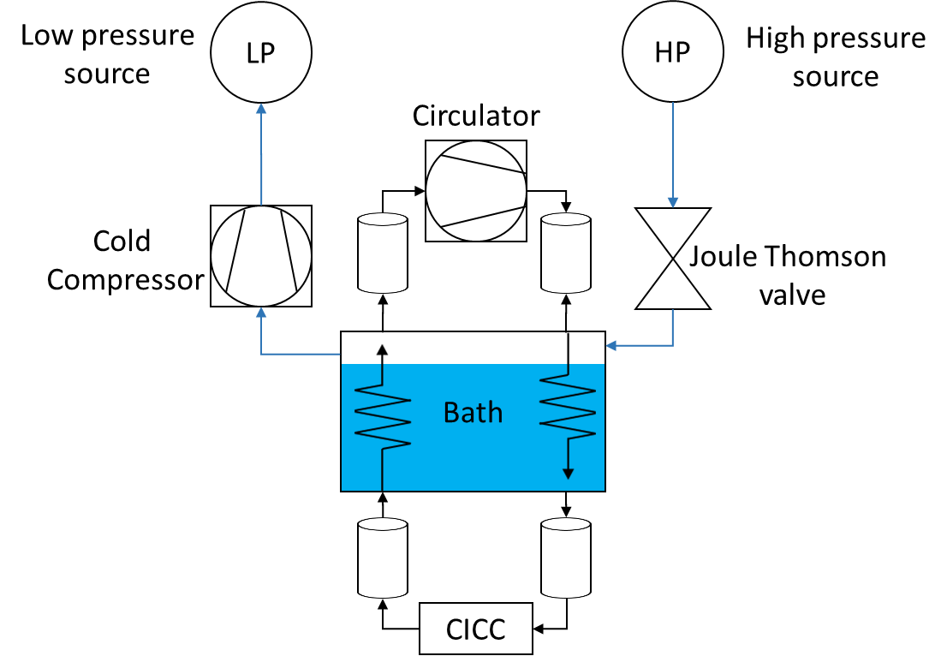
SHe helium loop
Simcryogenics to model the CS with a Supercritical helium loop → Relevant behavior of a CICC including its cooling process circuit
Pipe length and diameter (inspired by WPDES)
Pipe | Section | Diameter (mm) | Length (m)
Upstream and downstream the conductor | Close to the bath | 125 | 33.5
 | Middle | 100 | 35.2
 | Close to the conductor | 50 | 1.6
Upstream and downstream the circulator |  | 125 | 2.0

Slide 4
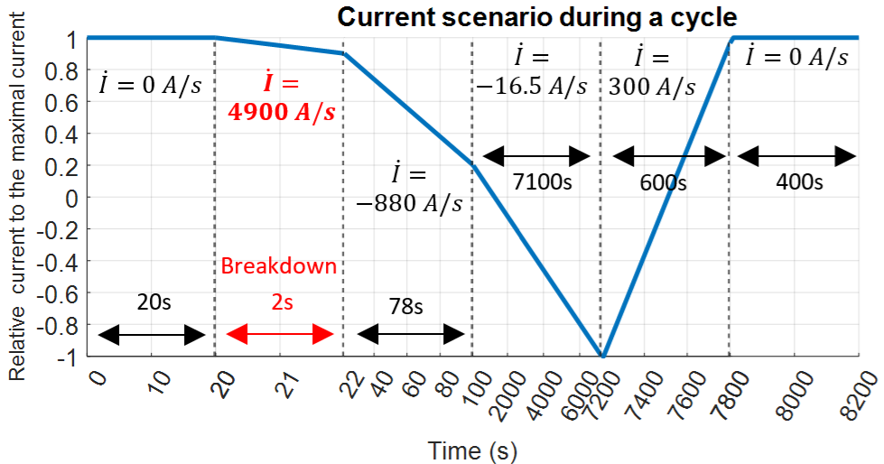
Current scenario and AC losses
The same current scenario is applied since 2022 to help with comparisons. The CS design has not changed for the same reason
(time not linear)

Slide 5
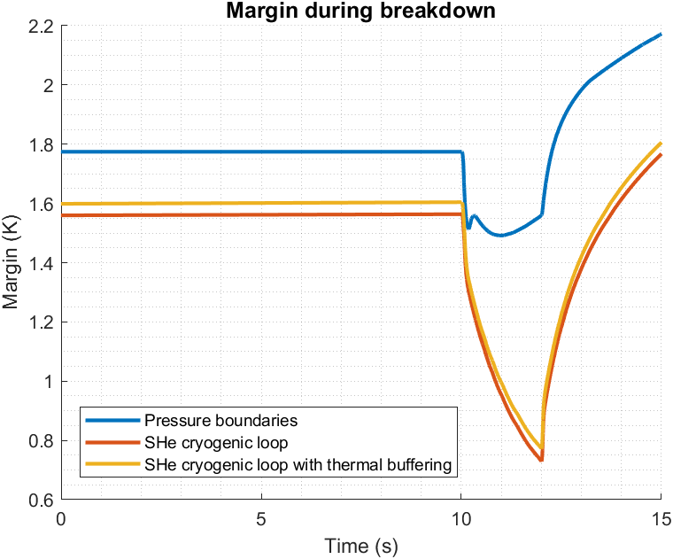
Context : Margin loss
Initially, the model used pressure boundaries to compute margin.
Then, implementation of SHe cryogenic loop and thermal buffering in the model has been done. Each ones contributing of a more relevant behavior of the system but causing margin loss.
Pressure boundaries
SHe cryogenic loop
With thermal buffer : +0,4K allowed inside the bath
5 bars
4,6K
Magnet
6 bars
4,5 K
HXPS1 to circulator pipes
Circulator to HXPS2 pipes
HP1
HP
LP
Load valve
Cold compressor
Joule Thomson valve
HXPS1
HXPS2
Bath 1 : 4,4K
Return pipes
Supply pipes
Magnet
Unload valve
LP1
0,75 K lost due to implementation of cryogenic loop and around 50 mK lost due to thermal buffering (0,4K maximal temperature increase allowed inside the bath).

Slide 6
How to regain margin using different configurations ?
Lower the inlet temperature
Lower the Inlet Temperature when needed
Depressurize the loop

Slide 7
How to regain margin ? Single bath configuration thermally bufferized
1 bath configuration with a nominal CICC pressure of 6 bars
HXPS1 to circulator pipes
Circulator to HXPS2 pipes
HP1
HP
LP
Load valve
Cold compressor
Joule Thomson valve
Bath 1 : T < 4,4K
Decrease bath temperature until the magnet reaches suitable temperature margin
HXPS1
HXPS2
Bath 1 : 4,4K
Easiest way to regain margin
Return pipes
Supply pipes
High « cryogenic » cost as cooler SHe during all the cycle
Unload valve
Magnet
LP1

Slide 8
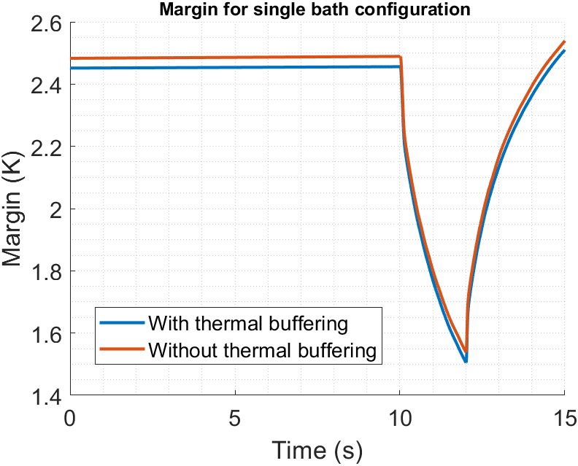
How to regain margin ? : Single bath configuration, thermal buffer impact on margin
Bath temperature set to 3,43 K to obtain 1,5 K margin
 | Minimal margin (K)
With thermal buffering | 1,5046
Without thermal buffering | 1,5379
33 mK margin lost due to thermal buffering

Slide 9
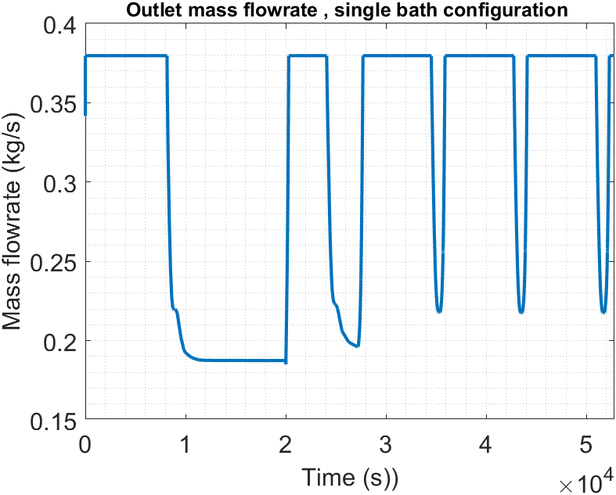
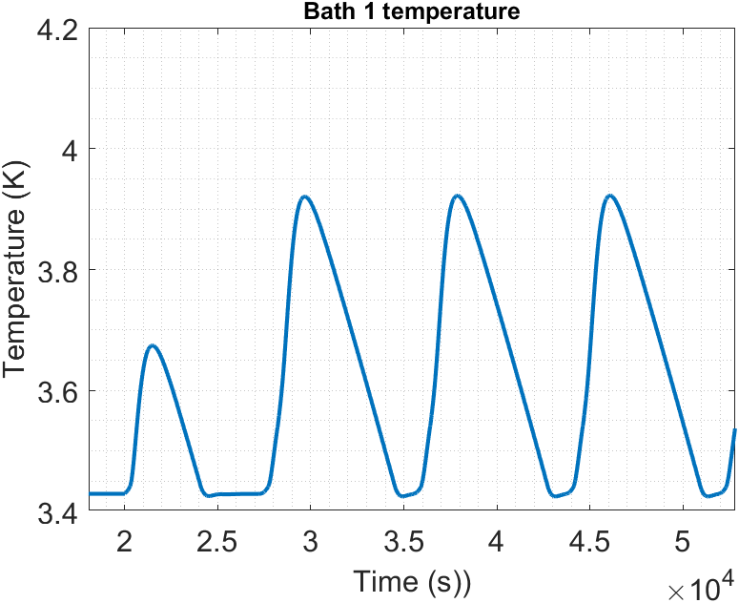
How to regain margin ? : Single bath configuration thermally bufferized
Bath temperature set to 3,43K to obtain 1,5 K margin
HXPS1 to circulator pipes
Circulator to HXPS2 pipes
HP1
HP
LP
Load valve
Cold compressor
Joule Thomson valve
0,5 K increase
HXPS1
HXPS2
Bath 1 : 3,43K
Volume = 50,4 m3
Return pipes
Supply pipes
Unload valve
Magnet
LP1

Slide 10
How to regain margin : 2 baths configurations
2 baths configuration with a nominal CICC pressure of 6 bars
HP
LP1
HP1
HXPS1 to circulator pipes
Circulator to HXPS2 pipes
LP
Cold compressor
Joule Thomson valve
Cryogenic cost more optimized. Second bath used only preventively to cool down SHe before breakdown
HXPS1
HXPS2
Bath 2 : T° < T° Bath 1
Bath 1 : 4,4K
Return pipes
Supply pipes
Magnet

Slide 11
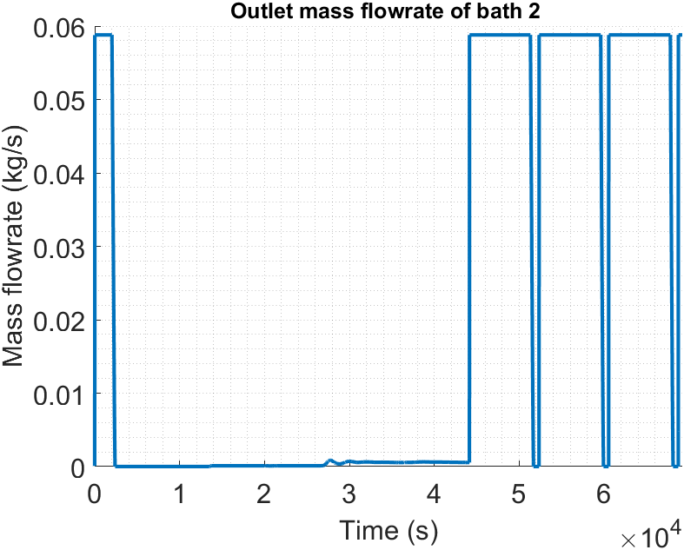
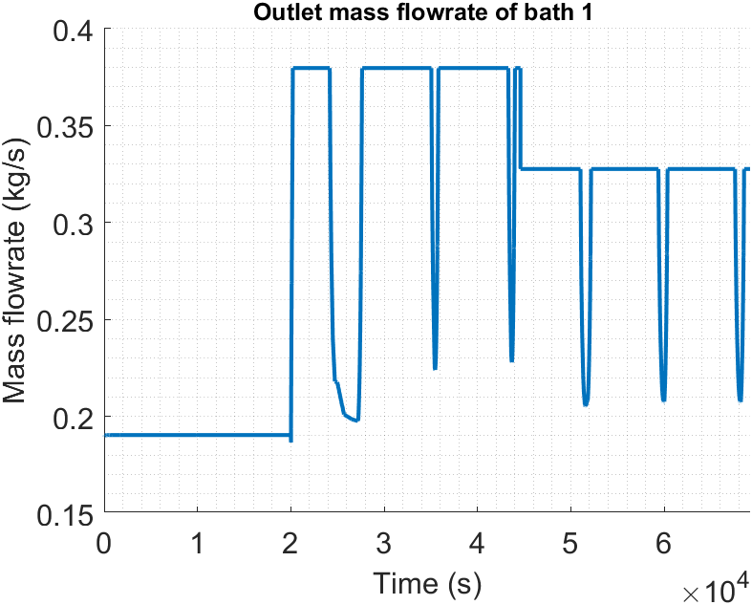
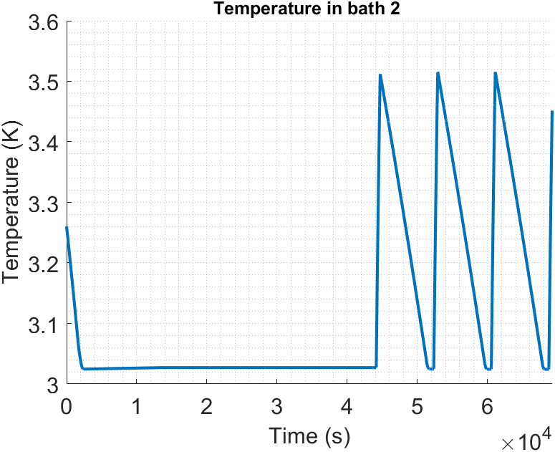
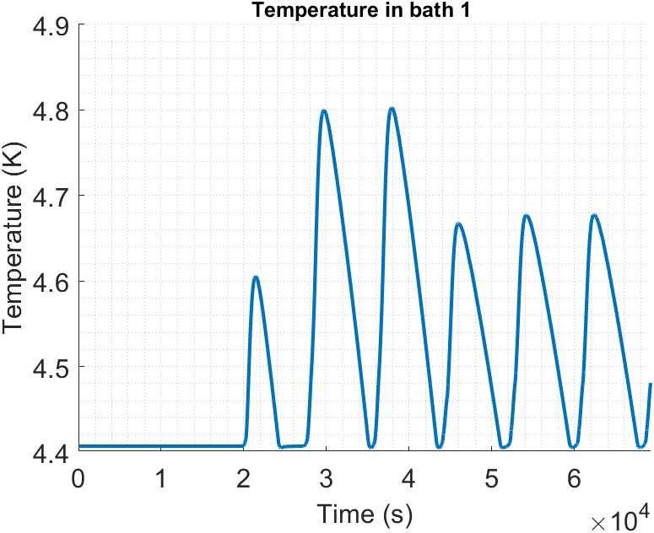
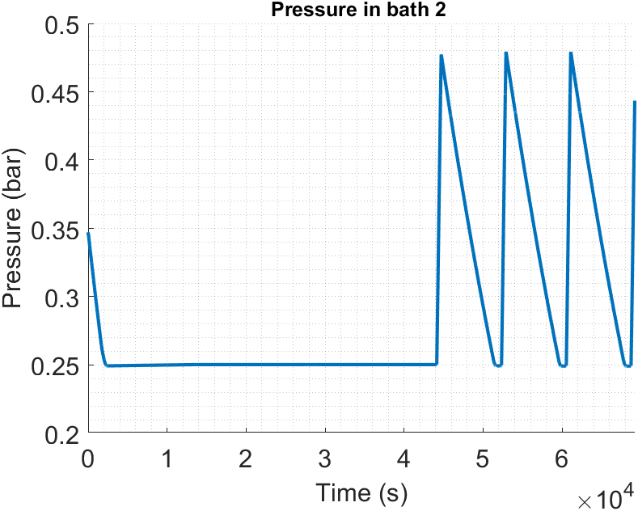
How to regain margin : 2 baths configurations
HP
LP1
HP1
HXPS1 to circulator pipes
Circulator to HXPS2 pipes
LP
Joule Thomson valve
Cold compressor
HXPS1
HXPS2
Bath 1 : 4,4K
Volume = 50,4 m3
Bath 2 : 3,02 K
Volume = 37,6 m3
Return pipes
Supply pipes
0,5 K increase
Magnet
0,25 to 0,4 K increase

Slide 12
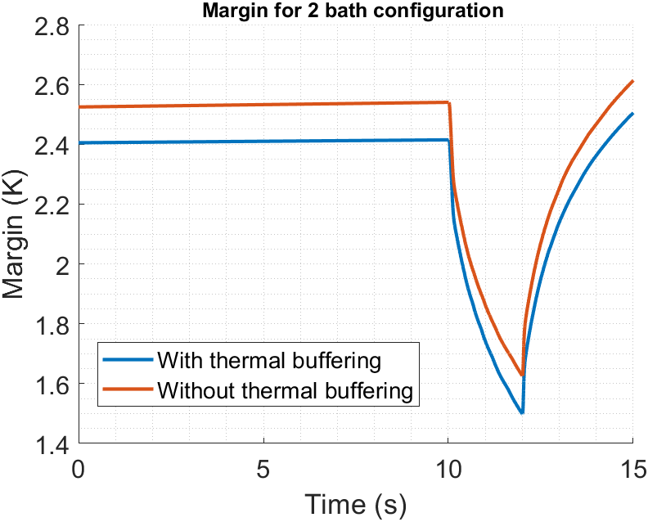
How to regain margin ? : 2 bath configuration, thermal buffer impact on margin
 | Minimal margin (K)
With thermal buffering | 1,498
Without thermal buffering | 1,626
128 mK margin lost due to thermal buffering

Slide 13
Simcryogenics : 10 bars ramp discharge at a nominal CICC pressure of 14 bars
10 bars ramp discharge with a nominal CICC pressure of 14 bars
HP1
HP
Circulator to HXPS2 pipes
Optimal cryogenic cost as SHe is cooled down only the necessary time (about a dozen of seconds instead of hundreds)
New concept
HXPS1 to circulator pipes
Load valve
LP
Cold compressor
HXPS1
HXPS2
Bath 1 : 4,4K
Unload valve
Return pipes
Supply pipes
Magnet

Slide 14
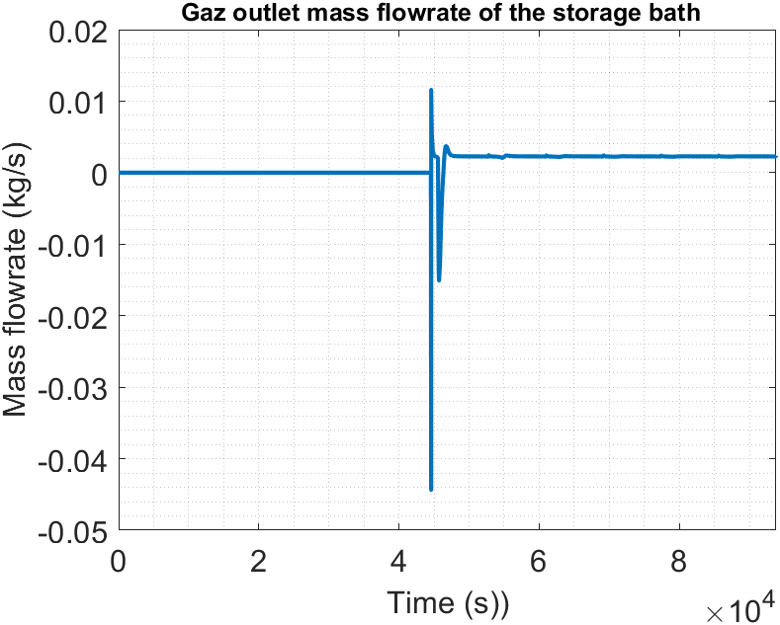
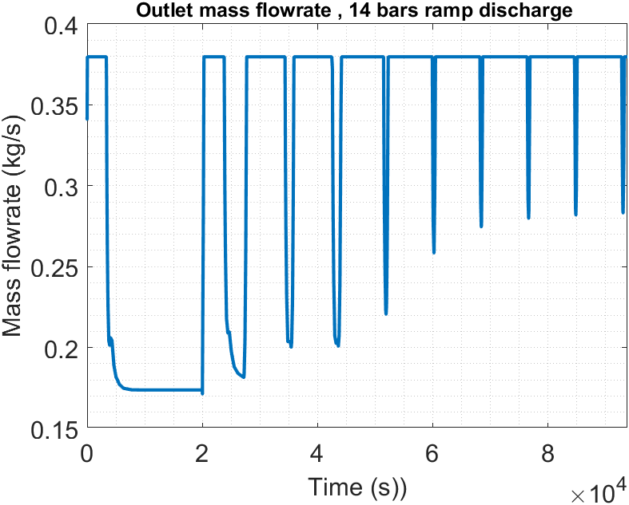
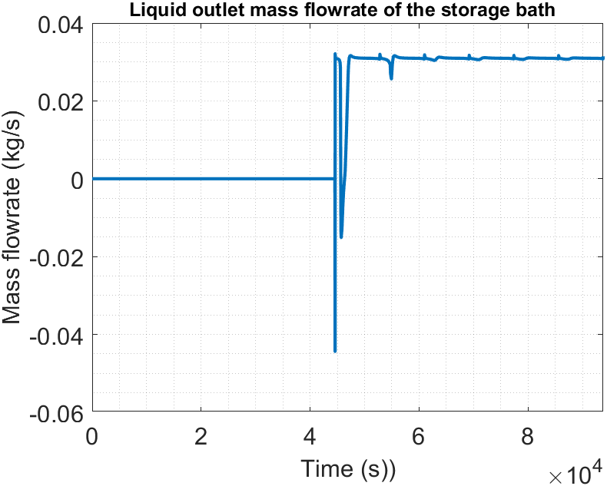
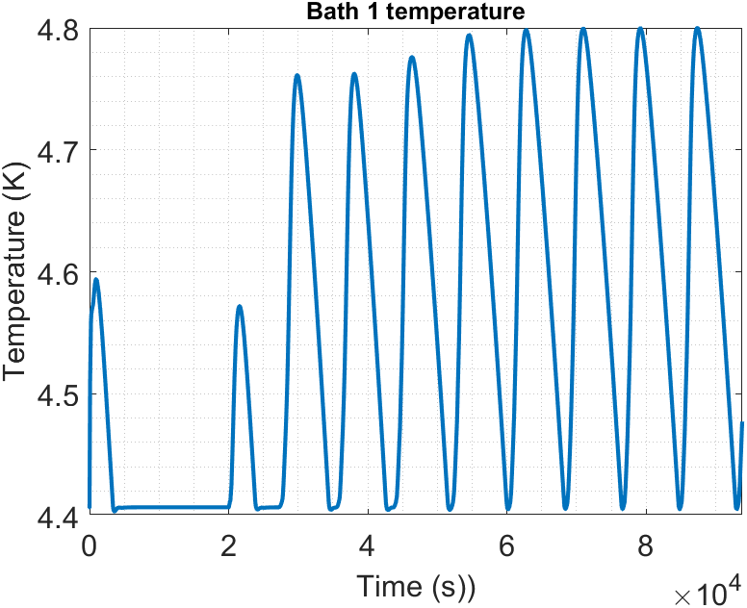
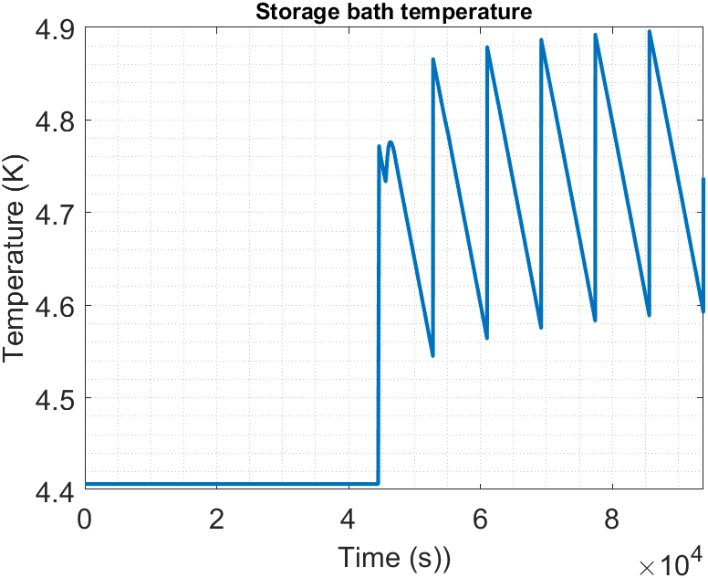
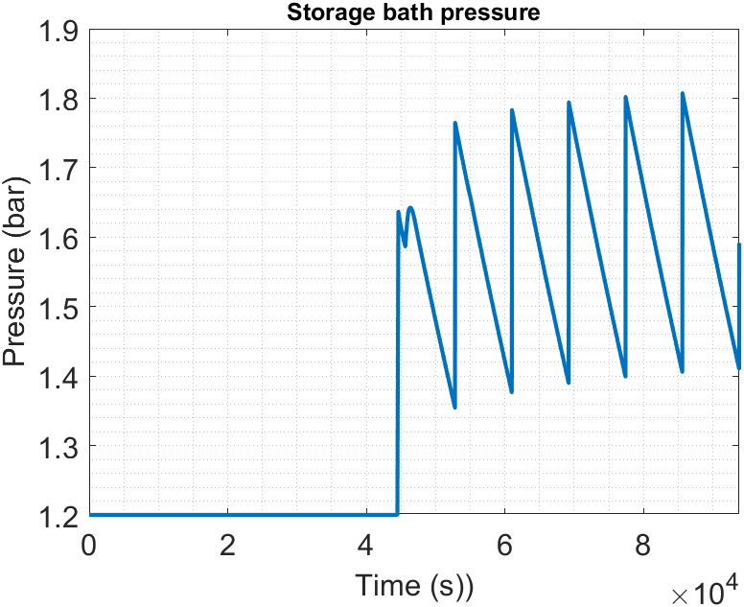
Simcryogenics : 14 bars ramp discharge
HP1
HP
HXPS1 to circulator pipes
Circulator to HXPS2 pipes
Load valve
LP
Cold compressor
HXPS1
HXPS2
Bath 1 : 4,4K
Volume = 50,4 m3
Unload valve
Return pipes
Supply pipes
Liq outlet
Magnet
Gaz outlet
0,35 to 0,4 K increase
Storage bath : 4,4 K
Volume = 12 m3

Slide 15
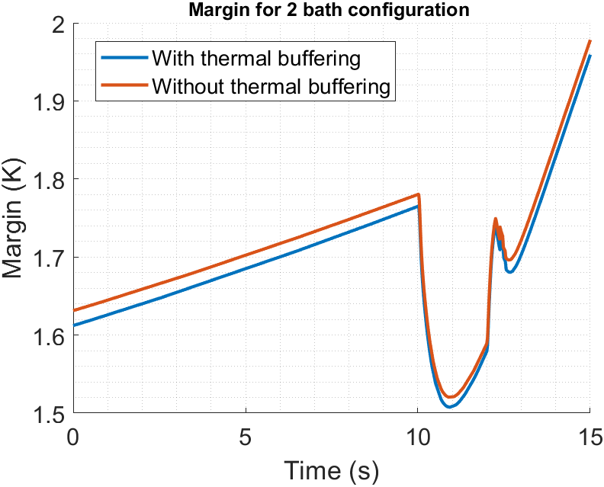
How to regain margin ? :, thermal buffer impact on margin
 | Minimal margin (K)
With thermal buffering | 1,5075
Without thermal buffering | 1,52
12,9 mK margin lost due to thermal buffering

Slide 16
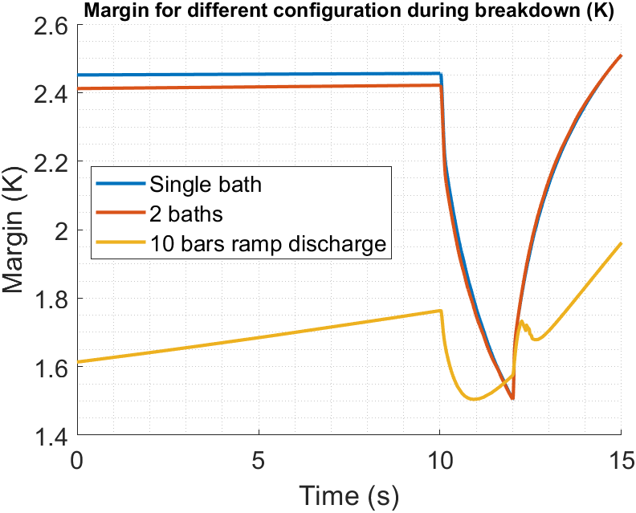
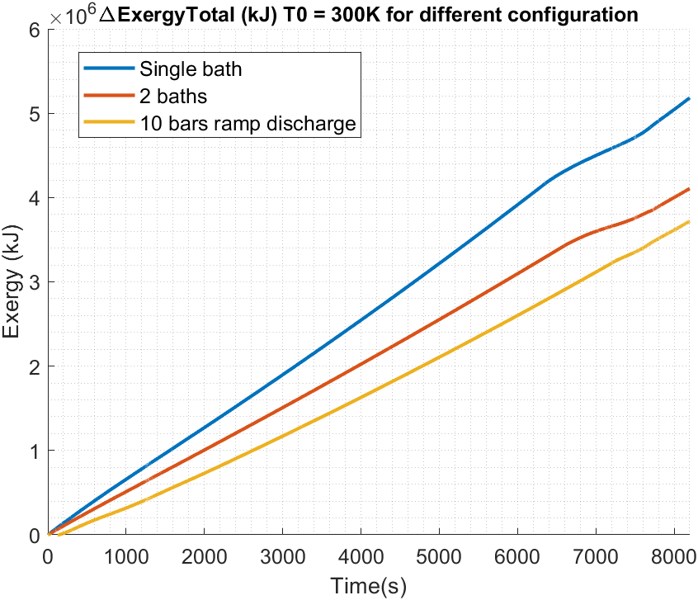
Comparison of thermally bufferized configurations : Margin
 | Total exergy (GJ)
Single bath | 5,18
2 baths | 4,1
10 bars ramp discharge | 3,72
10 bars pre cooling by ramping the discharge produce less total exergy compared to others configurations.
More particularly : 28,2 % less than single bath configuration and 9,1 % less than 2 baths configurations

Slide 17
Conclusion
Magin lost using a realistic cryogenic configuration can be retreive using different cryogenic schemes
Among the presented configuration, the 10 bars ramp discharge with a nominal CICC pressure of 14 bars shows the best results in terms of energy consumtion production (28% and 9,1 % less than single bath and 2 bath configurations respectively)
The lost margin has been recovered and it could be 1,5 K again using this solution

Slide 18
Bonus : Combination of 2 cryogenic processes : 2 baths and 10 bars ramp discharge

Slide 19
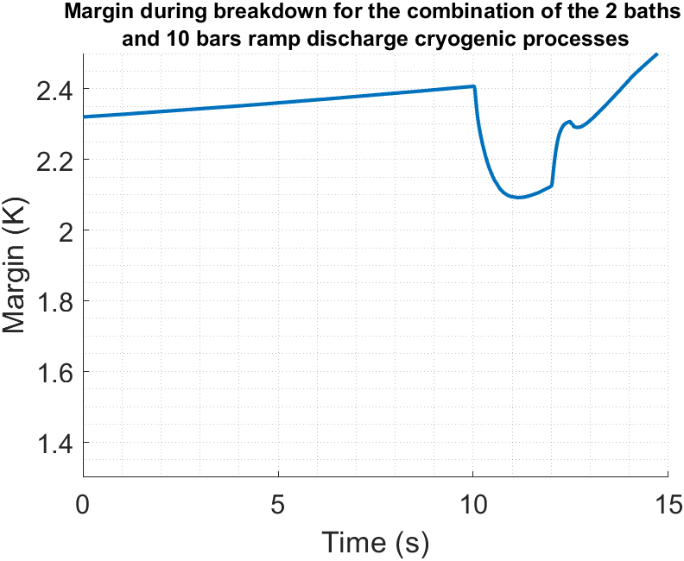
Combination of 2 cryogenic processes : 2 baths and 10 bars ramp discharge with a nominal CICC pressure of 14 bars
HP2
The combination of the 2 cryogenic processes allows to gain 590 mK of margin
HP
LP1
HP1
HXPS1 to circulator pipes
Load valve
LP
Joule Thomson valve
Cold compressor
HXPS1
HXPS2
HXPS3
2,09 K
Bath 1 : 4,4 K
Volume = 50,4 m3
Bath 2 : 3,02 K
Volume = 37,6 m3
Return pipes
Supply pipes
1,5 K threshold
Magnet
Nominal pressure = 14 bars
Unload valve
Gas outlet
Liq outlet
Storage bath : 4,4 K
Volume = 12 m3

Slide 20
Preliminary Costs exploration : Reduction of the CS superconducting amont (simply proportionally, needs to be refine)

Slide 21
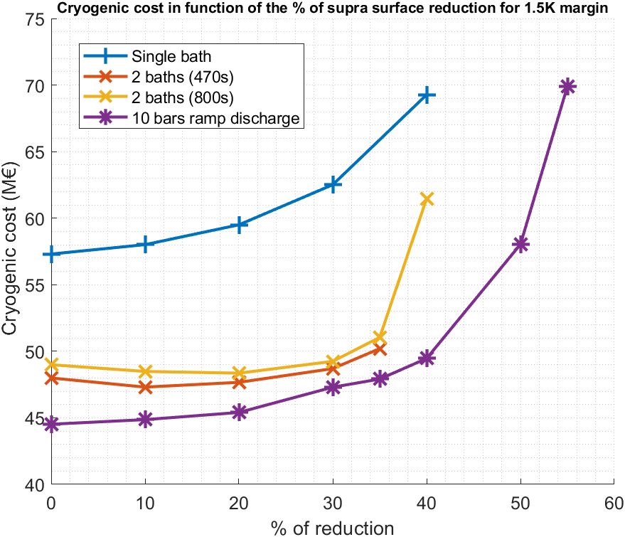
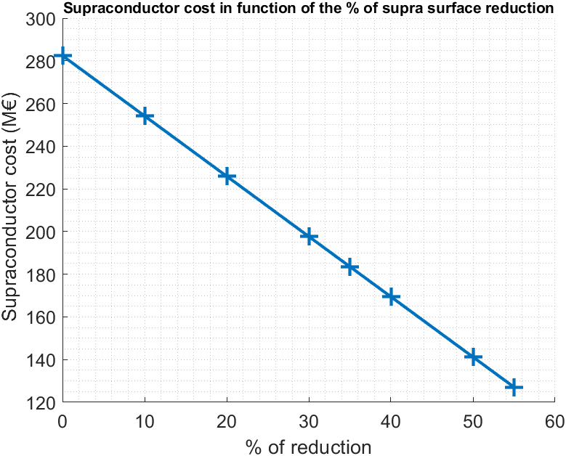
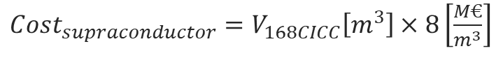



Cryogenic costs and supraconductor cost (M€)
$Cost_{supraconductor}=V_{168CICC}\left[m^{3}\right]×8\left[\frac{M€}{m^{3}}\right]$
$$P_{eq4,5K}=\left(\frac{Exergy_{300K}\left(J\right)}{time_{cycle}}\right)×\left(\frac{4,5}{(300−4,5)}\right)$$
Calculation has been performed with the same current scenario, with a 1,5 K margin
$$CAPEX\left(M€\right)=2,9×P_{eq_{4,5K}}^{0,63}[kW]×3$$
$Elec_{cost}(M€)=250 \left[\frac{W_{elec}}{W_{4,5K}}\right]×$ ${P_{eq}}_{45K}[MW]×24×365×20×\frac{50\left[\frac{€}{MWh}\right]}{1000000 }$
$$Cryogenic cost=CAPEX+Elec_{cost}$$

Slide 22
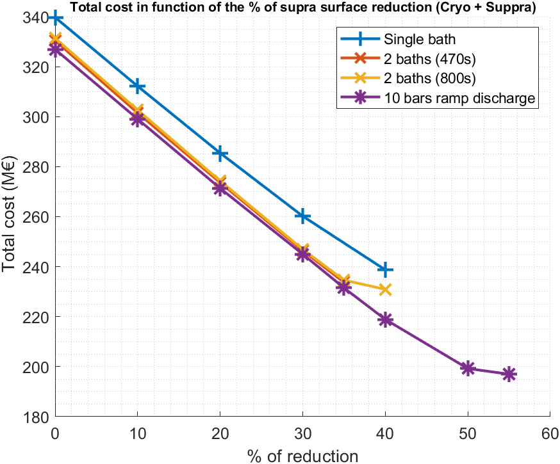
Total cost (M€) : Cryogenic cost + Supraconductor cost
Calculation has been performed with the same current scenario, with a 1,5 K margin
Points which cryogenic cost starts increse to be higher than supraconductor costs diminution.
10 bars ramp discharge configuration allows to save more than 120 M€ by reducing size of the supraconductor.

Slide 23
Conclusion
The cryogenic process can have a large impact on the CS operation and specifically its margin
Using appropriate process can lead to
an increased margin
and / or
a CS superconducting amount reduction
And needs to be investigate more into details

