Slide 1
Update on EU-CN Collaboration
WPMAG Final Meeting
14-16 January 2026
PSI, Villigen
Richard Kamendje
EUROfusion

Slide 2
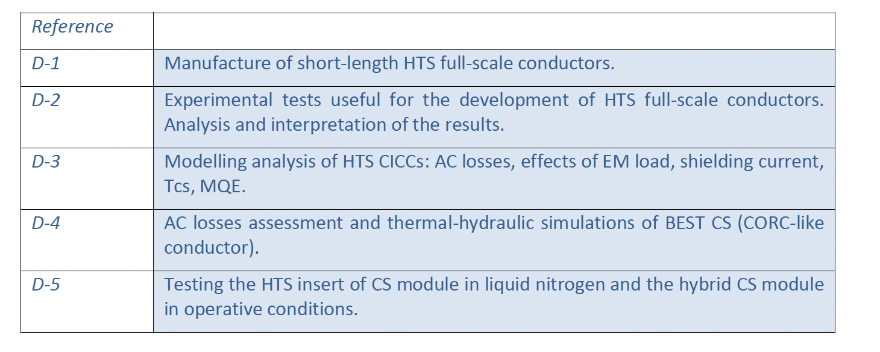
Specific Agreement on Magnets
Formally valid until 31 December 2025
To be extended to 2027 based on mutual consent?
Activities for 2026-2027?
Status of Deliverables?
Report for 2021-2025?

Slide 3
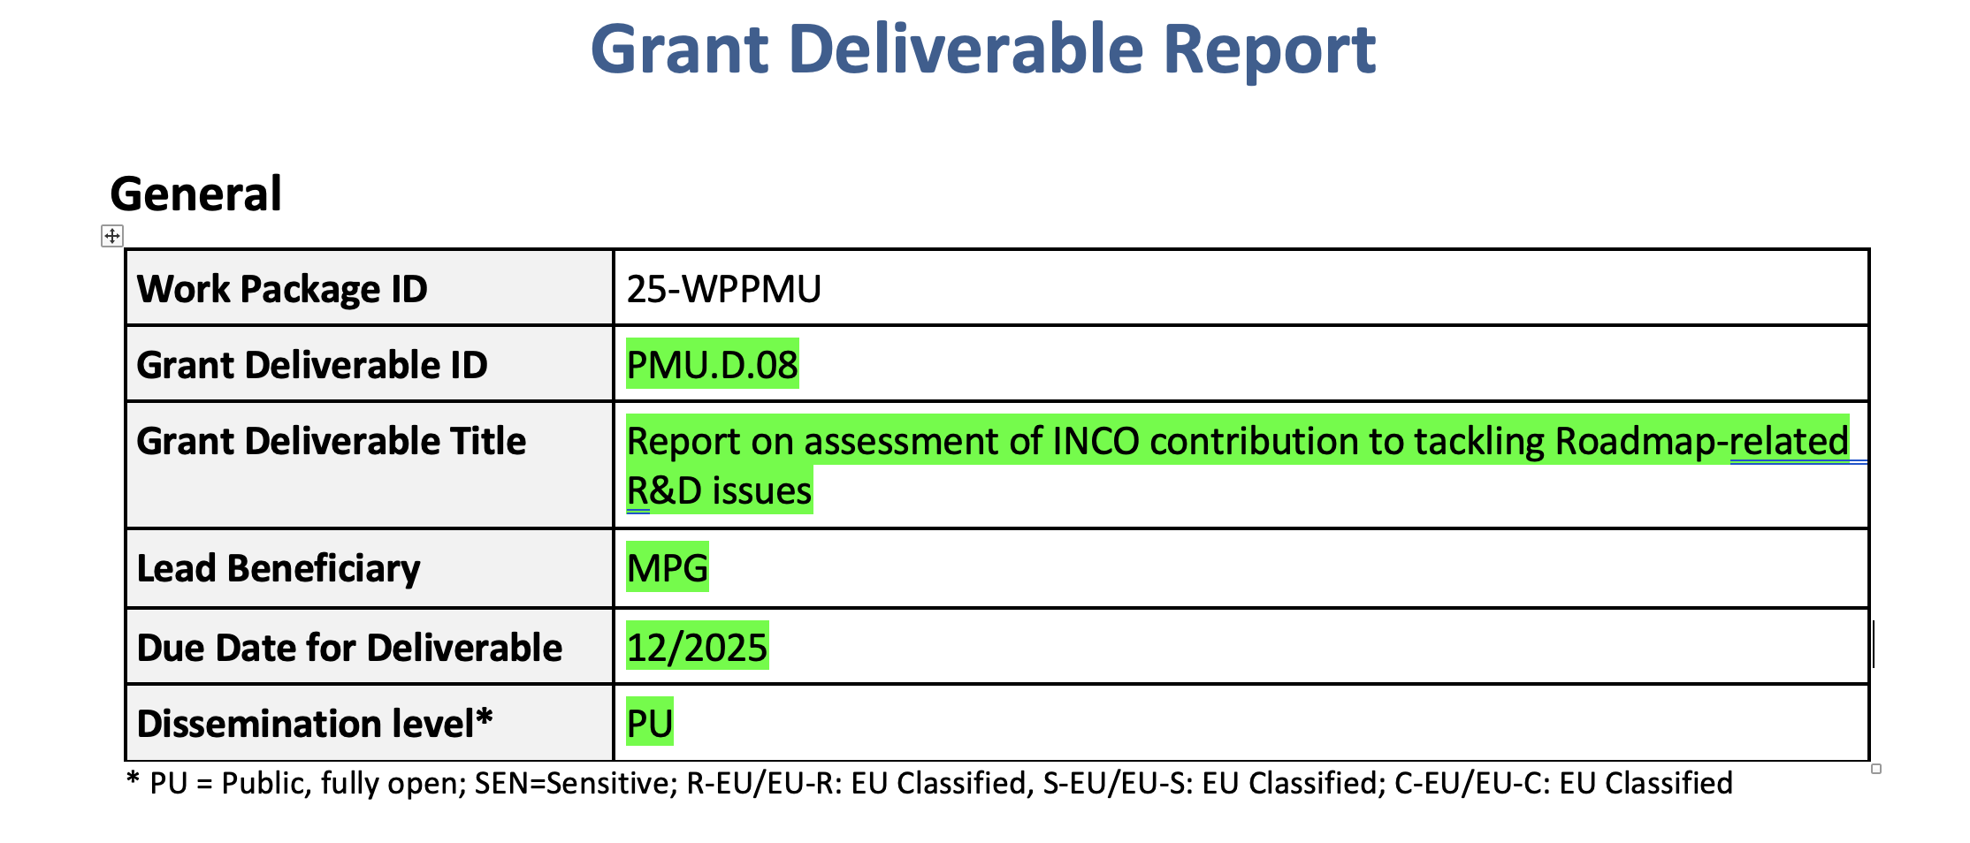
Grand Deliverable Report
Report on assessment of INCO contribution to tackling Roadmap-related R&D issues
Technology/Engineering
Magnets
Remote Maintenance
Breeding Blankets
Physics
Plasma scenarios
Long pulse operation
Plasma exhaust

Slide 4
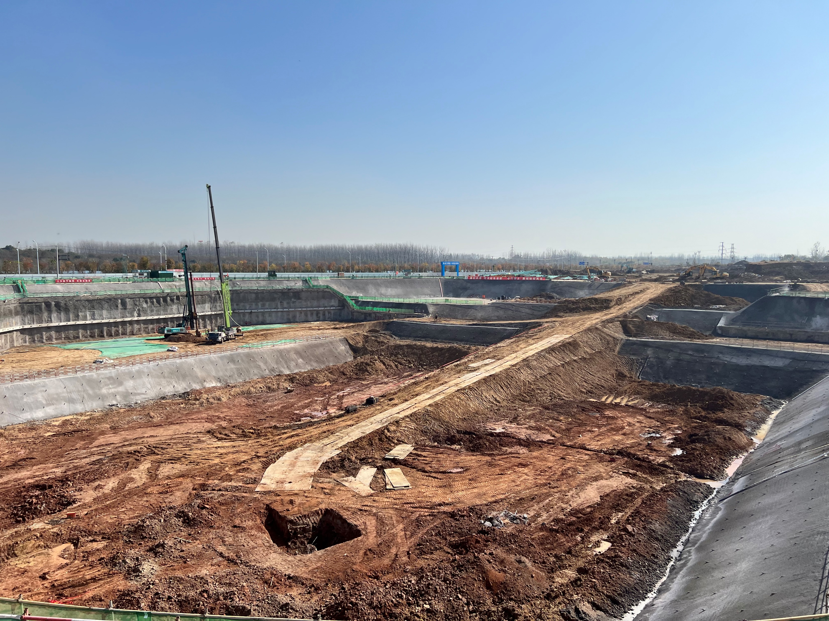
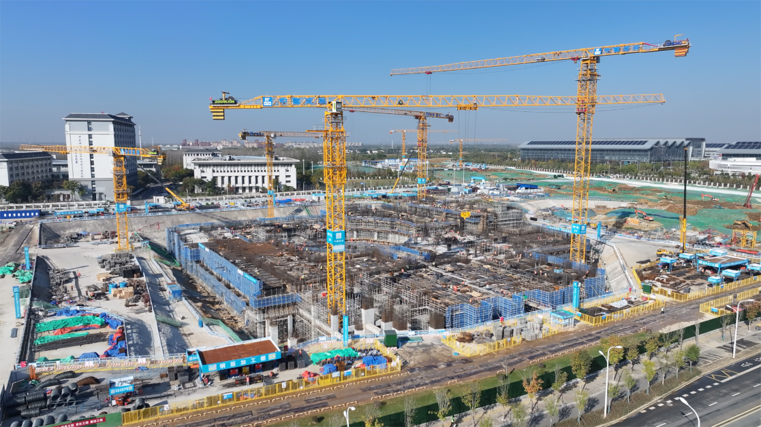
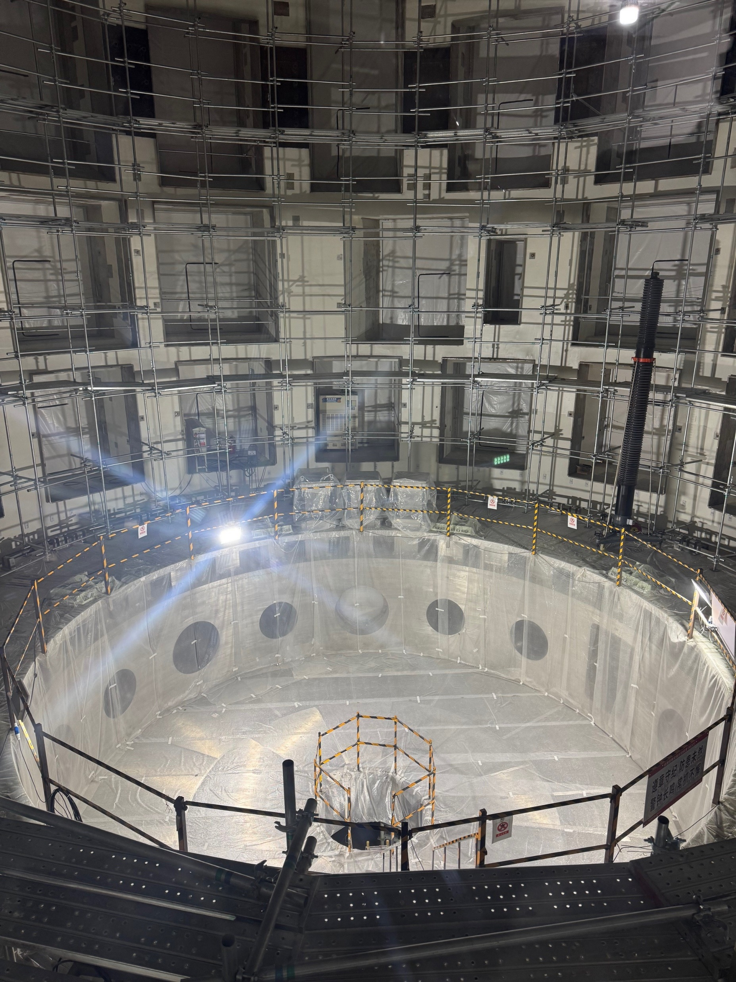
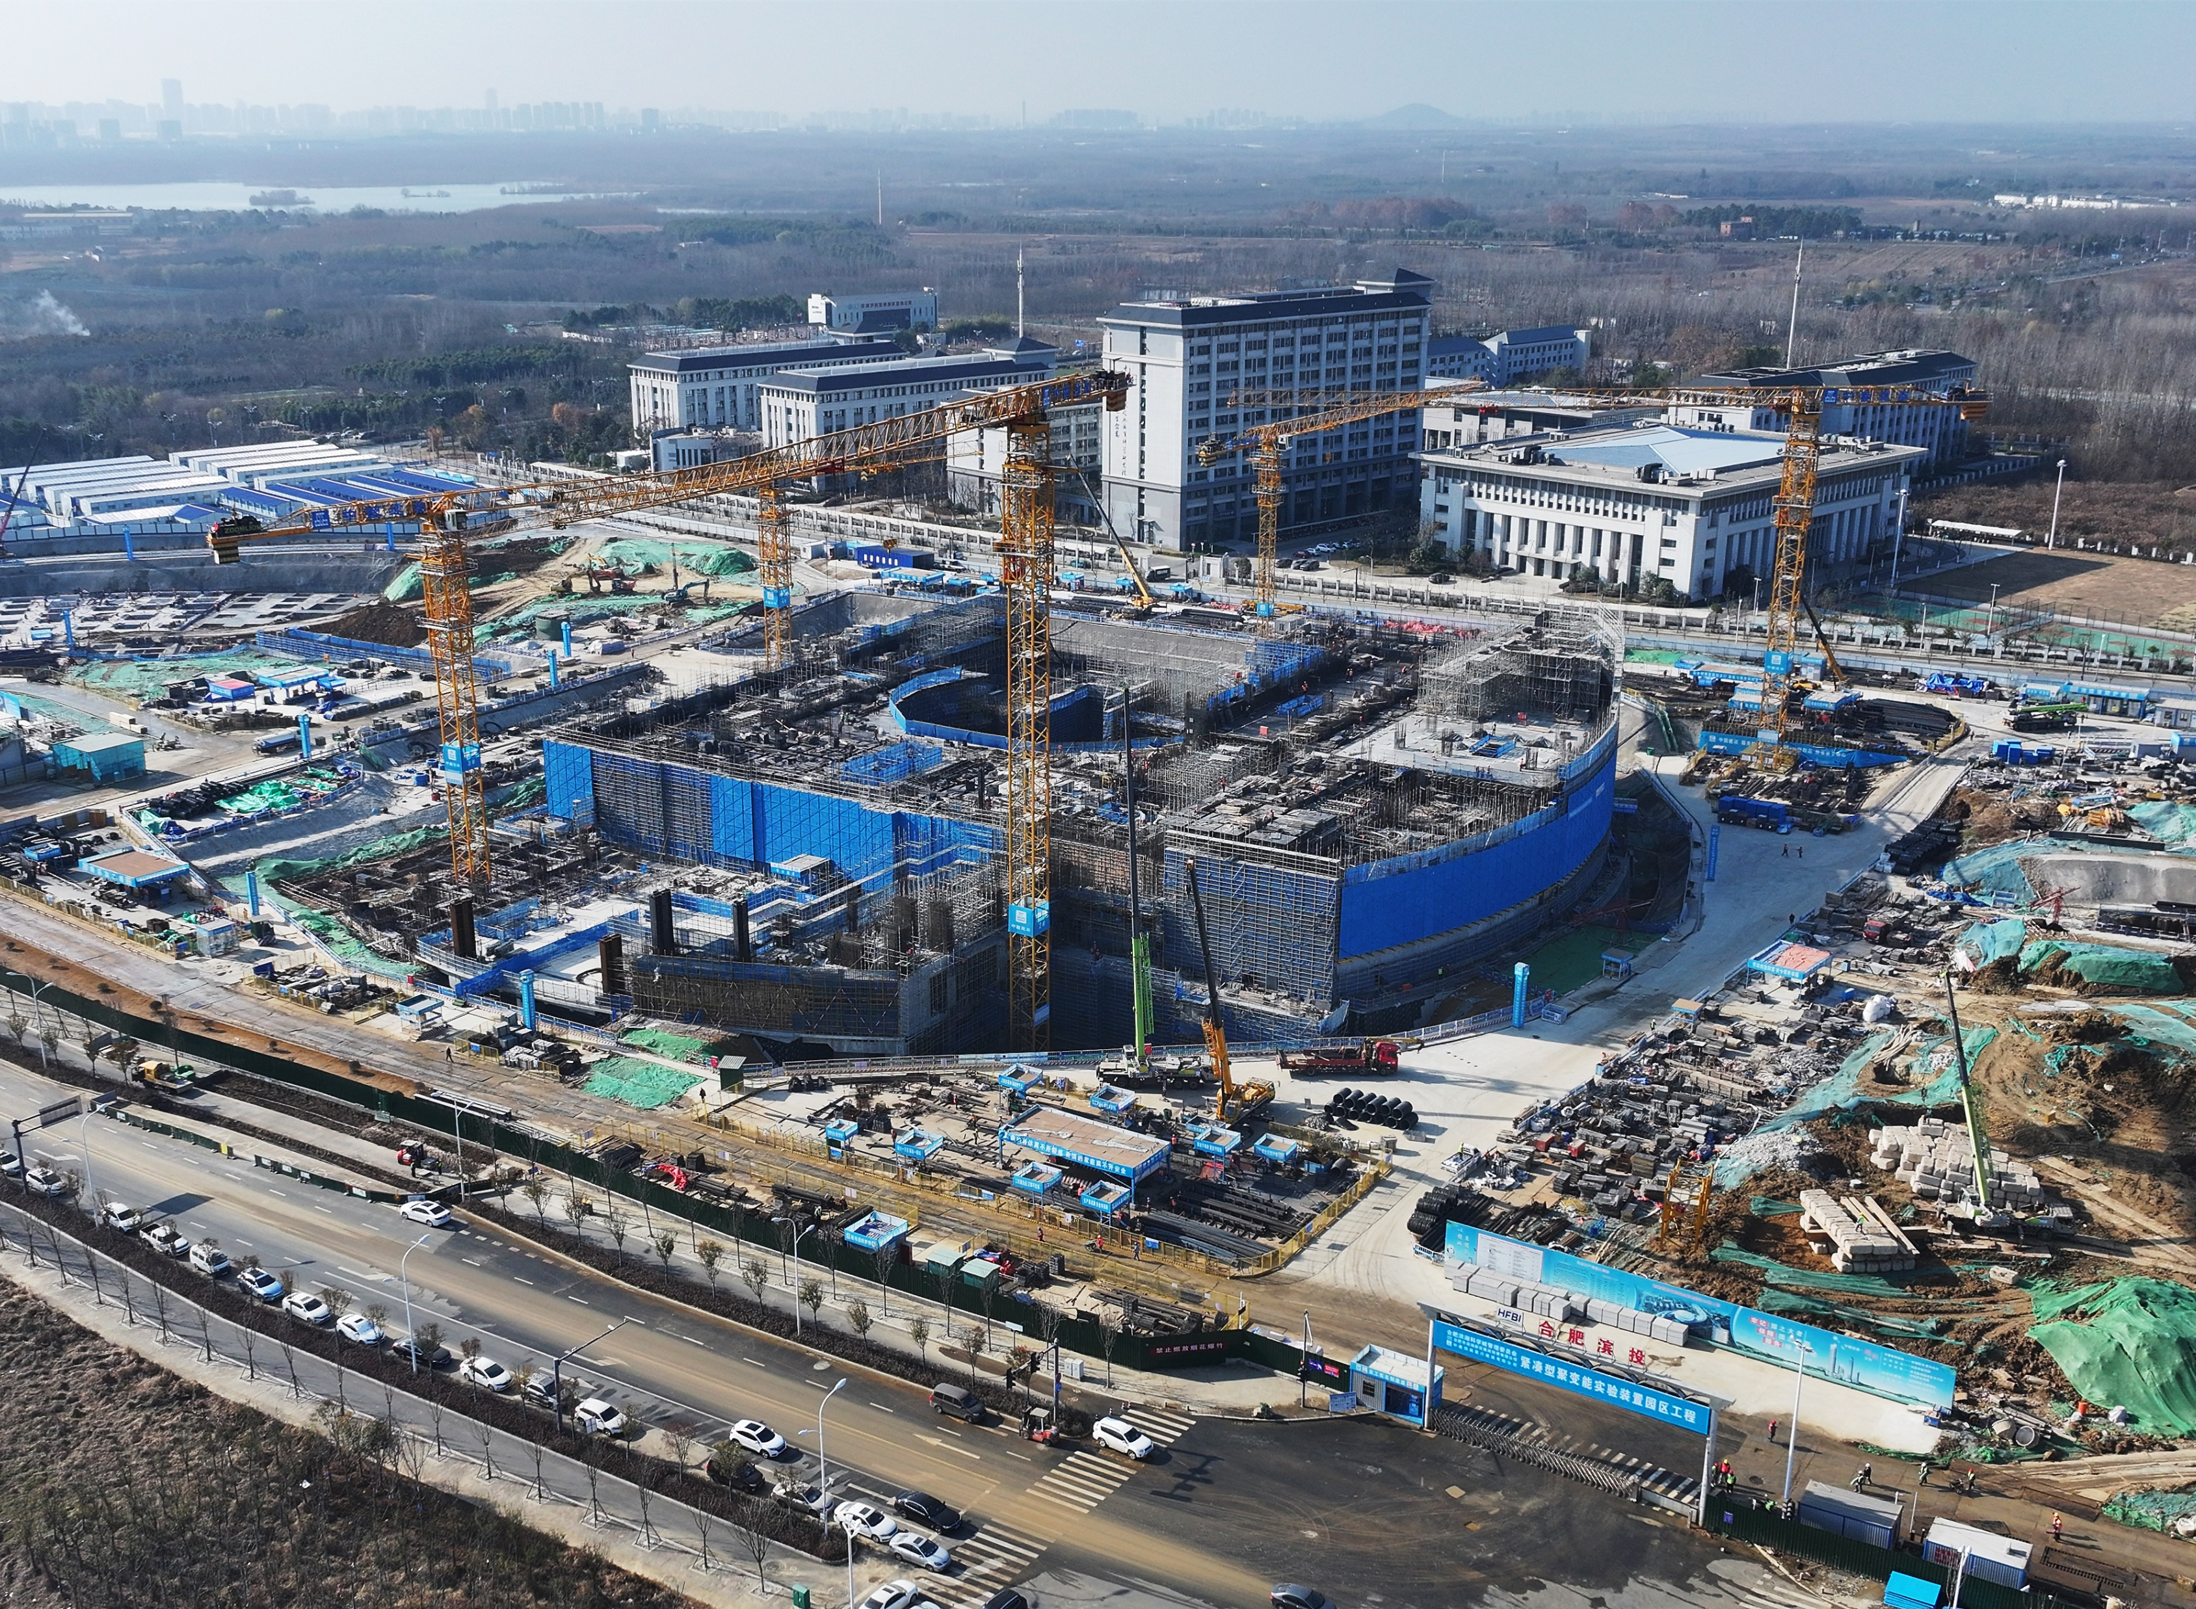
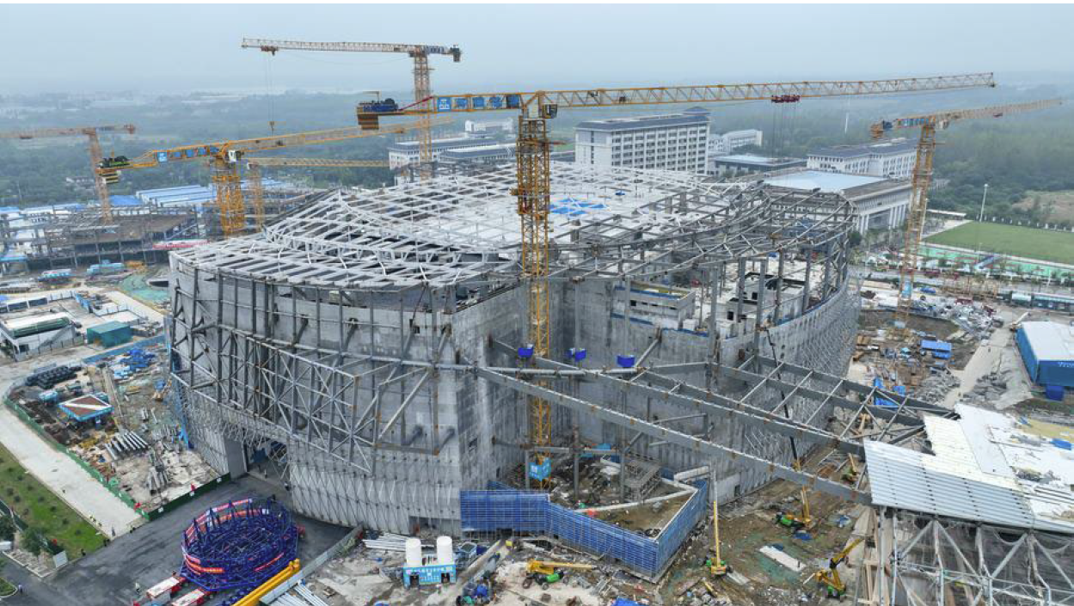
BEST is coming…..!
Oct. 2023
May 2024
Oct. 2024
Oct. 2025
30 Sept. 2025

Slide 5
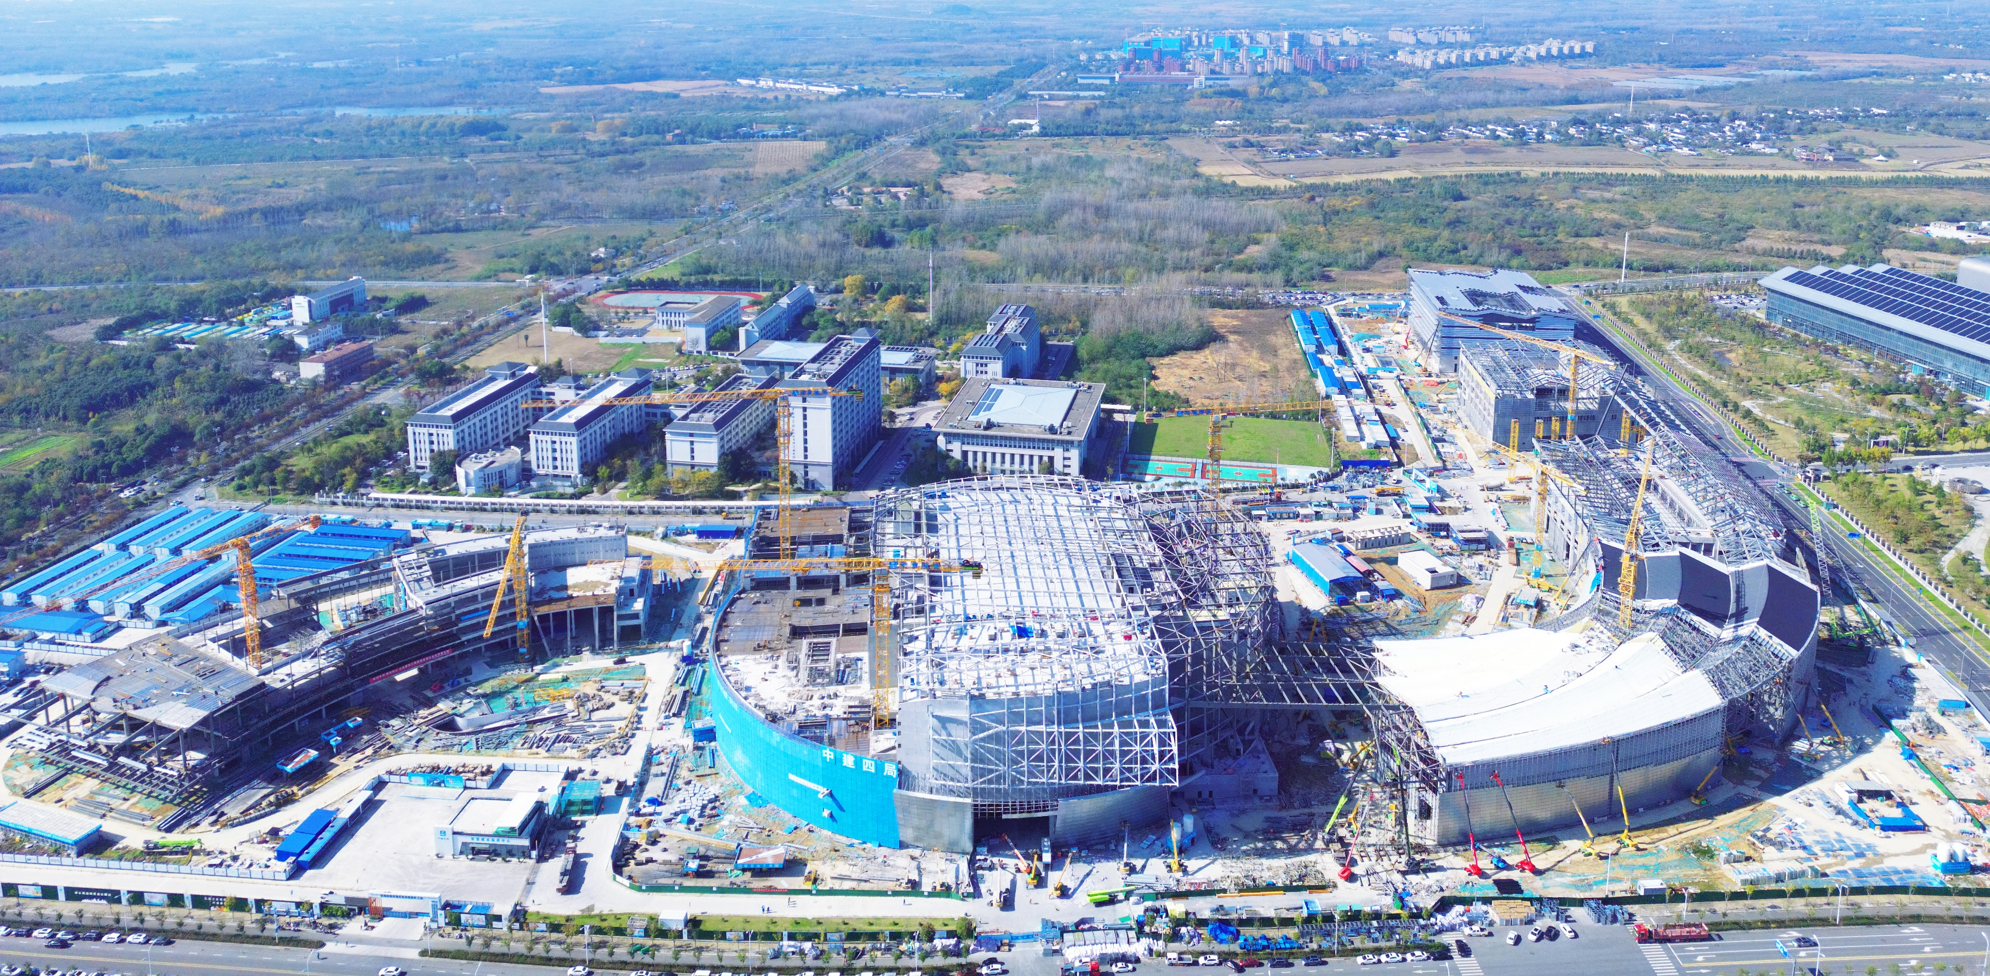
Nov. 2025

Slide 6
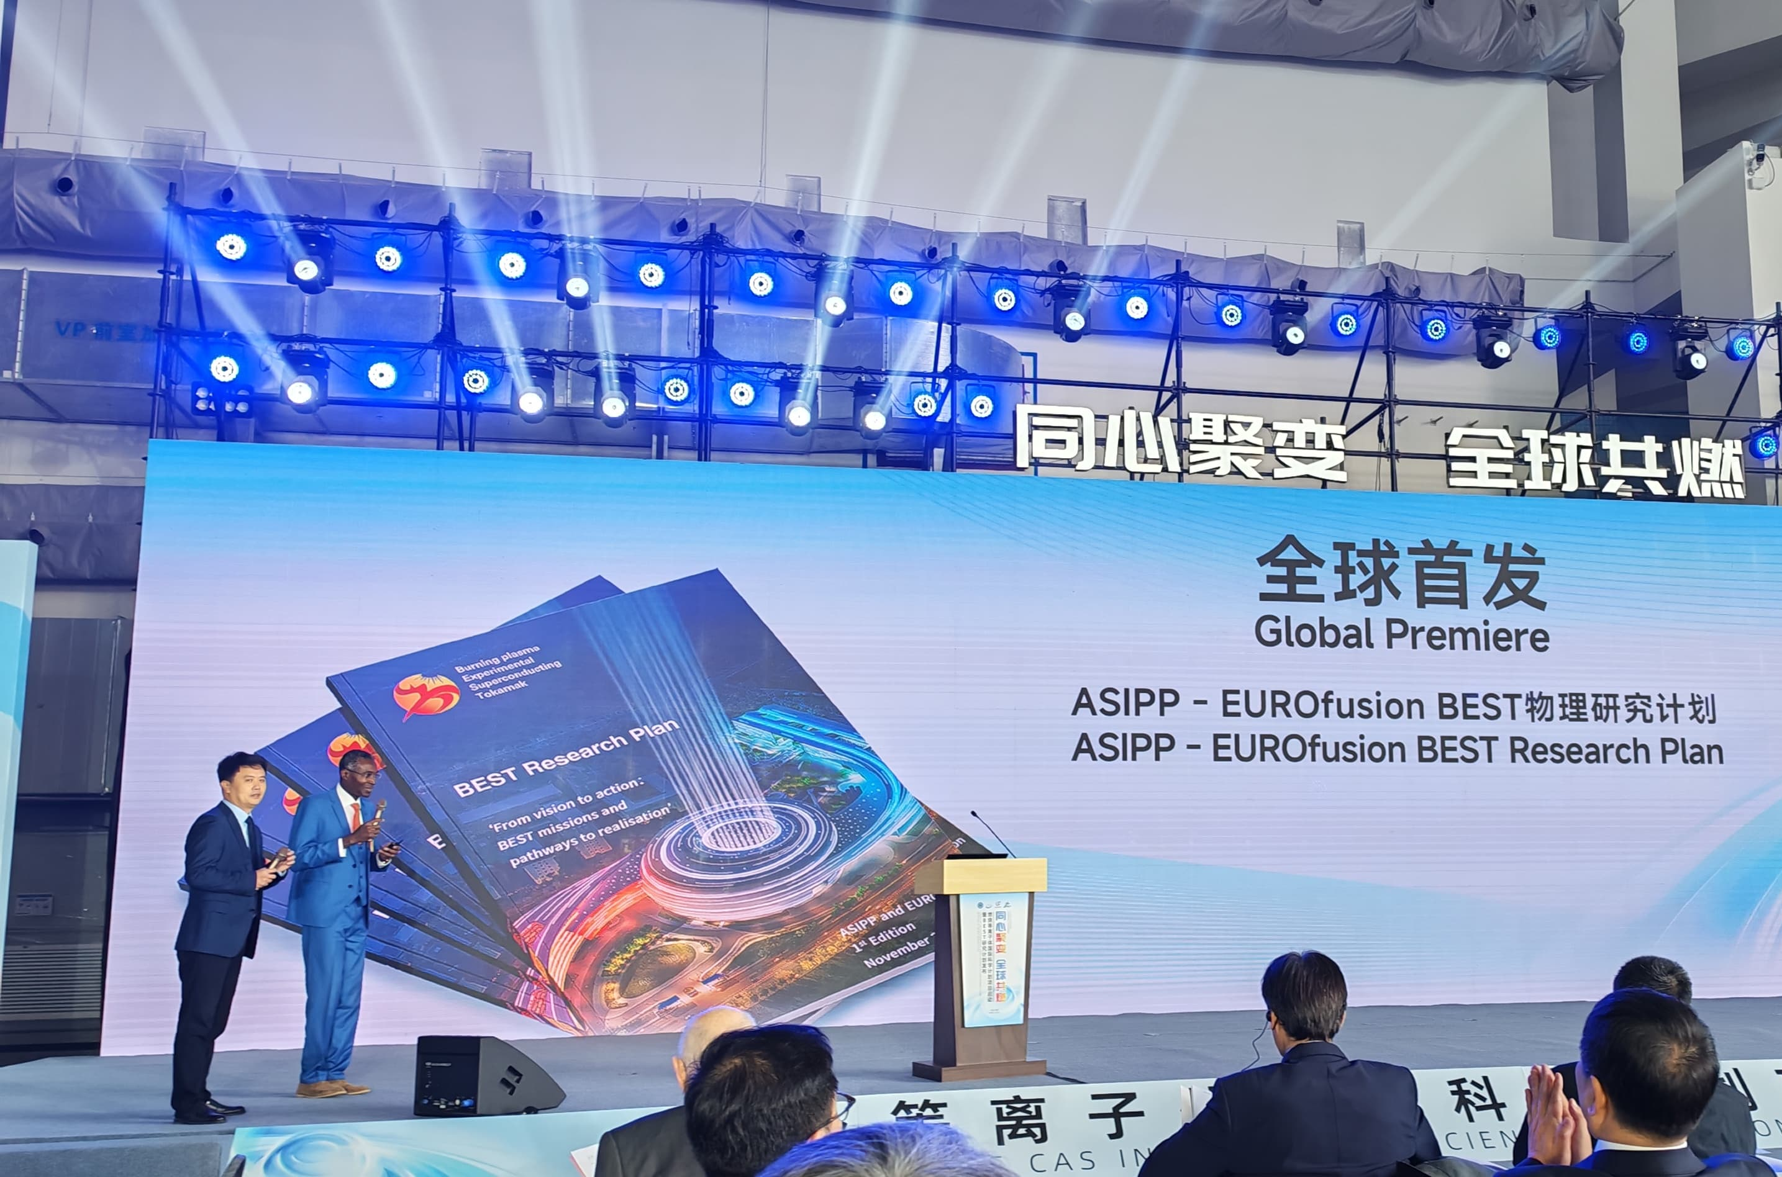



Release of the BEST Research Plan
A big thank to all contributors from EUROfusion for the sizable amount of work done within a one-year time span
Above all, Yevgen Kazakov should be commended for his strong leadership and dedication that have made this possible
Research Plan Available under:
https://euro-fusion.org/wp-content/uploads/2025/11/BEST-Research-Plan-v1.1.pdf

Slide 7



Next Steps Following the Release of the BEST Research Plan
Focus in 2026 will be on
Jointly elaborating an Integrated Commissioning Plan for BEST
Establishing the various EUROfusion teams to be involved in commissioning, operation and experiments → achieve integration with CN teams
Finalising and signing a dedicated Technology Management Plan for BEST with the help of the EC

