Slide 1
WPMAG - CEA IRFM
HWRC (CORC-like) Properties
15/01/2025
A.Torre, J. Pavan

Slide 2
2025 CEA TS
HWRC (CORC-like) Properties
MAG-S.01.01-T025-D001
EU-CN: Deliverable on 2025 CEA CORC Conductor Performances Analyses

Slide 3
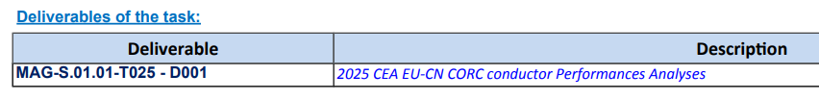
2025 CEA TS
HWRC (CORC-like) Properties
Already presented at EUCN meeting by C. Nguyen

Slide 4
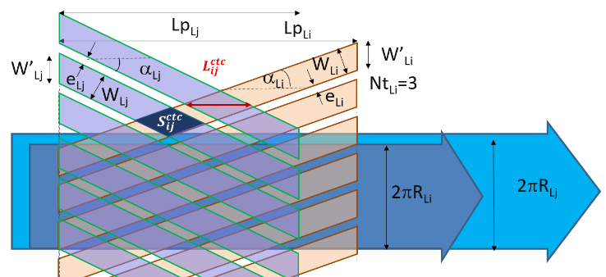
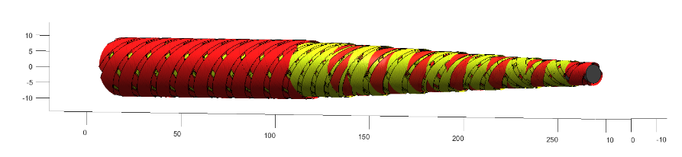
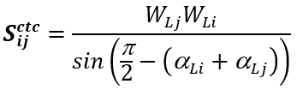
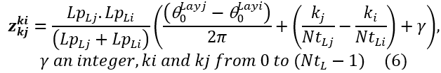
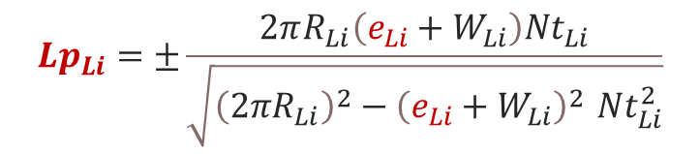
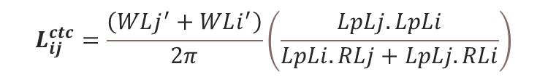
2025 CEA
HWRC (CORC-like) Properties
Geometrical description of Helically Wound Rebco Cables (HWRC)
Important features for electrical/thermal models need to be deduced from geometrical considerations:
Contact lenghts:
Contacts surface:
Contacts posistions:
Description of structures and as function of layer parameters
$${Lp}_{Li}=±\frac{2πR_{Li}\left(e_{Li}+W_{Li}\right)Nt_{Li}}{\sqrt{{\left(2πR_{Li}\right)}^{2}−{\left(e_{Li}+W_{Li}\right)}^{2 }Nt_{Li}^{2}}}$$
$$L_{ij}^{ctc}=\frac{\left(WLj^{′}+WLi^{′}\right)}{2π}\left(\frac{LpLj.LpLi}{LpLi.RLj+LpLj.RLi}\right)$$
LpLi = Twist pitch
NtLi = # tapes
RLi = cabling radius
eLi = Gap
WLi = Tape Width

Slide 5
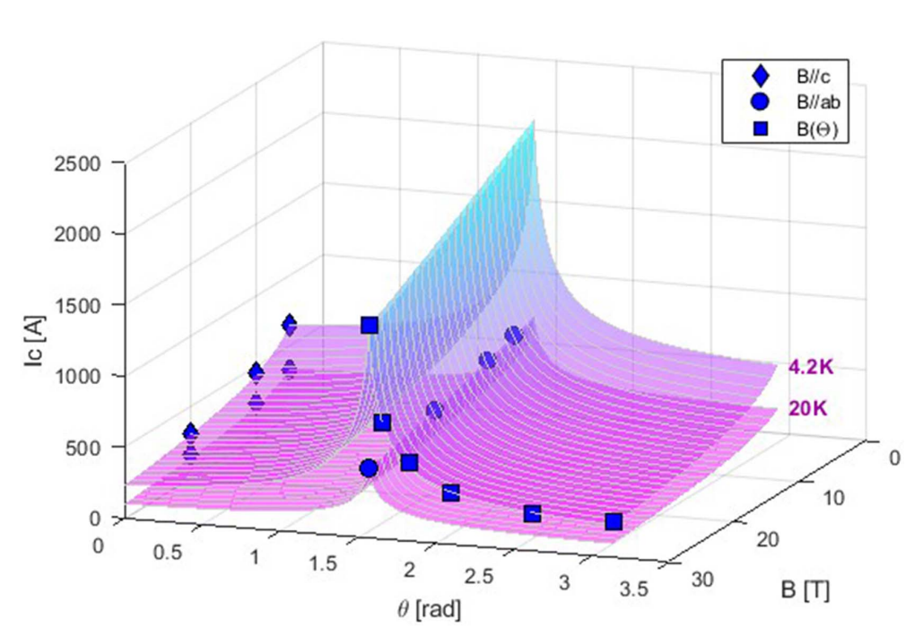
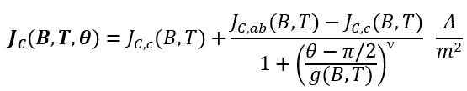


2025 CEA
HWRC (CORC-like) Properties
Tape properties fit
Fit of SST properties using CERN 2014 scaling law
Deducing individual tapes critical current
General parameters |  |  | ab-axis parameters |  |  | θ sensitivity
T_{C0} | [K] | 93 | B_{i0,ab} | [T] | 250 | ν | [-] | 0.857
n | [-] | 1 | α_{αβ} | [MA.T/mm²] | 84 | g₀ | [-] | -0.005
c-axis parameters |  |  | p_{ab} | [-] | 1.02 | g₁ | [-] | 0.094
B_{i0,c} | [T] | 140 | q_{ab} | [-] | 4.45 | g₂ | [-] | -0.0008
α_{χ} | [MA.T/mm²] | 1.41 | γ_{αβ} | [-] | 4.73 | g₃ | [-] | 0.0039
p_{c} | [-] | 0.31 | n₁ | [-] | 1.77 | REBCO properties
q_{c} | [-] | 0.87 | n₂ | [-] | 4.1 | t | [μm] | 1.5
γ_{χ} | [-] | 3.09 | a | [-] | 0.1 | w | [mm] | 4
Fit is OK within 10-15 %
Effective parameters (angle) can be deduced

Slide 6
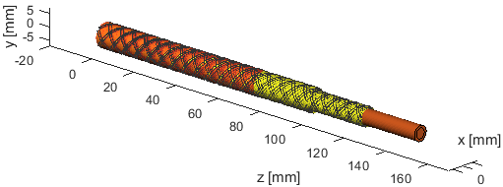

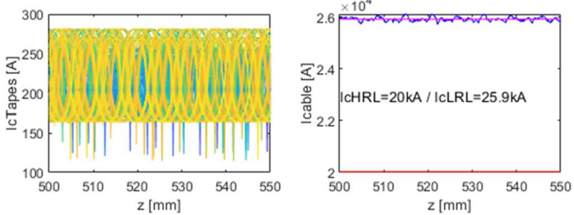

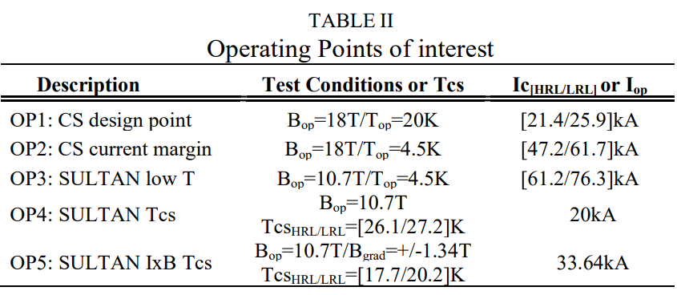
2025 CEA
HWRC (CORC-like) Properties
Cable properties
Definition of two analytical limiting cases:
Parametric study of dropouts impact
Cable limiting cases between 20kA and 26kA (as expected)
SULTAN test program refined
Extrapolated performance at given operating points

Slide 7
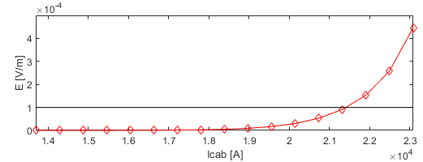
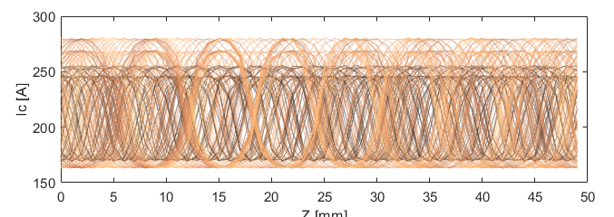
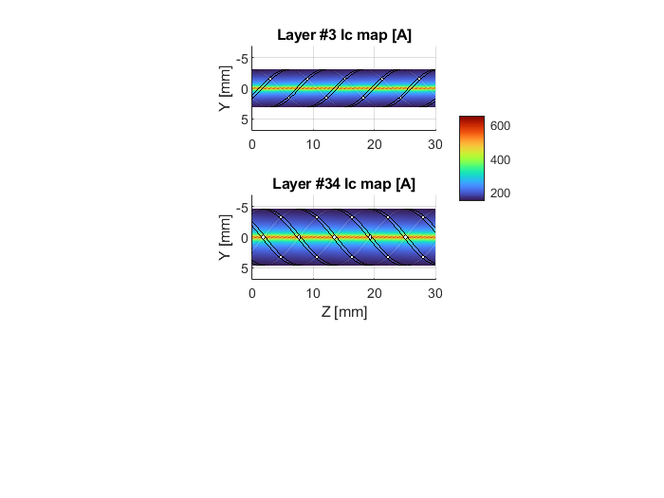
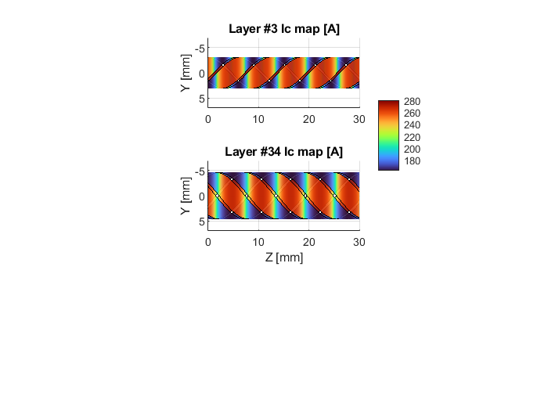
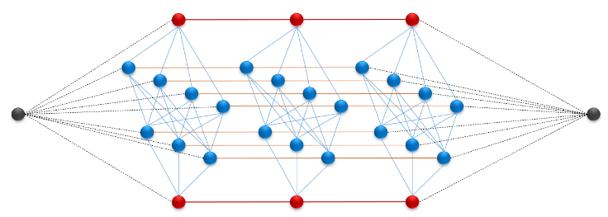
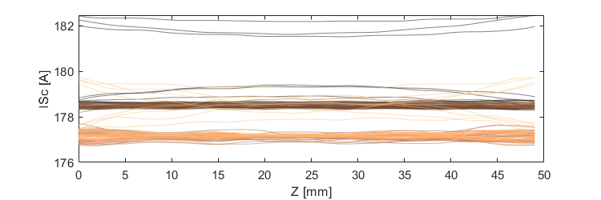
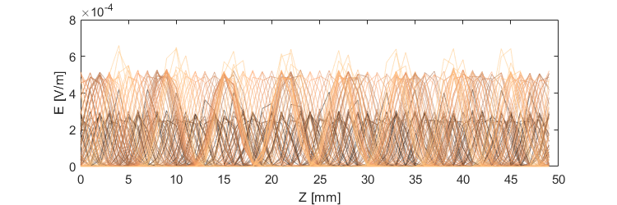
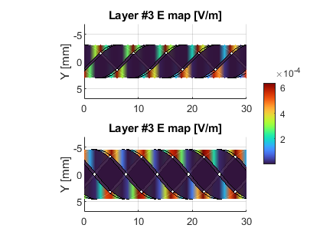
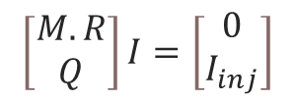
2025 CEA
HWRC (CORC-like) Properties
Full E(I) curve confirms Ic~21kA
DC Electrical model for current re-distribution (CARMEN)
Resistive network model developed (only resistive): CARMEN tool
$$\left[\begin{matrix}M.R \\ Q\end{matrix}\right]I=\left[\begin{matrix}0 \\ I_{inj}\end{matrix}\right]$$
Electrical model able to see very small redistribution (negligible)
Performances confirmed around Ic=20kA

Slide 8
2025 CEA
HWRC (CORC-like) Properties
Perspectives
Continue modelling (maybe smaller units, faster computation)
Vary the current injection (imbalance)
Maybe couple to Thermohydraulic model

