Slide 1

EU-CN: Model and analysis of HTS performance degradation after quench
Andrea Zappatore
NEMO group, Dipartimento Energia, Politecnico di Torino, Italy
WPMAG final meeting, 14-16 Jan 2026

Slide 2
Outline
Background & aim
Full 3D thermal-hydraulic + electric model
Full 3D thermo-mechanical model
Conclusions

Slide 3
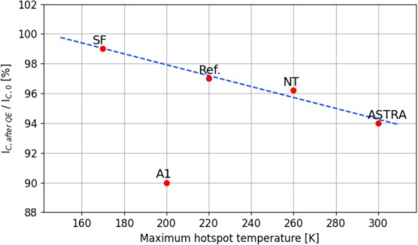




Background & aim
Quench propagation tests in HTS conductors (EU-CN collaboration within EUROfusion Consortium) started in 2020 in SULTAN
Degradation was found for all conductors tested so far, likely due to hotspot temperature reached during quench
Aim of the deliverable:
Compute temperature distribution during quench
Develop and apply a thermo-mechanical model to compute strain state

Slide 4
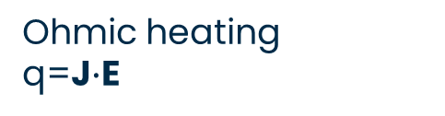

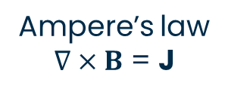
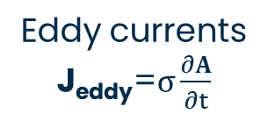

Full 3D model for quench simulation
Model equations
Eddy currents
J_{eddy}=$σ\frac{∂A}{∂t}$
J(x,y,z,t)
ELEC
MAG
A(x,y,z,t)
Ampere’s law
$∇×B$ = J
E=$ρ(T)$J
$$ρ=ρ(T)$$
Ohmic heating
q=J$∙$E
v_{fluid}(x,y,z,t)
T_{solids}(x,y,z,t)
HEAT
FLUID
p_{fluid}(x,y,z,t)
Heat flux
q’’ = f(T_{solids}, T_{fluid})
T_{fluid}(x,y,z,t)

Slide 5
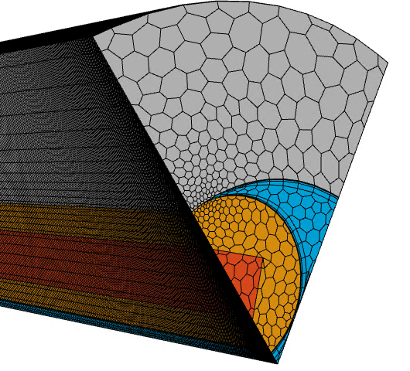
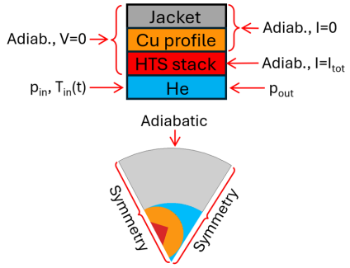
Full 3D model for quench simulation: Boundary conditions and mesh
V=0 on the opposite boundary
P=0 (gauge) at the outlet
Finite Volume polyhedral mesh
0.5 mm characteristic size in High Field Zone
Exploiting symmetry → ~2 Mcells
Adaptive time step based on rate of change in the current density
Imposed transport current (I_{tot} = 15 kA) at SC boundary, I_{tot} = 0 kA elsewhere
Experimental inlet temperature and mass flow rate for the He
Adiabatic/insulation on the other (external) boundaries
[A Zappatore 2024 Supercond. Sci. Technol. 37 125012]

Slide 6
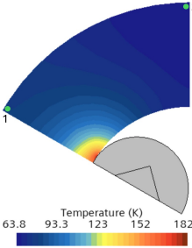
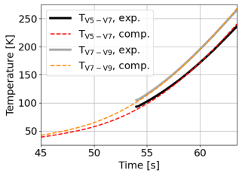
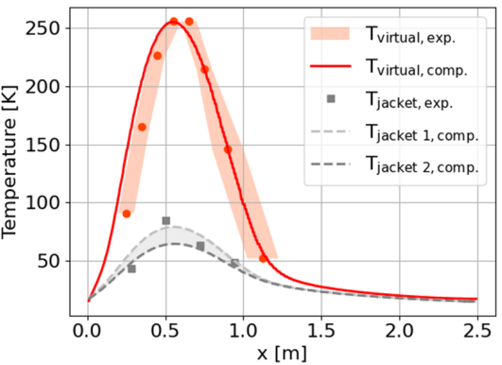
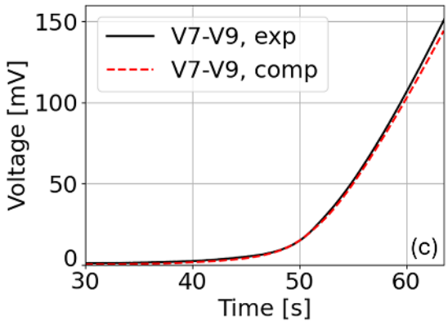
Full 3D model validation & results
Computed results (temperature distribution, temperature and local voltage evolutions) agree well with measured results
Temperature in the jacket is confirmed to be non-uniform in the radial-azimuthal directions

Slide 7
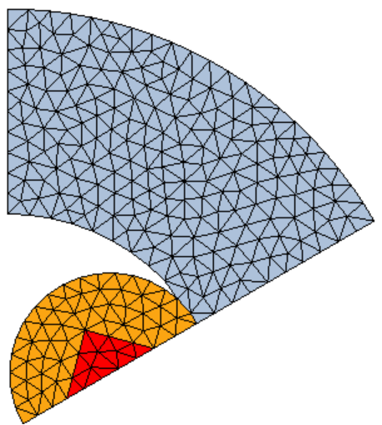
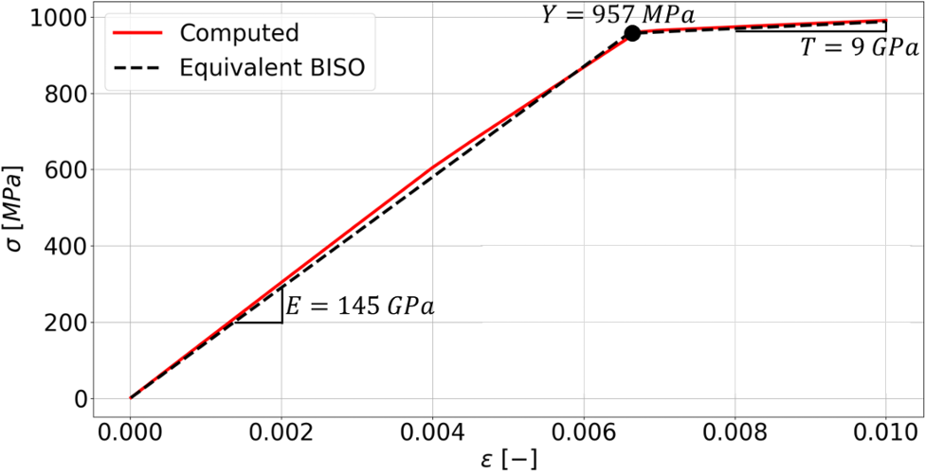
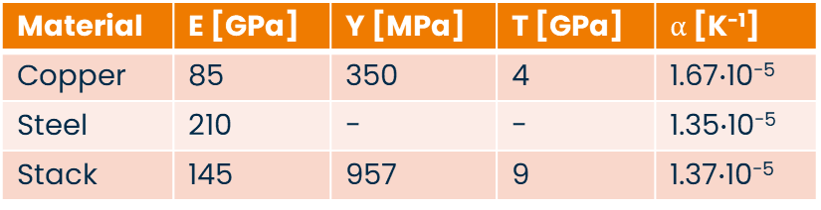
3D thermo-mechanical model
Tape model to evaluate equivalent mechanical properties (including plastic behavior) → Bilinear isotropic hardening
Homogeneous model of the stack → lighter conductor model (main assumption: temperature distribution uniform across the stack)
Material | E [GPa] | Y [MPa] | T [GPa]
Copper | 85 | 350 | 4
Hastelloy | 180 | 1225 | 7.5
Silver | 90 | 225 | 22
HTS layer | 150 | - | -
Material | E [GPa] | Y [MPa] | T [GPa] | $α$ [K⁻¹]
Copper | 85 | 350 | 4 | 1.67$∙$10⁻⁵
Steel | 210 | - | - | 1.35$∙$10⁻⁵
Stack | 145 | 957 | 9 | 1.37$∙$10⁻⁵
Extreme cases considered for boundary conditions (bottom joint) and contact type
Case simulated | Boundary condition | Contact type (Jkt-Copper)
1 | Fully bonded | Frictionless
2 |  | Bonded
3 | One bonded edge, one free | Frictionless
4 |  | Bonded
[M De Bastiani et al 2024 IEEE Trans. Appl. Supercond. 35 4600205]

Slide 8
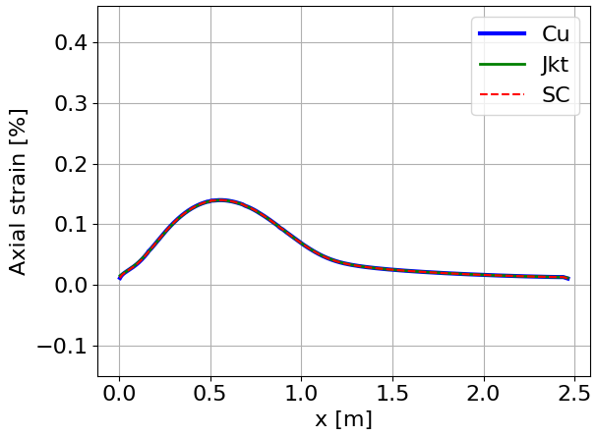
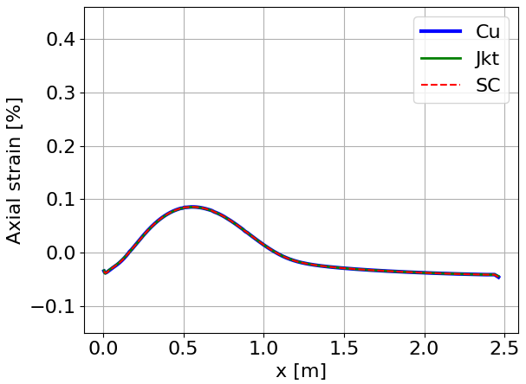
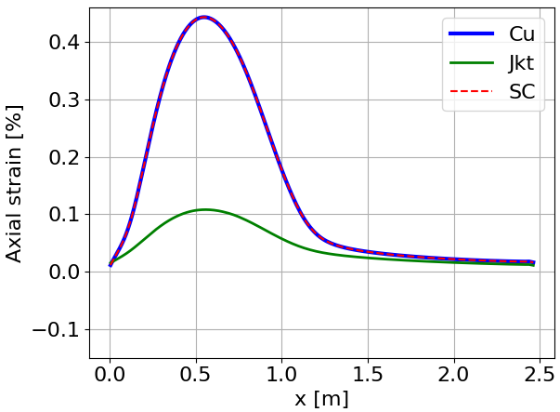
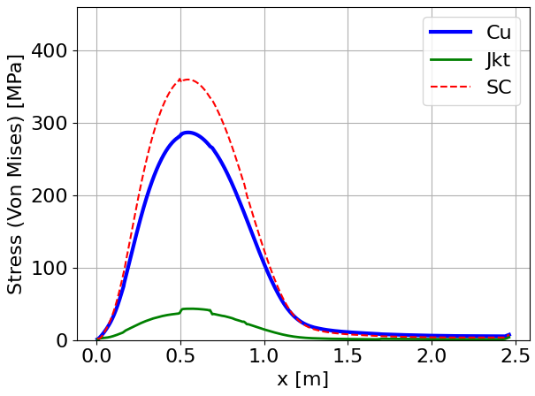
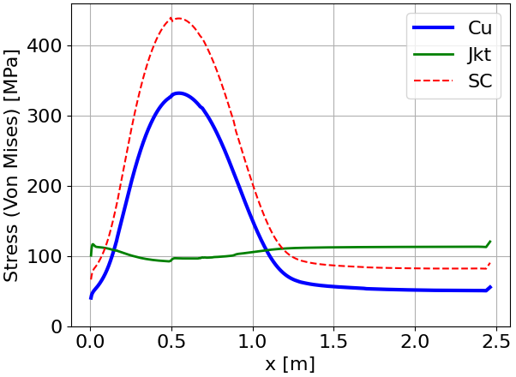
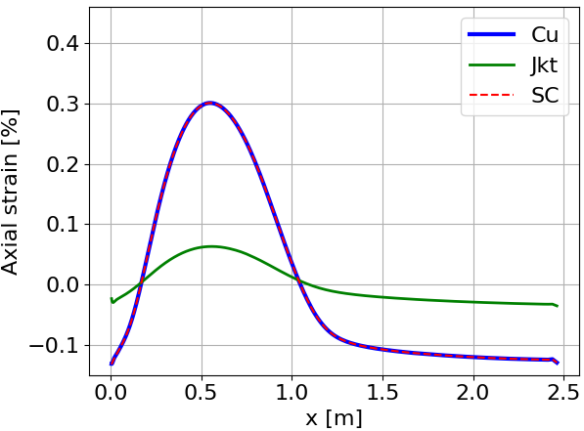
Results
If conductor is assumed to be fully bonded → stress is maximum (~430 MPa)
If conductor can expand, strain is maximum (~0.44%)
If bonded, colder jacket limits the expansion of the strands → lower strain
Case 1
Frictionless contact
Right and left edge fixed
Case 2
Bonded contact
Right and left edge fixed
Case 3
Frictionless contact
Right edge fixed, left free
Case 4
Bonded contact
Right edge fixed, left free

Slide 9
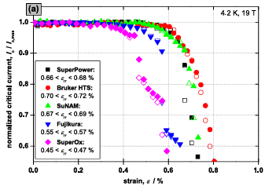
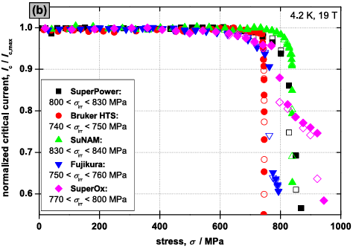
Discussion
0.44 % axial strain looks compatible with few % irreversible degradation
Stress <600 MPa should not lead to permanent degradation
Strain computed in ENEA A1
[C Barth et al 2015 Supercond. Sci. Technol. 28 045011]

Slide 10
Conclusions
Fully 3D multi-physics (thermal-hydraulic and electro-magnetic) model has been developed validated against quench test results
3D thermo-mechanical model has been developed and applied in the case of the largest hotspot reached during quench
In case of frictionless contact between strand and jacket + one free edge, axial strain overcomes 0.4% which could be compatible with few % degradation

Slide 11
Thank you for your attention!

Slide 12
Full 3D model for quench simulation
Models and solvers
Electric (SC, Cu, SS) model:
Transient
3D
Electric current density → J(x,y,z,t)
Ohmic heating
(T,B)-dependent material properties
Power-law for SC
Magnetic (SC, Cu, SS, He, Air) model:
Transient
3D
A-formulation → A(x,y,z,t)
Coupled implicit solver to cope with strong non-linearity of the supercritical helium
Hypre solver
Adaptive time step to cope with strong non-linearity of power law
Heat diffusion (SC, Cu, SS) model:
Transient
3D
Heat conduction → T(x,y,z,t)
Ohmic heating
(T,B)-dependent material properties
Fluid (He) model:
Transient
3D
N-S equations → v(x,y,z,t), p(x,y,z,t), T(x,y,z,t)
Turbulence
(T, p)-dependent material properties

Slide 13
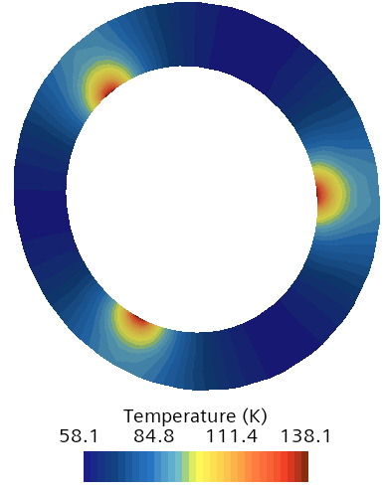
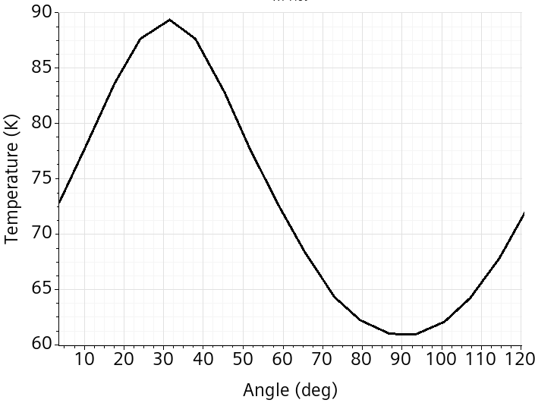
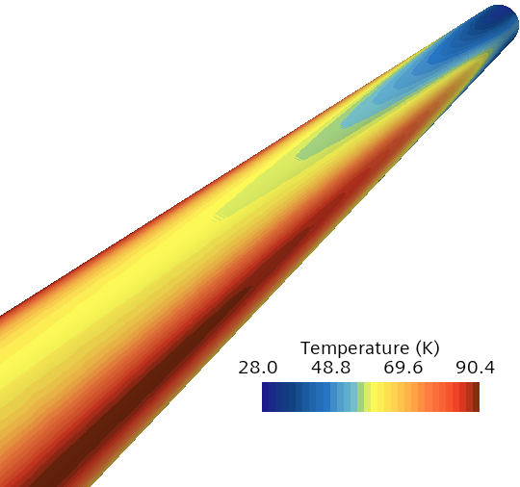
Full 3D model results
Azimuthal jacket temperature (external surface)
External jacket temperature
Jacket cross-sectional temperature
Local contact of SC+Cu strands with stainless lead to 3D distribution (axial, azimuthal, radial directions) on jacket temperature throughout the transient
This maybe useful for QD using SC wires or fibers (either due to temperature or, indirectly, due to secondary stresses → TH-MEC analysis)

Slide 14
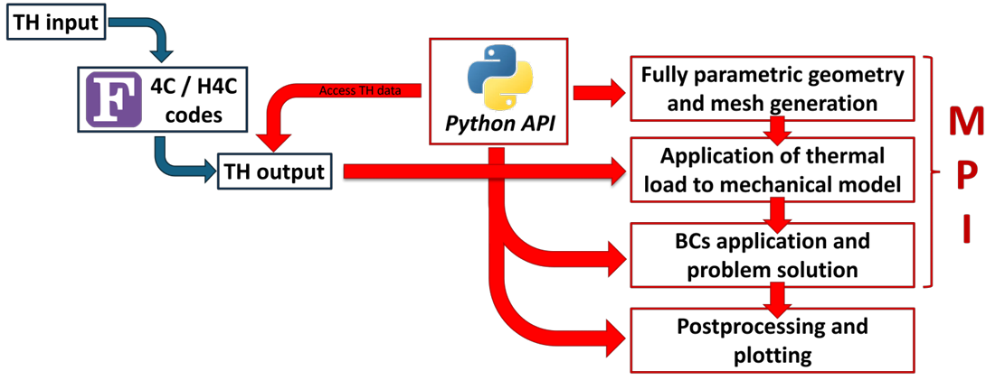
Coupling the TH and T-MEC models
Mechanical model (geometry, mesh, boundary conditions, solution) is developed in ANSYS APDL
The python package PyMAPDL allows the communication between a python script and the ANSYS kernel
Main advantages:
  flexibility of python high level scripting
  Pre-processing of TH results before sending them of the mechanical model
  Mech. model is parametric → different analysis can be performed directly from the python master
  Same API can be used to solve different problems (from cable to coils)
Quench with hotspot = 210 K is considered here
[M. De Bastiani et al 2024 IEEE Trans. Appl. Supercond. 35 4600205]

Slide 15
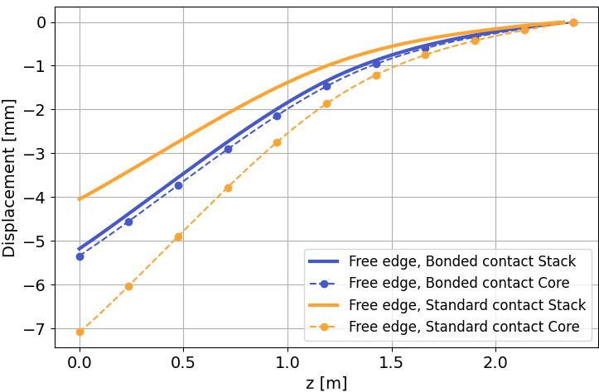
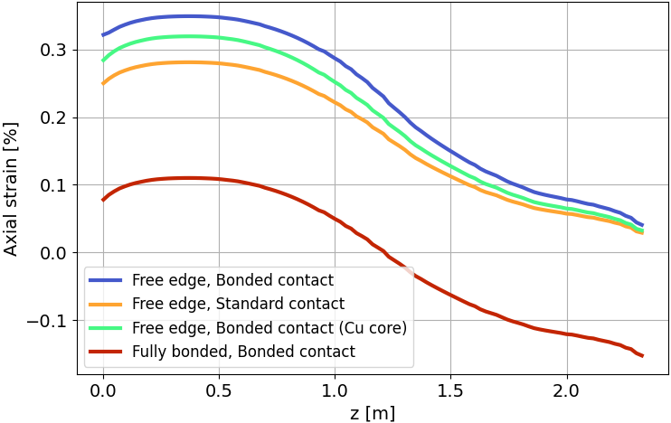
Results (I)
Fully bonded conductor → much lower (axial) strain
If one edge is free → larger axial displacement → larger strain
Core expands more than the stack:
  If stack is bonded to the core → it pulls the stack → larger strain
  Otherwise (standard) → they can expand freely → smaller strain on the stack
Copper core expands similarly to the stack → smaller strain in case of bonded contact

